Slide 1
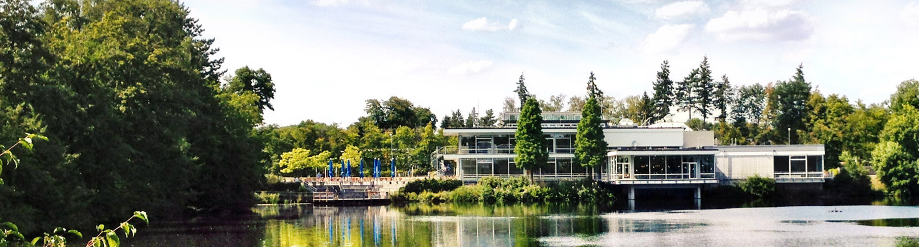
Open Access
An Introdcution
2023 I linda McGrath

Slide 2
Agenda
What is Open Access?
What kinds of Open Access are there?
Funding OA publications at Forschungszentrum Jülich
Finding the right OA outlet for your publication
Your publication in JuSER

Slide 3
What is open Access?

Slide 4
“Open Access describes the goal of making global knowledge accessible and re-usable in digital form without financial, technical or legal barriers.”
Allianz der deutschen Wissenschaftsorganisationen

Slide 5
What kinds of Open Access are there?

Slide 6
SUBSCRIPTION JOURNALS
Closed Access
Publisher‘s version immediately available for subscribers on publisher‘s website
Possibly publication fees
No additional charge
Author transfers the copyright
Permissions for re-use necessary

Slide 7
SUBSCRIPTION JOURNALS
OPEN ACCESS JOURNALS
Closed Access
Publisher‘s version immediately available for subscribers on publisher‘s website
Possibly publication fees
No additional charge
Author transfers the copyright
Permissions for re-use necessary
Gold Open Access
Publisher‘s version immediately available without restrictions on publisher‘s website
Article Processing Charge
No additional charge
Author retains the copyright

Slide 8
SUBSCRIPTION JOURNALS
OPEN ACCESS JOURNALS
Closed Access
Publisher‘s version immediately available for subscribers on publisher‘s website
Possibly publication fees
No additional charge
Author transfers the copyright
Permissions for re-use necessary
Gold Open Access
Publisher‘s version immediately available without restrictions on publisher‘s website
Article Processing Charge
No additional charge
Author retains the copyright
Diamond Open Access
Publisher‘s version immediately available without restrictions on publisher‘s website
No Article Processing Charge
No additional charge
Author retains the copyright

Slide 9
SUBSCRIPTION JOURNALS
OPEN ACCESS JOURNALS
Closed Access
Publisher‘s version immediately available for subscribers on publisher‘s website
Possibly publication fees
No additional charge
Author transfers the copyright
Permissions for re-use necessary
Gold Open Access
Publisher‘s version immediately available without restrictions on publisher‘s website
Article Processing Charge
No additional charge
Author retains the copyright
Hybrid Open Access
Publisher‘s version immediately available without restrictions on publisher‘s website
Possibly publication fees
Additional charge
Author might transfer the copyright
Diamond Open Access
Publisher‘s version immediately available without restrictions on publisher‘s website
No Article Processing Charge
No additional charge
Author retains the copyright

Slide 10
SUBSCRIPTION JOURNALS
OPEN ACCESS JOURNALS
Closed Access
Publisher‘s version immediately available for subscribers on publisher‘s website
Possibly publication fees
No additional charge
Author transfers the copyright
Permissions for re-use necessary
Gold Open Access
Publisher‘s version immediately available without restrictions on publisher‘s website
Article Processing Charge
No additional charge
Author retains the copyright
Hybrid Open Access
Publisher‘s version immediately available without restrictions on publisher‘s website
Possibly publication fees
Additional charge
Author might transfer the copyright
Diamond Open Access
Publisher‘s version immediately available without restrictions on publisher‘s website
No Article Processing Charge
No additional charge
Author retains the copyright
Green Open Access
Post-Print immediately or after embargo available without restrictions in repository
Possibly publication fees
No additional charge
Author transfers the copyright, Permissions

Slide 11
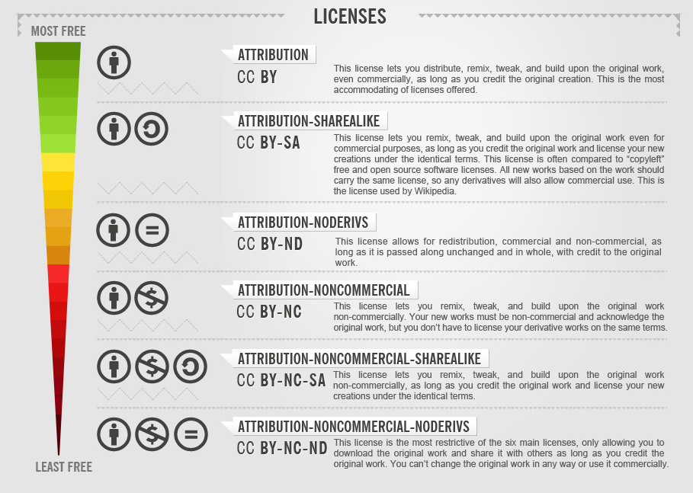
Creative Commons Licences
Six flavors, one preference.
Different licenses
translate to icons
Infographic https://commons.wikimedia.org/wiki/File:CC_License_Freedom_Scale_Chart.png
Icons and information © Creative Commons

Slide 12
Creative Commons Licences
Six flavors, one preference.
Different licenses
translate to icons
Infographic https://commons.wikimedia.org/wiki/File:CC_License_Freedom_Scale_Chart.png
Icons and information © Creative Commons

Slide 13
Funding OA Publications at Forschungszentrum Jülich

Slide 14

“The DFG expects the research results funded by it to be published and to be made available, where possible, digitally and on the internet via open access. To achieve this, the contributions involved should either be deposited in discipline-specific or institutional electronic archives (repositories) following conventional publication, or should be published in a recognised peer-reviewed open access journal.”
In this programme, the approved funds are available exclusively for the financing of publications of articles in Gold Open Access Journals.
DFG: Guidelines for the Use of Funds
DFG: Verwendungsrichtlinien Allgemeine Bedingungen für Förderverträge mit der DFG

Slide 15

Conditions to receive funding through ZB
Open Access Strategy of Forschungszentrum Jülich, effective as of January 1, 2023
Diamond open access
The publication of the scientific findings of Forschungszentrum Jülich using the diamond open access model is explicitly encouraged.
Corresponding author from FZJ
The corresponding author must be from FZJ. If there are several corresponding authors, the costs should ideally be shared between the institutions involved.
Cap at € 3,000 / OA article or € 5,000 / OA monograph
Gold open access costs are covered by the Central Library (ZB) when the corresponding author is from Forschungszentrum Jülich.
Restricted funding of hybrid OA publications
Hybrid OA APCs are only covered by the publication fund when the publication appears in a journal that is part of a transformative agreement concluded by ZB.
Notes:
1. Diamond open access
Forschungszentrum Jülich offers the option of publishing journal articles and monographs through its publishing house free of charge with the diamond open access model.
The publication of the scientific findings of Forschungszentrum Jülich using the diamond open access model is explicitly encouraged. Forschungszentrum Jülich can contribute within the scope of the library budget to funding publisher-independent publication options in line with the principle of diamond open access.
2. Gold open access
Article processing charges (APCs) for gold open access journals are covered up to the amount of € 3,000 by the publication fund managed by the Central Library (ZB) when the corresponding author is from Forschungszentrum Jülich. *1
APCs for gold open access monographs are covered up to the amount of € 5,000 by the publication fund managed by ZB when the corresponding author or editor is from Forschungszentrum Jülich. If several authors or editors from different institutions are involved, the costs should ideally be shared between the various institutions.
3. Green open access
ZB completes – as far as possible – the data sets in JuSER by adding the publishers’ versions of publications.
The authors or the organizational units send the “Final Draft Post Referee” version of publications to ZB. ZB clarifies secondary-use copyright issues and uploads the publications to Forschungszentrum Jülich’s repository accordingly (cf. Directive No. 2/2020 “Publications by Forschungszentrum Jülich GmbH”).
4. Subscription journals
Through active collection management of subscription journals, ZB ensures that the increasing financial requirements of the publication fund are covered where possible by procurement resources that become available due to subscription cancellations.
Hybrid open access APCs are only covered by the publication fund when the publication appears in a journal that is part of a transformative agreement concluded by ZB. In the JuLib eXtended information portal, ZB maintains a list of journals for which open access fees are covered (https://go.fzj.de/OAjournals).
Other APCs for subscription journals are not covered by the publication fund.
5. Limiting costs
Forschungszentrum Jülich strives for an average expenditure of no more than € 2,000 per journal publication. ZB will monitor the development of costs and make adjustments if required.
*1 The following applies to publications to be paid for by Forschungszentrum Jülich:
The corresponding author must be from Forschungszentrum Jülich. If there are several corresponding authors, the costs should ideally be shared between the institutions involved. If this is not possible or can only be achieved with great difficulty, Forschungszentrum Jülich will bear the full costs.
If the corresponding author has several affiliations, Forschungszentrum Jülich must be listed as the first affiliation.
The email address provided must be a Forschungszentrum Jülich email address.

Slide 16
Finding the right OA outlet for your publication

Slide 17


Tools
Where to start to find an open access journal for your paper
The intranet gives you an overview over all the publishers the FZJ has agreements with
For several publishers, further links to find out what journals are supported OA journals are included
DOAJ is an independent database for open access journals from around the world
In order to be listed, journals have to comply to quality standard
The central library will fund APC for Gold OA journals listed in DOAJ with up to EUR 3,000
https://intranet.fz-juelich.de/en/organization/zb/expertise/open_access/oa-publication-charges-cooperation
https://doaj.org/

Slide 18


Tools
Where to start to find an open access journal for your paper
Search for suitable Open Access journals for the publication of a paper
Results are based on a keyword search/browse and can be narrowed down by various filters
Tool focuses on APC costs and funding availabilities through the author's institution
Search for suitable Open Access journals for the publication of a paper
Results are shown after entering metadata information or article abstract in the search bar
Tool focuses on matching results by subject
https://finder.open-access.network/
https://service.tib.eu/bison/

Slide 19
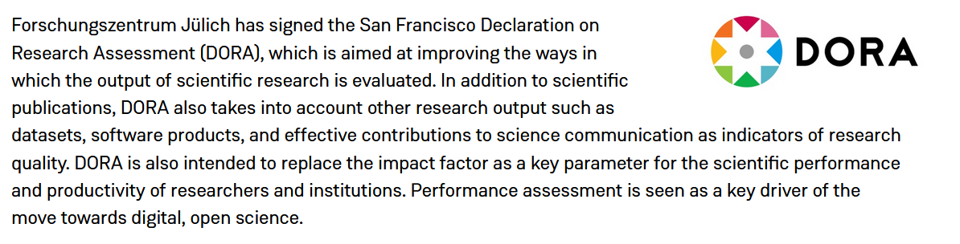
Impact factor Journals
https://intranet.fz-juelich.de/en/media/news/2023/dora-a-different-way-of-evaluating-scientific-output

Slide 20
Impact factor Journals
… both useful and problematic at the same time
Good tool to distinguish one journal from another.
A high IF is usually a good indicator for high quality services.
A publication in a high IF journal will most likely generate more traction in the scientific community.
IF reinforce the reputation system in academia which puts young researchers, reseachers from institutions that are not well funded, researchers from the global south at a disadvantage.
The calculation of impact factor doesn’t say anything about the citations on an article level.
IF are self-reinforcing: if a journal has a good IF it will attract more high quality papers which in turn will be receive more citations

Slide 21
Predatory Publishing
Charge authors a high fee for publication without providing quality services
Charge high costs for attending
Predatory Conferences
Predatory Journals
Do not offer waivers for speakers
Pretend to be trustworthy by listing false information on the journal website
Do not have any sponsors or official society affiliation
Imitate existing journals to receive submissions
Invite keynote speakers out of the blue
Publish nonsense articles, articles with no editing

Slide 22

Predatory Journals
… and how to identify them
On the intranet you find a blacklist of predatory journals, a check list of how to identify them as well as additional information
Any journal listed on https://doaj.org/ can be considered legit.
https://thinkchecksubmit.org/ gives you advice on how to tell if a journal is trustworthy

Slide 23
Your publication in JuSER

Slide 24
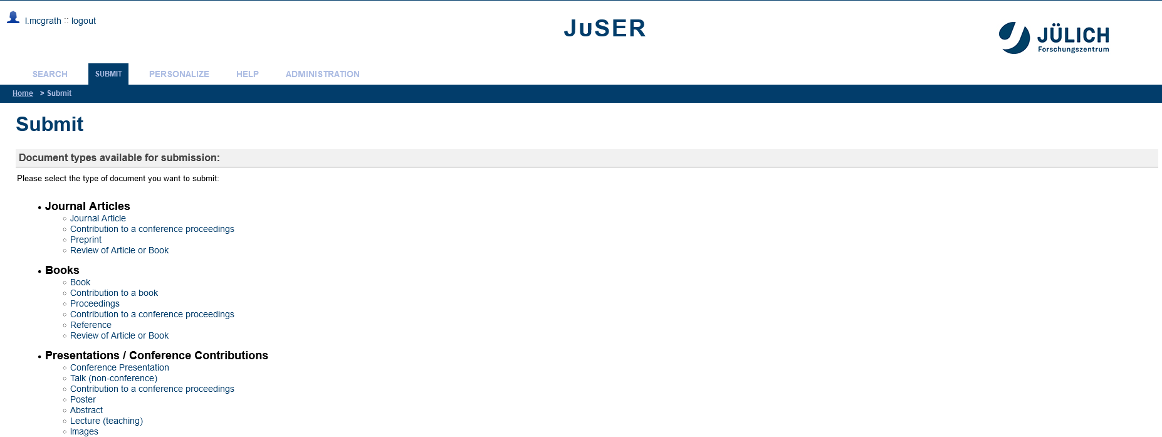
Create a new JuSER entry

Slide 25
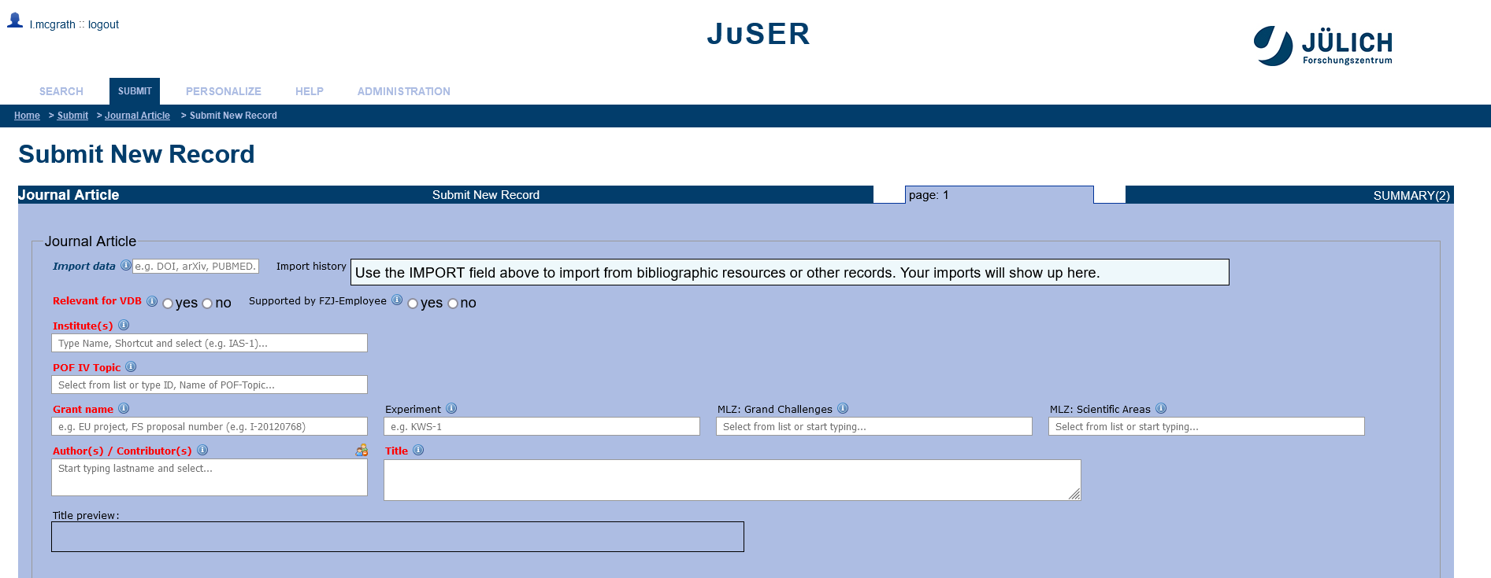
Create a new JuSER entry

Slide 26
Create a new JuSER entry
Enter DFG grant number!

Slide 27
Contact information
Linda McGrath
Forschungszentrum Jülich GmbH
Zentralbibliothek / Central Library
52425 Jülich
Tel: +49 (0) 2461 61-6123
Email: zb-copyright@fz-juelich.de
Heike Lexis
Forschungszentrum Jülich GmbH
Zentralbibliothek / Central Library
52425 Jülich
Tel: +49 (0) 2461 61-5367
Email: zb-copyright@fz-juelich.de

