Slide 1

(Semi-)Closed loop recycling of solid oxide cells
9th International Conference on Fundamentals & Development of Fuel Cells
FDFC 2023
SEP 25th 2023 | S. Sarner | N.H. Menzler | O. Guillon
Forschungszentrum Jülich | Materials synthesis & Processing (IEK-1)

Slide 2
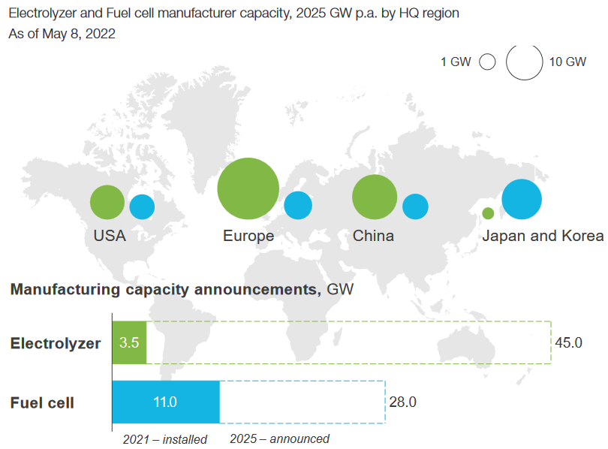
H₂ electrolyser development
2025
H₂ policy agreements Germany:
10 GW installed electrolyser capacity in 2030
H₂Giga flagship project: Scale-up of electrolyser technologies
SOC market development:
SOC market share low until 2030 (~5%)
5% refers to 12 million SOC (10x10 Jülich design)
Critical raw materials in SOCs:
REEs, Nickel, Cobalt, Strontium
[1]
Recycling targets: cost reduction, material preservation, decrease CO₂-emissions
[1] Hydrogen Insights Report September, Hydrogen Council, McKinsey & Company (2022).

Slide 3
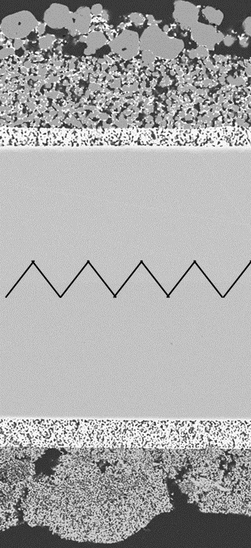
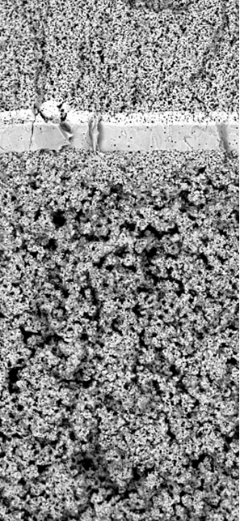
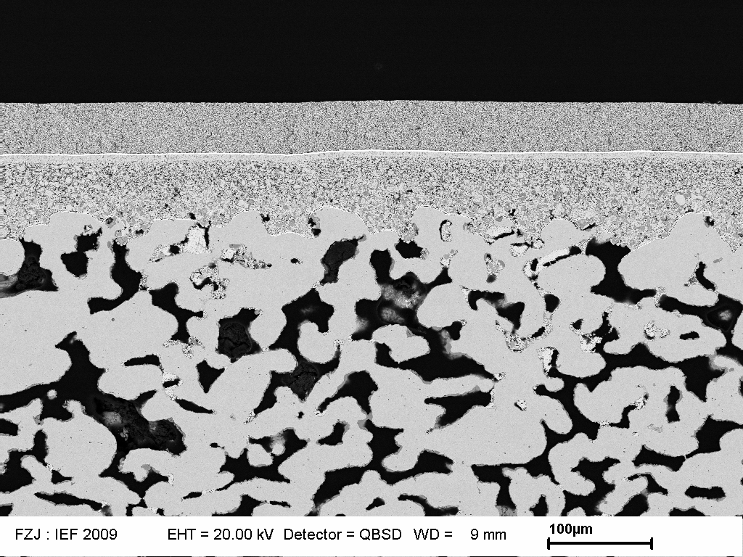
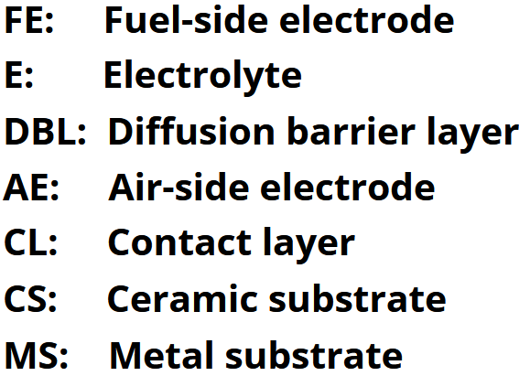
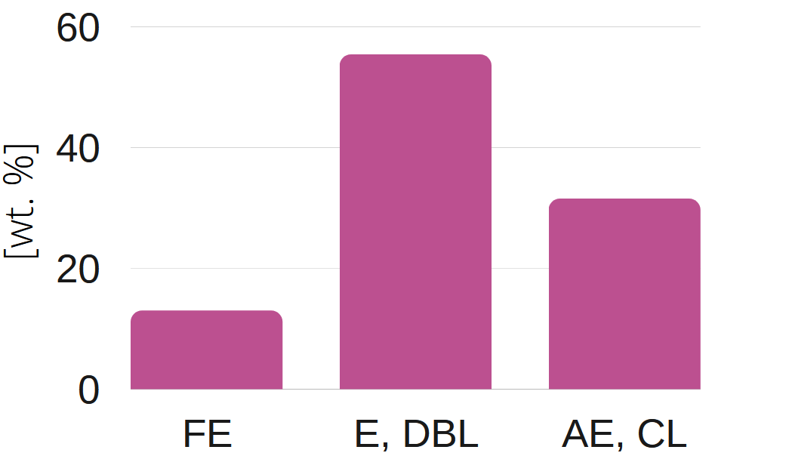
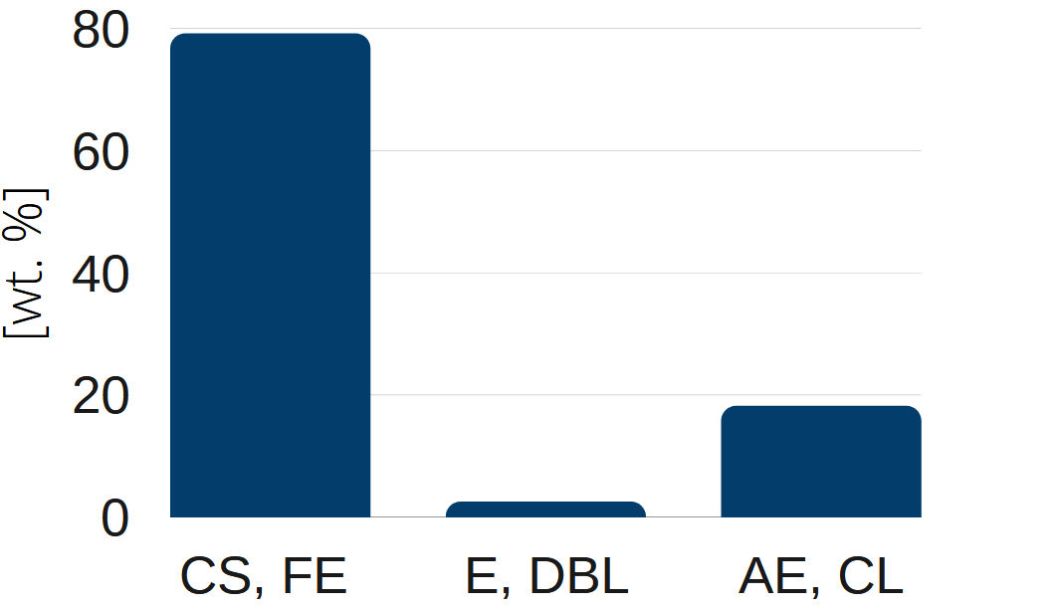
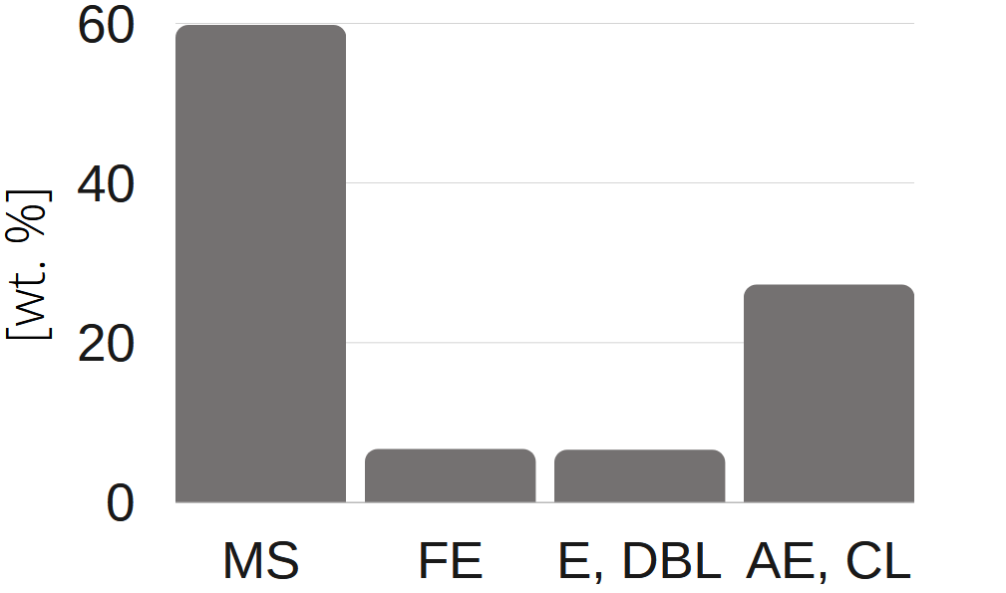
SOC designs & Challenges
Electrolyte-supported
Fuel electrode-supported
Metal-supported
FE, E, DBL, AE, (CL)
AE, DBL, E, FE
DBL, FE, (CL)
E
CS
MS
(CL), AE
wt%
wt%
wt%

Slide 4
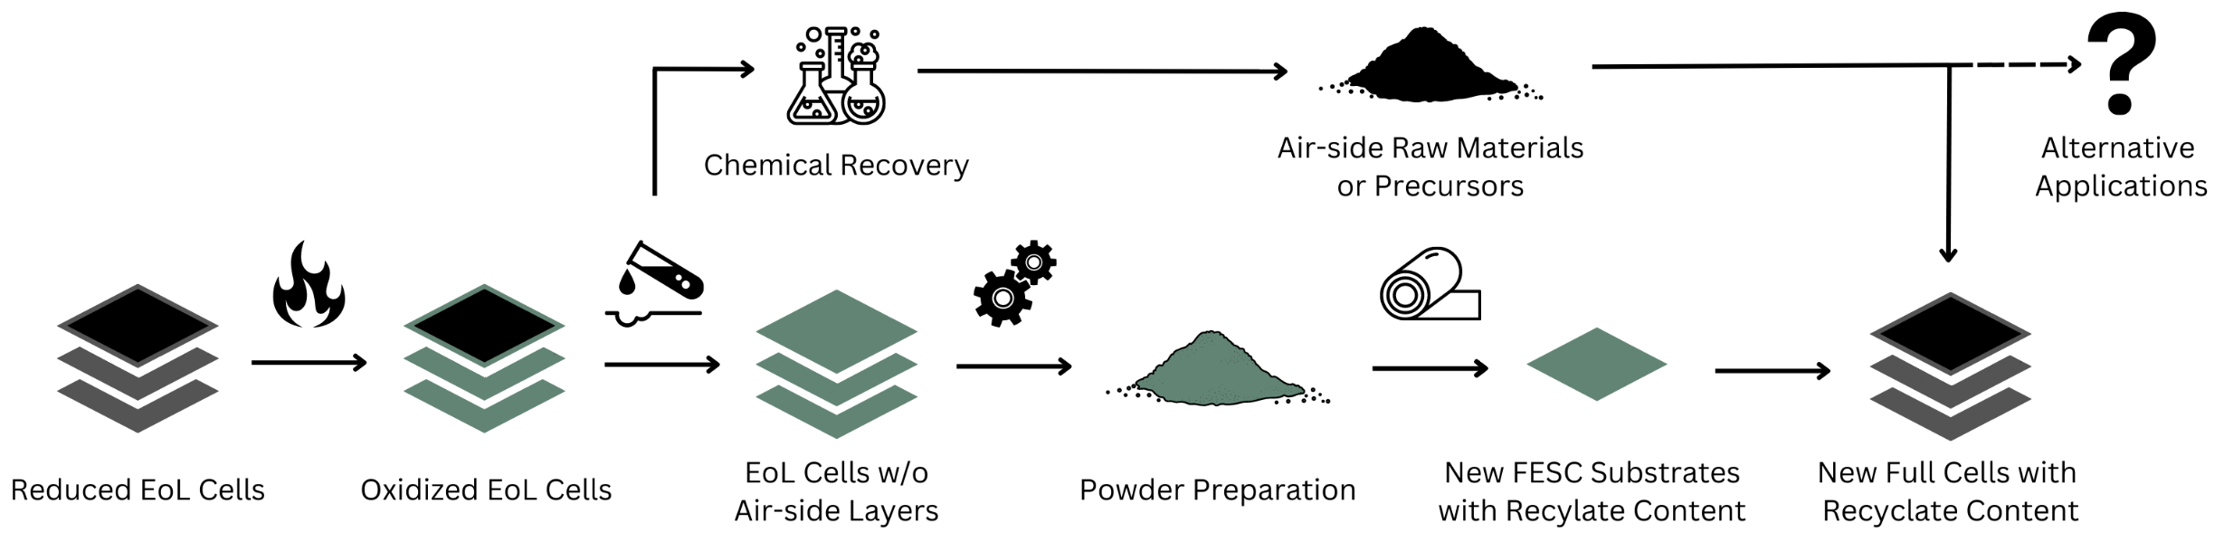
FESC recycling concept
Air-side
recycling
Fuel-side recycling

Slide 5
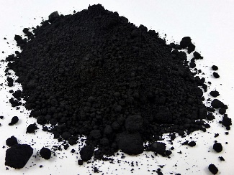
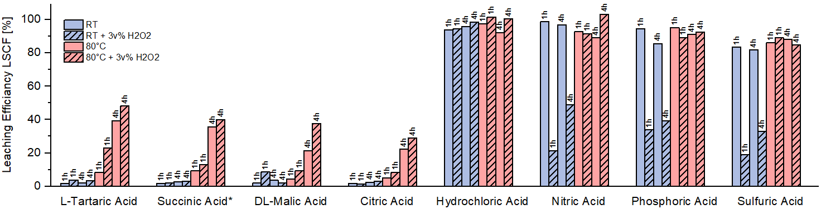

LSCF leaching
Cell powder
wt%
53
39
6
1
NiO:
YSZ:
LSCF:
GDC:
Concentration:
2M (org.) 6M (inorg.)
Solid to Liquid:
1g/L
Temperature
Why H₂O₂?
increases solubility
reducing agent
oxidizing agent
Additive H₂O₂
Time
Acid type
Notes:
Y-Axis = Sum of all LSCF components
X-axis = different acid types
Cell powder

Slide 6


LSCF leaching
~100%
~100%
<95%
<89%
<48%

Slide 7
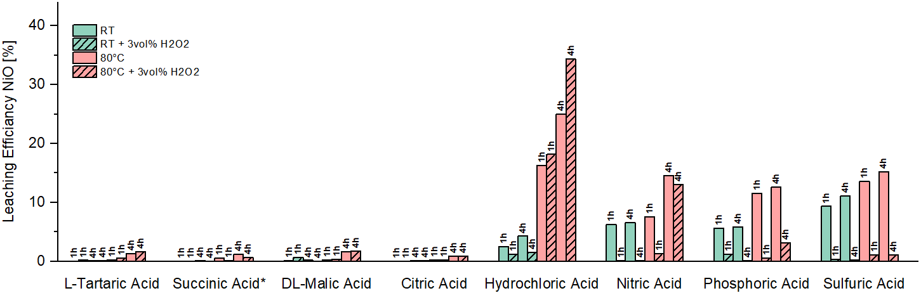
Nickel leaching
~34%

Slide 8
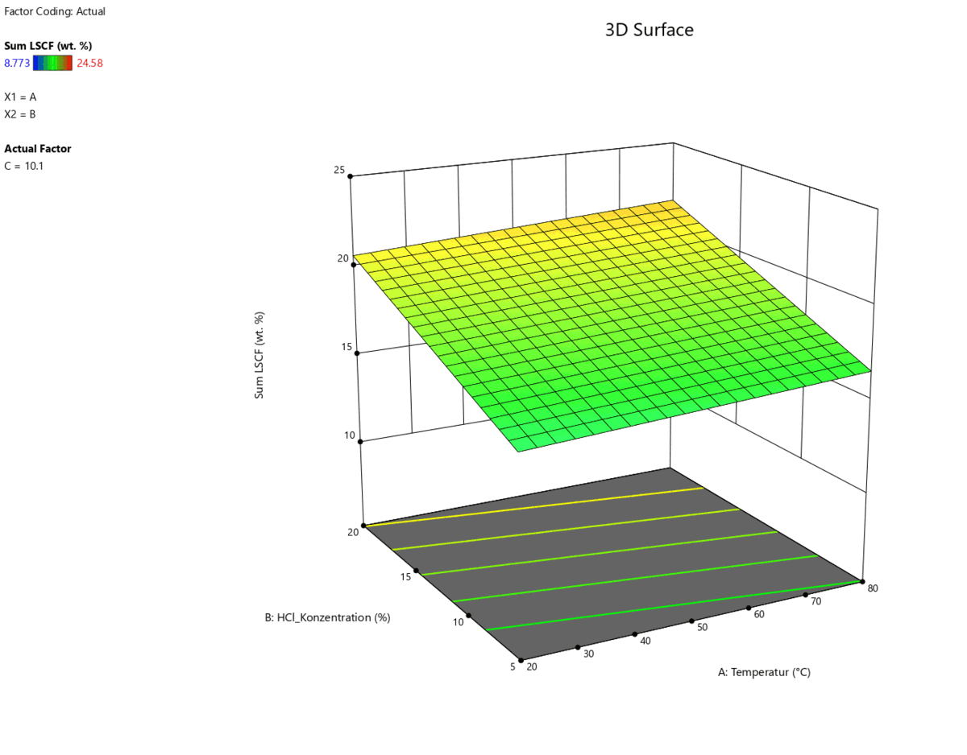


Response surface Methodology
25
LSCF [wt%]
Fraction completely dissolved
Contact time
20
Sweet spot for LSCF leaching:
Leaching media: HCl
Concentration: 6M/~20%
Contact time: 2h
Solid/Liquid (S/L): 50g/L
US-stirred
15
LSCF [wt%]
10
20
15
Concentration [%]
70
80
10
60
40
50
20
30
Temperature [°C]

Slide 9
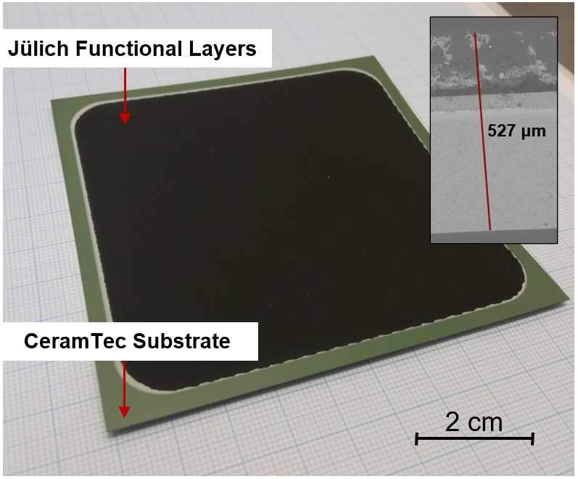
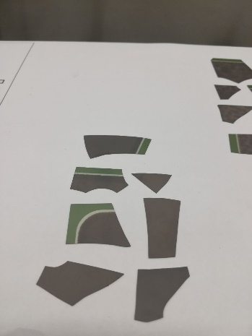
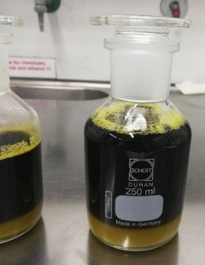
Bulk cell material investigated
Cell structure
YSZ
Ni-YSZ
GDC
LSCF
LCC10*
electrolyte
fuel electrode
barrier layer
air electrode
contact layer
>85wt%
(fuel-side recycling)
<15wt%
(air-side recycling)
* La₁Mn_{0.45}Co_{0.35}Cu_{0.2}O_{3-δ}
[5] European Commission, Study on the Critical Raw Materials for the EU 2023, Publications Office of the European Union, DOI: 10.2873/725585.

Slide 10
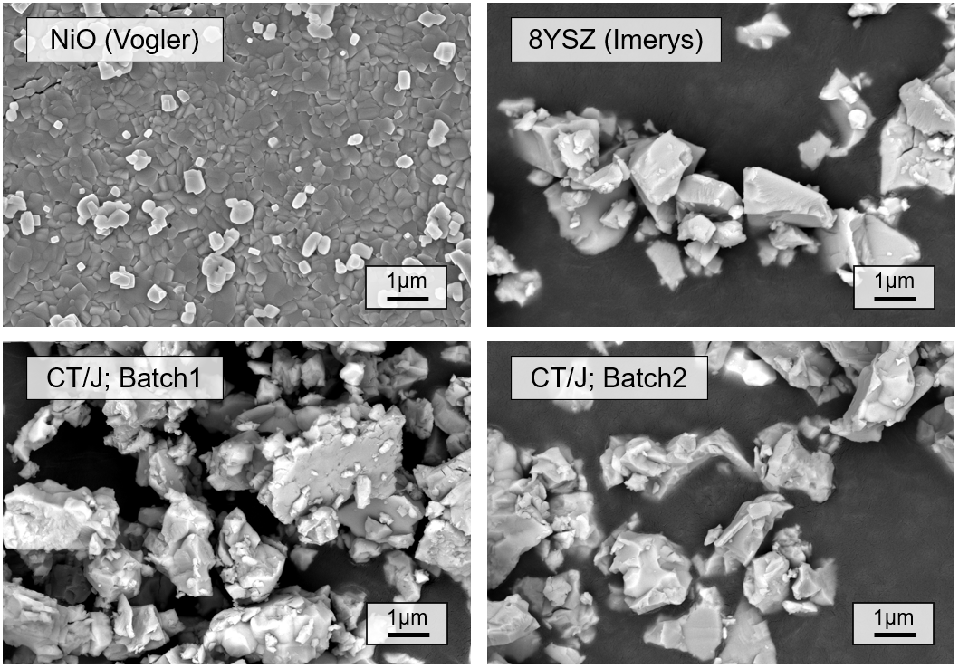
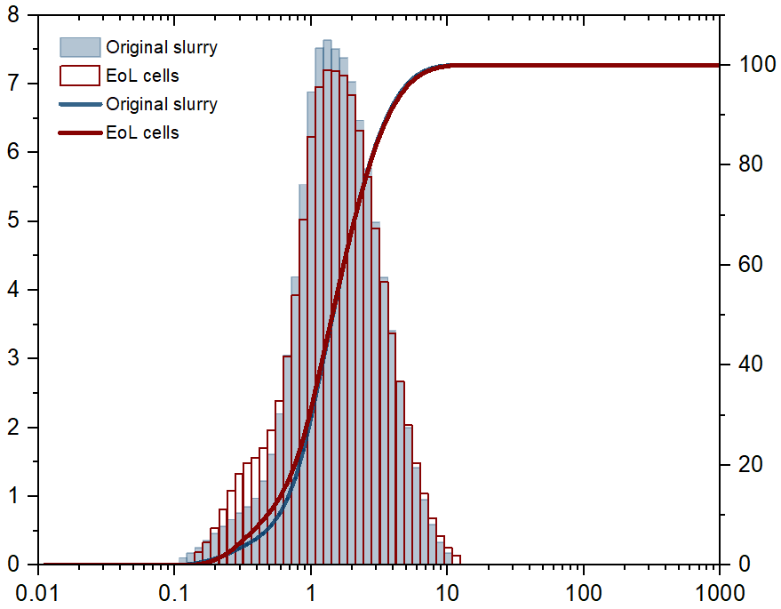
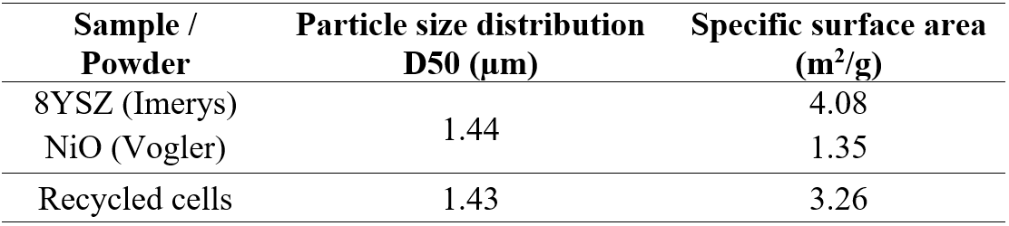
Powder preparation
Milling study via tumble mixing
*
*
Relative fraction [%]
Cumulative fraction [%]
**
Diameter [µm]
*EoL End-of-Life
**CT/J CeramTec/Jülich cells

Slide 11
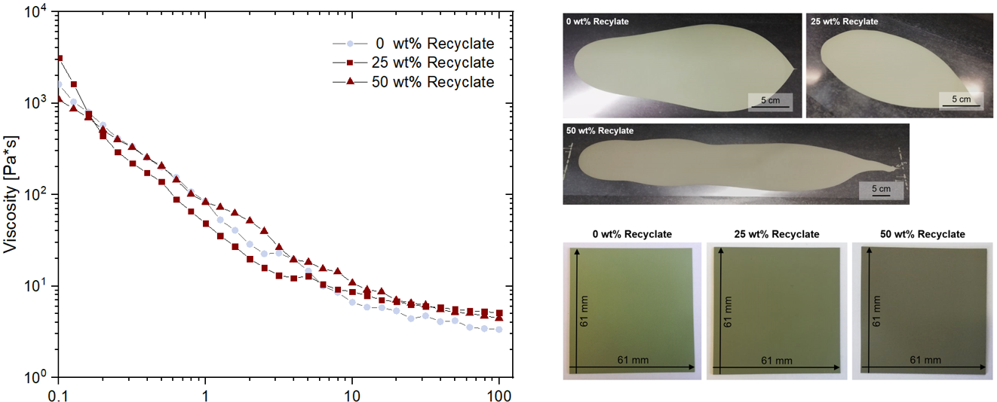

Tape casting
Viscosity
Green tapes

Slide 12
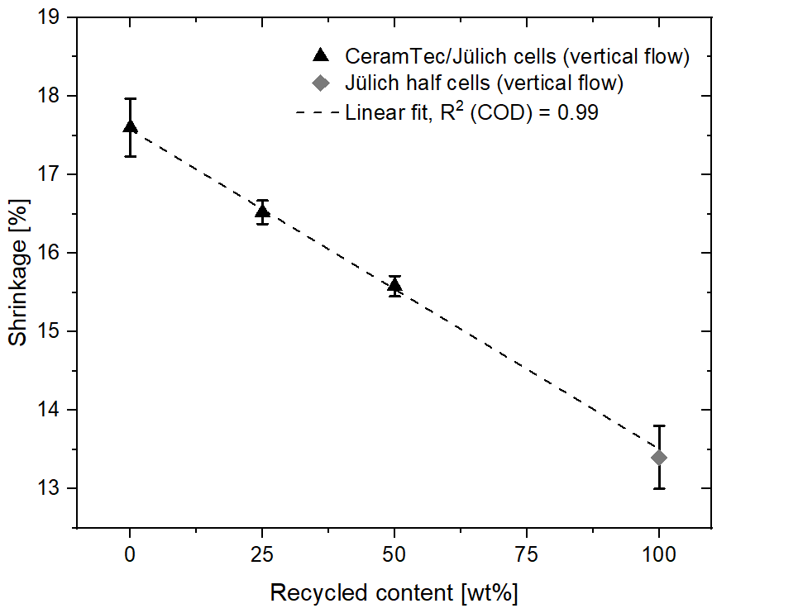
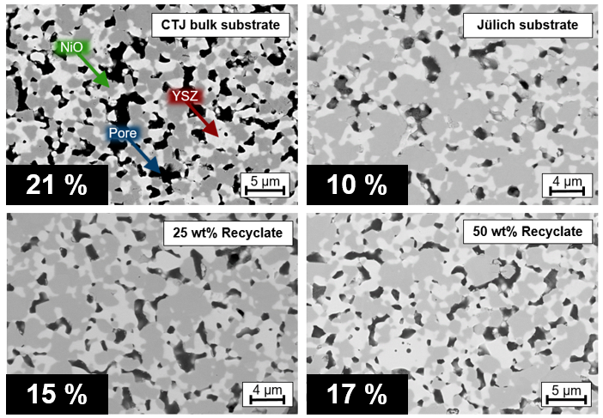

Substrate shrinkage & Porosity
Shrinkage
Porosity (ox. substrates)
*
Shrinkage decreasing (linear) ↓ ; Porosity increasing (non-linear, max. Δφ = 9.6%) ↑
Grain shape & nickel distribution comparable to standard, no visible defects
* pre-study by M. Hilger (master‘s thesis, 2022)

Slide 13
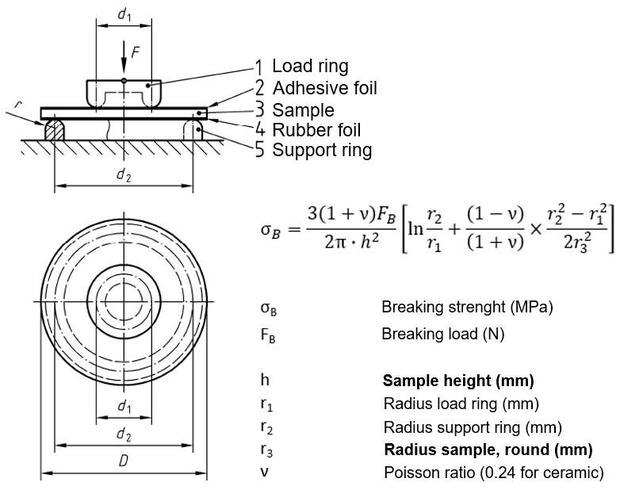
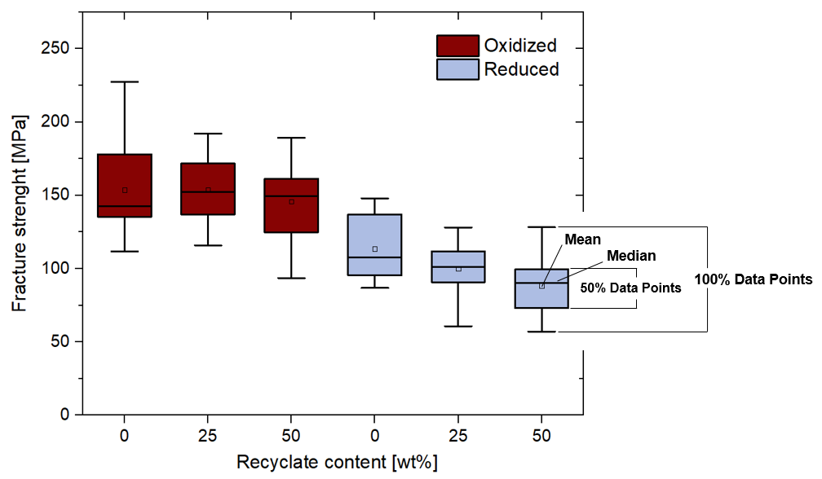
Mechanical stability of substrate
Results:
Fracture strength Ox. > Red.
Weibull modulus 5.8–8.5
Ring-on-ring set up (FZJ, IEK-2):
Room temperature
100 N min⁻¹
20 samples per series

Slide 14
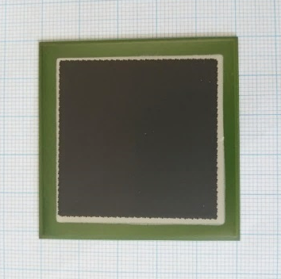
Take home messages
Separation of oxygen-electrode via mineral acids (HCl/HNO₃)
Reprocessing to new substrate possible by adjusting particle size & specific surface area
Predictable changes in shrinkage & porosity with increasing recycled content
Mechanical stability slightly lower for recycled samples
(LSCF precursor recovery via oxalate precipitation)
OUTLOOK
11/12 manufactured full cells survived without defects!
Leakage test succesful
Single cell testing @FZJ; IEK-9 (currently performed)

Slide 15


Thank you for your attention
9th International Conference on Fundamentals & Development of Fuel Cells
SEP 25th 2023 | S. Sarner | N.H. Menzler | O. Guillon
ACKNOWLEDGEMENTS
Collaboration:
N. Wettengl (ZEA-3, FZJ)
T. Osipova (IEK-2, FZJ)
J. Malzbender (IEK-2, FZJ)
Supervision:
O. Guillon
N.H. Menzler

