Slide 1
Measurement of the refractive index increment with temperature of aqueous guandinium salts solutions
Andre Jakubowski

Slide 2
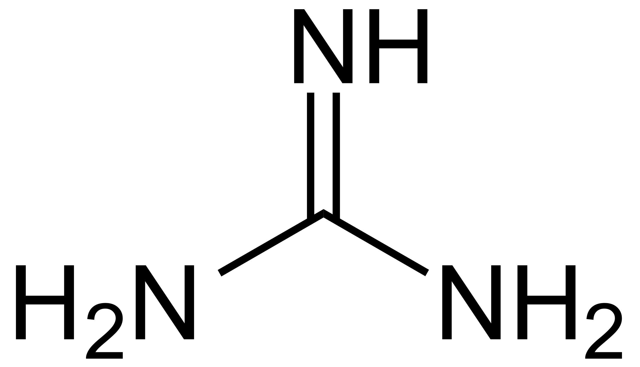
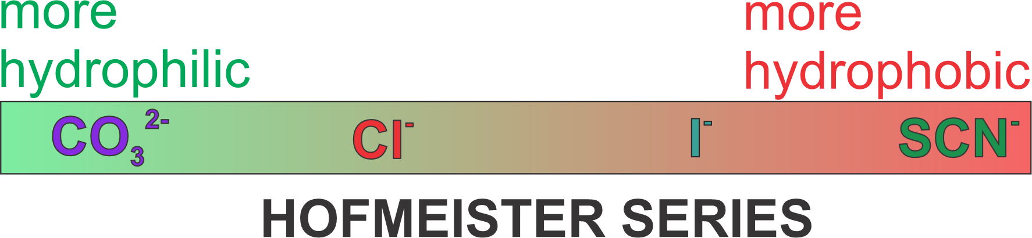
Guanidinium Salts
Guanidinium cation:
Important role in protein folding, protein denaturation and hydration of biological molecules.
Guanidine Salts on the whole Hofmeister Series with the anions: carbonate, chloride, iodid, thiocyanat
Concentrations: [0.5 , 3]mol/kg
Temperatures: [15 , 45]℃
(From Wikipedia user: NEUROtiker)

Slide 3
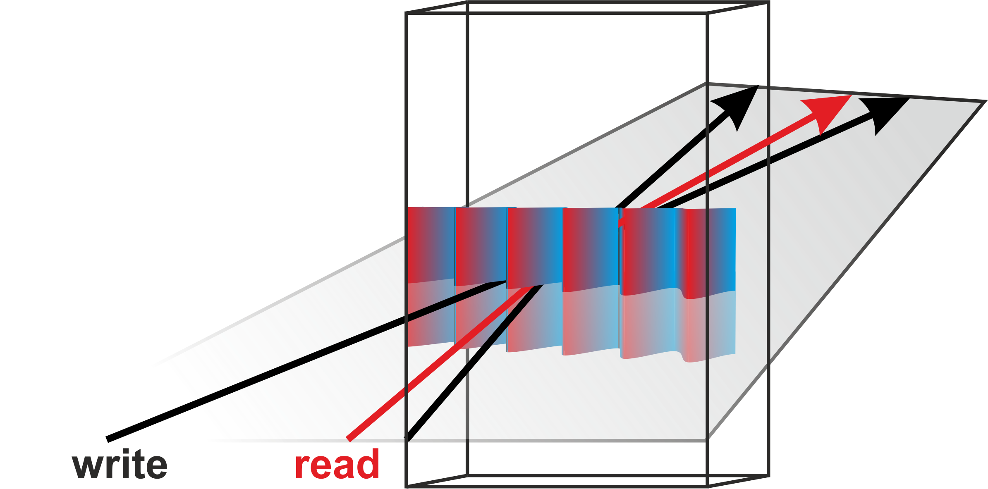
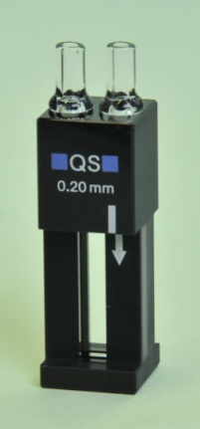

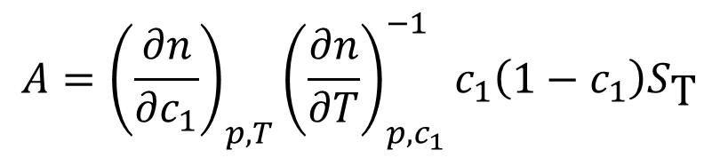
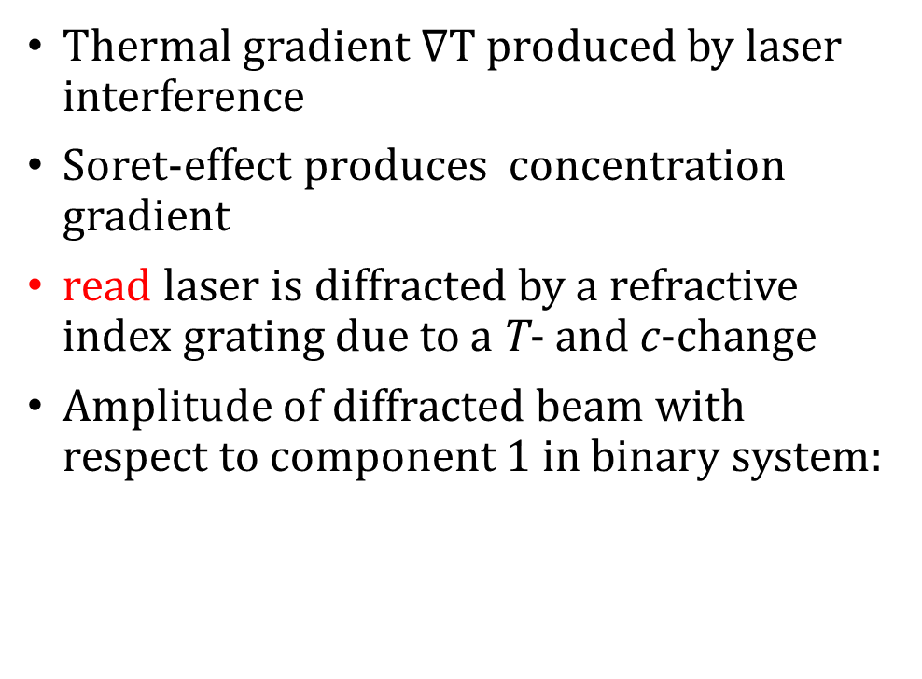
Thermal Diffusion Forced Rayleigh Scattering (TDFRS)
Thermal gradient $∇T$ produced by laser interference
Soret-effect produces concentration gradient
read laser is diffracted by a refractive index grating due to a T- and c-change
Amplitude of diffracted beam with respect to component 1 in binary system:
$$A={\left(\frac{∂n}{∂c_{1}}\right)}_{p,T}{\left(\frac{∂n}{∂T}\right)}_{p,c_{1}}^{−1}c_{1}\left(1−c_{1}\right)S_{\text{T}}$$

Slide 4
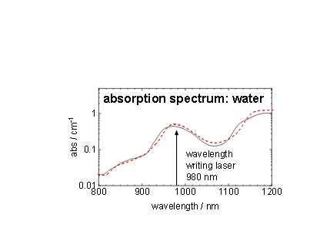
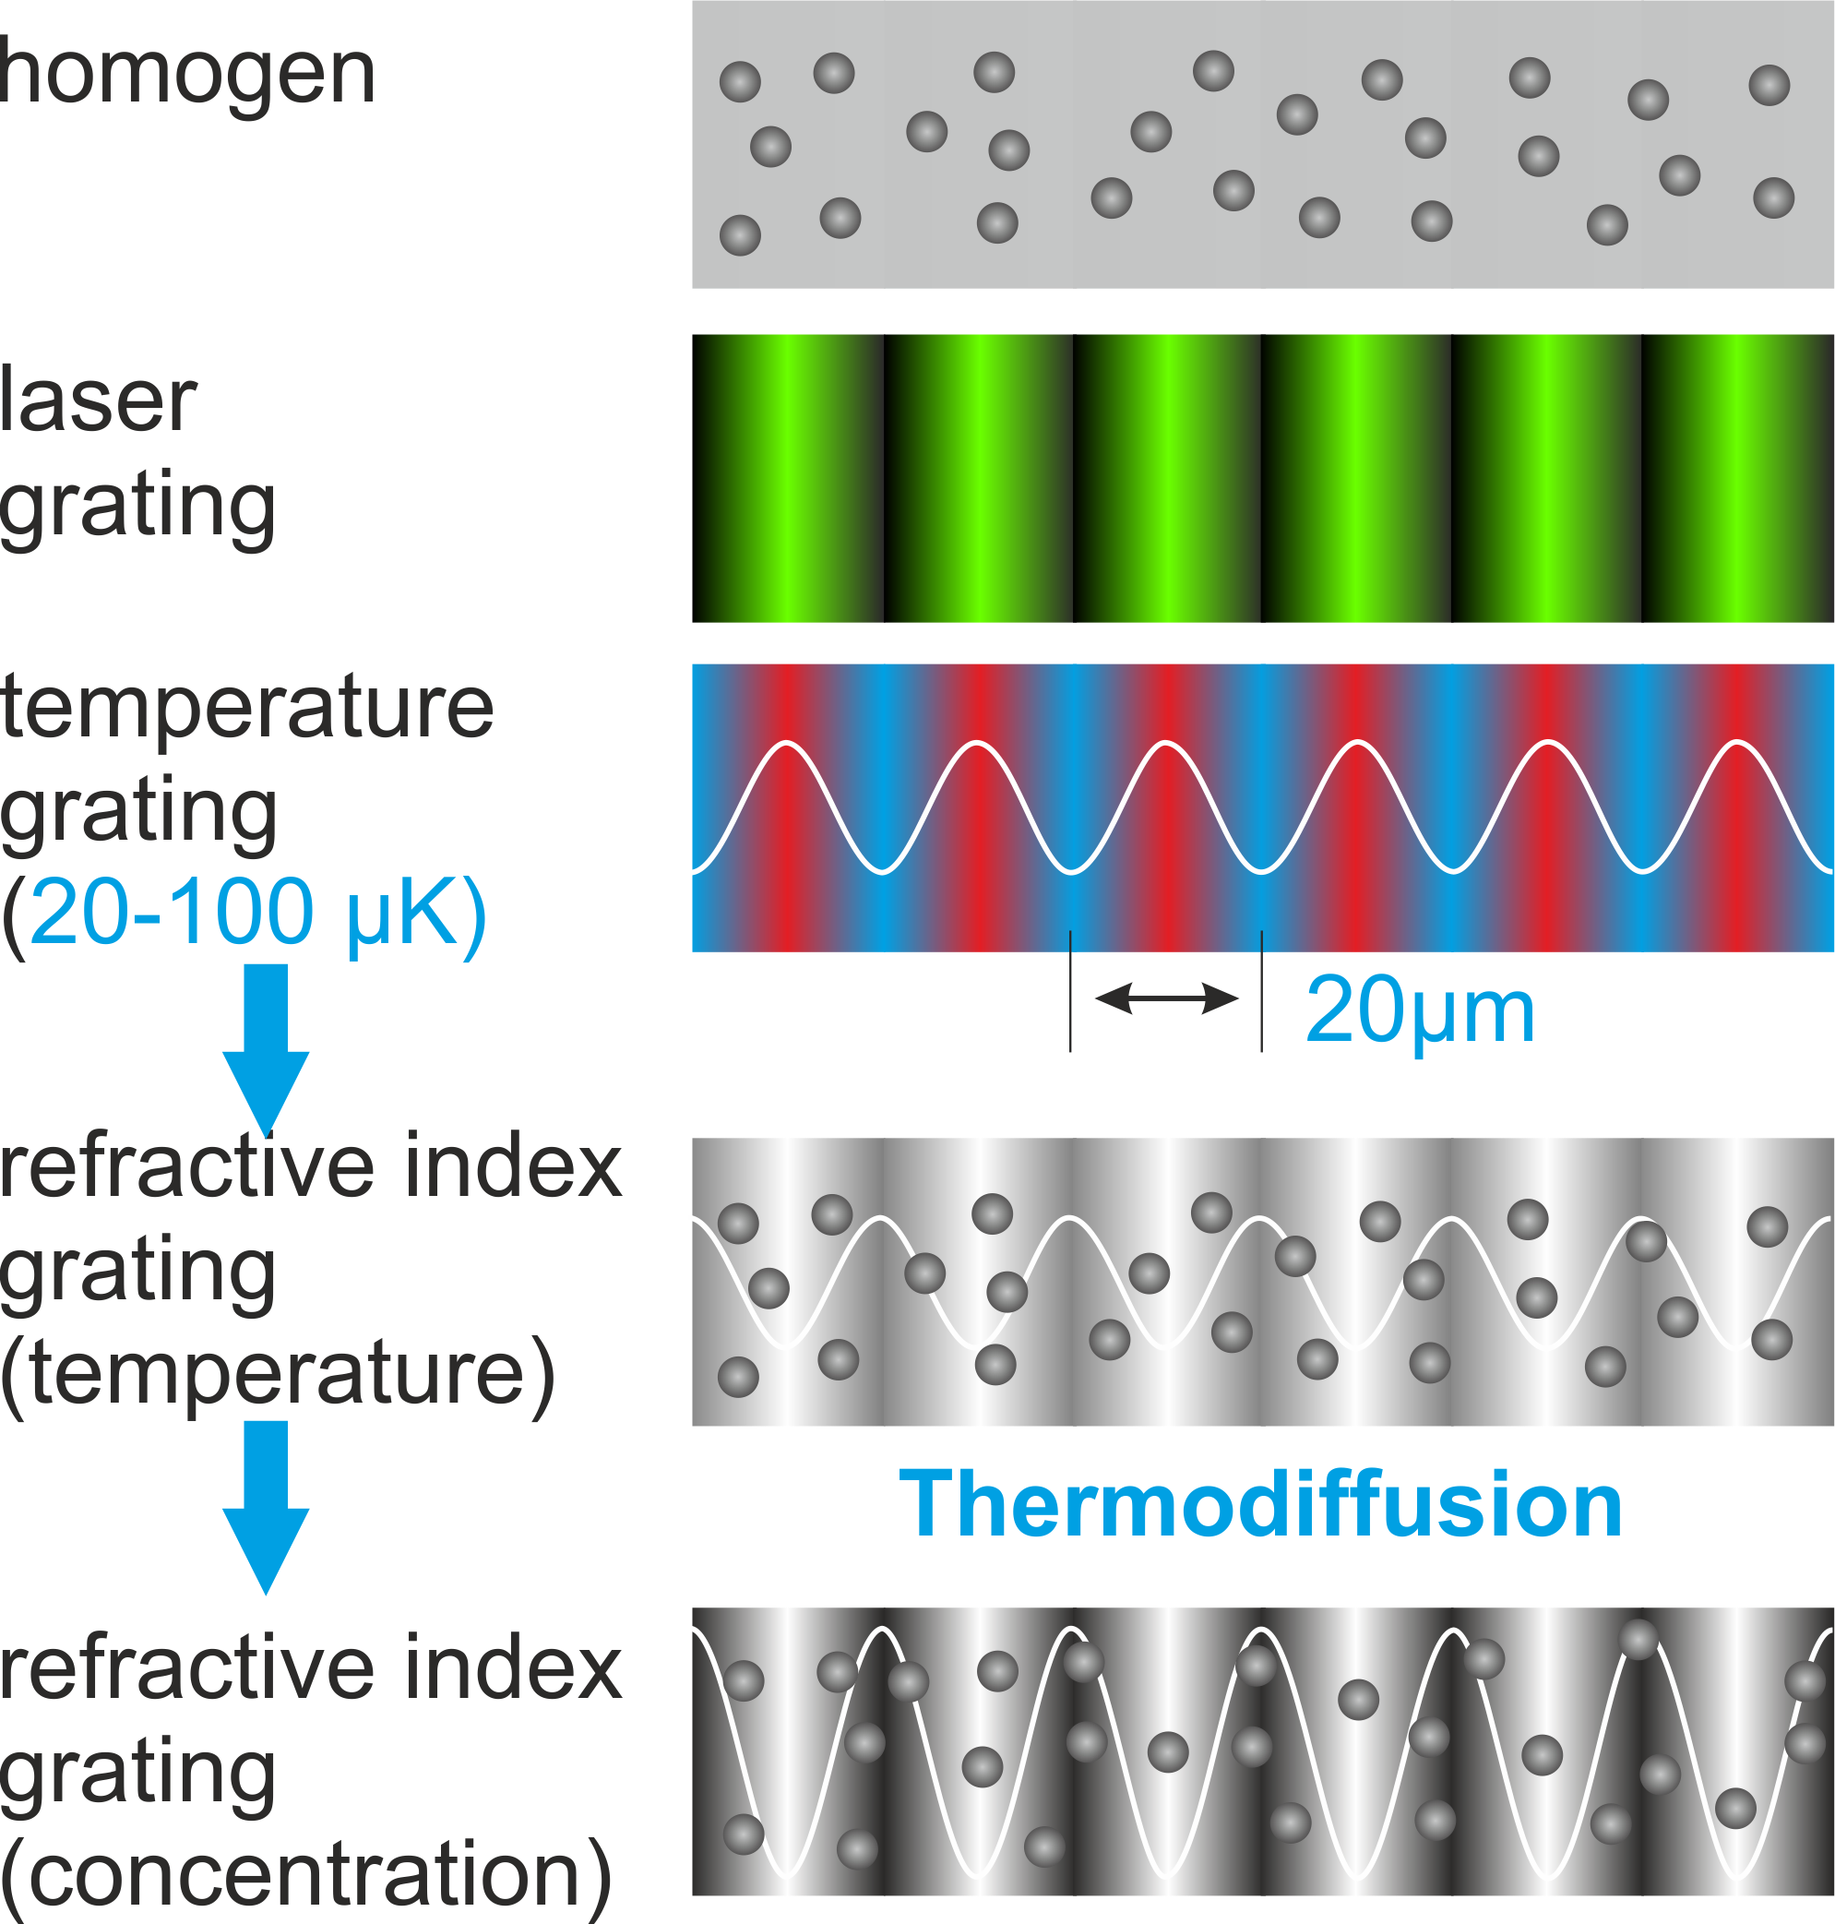


Thermal Diffusion Forced Rayleigh Scattering
$${\left(∂n/∂T\right)}_{p,c}$$
$${\left(∂n/∂c_{1}\right)}_{p,T}$$

Slide 5
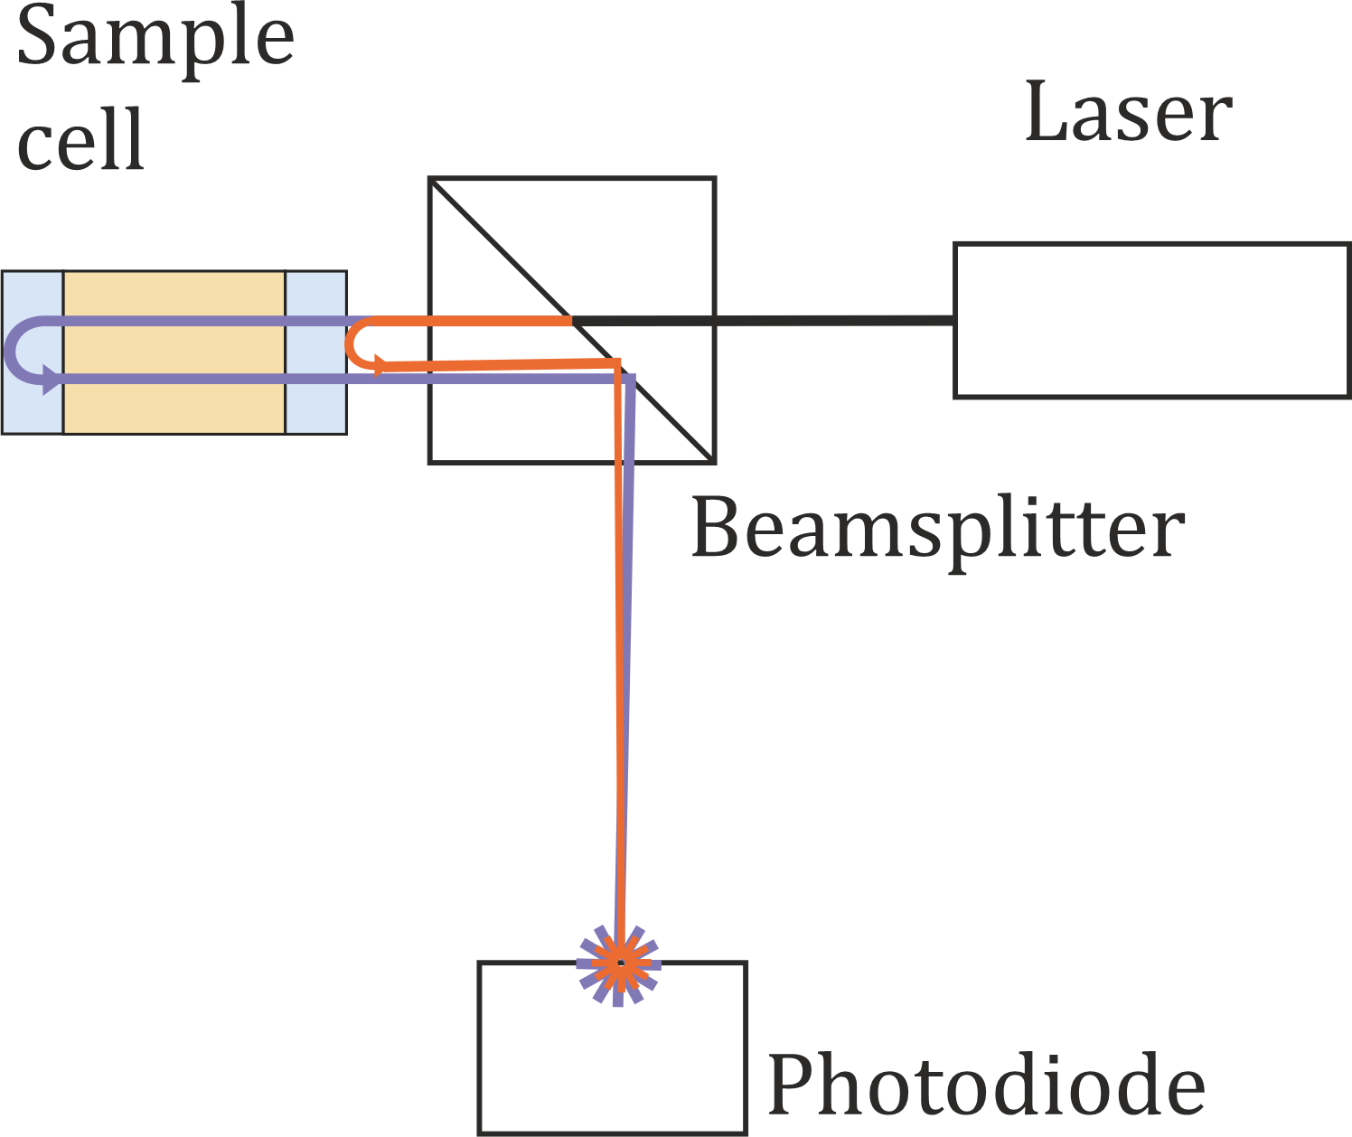


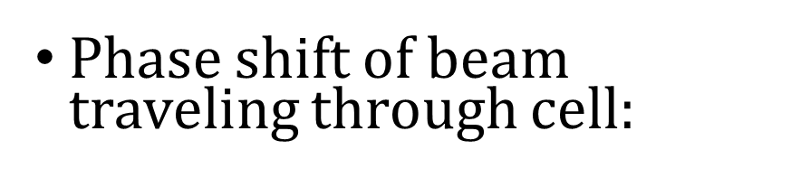

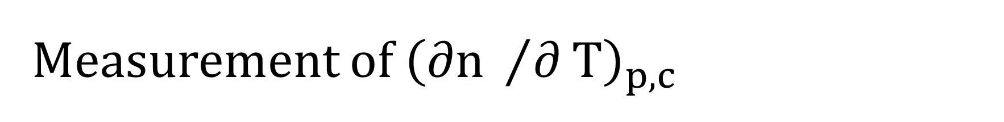



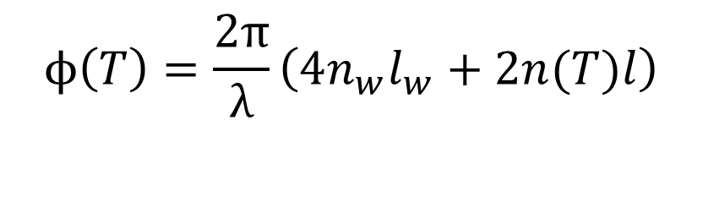

Measurement of ${\left(∂n /∂T\right)}_{p,c}^{}$
Phase shift of beam traveling through cell:
$$ϕ\left(T\right)=\frac{2π}{λ}\left(4n_{w}l_{w}+2n(T)l\right)$$
Window contribution
Sample contribution
$$l_{w}$$
$$l_{w}$$
$$n_{w}$$
$$n(T)$$
$$n_{w}$$
$$l_{}$$

Slide 6
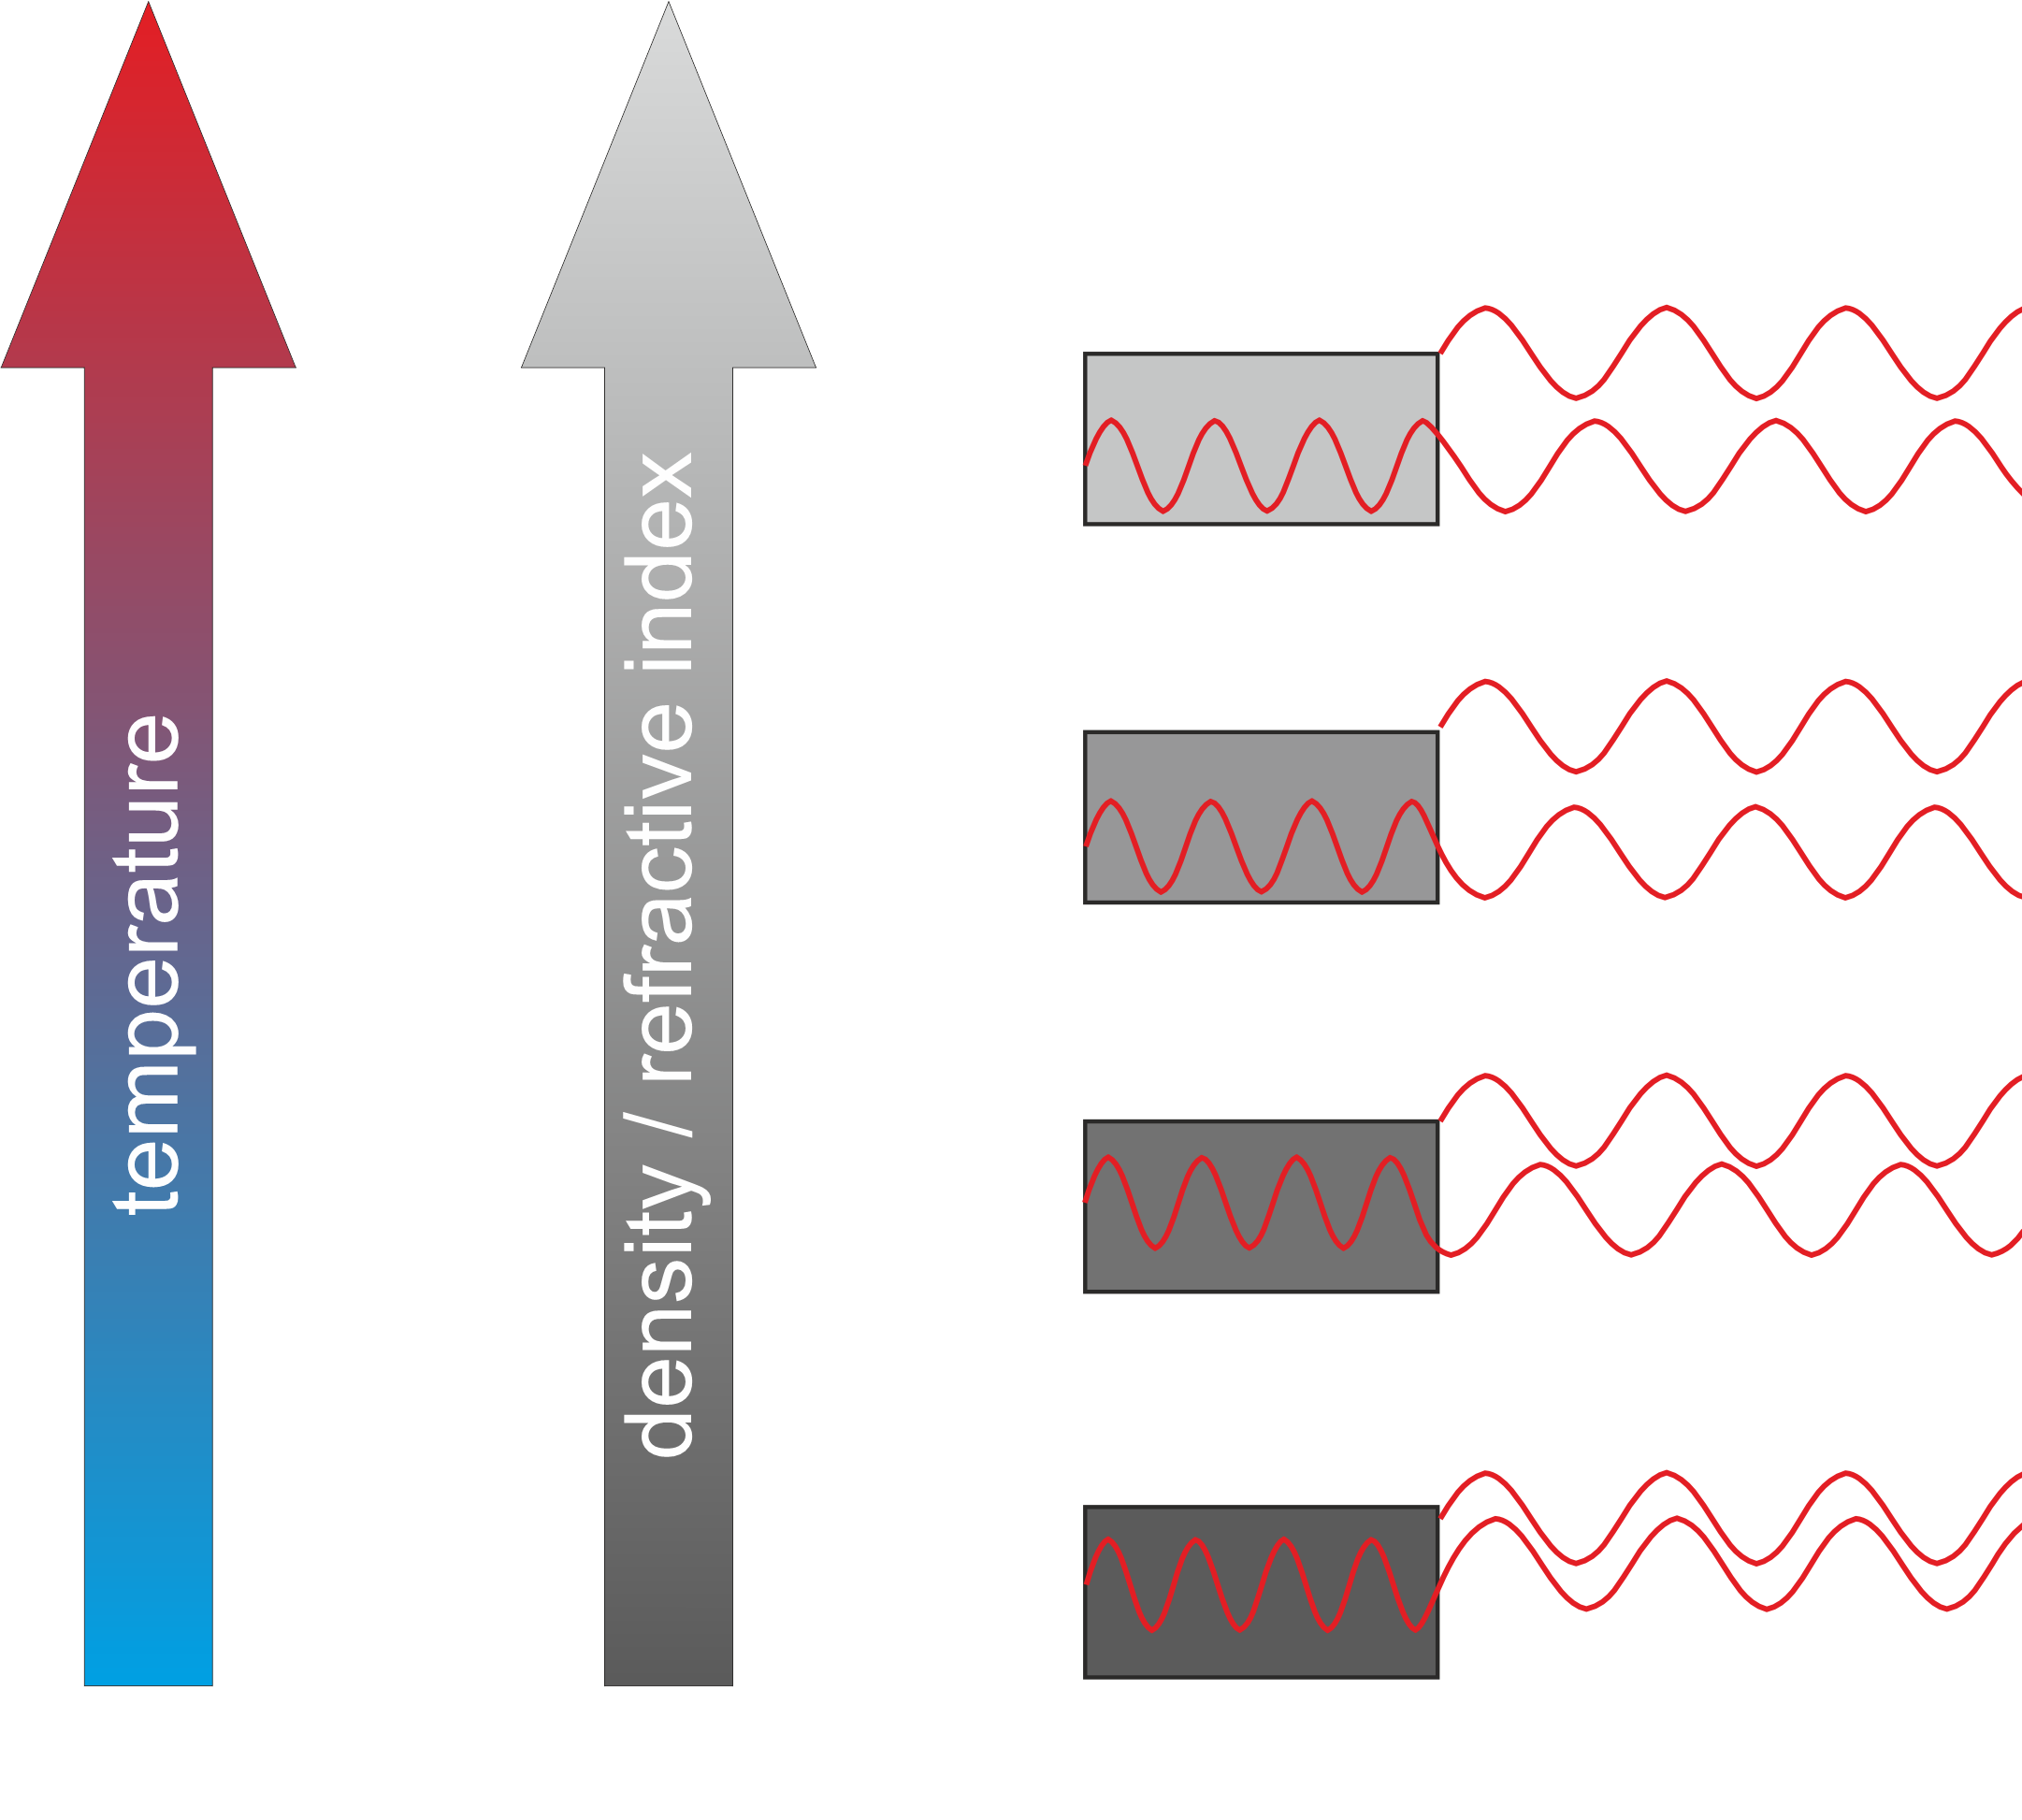
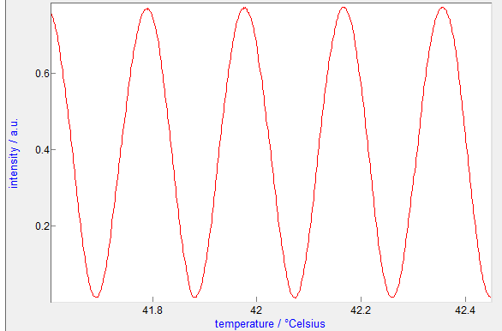
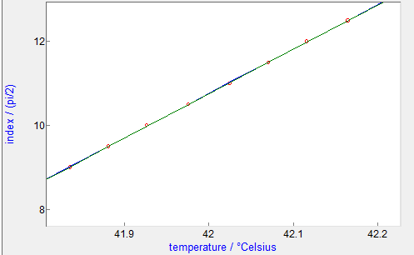

Measurement of ${\left(∂n /∂T\right)}_{p,c}^{}$
$${\left(\frac{∂n}{∂T}\right)}_{p,c}=\frac{1}{4π}\frac{λ}{l}\frac{∂ϕ}{∂T}−2\frac{n_{w}}{l}\frac{∂l_{w}}{∂T}−2\frac{l_{w}}{l}\frac{∂n_{w}}{∂T}−\frac{n}{l}\frac{∂l}{∂T}$$
Constant

Slide 7
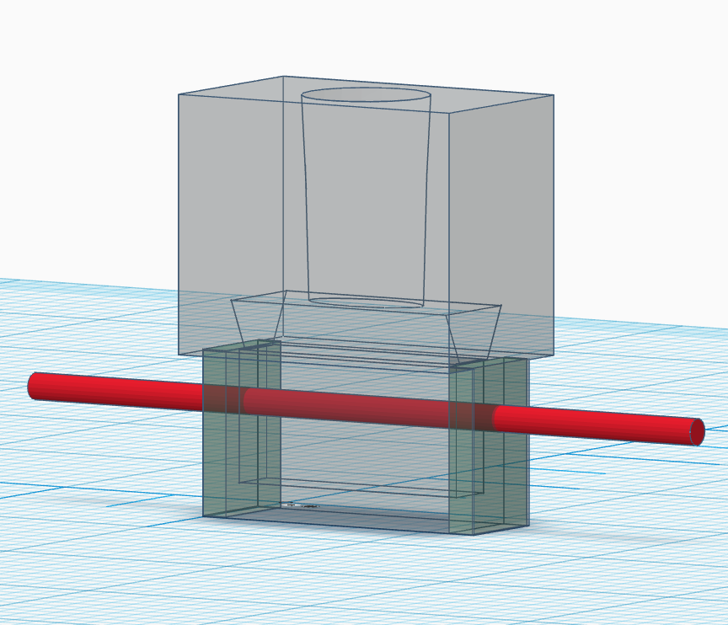
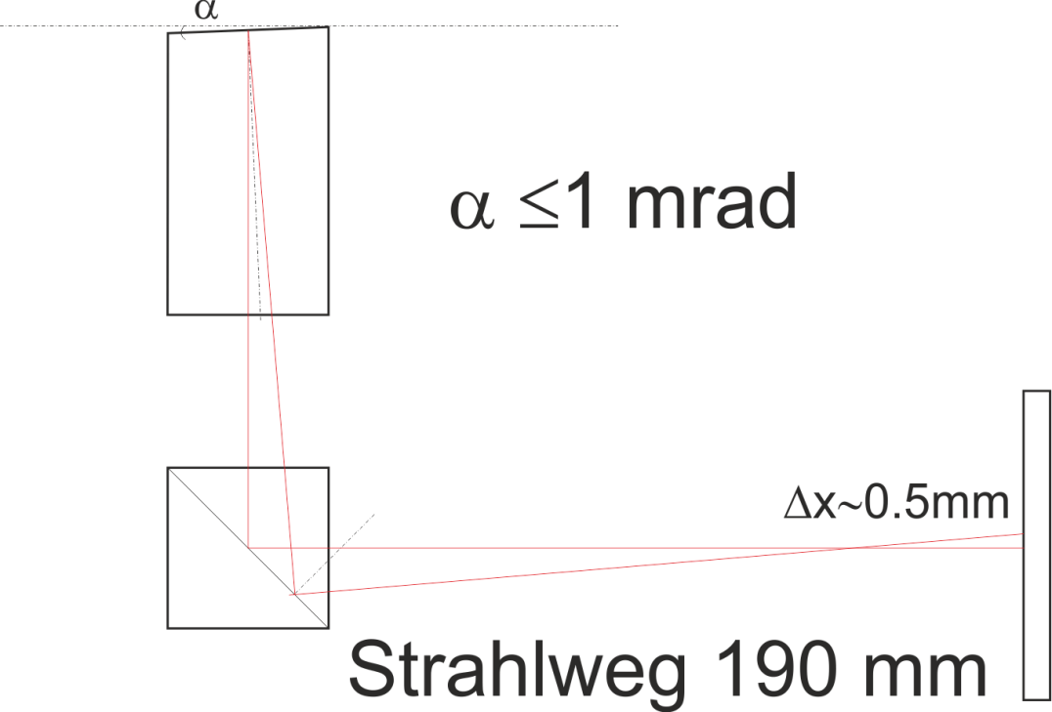
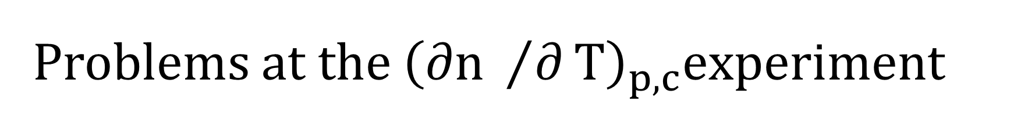

Problems at the ${\left(∂n /∂T\right)}_{p,c}^{}experiment$
Parallelism of the sample cell windows required
path length$\text{190}\text{mm}$

Slide 8
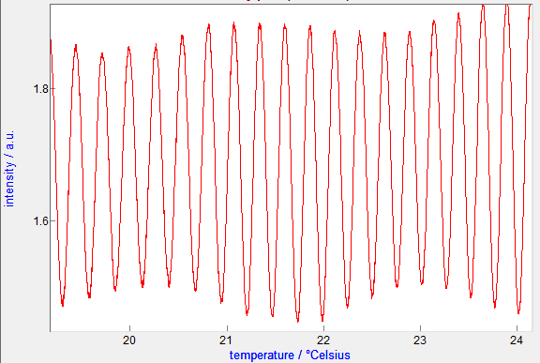
Problems at the ${\left(∂n /∂T\right)}_{p,c}^{}experiment$
Optical beating:
  Reflection from the walls of the sample cell holder
  Unwanted thermal effects of the sample cell or the cell holder

Slide 9
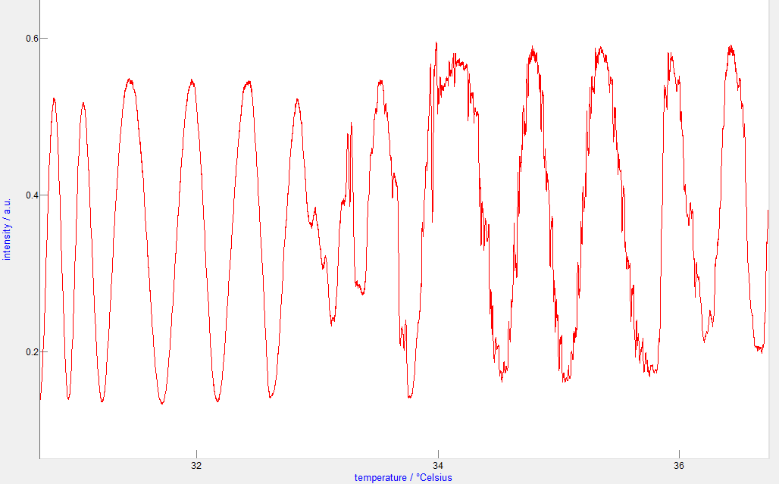
Problems at the ${\left(∂n /∂T\right)}_{p,c}^{}experiment$
Uncontinuous signals:
  Appeared at higher concentrations 1.5mol/kg of Guanidinium Chloride and temperatures >34℃
  Wasn’t reproducible in more recent measurements
Guanidinium Chloride solutions can crystallize at high temperatures and concentrations

Slide 10
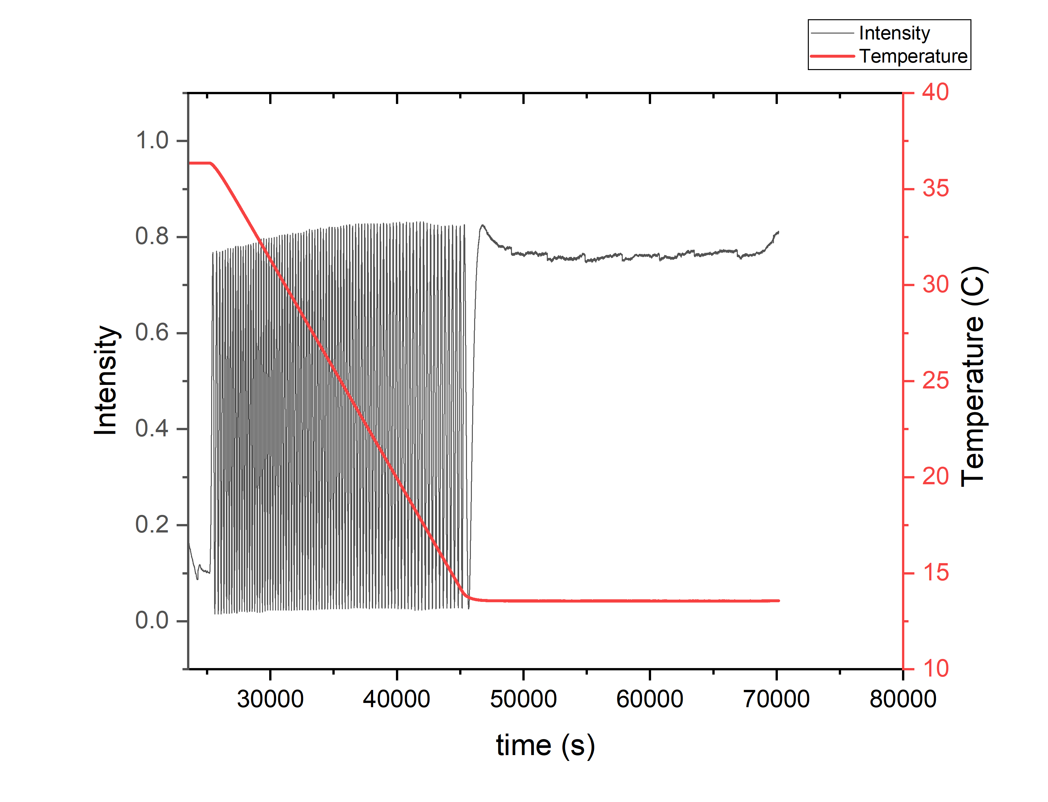
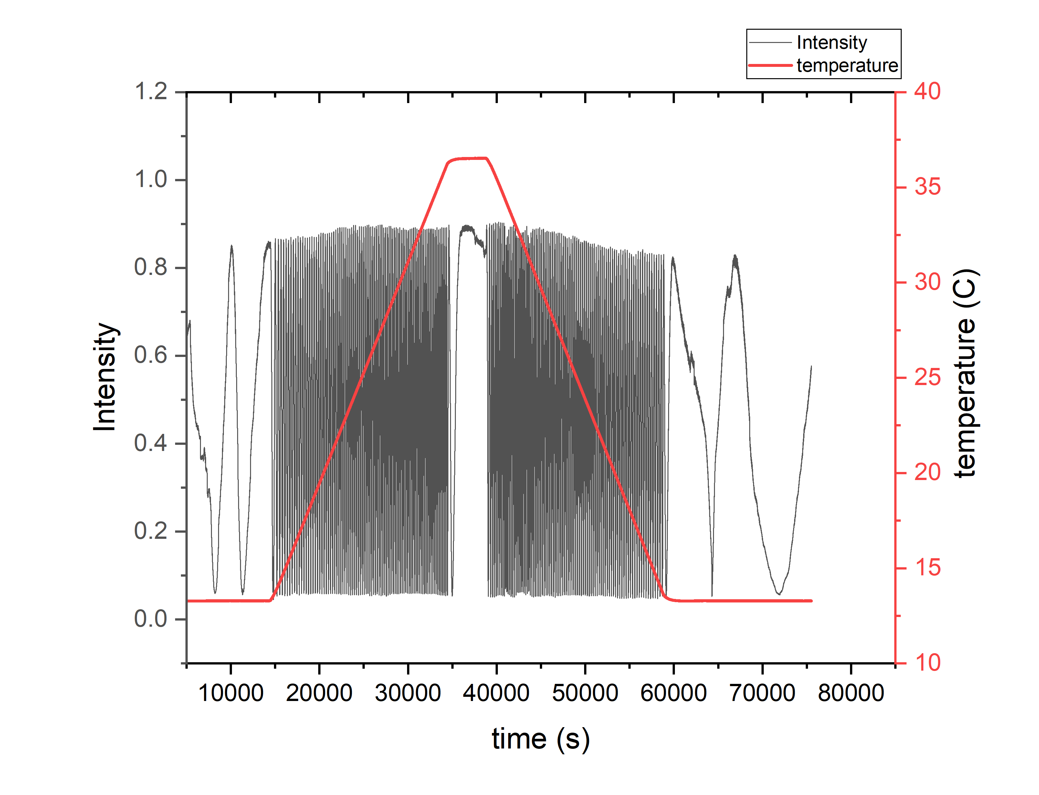
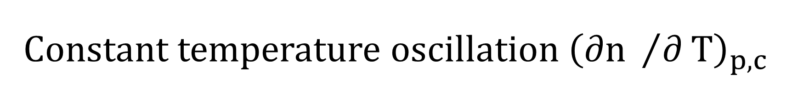
Constant temperature oscillation ${\left(∂n /∂T\right)}_{p,c}^{}$
Gnd Carbonate 0.8mol/kg
Gnd Chloride 1.3mol/kg

Slide 11
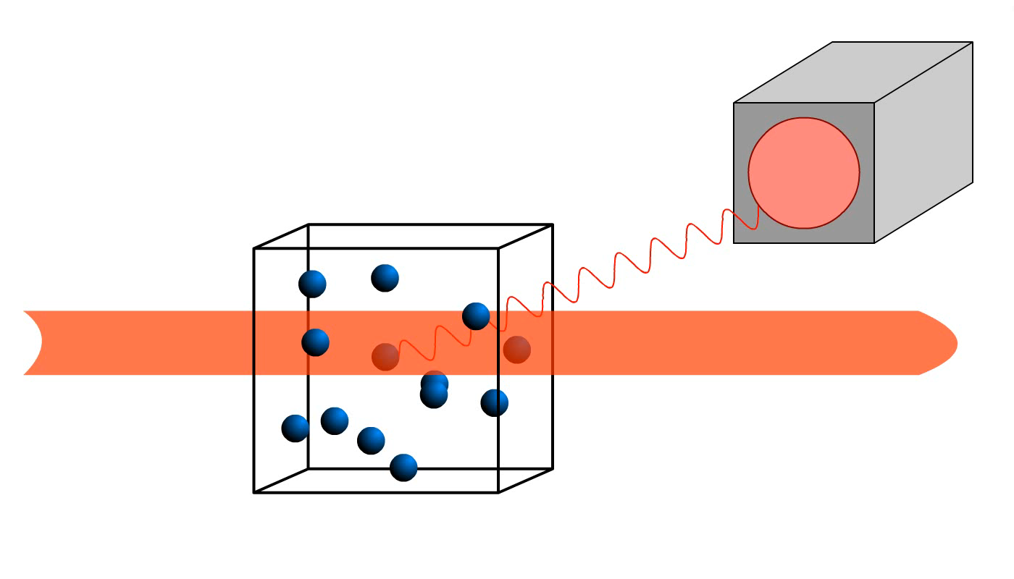
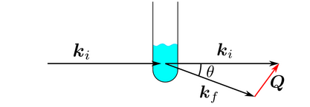
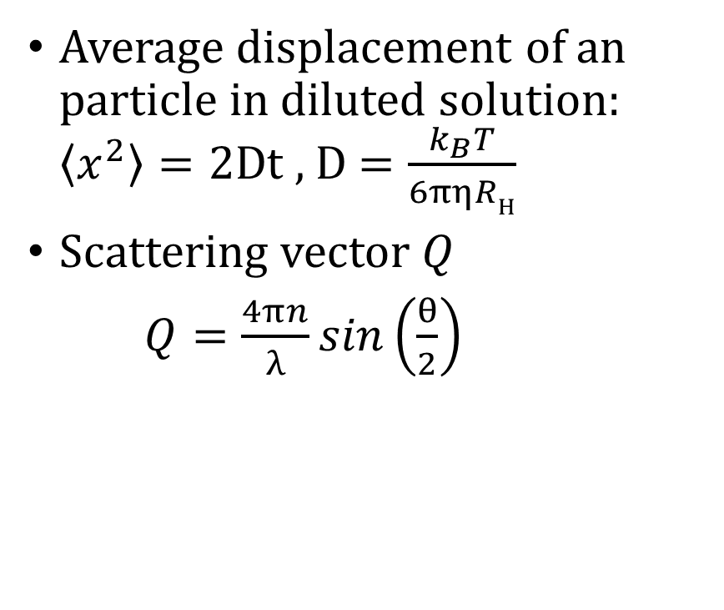
Dynamic Light Scattering
Average displacement of an particle in diluted solution: $\left\langle x^{2}\right\rangle =2Dt$ , D $=\frac{k_{B}T}{6πηRH}$
Scattering vector Q
$Q=\frac{4πn}{λ}\sin\left(\frac{θ}{2}\right)$
From http://www.soft-matter.uni-tuebingen.de/dls.html

Slide 12
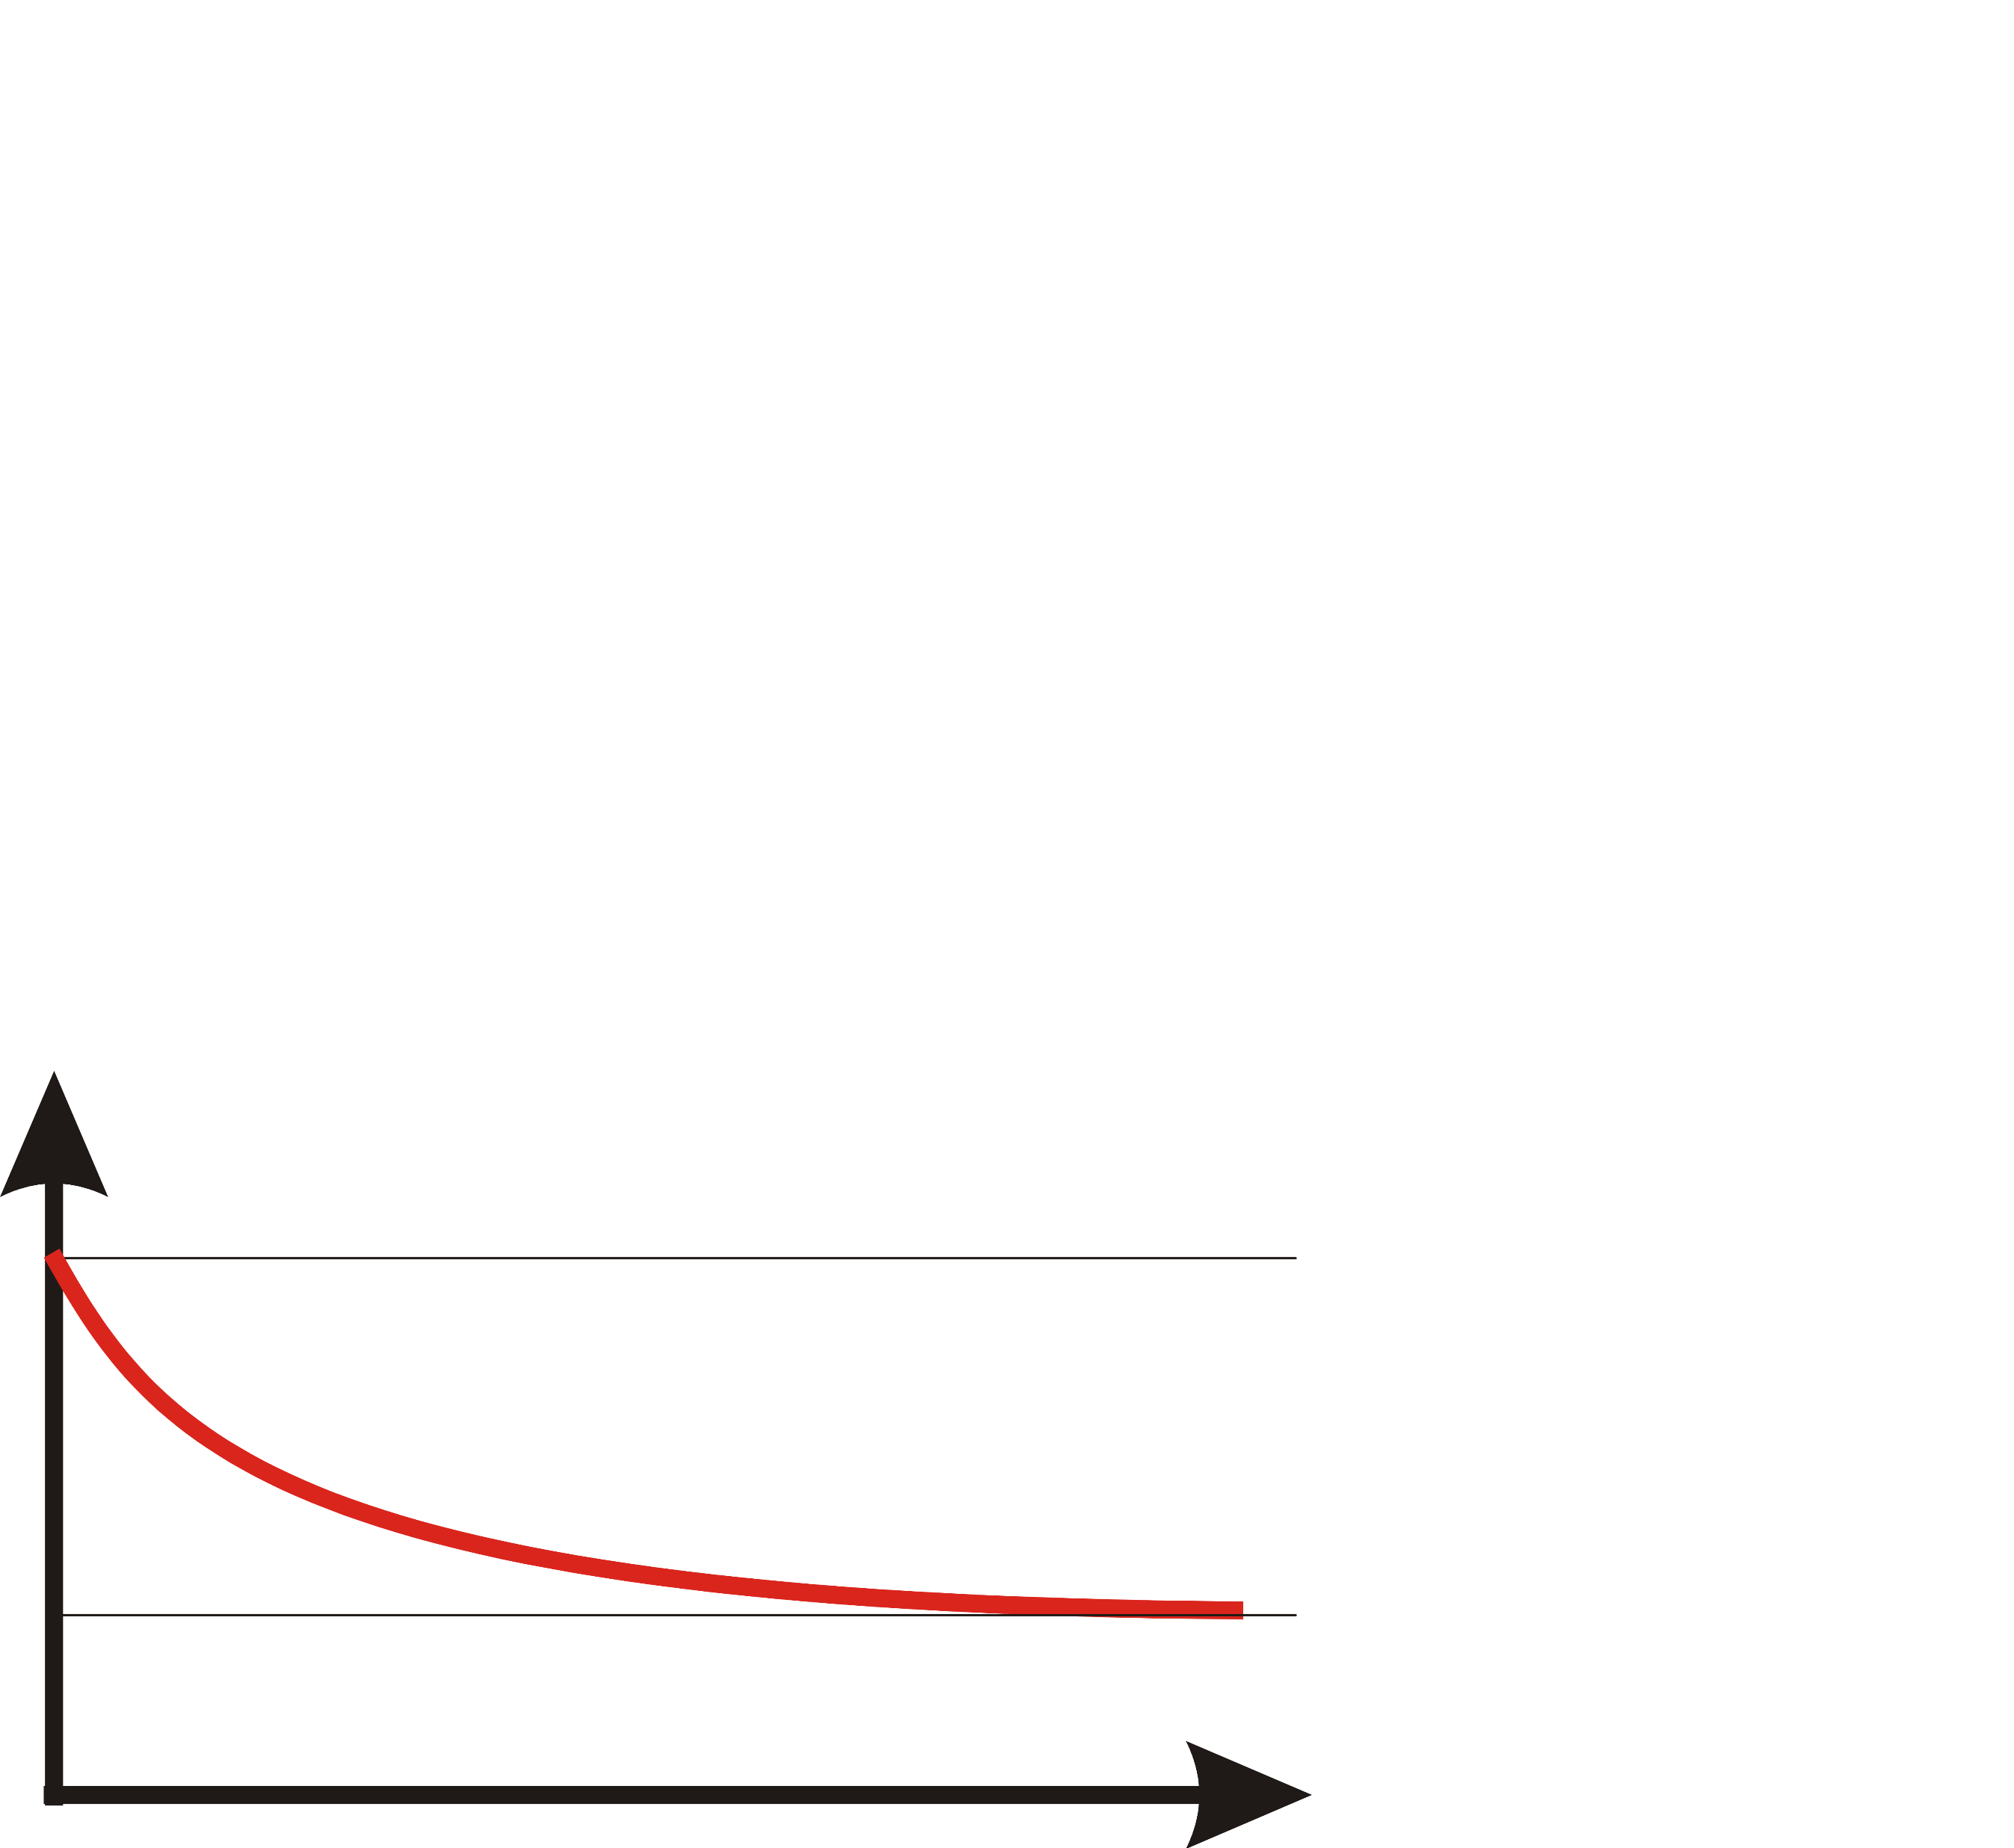
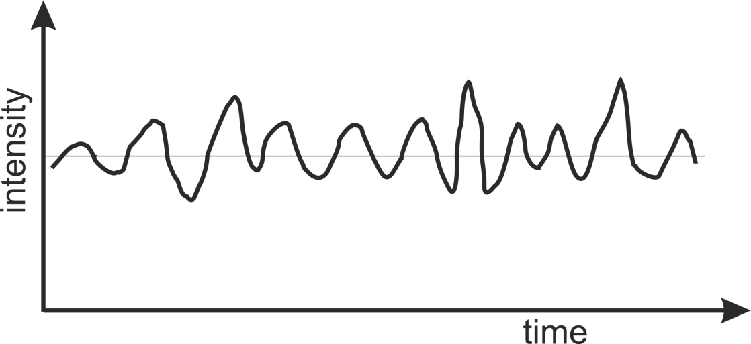

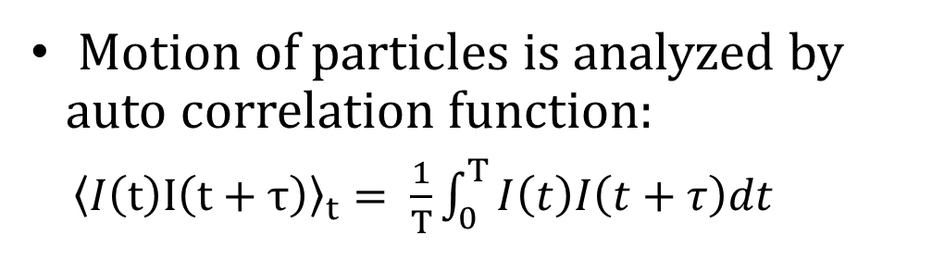

Dynamic Light Scattering
Motion of particles is analyzed by auto correlation function:
${\left\langle I\left(t\right)I\left(t+τ\right)\right\rangle }_{t}= \frac{1}{T}\int_{0}^{T}{I\left(t\right)I\left(t+τ\right)dt}$
For monodisperse systems: $g^{\left(2\right)}\left(τ\right)=\frac{{\left\langle I\left(t\right)I\left(t+τ\right)\right\rangle }_{t}}{{\left\langle I\left(t\right)\right\rangle }^{2}}=1+β\exp\left(−2DQ^{2}τ\right)$
$$\left\langle I{\left(t\right)}^{2}\right\rangle$$
$${\left\langle I\left(t\right)\right\rangle }^{2}$$
τ

Slide 13
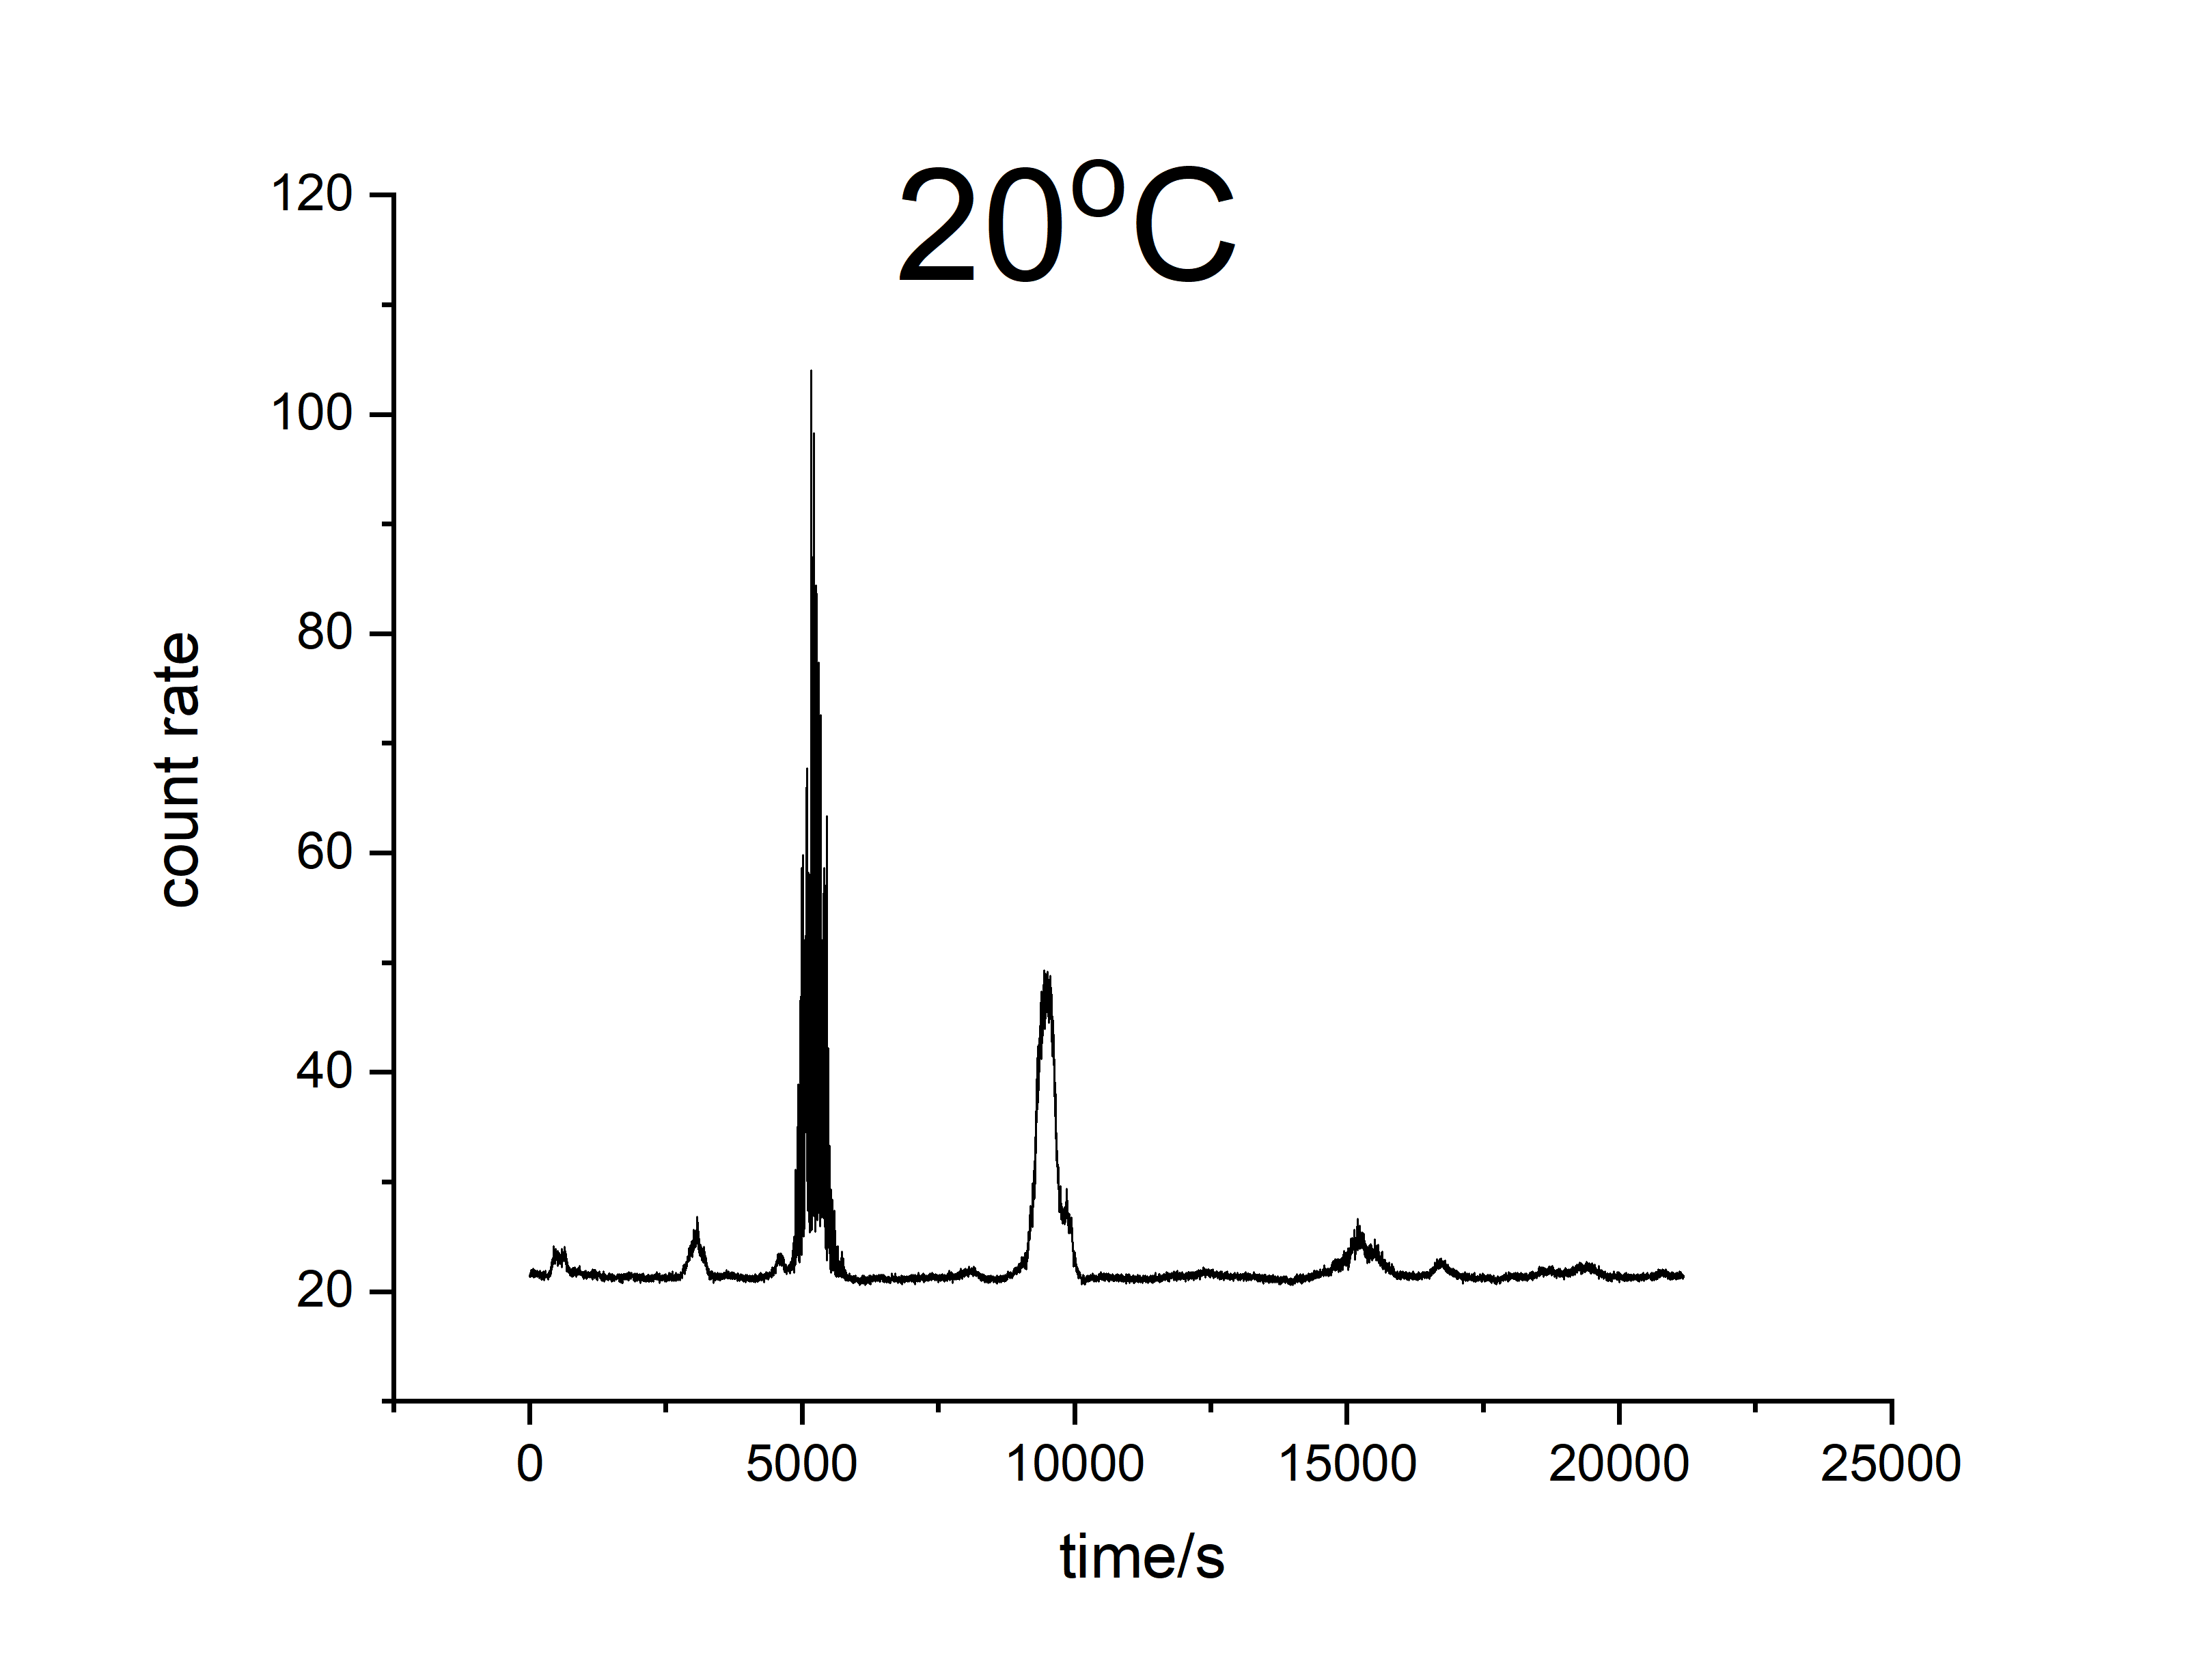
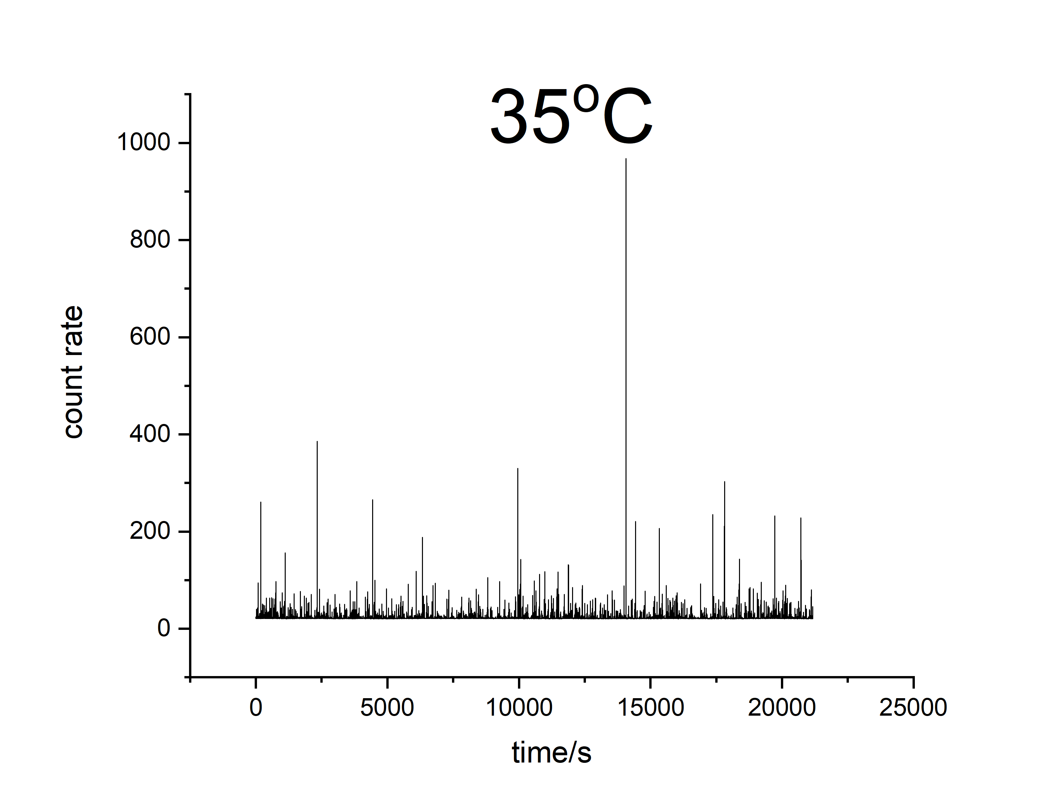
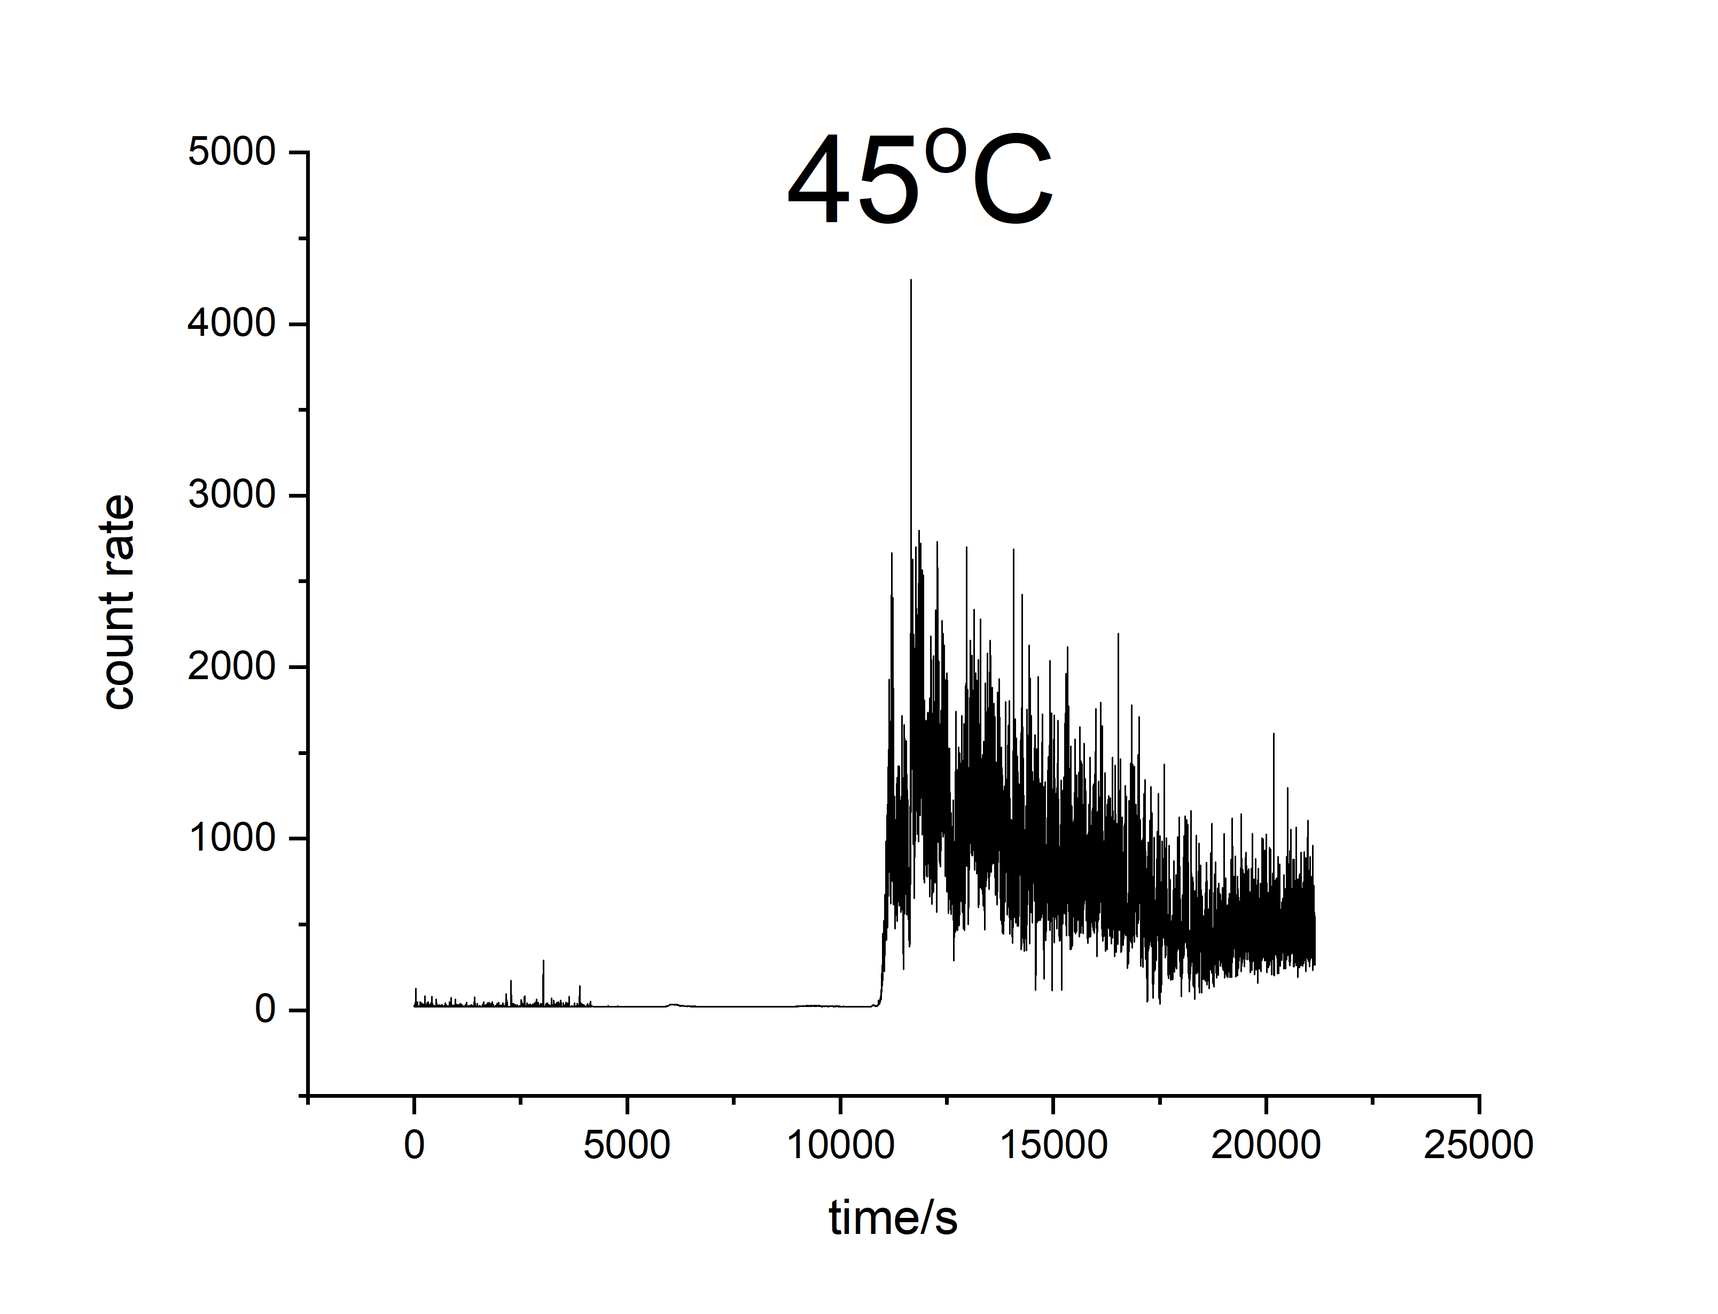
Dynamic Light Scattering
Guanidine Chloride 3mol/kg measured at scattering angle of 30°

Slide 14
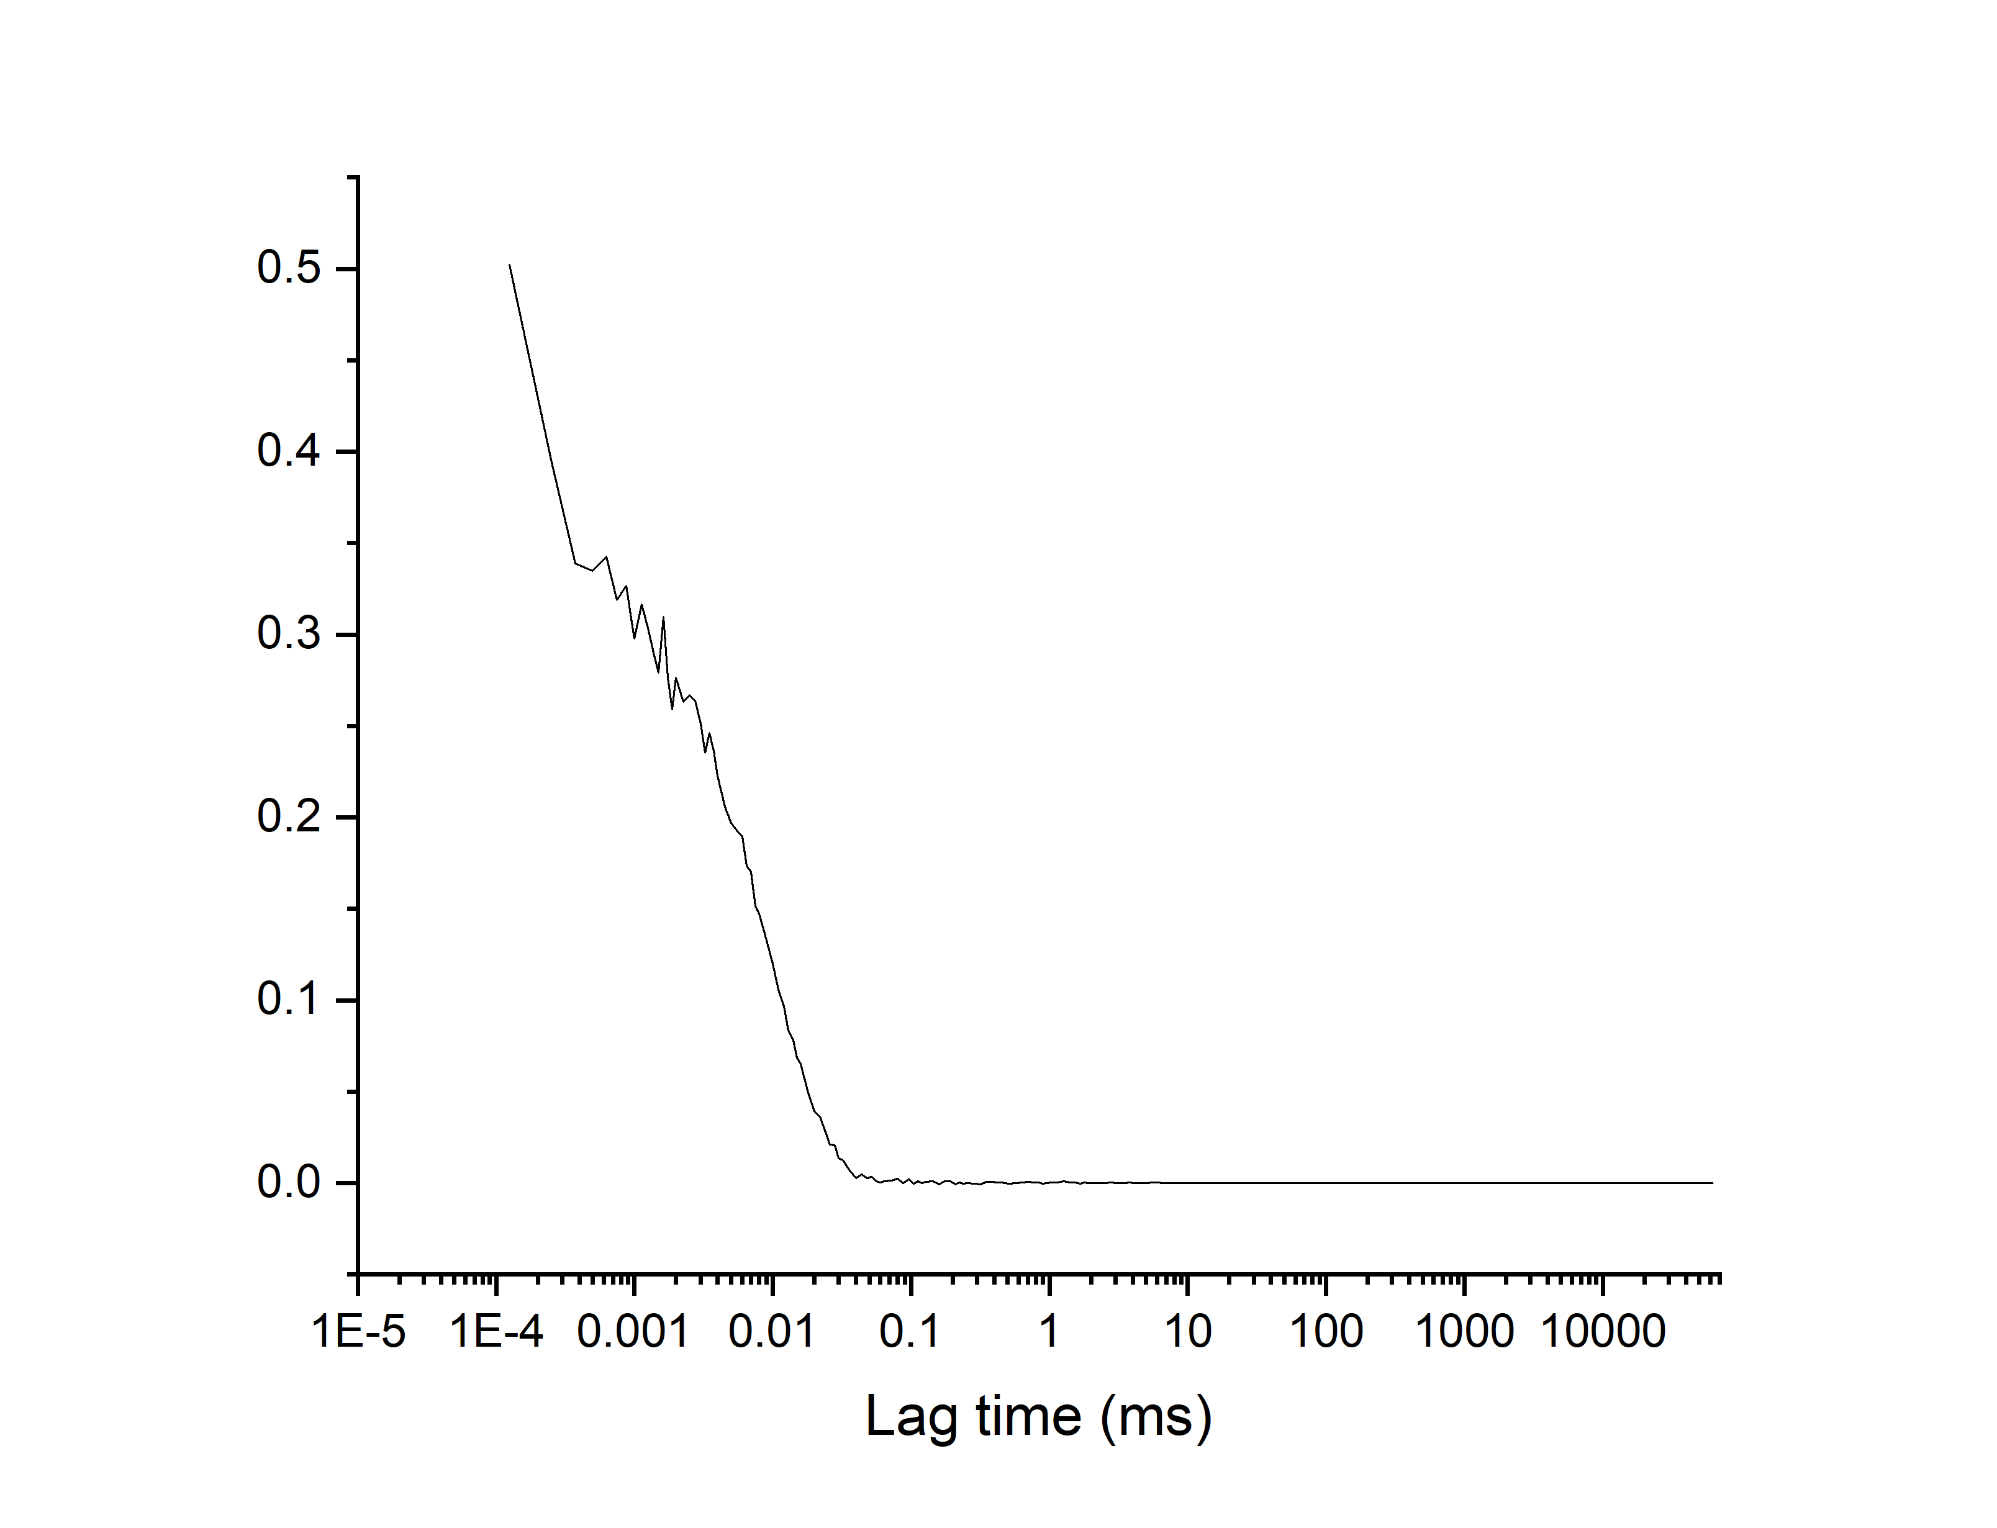
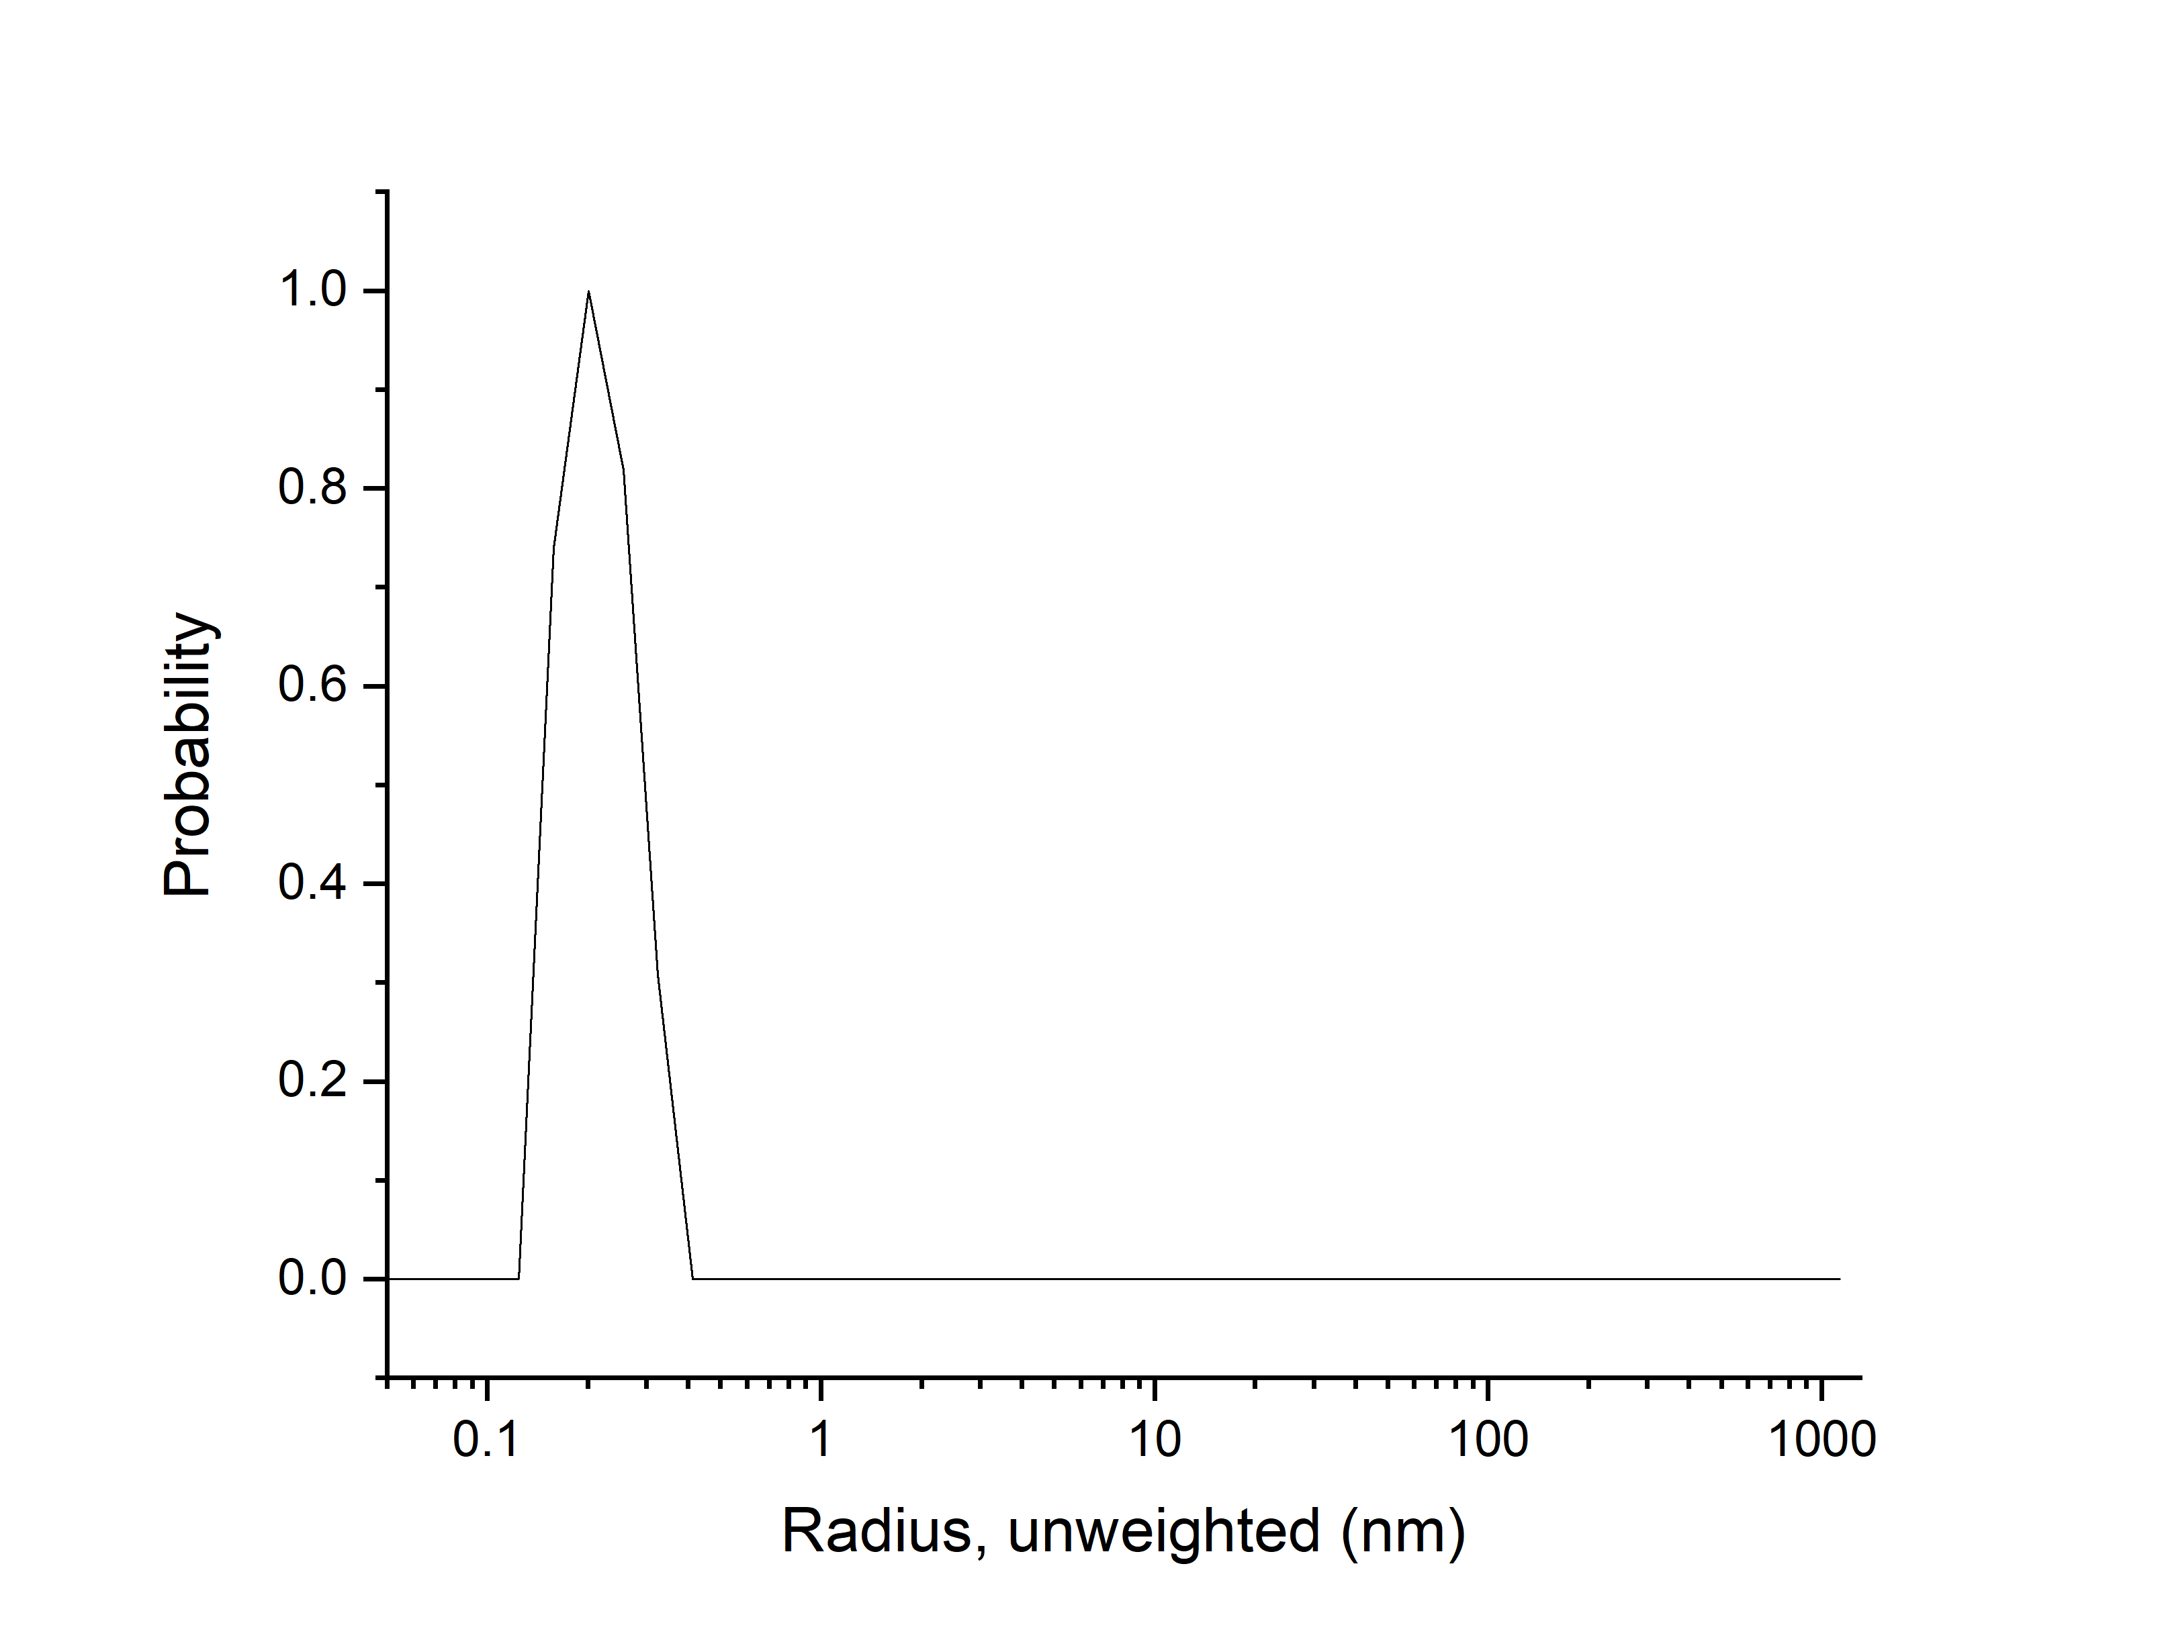
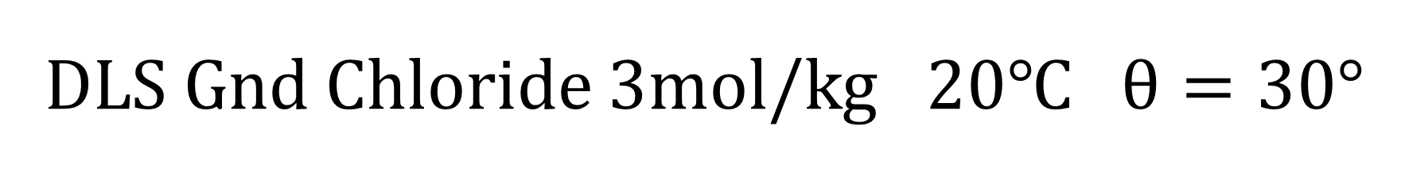

DLS Gnd Chloride 3mol/kg 20℃ $θ=30°$
Correlation function $g^{\left(2\right)}\left(τ\right)$
Contin analysis

Slide 15
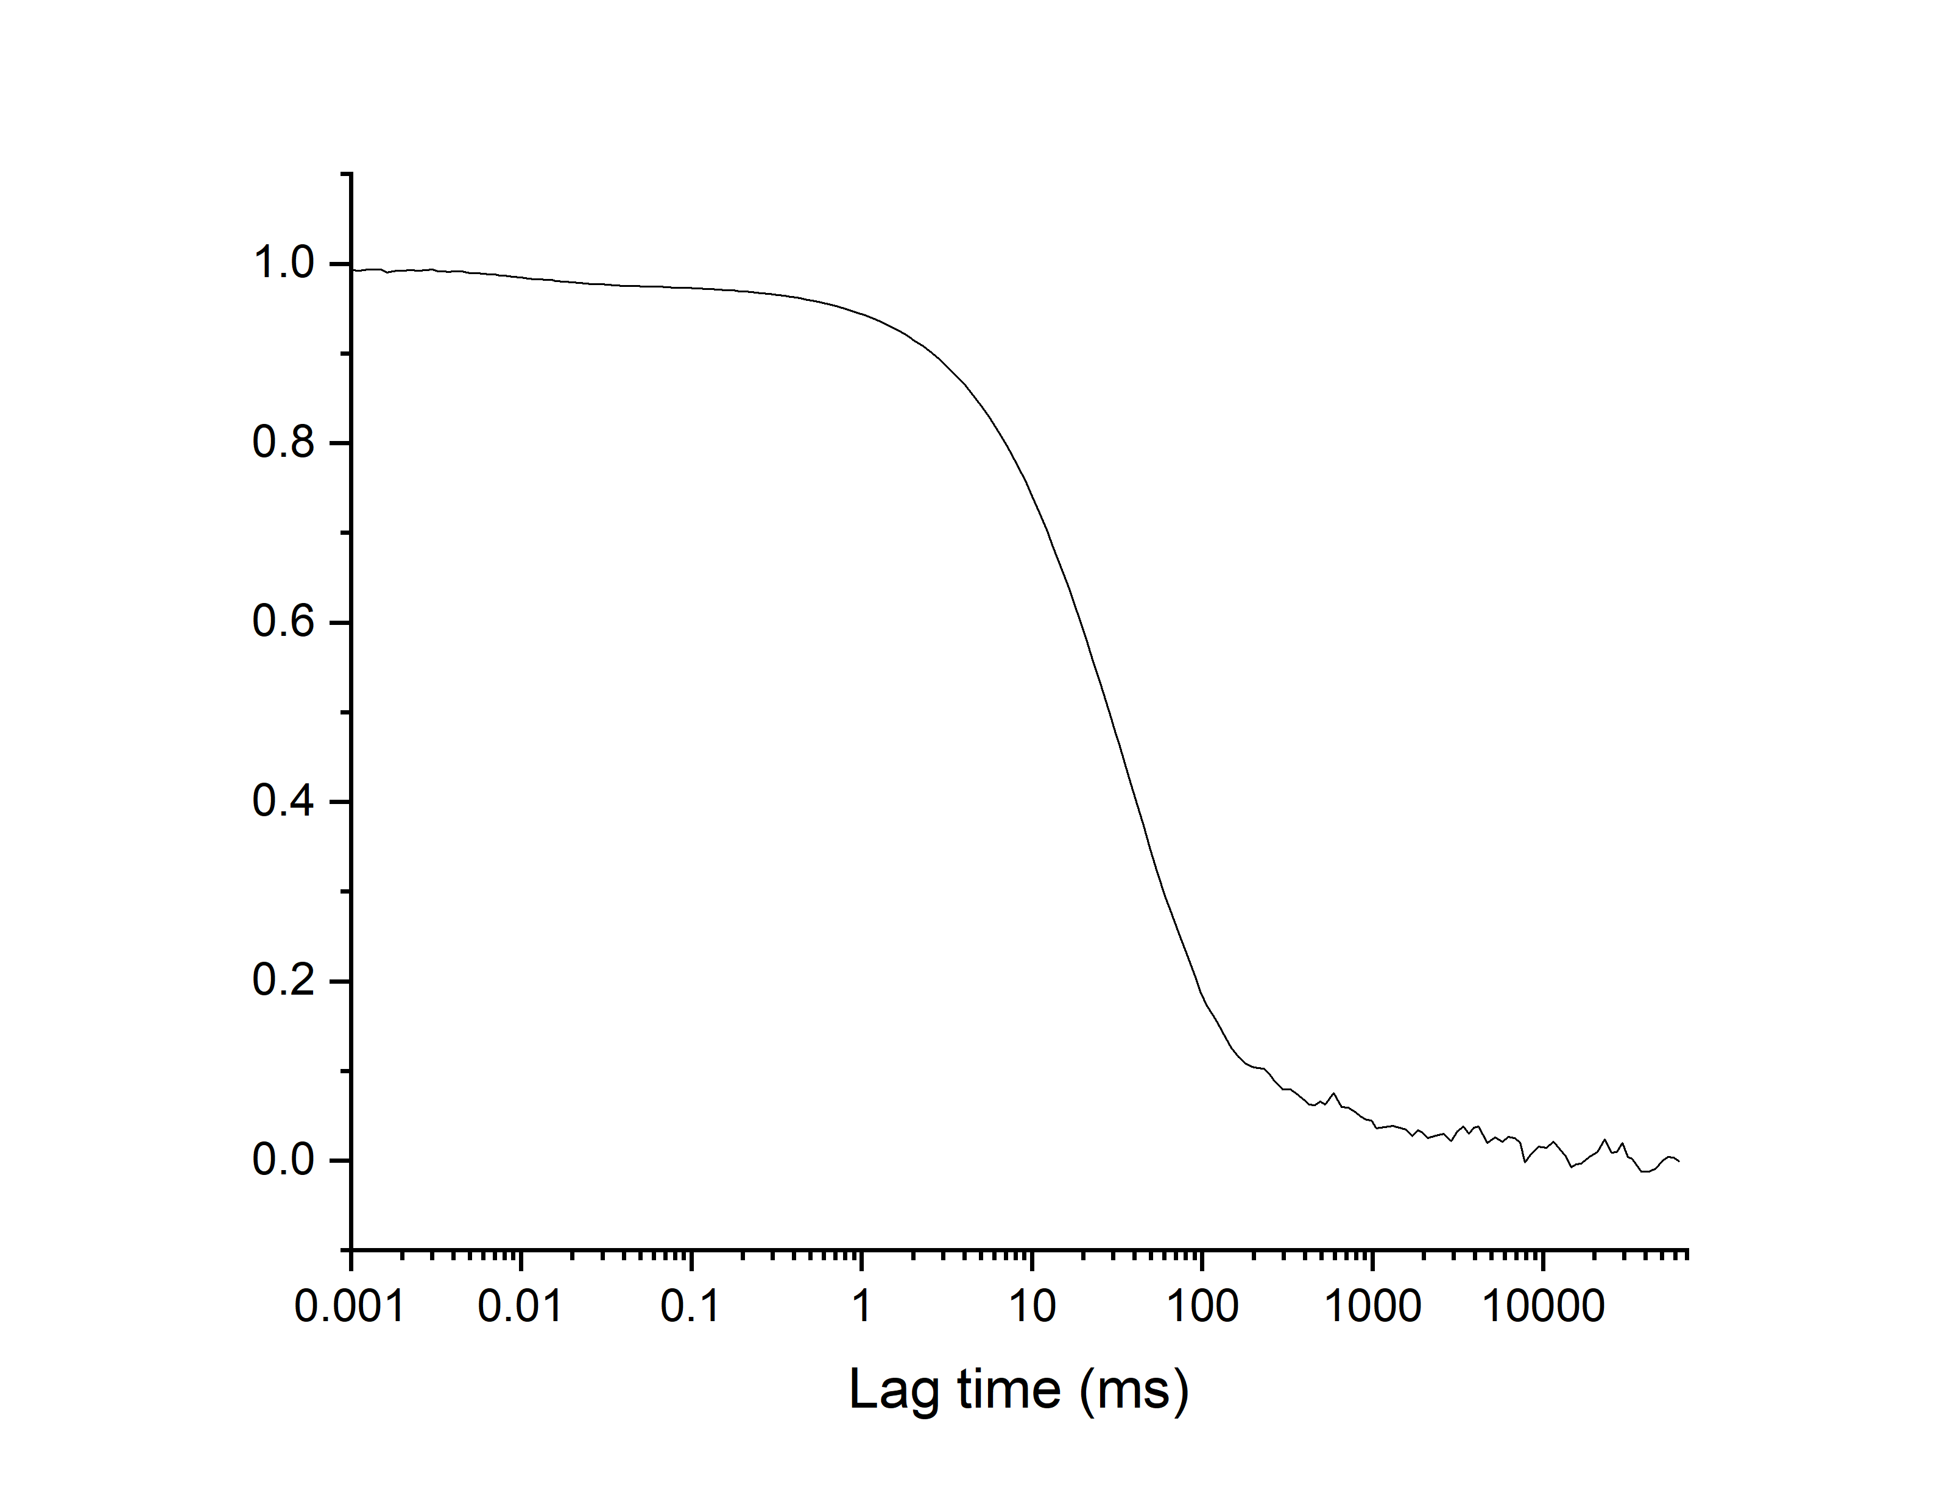
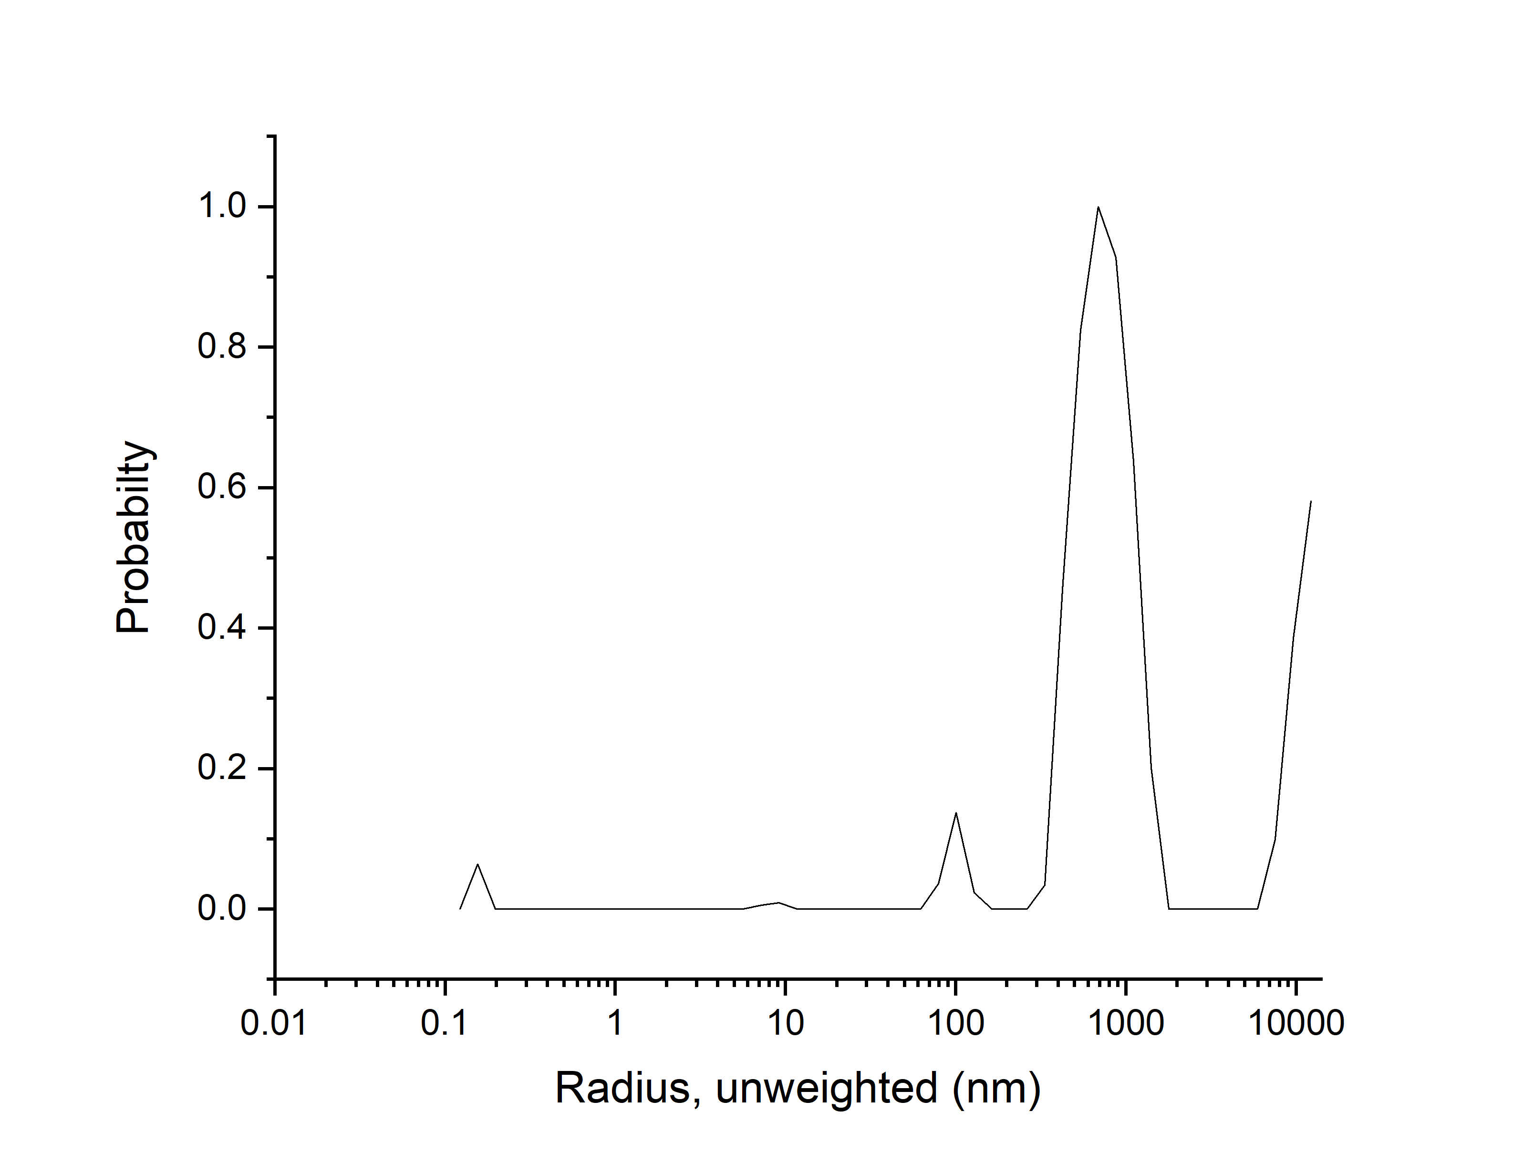
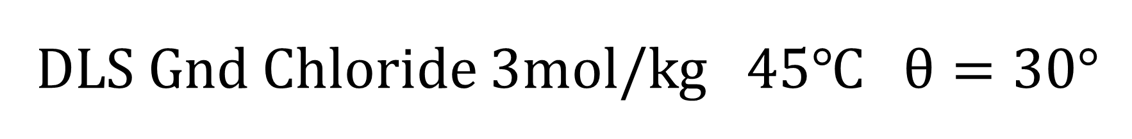

DLS Gnd Chloride 3mol/kg 45℃ $θ=30°$
Correlation function $g^{\left(2\right)}\left(τ\right)$
Contin analysis

Slide 16
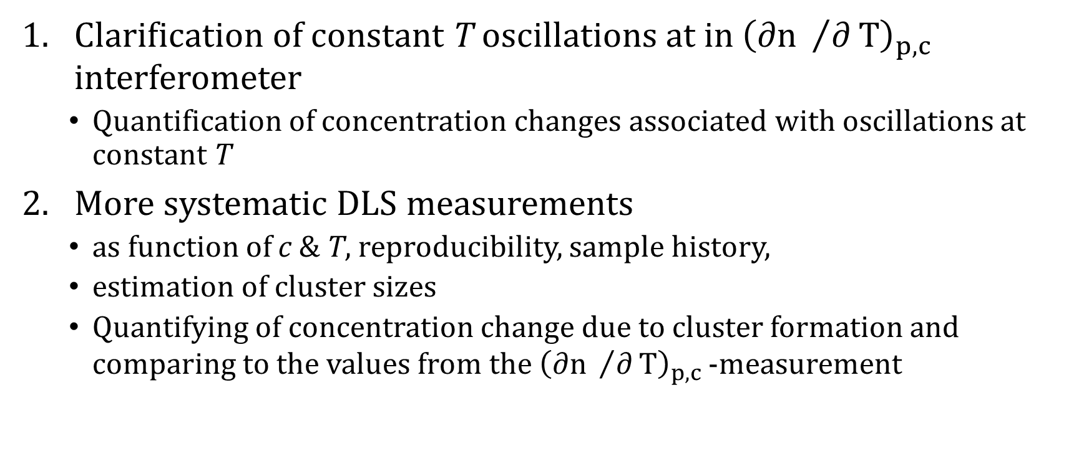
Summary and next steps
Clarification of constant T oscillations at in${ \left(∂n /∂T\right)}_{p,c}^{}$ interferometer
  Quantification of concentration changes associated with oscillations at constant T
More systematic DLS measurements
  as function of c & T, reproducibility, sample history,
  estimation of cluster sizes
  Quantifying of concentration change due to cluster formation and comparing to the values from the${ \left(∂n /∂T\right)}_{p,c}^{}$ -measurement

Slide 17
Why this stuff_?
Guanidine salts are more complex system then the previous studied inorganic salts(Shilpa )
Have a simple rigid structure
Have a

Slide 18
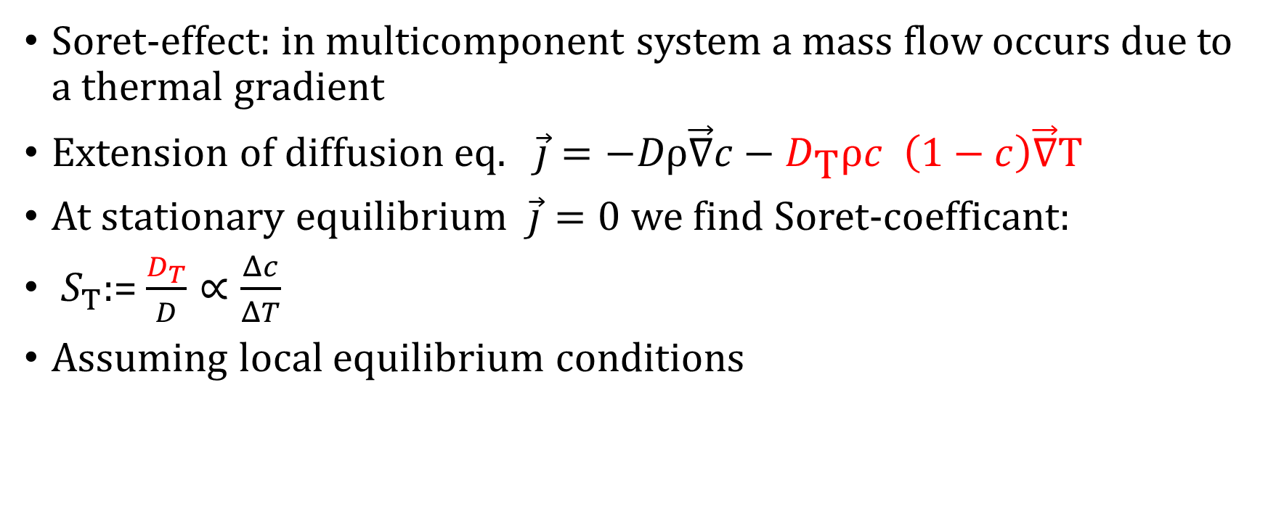
Phenomenology of Thermodiffusion
Soret-effect: in multicomponent system a mass flow occurs due to a thermal gradient
Extension of diffusion eq. $\vec{j}=−Dρ\vec{∇}c−D_{\text{T}}ρc \left(1−c\right)\vec{∇}$T
At stationary equilibrium $\vec{j}=0$ we find Soret-coefficant:
$S_{T}$:= $\frac{D_{T}}{D}∝\frac{Δc}{ΔT}$
Assuming local equilibrium conditions

Slide 19
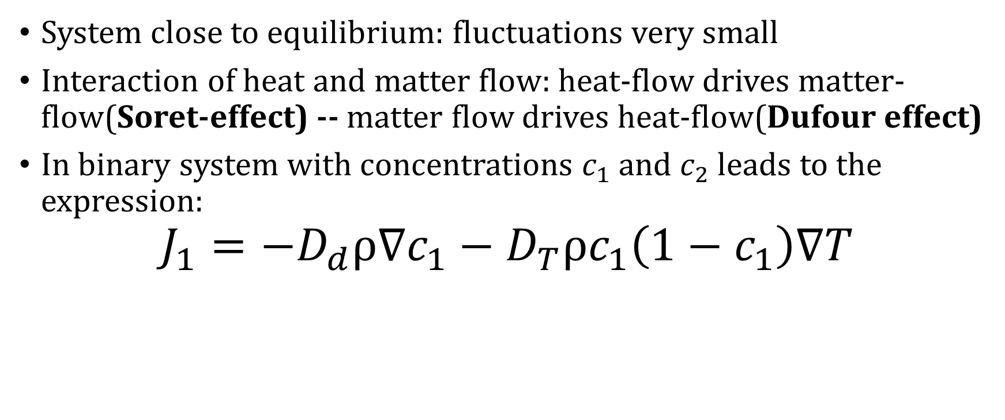
Linear Nonequilibrium Thermodynamics
System close to equilibrium: fluctuations very small
Interaction of heat and matter flow: heat-flow drives matter-flow(Soret-effect) -- matter flow drives heat-flow(Dufour effect)
In binary system with concentrations $c_{1}$ and $c_{2}$ leads to the expression:
$$J_{1}=−D_{d}ρ∇c_{1}−D_{T}ρc_{1}\left(1−c_{1}\right)∇T$$
matter-flow of component 1
Diffusion
Thermal Diffusion

Slide 20
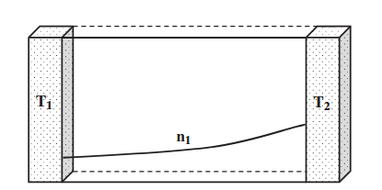
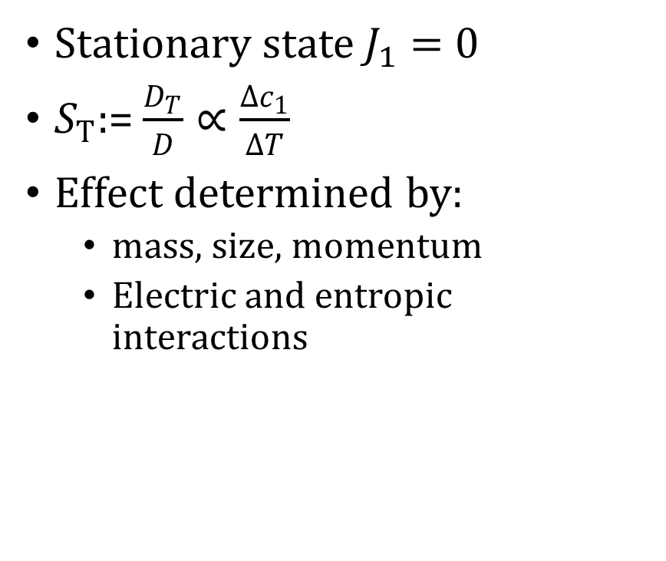

Soret effect
Stationary state$J_{1}=$ 0
$S_{T}$:= $\frac{D_{T}}{D}∝\frac{Δc_{1}}{ΔT}$
Effect determined by:
  mass, size, momentum
  Electric and entropic interactions
$$c_{1}$$
From Kondepudi, D., & Prigogine, I. (2014).
Modern thermodynamics : From heat engines to dissipative structures. John Wiley & Sons, Incorporated.

Slide 21
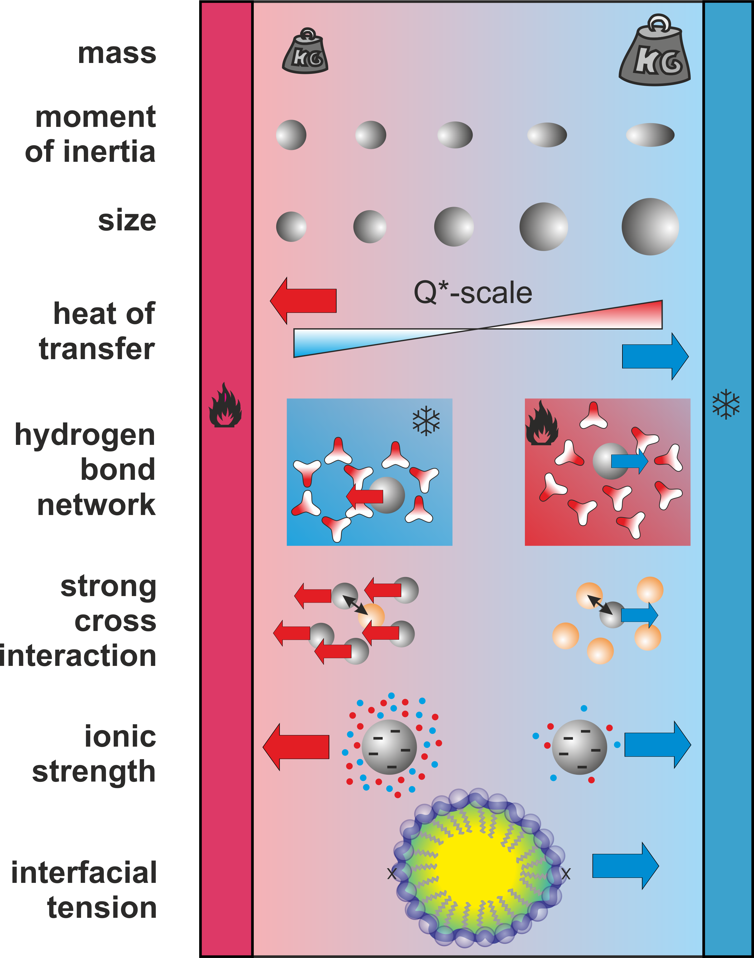
Parameters determining the effect
Mass, momentum, size of the species play fundamental role
In liquid systems specific inter-molecular interactions play a role
Especially the boundary area between the solute and solvent play a crucial role

Slide 22
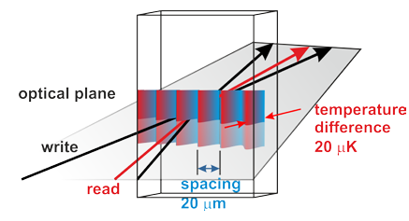

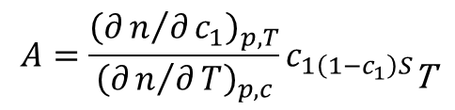
Experimental method: TDFRS
$$A=\frac{{\left(∂n/∂c_{1}\right)}_{p,T}}{{\left(∂n/∂T\right)}_{p,c}}c_{1\left(1−c_{1}\right)S_{\text{T}}}$$
Temperature gradient leads to additional concentration gradient.
Bragg diffraction occurs with the beam intensity:

Slide 23
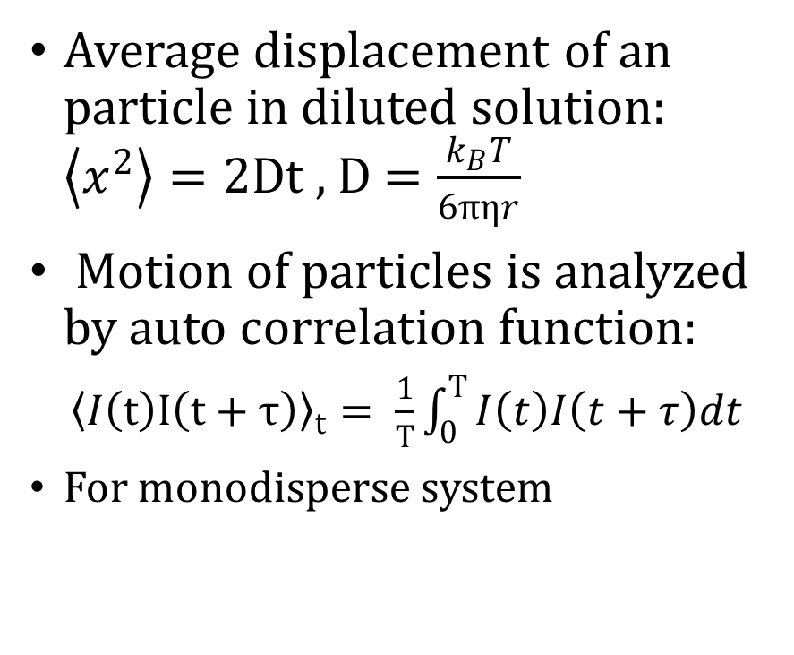
Dynamic Light Scattering
Average displacement of an particle in diluted solution: $\left\langle x^{2}\right\rangle =2Dt$ , D $=\frac{k_{B}T}{6πηr}$
Motion of particles is analyzed by auto correlation function:
${\left\langle I\left(t\right)I\left(t+τ\right)\right\rangle }_{t}= \frac{1}{T}\int_{0}^{T}{I\left(t\right)I\left(t+τ\right)dt}$
For monodisperse system

