Slide 1

the Symbiotic Relationship between Ionomer and Water in Catalysts of PEM Fuel Cells
March 21, 2023 I Thomas Kadyk
Theory and Computation of Energy Materials (IEK-13), Forschungszentrum Jülich

Slide 2





What can be learned from existing models?
Rationalize wetting behaviour in CCL
Importance of cross-component coupling
Open Access Modeling Platform

Slide 3
Why theory and computation?
technology needs

Slide 4
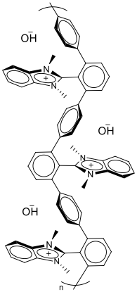
Why theory and computation?
Molecular &
atomistic design
catalytic
technology needs
functional materials
electronic
ionic
Notes:
Talking about specific energy technology and understanding their use requirements a set of technology needs can be formulated, usually associated with power performance, storage capacity, economic viability or cost
Technology needs known, materials chemist or engineers can go to work to impart desired function into catalytic materials, ionic media, …,
however, rarely a simple correlation between materials structure and properties on the one hand and device level properties and opration can be drawn…

Slide 5
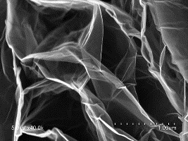
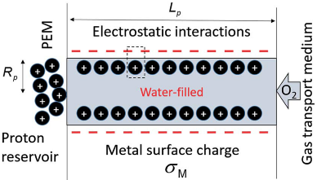
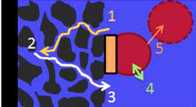
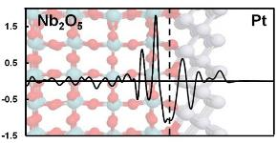
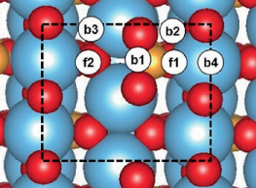

Why theory and computation?
Molecular &
atomistic design
Structured materials
& interfaces
Composites & porous media
polymer/
ionomer networks
2D materials
(doping)
catalytic
nanoprotonics/-ionics
nanotemplated metals & alloys
transport media
electronic
metal oxides
mixed conductors
ionic
multiphase composites
oxynitrides
Notes:
Form structured materials, modified environment and function, complex structures and local reaction conditions in composites and porous transport media
Maybe main challange is not to make a highly performing catalytic or ionic material but to sorround it with a well designed porous medium

Slide 6
Why theory and computation?
Molecular &
atomistic design
Structured materials
& interfaces
Composites & porous media
polymer/
ionomer networks
DEVICE LEVEL ➔ do properties meet use-specific demands?
MACROSCALE ➔ mixed (“multi”) functionality
MESOSCALE ➔ interfacial phenomena
MICROSCALE ➔ transfer of energy, charge, and matter
INTRINSIC ➔ mechanical, thermal, electronic, ionic, electrostatic, catalytic etc.
METRICS
2D materials
(doping)
catalytic
nanoprotonics/-ionics
nanotemplated metals & alloys
DESCRIPTORS
transport media
electronic
metal oxides
mixed conductors
ionic
multiphase composites
oxynitrides
Notes:
Pick up descriptors while moving along structural hierarchy, become more complex (from simple adsorption energy where established and efficient tools to calculate to complex reaction conditions… )
level of sophistication, complexity of tools
Identifying viable descriptors or feature vectors and relating them to metrics of performance, lifetime, cost is main task of AI-driven materials design
Depending on depth of problem and complexity of tools: different level of maturity of AI concept

Slide 7
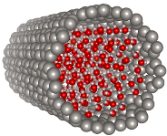
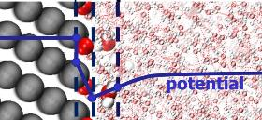
Integration across scales
components to devices
mesostructures
pores
percolation, MHM,
fluid dynamics
CGMD, MF th.,
fluid dynamics
performance & lifetime
interfaces
nanostructures
cMD, MF theory,
electrokinetics
effectiveness
materials
DFT, AIMD,
CSM, DL theory
local pH, ion conc.
DFT + micro-
kinetic modeling
potential distribution
transformations
DFT
basic properties & interactions

Slide 8

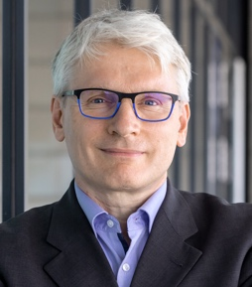
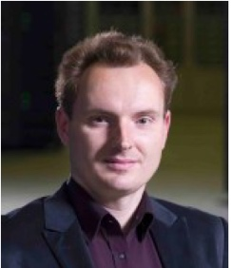
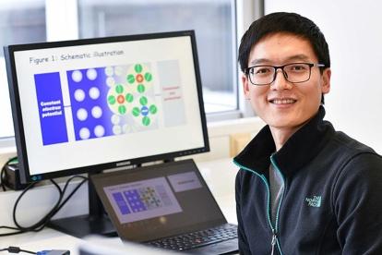

Integration across scales
components to devices
mesostructures
pores
percolation, MHM,
fluid dynamics
CGMD, MF th.,
fluid dynamics
performance & lifetime
interfaces
nanostructures
cMD, MF theory,
electrokinetics
effectiveness
Thomas Kadyk
Physical Modeling and Diagnostics
materials
DFT, AIMD,
CSM, DL theory
local pH, ion conc.
DFT + micro-
kinetic modeling
potential distribution
Michael Eikerling
Theory of EC Interfaces & Materials
transformations
DFT
basic properties & interactions
Piotr
Kowalski
Computational Materials Modeling
Young Invest. Group: EDL in Electrocatalysis
Artificial Materials Intelligence
Kourosh Malek

Slide 9
Structure-based modeling of cathode catalyst Layers in PEM Fuel cells
Notes:
Must understand local reaction conditions! Explain – next slide…

Slide 10
From composition to effective properties
Primary parameters
component densities:
weight fractions:
Pt mass loading:
layer thickness:
per geometric surface area

Slide 11
From composition to effective properties
Primary parameters:
component densities:
weight fractions:
Pt mass loading:
layer thickness:
Volumetric composition
per geometric surface area

Slide 12
From composition to effective properties
Primary parameters
component densities:
weight fractions:
Pt mass loading:
layer thickness:
Volumetric composition
per geometric surface area
Effective properties from percolation theory
,
,

Slide 13
Coupled species fluxes in CCLs

Slide 14
Macrohomogeneous catalyst layer model
Part A: Governing equations for electrochemical processes
Proton transport
One free parameter: j₀
Interfacial
reaction
Oxygen diffusion
Polymer Electrolyte Fuel Cells – Physical Principles of Materials and Operation, M. Eikerling and A.A. Kulikovsky, CRC Press, 2014.
Part B: Governing equations for water fluxes
Water formation
and vaporization
Liquid transport
Vaporization
exchange
Problem: this part has two free parameters (total water flux, fraction of liquid flux)
➔ requires full MEA model
Vapour diffusion

Slide 15
MHM: Coupling
Part A: Governing equations for electrochemical processes
Proton transport
Interfacial
reaction
explicit
coupling
Oxygen diffusion
Polymer Electrolyte Fuel Cells – Physical Principles of Materials and Operation, M. Eikerling and A.A. Kulikovsky, CRC Press, 2014.
Part B: Governing equations for water fluxes
Water formation
and vaporization
Liquid transport
Vaporization
exchange
Problem: implicit coupling –
dependence of solution on S(x)
Vapour diffusion

Slide 16
What harm can a flooded CCL possibly do?
important impact: thickness, composition, pore size distribution, wettability
assumption of constant composition sufficient below transition region
CCL flooding: important, but not critical! A flooded electrode could still perform well.

Slide 17
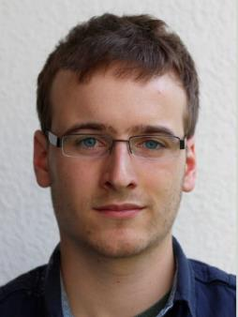

Modeling Microstructure formation and wettability effects in Catalyst layers
Wolfgang
Notes:
Must understand local reaction conditions! Explain – next slide…

Slide 18
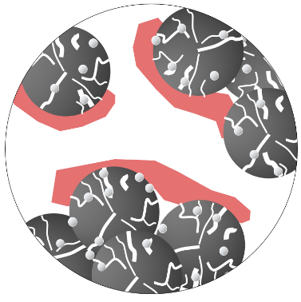
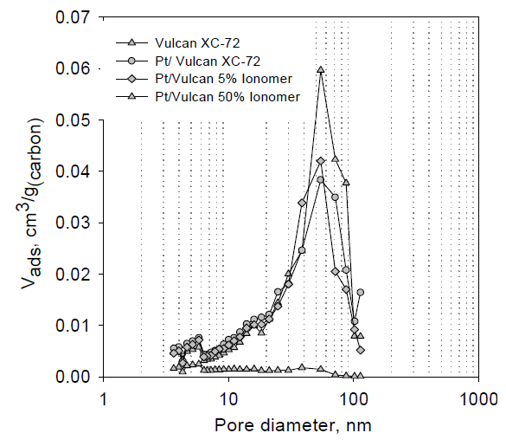
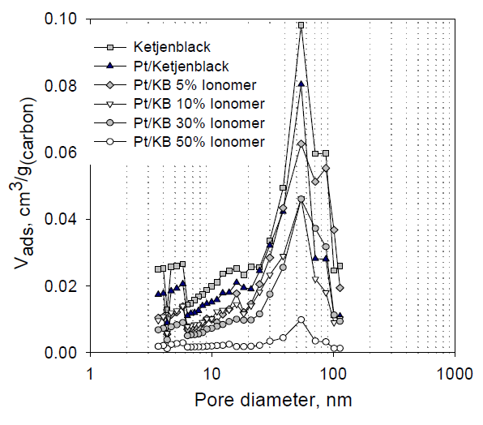



Modeling microstructure formation in CCL
Prediction of volumetric composition and ionomer film thickness and coverage based on ink recipe
Ink recipe & fab conditions
CCL structure
T. Soboleva, PhD Thesis, Simon Fraser University, 2010.
support
ionomer
catalyst
~ 100 nm
ink composition (Pt:C, I:C)
specific materials properties
dispersion medium
fabrication conditions
volume fractions (percolation)
pore size distribution
wettability (distribution)
interface areas and activity
transport properties
Example: evolution of pore size distribution and porosity
Notes:
Three crucial ingredients that influence surface properties (and bulk)

Slide 19
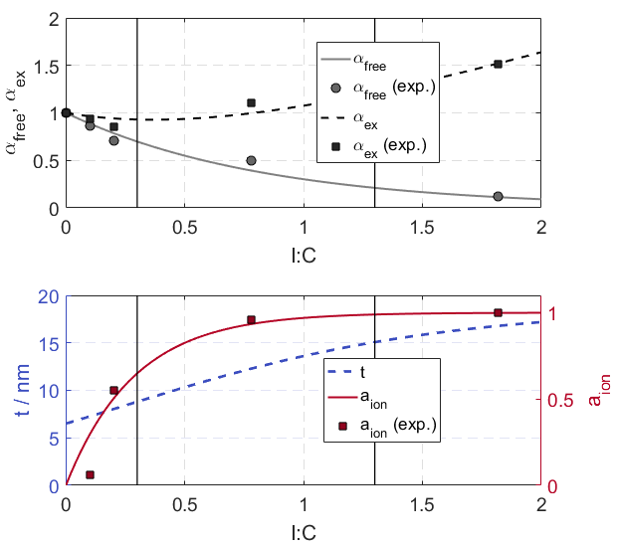
microstructure formation model: results
Basic correlations of ink parameters with CCL structure
volume expansion
A
B
C
Exp. data: T. Soboleva., PhD thesis, Simon Fraser University, 2010.
W. Olbrich et al., Electrochim. Acta 431, 140850.

Slide 20
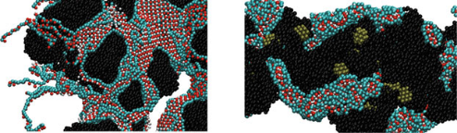
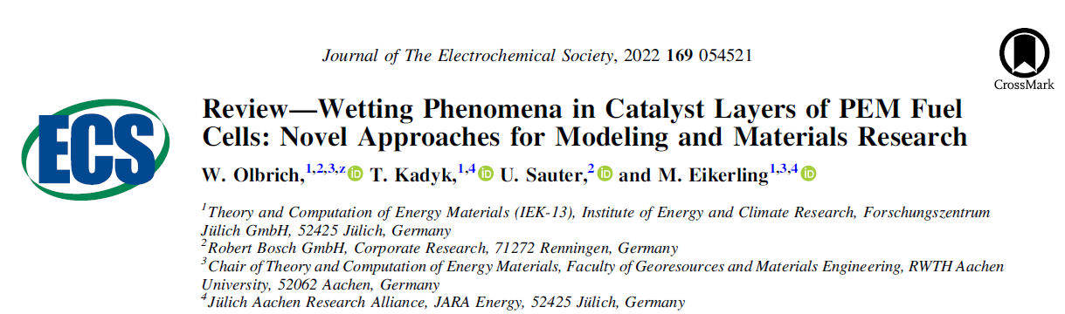
Wettability model: role of ionomer
Orientation of ionomer sidechains is the key (surface-induced ionomer inversion effect)
Hydrophilic ionomer surface
Hydrophobic ionomer surface
SO₃⁻
Ionomer inversion
earlier MD simulations
experimental studies
SO₃⁻
F
F
F
F
SO₃⁻
F
F
SO₃⁻
SO₃⁻
SO₃⁻
SO₃⁻
F
F
SO₃⁻
SO₃⁻
SO₃⁻
F
F
F
F
SO₃⁻
F
F
SO₃⁻
F
F
F
F
HO surface
HI surface
K. Malek et al. (2011). Electrocatalysis 2, 141-157.
quantitative analytical model
Yu. M. Vol’fkovich et al. (2010). Russ. J. Electrochem. 438, 46.

Slide 21
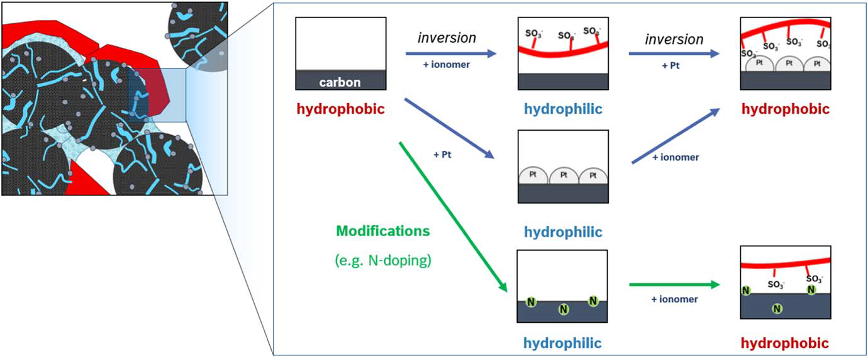
Inversion mechanism based on Vol’fkovich data
W. Olbrich et al. (2022). J. Electrochem. Soc. 169, 054521.

Slide 22

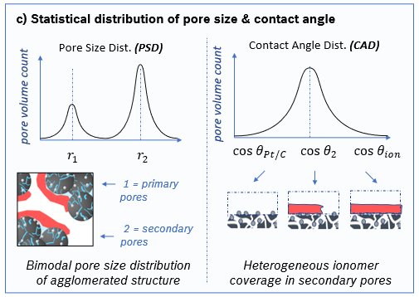
Wettability model
Bernoulli process
n = trials
p = chance
r_{ion}
Stochastic process to generate heterogeneously wetted surfaces
ionomer (chunks of fixed size, r_{ion} ~ 5 nm) distributed randomly in secondary pore space
heterogeneous ionomer coverage → contact angle distribution (CAD)
Obtain water retention curve by integration over pore size distribution (PSD), contact angle distribution (CAD) and Young-Laplace criterion (YLP):
W. Olbrich et al., Electrochim. Acta 431, 140850.
Notes:
YPL: flooded or not - Heaviside

Slide 23
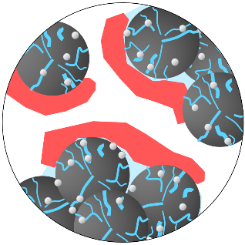
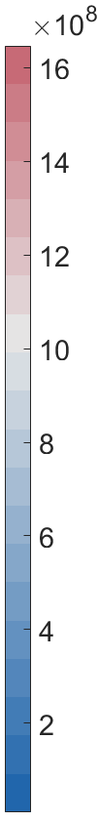
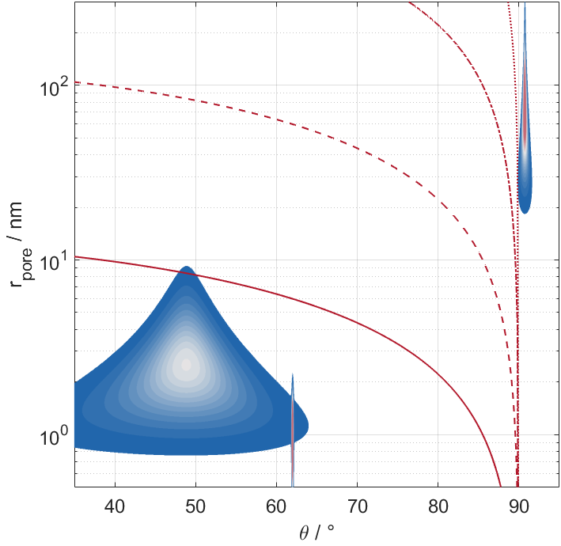
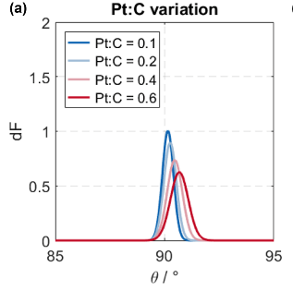
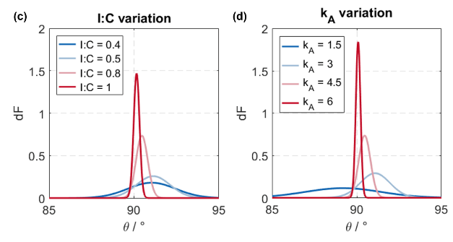
Wettability model: results
(1) Hydrophilic primary pores and Pt-free nanopores
Pore size and contact angle distribution
Combined PSD & CAD
-10⁴ Pa
(2) Secondary pores with mixed wettability
-10⁵ Pa
(2)
-10⁶ Pa
Contact angle distribution (secondary pores)
(1)
-10⁷ Pa
Pt content
ionomer content
dispersion param
W. Olbrich et al., Electrochim. Acta 431, 140850.

Slide 24
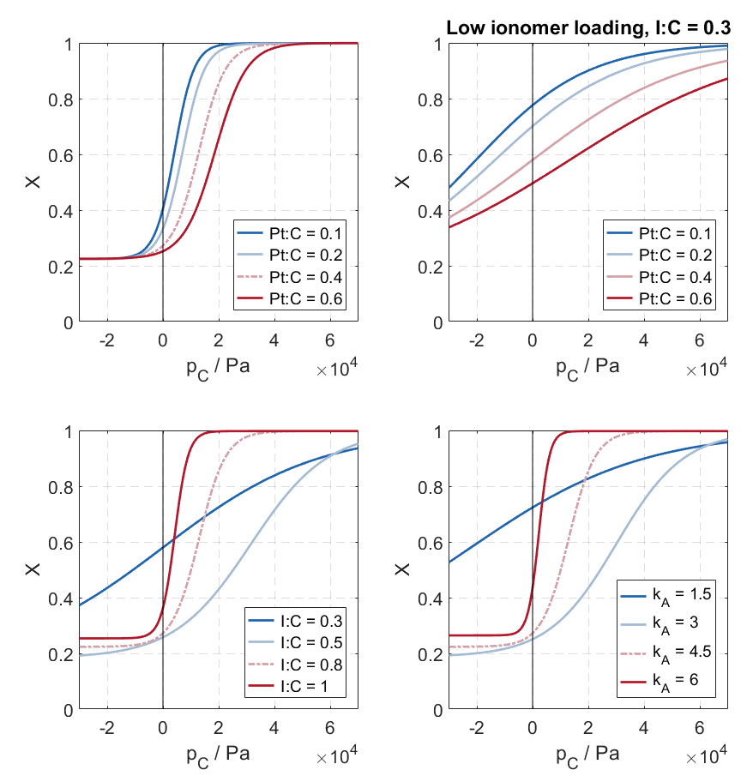
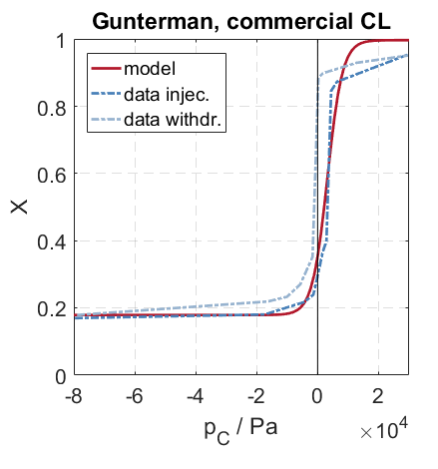
Wettability model: water retention curves
Parametric effects
Comparison to experiment
H. P. F. Gunterman, PhD thesis, UC Berkeley, 2011.
W. Olbrich et al., Electrochim. Acta 431, 140850.

Slide 25
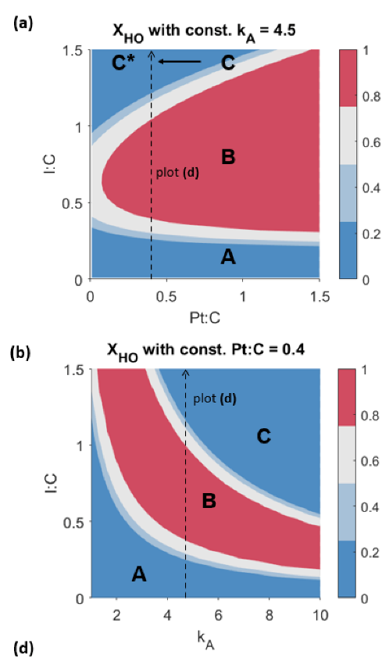
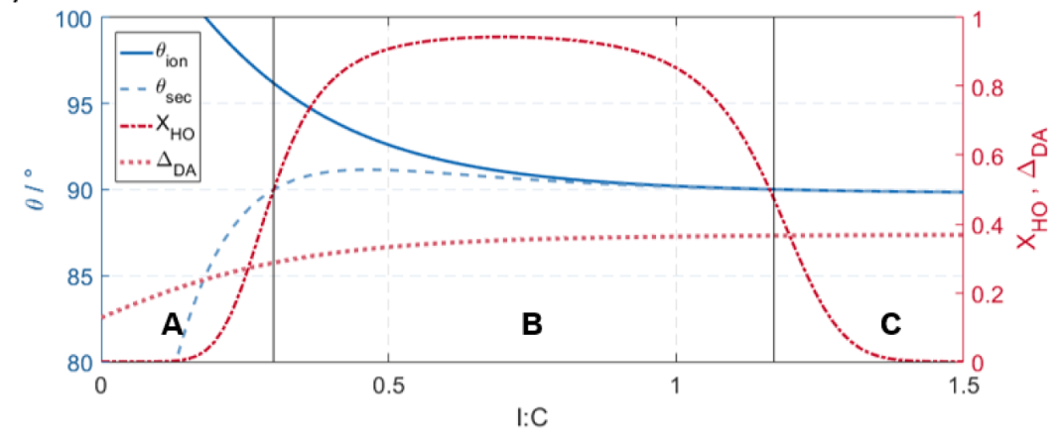
Wettability Model: ccl optimization
Materials selection, modification, and design: tune parameters for optimal wettability distribution
k_{A} = 4.5, Pt:C = 0.4
fraction of hydrophobic secondary pore volume
reducing Pt loading can tip the water balance (as seen earlier)
lower Pt loading: ionomer content must be more finely tuned
support modification → less sensitive to Pt and ionomer loading
W. Olbrich et al., Electrochim. Acta 431, 140850.

Slide 26


Modeling Liquid Water Accumulation in Pem Fuel cell Cathode
CL
D
M
…
…
Yufan
Notes:
Must understand local reaction conditions! Explain – next slide…

Slide 27
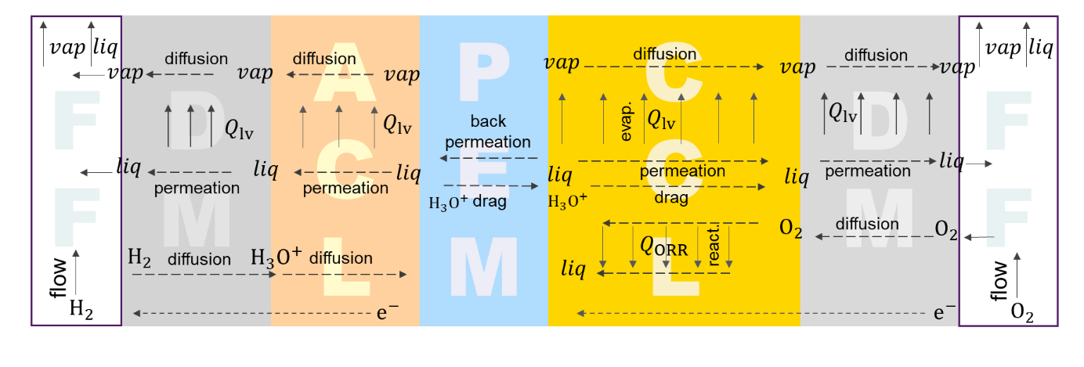
Account for cross component coupling
Comprehensive model for water balance in cathode CL and DM
Solution space: pressure distribution → liquid saturation, fluxes

Slide 28
Model assumptions
cathode side: CL & DM and DM-FF interface
transport of oxygen (air), liquid and vapor water
one-dimensional
macrohomogeneous
isothermal
C
L
D
M
FF
vapor
diffusion
diffusion
vaporization
vaporization
permeation
permeation
liquid
reaction
O₂
diffusion
diffusion

Slide 29
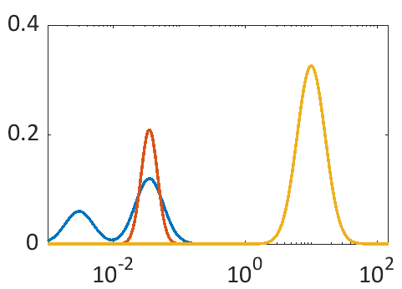
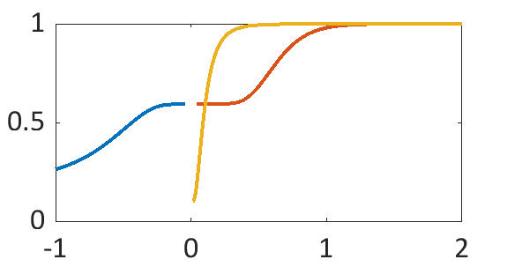







Pore size distributions and water retention curves
DM HO
DM HO
CL HO
CL HO
$$35 nm$$
$$10 μm$$
$$dX_{p}/dlnr [{μm}^{−1}]$$
$$S_{r}$$
CL HI
$$3 nm$$
CL HI
$$r [μm]$$
$$p_{c} [bar]$$
At the same $p_{c}$, $S_{r}$ in CL and in DM are different.

Slide 30
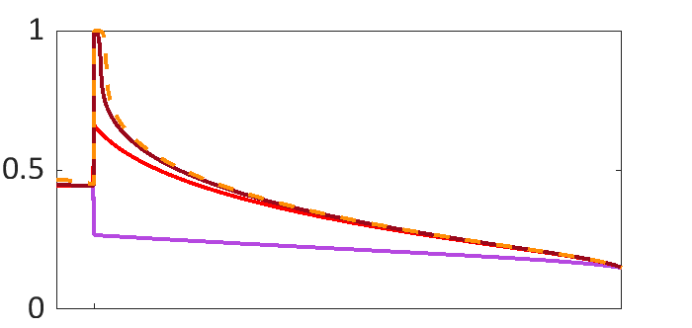
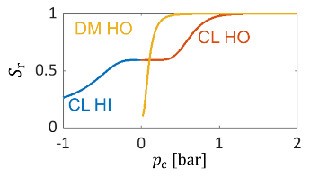
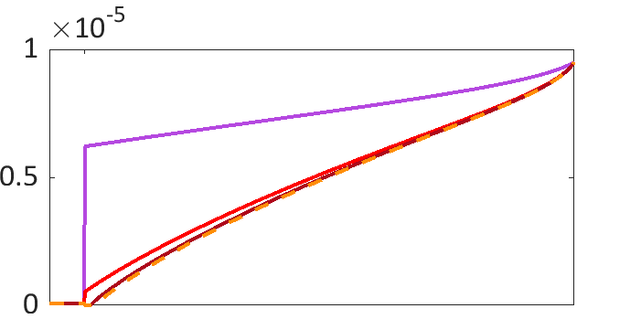

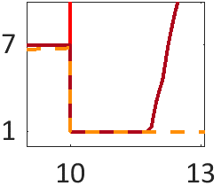
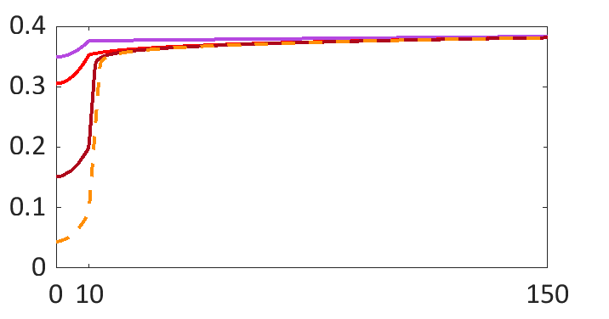
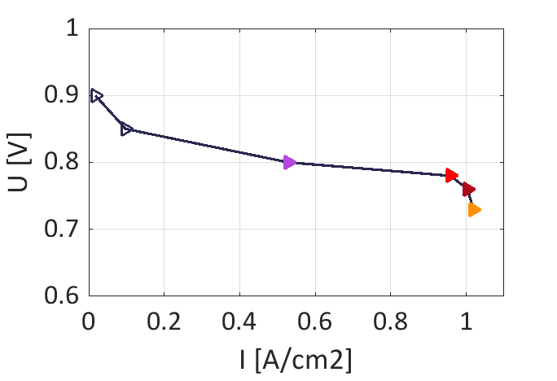














results
CL
GDL
$$η [V]$$
$$j [A/{cm}^{2}]$$
Liquid saturation:
does not change much in CCL with j
GDL: formation of water layer at CL|GDL above j_{c}
$$0.47$$
$$1.02$$
$$0.44$$
$$1$$
$$S_{r}$$
$$0.42$$
$$0.96$$
$$0.4$$
$$0.53$$
O₂ diffusivity:
water layer causes abrupt decrease in diffusivity (to residual value)
$$D_{O_{2}} [m^{2}/s]$$
O₂ partial pressure:
drops drastically above j_{c} before even reaching the CCL
$$p_{O_{2}} [bar]$$
$$x [μm]$$

Slide 31
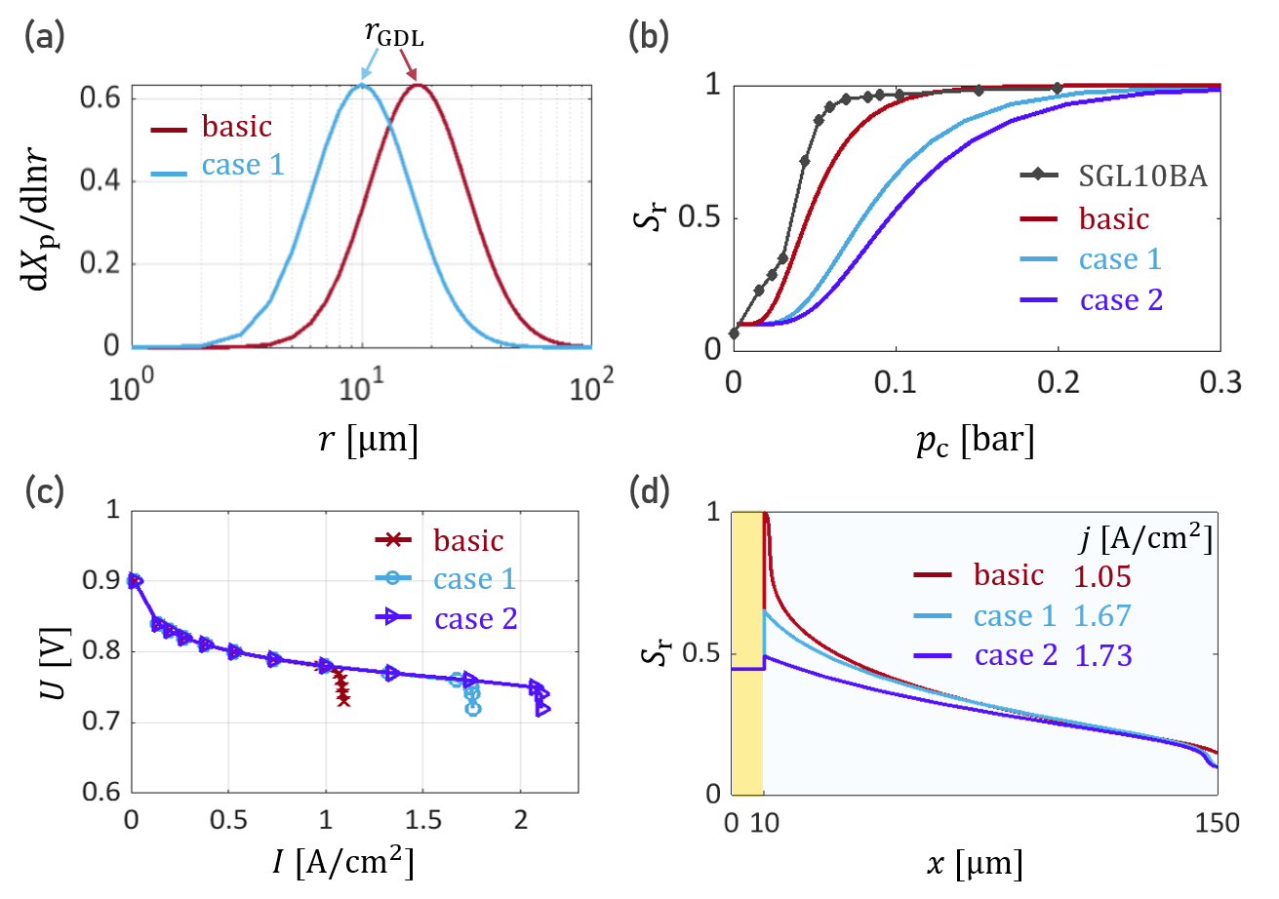
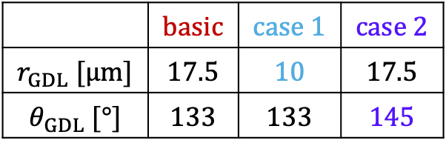
How to suppress water layer formation?
Tune the water retention curve: pore size distribution or contact angle
 | $$basic$$ | $$case 1$$ | $$case 2$$
$$r_{GDL} [μm]$$ | $$17.5$$ | $$10$$ | $$17.5$$
$$θ_{GDL} [°]$$ | $$133$$ | $$133$$ | $$145$$
Strategies
smaller HO pores
larger contact angle
Water retention curve matters!

Slide 32






How to suppress water layer formation?
Introducing another porous layer, the MPL!
Underlying correlations
$$dX_{p}/dlnr [{μm}^{−1}]$$
$$S_{r}$$
$$r [μm]$$
K. Totaka et al. (2014). ECS Trans. 64, 839.
$$S_{r}$$
$$p_{c} [bar]$$
$$p_{c} [bar]$$

Slide 33

Open Access Modeling Platform
Subline der Präsentation bei umfänglicher Erläuterung
Datum I Name

Slide 34
Open Access Modeling Platform

Slide 35
Open Access Modeling Platform
Objectives
share models, tools and method
foster collaboration
enable others to use (and expand) our knowledge
provoke feedback
avoid redundant work
create visibility

Slide 36
Open Access Modeling Platform
Modus Operandi
Modular Model Implementation
  modules for governing equations, kinetics, parameters, diagnostic and analysis tools (Polcurve, EIS, CV, curr./volt. steps)
  allows restricting access to parts of the model -> allows using the platform for industry projects
Collaborative Programming Environment (GitLab etc.)

Slide 37
Open Access Modeling Platform
„Customers“
Users
want to apply the model
(e.g. Expermentalists)
need easy use (GUI, no need to install software, runs on server)
Developers
want to modify/contribute to the model
(Modelers)
need easy understanding (documentation, programming language)
need collaborative environment (Gitlab, guidance/structure)
need exchange with other modelers (chat, meetings, workshops)

Slide 38
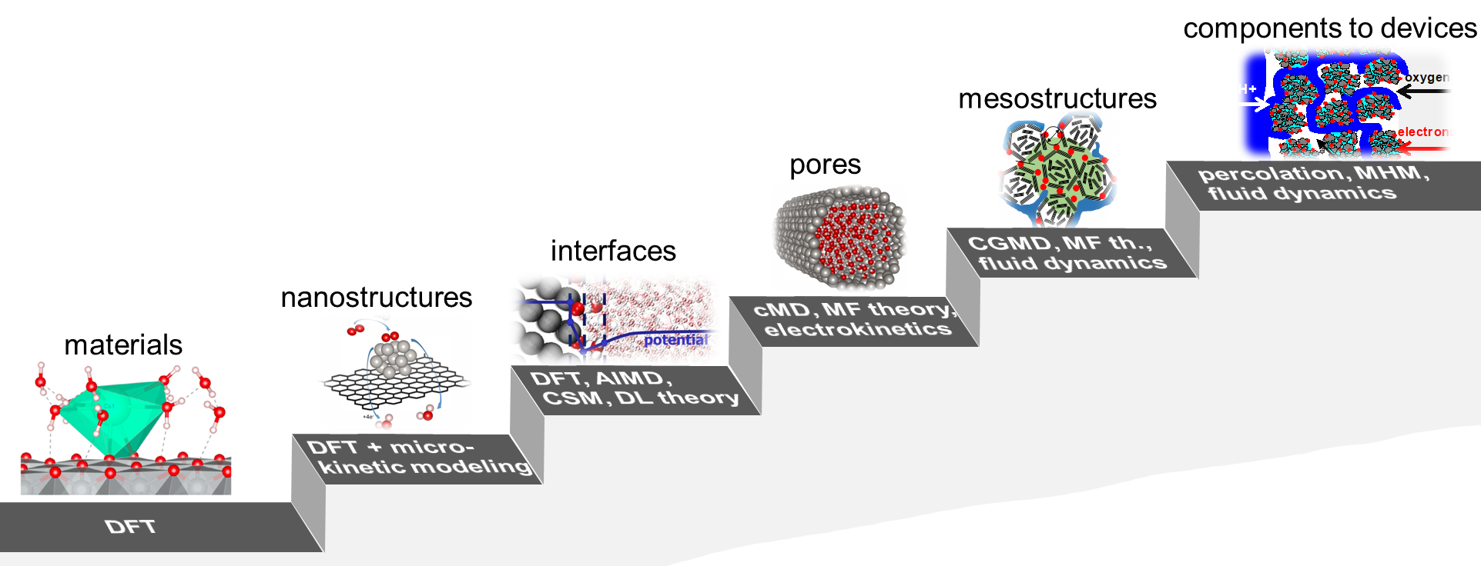
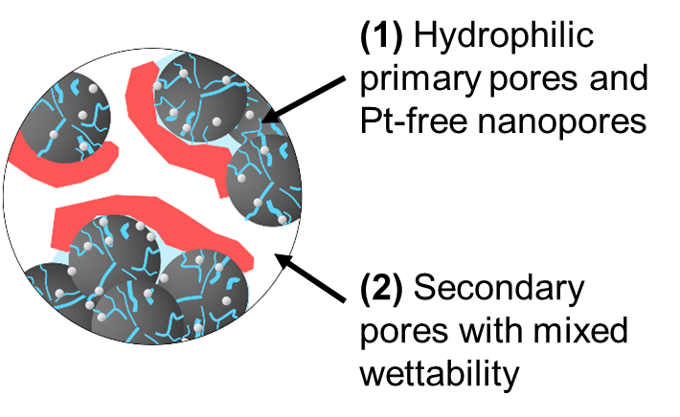
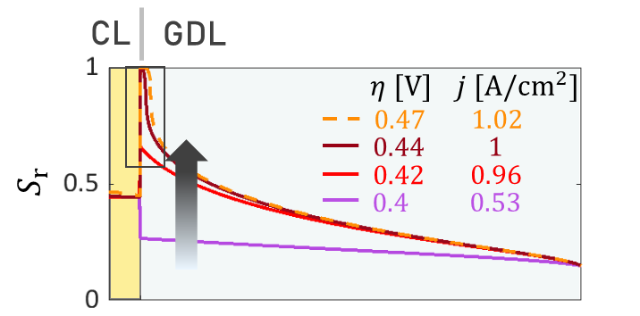
Summary
energy materials design: a hierarchical challenge
role of ionomer on water retention in catalysts
interfaces between components

Slide 39
Backup

Slide 40
How to select or design materials?
components to devices
mesostructures
pores
percolation, MHM,
fluid dynamics
CGMD, MF th.,
fluid dynamics
performance & lifetime
interfaces
thickness, composition
nanostructures
cMD, MF theory,
electrokinetics
effectiveness
materials
ionomer & water distrib., …
DFT, AIMD,
CSM, DL theory
local pH, ion conc.
pore geometry, …
DFT + micro-
kinetic modeling
potential distribution
interface properties,
local pH, …
transformations
DFT
support properties,
particle density, …
basic properties & interactions
electronic structure,
adsorption energies, …

Slide 41
How to select or design materials?
components to devices
mesostructures
pores
percolation, MHM,
fluid dynamics
interfaces
CGMD, MF th.,
fluid dynamics
nanostructures
cMD, MF theory,
electrokinetics
Cross-component coupling and response to ext. cond.
materials
DFT, AIMD,
CSM, DL theory
Fabrication and structure formation → properties
DFT + micro-
kinetic modeling
Local reaction environment and rate determining term (set of parameters)
DFT
Set of structural and geometric parameters
Intrinsic properties (usual suspects)

Slide 42
How to select or design materials?
components to devices
mesostructures
pores
percolation, MHM,
fluid dynamics
interfaces
CGMD, MF th.,
fluid dynamics
nanostructures
cMD, MF theory,
electrokinetics
materials
DFT, AIMD,
CSM, DL theory
Coupled reaction and transport (lifetime-performance, prospects and reserves for impovement)
DFT + micro-
kinetic modeling
DFT
Local reaction environment (charging relation, activity, stability and cat. utilization)
Intrinsic properties (electronic structure, rxn mechanisms, and rates)

Slide 43
Experimental Pore size distributions
T. Suzuki et al., Int. J. Hydrogen Energy, 36, 12361 (2011).
T. Soboleva et al., ACS AMI, 2, 375 (2010).
bimodal pores size distribution (➔ agglomeration)
hydrophobic and hydrophilic pores

Slide 44
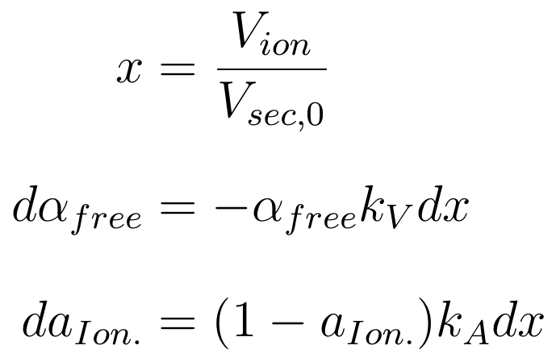
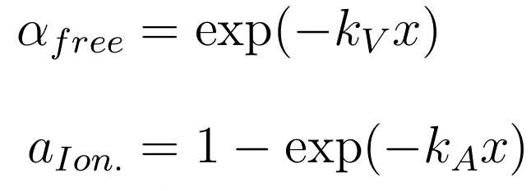
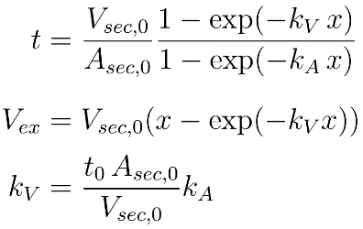
Modeling microstructure formation in CCL
Prediction of volumetric composition and ionomer film thickness and coverage based on ink recipe
Model: Piecewise self-assembly of ionomer during fabrication
Key parameter (descriptor): ionomer dispersion parameter, k_{A}
W. Olbrich et al., Electrochim. Acta 431, 140850.
Notes:
Decrease of free volume of secondary pore space
Growth of ionomer coverage at surface in secondary pore space
x: ratio of dry ionomer volume to volume of seconary pore space in ionomer-free sample
Film thickness: ratio of film volume to surface area covered

Slide 45
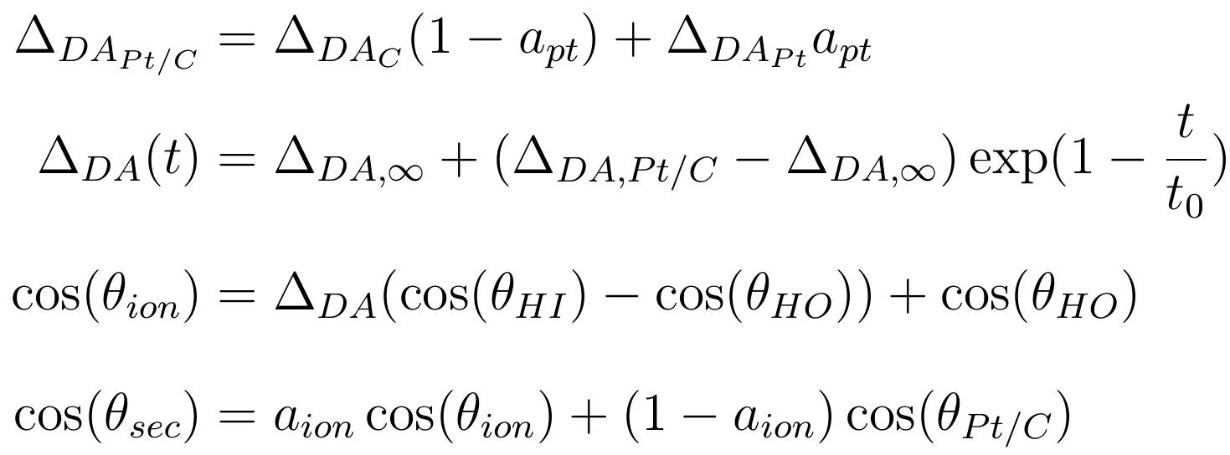



Wettability Model
Alignment of ionomer sidechains
preferential ionomer sidechain orientation alters wettability in secondary pore space
depends on chemical nature of surface and interaction with ionomer constituents
Pt particles: help align sidechains towards support surface
Definition: degree of alignment, Δ_{DA},
W. Olbrich et al., Electrochim. Acta 431, 140850.
Notes:
First equationlinear interpolation between surface area contributions
Third equation linear interplation
Fourth equation: mixing at surface
Second equation decay of alignment

Slide 46
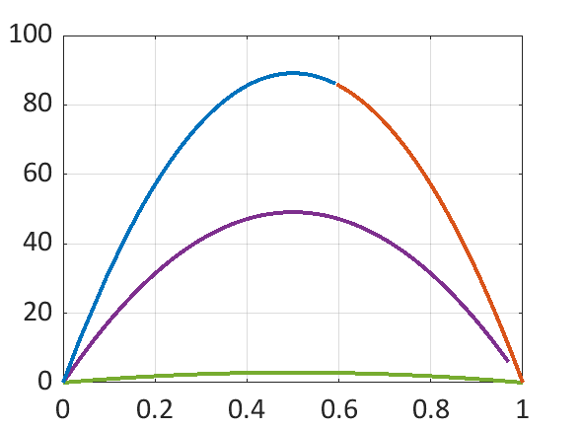
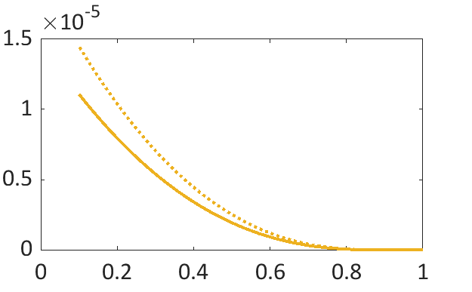
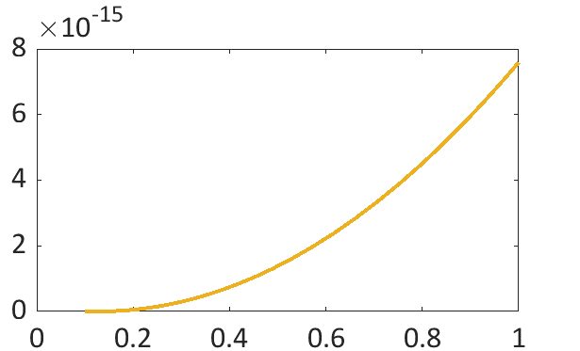














Effective properties as fuNCtion of liquid sat
(a) CL
(c) CL
HO
HI HO
$$Diffusivity [m^{2}/s]$$
$$K_{l} [m^{2}]$$
$$ξ^{lv}$$
$$O_{2}$$
vapor
HI
GDL
$$S_{r}$$
$$S_{r}$$
$$S_{r}$$
(b) DM
(d) DM
$$Diffusivity [m^{2}/s]$$
vapor
$$K_{l} [m^{2}]$$
$$p_{v}^{s} [bar]$$
$$O_{2}$$
HO
$$S_{r}$$
$$S_{r}$$
$$S_{r}$$

