Slide 1
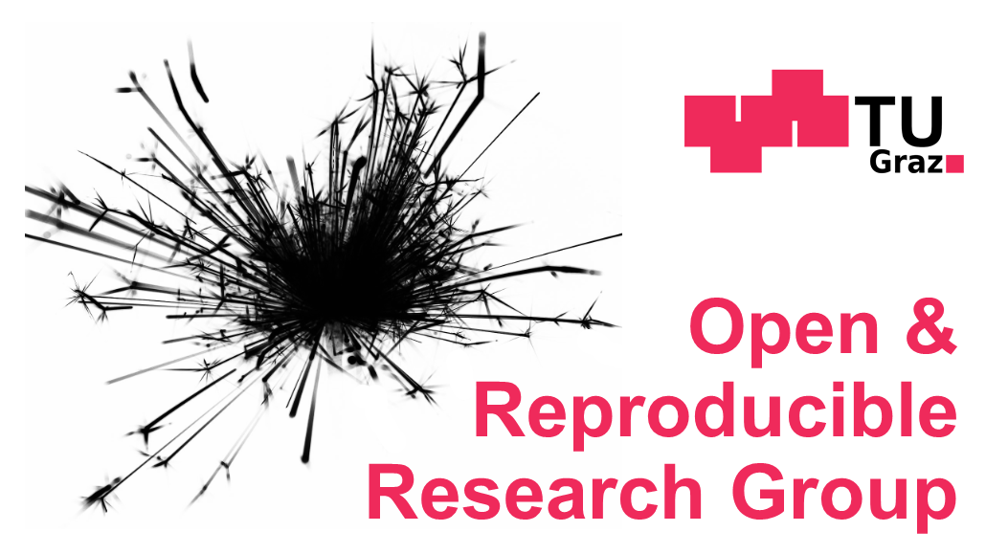

Valuing Open Science
Tony Ross-Hellauer
Open & Reproducible Research Group, TU Graz
Know-Center GmbH
Österreichischer Bibliothekartag 2019
10.-13. September
Messe Congress Graz
1

Slide 2
Open Science is a diverse bunch of practices
Opening up scientific processes and products from all levels to everyone …
Open Access to publications
Open/FAIR data
Open Source software
Open methods, protocols & materials
Citizen Science
Open Evaluation / Open Peer Review
But its also a bunch of principles …
2
Österreichischer Bibliothekartag 2019

Slide 3

Principles of Open Science
Findability
Public good
Community & Collaboration
Inclusivity
Transparency
Accountability
Visibility
Rigour
Re-usability
Accessibility
Interoperability
Reproducibility
Innovation
Responsibility
Equality
3
CC BY @tonyR_H

Slide 4
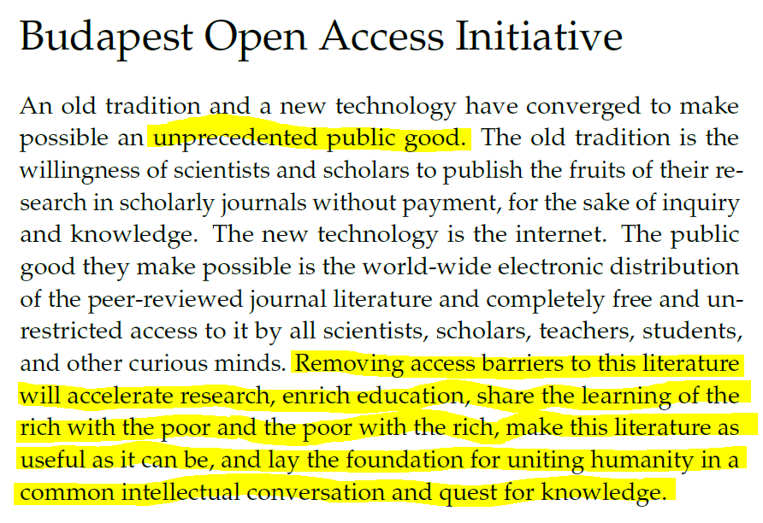
Open Science as a virtue in itself?
OA (free, unrestricted online access to research outputs) will:
Accelerate research
Enrich education
Share learning
Increase utility
Unite humanity
https://www.budapestopenaccessinitiative.org/read

Slide 5
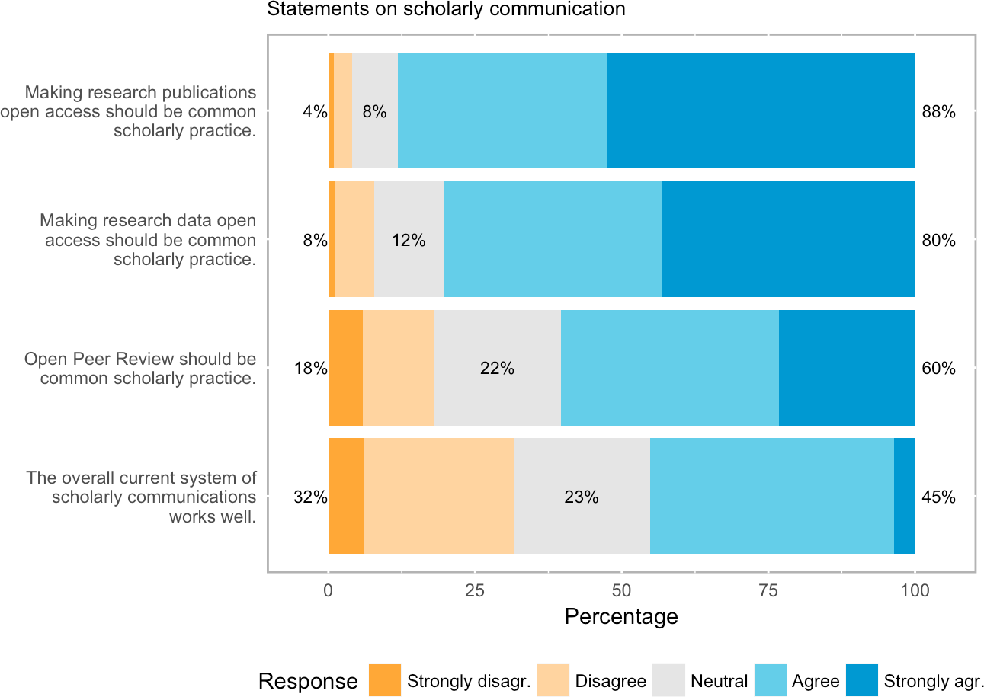
Researchers are generally very receptive to Open Science practices (in principle)
CC BY Dallmeier-Tiessen et al. (2011) Highlights from the SOAP project survey https://arxiv.org/abs/1101.5260
CC BY Ross-Hellauer et al. (2017) Survey on open peer review https://doi.org/10.1371/journal.pone.0189311 CC BY

Slide 6
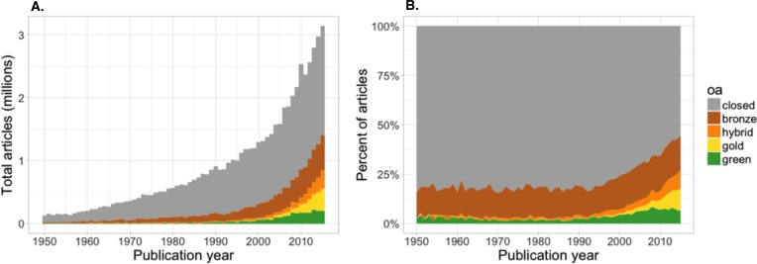
Less so in practice
Laviere – paper health system
CC BY Piwowar et al (2018) The state of OA https://doi.org/10.7717/peerj.4375

Slide 7
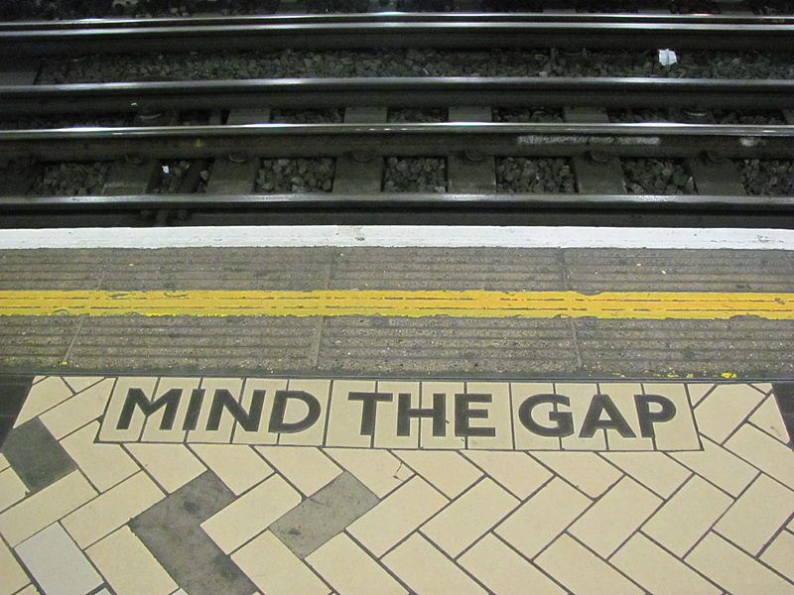
Attitude-behavior gap =
Attitudes/intentions don’t translate into action
Boulstridge, E., & Carrigan, M. (2000). Do consumers really care about corporate responsibility? Highlighting the attitude-behaviour gap. Journal of Communication Management, 4(4), 355–368.
Carrigan, M., & Attalla, A. (2001). The myth of the ethical consumer-do ethics matter in purchase behaviour? Journal of Consumer Marketing, 18(7), 560–577.
Sheeran, P. (2002). Intention-behavior relations: a conceptual and empirical review. European Review of Social Psychology, 12(1), 1–36.

Slide 8
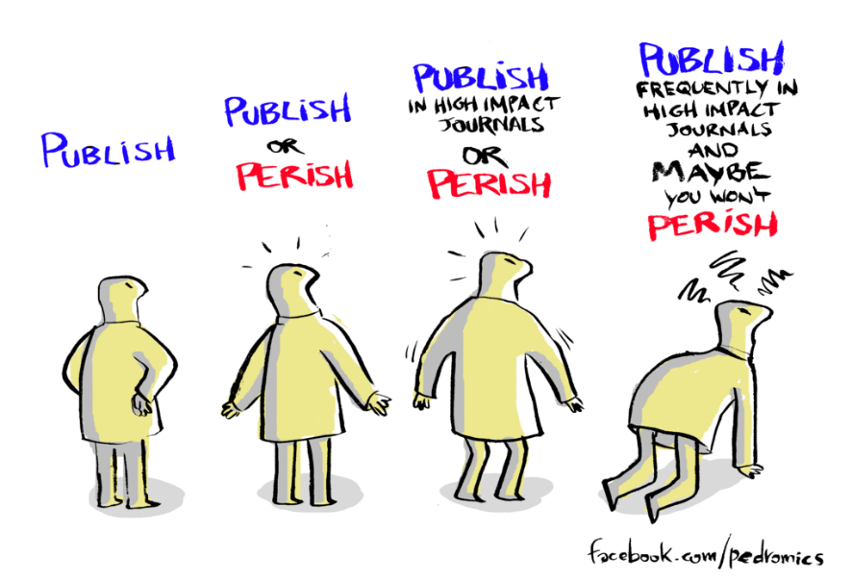
There is no mystery why
Picture in the UK, post-PhD in science subjects, © The Royal Society, 2010
https://royalsociety.org/~/media/Royal_Society_Content/policy/publications/2010/4294970126.pdf

Slide 9
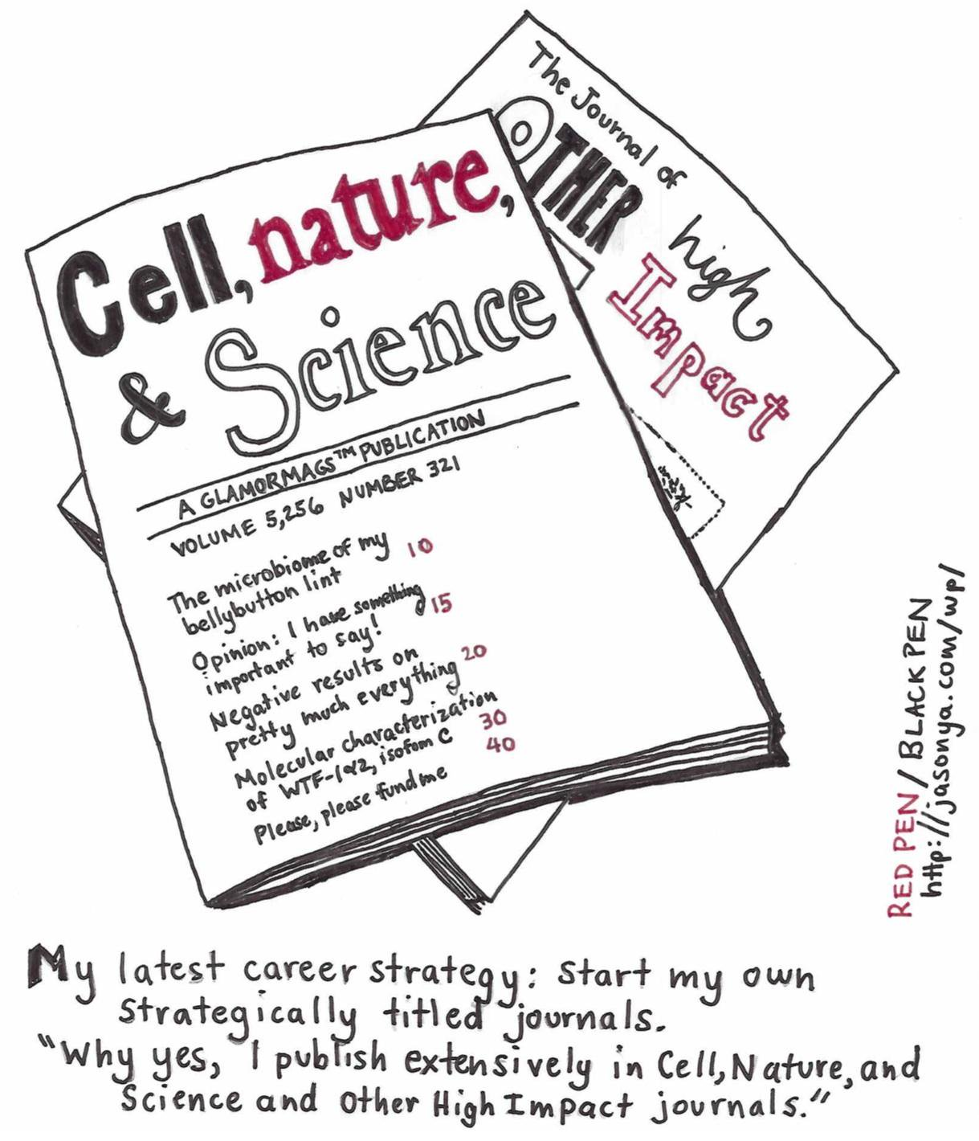
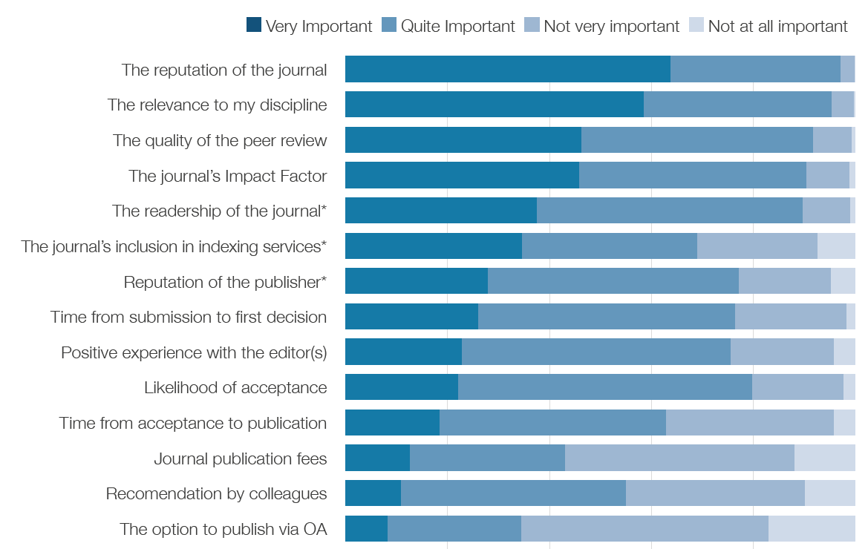

Competing priorities in publishing
2015 Nature Research survey asked: “how important were the following factors when choosing where to submit your most recently published paper?”
Top was reputation
OA was 14th of 17 options
Nature Publishing Group/Palgrave Macmillan. (2015). Author Insights 2015 survey. Figshare. https://doi.org/10.6084/m9.figshare.1425362.v7

Slide 10
Incentives as the core concern
What?
Information
Skills
Tools
Incentives
How?
Why?

Slide 11

Mertonian norms – “ the ethos of modern science”?
Commun(al)ism
Universalism
Disinterestedness
Organised skepticism
BUT
If scholarship actually matched these ideals, wouldn’t we already have Open Science?
Merton (1942) The Normative Structure of Science
Notes:
communism: all scientists should have common ownership of scientific goods (intellectual property), to promote collective collaboration; secrecy is the opposite of this norm.
universalism: scientific validity is independent of the sociopolitical status/personal attributes of its participants
disinterestedness: scientific institutions act for the benefit of a common scientific enterprise, rather than for the personal gain of individuals within them
organized scepticism: scientific claims should be exposed to critical scrutiny before being accepted: both in methodology and institutional codes of conduct.

Slide 12
Credibility cycle
Recognition
Money
Outputs
Staff & equipment
Data
Arguments
Adapted from: Latour and Woolgar (1979) Laboratory Life, and: Hessels, van Lente, & Smits (2009) In search of relevance https://doi.org/10.3152/030234209X442034

Slide 13
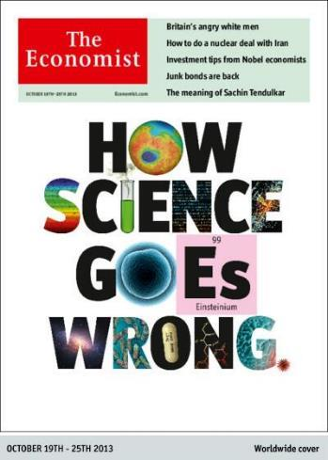

Credibility cycle
Recognition
Money
Outputs
Staff & equipment
Data
Arguments
The incentives underlying science …
(publications = citations = career advancement)
… hardly promote the best science
Adapted from: Latour and Woolgar (1979) Laboratory Life, and: Hessels, van Lente, & Smits (2009) In search of relevance https://doi.org/10.3152/030234209X442034

Slide 14
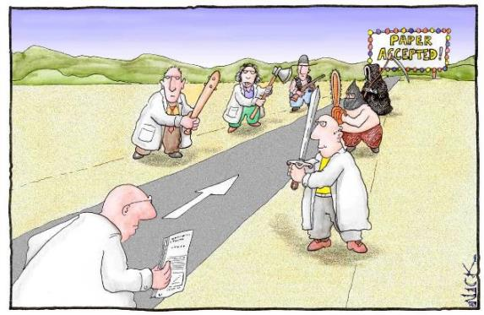
Anti-norms – a more realistic picture?
Particularism
Competition
Self-interestedness
Organized dogmatism
Image: Nick D. Kim, scienceandink.com. Used by permission
Adapted from: Anderson (2000) Normative Orientation of University Faculty and Doctoral Students https://doi.org/10.1007/s11948-000-0002-6; and: Mitroff (1974) Norms and counter-norms in a select group of the Apollo moon scientists https://www.doi.org/10.2307/2094423
Notes:
Particularism: Scientists assess new knowledge and its applications based on the reputation and past productivity of the individual or research group.
Competition: Scientists protect their newest findings to ensure priority in publishing, patenting, or applications.
Self-interestedness: Scientists compete with others in the same field for funding and recognition of their achievements.
Organized dogmatism: Scientists invest their careers in promoting their own most important findings, theories, or innovations [3]

Slide 15
Four ways to incentivize Open Science

Slide 16
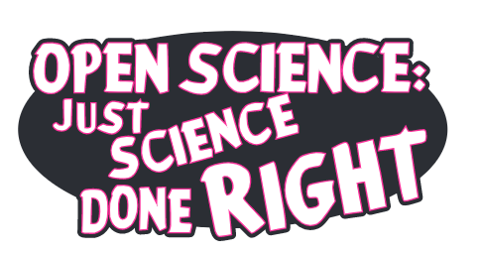
Step one: Make the moral case
Findability
Public good
Community & Collaboration
Inclusivity
Transparency
Accountability
Visibility
Rigour
Re-usability
Accessibility
Interoperability
Reproducibility
Innovation
Responsibility
Equality

Slide 17
Step two: Appeal to self-interest
Open research is associated with increases in:
Citations
Media attention
Potential collaborators
Job opportunities
Funding opportunities

Slide 18
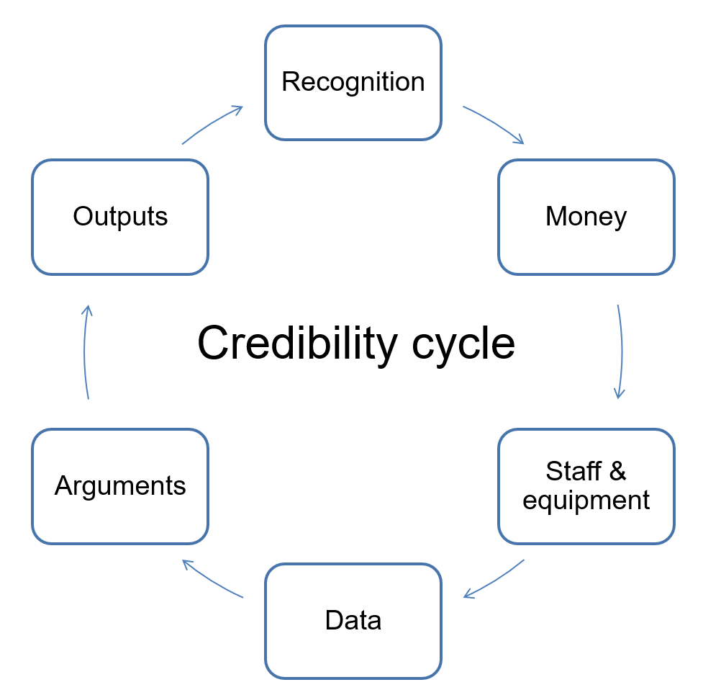
In other words …
Make it known that Open Science can be a good strategy for playing this game

Slide 19
Step three: Change incentives to further align Open Science and self-interest

Slide 20

Recognition
Money
Outputs
Staff & equipment
Data
Arguments
Scholarly communities (prizes, honours, citations, esteem)
Assessment
Selection
Institutions
Funders
Major pressure points
Peer review
Selection
Journals and publishers
Who decides?
PIs
Hiring committees
Institutions
Credibility cycle
Adapted from: Latour and Woolgar (1979) Laboratory Life, and: Hessels, van Lente, & Smits (2009) In search of relevance https://doi.org/10.3152/030234209X442034

Slide 21
Step three: Change incentives to further align Open Science and self-interest
Mandate Open Access, FAIR data
Include Open Science criteria in funding, hiring and promotion criteria
Require data deposit, code, etc. on journal publication
Make journals where people want to publish OA [Plan S]

Slide 22
But these steps are just realpolitik answers to a system of anti-norms
Particularism
Competition
Self-interestedness
Organized dogmatism
Image: Nick D. Kim, scienceandink.com. Used by permission
Notes:
Particularism: Scientists assess new knowledge and its applications based on the reputation and past productivity of the individual or research group.
Competition: Scientists protect their newest findings to ensure priority in publishing, patenting, or applications.
Self-interestedness: Scientists compete with others in the same field for funding and recognition of their achievements.
Organized dogmatism: Scientists invest their careers in promoting their own most important findings, theories, or innovations [3]

Slide 23
Step four: Structural change to foster Mertonian norms, so that Open Science follows naturally?
Commun(al)ism
Universalism
Disinterestedness
Organised skepticism
How?
Three suggestions based on work we’re doing in my group …
Merton (1942) The Normative Structure of Science
Notes:
communism: all scientists should have common ownership of scientific goods (intellectual property), to promote collective collaboration; secrecy is the opposite of this norm.
universalism: scientific validity is independent of the sociopolitical status/personal attributes of its participants
disinterestedness: scientific institutions act for the benefit of a common scientific enterprise, rather than for the personal gain of individuals within them
organized scepticism: scientific claims should be exposed to critical scrutiny before being accepted: both in methodology and institutional codes of conduct.

Slide 24

Suggestion 1. Joined-up approaches
Its all connected – many of the key blockers to Open Science are actually (at root) motivated by wider problems with “publish or perish” culture, hypercompetition and the cult of metrics/managerialism
  The Open Science conversation must be part of a wider effort to reform a messed-up system
Start with conversation about signing DORA

Slide 25
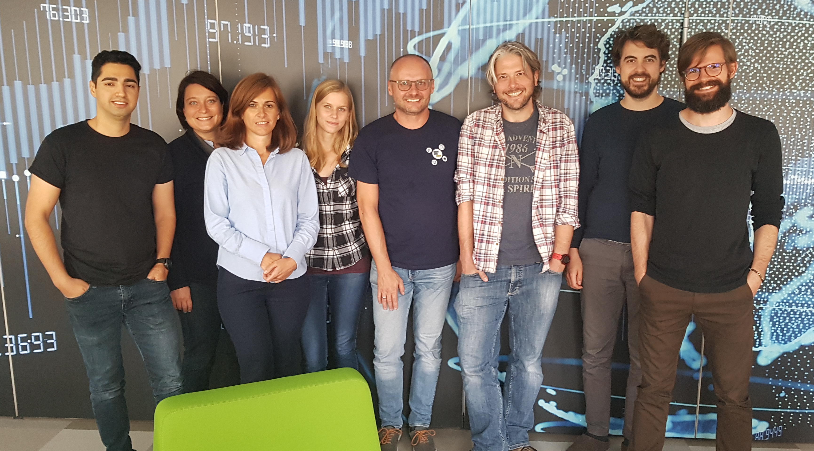
Fuse the social with the technical
E.g., at ORRG, sociologists and data stewards work side by side with developers on new researcher-led services, tools, policies

Slide 26
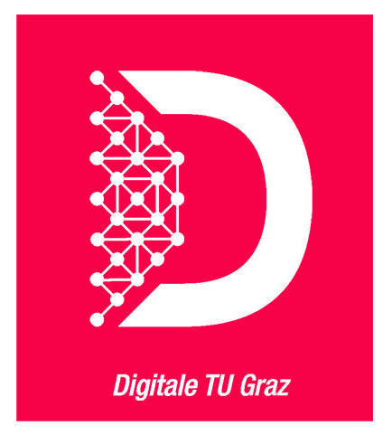
Digital TU Graz
An integrated approach to digitization of research, teaching, and administration
ORRG is leading activities to conceptualiseand implement Open Science and FAIR data services for TU Graz
New repositories, data management planning tools, discipline-specific infrastructures, policies and Open Science training/support

Slide 27
Suggestion 2. Avoid unforeseen negative consequences
Or, try to make sure that in trying to fix something we aren’t harming the ecosystem somewhere else
For example …

Slide 28
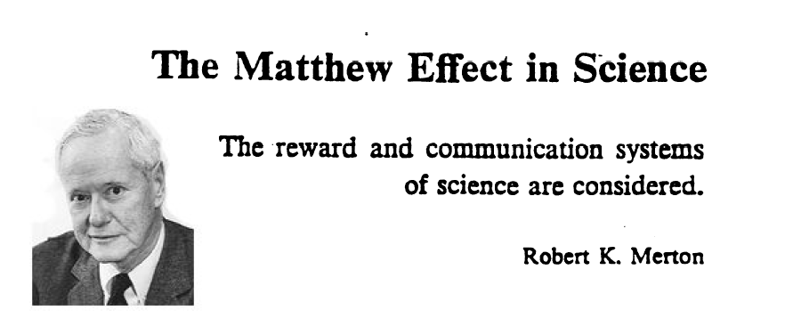
Matthew Effect first proposed Robert Merton in Science, 1968
Idea: Already successful scientists tend to receive disproportionately high recognition or rewards in comparison to their less-famous counterparts

Slide 29
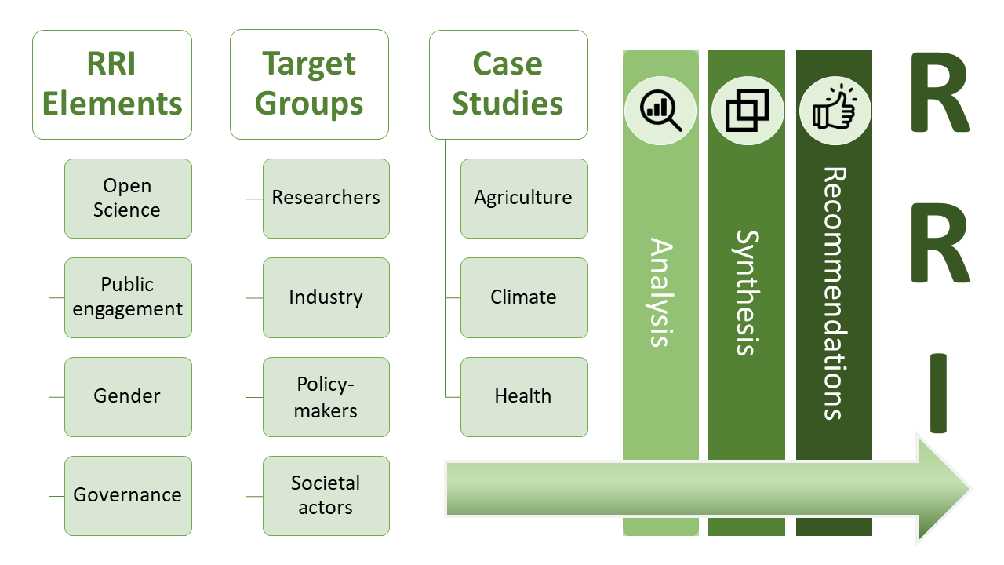
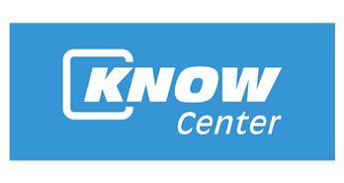
ON-MERRIT: Observing and Negating Matthew Effects in Responsible Research and Innovation Transition
New 1m EUR, EC-funded project
Will study Matthew effects in Open Science and RRI
Make evidence-based policy recommendations to mitigate negative effects

Slide 30
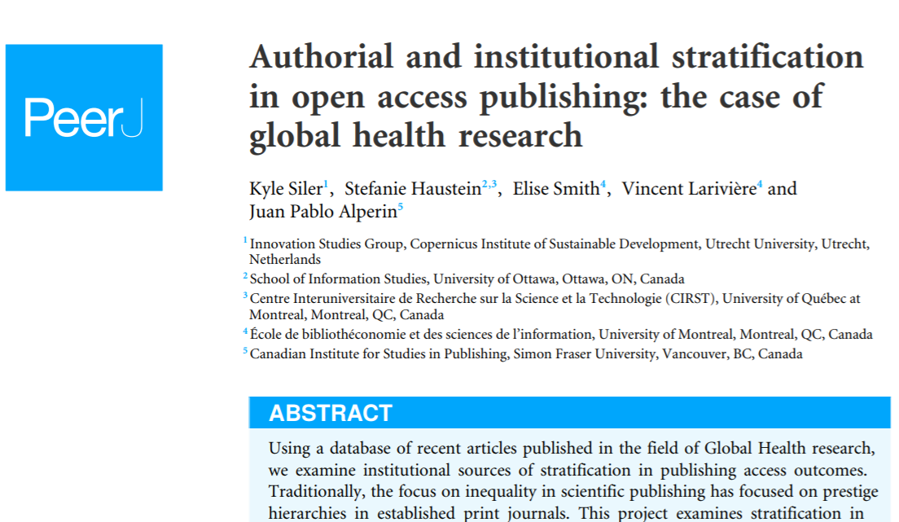
Example: Open Access publishing patterns
“Results suggest that authors affiliated with high-ranked universities and well-funded institutions tend to have more resources to choose pay options with publishing. Our research suggests new professional hierarchies developing in contemporary publishing … [T]here is stratification in institutional representation”
Siler K, Haustein S, Smith E, Larivière V, Alperin JP. (2018) Authorial and institutional stratification in open access publishing: the case of global health research. PeerJ6:e4269 https://doi.org/10.7717/peerj.4269

Slide 31
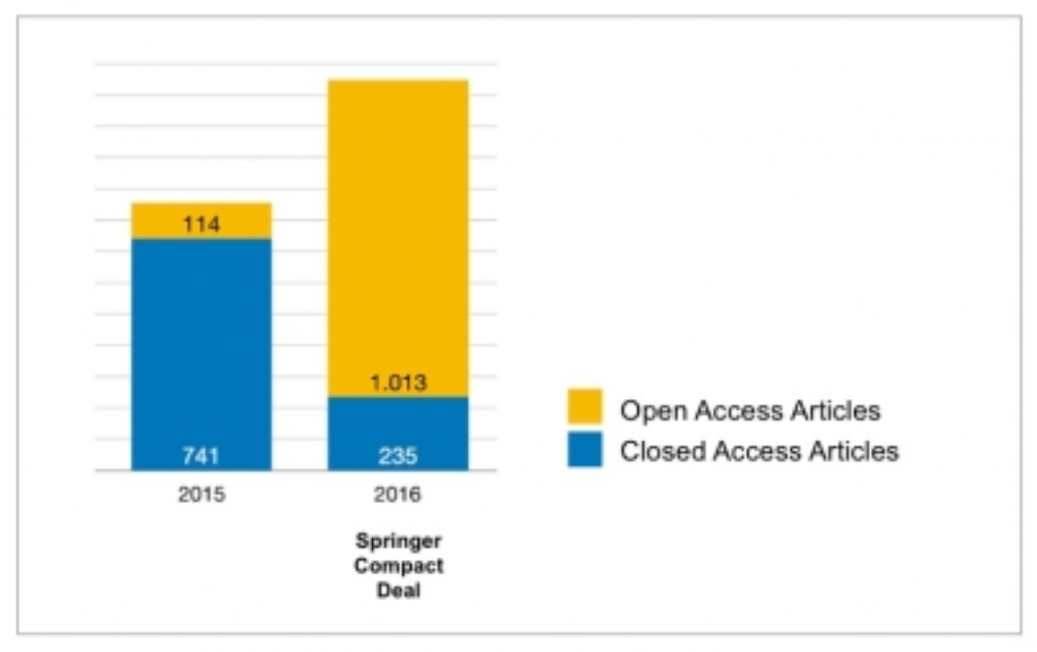
Do no harm?
E.g., number of Austrian articles published with Springer jumped 45% in one year with Compact Deal
“Transformative Agreements” can just further funnel authors towards legacy journals and publishers …
Source: Guido Blech, COASP 2018, license unknown

Slide 32
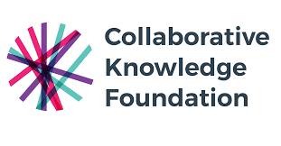

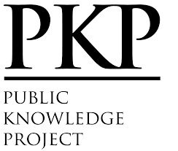

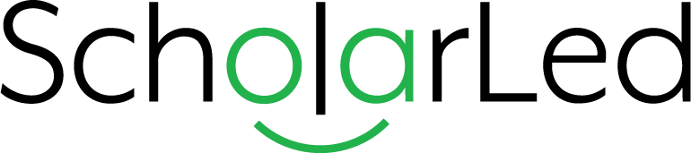
Suggestion 3. Innovate (and claim a central role for the library in dissemination of knowledge)
Libraries should support open source, sustainable initiatives for research dissemination based on consortial/community-led models
But libraries shouldn’t just support such initiatives – they should help lead the way in building them.
Introducing PubFAIR …

Slide 33

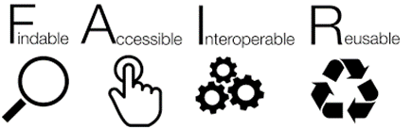
PubFAIR
A vision for an open publishing services framework, which aims to enrich repositories with a layer of services for the quality assurance, dissemination and discovery of a range of research outputs (including preprints, data and software).
PubFAIR enables FAIR research objects in two senses:

Slide 34
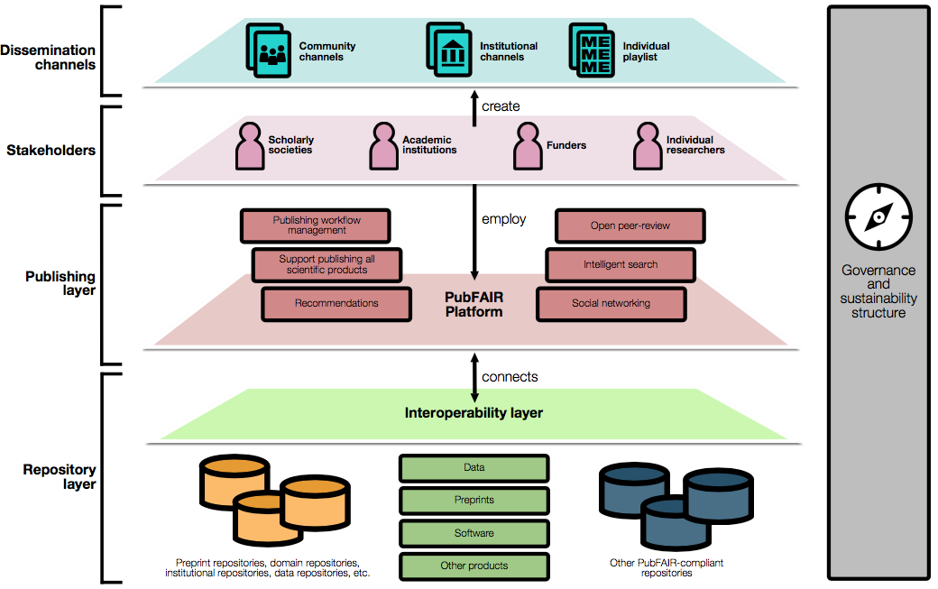

Slide 35
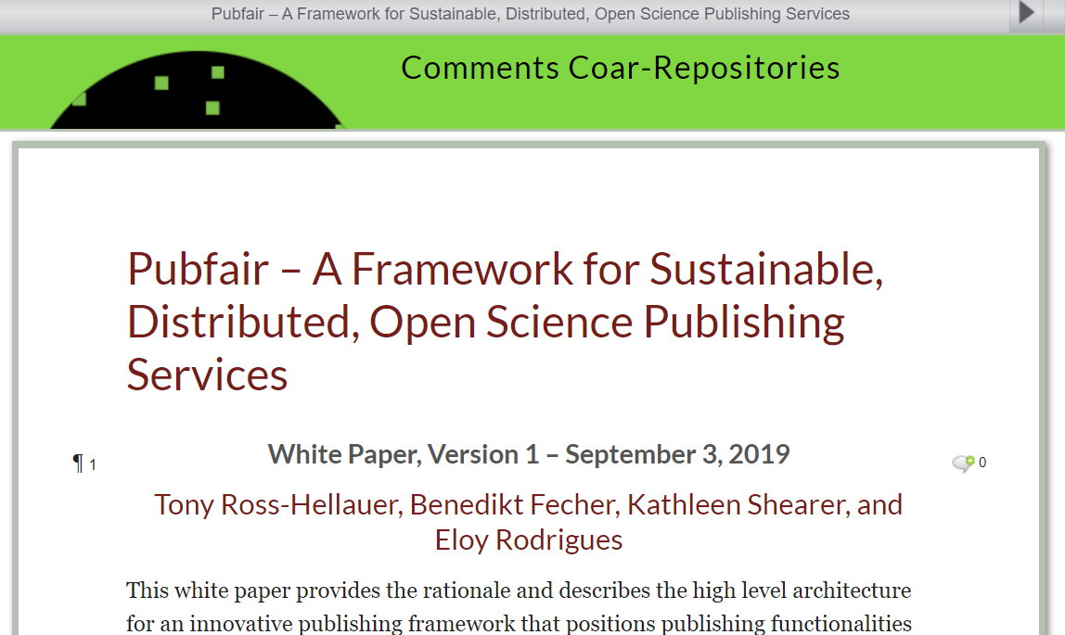

https://comments.coar-repositories.org/
PubFAIR White Paper published by COAR this month
Open for comments until 30th Sept 2019
Comment or contact us if interested to collaborate in realizing PubFAIR!

Slide 36
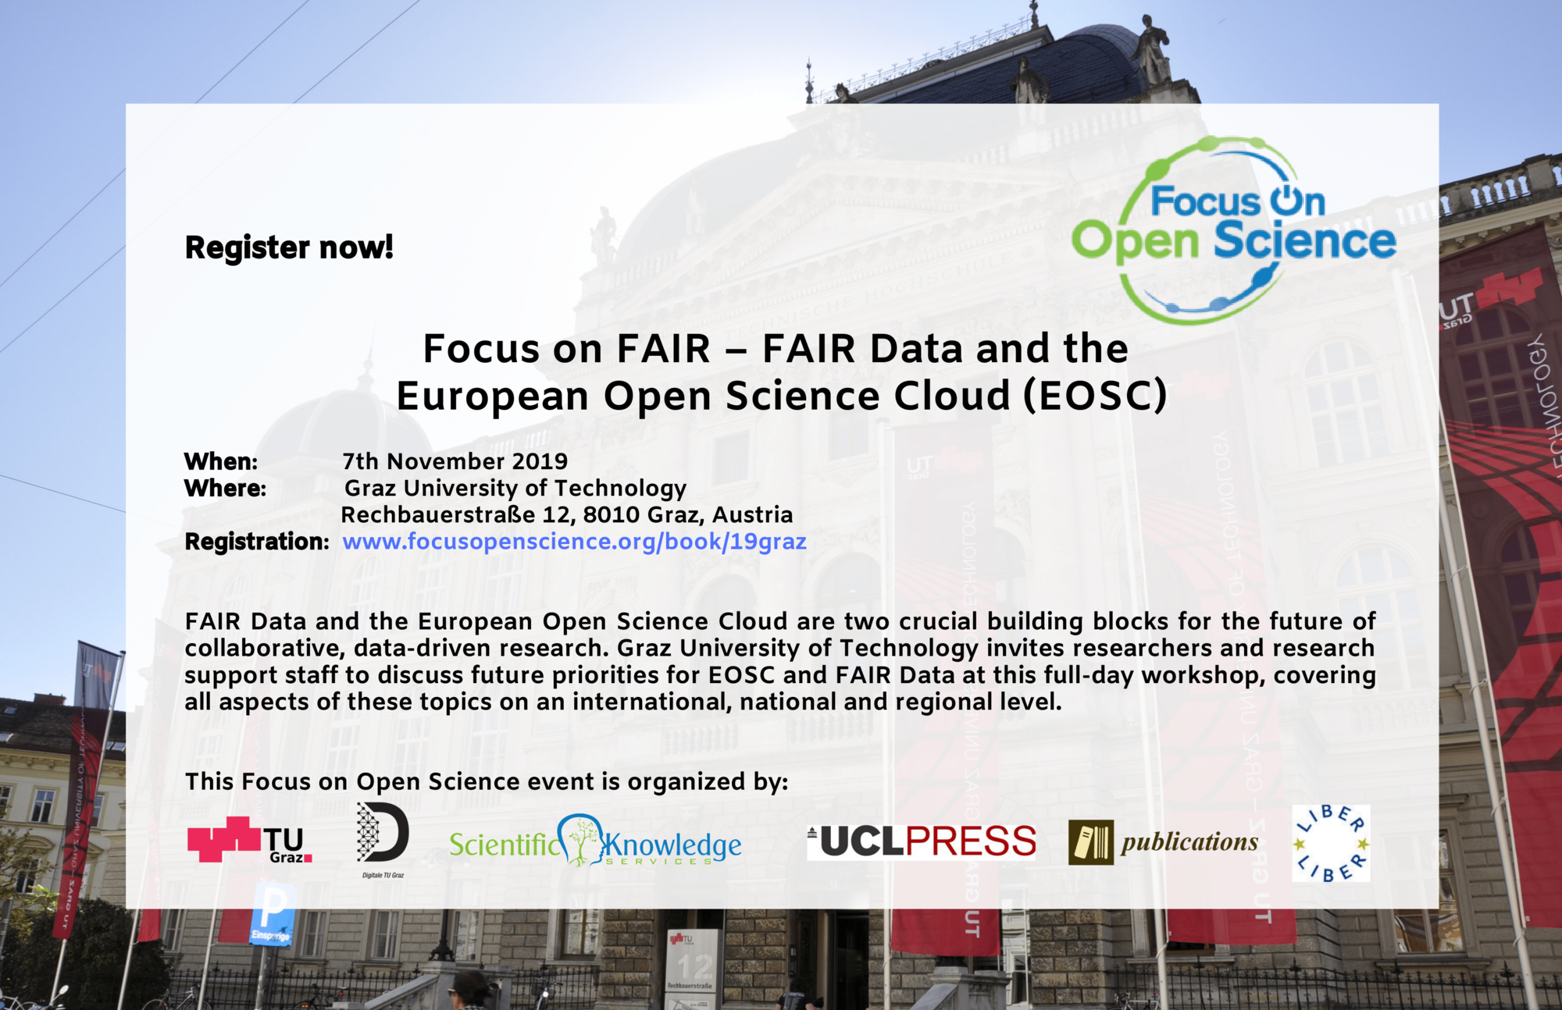
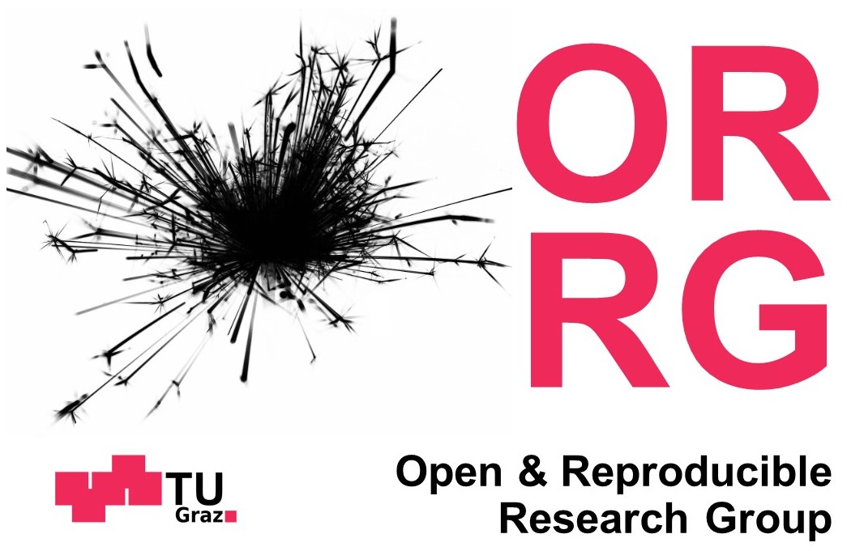

Thanks!
Register for our Nov 7th FAIR data workshop!
https://www.focusopenscience.org/book/19graz/
Get in touch:
  Email: tross@know-center.at
  Twitter: @tonyR_H
  Web: https://www.tugraz.at/institute/isds/research/orrg/

