Slide 1
Open Science, why?!
Dr Sünje Dallmeier-Tiessen
CERN
Madrid, November 2016

Slide 2
Agenda
Introduction
Going digital
  Open Access, Open Data, Open Source, Open…
  Openness and competitive research – can this go together?
What can you do to be “open”?
    Find a place to do it
    Make sure you are found
    Get credit
    Tell others to do the same

Slide 3
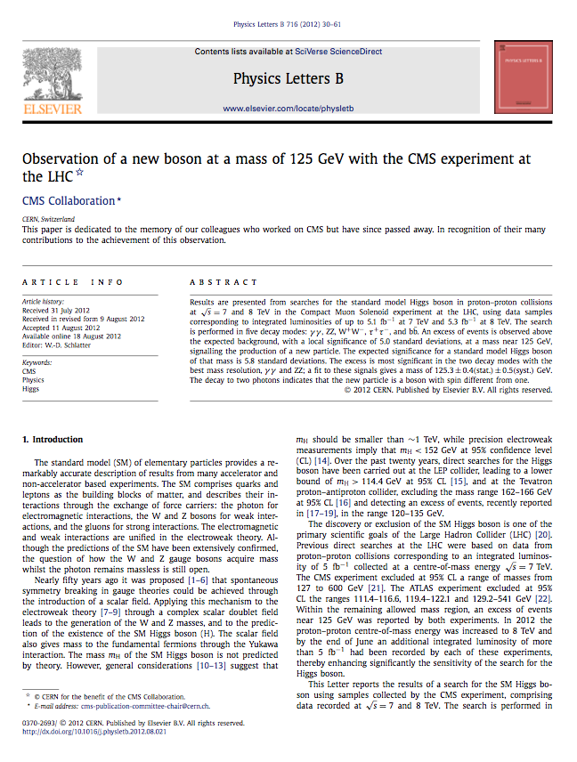


Slide 4


Slide 5


Slide 6


Slide 7



Slide 8


Slide 9


Slide 10
Copyright: Royal Society and CERN
1665
2012

Slide 11


Slide 12
So why OPENING things up?
Open Science is the practice of science in such a way that others
…can collaborate and contribute,
…where research data, lab notes and other research processes are freely available,
…under terms that enable reuse, redistribution and reproduction of the research and its underlying data and methods.
Reference: Foster Glossary

Slide 13
Open Science = More Visibility
You can give your research much more visibility through
Sharing articles openly
Sharing data,
Sharing code
(follow a few standards that help other services finding your shares)
and by using tools like ORICD to connect all your outputs

Slide 14
Open Science = Better research
Newton:
“If I have seen further, it is by standing on the shoulder of giants”
To build on other peoples work, you need to get access to their results.
Papers are only the tip of the iceberg
Notes:
Newton: If I have seen further, it is by standing on the shoulders of giants.

Slide 15
Open Science = Being more organized and up to date
Document research “live”, when you are in the lab (not months later)
Get feedback from colleagues earlier than usual (because its easier to do)
Get your references organized for you, profit from others doing the same
Track how others build on your work

Slide 16
Reproducible research needed

Slide 17
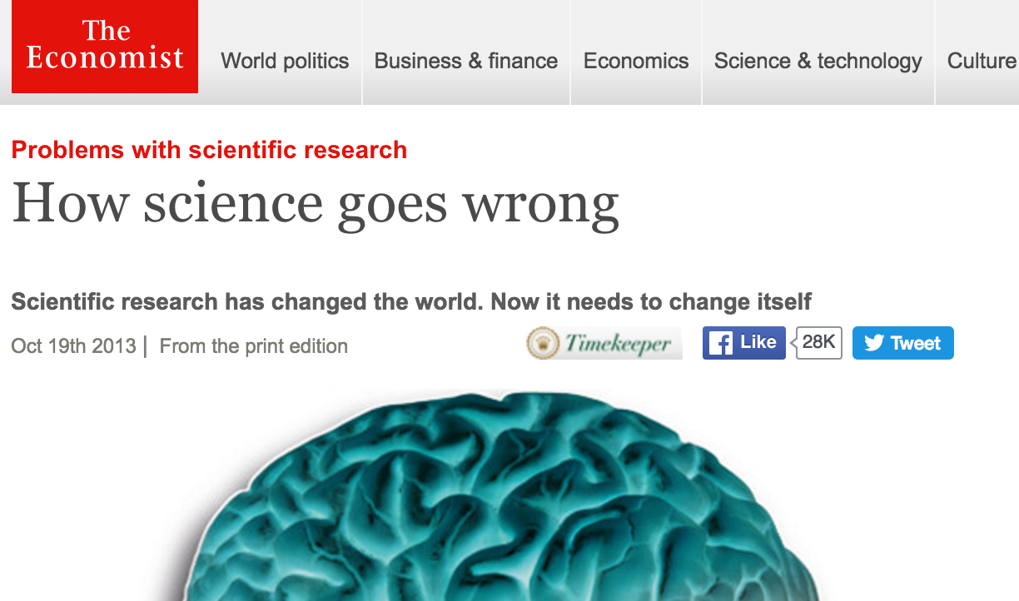
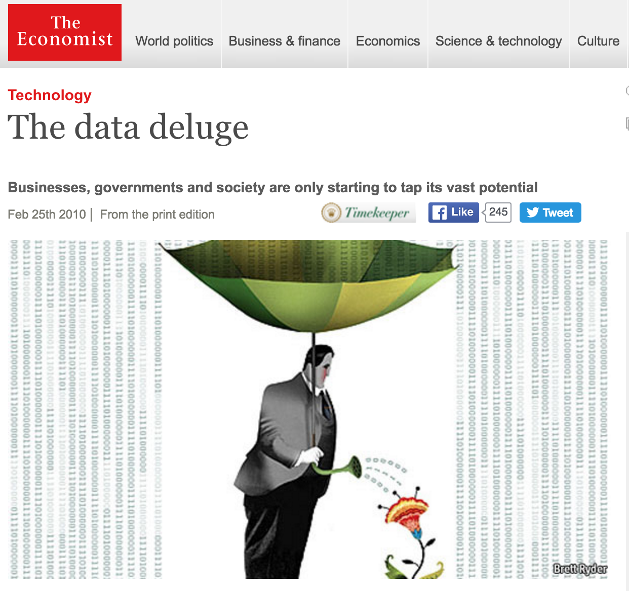
http://www.economist.com/news/leaders/21588069-scientific-research-has-changed-world-now-it-needs-change-itself-how-science-goes-wrong
http://www.economist.com/node/15579717

Slide 18
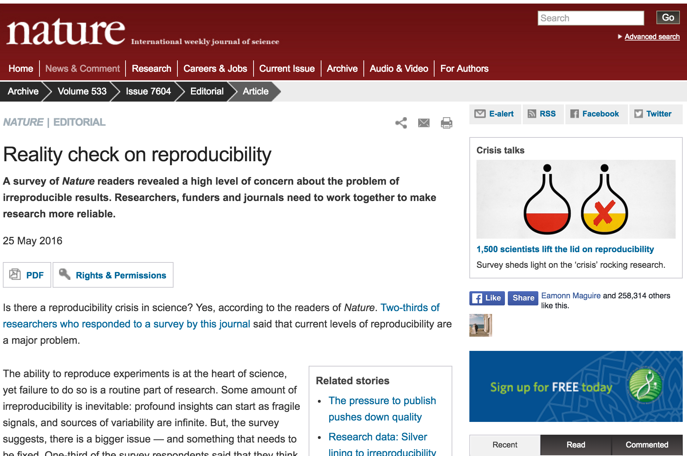
http://www.nature.com/news/reality-check-on-reproducibility-1.19961

Slide 19
Policy pressure
Not a reason to be scared

Slide 20
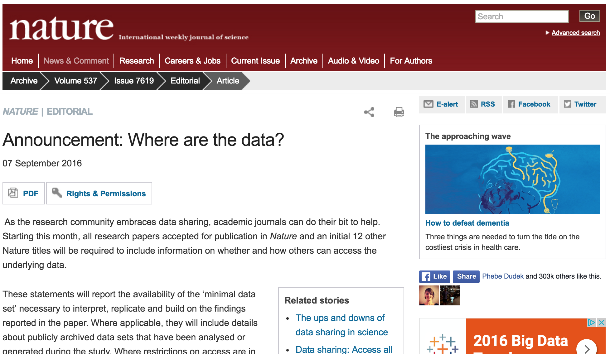
Journals’ policies
http://www.nature.com/news/announcement-where-are-the-data-1.20541
Notes:
Springer Nature Data policy

Slide 21
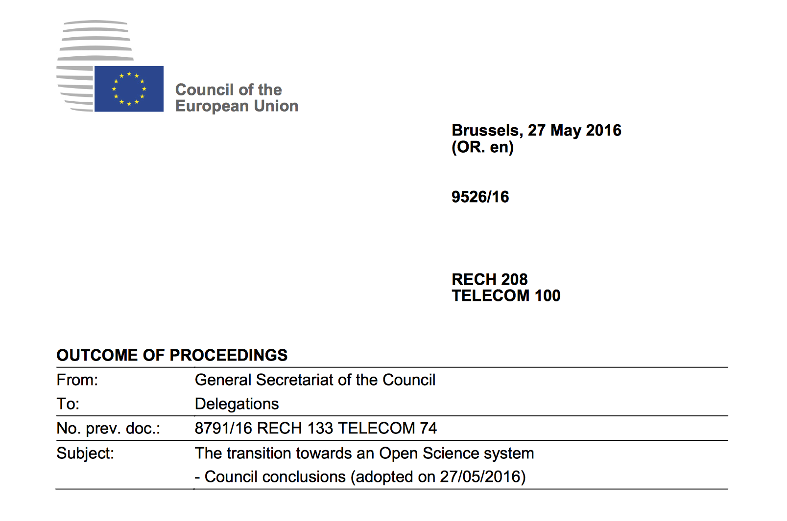
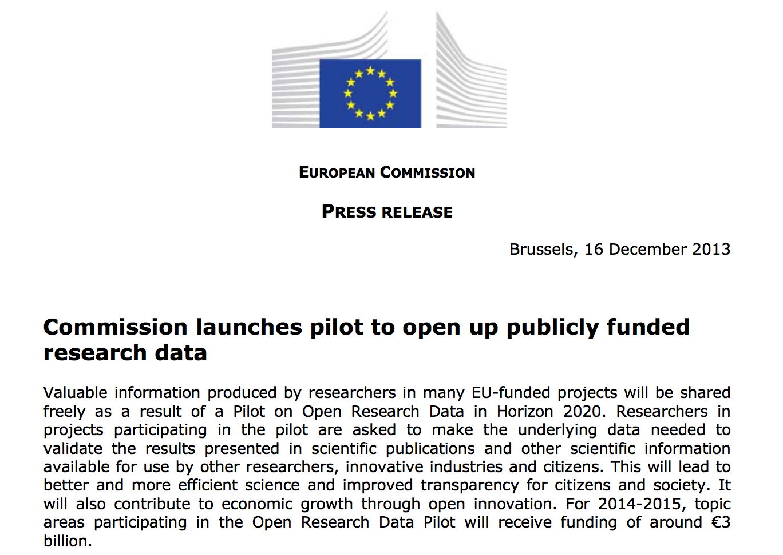
Funder’s policy
WELCOMES Open Access to scientific publications as the option by default for publishing the results of publicly funded research; […]
RECOGNISES that the full scale transition towards Open Access should be based on common principles such as transparency, research integrity, sustainability, fair pricing and economic viability; and […]
CALLS on Member States, the Commission and stakeholders to remove financial and legal barriers, and to take the necessary steps for successful implementation in all scientific domains, including specific measures for disciplines where obstacles hinder its progress.
See for example: http://ec.europa.eu/research/participants/data/ref/h2020/grants_manual/hi/oa_pilot/h2020-hi-oa-data-mgt_en.pdf

Slide 22
There are many ways one can take first steps
Open Access Publishing
Code Sharing
Data Sharing
Better public documentation to enable more reuse
Transparent (sharable) workflows

Slide 23
But Open Science is about more than just having the “open” tag!
License? Ask your librarian if needed
Dependencies (software, methods)
Versioning – update when needed
Quality assessments possible?
Reference other peoples work (also for data and code) and demand being referenced too!
Use DOIs and link all shared things to your ORCID

Slide 24
Easy Open Access
Green Open Access
Submit your article to a repository (institute or discipline) – alongside journal publishing
Check the license carefully (does the publisher allow sharing?)
Check that it gets a DOI to be citable
Connect to your ORCID. Tell others you put it there
Gold Open Access
Publish through direct Open Access journals (like PLOS)
Often an Article Processing Charge needs to be paid
Check for example DOAJ or ask your librarian for help, https://doaj.org/
Check license carefully (CC-BY)

Slide 25
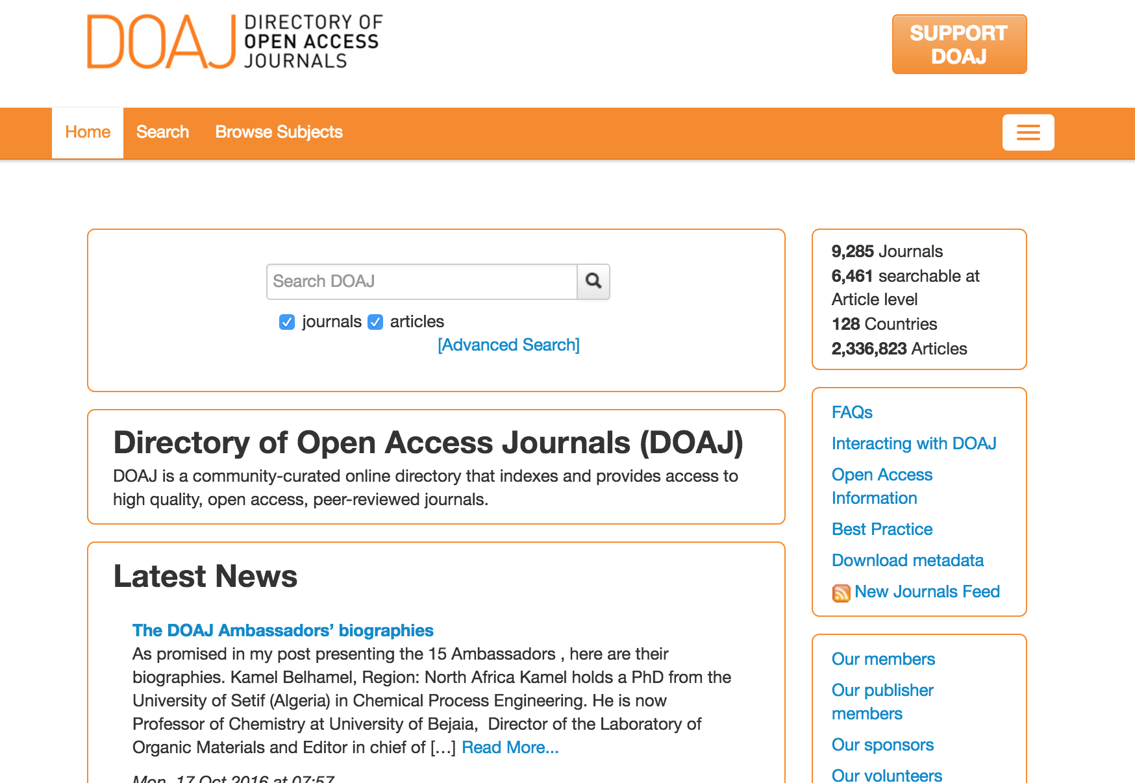
Open Access Journals
https://doaj.org/
Notes:
DOAJ? And some guideline on how to publish OA

Slide 26
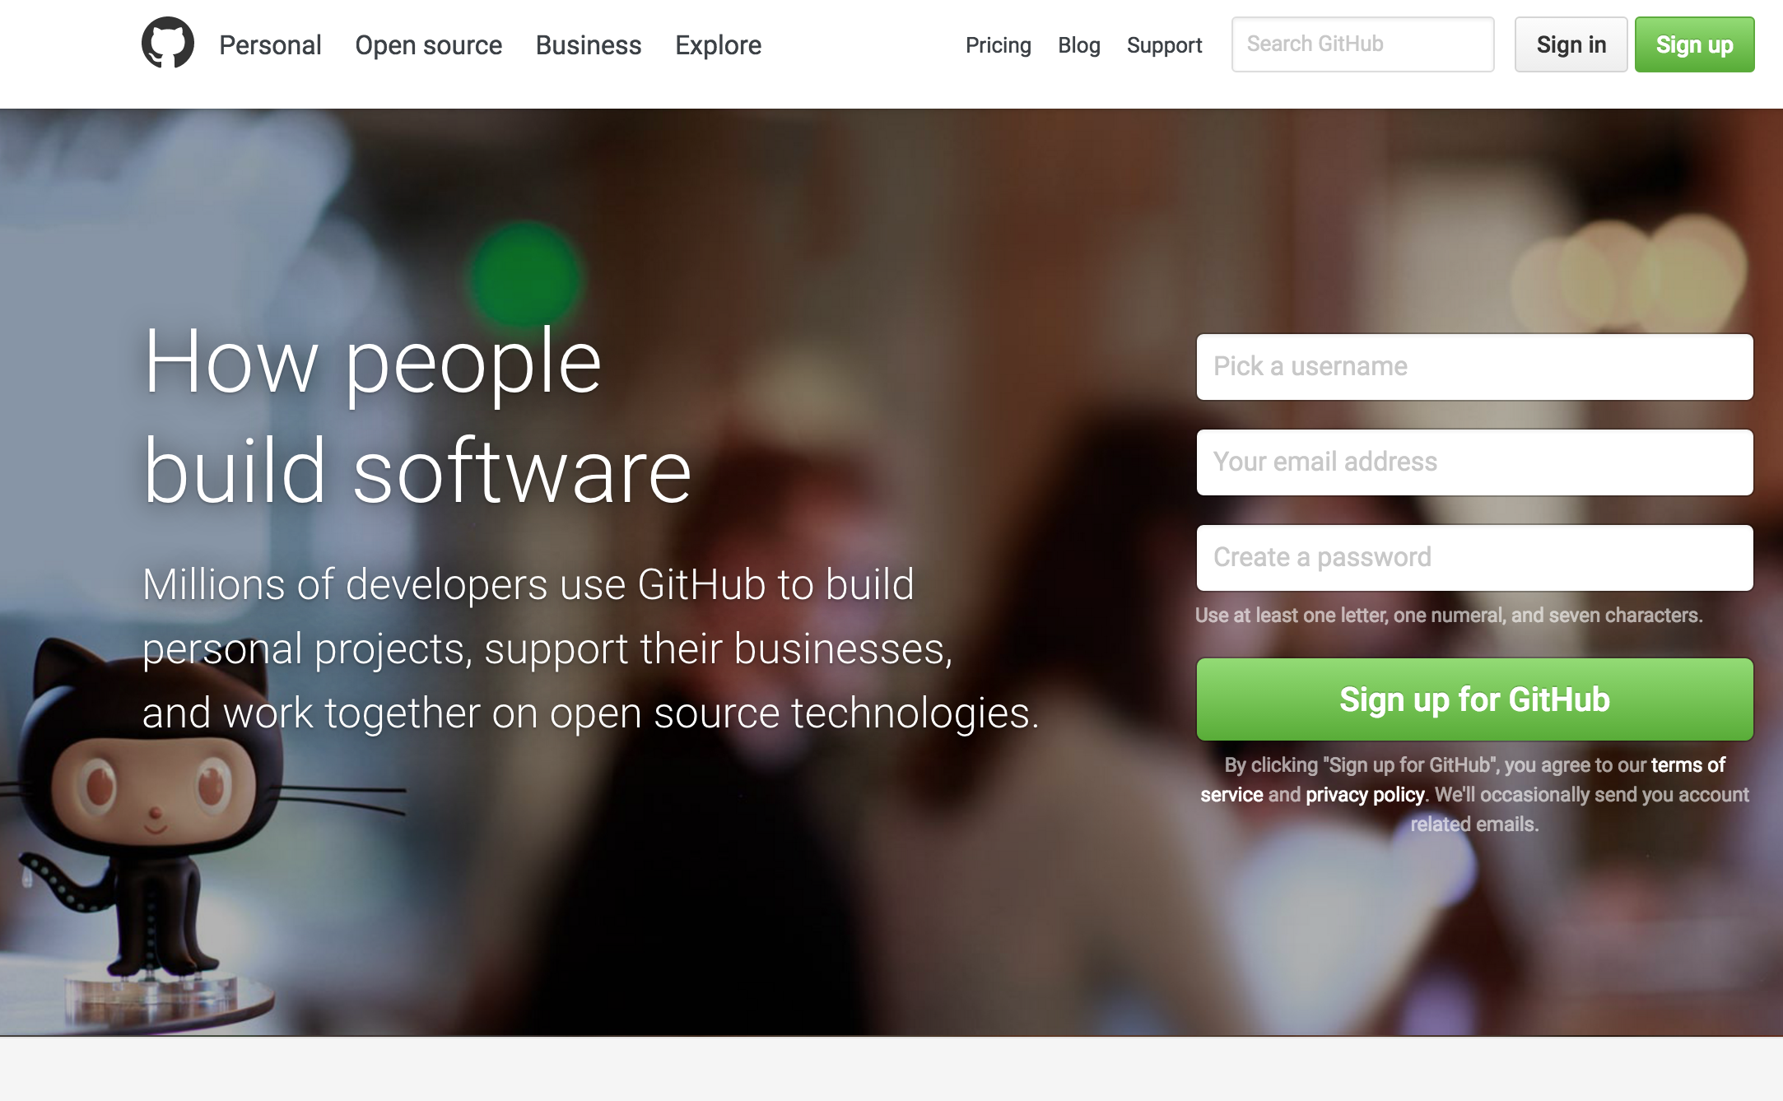
Sharing code was never easier
https://github.com/
Notes:
Sreenshot and refer to ioannis and xiaoli’s presentation

Slide 27
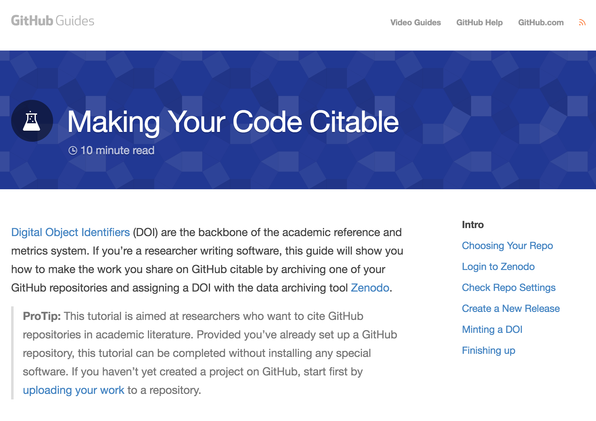
Making code citable through Github and Zenodo
https://guides.github.com/activities/citable-code/

Slide 28
Open Data Publishing

Slide 29
Various solutions
Publish your data and code
  Disciplinary and institutional repositories exist
  It’s your choice: re3data.org
Link your data and code to the article you publish
  Now easier with selected repositories/publishers
Data/software journals already exist
  With partner repositories
  With repository recommendations

Slide 30
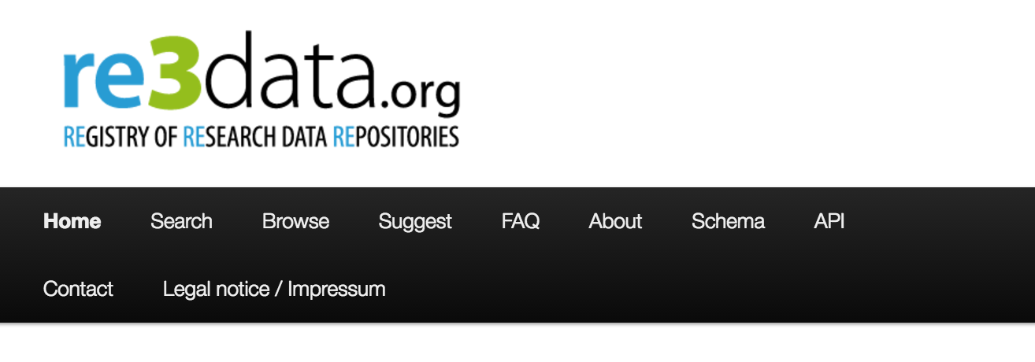
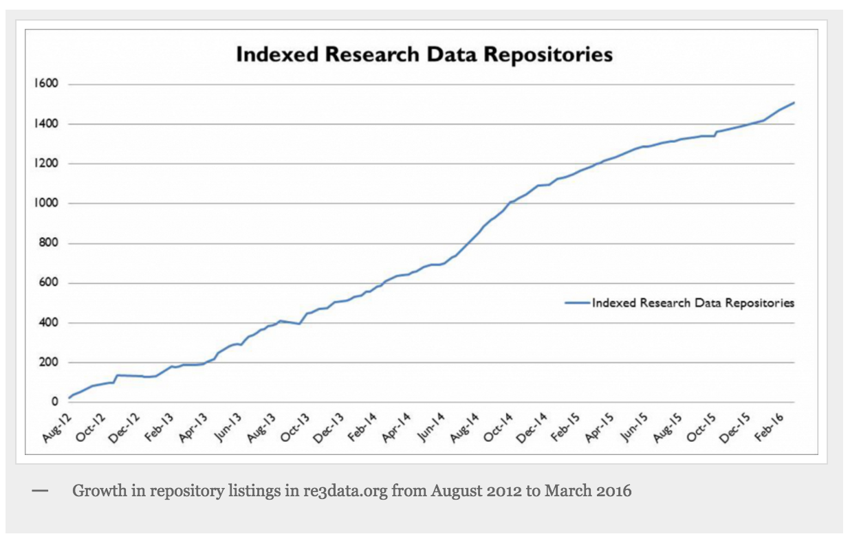
re3data.org

Slide 31
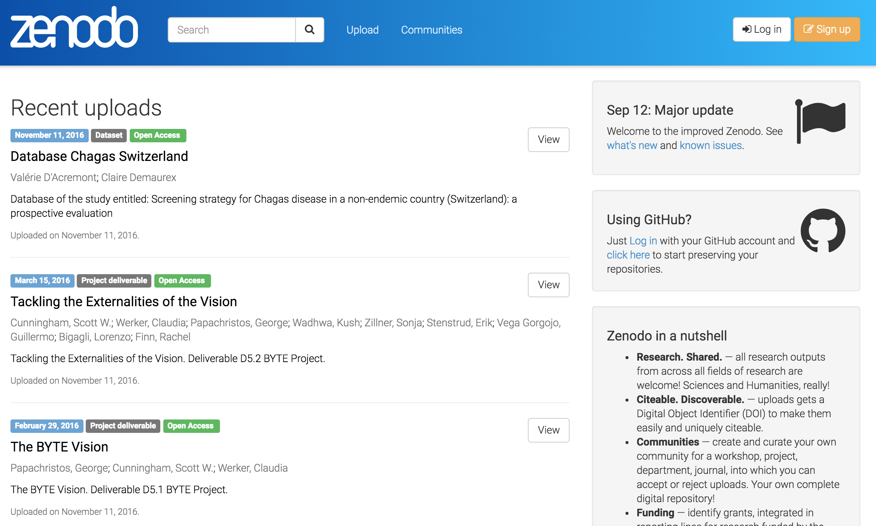
Share and cite your data
Zenodo.org

Slide 32
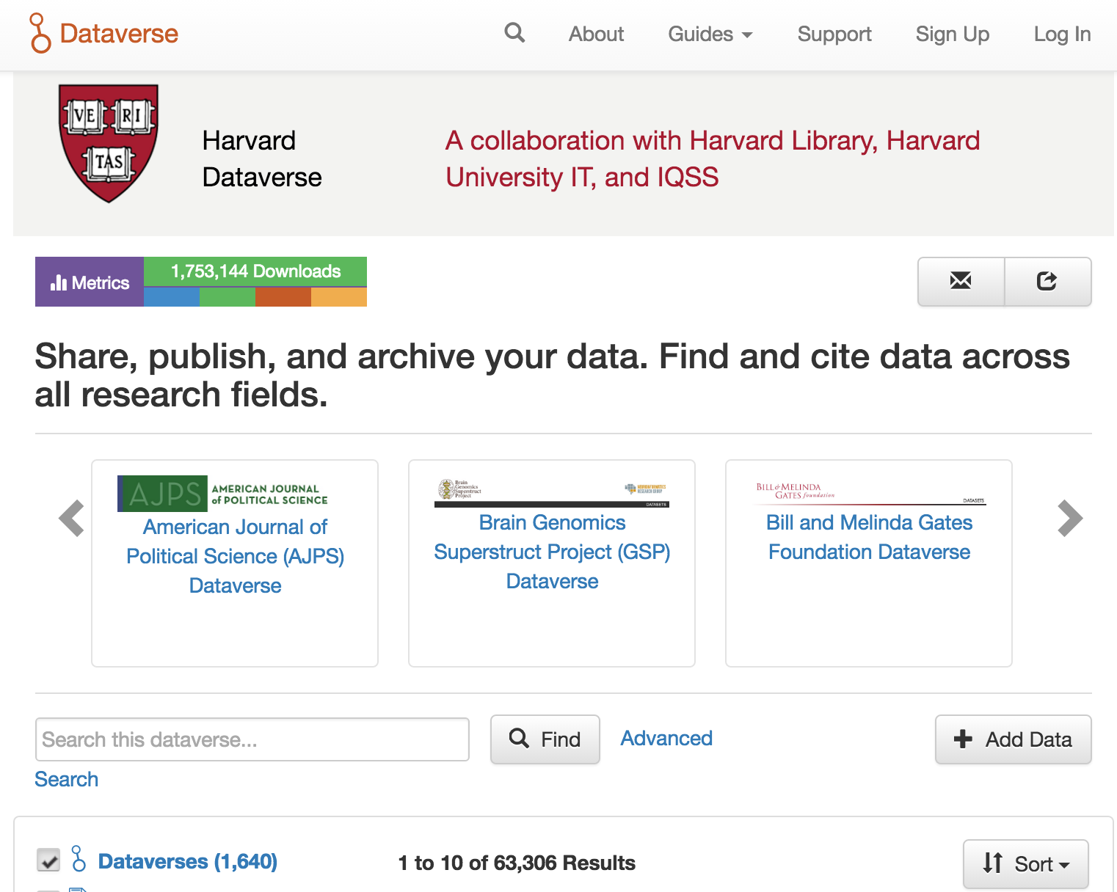
dataverse.org

Slide 33
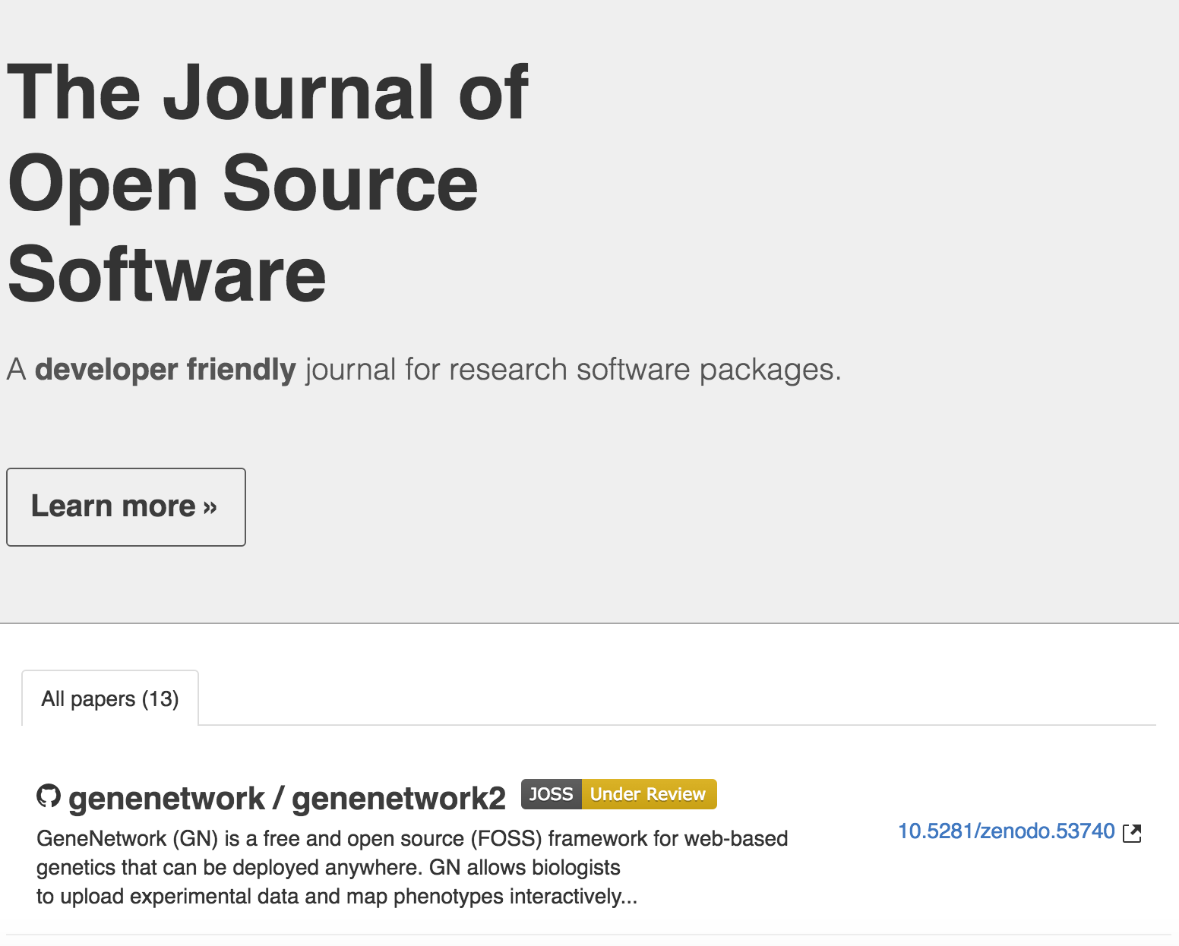
http://joss.theoj.org/

Slide 34
Using tools to support your research
Examples!

Slide 35

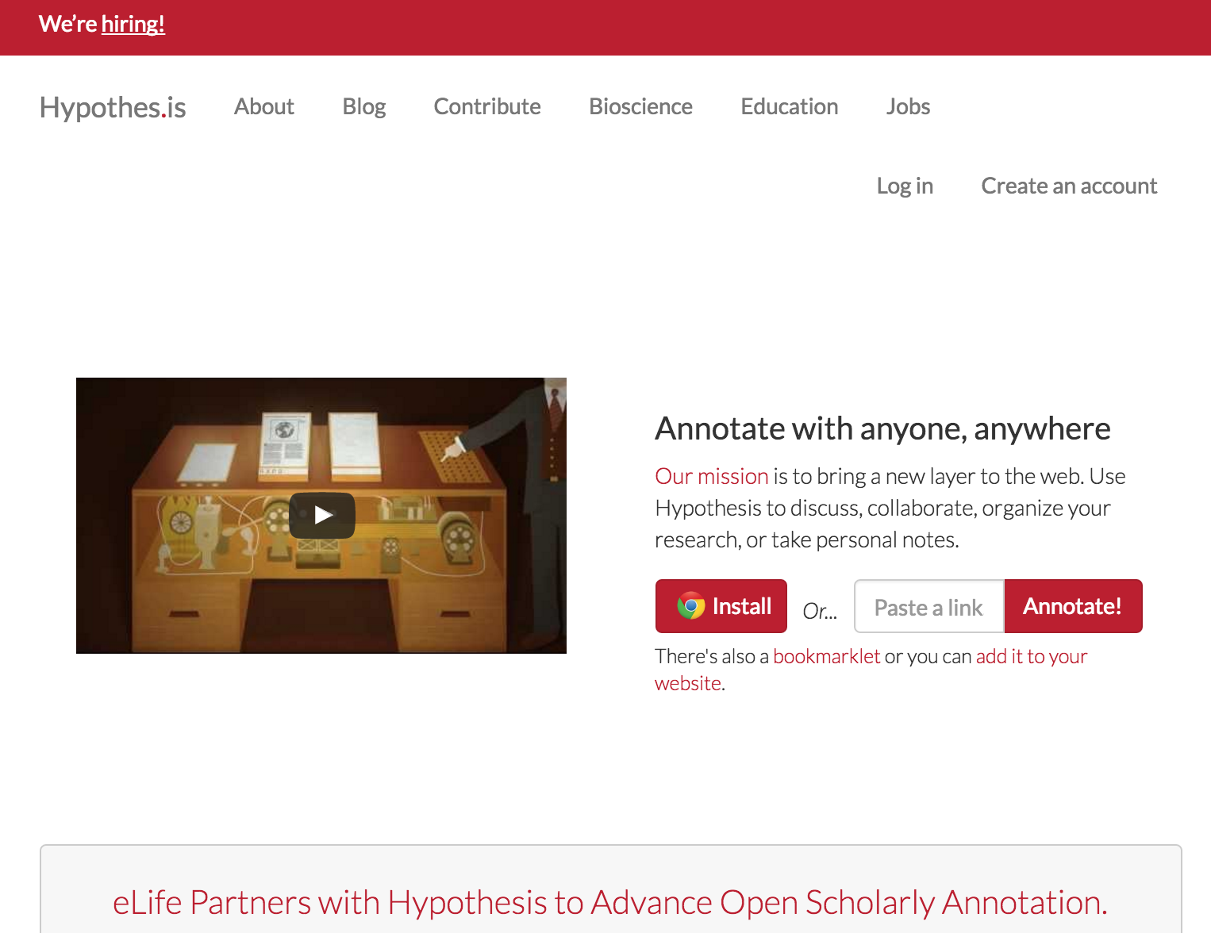
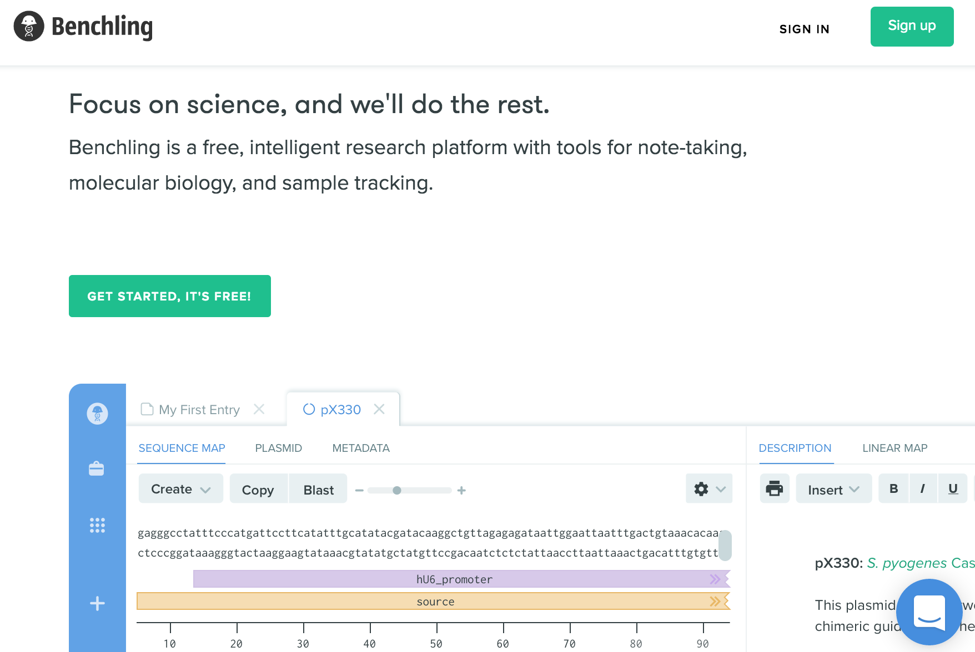
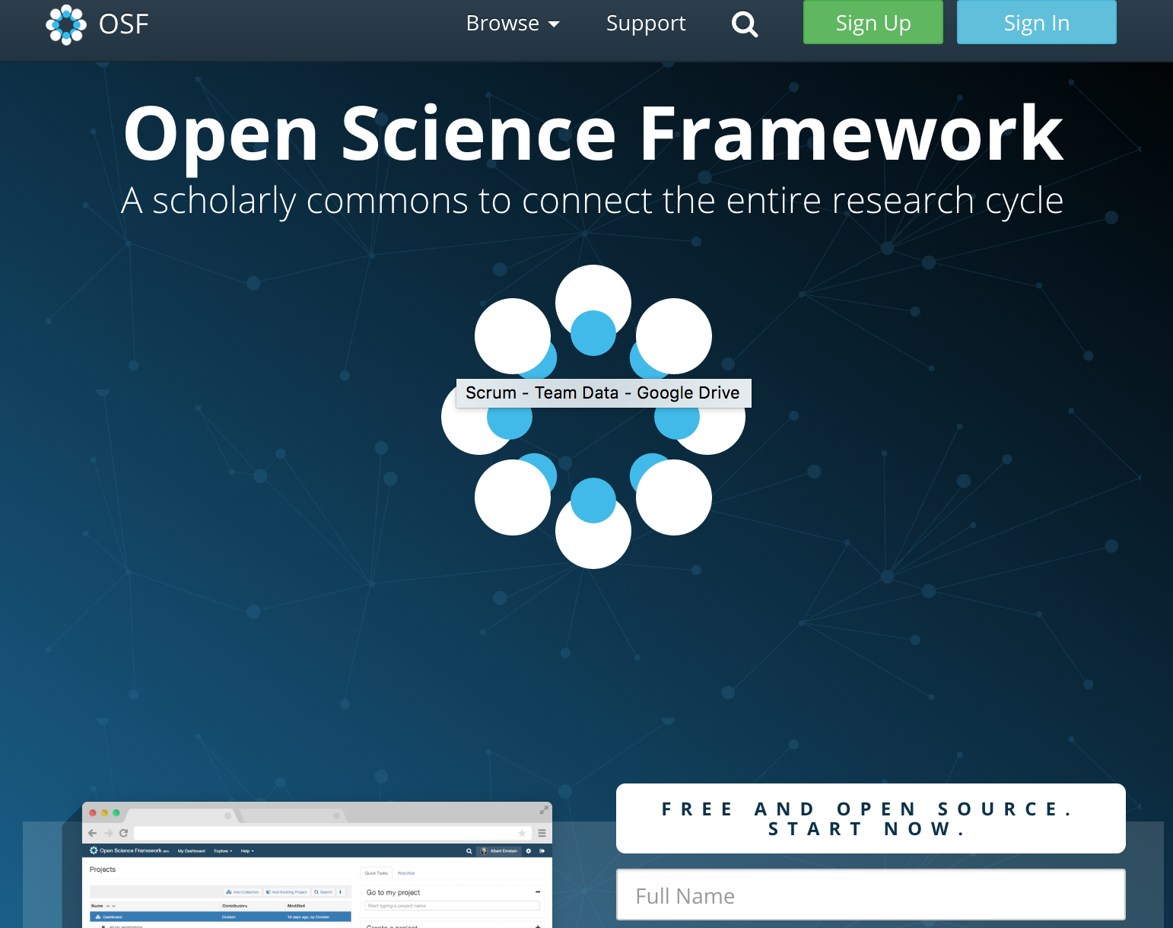
http://jupyter.org/
https://benchling.com/
https://hypothes.is/
https://osf.io/
Notes:
Docker

Slide 36
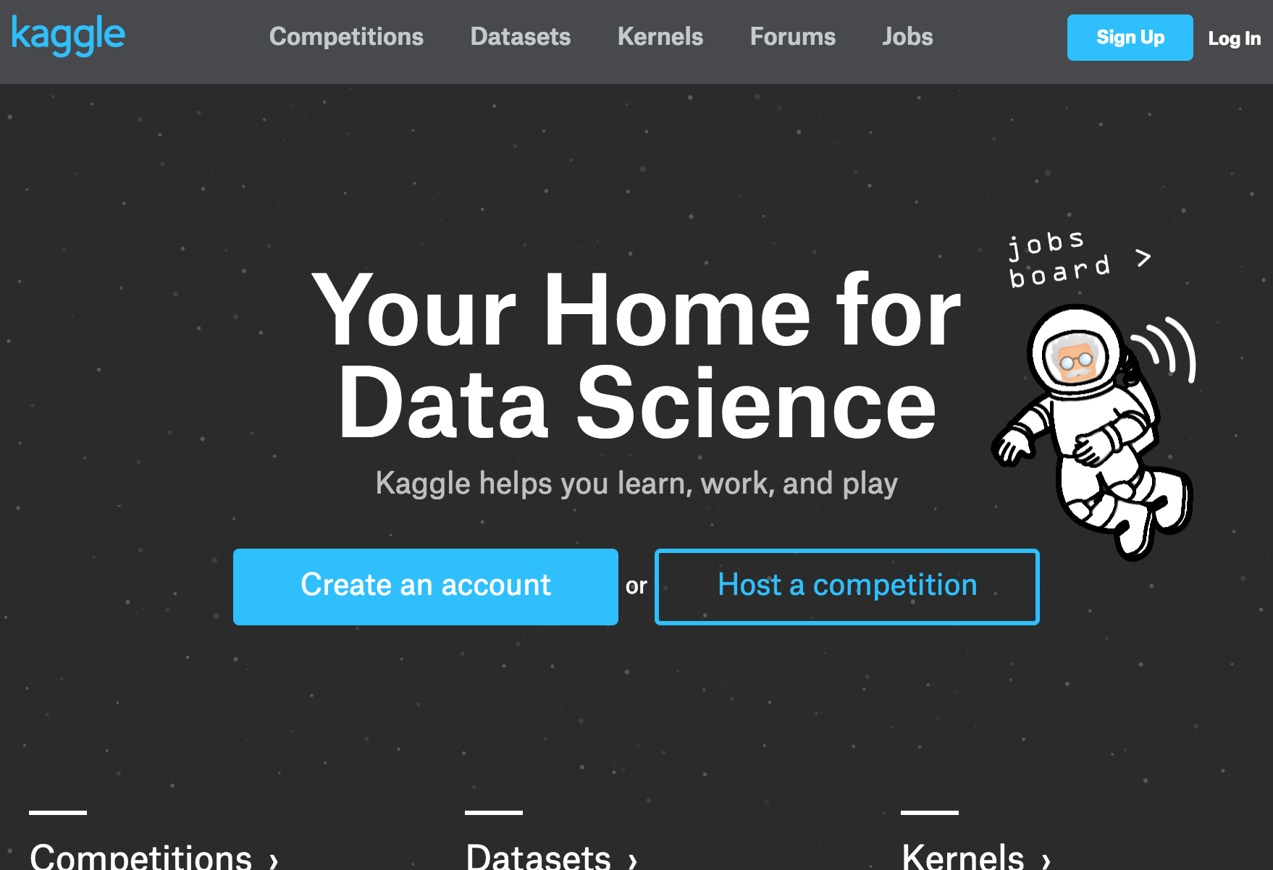
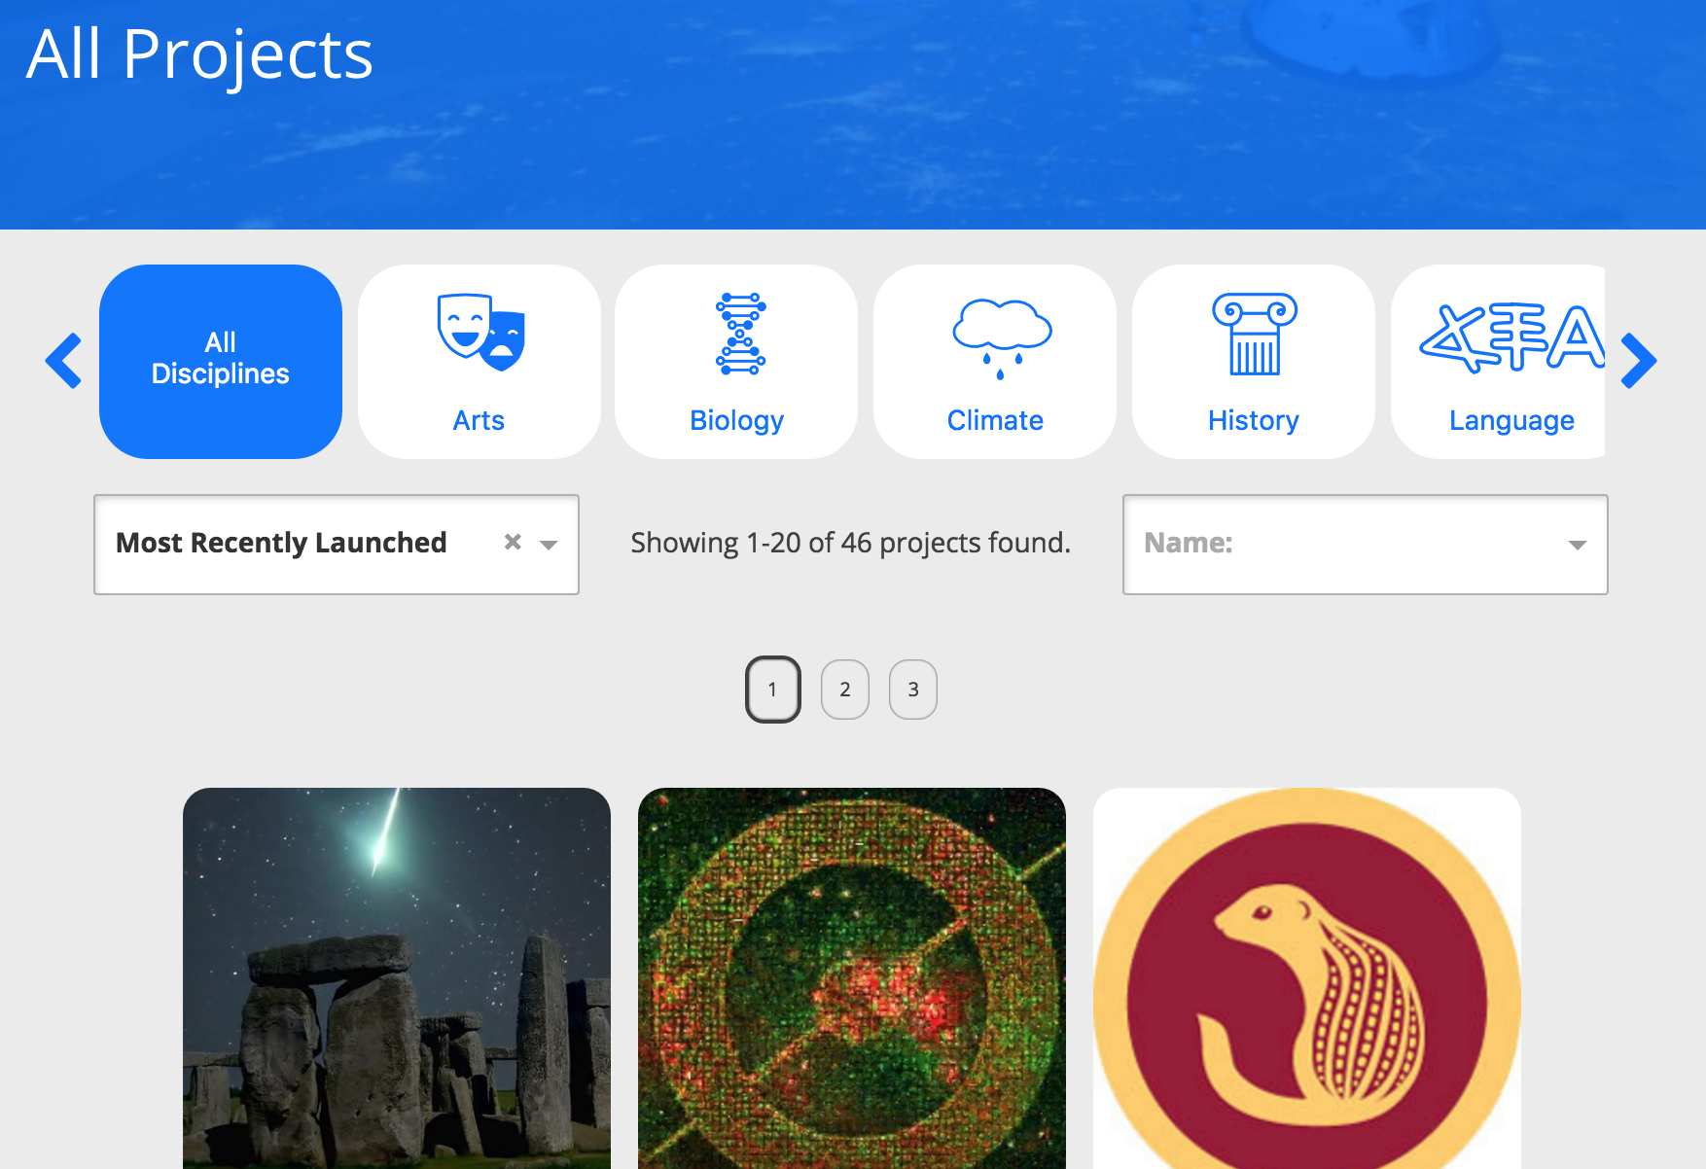
Crowdsource your research
https://www.kaggle.com/
https://www.zooniverse.org/
Notes:
Citizenscience – zooniverse
Moodle?
I python notebooks?

Slide 37
Considerations
Keep in mind what others wanna do with it
License? Ask your librarian if needed
Dependencies (software, methods)
Versioning – update when needed
Quality assessments possible?
Reference other peoples work (also for data and code) and demand being referenced too!
Use DOIs and link all shared things to your ORCID

Slide 38

ORCID
Open Researcher and Contributor ID
Global unique ID
Used by all major publishers and many repositories worldwide
Connects to your articles, data, code, reviews…
So everyone and everything gets credited for the work they share

Slide 39
Xiaoli Chen, PhD student at Sheffield University and CERN
What kind of research do you do?
Do you produce data that needs to be “treated” specifically?
How do you share your results? Which tools do you use?
Any recommendations?

Slide 40
References
THOR project; https://project-thor.eu/
ORCID: orcid.org
All icons are kindly provided by freeicon via flaticon

