Slide 1
Pathways to Open Science
Daniel Mietchen - IGB Open Science Week 2021 - 18 November 2021
DOI: 10.5281/zenodo.5667649

Slide 2
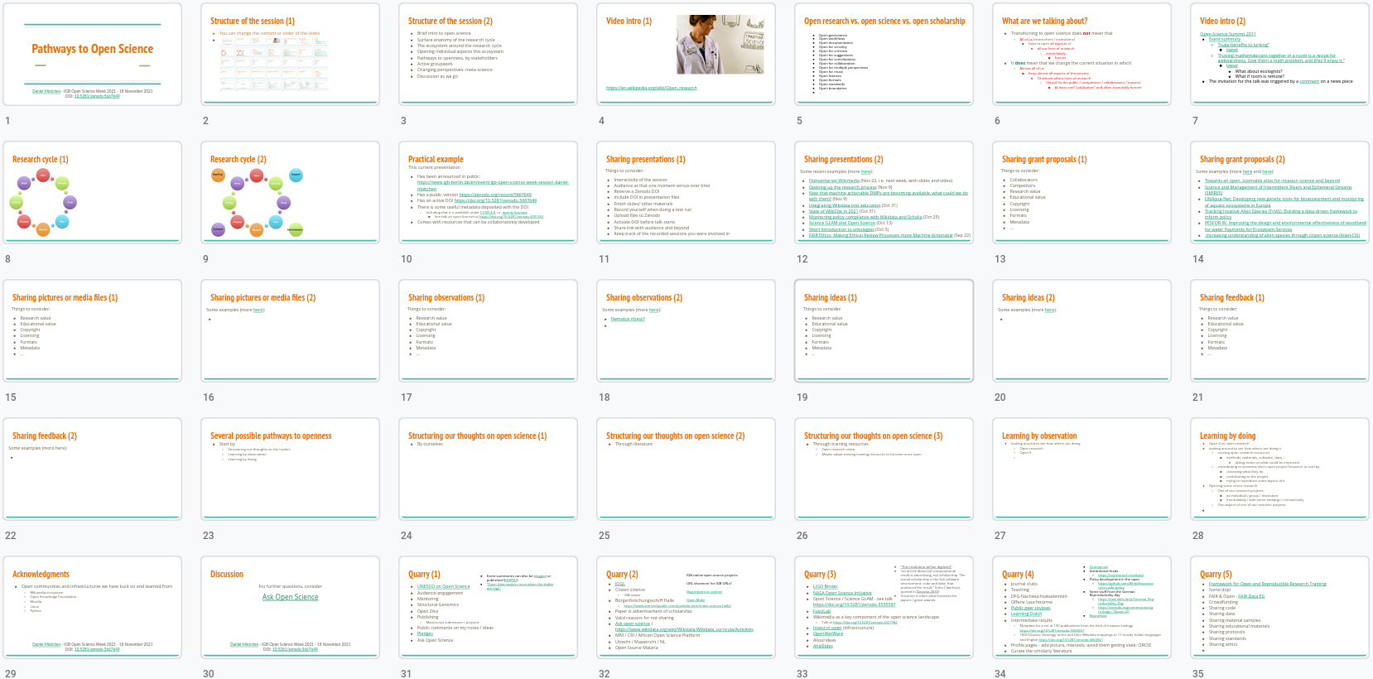
Structure of the session (1)
You can change the content or order of the slides

Slide 3
Structure of the session (2)
Brief intro to open science
Surface anatomy of the research cycle
The ecosystem around the research cycle
Opening individual aspects this ecosystem
Pathways to openness, by stakeholders
Active groupwork
Changing perspectives: meta-science
Discussion as we go

Slide 4
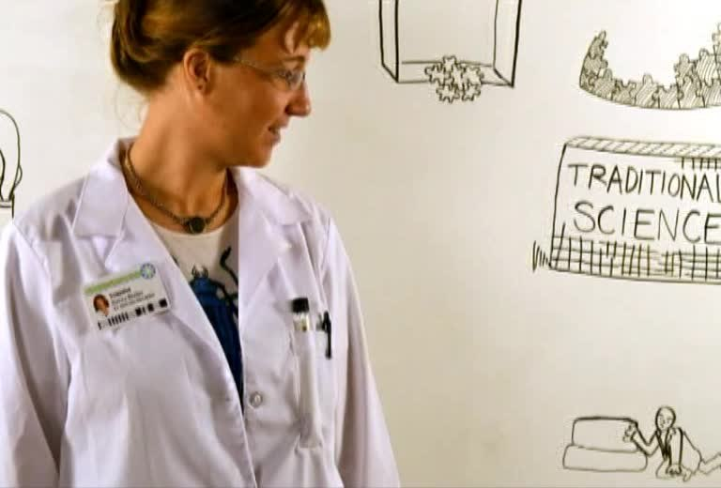
Video intro (1)
https://en.wikipedia.org/wiki/Open_research

Slide 5
Open research vs. open science vs. open scholarship
Open governance
Open workflows
Open documentation
Open for scrutiny
Open for criticism
Open for suggestions
Open for contributions
Open for collaboration
Open for multiple perspectives
Open for reuse
Open licenses
Open formats
Open standards
Open boundaries
…

Slide 6
What are we talking about?
Transitioning to open science does not mean that
All of us (researchers / institutions)
have to open all aspects of
all our lines of research
immediately
forever
It does mean that we change the current situation in which
Almost all of us
Keep almost all aspects of the process
Of almost all our lines of research
Closed (to the public / competitors / collaborators / reusers)
At least until “publication” and often essentially forever

Slide 7
Video intro (2)
Open Science Summit 2011
Event summary
“huge benefits to lurking”
tweet
“Putting mathematicians together in a room is a recipe for awkwardness. Give them a math problem, and they'll enjoy it.”
tweet
What about ecologists?
What if room is remote?
The invitation for the talk was triggered by a comment on a news piece

Slide 8
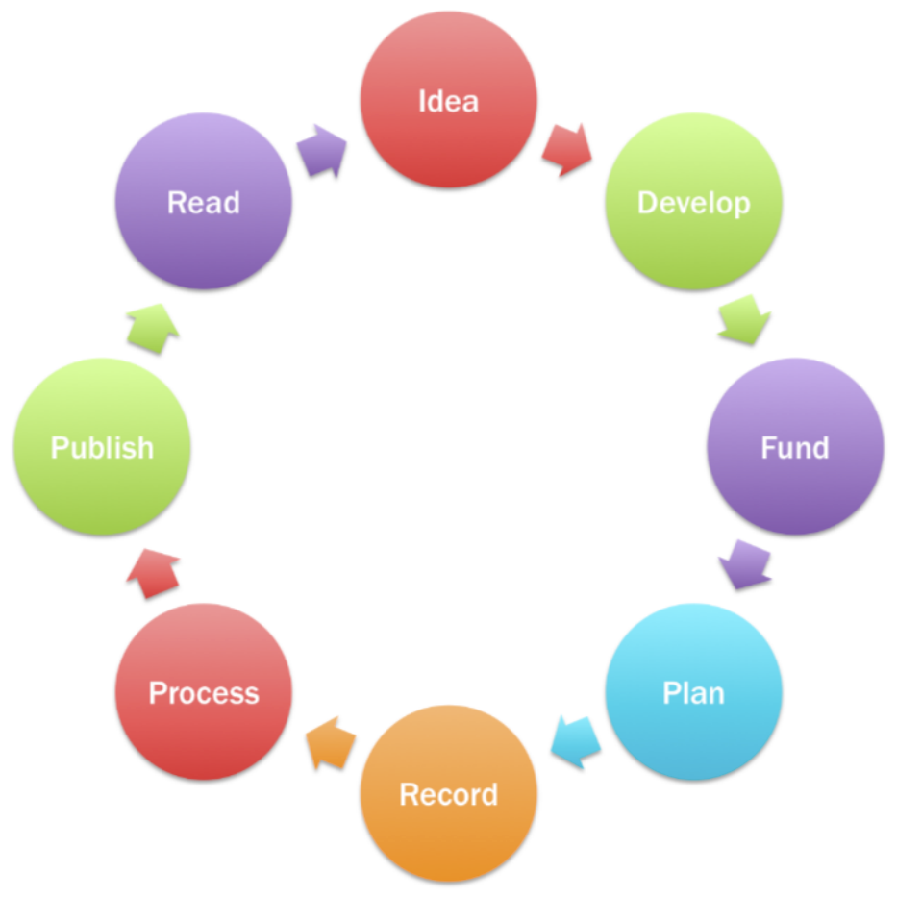
Research cycle (1)

Slide 9
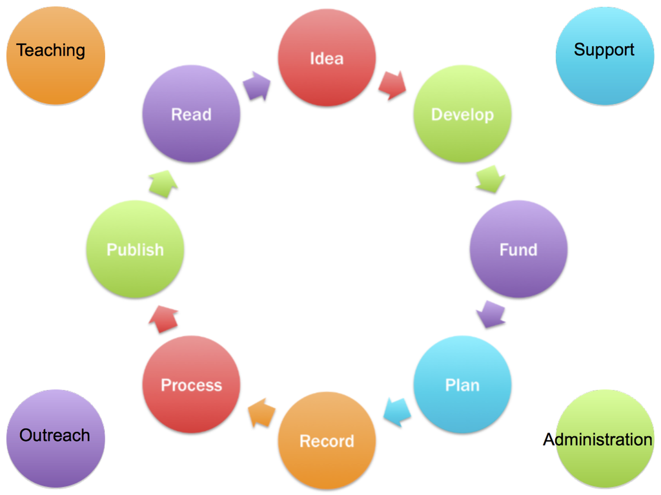
Research cycle (2)

Slide 10
Practical example
This current presentation
Has been announced in public: https://www.igb-berlin.de/en/event/igb-open-science-week-session-daniel-mietchen
Has a public version https://zenodo.org/record/5667649
Has an active DOI https://doi.org/10.5281/zenodo.5667649
There is some useful metadata deposited with the DOI
Including that it is available under CC BY 4.0, i.e. openly licensed
See talk on open licenses at https://doi.org/10.5281/zenodo.4001555
Comes with resources that can be collaboratively developed

Slide 11
Sharing presentations (1)
Things to consider:
Interactivity of the session
Audience at that one moment versus over time
Reserve a Zenodo DOI
Include DOI in presentation files
Finish slides/ other materials
Record yourself when doing a test run
Upload files to Zenodo
Activate DOI before talk starts
Share link with audience and beyond
Keep track of the recorded sessions you were involved in

Slide 12
Sharing presentations (2)
Some recent examples (more here):
Humanitarian Wikimedia (Nov 22, i.e. next week, with slides and video)
Opening up the research process (Nov 9)
Now that machine actionable DMPs are becoming available, what could we do with them? (Nov 9)
Integrating Wikidata into education (Oct 31)
State of WikiCite in 2021 (Oct 31)
Monitoring policy compliance with Wikidata and Scholia (Oct 25)
Science GLAM and Open Science (Oct 13)
Short introduction to ontologies (Oct 5)
FAIR Ethics: Making Ethical Review Processes more Machine Actionable (Sep 22)

Slide 13
Sharing presentations (3)
New approaches:

Slide 14
Sharing grant proposals (1)
Things to consider:
Collaborators
Competitors
Research value
Educational value
Copyright
Licensing
Formats
Metadata
…

Slide 15
Sharing grant proposals (2)
Some examples (more here and here):
Towards an open, zoomable atlas for invasion science and beyond
Science and Management of Intermittent Rivers and Ephemeral Streams (SMIRES)
DNAqua-Net: Developing new genetic tools for bioassessment and monitoring of aquatic ecosystems in Europe
Tracking Invasive Alien Species (TrIAS): Building a data-driven framework to inform policy
PESFOR-W: Improving the design and environmental effectiveness of woodlands for water Payments for Ecosystem Services
Increasing understanding of alien species through citizen science (Alien-CSI)

Slide 16
Sharing grant proposals (3)
New approaches:

Slide 17
Sharing pictures or media files (1)
Things to consider:
Research value
Educational value
Copyright
Licensing
Formats
Metadata
…

Slide 18
Sharing pictures or media files (2)
Some examples (more here):

Slide 19
Sharing pictures or media files (3)
New approaches:

Slide 20
Sharing observations (1)
Things to consider:
Research value
Educational value
Copyright
Licensing
Formats
Metadata
…

Slide 21
Sharing observations (2)
Some examples (more here):
Nematus ribesii?

Slide 22
Sharing observations (3)
New approaches:

Slide 23
Sharing as individuals (1)
Things to consider:
Research value
Educational value
Personal information
Own rights versus rights of others
Licensing
Formats
Metadata
…

Slide 24
Sharing as individuals (2)
Some examples (more here):
https://github.com/Daniel-Mietchen/pledges

Slide 25
Sharing as individuals (3)
New approaches:

Slide 26
Sharing as groups (1)
Things to consider:
Research value
Educational value
Personal information
Coordination
Social norms
Communication
Licensing
Formats
Metadata
…

Slide 27
Sharing as groups (2)
Some examples (more here):
https://freeourknowledge.org/

Slide 28
Sharing as groups (3)
New approaches:

Slide 29
Sharing as institutions (1)
Things to consider:
Research value
Educational value
Personal information
Coordination
Policies
Infrastructure
Communication
Licensing
Formats
Metadata
…

Slide 30
Sharing as institutions (2)
Some examples (more here):
Montreal Neurological Institute
Open Science at an institutional level: an interview with Guy Rouleau. Genome Biol 18, 14 (2017). https://doi.org/10.1186/s13059-017-1152-z
Sicco de Knecht, Martijn van der Meer, Loek Brinkman, Manon Kluijtmans, & Frank Miedema. (2021). Reshaping the Academic Self: Connecting Education & Open Science (Version 2). Zenodo. https://doi.org/10.5281/zenodo.5345573
Demo: https://myresearch.institute/
Open and FAIR science in an institutional context. https://doi.org/10.5281/zenodo.4720432

Slide 31
Sharing as institutions (3)
New approaches:
What about selecting some pilot projects to get institutional support on the premise that the pilots are being conducted entirely in the open?

Slide 32
Sharing ideas (1)
Things to consider:
Research value
Educational value
Copyright
Licensing
Formats
Metadata
…

Slide 33
Sharing ideas (2)
Some examples (more here):

Slide 34
Sharing ideas (3)
New approaches:

Slide 35
Sharing feedback (1)
Things to consider:
Research value
Educational value
Copyright
Licensing
Formats
Metadata
…

Slide 36
Sharing feedback (2)
Some examples (more here):

Slide 37
Sharing feedback (3)
New approaches:

Slide 38
Several possible pathways to openness
Start by
Structuring our thoughts on the matter
Learning by observation
Learning by doing

Slide 39
Structuring our thoughts on open science (1)
By ourselves

Slide 40
Structuring our thoughts on open science (2)
Through literature

Slide 41
Structuring our thoughts on open science (3)
Through training resources
Open research video
Maybe adapt existing training resources to become more open

Slide 42
Learning by observation
looking around to see how others are doing
Open research
Open X

Slide 43
Learning by doing
Open X vs. open research
looking around to see how others are doing it
reusing open research resources
methods, materials, software, data, …
taking notes on what could be improved
contributing to someone else’s open project (research or not) by
reviewing what they do
contributing to the project
trying to reproduce some aspect of it
Opening some of our research
One of our research projects
as individual / group / institution
Immediately / with some embargo / retroactively
One aspect of one of our research projects

Slide 44
Acknowledgments
Open communities and infrastructures we have built on and learned from
Wikipedia ecosystem
Open Knowledge Foundation
Mozilla
Linux
Python
Daniel Mietchen - IGB Open Science Week 2021 - 18 November 2021
DOI: 10.5281/zenodo.5667649

Slide 45
Discussion
For further questions, consider
Ask Open Science
Daniel Mietchen - IGB Open Science Week 2021 - 18 November 2021
DOI: 10.5281/zenodo.5667649

Slide 46
Quarry (1)
Event summaries can also be blogged or published (BDJ/RIO)
“Open data matters most when the stakes are high”
UNESCO on Open Science
Audience engagement
Mentoring
Structural Genomics
Open Zika
Publishing
Manuscript submission / preprint
Public comments on one’s notes / ideas
Pledges

Slide 47
Quarry (2)
IGB-native open-source projects
URL shortener for IGB URLs?
Bug reports to science
Open.Make
JOGL
Citizen science
IGB-native
Bürgerforschungsschiff Halle
https://www.science2public.com/portfolio-item/make-science-halle/
Paper is advertisement of scholarship
Valid reasons for not sharing
Ask open science / https://www.wikidata.org/wiki/Wikidata:Wikidata_curricula/Activities
MNI / CRI / African Open Science Platform
Utrecht / Maastricht / NL
Open Source Malaria

Slide 48
Quarry (3)
“This revolution will be digitized”
"an article about [a] computational result is advertising, not scholarship. The actual scholarship is the full software environment, code and data, that produced the result." (John Claerbout, quoted in Donoho 2010)
Scicomm is often advertisement for papers / grant awards
LIGO Binder
NASA Open Science Initiative
Open Science / Science GLAM - see talk https://doi.org/10.5281/zenodo.5535597
FossiLab
Wikimedia as a key component of the open science landscape
Talk at https://doi.org/10.5281/zenodo.4321982
Invest in open (infrastructure)
OpenWetWare
Allourideas
AhaSlides

Slide 49
Quarry (4)
Cinema.md
Institutional feeds
https://myresearch.institute/
Policy development in the open
https://github.com/WhiteHouse/source-code-policy
Some stuff from the German Reproducibility day
https://pad.okfn.de/p/German_Reproducibility_Day
https://zenodo.org/communities/grn?page=1&size=20
ReproHack
Journal clubs
Teaching
DFG-Nachwuchsakademien
Offene Leuchttürme
Public peer reviews
Learning Dutch
Intermediate results
Metadata for a set of 100 publications from the field of invasion biology. https://doi.org/10.5281/zenodo.5565037
1000 Disease Ontology terms and their Wikidata mappings to 17 mostly Indian languages and English https://doi.org/10.5281/zenodo.3666921
Profile pages - add picture, interests; avoid them getting stale; ORCID
Curate the scholarly literature

Slide 50
Quarry (5)
Framework for Open and Reproducible Research Training
Some dojo
FAIR & Open - FAIR Data EG
Crowdfunding
Sharing code
Sharing data
Sharing material samples
Sharing educational materials
Sharing protocols
Sharing standards
Sharing ethics

Slide 51
Quarry (6)
Problems with open science
General
Misaligned to perverse incentives that dominate the research landscape
Ethics processes are not open, so best practice around how to decide/ document/ teach what is sensitive data that cannot be shared is not readily findable
Blurred definitions
Open Definition
Open Science / Research / Scholarship
Open Science is just Science
Open Science is more than just open access to the final thing
Open != FAIR
Specific
In some cases involving human subject research, it would be methodologically problematic if the studied people knew too much about the research

