Slide 1
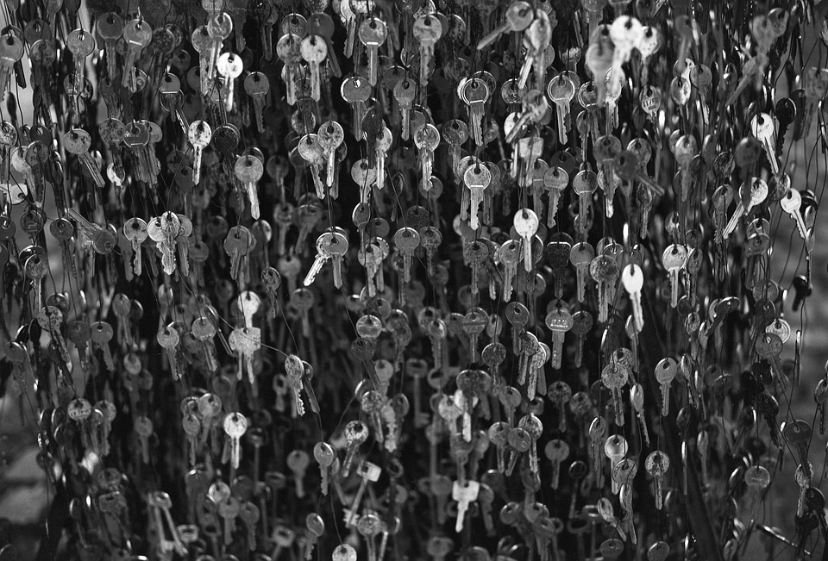


cover
An Open Science voice for the Humanities - a Humanities voice for Open Science
Erzsébet Tóth-Czifra
Open Science Officer at DARIAH-EU
@etothczifra
Open Science Fair 2021

Slide 2
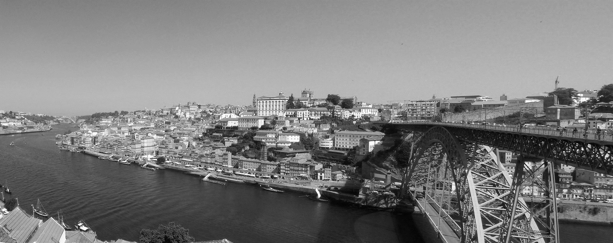
Bringing forward open research cultures that are meaningful for humanists
Reducing the implementation gap is crucial not only because of the future and inclusivity of Open Science but also because of the future of Arts and Humanities research.
How to increase the profile of Arts and Humanities within the Open Science paradigm?
Notes:
How to increase the profile of humanities within the Open Science paradigm?

Slide 3
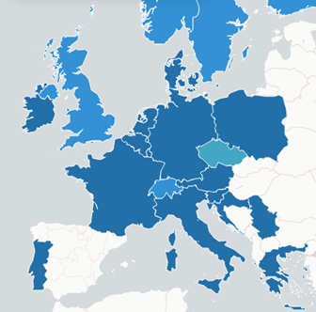

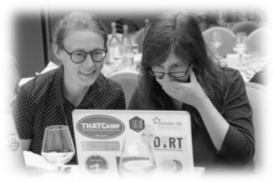
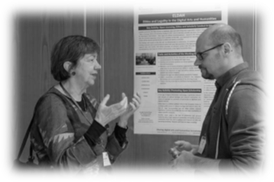
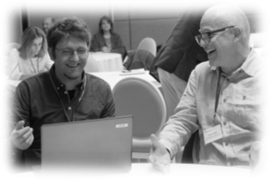
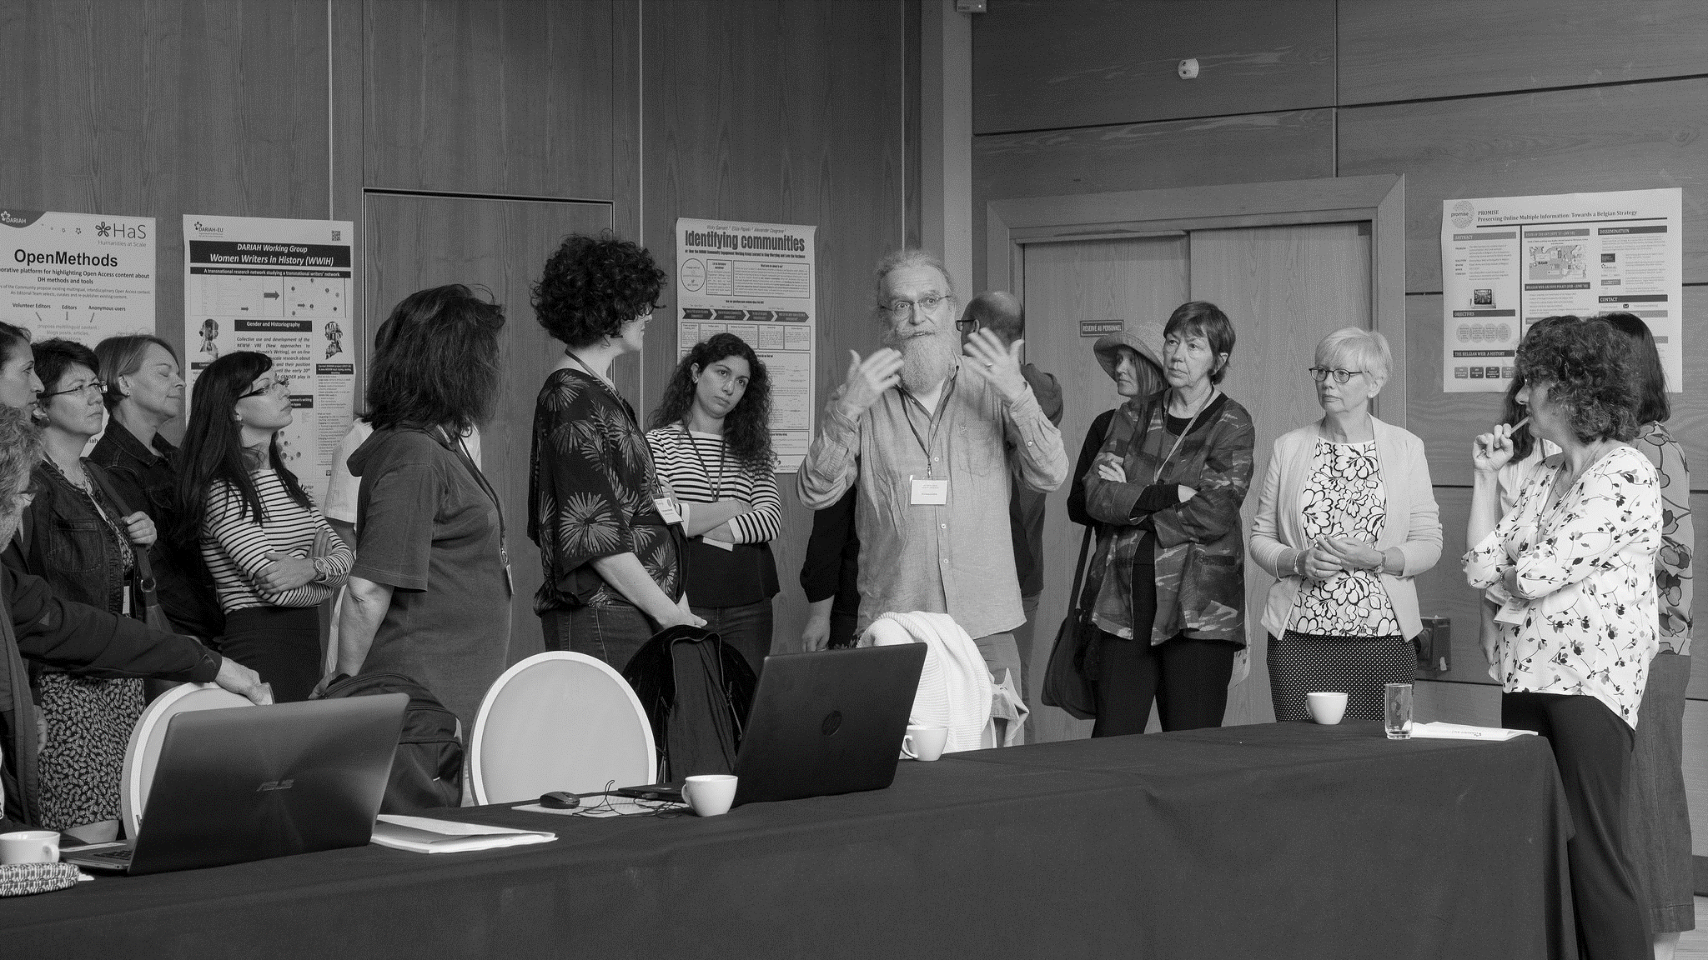

Mission: to empower arts and humanities research communities with digital methods to create, connect and share knowledge about culture and society
.
https://www.dariah.eu/
@DARIAHeu
Notes:
In fact, it’s pretty much this is where my organization, DARIAH comes to the picture. So once again, DARIAH is a pan-European infrastructure for arts and humanities scholars. I know the notion of research infrastructure is a fairly abstract one, but imagine it as an organization who provides all kinds of research and teaching support for arts and humanities disciplines and connects several hundreds of scholars and dozens of research facilities, tools and services in currently 19 European countries. So facilitating Open Access to resources and data-sharing to make scholars’ life easier is pretty much in the DNA of DARIAH.

Slide 4
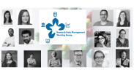
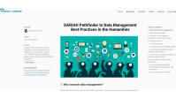
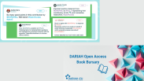

Pathways to Open Humanities
Strengthening the discourse on open Humanities, on good practices
Training and advocacy
Nurturing communities
Providing a strong voice for Arts and Humanities in EU science policy
Notes:
A set of pointers, more about making connections than in depth intro to connect you

Slide 5
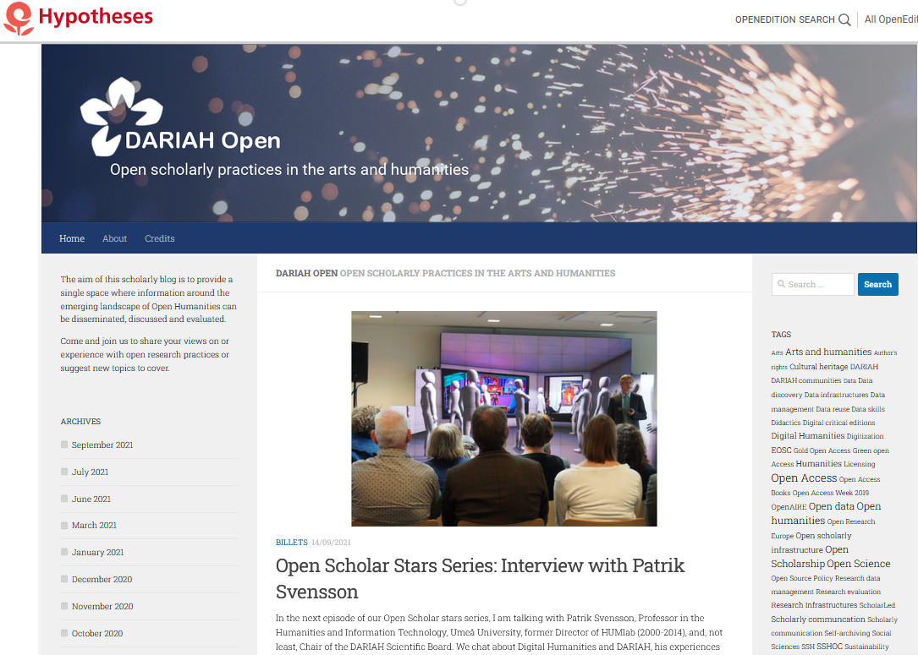
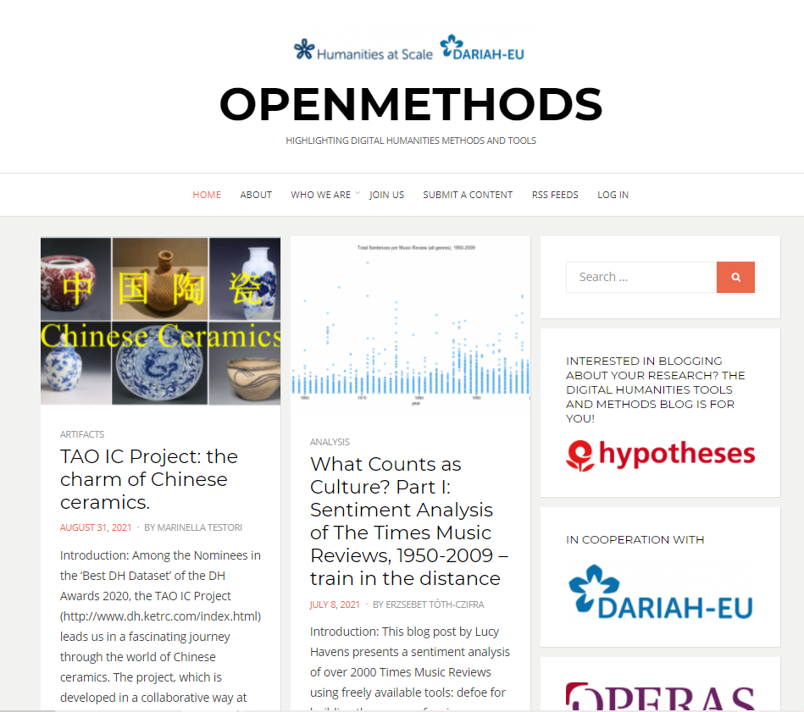

Slide 6
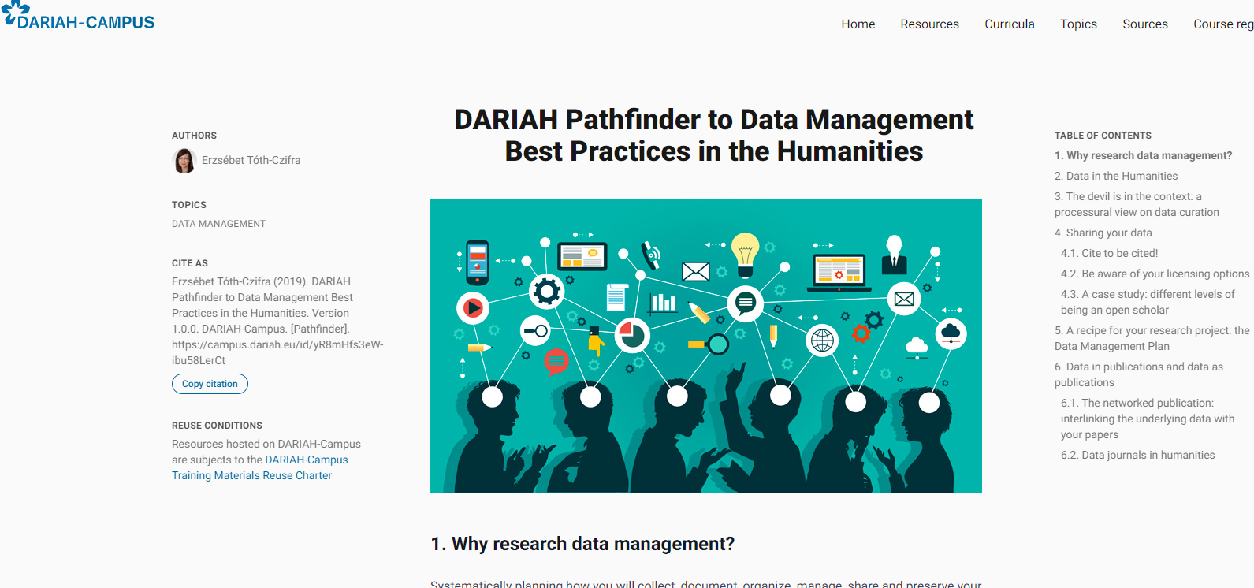

Slide 7
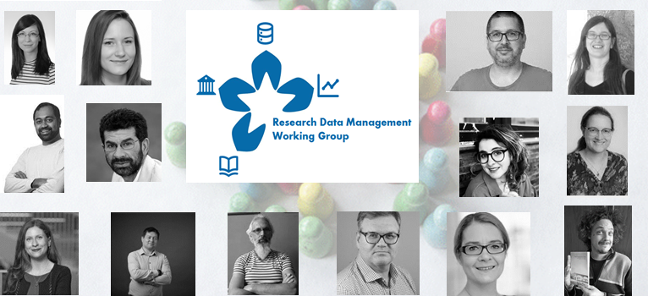

Slide 8
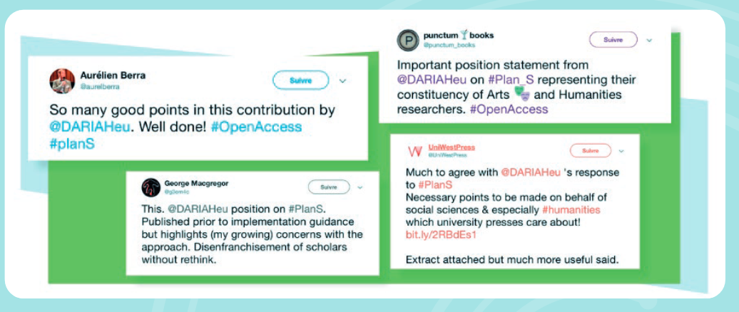
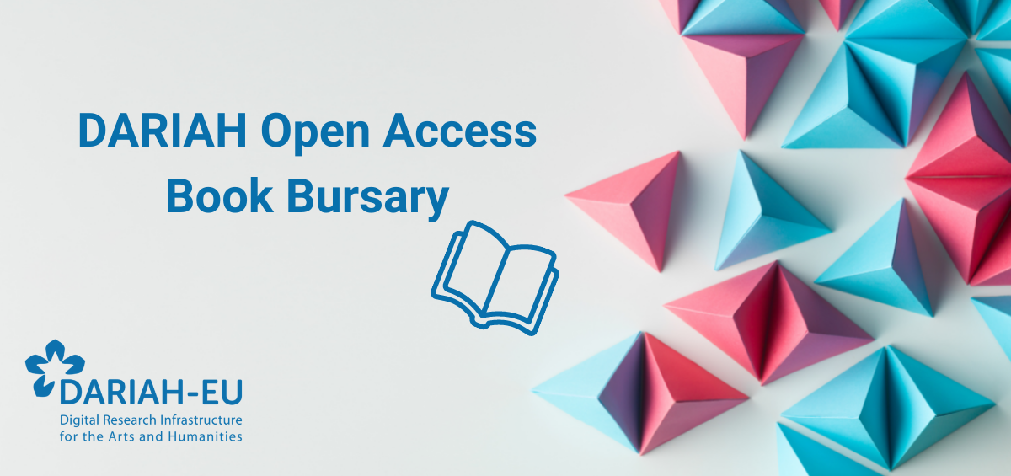

Slide 9
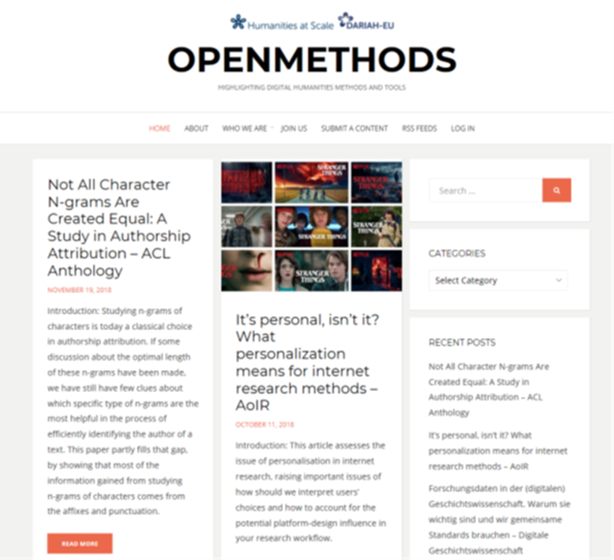
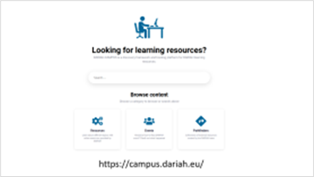
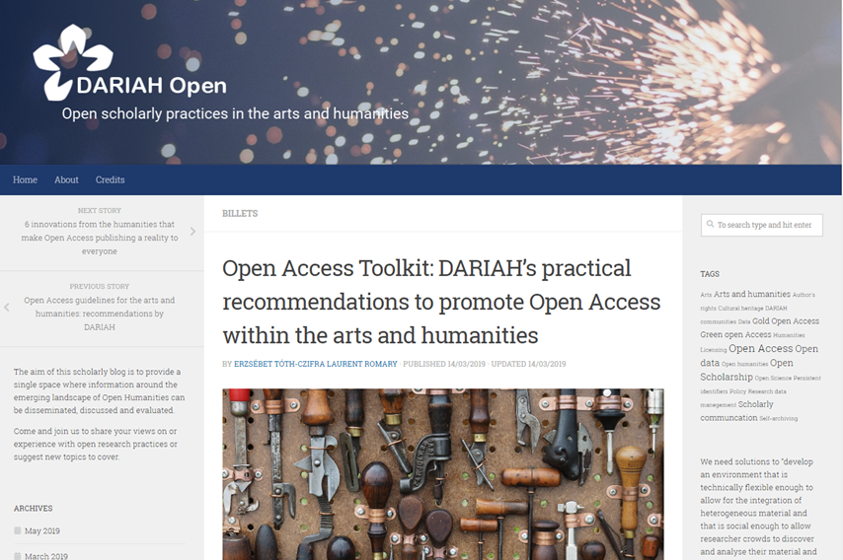


Ready, set, explore, reuse!
Training materials on DARIAH Campus (contains Open Science!)
DARIAH Open blog
OpenMethods platform
Annual bursary for first Open Access monographs in Digital Humanities
DARIAH Research Data Management Working Group
7
Open Science Helpdesk

Slide 10
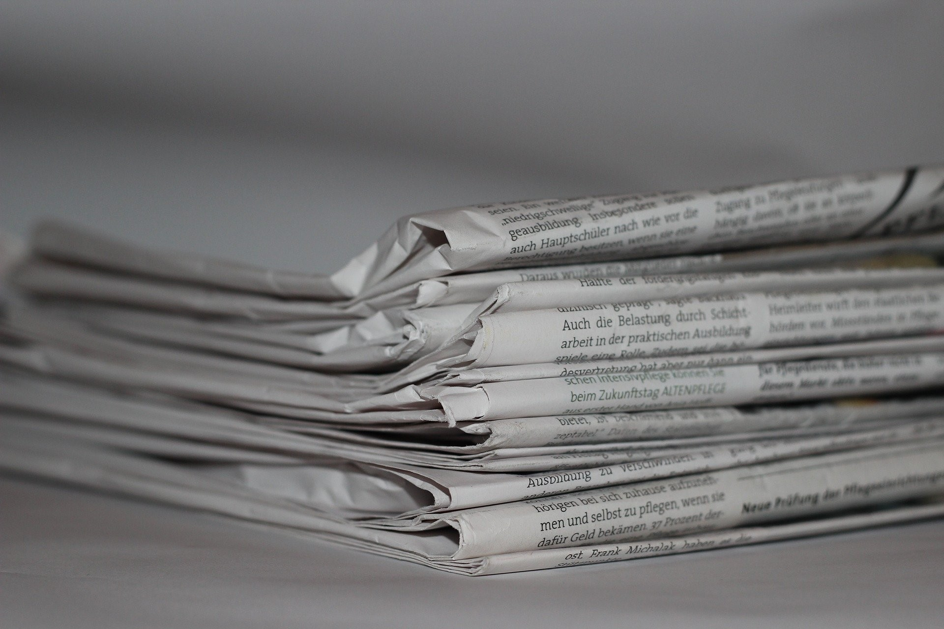
Hungry for more?
Tóth-Czifra, Erzsébet, Błaszczyńska, Marta, Buchner, Anna, & Maryl, Maciej. (2021). OPERAS-P Deliverable D6.6: Report on quality assessment of innovative research in SSH (Version DRAFT). Zenodo. https://doi.org/10.5281/zenodo.4922538
Tóth-Czifra, Erzsébet. 2021. ‘Rethinking Text, Techné and Tenure: Evaluation and Peer-Review Challenges around Virtual Research Environments in the Arts and Humanities’. Classics. https://classics-at.chs.harvard.edu/classics18-toth-czifra/
Toma Tasovac, Sally Chambers, Erzsébet Tóth-Czifra. Cultural Heritage Data from a Humanities Research Perspective: A DARIAH Position Paper. 2020. ⟨hal-02961317⟩
Tóth-Czifra, Erzsébet. 2020. ‘10. The Risk of Losing the Thick Description: Data Management Challenges Faced by the Arts and Humanities in the Evolving FAIR Data Ecosystem’. In Digital Technology and the Practices of Humanities Research, 126.
Erzsébet Tóth-Czifra, Laurent Romary. The Heritage Data Reuse Charter: from principles to research workflows. 2020. ⟨halshs-02475692⟩

