Slide 1



Open Science and academic libraries: managing the change
Dr Paul Ayris
Pro-Vice-Provost (UCL Library Services)
Dr Tiberius Ignat
Scientific Knowledge Services
p.ayris@ucl.ac.uk
linkedin.com/in/TiberiusIgnat

Slide 2

Content
Open Science – What is it?
Cultural Change in universities
Open Science Cultural Change: Collaboration & Competition
Managing the Open Science transition
Measuring Open Science success
Conclusions
Plaster Relief by John Flaxman,
Flaxman Gallery, UCL

Slide 3
Content
Open Science – What is it?
Cultural Change in universities
Open Science Cultural Change: Collaboration & Competition
Managing the Open Science transition
Measuring Open Science success
Conclusions
Plaster Relief by John Flaxman,
Flaxman Gallery, UCL

Slide 4
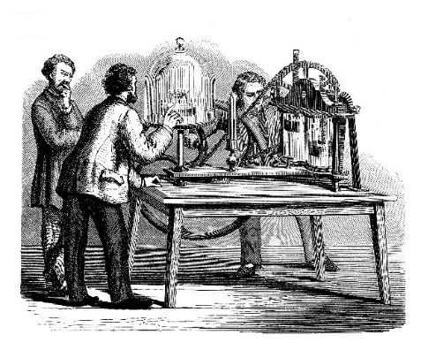
What is Open Science?
The 8 pillars of Open Science
European Commission’s
Open Science Policy Platform (OSPP)
Future of Scholarly Communication
EOSC (European Open Science Cloud)
FAIR Data
Skills
Research Integrity
Rewards
Altmetrics
Citizen Science

Slide 5
Content
Open Science – What is it?
Cultural Change in universities
Open Science Cultural Change: Collaboration & Competition
Managing the Open Science transition
Measuring Open Science success
Conclusions
Plaster Relief by John Flaxman,
Flaxman Gallery, UCL

Slide 6
LERU Cultural Change
Open Science
Management
Engagement
Leadership
Inspiration
Information
Integration
Developed from Steve Denning, ‘How do you change an organizational culture?’ at https://www.forbes.com/sites/stevedenning/2011/07/23/how-do-you-change-an-organizational-culture

Slide 7
Cultural Change in an Organisation
Leadership, Vision and Strategy
Develop targeted measures
Implement via transparency, accountability and monitoring
Trust and confidence in a shared vision between all parties

Slide 8
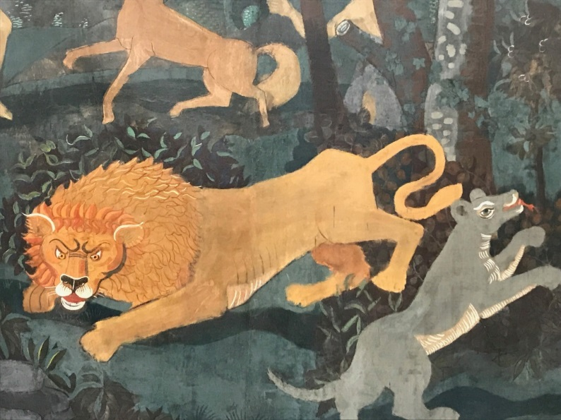
Leadership: Issues
Universities should be leaders, not followers
University should have a Vice-Provost/Vice-Rector to lead on Open Science…
At national level, should there be a national Open Science Co-Ordinator…?
Open Science has deliverables… the imperative is no longer discussion but delivery
André Derain: L’Age d’Or ou La Chasse

Slide 9
Content
Open Science – What is it?
Cultural Change in universities
Open Science Cultural Change: Collaboration & Competition
Managing the Open Science transition
Measuring Open Science success
Conclusions
Plaster Relief by John Flaxman,
Flaxman Gallery, UCL

Slide 10
Open Science: A Cultural Change
COMPETITION
COLLABORATION
+ COMPETITION
Promote new ideas!
Win calls for funding!
1st to discover!
1st to communicate
Obtain that position!
Publish more!
Get more attention!
Reach bigger index!
Compete and WIN !
More resources
Shared infrastructure
Efficient and responsible use
Collective intelligence
Activate micro-expertize
Save time - Re-use
Communicate efficiently
Disseminate and share
Collaborate and GAIN !

Slide 11
Open Science: A Cultural Change
~ the Function ~
The Function
f_{(X)} = Y
The Input
The Output

Slide 12
Open Science: A Cultural Change
Collaboration_{(COMPETITIONS)} =
EFFECTIVENESS^{Fair}
AND
Competition_{(COLLABORATIONS)} =
EFFICIENCY

Slide 13
Open Science: A Cultural Change
Collaboration_{(COMPETITIONS)} =
EFFECTIVENESS^{Fair}
AND
Competition_{(COLLABORATIONS)} =
EFFICIENCY

Slide 14
Content
Open Science – What is it?
Cultural Change in universities
Open Science Cultural Change: Collaboration & Competition
Managing the Open Science transition
Measuring Open Science success
Conclusions
Plaster Relief by John Flaxman,
Flaxman Gallery, UCL

Slide 15
Open Science: A Cultural Change
~ The Management of the Transition ~
Create functions between
Collaboration and Competition for
FAIR Effectiveness and Efficiency in Science .
- OPEN SCIENCE
Develop unique skills and infrastructure to compete for opportunities around Science
- LOCKED SCIENCE

Slide 16
Open Science: A Cultural Change
~ Recommendations for Managing the Transition ~
Appoint national coordinators and task forces for the implementation of Open Science
Ensure the HR Strategy for Researchers (HRS4R) practices and FP9 evaluation reflect the principles
Foster Open Science literacy as essential to European competitiveness at the global level
Implement a Europe-wide campaign, coordinated by the EC, to raise awareness and communicate the benefits of Open Science
Ensure the scholarly infrastructure in Europe is highly interoperable
Appoint a senior manager to lead Open Science approaches
Develop a Programme of Cultural Change
Establish advocacy programmes
Draw up a communication strategy
OSPP Integrated Advice, May 2018
LERU AP24 on Open Science, May 2018

Slide 17
Open Science: A Cultural Change
~ The Management of the Transition ~
Culture does not change overnight !
A Programme of Change Management needs to accompany and support any move to Open Science
Tailored Management Solutions
LERU AP24 on Open Science, May 2018

Slide 18
Open Science: A Cultural Change
~ The Management of the Transition ~
Culture does not change overnight !
Team Development (People, Skills)
Build Tools
(for OA, for RDM, integrate with EOSC, for Citizen Science, for Altmetrics, etc)
Leading through actions, not through statements
Successful management of the implementation
Attract resources

Slide 19
Content
Open Science – What is it?
Cultural Change in universities
Open Science Cultural Change: Collaboration & Competition
Managing the Open Science transition
Measuring Open Science success
Conclusions
Plaster Relief by John Flaxman,
Flaxman Gallery, UCL

Slide 20
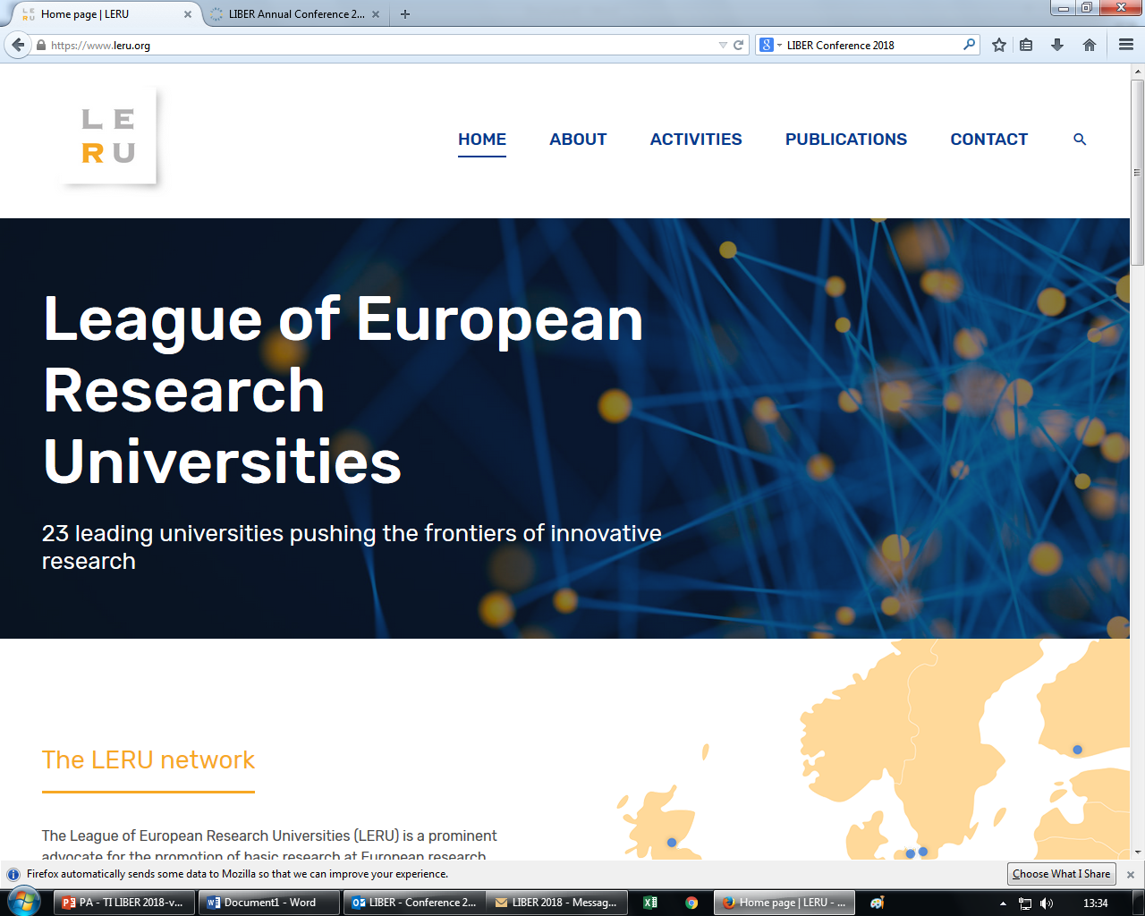
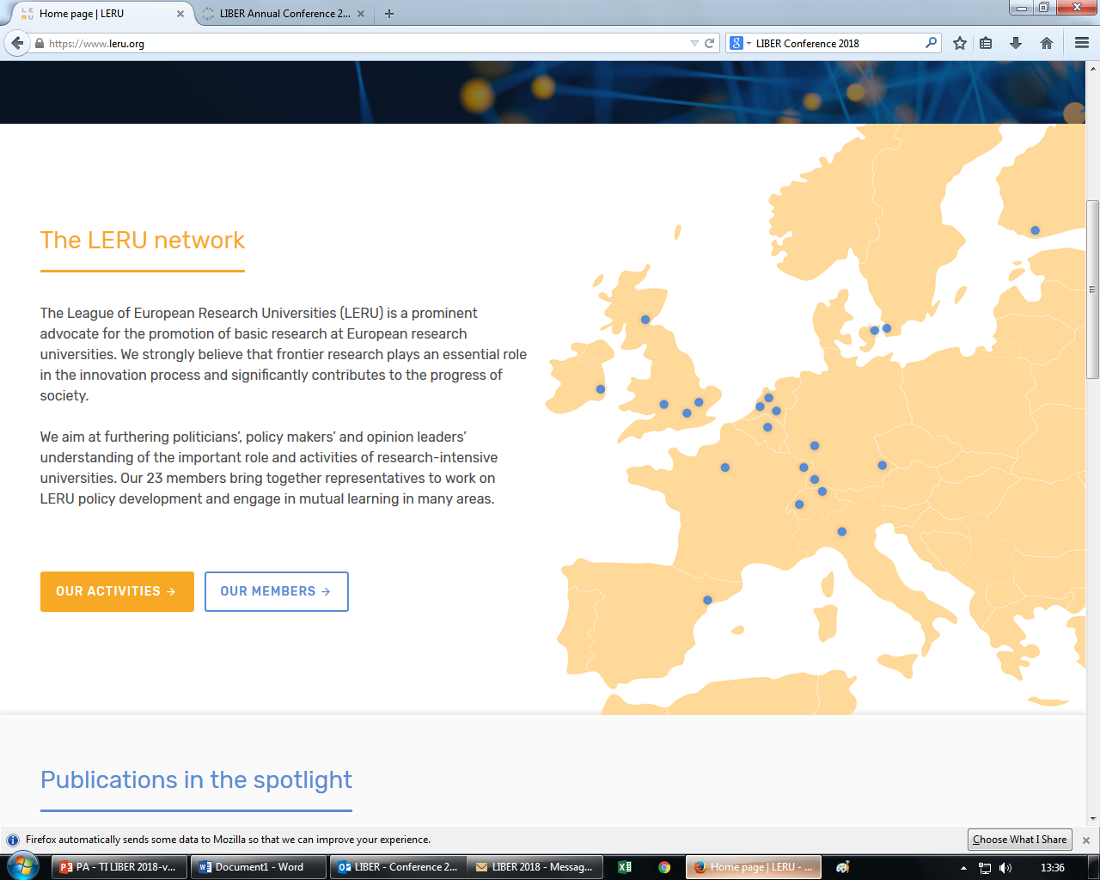
Measuring Open Science success
LERU has produced an Open Science Roadmap
Launched in June 2018 at
http://www.leru.org
Roadmap to enable universities to embrace Open Science
41 Recommendations

Slide 21
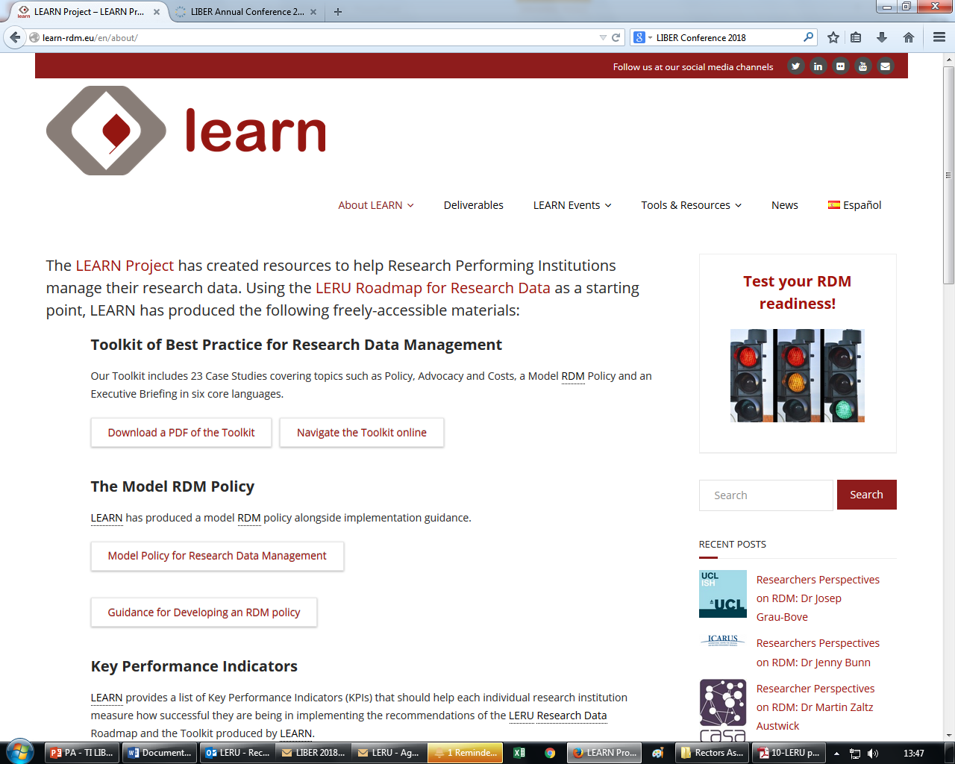
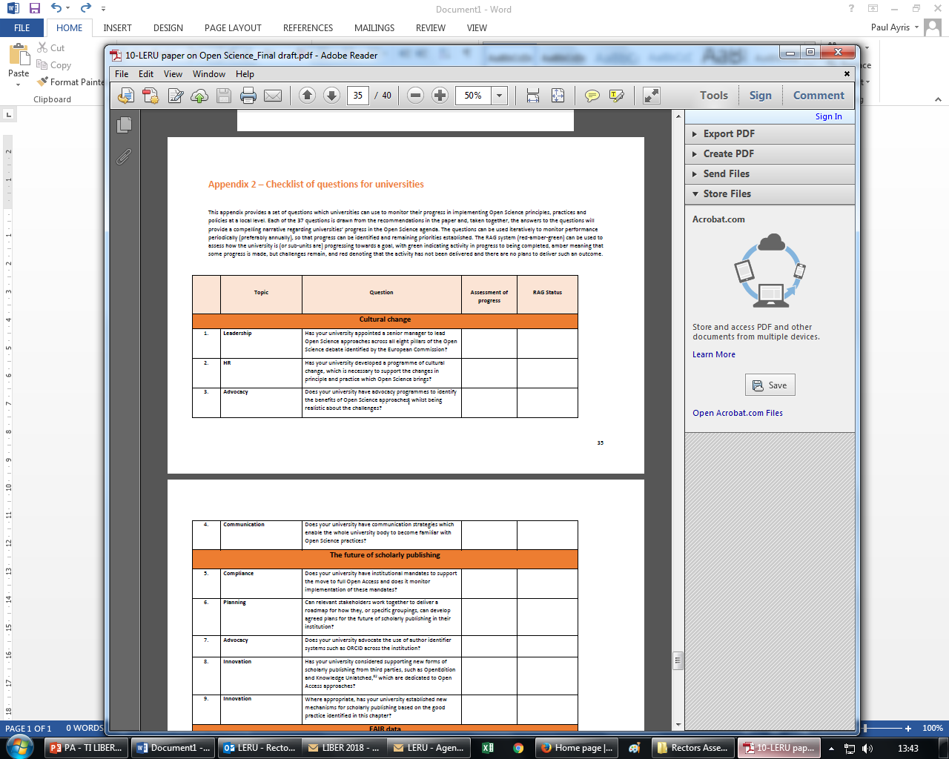
Monitoring progress
37 questions for monitoring progress on Open Science
Marked with Traffic Lights (RAG)
Repeat annually
Describe progress
Assess success or otherwise in Open Science implementations

Slide 22
Content
Open Science – What is it?
Cultural Change in universities
Open Science Cultural Change: Collaboration & Competition
Managing the Open Science transition
Measuring Open Science success
Conclusions
Plaster Relief by John Flaxman,
Flaxman Gallery, UCL

Slide 23
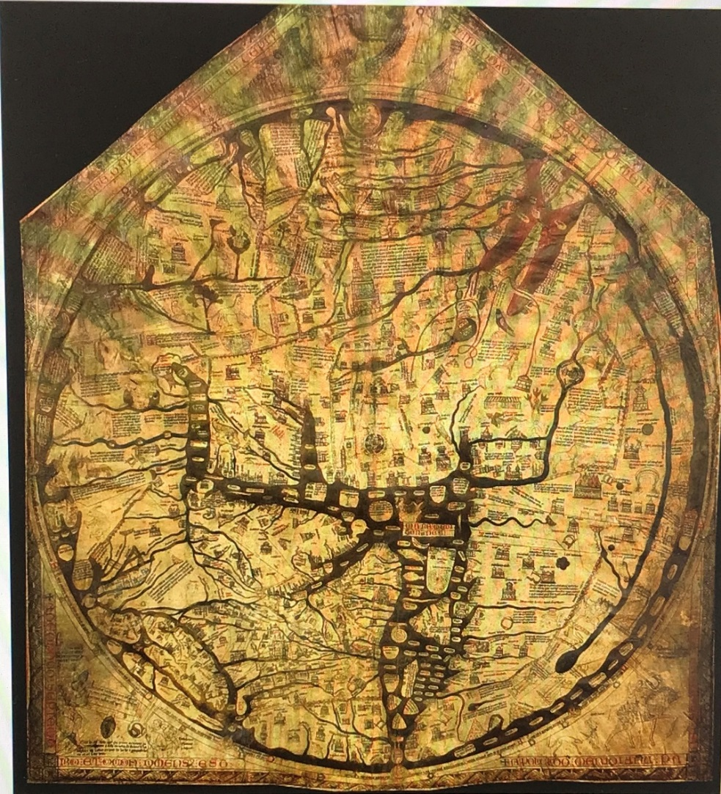
A pan-European Roadmap for
Open Science?
Hereford ‘Mappa Mundi’
Largest surviving medieval map
A theological statement
Drawn in Lincoln c. 1300
But Africa is called Europe and vice versa…
England

Slide 24
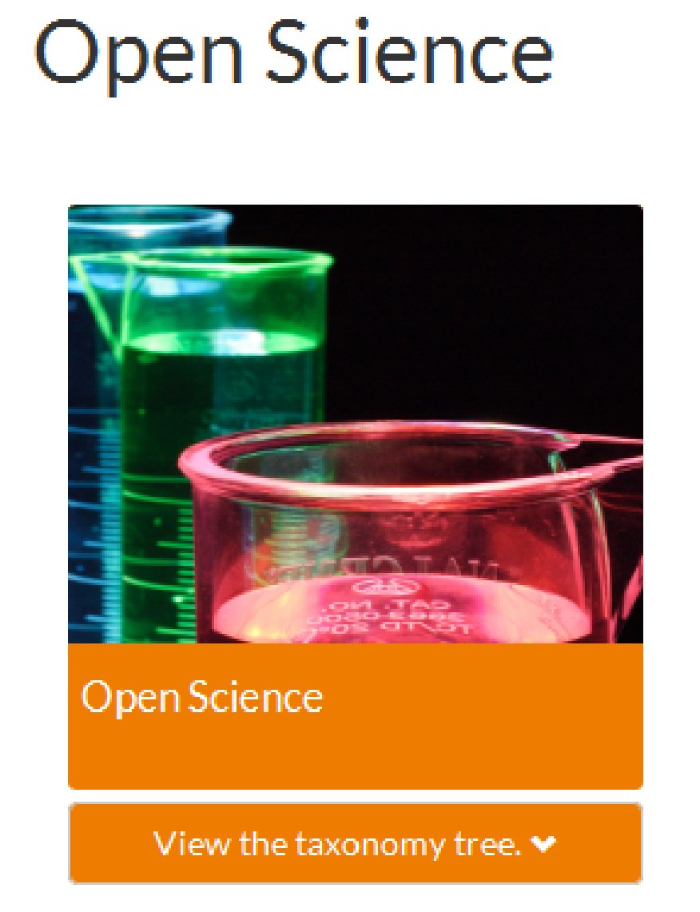
A pan-European Roadmap for
Open Science?
Hereford ‘Mappa Mundi’
Largest surviving medieval map
A theological statement
Drawn in Lincoln c. 1300
But Africa is called Europe and vice versa…

Slide 25
Thank you for listening
Happy to answer questions
Dr Paul Ayris
Pro-Vice-Provost (UCL Library Services)
p.ayris@ucl.ac.uk
Dr Tiberius Ignat
Scientific Knowledge Services
linkedin.com/in/TiberiusIgnat

Slide 26
Open Science: A Cultural Change
Template

