Slide 1
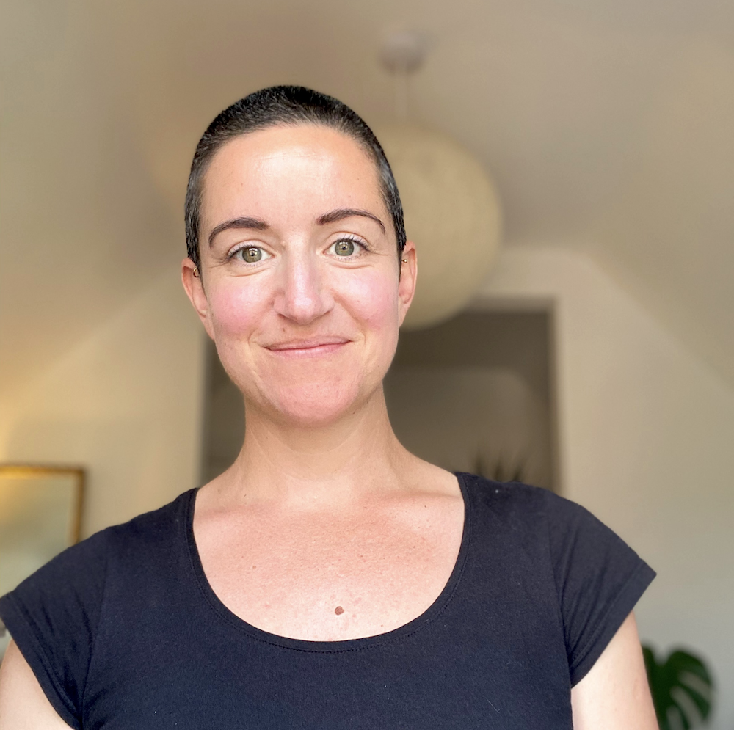
Introduction to Open Science
Why it is necessary and how we practice open science @ WIN
Cassandra Gould van Praag (she/her)
PhD Neuroimaging
Open Science Community Engagement Coordinator
Notes:
At the beginning of your talk, state your preference of what can and cannot be discussed on social media.

Slide 2
The problem: Incentive structures
H-index
An h-index of 25 means the researcher has 25 papers, each of which has been cited 25+ times
Impact factor
The yearly average number of citations that recent articles published in a given journal have received
Notes:
At the beginning of your talk, state your preference of what can and cannot be discussed on social media.
What are the challenges?
Reproducibility issue…
Translation is slow
Education is patchy – few unified resources
Lack of unified standards
Site specific requirements (cf Open Neuro)
Siloed communities?
How will we know when we have solved it?
People sharing all forms/levels of research output: acquisition, tasks, analysis, data
Outputs are reproducible
Why does it matter?
Efficacy and accuracy of research outputs and translation to medical benefit
Value for money from funders if resources are shared
Greater expectations of new graduates to be "reproducible" literate. We want our graduates to be the best on the market… Developing the next generation… Leading…?

Slide 3
The problem: Incentive structures
H-index
An h-index of 25 means the researcher has 25 papers, each of which has been cited 25+ times
Impact factor
The yearly average number of citations that recent articles published in a given journal have received
Notes:
At the beginning of your talk, state your preference of what can and cannot be discussed on social media.
What are the challenges?
Reproducibility issue…
Translation is slow
Education is patchy – few unified resources
Lack of unified standards
Site specific requirements (cf Open Neuro)
Siloed communities?
How will we know when we have solved it?
People sharing all forms/levels of research output: acquisition, tasks, analysis, data
Outputs are reproducible
Why does it matter?
Efficacy and accuracy of research outputs and translation to medical benefit
Value for money from funders if resources are shared
Greater expectations of new graduates to be "reproducible" literate. We want our graduates to be the best on the market… Developing the next generation… Leading…?

Slide 4
The problem: Publication bias
Randomized clinical trials with positive findings are nearly four times more likely to be submitted and published than trials with negative or null findings.
They are also published 2-3 years earlier than trials with negative findings and more likely to be published in English or in journals with higher impact factor.
Murad et al.(2018) BMJ Evidence-Based Medicine
Notes:
At the beginning of your talk, state your preference of what can and cannot be discussed on social media.
What are the challenges?
Reproducibility issue…
Translation is slow
Education is patchy – few unified resources
Lack of unified standards
Site specific requirements (cf Open Neuro)
Siloed communities?
How will we know when we have solved it?
People sharing all forms/levels of research output: acquisition, tasks, analysis, data
Outputs are reproducible
Why does it matter?
Efficacy and accuracy of research outputs and translation to medical benefit
Value for money from funders if resources are shared
Greater expectations of new graduates to be "reproducible" literate. We want our graduates to be the best on the market… Developing the next generation… Leading…?

Slide 5
Reproducibility crisis
“A recent report […] noted that the success rates for new development projects in Phase II trials have fallen from 28% to 18% in recent years, with insufficient efficacy being the most frequent reason for failure.”
“…validation projects that were started in our company based on exciting published data have often resulted in disillusionment when key data could not be reproduced.”
Prinz, F., et al. (2011). Nat Rev Drug Discovery
Notes:
At the beginning of your talk, state your preference of what can and cannot be discussed on social media.
What are the challenges?
Reproducibility issue…
Translation is slow
Education is patchy – few unified resources
Lack of unified standards
Site specific requirements (cf Open Neuro)
Siloed communities?
How will we know when we have solved it?
People sharing all forms/levels of research output: acquisition, tasks, analysis, data
Outputs are reproducible
Why does it matter?
Efficacy and accuracy of research outputs and translation to medical benefit
Value for money from funders if resources are shared
Greater expectations of new graduates to be "reproducible" literate. We want our graduates to be the best on the market… Developing the next generation… Leading…?

Slide 6
Reproducibility crisis
“By now, most scientists are familiar with the global and enormously expensive problem of irreproducible biomedical research.”
”Irreproducibility: A $28B Year Problem with some Tangible Solutions” (2015). Genetic Engineering and Biotechnology News
Notes:
At the beginning of your talk, state your preference of what can and cannot be discussed on social media.
What are the challenges?
Reproducibility issue…
Translation is slow
Education is patchy – few unified resources
Lack of unified standards
Site specific requirements (cf Open Neuro)
Siloed communities?
How will we know when we have solved it?
People sharing all forms/levels of research output: acquisition, tasks, analysis, data
Outputs are reproducible
Why does it matter?
Efficacy and accuracy of research outputs and translation to medical benefit
Value for money from funders if resources are shared
Greater expectations of new graduates to be "reproducible" literate. We want our graduates to be the best on the market… Developing the next generation… Leading…?

Slide 7
Reproducibility crisis
INCENTIVES
Baker (2016) Nature News
Notes:
At the beginning of your talk, state your preference of what can and cannot be discussed on social media.
What are the challenges?
Reproducibility issue…
Translation is slow
Education is patchy – few unified resources
Lack of unified standards
Site specific requirements (cf Open Neuro)
Siloed communities?
How will we know when we have solved it?
People sharing all forms/levels of research output: acquisition, tasks, analysis, data
Outputs are reproducible
Why does it matter?
Efficacy and accuracy of research outputs and translation to medical benefit
Value for money from funders if resources are shared
Greater expectations of new graduates to be "reproducible" literate. We want our graduates to be the best on the market… Developing the next generation… Leading…?

Slide 8
Reproducibility crisis
METHODS
Baker (2016) Nature News
Notes:
At the beginning of your talk, state your preference of what can and cannot be discussed on social media.
What are the challenges?
Reproducibility issue…
Translation is slow
Education is patchy – few unified resources
Lack of unified standards
Site specific requirements (cf Open Neuro)
Siloed communities?
How will we know when we have solved it?
People sharing all forms/levels of research output: acquisition, tasks, analysis, data
Outputs are reproducible
Why does it matter?
Efficacy and accuracy of research outputs and translation to medical benefit
Value for money from funders if resources are shared
Greater expectations of new graduates to be "reproducible" literate. We want our graduates to be the best on the market… Developing the next generation… Leading…?

Slide 9
Reproducibility crisis
CULTURE
Baker (2016) Nature News
Notes:
At the beginning of your talk, state your preference of what can and cannot be discussed on social media.
What are the challenges?
Reproducibility issue…
Translation is slow
Education is patchy – few unified resources
Lack of unified standards
Site specific requirements (cf Open Neuro)
Siloed communities?
How will we know when we have solved it?
People sharing all forms/levels of research output: acquisition, tasks, analysis, data
Outputs are reproducible
Why does it matter?
Efficacy and accuracy of research outputs and translation to medical benefit
Value for money from funders if resources are shared
Greater expectations of new graduates to be "reproducible" literate. We want our graduates to be the best on the market… Developing the next generation… Leading…?

Slide 10
Reproducibility crisis
TRANSPARENCY
Baker (2016) Nature News
Notes:
At the beginning of your talk, state your preference of what can and cannot be discussed on social media.
What are the challenges?
Reproducibility issue…
Translation is slow
Education is patchy – few unified resources
Lack of unified standards
Site specific requirements (cf Open Neuro)
Siloed communities?
How will we know when we have solved it?
People sharing all forms/levels of research output: acquisition, tasks, analysis, data
Outputs are reproducible
Why does it matter?
Efficacy and accuracy of research outputs and translation to medical benefit
Value for money from funders if resources are shared
Greater expectations of new graduates to be "reproducible" literate. We want our graduates to be the best on the market… Developing the next generation… Leading…?

Slide 11
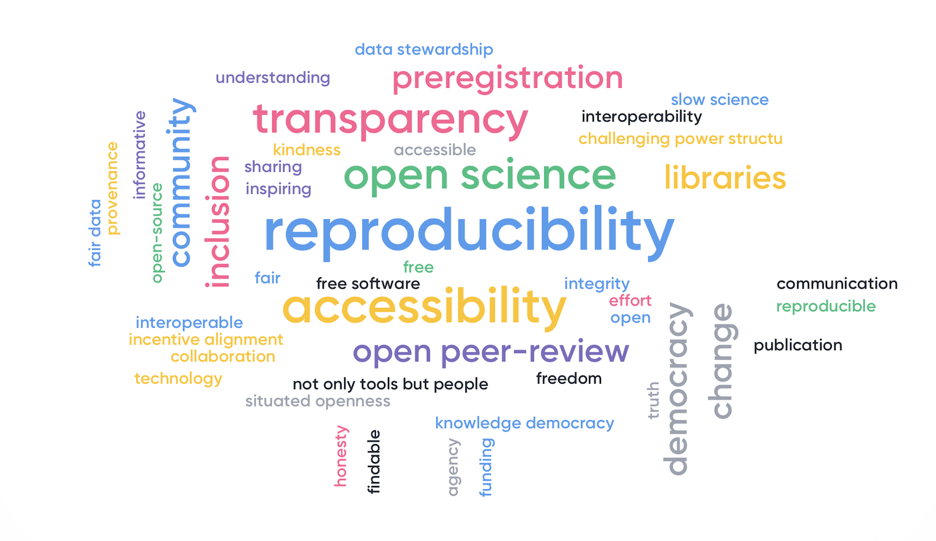
The solution: Open Science
“System of practices for ensuring transparency and reproducibility of research findings”
(Cass, 2020)
Avengers for Better Science, Leiden (Sept 2019)
Notes:
At the beginning of your talk, state your preference of what can and cannot be discussed on social media.
What are the challenges?
Reproducibility issue…
Translation is slow
Education is patchy – few unified resources
Lack of unified standards
Site specific requirements (cf Open Neuro)
Siloed communities?
How will we know when we have solved it?
People sharing all forms/levels of research output: acquisition, tasks, analysis, data
Outputs are reproducible
Why does it matter?
Efficacy and accuracy of research outputs and translation to medical benefit
Value for money from funders if resources are shared
Greater expectations of new graduates to be "reproducible" literate. We want our graduates to be the best on the market… Developing the next generation… Leading…?

Slide 12
Why I care about open science
Sharing of resources mandated by funders and publishers
Improves reliability and confidence in research findings
Speeds up translation and reduces “wasted” (tax-payer, charity) money
Good for your CV 🙌🏻
  ↑ citations, media attention, potential collaborators, job opportunities and funding opportunities (McKiernan, 2016, eLife)

Slide 13
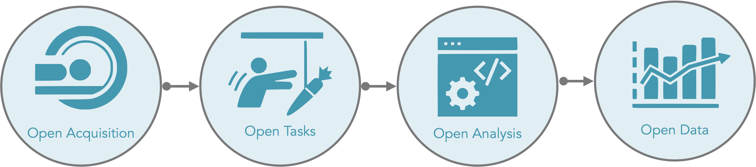


WIN Open Tools

Slide 14
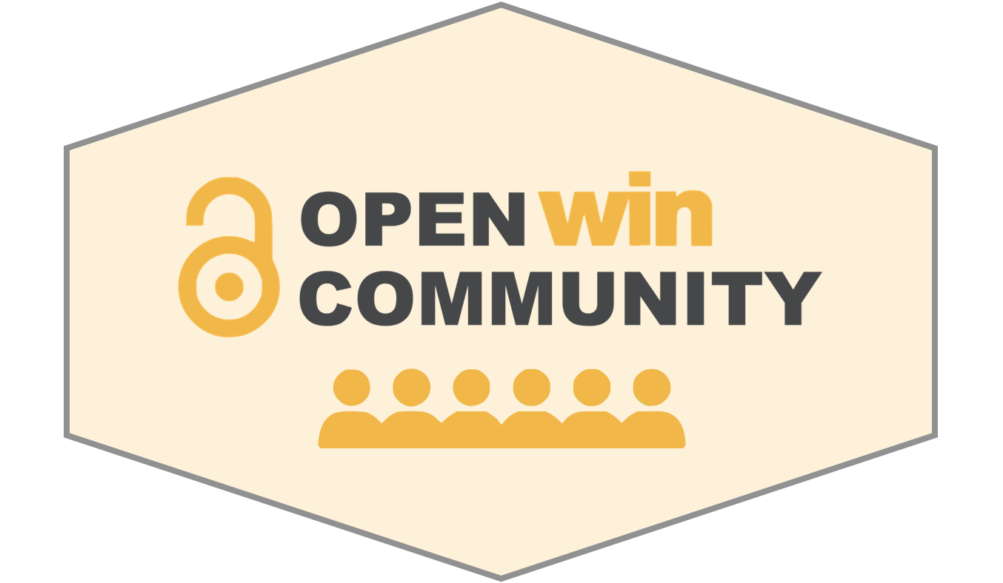
Community Hack Day 19th October
Introduce you to the community:
  how you may benefit from participation
  what kind of activities you may be able to take part in
  how you will be recognised for your contributions
  what behaviours or commitment (if any) may be expected of you
Provide training on how to use the Open WIN Tools
Provide training on GitHub/GitLab and how it will be used to update the community pages
Begin writing documentation and submitting feedback to share with others
Notes:
At the beginning of your talk, state your preference of what can and cannot be discussed on social media.
What are the challenges?
Reproducibility issue…
Translation is slow
Education is patchy – few unified resources
Lack of unified standards
Site specific requirements (cf Open Neuro)
Siloed communities?
How will we know when we have solved it?
People sharing all forms/levels of research output: acquisition, tasks, analysis, data
Outputs are reproducible
Why does it matter?
Efficacy and accuracy of research outputs and translation to medical benefit
Value for money from funders if resources are shared
Greater expectations of new graduates to be "reproducible" literate. We want our graduates to be the best on the market… Developing the next generation… Leading…?

Slide 15
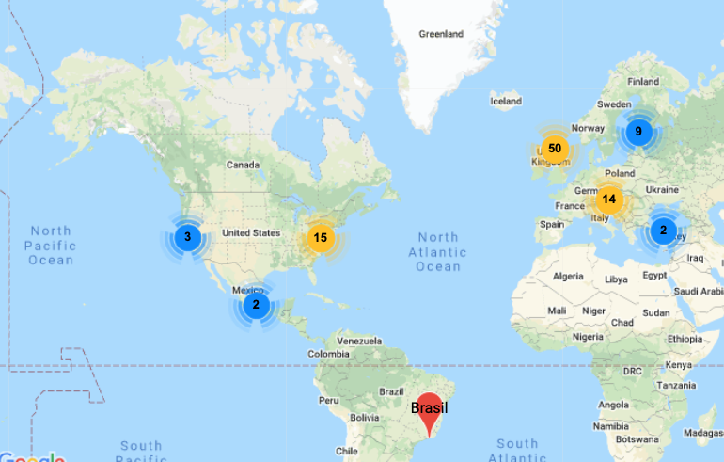
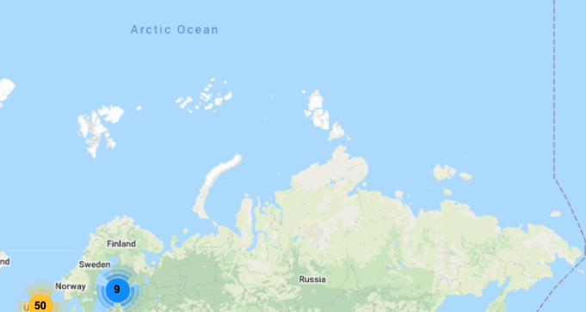
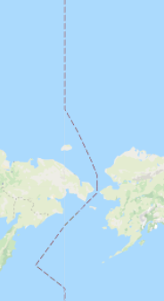
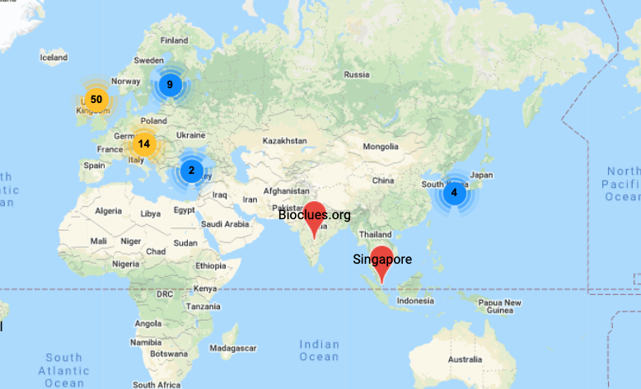
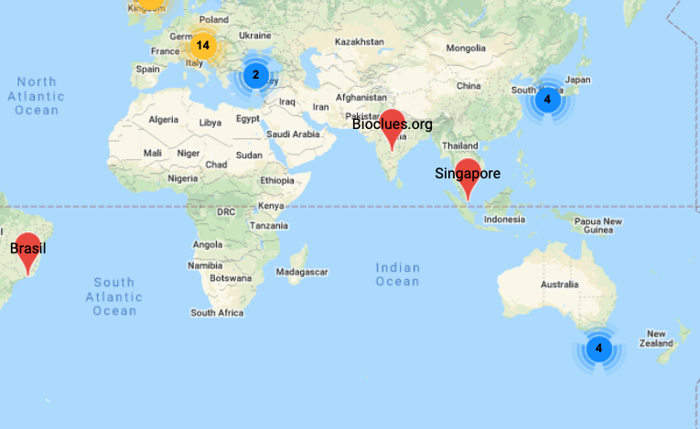

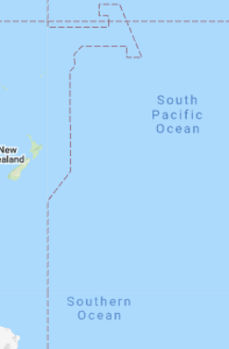
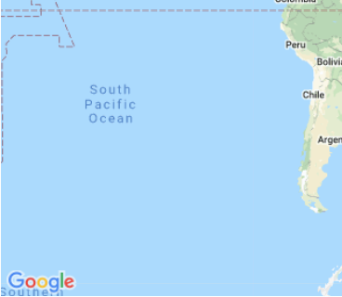
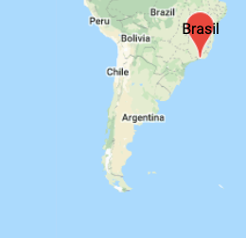
ReproducibiliTea Journal Club
A grassroots journal club initiative that supports researchers to discuss diverse issues, papers and ideas about improving science, reproducibility and the Open Science movement.
reproducibilitea.org
Started in early 2018 at the University of Oxford, ReproducibiliTea has now spread to 106 institutions in 25 different countries.
We are completely volunteer run, and provide a unique and supportive community for our members.
Notes:
At the beginning of your talk, state your preference of what can and cannot be discussed on social media.
What are the challenges?
Reproducibility issue…
Translation is slow
Education is patchy – few unified resources
Lack of unified standards
Site specific requirements (cf Open Neuro)
Siloed communities?
How will we know when we have solved it?
People sharing all forms/levels of research output: acquisition, tasks, analysis, data
Outputs are reproducible
Why does it matter?
Efficacy and accuracy of research outputs and translation to medical benefit
Value for money from funders if resources are shared
Greater expectations of new graduates to be "reproducible" literate. We want our graduates to be the best on the market… Developing the next generation… Leading…?

Slide 16
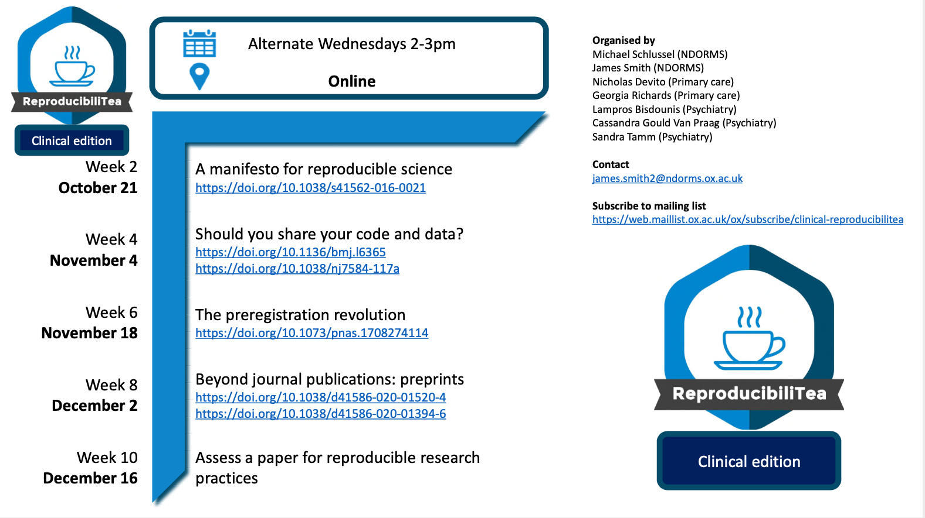

ReproducibiliTea Journal Club
Notes:
At the beginning of your talk, state your preference of what can and cannot be discussed on social media.
What are the challenges?
Reproducibility issue…
Translation is slow
Education is patchy – few unified resources
Lack of unified standards
Site specific requirements (cf Open Neuro)
Siloed communities?
How will we know when we have solved it?
People sharing all forms/levels of research output: acquisition, tasks, analysis, data
Outputs are reproducible
Why does it matter?
Efficacy and accuracy of research outputs and translation to medical benefit
Value for money from funders if resources are shared
Greater expectations of new graduates to be "reproducible" literate. We want our graduates to be the best on the market… Developing the next generation… Leading…?

Slide 17
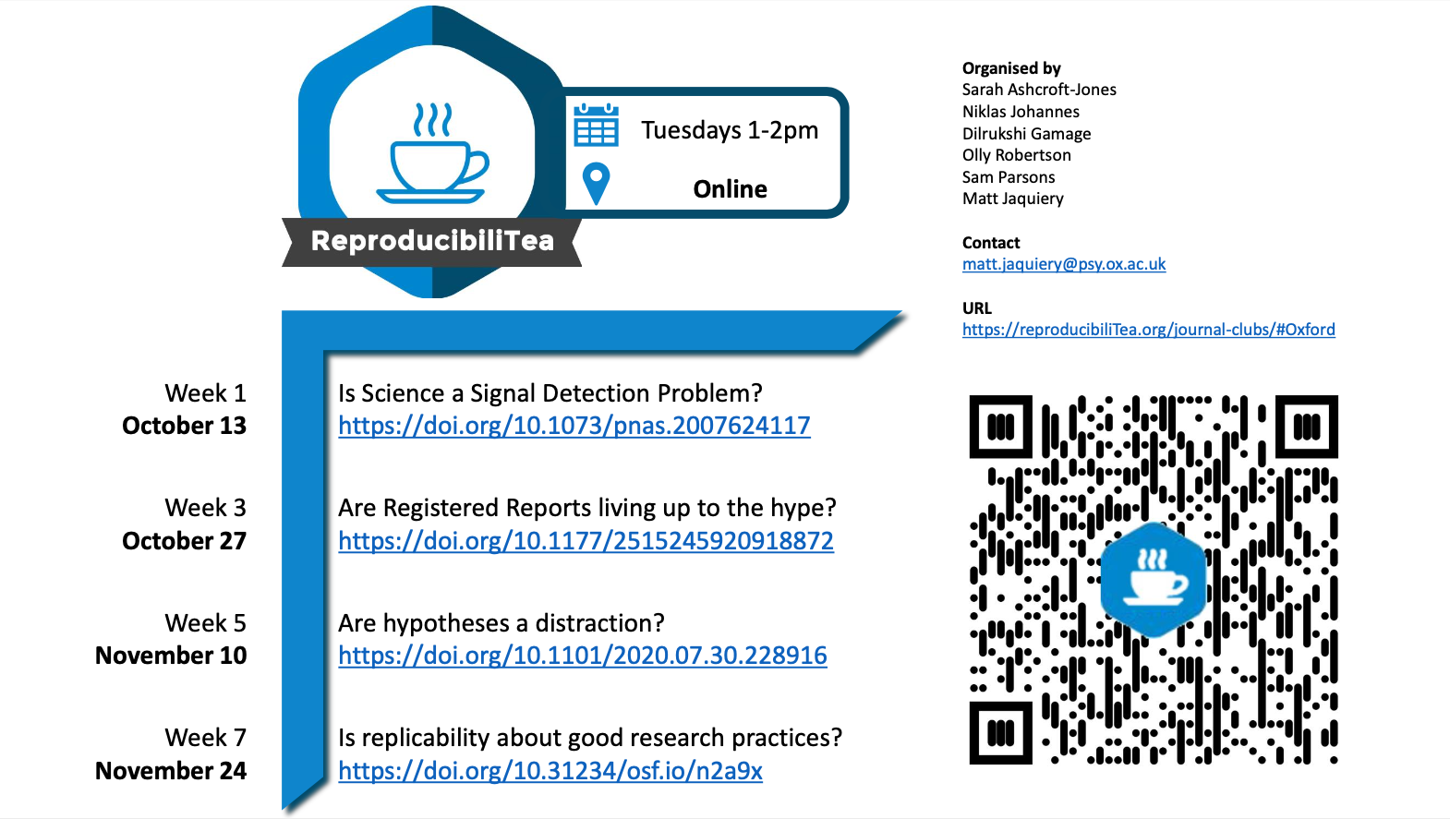
ReproducibiliTea Journal Club
Notes:
At the beginning of your talk, state your preference of what can and cannot be discussed on social media.
What are the challenges?
Reproducibility issue…
Translation is slow
Education is patchy – few unified resources
Lack of unified standards
Site specific requirements (cf Open Neuro)
Siloed communities?
How will we know when we have solved it?
People sharing all forms/levels of research output: acquisition, tasks, analysis, data
Outputs are reproducible
Why does it matter?
Efficacy and accuracy of research outputs and translation to medical benefit
Value for money from funders if resources are shared
Greater expectations of new graduates to be "reproducible" literate. We want our graduates to be the best on the market… Developing the next generation… Leading…?

Slide 18



Thank you
WIN Open Neuroimaging Project (alphabetically)
Jon Campbell
Stuart Clare
Geoff Ferrari
Dave Flitney
Gary Gibbs
Taylor Hanayik
Verena Heise
Laurence Hunt
Mark Jenkinson
Clare Mackay
Paul McCarthy
Duncan Mortimer
Caroline Nettekoven
Tom Nichols
Sebastien Rieger
Nancy Rawlings
Paul Semple
Duncan Smith
Matthew South
Andrew Quinn
Natalie Voets
Mathew Webster
@cassgvp
cassgvp.github.io/WIN-Open-Neuroimaging-Community
cassandra.gouldvanpraag@psych.ox.ac.uk
10.5281/zenodo.4079460 CC BY 4.0

