Slide 1
Open Science & FAIR Data
In general, and at the Delft University of Technology in particular
Dec. 10th 2019
By: Nicolas Dintzner
Email: N.J.R.Dintzner@tudelt.nl
Available on ZENODO:
10.5281/zenodo.3569211

Slide 2
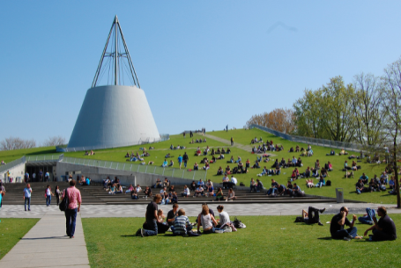
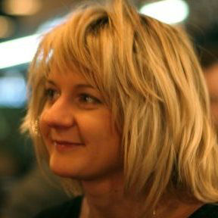
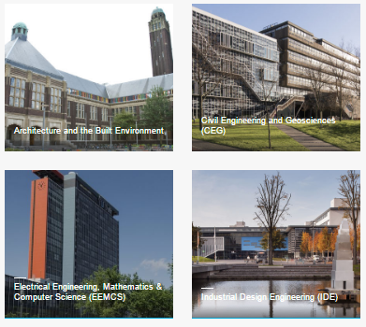
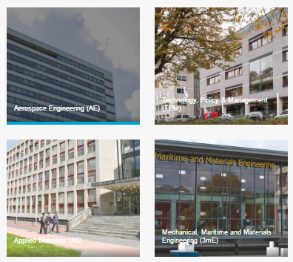
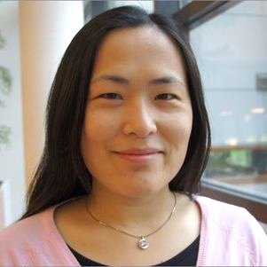

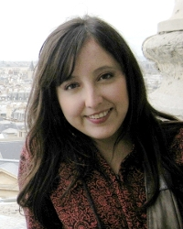
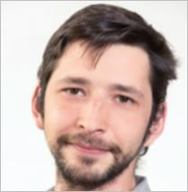
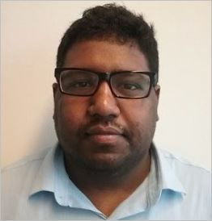
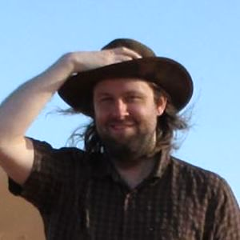
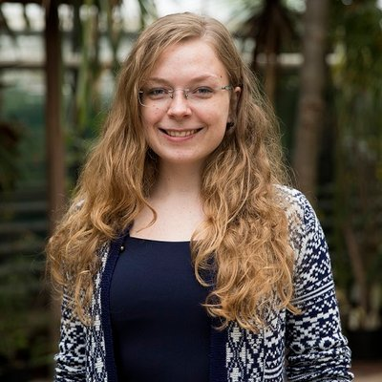
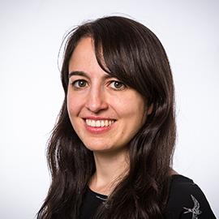
Data Stewards @ TUD
Coordinated at TU Library
Data Stewards: ‘Go-to’ person for research data management (RDM) at faculty level
https://tudelft.nl/library/datastewards

Slide 3







Data Stewards @ TUD
Secure data storage, data sharing, citation
For data management in grant proposals
Advice and templates
Workshops, information sessions
Advice
Archiving
Costs
Compliance
DMPs
Tools
Training
4TU.Centre for Research Data or disciplinary repositories
With funders' and journals’ policies
For data and software management

Slide 4
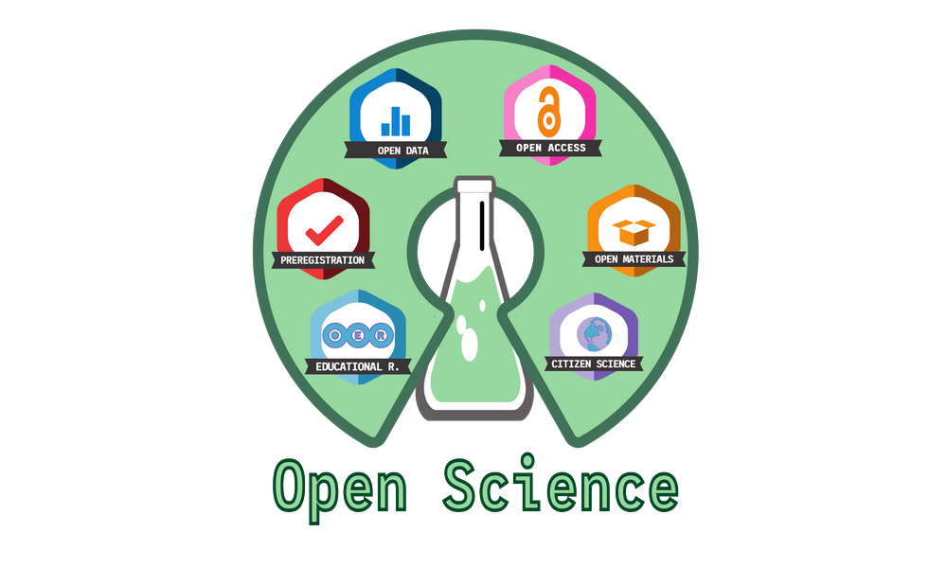
Open Science
Credit: Open Universe, University of Salamanca
Berlin Declaration : https://openaccess.mpg.de/67605/berlin_declaration_engl.pdf
Budapest Open Access Initiative : https://www.budapestopenaccessinitiative.org/read
Notes:
Berlin – Open License for everything
Budapest – Open Access and self archiving

Slide 5
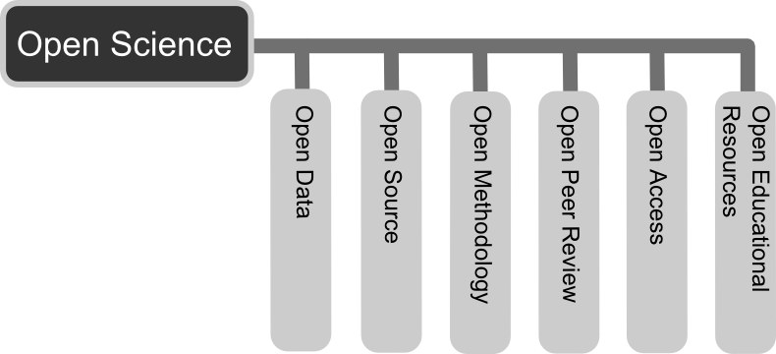
Open Science ?
Diagram by Andreas E. Neuhold - Own work, CC BY 3.0, https://commons.wikimedia.org/w/index.php?curid=33542838

Slide 6
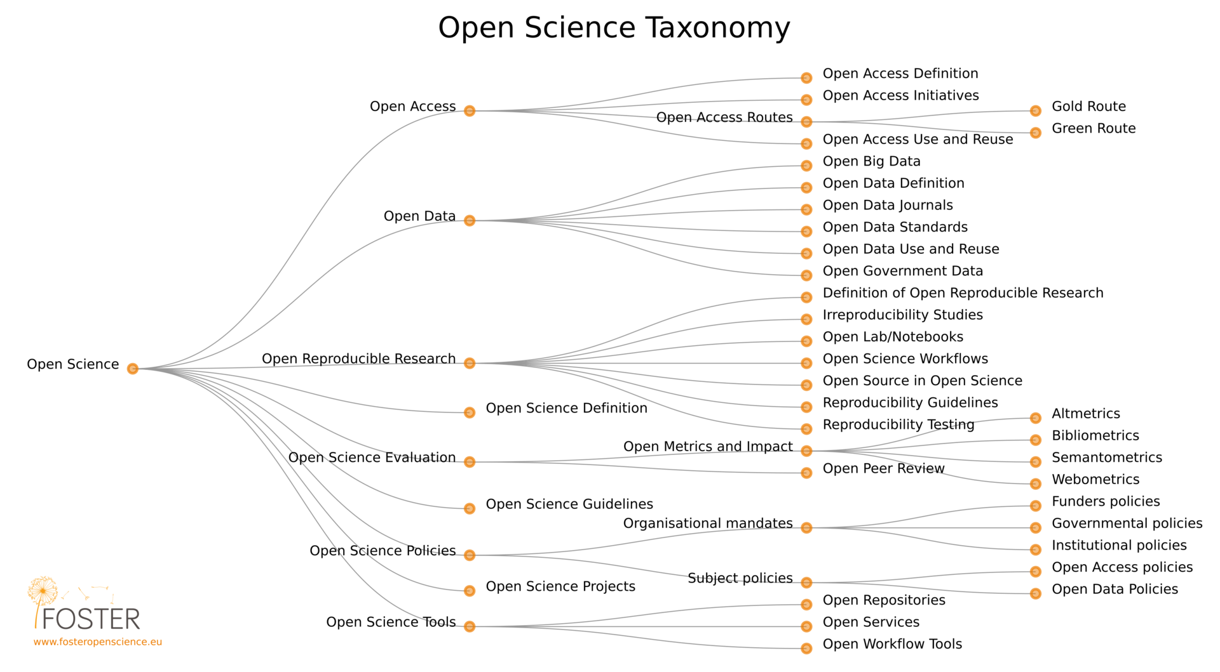
Open Science!
By Petr Knoth and Nancy Pontika - https://en.wikipedia.org/wiki/Open_science#/media/File:Os_taxonomy.png, CC BY 3.0, https://commons.wikimedia.org/w/index.php?curid=61125075

Slide 7
The Big Ideas of Open Science
Transparency
Reproducibility
Fast feedback loop
Traceability and accountability
Increased cooperation

Slide 8

Shout out to Melanie Imming‏ for the awesome sticker!

Slide 9

For today
Credit: Open Universe, University of Salamanca

Slide 10
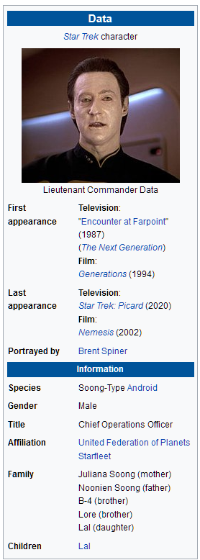
Data?
Star Trek ® is a registered trademark of Paramount Pictures registered in the United States Patent and Trademark Office.
Star Trek ©, Star Trek: The Next Generation ©, Star Trek: Deep Space Nine ©, Star Trek: Voyager ©, and Star Trek: Enterprise © are Trademarks of Paramount Pictures.

Slide 11
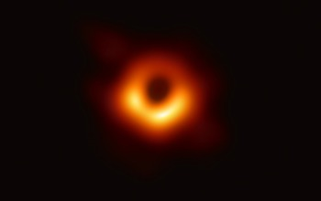
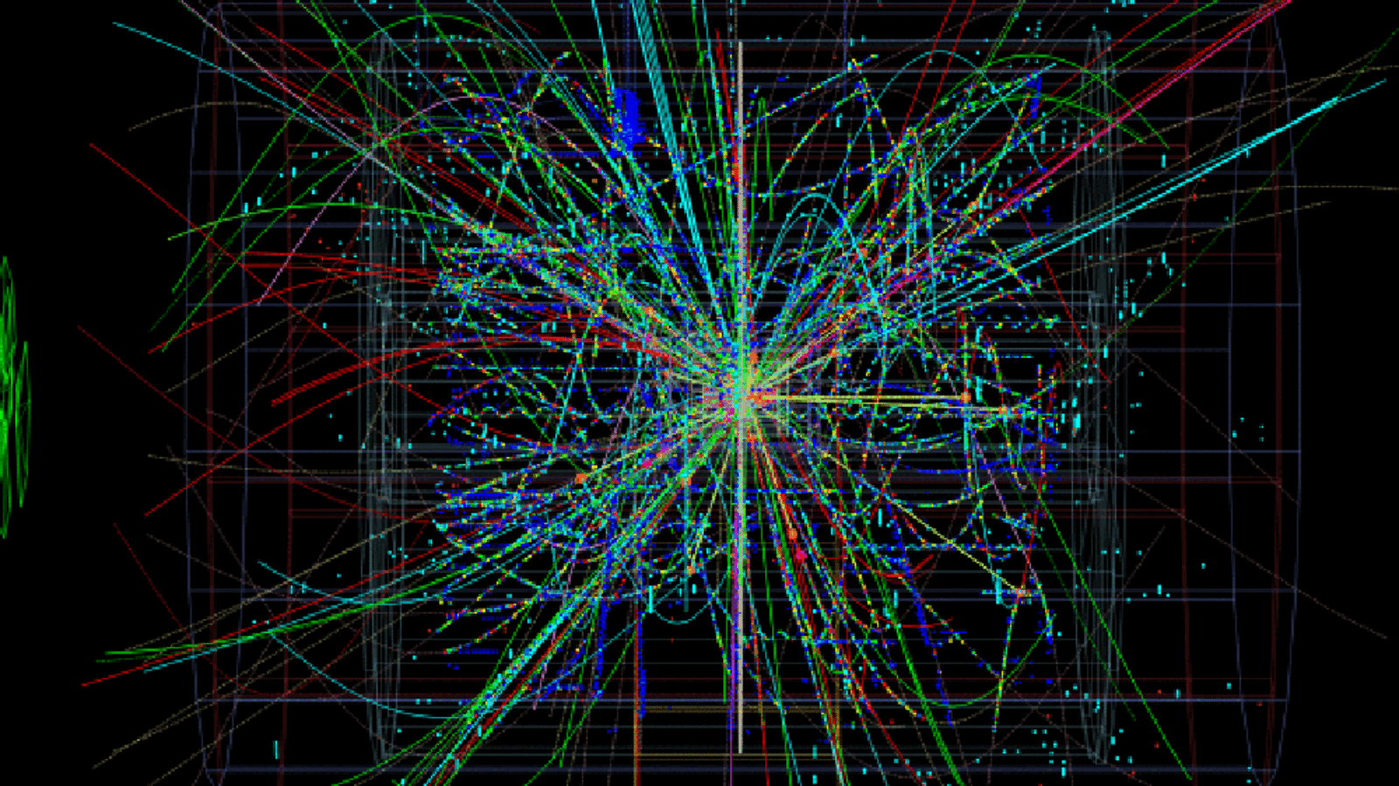
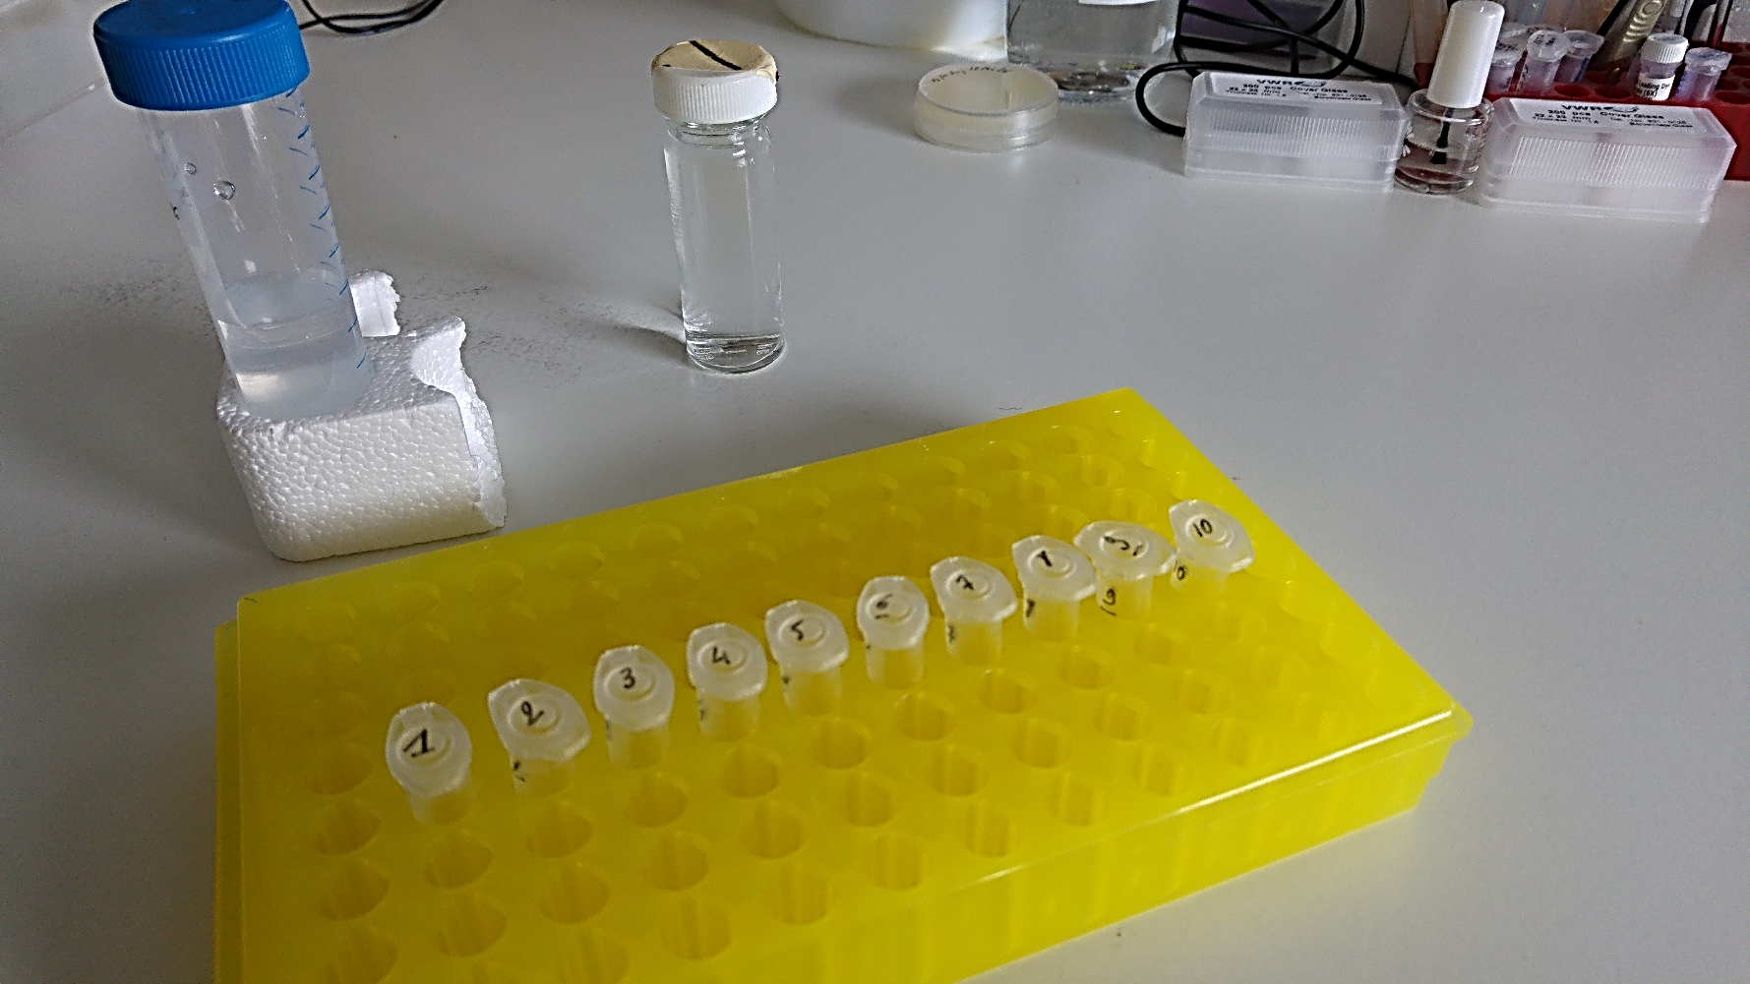

Research data...
Event Horizon Telescope collaboration et al.
Illustration by CERN
Vincent Gaggioli

Slide 12
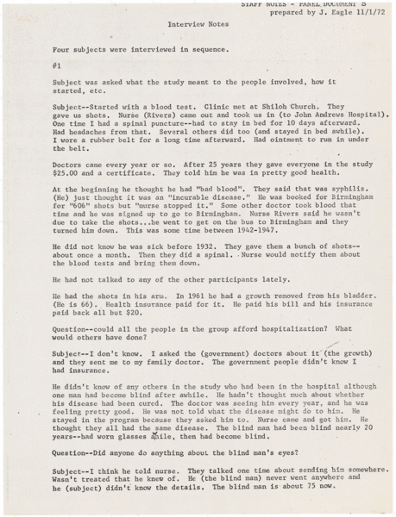
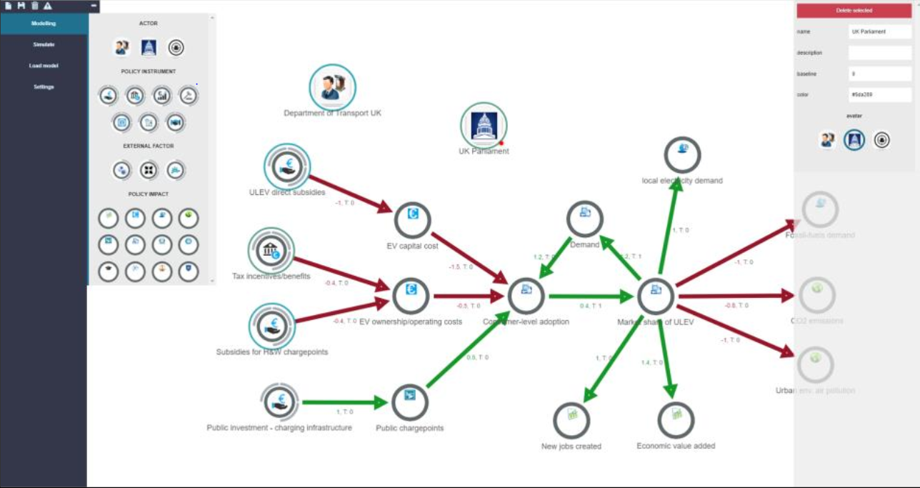
Research data
Ibrahim, O. (2018). Design and Investigation of a Decision Support System for Public Policy Formulation (PhD dissertation). Computer and Systems Sciences, Stockholm University, Stockholm. Retrieved from http://urn.kb.se/resolve?urn=urn:nbn:se:su:diva-159437
Description | English: U.S. Public Health Service interview transcipt with subjects of the Tuskegee Syphilis Experiment
Source | ARC Identifier 650715, U.S. National Archives
Author | Department of Health, Education, and Welfare. Public Health Service. Health Services and Mental Health Administration. Center for Disease Control. Venereal Disease Branch (1970 - 1973)

Slide 13
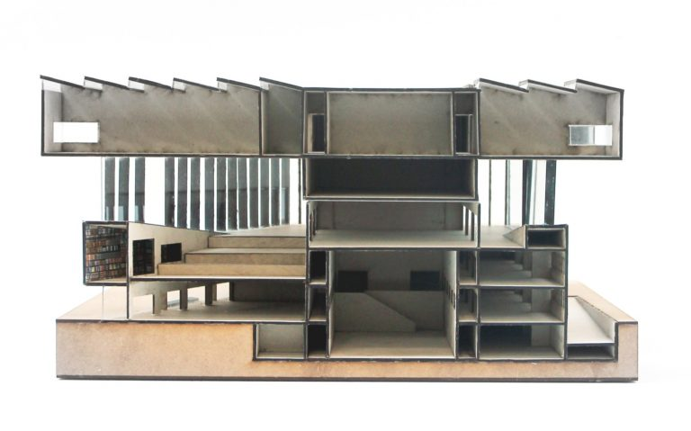
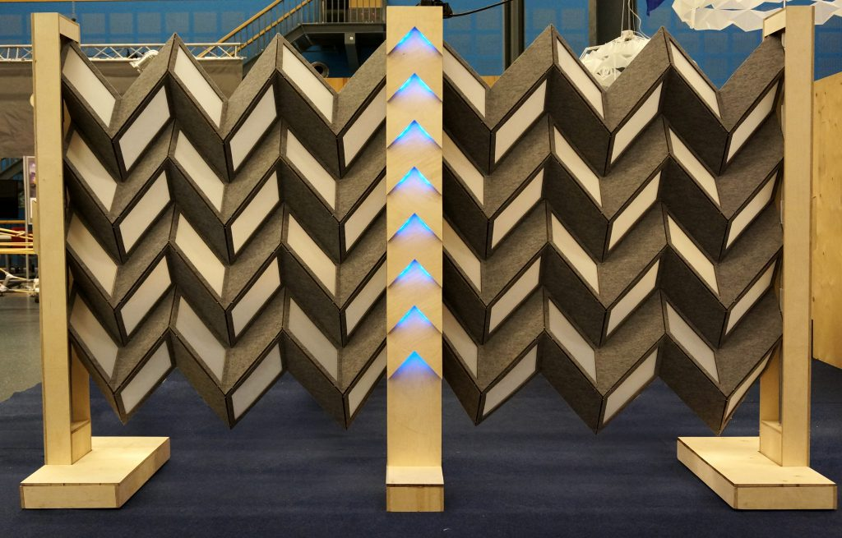
Research data
“Miura” Project – Interactive Environment in the Industrial Design Faculty of TU Delft.
Students: David van der Blonk, Patrick Keesmaat, Max van Manen, Carmen Pepping, Elias van der Linden,
Marijke Blom, Alice Coey.
Coaches: Martin Havranek, Aadjan van der Helm, Wouter van der Hoog, Tomasz Jaskiewicz.
Analytical Models by: Jiani You, Licheng Wang, Wei Jiang and Zhuting Li. Project: Eemhuis, by Neutelings Riedijk Architects, Amersfoort, the Netherlands.
Models in Architecture by TU Delft OpenCourseWare is licensed under a Creative Commons Attribution-NonCommercial-ShareAlike 4.0 International License. Based on a work at https://ocw.tudelft.nl/courses/models-architecture-design-physical-digital-models/.

Slide 14
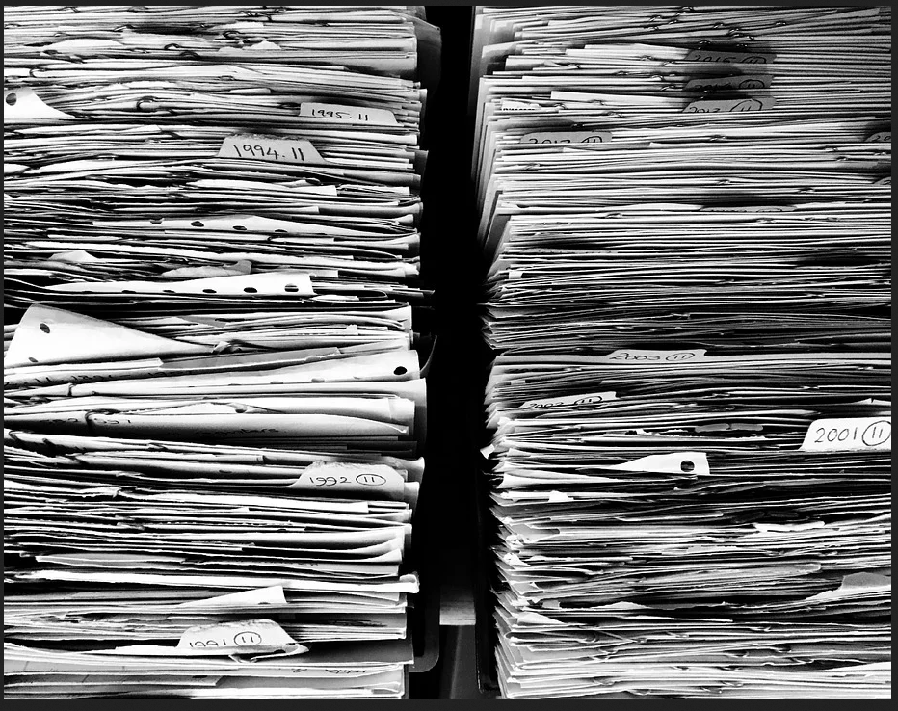
Too much data ?

Slide 15
From data to “relevant research data”
“Relevant research data” might mean different things in different disciplines: source code, experimental notes, protocols, models, and other forms of information supporting traditional publication
Delft University of Technology Research Data Management Framework Policy
https://d1rkab7tlqy5f1.cloudfront.net/Library/Themaportalen/RDM/researchdata-framework-policy.pdf
Research data is any information that has been collected, observed, generated or created to validate original research findings.
Although usually digital, research data also includes non-digital formats such as laboratory notebooks and diaries.
Library of the University of Leeds
https://library.leeds.ac.uk/info/14062/research_data_management/61/research_data_management_explained

Slide 16
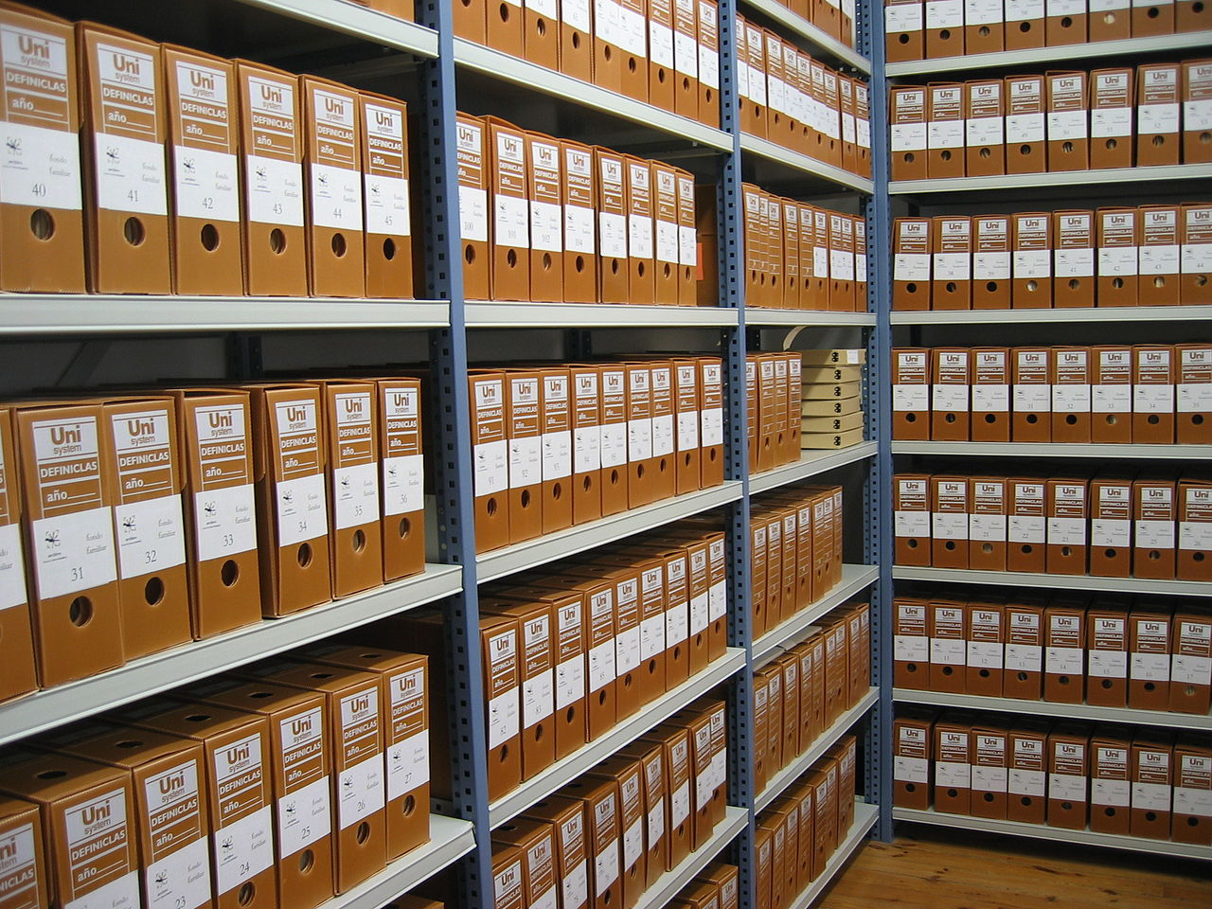
The way of the future
By Archivo-FSP - Own work, CC BY-SA 3.0, https://commons.wikimedia.org/w/index.php?curid=2942596

Slide 17
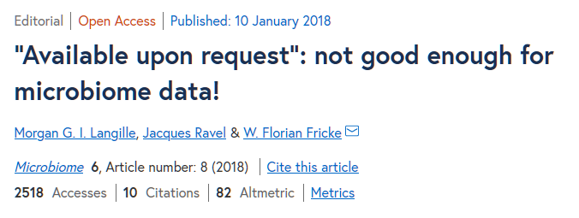
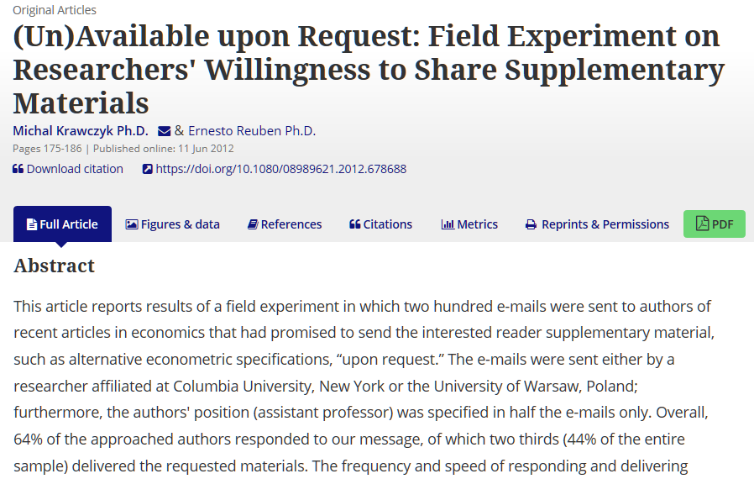
At the moment...

Slide 18
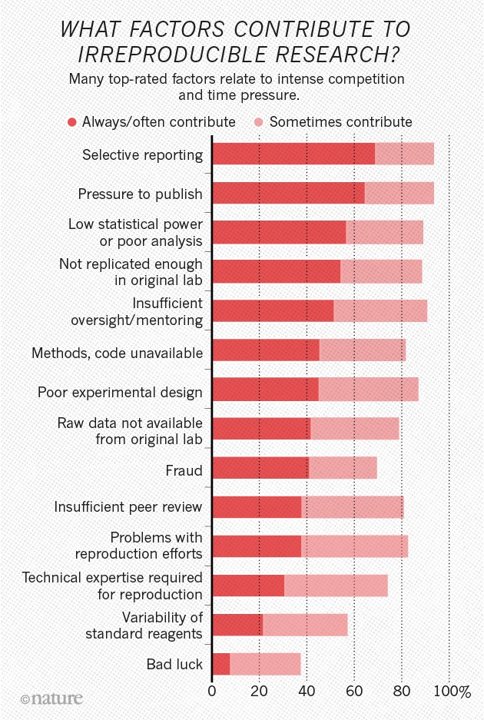
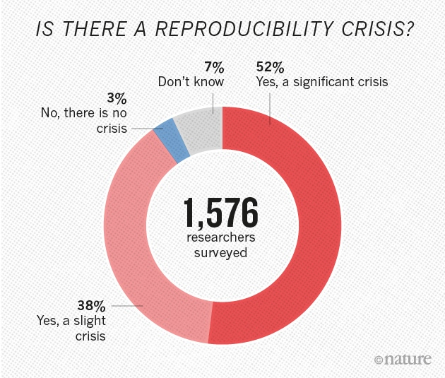
Problem ?
Nature 533, 452–454 (26 May 2016) doi:10.1038/533452a

Slide 19

“FAIR principles” to the rescue
Door SangyaPundir - Eigen werk, CC BY-SA 4.0, https://commons.wikimedia.org/w/index.php?curid=53414062
Founding paper: Wilkinson, M., Dumontier, M., Aalbersberg, I. et al. The FAIR Guiding Principles for scientific data management and stewardship. Sci Data 3, 160018 (2016) doi:10.1038/sdata.2016.18
“FAIR” definitions from : https://www.go-fair.org/fair-principles/

Slide 20
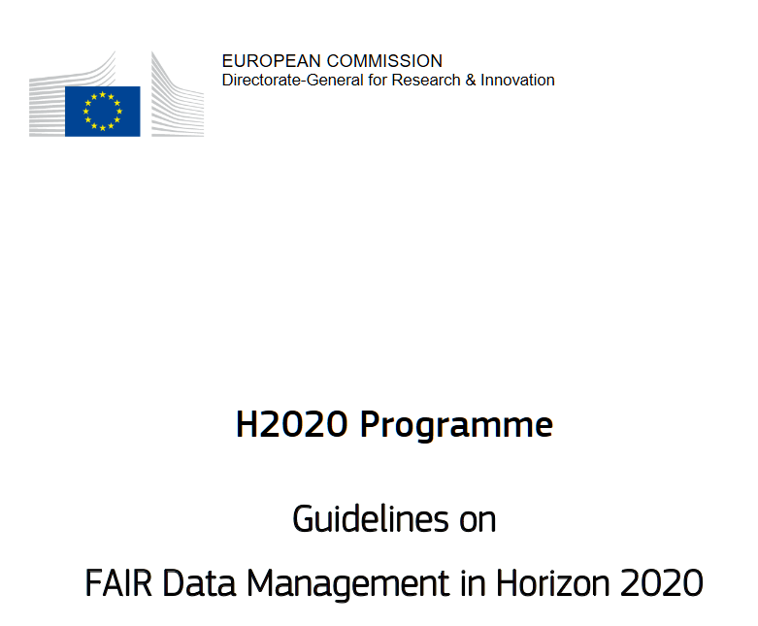
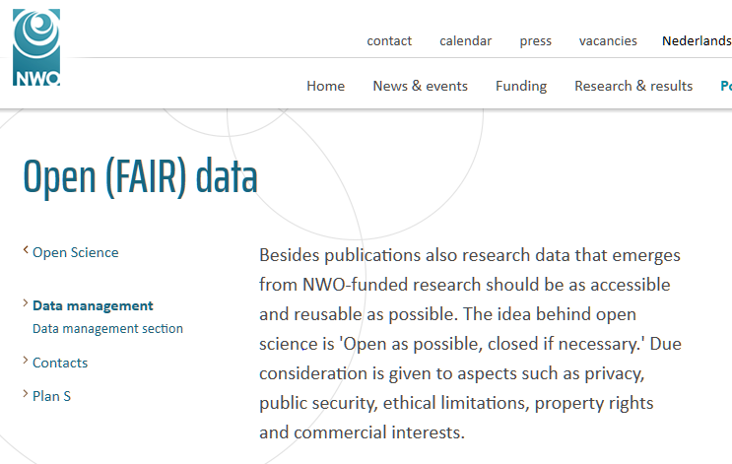
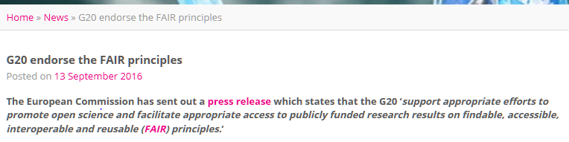
FAIR
Official EU H2020 project documentation
National Dutch Research Funding Organization
https://www.dtls.nl/2016/09/13/g20-endorse-fair-principles/

Slide 21
Data & Datasets according to FAIR
Meta Data
Description of what is in, how it is organized...
Meta Data
of the dataset!
Description of what is in, how it is organized...
“contains”
“describes”
Dataset
“any number of”
Excel Tables
Transcripts
Notes
...
Data

Slide 22
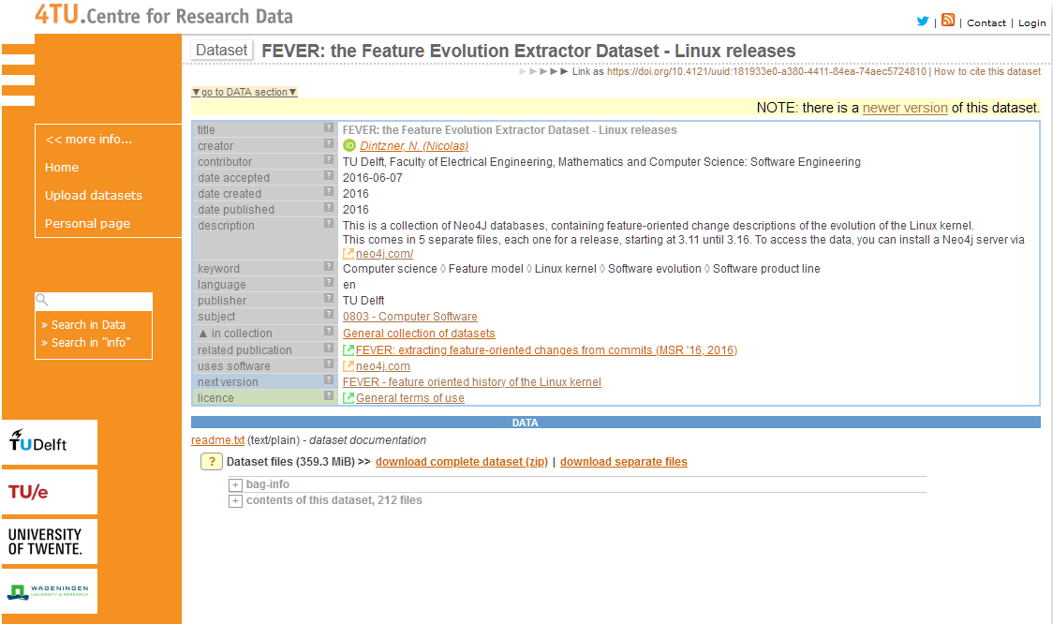
Nico’s dataset
Title : string
Creator: string
Next version: dataset_ID
...
Meta Data
of the dataset!
(4TU: DublinCore standard)
Meta Data
README.txt
“contains”
Dataset
“describes”
“any number of”
“Commit history of Linux”
Data
(Neo4J database)

Slide 23
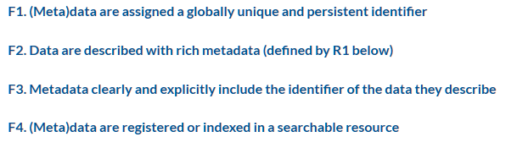
F – “Findable” (definition)
Unique ID
Data: 0987
Described_by: 0123
12,421,567,235
312,342,5325,56
...,...,...,...
...
Meta data: 0123
(info)
“Described by”
“registered/indexed”
“Rich” information
“searchable resource”
Notes:
Example https://www.dublincore.org/schemas/xmls/simpledc20021212.xsd

Slide 24

F- “Findable”
If you say “I have data” then you must tell me “how/where to find it”
“Available upon request”
“Send an email to XXX@Univ.country”
“Available here: www.my_personal_webpage.html ”
Those do NOT work over time

Slide 25
F – “Findable”
If you say “I have data” then you must tell me “how/where to find it”
Upload your data to a research data repository
Get a PID (Persistent Identifier) for your data
Provide the link to the datasets based on this PID
PID = D.O.I. or HANDLE or ...
And then cite as:
Dintzner, N. (Nicolas) (2016) FEVER - feature oriented history of the Linux kernel. TU Delft. Dataset. https://doi.org/10.4121/uuid:c478028a-ac6d-4c45-9e2d-8ad63c7ca75f
DOI of my dataset
Notes:
Go back to 22 if need be

Slide 26




F – “Findable” – how do I get a DOI ? Or a Handle ? Or ... ?
It is provided by your Research Data Repository of choice
Notes:
10 years, Dublin core, Core Trust Seal if possible, Open Access
10GB Per researcher for free at the 4TU !

Slide 27
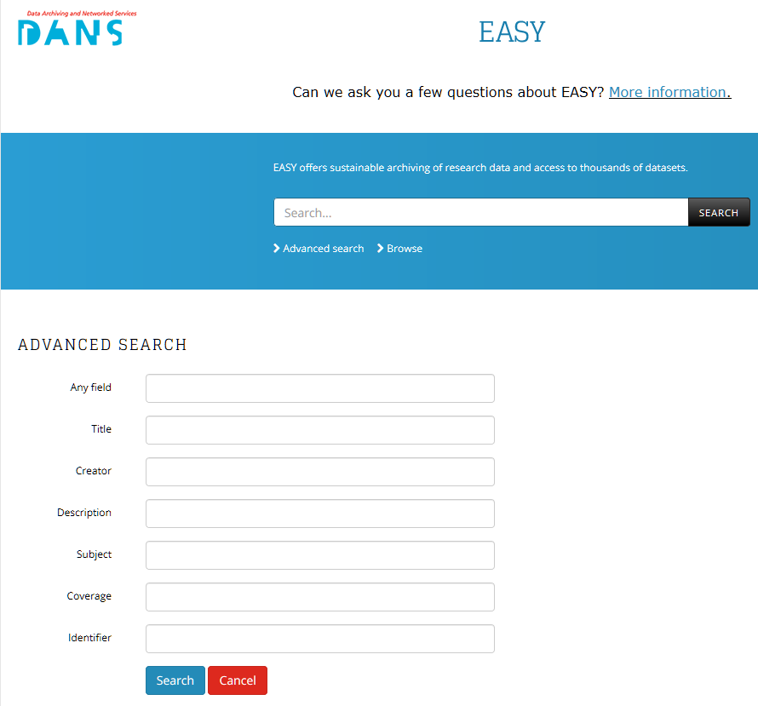
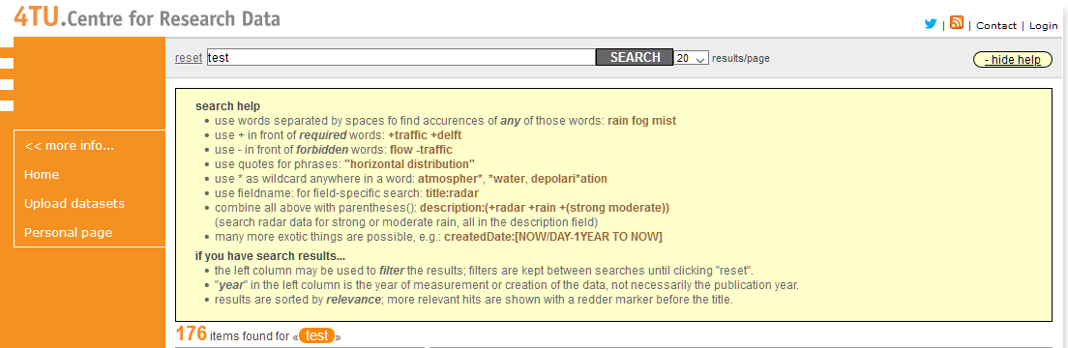
F – “Findable” for the general case (“discoverable”)
Imaging someone is trying to find your data,
how would they formulate the question?

Slide 28
F – “Findable” for the general case (the last one)
Extract of a CSV file
GID, On Street, Species, Trim Cycle, Inventory Date
1, ADDISON AV, Celtis australis, Large Tree Routine Prune, 10/18/2010
2, EMERSON ST, Liquidambar styraciflua, Large Tree Routine Prune, 06/02/2010
Description (metadata) of the last column
{
"name": "inventory_date",
"titles": "Inventory Date",
"datatype": {
"base": "date",
"format": “MM/dd/yyyy"
}
}
“Agreed upon” vocabulary:
CSVW (C.S.V. tabular data format for the Web)
from IETF and W3C

Slide 29
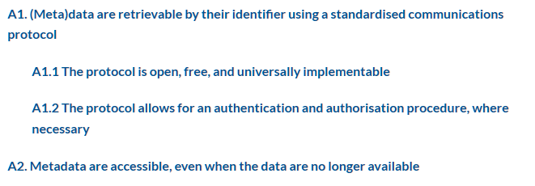
A – “Accessible” (definition)
Dataset must describe their access conditions

Slide 30

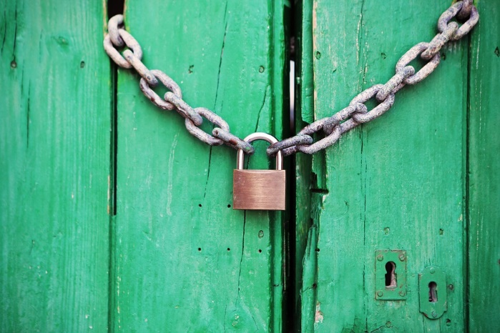

A- “Accessible”
If I can see that “dataset is here” then I must know “how I can access its content”
Measurements, aggregated results, ...
Personal data, confidential data, ...
Great ! What can I do with it ?
Ok... How do I get access ?
Open license
Creative commons for data
MIT/BSD/Apache Licenses for software
Conditions +
legal agreements +
closed repositories
Notes:
People coming and leaving the university ?

Slide 31

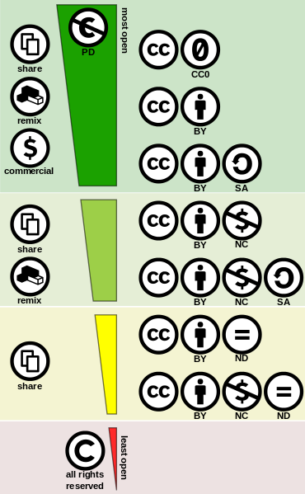
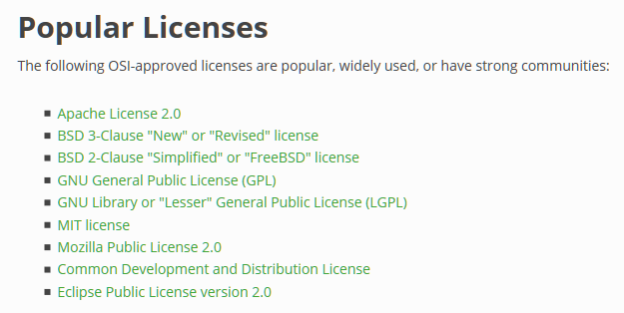
A – “Accessible”: Open licenses

Slide 32
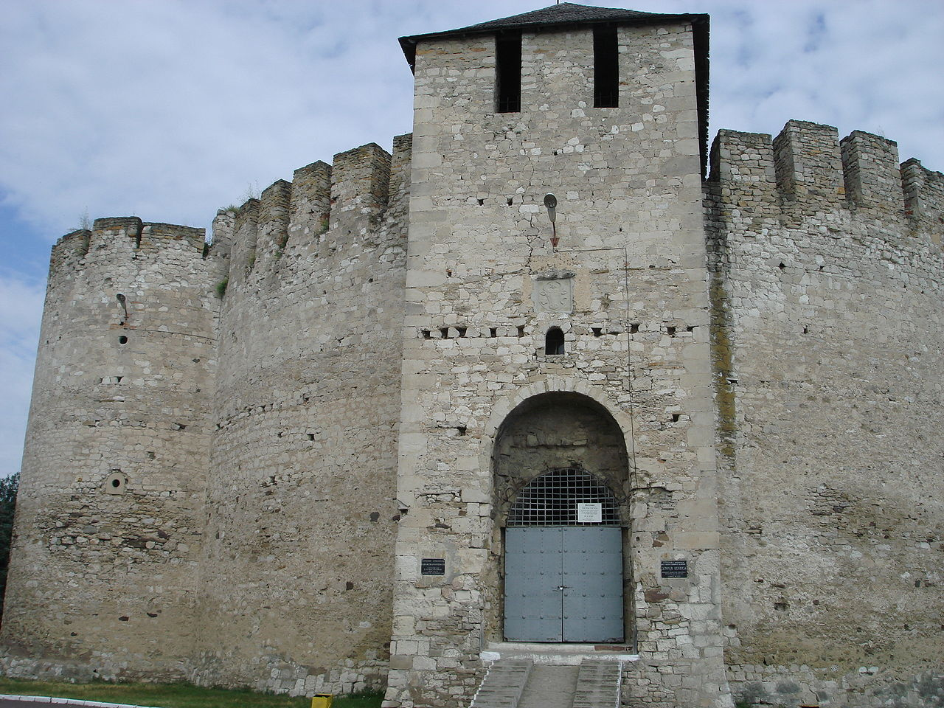
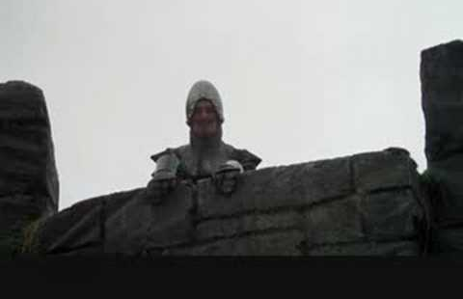
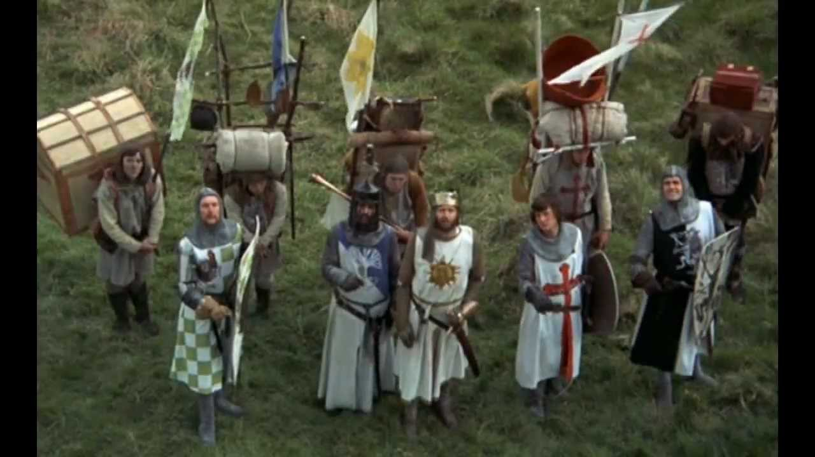
A – “Accessible” but not too much ?
MY DATA ?
Under conditions...
Copyrights on this slide ?
Well....
...
Sure ! Fair Use ?
Hum... Yes ? Sure ! ... Whatever!

Slide 33
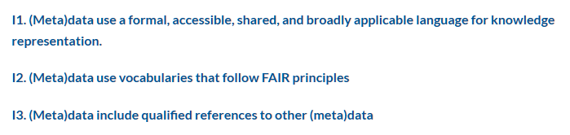
I – “Interoperable” (definition)

Slide 34
I- “Interoperable” – the case of datasets
Data set 1: My ToDo list
{Name:Date, Type: Date, Format: M/Y}
{Name:Actor, Type: String, Format: 250CHAR }
{Name:Action, Type: String, Format: 250CHAR }
{Name:Target, Type: String, Format: 250CHAR }
Date | Actor | Action | Target
03/12 | Nicolas | PowerPointing | Inform
Data set 2: Your ToDo list
{Name:Date, Type: Date, Format: M/Y}
{Name:Actor, Type: String, Format: 250CHAR }
{Name:Action, Type: String, Format: 250CHAR }
{Name:Target, Type: String, Format: 250CHAR }
Date | Actor | Action | Target
04/12 | Bob | Send message | Alice
IF “Date”, “Actor” .. are the same concept in both dataset, I can combine them
that’s “interoperability”

Slide 35
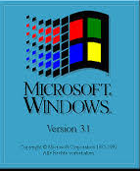
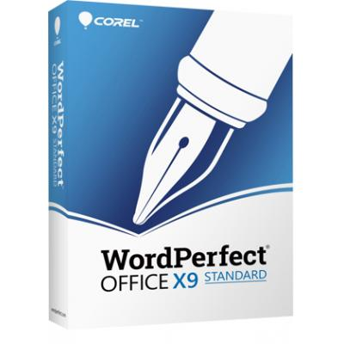
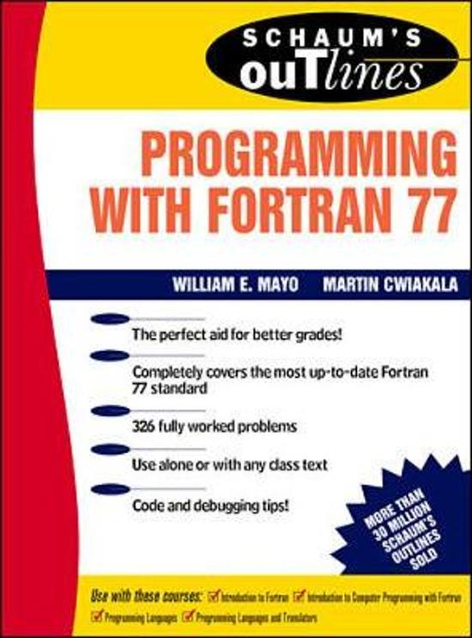
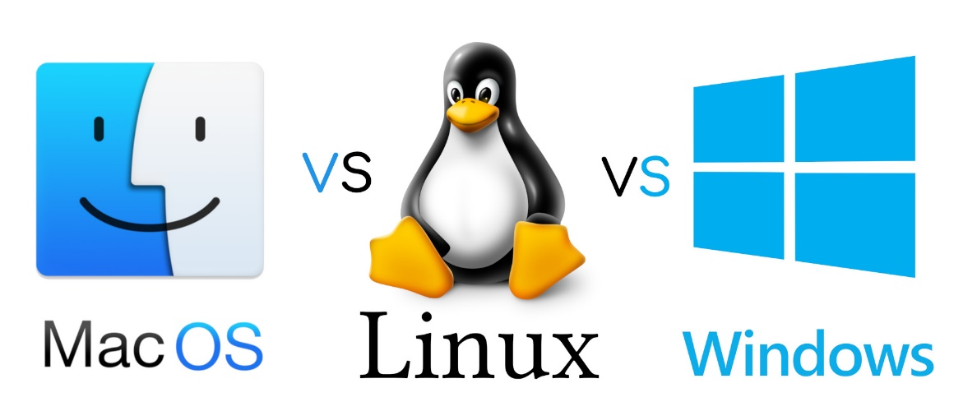
I- “Interoperable”
If I can access “data” then I must know “how to visualize and manipulate it”
Avoid !
Do I need a very specific system?
Do I need a very specific set of tools ?
Document !
What is needed ?
Stay Open ! ... And closed ...
Favor raw text files when possible (data & doc)
Commonly used format (even if proprietary)

Slide 36





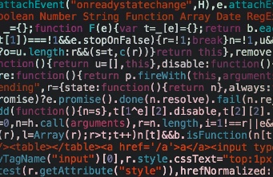
I- “Interoperable” – the case of Software
If I can access “data” then I must know “how to visualize and manipulate it”
The code I want to share
?
?
Dependencies
Cross platform
?
Development history
?
?

Slide 37
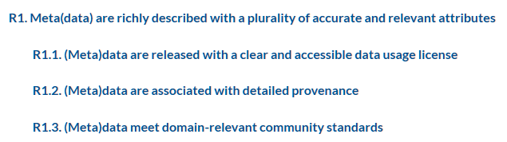
R – “Reusable” (definition)

Slide 38

R – “Reusable”
If I can read and manipulate “data” then I must know “what I am allowed to do with” and “how to do it”
License
Documentation
source code
README.txt
//function that does X and Y
def function (var):
....

Slide 39
FAIR in theory
- Machine-readable information
- Archived data

Slide 40
FAIR in theory
FAIR is not OPEN
FAIR principles are NOT RULES

Slide 41
FAIR everywhere and all the time
In practice: the basis of Research Data Management

Slide 42
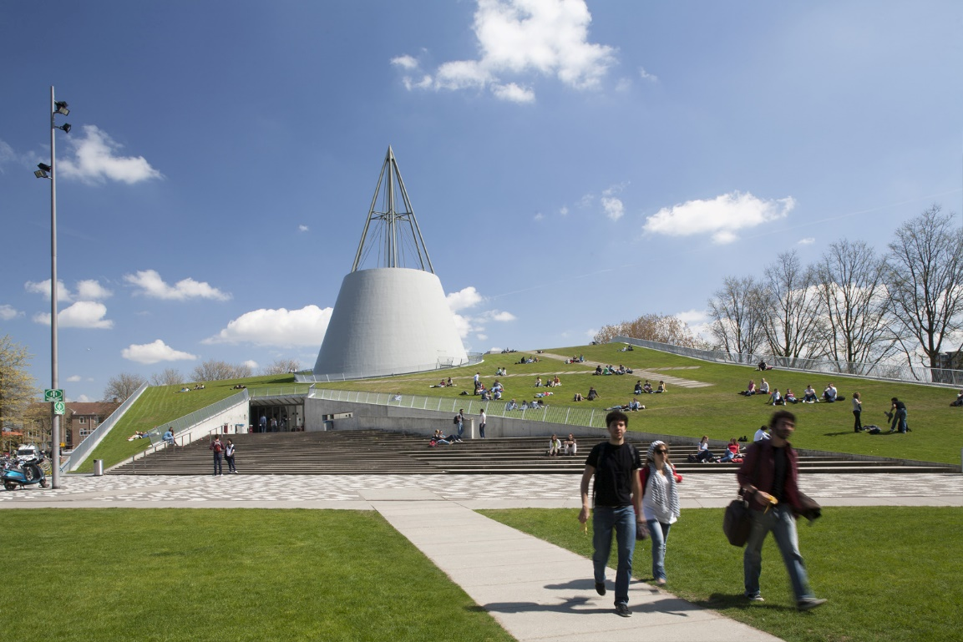
Road to FAIR
RDM support from the Library
Data Steward initiative
Research Data Management policy
For the whole university (framework)
For each faculty

Slide 43
Data steward integration
Secure data storage, data sharing, citation
For data management in grant proposals
Advice and templates
Workshops, information sessions
Advice
Archiving
Costs
Compliance
DMPs
Tools
Training
4TU.Centre for Research Data or disciplinary repositories
With funders' and journals’ policies
For data and software management
With contract team, privacy team, ethic committee, ...

Slide 44

Where are we at ?
Do you want to know more ?
https://openworking.wordpress.com/2019/12/02/research-data-management-survey-2019-the-results-are-here/
Notes:
It’s a culture change!

Slide 45

But !
Increase in the number of Data Management Plan
Less data loss (not much, just a bit better)
Awareness of the FAIR principles on the rise
Data Steward as support are now well known

Slide 46

Research data management focus
Compliance with data related laws & internal policies
Storage solutions
Ethics and Privacy reviews
More data deposited, properly documented
MUST HAVE license
FAIR as the endgame
Mandatory of PhD students (or no defence!)
Better planning
DMP mandatory for all project with personal data

Slide 47

Training and communication
Data Management training
For PhD Students and above
Starting with Bachelor level (for some specific groups)
Software skills training
Better data through better code !
Software Carpentry
Faculty specific communication
RDM for your research group!
Discussion about RDM Policy

Slide 48




More engagement: Data champions

Slide 49


“How to engage with researchers?”
https://www.openbookpublishers.com/product/1080 (PDF version is FREE)

Slide 50

At TUD : Data Management + FAIR data + Open Science
https://www.tudelft.nl/2019/library/opentudelftnl/open-science-strategic-plan-2020-2024-in-the-making/
Notes:
It’s FAIR software !

Slide 51


Almost there

Slide 52
Thanks!
Email: N.J.R.Dintzner@tudelft.nl
On twitter : NJRDintzner

Slide 53


Slide 54
F – “Findable” for the general case (“discoverable”)
GeoJSON Example
{
"type": "Feature",
"geometry":
{
"type": "Polygon",
"coordinates":
[[ [100.0, 0.0], [101.0, 0.0], [101.0, 1.0], [100.0, 1.0], [100.0, 0.0] ]]
},
"properties":
{
"prop0": "value0",
"prop1": { "this": "that" }
}
}
Format standard:
For type “Polygon”, “coordinates” MUST be an array of linear ring coordinates.

