Slide 1



Emma Lazzeri
GARR
Istituto di Scienza e Tecnologie dell’Informazione
Consiglio Nazionale delle Ricerche
https://orcid.org/0000-0003-0506-046X
Horizon Europe:
Open Science is the "new" normal
The European Commission perspective
from H2020 to Horizon Europe
Åpen forskning: Delta i European Open Science Cloud
26 May 2021 | Forskningsradet

Slide 2
Why Open Science?

Slide 3
Because it…
“Open science” means an approach to the scientific process based on open cooperative work, tools and diffusing knowledge
Horizon Europe Regulation and Model Grant Agreement
The concepts of Open Science, Open Innovation, Open to the World should ensure excellence and impact of the Union´s investment in research and innovation, while safeguarding the Union´s interests
Recital 7 Horizon Europe Regulation
accelerates scientific progress
enhances research quality and society trust in science (transparency)
reduces time to market and technological transfer time
increases impact
We are no more discussing about the opportunity: open science is the new normal

Slide 4
The European Commission and Open Science
2021
FP7
OA Pilot
Deposit and open access
H2020
OA Mandatory
Deposit and open access
& ORD/DMP Pilot
H2020
OA Mandatory
Deposit and open access
& ORD/DMP by default
(exceptions)
2017
Horizon Europe
OA Mandatory
Deposit and open access
DMP in line with FAIR Mandatory
OD by default (exceptions)
& Open Science embedded
2014
2008

Slide 5
A change in the approach
Competition
Collaboration and sharing

Slide 6
Evaluation focus
What
How
Who
Results
Methodology
Single researchers and consortium
In Horizon Europe the proposal is evaluated
under the Open Science perspective

Slide 7



HORIZON EUROPE LEGISLATION defines three types of impact, tracked with Key Impact Pathways
1. Creating high-quality new knowledge
Scientific
Impact
2. Strengthening human capital in R&I
3. Fostering diffusion of knowledge and Open Science
4. Addressing EU policy priorities & global challenges through R&I
Societal
Impact
5. Delivering benefits & impact via R&I missions
6. Strengthening the uptake of R&I in society
Economic/
Technological
Impact
7. Generating innovation-based growth
8. Creating more and better jobs
9. Leveraging investments in R&I
Article 50 & Annex V ‘Time-bound indicators to report on an annual basis on progress of the Programme towards the achievement of the objectives referred to in Article 3 and set in Annex V along impact pathways’
Courtesy of Angelica Marino, April 21, 2021, Webinar: A successful proposal for Horizon Europe: Scientific-technical excellence is key, but don’t forget the other aspects

Slide 8
Open Science practices in Horizon Europe
Required for all the calls
Mandatory
Desiderable for all,
in some cases mandatory for specific calls
Non-Mandatory

Slide 9
Open Science practices*
early and open sharing of research (for example through preregistration, registered reports, pre-prints, or crowd-sourcing)
research output management including research data management
measures to ensure reproducibility of research outputs
providing open access to research outputs (e.g. publications, data, software, models, algorithms, and workflows) through deposition in trusted repositories
participation in open peer-review
involving all relevant knowledge actors including citizens, civil society and end users in the co-creation of R&I agendas and contents (such as citizen science)
*Listed in the proposal template
** Mandatory and non-mandatory practices. Mandatory in MGA and WP
Courtesy of Victoria Tsoukala, April 21, 2021, Webinar: A successful proposal for Horizon Europe: Scientific-technical excellence is key, but don’t forget the other aspects

Slide 10
Excellence Criterion
Up to 1 page to describe how OS practices are embedded in the methodology
Up to 1 page to describe research data/output management strategy
Evaluation of the quality of open science practices
Methodology
Adapted from Victoria Tsoukala, April 21, 2021,
Webinar: A successful proposal for Horizon Europe: Scientific-technical excellence is key, but don’t forget the other aspects

Slide 11
Capacity of participants and consortium as a whole
and list of achievements
Explain expertise on OS (if no OS practices are involved then no expertise required)
  List publications, software, data, etc, relevant to the project with qualitative assessment and, where available, persistent identifiers
                Publications expected to be open access;
              datasets expected to be FAIR and ‘as open as possible, as closed as necessary‘.
              Significance of publications to be evaluated on the basis of proposers’ qualitative assessment and not per Journal Impact Factor
Quality of Implementation
Criterion
Adapted from Victoria Tsoukala, April 21, 2021,
Webinar: A successful proposal for Horizon Europe: Scientific-technical excellence is key, but don’t forget the other aspects

Slide 12
Model Grant Agreement requirements
Open access to scientific publications
Research Data Management
Additional open science practices
Courtesy of Victoria Tsoukala, April 21, 2021, Webinar: A successful proposal for Horizon Europe: Scientific-technical excellence is key, but don’t forget the other aspects

Slide 13
1. Open access to scientific publications I/II
Beneficiaries must ensure OA to peer-reviewed scientific publications relating to their results. In particular, they must ensure:
  at the latest upon publication, deposition of the AAM or VoR in a trusted repository + immediate open access via the repository under CC BY or equivalent (CC BY-NC/CC BY-ND are allowed for long-text formats)
  information via the repository about any research output/tools/instruments needed to validate the conclusions of the scientific publication
Metadata must be open under CC 0 or equivalent, in line with the FAIR principles and provide information about the licensing terms and persistent identifiers, amongst others.
Trusted repository: new term for HE; explained in the AGA; seek assistance from your library to assess whether a repository is trusted
Courtesy of Victoria Tsoukala, April 21, 2021, Webinar: A successful proposal for Horizon Europe: Scientific-technical excellence is key, but don’t forget the other aspects

Slide 14
1. Open access to scientific publications II/II
Beneficiaries (or authors) must retain sufficient intellectual property rights to comply with the OA requirements
Publication in venue of choosing but publication fees are reimbursable only if publishing venue is full open access (publication fees in hybrids not reimbursed)
Courtesy of Victoria Tsoukala, April 21, 2021, Webinar: A successful proposal for Horizon Europe: Scientific-technical excellence is key, but don’t forget the other aspects

Slide 15
2. Research data management
Beneficiaries must manage the digital research data generated in the action responsibly, in line with the FAIR principles and:
  establish + regularly update a data management plan (‘DMP’) for generated (and/or collected) data; by mo 6 of project; with submission or latest by grant agreement in cases of public emergency (e.g. COVID projects)
  as soon as possible and within the deadlines set out in the DMP, deposit the data in a trusted repository (federated in the EOSC if required in the call conditions) + ensure OA under CC BY, CC 0 or equivalent, following the principle ‘as open as possible as closed as necessary’
  provide information via the repository about any research output/tools/instruments needed to re-use or validate the data
Metadata must be open under CC 0 or equivalent (to the extent legitimate interests or constraints are safeguarded), in line with the FAIR principles and provide information about the licensing terms and persistent identifiers, amongst others.
Courtesy of Victoria Tsoukala, April 21, 2021, Webinar: A successful proposal for Horizon Europe: Scientific-technical excellence is key, but don’t forget the other aspects

Slide 16
3. Additional Open Science practices
Some calls may have additional obligations on OS practices- they must be complied with
Beneficiaries must provide (digital or physical) access to data or other results needed for validation of the conclusions of scientific publications, provided legitimate interests safeguarded and unless (open) access already provided at publication (mainstreamed through general annexes of WP; does not currently apply to ERC)
Additional obligations in cases of public emergency
Courtesy of Victoria Tsoukala, April 21, 2021, Webinar: A successful proposal for Horizon Europe: Scientific-technical excellence is key, but don’t forget the other aspects

Slide 17
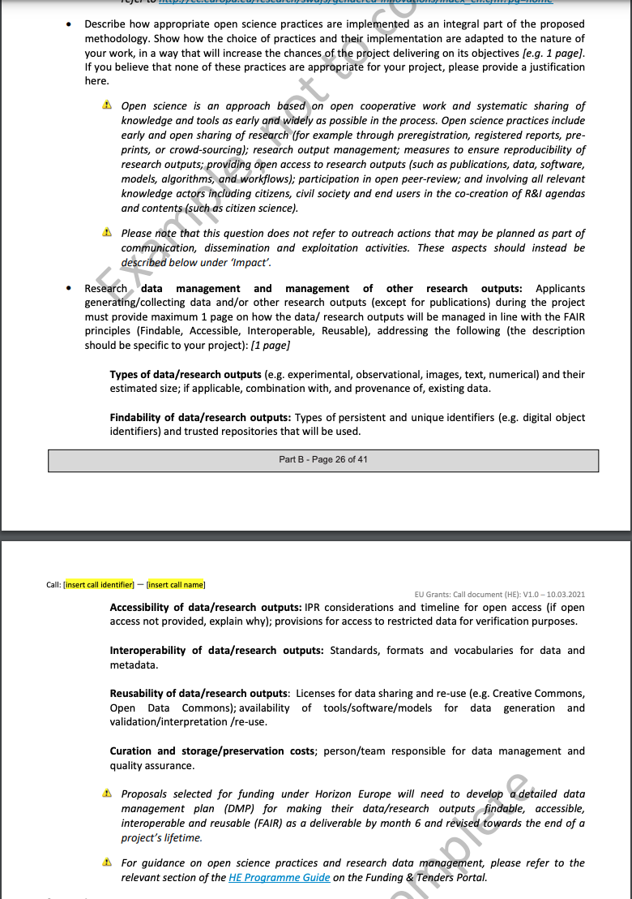
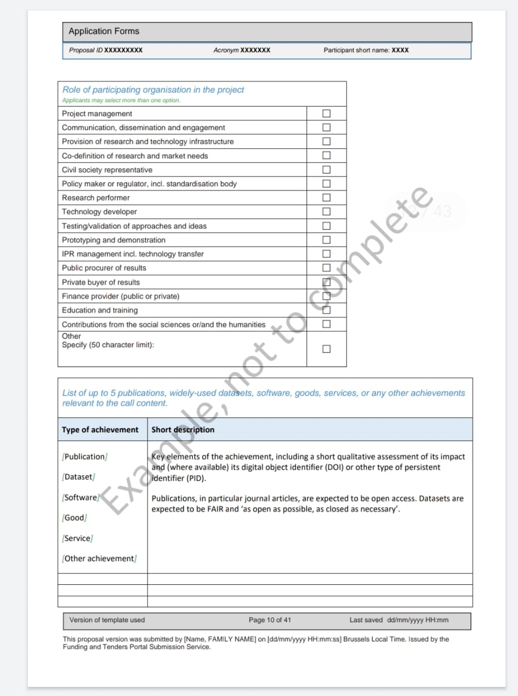
From the Horizon Europe Template
CV of beneficiaries are avaluated for publications (expected to be Open Access) but also widely-used datasets (expected to be FAIR and as open as possible, as closed as necessary), software, goods, services or any other achievements relevant to the call content.
No IF will be used
In proposal part B – methodology:
  Describe how appropriate open science practices are implemented as an integral part of the methodology
  Describe the strategy for FAIR Reseach Data Management

Slide 18

Tools are key
Photo by Todd Quackenbush on Unsplash

Slide 19

Open Research Europe
It is not a Journal, it is a publishing platform
The aim is to give researcher a venue where to publish the results of their research funded by the EC, irrespective of the perceived level of interest or novelty
Confirmatory or negative results, as well as null studies are suitable
The scope of the Peer Review is not to reject or accept a result but to improve its publication thanks to a collaboration effort among experts
The Reviewers role is to assess whether the research is technically sound and of academic merit.
Photo by Markus Winkler on Unsplash

Slide 20
Open Science is the new normal

Slide 21

emma.lazzeri@garr.it
This work was partially supported by European Union's Horizon 2020
under projects grant Agreement numbers 857650, and 777541.

