Slide 1
Najla Rettberg
University of Göttingen
OpenAIRE
How OpenAIRE can Support Open Science

Slide 2
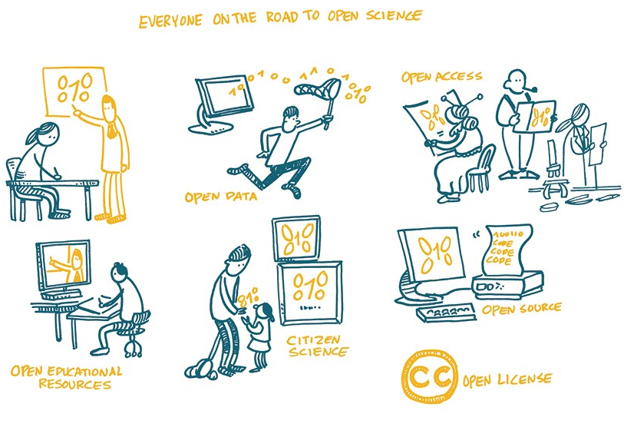
‘Everyone on the road to Open Science’ CC-BY 4.0 by Patrick Hochstenbach

Slide 3
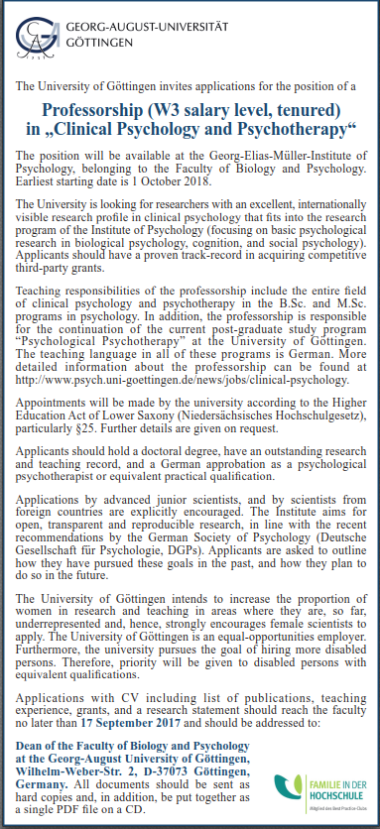
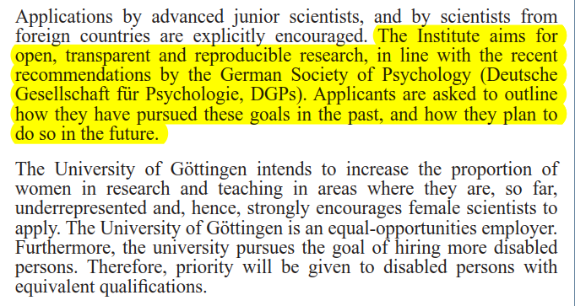

Slide 4
What does Open Science mean to you?
Publishing a paper in an OA journal
Deposit of a preprint* or final version in a repository
Rethinking workflows, what tools enable Open Science
Checking out data repositories, how to cite data
Making own research more reproducible
Engaging in replication studies
…
* Preprint = final author manuscript (before peer review), submitted or ready for submission to a publisher

Slide 5

open and reproducible science
scientific/scholarly communication
data infrastructure
social + technical links
service + data interoperability
Notes:
WHY: open and reproducible science
HOW: scientific / scholarly communication. To reach researchers as the main users of EOSC, a language of scientific / scholarly communication should be spoken. Excellent researchers do not have time to design infrastructure or temper technology but are eventually targeted towards communicating with peers through publishing any forms of research results, which contribute to their career development.
WHAT: a data infrastructure, establishing social and technical links, and offering interoperable services and data

Slide 6
3 levels of operation
National
Thematic
Global
Social/People
Technical/Services

Slide 7

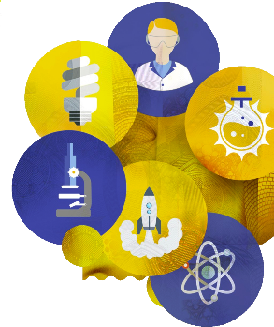


Open Science in the EU and OpenAIRE
OA to all publications
OA data pilot
Open Science the modus operandi
2007
Started
2013
OA pilot for publications
Legal Entity
2017
2021
OA data by default
2018
Zooming on Open Science

Slide 8




Services

Slide 9
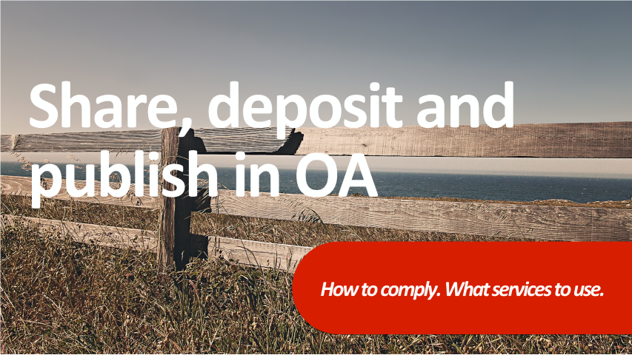

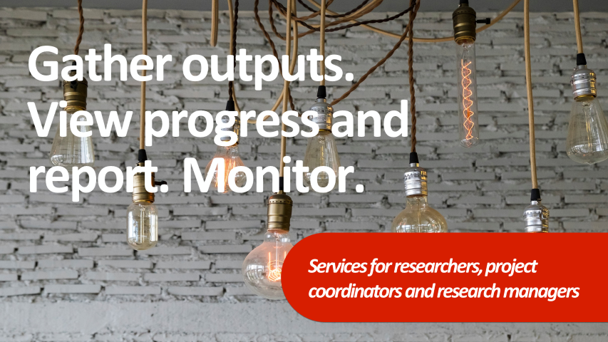


Slide 10

OpenAIRE services & tools for H2020 compliance:
Open Access depositing
Storing research data in Zenodo
Claiming publications and datasets
Reporting research outputs
Discover, analyse and access
Helpdesk, training and support material
10
10

Slide 11

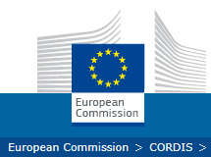
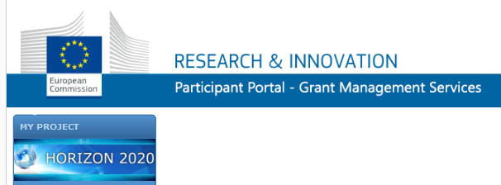
PROJECT
PUBLICATIONS
AND DATASETS
Automatically

Slide 12

Degrees of data sharing
Participation in ORD Pilot does NOT mean you have to open up all data!
“As open as possible, as closed as necessary”
OPEN
RESTRICTED/CONTROLLED
CLOSED
“Can be freely used, modified & shared by anyone for any purpose”
Limits on who can access & use data, how, and/or for what purpose
  only subset of data
  only certain (types of) users
  only certain types of use
  …
Under embargo
Unable to share
http://opendefinition.org
Adapted from ‘Managing and sharing research data’ by S. Jones, CC-BY
Notes:
Open data: sit at one end of data sharing spectrum
Open => data can be freely used…
Opposite of that: closed data (temporarily/permanently)
BUT: doesn’t have to be all or nothing
=> possible to share under more restricted conditions
Ideal here: as open as possible…

Slide 13
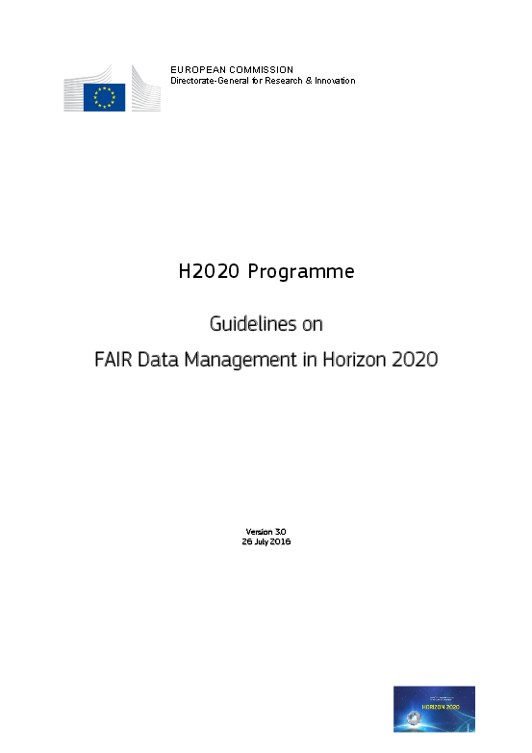
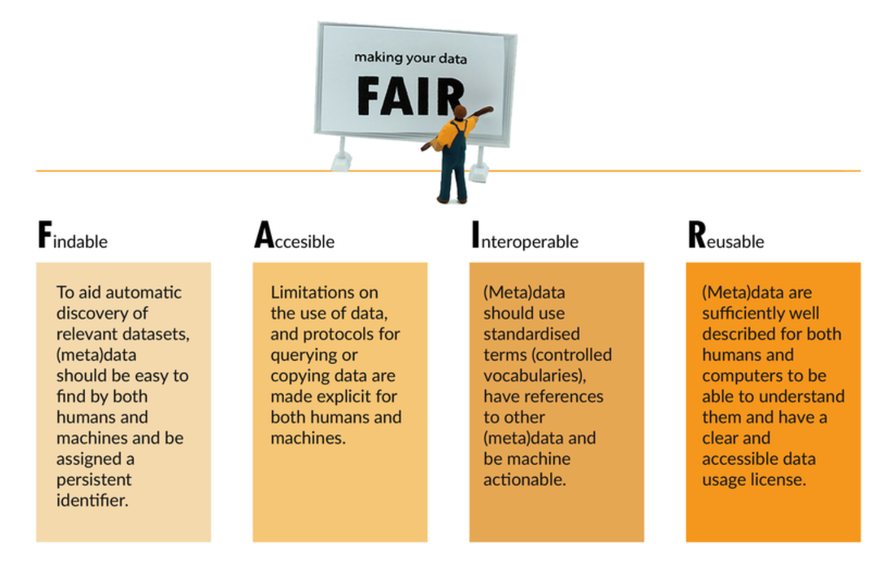
Aim to make your data FAIR
EC’s Guidelines on FAIR Data Management in Horizon 2020
From ‘Expert Tour Guide on Data Management’ by CESSDA ERIC, CC-BY-SA
Notes:
EC wants you to

Slide 14
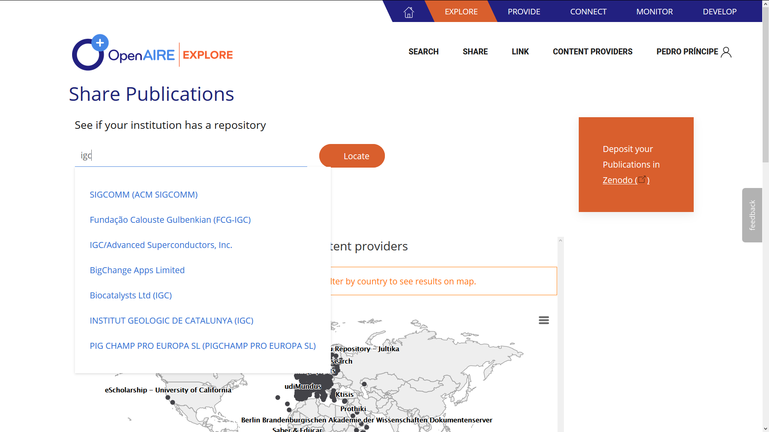
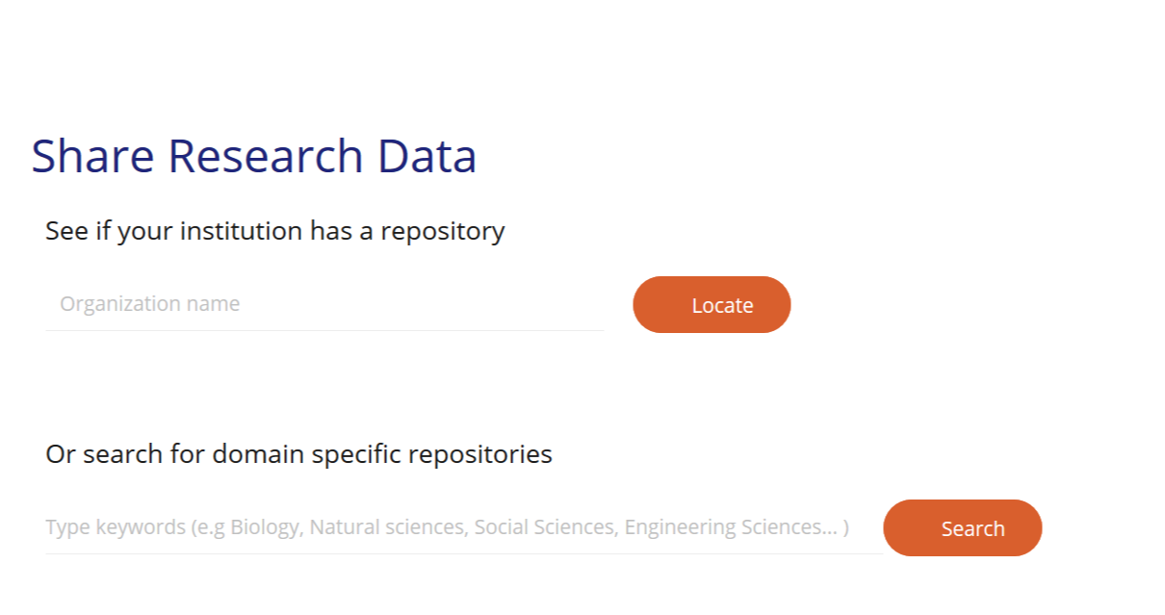
Find where to deposit
https://explore.openaire.eu/participate/deposit-publications
Notes:
If a researcher isn’t sure where to deposit , OPenAIRE can help.

Slide 16

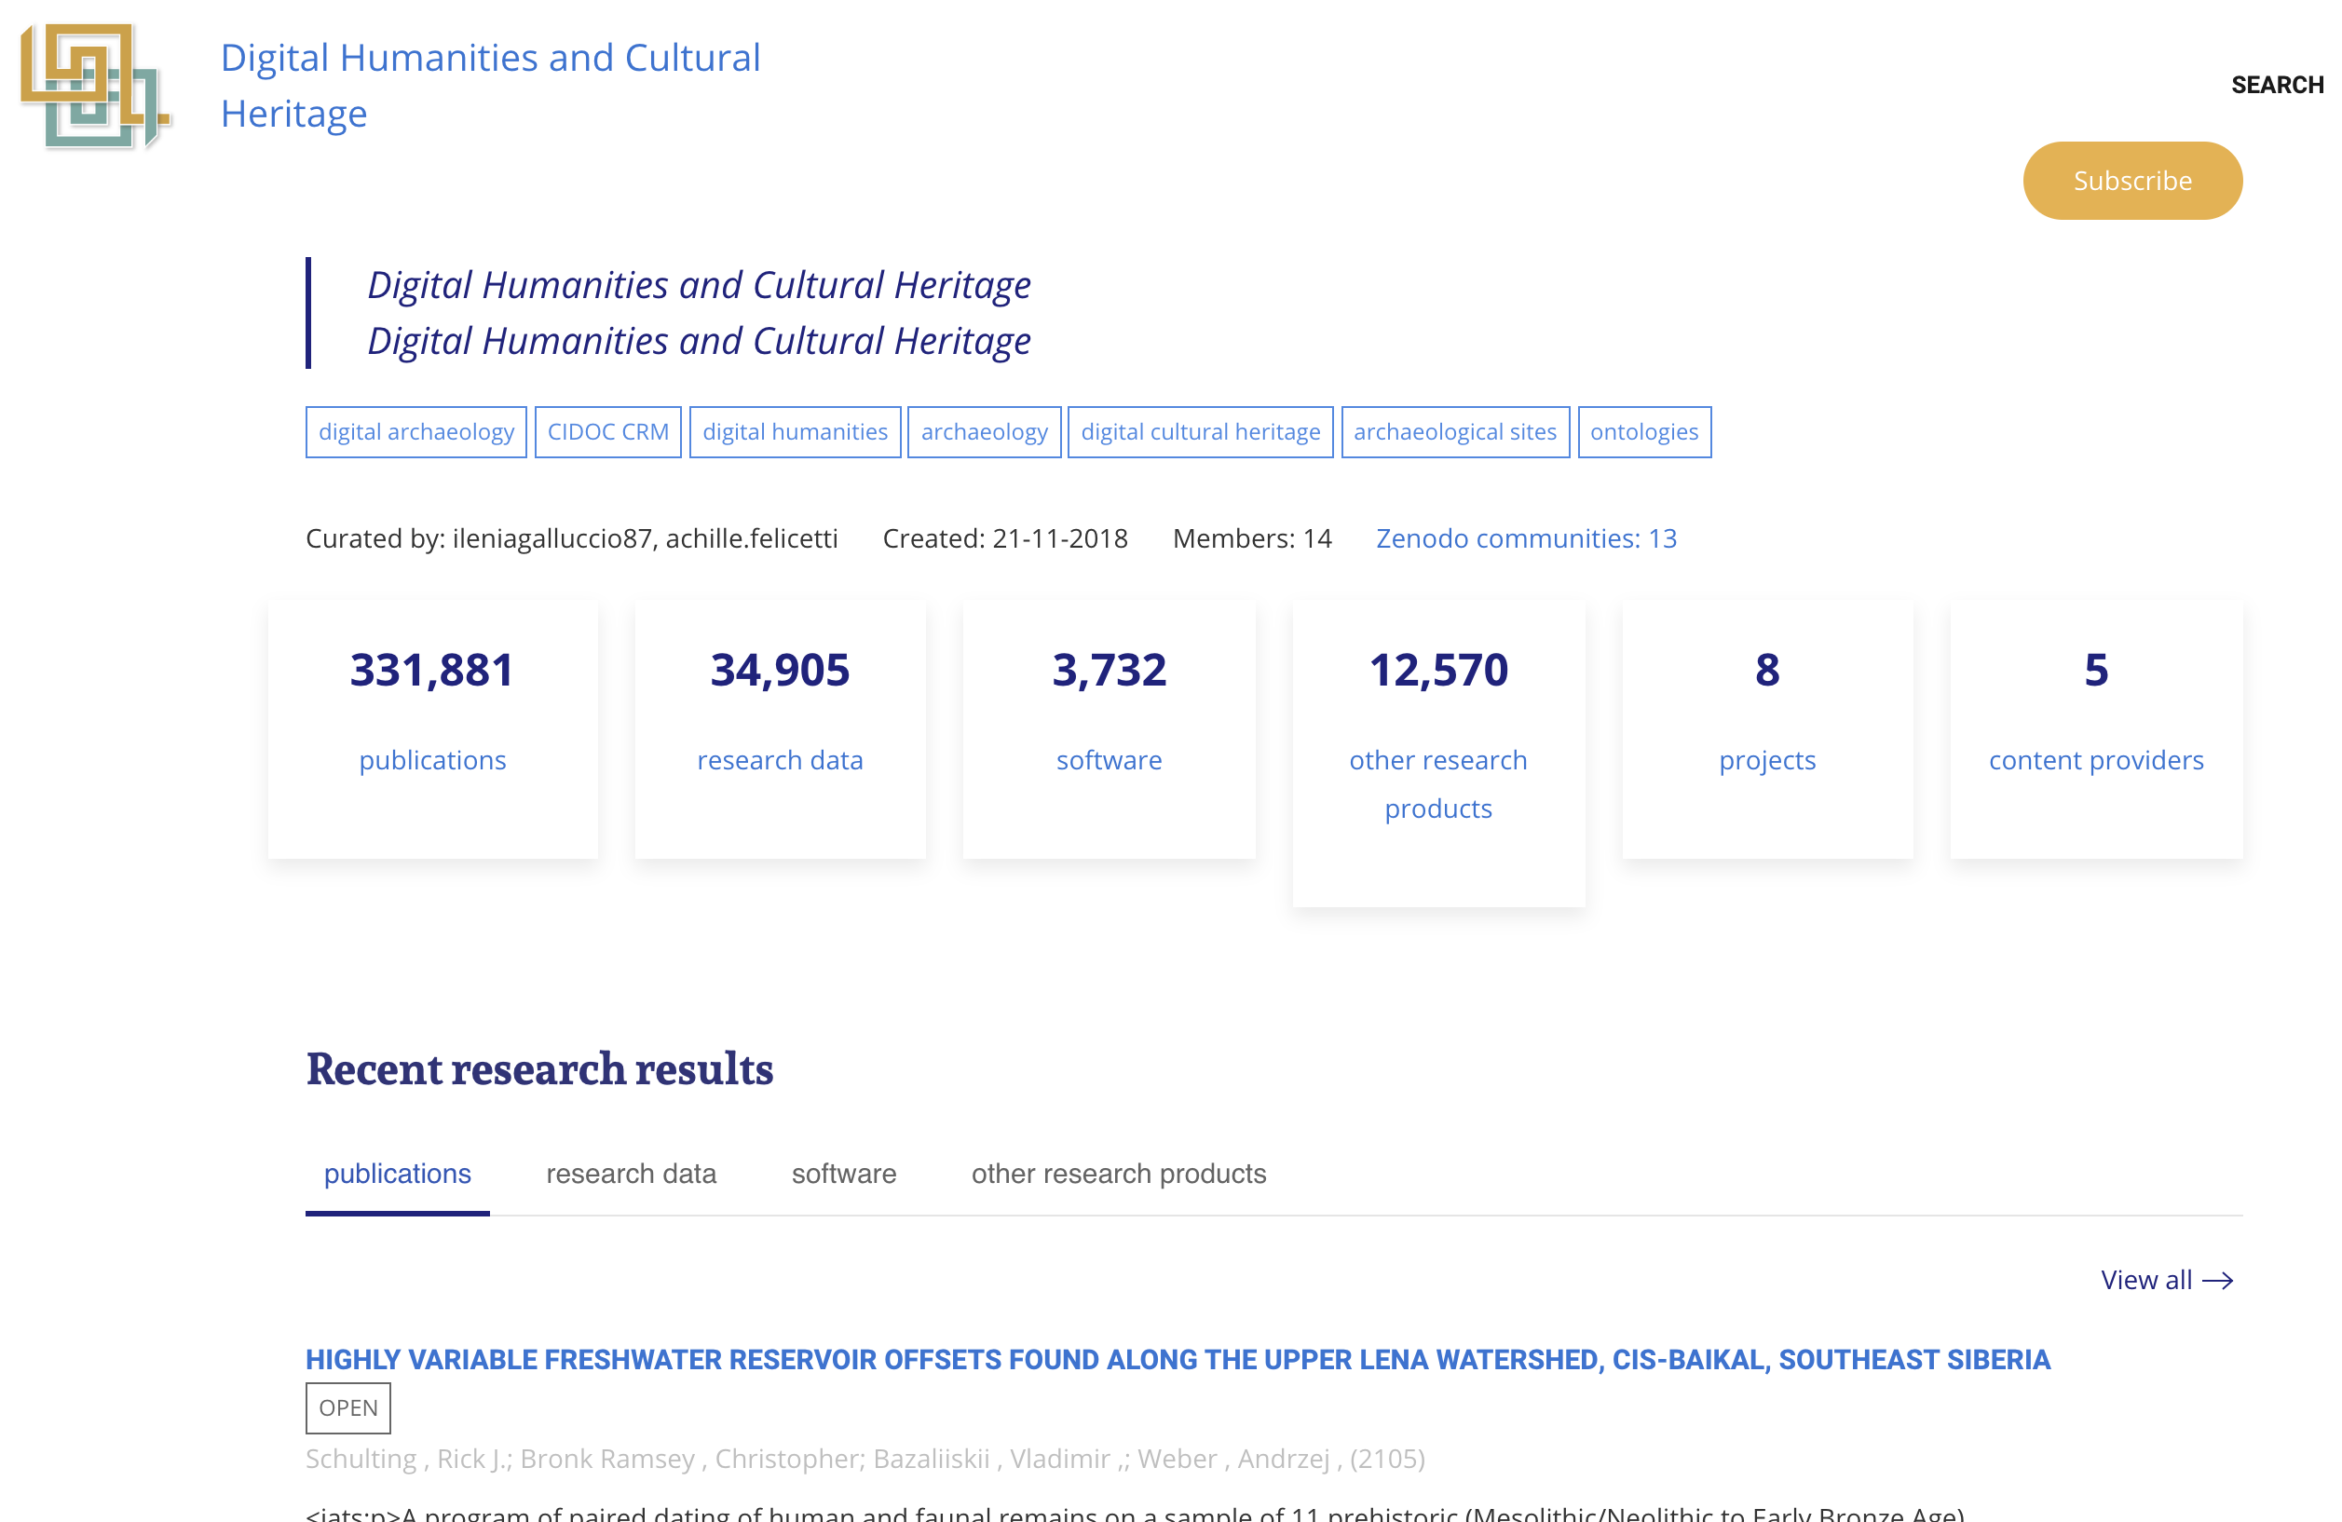

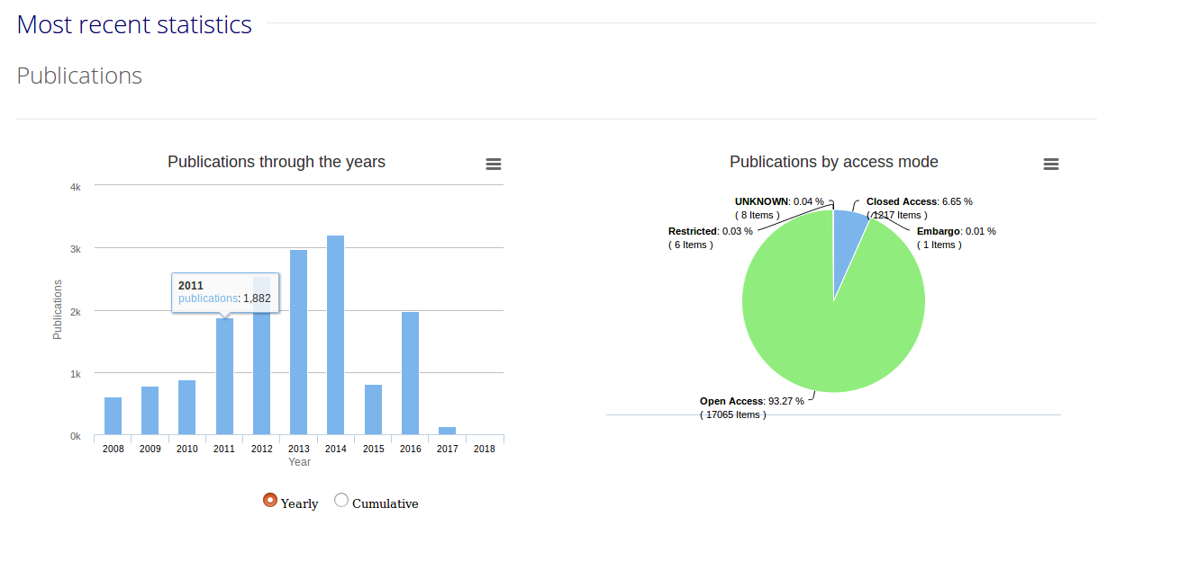
Customized portal for end users

Slide 17
Research Communities on board
Sustainable and Development Solutions Network - Greece
Is there interest from you as a Physics Community?
All your Outputs in One Place
Fisheries & Aquaculture Management
Digital Humanities and Cultural Heritage
Neuroinformatics
European Marine Science

Slide 18
Blowing on the fire of Open Science
Facilitate Research Communities adoption of Open Science publishing principles by supporting artefact publishing tools as-a-Service
Facilitate Content Providers at moving towards Open Science publishing by supporting notification-based research communication as-a-Service.
Agreenskills | Brussels | April 11th 2019

Slide 19

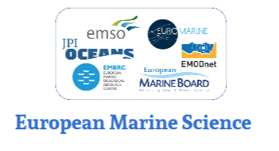




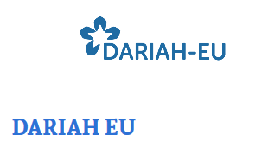





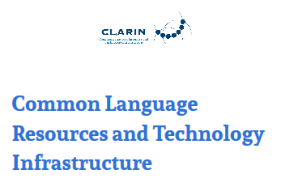
OpenAIRE Research Communities services status
COMMUNITY
RESEARCH INITIATIVE
Aims: publish, share and discovery
Aims: research impact

Slide 20
Research Communities and Open Science benefits
Common repository for publishing (deposition) of datasets, methods, and packages
Collaborative curation of a community-specific research communication domain
Research impact and statistics
Can continue their publishing practices, but, if needed they have support for deposition of any artefact
Community information space to share, discovery, and reuse (reproduce) scientific results
Scientific reward strategies can be developed
EuroMarine Young Scientist Working Group Workshop – Cádiz, Spain, January 28, 2019

Slide 21
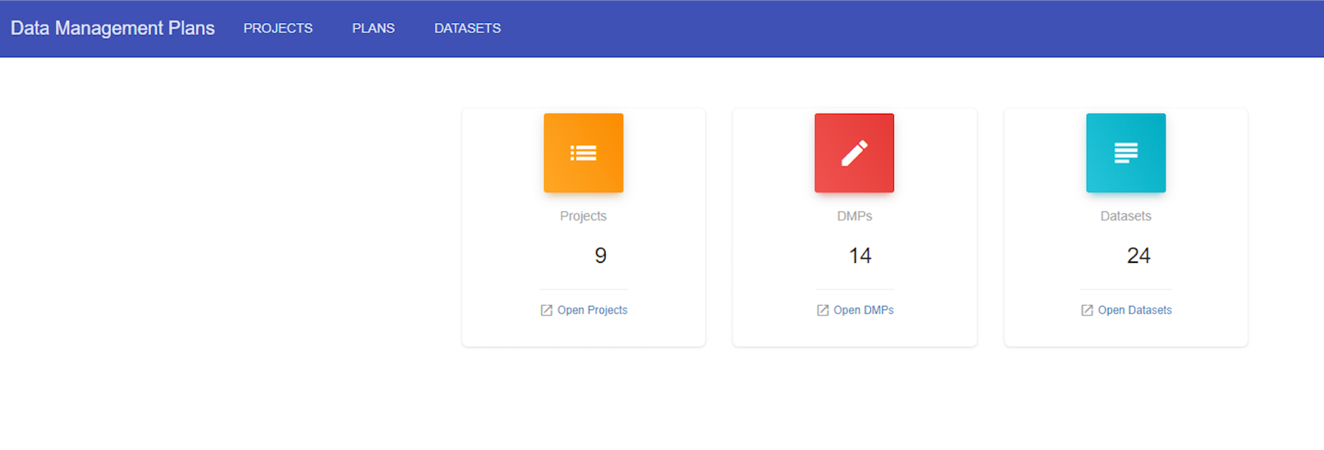

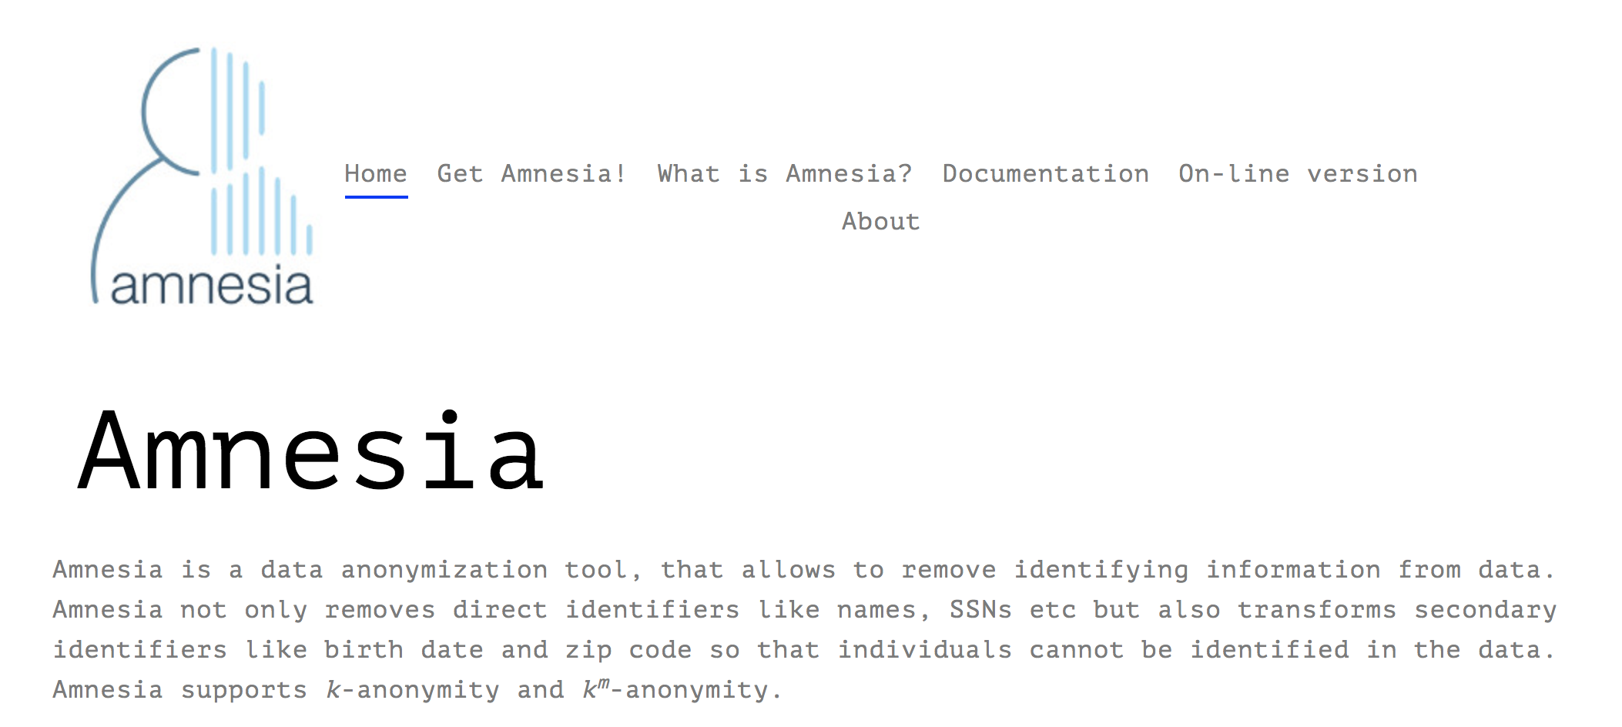
Services for RDM

Slide 22
Support

Slide 23
How we support
Distributed and hierarchical training: train-the-trainers
NOADs ⇢ National / research infras, organizations ⇢ Researchers
RESOURCES
TRAINING
HELPDESK
FAQs
OA guides
Copyright issues
Factsheets
Webinars
Workshops
Ask a question
Notes:
OpenAIRE supports the various Open Access policies in the European Research Area. OpenAIRE offers a variety of resources and support info materials, and if you still have questions – helpdesk.

Slide 24
OpenAIRE: A pillar in EOSC

Slide 25
Why European Open Science Cloud?
Now: A fragmented e-infrastructure landscape
End-users, such as researchers, innovators or industry actors, often are unaware of the available e-infrastructure services
  Even if users find out about the availability of a certain e-service, it is difficult to gather further information and compare it with other existing services.
Service providers and data producers often have difficulty reaching out to potential new users
  Even when they reach them, service providers often lack user feedback on the ways they could improve their offerings.

Slide 26
EOSC at a glance
The role of the EOSC is to ensure that European scientists reap the full benefits of data-driven science, by offering:
“1.7 million European researchers and 70 million professionals in science and technology a virtual environment with free at the point of use, open and seamless services for storage, management, analysis and re-use of research data, across borders and scientific disciplines”
2016 Communication on the “European Cloud Initiative”

Slide 27
Key characteristics
Trusted and open virtual environment with seamless access to services (with highest TRLs) addressing the whole research
  Federating core services to federate and connect existing or planned RIs
  Services to make data FAIR, store them, ensure their long-term preservation
  Services to find, access, combine, analyse and process data
  Protected, personalized work environmenth data life cycle:
Multi-layered federation (federating core, rest of the ecosystem), which brings together supply and demand in a trusted environment
Open, transparent, rule of law based: no lock-in by individual service providers, data portability, IPR, cloud security…
Adaptively user-oriented and inclusive (across borders and disciplines)
Accessible through a non-exclusive, simple, universal hub/ gateway
Governed by a minimal set of Rules of Participation
Steered by an inclusive governance structure

Slide 28
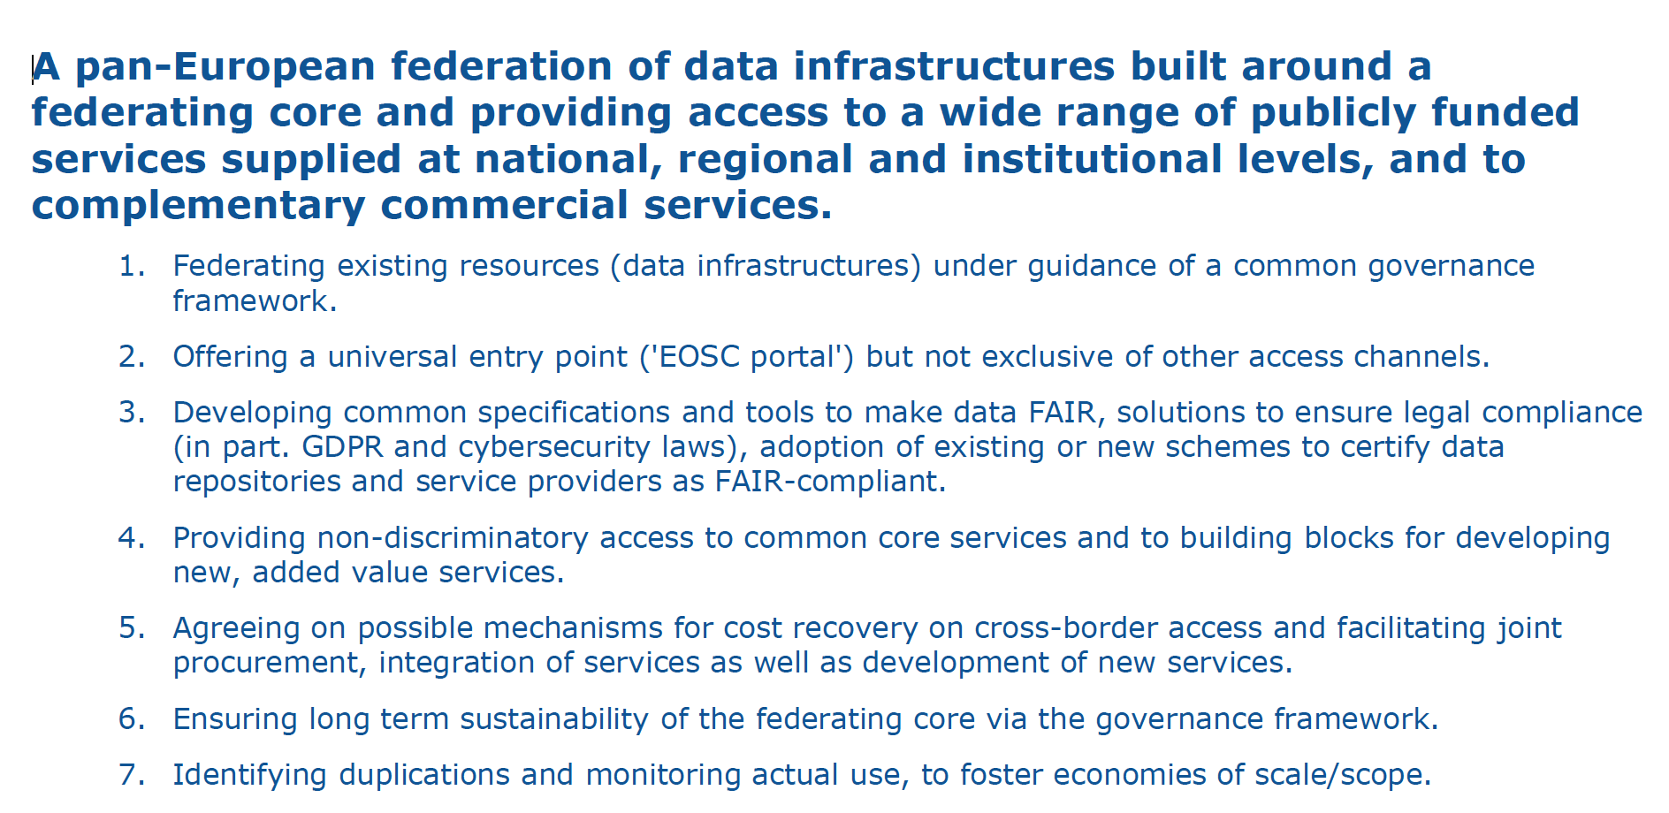
EOSC is a federated model

Slide 29
Najla Rettberg
nrettbe@gwdg.de

