Slide 1
Open Science: from vision to action
J.C. Burgelman
S.Luber, R. Von Schomberg, W. Lusoli, D.Spichtinger
European Commission
DG Research & Innovation
LIBER Annual Conference, Senate House, London, 24-26th June 2015.
(does not represent an official point of view of the EC)

Slide 2
Overview
A changing paradigm
Outcome of the consultation and stakeholder discussions
Suggested policy actions
Priorities for the European Commission: European Open Science Agenda

Slide 3
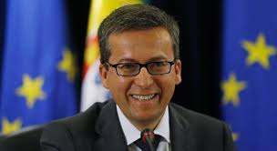
Commissioner view
"Open Science, of which Open Access is an important part, will be vital to ensuring European progress and prosperity in the future"
(Speech at NETHER, January 26, 2015)

Slide 4
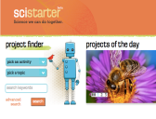







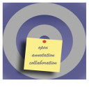




It's real!
An emerging ecosystem of services and standards
Sci-starter.com
Figshare.com
Data-intensive
Citizens science
Open code
Runmycode.org
Myexperiment.org
Open workflows
Pre-print
ArXiv
Analysis
Publication
Review
Conceptualisation
Data gathering
Open data
Roar.eprints.org
Open access
Datadryad.org
Open annotation
Impact Story
Alternative Reputation systems
Openannotation.org
Scientific blogs
Altmetric.com
Collaborative bibliographies
Researchgate.com
Academia.edu
Mendeley.com

Slide 5
Key drivers of Open Science
  Exponential growth of data
  Availability of digital technologies
  Increase of the global scientific population
  Public demand for better and more efficient science
  Demand for accountable, responsive and transparent science
  Need to address faster societal challenges
  Need to contribute to economic growth

Slide 6
It's not happening in isolation
Open source software
Collaborative knowledge production
Creative commons
Open innovation
The sharing/collaborative economy ("collaboratism")
MOOC
Web 2…
→ what started +/- 15 years ago is deeply affecting (“paradigm shift”) commerce, manufacturing, health, government, social relations, media, culture,….
→ and now science and research
Notes:
Ad 1) Linux works, P2P dominates…
Ad 2) Wikipedia, wiki science….
Ad 3) >400 MM works under CC license
Ad 4) becoming mainstream: e.g. Novartis use 30% of their R&D budget to buy in from external research centers.
Ad 5) helped to solve one-third of a sample of problems that large and well-known R & D-intensive firms had been unsuccessful in solving internally.
OECD (2008b), Open Innovation in Global Networks, Lakhani et al., 2007
Ad 6) – Air BnB (*2008, 500K listings, 4.000K bookings in 2013) – crowd financing (Scanadu, 1.8000K in US in 2013)
Ad 7) : 3 US MOOC providers offering 400 courses for 3 million users world wide

Slide 7
It offers opportunities for society and the economy
Better value for money by strengthening the productivity of the European science and research system through the uptake of results by businesses, in particular SMEs that may not have the resources to pay for access to research results.
More transparency, openness and networked collaboration leading to a higher degree of responsiveness of the research community to societal challenges.
A sound science and society relationship: more openness may also lead to more trustworthy science from the point of view of the citizen and civil society organisations (NGOs).
Big and open data are estimated to add 1.9% of EU-28 GDP by 2020.
Notes:
Describe the importance of opening up the research processes and why
Benefits of 'Open Science':
Contributing to Innovation, Growth and Employment if: key elements of 'Open Science' becomes target of coordinated EU Policy and bottom-up stakeholder involvement
Making ERA more efficient: sharing and better (re-)use of resources
An European Open Science Agenda under ERA would enable Member States to work together on issues of common concern (Grand Challenges) facilitated by collaborative, open research possibly funded through schemes under H2020 and joint initiatives by Member States
Is it becoming also more demanding?

Slide 8
Background
    Public consultation: Science 2.0: Science in Transition
Assess the degree of awareness amongst the stakeholders of the changing modus operandi
Assess the perception of the opportunities and challenges
Identify possible policy implications and actions to strengthen the competitiveness of the European science and research system
Numbers:
From 03.07.2014 to 30.09.2014
498 submitted responses of which 164 Organisations and 38 Public Authorities
28 position papers voluntary submitted in addition to questionnaire

Slide 12
Notes:
85% of respondents (the third highest priority) consider the lack of integration in the existing infrastructure as a very important or important barrier!

Slide 13
Notes:
Our view on the opportunities and benefits of Open Science are shared by a large majority of respondents, e.g.
Open Science can make science more reliable, efficient and responsive
Open Science can have a considerable socio-economic impact – faster and wider innovation/ data-driven science as key economic driver

Slide 14
Rank : the lowest need (1) to the highest need (11)
Notes:
Third priority: research infrastructure

Slide 15
    Objectives of possible future policy initiative (results from validation workshops)
Support big data (infrastructure) needs – includes governance
Improving Framework Conditions (Removing barriers, creating incentives) for fostering Open Science
Making science more efficient (better use of and sharing of resources), reliable (replicability/re-use of data) and more responsive to societal challenges
Stakeholders share these expectations of 'Open Science' with large majority, on "condition":
bottom-up
stakeholder-driven

Slide 16
  From policy to action
  Open Science as an action under the Digital Single Market initiative of the European Commission (adopted 6 May 2015), e.g. establishment of a 'European Open Science Cloud'
  Policy Debate on Open Science at May Competitiveness Council (28 May 2015)

Slide 17
Open Science
Competitiveness Council 29 May 2015
Member States expressed their wish for the development of a European Open Science Agenda
CALLS for action to remove obstacles to wide access to publicly funded research publications and underlying data;
CALLS for actions addressing better data management and, in this context, WELCOMES the Pilot on Open Research Data under Horizon 2020;
In the context of the implementation of the European Research Area (ERA), LOOKS FORWARD to the possible development of action plans or strategies for open science

Slide 18
  Three priorities of CssR Moedas
  - Open Science
  - Open Innovation
  - Open to the world
22/23-6-2015 Conference:
"A new start for Europe:
Opening up to an ERA of Innovation”
Launch of a European Open Science Agenda

Slide 19
Developing a European Open Science Agenda: Three building blocks
Removing barriers and creating incentives (e.g. Text and Data Mining (TDM), alternative metrics, research integrity)
Developing infrastructures for Open Science (e.g. European Open Science Cloud)
Embedding Open Science in society (e.g. citizen science, knowledge coalitions to address societal challenges)

Slide 20
Underlying principle:
The European Open Science Agenda must be the result of:
a bottom-up process
co-creation and co-responsibility of all actors on all levels
To ensure that the European science and innovation system will catch the momentum and grasp all benefits.

Slide 21
Developing a European Open Science Agenda: The Roadmap
  Autumn 2015: Stakeholder Discussion on the European Open Science Agenda
  Autumn 2015\Spring 2016: Concretization of Open Science actions under the DSM strategy
  4-5 April 2016: Conference on Open Science during the Dutch Presidency
  May 2016: Presentation of the European Open Science Agenda to the Competitiveness Council

Slide 22
Open Science 2030
A Day in the Life of a Scientist, AD 2030

Slide 23
This is a common endeavor.
Contribute!
http://scienceintransition.eu/

Slide 24
A European Open Science Cloud
Rationale and first ideas
Work in progress.

Slide 25
European
Open Science Agenda
  Science 2.0 consultation (July-Sept 2014)
  ~ 85 % agree to some extent that data infrastructures are a bottleneck
  Spontaneous position papers from research stakeholders
  Possible actions
  Mandate the development of common interfaces and data standards
  Coordinate at European Level the funding/ maintenance and interoperability of research infrastructures
  Support the development of a European Open Science Cloud for research

Slide 26
European
Open Science Cloud
The European Open Science Cloud is part of Europe´s ambition to support the transition to Open Science and make the most of data-driven science.
European scientists strongly stated the need for a research data infrastructure that is cost-effective, preserves privacy and is IPR-conscious (Science 2.0 consultation).
The cloud provides all EU researchers a virtual environment with free, open and seamless services for data storage, management, analysis and re-use, across disciplines.
The cloud will federate existing and emerging horizontal and thematic data infrastructures, effectively bridging todays fragmentation and ad-hoc solutions.
The cloud adds value - scale, data-driven science, inter-disciplinarity, data to knowledge to innovation - and leverages current and past infrastructure investment (10b per year by MS, two decades EU investment).

Slide 27


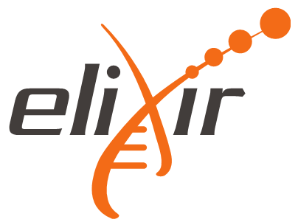





European
Open Science Cloud
Scale of scientific activity (data-driven science)
Physics
Life sciences
Earth sciences
Applied - engineering
Economics
… …
Social
sciences
Humanities
Citizen science
Lead users… Scientific communities …long tail

Slide 28






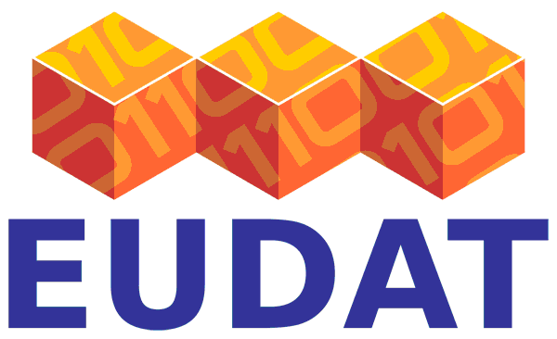



European
Open Science Cloud
Scale of scientific activity (data-driven science)
Governance
layer
Bottom-up governance
Federation
Legacy and sustainability
Leverage of MS investment
Physics
Trust
Service
layer
Life sciences
IPR protection
Privacy and personal data protection
Big data analytics
Earth sciences
Data fusion across disciplines
High performance computing
Applied - engineering
Data
layer
Data storage
Economics
Data access and re-use
… …
Data manipulation and export
Data discovery and catalogue
Social
sciences
… …
Humanities
Citizen science
Lead users… Scientific communities …long tail

