Slide 1
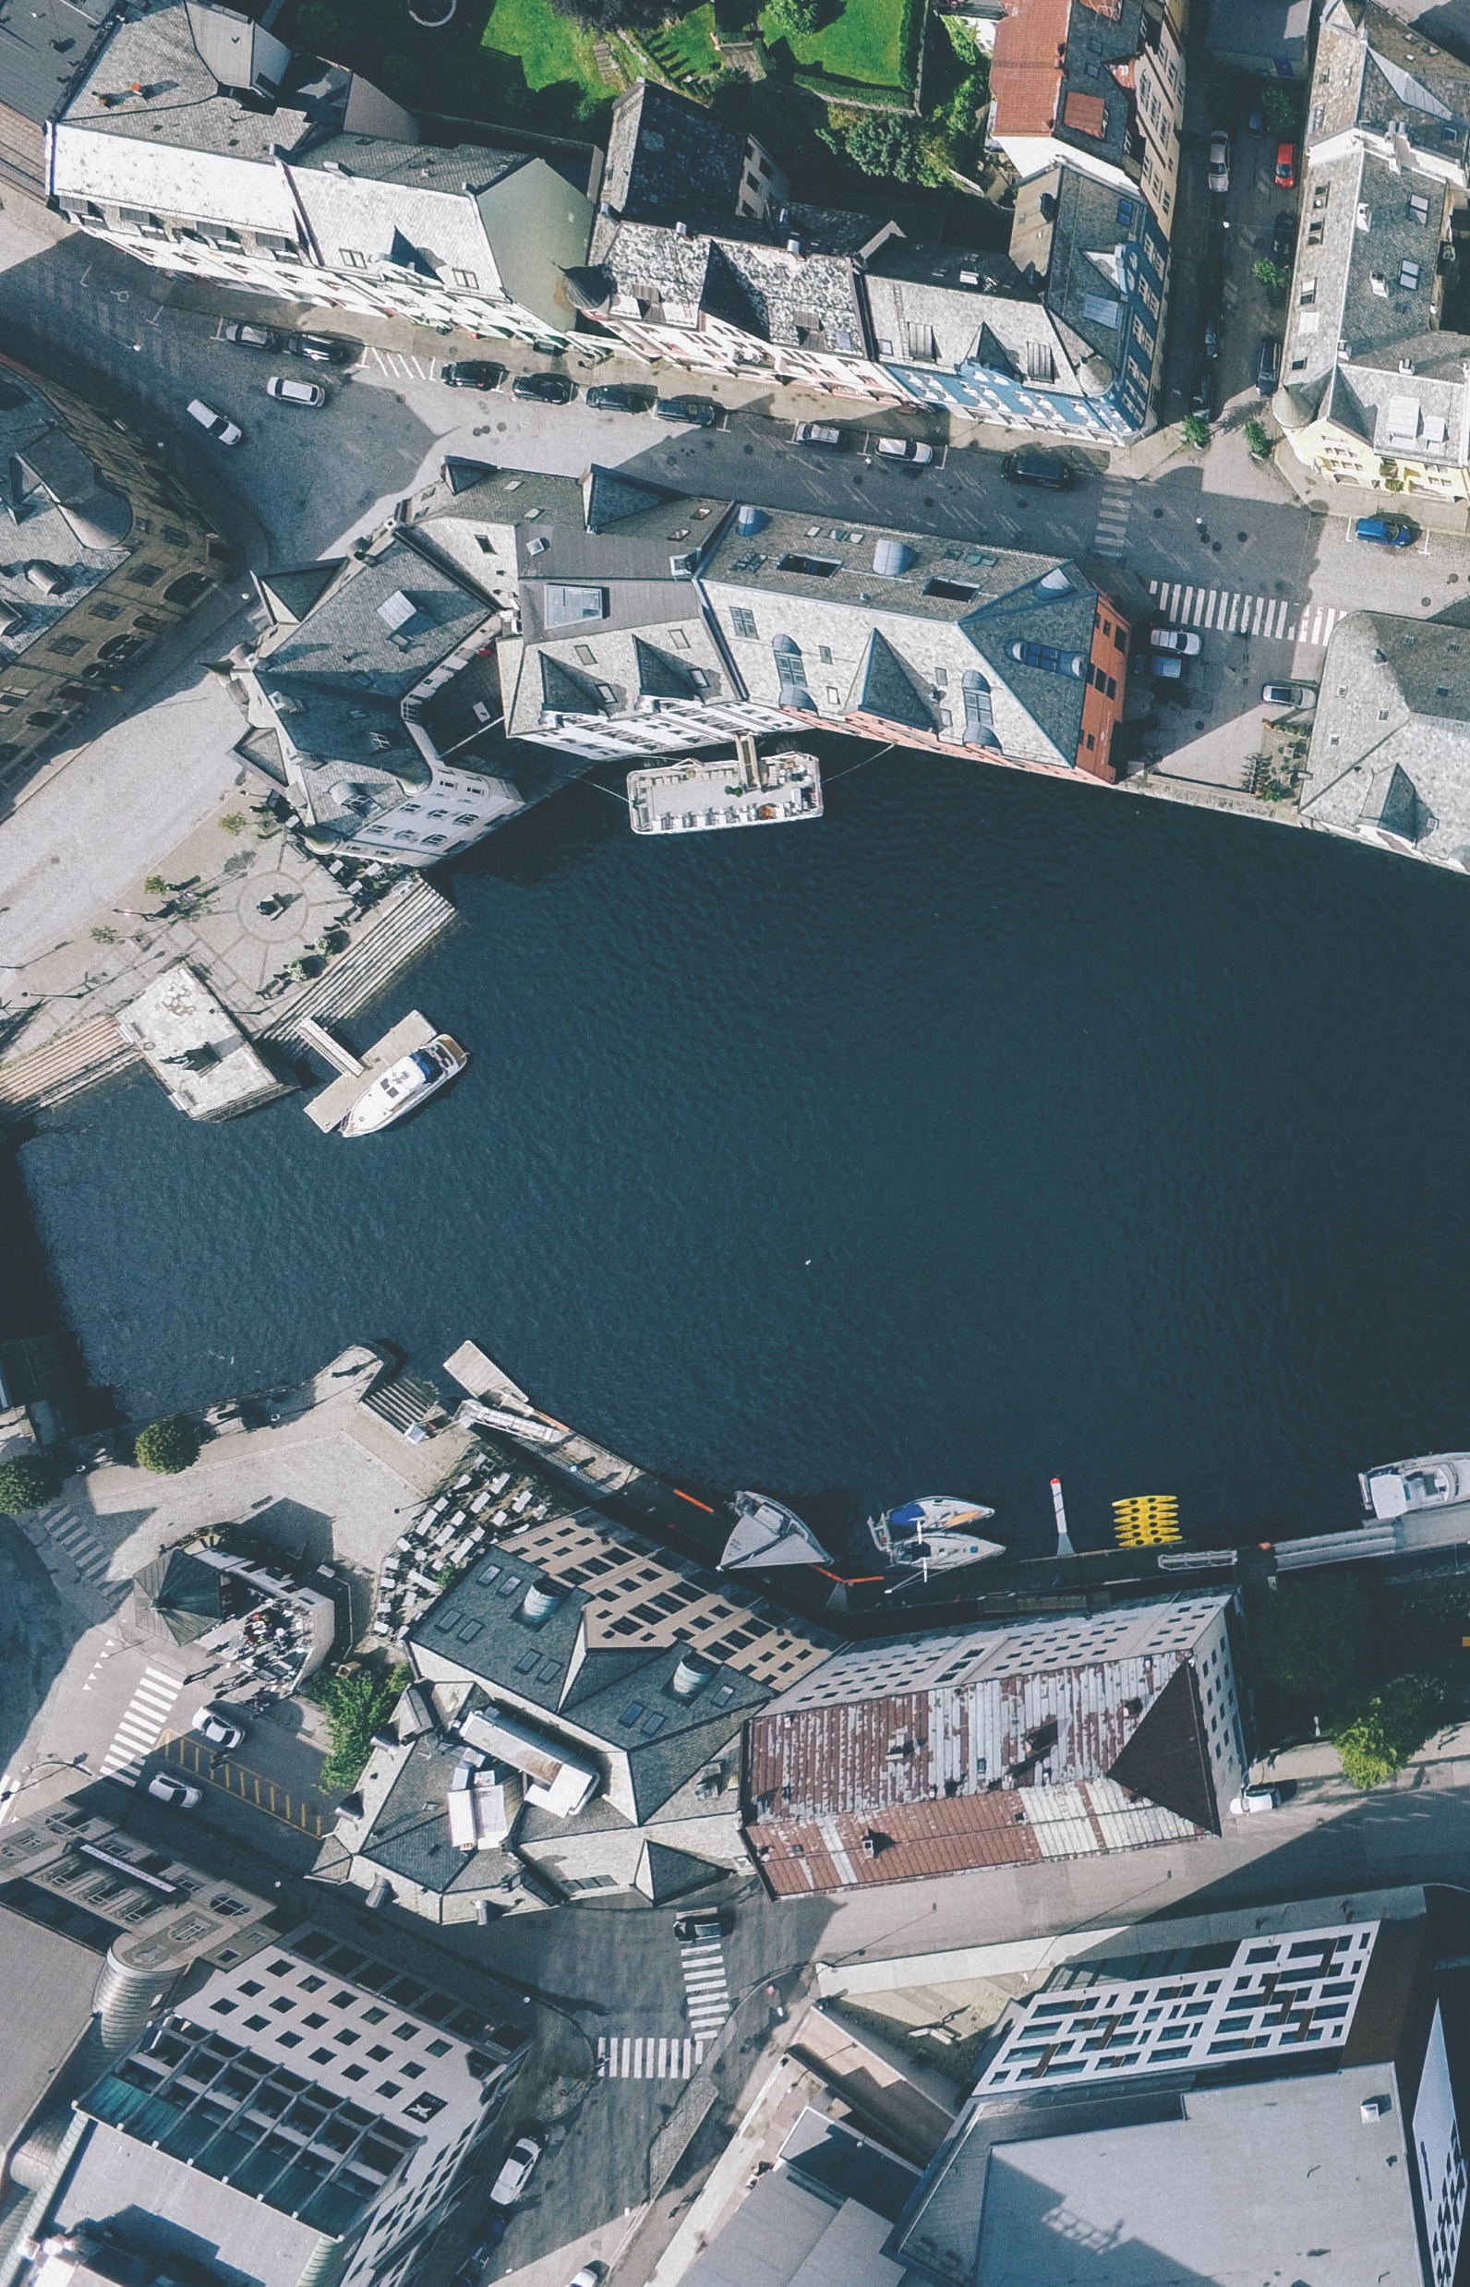
www.osgeo.org
Townhall TM8
Demystifying Open Science
P. Löwe
Notes:
The above slide is made up of three layers
- Icons, Title and Subtitle
Triangle shapes in transparent, green, white and dark
A picture which you can replace, we have left it sticking out a bit on the bottom to make it easier to replace

Slide 2

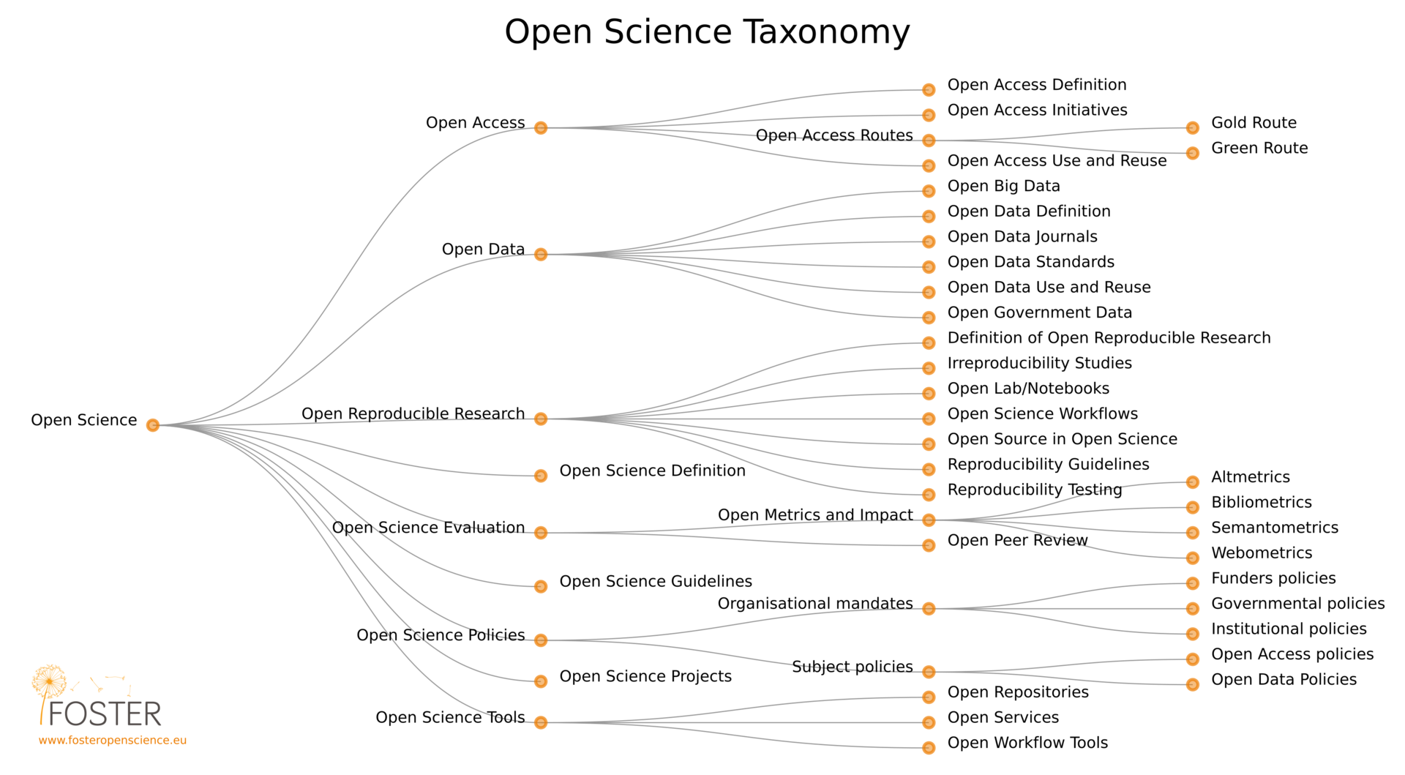
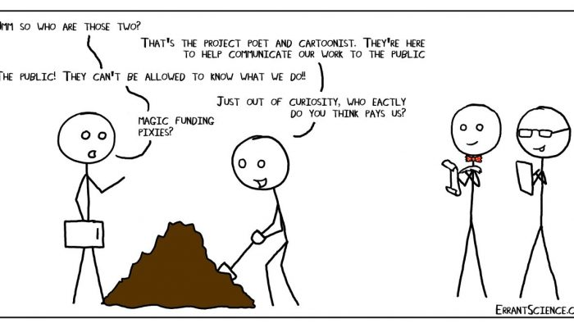


What is Open Science ?
https://en.wikipedia.org/wiki/Open_science#/media/File:Os_taxonomy.png
Matthew Partridge,
EGU’s Cartoonist in Residence
https://blogs.egu.eu/geolog/files/2018/04/EGU-cartoon-700x400.jpg

Slide 3
The Open Source Geospatial Foundation
OSGeo is a not-for-profit software foundation
  Provides projects financial, organizational and legal support
Outreach and advocacy
  Promoting global adoption of open source geospatial technology
  Partnerships on open approach to standards, data and education.
OSGeo is a volunteer driven
  Passionate membership of individuals from around the world.

Slide 4
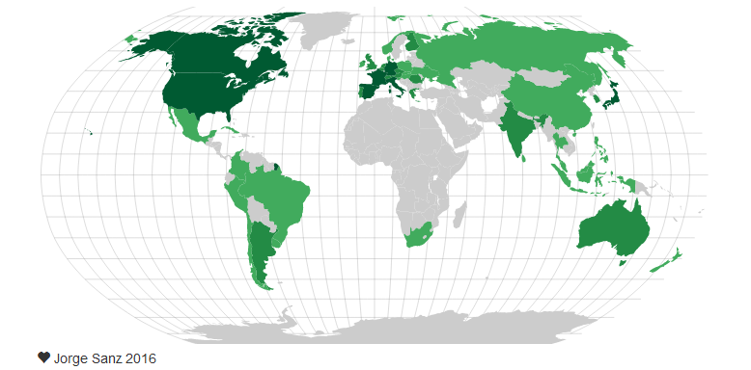
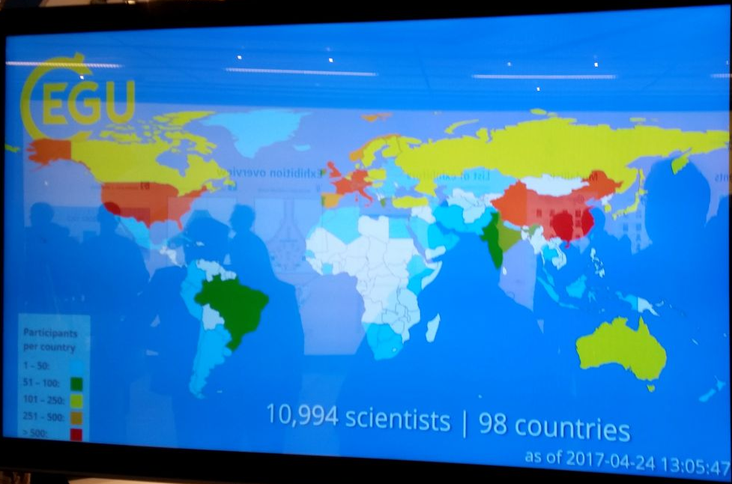
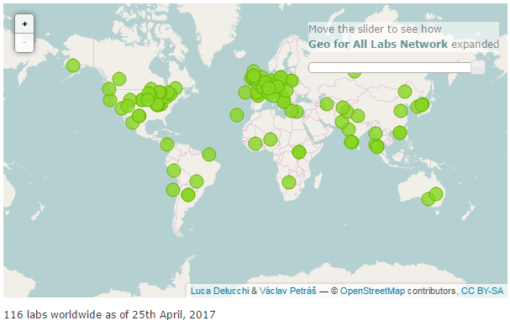
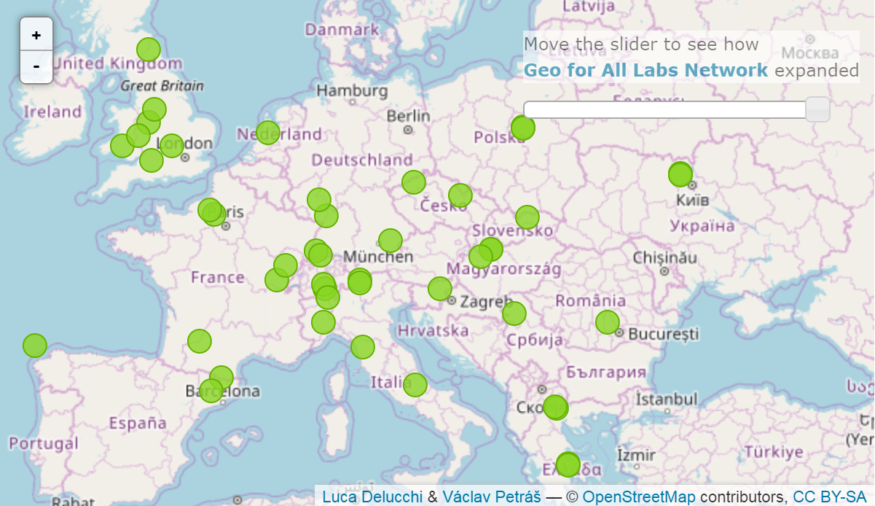
OSGeo
People, Ressources, Education
OSGeo volunteers
Geo4all:
Open geospatial education @ universities
EGU GA
2017
participants
Register your open geospatial education ressources: https://www.osgeo.org/initiatives/geo-for-all/how-to-join-geo-for-all/

Slide 5
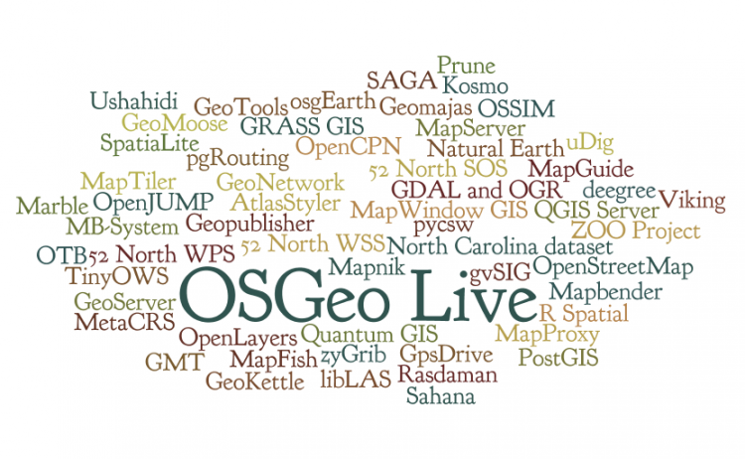
Over 10 years of software project incubation
Software projects are sanctuaries for the research code:
Ensuring long term reuse and credit
Trustable quality-checked software projects
average of ~2 years for graduating
23 graduated projects
7 still incubating (2017)
Notes:
10 nel 2006 e poi 11 in 10 anni !!!!!

Slide 6

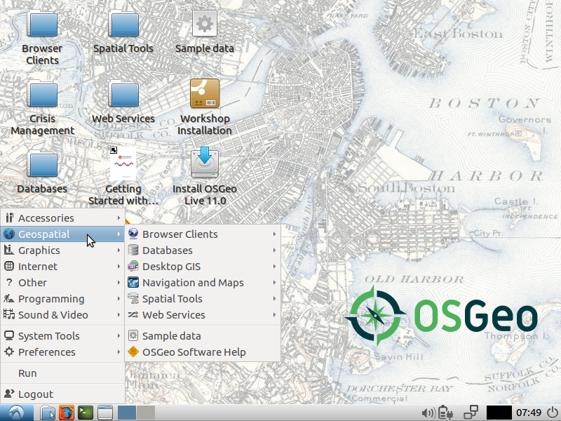
OSGeo Projects: The OSGeo live bundle
a self-contained bootable DVD,
USB thumb drive or Virtual Machine
Download OSGeo live: https://live.osgeo.org

Slide 7
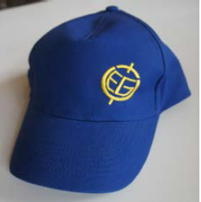

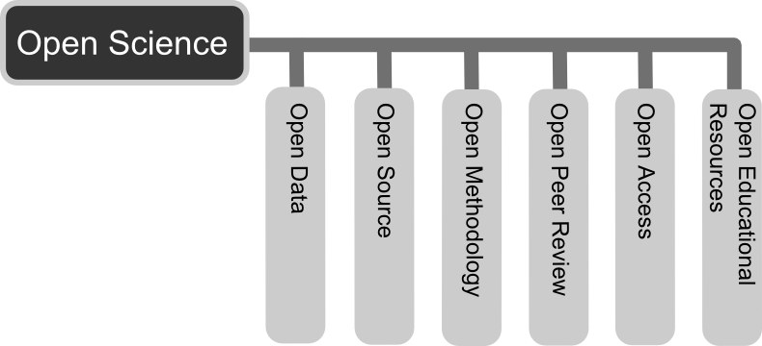
OSGeo: An integral part of Open Science
Community driven software projects

Slide 8
OSGeo: An integral part of Open Science
Community driven software projects

Slide 9


Communities and projects
OSGeo Software Foundation
- collaborative development of open geospatial technologies and data for Open Science in Europe
Communities and community projects
Graduated projects
Notes:
OSGeo supports projects
Technically with community of their peers
Socially with community building and outreach
Professionally ensuring each project is governed in a fair and sustainable manner

Slide 10
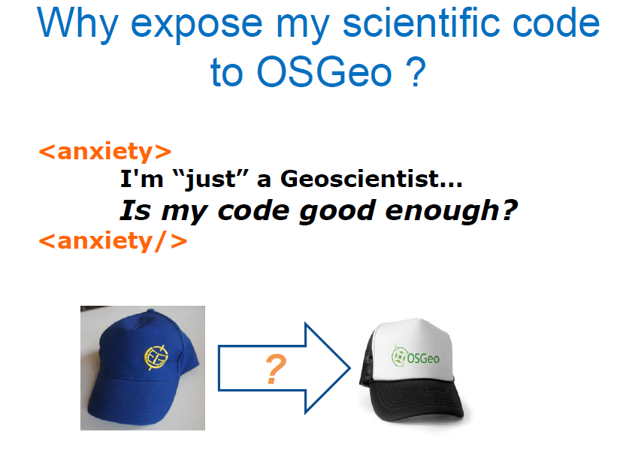
Open Science for EGU Early Career Scientists ?
Anxiety as a blocker

Slide 11

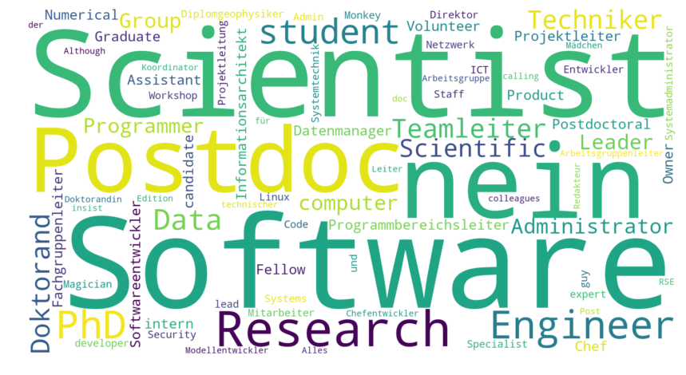
Thursday night:
First Research Software Engineers
in the Geosciences Townhall @ EGU !
☑ “Better software - better research!”
☑ “It's impossible to conduct research without software, say 7 out of 10 UK researchers.” (2010 SSI, UK, study)
☑ “I contribute to software for Science.”
TM13 | Thursday | 19:00–20:00 | Room L8
Conveners: D. Nüst, M. Hammitzsch, B. Fritzsch, D. Topping

Slide 12



News: A OSGeo chapter for Europe
National OSGeo local chapters have been established
New: OSGeo Europe Chapter has been funded (legal European non for profit entity, Belgium) as a central point of contact to the European Commission
European efforts like INSPIRE, GEANT, FOSTER, etc. will benefit from input by OSGeo
OSGeo fosters Open Geospatial Education in Europe: Next step - An European open geospatial curriculum ?

Slide 13

News: OSGeo and AGU sign a Memorandum of Understanding
“establish a collaborative relationship between the Open Source Geospatial Foundation (OSGeo) and the American Geophysical Union (AGU). Both parties to this MOU share the goal of helping share openly all global geo-information with all communities.”
“The American Geophysical Union is dedicated to advancing the Earth and space sciences for the benefit of humanity through its scholarly publications, conferences, and outreach programs. AGU is a not-for-profit, professional, scientific organization representing 60,000 members in 137 countries. “

Slide 14
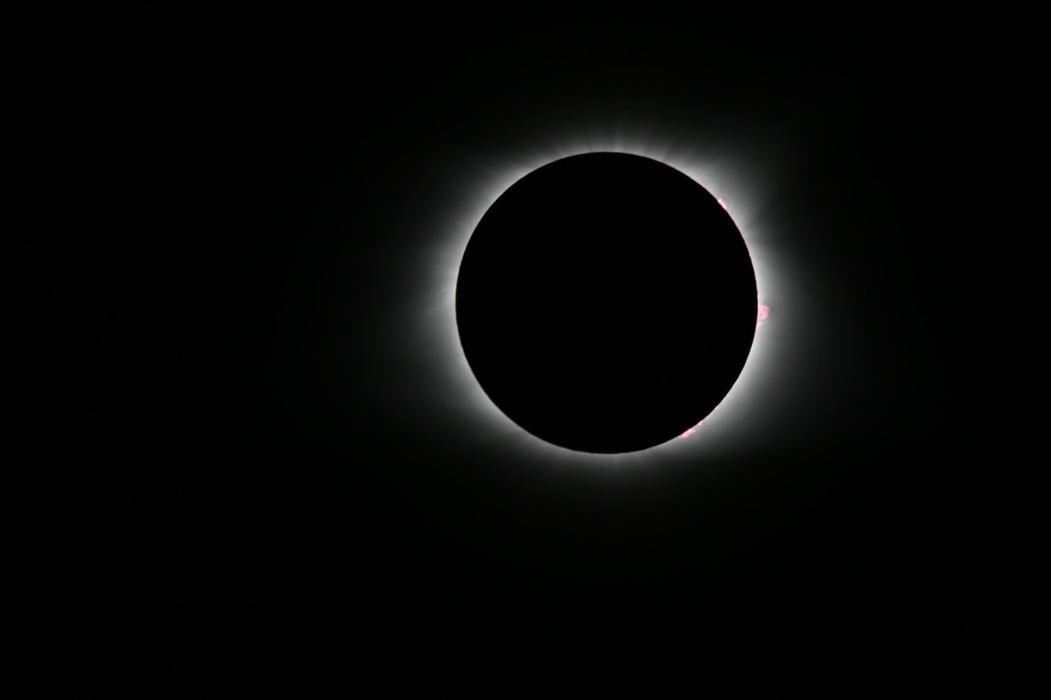
AGU’s position statement on data affirms that
“Earth and space sciences data are a world heritage. Properly documented, credited, and preserved, they will help future scientists understand the Earth, planetary, and heliophysics systems.”
https://sciencepolicy.agu.org/files/2013/07/AGU-Data-Position-Statement-Final-2015.pdf Photo Credit: Photo by Rick Meyers on Unsplash
Notes:
Photo by Rick Meyers on Unsplash, Smith County I-40 Rest Area, Lancaster, United States
Statement adopted by the American Geophysical Union 29 May 1997; Reaffirmed May 2001, May 2005, May 2006; Revised and Reaffirmed May 2009, February 2012 and September 2015.

Slide 15

FAIR Guiding Principles
FAIR is…
  Findable
  Accessible
  Interoperable
  Reusable
Article in Nature journal Scientific Data: Wilkinson, M. D. et al. The FAIR Guiding Principles for scientific data management and stewardship. Sci. Data 3:160018 doi: 10.1038/sdata.2016.18 (2016).

Slide 16
The Enabling FAIR project
New Grant from Laura and John Arnold Foundation
Mission of Enabling FAIR:
Align publishers and repositories in following best practices to enable FAIR and open data and to create workflows so that researchers will have a simplified, common experience when submitting their paper to any leading Earth and space science journal.
This will accelerate scientific discovery and enhance the integrity, transparency, and reproducibility of this data.

Slide 17
Enabling FAIR – Take aways
Community-driven solution with AGU as convener
Builds on the work previously done by COPDESS.org
Data associated with publication will be open “by default”
Quality of data documentation (metadata) becomes consistent – supports FAIR principles
ESS Publishers and Repositories adopt project recommendations and guidelines
http://www.copdess.org/home/enabling-fair-data-project/

Slide 18

OSGeo: Many ways to participate
OpenGeoscience Committee
Outreach activities with the EGU and AGU: Townhalls, Early Career Scientists, [more to come]
Geo4All
Open geospatial education @ universities
Open Monitoring Systems Working Group
Collaborative working group to share experience on open monitoring systems for in-situ earth observations with the aim of advancing beyond the state-of-the-art in various involved scientific fields.
Please join us !
It‘s fun !
https://www.osgeo.org/

Slide 19
We need your input !
How can OSGeo better support the push for Open Science within EGU ?
New Sessions ?
Short courses ?
Debates ?
Support for Early Career Scientists ?
Hackathons ?
Medals ?

Slide 20
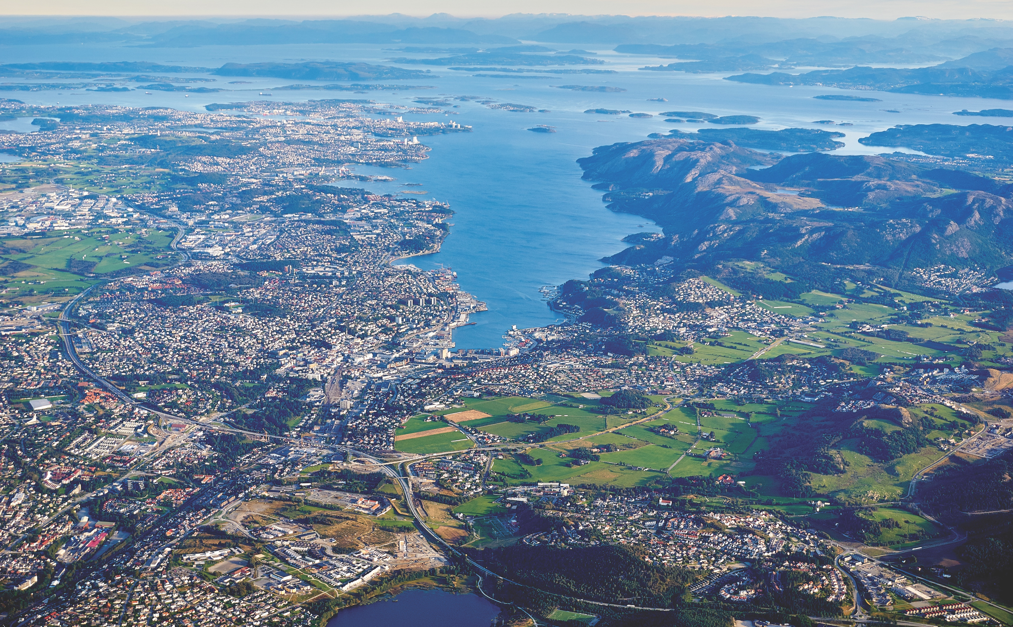
Thanks for listening.
Have a great EGU !
Peter Löwe (ploewe@osgeo.org)
Notes:
The above slide is made up of three layers
- Icons, Title and Subtitle
Triangle shapes in transparent, green, white and dark
A picture which you can replace, we have left it sticking out a bit on the bottom to make it easier to replace

Slide 21
Research Software Engineers
in the Geosciences
Do you agree with one of the following statements?
☑ “Better software - better research!”
☑ “It's impossible to conduct research without software, say 7 out of 10 UK researchers.” (2010 SSI, UK, study)
☑ “I contribute to software for Science.”
Then come to the RSE Townhall Meeting!
TM13 | Thursday | 19:00–20:00 | Room L8
Conveners: D. Nüst, M. Hammitzsch, B. Fritzsch, D. Topping

