Slide 1
Making Open Science the new normal
15th International Digital Curation Conference
19 February 2020
Kostas Glinos
Open Science
European Commission

Slide 2
Why do we need Open Science?
Open Science means sharing
  knowledge and tools
  as early as possible
  between researchers and between disciplines, and also with society at large
Open Science has the potential to increase:
  Quality and efficiency of R&I, if all the produced results are shared, made reusable, and if their reproducibility is improved;
  Creativity, through collective intelligence and cross-disciplinary research that does not require laborious data wrangling;
  Trust in the science system, engaging both researchers and citizens.

Slide 3
Health R&I: a reproducibility crisis?
Close to €300bn/year for Health R&I (worldwide)
As much as 85% of the research investment may be wasted
(Chalmers & Glasziou, 2009; Macleod, 2014)
Unusable research reports
Methods and codes unavailable
Inadequate info on medical interventions in trials, etc..
Scientific question not pertinent
Lack of awareness of existing evidence
Not relevant to clinicians, carers
and patients, etc.
Biased reporting of results
Selective reporting
Reported data not made comparable with other studies
Conflicts of interest
Fraud, etc.
Poor study design, conduct & analysis
Not replicated enough
Not enough collaborative efforts
Poor training/mentoring of researchers, etc.
Results not fully accessible
‘Disappointing’ or negative results less likely to be shared
Trials not registered, etc..

Slide 4
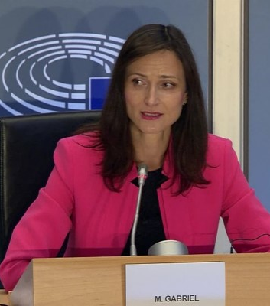
Commissioner Gabriel
Hearing at the European Parliament, Sept. 30th, 2019
“The Open Science issue is […] an issue that is dear to my heart”
“Today, more than ever, we need researchers to share the results of their projects […] and to capitalize on the research of others”
“I will insist on having data that are […] reusable, accessible, of quality”

Slide 5
Main challenges and priorities
Improve the practice of research and innovation
Openly accessible scholarly publications
Early sharing of all research outputs
All data FAIR, RDM
Reproducible results
Societal engagement and responsibility
Towards a new ethical conduct for researchers?
Develop proper enablers
Rewards and incentives to adopt Open Science practices, with appropriate metrics
Infrastructures (including EOSC)
Appropriate skills and education, including for research integrity

Slide 6
Practices

Slide 7
Open Access
  OA to publications has been the cornerstone of EU Open Science policy since 2007
  Encouraged open access policies in EU member states through the Recommendation on access to and preservation of scientific information (2012, revised in 2018)
    Implementation monitored through the national points of reference. New report to be released March 2020
  Implementation in EU research programmes
    From pilot on OA to publications in FP7 to a pilot on open data in H2020 to mandatory OA to publications and “as open as possible as closed as necessary” access to data today
    Above 90% OA to publications uptake in Horizon 2020
  The European Commission supports Plan S

Slide 8
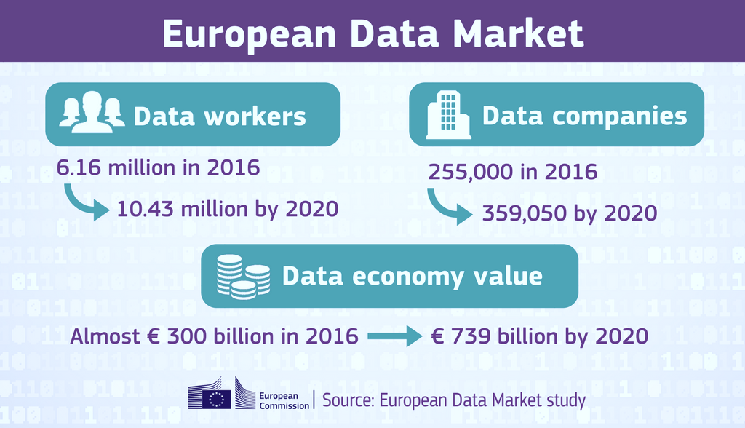
Data
Data is the main asset of the digital economy
Poor data management incurs an opportunity cost in the billions of euros
Data production continues to grow exponentially→ from 33 zettabytes in 2018 to 175 zettabytes in 2025
Research/Science is one of the main data producing/consuming domains

Slide 9
Responsible Research Data Management
The Commission embraces the FAIR principles (Findability, Accessibility, Interoperability, and reusability)
  FAIR research data to be complemented by additional requirements on identifiers, trusted repositories, machine-readable licences, etc.
The opportunity cost of having research data that is not FAIR has been estimated at €10.2bn
(Source: Cost-benefit analysis of FAIR research data, 2017)
The Commission, as a funder, plans on introducing RDM requirements under Horizon Europe
A usual misconception is that FAIR = open

Slide 10
Science & society
  Improving trust between science and society
    Engaging citizens and civil society in co-designing & co-creating responsible R&I agendas and contents
    Facilitating participation by citizens and civil society organisations in research activities
    Improving science communication, also in local settings
    Ensuring the integrity of research and cultivating a new ethos in science
  Horizon 2020 work programme 2018-2020 included:
    “Exploring and supporting citizen science”
    “Accelerating and catalysing processes of institutional change”, including research integrity
    “Building the knowledge base for SwafS”, including science communication

Slide 11
Enablers

Slide 12
OS practice and research careers
Source: EUA, 2019 Open Science survey

Slide 13
Rewards and incentives
[From various expert group reports and position papers:]
Extra credit to individuals, groups and projects, that practice Open Science, based on appropriate indicators
  All evaluation steps at all stages of careers are concerned: from PhD thesis examination, recruitment, promotion, project proposal assessment, funding allocation systems, prizes and recognitions, etc.
  In the evaluation processes, more emphasis needs to be put on the quality of the outputs, including on reproducibility of results.
Journal impact factors should not be used as a proxy for quality. Article-level and societal impact metrics should be developed and used.
There are already good practices that need to be collected and further exploited.
Incentives for life-long training on Open Science practices and research integrity are required.

Slide 14
Skills and education
[From various expert group reports and position papers:]
Open Science principles and practice, together with data literacy, ethics and research integrity, should be an integral part of researcher’s education and career development
Training on Open Science needs to be tailored for different disciplines and levels of researchers, but also for students and research managers and administrators
Life-long training needs to be incentivised, sustainably resourced and its impact be monitored
There are already good practices that need to be collected and further exploited.
Integrate Open Science principles and baseline skills in
  the Innovative Doctoral Training Principles?
  the European Charter for researchers and Code of conduct for recruitment?
  the Human Resources Strategy for Researchers?

Slide 15

European Open Science Cloud
The European Open Science Cloud (EOSC)—European Cloud Initiative Communication, 2016—is an enabler of Open Science
ESOC will be a trusted and open distributed system for the scientific community, providing seamless access to data and interoperable services addressing the whole research data lifecycle
EOSC design principles: co-creation, research-led, community-driven, scalable, incremental and iterative, continuous engagement, consultation & user testing.

Slide 16
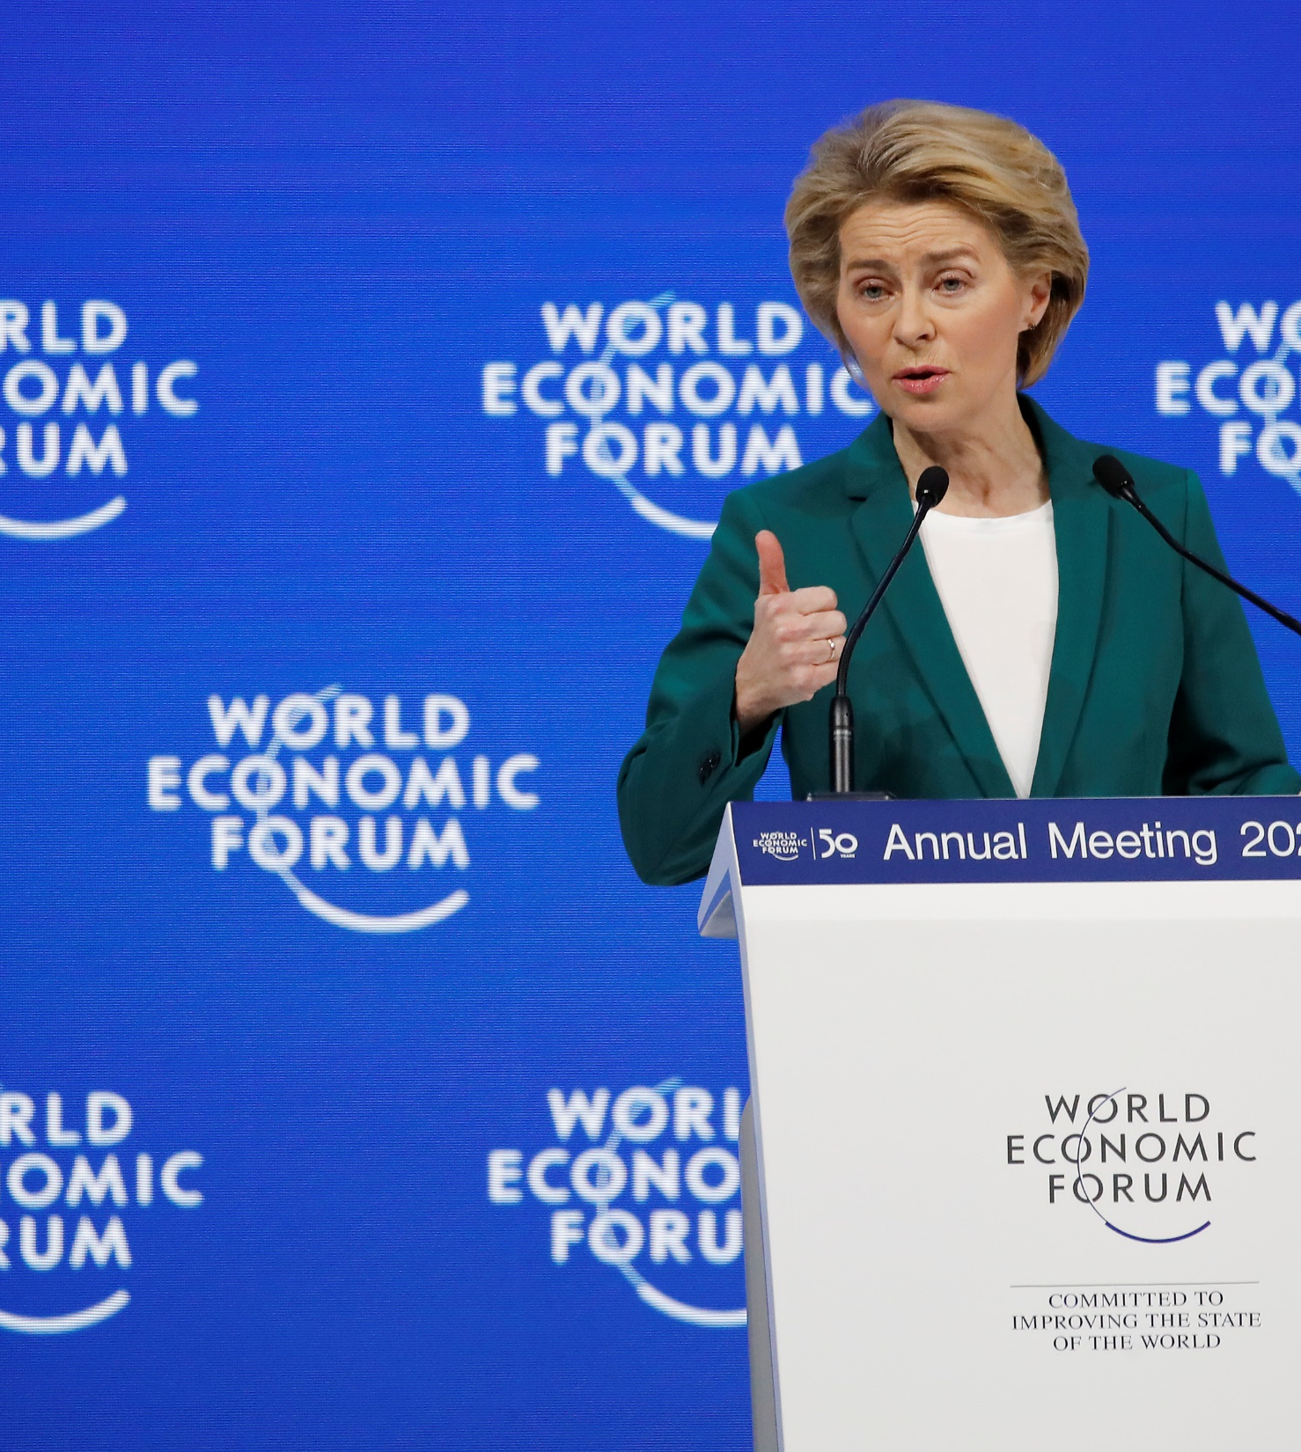
President U. von der Leyen
World Economic Forum, Davos, Jan. 22nd, 2020
“We are creating a European Open Science Cloud now”
“It is a trusted space for researchers to store their data and to access data from researchers from all other disciplines”
“We will create a pool of interlinked information, a web of research data”

Slide 17
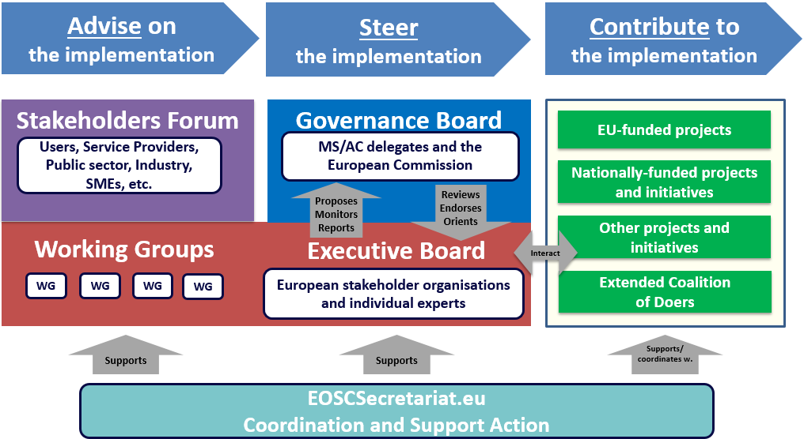
EOSC governance structure

Slide 18
EOSC EB Working Groups and Task Forces
EOSC Executive Board
Communications Task Force
International Engagement Task Force
Landscape WG
Sustainability WG
Strategic focus
Close liaison with Governance Board
Rules of Participation WG
Architecture WG
FAIR WG
Practical implementation focused WGs
Skills & Training WG

Slide 19
A first edition of EOSC by end 2020
Rules of Participation WG:
  Agreed and tested Rules of Participation
Landscape WG:
  Analysis of existing national infrastructures and policies
Sustainability WG:
  Financing model, legal entity, and post 2020 governance structure
Architecture WG:
  Functioning federated core
  Initial/minimum set of EOSC data and services
  EOSC Interoperability Framework (with FAIR WG)
FAIR WG:
  Persistent Identifier policy (with Architecture WG)
  Metrics for FAIR data and certified services
Training & Skills WG:
  EOSC MVP for training & sustainability model (with Architecture WG and Architecture WG)
  Recommendation for EOSC skills/training in national digital skills policies

Slide 20
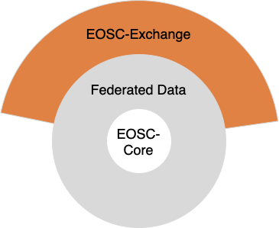
First edition: minimum viable EOSC (MVE)
The MVE includes EOSC-Core (layer of discovery and interoperability) and EOSC-Exchange (layer of enriched services), both of which work with federated FAIR datasets
MVE must enable the federation of existing and planned research data infrastructures
Step 1: Federate the thematic clusters and regional projects
Advance incrementally: Begin with simple use cases (open data, rather than sensitive or closed).

Slide 21
EOSC-Core: functions and proposed coverage
Provides the means to discover, share, access and re-use data and services (layer of discovery and interoperability)
In its first iteration, not planned to store, transport or process data
To be as widely used as possible: accessible to any authenticated user to promote uptake of EOSC
Current discussion on minimum requirements vs. nice to have (Minimum Viable EOSC vs. Maximum Valuable EOSC)
Some services under consideration:
AAI framework
PID services
Shared open science policy framework
Data access framework
Service management & access framework
Minimum legal metadata framework
Help-desk

Slide 22
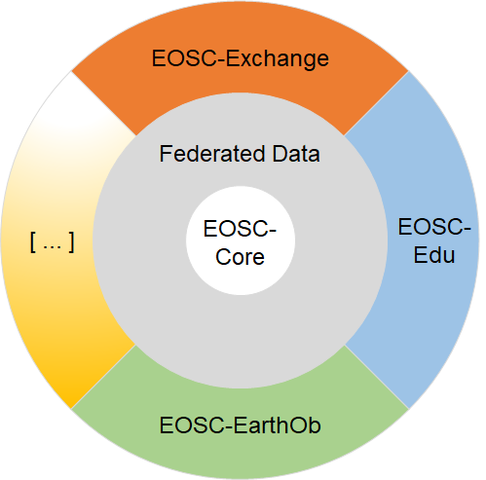
Proposed second and third iterations
Public-funded research
All research communities to be tackled by the first iteration under EOSC-Exchange layer
Incremental extensions to target public administration and industry
Vision: One ‘marketplace’.
Differing requirements/legislation may require linked but alternately governed spaces
Public sector
Private sector

Slide 23
Ongoing partnership proposal and SRIA
Current governance of EOSC will present a proposal to the European Commission for a co-programmed partnership under Horizon Europe
The proposed partnership will make the initiative evolve from a project-based approach to an all-encompassing ecosystem where the different stakeholders take the necessary commitments to accomplish it.
Counter-signatory of the Commission will be a legal entity to be set up before the end of the year representing key stakeholders in the EOSC process
Discussions are taking place on how the European Commission, Member States and Associated Countries, and this legal entity of organisations will steer EOSC post-2020
A Strategic Research and Innovation Agenda will set the long-term strategic priorities and will serve as a handbook for implementing the EOSC vision

Slide 24
How do we move forward together?
Fully implementing Open Science practice requires engagement of all stakeholders
  Researchers, research performing organisations, funders, policy makers, citizens, etc.
  At all levels (regional, national, European and international).
One EU policy, three sets of complementary actions:
  Develop the necessary infrastructures and services
  Induce and support coordinated paradigm shifts
  Walk the talk in European R&I programmes and lead by example

Slide 25
Evolution of our policies across the FPs
Likely under Horizon Europe (2021):
Open Science embedded throughout the FP
OA mandatory: deposit and open access. Probably more stringent conditions
Open data by default
RDM considerations to be evaluated at proposal stage
Mandatory DMP, in line with FAIR, for all projects that generate/collect/reuse research data
FP7
OA Pilot
Deposit and open access
H2020
OA Mandatory
Deposit and open access
& ORD/DMP Pilot
H2020
OA Mandatory
Deposit and open access
& ORD/DMP by default
(exceptions)
2017
2014
2008
We are pioneers with respect
to other funders!

Slide 26
RDM and DMPs in Horizon Europe
DMP for all projects that generate/collect research data:
  No need to reinvent the wheel—we will seek alignment and build on already existing initatives (e.g. Science Europe core requirements, DMPOnline/ARGOS DMP tools, etc.)
  Data is not the only digital output to be managed (software, code, workflows, protocols, models, etc.). The Wellcome Trust devotes a section of their DMP to ‘Other research output’
  Machine-actionability is key to allow computers to integrate external services to interlink basic building-blocks: author (ORCID), data (DataCite), organisations (RoR, FundRef), etc.
Initial RDM considerations to be provided at proposal level

Slide 27
Open Science in EU legislation
Revision of the Recommendation on access to and preservation of scientific information (2018)
  Also covers infrastructure, metrics, rewards, skills, etc.
Revision of the Open data and the re-use of public sector information directive (2019)
  Applies to publicly funded research data that are publicly available through repositories
Revision of the EU Copyright Directive (2019)
  Provides for an exception for research organisations to carry out Text and Data Mining (data analytics)
Is there something more needed?

Slide 28
Potential actions for system changes (1)
“Open Science coordinators” at national level, and “Open Science officers” at institutional level, would facilitate Open Science policy coherence and implementation, and learning from good practice
Monitor the implementation of the Commission recommendations on access to and preservation of scientific information, with the National Points of Reference, and incentivize good practice
Support the further development of infrastructures for Open Science, including EOSC
Open Science in a revitalised European Research Area (ERA), in synergy with the European Higher Education Area (EHEA)
Recognition of Open Science in regional R&I Smart Specialisation Strategies (RIS3s)

Slide 29
Potential actions for system changes (2)
  Support institutions including Universities and their alliances on the modernisation of research and researchers’ assessment, including by identifying, assessing and piloting the validity of metrics and quantitative/qualitative indicators
  Support policies and conditions (e.g. infrastructures) that enable open access as the default way of disseminating research (publications, data and other contributions)
  Develop a strong narrative for the role of Science in Society and promote specific actions, e.g. in science communication, science skills, rewarding engagement with citizens, research assessment pilots, promoting reproducibility, etc.
  Mainstream OS practices in thematic areas, e.g. FAIR data projects in specific domains
  …

Slide 30








Keep in touch
ec.europa.eu/
europeancommission
europa.eu/
@EuropeanCommission
@EU_Commission
EUTube
@EuropeanCommission
EU Spotify
European Commission
Notes:
Delete/update as appropriate

Slide 31

Thank you
© European Union 2020
Unless otherwise noted the reuse of this presentation is authorised under the CC BY 4.0 license. For any use or reproduction of elements that are not owned by the EU, permission may need to be sought directly from the respective right holders.
Notes:
Update/add/delete parts of the copy right notice where appropriate.
More information: https://myintracomm.ec.europa.eu/corp/intellectual-property/Documents/2019_Reuse-guidelines%28CC-BY%29.pdf

Slide 32
Relevant updates from the WGs
Persistent Identifier Policy (FAIR WG and Architecture WG):
  Out for public consultation since mid December 2019
  Popularly received document: Over 900 downloads and comments from Europe, Australia, USA and China
  New version due in March and implementation guidelines in Summer 2020
  PID policy openly available:
      https://doi.org/10.5281/zenodo.3574203
  Join the international discussion and provide your feedback: https://www.pidforum.org/t/please-give-us-your-feedback/775

Slide 33
Relevant updates from the WGs
Draft Rules of Participation out for consultation this week for a period of 4 to 6 weeks
The primary targets of this consultation are:
  INFRAEOSC projects
  Executive Board Working Groups
  Member States and Associated Countries
National input to be compiled by WG members nominated by the governance board
A wider consultation will be launched later this year with the objective of having a completed version before the EOSC symposium (end of October)
A final version consolidating any feedback from the symposium will be presented in December

Slide 34
Relevant updates from the WGs
Interim metrics and certification recommendations:
  Metrics based on output from RDA FAIR Maturity Working Group & deliverables from the Horizon2020 project FAIRsFAIR
  Based on community feedback, tbd what can be required in EOSC
  Repository certification based on CoreTrustSeal, with phased entry
  Workshop planned end of April to define other services/elements to be certified
  Reports: FAIR metrics for EOSC and EOSC service certification
  We welcome your feedback at the EOSC Liaison Platform or by email at inform-FAIR-wg@eoscsecretariat.eu
  Full recommendations will be out for consultation early Summer 2020 & finalised community-approved version out before the EOSC Symposium in Autumn

Slide 35

RDA FAIR Data Maturity Model WG
https://www.rd-alliance.org/groups/fair-data-maturity-model-wg
Context: Ambiguity/wide range of interpretations surrounding FAIR (for data)
18-month Working Group launched in January 2019, co-chaired by Edit Herczog, Keith Russell and Shelley Stall
Supported by the European Commission (DG R&I) through a tender with PricewaterhouseCoopers (PwC). PwC acts as a secretariat for the WG and performs editorial work
Output:
  RDA recommendation
  A common set of core assessment criteria for FAIRness (indicators) and guidelines/checklists to help create assessment methodologies. Currently, indicators and guidelines under testing by user communities, whose feedback will be integrated into the WG’s output.
Indicators: https://docs.google.com/spreadsheets/d/1mkjElFrTBPBH0QViODexNur0xNGhJqau0zkL4w8RRAw/edit#gid=1210743571
Guidelines: https://docs.google.com/document/d/1pDGGL3-BbBJu18KlfZUI3AizKLHXGXdIi_mPtpEWmeg/edit

