Slide 1

The OpenAIRE Research Graph
Opportunities and challenges for science
Paolo Manghi
Alessia Bardi
Institute of Information Science and Technologies - CNR
Notes:
Paolo Manghi is the technical director of OpenAIRE

Slide 2






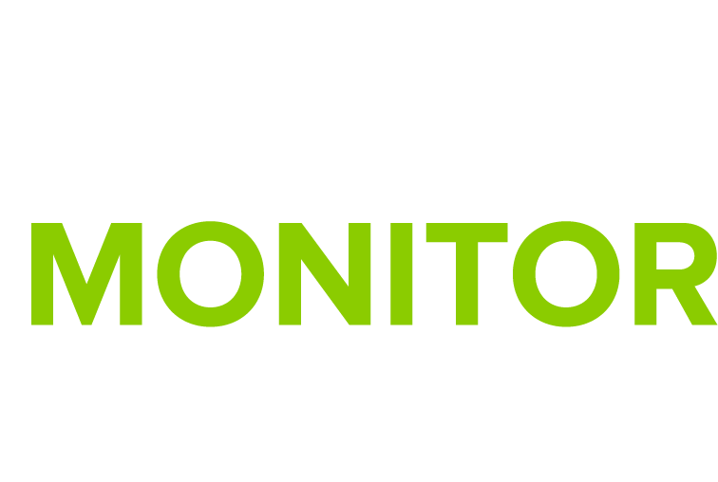
Supporting Open Science scholarly communication workflows
European (and beyond) infrastructure
for Open Access and Open Science
Networking infrastructure: Open Access/Science advocacy and support, interoperability, global alignment on Open Science, National Open Access Desks, FAIRness of research data, citizen science, etc.
Technical infrastructure: services for, e.g., monitoring of Open Access/Science and Research Impact for funders and research infrastructures
Notes:
FP7 project in 2009
Legal entity in September 2018
One of the pillars of the EOSC
Global alignment on OS practices worldwide (e.g. West and Central Africa (WACREN), Japan, South America, Canada)

Slide 3
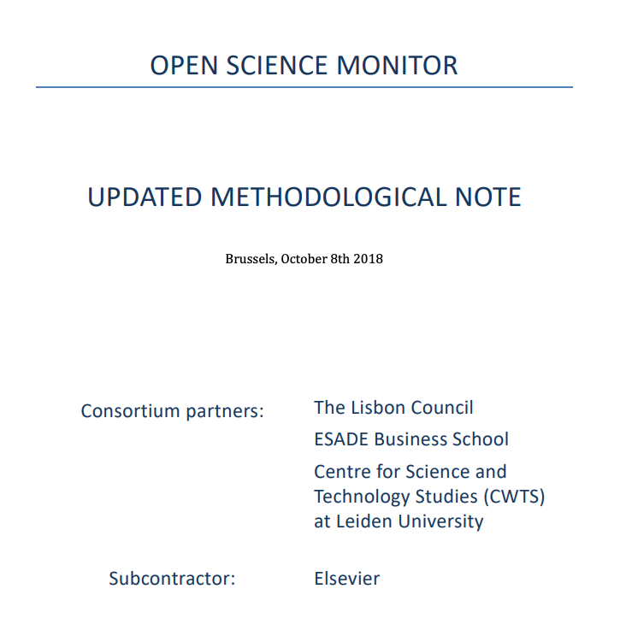
Science publishing, evaluation, and monitoring
Open
Science
Notes:
We started from Open Access to publications. A lot has changed but main players: big publishers and companies
Moving to Open Science. Because It’s not only about publications, data and software for example are included; still even the EC claims that Elsevier should play a role, mainly due to the quality of the metadata they provide (affiliation and citation metadata)
The scholarly community can do better: take back our research products into our hands. Virtous circle (not vicious like now), with all stakeholders and society at large

Slide 4
The OpenAIRE research graph
Open
De-duplicated
Transparent
Participatory
Trusted
Complete
Decentralized
Providing an open metadata research graph of interlinked scientific products, with Open Access information, linked to funding information and research communities
Monitoring and assessment by organizations, funders, research infrastructures, and researchers
Business by SMEs
Research by scientists
Notes:
GOAL: High quality open graph for
Open (because it must be), Complete (all «trusted»/known sources), Deduplicated (must be disambiguated for statistics), transparent (provenance), participatory (not a closed network), decentralised (ownership and redistribution), trusted (manual curation)

Slide 5
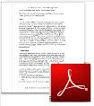

OpenAIRE e-infrastructure
Materializing the Open Science graph
Harvested data sources
10K +
Harvested records
500Mi +
Publication full-texts
10Mi +
Harvested/mined links
60Mi +
Funding
Funder
Organization
Project
community
Source
Product
Publication
Research Data
Software
Other res. products
Deduplication
Harvesting
Mining
Notes:
How does OpenAIRE materializes the graph?
Collection records (dedup)
Collection full-texts
Mining full-texts of publications to find links to data, software, other product, projects, research communities and infrastructures and enhance metadata with affiliation information, subjects/keywords

Slide 6
Open metadata graph
Repositories
Springer
Archives
Microsoft
Notes:
OpenAIRE will deliver 2 versions of the graph:
1 with CC0 license containg the subgraph of metadata that can be redistributed as CC0
The other with CCBY license that will contain everything, even metadata from Springer and Microsoft Academic Graph (for example) that require CCBY (and that’s the graph you currently can access via API and OpenAIRE portal)

Slide 7





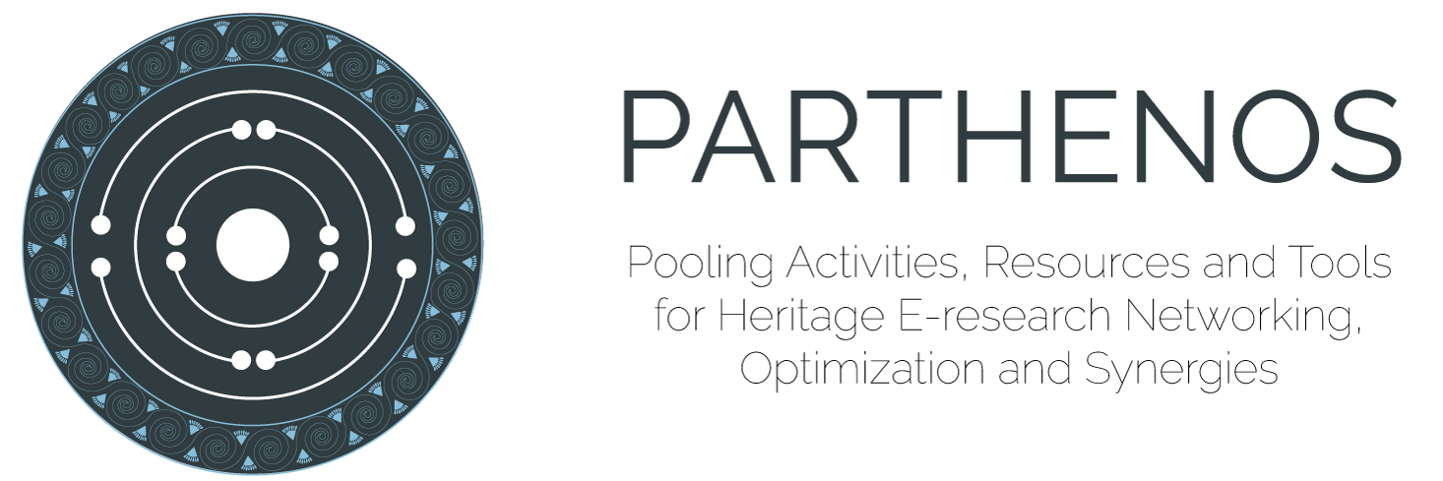








Complete aggregation coverage
… and more
Funding
Funder
Academic Graph
Organization
… and more
Project
community
Source
Product
… and more
Publication
Research Data
Software
Other res. products
… and more
… and more
… and more

Slide 8
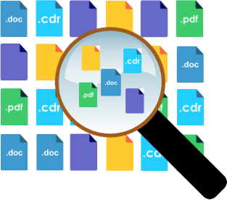
De-duplicated
Entity type | # Collected records | # Records after cleaning and de-duplication | # Identified duplicates
Publications | ~ 343M | ~ 94M | ~ 249 millions
Data | ~ 5,2M | ~4,6M | ~ 600K
Software | ~150K | ~ 134 K | ~ 20K
Other | ~ 5M | ~ 4,5M | ~ 500K
Organisations | ~ 380K | ~220K | ~ 160K
More information about the de-duplication framework used by OpenAIRE can be found searching on Zenodo for :
“De-duplicating the OpenAIRE Scholarly Communication Big Graph” (poster)
“GDup: De-Duplication of Scholarly Communication Big Graphs”
Notes:
Supported entity types
People to come with orcid collaboration
Algorithm can be improved but some cases can be handled only manually

Slide 9
Participatory
Institutional repositories
Aggregators
Data archives
Software repositories
Research infrastructure sources
Funder grant databases
Authors & Orgs entity registries
Publishers & journals
Rely on quality scholarly communication sources of different kinds
Include solutions and content from any interested and known content provider in scholarly communication
Notes:
Any interested content provider can join the network to provide content. Not a closed network. Interoperability guidelines help in the process.

Slide 10
Transparent
Metadata in the graph includes provenance when harvested and reliability indicators when obtained from mining
Notes:
Mining trust: probability of the mining information to be correct

Slide 11

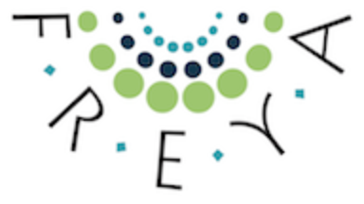
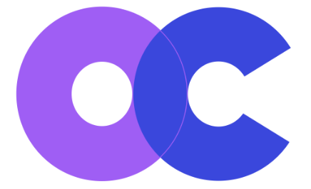

Decentralized
Preservation and ownership beyond OpenAIRE
Exchanged with other graph initiatives
Redistributed via subscription and notification to contributing data sources (provide.openaire.eu)
Openly accessible via APIs (develop.openaire.eu)
Notes:
OpenAIRE DOES NOT own the graph

Slide 12
Trusted (in progress)
Authors in the loop to enrich their ORCID record
Validation of end-user ”claims”

Slide 13

Transition from OA content acquisition policies to OS content acquisition policies
numbers from: explore.openaire.eu and beta.explore.openaire.eu
94Mi
4.6Mi
55Mi
literature-research data links
25Mi
670K
130K
4.5Mi
3.2Mi
11Mi
80K
Open Access PDFs for mining
Notes:
Transition phase.
Production system: OA content acquisition policies → more on Open Access content
Beta system: OS content acquisition policies → everything, regardless the access rights
Boost on publications and boost of research data (on production we collected only data linked to a publication or to a project)

Slide 14
Graph construction: harvested publications (before deduplication)
Source | Property | # Publication records collected
ORCID | author IDs (ORCID) | 7,340,990
MAG | DOIs | 120,000,000
 | affiliation (GRID.AC)
 | affiliation (Microsoft)
 | abstract
 | author ID (Microsoft)
Unpaywall | OA URLs | 90,254,461
CrossRef | all fields | 95,567,407
Repositories/publishers/journals/aggregators | all fields | 30,732,345
Total
343,895,203
Notes:
About the increase of publications: integration of all metadata from Crossref

Slide 15
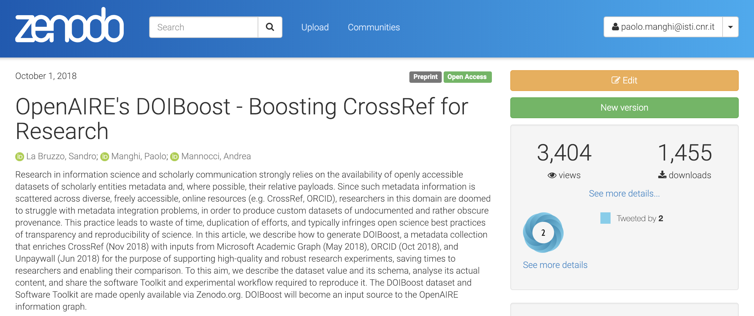
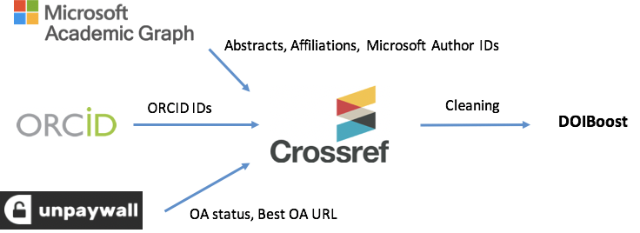
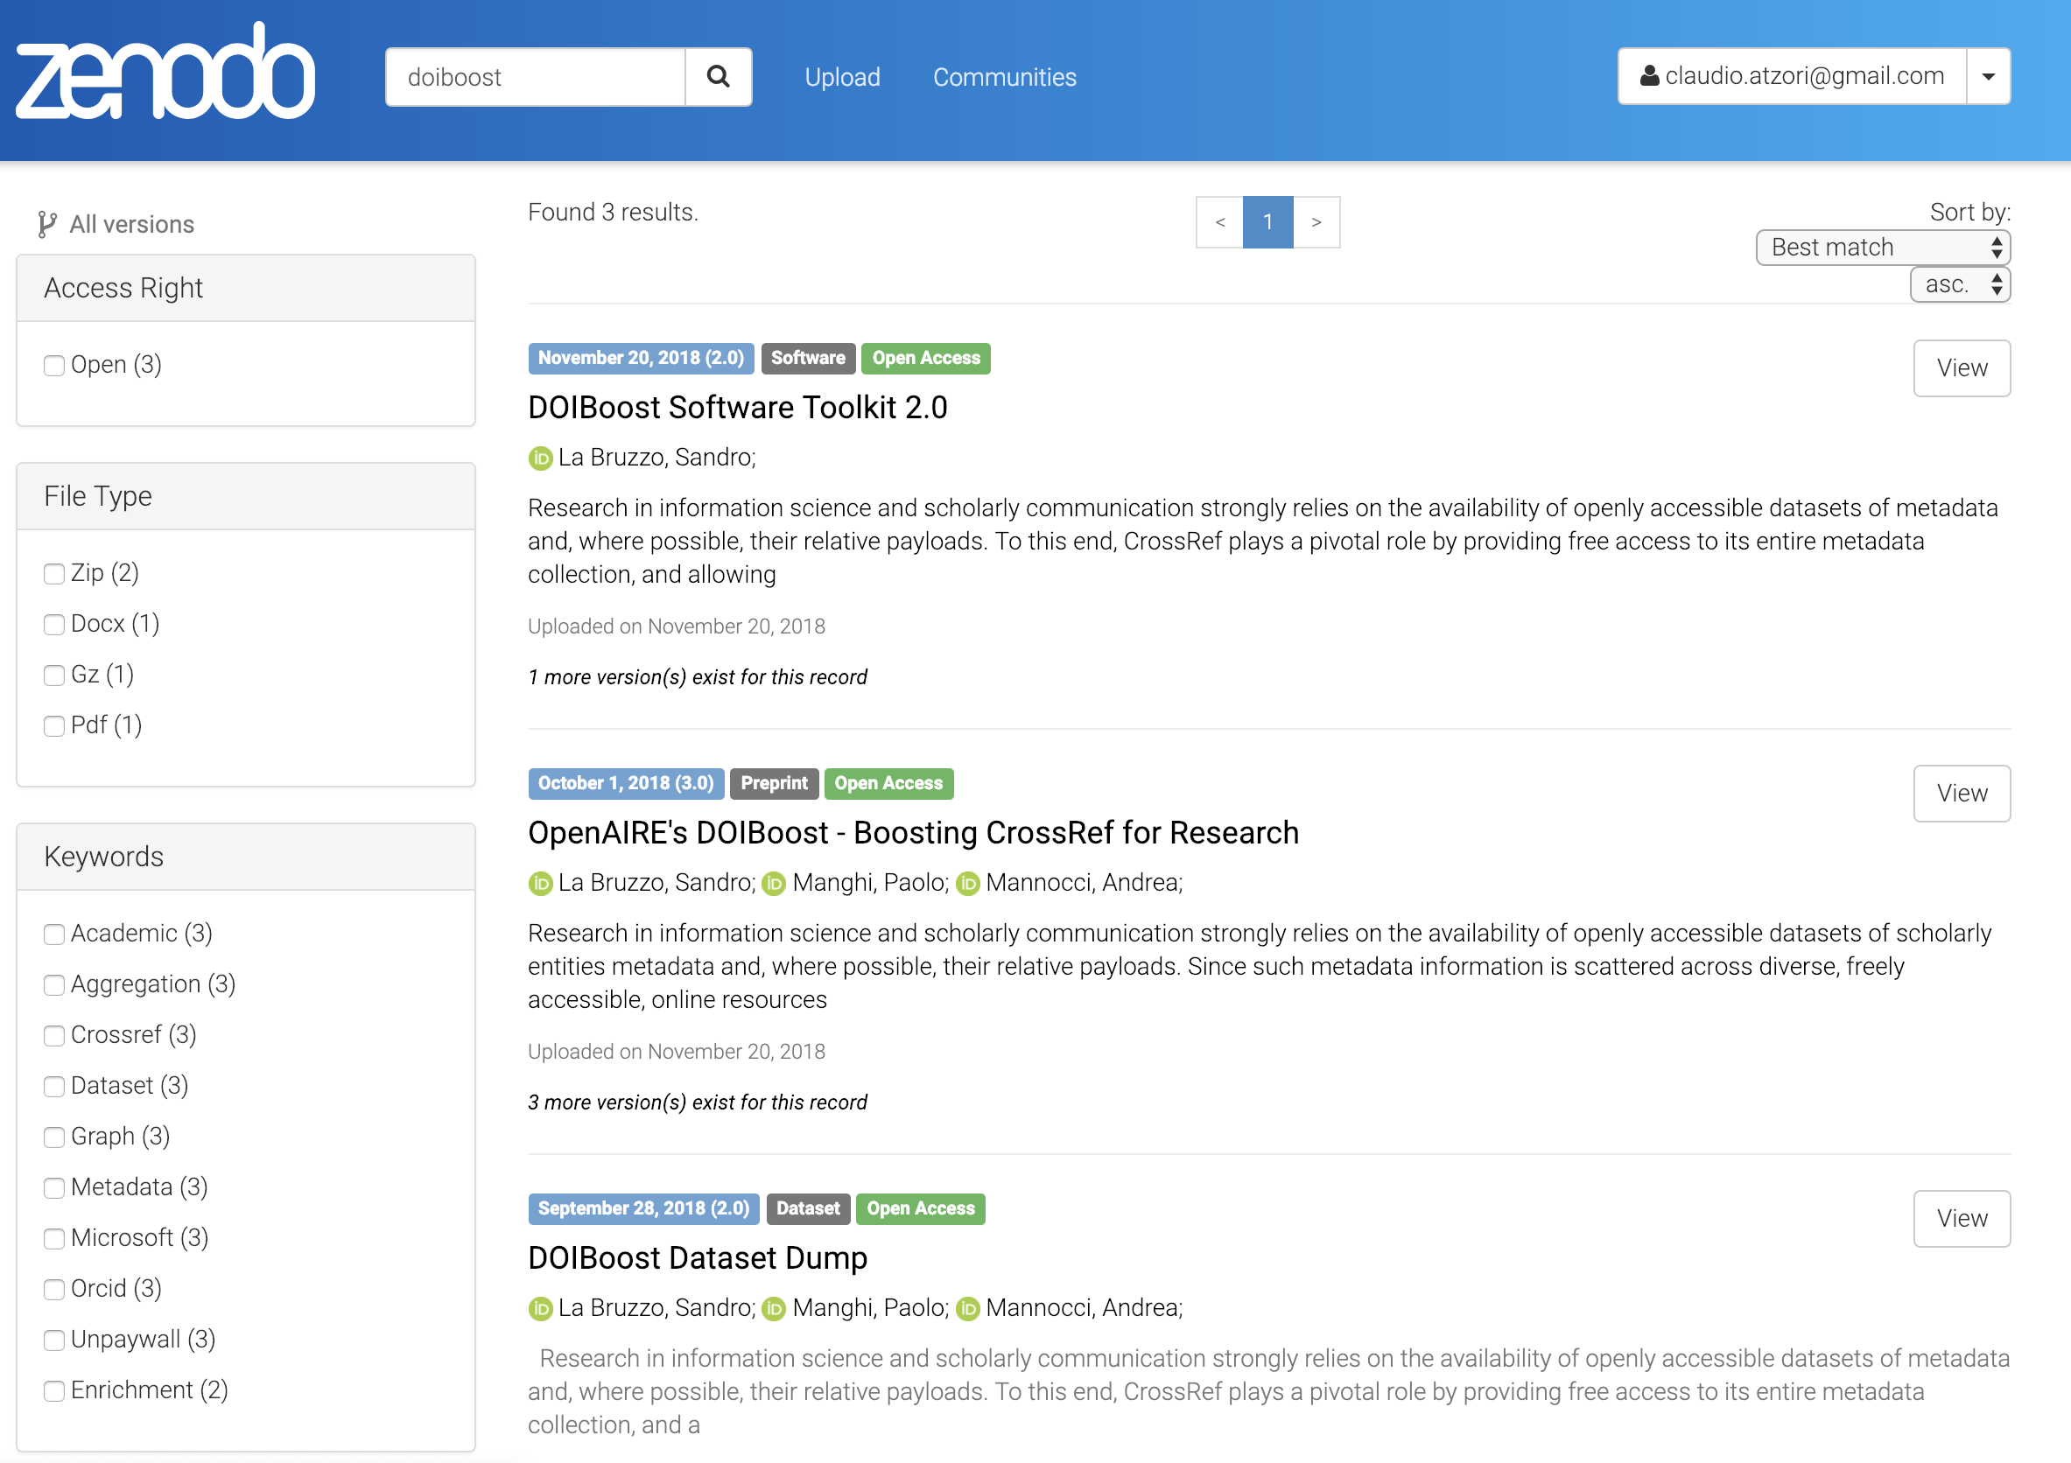
Opening processes: DOIBoost
Result | DOI
Preprint | 10.5281/zenodo.1492766
Software toolkit | 10.5281/zenodo.1492210
Dataset dump | 10.5281/zenodo.1438356
Notes:
Enriched crossref records == DOIBoost
Reproducible activity

Slide 16




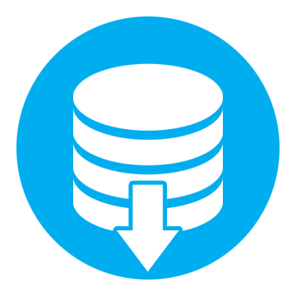


Strategic for Open Science
Making the research graph an EOSC resource
Open, Trusted, Complete, De-duplicated, Participatory, Transparent, Decentralized
Actors
Institutions, research organizations, funders, content providers, researchers, SMEs, etc.
Added value services
e.g. discovery services, monitoring services
Notes:
Plan to make the graph a resource of the EOSC without losing its properties
Public common good from which all actors can benefit from and on top of which different services can be built (not only discovery and monitoring: more can be built by exploiting the information in the graph).

Slide 17
Paolo Manghi
paolo.manghi@isti.cnr.it
Alessia Bardi
alessia.bardi@isti.cnr.it

