Slide 1
Emma Lazzeri
Paolo Manghi
CNR, Istituto di Scienza e Tecnologie dell’Informazione, Pisa
Italian National Open Access Desk, OpenAIIRE
ORCID: 0000-0003-0506-046X
CNR, Istituto di Scienza e Tecnologie dell’Informazione, Pisa
OpenAIIRE CTO
ORCID: 0000-0001-7291-3210
Open Science
Tutorial for SEBD2020

Slide 2

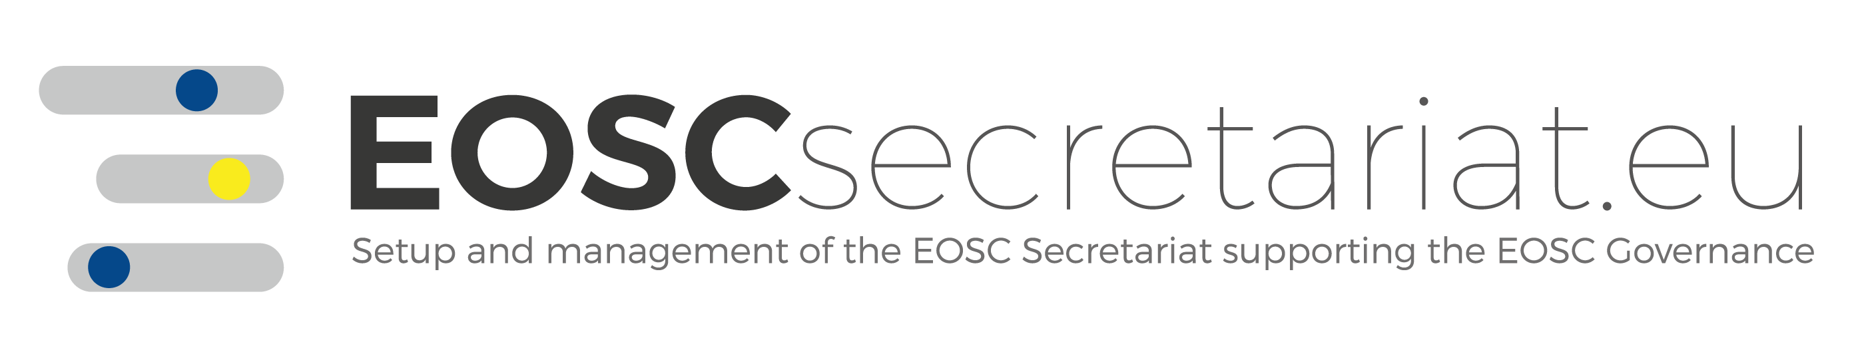
How does Science work today?

Slide 3
l’arte e la scienza sono libere e
libero ne è
l’ insegnamento
Costituzione italiana
art. 33 comma 1

Slide 4















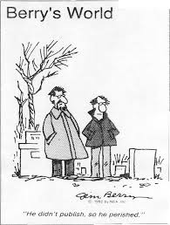

Funding
Results and Products
Research
Idea
Scientific Journals: Paywall

Slide 5
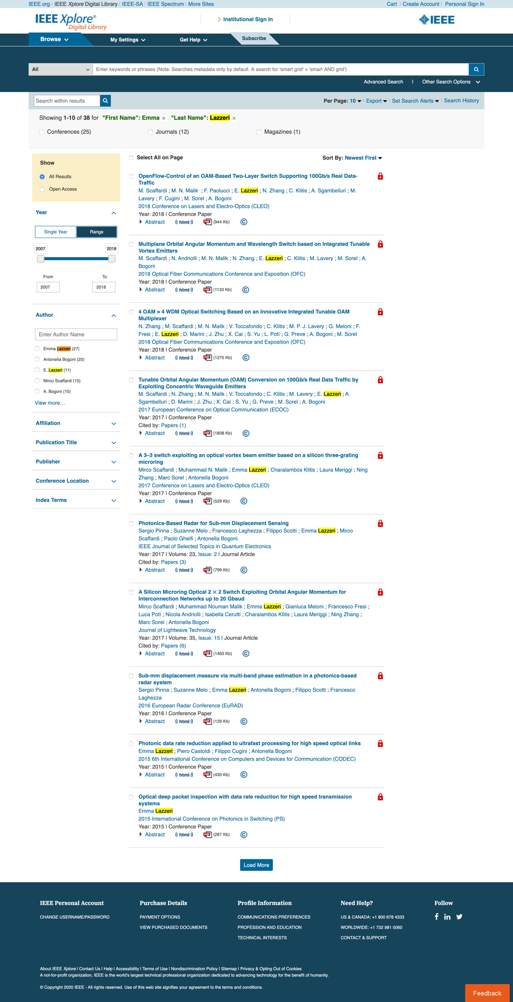
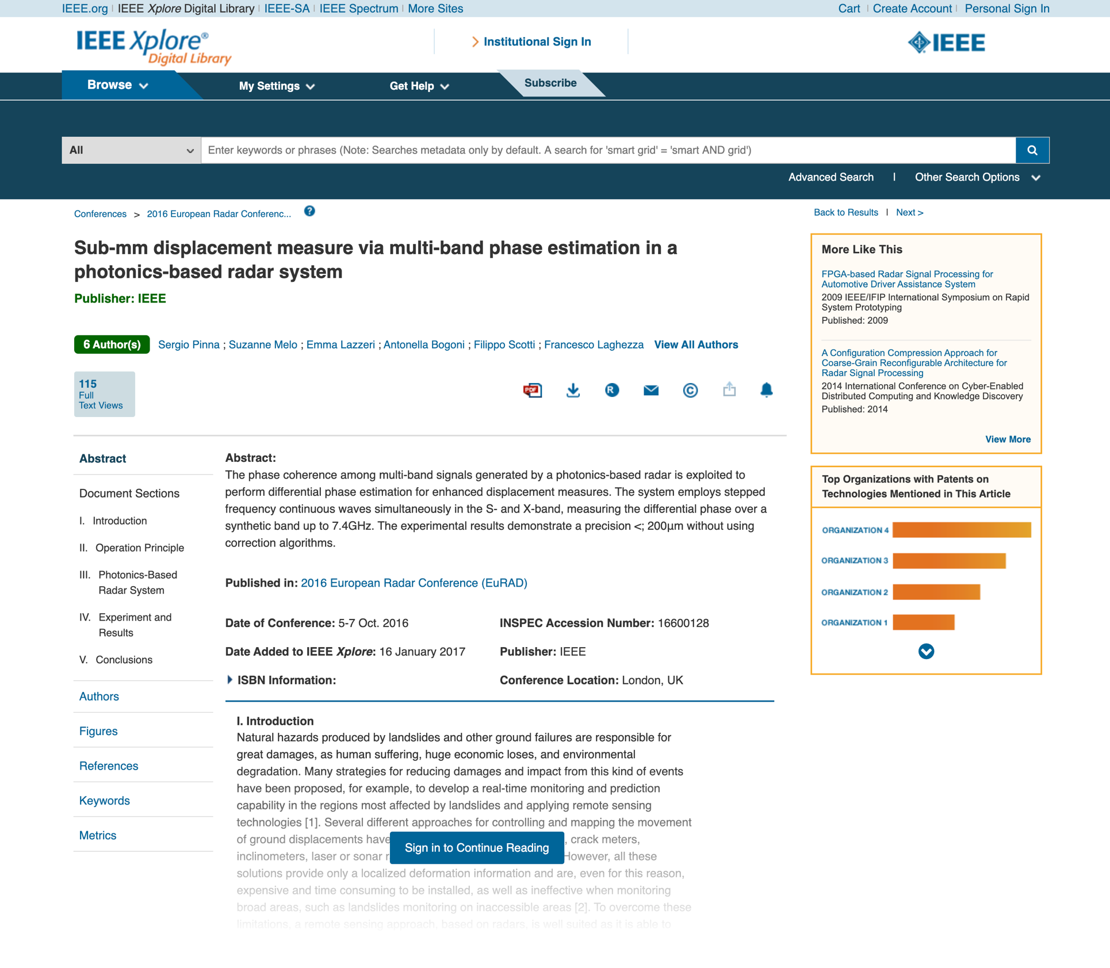
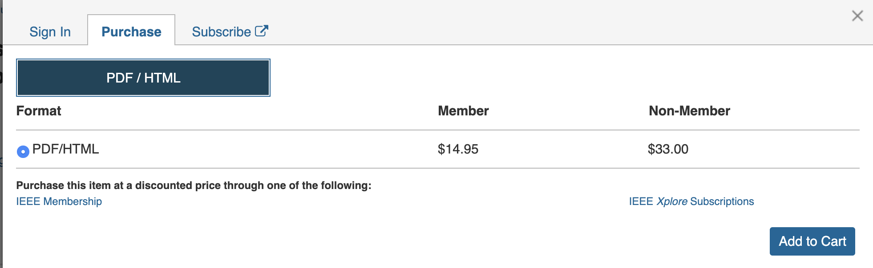
Are you aware?
Reading your own article outside the Institutional network is not free.
If you try to access from your home, you will hit a paywall
Paywall

Slide 6
Scientific Journals are based on Subscriptions: your Institution pays, you can access and read the contents
Your Institutions pays
What you get is access, not ownership!
Your institution owns nothig!!!
You get access

Slide 7
Why do we spend public money to close the research results behind limited access subscriptions scientific journals?

Slide 8
Research Evaluation

Slide 9
Based on bibliometric indexes or, for non-bibliometric sectors, on selected «fascia A» list of journals

Slide 10
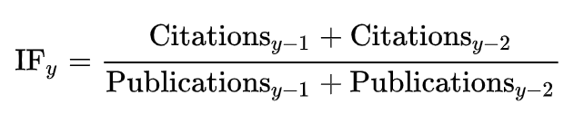
For a researcher: the maximum value of h such that the given author has published h papers that have each been cited at least h times
H-index
For a given year y, the specific journal Impact Factor is:
Impact Factor

Slide 11
Citation based indexes criticism
Early career researchers are penalised
The citation context is not considered (eg. Negative citation)
They are influenced by the limitation of the citational databases (which are all owned by big scientific publishers)
It can be manipulated by both authors and reviewers (self and cross citations)
It does not take into account the number of authors in a paper and their contribution given
It does not take into account research multidisciplinarity
It does not facilitate science freedom.

Slide 12
What are we evaluating?

Slide 13
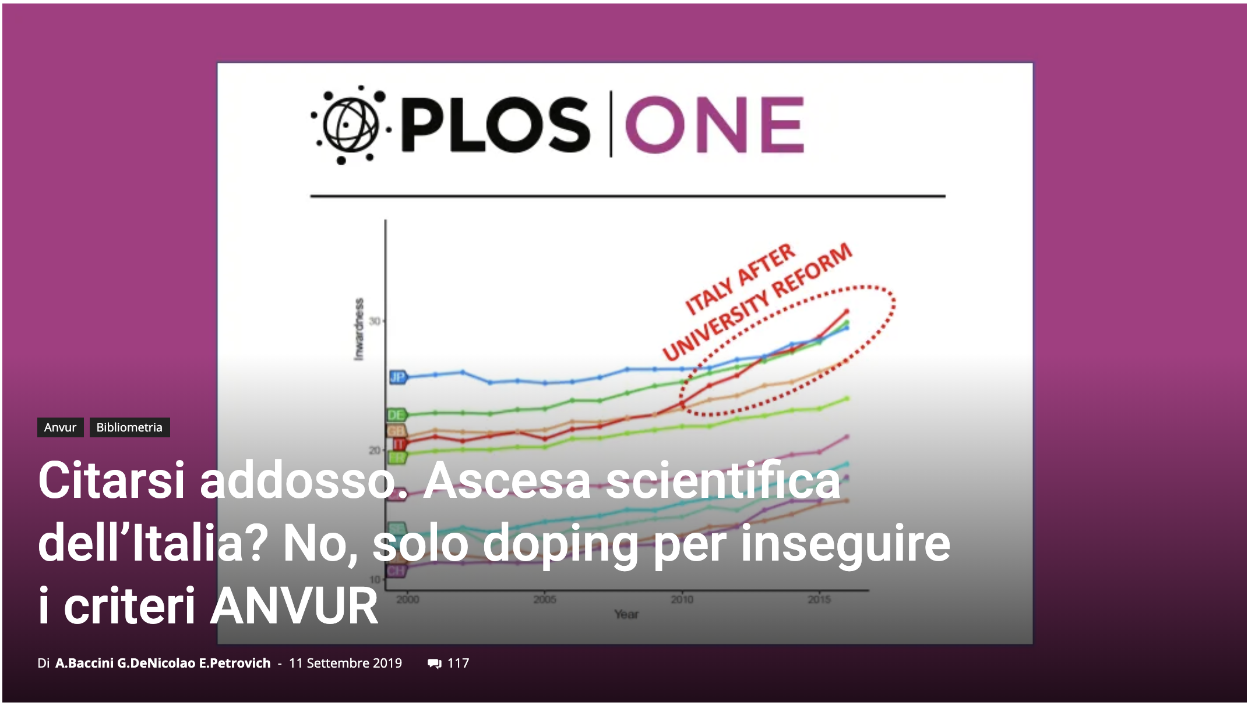
https://www.roars.it/online/citarsi-addosso-ascesa-scientifica-dellitalia-no-solo-doping-per-inseguire-i-criteri-anvur/#

Slide 14
Scientific Journals

Slide 15















Journal Editor
Reviewers
Journal Publisher
copyright
Pre-print
Pre-print
Published Version
Author
Post-print
Scientific Community

Slide 16
Access to
Scientific Literature

Slide 17

Costs of scientific literature: business models
Traditional subscription based
Research Institutions pay annual fees to give access to the Journal contents to their researchers (not to own the literature!)
Gold Open Access
Articles published in Gold Open Access Journals are accessible to anyone startinfg from the very moment of the publication. Sometimes the author pays an APC (Article Processing Charge) to give access to the public to his/her publication
Hybrid Model
The Journal is a traditional subscription based one, but the editor charges the authors an APC to open access their specific paper to the World.
1-3 Millions
euros
100-6000
euros
100-3000
euros
Double dipping

Slide 18
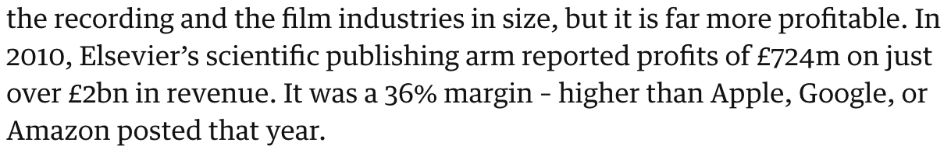




What is the problem?
Big deals with editors are not transparent
Research can be accessed by few with long delays
Authors are giving away their copyrights thinking they have no choice
Subscription costs are rising every year (by 1-2%)
APC costs are not tracked
Authors, reviewers and editors are not paid but are giving for free the raw material to scientific publishers who make great profit out of it:
https://www.theguardian.com/science/2017/jun/27/profitable-business-scientific-publishing-bad-for-science

Slide 19
How about the rest?

Slide 20



What are we missing in research evaluation?
Negative results
Data
Algorithms
Processes
Software
Methodologies
Educational Resources
Peer-review
Grey Literature
Project proposals
Leadeship skills
Product development
…

Slide 21
…how about data?

Slide 22
Publishing research without data is simply advertising, not science
Graham Steel

Slide 23
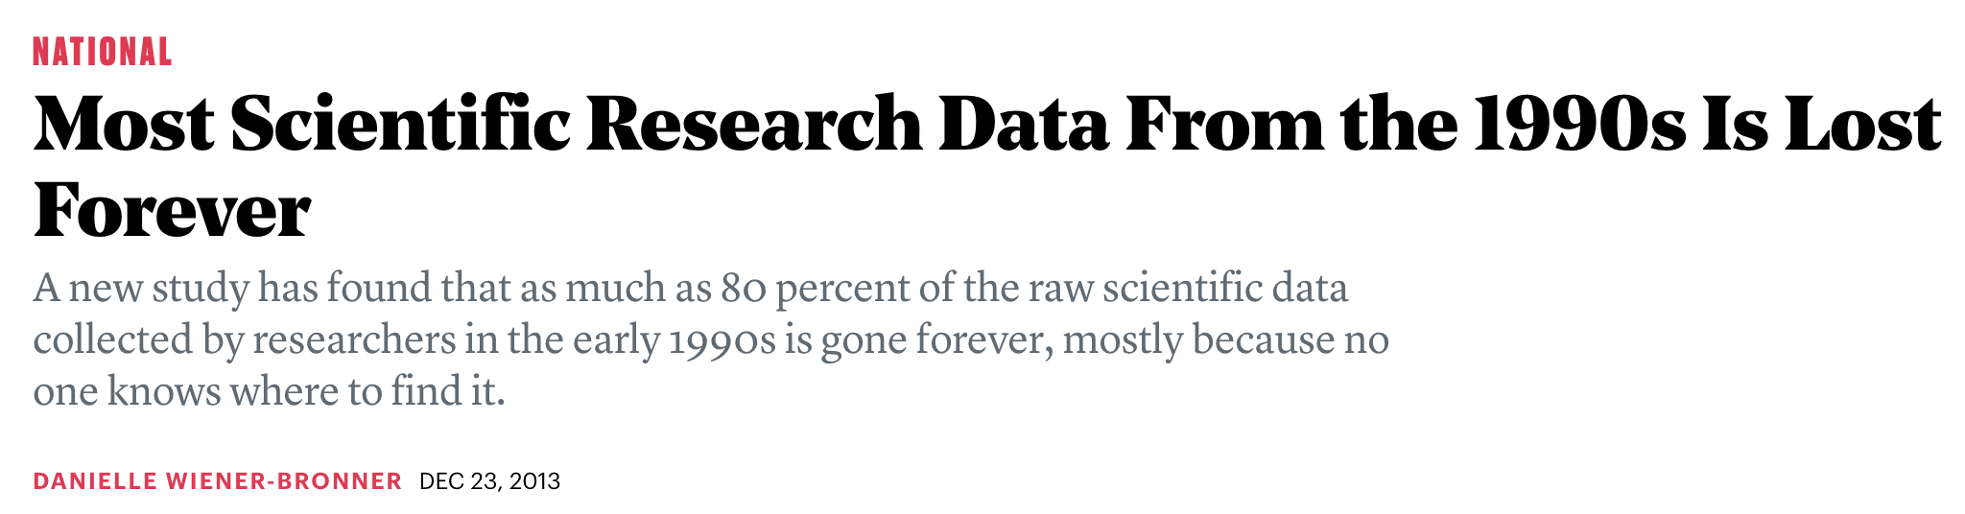
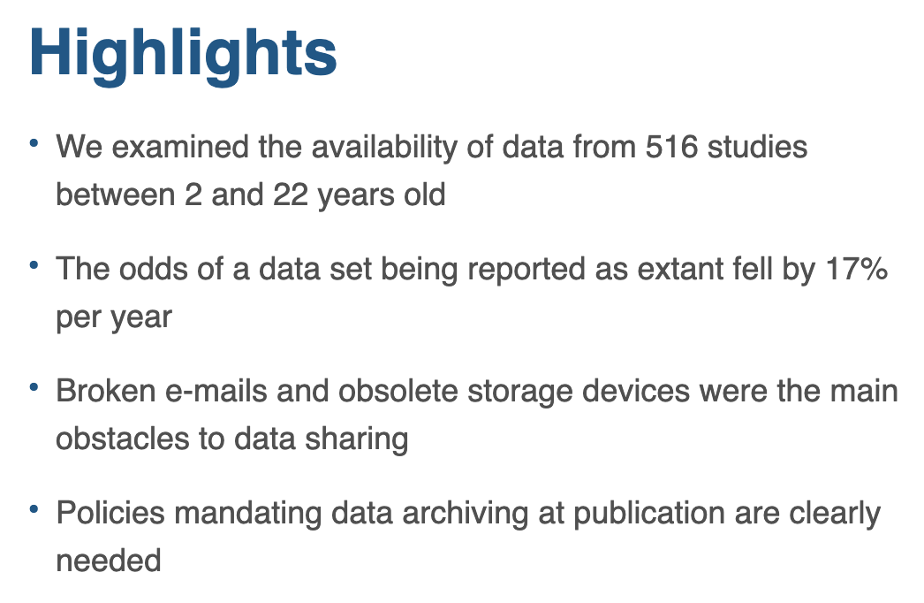
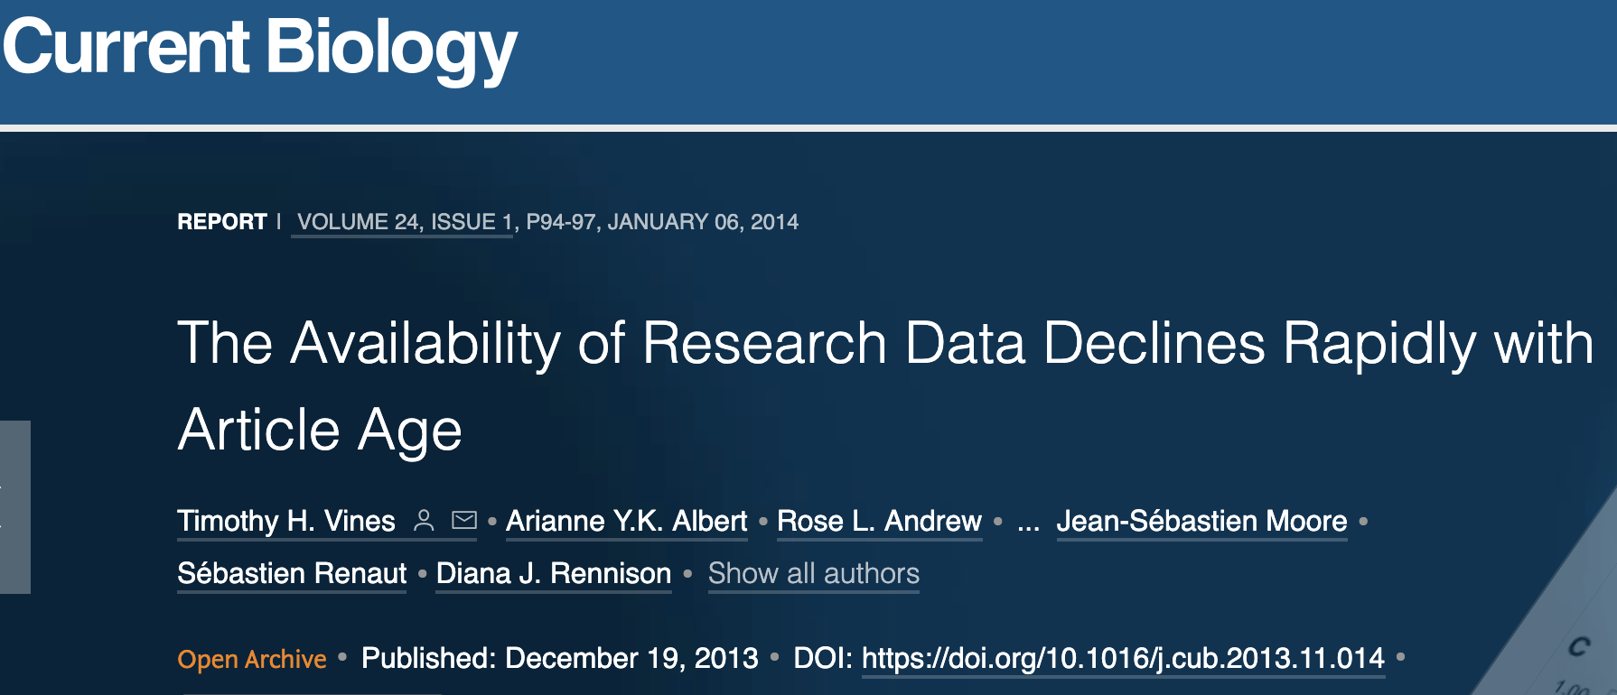
https://www.cell.com/current-biology/fulltext/S0960-9822(13)01400-0

Slide 24
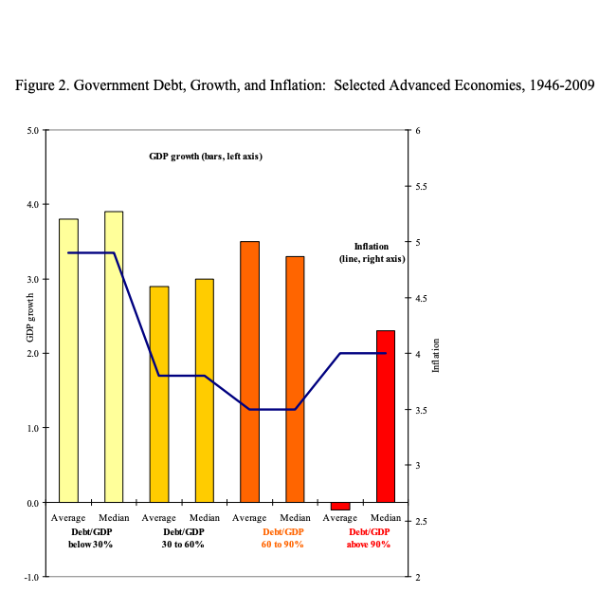
Austerity theory
Thesis presented: A Country economic growth is strongly affected (and decreased) whenever the amount of debt exceeds 90% of the Gross Domestic Product.
The results shown in the paper have been used to support public austerity policies during the recent economic crisis.
But some considerations were based on incorrect calculations.
A PhD student who fails to replicate the results finds out when asking the authors for the original dataset.

Slide 25
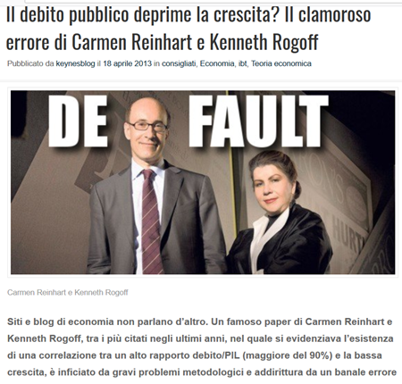
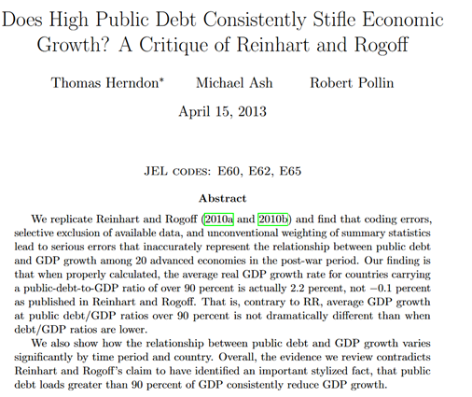
2013
Herndon, 2013

Slide 26
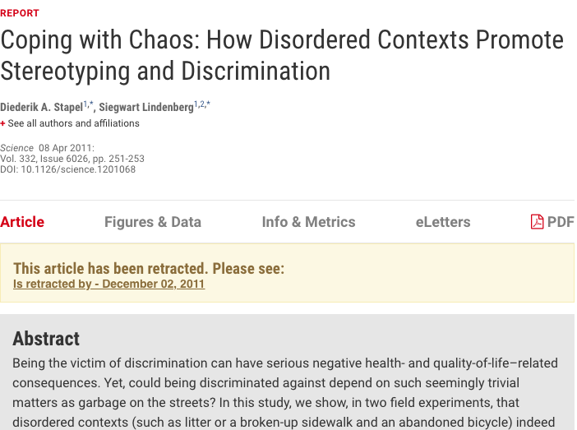
Social Studies
58 articles published by Diederik Stapel were withdrawn because they were based on invented data.
His papers had been published in scientific journals considered prestigious (very high IFs!).
Following reports from three doctoral students, the Dutch university for which he worked had started an investigation. Stapel then admitted that he had fabricated the data on numerous occasions.
If he had shared his data before, he probably wouldn't have been able to fabricate fakes for so long.
http://www.insidehighered.com/news/2011/11/28/scholars-analyze-case-massive-research-fraud

Slide 27
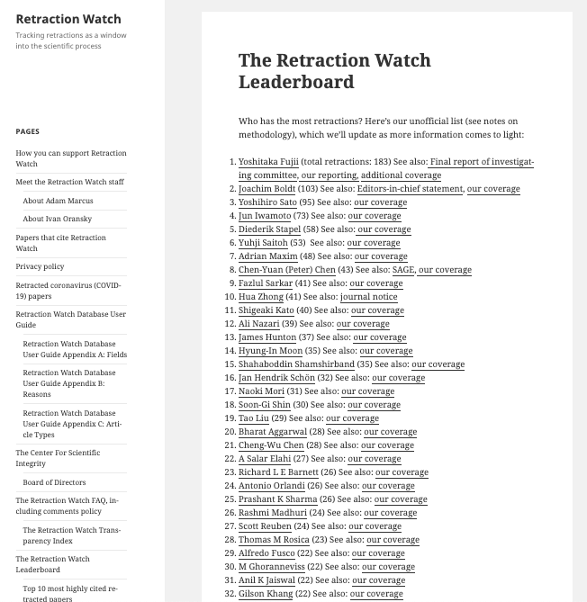
Retraction Watch Blog
Top 10 most highly cited retracted papers
Article | Year of retraction | Citing Articles before retraction | Citing Articles after retraction | Total cites (journals indexed by Web of Science)
Primary Prevention of Cardiovascular Disease with a Mediterranean Diet. N Engl J Med April 4, 2013 Estruch R, Ros E, Salas-Salvado J, Covas MI, Corella, D, Aros F, Gomez-Gracia E, Ruiz-Gutiérrez V, Fiol M, Lapetra J, Lamuela-Raventos RM, Serra-Majem L, Pinto X, Basora J, Munoz MA, Sorli JV, Martinez JA, Martinez-Gonzalez MA, et al., for the PREDIMED Study Investigators | 2018 | 1895 | 371 | 2266
2. Visfatin: A protein secreted by visceral fat that mimics the effects of insulin. SCIENCE, JAN 21 2005 Fukuhara A, Matsuda M, Nishizawa M, Segawa K, Tanaka M, Kishimoto K, Matsuki Y, Murakami M, Ichisaka T, Murakami H, Watanabe E, Takagi T, Akiyoshi M, Ohtsubo T, Kihara S, Yamashita S, Makishima M, Funahashi T, Yamanaka S, Hiramatsu R, Matsuzawa Y, Shimomura I. | 2007 | 228 | 1096 | 1324
3. Ileal-lymphoid-nodular hyperplasia, non-specific colitis, and pervasive developmental disorder in children. LANCET, FEB 28 1998 Wakefield AJ, Murch SH, Anthony A, Linnell J, Casson DM, Malik M, Berelowitz M, Dhillon AP, Thomson MA, Harvey P, Valentine A, Davies SE, Walker-Smith JA | 2010 | 633 | 669 | 1302
4. An enhanced transient expression system in plants based on suppression of gene silencing by the p19 protein of tomato bushy stunt virus. PLANT JOURNAL, MAR 2003 Voinnet O, Rivas S, Mestre P, Baulcombe D. | 2015 | 895 | 271 | 1166
5. Cardiac stem cells in patients with ischaemic cardiomyopathy (SCIPIO): initial results of a randomised phase 1 trial. LANCET, NOV 2011 Bolli, Roberto; Chugh, Atul R.; D’Amario, Domenico; et al. | 2019 | 904 | 22 | 926
7. TREEFINDER: a powerful graphical analysis environment for molecular phylogenetics. BMC EVOLUTIONARY BIOLOGY, JUN 28 2004 Jobb G, von Haeseler A, Strimmer K. | 2015 | 772 | 132 | 904
6. Purification and ex vivo expansion of postnatal human marrow mesodermal progenitor cells. BLOOD, NOV 1 2001 Reyes M, Lund T, Lenvik T, Aguiar D, Koodie L, Verfaillie CM. | 2009 | 600 | 292 | 892
8. Viral pathogenicity determinants are suppressors of transgene silencing in Nicotiana benthamiana. EMBO JOURNAL, NOV 16 1998 Brigneti G, Voinnet O, Li WX, Ji LH, Ding SW, Baulcombe DC | 2015 | 773 | 54 | 827
9. Spontaneous human adult stem cell transformation. CANCER RESEARCH, APR 15 2005 Rubio D, Garcia-Castro J, Martín MC, de la Fuente R, Cigudosa JC, Lloyd AC, Bernad A. | 2010 | 326 | 429 | 755
10. Combination treatment of angiotensin-II receptor blocker and angiotensin-converting-enzyme inhibitor in non-diabetic renal disease (COOPERATE): a randomised controlled trial. LANCET, JAN 11 2003 Nakao N, Yoshimura A, Morita H, Takada M, Kayano T, Ideura T. | 2009 | 583 | 148 | 731

Slide 28
Open Science

Slide 29
Schimmer, R., Geschuhn, K. K., & Vogler, A. (2015). Disrupting the subscription journals’ business model for the necessary large-scale transformation to open access. doi:10.17617/1.3.
Estimation:10 Billions Dollars used for journal subscriptions
That is the money Institutions pay to re-buy the article their own researchers write!

Slide 30
Open Science: Science the correct way!
Open Science means: open each step of the research cycle.
Open Science principles are: transparency, reproducibility, collaboration, inclusiveness, accessibility, accuracy, re-use
Open Science steps from the concept that the reseach that is funded with public money has to be made immediately available to the community: «every EU citizen has the right to access and benefit from knowledge produced using public funds» [Neelie Kroes, European Commission]
The European Commission and a long list of International Funders made a clear choice towards Open Science

Slide 31
Open Science
Open Science means a broader access to publicly funded research results and therefore helps to:
build on previous research results (improved quality of results)
encourage collaboration and avoid duplication of effort (greater efficiency)
speed up innovation (faster progress to market means faster growth)
involve citizens and society (improved transparency of the scientific process).

Slide 32

Research
Infrastructures
Open Science
Research
Integrity
Open
Software
Open Access Publications
Open Metodologies
Open Access Data
Evaluation:Altmetrics
Open Workflows/Protocols
Open Education
Citizen
Science
Open Peer-Review

Slide 33
Open Access
The main pillar of
Open Science is
to publications
and research data

Slide 34
Open Access
Open Access is «free and unrestricted online access to research outputs (texts and data)»

Slide 35
Beware!
Open Access doesn’t mean paying for publishing!
Do not confuse
Open Access with the business model behind Gold Open Access

Slide 36
How do you give access to your production?
Through a Repository

Slide 37
Repository Open Access
A repository stores Open Access digital objects and makes them available and downloadable. It’s accessible and interoperable through a OAI-PMH protocol and it deploys a long-term archiving policy
Institutional
Thematic/Disciplinary
Litterature
How do you chose a Repository?
Literature Repositories: Open Access Repository Directory
www.opendoar.org
Data Repositories: Registry of Research Data Repository
https://www.re3data.org/
Data
Catch All

Slide 38
Why do you need to deposit in a Repository?
Repositories are managed by institutions, countries, transnational infrastructures or solid scientific communities that implement long-term curation and preservation of content
Preserve
A repository provides a public interface that allows anyone to access the metadata of digital objects. The author can assign different access rights for attachments (open, restricted, closed, embargoed, ...)
Share

Slide 39
Open Access to Scientific Literature

Slide 40
Open Access to Scientific Literature
There are two ways to implement Open Access to scientific literature :
    Green Open Acces: when the Open Access version of papers, wherever they have been published, is deposited in open access repositories, in compliance with copyright regulations; editors that may retain the rights can require an embargo period (months in which the deposited paper remains closed).
    Gold Open Access: the publication in Open Access Journals, which are journals witouth subscription for readers, with transparent peer review and which leaves the rights to the authors; in 26% of cases they apply APC – Article Processing Charges – to support editorial costs.
To guarantee the reuse, authors should choose open licenses (ie. Creative Commons, which have 4 criteria: BY, SA, NC, ND)

Slide 41
Deposit in literature Repository
The possible versions are:
  PRE-PRINT: your final draft, as submitted to the journal (does not have reviewers comments yet)
  POST-PRINT or ACCEPTED MANUSCRIPT: the final version, with reviewers comments, identical to the published one except for the editorial layout
  EDITORIAL PDF or PUBLISHED VERSION: the exact version published in the journal, with layout and graphic
To know which version you can deposit and the eventual period of embargo, you can check SHERPA-RoMEO database
To find an Open Access Journal and and find out if charges APC (Article Processing Charges), you can check DOAJ, Directory of Open Access Journals (no predatory publishers included as the directory is curated!)

Slide 42
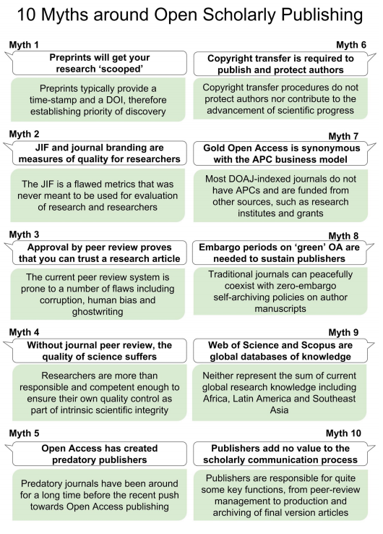
10 Myths around open scholarly publishing
Tennant JP, Crane H, Crick T, Davila J, Enkhbayar A, Havemann J, Kramer B, Martin R, Masuzzo P, Nobes A, Rice C, Rivera-López BS, Ross-Hellauer T, Sattler S, Thacker P, Vanholsbeeck M. 2019. Ten myths around open scholarly publishing. PeerJ Preprints 7:e27580v1 https://doi.org/10.7287/peerj.preprints.27580v1

Slide 43
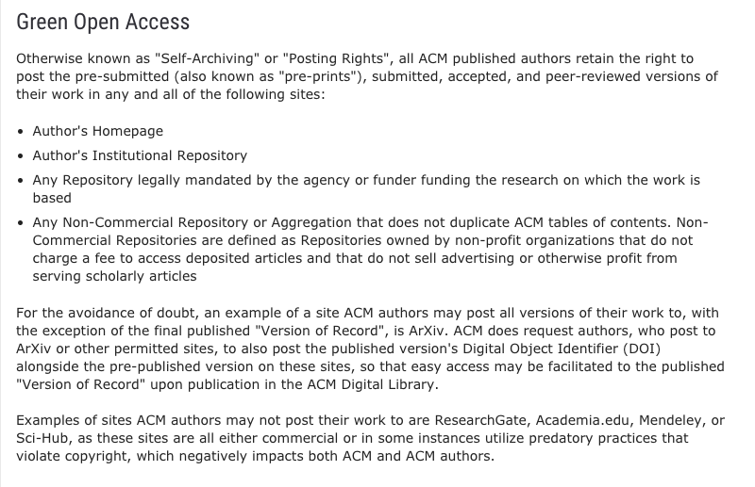
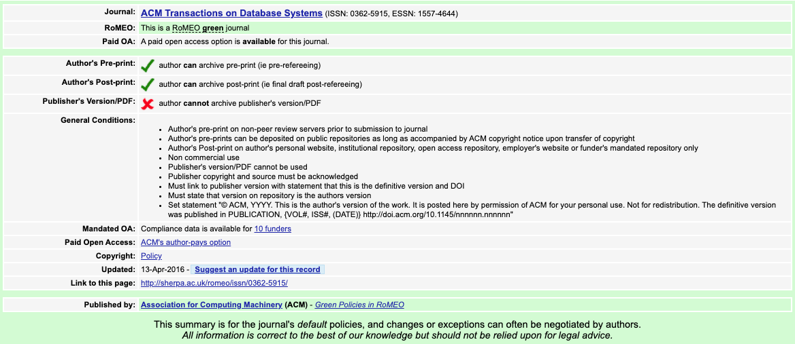

Some tips for OA in your community
ACM Transaction on Database Systems
http://sherpa.ac.uk/romeo/search.php?source=journal&sourceid=10678&la=en&fIDnum=|&mode=simple
https://authors.acm.org/open-access#green

Slide 44
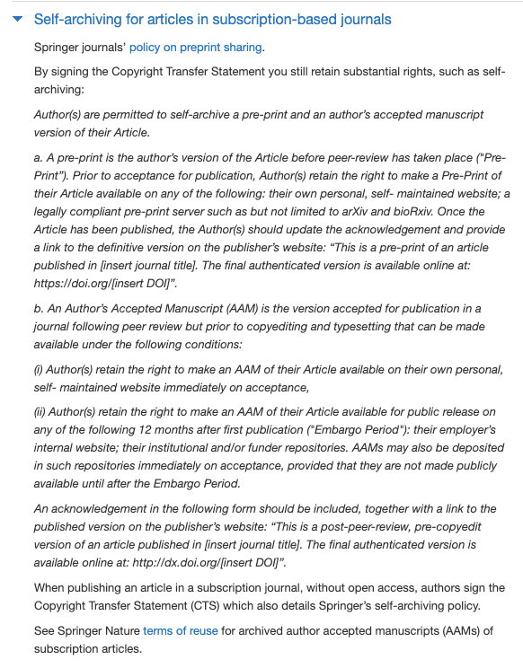
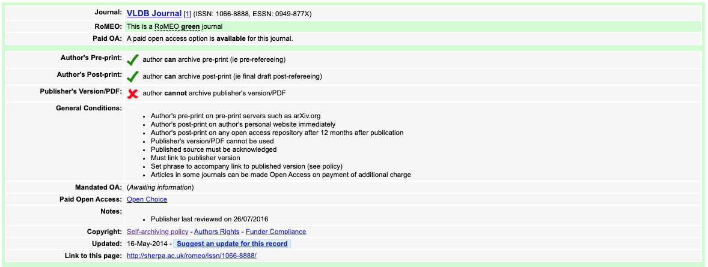
Some tips for OA in your community
VLDB Journal
http://sherpa.ac.uk/romeo/issn/1066-8888/
https://www.springer.com/gp/open-access/publication-policies/self-archiving-policy

Slide 45
Open Access to Research Data

Slide 46
Why?
Visibility and impact
Reuse, also for research purpose you will never think about
Reliability. Transparency and check
Reproducibility and results verification.

Slide 47
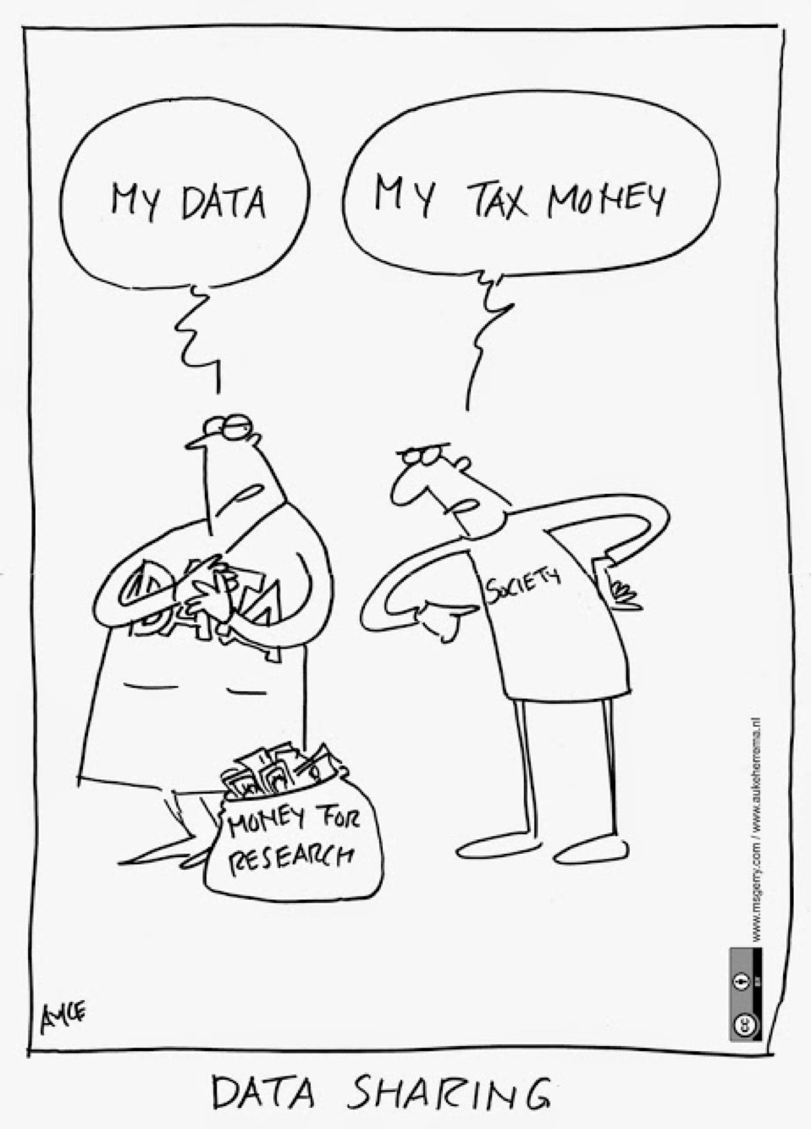
https://www.fosteropenscience.eu/content/cartoon-data-sharing

Slide 48
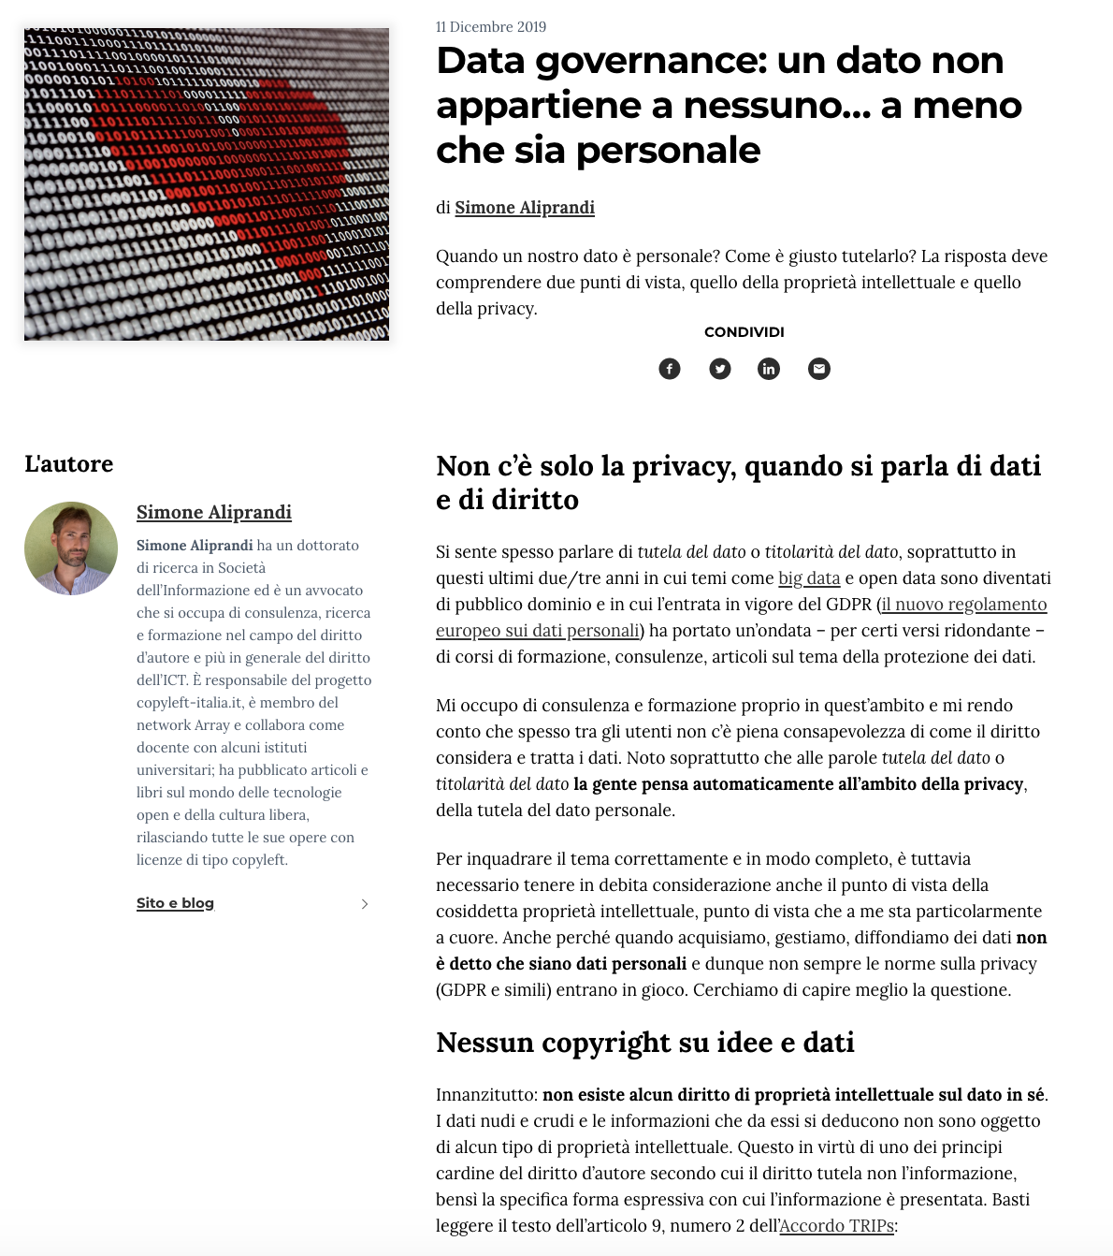
Data is not yours!
Data is not intellectual work.
Copyright protection covers expressions and not ideas, procedures, operating methods or mathematical concepts as such.
Protection is on databases and not on data. The data are protected only and especially when they are collected and organized in a database.
The sui generis property right (only in Europe) covers not only the reproduction and dissemination of the database, but also the extraction and reuse of substantial parts of the database.
Read complete article here.
A similar content article in English here.
OpenAIRE Guidelines on data protection: available here

Slide 49
Research data does not belong to you, this is why you should carefully manage it!

Slide 50
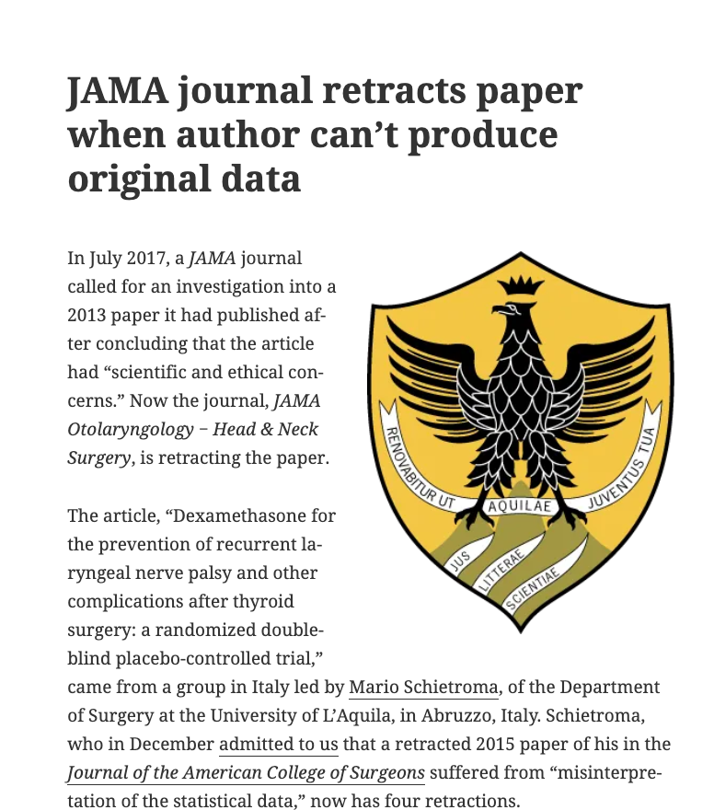
Data and Reliability
“Neither [the original dataset and the approved protocol] have been provided by Dr Schietroma, and the university has informed us that “without those pieces of information the results of the papers under investigation cannot be validated.”
https://retractionwatch.com/2018/10/25/jama-journal-retracts-paper-when-author-cant-produce-original-data/

Slide 51
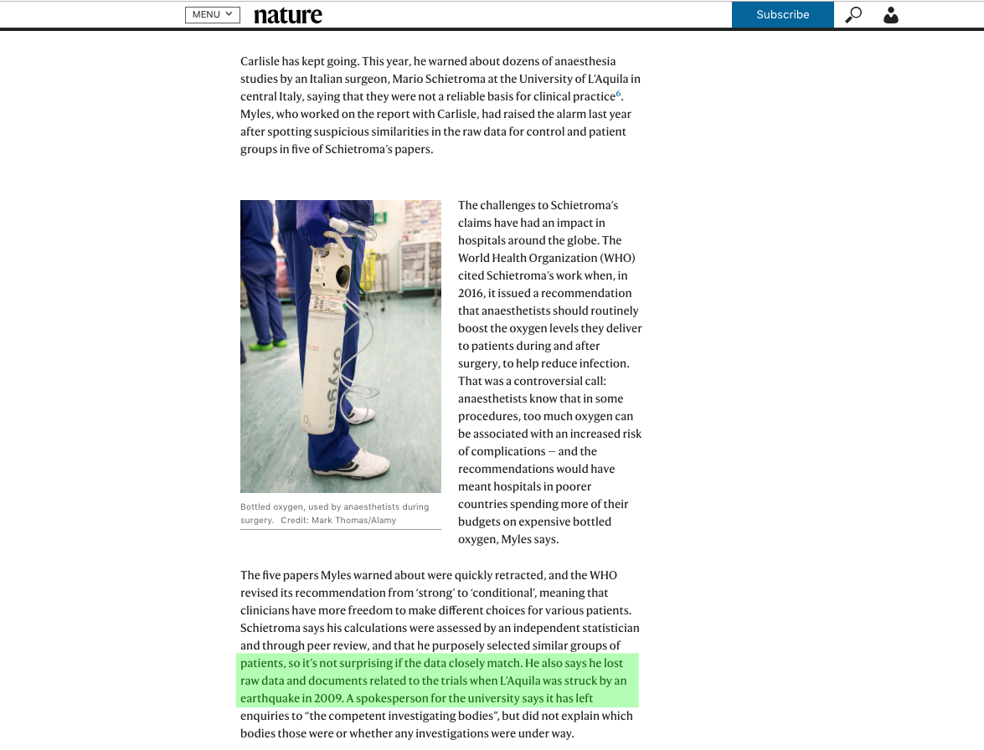
Depositing is of key importance
https://www.nature.com/articles/d41586-019-02241-z

Slide 52
Open Access to research Data
Storage: data must be deposited in a «trusted» repository
  Zenodo it’s the best solution because it’s already connected with OpenAIRE
  It’s better to deposit in disciplinary repositories, if available
  Disciplinary repositories can be found on Re3data (www.re3data.org)
  Provide full metadata, according to discipline standards.
OPEN ACCESS: data must be opened
  An embargo period can be imposed, depending on the project
  Choose the most open CC license possible: CC0 or CC-BY
DOCUMENTATION: all useful information about the gathering of the data must be provided, and possibly DEPOSIT the dataset.

Slide 53

European Commission and Open Science
For all Horizon 2020 and the next Horizon Europe framework programme

Slide 54
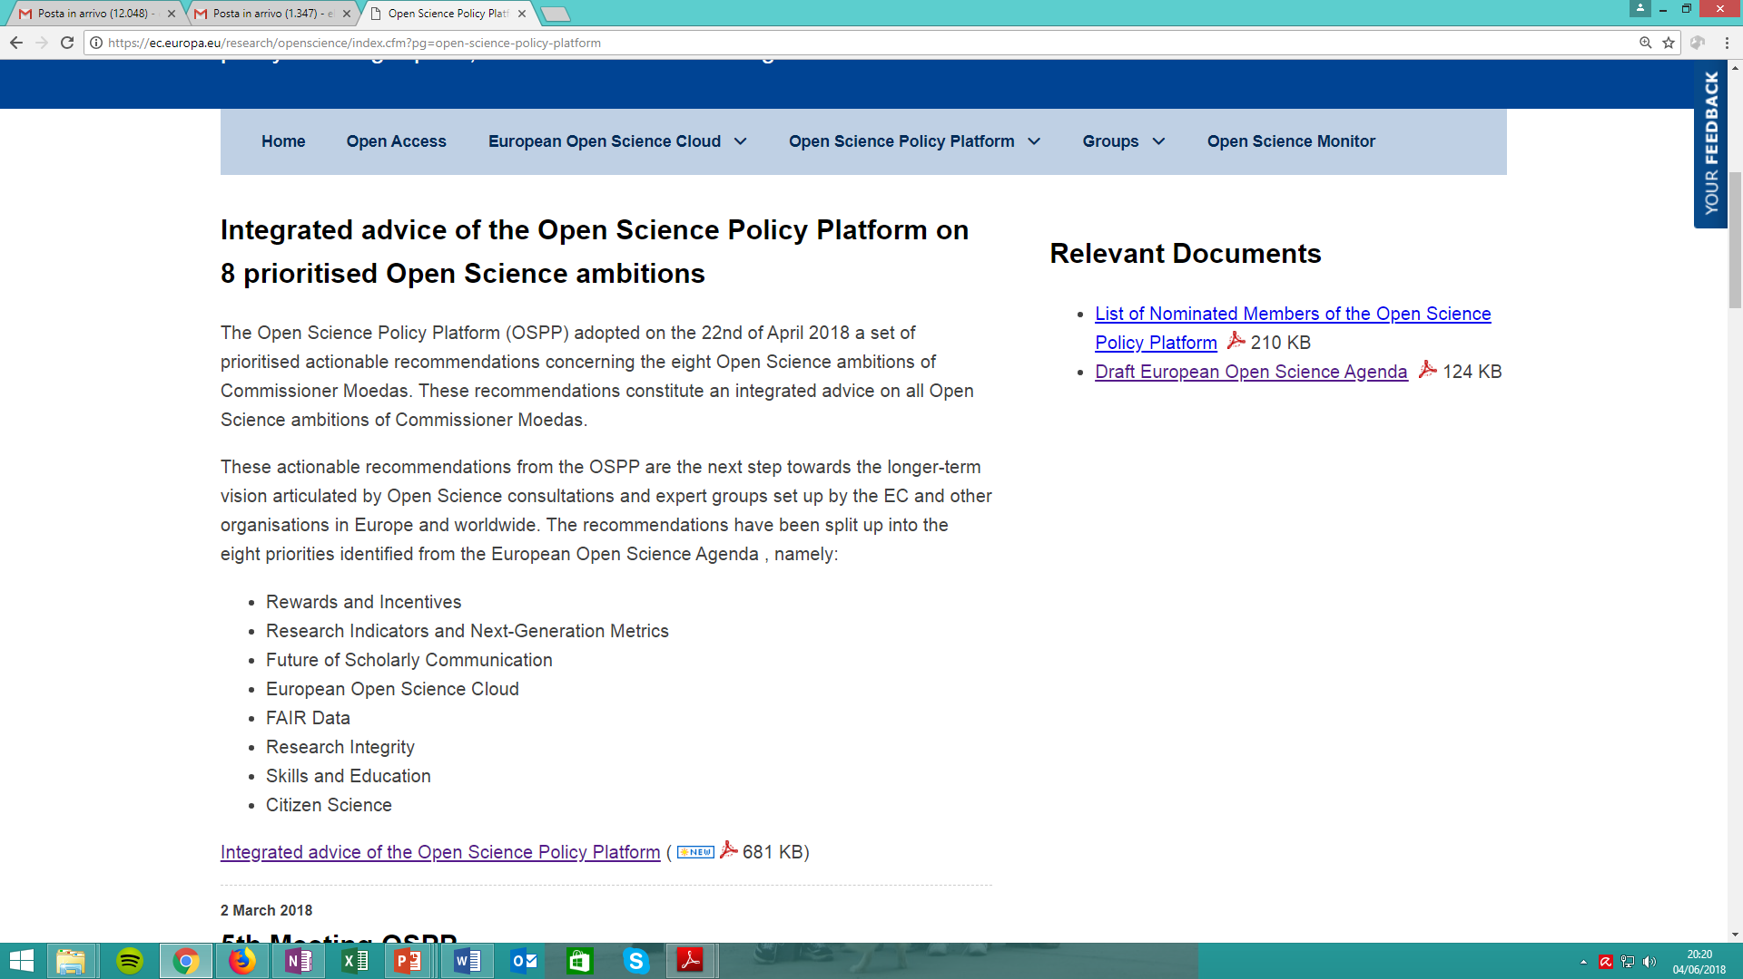
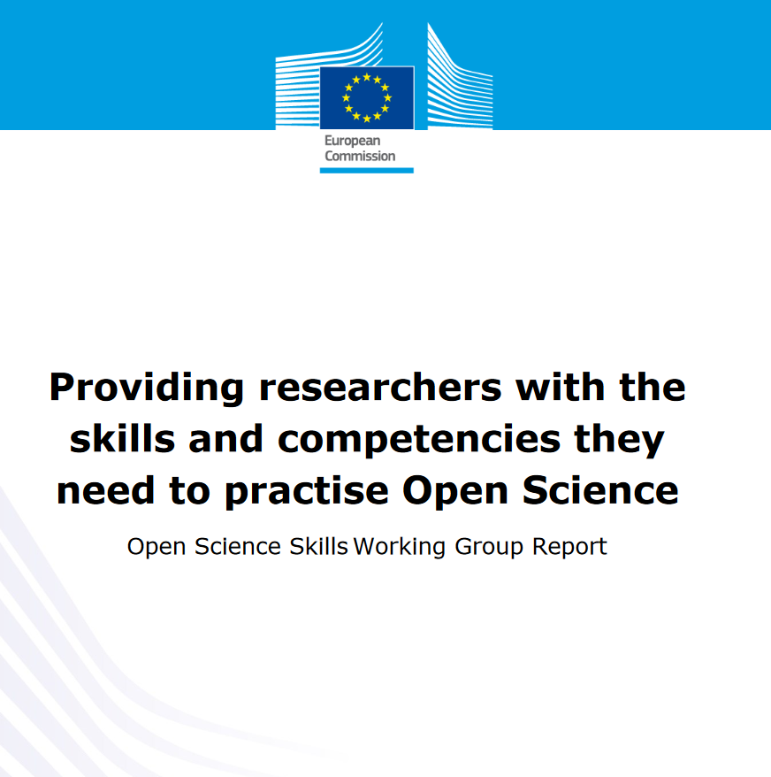

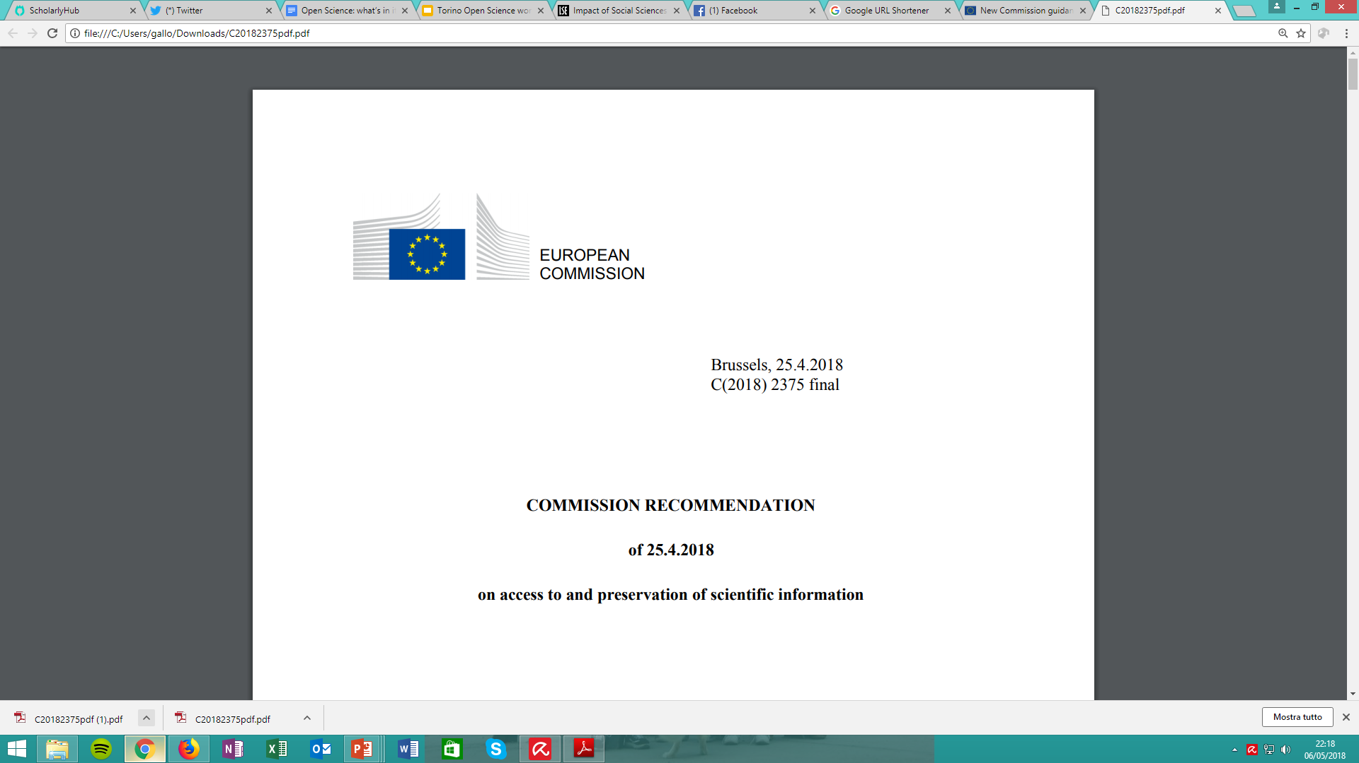
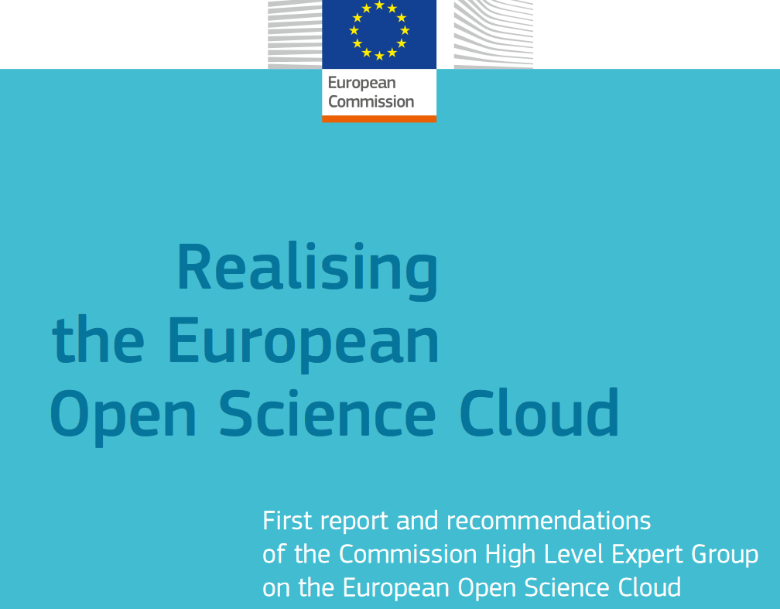
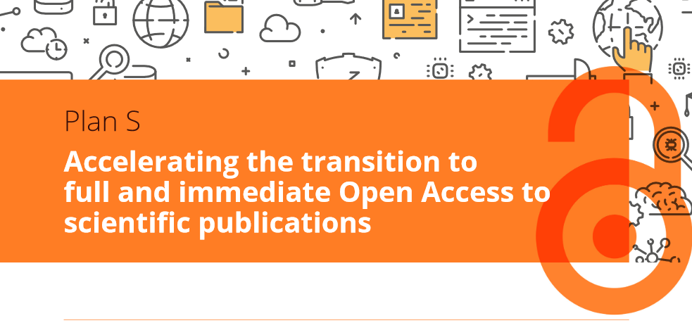
Open Science in Europe
Report, Sept.2017
May 29, 2018
25 Apr. 2018
Politiche nazionali e di ogni ateneo su Open Access e Open Data
Report, 2016
Sept. 4, 2018

Slide 55
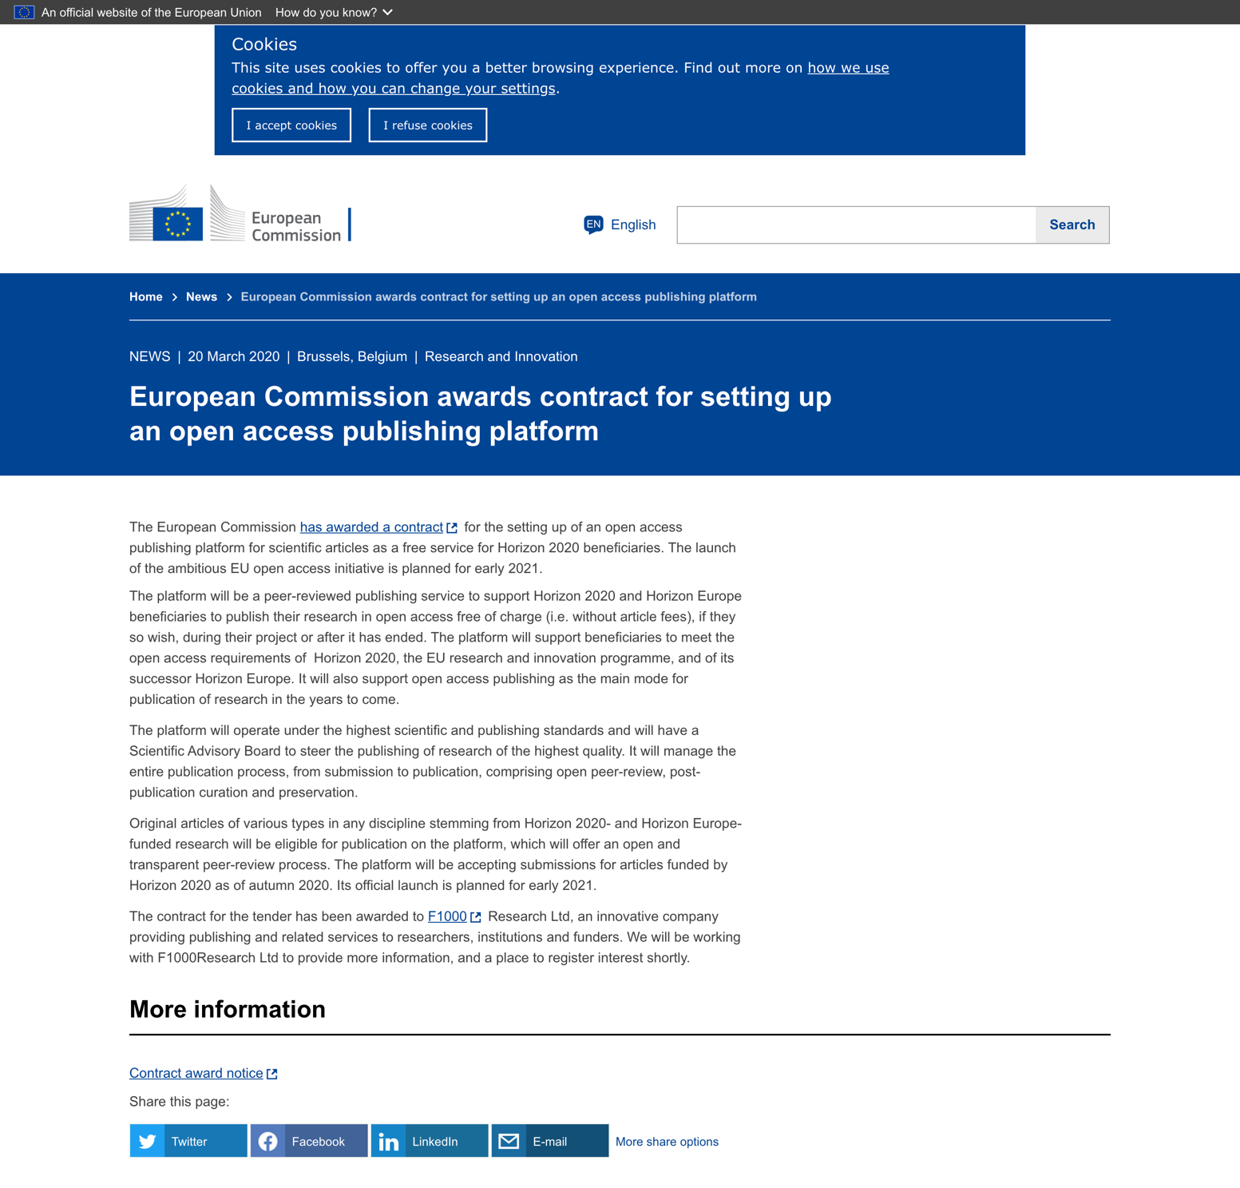
European Commission
Open Research Publishing Platform
Call for tender closed in September 2019, awarded to F1000
Online by end of 2020
Research publication platform for scientific papers – service dedicated to EC funding beneficiaries
The platform will manage all the publication, post-publication, curation and preservation process
Open peer-review
Pre-prints and final versions of papers will be open to the end users free of charge (also non-scientists)

Slide 56
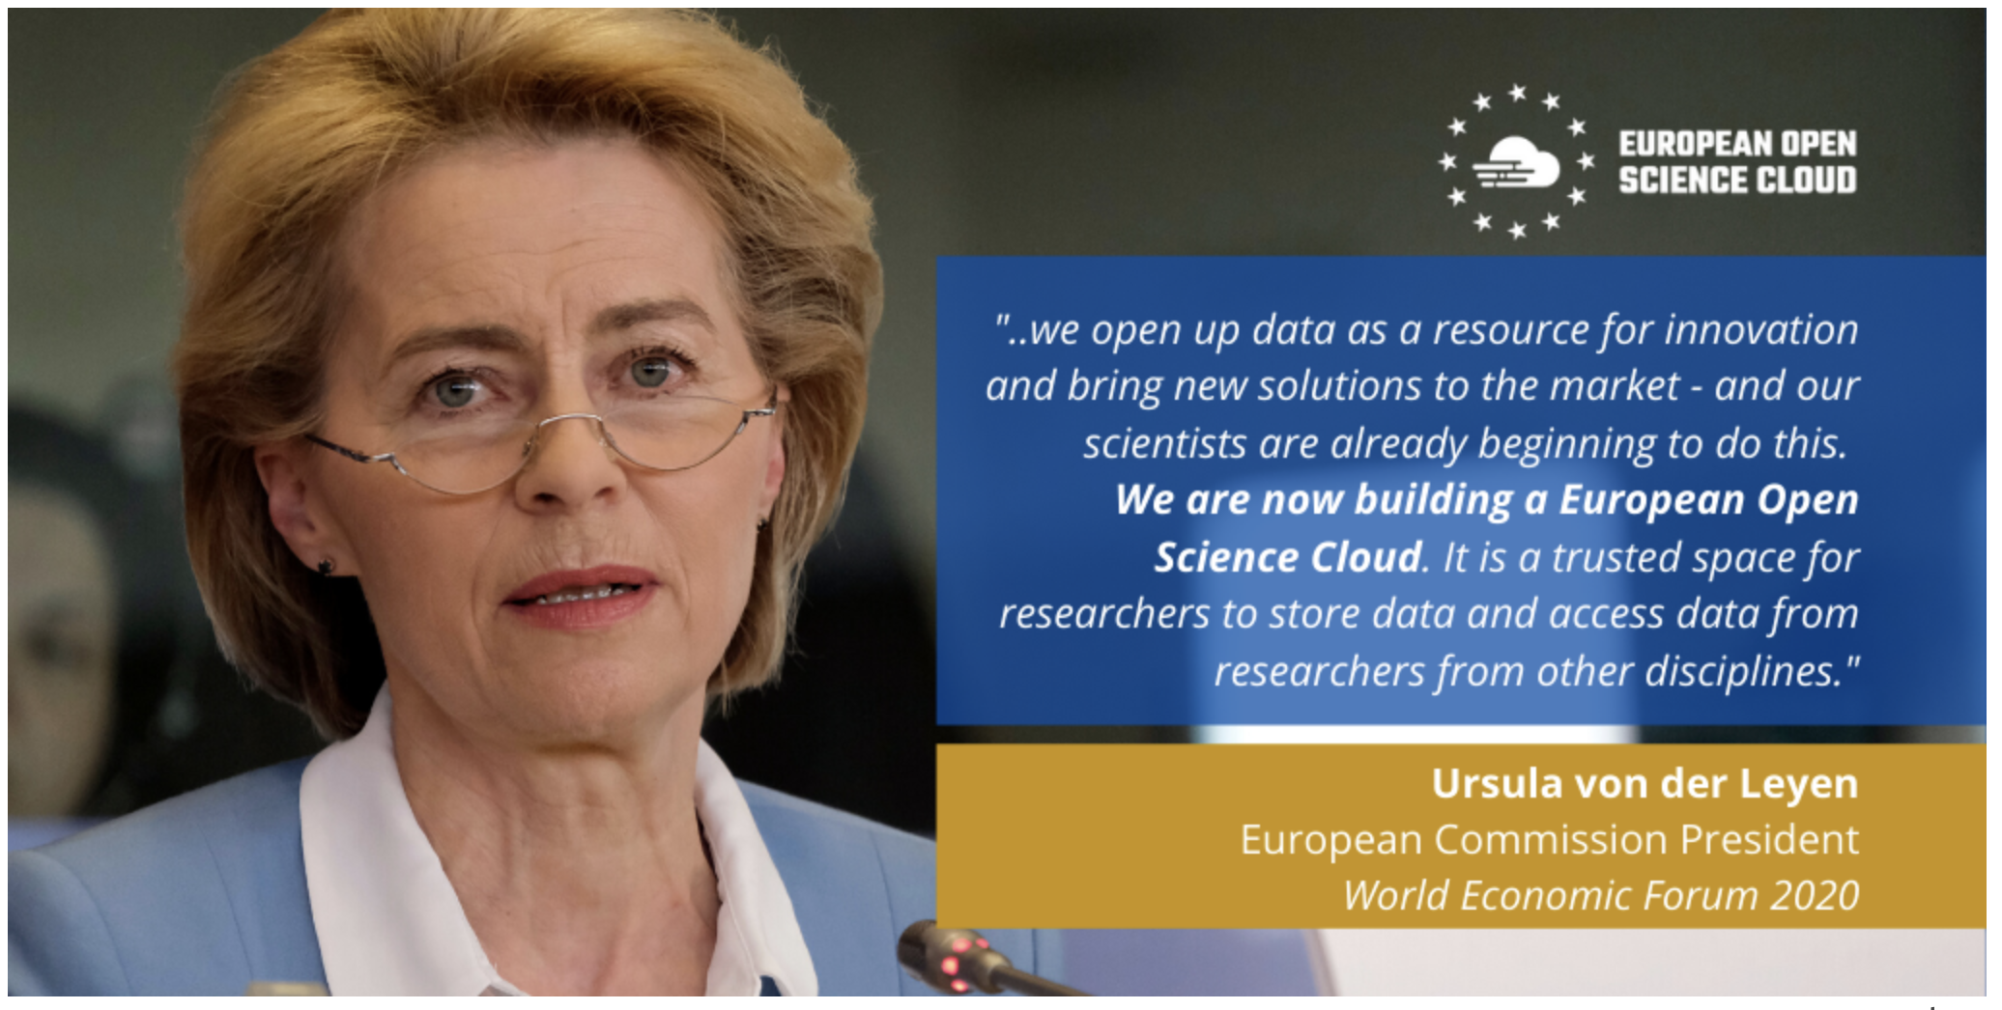
European Open Science Cloud - EOSC
EOSC aims at creating a virtual research environment to access and interoperate research data and other research outputs in Europe across the different disciplines.
Più informazioni su
https://ec.europa.eu/research/openscience/index.cfm?pg=open-science-cloud
www.eoscsecretariat.eu
https://www.eosc-portal.eu/

Slide 57
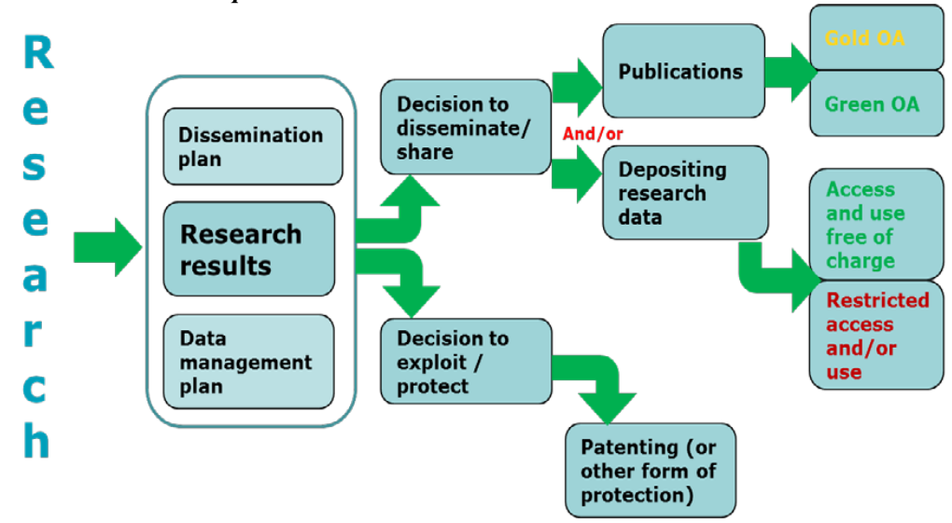
H2020 beneficiaries
Must decide whether to patent or publish
Guidelines to the Rules on Open Access to Scientific Publications and
Open Access to Research Data in Horizon 2020

Slide 58

EC Open Access Mandate to Scientific
Publications
    Open by mandate: each beneficiary must ensure open access to all peer-reviewed scientific publications relating to its results.
    Embargo period: at most 6 months (12 months for publications in the social sciences and humanities).
    What to deposit?
      Post Print or Editorial Version (machine-readable electronic copy)
      Metadata must contain project coordination (name of the
      action, acronym and grant number)
    Where to deposit?
      A repository that is compliant to OpenAIRE guidelines
Open by mandate

Slide 59
EC mandate on Open Access to research data
Open by default (“Opt Out” always possible)
What to deposit
    Data produced by funded research that led to a scientific publication, but in general all types of data
    Metadata with reference to the project
Where to deposit
A repository that is compliant to OpenAIRE guidelines
What to produce
    Data Management Plan
As Open As Possible
As Closed As Necessary

Slide 60
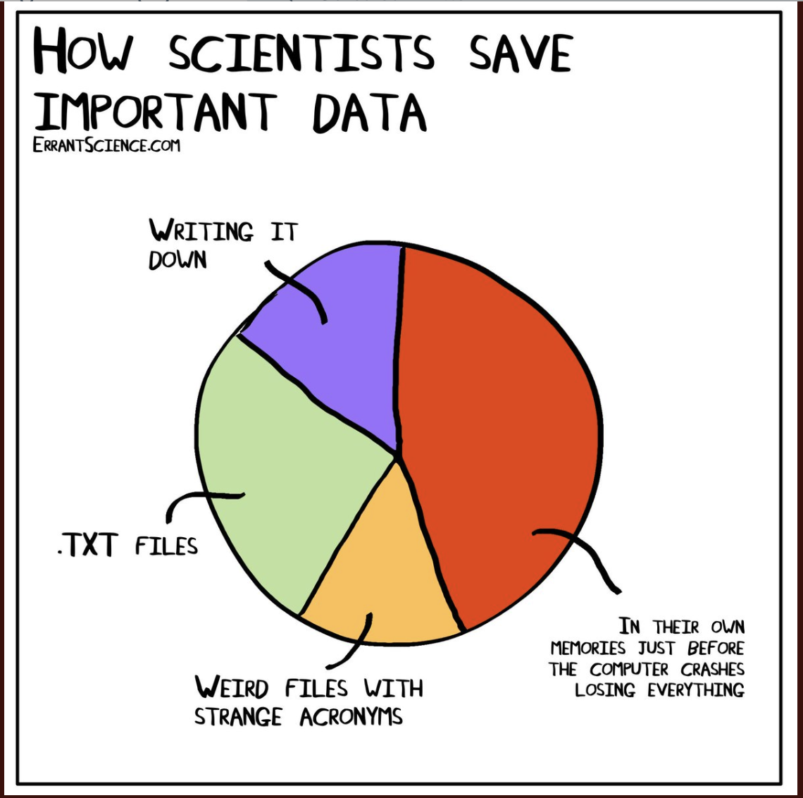
Research Data Management
European Commission policies aims to spread correct aspects of research data management
A Data Management Plan is required (mandatory deliverable within month 6)
You need to make your data compliant with the FAIR principles even if you will not assign Open Access rights to it.

Slide 61
Data must be FAIR
Accessible
Findable
For at least 10 years! It does not mean that data is open, but it must be clear who and how can access the data.
it should be clear where data are located and can be cited!
Interoperable
Reusable
Data should be easily integrated with other data, machine readeable, and linked to other research results
usable for re-analysis or new research (transparency, integrity)
FAIR does not mean Open

Slide 62
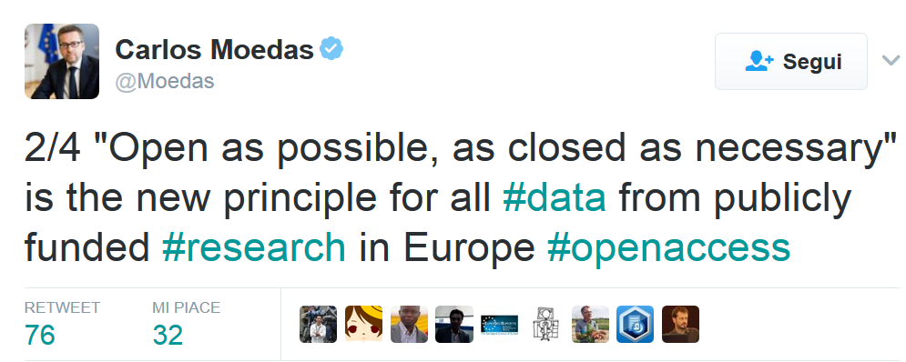
Once your data is FAIR, open it!
From 2014 until 2019, Moedas served as European Commissioner covering the portfolio of Research, Science and Innovation under the leadership of President Jean-Claude Juncker

Slide 63
Beware of Sanctions!
Grant Reductions or Payment Suspension
[Art. 43 of the Annotated Grant Agreement]

Slide 64
The tools, services, infrastructures, best practices, standards, procedures to make your data FAIR and Open already exist!
You only have to get to know them!

Slide 65
Fifty shades of no (to data sharing)
Too expensive
There’s no business case
There’s no commercial value
It’s private
It’s secret
It's our data
We have invested a lot of money in this
Link enough data and one will arrive at sensitive private information
It's not data, it's information
It will never work
We don't know how to do this
We don't have the right people to do this
We need the money
It’s not ours, and we don’t know who’s data it is
No idea what the quality of the data is
We don’t know where to find it
It’s not our job
It isn’t in the right format
I am not authorised
Who is going to use this anyway
People are going to misuse it
Image damage for the minister
We are not ready for this
Image loss for Government
The data file is too big
Not enough bandwidth
This is a first step, we will see what we can do later
We can’t find it
We have no access
It is out of date / too old
We have it only on paper
We don’t know if it’s legal
Management says no
We never did this before
No value in it
No time / no resources
We will open up (but adapt 90%)
It’s incorrect
Commercially sensitive
It is dangerous when linked
People are going to make the wrong conclusions
This is going to start a wrong discussion
We can’t say whether we have it or we don’t
We know the data is wrong, and people will tell us where it is wrong, then we'd waste resources inputting the corrections people send us
Our IT suppliers will charge us a fortune to do an ad hoc data extract
We have to be careful with existing contracts
Our website cannot hold files this large
It's not ours and we don't have authorization from the data owner
We've already published the data (but it's unfindable/unusable)
People may download and cache the data and it will be out of date when they reuse it
We don't collect it regularly
Too many people will want to download it, which will cause our servers to fail
People would get upset
It’s very sensitive information
We are not ready for this
Tell us who is going to use it and we will make it open

Slide 66
A step into the Future

Slide 67
A new research evaluation is coming…
Based on Open Science and all the FAIR objects researchers produce
Based on the reuse that (other) researchers will make of the FAIR products
Based on the links research objects enable
Researchers (and Funders) need to prepare for this
Make your research FAIR today
if you wish to be evaluated tomorrow

Slide 68
Part of the slides are borrowed from Carole Goble’s presentation at IRCDL2019, “Reproducibility (and the R*) of Science”
Paolo Manghi
Istituto di Scienza e Tecnologie dell’Informazione
National Research Council, Italy
http://orcid.org/0000-0001-7291-3210
Reproducibility (and the R*) of science in Computer Science: methodologies and research opportunities

Slide 69
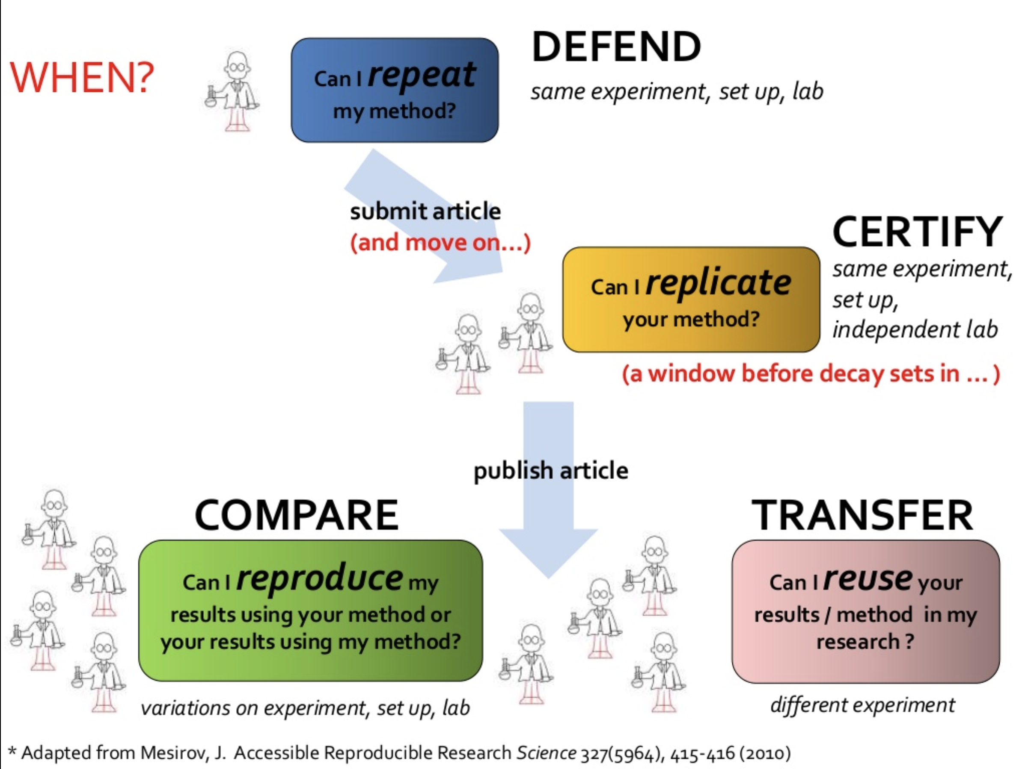
Reproduciblity (the R* of Science)

Slide 70
An experiment is reproducible until another laboratory tries to repeat it
Alexander Kohn, 1955
Co-founder, with physicist Harry J. Lipkin, of “The Journal of Irreproducible Results”

Slide 71







Open Science: challenges
Digital Laboratories
Scholarly Communication Infrastructure
Workflow
Workflow
Scientific Literature
01101010
01100001
11010010
01101010
01100001
11010010
01101010
01100001
11010010
01101010
01100001
11010010
01101010
01100001
11010010
01101010
01100001
11010010
Digital scientific process
Reproducibility and Transparency of science are compromised
Digital-Manual
Not trusted
Not transparent
Non collaborative
Heterogeneous resources
01101010
01100001
11010010
01101010
01100001
11010010
Disk
RAM
Lack of economy of scale
Notes:
Peer review

Slide 72
Current Open Science Practices in the ICT Domain

Slide 73


File sharing
Software management tools (GitHub)

Slide 74
What is missing?
Such methods DO NOT
Publish your products (in the academic sense),
Preserve your products,
Make your products citable and findable,
Carry attribution and scientific credit,
Enable reproducibility

Slide 75
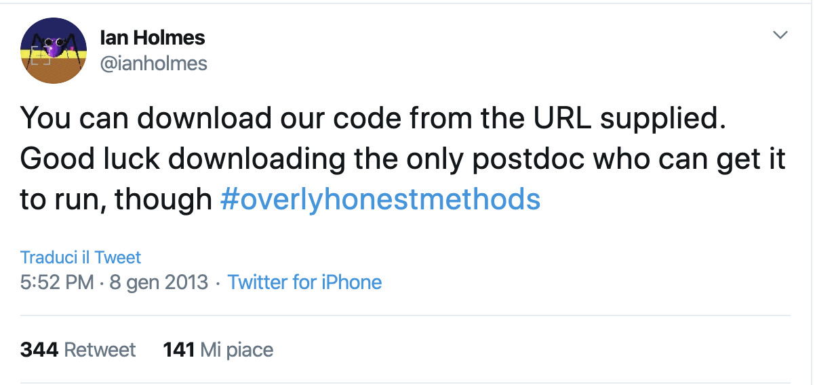

Slide 76
What can we do?

Slide 77
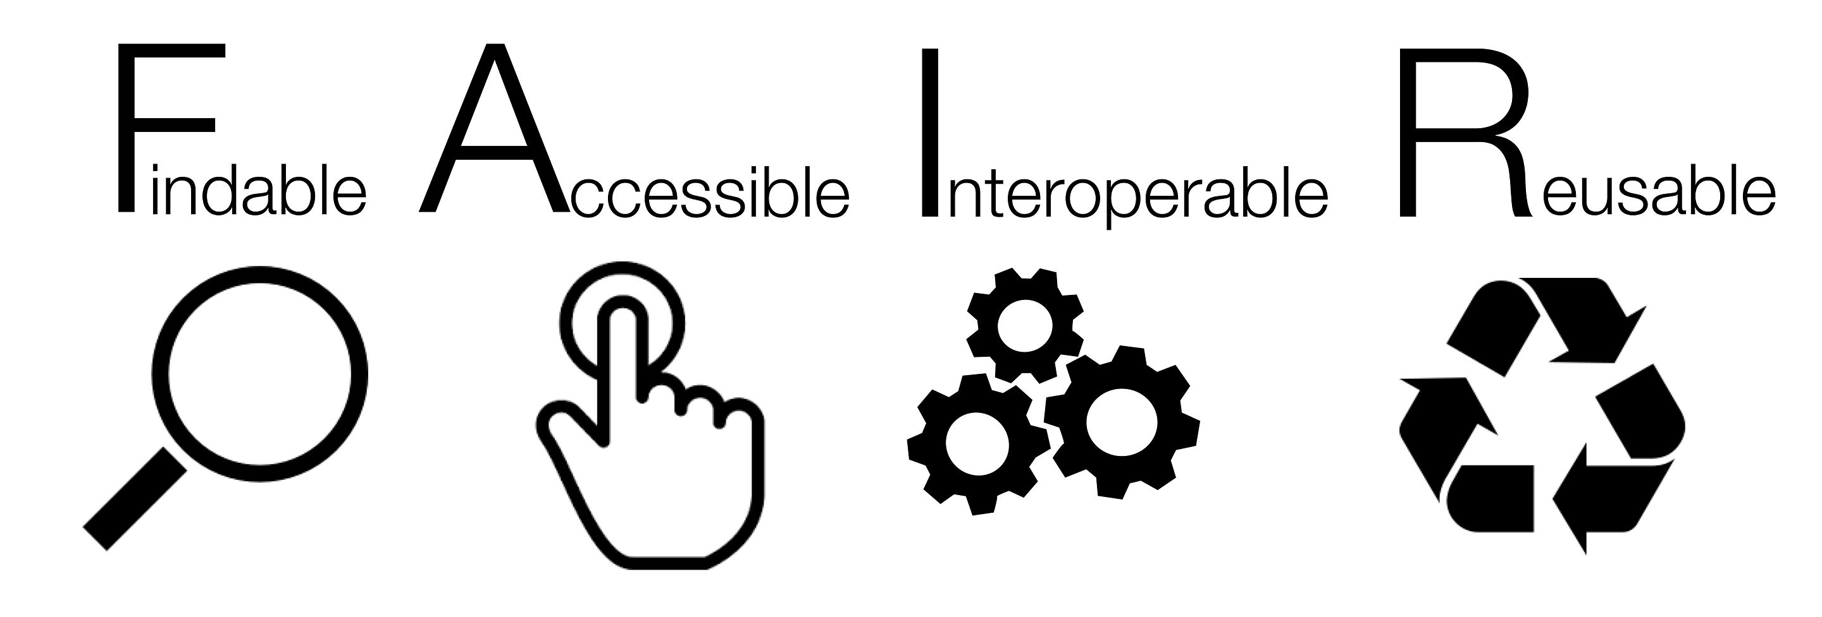
Make data and software FAIR
ORCID to identify the authors/contributors
Develop in a structured – and collaboratory/open – way (GitHub)
Deposit and preserve in a trustworthy repository: get a DOI! (Zenodo)
Choose a clear license
Deposit a (updated) README file with your code/data
Use versioning
Link to other research objects
(articles, data, software…)

Slide 78
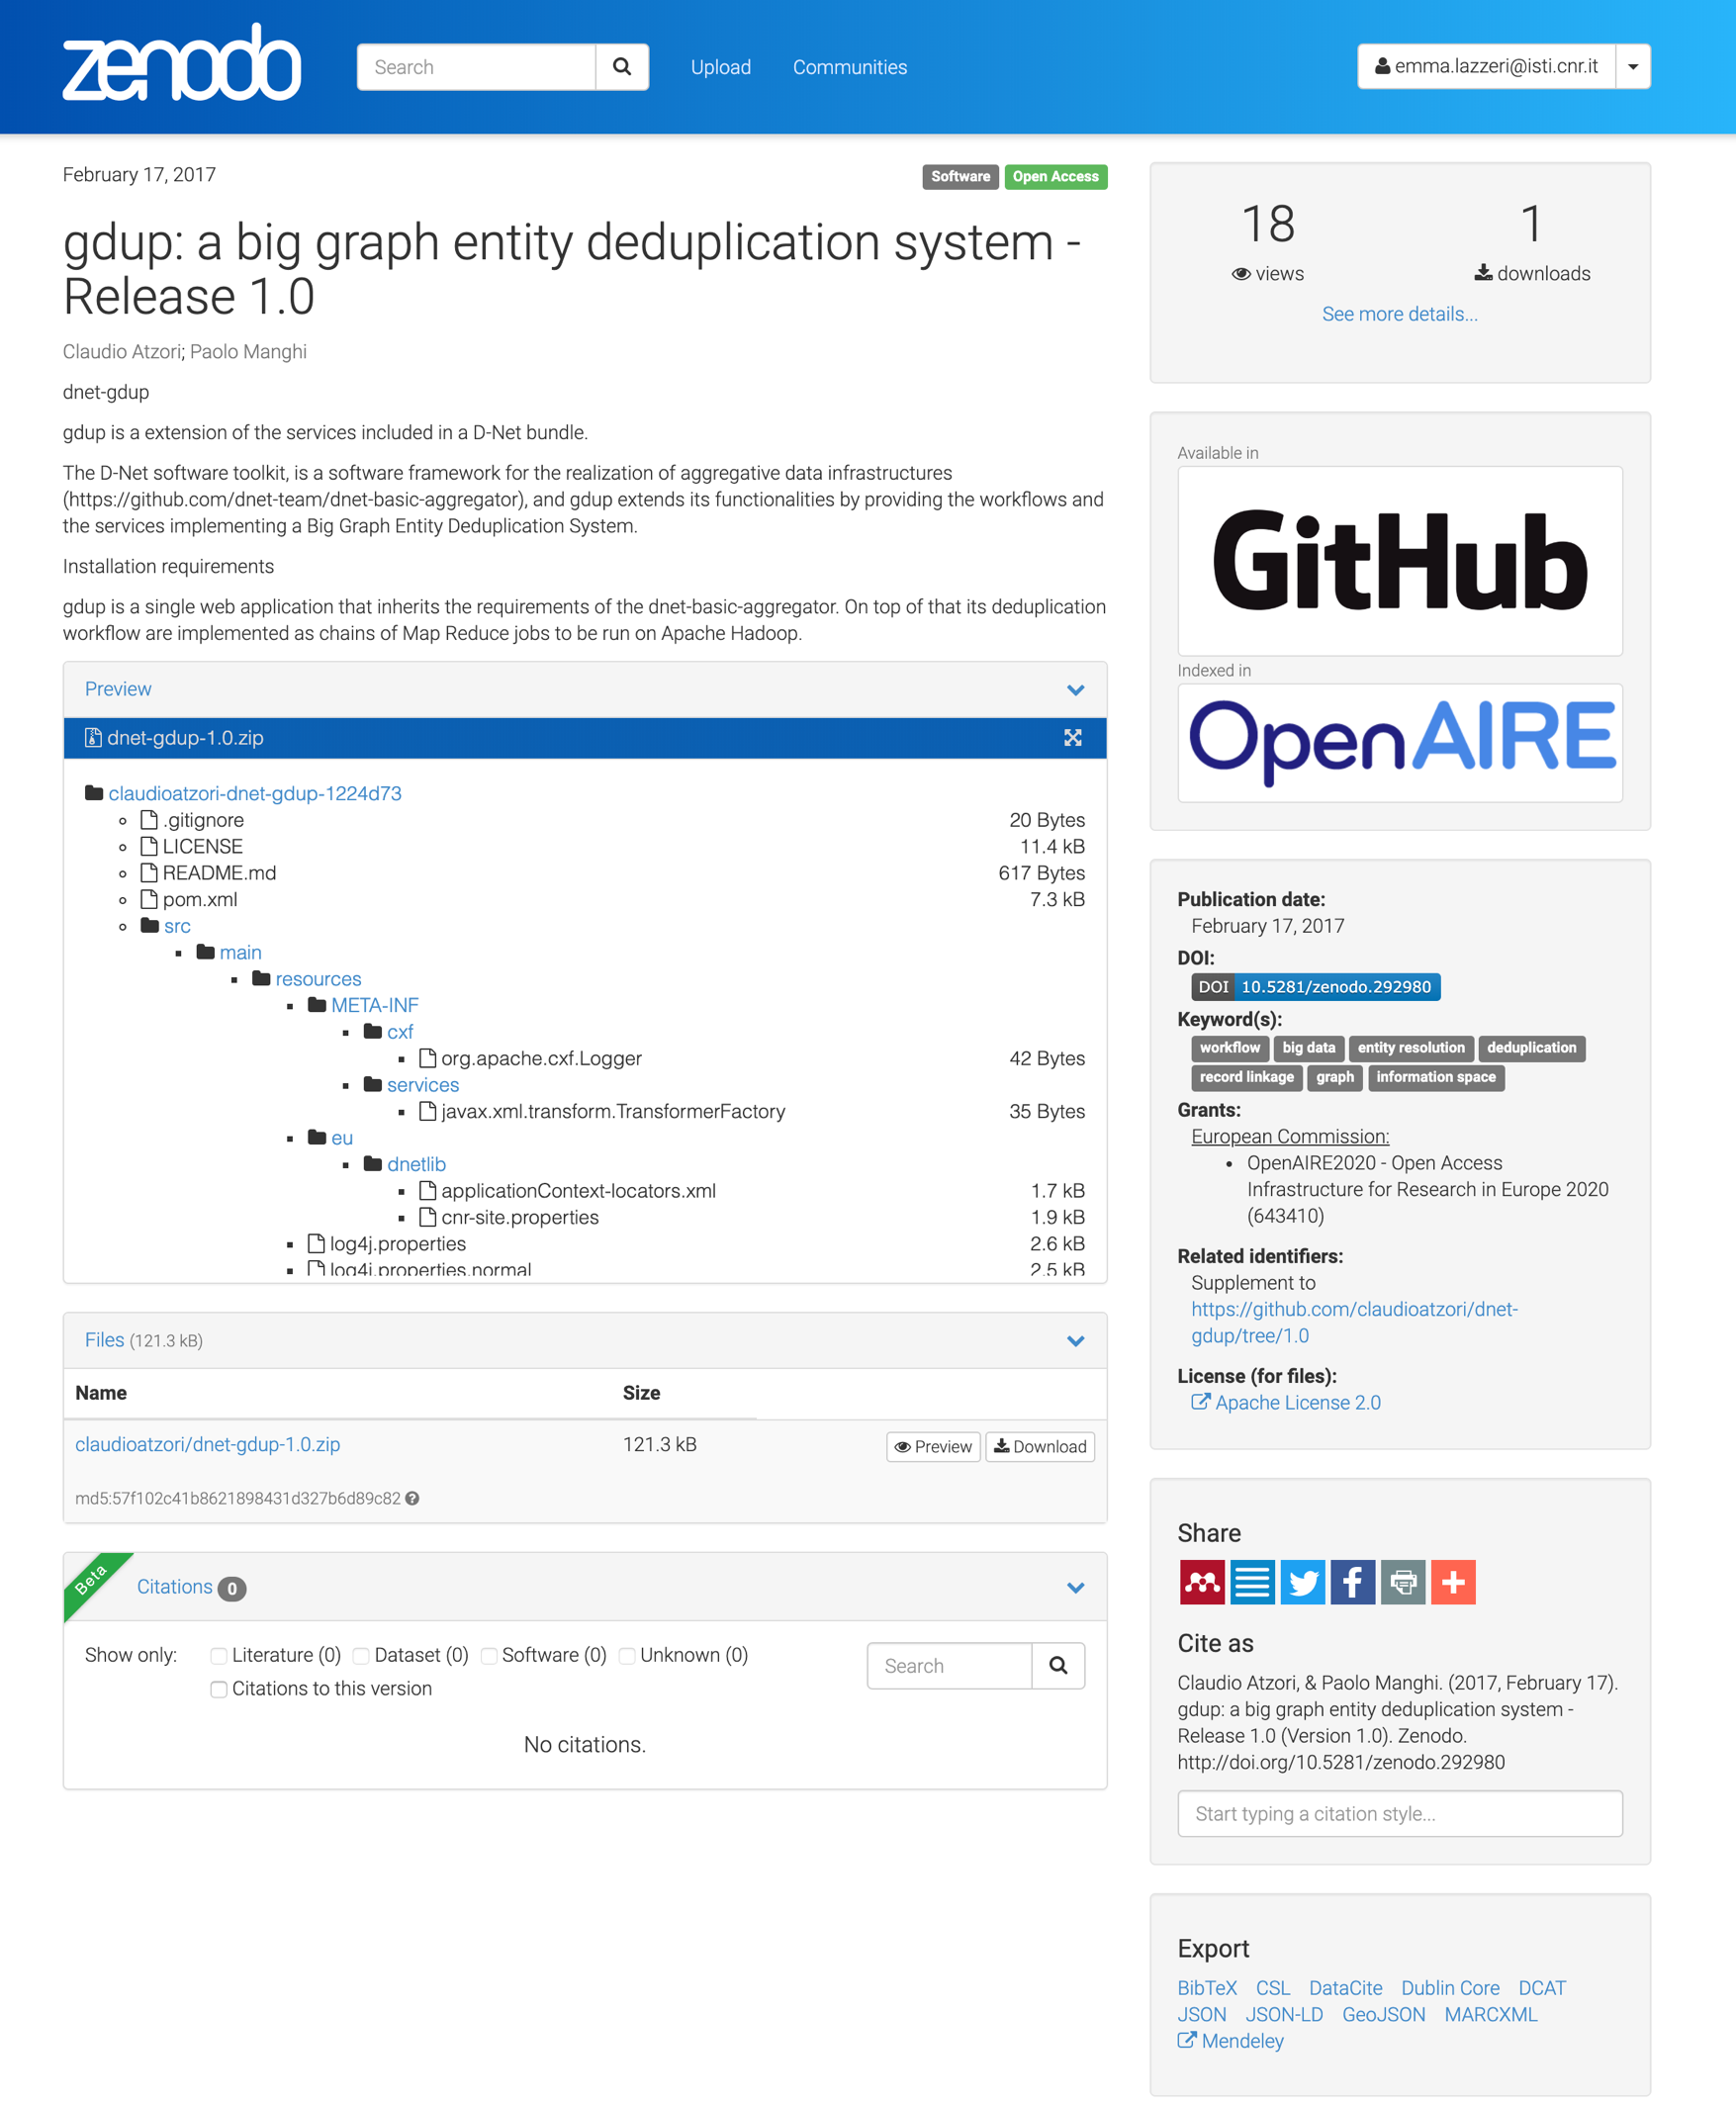
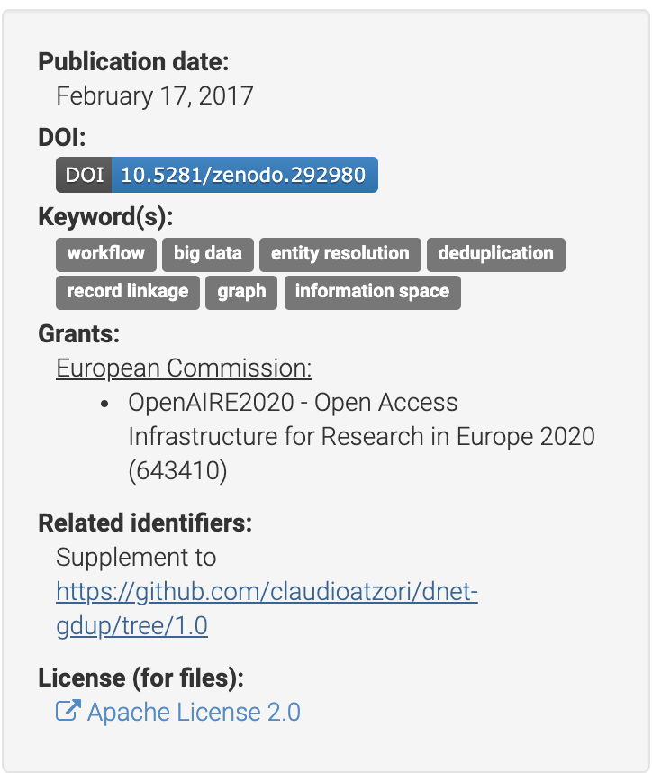
Zenodo
Catch all repository (CERN and OpenAIRE)
Free DOIs for citation and enable credit mechanisms
Enables tracking of usage (downloads and views) for credit
Citable products are findable, reusable, therefore enable degrees of R* ness

Slide 79


Software preservation
An international initiative to preserve software

Slide 80
Software and data papers
Software/data papers are written to describe software/data
The DOI attached to the article makes it citable
However the software/data itself should be cited on the same basis as any other research product
If a software/data paper exists and it contains results (performance, validation, etc.) that are important to the work, then the software/data paper should also be cited (in addition to the software/data)

Slide 81




Data paper Journals
Scientific Data (Nature)
  https://www.nature.com/sdata
Data in brief (Elsevier)
  https://www.journals.elsevier.com/data-in-brief/
Data (MDPI)
  https://www.mdpi.com/journal/data
Patterns (bio data intensive science)
  https://www.cell.com/patterns

Slide 82


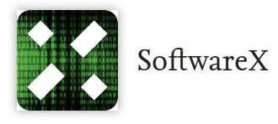



Software paper Journals
Journal of Open Research Software:
  https://openresearchsoftware.metajnl.com/
PeerJ Computer Science:
  https://peerj.com/computer-science
SoftwareX (Elsevier)
  https://www.journals.elsevier.com/softwarex
Software Impacts (Elsevier)
  https://www.journals.elsevier.com/software-impacts
The Journal of Open Source Software
  https://joss.theoj.org

Slide 83
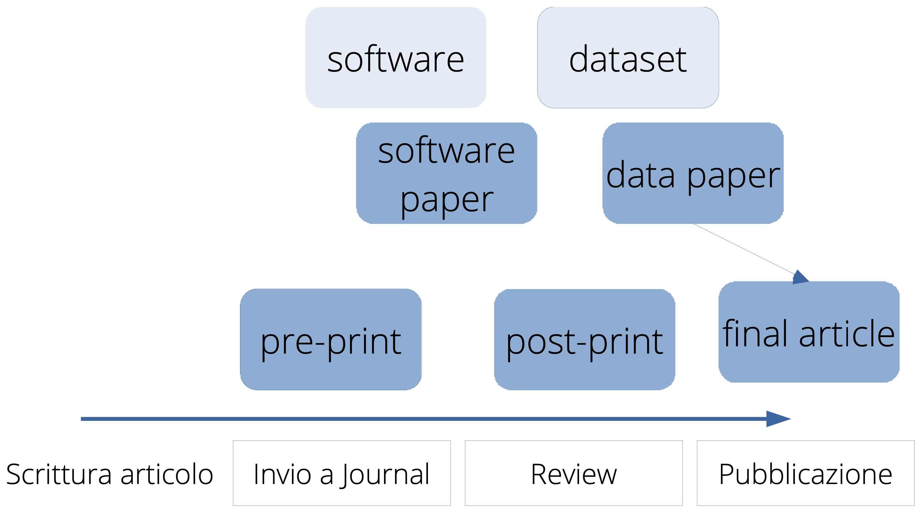
Best effort towards reproducibility
Archive your article pre-prints in public repositories
Publish post-prints of published articles (“closed juornals) in public repositories (in respect of copyrights)
Publish your data and software in an open repository (as open as possible as closed as necessary)
Publish data and software papers to describe your products
Keep your products semantically interlinked
Share on the web

Slide 84
Research opportunities

Slide 85
Open Science: challenges
Digital Laboratories
Scholarly Communication Infrastructure
Workflow
Workflow
Scientific Literature
01101010
01100001
11010010
01101010
01100001
11010010
01101010
01100001
11010010
01101010
01100001
11010010
01101010
01100001
11010010
01101010
01100001
11010010
Digital scientific process
Reproducibility and Transparency of science are compromised
Digital-Manual
Not trusted
Not transparent
Non collaborative
Heterogeneous resources
01101010
01100001
11010010
01101010
01100001
11010010
Disk
RAM
Lack of economy of scale
Notes:
Peer review

Slide 86

Open Science : establishing infrastructure
Digital Laboratories
Scholarly Communication Infrastructure
Workflow
object
Publishing all kinds of products
Fully-fledged assessment of science
Fully-fledged scientific reward
Fusion of digital laboratories and publishing
Enabling Reproducibility (R*)
Enabling Monitoring
01101010
01100001
11010010
01101010
01100001
11010010
Workflow
01101010
01100001
11010010
01101010
01100001
11010010
01101010
01100001
11010010
Scientific process
e-infrastructure (integration and transparency)
01101010
01100001
11010010
01101010
01100001
11010010
Disk
RAM
Notes:
Highlight difference between citation and other kinds of relationships

Slide 87
Bridging research infrastructures and scholarly communication
Research Infrastructures
Scholarly Communication Infrastructure
Scientific Literature
Workflow
object
01101010
01100001
11010010
01101010
01100001
11010010
Scientific Literature
Workflow
01101010
01100001
11010010
citation
01101010
01100001
11010010
01101010
01100001
11010010
01101010
01100001
11010010
Data
Repository
partOf
Scientific process
partOf
Software
Repository
e-infrastructure (integration and transparency)
01101010
01100001
11010010
01101010
01100001
11010010
01101010
01100001
11010010
“Experiment”
Repository
01101010
01100001
11010010
Disk
RAM
Notes:
Peer review

Slide 88
Open Science: establishing infrastructure
Digital Laboratories
Scholarly Communication Infrastructure
(Continuous)
Publishing workflows: peer review, transactions
Workflow
object
Literature
Repository
01101010
01100001
11010010
01101010
01100001
11010010
Workflow
Scientific product repositories
01101010
01100001
11010010
01101010
01100001
11010010
01101010
01100001
11010010
01101010
01100001
11010010
Data
Repository
partOf
citation
partOf
Scientific process
Software
Repository
e-infrastructure (integration and transparency)
Standards for interoperability
01101010
01100001
11010010
01101010
01100001
11010010
“Experiment”
Repository
01101010
01100001
11010010
01101010
01100001
11010010
Information models for reproducibility
Disk
RAM
Notes:
Peer review

Slide 89
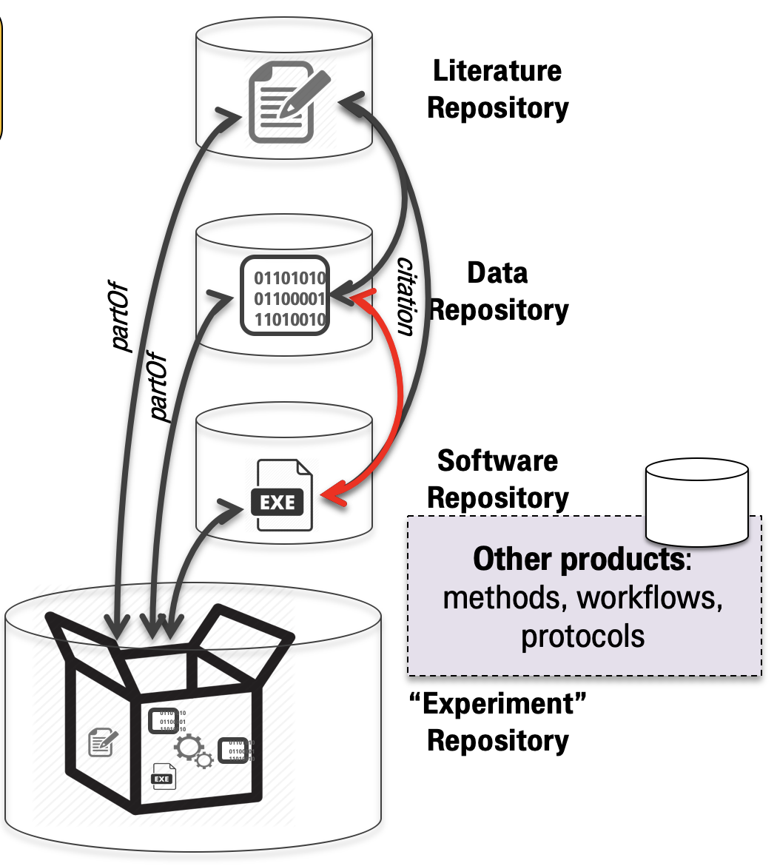
Open Science added value services
Scholarly Communication Infrastructure
End-user functionality
Datasets
Semantic-driven search
Brokering
Bibliometrics
Recommendation systems
End-user profiles
Software
Data processing
AI/Text mining
Big Graph Analysis
Patterns detection
Deduplication
Semantic Web/& LOD
Entity linking
Propagation
Inconsistency rules
Merge
Data aggregation
Knowledge
Graphs
Data flow languages
Funding
Funder
Organization
Information models
Data flow quality
Project
community
Data Validation
Source
Product
Research datasets
Publication
Research Data
Software
Other res. products

Slide 90


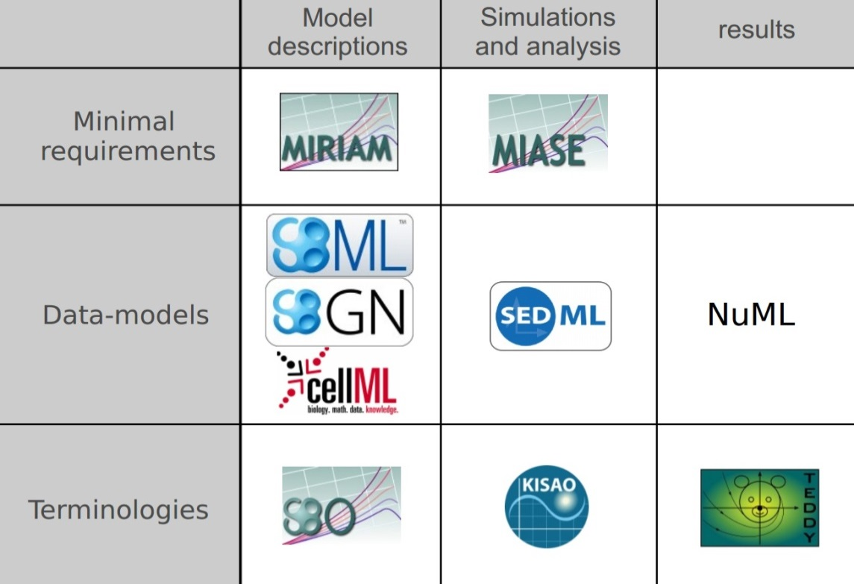


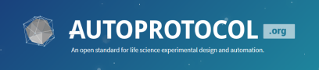





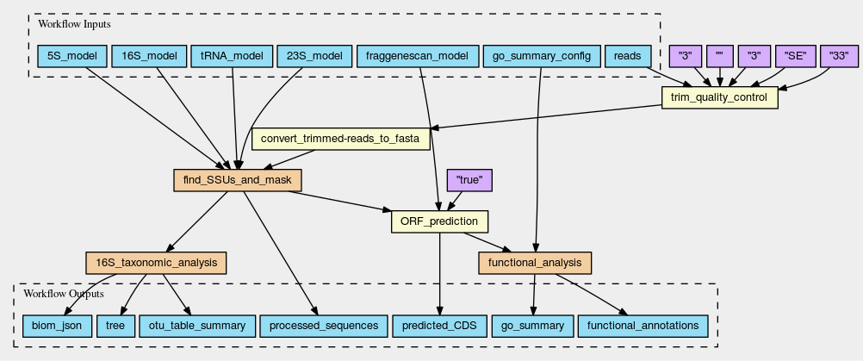


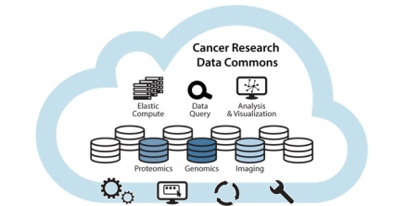




Research on reproducibility
…built-in reproducibility by side effect, reproducibility ramps, disguised as productivity. If only they worked together…
Standards and templates for reporting methods, provenance, tracking
Tools and platforms for capturing, tracking, structuring, organising assets throughout the whole project research cycle.
Guidelines
Workflow/Script Automation
Electronic Lab note books
Research Commons
Models and methods archives
Notes:
Joining them up and getting them adopted!

Slide 91





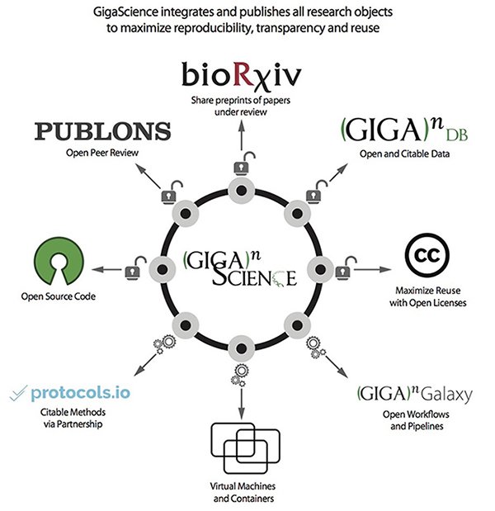








Research on reproducibility
Containers for executable software
dependencies & portability
Virtual Research Environments/Scientific Gateways
Shared Cloud-based analysis systems & collaboratories
Open source software repositories
Publishing tools: reproducible papers
Discovery, recommendations, monitoring, research impact
Data2Paper

Slide 92
Emma Lazzeri e Paolo Manghi
emma.lazzeri@isti.cnr.it
paolo.manghi@isti.cnr.it
This work was partially supported by European Union's Horizon 2020 under projects grant Agreement numbers 831644, 857650, and 777541

