Slide 1

Open Access to Publications, Open Data and FAIR Data, Open Software and FAIR software
Emma Lazzeri ORCID iD: https://orcid.org/0000-0003-0506-046X
Istituto di Scienza e Tecnologie dell’Informazione
Consiglio Nazionale delle Ricerche

Slide 2

Mentimeter
You can access mentimeter from any device (mobile pc, tablet…)
Go to www.menti.com and enter code: 27 19 65 0
Click on the direct link: https://www.menti.com/61g31jveon
Scan the QR code

Slide 3

Research Infrastructures
Open Science
Research Integrity
Open Software
Open Access Publications
Open Metodologies
Open Access Data
Evaluation:Altmetrics
Open Workflows/Protocols
Open Education
Citizen Science
Open Peer-Review

Slide 4
Open Access
The main pillar of
Open Science is
to publications
and research data

Slide 5
Open Access
Open Access is «free and unrestricted online access to research outputs (texts and data)»

Slide 6
Beware!
Open Access doesn’t mean paying for publishing!

Slide 7
Open Access to Scientific Literature in Practice

Slide 8


Open Access Repository
A repository stores Open Access digital objects and makes them available and downloadable. It’s accessible and interoperable through a OAI-PMH protocol and it deploys a long-term archiving policy
Institutional
Thematic/Disciplinary
Literature
How to chose your repository
Literature repository: Open Access Repository Directory www.opendoar.org
Data repository: Registry of Research Data Repository https://www.re3data.org/
Data
Catch All

Slide 9
Open Access to Scientific Literature
There are two ways to implement Open Access to scientific literature :
Green Open Acces: when the Open Access version of papers, wherever they have been published, is deposited in open archives (repositories), in compliance with copyright regulations; editors that may retain the rights can require an embargo period (months in which the deposited paper remains closed).
Gold Open Access: the publication in Open Access Journals, which are journals witouth subscription for readers, with transparent peer review and which leaves the rights to the authors; in 26% of cases they apply APC – Article Processing Charges – to support editorial costs.
To guarantee the reuse, authors should choose open licenses (ie. Creative Commons, which have 4 criteria: BY, SA, NC, ND)

Slide 10
Deposit in literature Repository
The possible versions are:
PRE-PRINT: your final draft, as submitted to the journal (does not have reviewers comments yet)
POST-PRINT or ACCEPTED MANUSCRIPT: the final version, with reviewers comments, identical to the published one except for the editorial layout
EDITORIAL PDF or PUBLISHED VERSION: the exact version published in the journal, with layout and graphic
To know which version you can deposit and the eventual period of embargo, you can check SHERPA-RoMEO database
To find an Open Access Journal and and find out if charges APC (Article Processing Charges), you can check DOAJ, Directory of Open Access Journals
To choose your journal use Think. Check. Submit. https://thinkchecksubmit.org/journals/

Slide 11
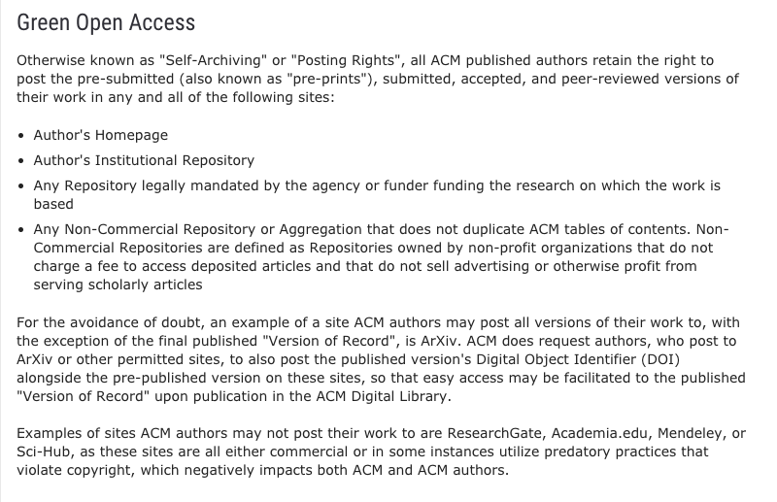
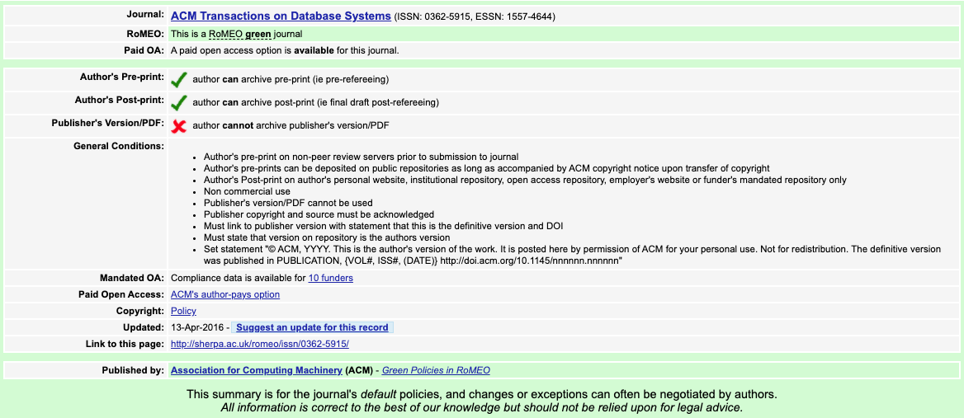
Some tips for OA in your community
ACM Transaction on Database Systems
http://sherpa.ac.uk/romeo/search.php?source=journal&sourceid=10678&la=en&fIDnum=|&mode=simple
https://authors.acm.org/open-access#green

Slide 12
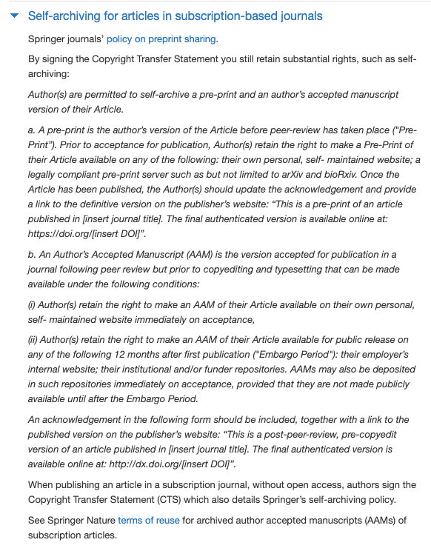
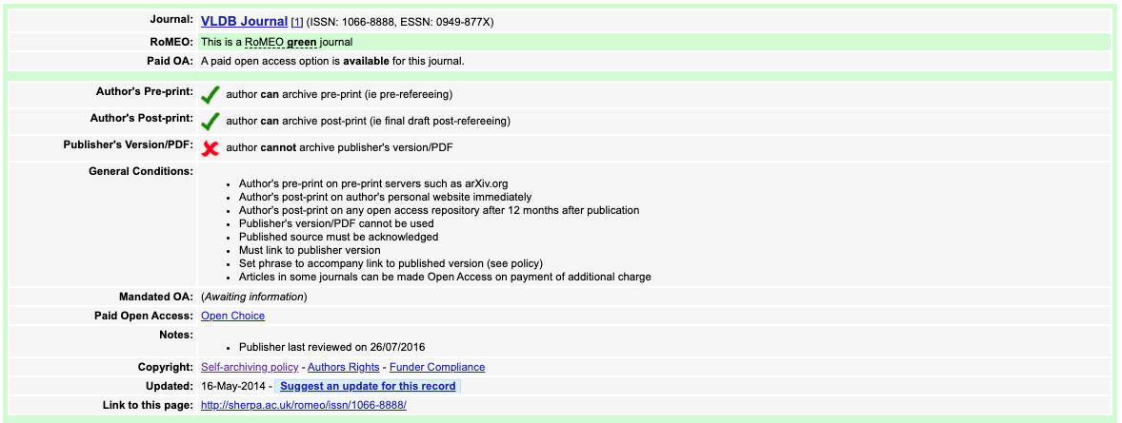
Some tips for OA in your community
VLDB Journal
http://sherpa.ac.uk/romeo/issn/1066-8888/
https://www.springer.com/gp/open-access/publication-policies/self-archiving-policy

Slide 13
The revolution of Plan-S

Slide 14
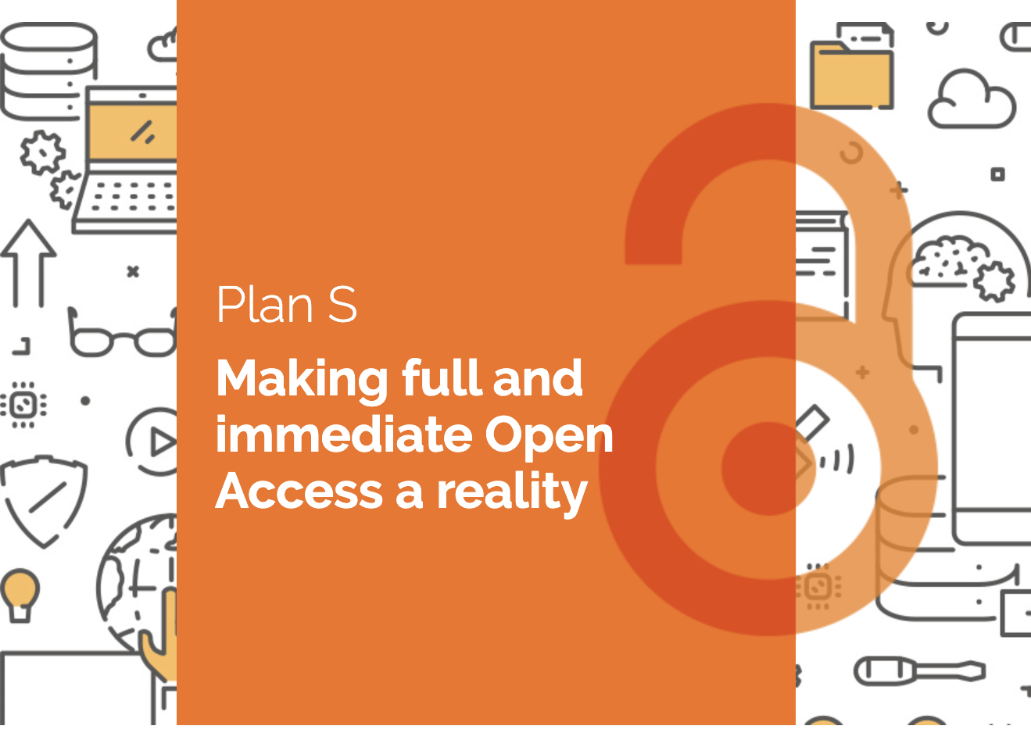
Plan-S
Plan S is an initiative for Open Access publishing that was launched in September 2018. The plan is supported by cOAlition S, an international consortium of research funders. Plan S requires that, from 2021, scientific publications that result from research funded by public grants must be published in compliant Open Access journals or platforms.

Slide 15
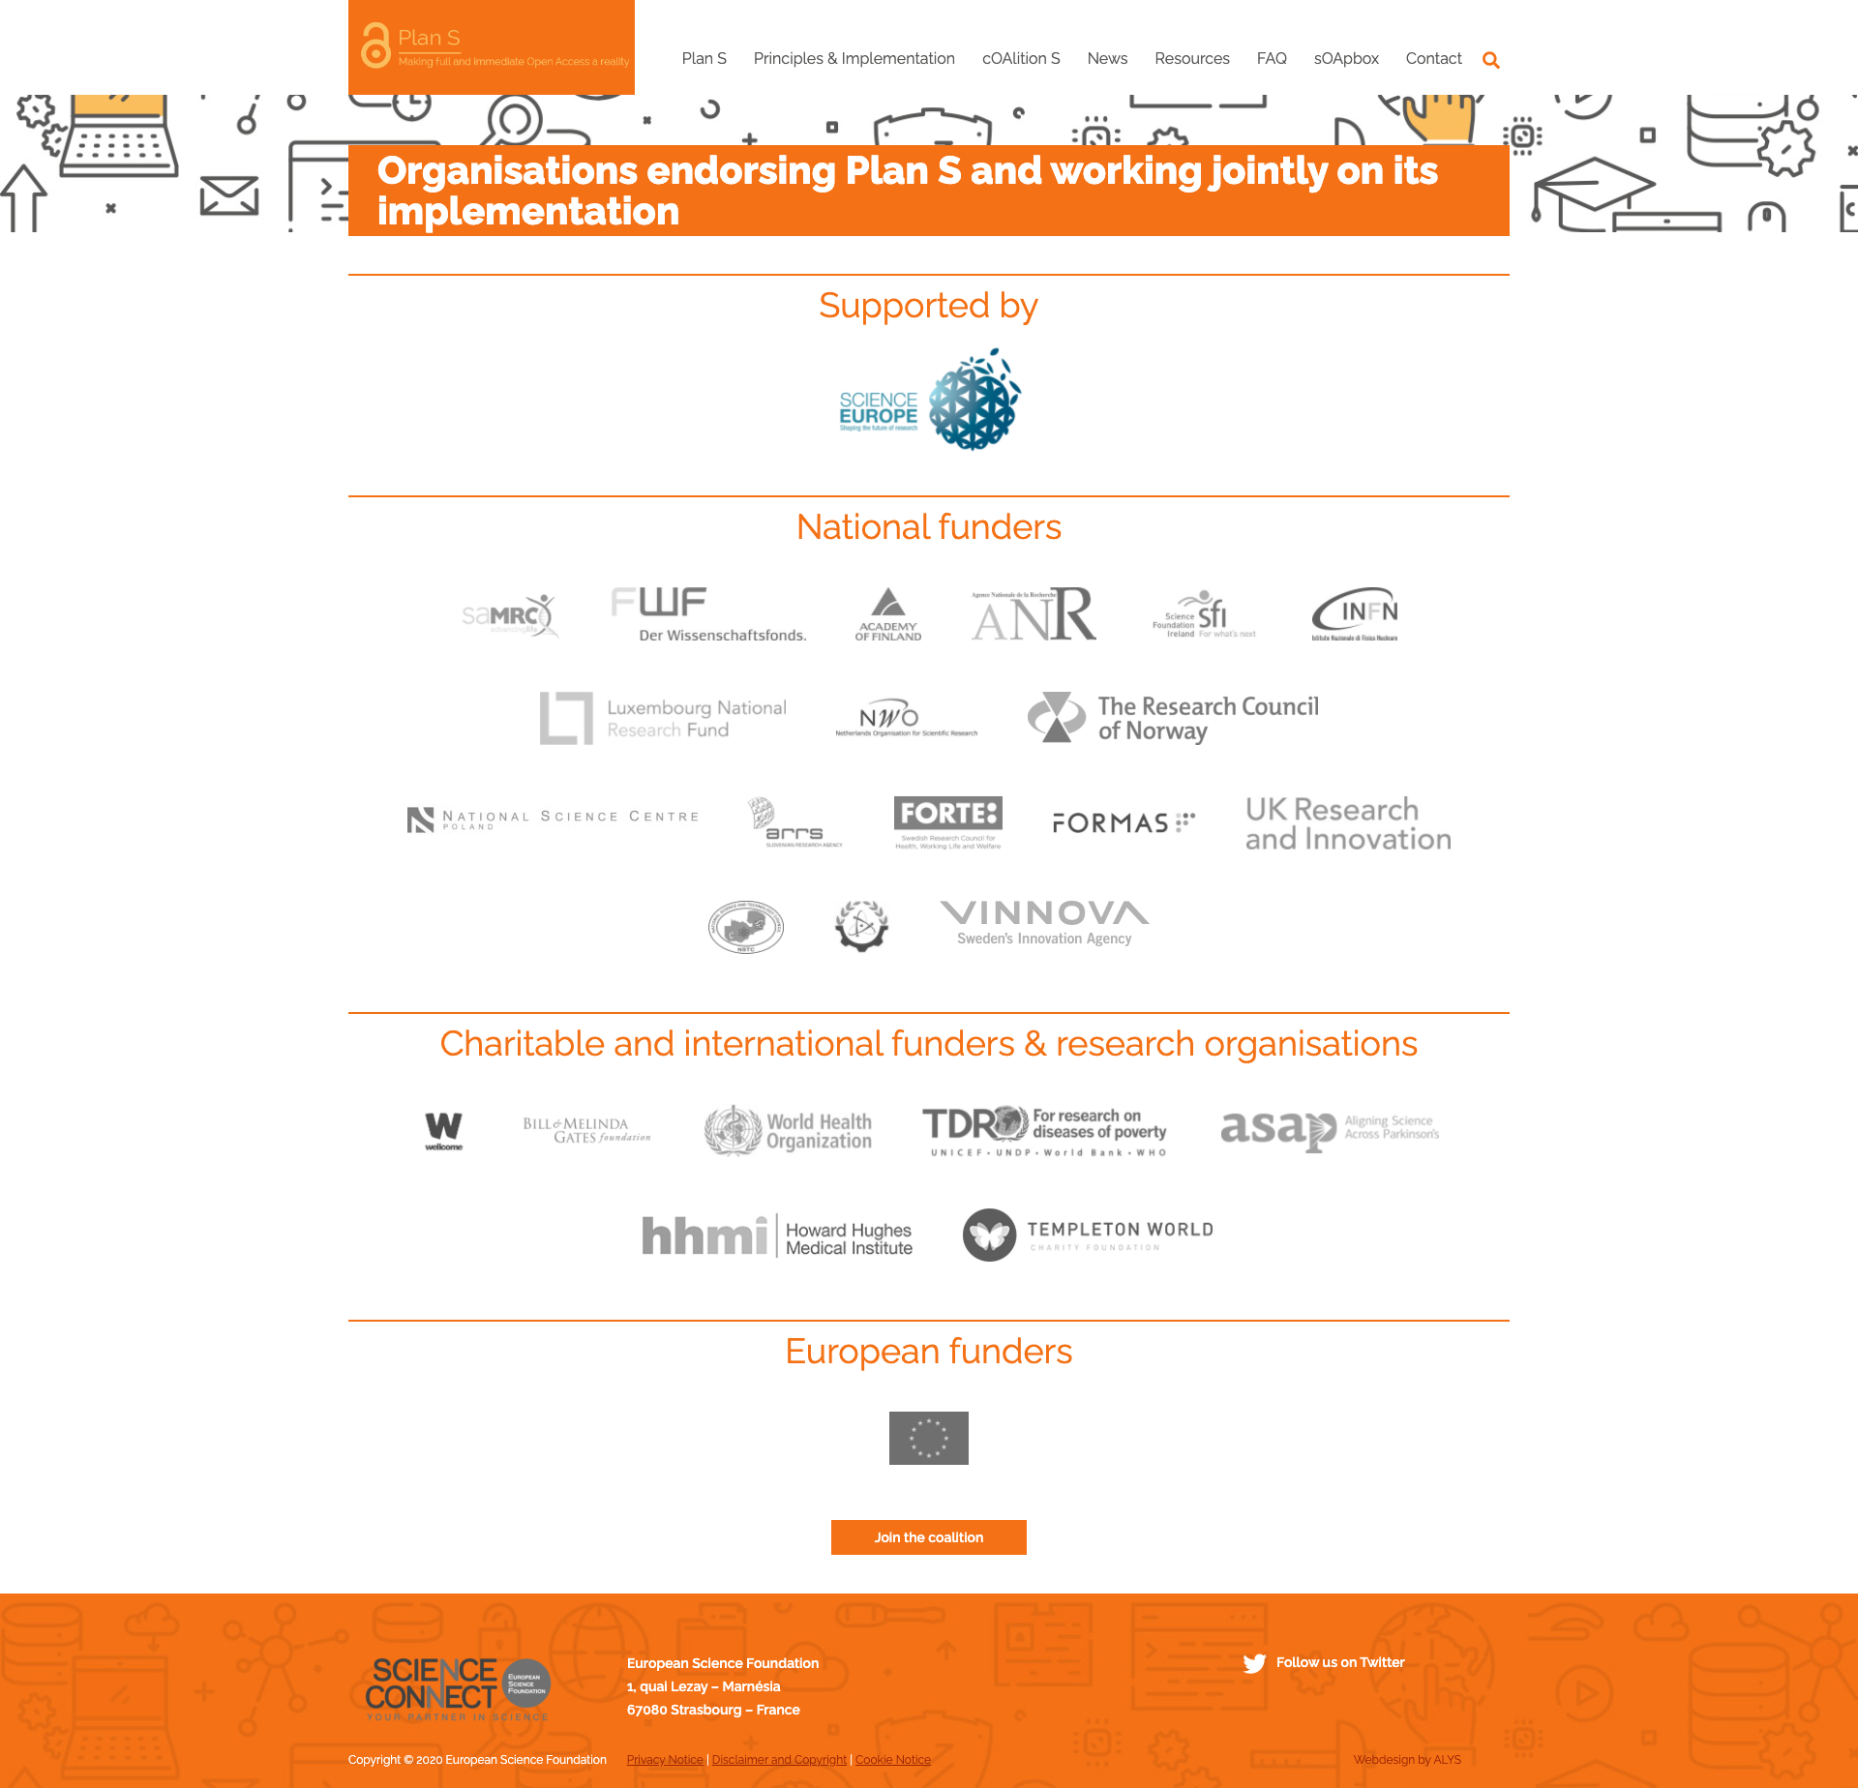
cOAlition S
Funders, organisations and initiatives that have endorsed Plan S and are jointly working on its implementation

Slide 16
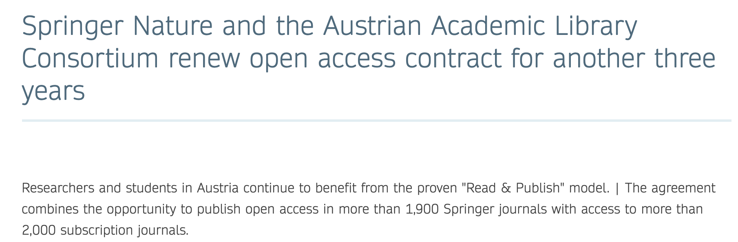
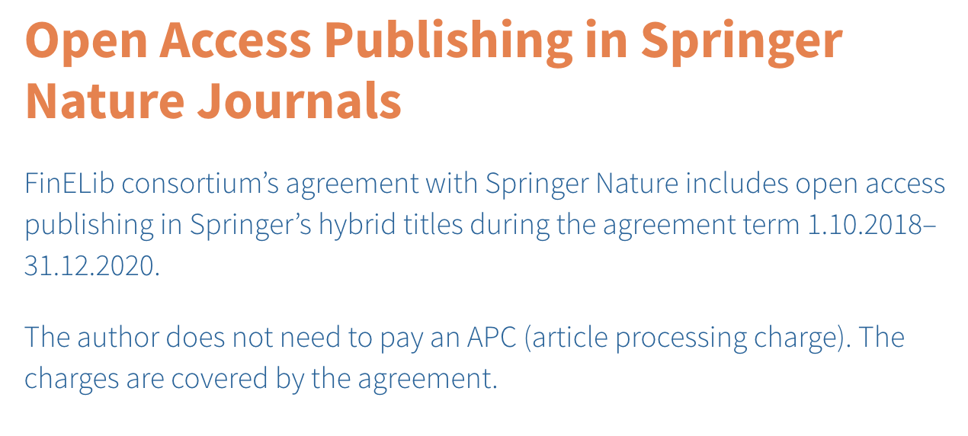
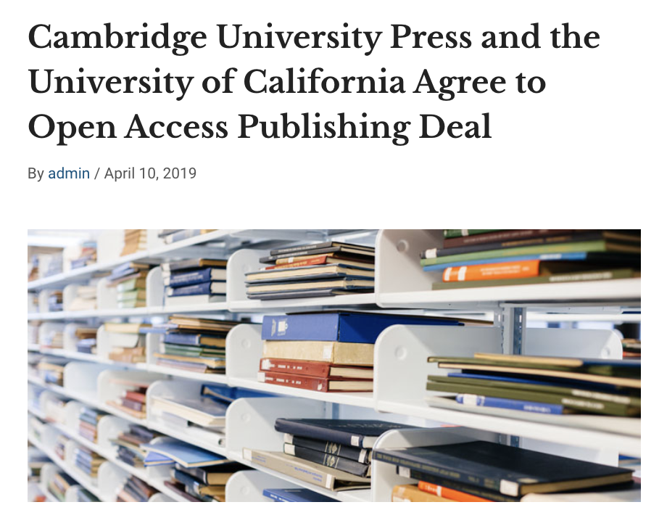
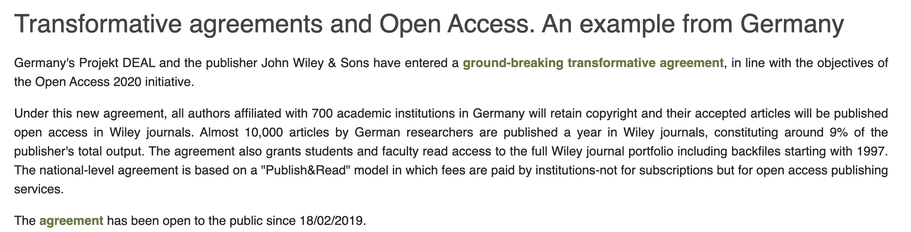
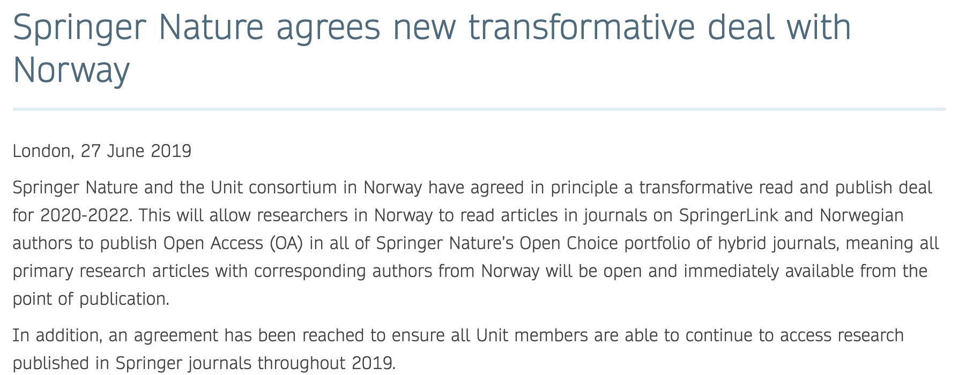
Consequences of Plan-S
Transformative agreements:
Large Institutions or Countries contracted different publishing models to allow their researchers to publish in OA all their works
Publish and Read contracts
Transparency on the contracts contents
Complete list at: https://esac-initiative.org/about/transformative-agreements/agreement-registry/

Slide 17


Useful tools
Journal Checker Tool
Find out if your combination (Journal, Funder, Institution) is compatible with Plan S
Find the tool at: https://journalcheckertool.org/

Slide 18
Some Definitions we will need in todays lecture

Slide 19
Digital object
In the context of this course: it is referred to any research result in its digital form that can be uploaded (and eventually openly shared) in a repository
Examples: articles, dataset, software, images, videos, reports, conference poster or presentations, lectures, etc

Slide 20
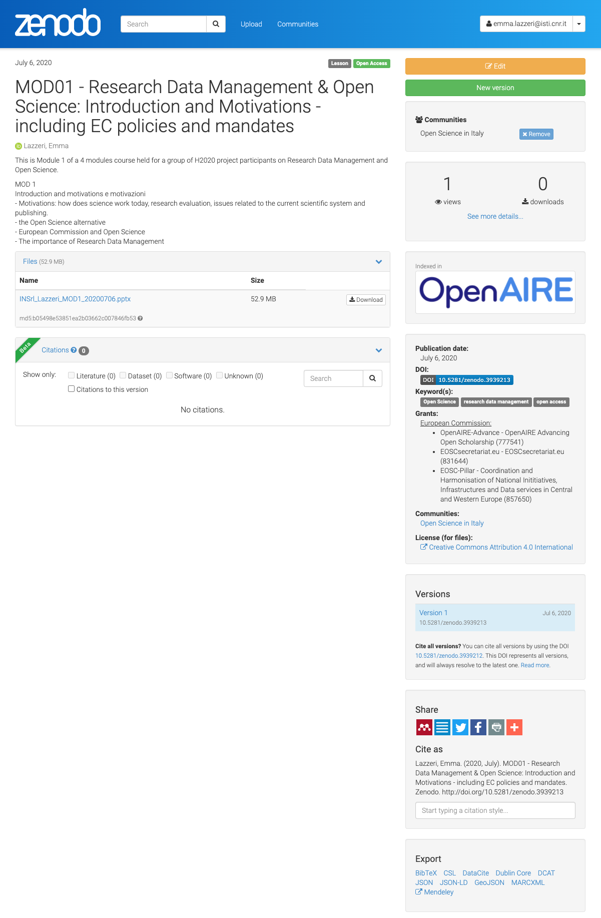
A Record deposited in a Repository
Metadata
Payload
A set of data describing the digital object(s) you are depositing
The digital object(s) you are uploading to be stored (and eventually shared). Payload includes attached files such as the file containing the data and the accompaning material(s), readmefile, etc

Slide 21
FAIR
Principles
These slides summarise the contents of Martínez-Lavanchy, P.M., Hüser, F.J., Buss, M.C.H., Andersen, J.J., Begtrup, J.W. (2019). ‘FAIR Principles’. In: Holmstrand, K.F., den Boer, S.P.A., Vlachos, E., Martínez-Lavanchy, P.M., Hansen, K.K. (Eds.), Research Data Management (eLearning course). doi: 10.11581/dtu:00000049
Find the video to this link: https://vidensportal.deic.dk/RDMelearn

Slide 22
FAIR Principles
FAIR indicate a list of principles that can help you in making your data ready for Open Science
They are principles, not standards!
They were designed to enable optimal use of research data and methods
A group of different experts designed the FAIR principles between 2014 and 2016
They identified a set of 15 principles

Slide 23



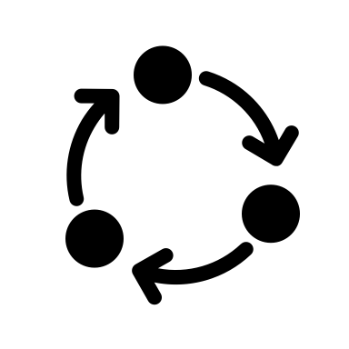
FAIR: What does it mean?
Findable
Accessible
Interoperable
Reusable
Other can find your data
Your data is accessible to others
Your data can be integrated with other data and/or they can be easily used and read by machines.
Your data can be reused by others in new research

Slide 24
FAIR principles
Plan
FAIR principles apply to the entire research data lifecycle.
They are strongly interconnected.
Reuse
Collect Create
Preserve
Process Analyse
Publish Share

Slide 25
FAIR principles
Plan
Please note:
Apply FAIR principles does not mean to openly share research data
Reuse
Collect Create
Preserve
Process Analyse
Publish
Share

Slide 26

FAIR Data
Open Data
$$≠$$

Slide 27
Open Data
Data can be freely used, shared, enriched by anyone, anywhere for any purpose.
FAIR Data
Data follow a series of good practices to allow data access, still respecting any ethical, legal and contractual restriction.

Slide 28
Your research data could
Contain personal information (privacy e GDPR)
Fall under copyright (in the case of a database with creative structure)
Fall under the Sui Generis right (database obtained thanks to a substantial investment)
Be protected by patent or industrial secret
Data sharing needs to respect the specific law.
Data needs to be protected against non authorised access.

Slide 29
How can you adhere to FAIR principles if your data cannot be opened?
Create and share a description of your data
This way other researchers may ask for permission to access your data for reuse purposes, by giving a specific aim and following the rules defined by the law.
Restrict access to the record payload (attachment, files,…)

Slide 30
Good practices to make your data
FAIR

Slide 31
By applying FAIR principles
You will produce high quality data
You will maximise the impact of your research
You will improve the recognition within and behind your research community

Slide 32
The application of FAIR principles strongly depends on the specific discipline and on the way the single researcher works
No one size fits all

Slide 33
Why should I apply FAIR principles?

Slide 34
Why do we need FAIR principles?
The ultimate goal of FAIR principles is to make your research data (or object) reusable and safe
You should always keep this goal in mind when trying to apply the FAIR principles to your results
Are my results reusable by someone that was not involved in its collection/creation?

Slide 35
So how can you make your data FAIR?

Slide 36
FAIRification basics
Documentation
Gives the context to make your data understandable by others
Metadata
Make your data easy to find
Data formats
Make your data simple to combine to other data and machine readable.
Access to data
It meas to decide who will have access to your data and how
Persistent identifiers
Persistent links to data that allows other to find and cite (give credit to) your data.
Licenses
Are used to tell others how they can reuse your data.

Slide 37
Documentation
Specifies the context that led to the creation/collection of your data to make them understandable
At the beginning of a new (project) activity, you need to clearly define with your collegues the strategy to structure and document your data.
Document every detail of data collection/generation:
Methods
Tools
Software
Processes (who worked with the data? What did he/she did with the data? What are the relation to other data and/or publications?)
Metadata

Slide 38
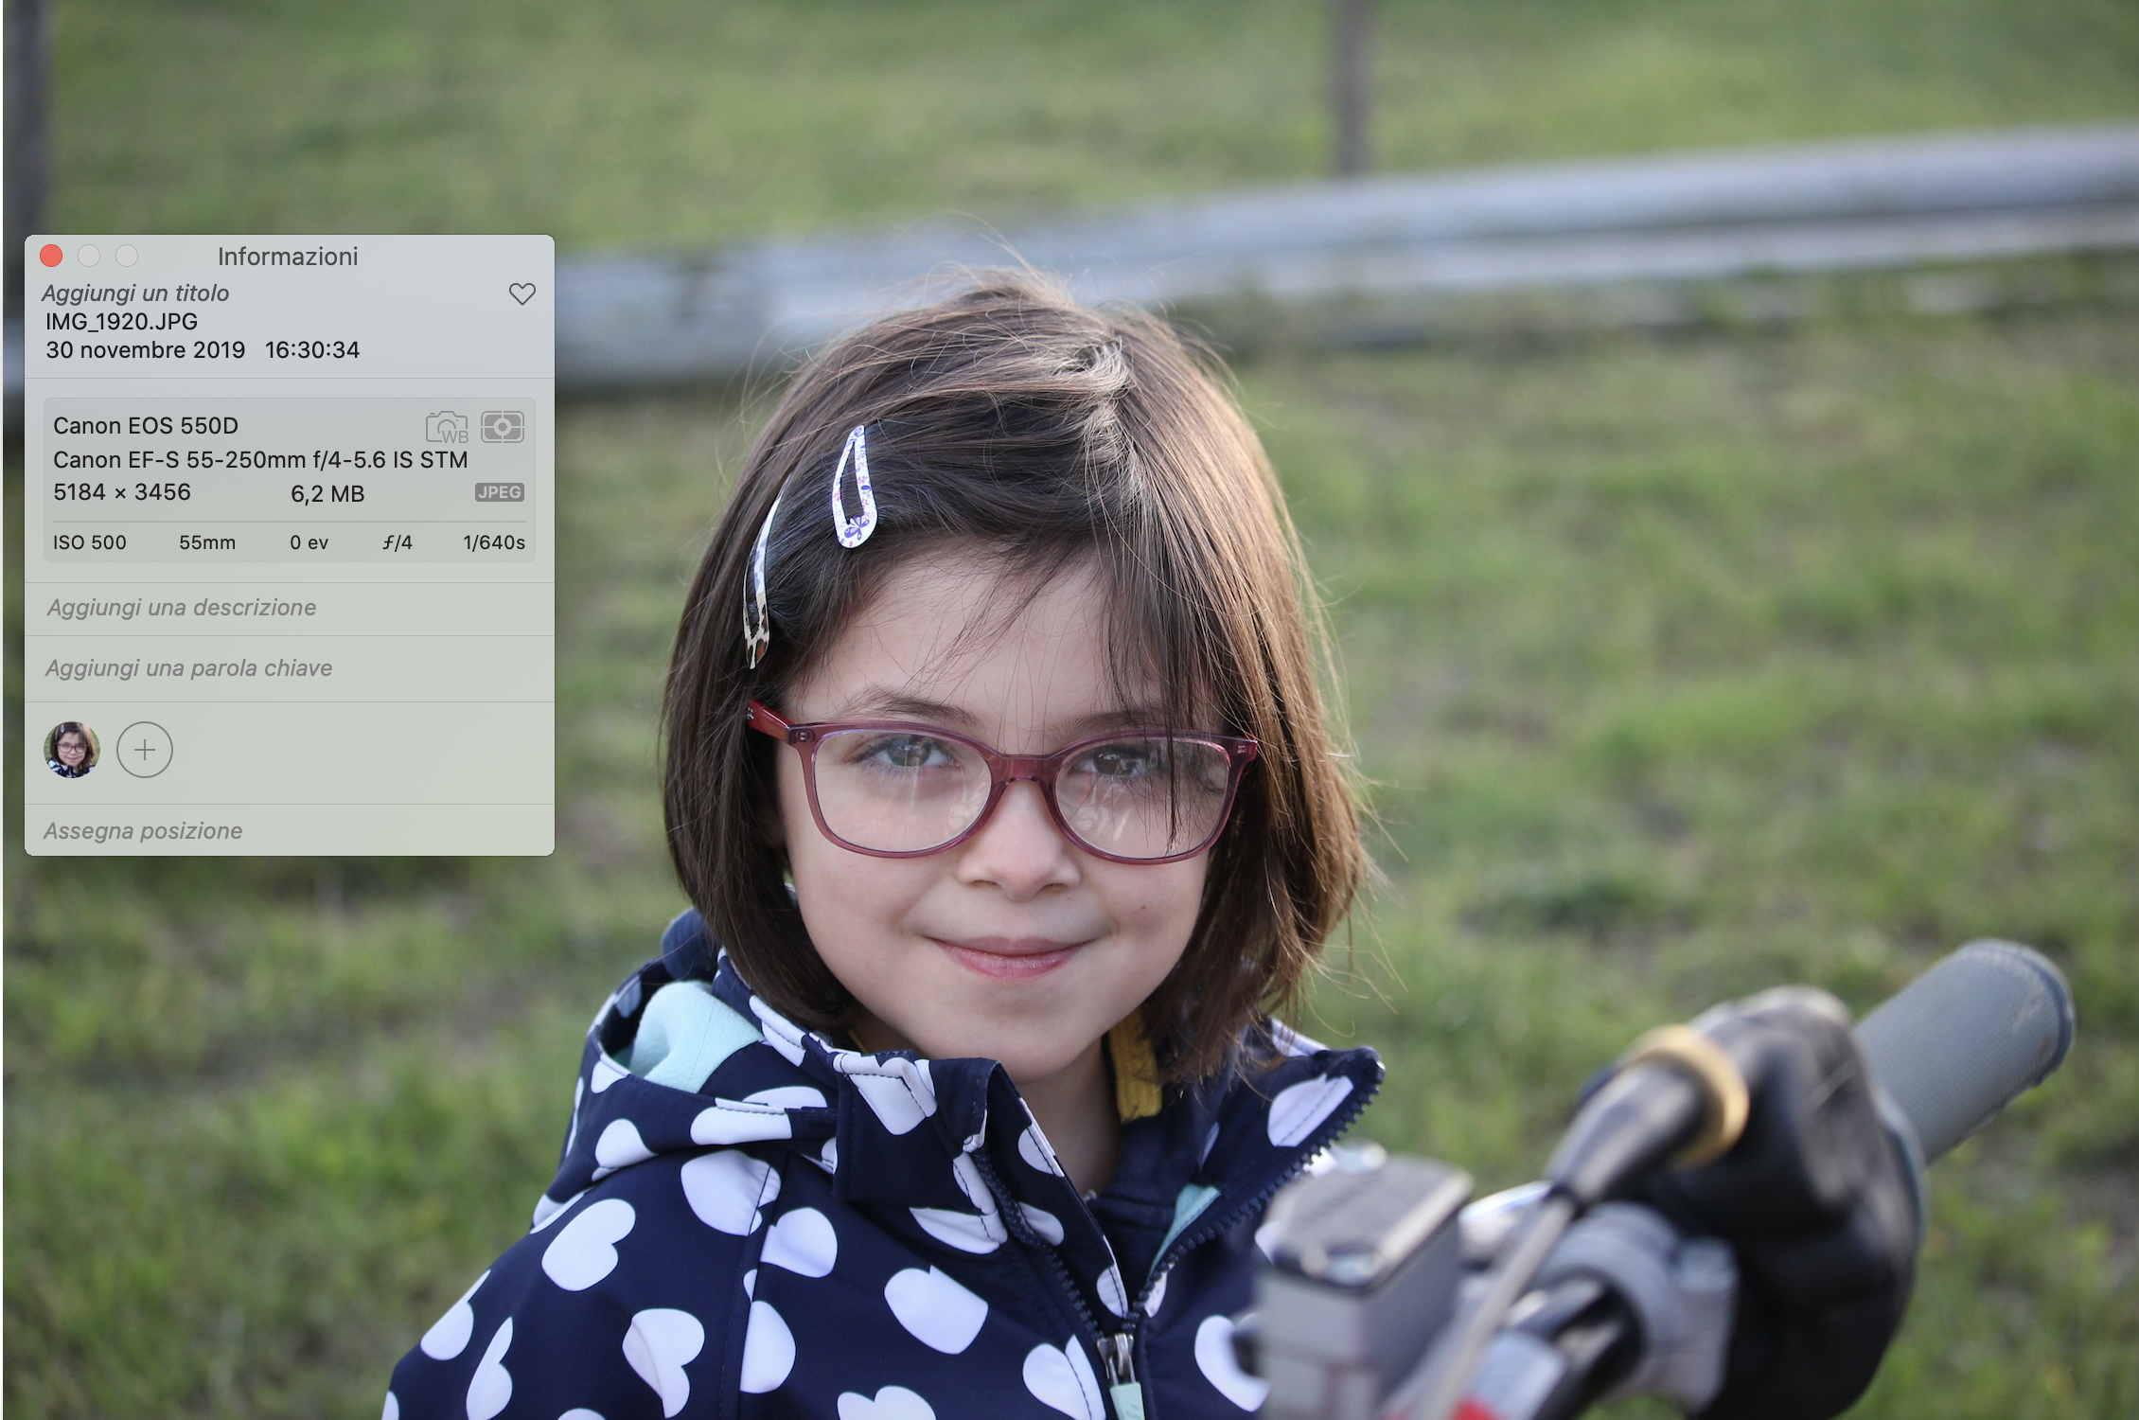
Metadata
Data describing data
Very important for:
Access
Comprehension
Process
Use your discipline specific standards: you will spend less time curating and interpreting data and more time to actually make science!

Slide 39
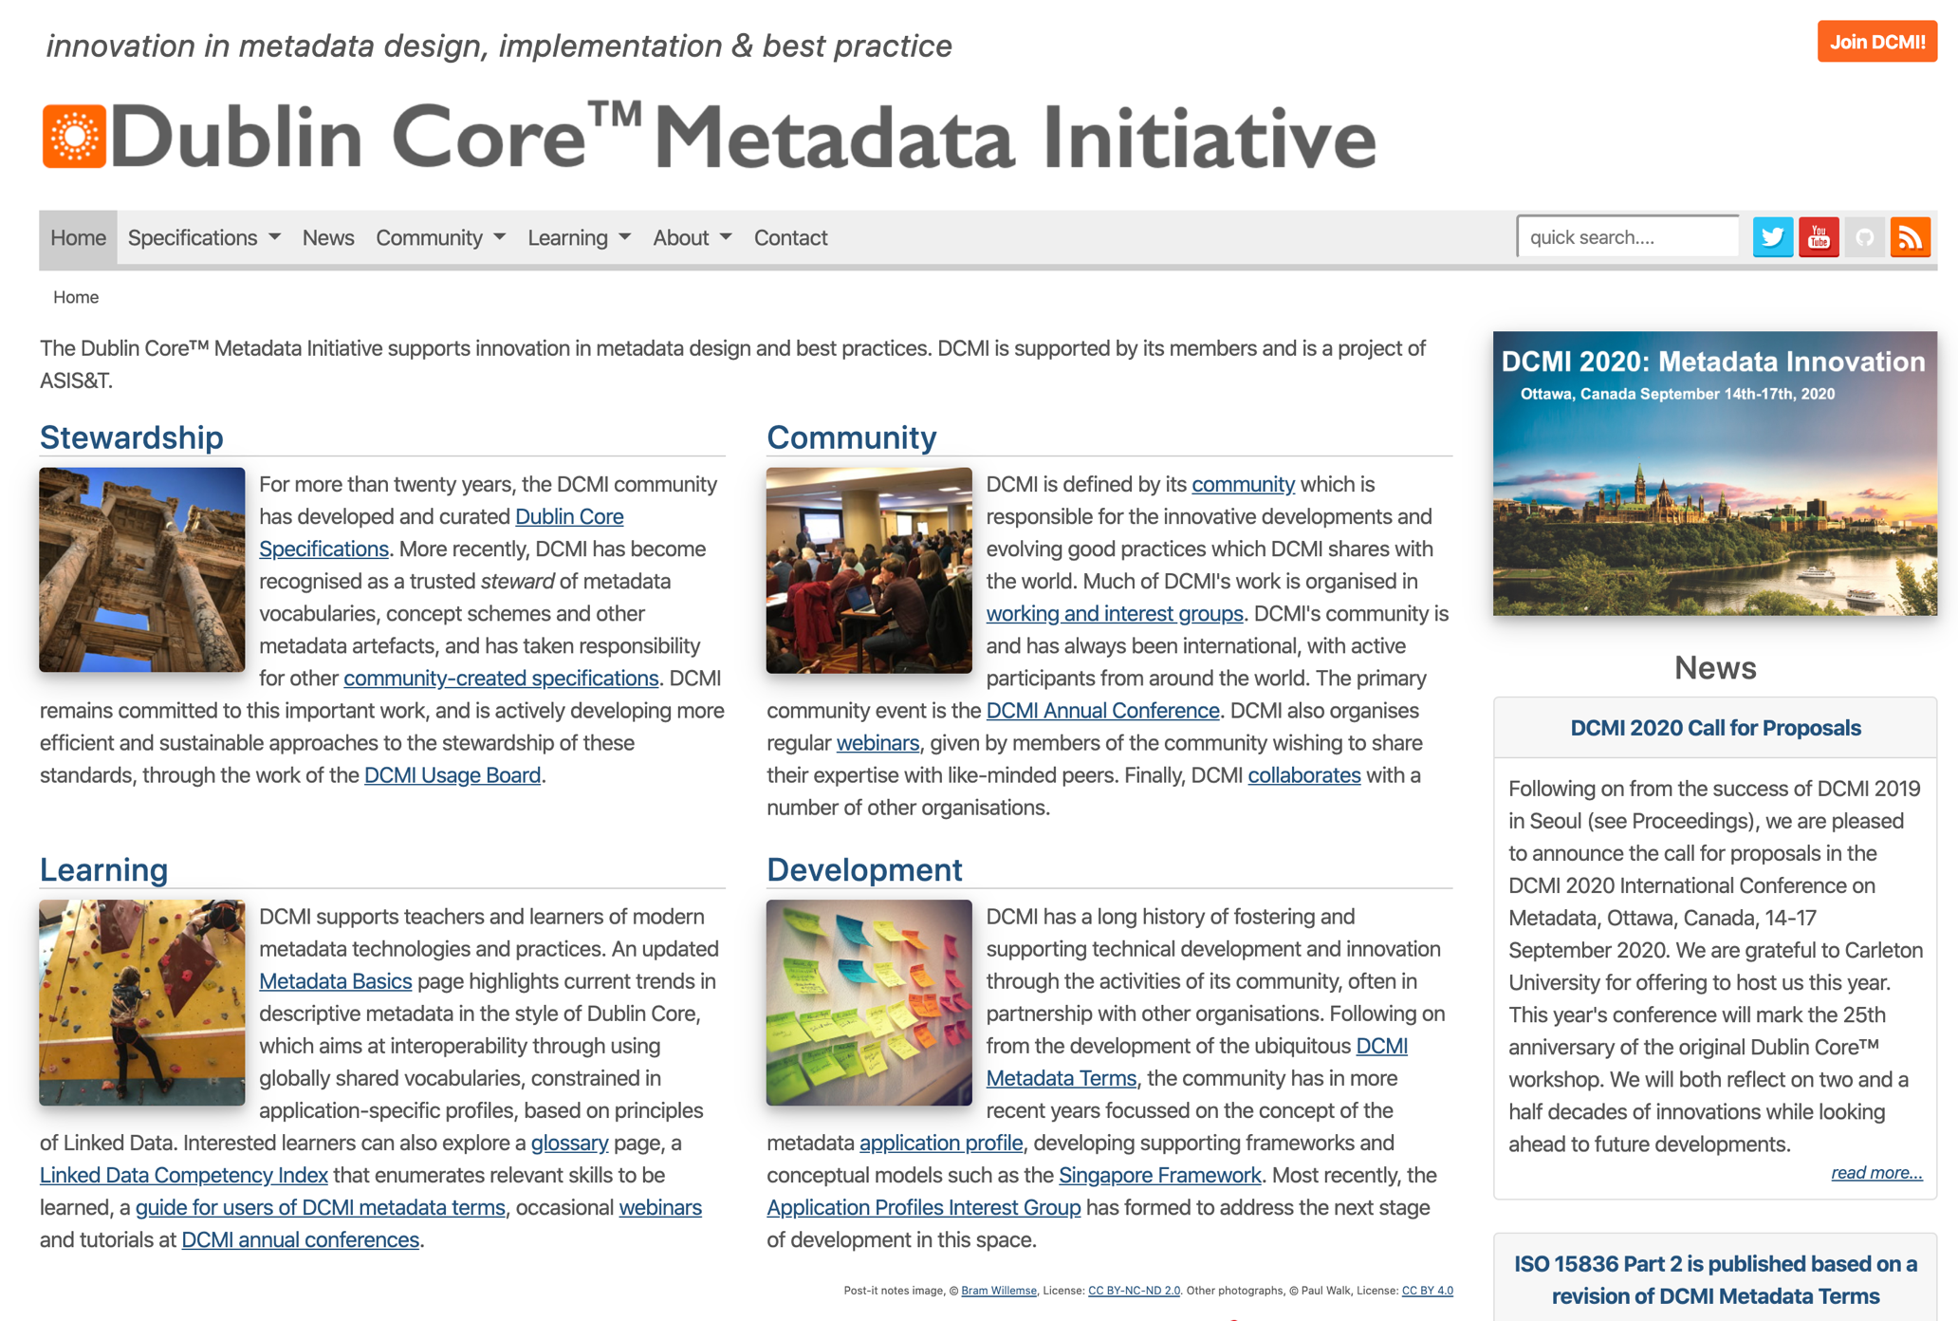


Metadata help making your data
Findable
Interoperable
Reusable
Generic!
Title
Authors
Subject
…
Social Science and Humanities

Slide 40
Accessibility
Can I make my data accessible to others?
Who will be granted access?
How?

Slide 41
Findable

Slide 42
Findable
The first step in (re)using data is to find them.
Metadata and data should be easy to find for both humans and computers.
Machine-readable metadata are essential for automatic discovery of datasets and services, so this is an essential component of the FAIRification process.

Slide 43
Some definitions

Slide 44

Persistent Identifiers
A persistent identifier (PI or PID) is a long-lasting reference to a document, file, web page, or other object.
The term persistent identifier is usually used in the context of digital objects that are accessible over the Internet.
Typically, such an identifier is not only persistent but actionable: you can plug it into a web browser and be taken to the identified source.
It is like the bar code used on products…

Slide 45
Some examples in the Open Science Context

Slide 46
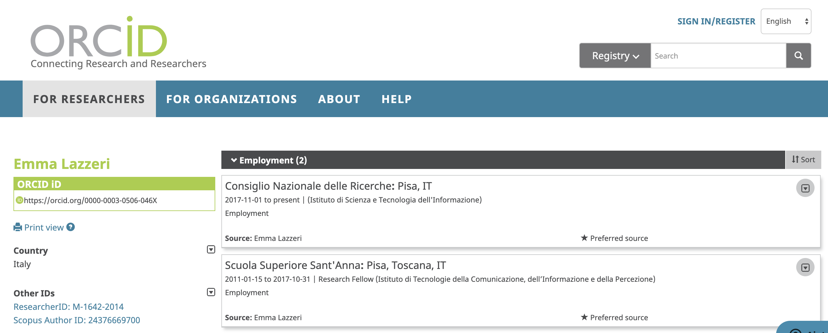
Orcid
The Open Researcher and Contributor ID (ORCID) is a nonproprietary alphanumeric code to uniquely identify scientific and other academic authors and contributors
Do you have one? You should…

Slide 47
DOI – Digital Object Identifier
In computing, a digital object identifier (DOI) is a persistent identifier or handle used to identify objects uniquely, standardized by the International Organization for Standardization (ISO).
A DOI aims to be resolvable, usually to some form of access to the information object to which the DOI refers.
This is achieved by binding the DOI to metadata about the object, such as a URL, indicating where the object can be found
a DOI differs from identifiers such as ISBNs and ISRCs which aim only to identify their referents uniquely

Slide 48
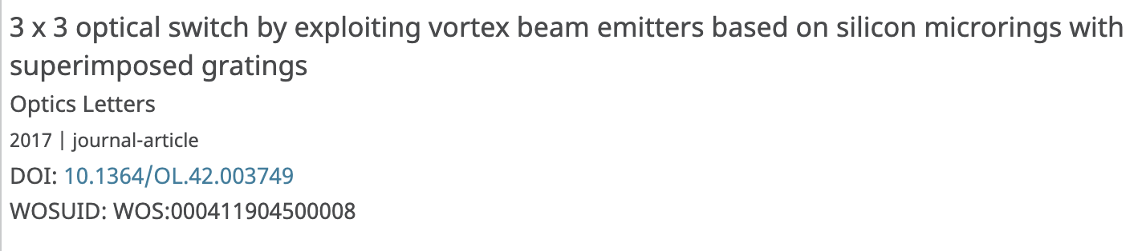
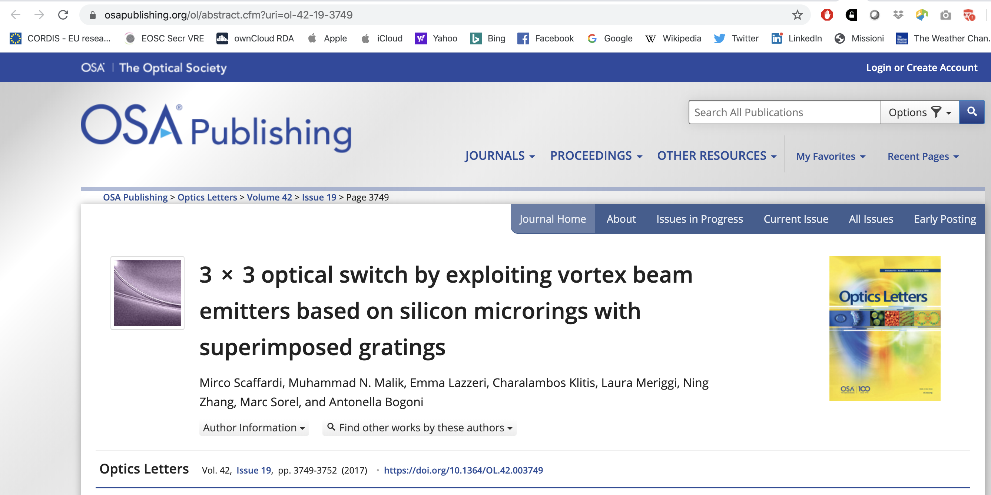
An example

Slide 49
Persistent identifiers make your data:
Findable
Accessible

Slide 50
How can you assign a Persisten Identifier to your digital object?
Persistent identifiers need to be assigned by an entity that can ensure the persistency of the link to the object
Zenodo assigns DOIs to digital objects that do not already have one
Your repository will probabily assign a persistent identifier to your digital object!

Slide 51
Accessible

Slide 52
Accessible
Once the user finds the required data, she/he needs to know how can they be accessed, possibly including authentication and authorisation.

Slide 53
How do you give access to your data?
Through a Repository

Slide 54
Open Access Respositories
Thematic or disciplinary repositories
Designed for specific contents, curated by specific communities: ArXiv, bioarXiv, PMC…
http://oad.simmons.edu/oadwiki/Disciplinary_repositories
Institutional or national repositories
Maintained and curated by single institutions/countries. Typically only authors based in the specific institution/country can deposit, everyone can access
Literature Repositories
Reserved to text deposit (articles, reports, books, …). Metadata reflect the repository contents.
https://v2.sherpa.ac.uk/opendoar/
Data repositories
Designed to deposit data. They often are disciplinary and have specific metadata to describe the type of data they preserve. https://www.re3data.org/
Catch-all repositories
All research products can be deposited (data, literature, presentations, poster, images, software, …). Example: Zenodo
Who does curate/deposit in the repository?
What are the repository contents?

Slide 55
An important difference
Deposit: upload a digital object (data, articles, …) on a platform that allows to correctly describe the object through medatada and that implements long-term preservation.
Give access: once the object has been deposited, the authors can choose the type of access that can be granted (open, restricted, closed, embargoed,…) and assigns a licence to reuse the contents (Creative Commons)

Slide 56
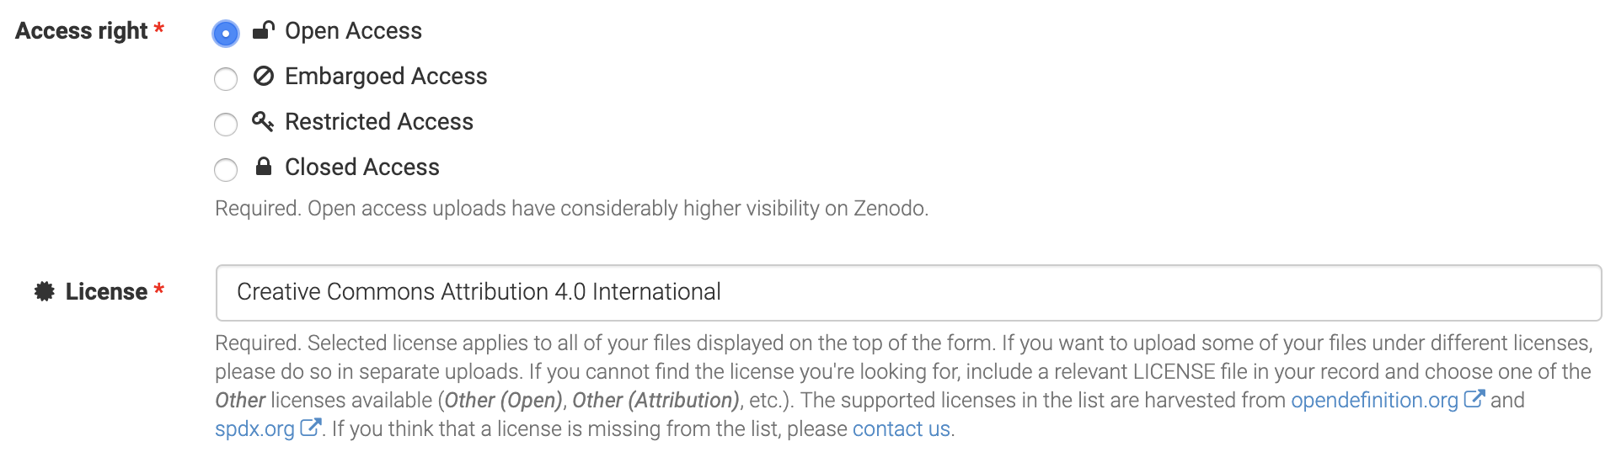
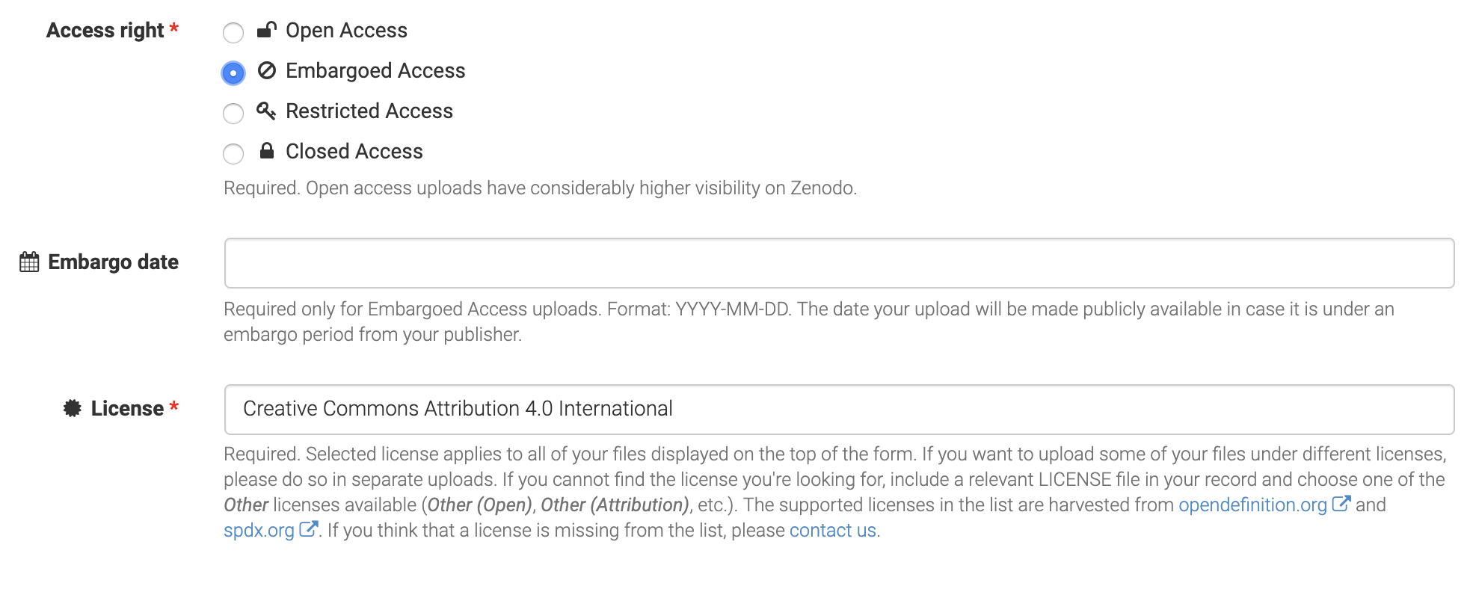
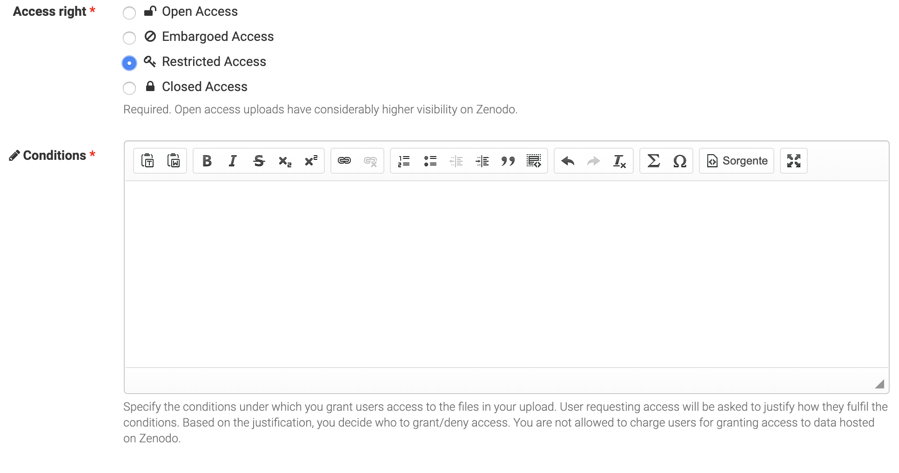
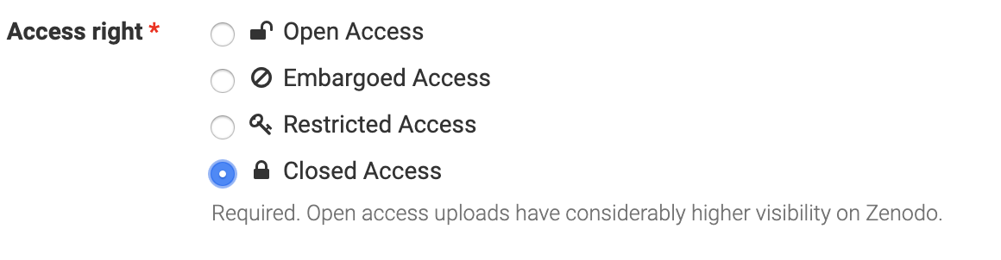

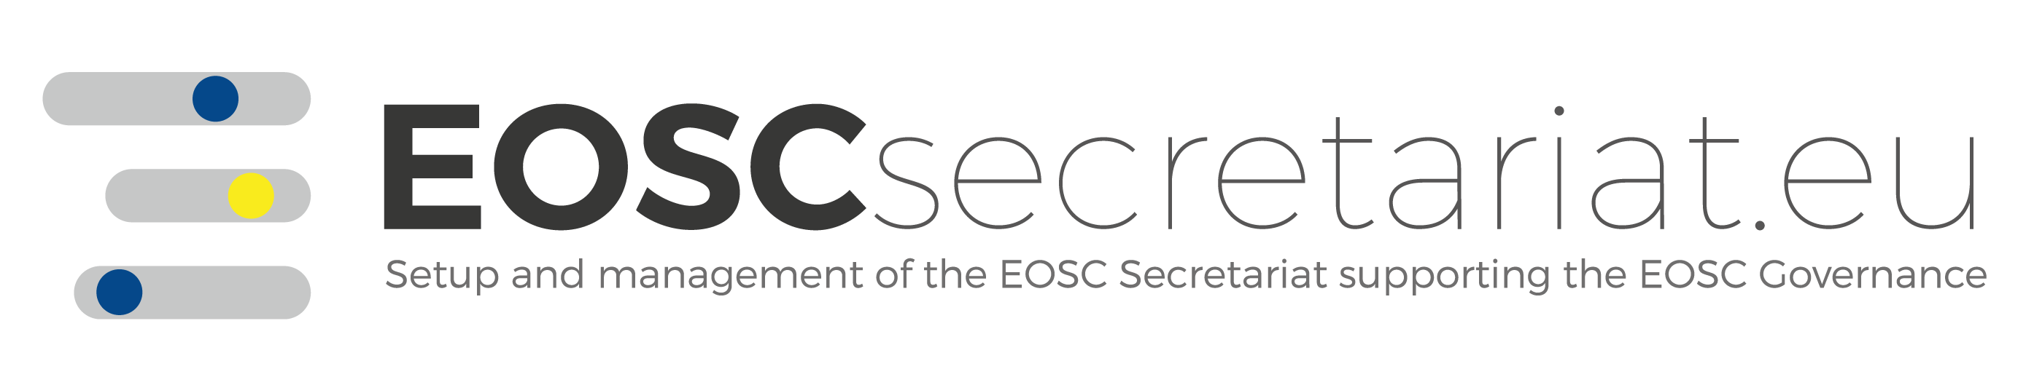
Access Rights in Zenodo

Slide 57
Warning!
Attaching your data to the article you published does not mean you are depositing the data.
Journals do not guarantee long term preservation and curation of the data.

Slide 58
Open Access to research Data
Storage: data must be deposited in a «trusted» repository
Zenodo it’s the best solution because it’s already connected with OpenAIRE
It’s better to deposit in disciplinary repositories, if available
Disciplinary repositories can be found on Re3data (www.re3data.org)
Provide full metadata, according to discipline standards.
OPEN ACCESS: data must be opened
An embargo period can be imposed, depending on the project
Choose the most open CC license possible: CC0 or CC-BY
DOCUMENTATION: all useful information about the gathering of the data must be provided, and possibly DEPOSIT the dataset.

Slide 59
Interoperable

Slide 60
Interoperable
The data usually need to be integrated with other data. In addition, the data need to interoperate with applications or workflows for analysis, storage, and processing.
Use community standard or best practice!

Slide 61
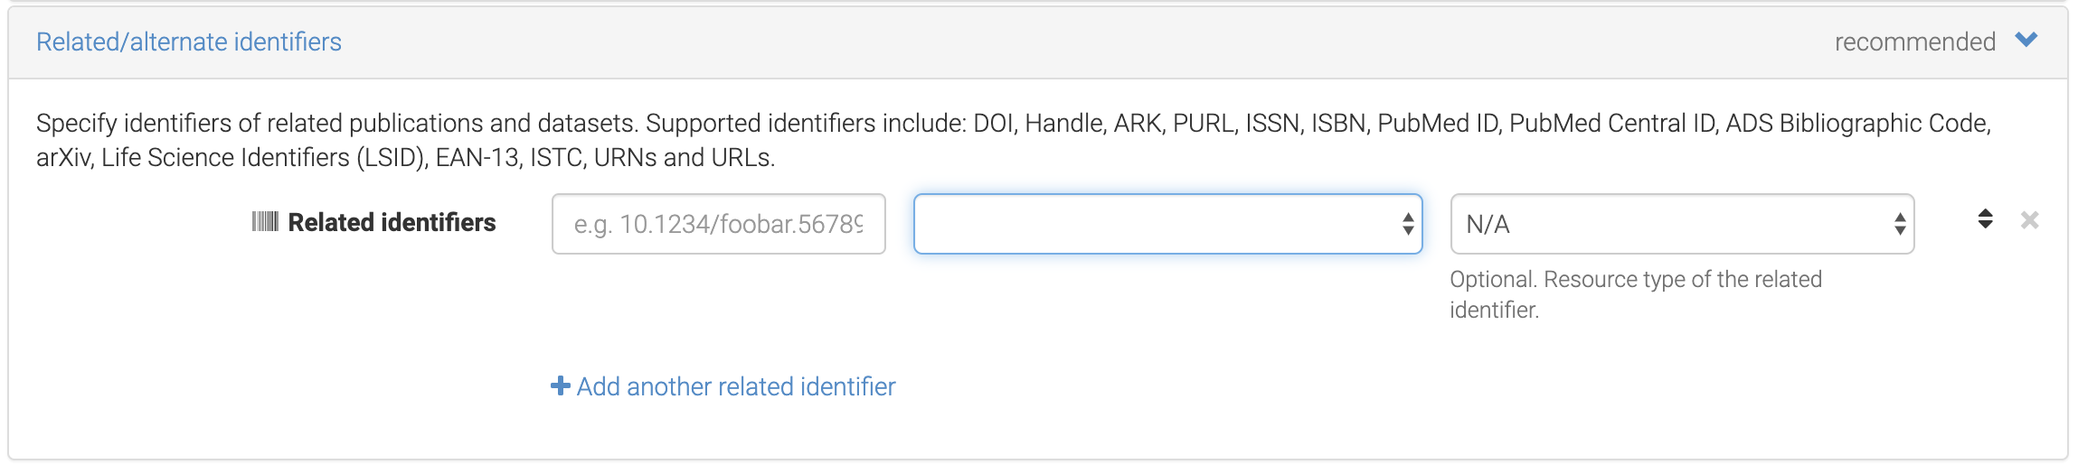
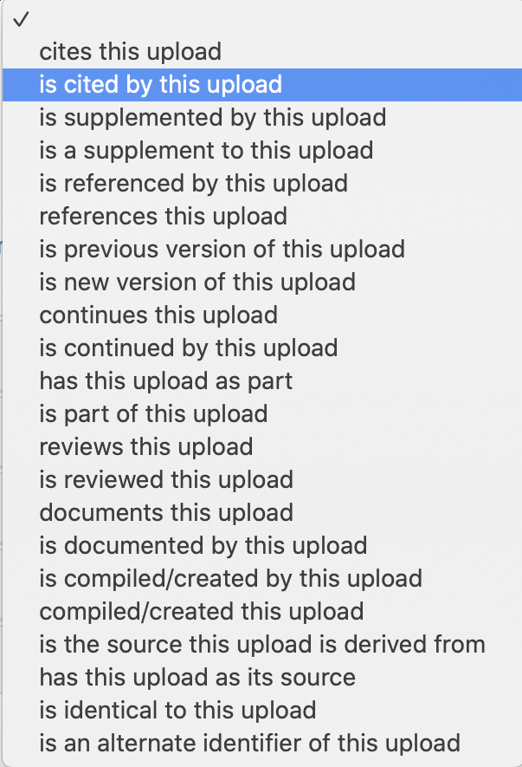
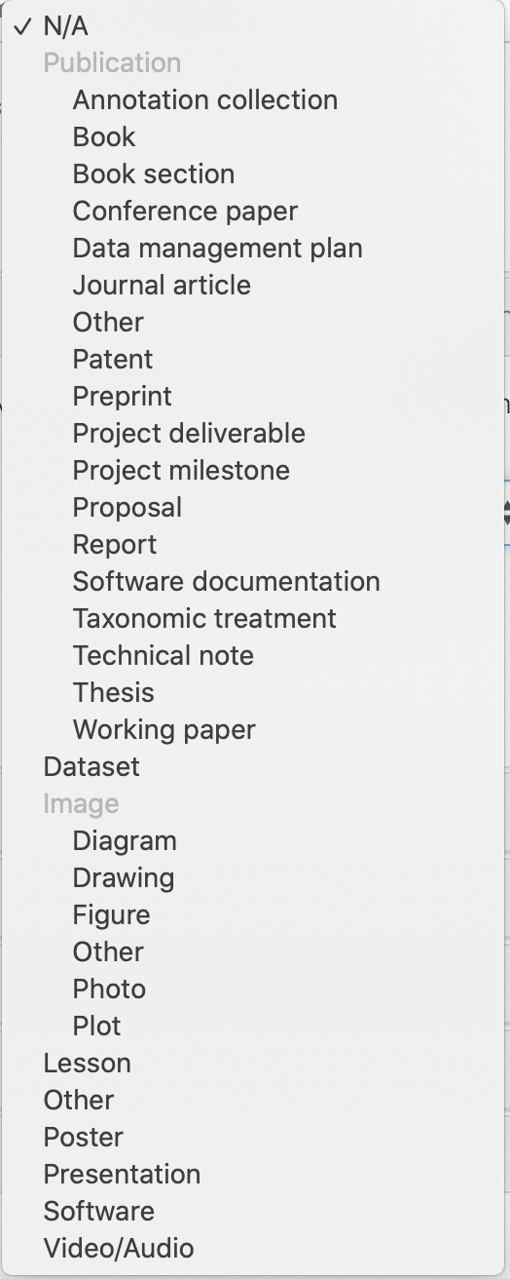
Linking Objects in Zenodo

Slide 62
Reusable

Slide 63
Reusable
The ultimate goal of FAIR is to optimise the reuse of data. To achieve this, metadata and data should be well-described so that they can be replicated and/or combined in different settings

Slide 64
Licenses
Tell others how they can reuse your data!
Where is your data coming from?
Provenance

Slide 65
Research data may be:
Automatically protected by the law;
Regulated by contract;
Subject to community norms such as academic best practices.

Slide 66
Some consideration on data protection
Copyright is a property right in certain types of original literary, artistic and scientific works.
Copyright does not protect ideas.
Confidentiality protects confidential information. This might be imposed by a contract or if the information is marked confidential. Use of confidential information might give rise to a claim for compensation if confidentiality is breached.
Data Subject Rights arise in information that identifies individuals and are recognised by data protection laws in the EU.
Patents are registered rights in novel inventions of products or processes.
Some research data may not benefit from any legal protection, although moral and ethical considerations may apply.

Slide 67
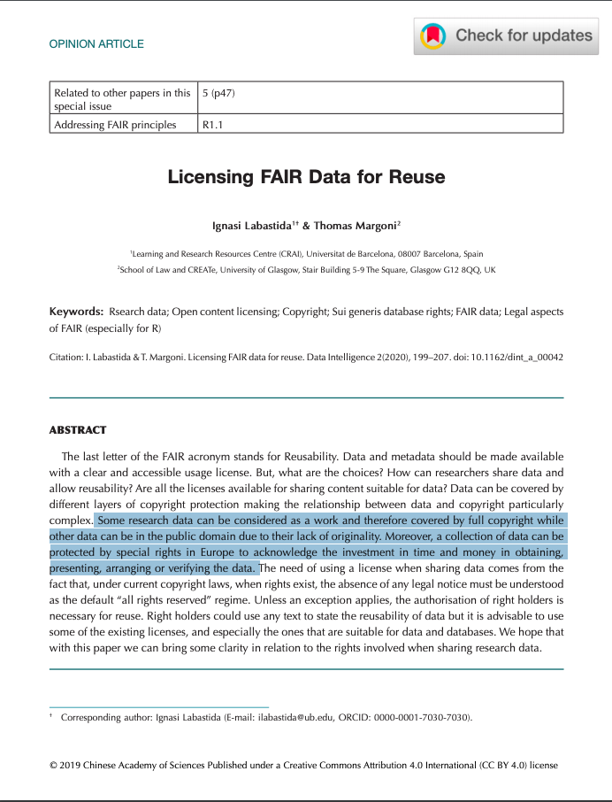
Data is not yours!
Data is not intellectual work, no copyright applies!
Copyright protection covers expressions and not ideas, procedures, operating methods or mathematical concepts as such.
Protection is on databases and not on data. The data are protected only and especially when they are collected and organized in a database.
The sui generis database right (only in Europe) covers not only the reproduction and dissemination of the database, but also the extraction and reuse of substantial parts of the database.
Read complete article here.
OpenAIRE Guidelines on data protection: available here

Slide 68
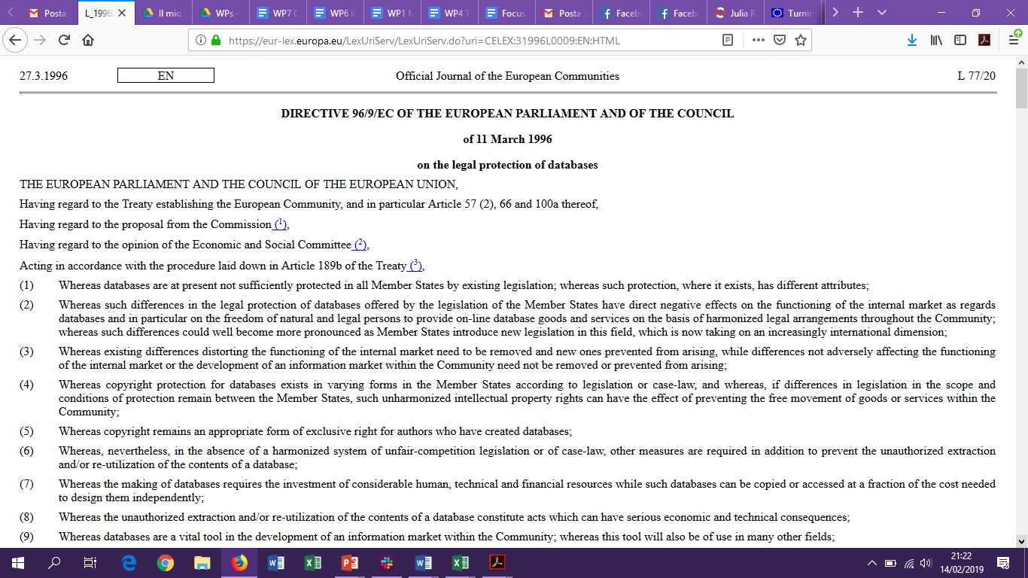
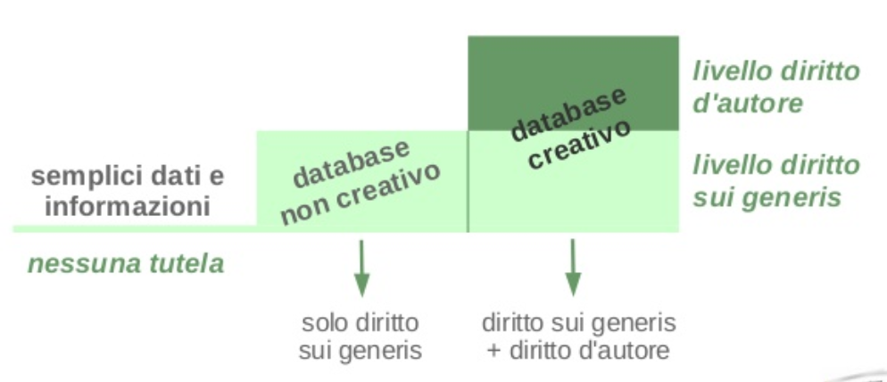
Data and law protection
Raw data are not protected by copyright
Database is defined as a collection of independent works, data or other materials arranged in a systematic or methodical way
Copyright protects the structure, selection or arrangement of the database contents, not the data
Sui generis database right: protects the substantial effort in obtaining data (not creating)
Note: the right owner is often the institution.
copyright
creative database
raw data
non creative database
sui generis
NO copyright
sui generis
sui generis+ copyright

Slide 69
Authors and rights owners
Are you the author of the data you collected?
Yes, in case you can proove it (deposit with clear date, DOI, … use a data repository!)
Do you own any rights on the raw data you collected?
No, data is facts/information and none can own rights on it!

Slide 70
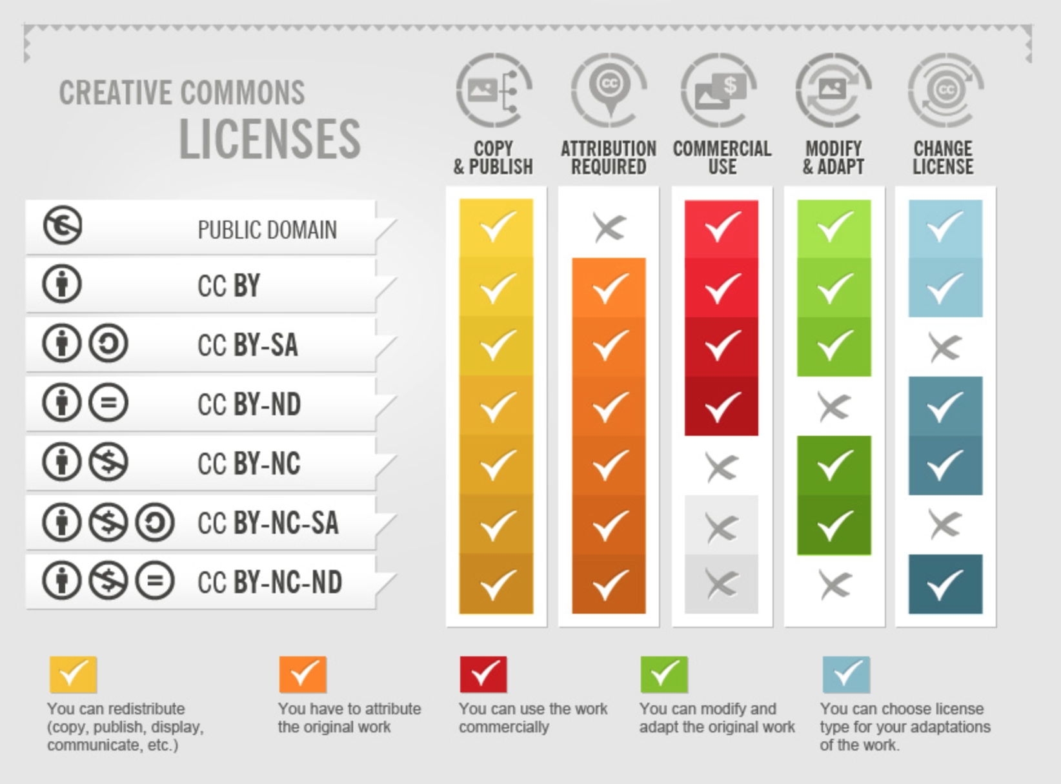
Creative Commons
Not all of us are legal experts capable of writing proper liceses
Creative Commons and Public Domain create legal certainty for everyone, who wants to use works, that are licensed respectively.
It is important to follow and understand the different meanings of the licenses and follow the rules for using them.
CC-Infographic by Foter under CC-BY-SA 3.0 license.

Slide 71
Creative Commons
Public Domain
Works are not covered by copyright
CC-0 (no rights reserved)
Allows creators to give up their copyright and put their works into the worldwide public domain
CC-BY (Attribution)
This license allows reusers to distribute, remix, adapt, and build upon the material in any medium or format, so long as attribution is given to the creator
CC-BY-SA (Attribution – ShareAlike)
This license allows reusers to distribute, remix, adapt, and build upon the material in any medium or format, so long as attribution is given to the creator. The license allows for commercial use. If you remix, adapt, or build upon the material, you must license the modified material under identical terms.
CC-BY-ND (Attribution – NonDerivative)
This license allows reusers to copy and distribute the material in any medium or format in unadapted form only, and only so long as attribution is given to the creator. The license allows for commercial use.
CC-BY-NC (Attribution – NonCommercial)
This license allows reusers to distribute, remix, adapt, and build upon the material in any medium or format for noncommercial purposes only, and only so long as attribution is given to the creator.
CC-Infographic by Foter under CC-BY-SA 3.0 license.

Slide 72
Warning!
Attaching your data to the article you published does not mean you are depositing the data.
Journals do not guarantee long term preservation and curation of the data.

Slide 73
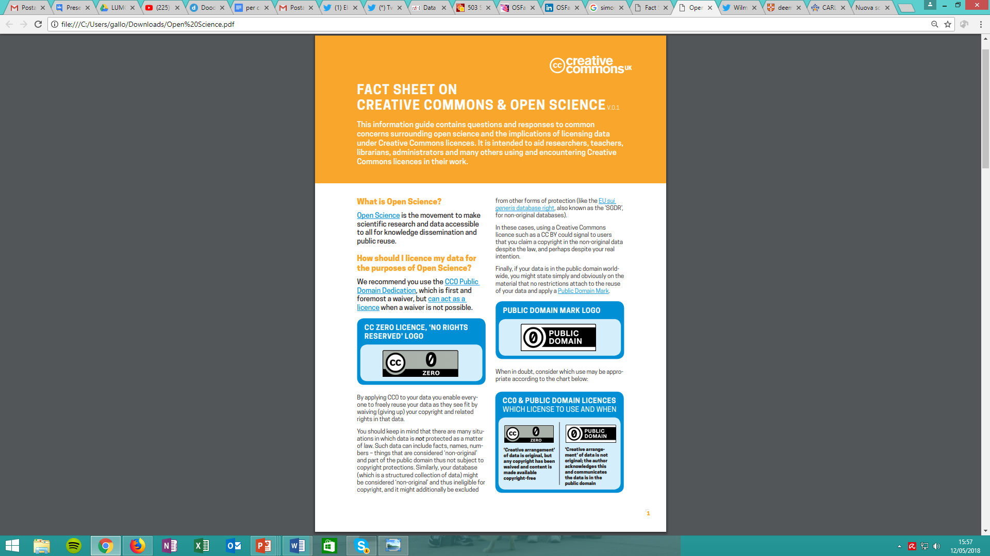
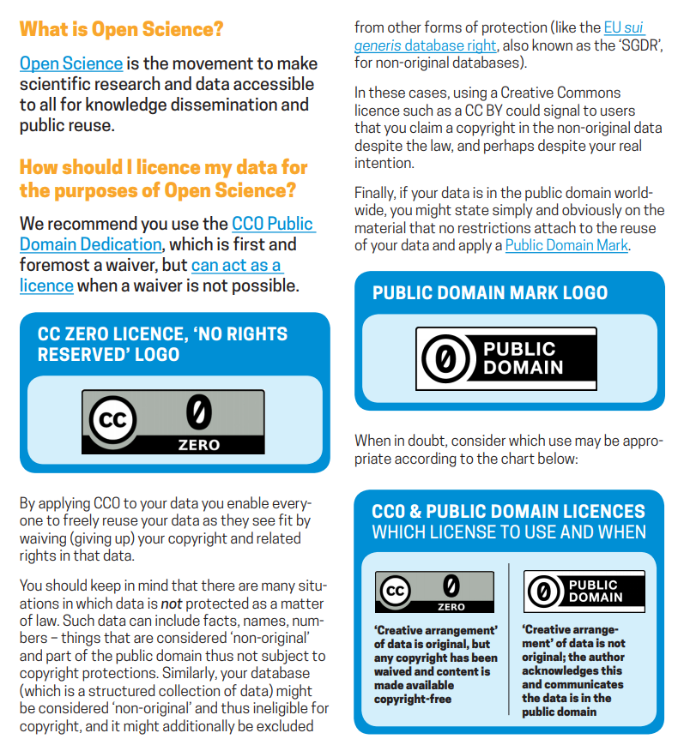
Licensing your data: Creative Commons
Creative Commons e Open Science
https://doi.org/10.5281/zenodo.840651

Slide 74
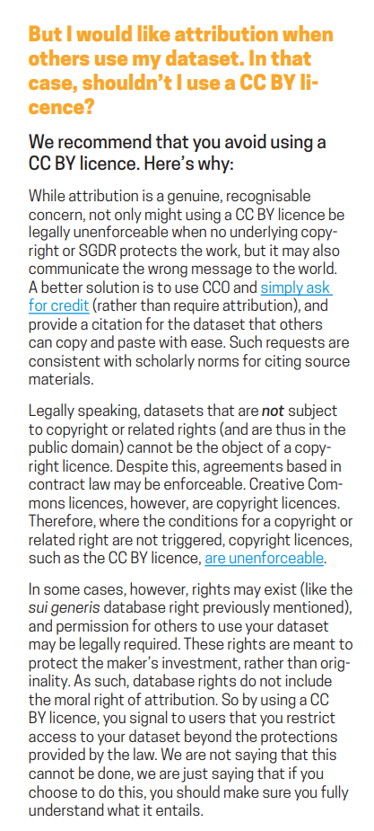
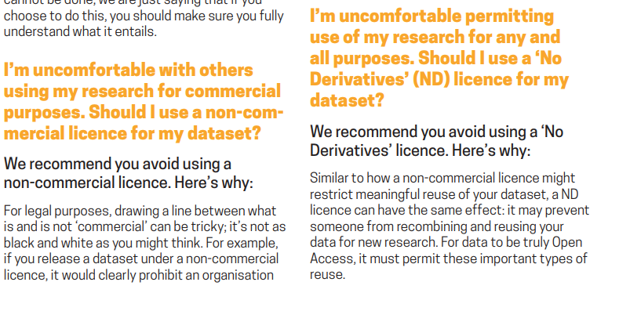
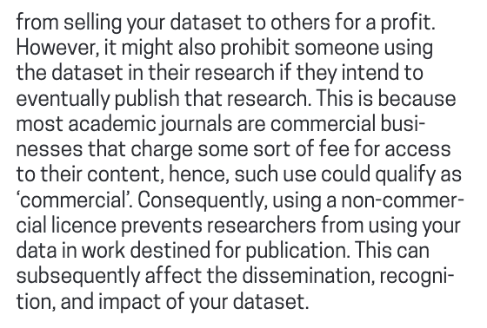
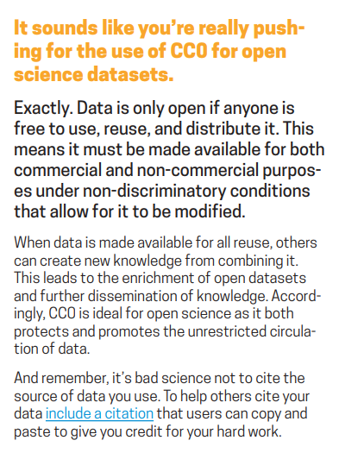
Licensing your data: Creative Commons
Use a CC0 or public domain
Then ask for credit
Provide a citation that researchers using your data can simply copy and paste to give you credit for your work
Bear in mind it’s bad science not to cite the source
CC0 does not mean academic unpoliteness
https://doi.org/10.5281/zenodo.840651

Slide 75
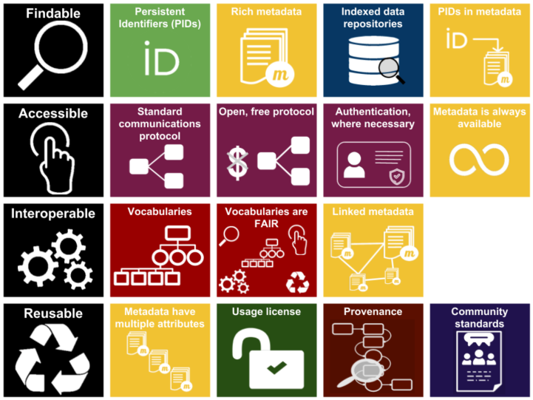
To summarise…

Slide 76
Once your data is FAIR, decide to go Open!

Slide 77
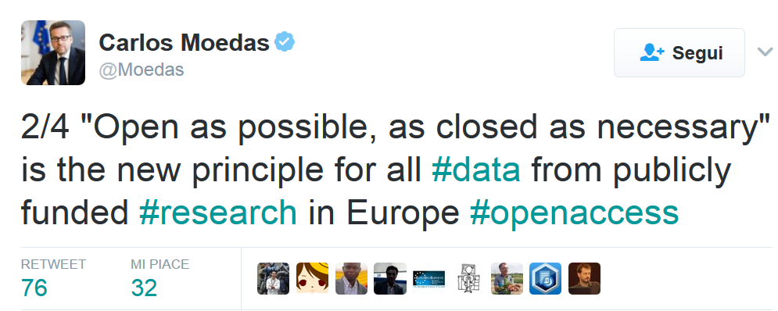
From 2014 until 2019, Moedas served as European Commissioner covering the portfolio of Research, Science and Innovation under the leadership of President Jean-Claude Juncker

Slide 78
Open your data in practice

Slide 79
How about Reliability? Is FAIR = Reliable
No, it is not

Slide 80
Mentimeter
You can access mentimeter from any device (mobile pc, tablet…)
Go to www.menti.com and enter code: 27 19 65 0
Click on the direct link: https://www.menti.com/61g31jveon
Scan the QR code

Slide 81
Current Open Science Practices in the ICT Domain

Slide 82


File sharing
Software management tools (GitHub)

Slide 83
What is missing?
Such methods DO NOT
Publish your products (in the academic sense),
Preserve your products,
Make your products citable and findable,
Carry attribution and scientific credit,
Enable reproducibility

Slide 84
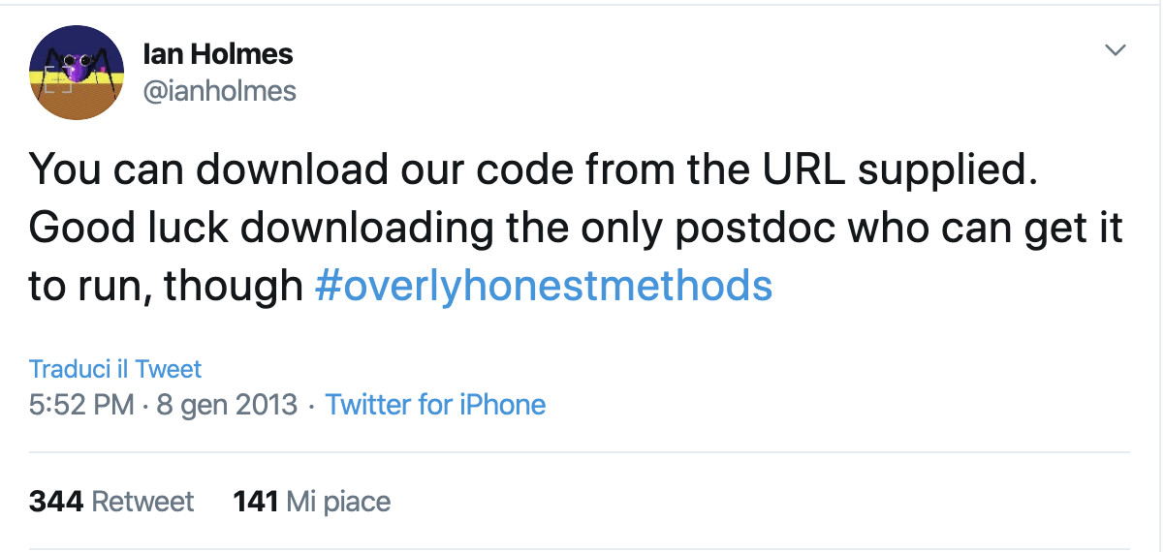

Slide 85
What can you do?

Slide 86
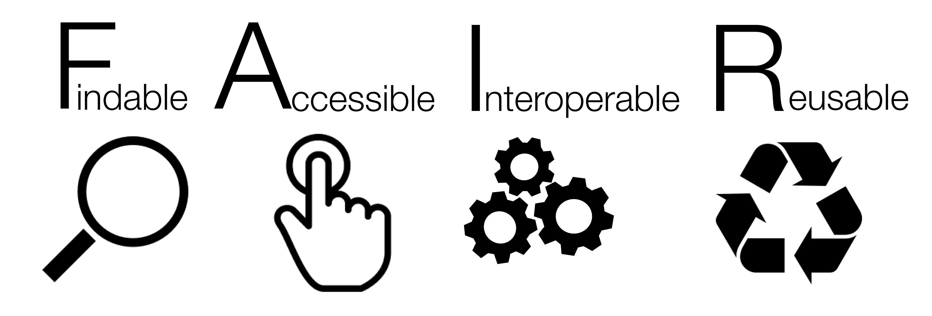
Make data and software FAIR
ORCID to identify the authors/contributors
Develop in a structured – and collaboratory/open – way (GitHub)
Deposit and preserve in a trustworthy repository: get a DOI! (Zenodo)
Choose a clear license
Deposit a (updated) README file with your code/data
Use versioning
Link to other research objects (articles, data, software…)

Slide 87
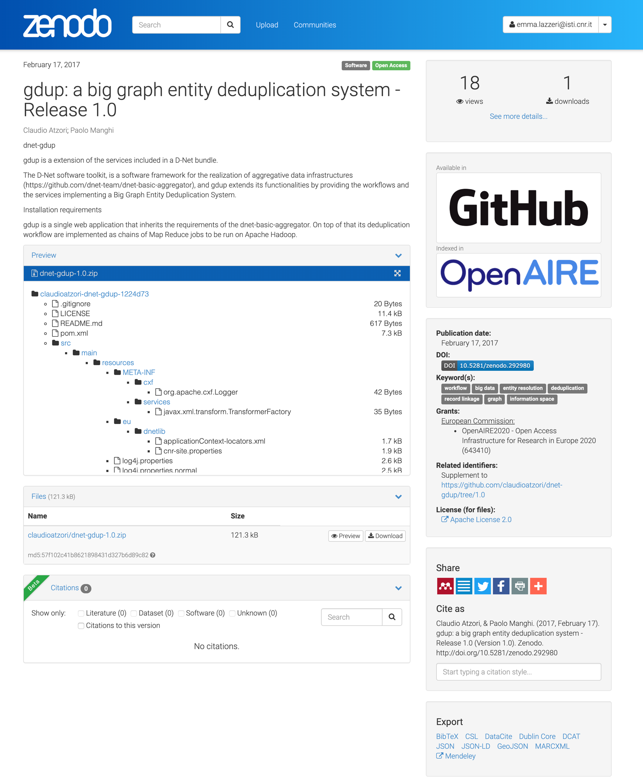
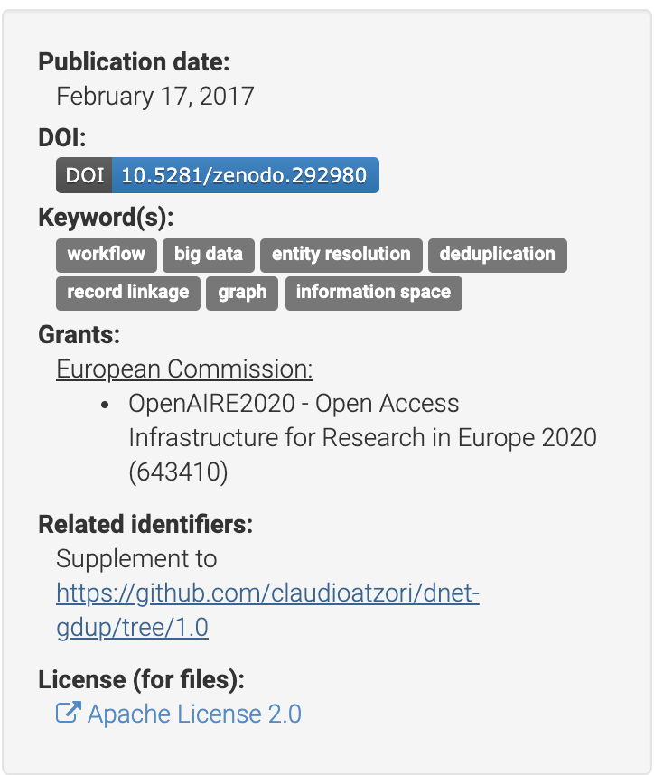
Zenodo
Catch all repository (CERN and OpenAIRE)
Free DOIs for citation and enable credit mechanisms
Enables tracking of usage (downloads and views) for credit
Citable products are findable, reusable, therefore enable degrees of R* ness

Slide 88


Software preservation
An international initiative to preserve software

Slide 89
Software and data papers
Software/data papers are written to describe software/data
The DOI attached to the article makes it citable
However the software/data itself should be cited on the same basis as any other research product
If a software/data paper exists and it contains results (performance, validation, etc.) that are important to the work, then the software/data paper should also be cited (in addition to the software/data)

Slide 90




Data paper Journals
Scientific Data (Nature)
https://www.nature.com/sdata
Data in brief (Elsevier)
https://www.journals.elsevier.com/data-in-brief/
Data (MDPI)
https://www.mdpi.com/journal/data
Patterns (bio data intensive science)
https://www.cell.com/patterns

Slide 91


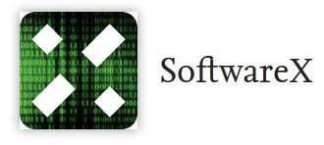



Software paper Journals
Journal of Open Research Software:
https://openresearchsoftware.metajnl.com/
PeerJ Computer Science:
https://peerj.com/computer-science
SoftwareX (Elsevier)
https://www.journals.elsevier.com/softwarex
Software Impacts (Elsevier)
https://www.journals.elsevier.com/software-impacts
The Journal of Open Source Software
https://joss.theoj.org

Slide 92
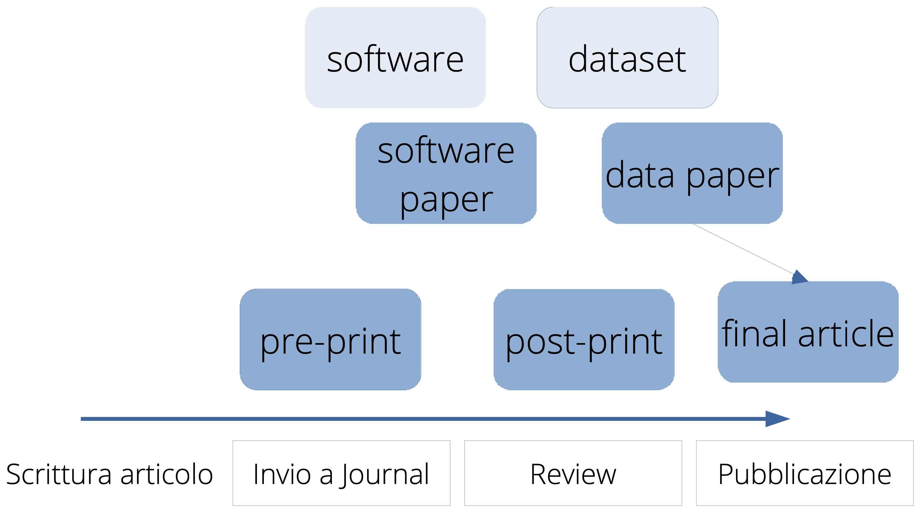
Best effort towards reproducibility
Archive your article pre-prints in public repositories
Publish post-prints of published articles (“closed juornals) in public repositories (in respect of copyrights)
Publish your data and software in an open repository (as open as possible as closed as necessary)
Publish data and software papers to describe your products
Keep your products semantically interlinked
Share on the web

Slide 93
Emma Lazzeri
emma.lazzeri@isti.cnr.it
This work was partially supported by European Union's Horizon 2020 under project grant Agreement number 777541

