Slide 1
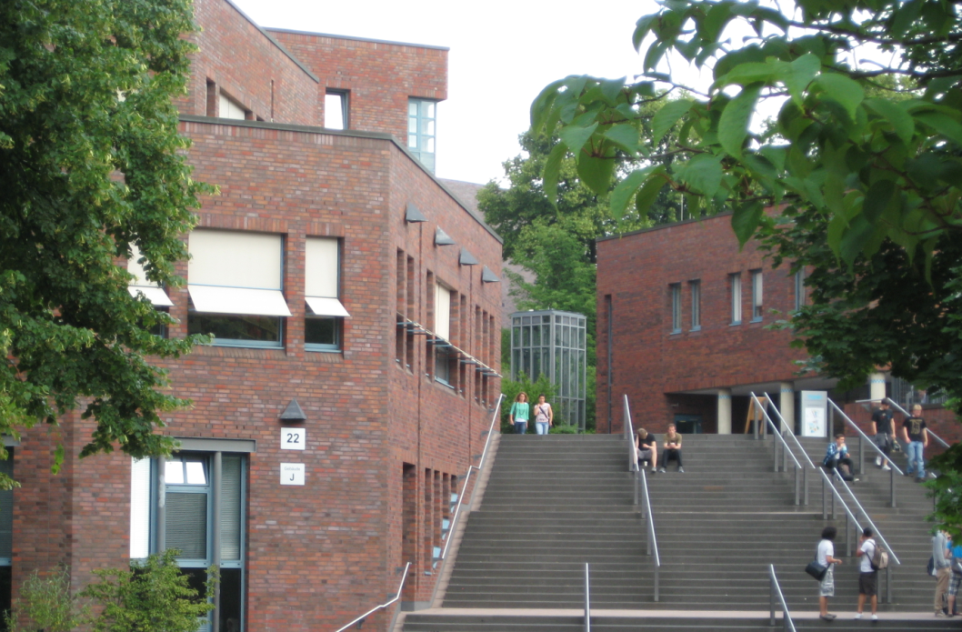
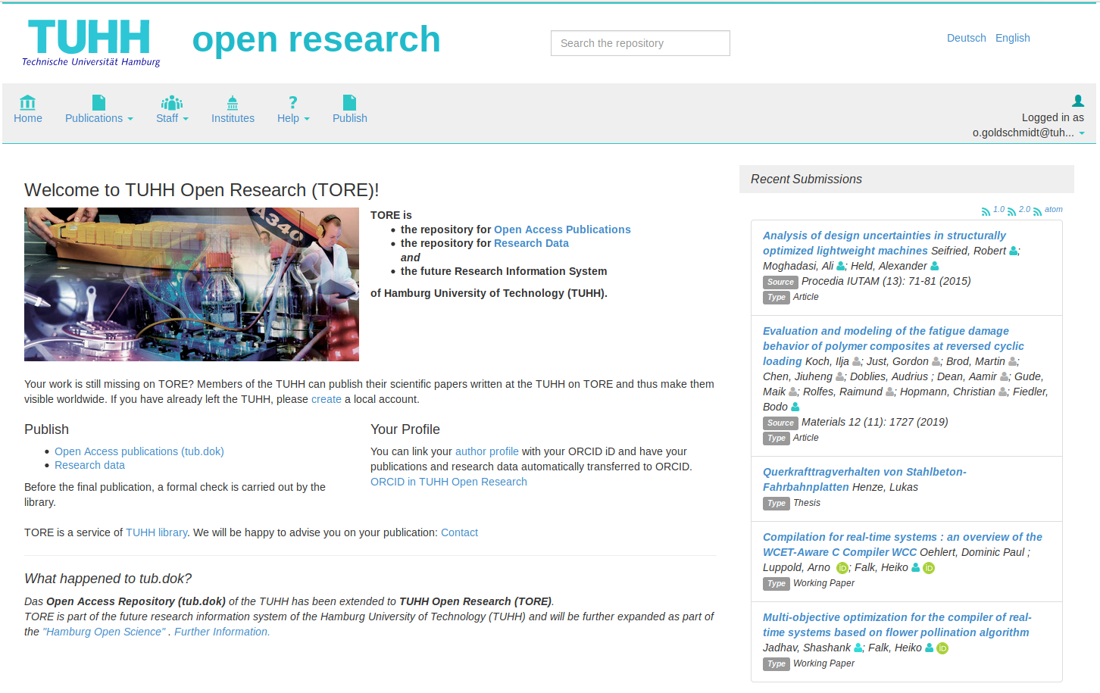


Hamburg Open Science
DSpace-CRIS @ TU Hamburg
Three Requirements
Three Collections
Requirement #1
Open Access Repository
All Open Access Publications
Requirement #2
Research Data Repository
Metadata and Research Data Files
Requirement #3
Research Information System
All University Output in terms of Publications
All University Researchers, Institutes, Projects, Journals, Conferences
Publications with Fulltext
Open Access Publications (CC)
Publications with Fulltext Files
Publications without Fulltext
Metadata only
Used to create a University Bibliography
and a Research Information System
Research Data Repository
Metadata and Research Data Files
Items (Publications, Research Data, ...)
Organizational Units (Institutes, Corporates, ...)
Researcher Profile (Persons)
Projects
Journals
Events (Conferences)
Content
One System
Publications with Browsing Options
Browsable TUHH staff (by name, by institute)
TUHH institutes with additional information
Different collections
Recent publications with basic information
Persons with differently coloured icons (TUHH staff member, former TUHH staff member, external/unknown person)
ORCID integration
Denickestr. 22
21073 Hamburg
www.tub.tuhh.de
tore.tuhh.de
University Library
TU Hamburg
Contact: Oliver Goldschmidt & Beate Rajski

