Slide 1




Emma Lazzeri
GARR
https://orcid.org/0000-0003-0506-046X
Horizon Europe: la strategia per una scienza europea aperta

Slide 2
Perché scienza aperta?

Slide 3
La scienza aperta
“Open science” means an approach to the scientific process based on open cooperative work, tools and diffusing knowledge
Horizon Europe Regulation and Model Grant Agreement
The concepts of Open Science, Open Innovation, Open to the World should ensure excellence and impact of the Union´s investment in research and innovation, while safeguarding the Union´s interests
Recital 7 Horizon Europe Regulation
accelera il processo scientifico
migliora la qualità della ricerca e la fiducia da parte della società (trasparenza)
riduce il time to market and il tempo per il trasferimento tecnologico
aumenta l’impatto
Non stiamo più discutendo se sia o meno una opportunità: la scienza aperta è ora la nuova normalità

Slide 4
La Commissione europea e la scienza aperta
2021
FP7
OA Pilot
Deposit and open access
H2020
OA Mandatory
Deposit and open access
& ORD/DMP Pilot
H2020
OA Mandatory
Deposit and open access
& ORD/DMP by default
(exceptions)
2017
Horizon Europe
OA Mandatory
Deposit and open access
DMP in line with FAIR Mandatory
OD by default (exceptions)
& Open Science embedded
2014
2008

Slide 5
Un cambio di prospettiva
Competizione
Collaborazione condivisione

Slide 6
Il focus della valutazione
What
How
Who
Risultati
Metodologia
Ricercatore e Consorzio
In Horizon Europe tutto viene valutato sotto la prospettiva Open Science, fin dalla proposta di progetto

Slide 7



HORIZON EUROPE LEGISLATION defines three types of impact, tracked with Key Impact Pathways
1. Creating high-quality new knowledge
Scientific
Impact
2. Strengthening human capital in R&I
3. Fostering diffusion of knowledge and Open Science
4. Addressing EU policy priorities & global challenges through R&I
Societal Impact
5. Delivering benefits & impact via R&I missions
6. Strengthening the uptake of R&I in society
Economic/
Technological
Impact
7. Generating innovation-based growth
8. Creating more and better jobs
9. Leveraging investments in R&I
Article 50 & Annex V ‘Time-bound indicators to report on an annual basis on progress of the Programme towards the achievement of the objectives referred to in Article 3 and set in Annex V along impact pathways’
Courtesy of Angelica Marino, April 21, 2021, Webinar: A successful proposal for Horizon Europe: Scientific-technical excellence is key, but don’t forget the other aspects

Slide 8
Open Science practices*
early and open sharing of research (for example through preregistration, registered reports, pre-prints, or crowd-sourcing)
research output management including research data management
measures to ensure reproducibility of research outputs
providing open access to research outputs (e.g. publications, data, software, models, algorithms, and workflows) through deposition in trusted repositories
participation in open peer-review
involving all relevant knowledge actors including citizens, civil society and end users in the co-creation of R&I agendas and contents (such as citizen science)
*Listed in the proposal template
** Mandatory and non-mandatory practices. Mandatory in MGA and WP
Courtesy of Victoria Tsoukala, April 21, 2021, Webinar: A successful proposal for Horizon Europe: Scientific-technical excellence is key, but don’t forget the other aspects

Slide 9
Evaluation of proposals and Open Science
“Excellence” criterion
(methodology)
Up to 1 page to describe OS practices + up to 1 page to describe research data/output management
Evaluation of the quality of open science practices
“Quality of implementation” criterion
(capacity of participants and consortium as a whole + list of achievements)
Explain expertise on OS (if no OS practices are involved then no expertise required)
List publications, software, data, etc, relevant to the project with qualitative assessment and, where available, persistent identifiers
Publications expected to be open access; datasets expected to be FAIR and ‘as open as possible, as closed as necessary‘. Significance of publications to be evaluated on the basis of proposers’ qualitative assessment and not per Journal Impact Factor
**evaluation concerns mandatory and non-mandatorypractices, the latter where appropriate
**exception: ERC does not evaluate open science
Courtesy of Victoria Tsoukala, April 21, 2021, Webinar: A successful proposal for Horizon Europe: Scientific-technical excellence is key, but don’t forget the other aspects

Slide 10
Model Grant Agreement requirements
Open access to scientific publications
Research Data Management
Additional open science practices
Courtesy of Victoria Tsoukala, April 21, 2021, Webinar: A successful proposal for Horizon Europe: Scientific-technical excellence is key, but don’t forget the other aspects

Slide 11
1. Open access to scientific publications I/II
Beneficiaries must ensure OA to peer-reviewed scientific publications relating to their results. In particular, they must ensure:
at the latest upon publication, deposition of the AAM or VoR in a trusted repository + immediate open access via the repository under CC BY or equivalent (CC BY-NC/CC BY-ND are allowed for long-text formats)
information via the repository about any research output/tools/instruments needed to validate the conclusions of the scientific publication
Metadata must be open under CC 0 or equivalent, in line with the FAIR principles and provide information about the licensing terms and persistent identifiers, amongst others.
Trusted repository: new term for HE; explained in the AGA; seek assistance from your library to assess whether a repository is trusted
Courtesy of Victoria Tsoukala, April 21, 2021, Webinar: A successful proposal for Horizon Europe: Scientific-technical excellence is key, but don’t forget the other aspects

Slide 12
1. Open access to scientific publications II/II
Beneficiaries (or authors) must retain sufficient intellectual property rights to comply with the OA requirements
Publication in venue of choosing but publication fees are reimbursable only if publishing venue is full open access (publication fees in hybrids not reimbursed)
Courtesy of Victoria Tsoukala, April 21, 2021, Webinar: A successful proposal for Horizon Europe: Scientific-technical excellence is key, but don’t forget the other aspects

Slide 13
2. Research data management
Beneficiaries must manage the digital research data generated in the action responsibly, in line with the FAIR principles and:
establish + regularly update a data management plan (‘DMP’) for generated (and/or collected) data; by mo 6 of project; with submission or latest by grant agreement in cases of public emergency (e.g. COVID projects)
as soon as possible and within the deadlines set out in the DMP, deposit the data in a trusted repository (federated in the EOSC if required in the call conditions) + ensure OA under CC BY, CC 0 or equivalent, following the principle ‘as open as possible as closed as necessary’
provide information via the repository about any research output/tools/instruments needed to re-use or validate the data
Metadata must be open under CC 0 or equivalent (to the extent legitimate interests or constraints are safeguarded), in line with the FAIR principles and provide information about the licensing terms and persistent identifiers, amongst others.
Courtesy of Victoria Tsoukala, April 21, 2021, Webinar: A successful proposal for Horizon Europe: Scientific-technical excellence is key, but don’t forget the other aspects

Slide 14
3. Additional Open Science practices
Some calls may have additional obligations on OS practices- they must be complied with
Beneficiaries must provide (digital or physical) access to data or other results needed for validation of the conclusions of scientific publications, provided legitimate interests safeguarded and unless (open) access already provided at publication (mainstreamed through general annexes of WP; does not currently apply to ERC)
Additional obligations in cases of public emergency
Courtesy of Victoria Tsoukala, April 21, 2021, Webinar: A successful proposal for Horizon Europe: Scientific-technical excellence is key, but don’t forget the other aspects

Slide 15
Horizon Europe
Full Plan-S compliance (nessun embargo per le pubblicazioni)
I beneficiari potranno pubblicare nella rivista che vorranno. Ma non potranno ricevere il rimborso per le APCs eventuali per le riviste ibride.
I beneficiari dovranno mantenere i diritti che consentano l’open access (via verde, attraverso il deposito in un repository) e l’uso di licenze compatibili con il riuso (controllate e modificate eventualmente il contratto di copyright)
La gestione dei dati secondo i principi FAIR sarà la norma (nessuna scusa, nessun opt out a livello di progetto)
L’Open Science e strategia di gestione dei dati sarà oggetto di valutazione della proposta di progetto
Per alcune call sarà richiesto l’uso di EOSC
Ci saranno sanzioni per chi non rispetta gli obblighi

Slide 16
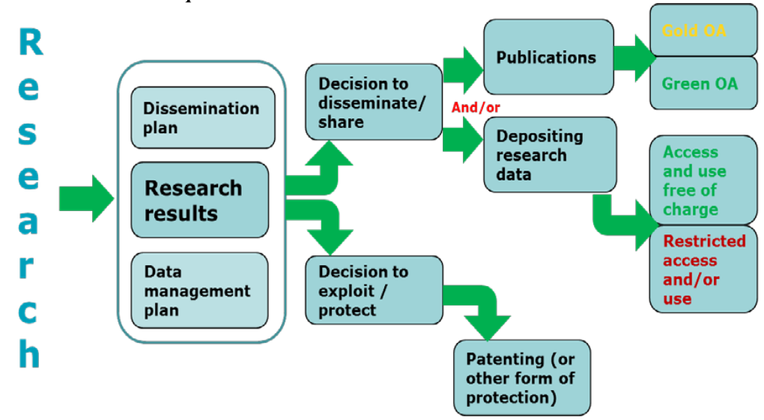
Chiunque sia finanziato dalla Commissione Europea
Deve decidere se Pubblicare o Sfruttare Commercialmente i Risultati della Ricerca (Brevettare)
Guidelines to the Rules on Open Access to Scientific Publications and Open Access to Research Data in Horizon 2020

Slide 17
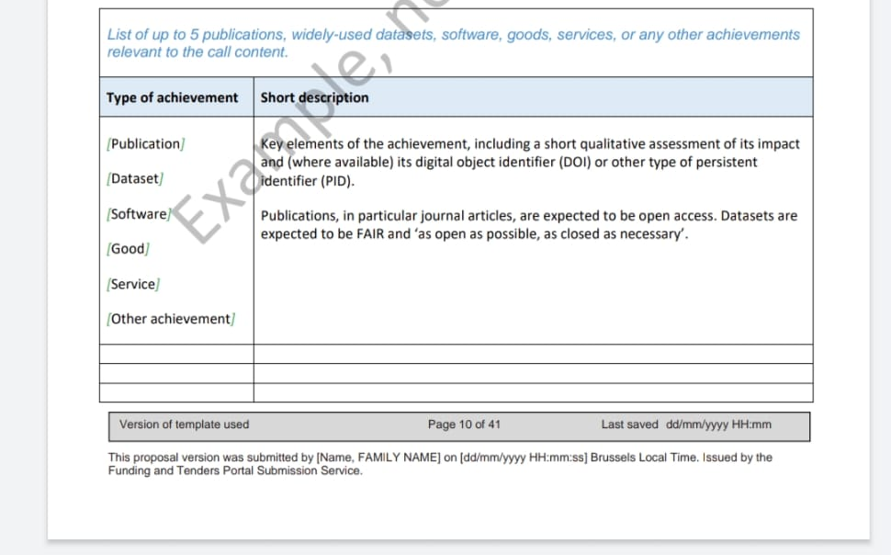
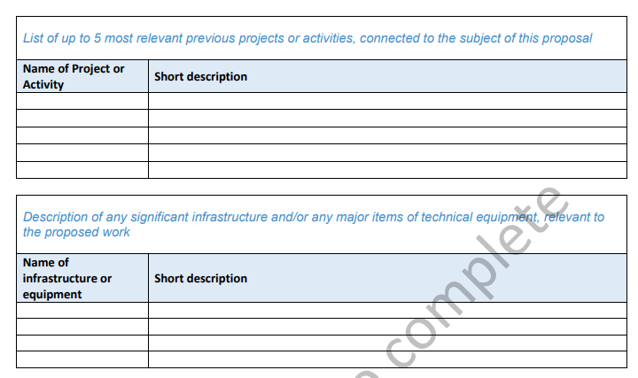
Dal nuovo template di Horizon Europe
L’istituzione non sarà più valutata solo in base alle pubblicazioni, ma in base a:
Publications, widely-used datasets, software, goods, services or any other achievements relevant to the call content
Relevant previous projects and activities
Significant infrastructure and technical equipment
Si dovrà includere un self assessment dell’impatto senza citare Impact Factor

Slide 18
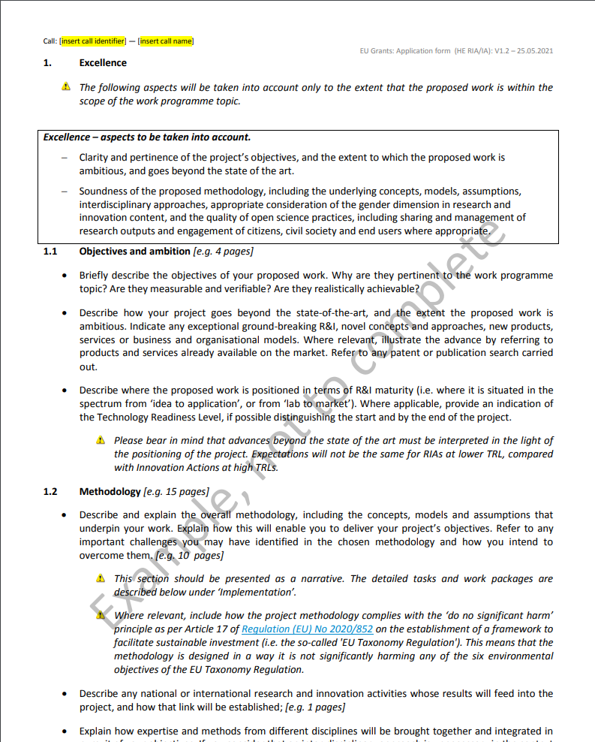
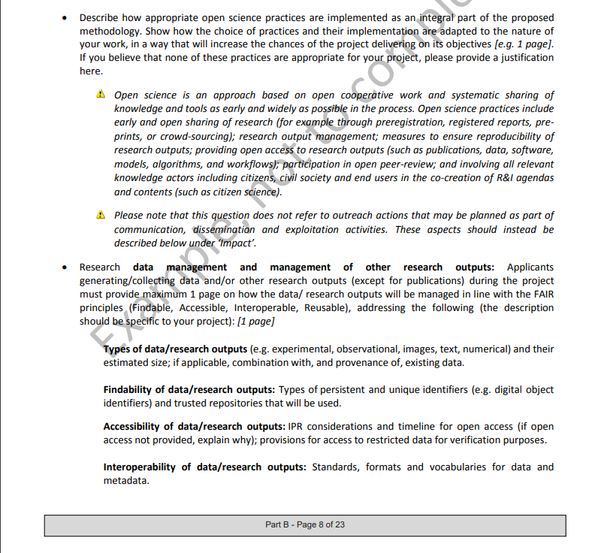
Dal template di Horizon Europe - Excellence
Nel proposal part B sezione Excellence - methodology:
si dovrà descrivere come le pratiche di open science verranno integrate nella metodologia
si dovrà descrivere la strategia di gestione dei dati/risultati secondo i principi FAIR

Slide 19
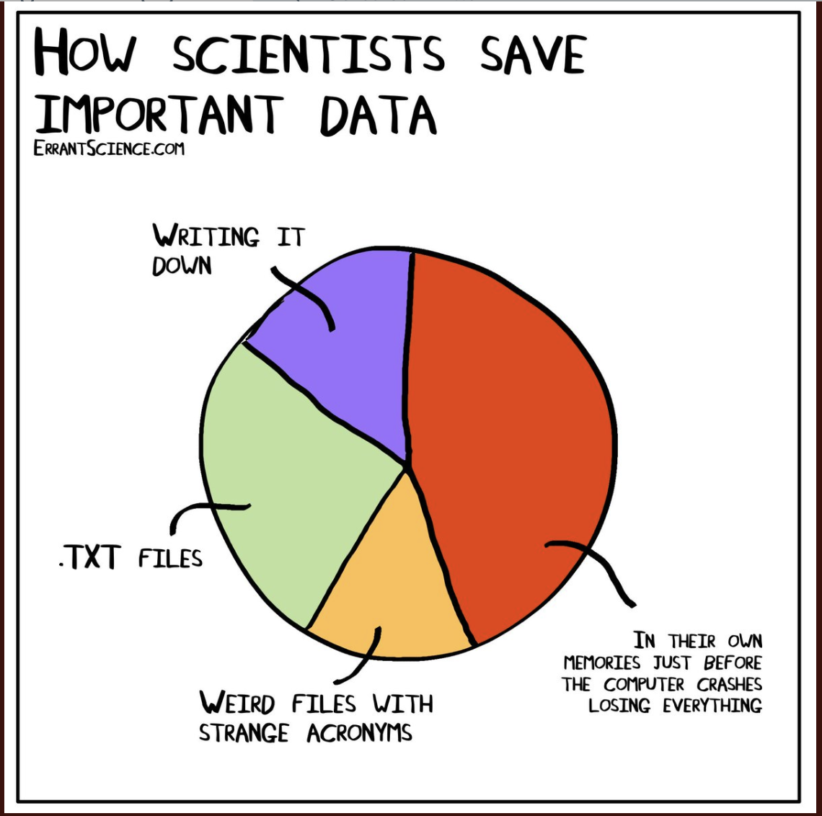
Research Data Management
Le politiche della Commissione Europea mirano a diffondere le pratiche della corretta gestione dei dati della ricerca
Per questo è richiesto il Data Management Plan (deliverable obbligatorio entro il mese 6)
La gestione dei dati deve rispettare i principi FAIR
Non ci sarà più possibiltà di Opt Out dell’intero progetto perché non c’è più un programma pilota per gli Open Data!

Slide 20
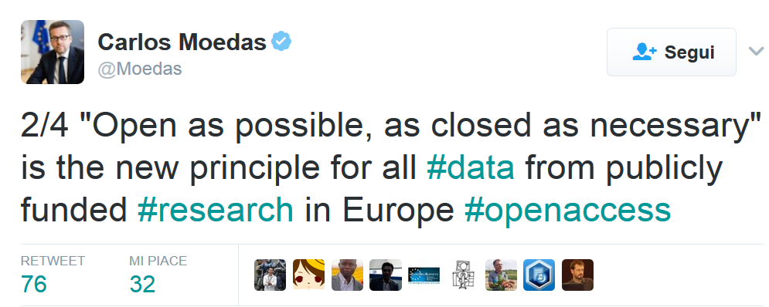
FAIR di default, chiuso solo se necessario
From 2014 until 2019, Moedas served as European Commissioner covering the portfolio of Research, Science and Innovation under the leadership of President Jean-Claude Juncker

Slide 21







As open as possible as closed as necessary…
Sfruttamento Commerciale o Industriale
Raggiungimento Obiettivi del Progetto
L’apertura dei dati è incompatibile con l’obbligo di proteggere i risultati che possono ragionevolmente venire sfruttati attraverso vie commerciali o industriali
L’Open Access ai dati è incompatibile con il raggiungimento degli obiettivi del progetto
Sicurezza
Nessun Dato Prodotto/Raccolto
L’open access ai dati è incompatibile con la necessità di riservatezza connessa a questioni di sicurezza
Il progetto non prevede la creazione o la raccolta di dati della ricerca
Protezione dei Dati Personali
Altre Legittime Ragioni
L’apertura dei dati è incompatibile con le regole relative alla protezione dei dati personali
Esistono atre ragioni legittime (è possibile motivare in fase di proposta o nel Data Management Plan)

Slide 22
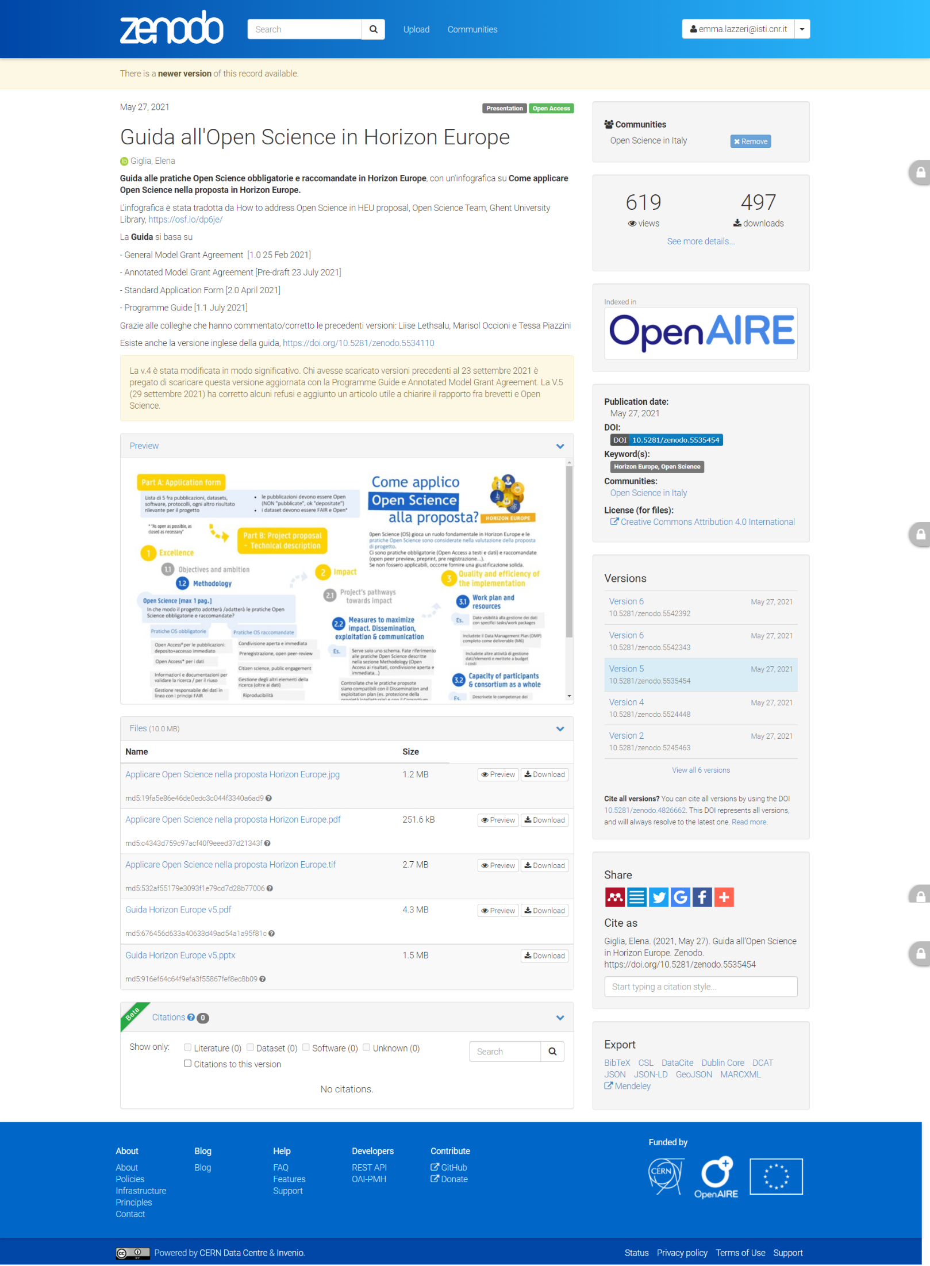
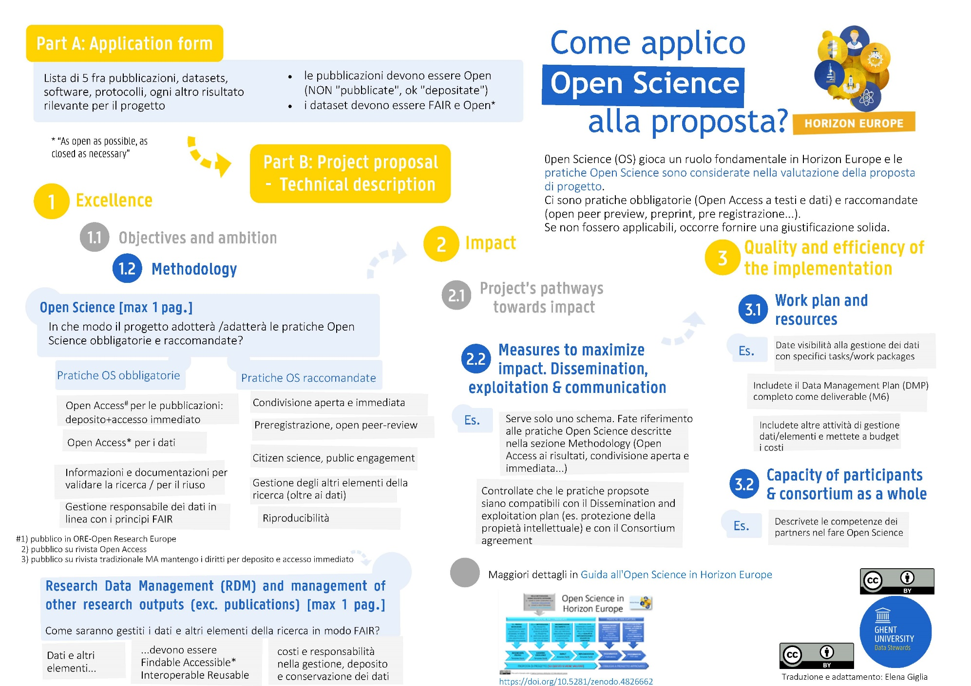
Una guida utile

Slide 23
emma.lazzeri@garr.it
This work was partially supported by European Union's Horizon 2020 under project grant Agreement number 857650, and by ICDI Competence Center

