Slide 1



Open Science
in Horizon Europe
Emma Lazzeri,
GARR emma.lazzeri@garr.it
https://orcid.org/0000-0003-0506-046X

Slide 2
Perché scienza aperta?

Slide 3
La scienza aperta
“Open science” means an approach to the scientific process based on open cooperative work, tools and diffusing knowledge
Horizon Europe Regulation and Model Grant Agreement
The concepts of Open Science, Open Innovation, Open to the World should ensure excellence and impact of the Union´s investment in research and innovation, while safeguarding the Union´s interests
Recital 7 Horizon Europe Regulation
accelera il processo scientifico
migliora la qualità della ricerca e la fiducia da parte della società (trasparenza)
riduce il time to market and il tempo per il trasferimento tecnologico
aumenta l’impatto
Non stiamo più discutendo se sia o meno una opportunità: la scienza aperta è ora la nuova normalità

Slide 4
La Commissione europea e la scienza aperta
2021
2017
Horizon Europe
OA Mandatory
Deposit and open access
DMP in line with FAIR Mandatory
OD by default (exceptions)
& Open Science embedded
2014
2008
H2020
OA Mandatory
Deposit and open access
& ORD/DMP by default
(exceptions)
H2020
OA Mandatory
Deposit and open access
& ORD/DMP Pilot
FP7
OA Pilot
Deposit and open access

Slide 5
Un cambio di prospettiva
Competizione
Collaborazione condivisione

Slide 6
Il focus della valutazione
Risultati
Metodologia
Ricercatore e Consorzio
What
How
Who
In Horizon Europe tutto viene valutato sotto la prospettiva Open Science, fin dalla proposta di progetto

Slide 7



HORIZON EUROPE LEGISLATION defines three types of impact, tracked with Key Impact Pathways
1. Creating high-quality new knowledge
Scientific
Impact
2. Strengthening human capital in R&I
3. Fostering diffusion of knowledge and Open Science
4. Addressing EU policy priorities & global challenges through R&I
Societal Impact
5. Delivering benefits & impact via R&I missions
6. Strengthening the uptake of R&I in society
Economic/
Technological
Impact
7. Generating innovation-based growth
8. Creating more and better jobs
9. Leveraging investments in R&I
Article 50 & Annex V ‘Time-bound indicators to report on an annual basis on progress of the Programme towards the achievement of the objectives referred to in Article 3 and set in Annex V along impact pathways’
Courtesy of Angelica Marino, April 21, 2021, Webinar: A successful proposal for Horizon Europe: Scientific-technical excellence is key, but don’t forget the other aspects

Slide 8
Open Science practices
early and open sharing of research (for example through preregistration, registered reports, pre-prints, or crowd-sourcing)
research output management including research data management
measures to ensure reproducibility of research outputs
providing open access to research outputs (e.g. publications, data, software, models, algorithms, and workflows) through deposition in trusted repositories
participation in open peer-review
involving all relevant knowledge actors including citizens, civil society and end users in the co-creation of R&I agendas and contents (such as citizen science)
*Listed in the proposal template
** Mandatory and non-mandatory practices. Mandatory in MGA and WP
Courtesy of Victoria Tsoukala, April 21, 2021, Webinar: A successful proposal for Horizon Europe: Scientific-technical excellence is key, but don’t forget the other aspects

Slide 9
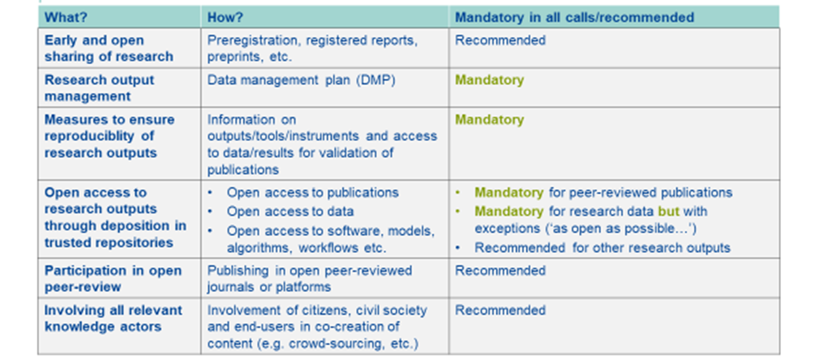
Mandatory and recommended OS practices
Courtesy of Victoria Tsoukala, April 21, 2021, Webinar: A successful proposal for Horizon Europe: Scientific-technical excellence is key, but don’t forget the other aspects

Slide 10
Evaluation of proposals and Open Science
“Excellence” criterion
(methodology)
Up to 1 page to describe OS practices + up to 1 page to describe research data/output management
Evaluation of the quality of open science practices
“Quality of implementation” criterion
(capacity of participants and consortium as a whole + list of achievements)
Explain expertise on OS (if no OS practices are involved then no expertise required)
List publications, software, data, etc, relevant to the project with qualitative assessment and, where available, persistent identifiers
Publications expected to be open access; datasets expected to be FAIR and ‘as open as possible, as closed as necessary‘. Significance of publications to be evaluated on the basis of proposers’ qualitative assessment and not per Journal Impact Factor
**evaluation concerns mandatory and non-mandatorypractices, the latter where appropriate
**exception: ERC does not evaluate open science
Courtesy of Victoria Tsoukala, April 21, 2021, Webinar: A successful proposal for Horizon Europe: Scientific-technical excellence is key, but don’t forget the other aspects

Slide 11
Model Grant Agreement requirements
Open access to scientific publications
Research Data Management
Additional open science practices
Courtesy of Victoria Tsoukala, April 21, 2021, Webinar: A successful proposal for Horizon Europe: Scientific-technical excellence is key, but don’t forget the other aspects

Slide 12
Open access to scientific publications I/II
Beneficiaries must ensure OA to peer-reviewed scientific publications relating to their results. In particular, they must ensure:
at the latest upon publication, deposition of the AAM or VoR in a trusted repository + immediate open access via the repository under CC BY or equivalent (CC BY-NC/CC BY-ND are allowed for long-text formats)
information via the repository about any research output/tools/instruments needed to validate the conclusions of the scientific publication
Metadata must be open under CC 0 or equivalent, in line with the FAIR principles and provide information about the licensing terms and persistent identifiers, amongst others.
Trusted repository: new term for HE; explained in the AGA; seek assistance from your library to assess whether a repository is trusted
Courtesy of Victoria Tsoukala, April 21, 2021, Webinar: A successful proposal for Horizon Europe: Scientific-technical excellence is key, but don’t forget the other aspects

Slide 13
Open access to scientific publications II/II
Beneficiaries (or authors) must retain sufficient intellectual property rights to comply with the OA requirements
Publication in venue of choosing but publication fees are reimbursable only if publishing venue is full open access (publication fees in hybrids not reimbursed)
Courtesy of Victoria Tsoukala, April 21, 2021, Webinar: A successful proposal for Horizon Europe: Scientific-technical excellence is key, but don’t forget the other aspects

Slide 14
Devo per forza pagare per pubblicare? No
Pubblicate in ORE, Open Research Europe - solo per risultati di ricerche finanziate dalla CE, gratuita, open peer review
Pubblicate su una rivista Open Access - più di 17.000 nella Directory of Open Access Journals, solo il 30% chiede una APC
Pubblicate su una rivista tradizionale in abbonamento e poi depositate la versione open access in un trusted repository:
verificate l’esistenza di contratti specifici tra l’editore e la vostra istituzione (contratti trasformativi),
controllate la policy Open Access della rivista in Sherpa Romeo
mantenete i diritti necessari
chiedete aiuto al servizio bibliotecario della vostra istituzione o a ICDI!

Slide 15
Research data management
Beneficiaries must manage the digital research data generated in the action responsibly, in line with the FAIR principles and:
establish + regularly update a data management plan (‘DMP’) for generated (and/or collected) data; by mo 6 of project; with submission or latest by grant agreement in cases of public emergency (e.g. COVID projects)
as soon as possible and within the deadlines set out in the DMP, deposit the data in a trusted repository (federated in the EOSC if required in the call conditions) + ensure OA under CC BY, CC 0 or equivalent, following the principle ‘as open as possible as closed as necessary’
provide information via the repository about any research output/tools/instruments needed to re-use or validate the data
Metadata must be open under CC 0 or equivalent (to the extent legitimate interests or constraints are safeguarded), in line with the FAIR principles and provide information about the licensing terms and persistent identifiers, amongst others.
Courtesy of Victoria Tsoukala, April 21, 2021, Webinar: A successful proposal for Horizon Europe: Scientific-technical excellence is key, but don’t forget the other aspects

Slide 16
Additional Open Science practices
Some calls may have additional obligations on OS practices they must comply with
Beneficiaries must provide (digital or physical) access to data or other results needed for validation of the conclusions of scientific publications, provided legitimate interests safeguarded and unless (open) access already provided at publication (mainstreamed through general annexes of WP; does not currently apply to ERC)
Additional obligations in cases of public emergency
Courtesy of Victoria Tsoukala, April 21, 2021, Webinar: A successful proposal for Horizon Europe: Scientific-technical excellence is key, but don’t forget the other aspects

Slide 17
Horizon Europe: novità rispetto a H2020
Full Plan-S compliance (nessun embargo per le pubblicazioni)
I beneficiari possono pubblicare in qualsiasi rivista. Ma le APCs eventuali per le riviste ibride non sono rimborsabili su fondi di progetto.
I beneficiari hanno l’obbligo di mantenere i diritti che consentono l’open access (via verde, attraverso il deposito in un trusted repository) e l’uso di licenze compatibili con il riuso (controllate e modificate eventualmente il contratto di copyright)
La gestione dei dati secondo i principi FAIR è la norma (nessuna scusa, nessun opt out a livello di progetto)
L’Open Science e strategia di gestione dei dati è oggetto di valutazione della proposta di progetto
Per alcune call è richiesto l’uso di EOSC
Sanzioni per chi non rispetta gli obblighi

Slide 18
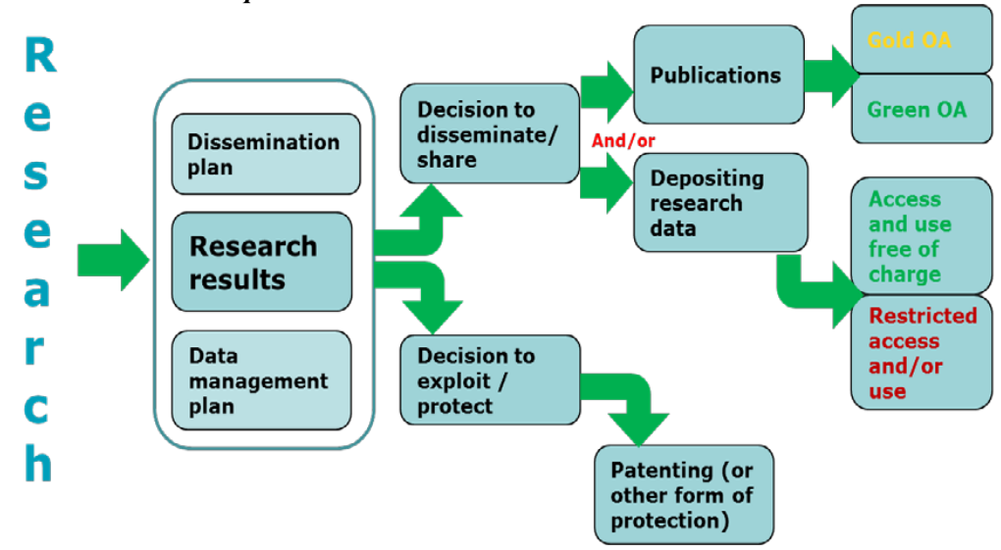
Open Science è compatibile con la protezione?
Chi ottiene fondi in HE può decidere se pubblicare o sfruttare commercialmente i risultati della ricerca (es: brevettare)
Guidelines to the Rules on Open Access to Scientific Publications and Open Access to Research Data in Horizon 2020

Slide 19
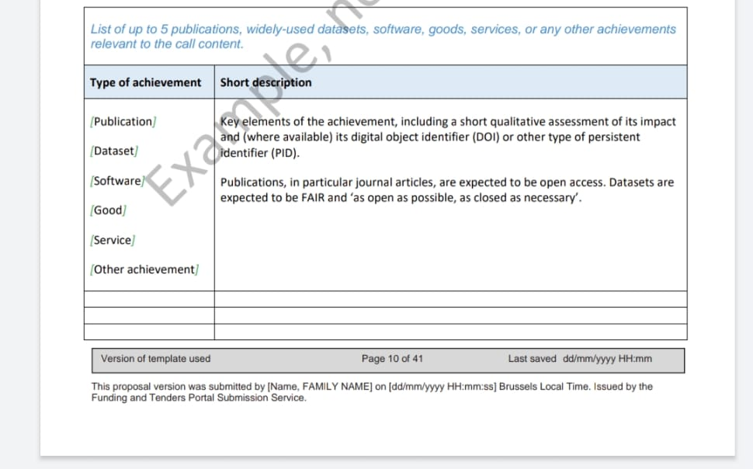
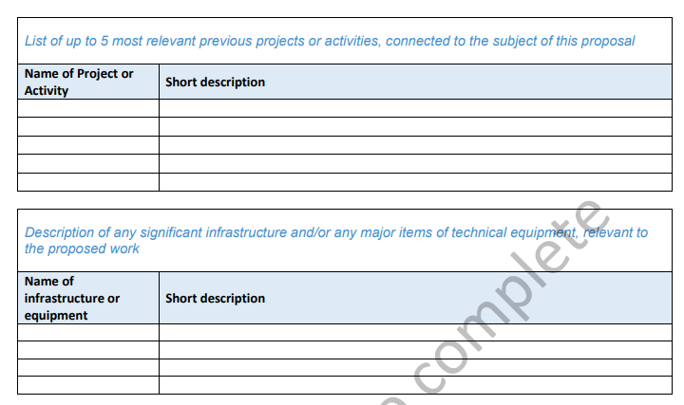
Dal template di Horizon Europe
L’istituzione non è più valutata solo in base alle pubblicazioni, ma in base a:
Publications, widely-used datasets, software, goods, services or any other achievements relevant to the call content
Relevant previous projects and activities
Significant infrastructure and technical equipment
Si deve includere un self assessment dell’impatto senza citare Impact Factor

Slide 20
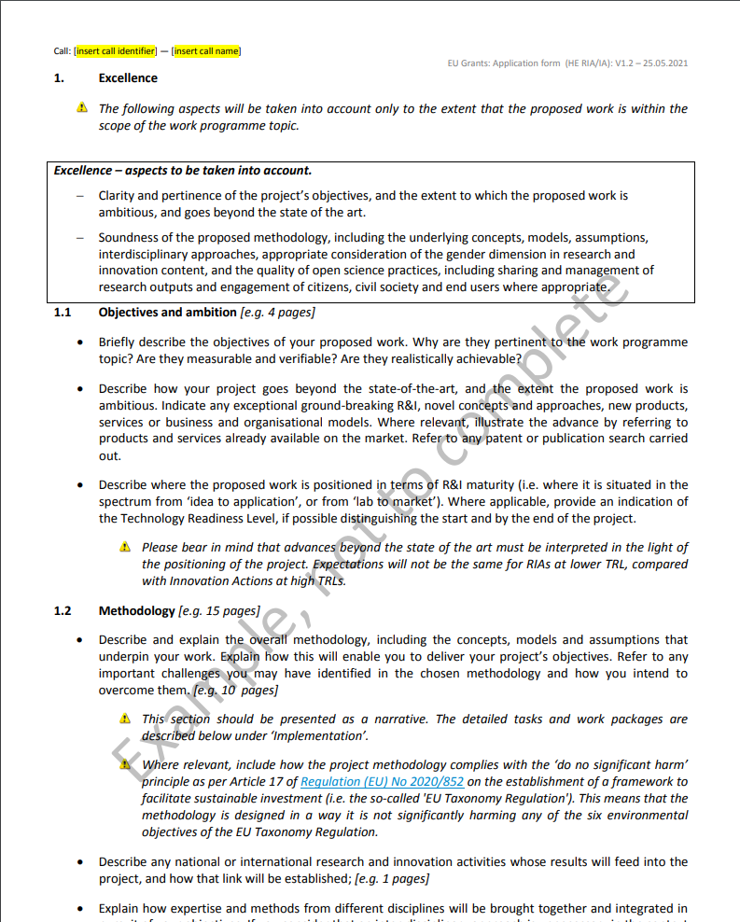
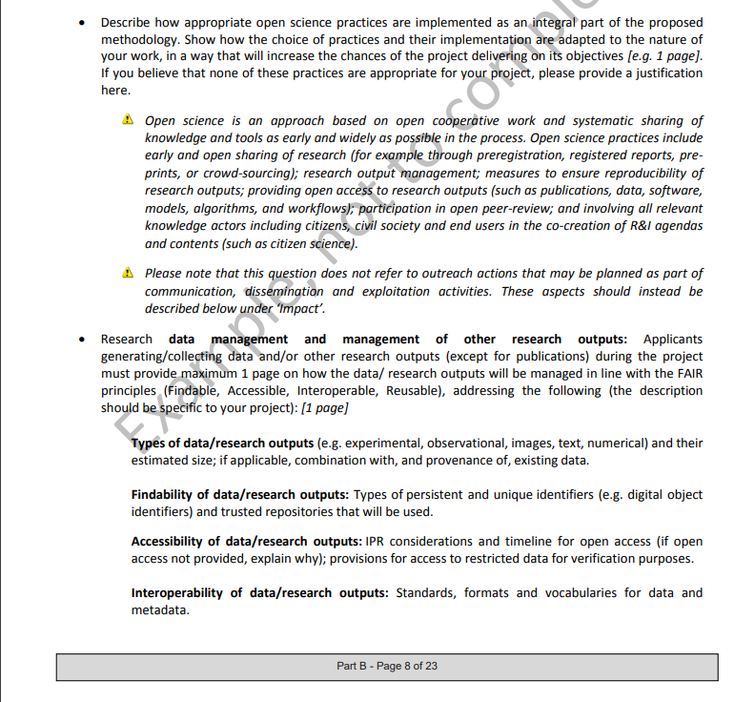
Dal template di Horizon Europe - Excellence
Nel proposal part B sezione Excellence - methodology:
si deve descrivere come le pratiche di open science verranno integrate nella metodologia
si deve descrivere la strategia di gestione dei dati/risultati secondo i principi FAIR

Slide 21
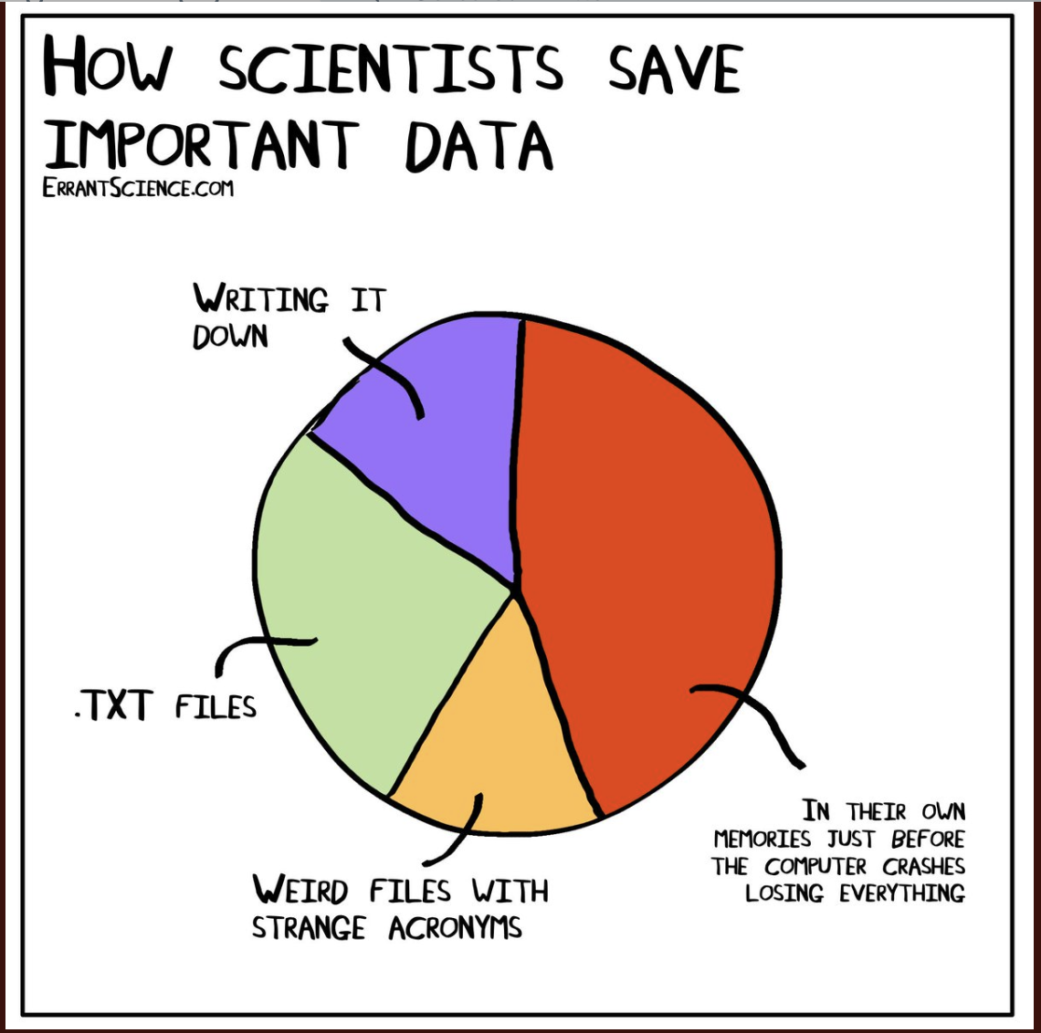
Research Data Management
Le politiche della Commissione Europea mirano a diffondere le pratiche della corretta gestione dei dati della ricerca
Per questo è richiesto il Data Management Plan (deliverable obbligatorio entro il mese 6)
La gestione dei dati deve rispettare i principi FAIR
In HE non è prevista la possibiltà di Opt Out dell’intero progetto perché non c’è più un programma pilota per gli Open Data!

Slide 22
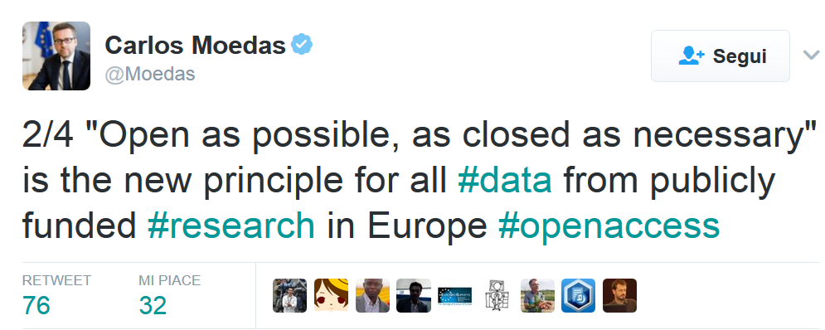
FAIR di default, chiuso solo se necessario
From 2014 until 2019, Moedas served as European Commissioner covering the portfolio of Research, Science and Innovation under the leadership of President Jean-Claude Juncker

Slide 23







As open as possible as closed as necessary…
Sfruttamento Commerciale o Industriale
Raggiungimento Obiettivi del Progetto
L’apertura dei dati è incompatibile con l’obbligo di proteggere i risultati che possono ragionevolmente venire sfruttati attraverso vie commerciali o industriali
L’Open Access ai dati è incompatibile con il raggiungimento degli obiettivi del progetto
Sicurezza
Nessun Dato Prodotto/Raccolto
L’open access ai dati è incompatibile con la necessità di riservatezza connessa a questioni di sicurezza
Il progetto non prevede la creazione o la raccolta di dati della ricerca
Protezione dei Dati Personali
Altre Legittime Ragioni
L’apertura dei dati è incompatibile con le regole relative alla protezione dei dati personali
Esistono altre ragioni legittime (è possibile motivare in fase di proposta o nel Data Management Plan)

Slide 24
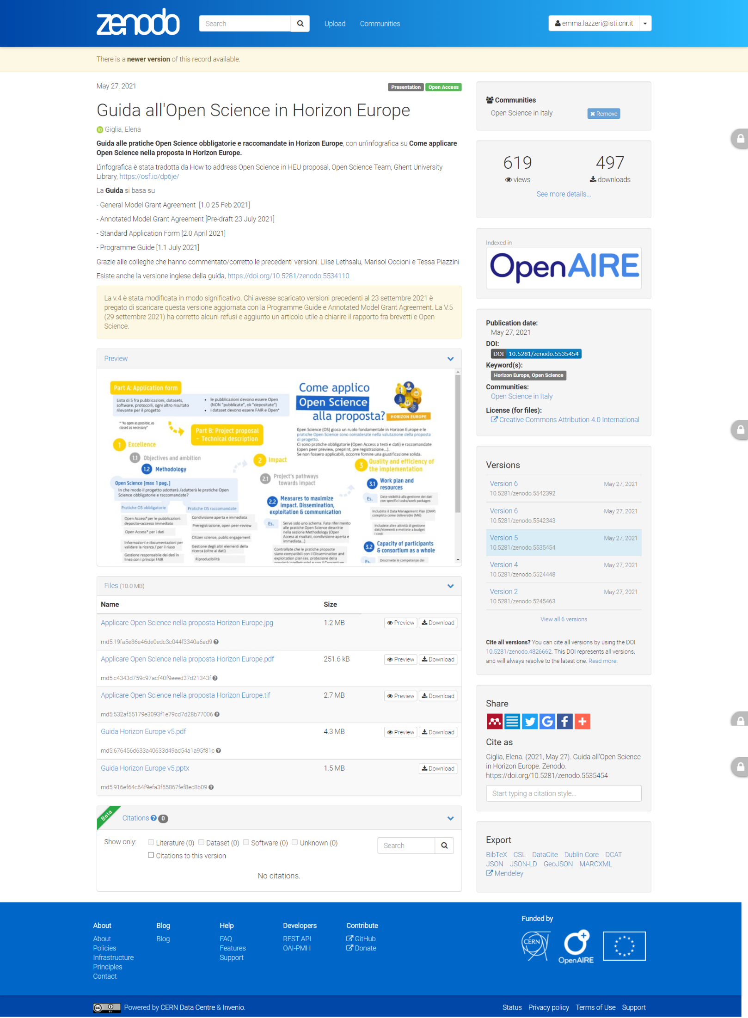
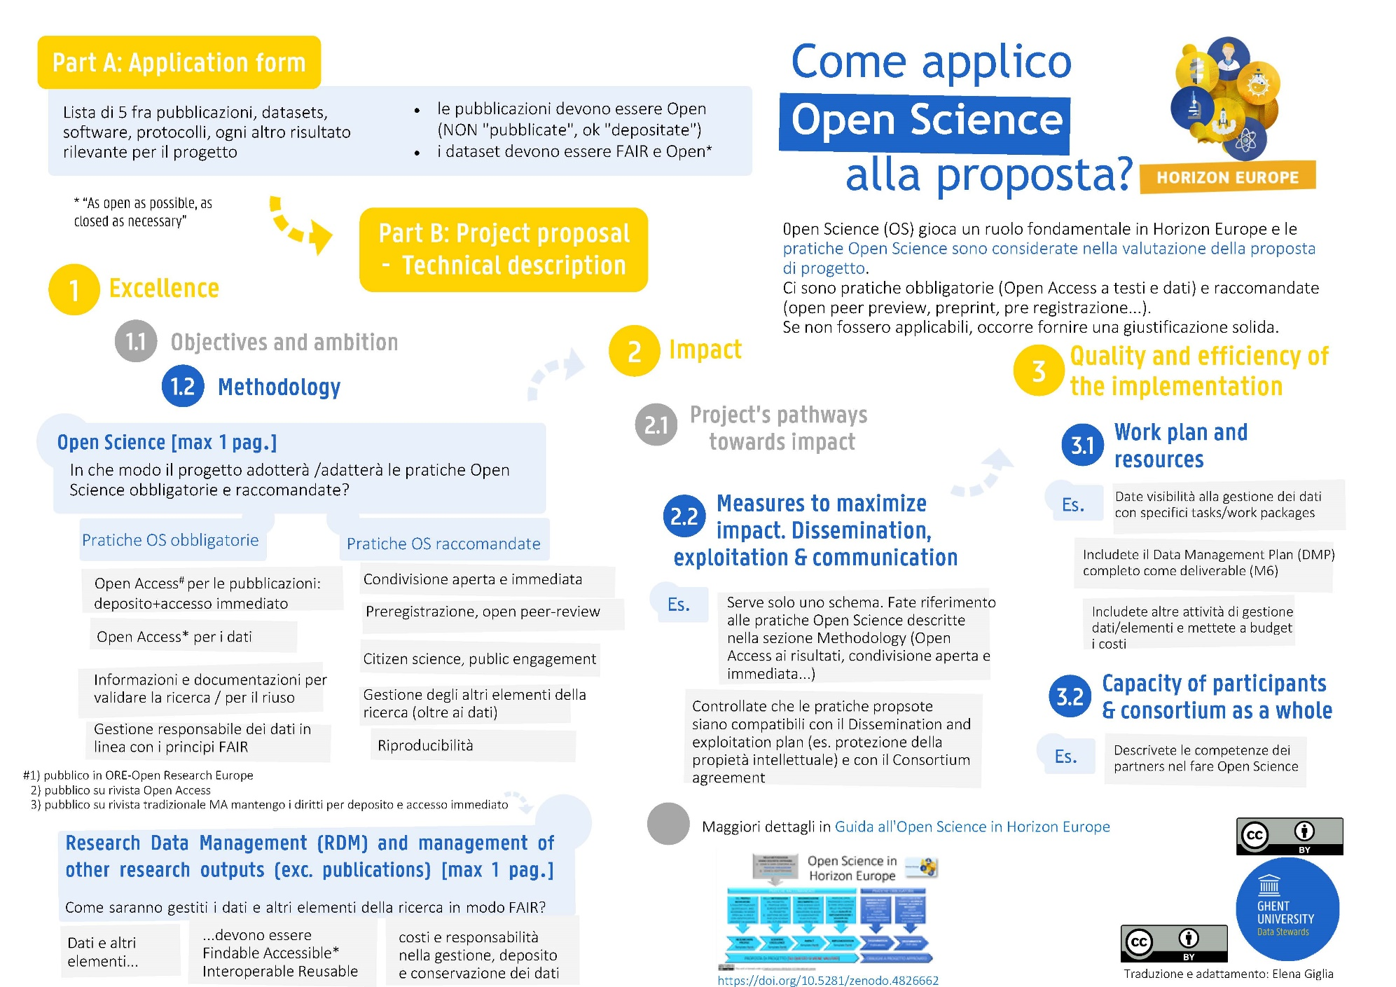
Una guida utile

Slide 25
Qualche lettura sulle criticità (e i danni) dell’impact Factor
In generale sulle criticità Fang-Casadevall Causes for the Persistence of Impact Factor Mania (2014) https://journals.asm.org/doi/pdf/10.1128/mBio.00064-14
Seglen PO Why the impact factor of journals should not be used for evaluating research (1997), https://www.ncbi.nlm.nih.gov/pmc/articles/PMC2126010/
B.Brembs et al. Deep impact: unintended consequences of journal rank (2013) https://www.frontiersin.org/articles/10.3389/fnhum.2013.00291/full
B.Brembs [su Impact Factor negoziabile, esempio reale slide 28-30) https://www.slideshare.net/brembs/digital-scholarship-and-open-science-need-a-digital-infrastructure
PLoS, the Impact Factor game, 2006 https://journals.plos.org/plosmedicine/article?id=10.1371/journal.pmed.0030291
Su Impact Factor causa di scientific misconduct, Fang-Casadevall Retracted Science and the Retraction Index (2011) https://journals.asm.org/doi/full/10.1128/iai.05661-11
Biagioli M (ed.) Gaming the metrics https://mitpress.mit.edu/9780262537933/
Biagioli m Watch out for cheats in citation game (2016) https://www.nature.com/articles/535201a
Gandevia S Publication pressure and scientific misconduct: why we need more open governance (2018) https://www.nature.com/articles/s41393-018-0193-9
EU Commission Towards a reform of the reward system - scoping report https://op.europa.eu/s/wYJB
EU Commission Agreement on the reform of research assessment https://research-and-innovation.ec.europa.eu/news/all-research-and-innovation-news/reforming-research-assessment-agreement-now-final-2022-07-20_en

Slide 26
Grazie!
This presentation is released under a CC-BY 4.0 licence. To cite this presentation, please copy and paste:
Lazzeri, Emma. (2022, September 15). Open Science Café - Open Science in Horizon Europe. Zenodo. https://doi.org/10.5281/zenodo.7082851

