Slide 1
Open science and the role of rights management
Paola GALIMBERTI (University of Milan)
Violaine JACQ (Sorbonne University)
Rasmus Rindom Riise (University of Copenhagen)

Slide 2
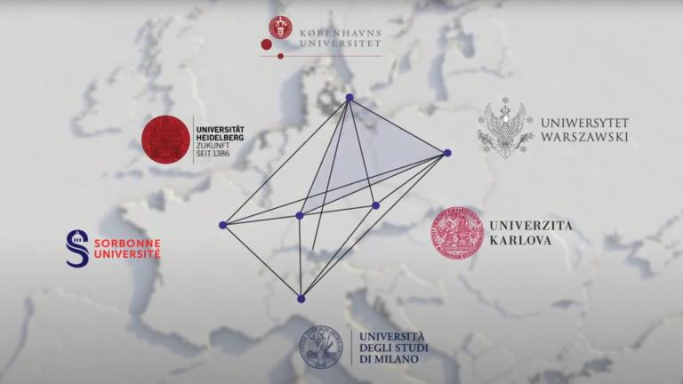
4EU+ Alliance and Open Science
4EU+ is a transnational strategic university association.
Aim: Strengthen the European vision of deepened cooperation and mutual enrichment in research and teaching
Open Science is an integral part of this.
Two 4EU+ projects currently work on Open Science.
Open for you – an Introduction Series to Open Science“ – 14 session on OS topics!

Slide 3
Agenda
Copyright, and the importance of rights management
Rights management and Open Access routes
Open licensing: Use of Creative Commons in publishing

Slide 4
Disclaimer
In this presentation, we will address the issue of copyright, taking into account the common elements in our countries and not entering into the specificities of individual national laws.

Slide 5
Who owns the copyright on your PHD thesis?
The tutor
You (Phd student)
The University
The copyright is equally shared between tutor and PHD student
The copyright is equally shared between student and University

Slide 6
Your PHD thesis is a collection of the articles published during your PHD studium
Are you entitled to reproduce your articles in the phd thesis?
Can you do it without any kind of restrictions?

Slide 7
Why it is important to know who owns the copyright
If you own the copyright on your work you can manage it!

Slide 8
Why is rights management so important?
This give you the possibility to decide about your work:
Who will have access to it
What he/she will be able to do with your work
What you will be able to do with your work.

Slide 9
Rights management affects you whether you are a user of someone else's work or the author of a research work.

Slide 10
What is copyright?
Copyright is ownership of control of the rights to the use and distribution of works of creative expression

Slide 11




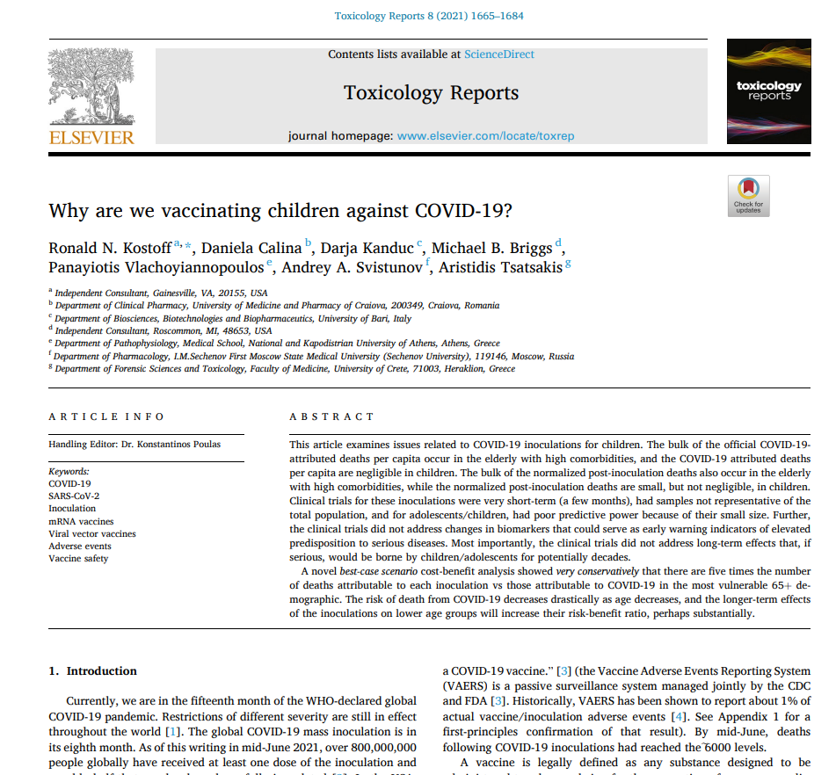
What is protected?
Artistic works Literary works
Scientific works

Slide 12
Which rights?
Moral rights
Right of paternity
Right of integrity
Economic rights
Right to reproduce or copy
Right to distribute
Right to adapt or modify
……..

Slide 13
Copyright basics
Copyright protects the expression of an idea as it is recorded, but not the idea itself. It arises automatically on creation.
To be protected, a work must be original
Copyright (in our law systems) lasts for 70 years after the death of the creator
Only economic rights can be transferred. They can be transferred in exclusive or non exclusive way

Slide 14

What is the difference?

Slide 15
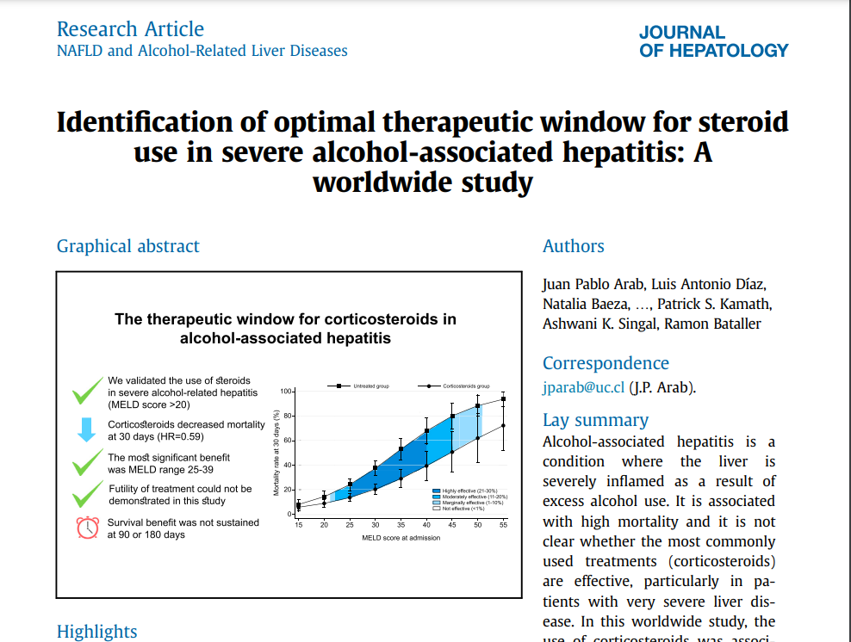
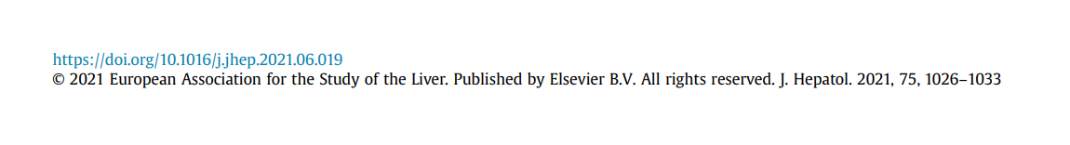
Copyright transfer agreement: exemple (elsevier)

Slide 16
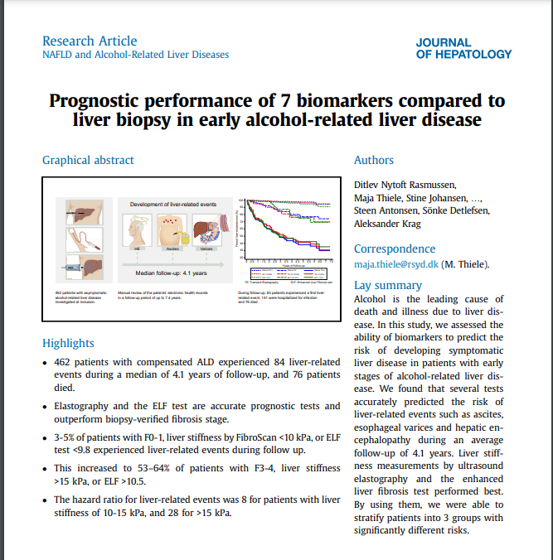
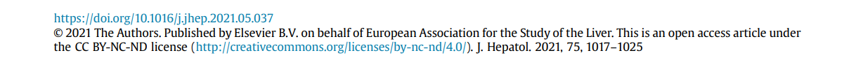
License to publish for OA articles in hybrid journals : exemple

Slide 17
if you assign the copyright exclusively to the publisher you may not be able to...
… reuse your article in teaching and research works
... include the article in future publications, e.g. PhD thesis
... make derivative works based on the article
... display or make presentations of the work

Slide 18
Coming up…
Copyright, and the importance of rights management
Rights management and Open Access routes
Open licensing: Use of Creative Commons in publishing

Slide 19





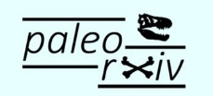



Research
Preprint
Peer reviewing
Accepted Manuscript Postprint
Publication
Archiving
19
Notes:
A quick reminder of open access ways and some specific vocabulary from publishers and librarian world.
Open access:
Preprint Sharing on preprint servers, like arXiv, bioRxiv….
Preprint is the first version of yours paper submited to a publisher = before peer-review.
Publication in open access journal: diamond (free for publish, free to read) or gold (publish with publication fees)
Or publish in subscription journal (paid to read) and after drop off your article in an open repository, this the green open access.
Next: Right Management at the differents stage of this cycle ragarding the SHARING and REUTILIZATION of your work.

Slide 20
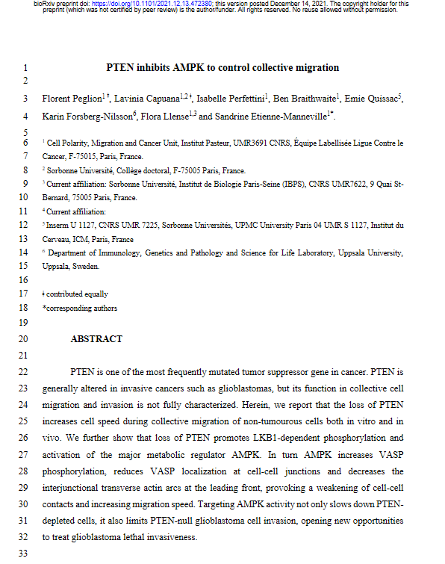

What can I do with my preprint ?
your work
  You can add a licence
  If not it’s © All right reserved
Sharing on a preprint server
You keep your right
You can published after
Most publisher are ok.
Check it’s policy
many preprint servers not allow
material to be removed
Usefull links: https://asapbio.org/licensing-faq
https://en.wikipedia.org/wiki/List_of_academic_publishers_by_preprint_policy
Notes:
Preprint is your work.
Basically the word or pdf file typing manuscript you submit.
Who holds the copyright of a manuscript?
Unless an author has already transferred their copyright to a publisher […] they own and control the copyright and have the option to retain all rights or license it under a Creative Commons or other public license.
If not, it’s © All right reserved so only YOU can distribute and reproduce it.
The author can also transfer or license some or all of the copyright to a journal.
Copyright transfer to the preprint server?
In order to legally post the preprint, almost all server providers require that authors grant them a perpetual, non-exclusive license to host and distribute the preprint (either under a Creative Commons license, or otherwise).
Note that non-exclusivity allows the author to engage in other licensing activities; the purpose of this grant to the preprint server is to ensure it has the right to make the work available on its website. You still keep right because it’s a non-exclusive grant.
Check the terms of service of a preprint server before submitting your article.
Copyright transfer for latter version (published e.g.)?
Authors maintain the ability to publish subsequent versions under a different license or even assign their copyright to a publisher if they wish.
ATTENTION: Any new copyrights in subsequent versions of a manuscript covers only the additions, changes, or other new material appearing for the first time in that particular version.
An author can always enter into other agreements with publishers for the final, published version
The publisher license to publish or copyright covers the publisher version of record
Remember, however, that the preprint itself, in the form published as a preprint, is always available for reuse under the CC license until the applicable copyright term expires (70 ans.. Public domain)
Will journal ok to publish after preprint sharing?
Most of STM journal, yes.
But check the publisher policy regarding this point.
You can find information on journal or publisher website but it's a kind of complicated mazeSherpa Romeo is a usefull tool to do that
Sherpa Romeo is a usefull tool to do that.
WARNING: in an effort to ensure preprints remain part of the permanent scholarly record, many preprint servers will not as a matter of practice allow material to be removed
Obtain consent from co-authors. Make sure that your co-authors accept this deposit, as well as the type of license and the chosen archive.
Do you make yourself more vulnerable by sharing a preprint?
Quite the contrary. Making a preprint public is not much different from presenting your research at a conference or publishing an abstract: all of these documents present your ideas. Sharing a preprint openly offers the advantage of dating your work with the timestamp of the preprint. This timestamp can attest to the anteriority of a discovery.

Slide 21
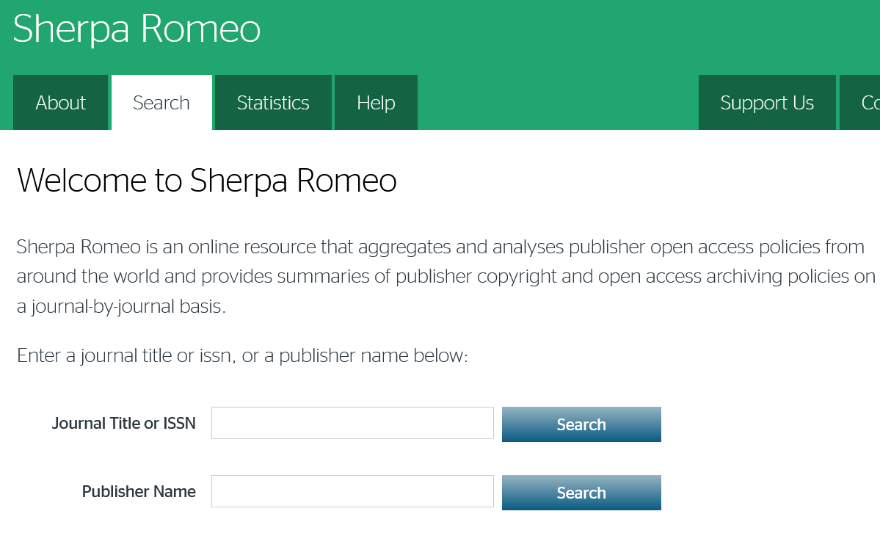
Check the policy of publishers for preprint
Sherpa Romeo’s homepage
Basics research fields
Notes:
Let’s have a look on how Sherpa Romeo works.

Slide 22
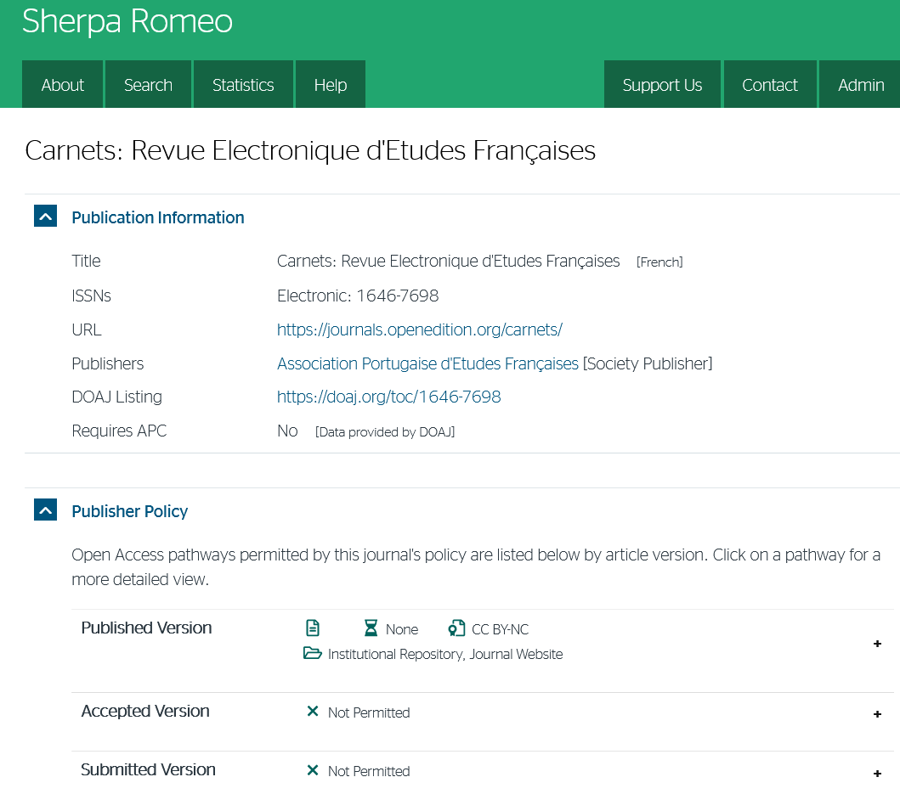

Check the policy of publishers for preprint
Sherpa Romeo’s results page
Journal:
Carnets: Revue Electronique d'Etudes Françaises
Notes:
A first example: a diamond open access SHS journal.
https://journals.openedition.org/carnets/?page=informations
Tips: use ISSN if you d’on’t find a journal with its tittle.
https://v2.sherpa.ac.uk/id/publication/21348

Slide 23
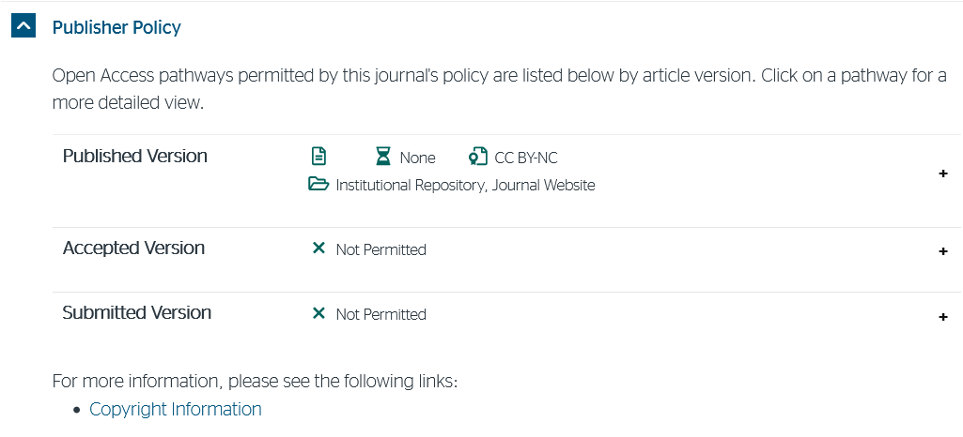
Check the policy of publishers for preprint
Journal:
Carnets: Revue Electronique d'Etudes Françaises
Informations about preprint
Notes:
Here is the part we’re interested in: the publisher’s policy.
Here is the part with information about the Submitted version, i.e. the Pre-Print.
We can see that sharing the preprint is not allowed with this journal, which is an Open Access journal.
Publisher website:
https://journals.openedition.org/carnets/12516#tocto1n7

Slide 24
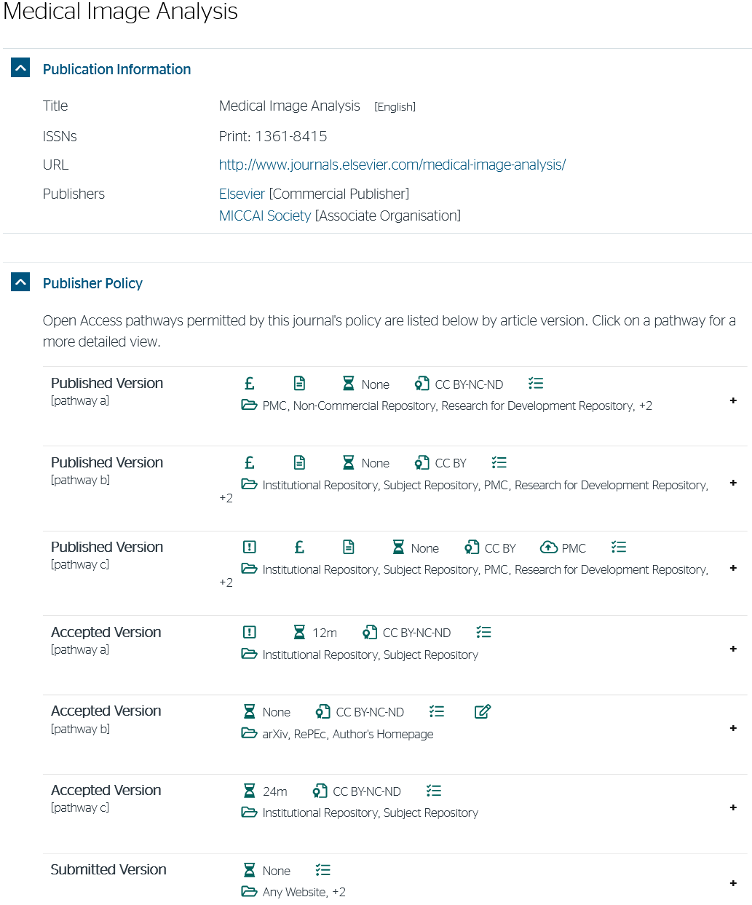

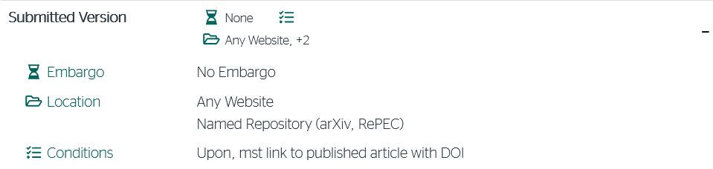
Check the policy of publishers for preprint
Journal:
Medical Image Analysis
Informations about preprint
Notes:
A second example: an hybrid, STM journal (Elsevier): Medical Image Analysis
https://www.journals.elsevier.com/medical-image-analysis
https://v2.sherpa.ac.uk/id/publication/16038
You can share your pre-print with no embargo (i.e. you don’t have to wait any time after submission).
But the publisher want you to follows some requiered conditions and some allowed location.
You can Share it on any website and on two Pre-Rpint servers: arXiv and RePEC.
Publisher’s website with tese informations:
1. Guide for Authors webpage: https://www.elsevier.com/journals/medical-image-analysis/1361-8415/guide-for-authors
2. Open Access information tab: https://www.elsevier.com/journals/medical-image-analysis/1361-8415/open-access-options
3. Link in the «Elsevier supports responsible sharing » paragraph: https://www.elsevier.com/authors/submit-your-paper/sharing-and-promoting-your-article
4. Scroll down ti the « Pre-Print servers » part.
5. Take some hollidays……. ^^

Slide 25
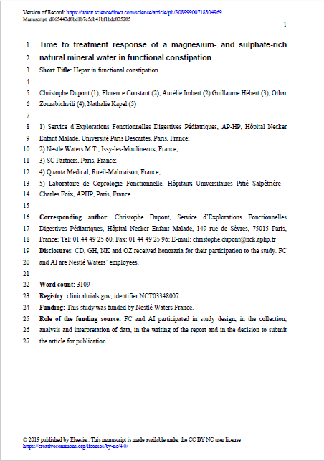
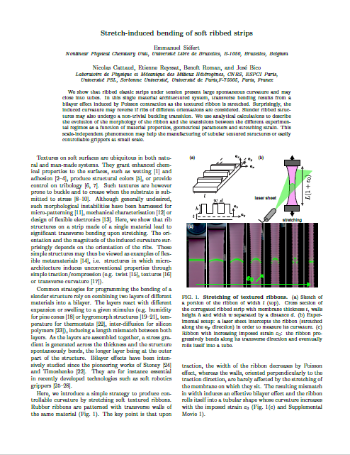
What can I do with my accepted manuscript ?
Sharing on an institutionnal repository
Check the publisher policy
Often with an embargo period
your final work
  No publisher mentions
  Concerned by the publication agreement
Subscription Journals
Elsevier: 6 – 36 months
Wiley: 12 – 24 m
Oxford U. P. : 12 – 24 m
Cambridge U. P. : 0 – 6 m Taylor & Francis: 0 – 18 m
Springer: 12 m
Depending on the journal
Notes:
Manage your rights with yous accepted manuscript (or post-print).
Accepted manuscript is basically your last word or LaTeX file before publication.
Post-Print technically is still your work but is concerned by publication contract (cf Paola’s part).
In the Subscription publication model it’s this file which is allowed to be shared, not the published layout version.
Most of the publisher allow you to diffuse your own acepted manuscript but after a specific period following publication.
Here is some embargo period from well known publishing groups.
Embargo periods: https://www.en.team.vbn.aau.dk/research-communication/open-science/open-access/open-access-publications-in-pure/Publisher+embargo+periods/

Slide 26
Check the policy of publishers for accepted manuscript
Journal:
Carnets: Revue Electronique d'Etudes Françaises
Informations about accepted manuscript
Notes:
Post Print policy of our first example (a diamond open access SHS journal)
You cannot share your postprint
Publisher website:
https://journals.openedition.org/carnets/12516#tocto1n7

Slide 27
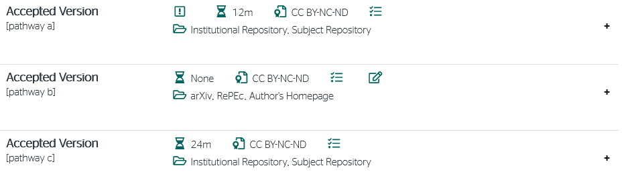
Check the policy of publishers for accepted manuscript
Journal:
Medical Image Analysis
Informations about accepted manuscript
Notes:
Post Print policy of our second example (an hybrid, STM journal (Elsevier)).
https://www.journals.elsevier.com/medical-image-analysis
You have 3 differents informations regarding PostPrint, named Pathways.
These depending on WHERE you want to share and WHO is your funders.
Let’s have a closer look on each by clicking on the « + » buttons

Slide 28
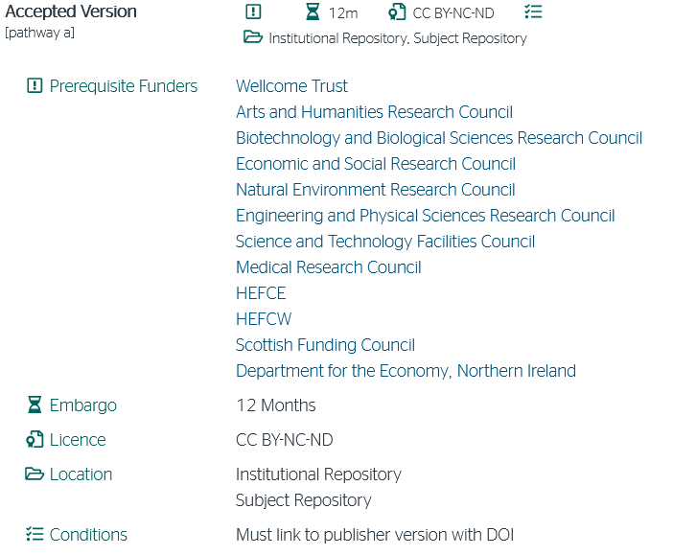
Check the policy of publishers for accepted manuscript
Journal:
Medical Image Analysis
Informations about accepted manuscript
Notes:
Pathway A
If you’re funded by the funders of the list, you can share your post print on the listed direction (Institutional repository, subject repository)
With a 12 mounth embargo, i.e. you have to wait 12 mounth after the FIRST publication date.
You have to put a specifc license (Rasmus will explain you that in the last part)
And you have a condition to follow.

Slide 29
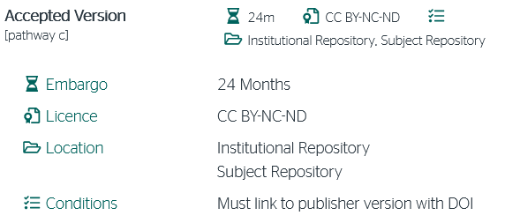
Check the policy of publishers for accepted manuscript
Journal:
Medical Image Analysis
Informations about accepted manuscript
Notes:
Pathway C (I show it second because it’s the same location, it will be more didactic to show them one after the other)
This for the same sharing plateform but with other funders than those listed in pathway A
You can share your post print on the listed direction: Institutional repository, subject repository
With a 24 mounth embargo this time

Slide 30
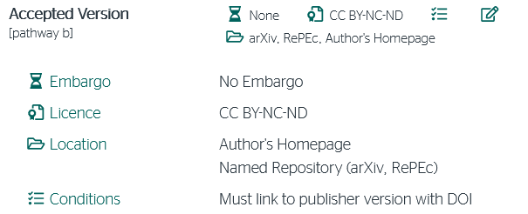
Check the policy of publishers for accepted manuscript
Journal:
Medical Image Analysis
Informations about accepted manuscript
Notes:
Pathway B
This is the specific sharing policy of the postprint for the indicated location: arXiv, RePEC and your personnal Homepage*.
You can share here your post print, with no embargo, but following the same conditions.
* Author’s homepage: your named webpage on the website of your labs. … A page never viewed by anyone……

Slide 31
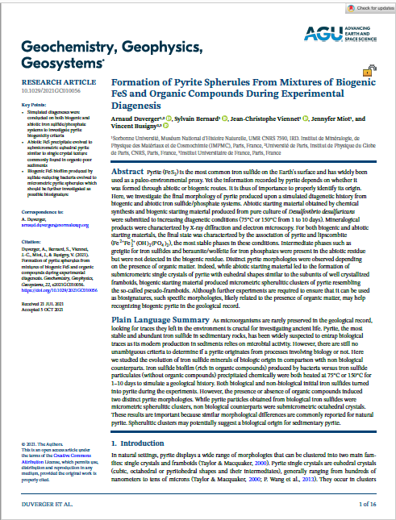
What can I do with the published version?
your published work
  © by publisher
  or
  Open license
Subscription Journals
An open license, often Creative Commons
Check the license, the readers AND YOU don’t have all the rights
Sharable on an institutionnal repository
Notes:
The published version is either:
© to the publisher in the subscription model
Open (mostly with a license) in open access models.
When you publish in subscription journals, you cannot share this version, you can’t depose it in open institutionnal reposositories,
Because it’s a publisher ©
If you publish in an OPEN ACCESS journal, eitheir diamond or gold, an open licencse (cf next Part of this training) is applied to the published paper.
In this case, you can deposit the published version.

Slide 32
Coming up…
Copyright, and the importance of rights management
Rights management and Open Access routes
Open licensing: Use of Creative Commons in publishing

Slide 33
Why apply CC licenses when publishing?
To make research free available for others
To reduce uncertainties and explicate terms of use
They are international standard licenses
They are machine readable
To enhance scientific collaboration
To promote verification of research
Because it’s required by funders, publishers or institutions

Slide 34
Notice…
CC licencing is binding and cannot be revoked by licensor
Only copyrightable works can be CC licensed
Only the copyright holder(s) can apply a CC license
CC licenses are not recommended for licensing software

Slide 35
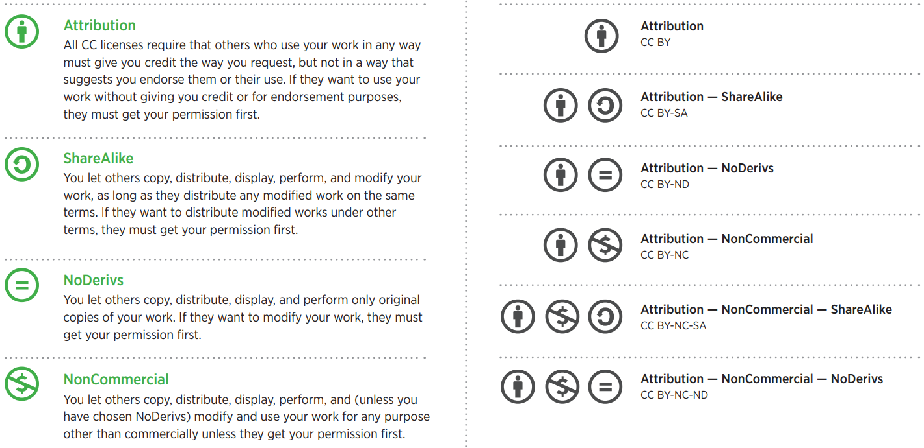
Four license terms | Six licenses
Most open
Least open
License overview available here: https://wiki.creativecommons.org/images/6/6d/6licenses-flat.pdf

Slide 36
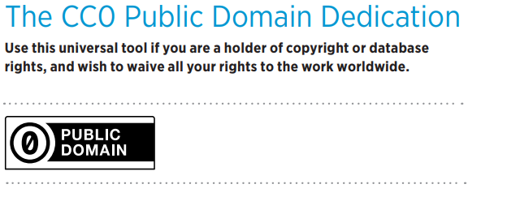
Public domain dedication and mark
Overview of public domain licenses is available here: https://wiki.creativecommons.org/images/8/88/Publicdomain.pdf

Slide 37
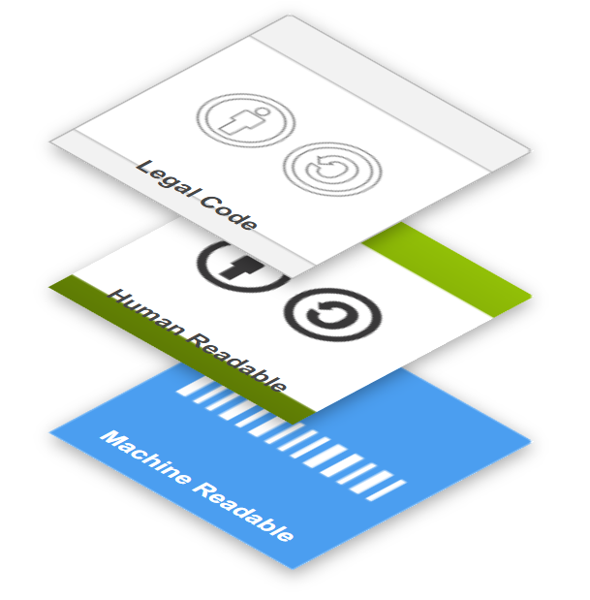
The three layers of a CC license
The legal foundation
Reader friendly license terms
Findable for search engines, software and databases
Three “Layers” Of Licenses by Creative Commons is licensed under CC BY 4.0

Slide 38
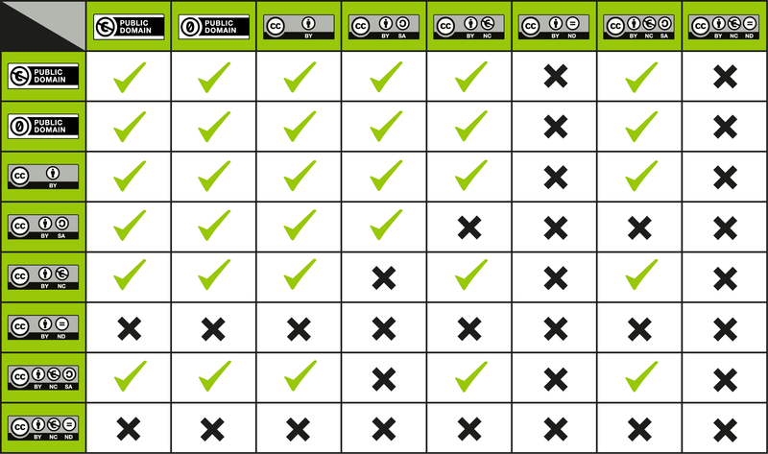
CC License Compatibility Chart
Chart available here: https://wiki.creativecommons.org/wiki/File:CC_License_Compatibility_Chart.png

Slide 39
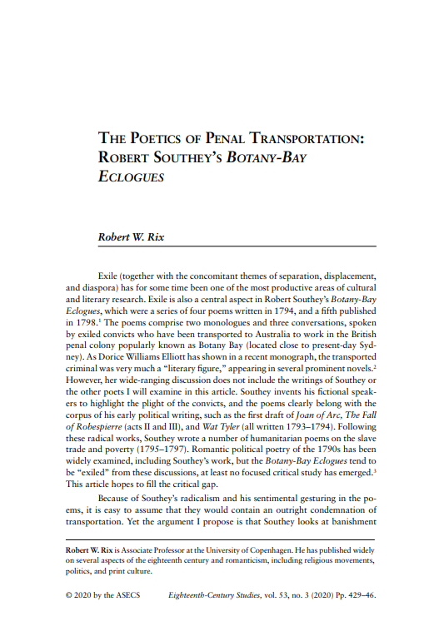

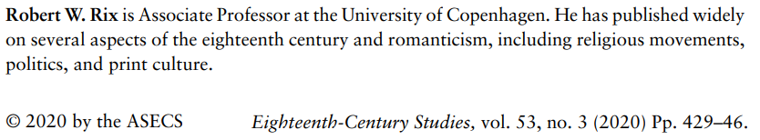
Toll Access article
Rix, R. W. (2020). The Poetics of Penal Transportation: Robert Southey’s Botany-Bay Eclogues. Eighteenth-Century Studies, 53(3), 429–446. https://doi.org/10.1353/ecs.2020.0040

Slide 40

Toll Access article
Blurred due to copyright

Slide 41
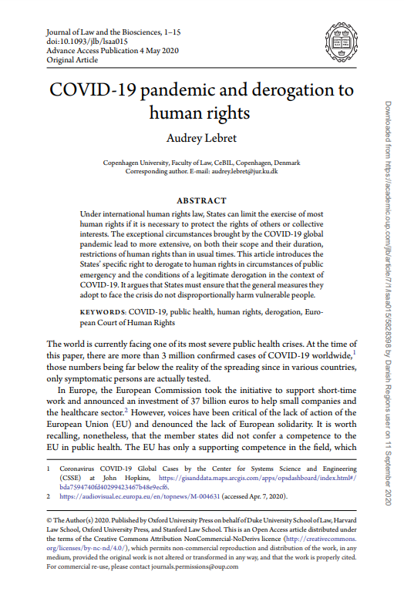

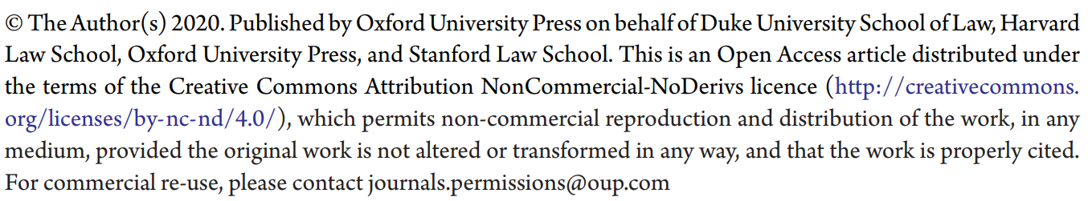
Open Access article
Lebret, A. (2020). COVID-19 pandemic and derogation to human rights. Journal of Law and the Biosciences, 7(1), lsaa015. https://doi.org/10.1093/jlb/lsaa015

Slide 42
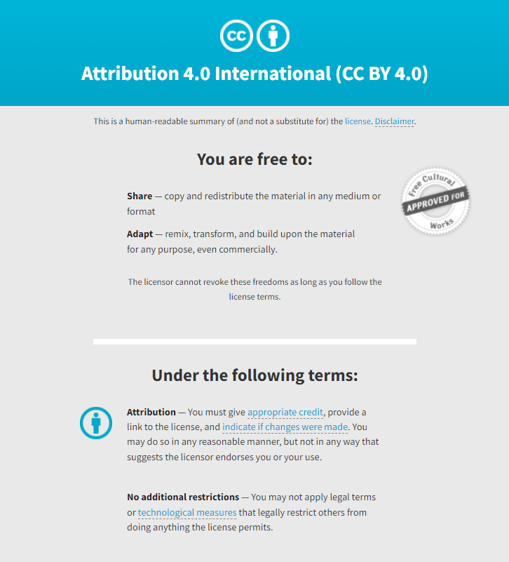
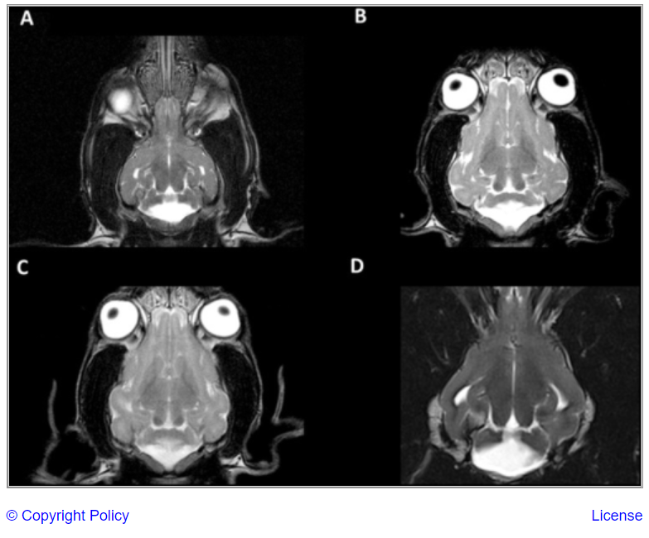
Biomedical Image
Image from: Bernardino, F., Rentmeister, K., Schmidt, M. J., Bruehschwein, A., Matiasek, K., Matiasek, L. A., Lauda, A., Schoon, H. A., & Fischer, A. (2015). Inferior Cerebellar Hypoplasia Resembling a Dandy-Walker-Like Malformation in Purebred Eurasier Dogs with Familial Non-Progressive Ataxia: A Retrospective and Prospective Clinical Cohort Study. PLoS ONE, 10(2), e0117670. https://doi.org/10.1371/journal.pone.0117670

Slide 43
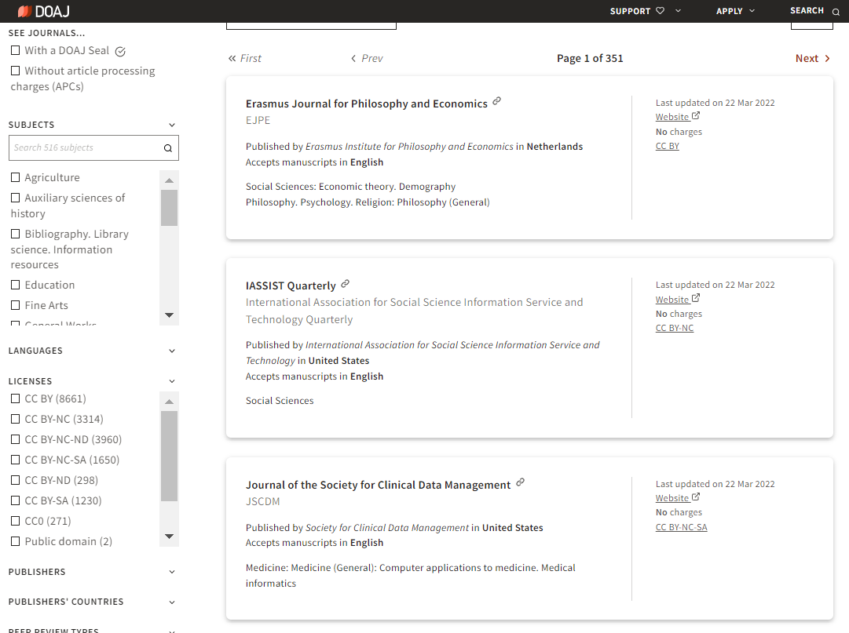
Directory of Open Access Journals (DOAJ) is available here: https://doaj.org/ - Screenshot is used under CC BY-SA 4.0

Slide 44
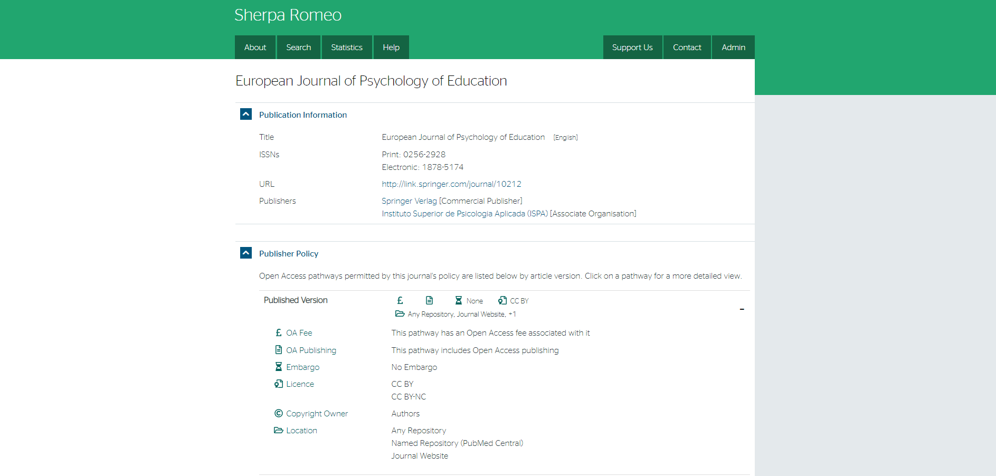

Look up journals in Sherpa Romeo
The Sherpa Romeo website’s content is licensed under CC BY-NC-ND 4.0

Slide 45
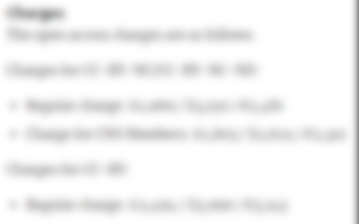
Charges of CC licenses in Hybrid OA journals
Blurred due to copyright
Journal: Neurosurgery (ISSN: 1524-4040) - Oxford University Press
Screenshot from website: https://academic.oup.com/neurosurgery/pages/author_guidelines

Slide 46
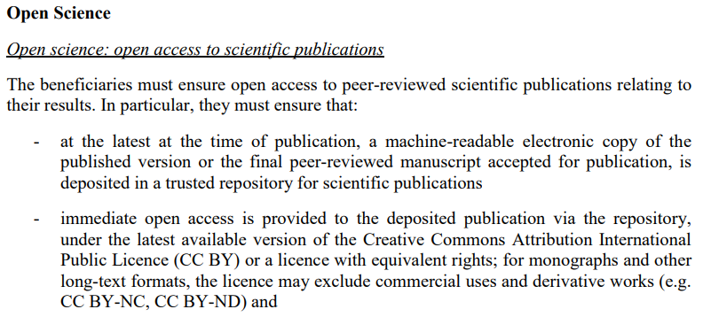
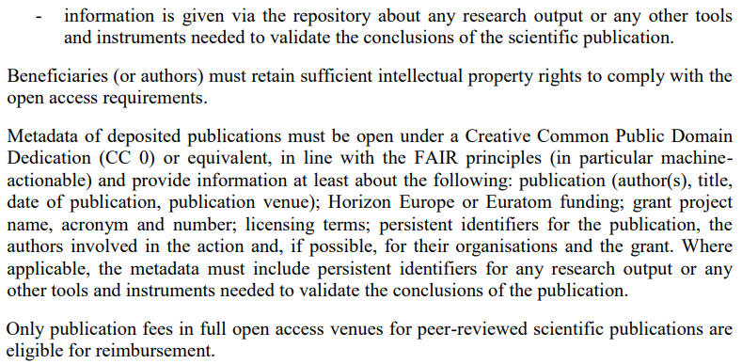
Funders requirement: EU – Horizon Europe
Horizon Europe: General Model Grant Agreement (pages 110-111) is available here: https://ec.europa.eu/info/funding-tenders/opportunities/docs/2021-2027/common/agr-contr/general-mga_horizon-euratom_en.pdf

Slide 47

Green Open Access
Self-archiving accepted manuscripts (post-prints)
Elsevier: CC BY-NC-ND
Wiley: Non-commercial use
Oxford University Press: Not specified
Cambridge University Press: CC BY-NC-ND
Taylor & Francis: CC BY-NC or CC BY-NC-ND
Springer: CC licenses not permitted
Palgrave MacMillan: Not specified
DeGruyter: Not specified
ACM: Not specified
IEEE: Not specified
Emerald: CC BY-NC
Sage: Non-commercial and no derivative uses

Slide 48
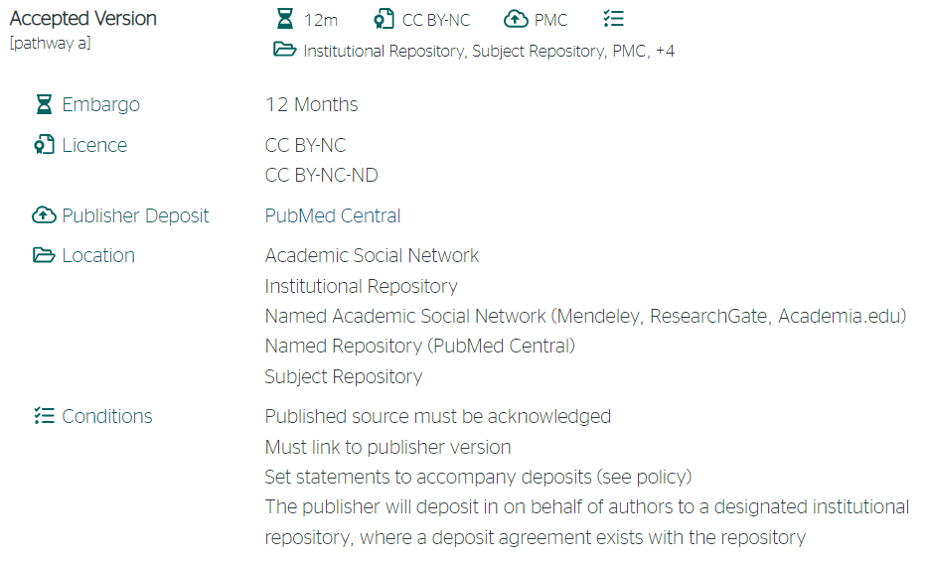
Green Open Access
Sherpa Romeo
Sherpa Romeo is available here: https://v2.sherpa.ac.uk/romeo - Screenshot is used under CC BY-NC-ND 4.0

Slide 49
Author retain copyright
Licensor: The author
Licensee: The publisher and the readers
Copyright is transferred to publisher
Licensor: The publisher
Licensee: The author and the readers
Licensor: The owner of the copyright - The CC license terms do not apply to the copyright holder
Licensee: Subject to the CC license terms

Slide 50

Blurred due to copyright
Elsevier: Copyright is available here: https://www.elsevier.com/about/policies/copyright

Slide 51

Register for our upcoming events: https://4euplus.eu/4EU-273.html
Next sessions:
“Humanities and FAIR data” | 9 May
“Citizen Science: Producing data with people for innovating research” | 7 June
"Research Integrity and Open Science: Is Sound Science Open Science?” | 20 June
”Research Impact & Bibliometrics: Open Science, Society, Innovation” | 4 July

Slide 52
Thank you!

Slide 53
Supplementary material
Notes:
Additionnal slides for more information or specific questions.

Slide 54
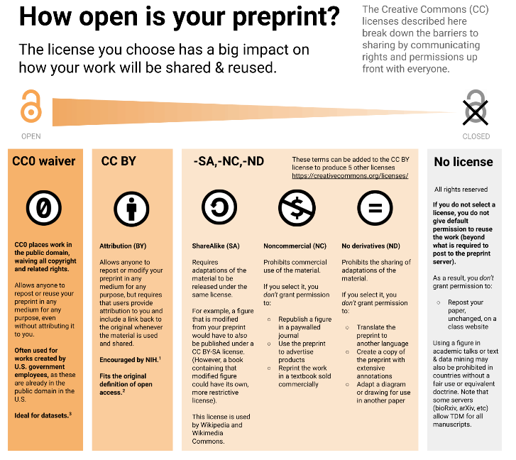
Source: ASAPbio.org
Creative Commons Attribution 4.0 International License.

Slide 55


The Right Retention Strategy
    Data
    production/analysis
Inform the publisher that you will add an open licence to your post-print
    Researchers
    Writing
    Peer
    reviewing
    Submission
    / Revision
Post-Print
Author Accepted Manuscript
    Editorial process
    Publishers
    Acceptation
    Publication
To know more:
https://www.coalition-s.org/rights-retention-strategy/
Notes:
https://www.coalition-s.org/plan_s_principles/
“With effect from 2021*, all scholarly publications on the results from research funded by public or private grants provided by national, regional and international research councils and funding bodies, must be published in Open Access Journals, on Open Access Platforms, or made immediately available through Open Access Repositories without embargo.”
Plan S is made of several principles. The common base [ss] is what you see on the screen. All scholarly publications must be
Published in OA
Or made immediately available through OA Repositories

Slide 56
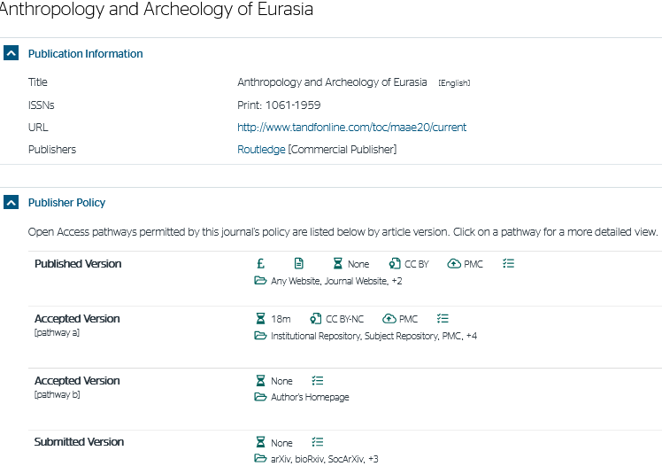

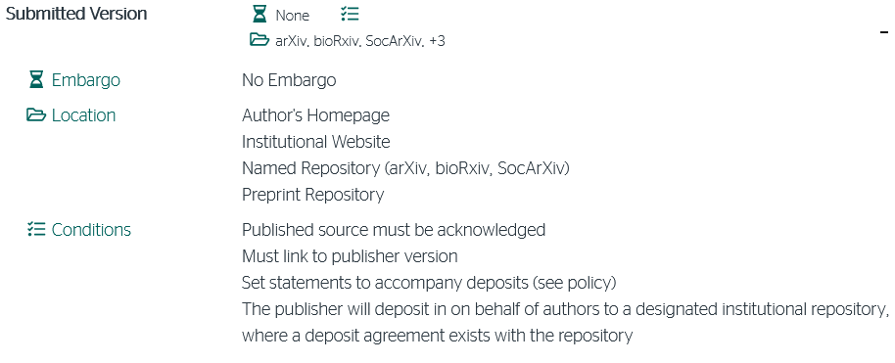
Check the policy of publishers for preprint
Informations about preprint
Journal:
Anthropology & Archeology of Eurasia
Notes:
A third supplementary example: a subscription SHS journal (Taylor & Francis) with additionnal stuff on sherpa romeo.
https://www.tandfonline.com/journals/maae20
https://v2.sherpa.ac.uk/id/publication/8175?template=romeo
You can share your pre-print with no embargo
You can Share it only on specified repository and website
You have to follows a lot of specific conditions.
Publisher’s website with these informations:
Instruction for Authors webpage: https://www.tandfonline.com/action/authorSubmission?show=instructions&journalCode=maae20
Link to Authors services website: https://authorservices.taylorandfrancis.com/?_gl=1%2A1ltxya6%2A_ga%2AMTI0MjgzMjM0Ny4xNjQ4MjA1ODU1%2A_ga_0HYE8YG0M6%2AMTY0ODIwNTg1NS4xLjEuMTY0ODIwNjU1My4w
Go to the « Promoting your article » tabs and clic to the https://authorservices.taylorandfrancis.com/research-impact/#promoteyourarticle
Scroll down to « Share your eprints » parts and clic on the link “share your eprints to boost your article visibility” https://authorservices.taylorandfrancis.com/research-impact/sharing-versions-of-journal-articles/
Scroll down to the “Using your eprints to share your article”
… You almost regret Elsevier….

