Slide 1



Polarimetry of pulsed H⁻/D⁻ ion beams: Extended applicability of the Lamb-shift polarimeter
Simon J. Pütz
With
T. El-Kordy, R. Engels, n. faatz,
R. Gebel, k. grigoryev, c. kannis, y. valdau

Slide 2
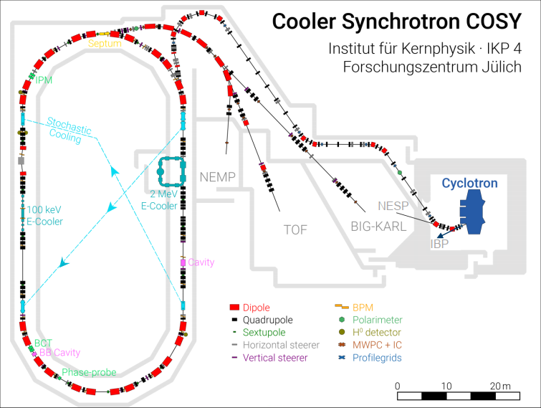
COSY and polarized $H^{−}$ and $D^{−}$ ion beams
The COSY source at FZJ provides polarized 𝑯⁻ and 𝑫⁻ ion beams
Before stripping injection, beam polarization must be determined and optimized
Low Energy Polarimeter (LEP)
→ requires pre-acceleration with a cyclotron (45 MeV)
Notes:
Here you can see where the experiments took place
The projects goal was to improve the research conditions at the COSY facility in Jülich
Can conduct experiments to investigate spin dependent phenomena in nuclear physics

Slide 3
COSY and polarized $H^{−}$ and $D^{−}$ ion beams
Alternative: Performing the polarization measurement with a Lamb-shift polarimeter directly at the source
Notes:
- COSY Facility

Slide 4
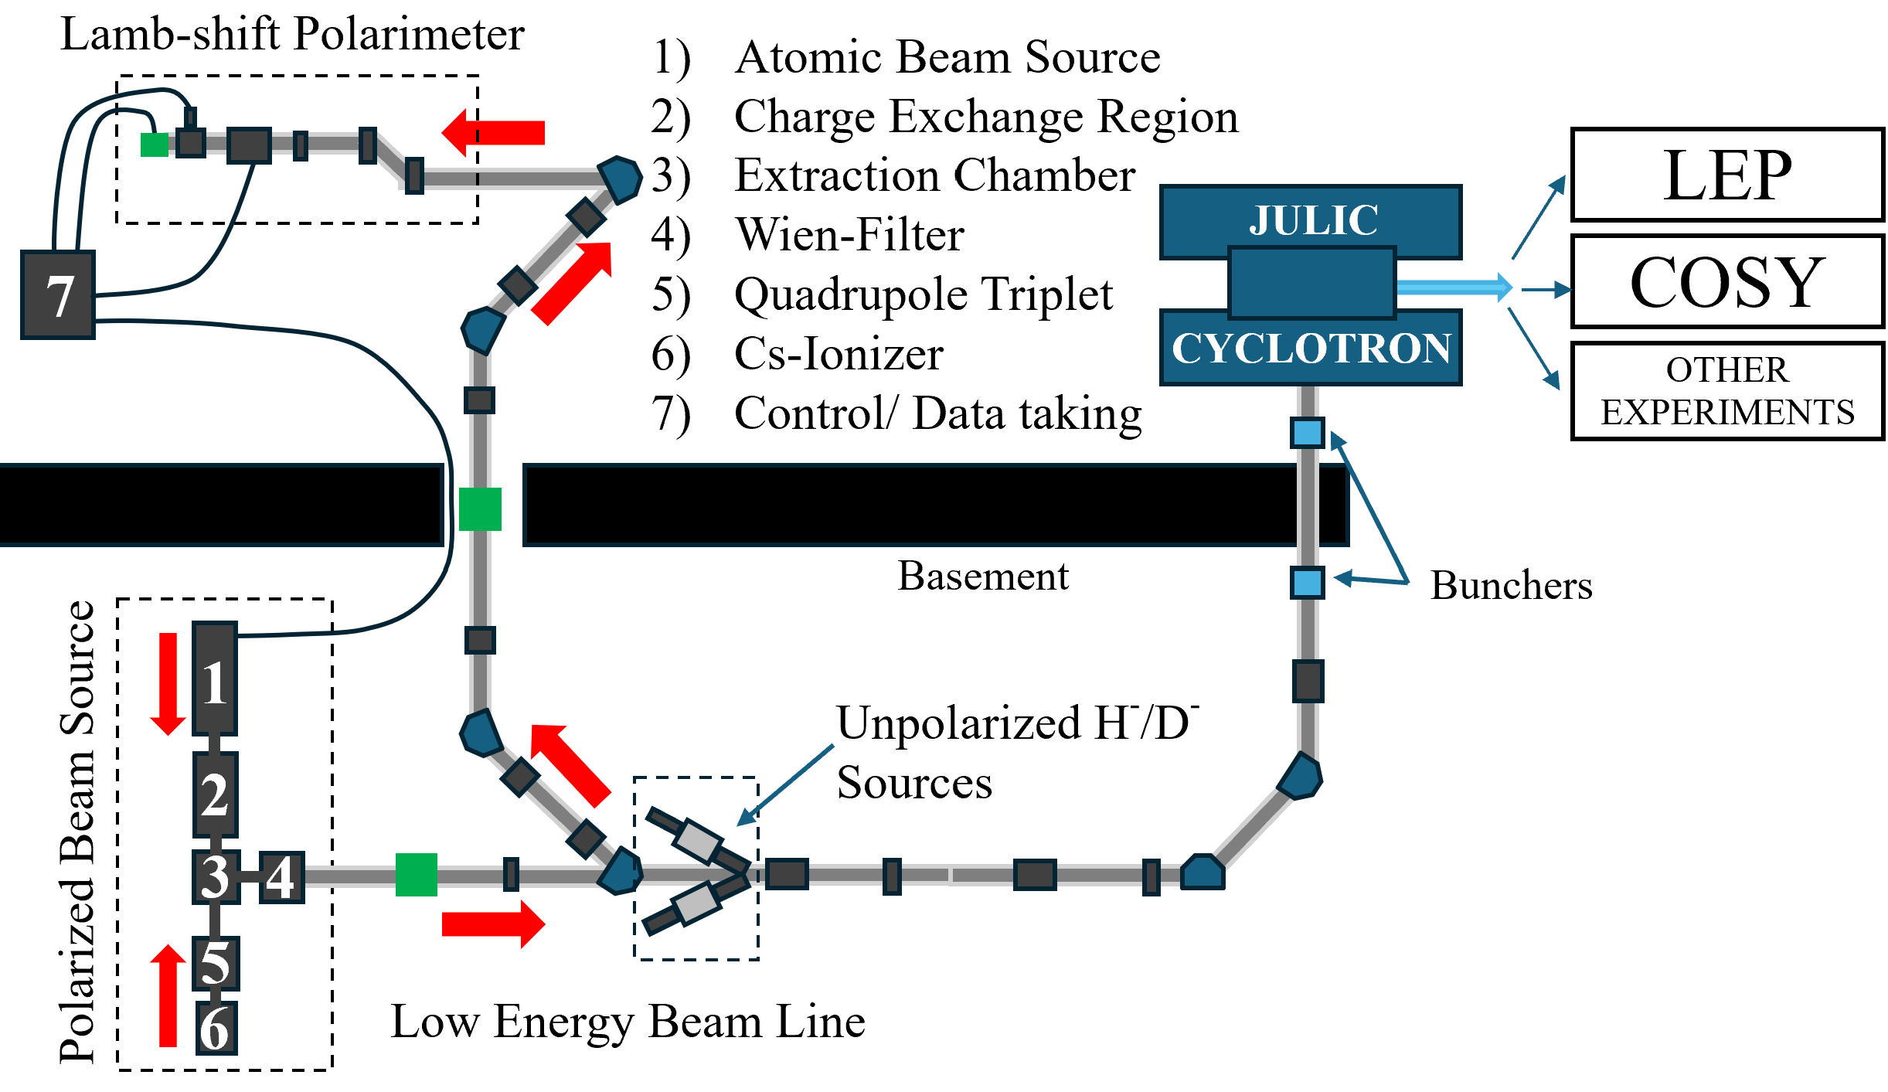

COSY and polarized $H^{−}$ and $D^{−}$ ion beams
a
Advantages of LSP:
  Parallel operation of experiments with unpolarized beams
  Increase time and energy efficiency
Page 4
Notes:
Here: Height difference made it quite complicated and hard to have nice beam conditions but we had no other choice – so three factors which made it hard, pulsed, H^- and rather complicated beamline

Slide 5
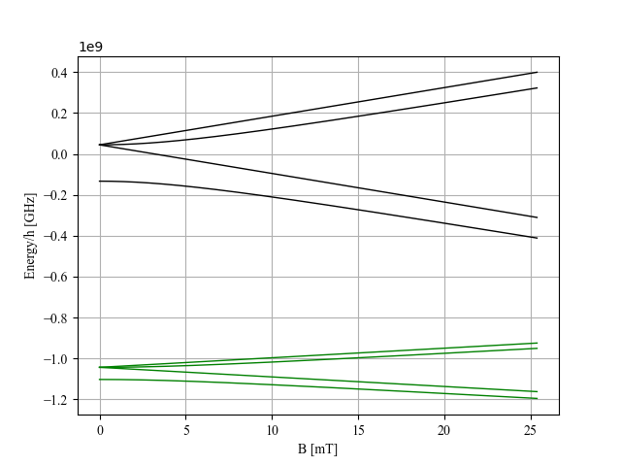
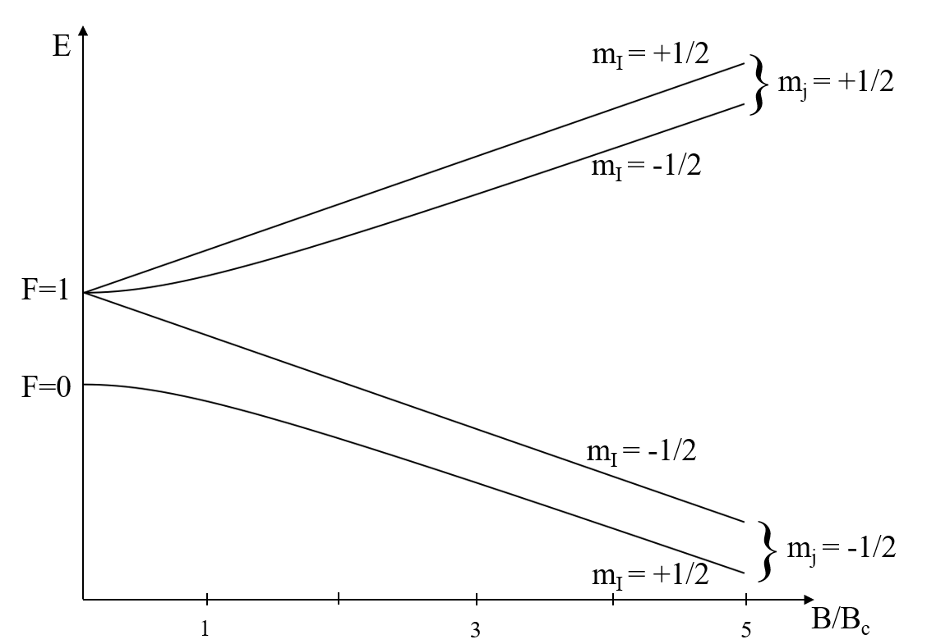







theory
Breit-Rabi diagram and beam polarization
Effective Hamiltonian:
Nuclear spin polarization:
  Comparison of rel. occupation numbers of particles with $m_{I}=+1/2$ and $m_{I}=−1/2$
  $P_{z}=\frac{N_{+}−N_{−}}{N_{+}+N_{−}}$
$$α$$
n=2
n=1
2S_{1/2}
$$β$$
2P_{1/2}
$$e$$
$$f$$

Slide 6
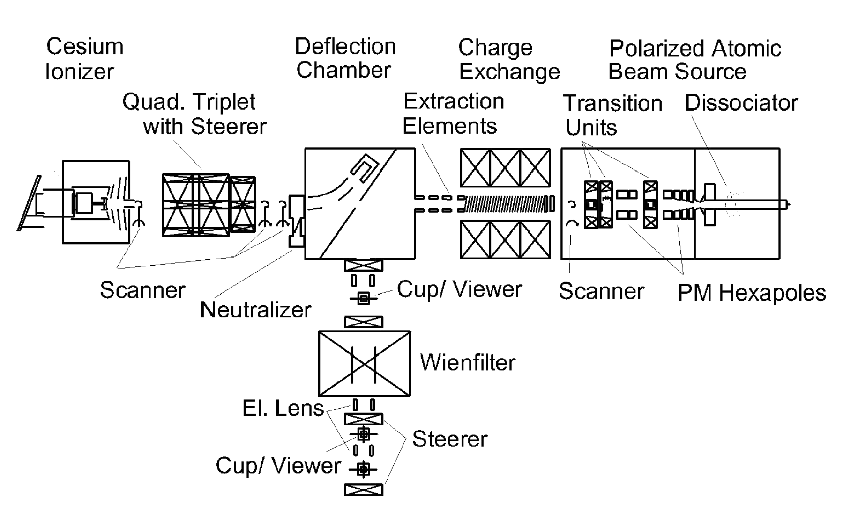
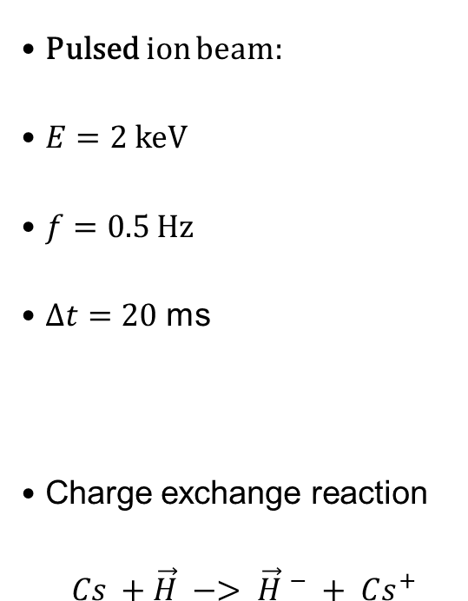
Experimental setup
Polarized ion source (Colliding beam source)
Pulsed ion beam:
$E=2$ keV
$f=0.5$ Hz
$Δt=20$ ms
Charge exchange reaction
$$Cs +\vec{H} −> {\vec{H} }^{−} + Cs^{+}$$
n=1

Slide 7
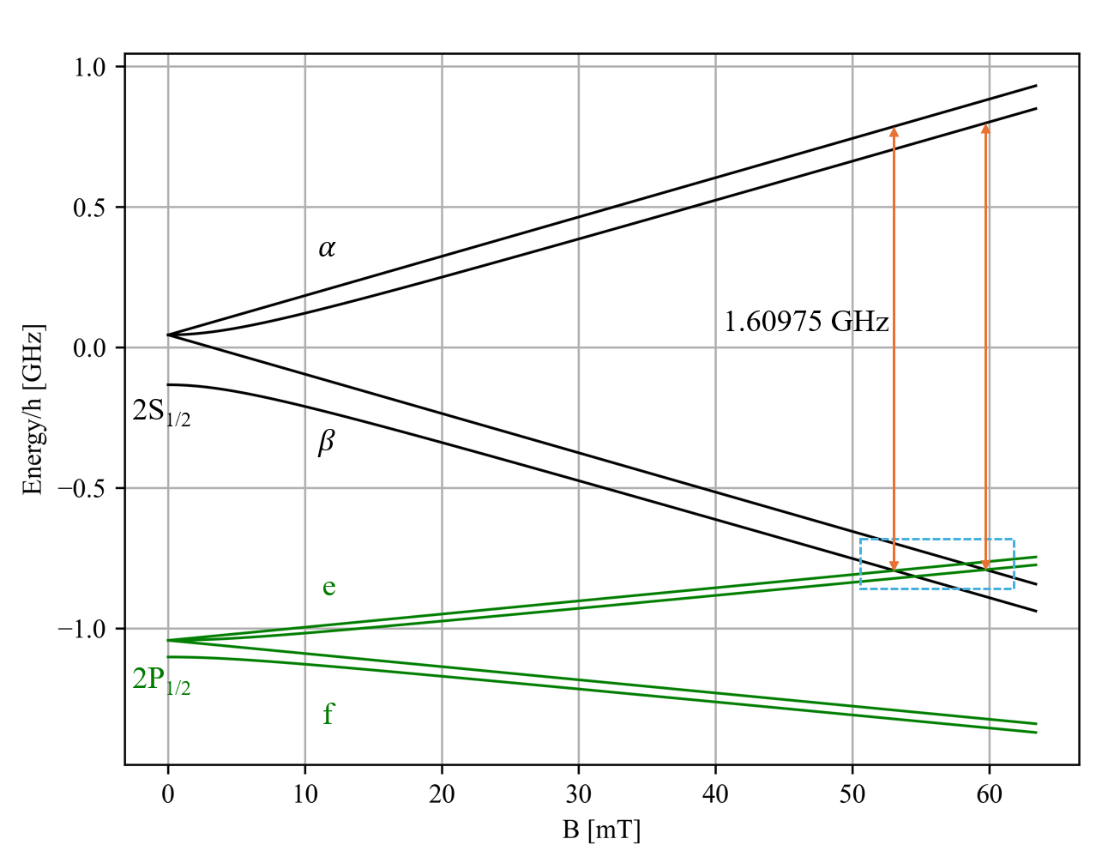
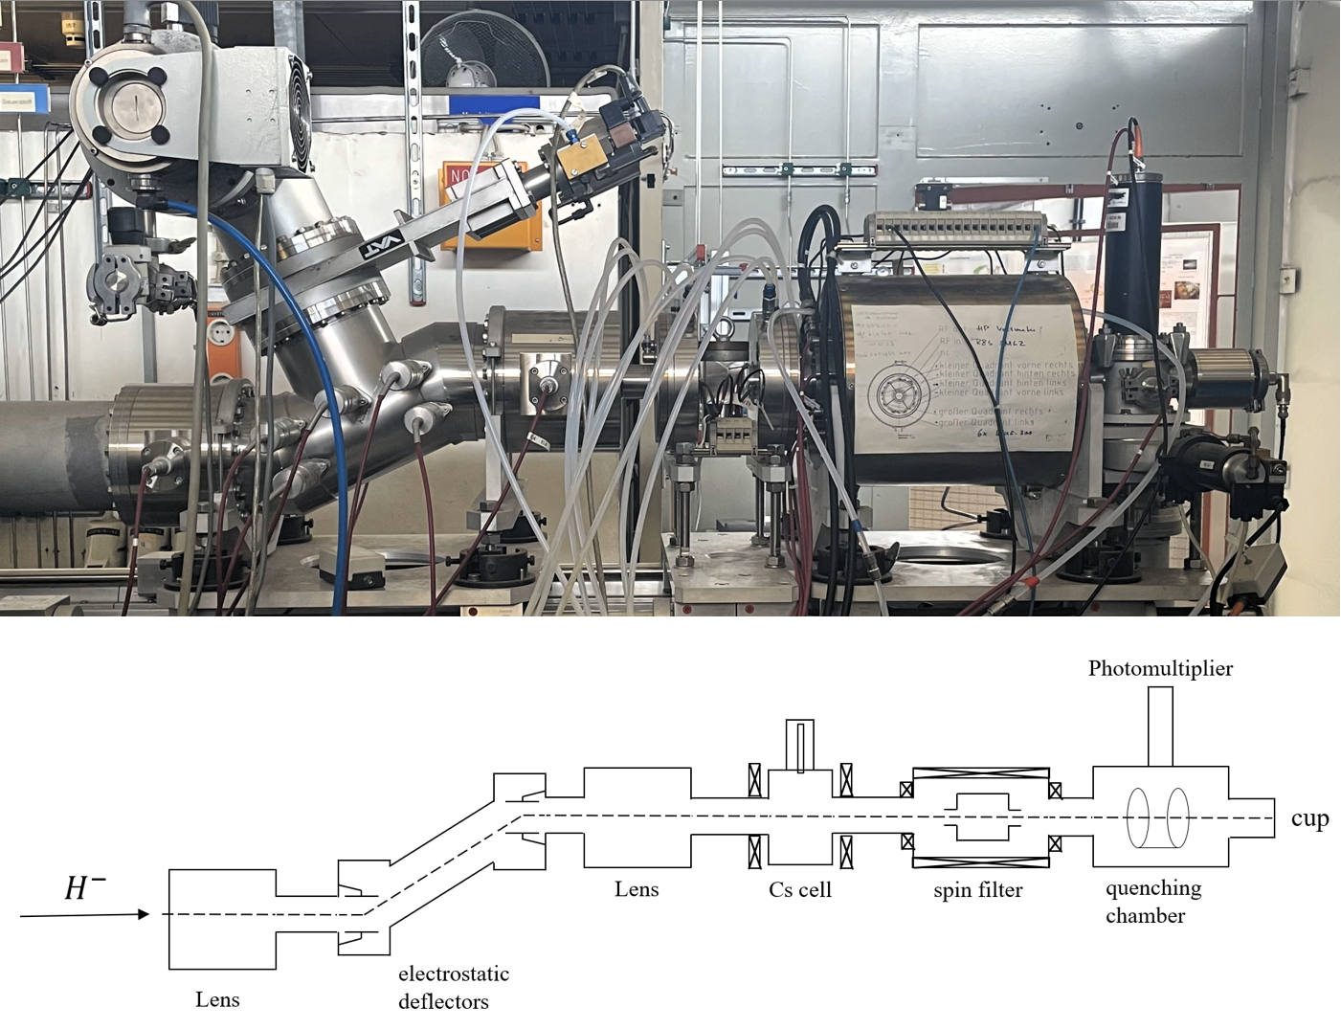
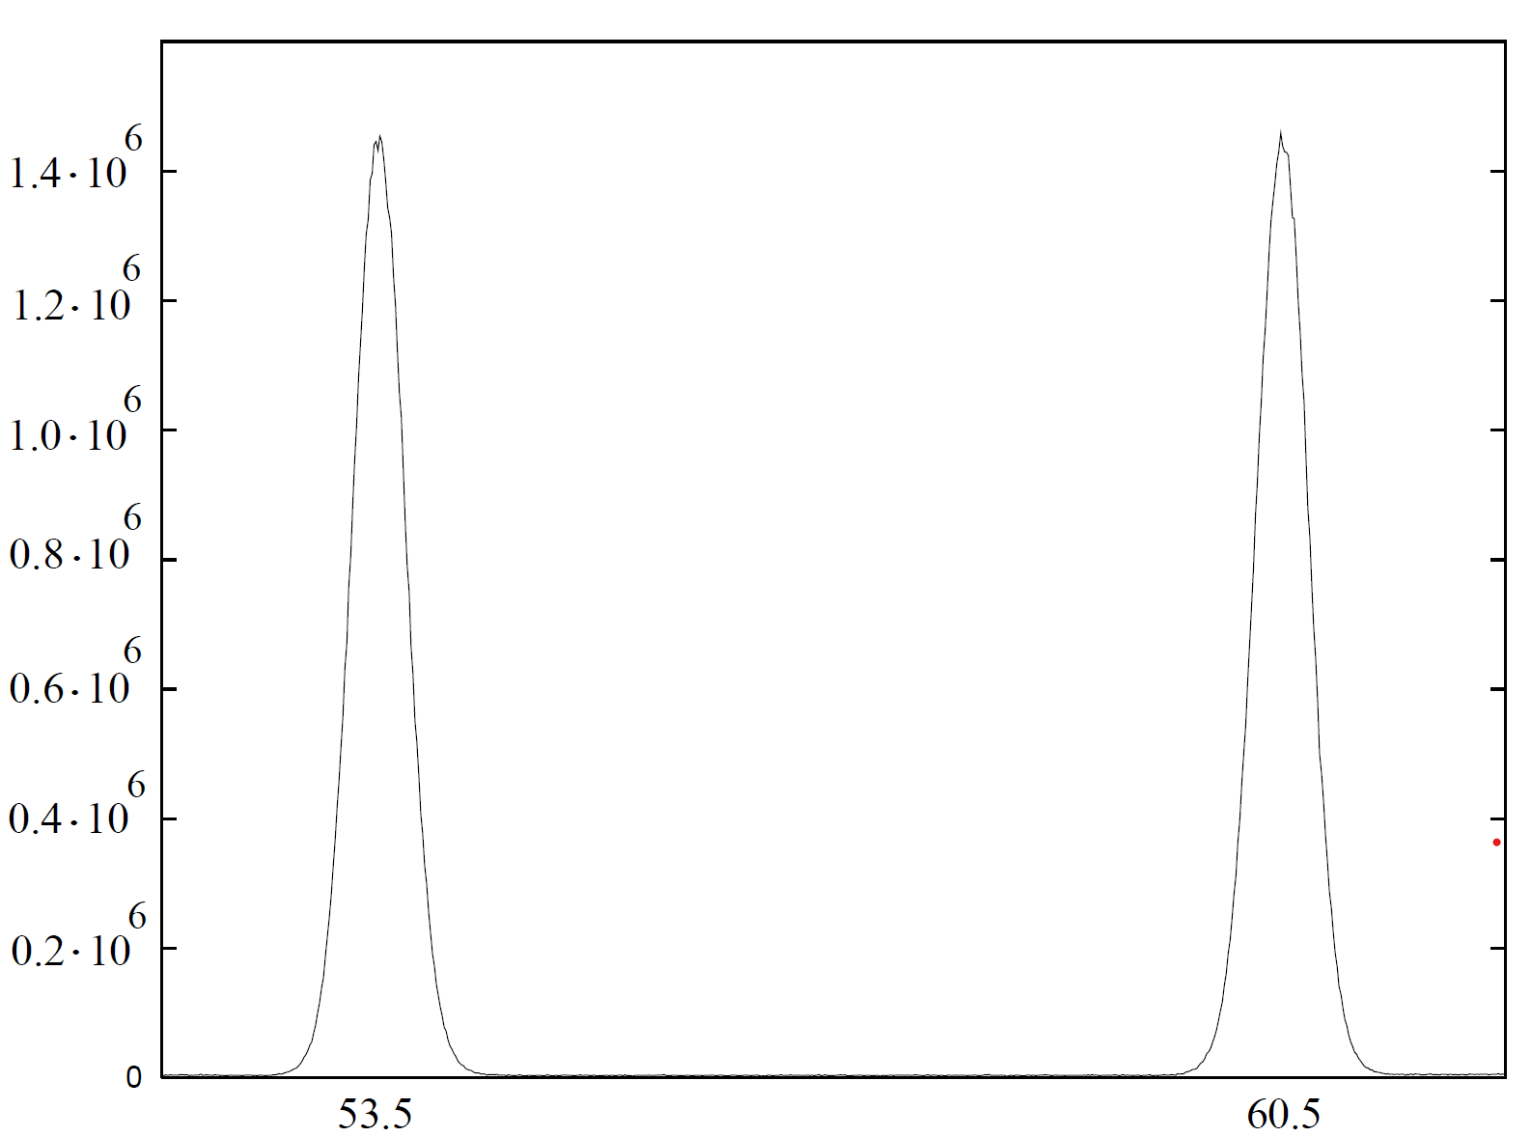



Experimental setup
Lamb-shift polarimeter
$$m_{I}= +\frac{1}{2}$$
$$m_{I}=−\frac{1}{2}$$
PMT signal [photons/s]
B_{SF}
Spin filter B-field [mT]
2S_{1/2}

Slide 8
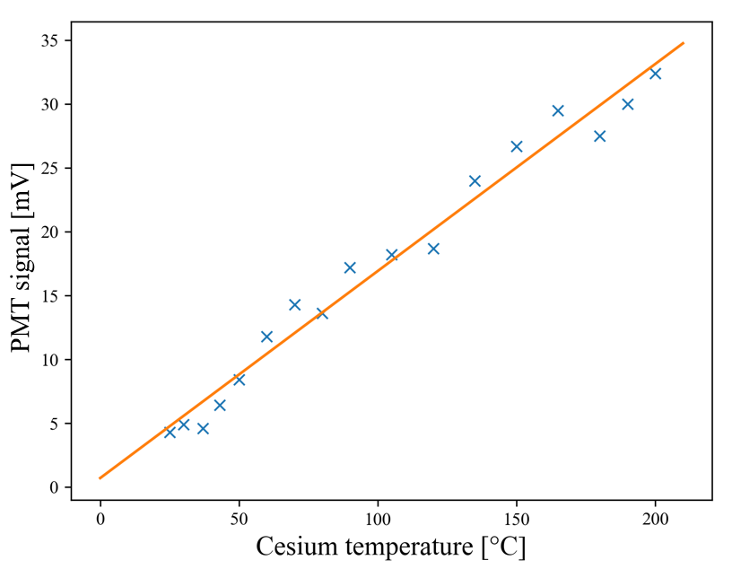


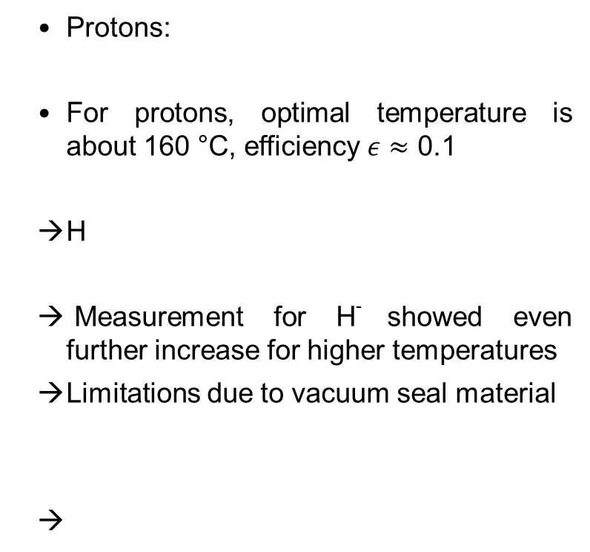
Cs temperature scan
a
  Protons:
  For protons, optimal temperature is about 160 °C, efficiency $ε≈$ 0.1
  H
  Measurement for H⁻ showed even further increase for higher temperatures
  Limitations due to vacuum seal material
For H⁻ : Cs + H⁻ -> ?? -> H_{2S1/2} + Cs + e⁻

Slide 9
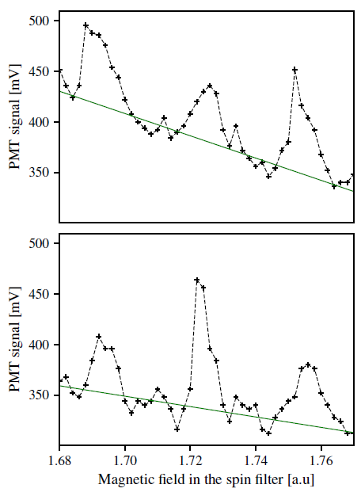
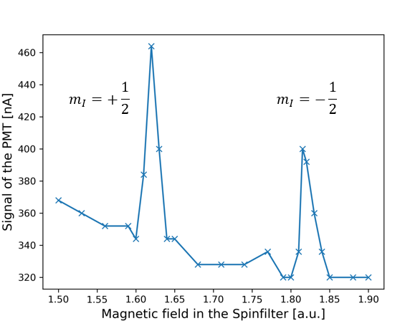



Proof of principle 2020
$$m_{I}=+1$$
a
$$m_{I}=−1$$
$$m_{I}=0$$
Resolution is not good enough
Data analysis is required post measurement which makes “live-tuning” impossible
→ New data acquisition system

Slide 10
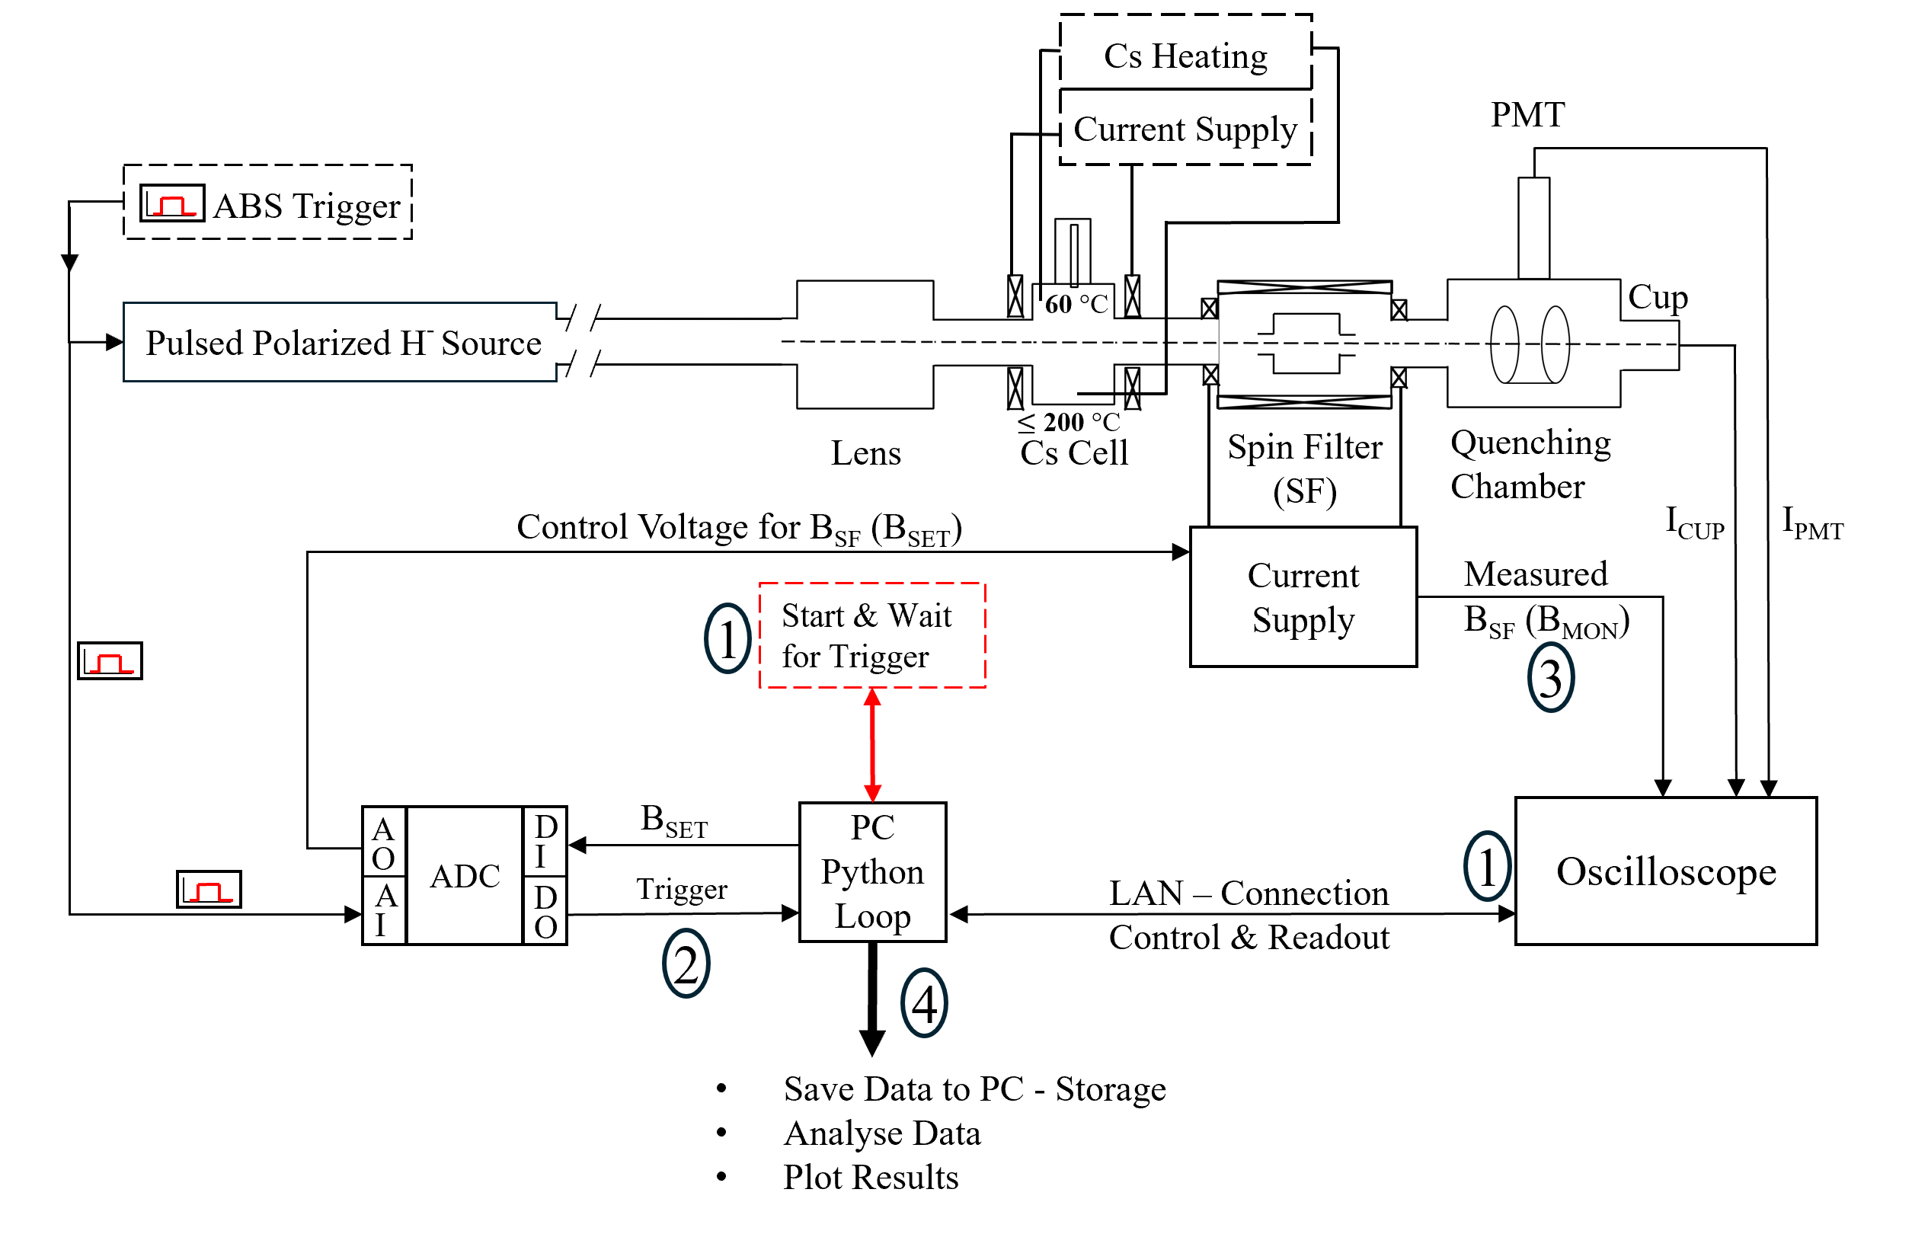
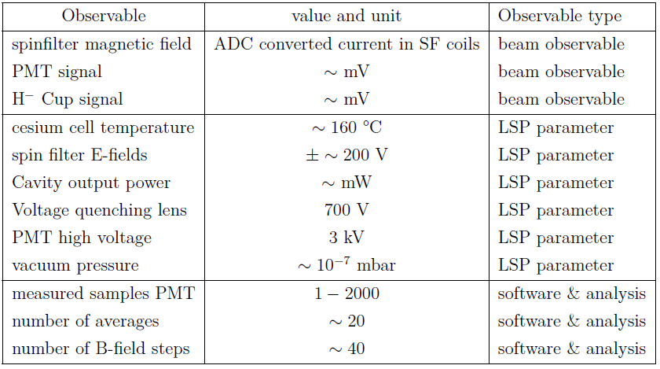
Polarization measurements - Improved
a

Slide 11
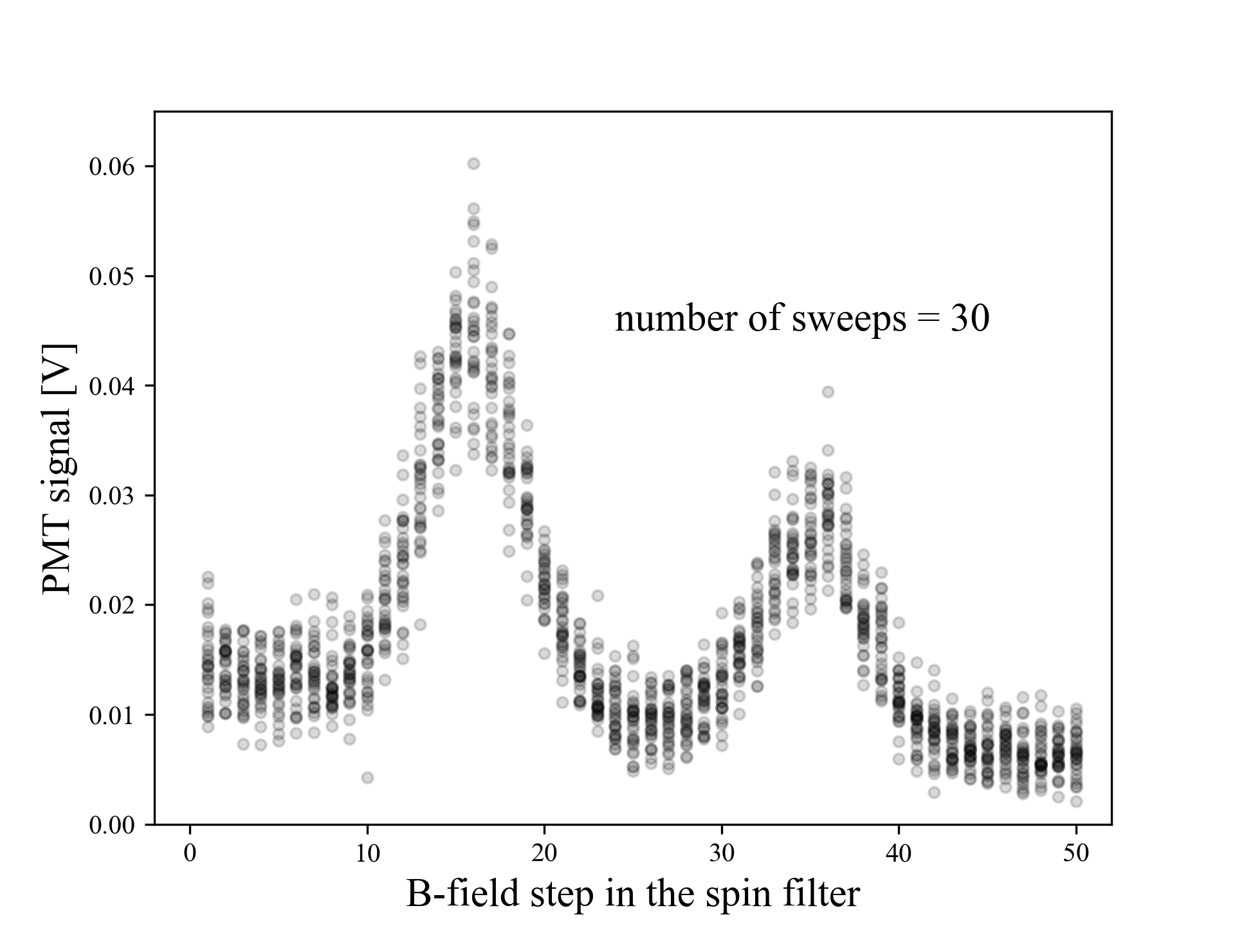
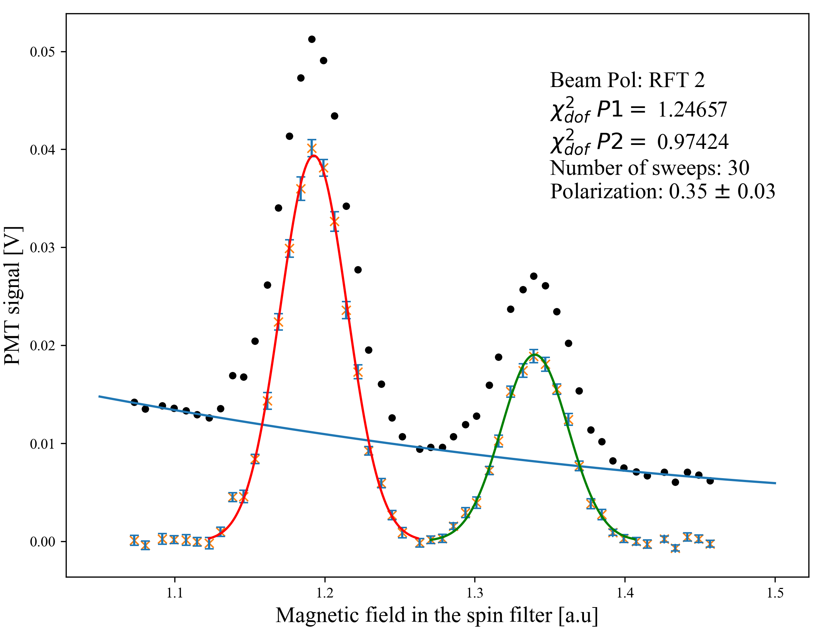
Polarization measurements – Run 2
a

Slide 12
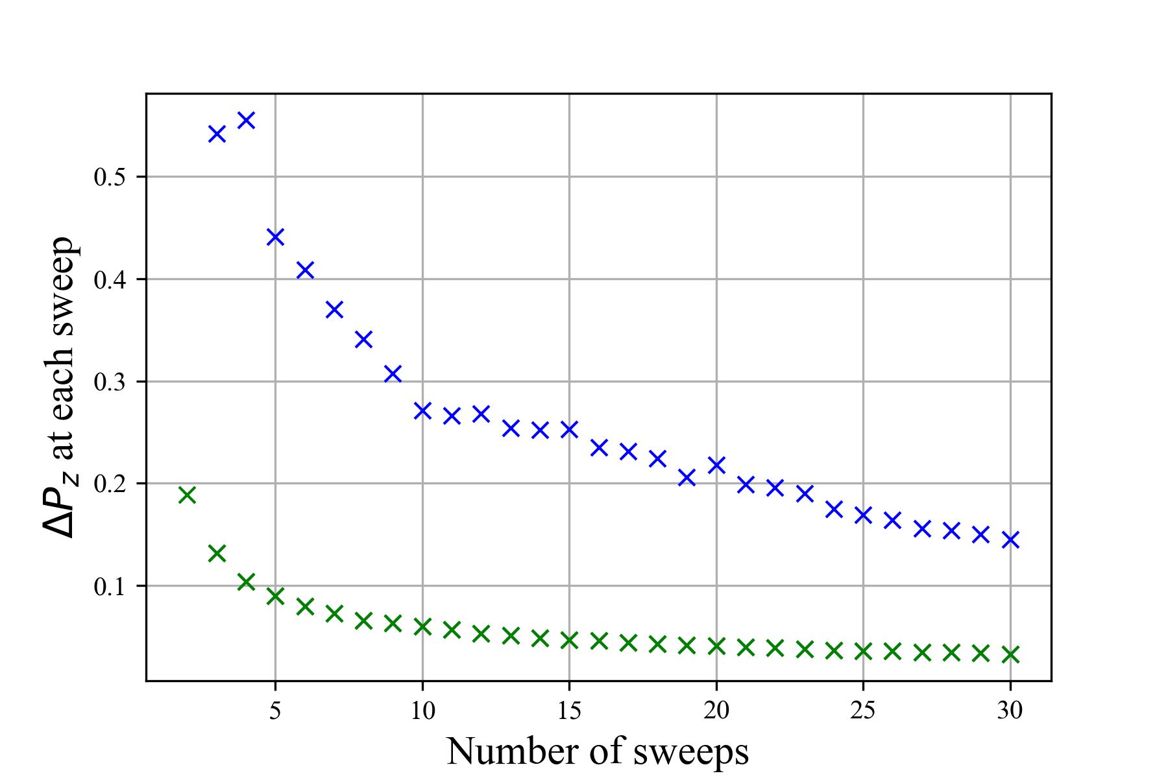
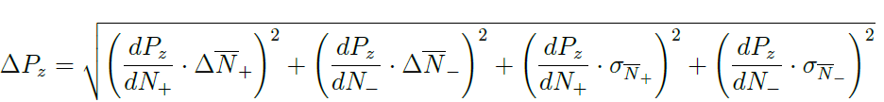
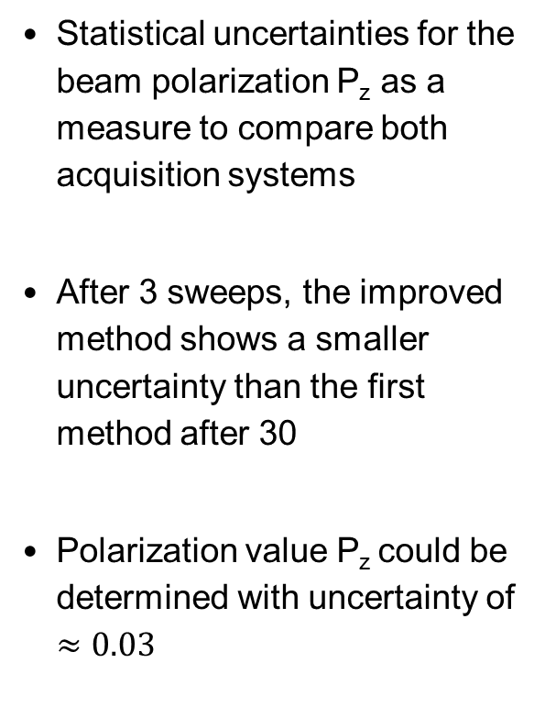
Polarization measurements – precision
a
Statistical uncertainties for the beam polarization P_{z} as a measure to compare both acquisition systems
After 3 sweeps, the improved method shows a smaller uncertainty than the first method after 30
Polarization value P_{z} could be determined with uncertainty of $≈0.03$
Run 1
Run 2

Slide 13
Polarization measurements – sequence
Background behavior
a

Slide 14
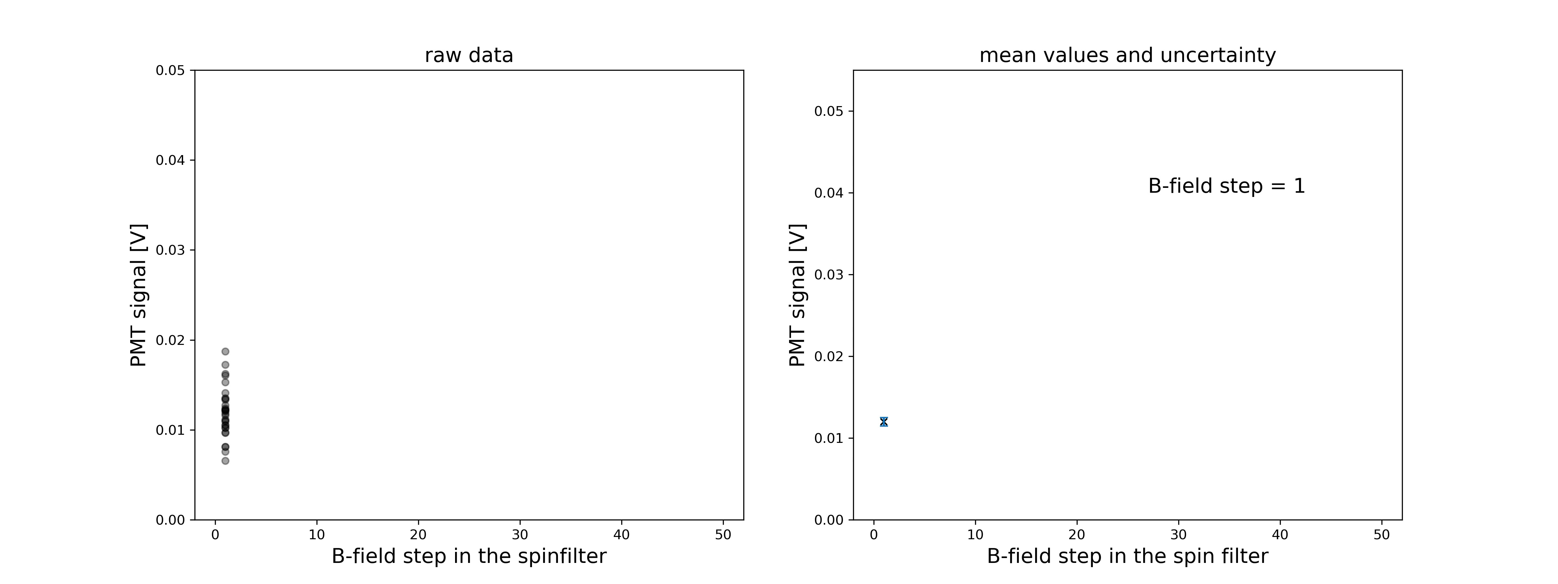
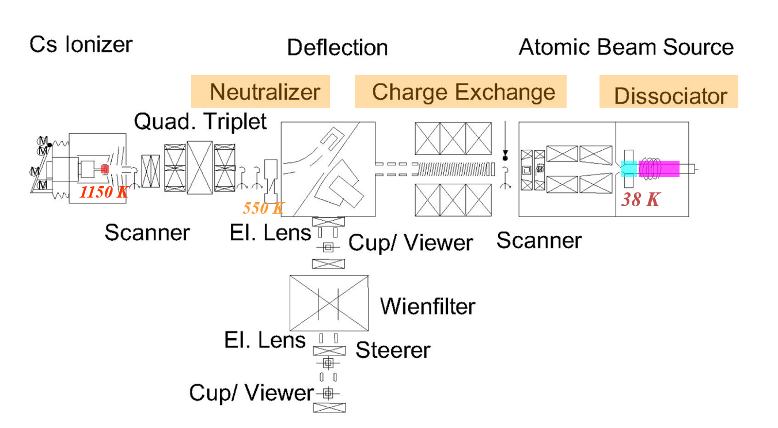
Polarization measurements – sequence
AVERAGE EACH STEP
a

Slide 15
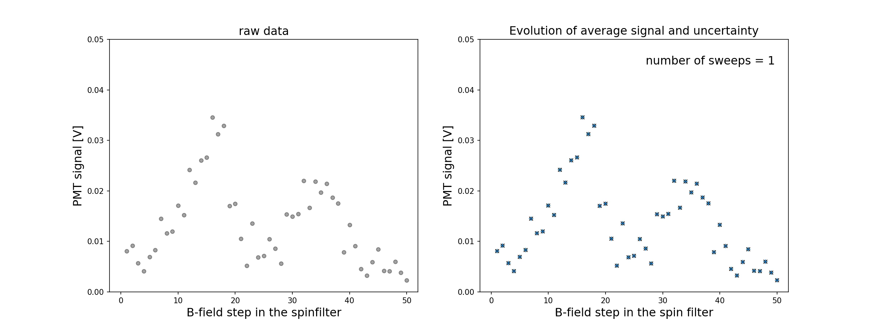
Polarization measurements – sequence
SWEEP AFTER SWEEP
a

Slide 16
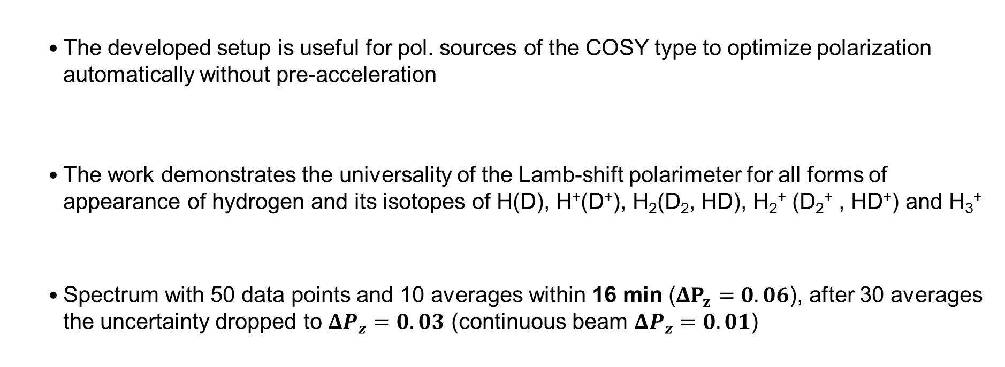
Summary
      The developed setup is useful for pol. sources of the COSY type to optimize polarization automatically without pre-acceleration
      The work demonstrates the universality of the Lamb-shift polarimeter for all forms of appearance of hydrogen and its isotopes of H(D), H⁺(D⁺), H₂(D₂, HD), H₂⁺ (D₂⁺ , HD⁺) and H₃⁺
      Spectrum with 50 data points and 10 averages within 16 min ($ΔP_{z}=0.06$), after 30 averages the uncertainty dropped to $ΔP_{z}=0.03$ (continuous beam $ΔP_{z}=0.01$)
Notes:
Moreover New idea: As onur presented there is a possibility to polarize molecules with the help of a storage cell. This leads to a new idea for polarized ion source for stripping injecting storage rings

