Slide 1





Spin manipulation in atomic and molecular systems for nuclear spin applications
Chrysovalantis Kannis
with
Ralf Engels, Tarek El-Kordy, Nicolas Faatz, Simon J. Pütz, Vincent Verhoeven, T. Peter Rakitzis, and Markus Büscher
23.09.2025

Slide 2
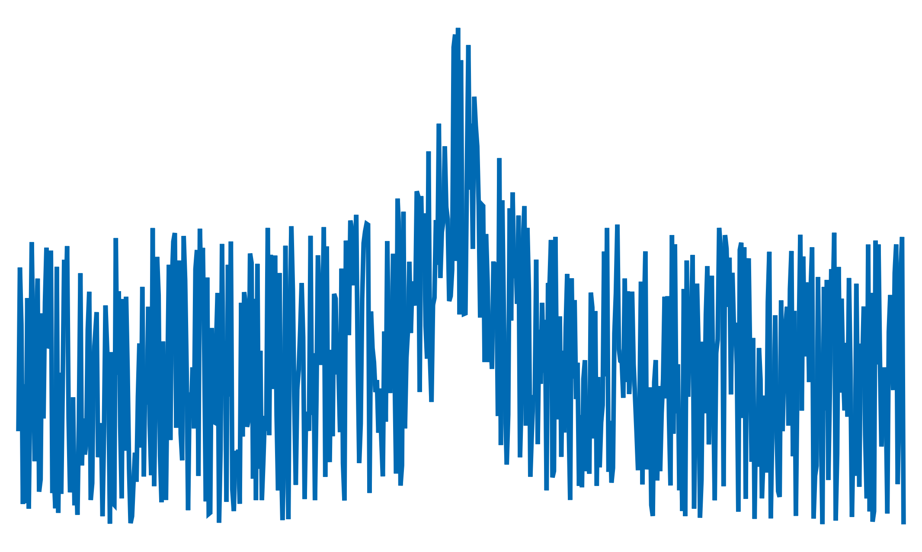
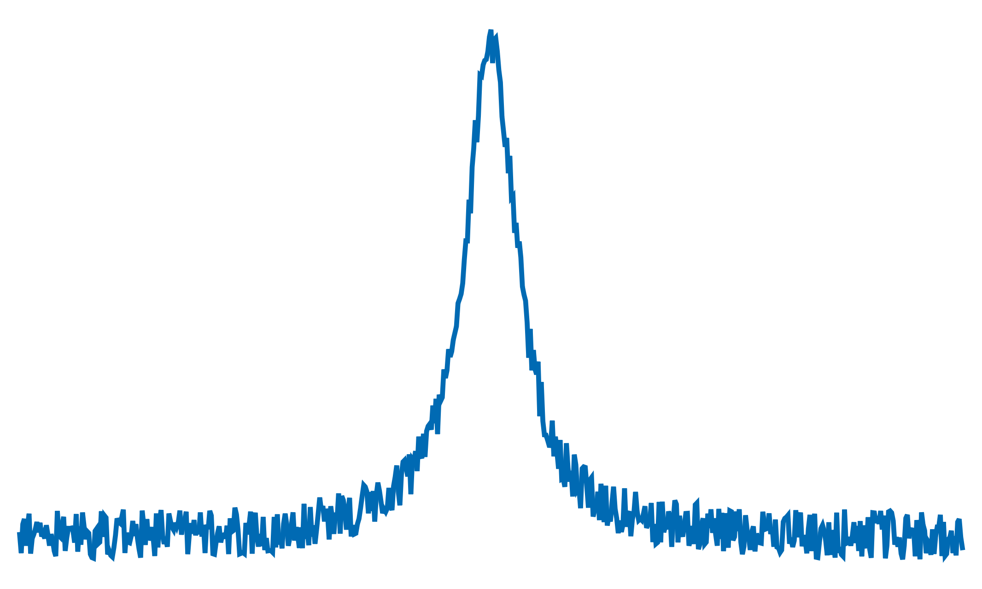

Why nuclear spin polarization is important
Physics and medicine
  NMR/MRI signal enhancement
Polarized fusion
  Five-nucleon reactions
    $d + t \underset{→}{ } α \left(3.5 MeV\right) + n \left(14.1 MeV\right)$
    $d + h \underset{→}{ } α \left(3.6 MeV\right) + p \left(14.7 MeV\right)$
  Four-nucleon reactions
    $d + d \underset{→}{\text{50\%}} t \left(1.01 MeV\right) + p \left(3.02 MeV\right)$
    $d + d \underset{→}{\text{50\%}} h \left(0.82 MeV\right) + n \left(2.45 MeV\right)$
  Ralf Engels-Polarized Fusion
  (Plenary talk, Thu 25/09, 8:30)
increase in reaction rate
control of the emission direction of products
?

Slide 3
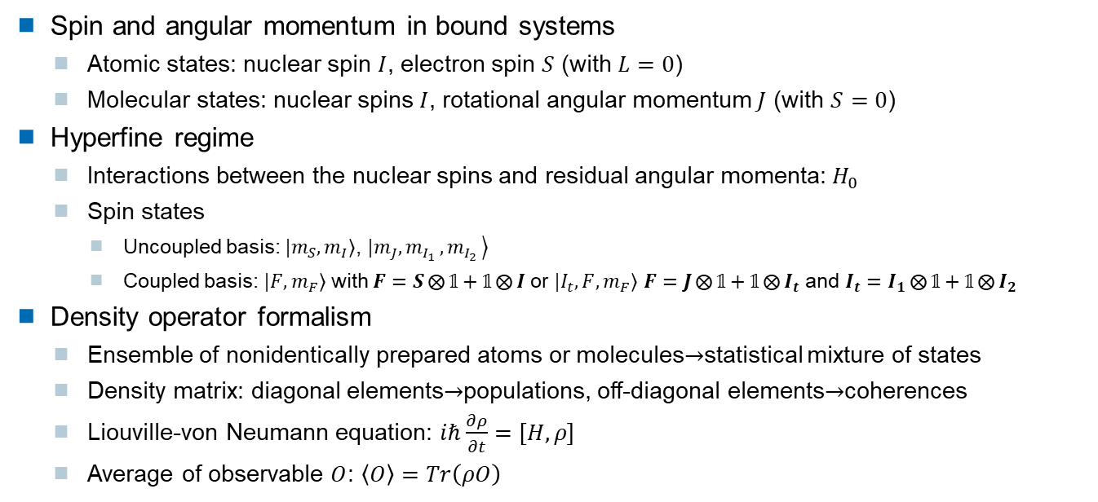
Key concepts
Spin and angular momentum in bound systems
  Atomic states: nuclear spin $I$, electron spin $S$ (with $L=0$)
  Molecular states: nuclear spins $I$, rotational angular momentum $J$ (with $S=0$)
Hyperfine regime
  Interactions between the nuclear spins and residual angular momenta: $H_{0}$
  Spin states
    Uncoupled basis: $|\left.m_{S}, m_{I}\right\rangle$, $|\left.m_{J}, m_{I_{1} },m_{I_{2} }\right\rangle$
    Coupled basis: $|\left.F, m_{F}\right\rangle$ with $F=S⨂{𝟙}+𝟙⨂{I}$ or $|\left.I_{t}, F, m_{F}\right\rangle$ $F=J⨂{𝟙}+𝟙⨂{I_{t}}$ and $I_{t}=I_{1}⨂{𝟙}+𝟙⨂{I_{2}}$
Density operator formalism
  Ensemble of nonidentically prepared atoms or molecules$→$statistical mixture of states
  Density matrix: diagonal elements$→$populations, off-diagonal elements$→$coherences
  Liouville-von Neumann equation: $iℏ\frac{∂ρ}{∂t}=\left[H,ρ\right]$
  Average of observable $O$: $\left\langle O\right\rangle =Tr\left(ρO\right)$

Slide 4

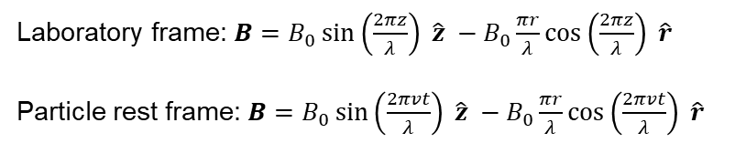
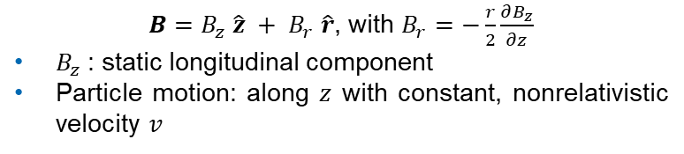
Key concepts
External perturbations
  Interaction with a magnetic field $B$: $H_{B}=−μ⋅B$, with total Hamiltonian $H=H_{0}+H_{B}$
  Sinusoidal field, inspired by P. G. Sona [Energ. Nucl. 14, 295 (1967)]
$B=B_{z} \hat{z} + B_{r} \hat{r}$, with $B_{r}=−\frac{r}{2}\frac{∂B_{z}}{∂z}$
$B_{z}$: static longitudinal component
Particle motion: along $z$ with constant, nonrelativistic velocity $v$
Laboratory frame: $B=B_{0}\sin\left(\frac{2πz}{λ}\right) \hat{z} −B_{0}\frac{πr}{λ}\cos\left(\frac{2πz}{λ}\right) \hat{r}$
Particle rest frame: $B=B_{0}\sin\left(\frac{2πvt}{λ}\right) \hat{z} −B_{0}\frac{πr}{λ}\cos\left(\frac{2πvt}{λ}\right) \hat{r}$
C. S. Kannis et al., Phys. Rev. A 112, 012801 (2025)

Slide 5
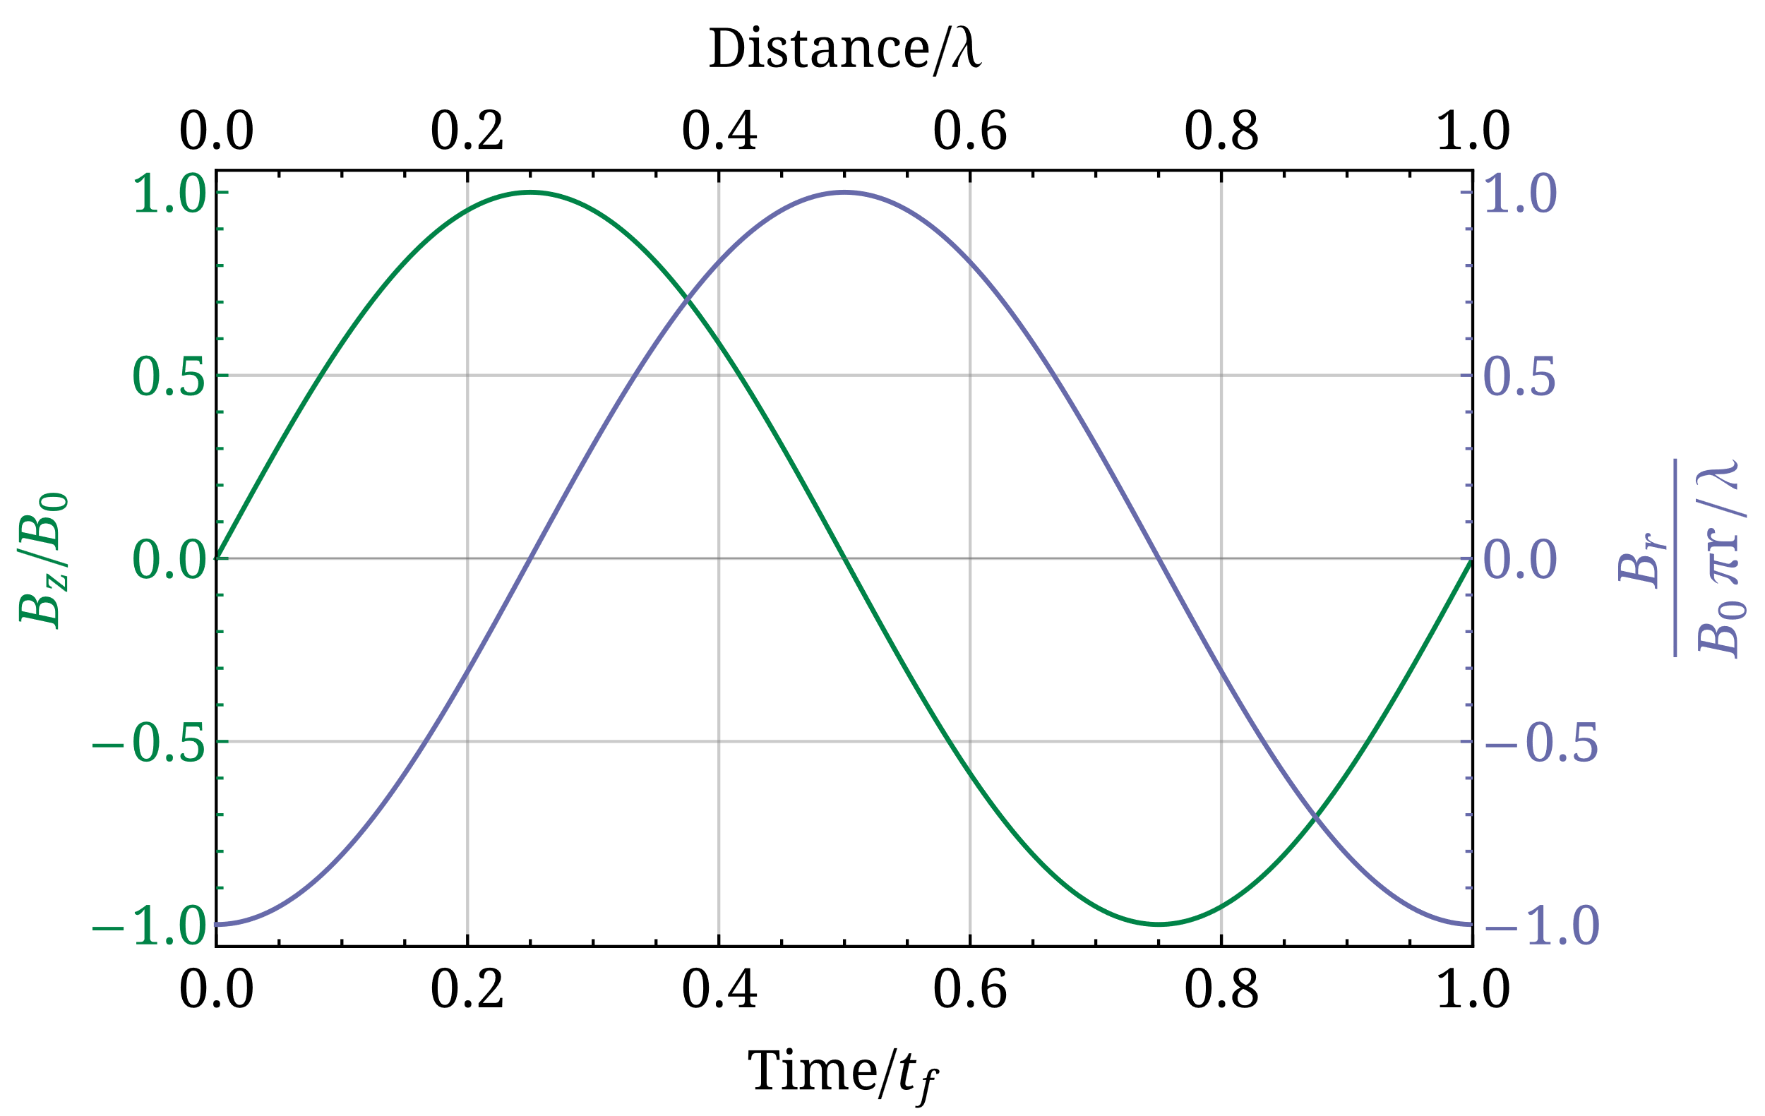

Key concepts
External perturbations
  Interaction with a magnetic field $B$: $H_{B}=−μ⋅B$, with total Hamiltonian $H=H_{0}+H_{B}$
  Sinusoidal field, inspired by P. G. Sona [Energ. Nucl. 14, 295 (1967)]
$B=B_{z} \hat{z} + B_{r} \hat{r}$, with $B_{r}=−\frac{r}{2}\frac{∂B_{z}}{∂z}$
$B_{z}$: static longitudinal component
Particle motion: along $z$ with constant, nonrelativistic velocity $v$
Laboratory frame: $B=B_{0}\sin\left(\frac{2πz}{λ}\right) \hat{z} −B_{0}\frac{πr}{λ}\cos\left(\frac{2πz}{λ}\right) \hat{r}$
Particle rest frame: $B=B_{0}\sin\left(\frac{2πvt}{λ}\right) \hat{z} −B_{0}\frac{πr}{λ}\cos\left(\frac{2πvt}{λ}\right) \hat{r}$
$$r≪λ$$
C. S. Kannis et al., Phys. Rev. A 112, 012801 (2025)

Slide 6
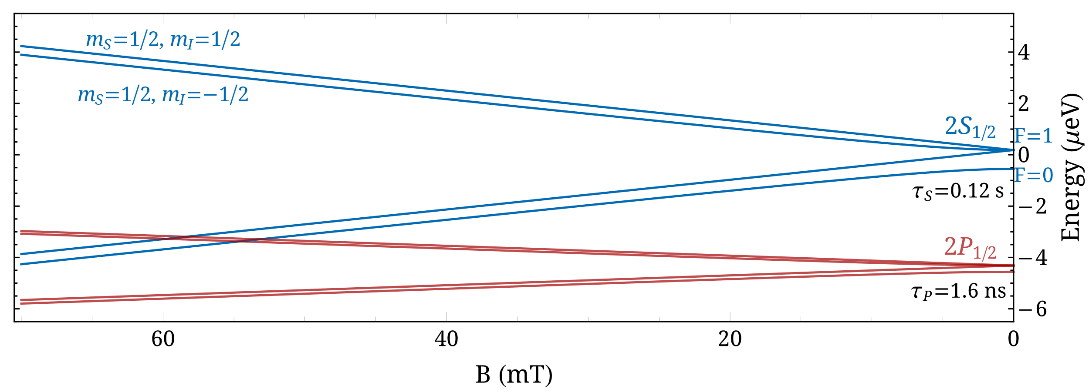

Incoherent initial preparation
Hydrogen atom
  Ground state: protons capture polarized electrons in an optically pumped, polarized Rb vapor cell (in high magnetic field)
  Metastable state: use of the $2S_{1/2}−2P_{1/2}$ level crossing (also at high magnetic field)

Slide 7
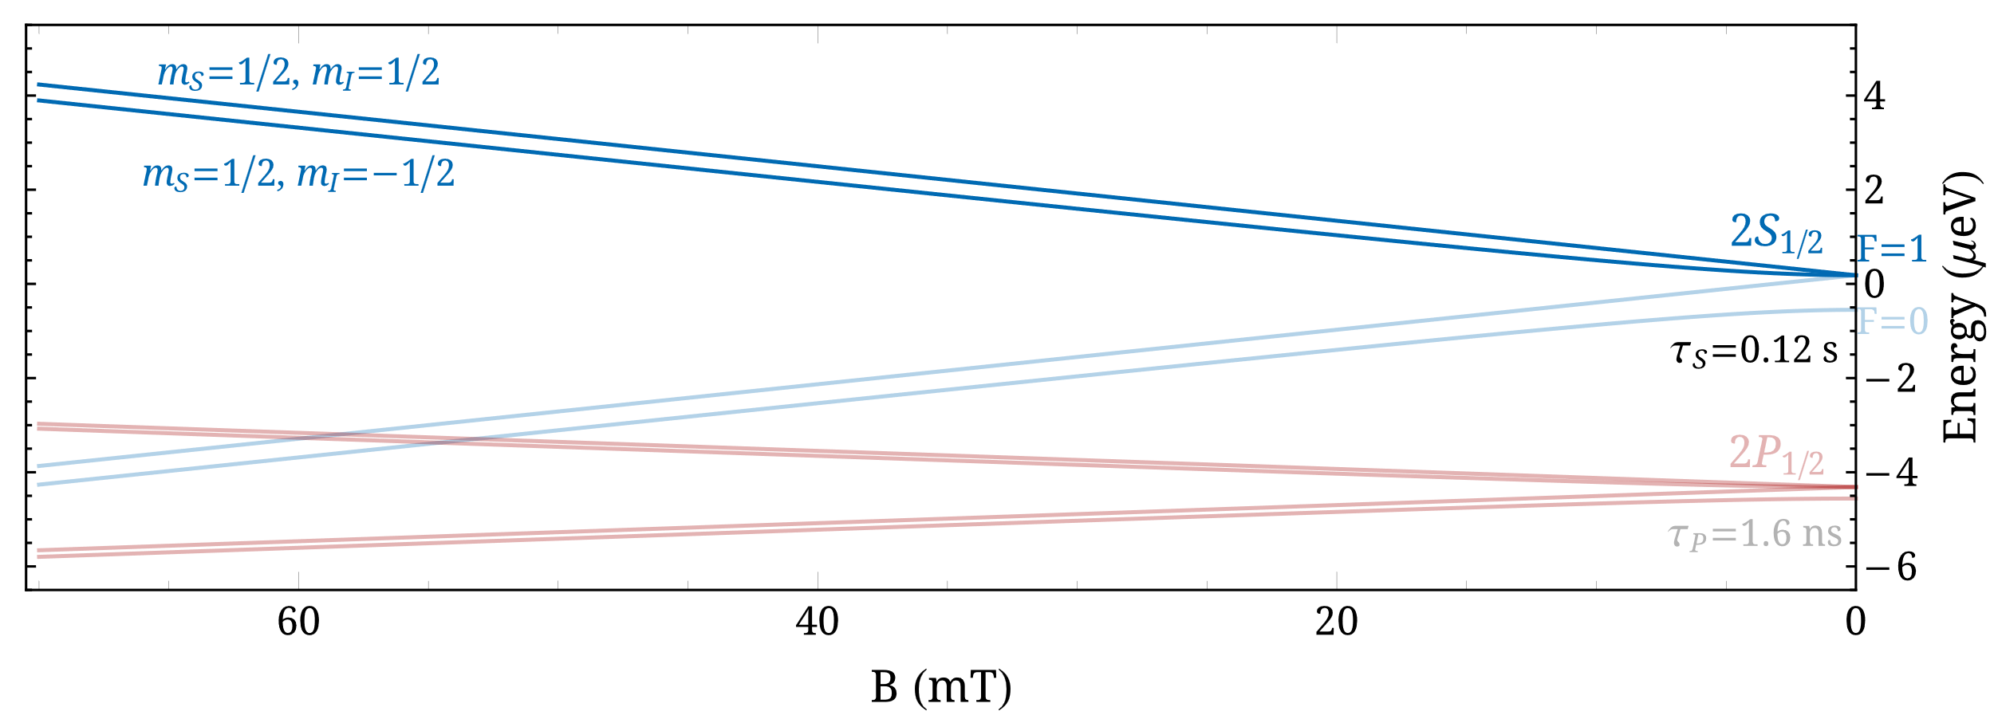
Incoherent initial preparation
Hydrogen atom
  Ground state: protons capture polarized electrons in an optically pumped, polarized Rb vapor cell (in high magnetic field)
  Metastable state: use of the $2S_{1/2}−2P_{1/2}$ level crossing (also at high magnetic field)

Slide 8
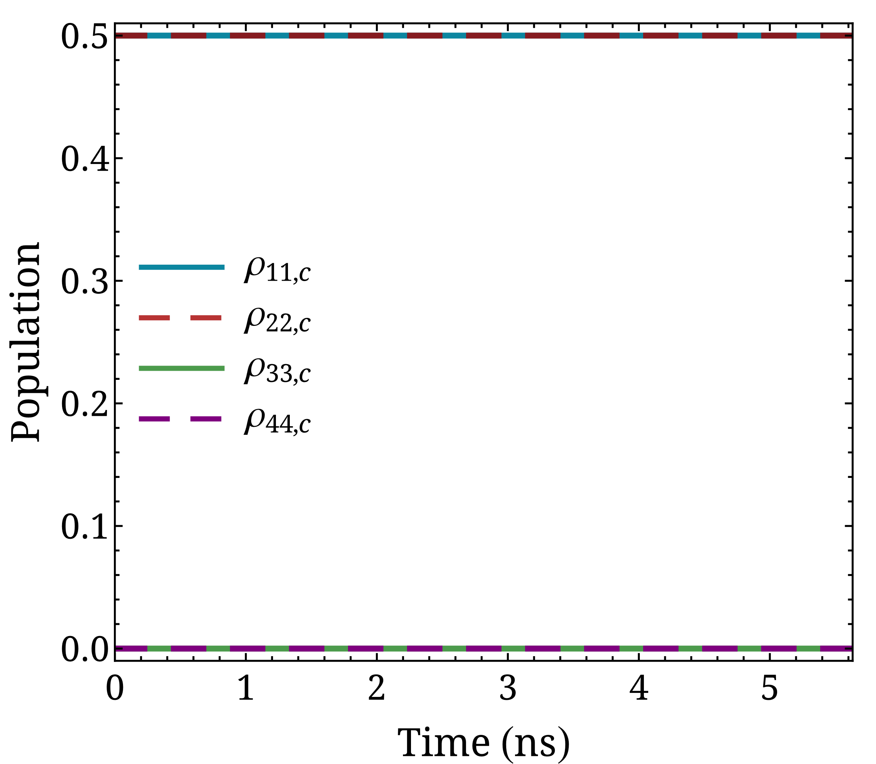
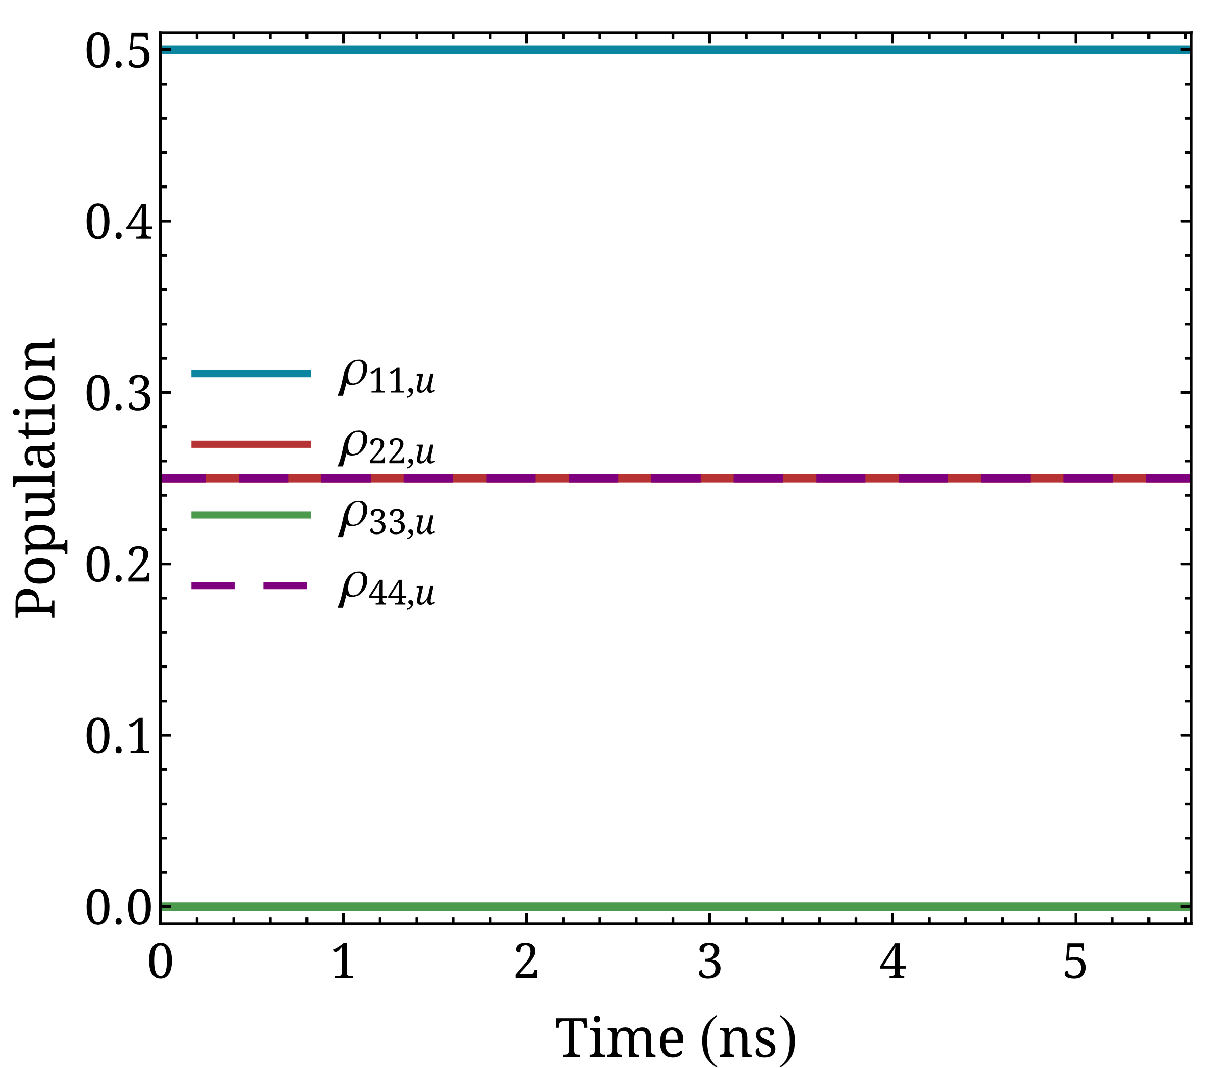
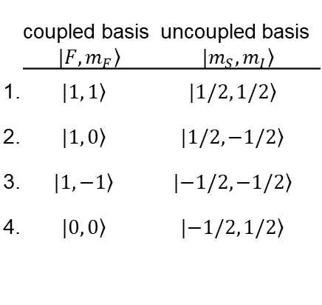

Incoherent initial preparation
Hydrogen atom
$$ρ_{c}=\left(\begin{matrix}1/2 & 0 & 0 & 0 \\ 0 & 1/2 & 0 & 0 \\ 0 & 0 & 0 & 0 \\ 0 & 0 & 0 & 0\end{matrix}\right)$$
$H_{0}=\frac{A_{2S}}{ℏ^{2}} I⋅S \text{with} \frac{A_{2S}}{h}=177.6 \text{MHz} t_{f}=\frac{h}{ΔE_{hfs}}=\frac{h}{A_{2S}}∼5.6$ ns
 | coupled basis $|\left.F, m_{F}\right\rangle$ | uncoupled basis $|\left.m_{S}, m_{I}\right\rangle$
1. | $$|\left.1, 1\right\rangle$$ | $$|\left.1/2, 1/2\right\rangle$$
2. | $$|\left.1, 0\right\rangle$$ | $$|\left.1/2,−1/2\right\rangle$$
3. | $$|\left.1, −1\right\rangle$$ | $$|\left.−1/2,−1/2\right\rangle$$
4. | $$|\left.0, 0\right\rangle$$ | $$|\left.−1/2, 1/2\right\rangle$$

Slide 9
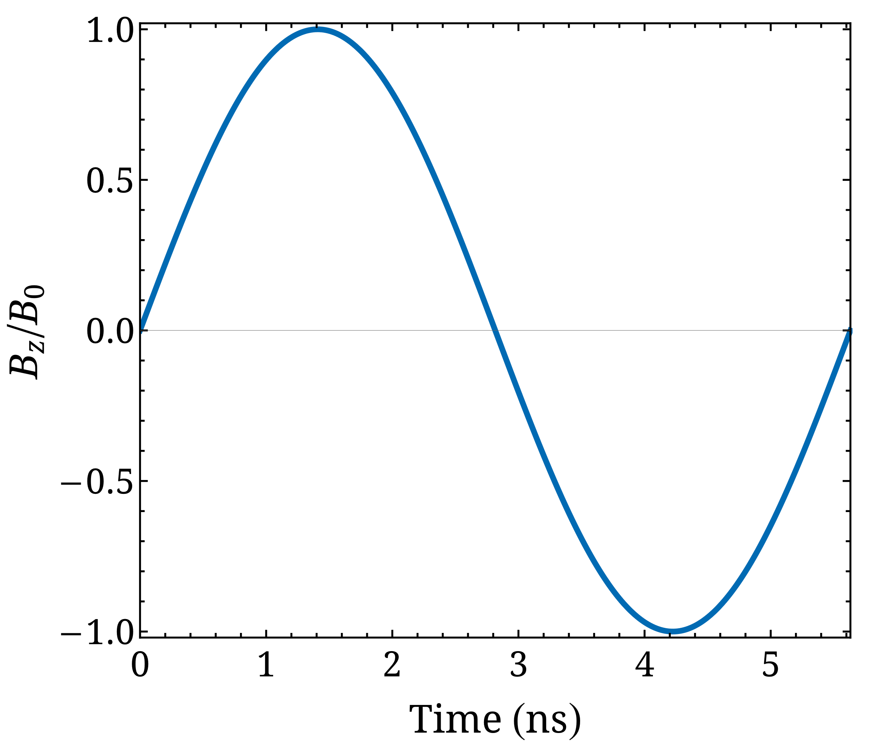

Incoherent initial preparation
Hydrogen atom
How is population evolution affected by $B_{z}=B_{0}\sin\left(\frac{2πvt}{λ}\right)$?
$$ρ_{c}=\left(\begin{matrix}1/2 & 0 & 0 & 0 \\ 0 & 1/2 & 0 & 0 \\ 0 & 0 & 0 & 0 \\ 0 & 0 & 0 & 0\end{matrix}\right)$$
$H_{0}=\frac{A_{2S}}{ℏ^{2}} I⋅S \text{with} \frac{A_{2S}}{h}=177.6 \text{MHz} t_{f}=\frac{h}{ΔE_{hfs}}=\frac{h}{A_{2S}}∼5.6$ ns
$$λ=v t_{f}$$
 | coupled basis $|\left.F, m_{F}\right\rangle$ | uncoupled basis $|\left.m_{S}, m_{I}\right\rangle$
1. | $$|\left.1, 1\right\rangle$$ | $$|\left.1/2, 1/2\right\rangle$$
2. | $$|\left.1, 0\right\rangle$$ | $$|\left.1/2,−1/2\right\rangle$$
3. | $$|\left.1, −1\right\rangle$$ | $$|\left.−1/2,−1/2\right\rangle$$
4. | $$|\left.0, 0\right\rangle$$ | $$|\left.−1/2, 1/2\right\rangle$$

Slide 10
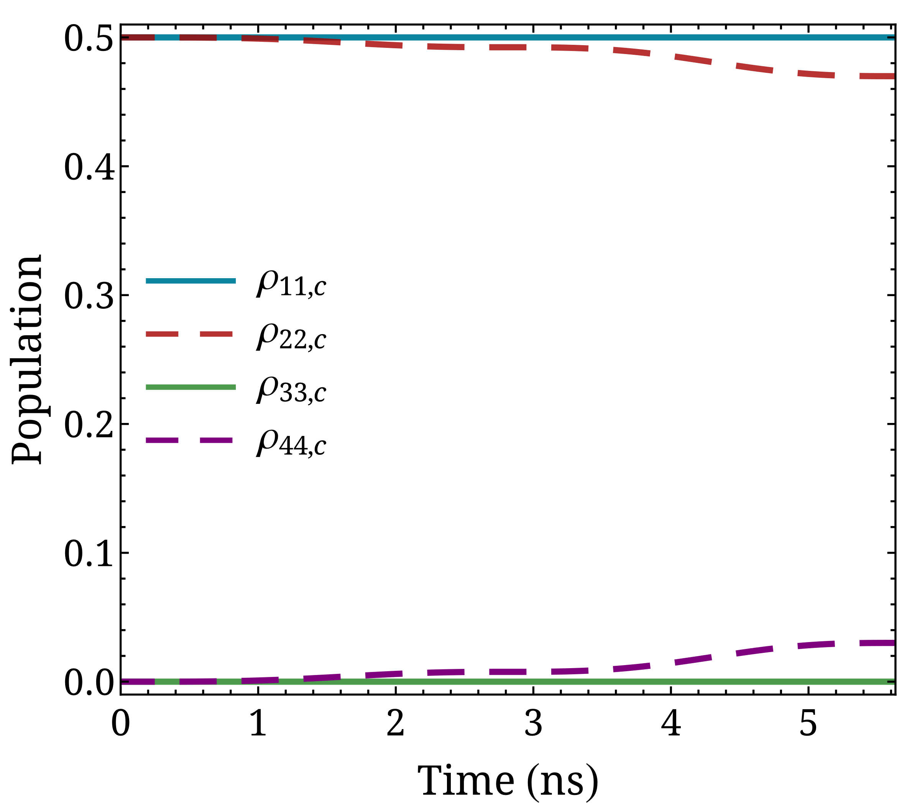
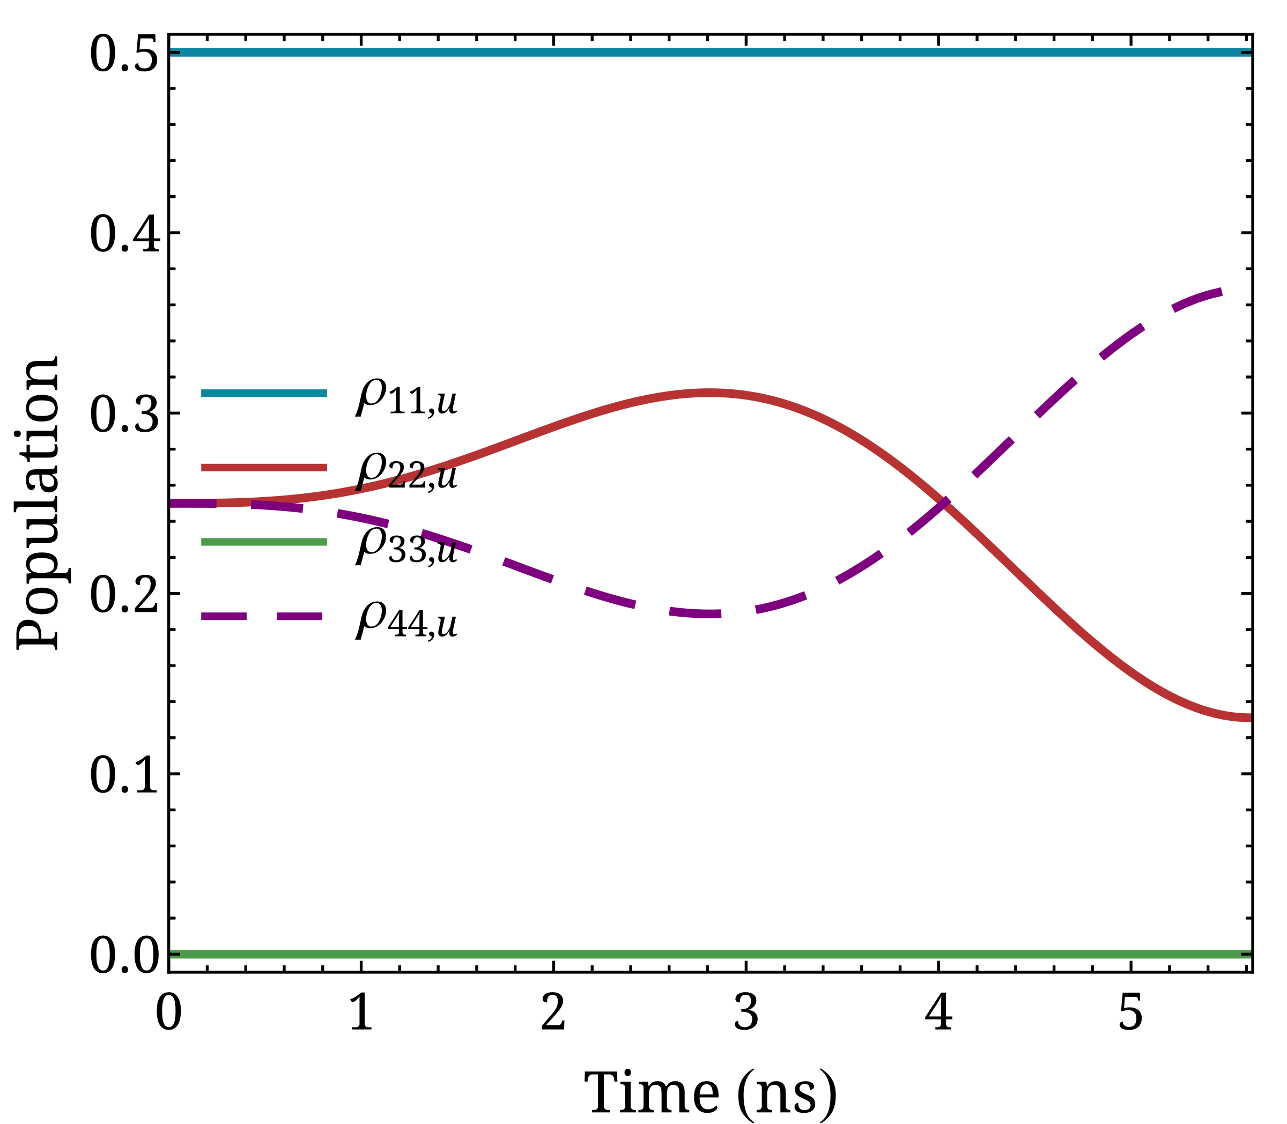


Incoherent initial preparation
Hydrogen atom
How is population evolution affected by $B_{z}=B_{0}\sin\left(\frac{2πvt}{λ}\right)$?
$$ρ_{c}=\left(\begin{matrix}1/2 & 0 & 0 & 0 \\ 0 & 1/2 & 0 & 0 \\ 0 & 0 & 0 & 0 \\ 0 & 0 & 0 & 0\end{matrix}\right)$$
$$H=H_{0}+H_{B}=\frac{A_{2S}}{ℏ^{2}} I⋅S−\left(\frac{g_{S}μ_{B}}{ℏ}S+\frac{g_{I}μ_{N}}{ℏ}I\right)⋅B$$
$B_{0}=1$ mT
 | coupled basis $|\left.F, m_{F}\right\rangle$ | uncoupled basis $|\left.m_{S}, m_{I}\right\rangle$
1. | $$|\left.1, 1\right\rangle$$ | $$|\left.1/2, 1/2\right\rangle$$
2. | $$|\left.1, 0\right\rangle$$ | $$|\left.1/2,−1/2\right\rangle$$
3. | $$|\left.1, −1\right\rangle$$ | $$|\left.−1/2,−1/2\right\rangle$$
4. | $$|\left.0, 0\right\rangle$$ | $$|\left.−1/2, 1/2\right\rangle$$

Slide 11
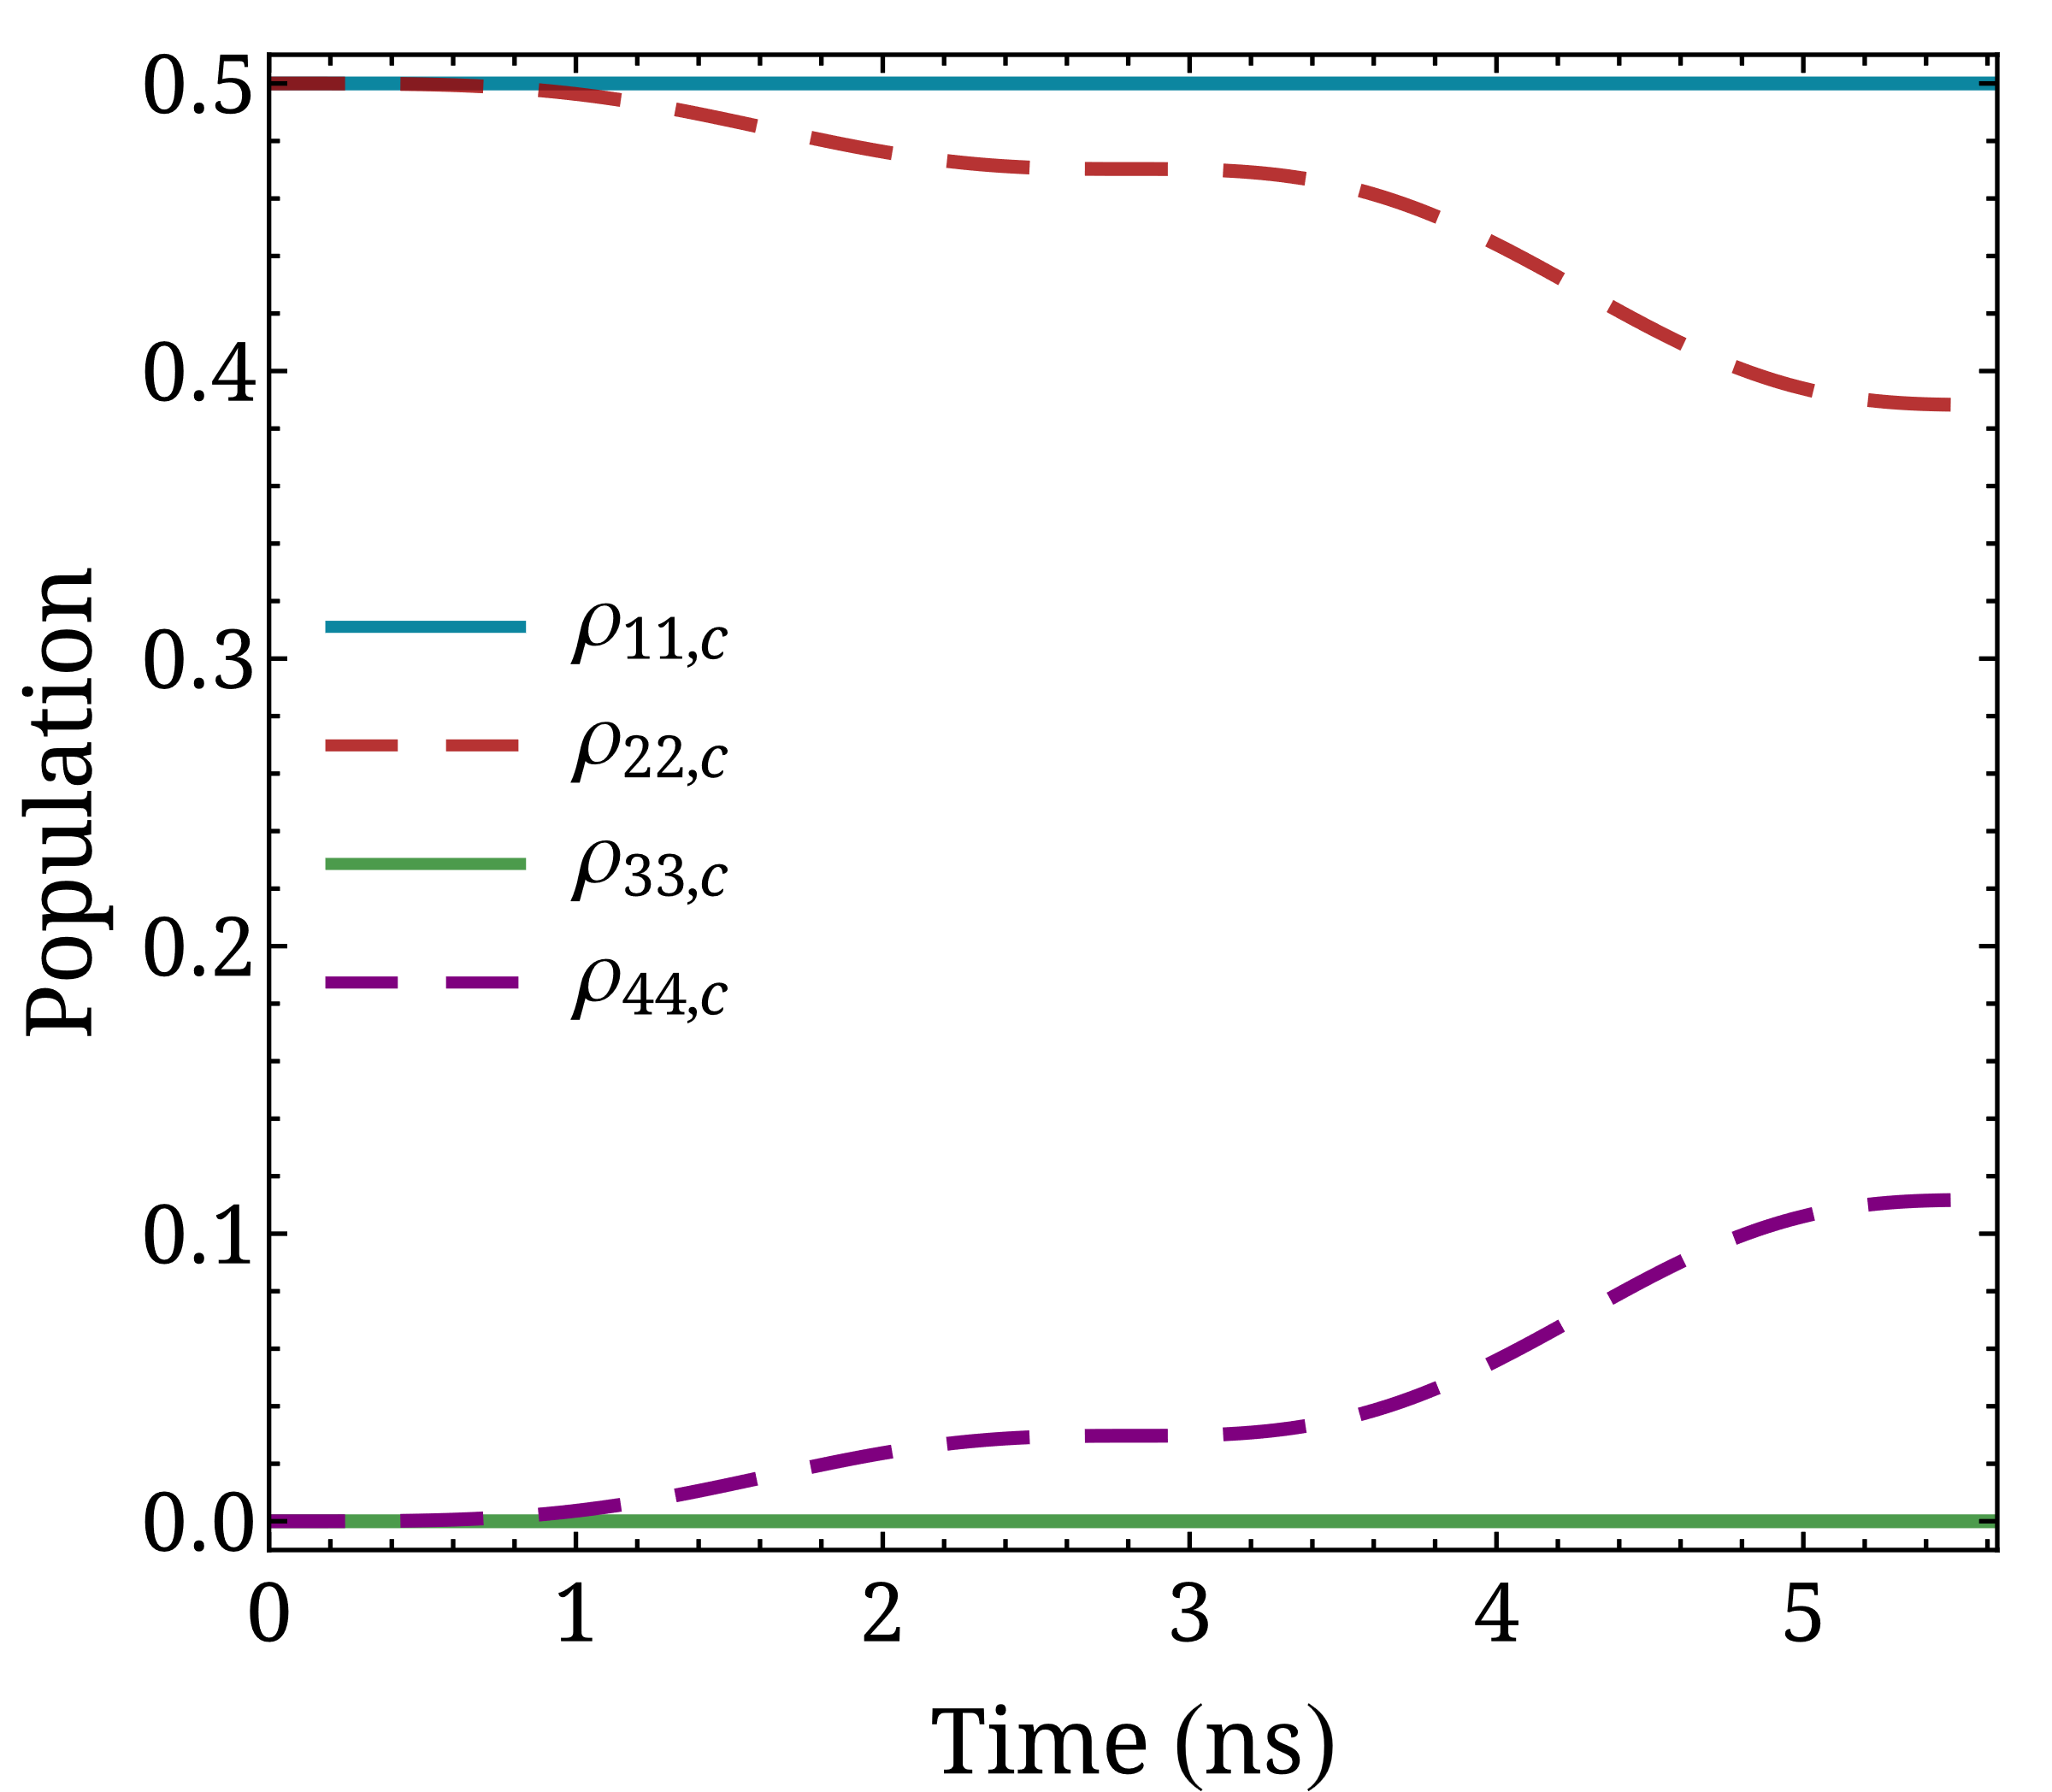
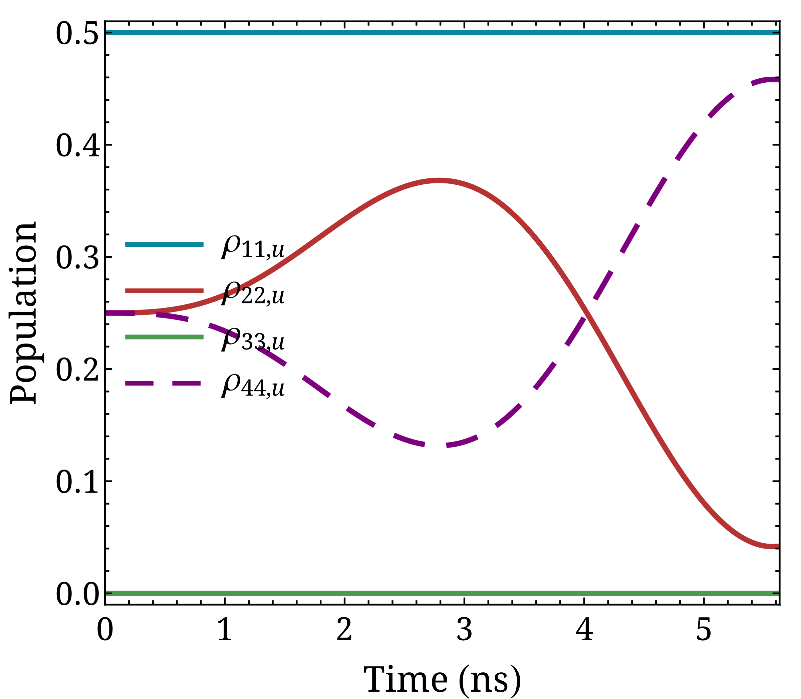

Incoherent initial preparation
Hydrogen atom
How is population evolution affected by $B_{z}=B_{0}\sin\left(\frac{2πvt}{λ}\right)$?
$$ρ_{c}=\left(\begin{matrix}1/2 & 0 & 0 & 0 \\ 0 & 1/2 & 0 & 0 \\ 0 & 0 & 0 & 0 \\ 0 & 0 & 0 & 0\end{matrix}\right)$$
$$H=H_{0}+H_{B}=\frac{A_{2S}}{ℏ^{2}} I⋅S−\left(\frac{g_{S}μ_{B}}{ℏ}S+\frac{g_{I}μ_{N}}{ℏ}I\right)⋅B$$
$B_{0}=2$ mT
 | coupled basis $|\left.F, m_{F}\right\rangle$ | uncoupled basis $|\left.m_{S}, m_{I}\right\rangle$
1. | $$|\left.1, 1\right\rangle$$ | $$|\left.1/2, 1/2\right\rangle$$
2. | $$|\left.1, 0\right\rangle$$ | $$|\left.1/2,−1/2\right\rangle$$
3. | $$|\left.1, −1\right\rangle$$ | $$|\left.−1/2,−1/2\right\rangle$$
4. | $$|\left.0, 0\right\rangle$$ | $$|\left.−1/2, 1/2\right\rangle$$

Slide 12
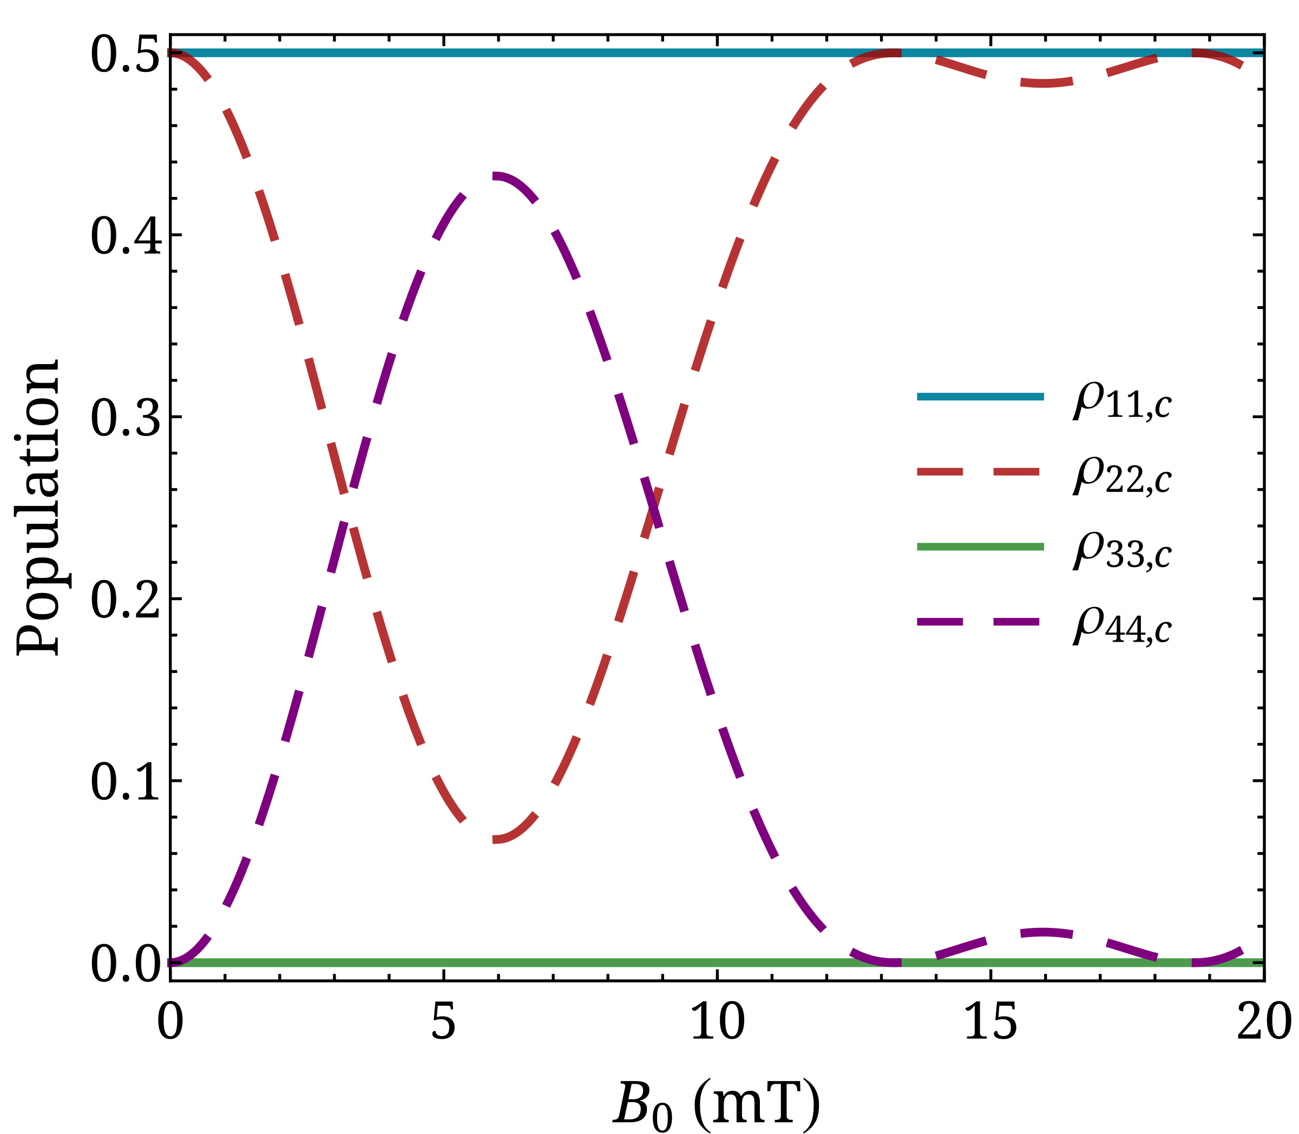
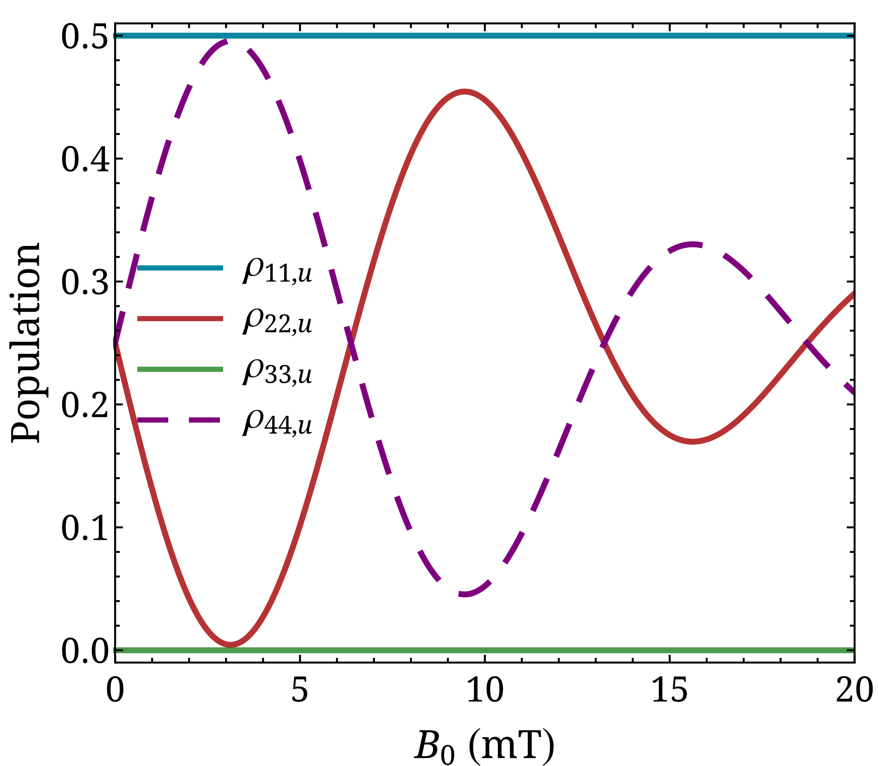
Incoherent initial preparation
Hydrogen atom
How is population evolution affected by $B_{z}=B_{0}\sin\left(\frac{2πvt}{λ}\right)$?
$$ρ_{c}=\left(\begin{matrix}1/2 & 0 & 0 & 0 \\ 0 & 1/2 & 0 & 0 \\ 0 & 0 & 0 & 0 \\ 0 & 0 & 0 & 0\end{matrix}\right)$$
$$H=H_{0}+H_{B}=\frac{A_{2S}}{ℏ^{2}} I⋅S−\left(\frac{g_{S}μ_{B}}{ℏ}S+\frac{g_{I}μ_{N}}{ℏ}I\right)⋅B$$
 | coupled basis $|\left.F, m_{F}\right\rangle$ | uncoupled basis $|\left.m_{S}, m_{I}\right\rangle$
1. | $$|\left.1, 1\right\rangle$$ | $$|\left.1/2, 1/2\right\rangle$$
2. | $$|\left.1, 0\right\rangle$$ | $$|\left.1/2,−1/2\right\rangle$$
3. | $$|\left.1, −1\right\rangle$$ | $$|\left.−1/2,−1/2\right\rangle$$
4. | $$|\left.0, 0\right\rangle$$ | $$|\left.−1/2, 1/2\right\rangle$$

Slide 13
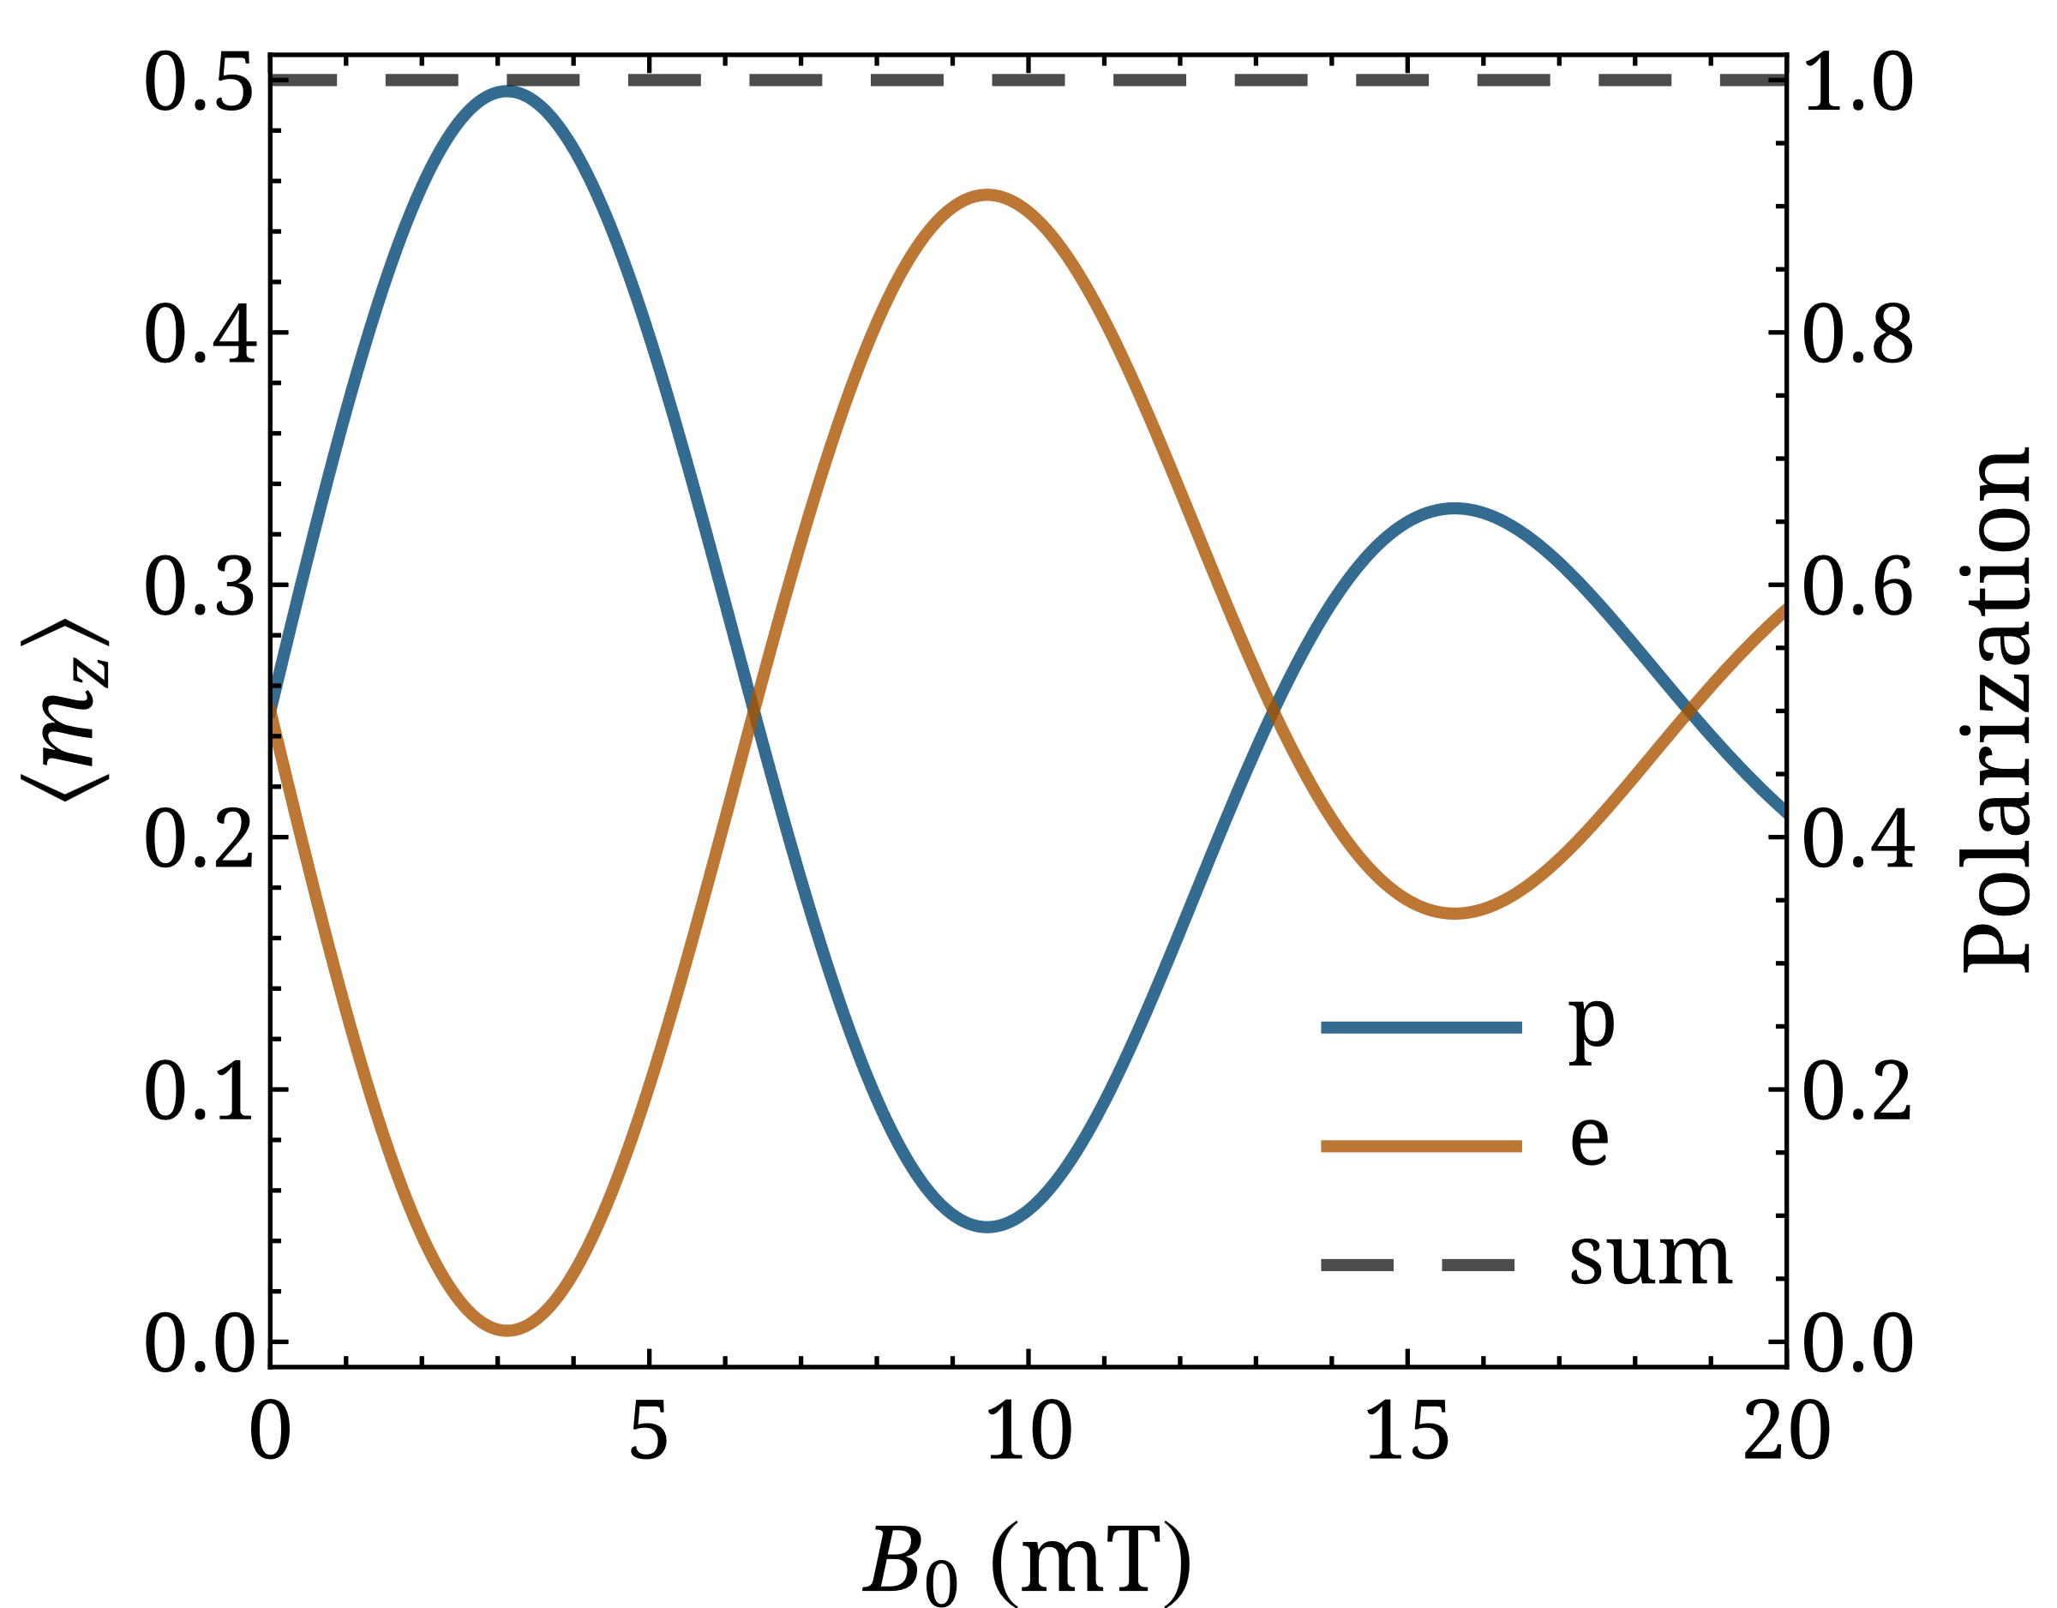
Incoherent initial preparation
Hydrogen atom
How is population evolution affected by $B_{z}=B_{0}\sin\left(\frac{2πvt}{λ}\right)$?
$$H=H_{0}+H_{B}=\frac{A_{2S}}{ℏ^{2}} I⋅S−\left(\frac{g_{S}μ_{B}}{ℏ}S+\frac{g_{I}μ_{N}}{ℏ}I\right)⋅B$$

Slide 14

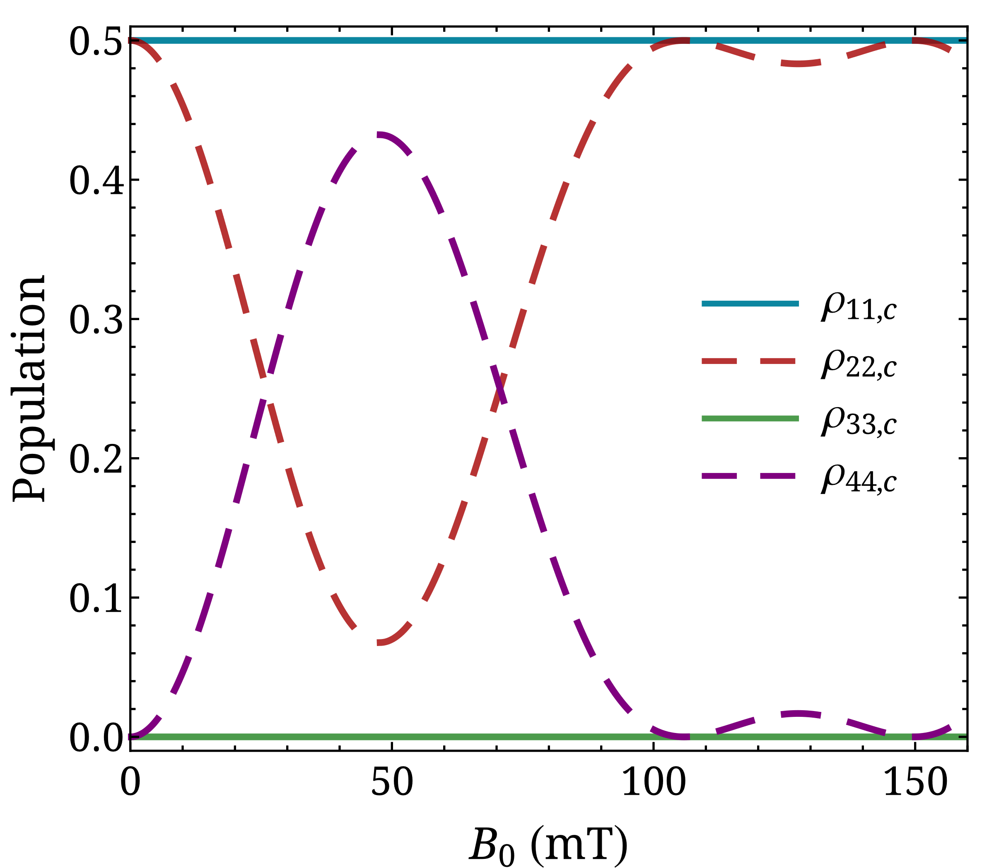



Incoherent initial preparation
Hydrogen atom
  Ground state ($A_{1S}=1.42$ GHz)
How is population evolution affected by $B_{z}=B_{0}\sin\left(\frac{2πvt}{λ}\right)$?
$$H=H_{0}+H_{B}=\frac{A_{1S}}{ℏ^{2}} I⋅S−\left(\frac{g_{S}μ_{B}}{ℏ}S+\frac{g_{I}μ_{N}}{ℏ}I\right)⋅B$$

Slide 15
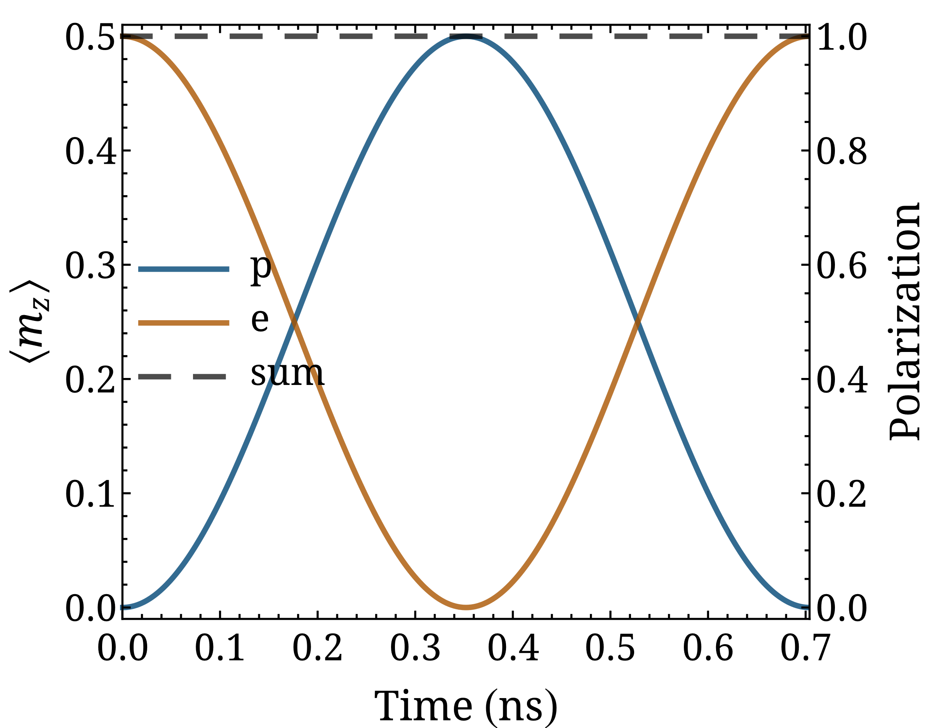
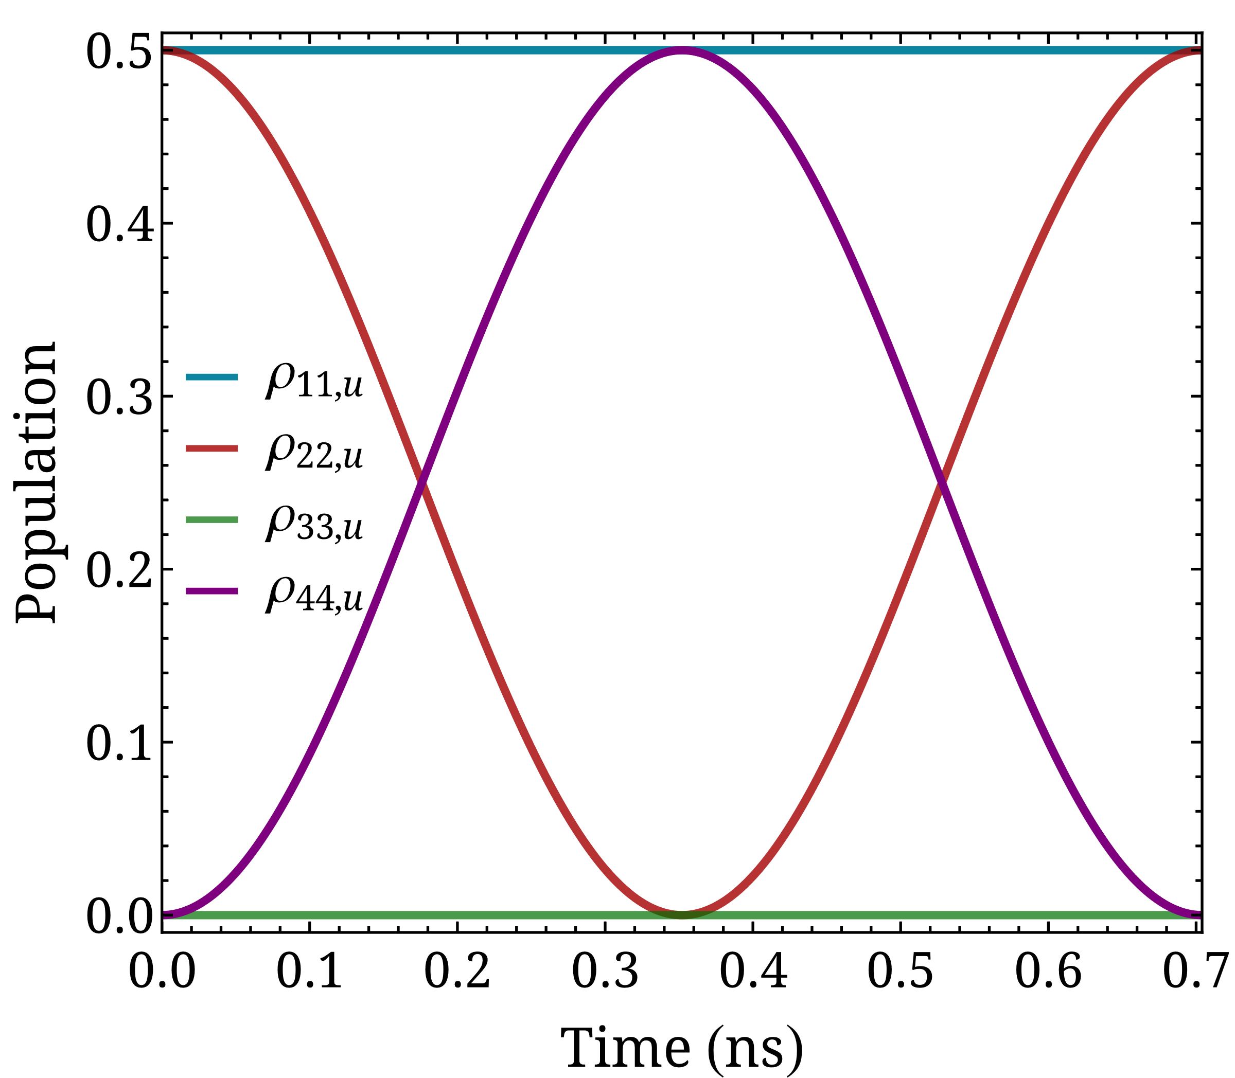



Coherent initial preparation
Hydrogen atom
  Ground state: Molecular photodissociation of a hydrogen halide
  Example reaction: $HY+hf→…→H\left(m_{H}=±\frac{1}{2}\right)+Y\left(m_{Y}=±\frac{1}{2}\right)$
$$H_{0}=\frac{A_{1S}}{ℏ^{2}} I⋅S$$
$$ρ_{u}=\left(\begin{matrix}1/2 & 0 & 0 & 0 \\ 0 & 1/2 & 0 & 0 \\ 0 & 0 & 0 & 0 \\ 0 & 0 & 0 & 0\end{matrix}\right)$$
$ρ_{c}=\left(\begin{matrix}1/2 & 0 & 0 & 0 \\ 0 & 1/4 & 0 & 1/4 \\ 0 & 0 & 0 & 0 \\ 0 & 1/4 & 0 & 1/4\end{matrix}\right)$

Slide 16
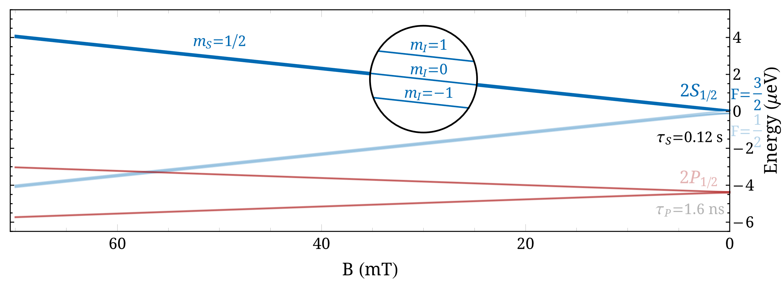

Incoherent initial preparation
Deuterium atom
  Ground state: similar to hydrogen
  Metastable state: use of the $2S_{1/2}−2P_{1/2}$ level crossing (at high magnetic field)

Slide 17
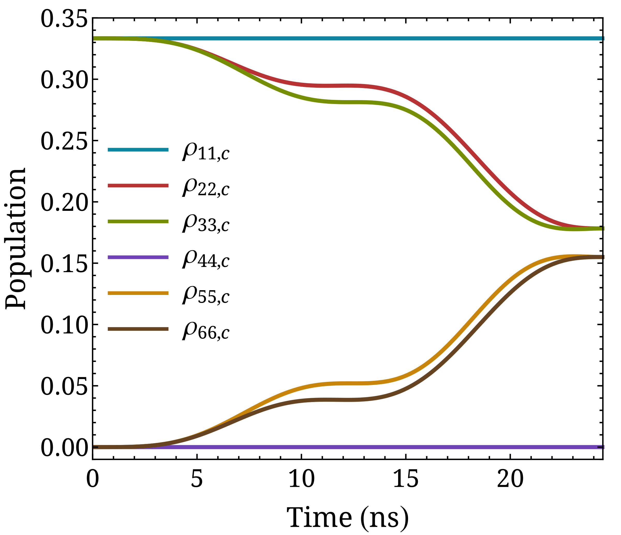
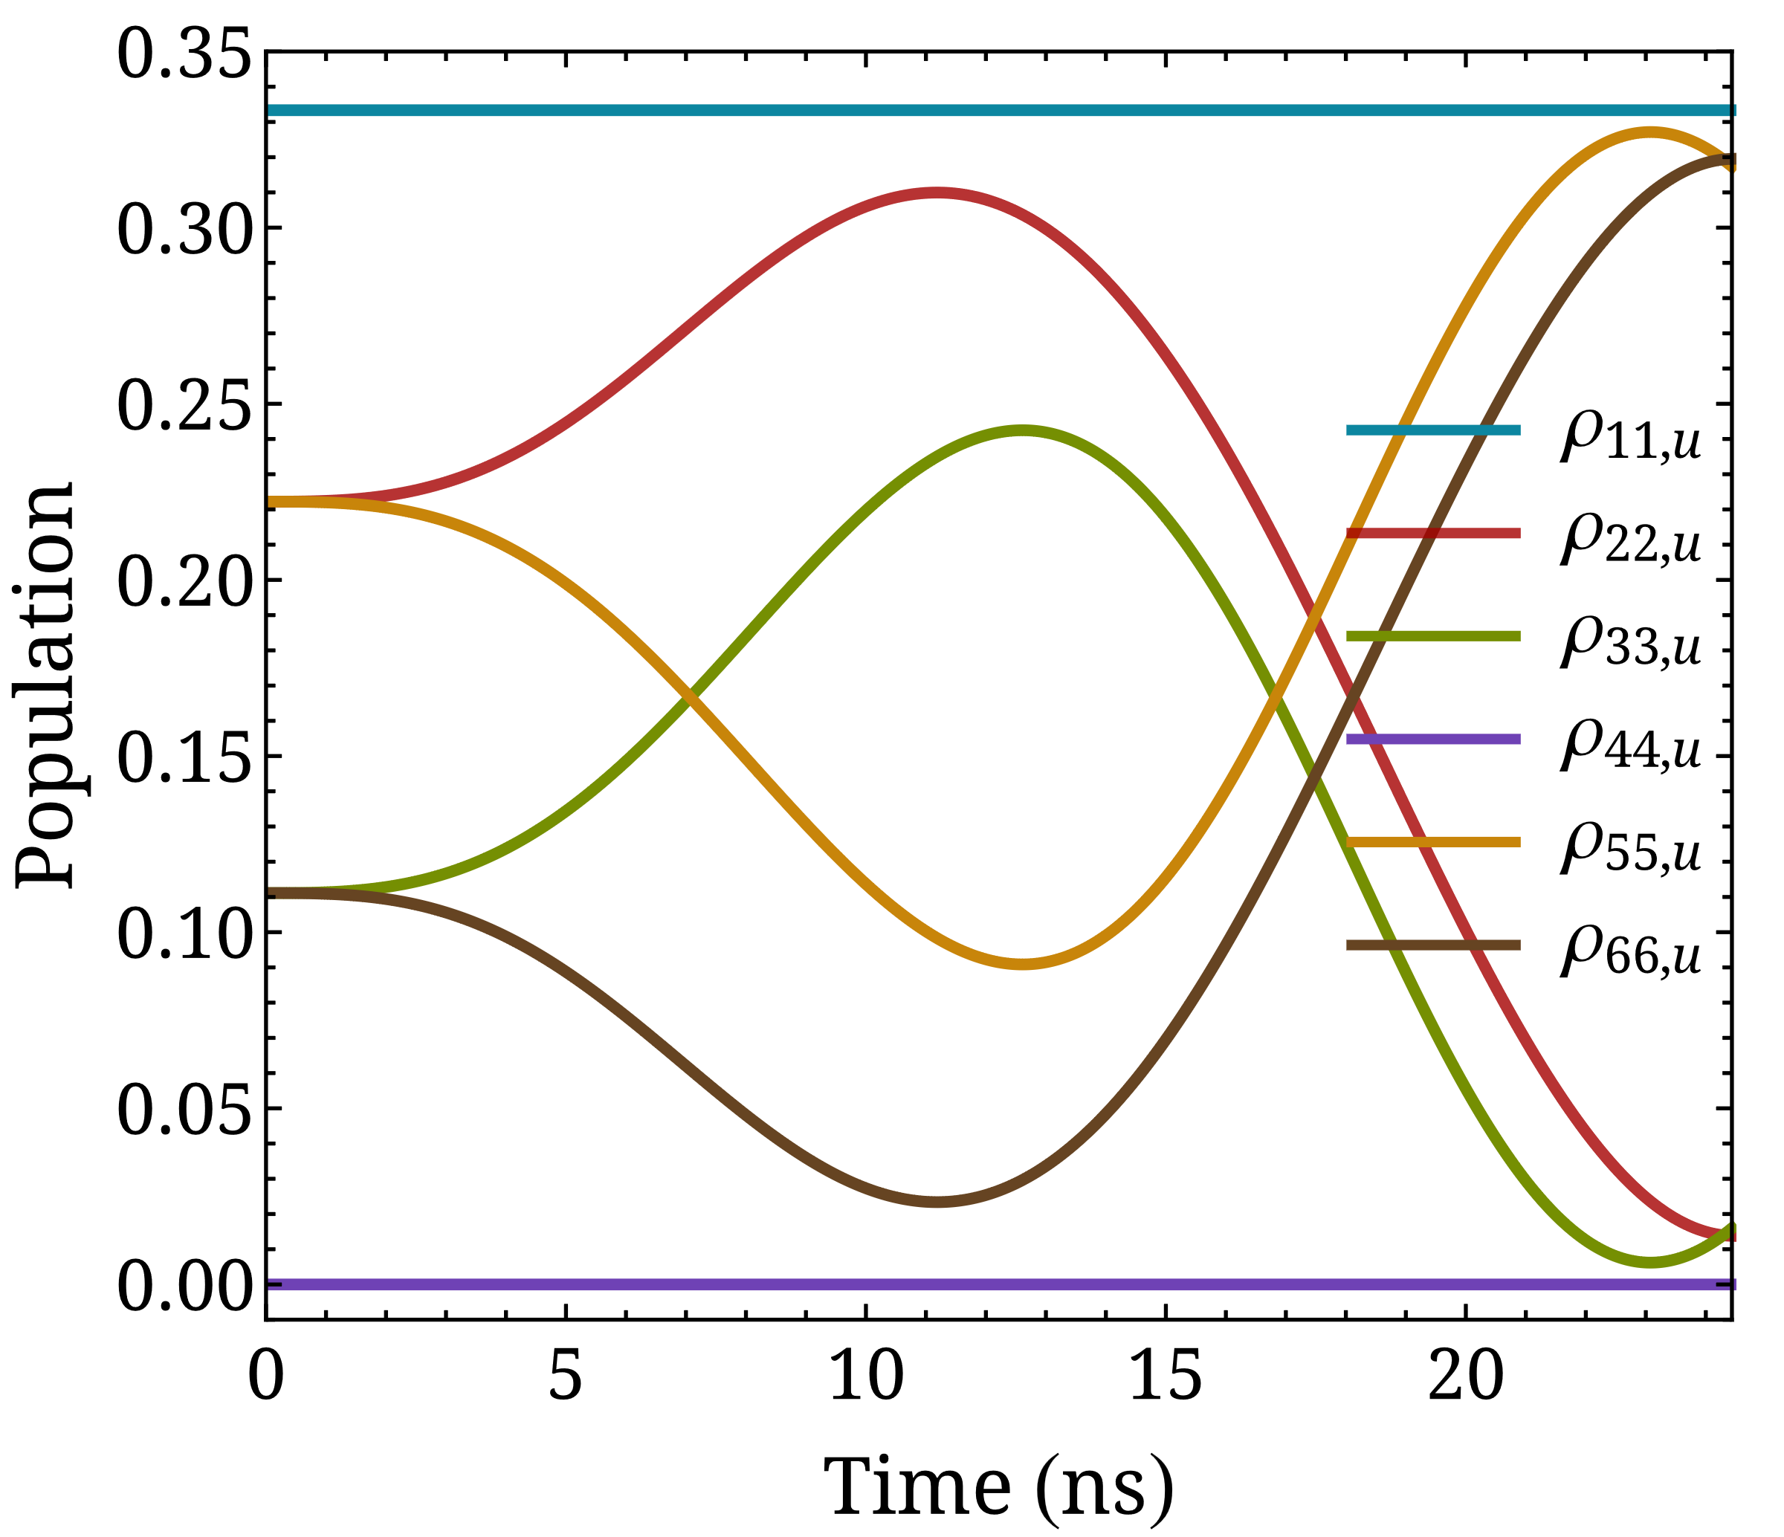
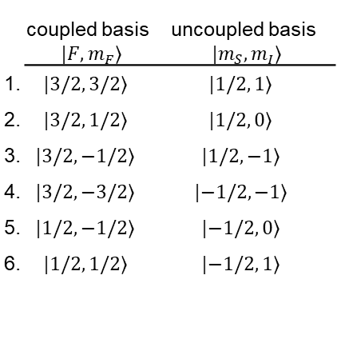



Incoherent initial preparation
$$H=H_{0}+H_{B}=\frac{A_{2S}}{ℏ^{2}} I⋅S−\left(\frac{g_{S}μ_{B}}{ℏ}S+\frac{g_{I}μ_{N}}{ℏ}I\right)⋅B$$
Deuterium atom
$$ρ_{c}=\left(\begin{matrix}1/3 & 0 & 0 & 0 & 0 & 0 \\ 0 & 1/3 & 0 & 0 & 0 & 0 \\ 0 & 0 & 1/3 & 0 & 0 & 0 \\ 0 & 0 & 0 & 0 & 0 & 0 \\ 0 & 0 & 0 & 0 & 0 & 0 \\ 0 & 0 & 0 & 0 & 0 & 0\end{matrix}\right)$$
$H_{0}=\frac{A_{2S}}{ℏ^{2}} I⋅S \text{with} \frac{A_{2S}}{h}=27.28 \text{MHz} t_{f}=\frac{h}{ΔE_{hfs}}=\frac{2h}{{3A}_{2S}}∼24.4$ ns
$B_{0}=0.76$ mT
 | coupled basis $|\left.F, m_{F}\right\rangle$ | uncoupled basis $|\left.m_{S}, m_{I}\right\rangle$
1. | $$|\left.3/2, 3/2\right\rangle$$ | $$|\left.1/2, 1\right\rangle$$
2. | $$|\left.3/2, 1/2\right\rangle$$ | $$|\left.1/2, 0\right\rangle$$
3. | $$|\left.3/2, −1/2\right\rangle$$ | $$|\left.1/2, −1\right\rangle$$
4. | $$|\left.3/2, −3/2\right\rangle$$ | $$|\left.−1/2, −1\right\rangle$$
5. | $$|\left.1/2,−1/2\right\rangle$$ | $$|\left.−1/2, 0\right\rangle$$
6. | $$|\left.1/2, 1/2\right\rangle$$ | $$|\left.−1/2, 1\right\rangle$$

Slide 18
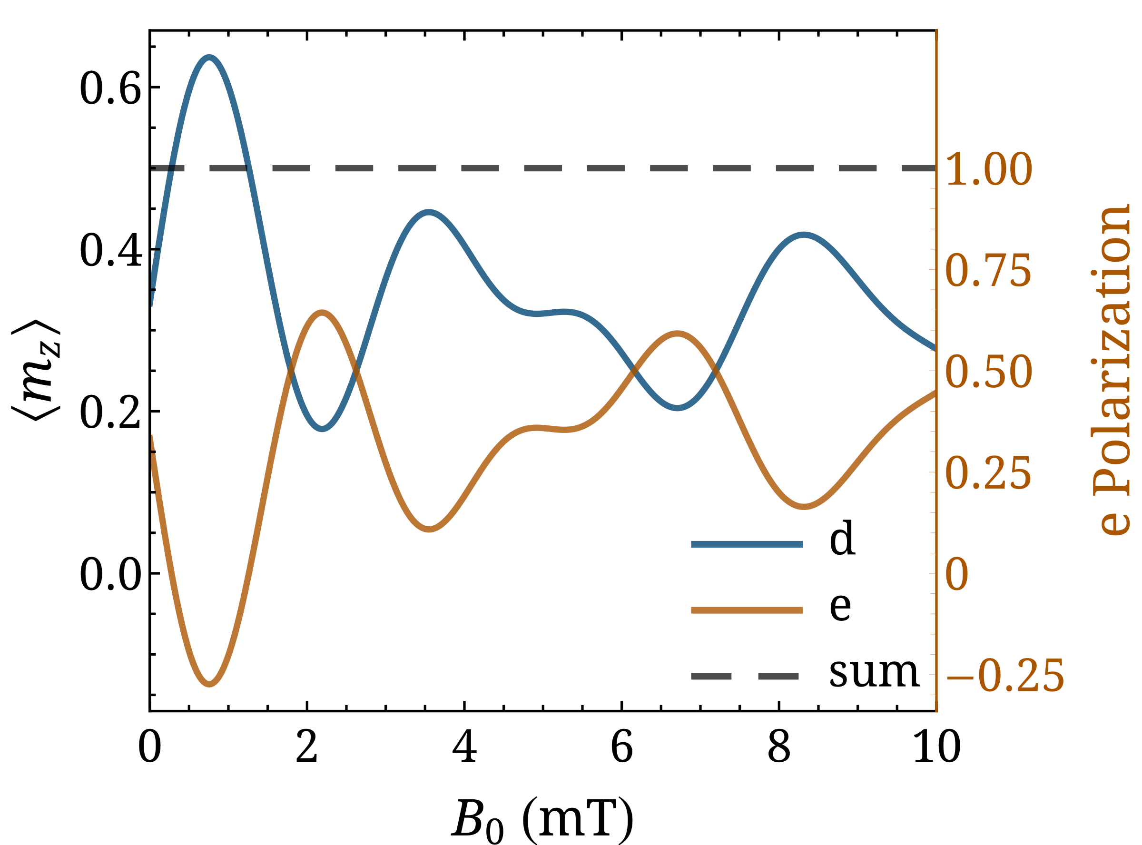
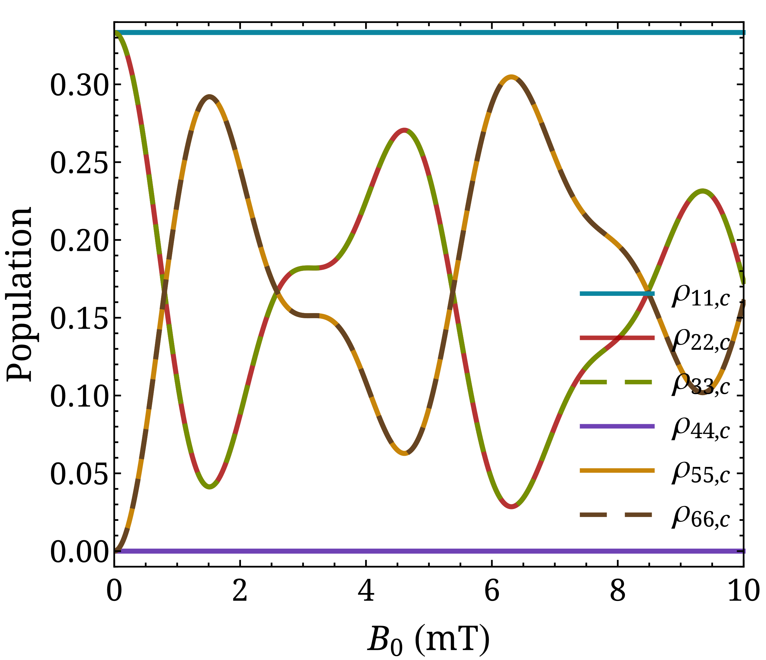
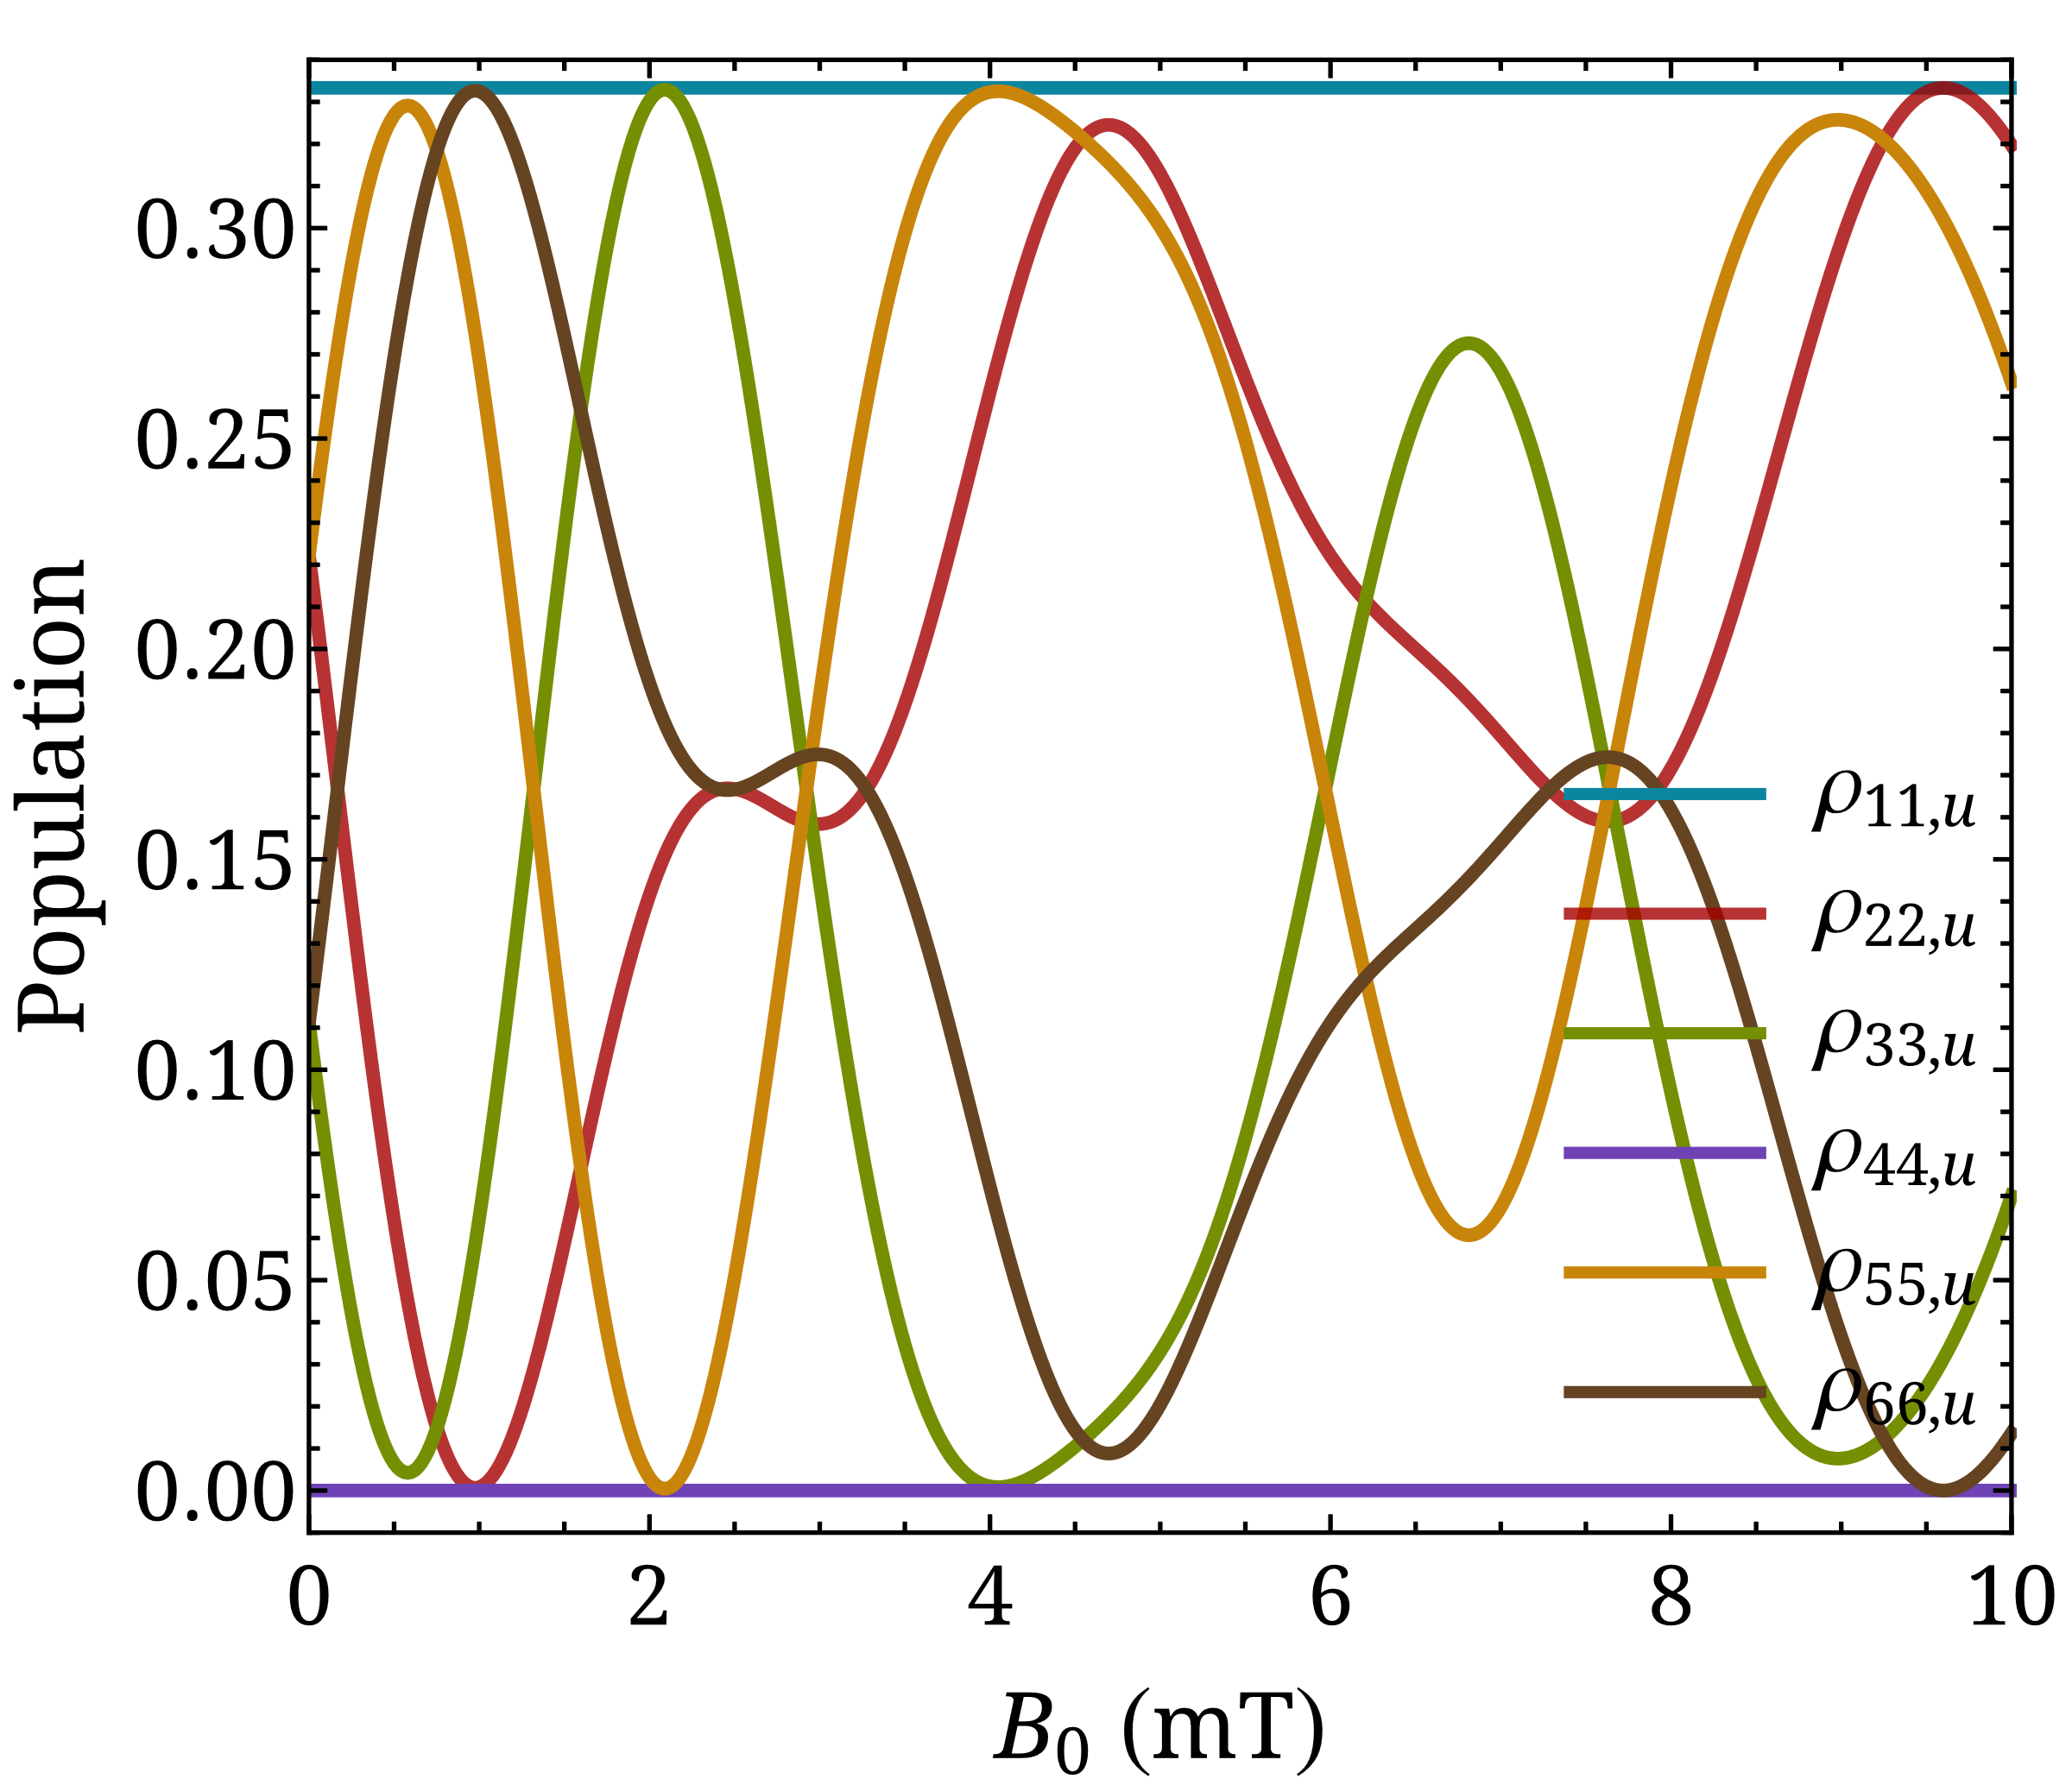
Incoherent initial preparation
$$H=H_{0}+H_{B}=\frac{A_{2S}}{ℏ^{2}} I⋅S−\left(\frac{g_{S}μ_{B}}{ℏ}S+\frac{g_{I}μ_{N}}{ℏ}I\right)⋅B$$
Deuterium atom
$H_{0}=\frac{A_{2S}}{ℏ^{2}} I⋅S \text{with} \frac{A_{2S}}{h}=27.28 \text{MHz} t_{f}=\frac{h}{ΔE_{hfs}}=\frac{2h}{{3A}_{2S}}∼24.4$ ns

Slide 19
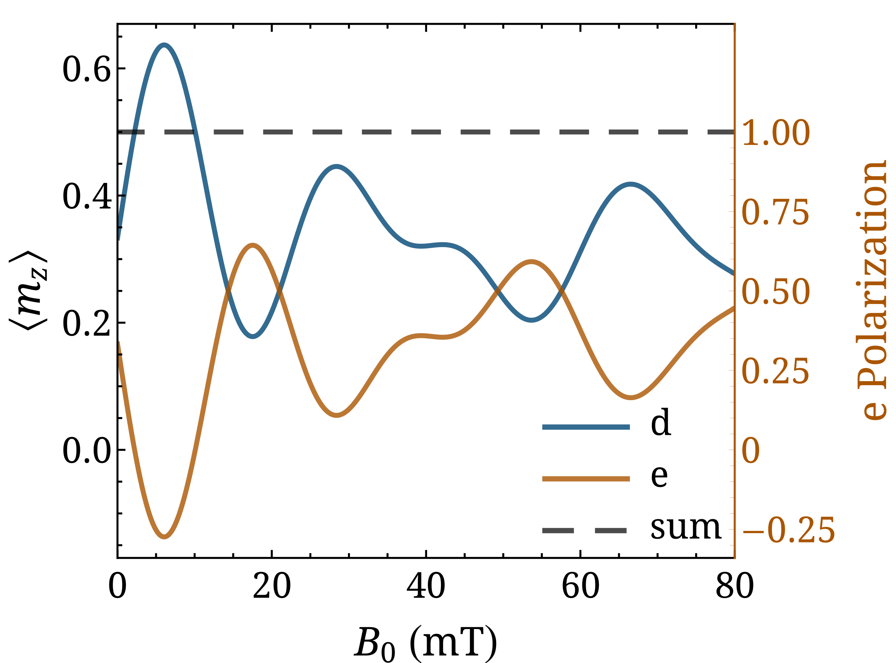



Incoherent initial preparation
$$H=H_{0}+H_{B}=\frac{A_{1S}}{ℏ^{2}} I⋅S−\left(\frac{g_{S}μ_{B}}{ℏ}S+\frac{g_{I}μ_{N}}{ℏ}I\right)⋅B$$
Deuterium atom
  Ground state
$H_{0}=\frac{A_{1S}}{ℏ^{2}} I⋅S \text{with} \frac{A_{1S}}{h}=218.2\text{6} \text{MHz} t_{f}=\frac{h}{ΔE_{hfs}}=\frac{2h}{{3A}_{1S}}∼3$ ns

Slide 20
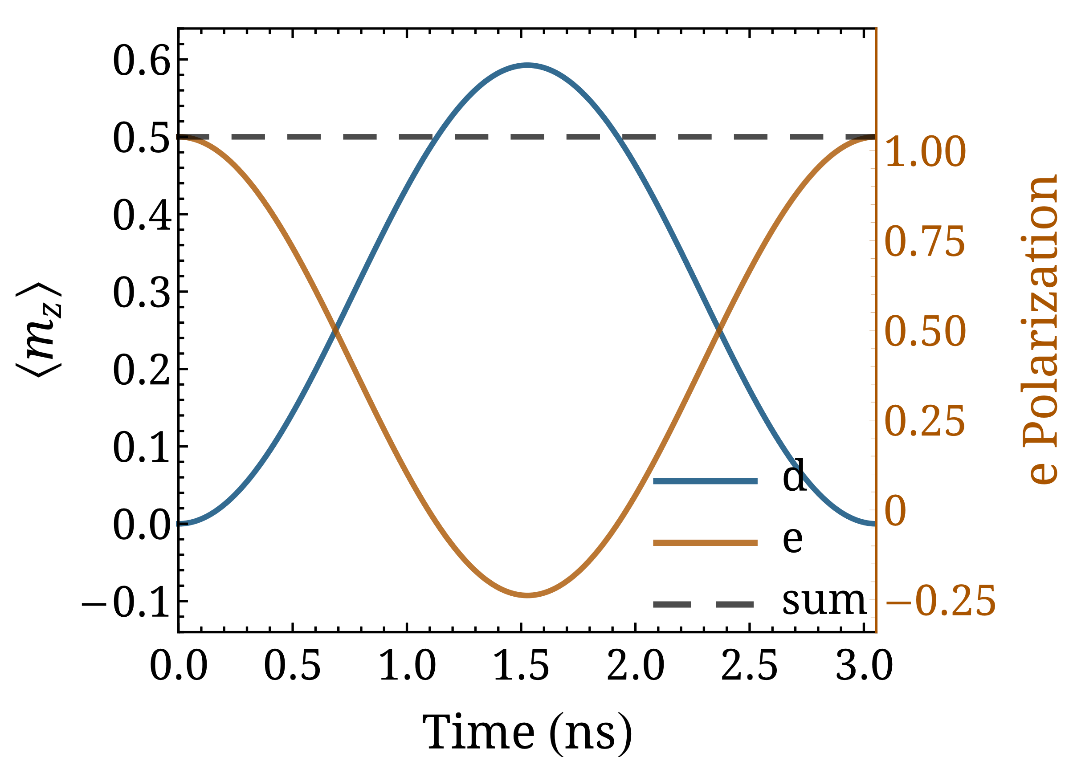
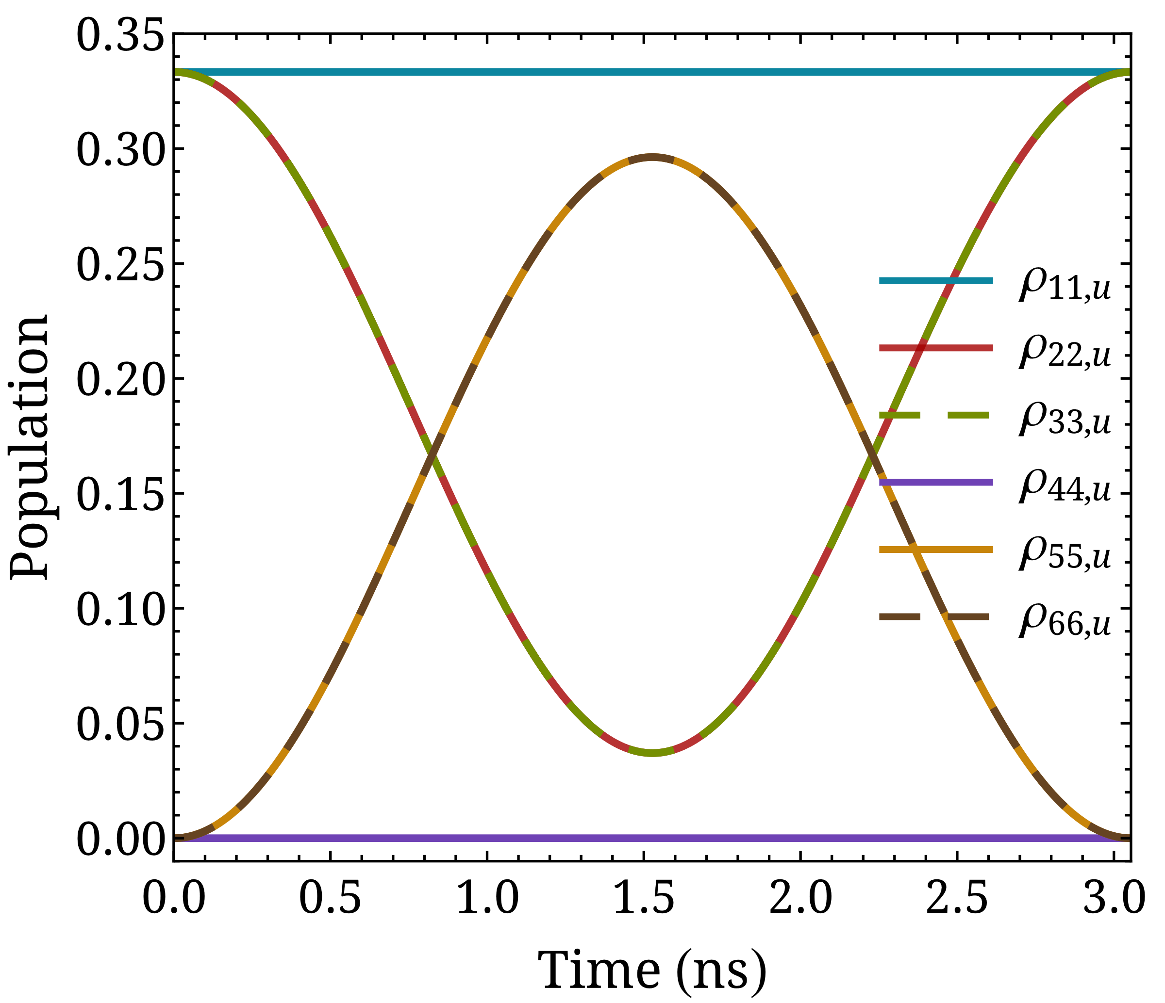



Coherent initial preparation
Deuterium atom
  Ground state: Molecular photodissociation of a deuterium halide
  Example reaction: $DY+hf→…→D\left(m_{D}=±\frac{1}{2}\right)+Y\left(m_{Y}=±\frac{1}{2}\right)$
$$H_{0}=\frac{A_{1S}}{ℏ^{2}} I⋅S$$
$$ρ_{u}=\left(\begin{matrix}1/3 & 0 & 0 & 0 & 0 & 0 \\ 0 & 1/3 & 0 & 0 & 0 & 0 \\ 0 & 0 & 1/3 & 0 & 0 & 0 \\ 0 & 0 & 0 & 0 & 0 & 0 \\ 0 & 0 & 0 & 0 & 0 & 0 \\ 0 & 0 & 0 & 0 & 0 & 0\end{matrix}\right)$$
$ρ_{c}=\left(\begin{matrix}1/3 & 0 & 0 & 0 & 0 & 0 \\ 0 & 2/9 & 0 & 0 & 0 & \sqrt{2}/9 \\ 0 & 0 & 1/9 & 0 & \sqrt{2}/9 & 0 \\ 0 & 0 & 0 & 0 & 0 & 0 \\ 0 & 0 & \sqrt{2}/9 & 0 & 2/9 & 0 \\ 0 & \sqrt{2}/9 & 0 & 0 & 0 & 1/9\end{matrix}\right)$

Slide 21
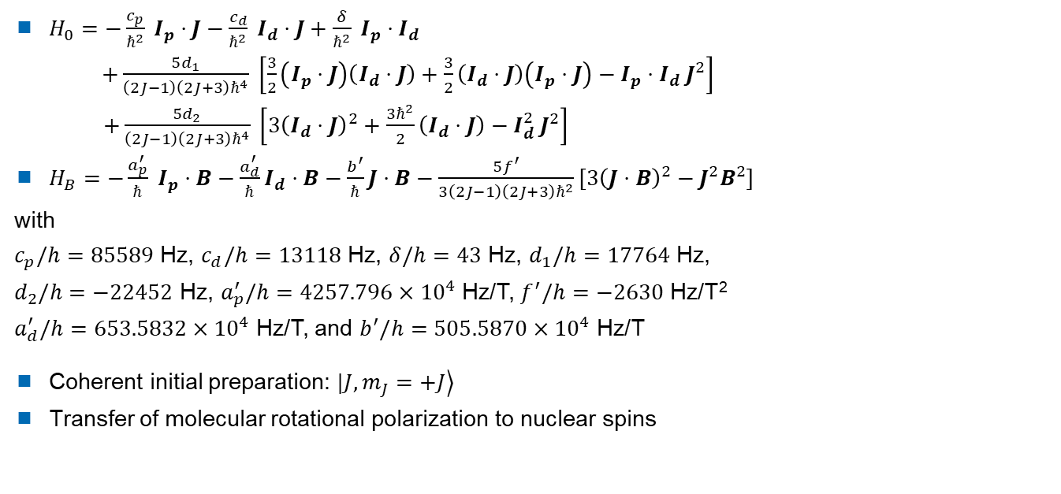
Coherently rotationally state-selected HD
$H_{0}=−\frac{c_{p}}{ℏ^{2}} I_{p}⋅J−\frac{c_{d}}{ℏ^{2}} I_{d}⋅J+\frac{δ}{ℏ^{2}} I_{p}⋅I_{d}$
$+\frac{5d_{1}}{\left(2J−1\right)\left(2J+3\right)ℏ^{4}} \left[\frac{3}{2}\left(I_{p}⋅J\right)\left(I_{d}⋅J\right)+\frac{3}{2}\left(I_{d}⋅J\right)\left(I_{p}⋅J\right)−I_{p}⋅I_{d} J^{2}\right]$
$+\frac{5d_{2}}{\left(2J−1\right)\left(2J+3\right)ℏ^{4}} \left[3{\left(I_{d}⋅J\right)}^{2}+\frac{3ℏ^{2}}{2}\left(I_{d}⋅J\right)−I_{d}^{2} J^{2}\right]$
$H_{B}=−\frac{a_{p}^{′}}{ℏ} I_{p}⋅B−\frac{a_{d}^{′}}{ℏ}I_{d}⋅B−\frac{b^{′}}{ℏ}J⋅B−\frac{5f^{′}}{3\left(2J−1\right)\left(2J+3\right)ℏ^{2}}\left[3{\left(J⋅B\right)}^{2}−J^{2}B^{2}\right]$
with
$c_{p}/h=85589$ Hz, $c_{d}/h=13118$ Hz, $δ/h=43$ Hz, $d_{1}/h=17764$ Hz,
$d_{2}/h=−22452$ Hz, $a_{p}^{′}/h=4257.796×{10}^{4}$ Hz/T, $f^{′}/h=−2630$ Hz/T²
$a_{d}^{′}/h=653.5832×{10}^{4}$ Hz/T, and $b^{′}/h=505.5870×{10}^{4}$ Hz/T
Coherent initial preparation: $|\left.J, m_{J}=+J\right\rangle$
Transfer of molecular rotational polarization to nuclear spins
N. C.-M. Bartlett et al., Phys. Chem. Chem. Phys. 11, 142 (2009)

Slide 22
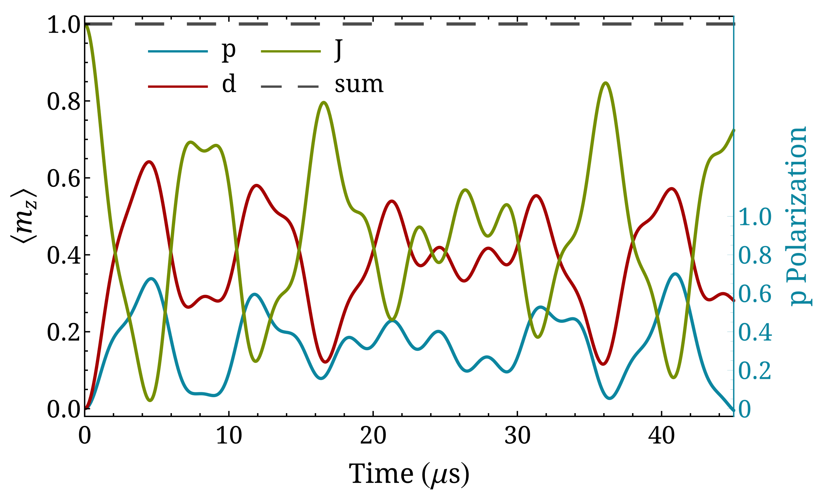
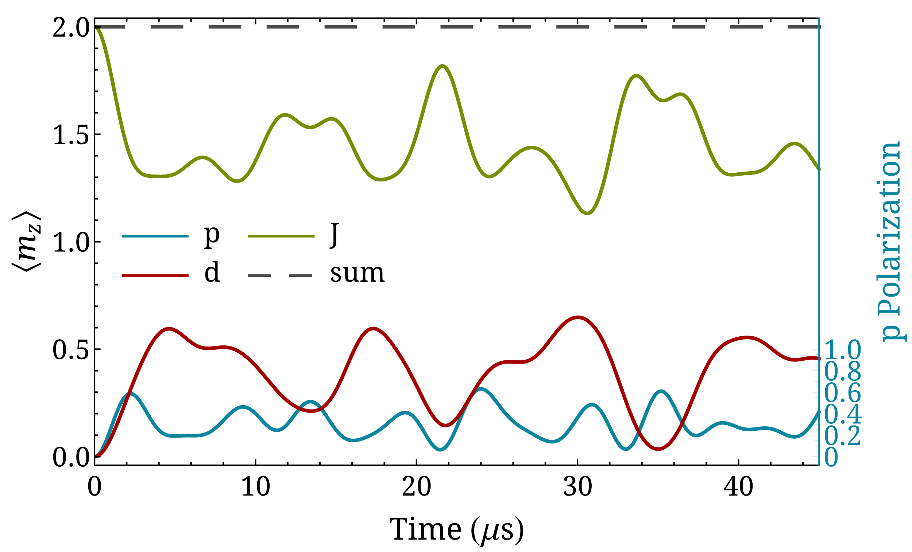

Coherently rotationally state-selected HD
$J=1$: proton pol. 70% at 41 μs and deuteron pol. 64% at 4.5 μs
$J=2$: proton pol. 63% at 24 μs and deuteron pol. 65% at 30 μs

Slide 23
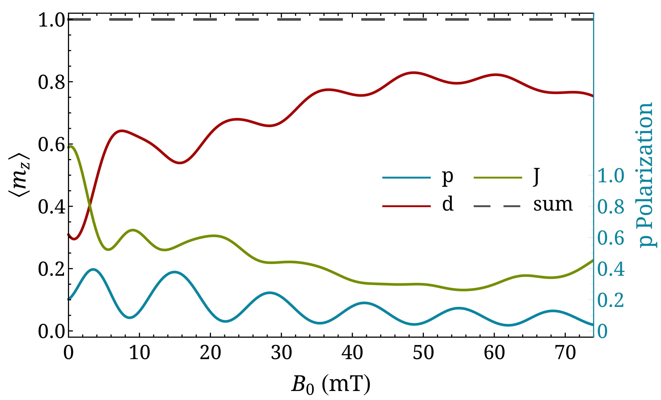
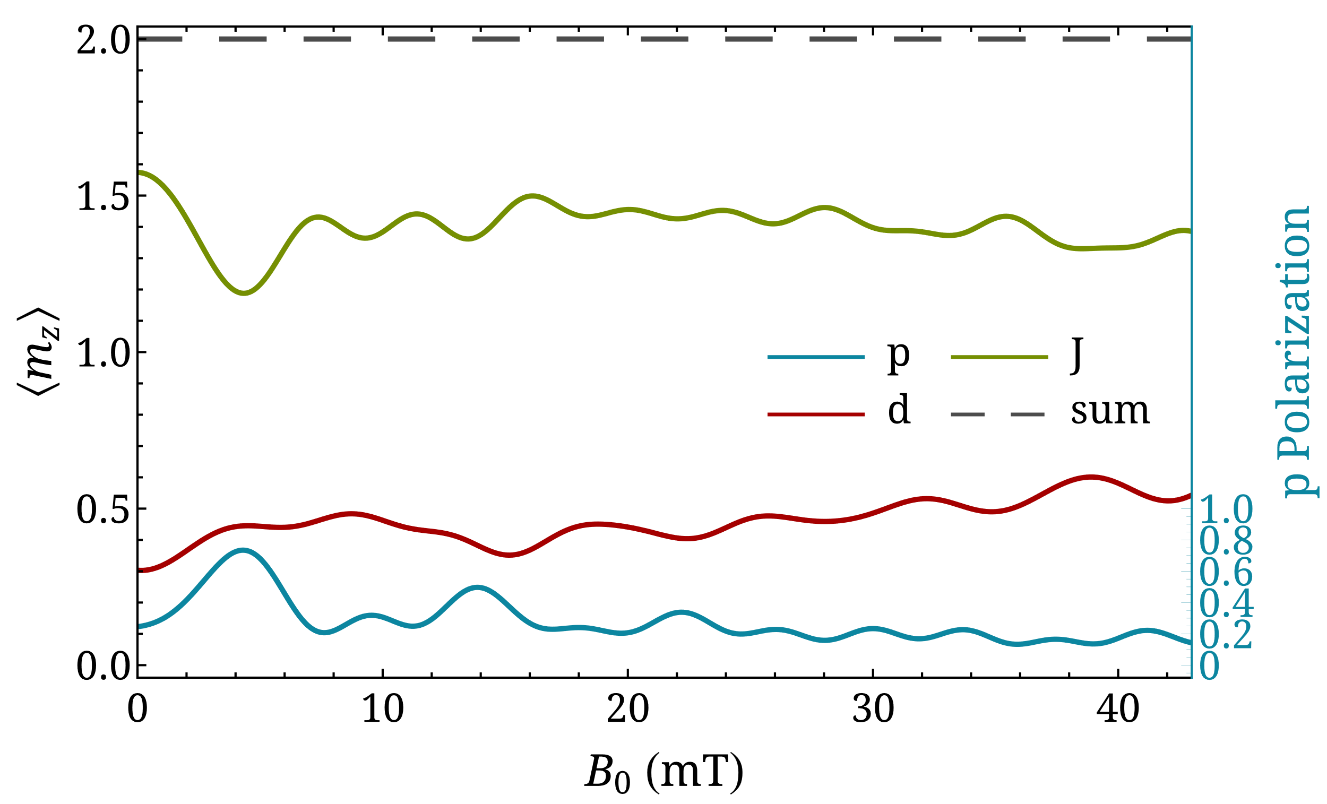

Coherently rotationally state-selected HD
$J=1$: $t_{f}=\frac{1}{153935 Hz}∼6.5$ μs, deuteron pol. 83% $\left(B_{0}=48.6 mT\right)$
$J=2$: $t_{f}=\frac{1}{87852 Hz}∼11.4$ μs, proton pol. 74% $\left(B_{0}=4.3 mT\right)$

Slide 24
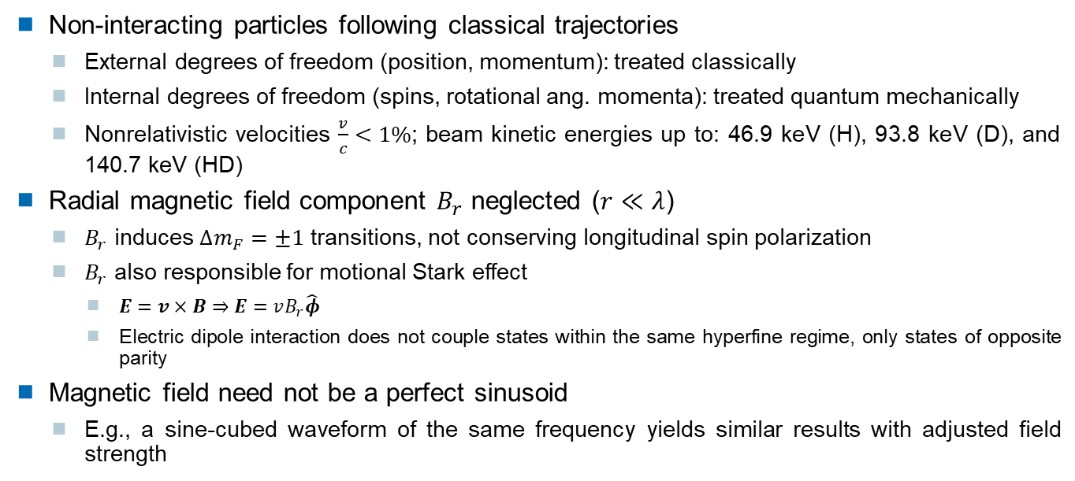
Limitations
Non-interacting particles following classical trajectories
  External degrees of freedom (position, momentum): treated classically
  Internal degrees of freedom (spins, rotational ang. momenta): treated quantum mechanically
  Nonrelativistic velocities $\frac{v}{c}<1\%$; beam kinetic energies up to: 46.9 keV (H), 93.8 keV (D), and 140.7 keV (HD)
Radial magnetic field component $B_{r}$ neglected ($r≪λ$)
  $B_{r}$ induces $Δm_{F}=±1$ transitions, not conserving longitudinal spin polarization
  $B_{r}$ also responsible for motional Stark effect
    $E=v×B⇒E=vB_{r}\hat{φ}$
    Electric dipole interaction does not couple states within the same hyperfine regime, only states of opposite parity
Magnetic field need not be a perfect sinusoid
  E.g., a sine-cubed waveform of the same frequency yields similar results with adjusted field strength

Slide 25
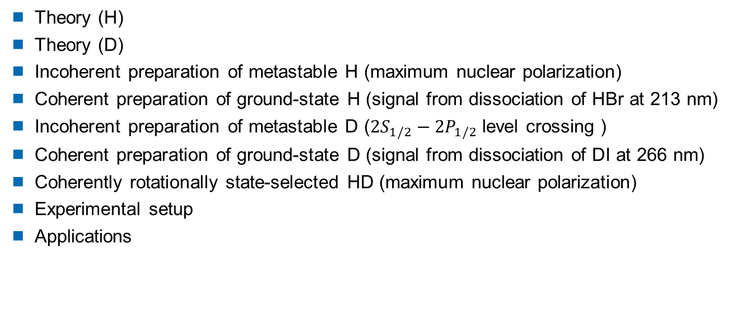
Additional information
Theory (H)
Theory (D)
Incoherent preparation of metastable H (maximum nuclear polarization)
Coherent preparation of ground-state H (signal from dissociation of HBr at 213 nm)
Incoherent preparation of metastable D ($2S_{1/2}−2P_{1/2}$ level crossing )
Coherent preparation of ground-state D (signal from dissociation of DI at 266 nm)
Coherently rotationally state-selected HD (maximum nuclear polarization)
Experimental setup
Applications

Slide 26
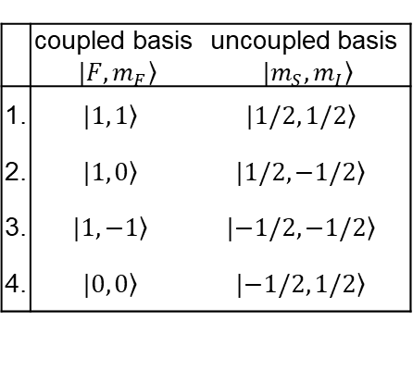





Theory: coupled and uncoupled bases
Hydrogen atom: $\frac{1}{2}⊗\frac{1}{2}=1⊕0$
 | coupled basis $|\left.F, m_{F}\right\rangle$ | uncoupled basis $|\left.m_{S}, m_{I}\right\rangle$
1. | $$|\left.1, 1\right\rangle$$ | $$|\left.1/2, 1/2\right\rangle$$
2. | $$|\left.1, 0\right\rangle$$ | $$|\left.1/2,−1/2\right\rangle$$
3. | $$|\left.1, −1\right\rangle$$ | $$|\left.−1/2,−1/2\right\rangle$$
4. | $$|\left.0, 0\right\rangle$$ | $$|\left.−1/2, 1/2\right\rangle$$
$$\left\langle m_{z, p/e}\right\rangle =\frac{1}{ℏ}\left\langle S_{z, p/e}\right\rangle =\frac{1}{ℏ}Tr\left(ρS_{z, p/e}\right)$$
$S_{z,p,u}=\frac{ℏ}{2}\left(\begin{matrix}1 & 0 & 0 & 0 \\ 0 & −1 & 0 & 0 \\ 0 & 0 & −1 & 0 \\ 0 & 0 & 0 & 1\end{matrix}\right)$ and $S_{z,p,c}=QS_{z,p,u}Q^{−1}=\frac{ℏ}{2}\left(\begin{matrix}1 & 0 & 0 & 0 \\ 0 & −1 & 0 & 0 \\ 0 & 0 & −1 & 0 \\ 0 & 0 & 0 & 1\end{matrix}\right)$
$|{\left.χ\right\rangle }_{c}=Q|{\left.χ\right\rangle }_{u}$ with $Q=\left(\begin{matrix}1 & 0 & 0 & 0 \\ 0 & 1/\sqrt{2} & 0 & 1/\sqrt{2} \\ 0 & 0 & 1 & 0 \\ 0 & 1/\sqrt{2} & 0 & −1/\sqrt{2}\end{matrix}\right)$
For $ρ_{c}=\left(\begin{matrix}1/2 & 0 & 0 & 0 \\ 0 & 1/2 & 0 & 0 \\ 0 & 0 & 0 & 0 \\ 0 & 0 & 0 & 0\end{matrix}\right)$, $ρ_{u}=\left(\begin{matrix}1/2 & 0 & 0 & 0 \\ 0 & 1/4 & 0 & 1/4 \\ 0 & 0 & 0 & 0 \\ 0 & 1/4 & 0 & 1/4\end{matrix}\right)$

Slide 27






Theory: coupled and uncoupled bases
Deuterium atom: $\frac{1}{2}⊗1=\frac{3}{2}⊕\frac{1}{2}$
 | coupled basis $|\left.F, m_{F}\right\rangle$ | uncoupled basis $|\left.m_{S}, m_{I}\right\rangle$
1. | $$|\left.3/2, 3/2\right\rangle$$ | $$|\left.1/2, 1\right\rangle$$
2. | $$|\left.3/2, 1/2\right\rangle$$ | $$|\left.1/2, 0\right\rangle$$
3. | $$|\left.3/2, −1/2\right\rangle$$ | $$|\left.1/2, −1\right\rangle$$
4. | $$|\left.3/2, −3/2\right\rangle$$ | $$|\left.−1/2, −1\right\rangle$$
5. | $$|\left.1/2,−1/2\right\rangle$$ | $$|\left.−1/2, 0\right\rangle$$
6. | $$|\left.1/2, 1/2\right\rangle$$ | $$|\left.−1/2, 1\right\rangle$$
$$\left\langle m_{z, d/e}\right\rangle =\frac{1}{ℏ}\left\langle S_{z, d/e}\right\rangle$$
$=\frac{1}{ℏ}Tr\left(ρS_{z, d/e}\right)$
$$S_{z,d,u}=ℏ\left(\begin{matrix}1 & 0 & 0 & 0 & 0 & 0 \\ 0 & 0 & 0 & 0 & 0 & 0 \\ 0 & 0 & −1 & 0 & 0 & 0 \\ 0 & 0 & 0 & −1 & 0 & 0 \\ 0 & 0 & 0 & 0 & 0 & 0 \\ 0 & 0 & 0 & 0 & 0 & 1\end{matrix}\right)$$
$S_{z,d,c}=QS_{z,d,u}Q^{−1}=ℏ\left(\begin{matrix}1 & 0 & 0 & 0 & 0 & 0 \\ 0 & 1/3 & 0 & 0 & 0 & −\sqrt{2}/3 \\ 0 & 0 & −1/3 & 0 & −\sqrt{2}/3 & 0 \\ 0 & 0 & 0 & −1 & 0 & 0 \\ 0 & 0 & −\sqrt{2}/3 & 0 & −2/3 & 0 \\ 0 & −\sqrt{2}/3 & 0 & 0 & 0 & 2/3\end{matrix}\right)$
$|{\left.χ\right\rangle }_{c}=Q|{\left.χ\right\rangle }_{u}$ with $Q=\left(\begin{matrix}1 & 0 & 0 & 0 & 0 & 0 \\ 0 & \sqrt{2/3} & 0 & 0 & 0 & 1/\sqrt{3} \\ 0 & 0 & 1/\sqrt{3} & 0 & \sqrt{2/3} & 0 \\ 0 & 0 & 0 & 1 & 0 & 0 \\ 0 & 0 & \sqrt{2/3} & 0 & −1/\sqrt{3} & 0 \\ 0 & 1/\sqrt{3} & 0 & 0 & 0 & −\sqrt{2/3}\end{matrix}\right)$
For $ρ_{c}=\left(\begin{matrix}1/3 & 0 & 0 & 0 & 0 & 0 \\ 0 & 1/3 & 0 & 0 & 0 & 0 \\ 0 & 0 & 1/3 & 0 & 0 & 0 \\ 0 & 0 & 0 & 0 & 0 & 0 \\ 0 & 0 & 0 & 0 & 0 & 0 \\ 0 & 0 & 0 & 0 & 0 & 0\end{matrix}\right)$, $ρ_{u}=\left(\begin{matrix}1/3 & 0 & 0 & 0 & 0 & 0 \\ 0 & 2/9 & 0 & 0 & 0 & \sqrt{2}/9 \\ 0 & 0 & 1/9 & 0 & \sqrt{2}/9 & 0 \\ 0 & 0 & 0 & 0 & 0 & 0 \\ 0 & 0 & \sqrt{2}/9 & 0 & 2/9 & 0 \\ 0 & \sqrt{2}/9 & 0 & 0 & 0 & 1/9\end{matrix}\right)$

Slide 28



Incoherent initial preparation
Hydrogen atom
How is population evolution affected by $B_{z}=B_{0}\sin\left(\frac{2πvt}{λ}\right)$?
$$ρ_{c}=\left(\begin{matrix}1/2 & 0 & 0 & 0 \\ 0 & 1/2 & 0 & 0 \\ 0 & 0 & 0 & 0 \\ 0 & 0 & 0 & 0\end{matrix}\right)$$
$$H=H_{0}+H_{B}=\frac{A_{2S}}{ℏ^{2}} I⋅S−\left(\frac{g_{S}μ_{B}}{ℏ}S+\frac{g_{I}μ_{N}}{ℏ}I\right)⋅B$$
$B_{0}=3.12$ mT
 | coupled basis $|\left.F, m_{F}\right\rangle$ | uncoupled basis $|\left.m_{S}, m_{I}\right\rangle$
1. | $$|\left.1, 1\right\rangle$$ | $$|\left.1/2, 1/2\right\rangle$$
2. | $$|\left.1, 0\right\rangle$$ | $$|\left.1/2,−1/2\right\rangle$$
3. | $$|\left.1, −1\right\rangle$$ | $$|\left.−1/2,−1/2\right\rangle$$
4. | $$|\left.0, 0\right\rangle$$ | $$|\left.−1/2, 1/2\right\rangle$$

Slide 29

Incoherent initial preparation
Deuterium atom
  Ground state: similar to hydrogen
  Metastable state: use of the $2S_{1/2}−2P_{1/2}$ level crossing (at high magnetic field)

Slide 30



Coherent initial preparation
Hydrogen atom
  Ground state: Molecular photodissociation of a hydrogen halide
  Example reaction: $HY+hf→…→H\left(m_{H}=±\frac{1}{2}\right)+Y\left(m_{Y}=±\frac{1}{2}\right)$
$$ρ_{u}=\left(\begin{matrix}1/2 & 0 & 0 & 0 \\ 0 & 1/2 & 0 & 0 \\ 0 & 0 & 0 & 0 \\ 0 & 0 & 0 & 0\end{matrix}\right)$$
$ρ_{c}=\left(\begin{matrix}1/2 & 0 & 0 & 0 \\ 0 & 1/4 & 0 & 1/4 \\ 0 & 0 & 0 & 0 \\ 0 & 1/4 & 0 & 1/4\end{matrix}\right)$
D. Sofikitis et al., Phys. Rev. A 121, 083001 (2018)

Slide 31


Coherent initial preparation
Deuterium atom
  Ground state: Molecular photodissociation of a deuterium halide
  Example reaction: $DY+hf→…→D\left(m_{D}=±\frac{1}{2}\right)+Y\left(m_{Y}=±\frac{1}{2}\right)$
$$ρ_{u}=\left(\begin{matrix}1/3 & 0 & 0 & 0 & 0 & 0 \\ 0 & 1/3 & 0 & 0 & 0 & 0 \\ 0 & 0 & 1/3 & 0 & 0 & 0 \\ 0 & 0 & 0 & 0 & 0 & 0 \\ 0 & 0 & 0 & 0 & 0 & 0 \\ 0 & 0 & 0 & 0 & 0 & 0\end{matrix}\right)$$
$ρ_{c}=\left(\begin{matrix}1/3 & 0 & 0 & 0 & 0 & 0 \\ 0 & 2/9 & 0 & 0 & 0 & \sqrt{2}/9 \\ 0 & 0 & 1/9 & 0 & \sqrt{2}/9 & 0 \\ 0 & 0 & 0 & 0 & 0 & 0 \\ 0 & 0 & \sqrt{2}/9 & 0 & 2/9 & 0 \\ 0 & \sqrt{2}/9 & 0 & 0 & 0 & 1/9\end{matrix}\right)$
D. Sofikitis et al., Phys. Rev. A 121, 083001 (2018)

Slide 32


Coherently rotationally state-selected HD
$J=1$: $t_{f}=\frac{1}{153935 Hz}∼6.5$ μs, deuteron pol. 83% $\left(B_{0}=48.6 mT\right)$
$J=2$: $t_{f}=\frac{1}{87852 Hz}∼11.4$ μs, proton pol. 74% $\left(B_{0}=4.3 mT\right)$

Slide 33

Experimental setup

Slide 34

Applications
Experimental implementation
  Enhances nuclear spin polarization
    Atoms: $t_{f}∼ns$, $λ∼mm$, $B_{0}∼mT$ (nonconventional wire coils)
    Molecules: $t_{f}∼μs$, $λ∼m$, $B_{0}∼mT$ (conventional wire coils)
  Induces transitions within the hyperfine regime
    $B_{r}$ must be comparable to $B_{z}$ [R. Engels et al., Eur. Phys. J. D 75, 257 (2021)]
Computational modeling
  Numerical solution of spin dynamics for systems with interacting angular momenta, assuming no entanglement with external degrees of freedom
  Handles arbitrarily varying magnetic fields (not limited to zero-crossings or direction changes)
  Enables Fourier analysis of time-domain observables in periodic fields

