Slide 1
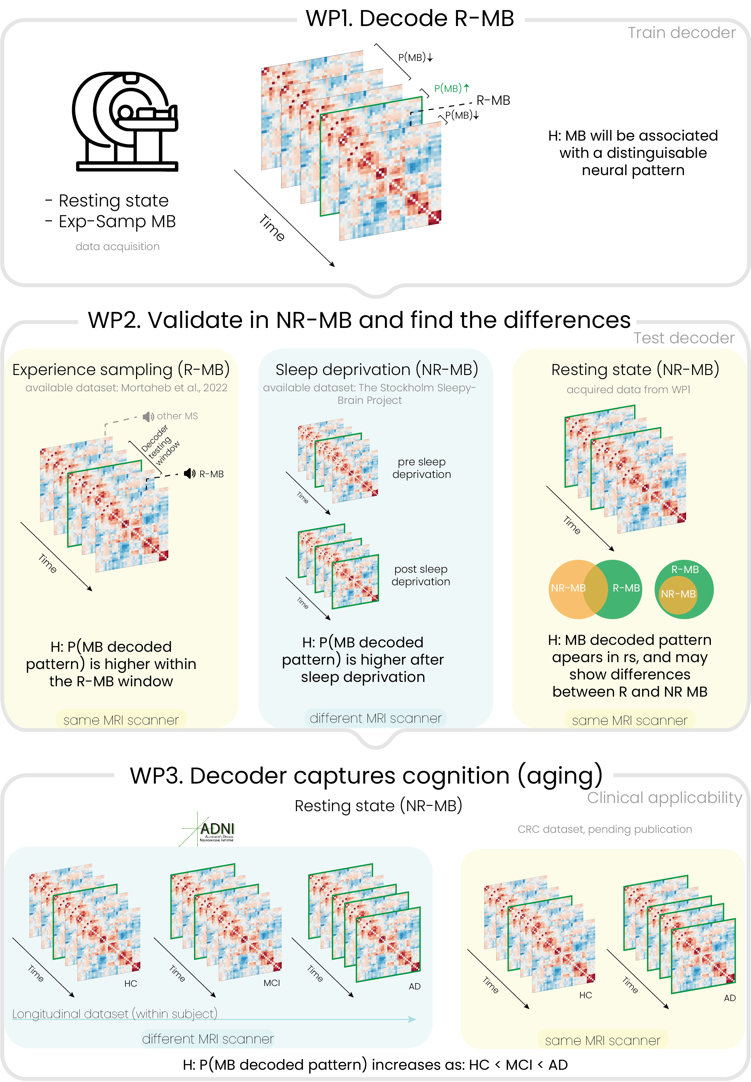




Toward a Brain-Based Signature of Mind Blanking:
Exploring Undetected Episodes Through EEG-fMRI and Machine Learning
Agustina Aragón Daud¹⁻³, Paradeisios A. Boulakis^{1,2,5}, Federico Raimondo³⁻⁴, Athena Demertzi^{1,2,5}
¹ University of Liège, GIGA Research, GIGA-CRC Human Imaging Unit, Physiology of Cognition Lab, Belgium
² Fund for Scientific Research (FNRS), Brussels, Belgium
³Institute of Neuroscience and Medicine, Brain and Behaviour (INM-7), Research Centre Jülich, Jülich, Germany
⁴Institute of Systems Neuroscience, Medical Faculty, Heinrich Heine University Düsseldorf, Düsseldorf, Germany
⁵Psychology and Neuroscience of Cognition Research Unit, University of Liège, Liège, Belgium
a.aragondaud@uliege.be
Introduction
Mind Blanking (MB) refers to episodes where individuals report having an empty mind when their thoughts are probed [1-3]. So far, research on MB has relied on such self-reports [2,4]. However, given that MB happens spontaneously [2], it may also be the case that episodes happen in the brain, but they do not get detected by the person and therefore are missed to report. Previous research suggests MB is associated with a hyperconnected brain state, characterized by widespread neural synchrony [2]. This study aims to test the possibility that undetected MB happens during ongoing cognition and that these episodes will be evident by brain activity. To achieve this, we will develop a machine learning model to decode MB instances from brain activity patterns.
Methods
Model Development
Model Validation
Hypothesis
MB signature will be decoded above chance and it will related to a hyperconnected brain state [2].
Objective
To identify instances of MB (target) based on the functional connectivity matrices (features).
Data acquisition
40 heathy participants [2], simultaneous EEG (BrainAmp MR, Brain Products) and fMRI (3T Siemens Prisma). Paradigm: (1) Resting state (2) Experience sampling (participants will be randomly prompt to report whether they were experiencing MB).
Hypothesis
The model will detect more instances of MB after sleep deprivation [4], in ADHD [5], and dementia [6].
Objective
To test the model performance in resting state data of populations with increased MB propensity.
Datasets
Resting state of the same participant
Stockholm Sleepy Brain [7]
Oregon ADHD-1000 [8]
Alzheimer's Disease Neuroimaging Initiative (ADNI) [9]
Functional connectivity patterns classified as MB or not
Condition with low MB frequency
Condition with high MB frequency
Expected Results
This project is expected to:
Establish a reproducible, brain-based signature of MB
Provide insights into the so-called stream of thought
Offer clinical applications for conditions where mind blanking is prevalent and self-reporting is unreliable or impossible (e.g., dementia)
More information about the project:
References
1. Andrillon et al., 2019. Front. Neurosci. Vol. 13, 949.
2. Mortaheb et al., 2022. Proc. Natl. Acad. Sci. Vol. 119, 41.
3. Kawagoe et al., 2019. Hum. Brain Mapp. Vol. 30, 17.
4. Boulakis et al., in press. Sci Rep.
5. Van den Driessche et al., 2017. APS. Vol 28, 10.
6. Huntley et al., 2017 Int J Geriatr Psychiatry. Vol. 32, 8.
7. Nilsonne. 2021 https://doi.org/10.5878/87y5-kh22
8. Nigg et al., 2023. Develop. Cog. Neurosc. Vol 60, 1-12
9. Petersen et al., 2010. Neurology. Vol 74, 3.

