Slide 1
New insights into the microstructure and redox chemistry of MIMAS MOX model systems supporting assessment of spent fuel behaviour
E. Iwaschko*, A. Bukaemskiy, K. Kvashnina, M. Henkes, M. Klinkenberg, F. Brandt, L. Amidani, K. Stuke, G. Leinders, D. Bosbach, G. Murphy
11.03.2025
*E-Mail: e.Iwaschko@fz-juelich.de
Nuclear Waste Disposal, Solid State Chemistry Team
Institute of Fusion Energy and Nuclear Waste Management (IFN-2)
Forschungszentrum Jülich Gmbh (FZJ)

Slide 2

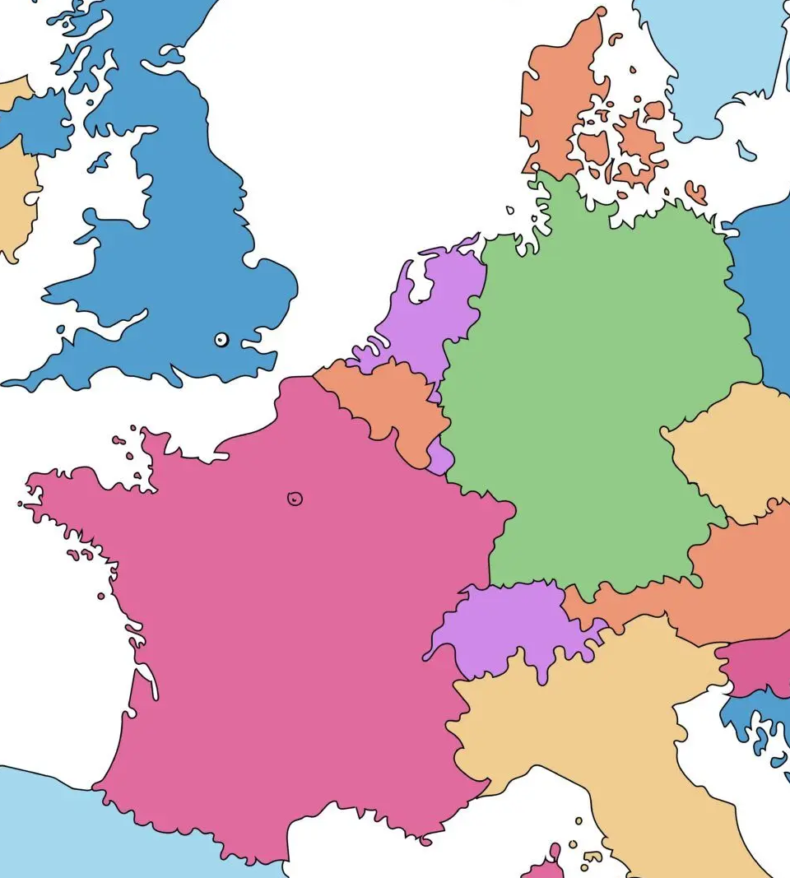




MIMAS MOX Spent Nuclear Fuel
MOX is a ceramic consisting of primarily UO₂ and 2 – 8 wt%HM Pu¹
Many industrial blending procedures known to obtain MOX ceramic, I focus on the Micronized Master Blend method (MIMAS)
MIMAS process developed by Belgonucleaire in 1986, MIMAS MOX has been supplied to many European nations and Japan.¹
Relevance for German SNF Research: MIMAS MOX SNF makes up roughly 7% of SNF inventory and highlighted as problematic by regulators.²
[1]: D. Haas, A. Vandergheynst, J. van Vliet, R. Lorenzelli, J.-L. Nigon, Nuclear Technology 1994, 106, 60.
[2]: Annual Report, Bundesgesellschaft für Zwischenlagerung mbH, 2023.
Notes:
In german NPP, if MOX has been used it was mostly of the MIMAS type. Accordingly, MIMAS MOX makes about 7% of germans SNF inventory
Mention the heterogeneous Pu distribution of MIMAS MOX! Maybe use EPMA map to visualize and come back.

Slide 3
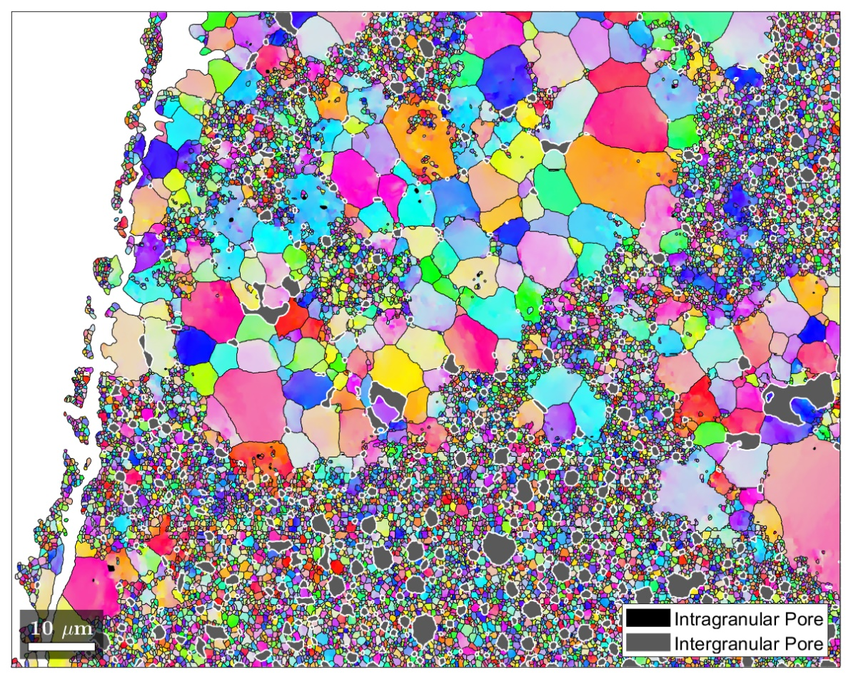
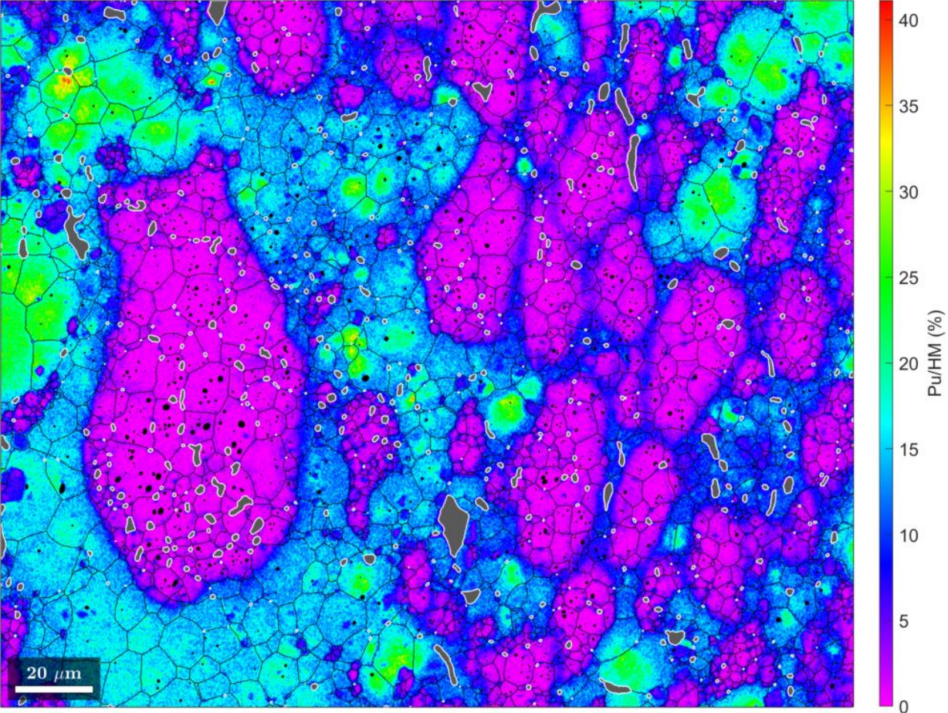
Challenges of MIMAS MOX SNF and Research focus
EBSD Map of irr. MIMAS MOX
Variable behaviour to spent UO₂ fuel:
  Heterogeneous Pu distribution leads to “Pu-islands” which cause local high-burn-up structure
Challenges of investigation:
  Challenging radioactive handling due to higher activities
  Extreme chemical/physical complexity challenges fundamental approaches
Need for simplified benchmarkable materials to better understand fundamental MOX SNF properties
“High-Burn-up Structure”
Iwaschko et al. in preparation
EPMA Map of Pu Distribution in unirr. MIMAS MOX
“Plutonium island”
interim deposition of spent MOX fuel
“UO₂-matrix”
“Intermediate phase”
R. Delville, M. Verwerft, Microscopy and Microanalysis 2023, 29, 78.
Notes:
Variable behaviour:
The Pu-islands which cause HBS change the microstructure of the material significantly (smaller grain size, increased porostiy)
Challenging investigaiton:
Due to higher radiation and heat emission much higher safety measured are required to conduct research on actual SNF, MOX or UO2 fuel
Highly complex composition of U, Pu and various fission products complicate the investigation of singular effects on structure and chemistry of SNF

Slide 4
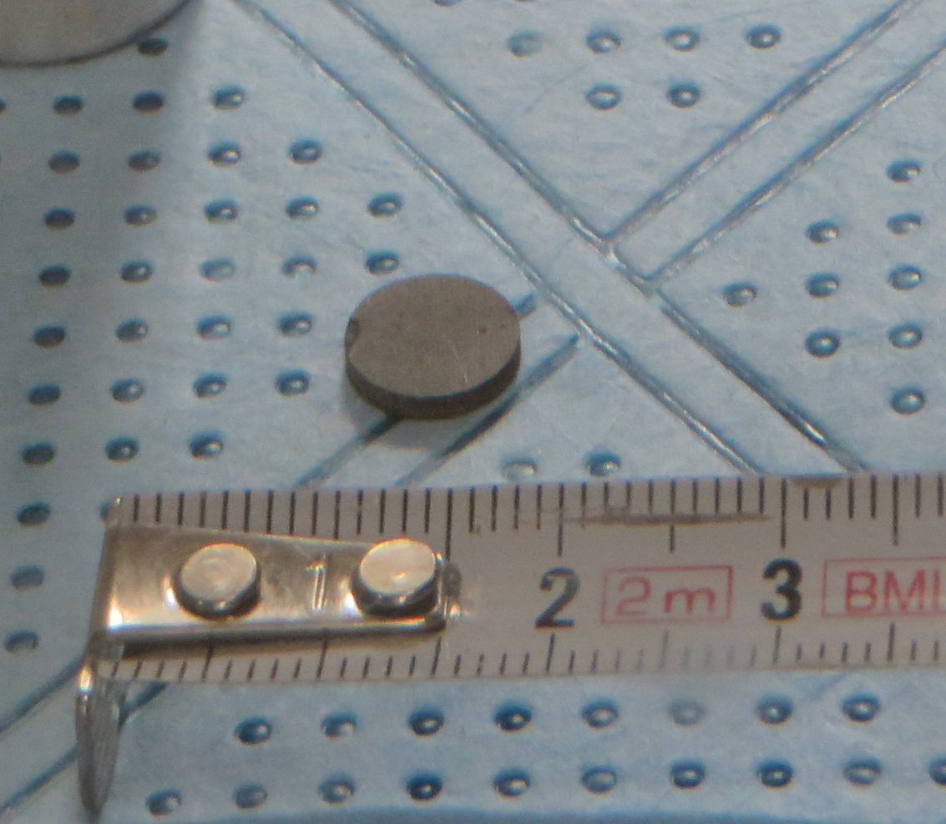
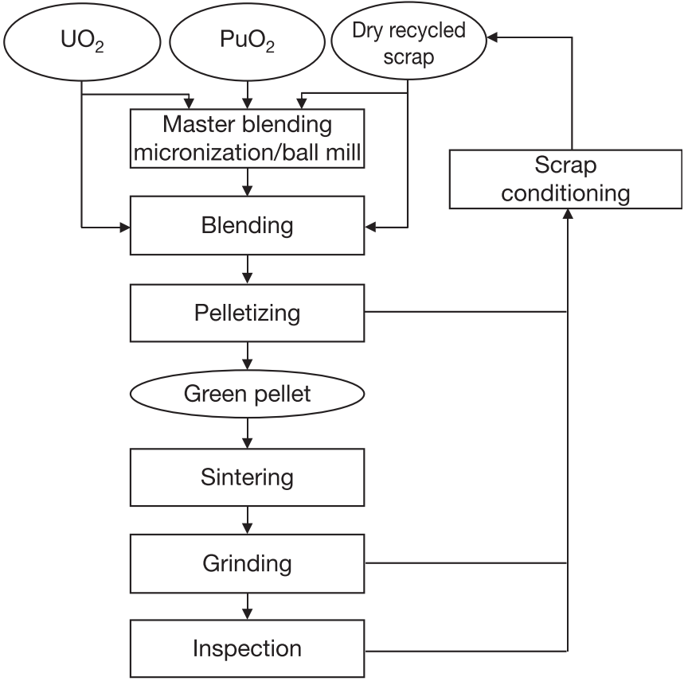

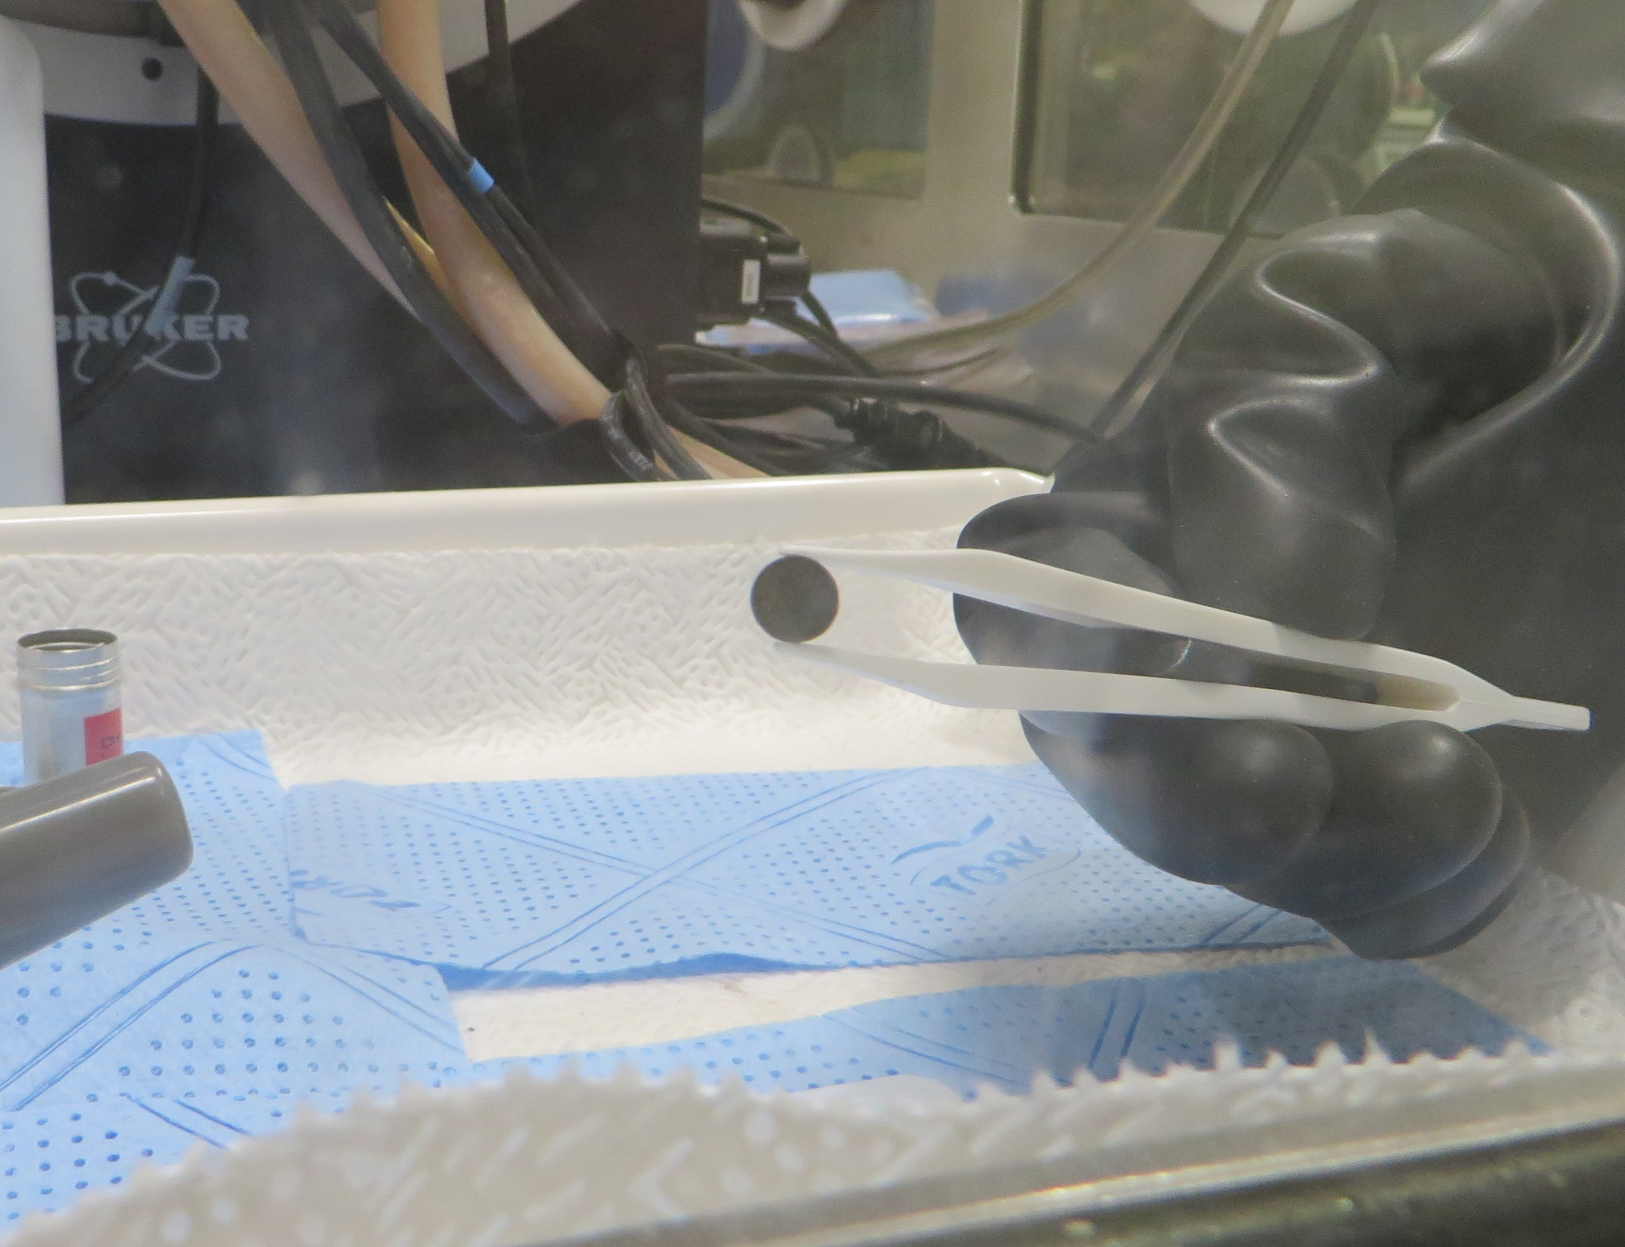
MIMAS MOX production
Actual unirr. MIMAS MOX samples
Industrial vs. lab surrogate
Reduced at higher T
Reduced normally
Industrial MIMAS method scheme
Surrogate Lab-scaled MIMAS method scheme*
“Inactive“ UO₂
“Active“ UO₂
CeO₂
Hand milling
Master Blend
70:30 UO₂/CeO₂
Benchmarked against
Hand mixing
Final Blend
90:10 UO₂/CeO₂
Pressing
Green Pellet
*UO₂ feed powder produced via 2 precipitation routes:
Ammonia diuranate (ADU)
Ammonia Uranyl Carbonate (AUC)
Sintering
Sintered Pellet
T. Abe, K. Asakura in Comprehensive Nuclear Materials. Online version (Ed.: R. Konings), Elsevier Science, Burlington, 2011, pp. 393–422.
Polishing, Analysis, etc…
Notes:
Die Besonderheit vom MIMAS Prozess ist, dass die Vermischung von UO2 und PuO2 in zwei Schritten ist.
Zuerst zu einem Masterblend mit 30mol% Ce Anteil mit Zerkleinerung.
Anschließend wird durch Zugabe von weiterem UO2 ein Final Blend mit der gewünschten CeO2 Konzentration erstellt, ohne Zerkleinerung.
Um die heterogene Mikrostruktur von echtem MIMAS MOX besser nachzuahmen, hatte Dr. Andrey Bukaemsky die wunderbare Idee, in beiden Teilschritten UO2 Pulver zu benutzen, das bei unterschiedlichen Temperaturen reduziert wurde, um so den Sinterungsprozess unterschiedlicher Fraktionen zu variieren. [Einvblenden Temp.]

Slide 5
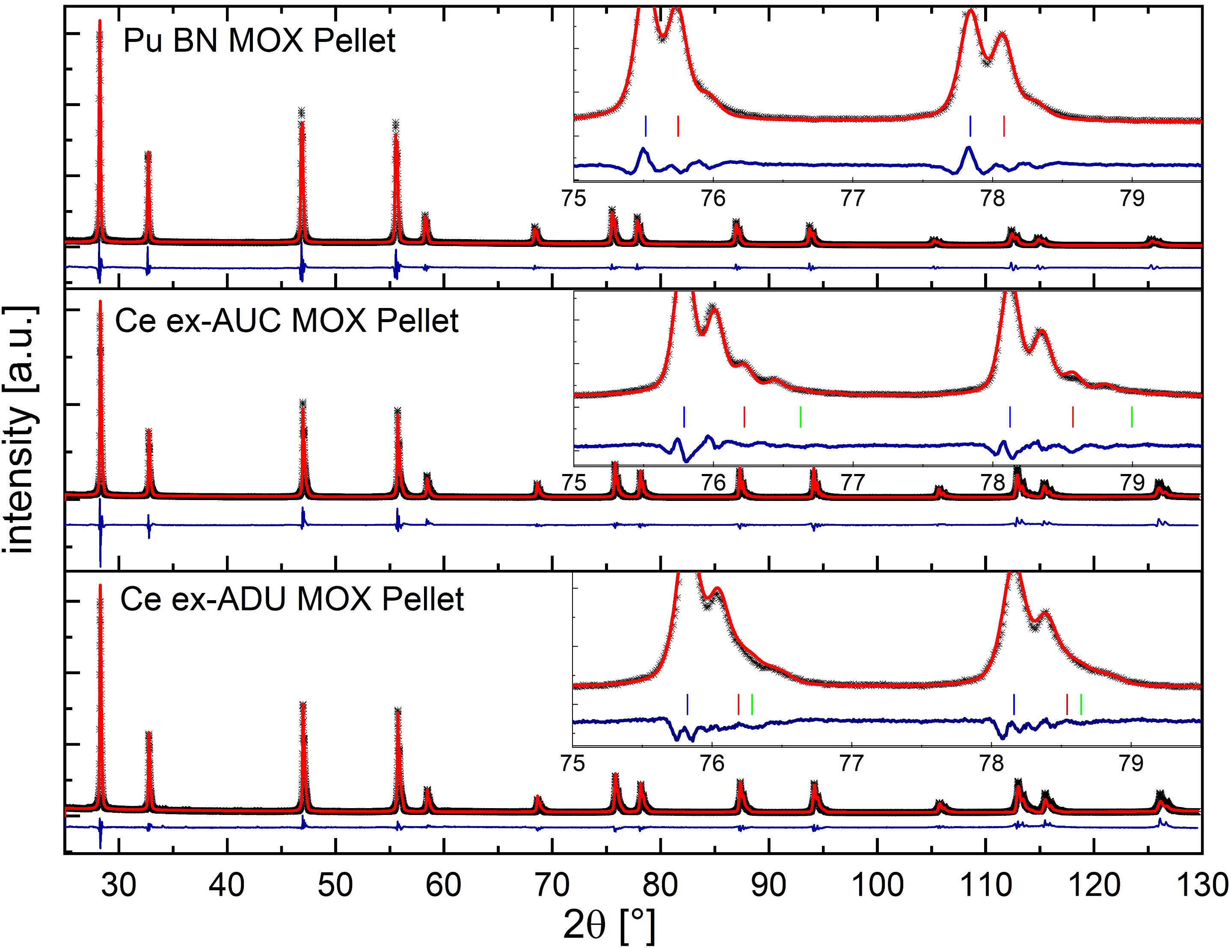
Powder X-ray Diffraction Results
Corrected lattice parameter for α-radiation damage swelling of 0.29%¹
Sample | Pu BN MOX Pellet
 | a [Å] | Wt%
Phase 1 | 5.48192(4) | 91.9
Phase 2 | 5.4676(1) | 8.1
Phase 3 | - | -
Sample | Pu BN MOX Pellet
 | a [Å] | Wt%
Phase 1 | 5.46607(4) | 91.9
Phase 2 | 5.4518(1) | 8.1
Phase 3 | - | -
Sample | Ce ex-AUC MOX Pellet
 | a [Å] | Wt%
Phase 1 | 5.46756(26) | 84.2
Phase 2 | 5.4412(1) | 13.5
Phase 3 | 5.4168(4) | 2.3
Sample | Ce ex-ADU MOX Pellet
 | a [Å] | Wt%
Phase 1 | 5.46376(3) | 84.3
Phase 2 | 5.4413(4) | 8.0
Phase 3 | 5.4354(4) | 7.7
[1]: M. Kato, A. Komeno, H. Uno, H. Sugata, N. Nakae, K. Konashi, M. Kashimura, Journal of Nuclear Materials 2009, 393, 134.
Notes:
First emphasize Pu vs Ce MOX difference! After compare ex-ADU / ex-AUC! Dont focus too much on the single values!
The swelling of the lattice parameters in the Pu MOX sample is due to its autoradiation damage, the pellet is over 40 years old.
When calculating back a reported swelling value of 0,29% for MIMAS MOX, the lattice parameter becomes close to that of the Ce samples.
Phase distribution differs between Ce MOX samlpes.

Slide 6
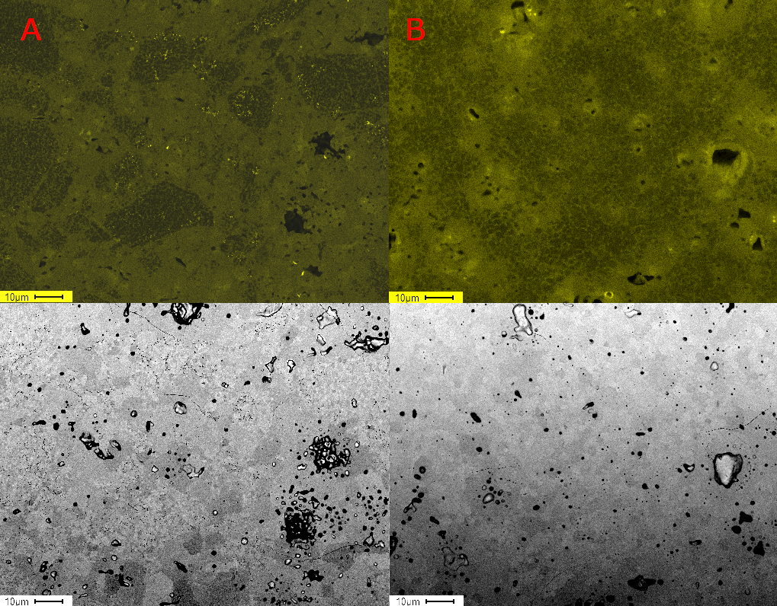
Scanning Electron Microscopy & Energy Dispersive Spectroscopy
Ce ex-ADU MOX
Ce ex-AUC MOX
Pu ex-ADU unirr. MOX
R. Delville, M. Verwerft, Microscopy and Microanalysis 2023, 29, 78.
Notes:
On the left you see EDX mappings for the element Ce with the pespective BSE image below.
You can see, that the Ce distribution is different between the ex-ADU and ex-AUC MOX sample, suggesting that the choice of UO2 precursor has an impact on the final ceramics microstructure.
At the same time, when comparing to acutal Pu MOX, some resemblance can be recognized in regards of the Ce/ Pu distribution, as you can see Ce depleted, intermeidate and Ce rich phase

Slide 7
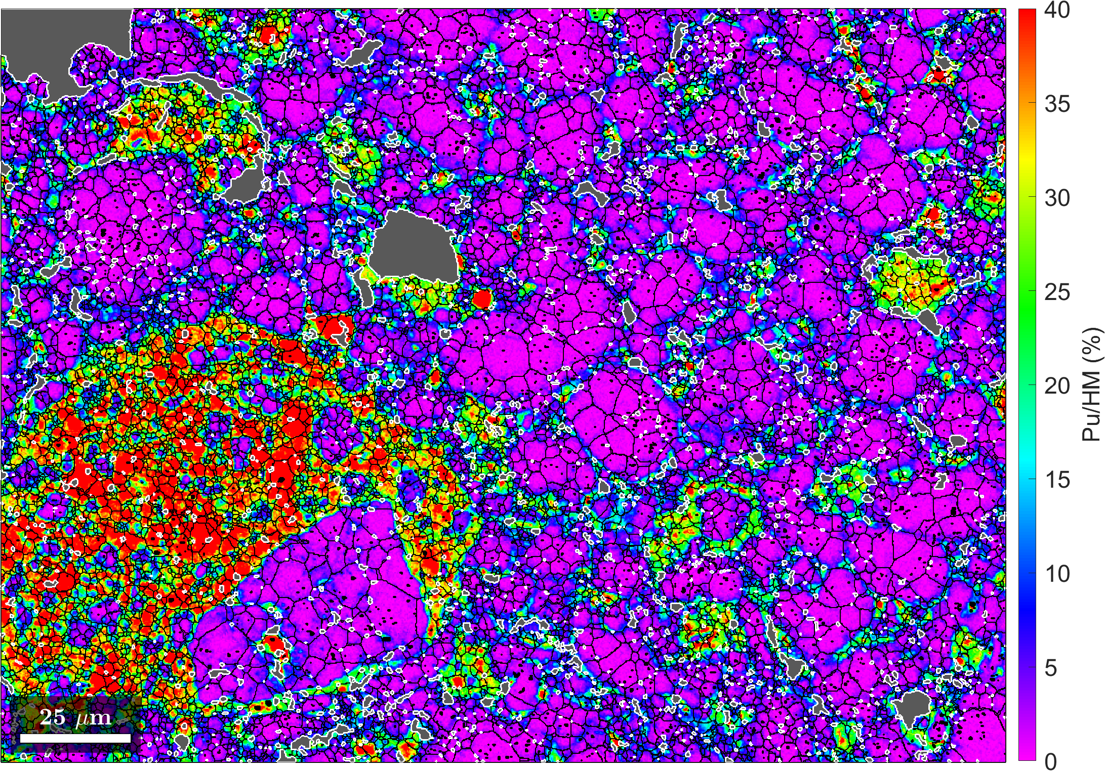
Scanning Electron Microscopy & Energy Dispersive Spectroscopy
Ce ex-ADU MOX
Ce ex-AUC MOX
Pu ex-AUC unirr. MOX
Iwaschko et al. in preparation
Notes:
Likewise for a comparison with ex-AUC Pu MOX, where both Ce and Pu MOX are somewhat lacking an intermediate phase unlike the ex-ADU MOX

Slide 8
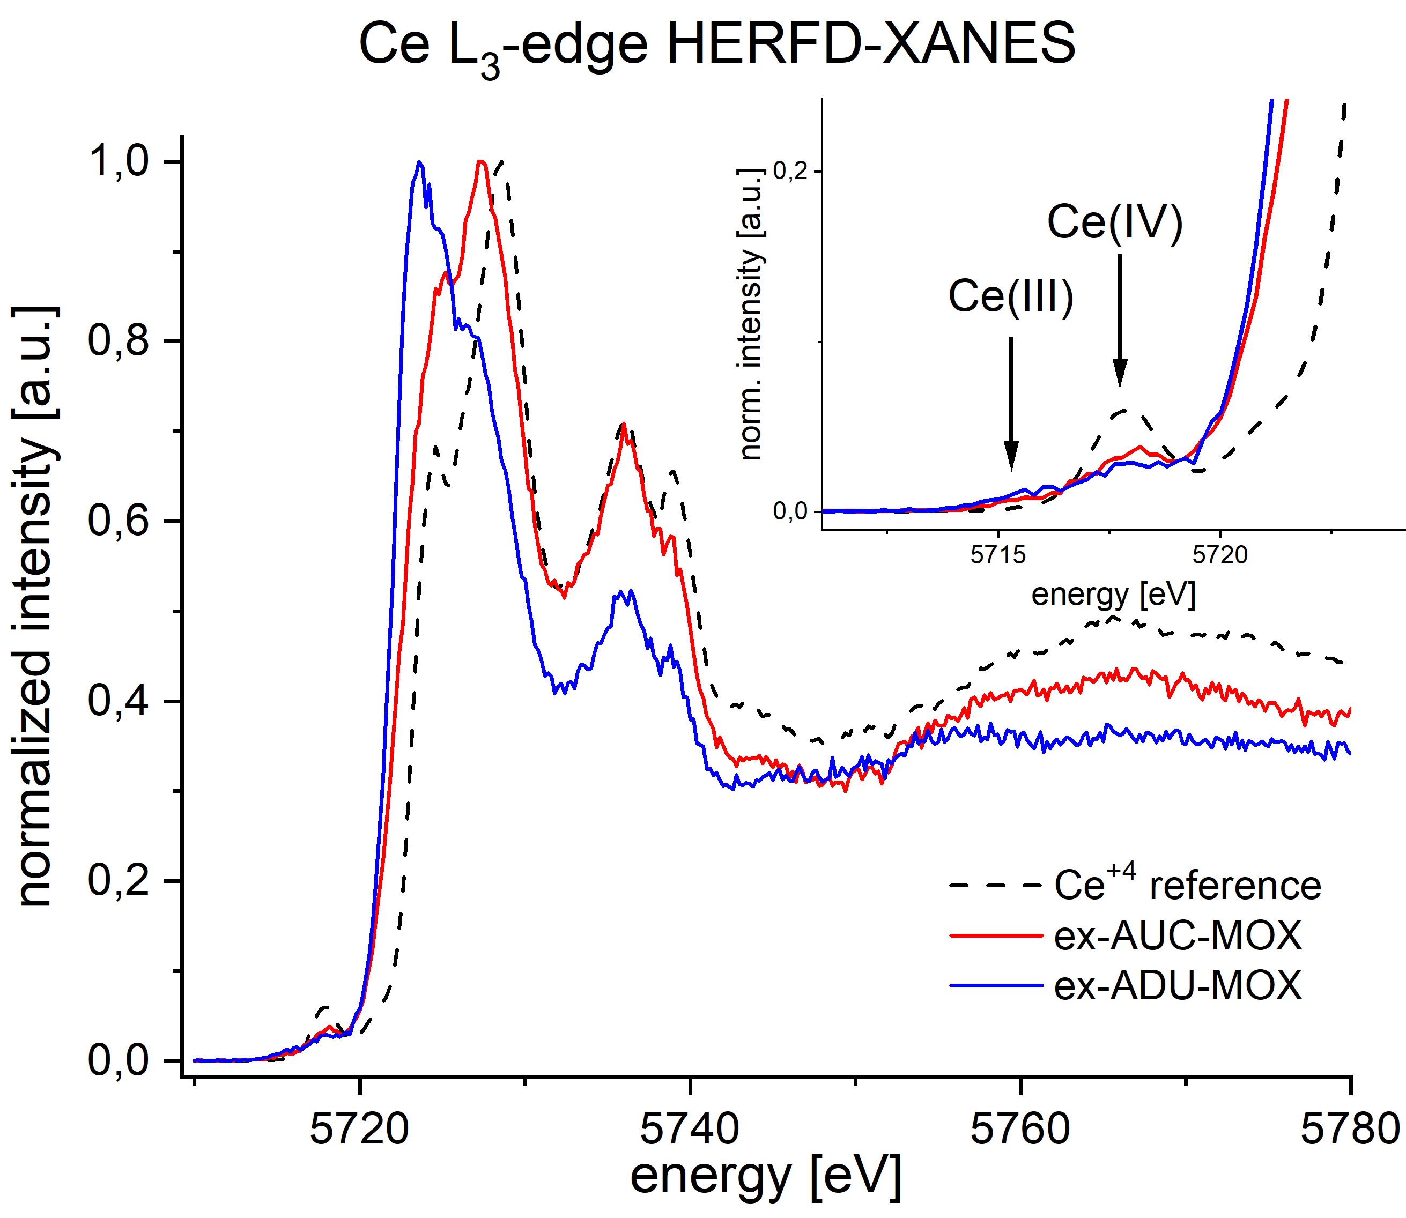


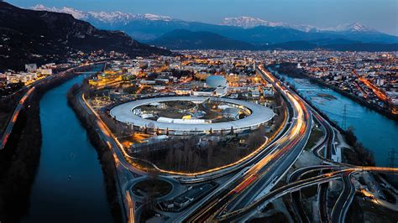
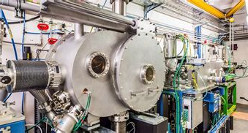
HERFD-XANES Results – Ce L₃ Edge
FZJ Ce ex-ADU MOX
FZJ Ce ex-AUC MOX
Both possess Ce³⁺ and Ce⁴⁺
Absorption edge shift suggests different Ce³⁺/Ce⁴⁺-ratio in both samples
Notes:
HERFD-XANES: High Energy Resolution Fluorescence Detected – X-Ray Absorption Near Edge Structure, Mention Lucia, Kristina and Eleanor
But not only the microstructure differs, HERFD-XANES experiments at ROBL showed, that ex-ADU and ex-AUC Ce MOX contain both Ce3+ and Ce4+ and that, the ratio of both oxidation states vary between the samples
Implying that the precursor not only influcences the microstructure, but also the chemistry of the final ceramic.
Vermutung: Es ist anzunehmen, dass das Ce+3 sich überwiegend in solchen Hotspots aufhält, da benachbarte Regionen mit abnehmender Ce-Konzentration wie eine Art Oxidationsschutzschicht wirkt.

Slide 9
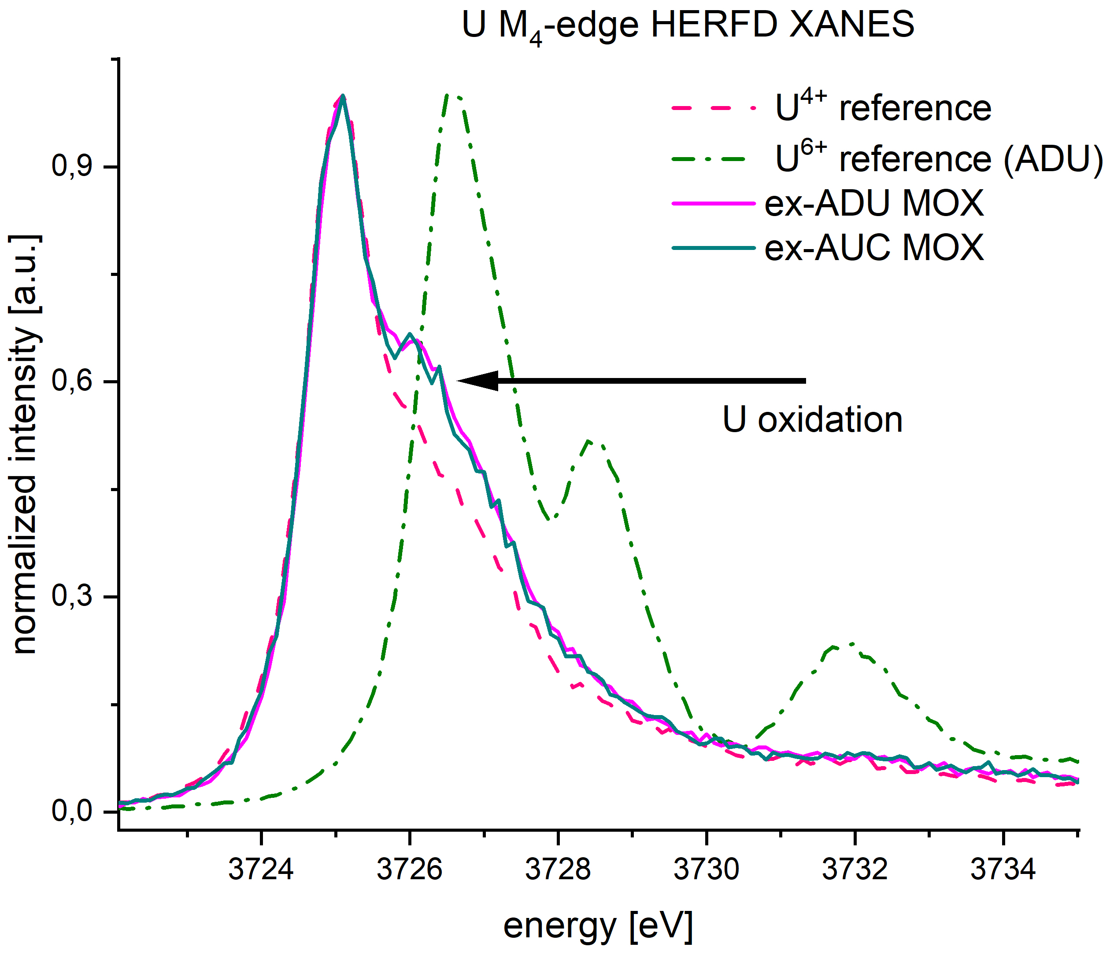
HERFD-XANES Results – U M₄ Edge
FZJ Ce ex-ADU MOX
FZJ Ce ex-AUC MOX
Similar U redox state distribution in both samples
Occurence of U⁵⁺ and U⁴⁺
Notes:
HERFD-XANES: High Energy Resolution Fluorescence Detected – X-Ray Absorption Near Edge Structure
HERFD-XANES of the U M4 Edge unveil also the presence of U4+ and oxidised U5+, which corresponds to the shoulder of the main Absorption edge.
Vermutung: Es ist anzunehmen, dass das Ce+3 sich überwiegend in solchen Hotspots aufhält, da benachbarte Regionen mit abnehmender Ce-Konzentration wie eine Art Oxidationsschutzschicht wirkt.

Slide 10
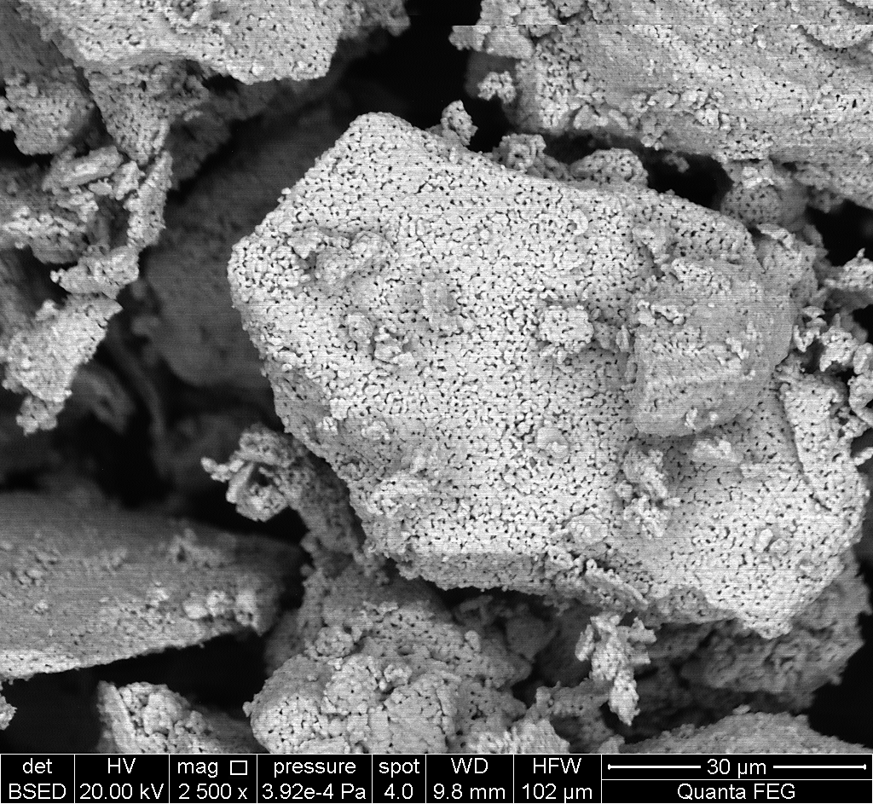
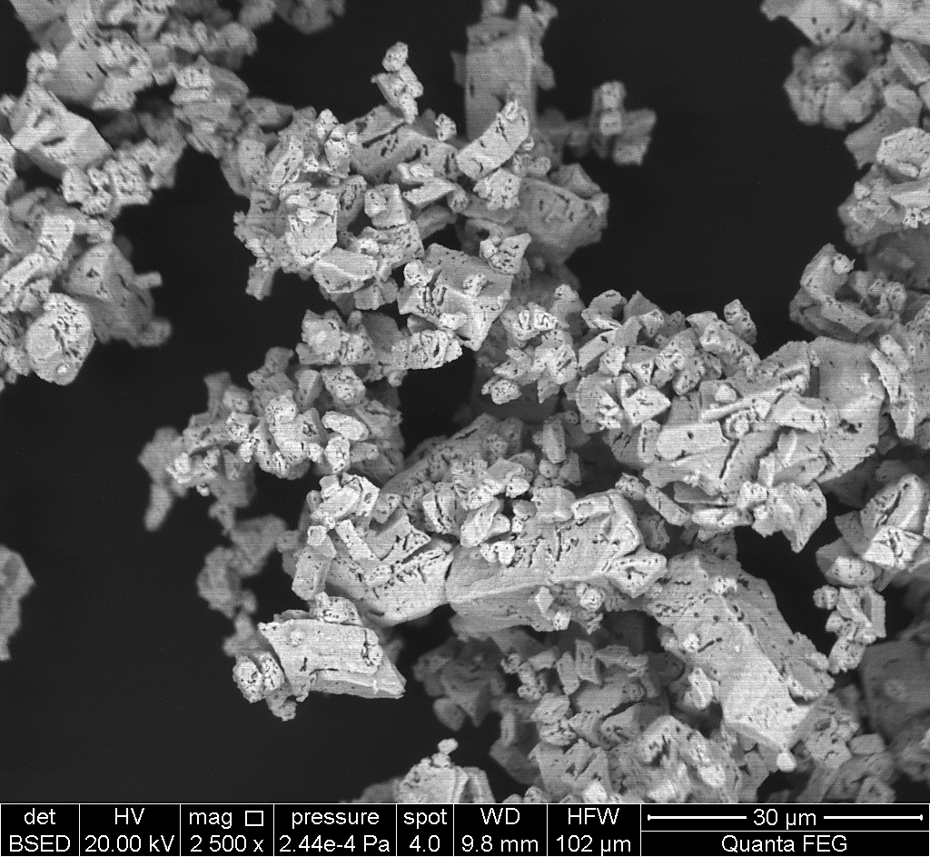
Role of Precursors
ex-AUC UO₂
ex-ADU UO₂
Surrogate Lab-scaled MIMAS method scheme
“Inactive“ UO₂
“Active“ UO₂
CeO₂
Hand milling
Master Blend
Hand mixing
Final Blend
Pressing
Green Pellet
Sintering
Sintered Pellet
Polishing, Analysis, etc…
Significant morphological differences of UO₂ particles
Possible explanation for morphology features and differences in Ce distribution in model systems
Notes:
But why are ex-AUC and ex-ADU Ce MOX that different? We investigated the feeder poweders.
You can see a clear morphological difference of the ex-ADU and ex-AUC UO2 particels:
Ex-ADU: larger particles, also larger in size distribution, more porous/brittle surface
Ex-AUC: smaller particles, more densified and compact
Diese Unterschiede in der Größenverteilung der Agglomerate und deren unterschiedliche Beschaffenheit sorgt für ein abweichendes Reaktionsverhalten beim Sintern.

Slide 11
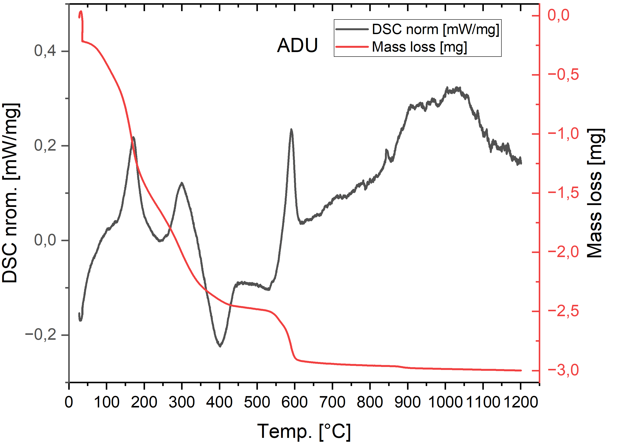
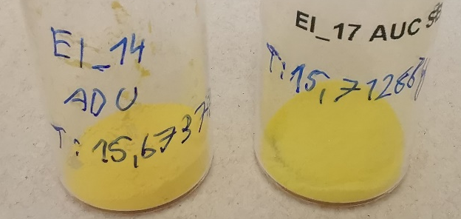
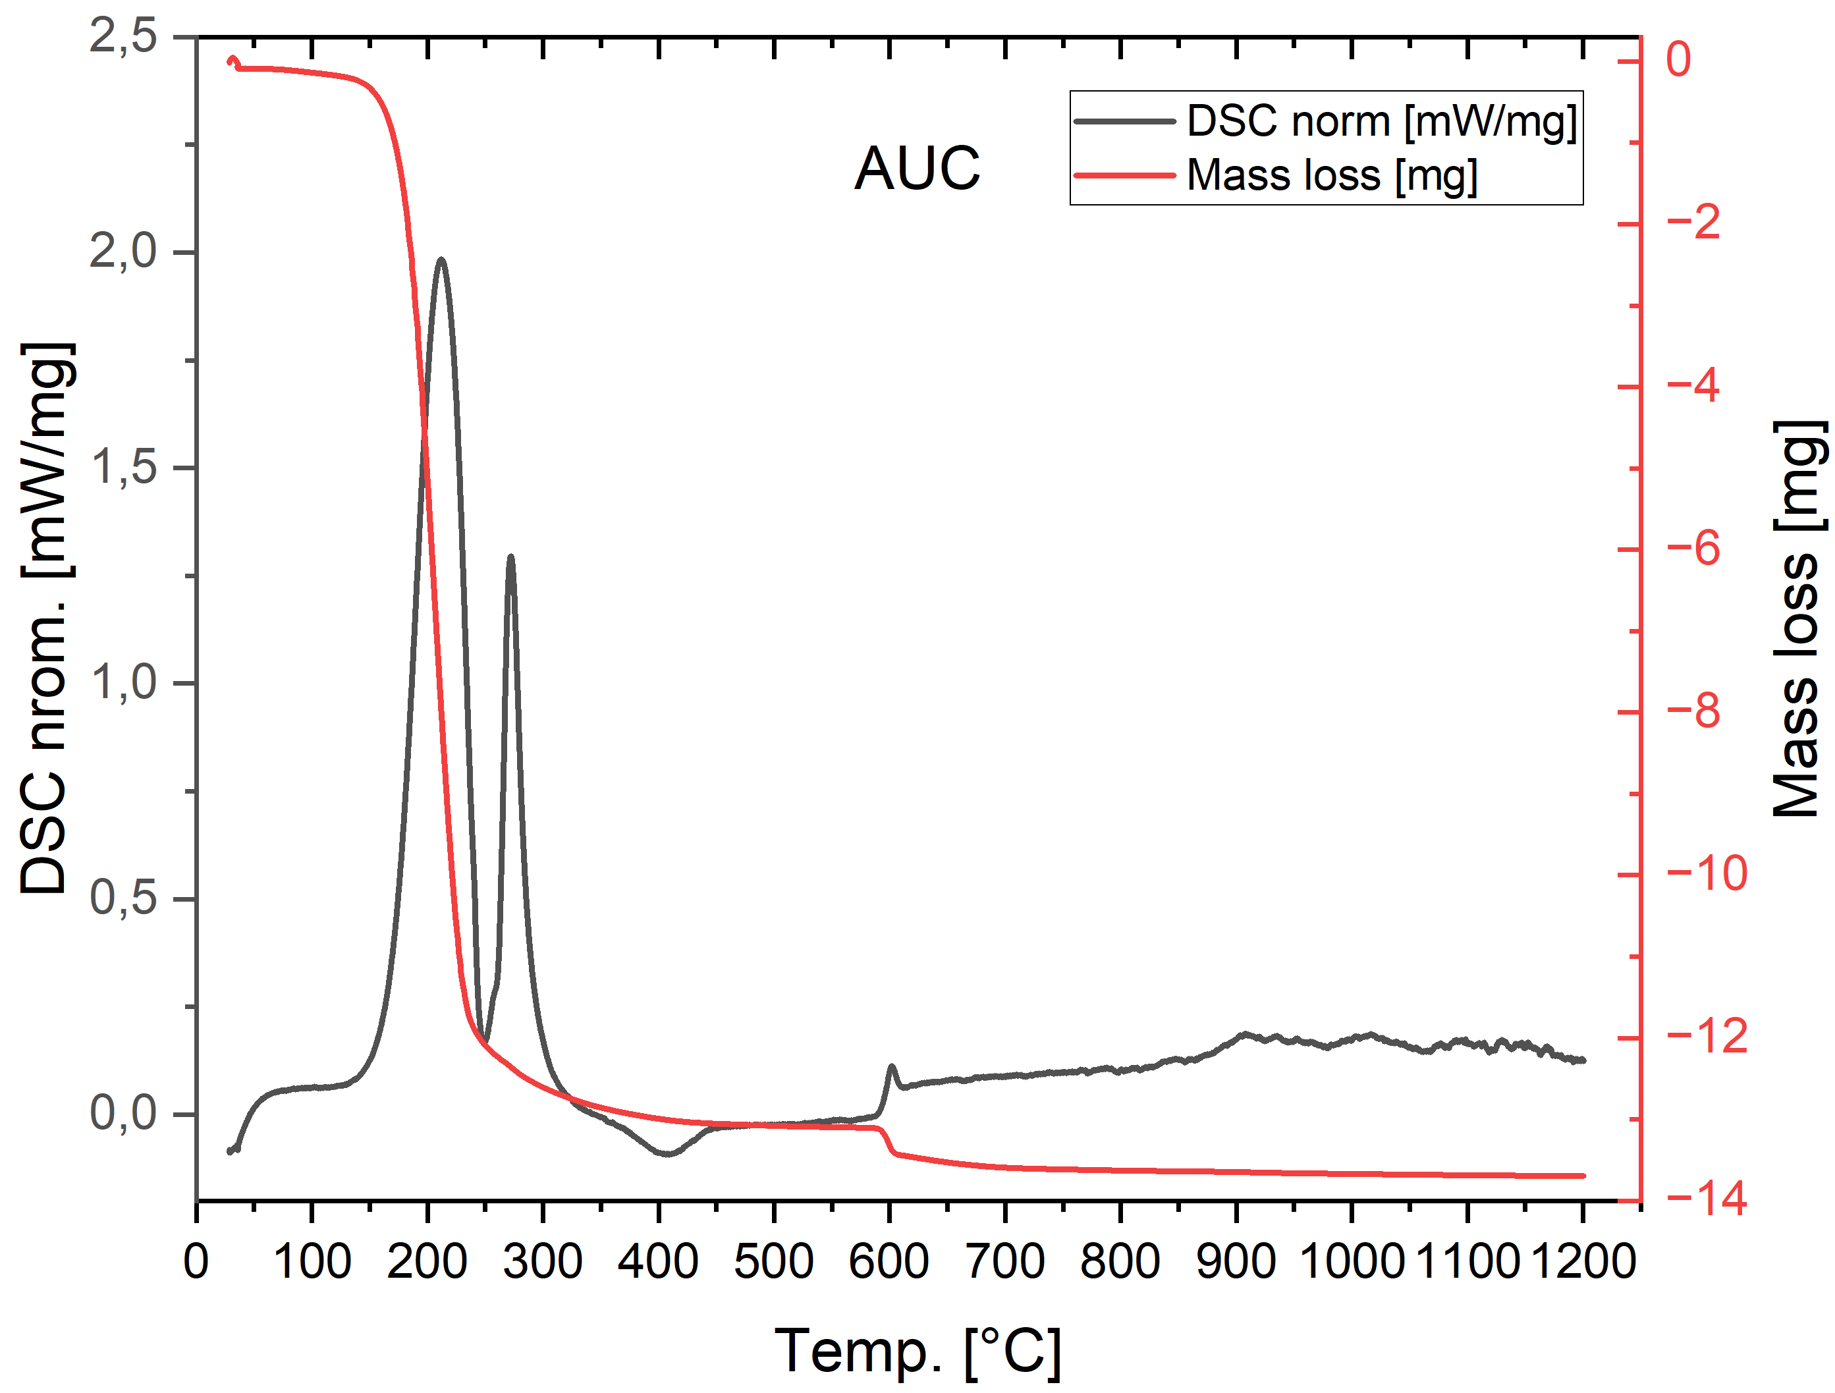
Role of Precursors
TG-DSC of ADU and AUC
Transition to U₃O₈ for ADU and AUC at 600°C
More mass loss on AUC compared to ADU due lots of NH₄⁺ and CO₃²⁻ leaving
Measured mass loss matches the theoretical expectations for transition ADU/AUC → U₃O₈
Sample | Theo. Mass frac. [%] | Real mass frac. [%]
ADU | 90,0 | 86,9
AUC | 53,8 | 55,5
Notes:
Maybe skip to save time!
Mass loss differs greatly and also different DSC responses from ADU and AUC, so it should have an effect on the topography of the obtained UO2 powder

Slide 12
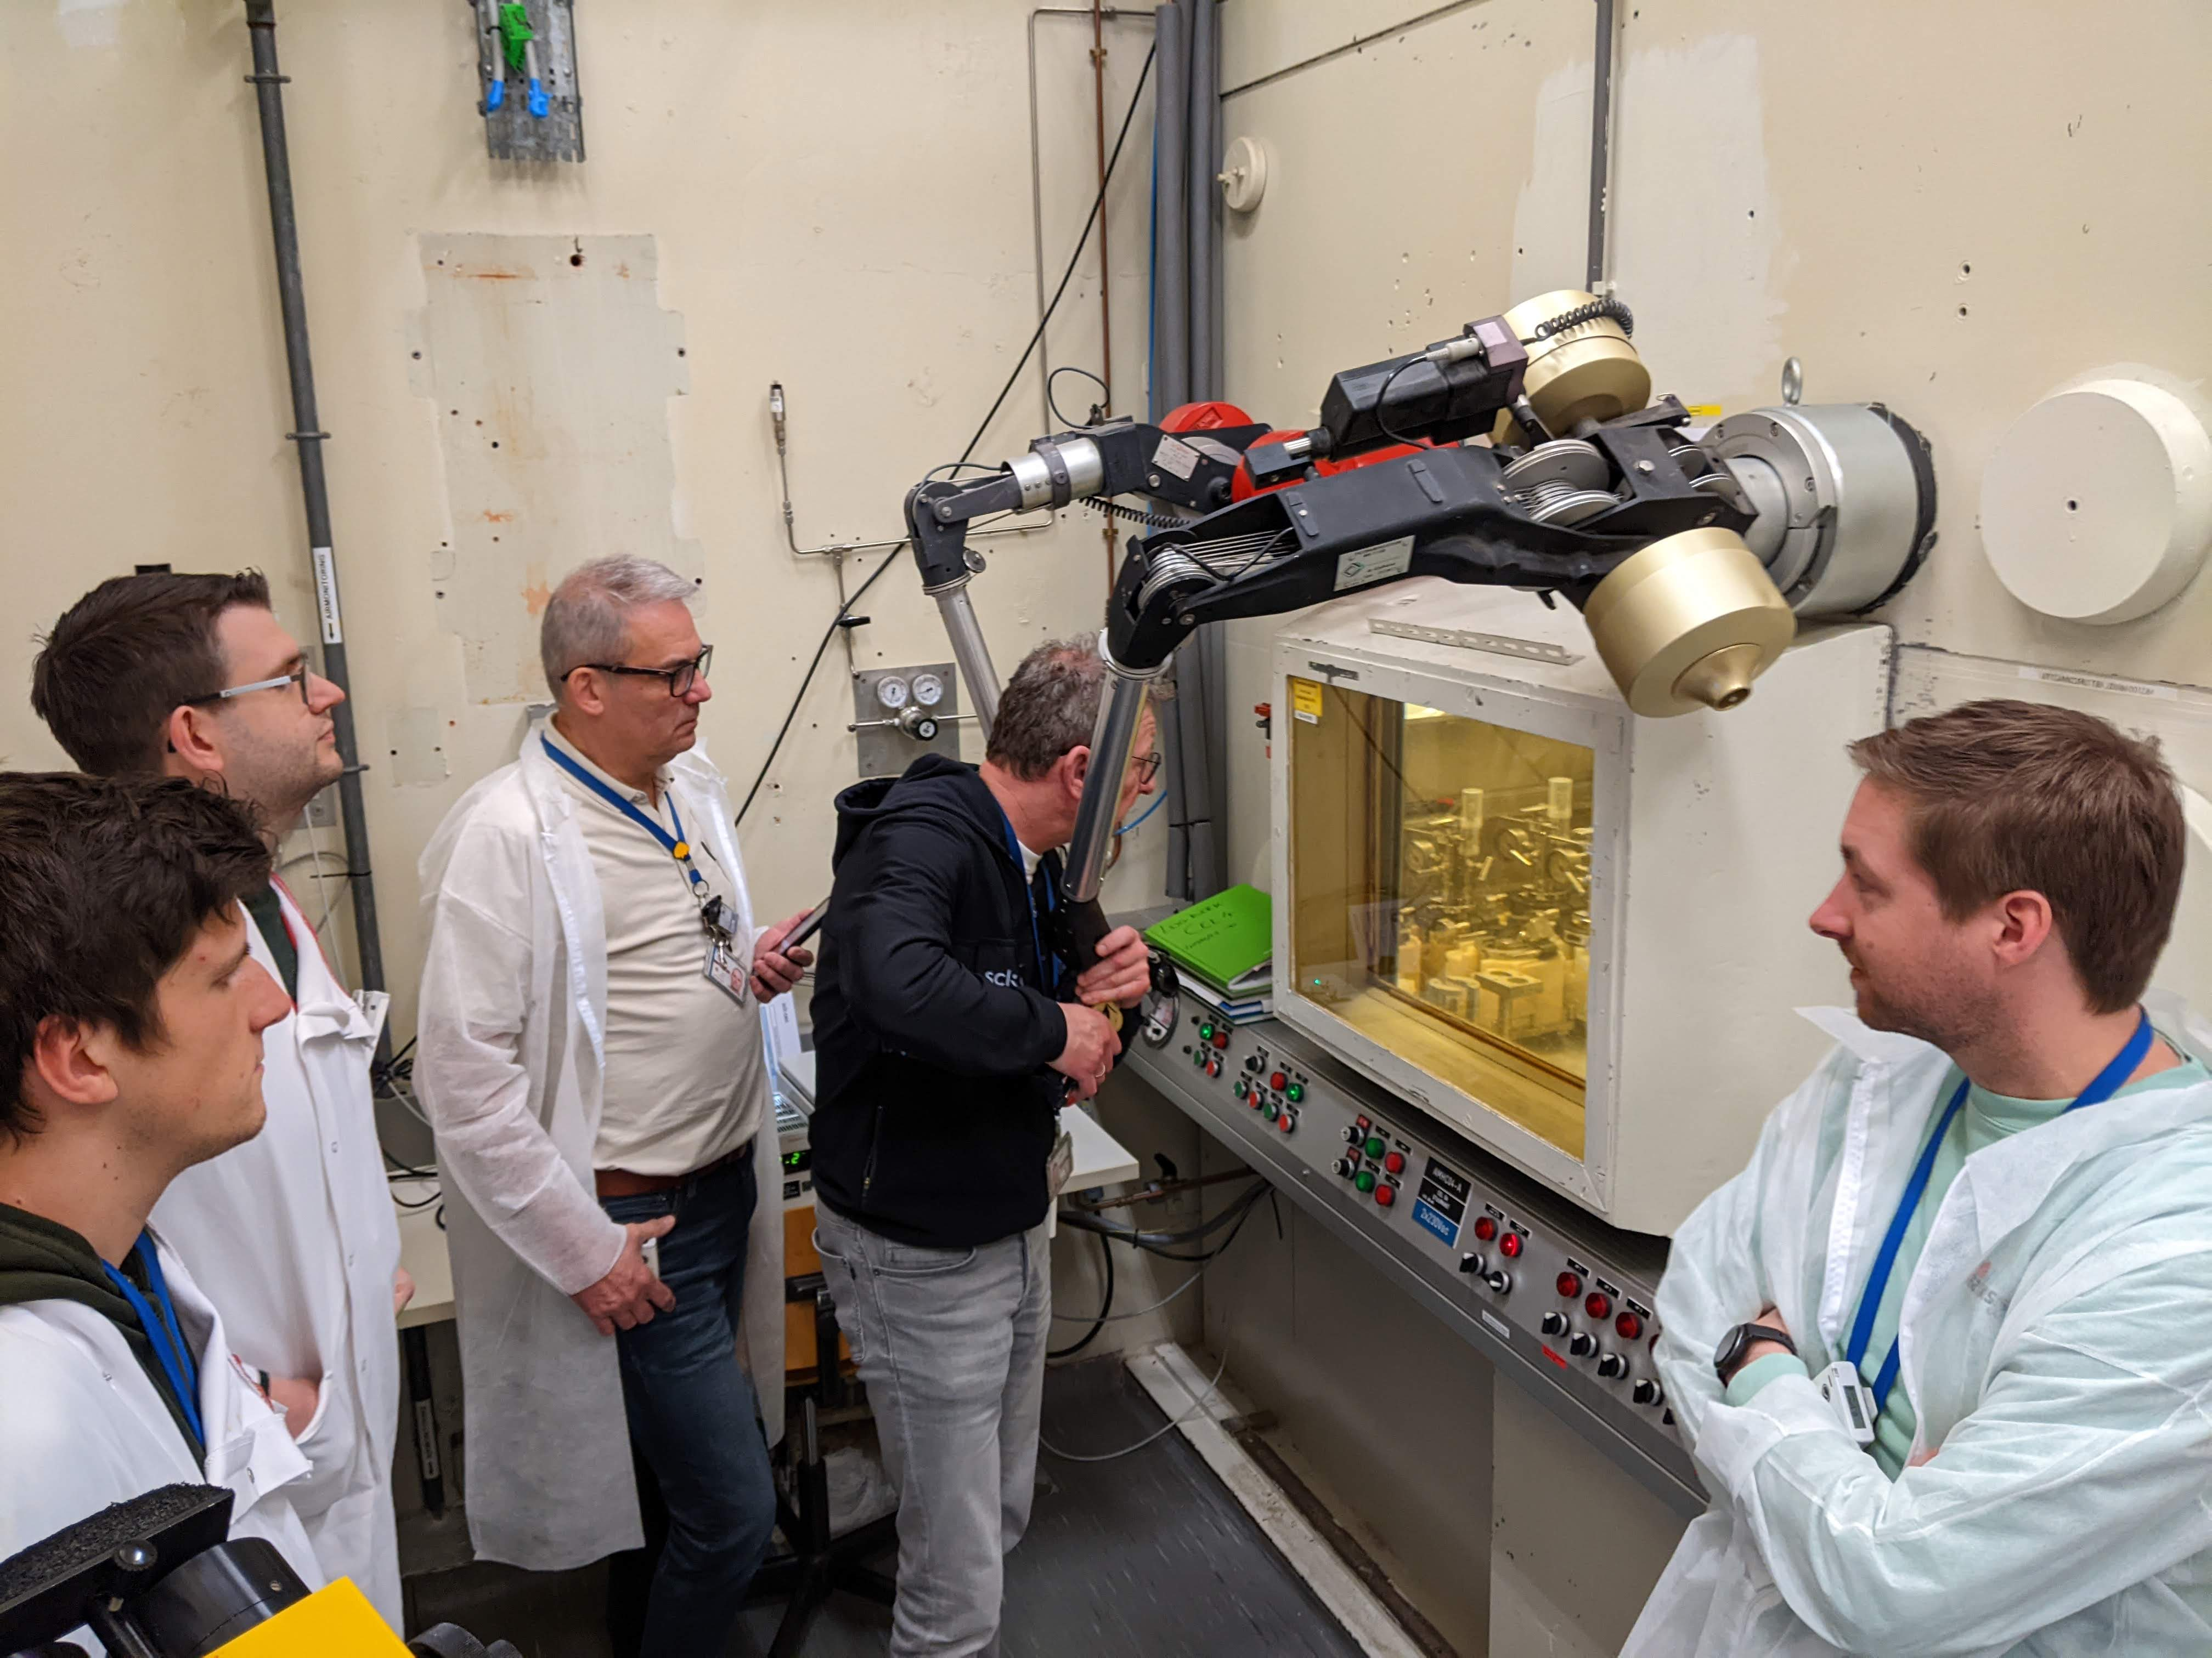
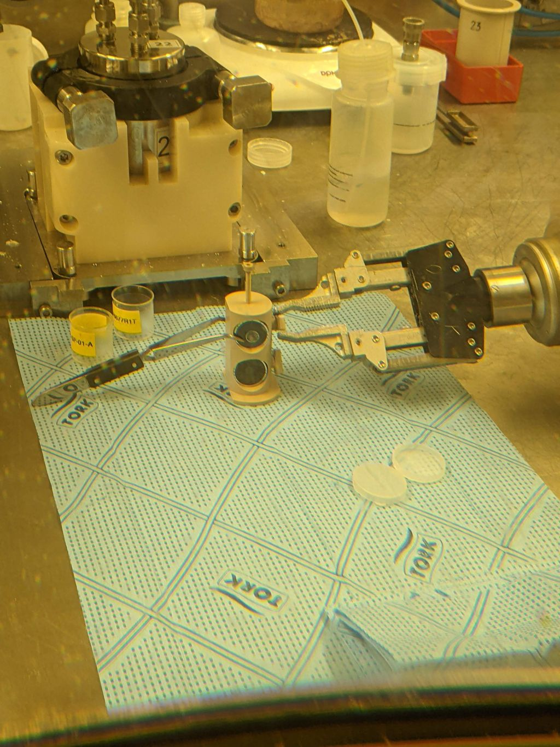
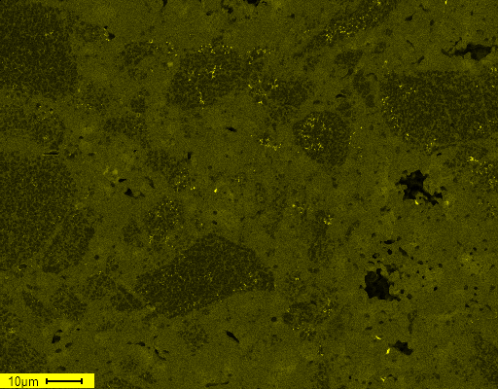
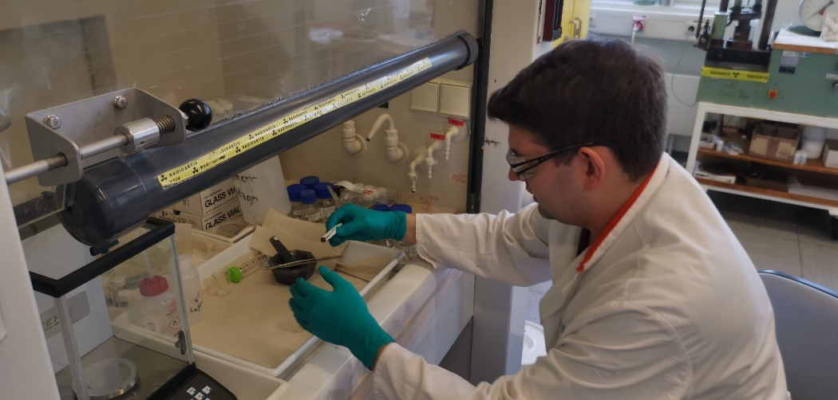

Conclusion / Outlook
Successful development of MIMAS MOX model systems that show microstructural resemblance to fresh MIMAS MOX. Benchmarked against real MOX.
UO₂ feed precursor has a significant effect on microstructure of Ce MOX samples.
High resolution analysis indicates mixed valence states in Ce MOX, ratio seems to be feeder material dependant (ADU vs. AUC). → Same for Pu MOX?...
Next step: Microstructural investigation of fresh/irradiated Pu MOX after leaching experiments to evaluate leaching impact on MOX microstructure.
Pu ex-ADU MOX
Ce ex-ADU MOX
Notes:
Zusammenfassend lässt sich sagen:
Es ist uns erfolgreich gelungen Keramiken herzustellen, die in ihrer Mikrostruktur und Elementverteilung an MIMAS MOX erinnern.
Die Hochauflösende Synchrotron-Analyse zeigte, dass der Ursprung des UO2 Pulvers einen beträchtlichen Einfluss auf die Chemie solcher Keramiken haben kann.
Für die Zukunft wäre es interessant XANES-Mapping experimente durchzuführen, um zu schauen, wie die Ce-Konzentration und dessen Redoxzustände in solchen Keramiken korrelieren.

Slide 13


Acknowledgements
Forschungszentrum Jülich (FZJ):
Prof. Dr. Dirk Bosbach
Prof. Dr. Giuseppe Modolo
Dr. Gabriel Murphy
Dr. Andrey Bukaemskiy
Mr. Maximilian Henkes
Mr. Murat Güngör
Dr. Philip Kegler
Dr. Martina Klinkenberg
Dr. Felix Brandt
Mr. Daniil Shirokiy
Mr. Norman Lieck
Dr. Christian Schreinemachers
Mr. Kevin Stuke
TRANSIENT Partners:
Dr. Gregory Leinders
Prof. Dr. Nina Huittinen
European Synchrotron Radiation Facility (ESRF):
Dr. Kristina Kvashnina
Dr. Lucia Amidani
Dr. Christoph Hennig
Dr. Eleanor Lawrence Bright
The Federal Ministry of Research, Technology and Space (BMFTR) Germany

Slide 14
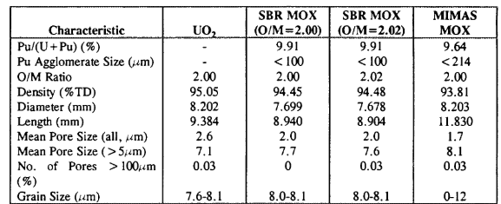
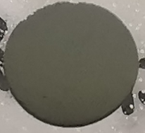
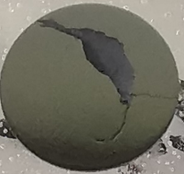
Appendix: Immersion density Ce MOX Pellets
ex-ADU MOX Pellet
ex-AUC MOX Pellet
J. R. Topliss, I. D. Palmer, S. Abeta, Y. Irisa, K. Yamate, Measurement and analysis of MOX physical properties, 1997.
Sample | ρ_{S1} [%] | ρ_{S2} [%] | P∑ [%] | Po [%] | Pc [%]
ex-ADU MOX Pellet | 94,12 | 94,48 | 5,88 | 0,36 | 5,52
ex-AUC MOX Pellet | 91,64 (*) | 93,07 | 8,36 | 1,43 | 6,93
Pc = (100 - ρ_{S2} ) - closed porosity
ρ_{S1} - real density of pellets
Po = (ρ_{S1} - ρ_{S2} ) - open porosity
ρ_{S2} - density of material with closed porosity
P∑ = (ρ_{S1} + ρ_{S2} ) - total porosity
* - lower real density of ex-AUC MOX Pellet due to large crack in pellet body
Notes:
Zuerst wurden die Dichten der Pellets bestimmt.
Die Dichte von Kernbrennstoffen ist für die Industrie eins der wichtigsten mechanischen Eigenschaften / Qualitätsmerkmale.
Dass die Dichten unserer Modellsysteme so ziemlich der von echtem MIMAS MOX entspricht, ist schon mal ein gutes Zeichen.
Aber weisen denn die hergestellten Pellets auch strukturelle Ähnlichkeiten zu MIMAS MOX auf?
Wie einige vllt wissen, hat unsere Institut kürzlich ein neues Elektronenmikroskop im Aktivlabor in Betrieb genommen. Meine Bilder stammen allerdings noch überwiegend vom alten Elektronenmikroskop.

