Slide 1
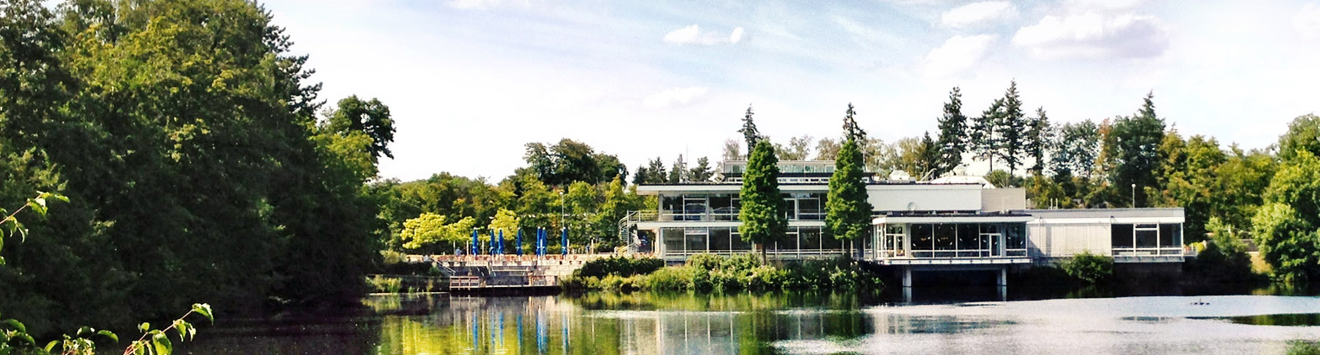
Probing the Physics of D-Wave Annealers: Insights from standard, Reverse, and fast Annealing
11.06.2025 I Vrinda mehta
QIP | JSC | FZJ

Slide 2
contents
Overview: Standard, reverse, and fast annealing
D-Wave results: 1- and 2-spin cases
Simulations: Schrödinger equation, Bloch equations, Lindblad and Markovian master equations
Numerical results
Conclusion
Notes:
Use simple 1- and 2-spin problems to investigate how the D-Wave quantum annealers behave by finding numerical models that can reproduce this

Slide 3
Overview

Slide 4
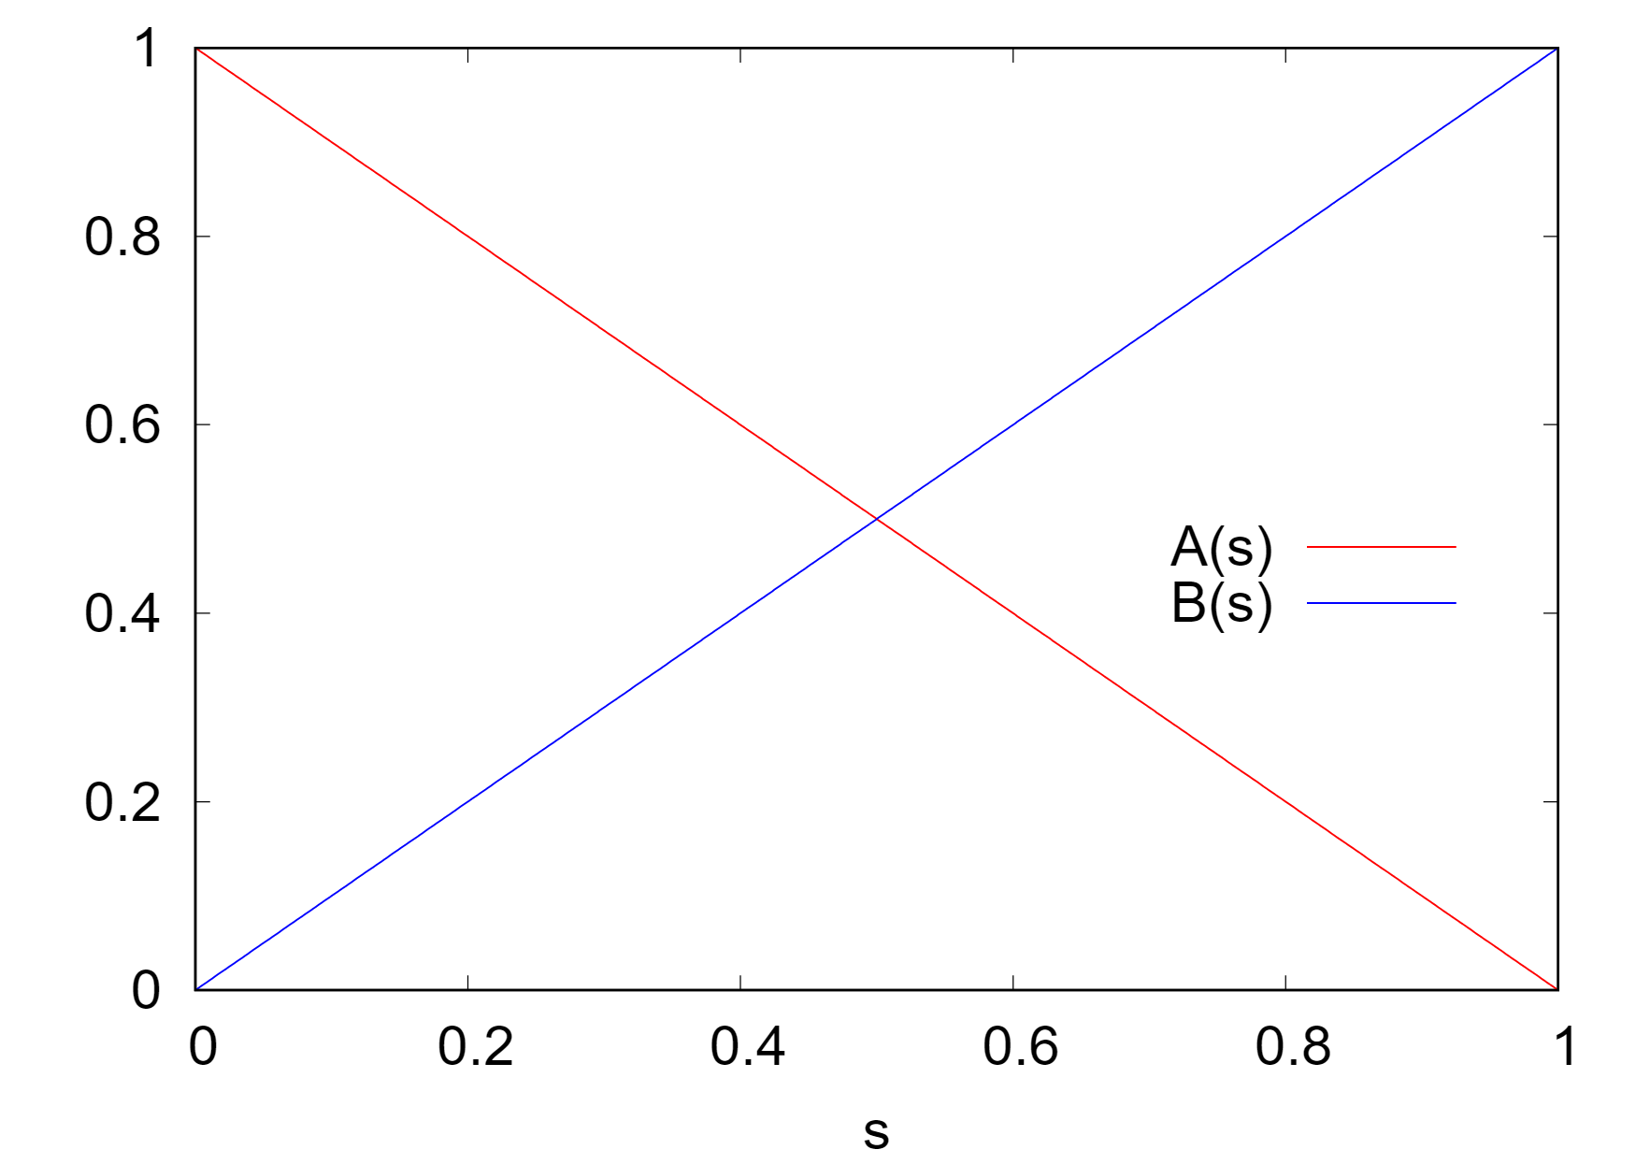
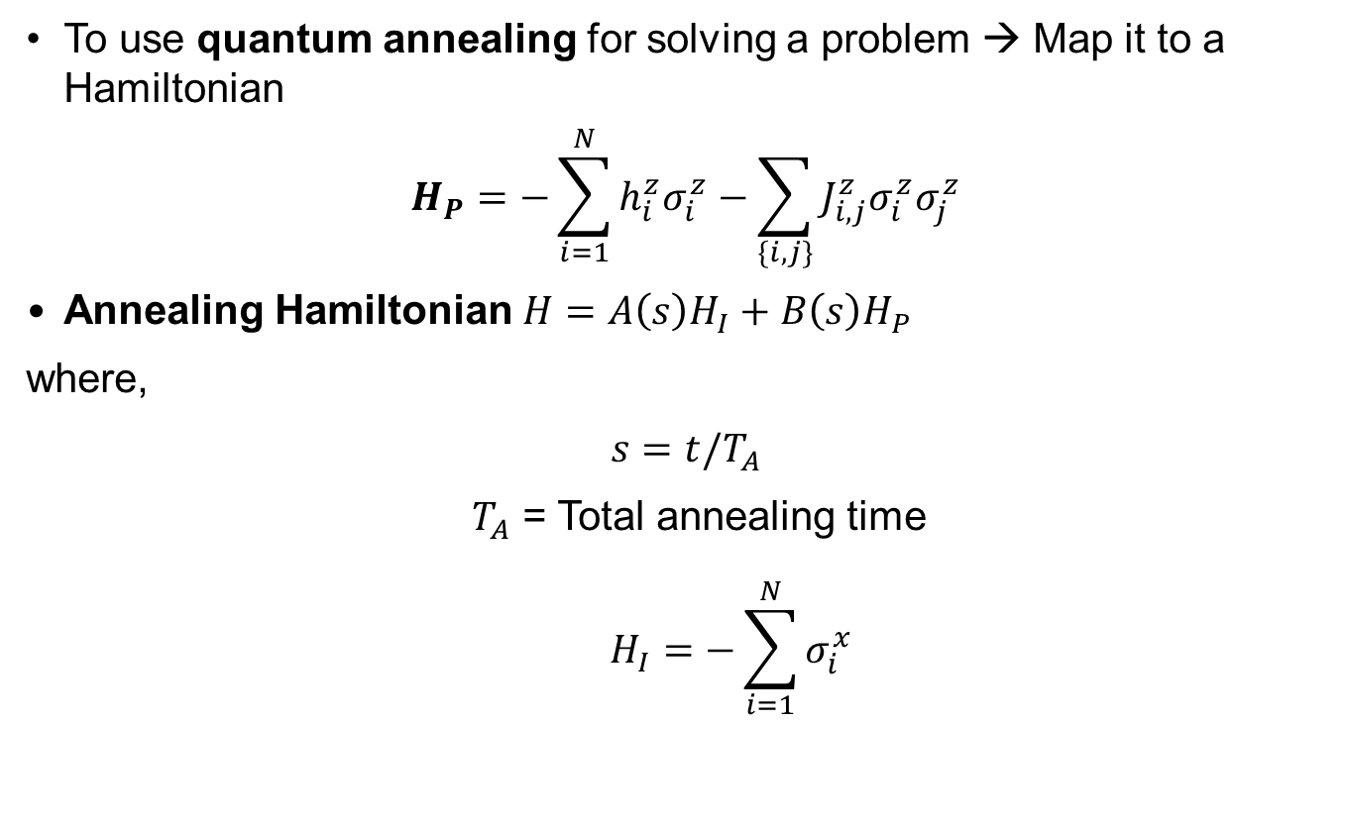
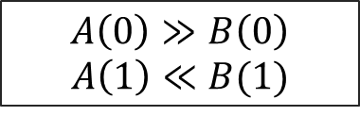
1.1 Standard annealing
To use quantum annealing for solving a problem → Map it to a Hamiltonian
$$H_{P}=−\sum_{i=1}^{N}{{h_{i}^{z}σ}_{i}^{z}}−\sum_{\{i,j\}}{J_{i,j}^{z}σ_{i}^{z}σ_{j}^{z}}$$
Annealing Hamiltonian $H=A\left(s\right)H_{I}+B\left(s\right)H_{P}$
where,
$$s=t/T_{A}$$
$T_{A}$ = Total annealing time
$$H_{I}=−\sum_{i=1}^{N}{σ_{i}^{x}}$$
$$A\left(0\right)≫B\left(0\right)$$
$$A\left(1\right)≪B(1)$$

Slide 5
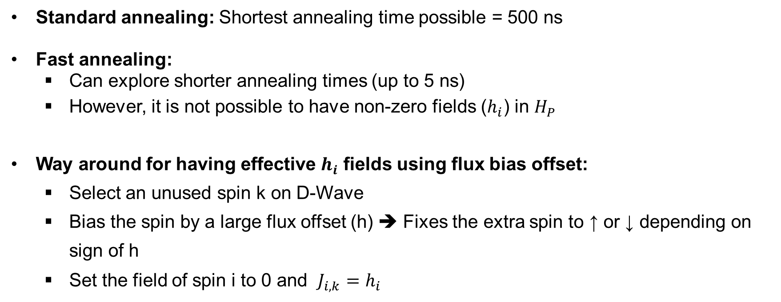
1.2 Fast annealing
Standard annealing: Shortest annealing time possible = 500 ns
Fast annealing:
Can explore shorter annealing times (up to 5 ns)
However, it is not possible to have non-zero fields ($h_{i}$) in $H_{P}$
Way around for having effective $h_{i}$ fields using flux bias offset:
Select an unused spin k on D-Wave
Bias the spin by a large flux offset (h) ➔ Fixes the extra spin to ↑ or ↓ depending on sign of h
Set the field of spin i to 0 and $J_{i,k}=$ $h_{i}$

Slide 6
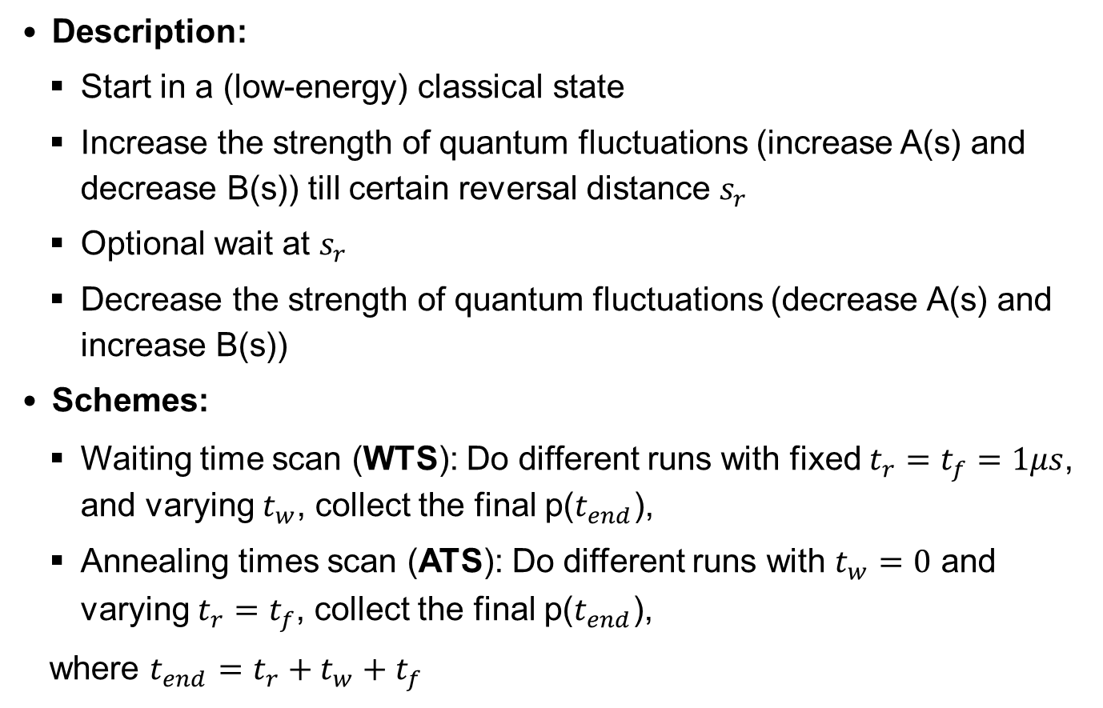




1.3 Reverse annealing
1
Description:
Start in a (low-energy) classical state
Increase the strength of quantum fluctuations (increase A(s) and decrease B(s)) till certain reversal distance $s_{r}$
Optional wait at $s_{r}$
Decrease the strength of quantum fluctuations (decrease A(s) and increase B(s))
Schemes:
Waiting time scan (WTS): Do different runs with fixed $t_{r}=t_{f}=1μs$, and varying $t_{w}$, collect the final p($t_{end}$),
Annealing times scan (ATS): Do different runs with $t_{w}=0$ and varying $t_{r}=t_{f}$, collect the final p($t_{end}$),
where $t_{end}=t_{r}+t_{w}+t_{f}$
$$s_{r}$$
s
0
$$t_{r}$$
$$t_{w}$$
$$t_{f}$$
t

Slide 7
D-Wave results

Slide 8
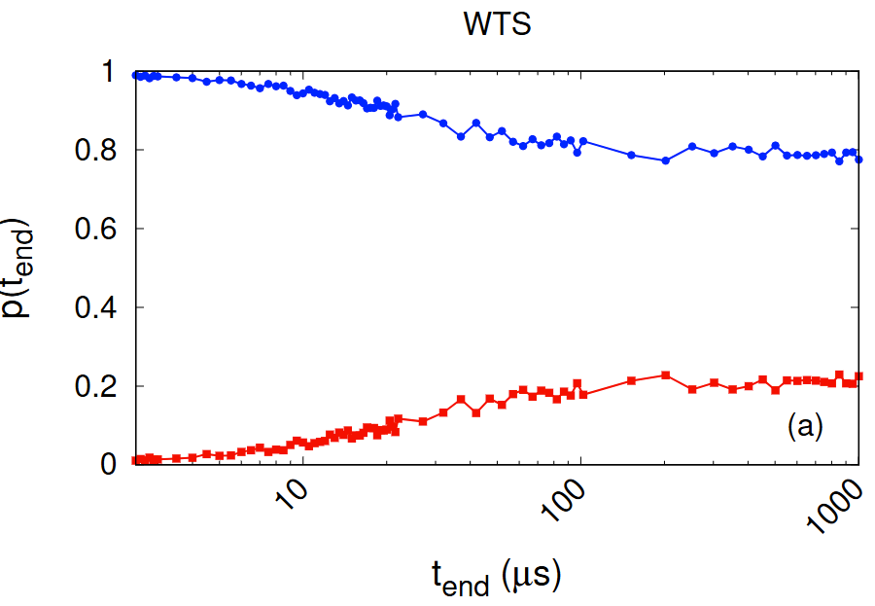
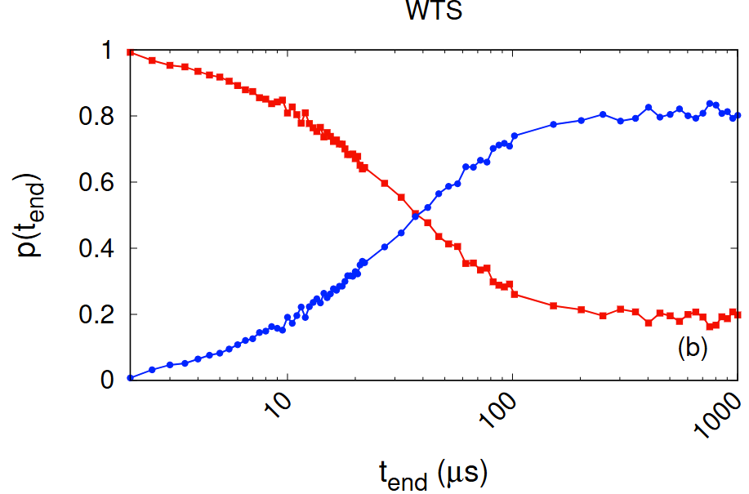

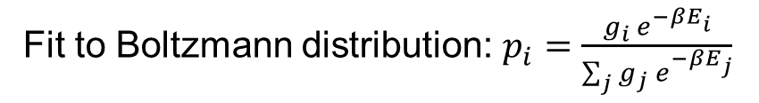

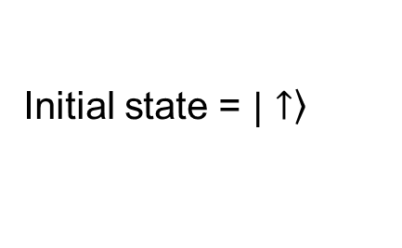
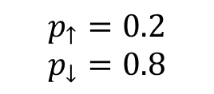

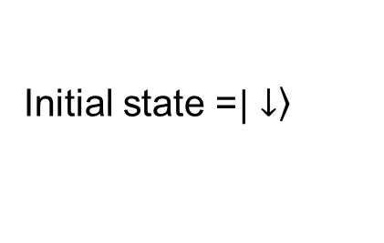

2.1 Reverse annealing
$$s_{r}=0.7$$
2.1.1 1-spin
$$H_{P}=0.1 σ^{z}$$
Initial state = $\left.|↑\right\rangle$
Initial state =$\left.|↓\right\rangle$
Fit to Boltzmann distribution: $p_{i}=\frac{g_{i}{ e}^{−βE_{i}}}{\sum_{j}{g_{j}{ e}^{−βE_{j}}}}$
$$p_{↑}=0.2$$
$$p_{↓}=0.8$$
$β=6.93$ ($T=29.7 mK$)
[1] V. Mehta, H. De Raedt, K. Michielsen, F. Jin, arXiv:2502.08575v1 (2025)
Notes:
1spin prob, only two states, down the gs
Results: different initial states, look at the probability for both states, for different t_end. S_r=0.7
Each point a different run
Both plots show a relaxation of the probabilities and eventually stabilize, try to match to values from Boltzmann
Substituting matches despite of starting from a different initial state

Slide 9
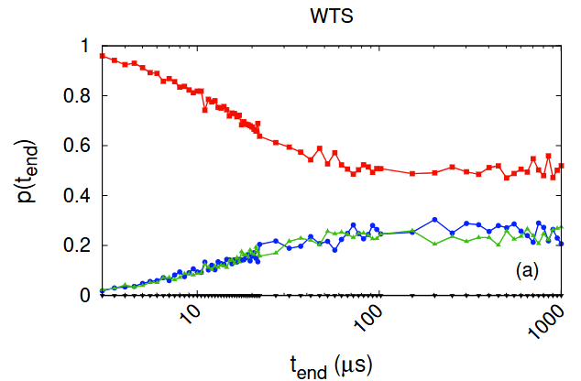
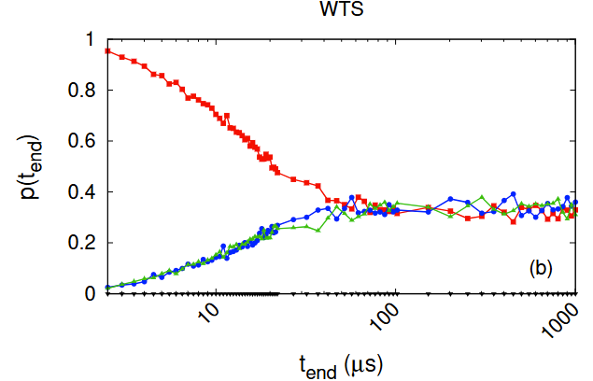
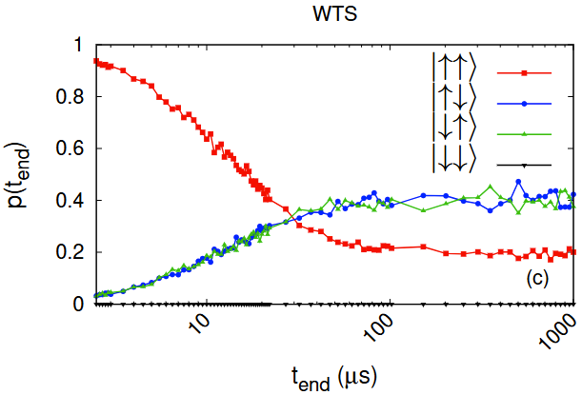
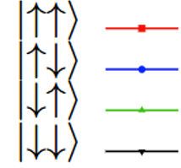
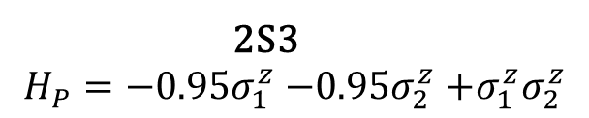
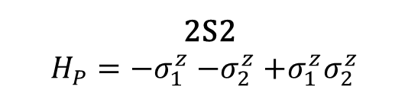
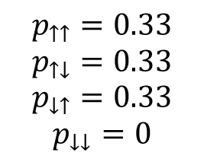
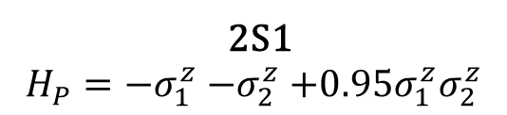



2.1 Reverse annealing
$$s_{r}=0.7$$
2.1.2 2-spin
$β=6.93$ ($T=29.7 mK$)
2S1
$$H_{P}=−σ_{1}^{z}{−σ}_{2}^{z}+0.95σ_{1}^{z}σ_{2}^{z}$$
2S2
$$H_{P}=−σ_{1}^{z}{−σ}_{2}^{z}+σ_{1}^{z}σ_{2}^{z}$$
2S3
$$H_{P}=−{0.95σ}_{1}^{z}{−0.95σ}_{2}^{z}+σ_{1}^{z}σ_{2}^{z}$$
$$p_{↑↑}=0.5$$
$$p_{↑↓}=0.25$$
$$p_{↓↑}=0.25$$
$$p_{↓↓}=0$$
$$p_{↑↑}=0.33$$
$$p_{↑↓}=0.33$$
$$p_{↓↑}=0.33$$
$$p_{↓↓}=0$$
$$p_{↑↑}=0.2$$
$$p_{↑↓}=0.4$$
$$p_{↓↑}=0.4$$
$$p_{↓↓}=0$$
[1] V. Mehta, H. De Raedt, K. Michielsen, F. Jin, arXiv:2502.08575v1 (2025)
Notes:
Next, 2-spin system, each with different gs. In the first….
Observe a similar trend

Slide 10
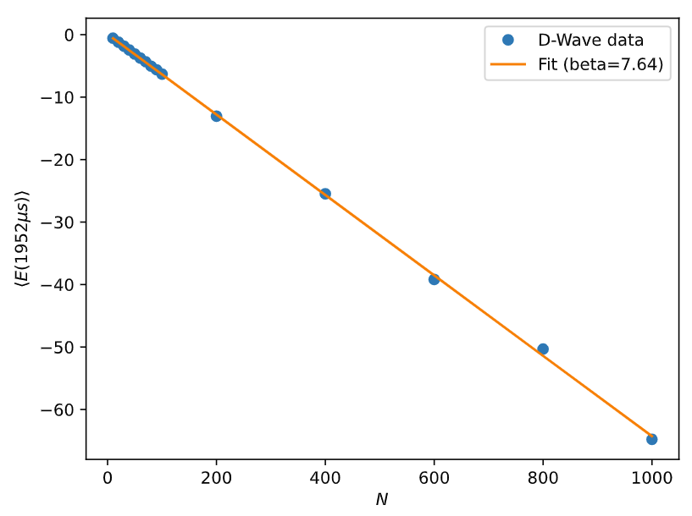
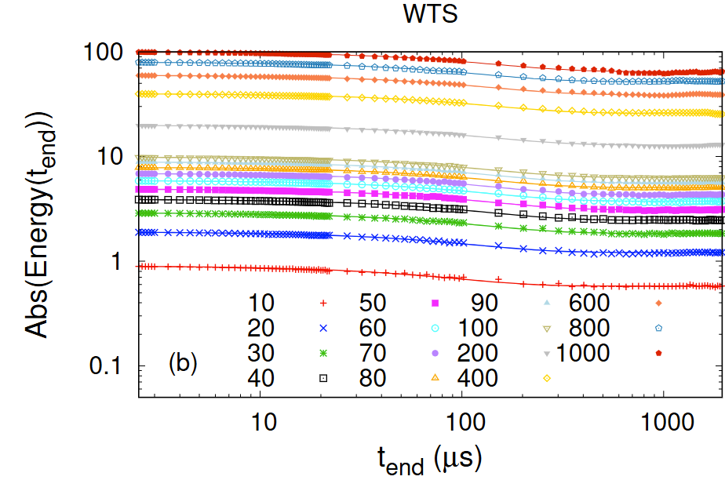
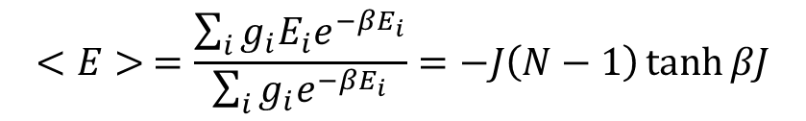

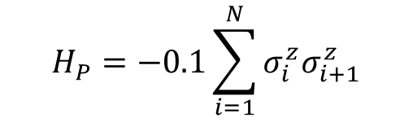
2.1 Reverse annealing
$$s_{r}=0.7$$
2.1.3 Ferromagnetic spin chain
$$H_{P}=−0.1\sum_{i=1}^{N}{σ_{i}^{z}σ_{i+1}^{z}}$$
$$<E> =\frac{\sum_{i}{g_{i}E_{i}e^{−βE_{i}}}}{\sum_{i}{g_{i}e^{−βE_{i}}}}=−J\left(N−1\right)\tanh{βJ}$$
$β=7.64$ ($T=27 mK$)
[1] V. Mehta, H. De Raedt, K. Michielsen, F. Jin, arXiv:2502.08575v1 (2025)
Notes:
So far only 1- and 2-spins
Now extend to ferro spin chains of upto 1000 variables. Look at the absolute values of average of energies over all samples from DW for each t_end
Collect final points, and plot as a func of N. The fact that a single value of beta can be used to fit through these points shows that this behavior is very systemic

Slide 11
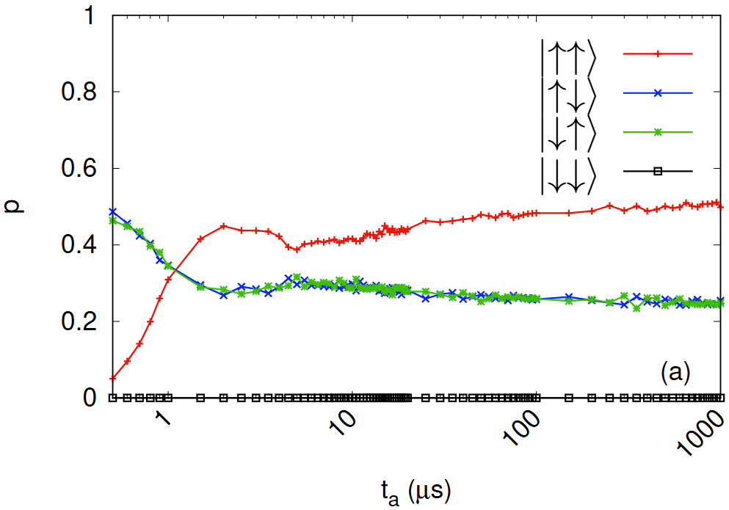
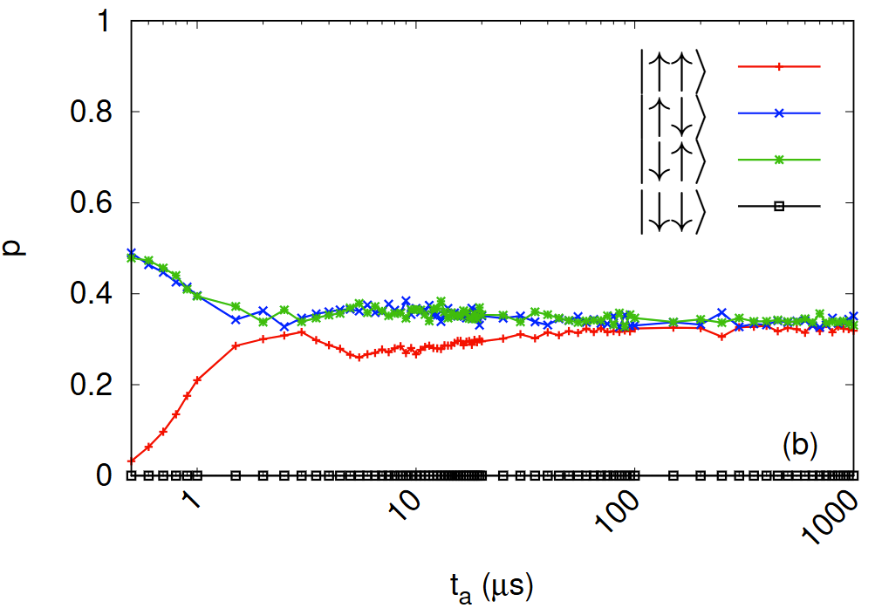
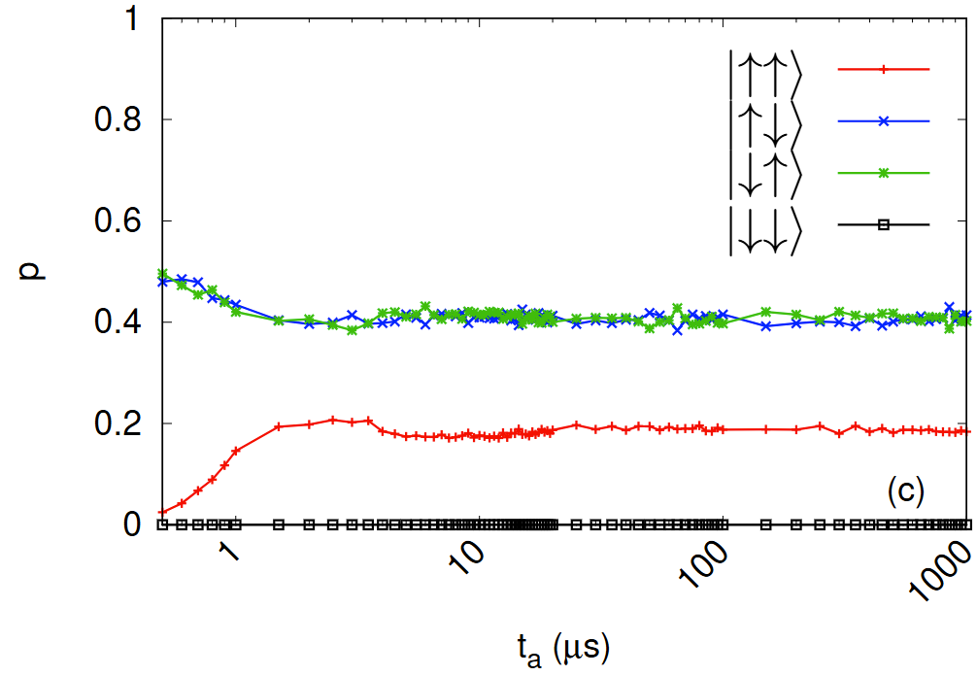


2.2 standard annealing
$$s_{r}=0.7$$
2-spin
$β=6.93$ ($T=29.7 mK$)
2S1
$$H_{P}=−σ_{1}^{z}{−σ}_{2}^{z}+0.95σ_{1}^{z}σ_{2}^{z}$$
2S2
$$H_{P}=−σ_{1}^{z}{−σ}_{2}^{z}+σ_{1}^{z}σ_{2}^{z}$$
2S3
$$H_{P}=−{0.95σ}_{1}^{z}{−0.95σ}_{2}^{z}+σ_{1}^{z}σ_{2}^{z}$$
$$p_{↑↑}=0.5$$
$$p_{↑↓}=0.25$$
$$p_{↓↑}=0.25$$
$$p_{↓↓}=0$$
$$p_{↑↑}=0.33$$
$$p_{↑↓}=0.33$$
$$p_{↓↑}=0.33$$
$$p_{↓↓}=0$$
$$p_{↑↑}=0.20$$
$$p_{↑↓}=0.40$$
$$p_{↓↑}=0.40$$
$$p_{↓↓}=0$$
Dips & Bumps
[2] V. Mehta, H. De Raedt, K. Michielsen, F. Jin, arXiv:2503.21565v1(2025)
Notes:
Focus on standard annealing
Now collect final probs for diff ta
Show the same trend, matches
Additional feature appears, state up up always starts from a value close to 0, and then reaches the thermal equil

Slide 12
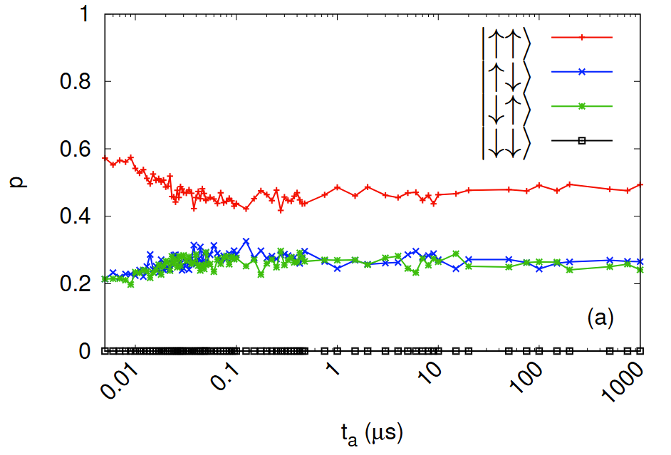
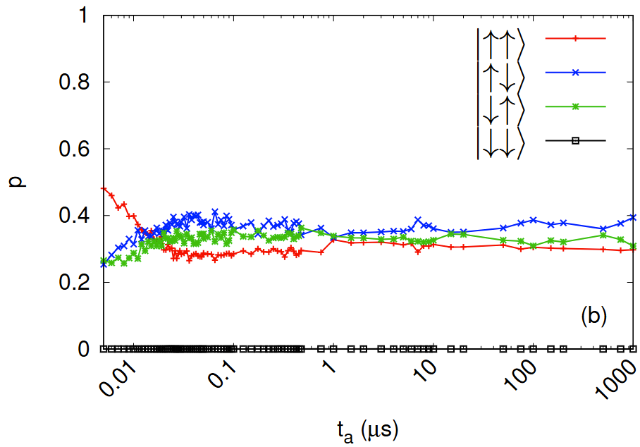
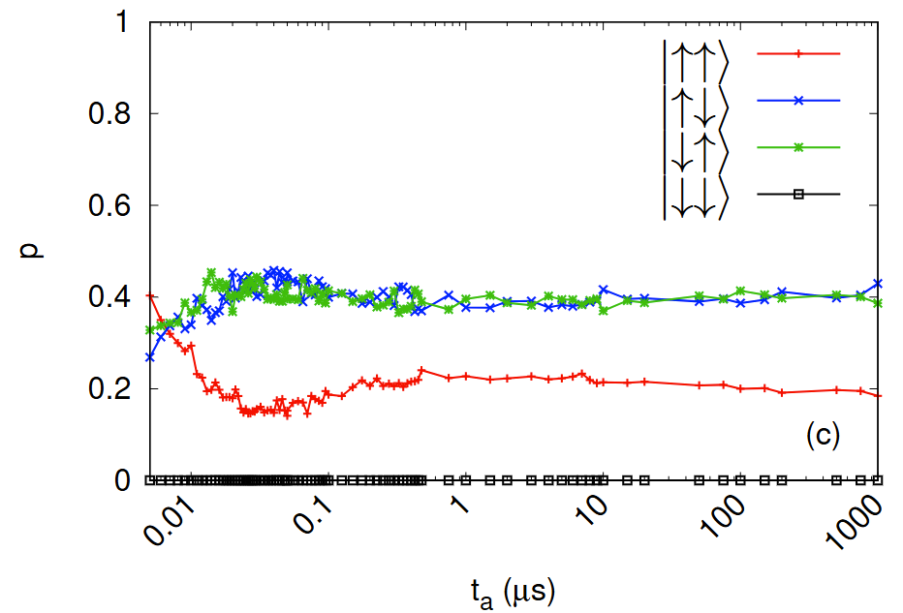
2.3 fast annealing
$$s_{r}=0.7$$
2-spin
$β=6.93$ ($T=29.7 mK$)
2S1
$$H_{P}=−σ_{1}^{z}{−σ}_{2}^{z}+0.95σ_{1}^{z}σ_{2}^{z}$$
2S2
$$H_{P}=−σ_{1}^{z}{−σ}_{2}^{z}+σ_{1}^{z}σ_{2}^{z}$$
2S3
$$H_{P}=−{0.95σ}_{1}^{z}{−0.95σ}_{2}^{z}+σ_{1}^{z}σ_{2}^{z}$$
$$p_{↑↑}=0.5$$
$$p_{↑↓}=0.25$$
$$p_{↓↑}=0.25$$
$$p_{↓↓}=0$$
$$p_{↑↑}=0.33$$
$$p_{↑↓}=0.33$$
$$p_{↓↑}=0.33$$
$$p_{↓↓}=0$$
$$p_{↑↑}=0.20$$
$$p_{↑↓}=0.40$$
$$p_{↓↑}=0.40$$
$$p_{↓↓}=0$$
No Dips & Bumps
[2] V. Mehta, H. De Raedt, K. Michielsen, F. Jin, arXiv:2503.21565v1(2025)
Notes:
Same drill
But no dips and bumps

Slide 13
simulations
Notes:
Next we take a look at the relevant simulation models that can potentially be used to describe a quantum annealer

Slide 14

3.1 Time-dependent Schrödinger equation
The time evolution of an ideal closed quantum system is governed by the time-dependent Schrödinger equation (TDSE)
$$iℏ\frac{∂}{∂t}\left.|ψ(t)\right\rangle =H\left(t\right)\left.|ψ(t)\right\rangle$$
$$\left.|ψ(t)\right\rangle =\sum_{i=0}^{D}{c_{i}\left.|i\right\rangle }$$
$H\left(t\right)$: time-dependent Hamiltonian modeling the quantum system
$\left.|ψ(t)\right\rangle$ describes the state of the whole quantum system at time t
$\left.|i\right\rangle$: basis states
$c_{i}$: complex valued coefficients
D: Dimension of the Hilbert space
Notes:
For completeness, start from …

Slide 15

3.2 Lindblad master equation
Master equation that approximates the time evolution of a density matrix $ρ(t)$ of a system interacting with an environment
$$\frac{dρ(t)}{dt}=−i\left[H,ρ\left(t\right)\right]+\frac{1}{2}\sum_{j}{γ_{j}\left(2L_{j}ρ\left(t\right)L_{j}^{†}−L_{j}^{†}L_{j}ρ\left(t\right)−ρ\left(t\right)L_{j}^{†}L_{j}\right)≔ℒρ\left(t\right)}$$
$ρ$: density matrix
$L_{j}$: dissipation operators
$γ_{j}$: dissipation rates
Coherent
Dissipative
Notes:
But for systems interacting with an environment the Lindblad master equation can serve as a good model

Slide 16
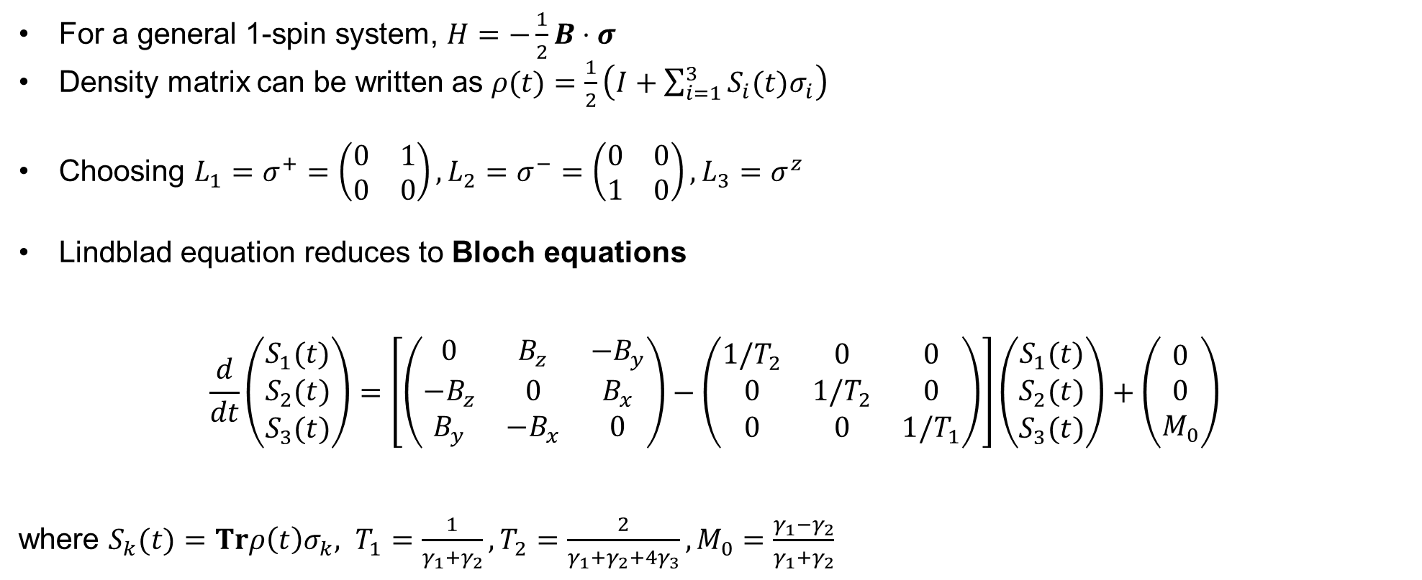
3.3 Bloch equations
For a general 1-spin system, $H=−\frac{1}{2}B⋅σ$
Density matrix can be written as $ρ(t)=\frac{1}{2}\left(I+\sum_{i=1}^{3}{S_{i}(t)σ_{i}}\right)$
Choosing $L_{1}=σ^{+}=\left(\begin{matrix}0 & 1 \\ 0 & 0\end{matrix}\right), L_{2}=σ^{−}=\left(\begin{matrix}0 & 0 \\ 1 & 0\end{matrix}\right),L_{3}=σ^{z}$
Lindblad equation reduces to Bloch equations
$$\frac{d}{dt}\left(\begin{matrix}S_{1}(t) \\ S_{2}(t) \\ S_{3}(t)\end{matrix}\right)=\left[\left(\begin{matrix}0 & B_{z} & −B_{y} \\ −B_{z} & 0 & B_{x} \\ B_{y} & −B_{x} & 0\end{matrix}\right)−\left(\begin{matrix}1/T_{2} & 0 & 0 \\ 0 & 1/T_{2} & 0 \\ 0 & 0 & 1/T_{1}\end{matrix}\right)\right]\left(\begin{matrix}S_{1}(t) \\ S_{2}(t) \\ S_{3}(t)\end{matrix}\right)+\left(\begin{matrix}0 \\ 0 \\ M_{0}\end{matrix}\right)$$
where ${S_{k}(t)=Trρ\left(t\right)σ_{k}, T}_{1}=\frac{1}{γ_{1}+γ_{2}},T_{2}=\frac{2}{γ_{1}+γ_{2}+4γ_{3}}, M_{0}=\frac{γ_{1}−γ_{2}}{γ_{1}+γ_{2}}$
Notes:
Where relaxation times T1 and T2 and the equilibrium magnetization M0 are related to the dissipation rates as given by these equations

Slide 17

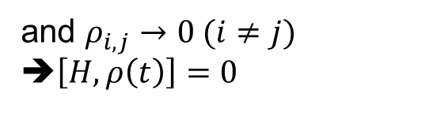
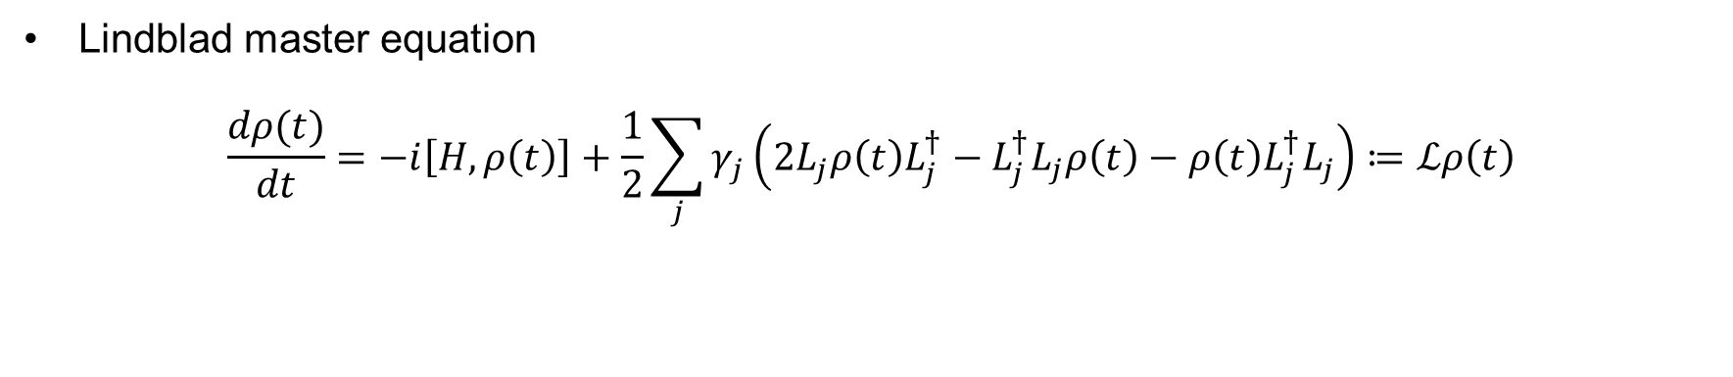
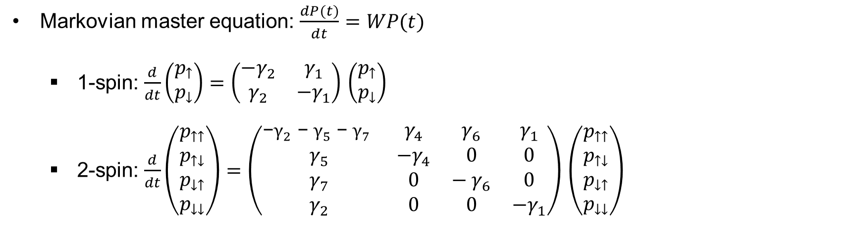

3.4 Markovian master equation
Lindblad master equation
$$\frac{dρ(t)}{dt}=−i\left[H,ρ\left(t\right)\right]+\frac{1}{2}\sum_{j}{γ_{j}\left(2L_{j}ρ\left(t\right)L_{j}^{†}−L_{j}^{†}L_{j}ρ\left(t\right)−ρ\left(t\right)L_{j}^{†}L_{j}\right)≔ℒρ\left(t\right)}$$
$$H\left(t\right)=A\left(t\right)H_{I}+B\left(t\right)H_{P}$$
and $ρ_{i,j}→0 (i≠j)$
➔$\left[H,ρ\left(t\right)\right]=0$
Markovian master equation: $\frac{dP(t)}{dt}=WP(t)$
1-spin: $\frac{d}{dt}\left(\begin{matrix}p_{↑} \\ p_{↓}\end{matrix}\right)=\left(\begin{matrix}−γ_{2} & γ_{1} \\ γ_{2} & {−γ}_{1}\end{matrix}\right)$ $\left(\begin{matrix}p_{↑} \\ p_{↓}\end{matrix}\right)$
2-spin: $\frac{d}{dt}\left(\begin{matrix}p_{↑↑} \\ p_{↑↓} \\ p_{↓↑} \\ p_{↓↓}\end{matrix}\right)=\left(\begin{matrix}\text{−}γ_{2}\text{ − }γ_{5}\text{ − }γ_{7} & γ_{4} & γ_{6} & γ_{1} \\ γ_{5} & −γ_{4} & 0 & 0 \\ γ_{7} & 0 & − γ_{6} & 0 \\ γ_{2} & 0 & 0 & −γ_{1}\end{matrix}\right)$ $\left(\begin{matrix}p_{↑↑} \\ p_{↑↓} \\ p_{↓↑} \\ p_{↓↓}\end{matrix}\right)$
Notes:
Now if we choose to ignore A(s) and the off-diagonal elements of rho completely, then comm =0, which means that we ignore the coherent part of the dynamics. we obtain Markovian master equation where P is the prob vector. For the 1 and the 2 spin problems is given by these equations.

Slide 18
numerical results

Slide 19
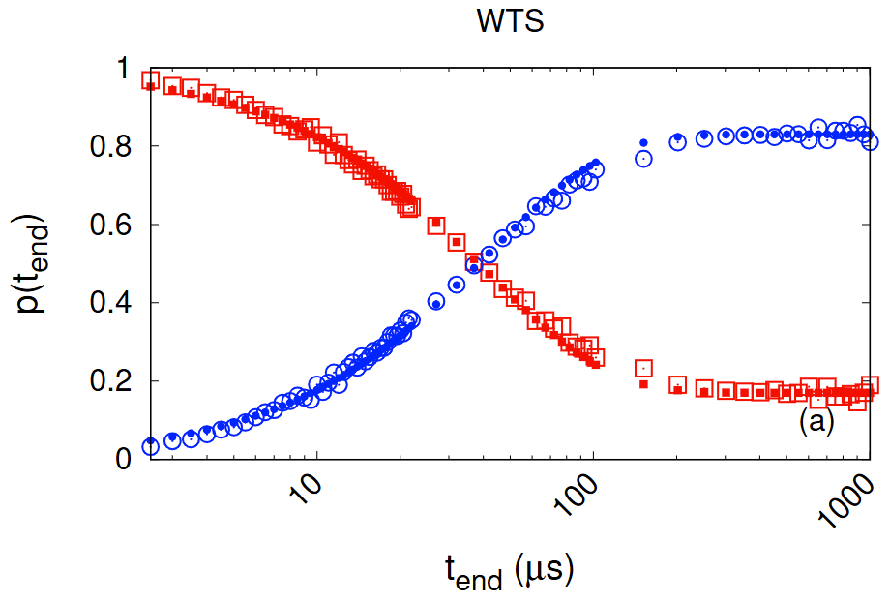
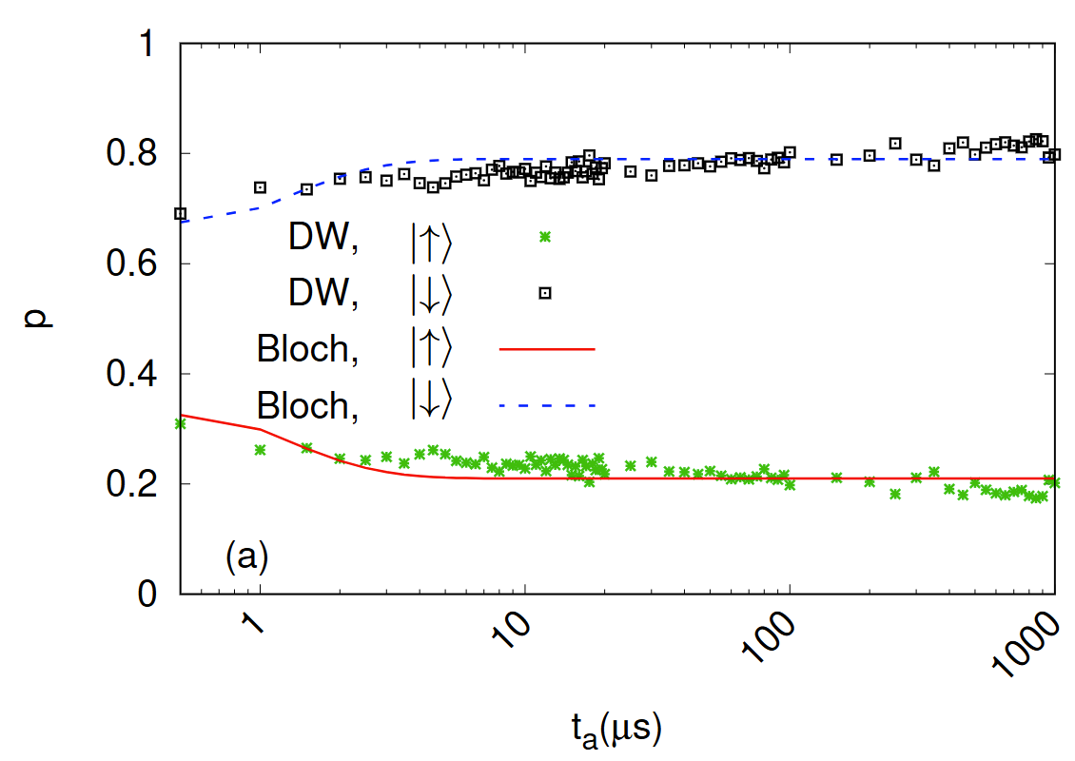
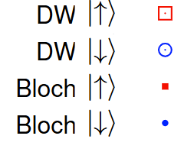

4.1 1-spin results
$$H_{P}=0.1 σ^{z}$$
Bloch equations
Reverse annealing
Standard annealing
[1] V. Mehta, H. De Raedt, K. Michielsen, F. Jin, arXiv:2502.08575v1 (2025)
[2] V. Mehta, H. De Raedt, K. Michielsen, F. Jin, arXiv:2503.21565v1(2025)

Slide 20
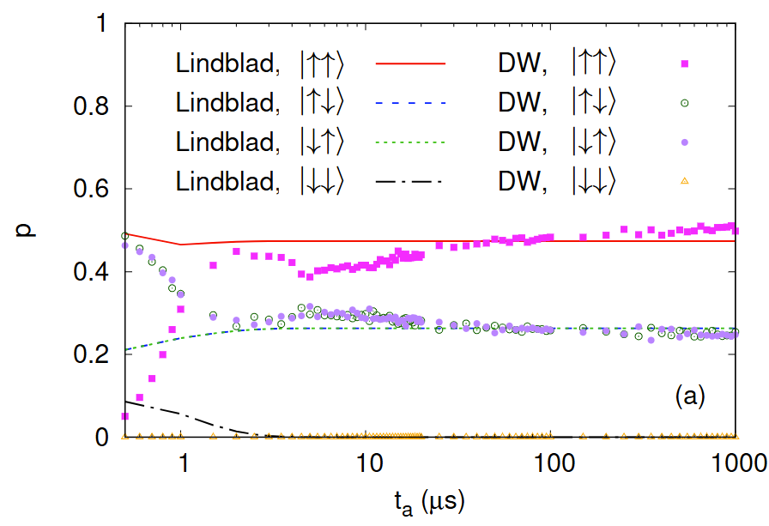
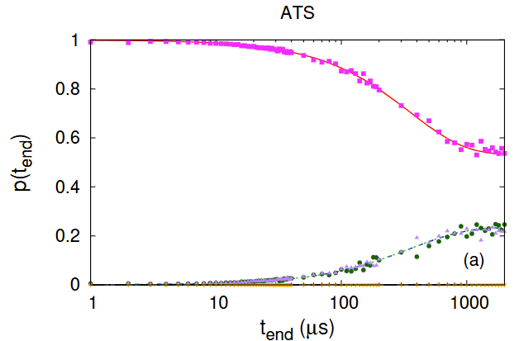
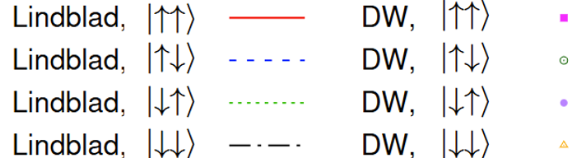
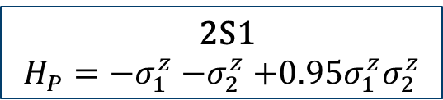
4.2 2-spin results
2S1
$$H_{P}=−σ_{1}^{z}{−σ}_{2}^{z}+0.95σ_{1}^{z}σ_{2}^{z}$$
4.2.1 Lindblad master equation
Standard annealing
Reverse annealing
Simulations cannot capture the initial dips & bumps
➔ Need time-dependent dissipation rates
[1] V. Mehta, H. De Raedt, K. Michielsen, F. Jin, arXiv:2502.08575v1 (2025)
[2] V. Mehta, H. De Raedt, K. Michielsen, F. Jin, arXiv:2503.21565v1(2025)

Slide 21
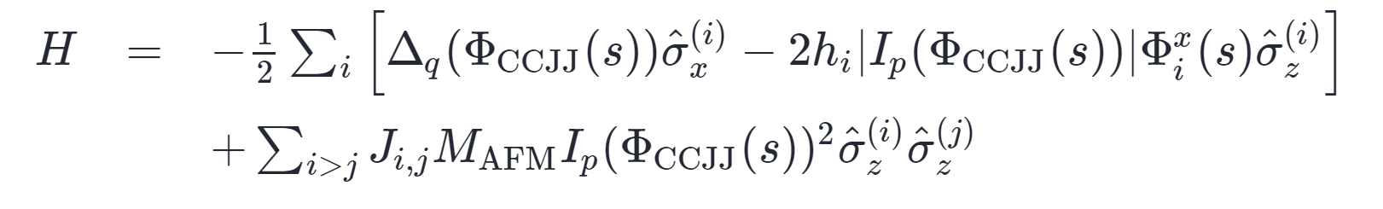
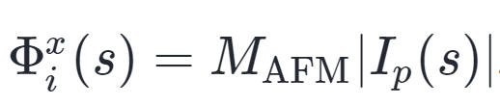
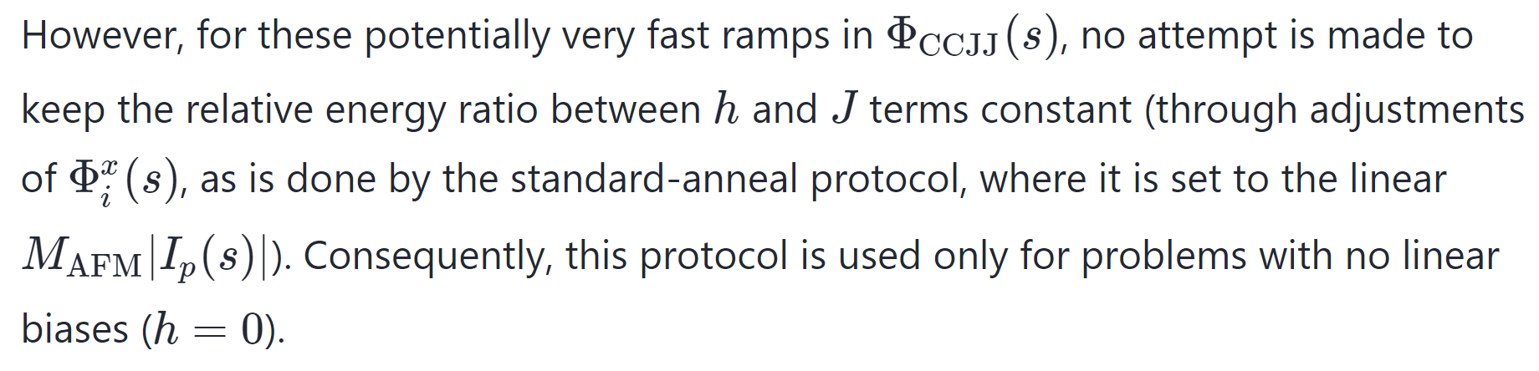

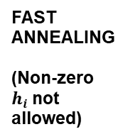


4.2 2-spin results
4.2.2 2-spin results: Tackling the dips & bumps
FAST ANNEALING
(Non-zero $h_{i}$not allowed)
STANDARD ANNEALING
(Non-zero $h_{i}$works fine)
For implementing B(s)
0.5
1
$$t_{a}(μs)$$
So that instead of $B\left(h_{i}+J_{i,j}\right)$, we have
$B′(h_{i})+{B(J}_{i,j})$?
Conjecture: For short annealing times (where non-zero allowed), the h and J ratio can no longer be kept constant…
[2] V. Mehta, H. De Raedt, K. Michielsen, F. Jin, arXiv:2503.21565v1(2025)
Notes:
For this we look at the physical Hamil in DW, where for implementing the annealing func B(s) this condition needs to be satisfied
As per D-Wave documentation, ensuring this seems to be a difficult task, without which energy ratios between h and J terms cannot be kept constant. This also seems to be the reason why non-zero hi’s cannot be allowed for fast annealing
Then can it be possible that even for the shortest few annealing times allowed in standard annealing, maintaining this ratio is not possible so that instead of….

Slide 22





4.2 2-spin results
4.2.2 2-spin results: Tackling the dips & bumps
FAST ANNEALING
(Non-zero $h_{i}$not allowed)
STANDARD ANNEALING
(Non-zero $h_{i}$works fine)
Conjecture: For short annealing times (where non-zero allowed), the h and J ratio can no longer be kept constant?
0.5
1
$$t_{a}(μs)$$
So instead of $B\left(h_{i}+J_{i,j}\right)$, we have
$B′(h_{i})+{B(J}_{i,j})$?
Idea for B’(s): 1) $B^{′}\left(t\right)=0$ for $t<t_{onset}^{start}$
2) $B^{′}\left(t\right)=B(t)\sin\left(\frac{π}{2}\frac{\left(t−t_{onset}^{start}\right)}{t_{onset}^{end}−t_{onset}^{start}}\right)$ for $t_{onset}^{start}≤t≤t_{onset}^{end}$
3) $B^{′}\left(t\right)=B(t)$ for $t> t_{onset}^{end}$
[2] V. Mehta, H. De Raedt, K. Michielsen, F. Jin, arXiv:2503.21565v1(2025)

Slide 23







4.2 2-spin results
4.2.2 Tackling the dips & bumps: Numerical results with Lindblad master equation
2S1
$$H_{P}=−σ_{1}^{z}{−σ}_{2}^{z}+0.95σ_{1}^{z}σ_{2}^{z}$$
2S2
$$H_{P}=−σ_{1}^{z}{−σ}_{2}^{z}+σ_{1}^{z}σ_{2}^{z}$$
2S3
$$H_{P}=−{0.95σ}_{1}^{z}{−0.95σ}_{2}^{z}+σ_{1}^{z}σ_{2}^{z}$$
p
[2] V. Mehta, H. De Raedt, K. Michielsen, F. Jin, arXiv:2503.21565v1(2025)

Slide 24



4.2 2-spin results
2S1
$$H_{P}=−σ_{1}^{z}{−σ}_{2}^{z}+0.95σ_{1}^{z}σ_{2}^{z}$$
4.2.3 Markovian master equation
Standard annealing
Reverse annealing
B and B’ used to reproduce the dips & bumps in forward annealing
Non-quantum equations can capture the D-Wave behavior equally well
Can be used to reproduce the results for larger systems
[2] V. Mehta, H. De Raedt, K. Michielsen, F. Jin, arXiv:2503.21565v1(2025)
Notes:
What to say here?

Slide 25


4.3 fast annealing
4.3.1 1-spin
Comparison of the D-Wave data with ideal quantum annealing simulations
Data matches the simulations closely only for $t_{a}=5$ ns
Beyond that data deviates from the coherent simulation results
[2] V. Mehta, H. De Raedt, K. Michielsen, F. Jin, arXiv:2503.21565v1(2025)
Notes:
What to say here?

Slide 26






4.3 fast annealing
4.3.2 Fast annealing results: 2-spin
2S1
$$H_{P}=−σ_{1}^{z}{−σ}_{2}^{z}+0.95σ_{1}^{z}σ_{2}^{z}$$
2S2
$$H_{P}=−σ_{1}^{z}{−σ}_{2}^{z}+σ_{1}^{z}σ_{2}^{z}$$
2S3
$$H_{P}=−{0.95σ}_{1}^{z}{−0.95σ}_{2}^{z}+σ_{1}^{z}σ_{2}^{z}$$
p
p
p
Data deviates from the coherent simulations beyond $t_{a}=5$ ns
Looking at specific cases can be misleading
[2] V. Mehta, H. De Raedt, K. Michielsen, F. Jin, arXiv:2503.21565v1(2025)
Notes:
What to say here?

Slide 27
Conclusion
Systematic thermalization: D-Wave results show consistent relaxation towards the thermal equilibrium across standard, reverse, and fast annealing protocols as a function of annealing time
Numerical agreement: Bloch (1-spin) and Lindblad/Markovian master equations (2-spin) reproduce D-Wave data well across all protocols
Possible implementation artifact: Standard annealing shows unexpected features (dips & bumps) at certain annealing times, which can be explained by incorporating a physically motivated modification to the annealing schedule
Coherent effects: Signs of coherence observed but limited to ~5 ns annealing time
Notes:
What to say here?

Slide 28







Advantage 2 (prototype)
2S1
$$H_{P}=−σ_{1}^{z}{−σ}_{2}^{z}+0.95σ_{1}^{z}σ_{2}^{z}$$
2S3
$$H_{P}=−σ_{1}^{z}{−σ}_{2}^{z}+1.05σ_{1}^{z}σ_{2}^{z}$$
$$H_{P}=0.1 σ^{z}$$
Notes:
What to say here?

Slide 29


Shimming
D-Wave
Notes:
What to say here?

