Slide 1
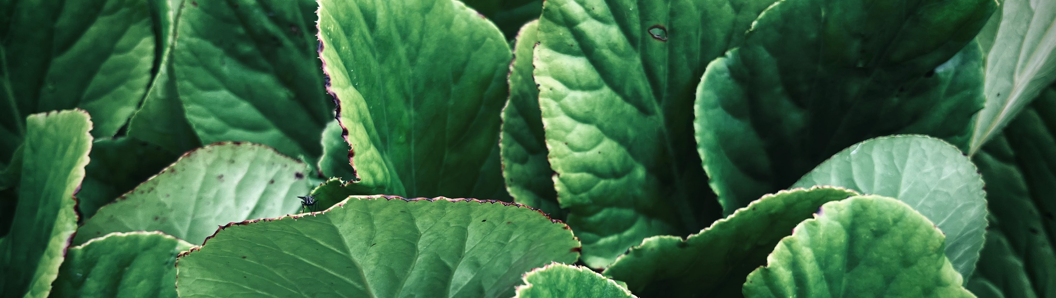

establishing ground RULES FOR SENSOR-LIKE APPLICATION OF NMR RELAXOMETRY FOR THE STUDY OF WATER AND DRY MATTER DYNAMICS IN LIVING PLANTS
ICMRM 18th l Antonia Wörtche, Carel Windt, Volkmar Schulz

Slide 2
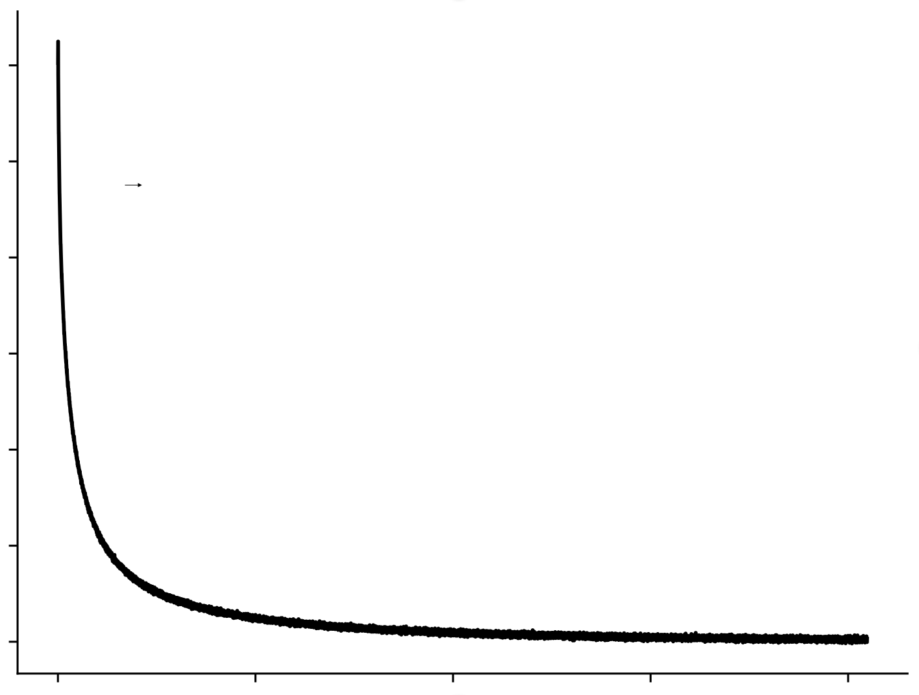
HOW CAN WE USE time domain NMR TO MONITOR WATER AND DRY MATTER DYNAMICS IN PLANTS?
Low-Field Time Domain (TD) NMR
Type A
Type B
?
NMR signal amplitude
Track diurnal and long-term water and dry matter dynamics
Characterize water and dry matter dynamics under heat and drought stress
Time
Page 2
Identify plants with resilient characterisics
Notes:
Key parameters for evaluating plant growth and yield are FW, WW and DW
Lack of non-invasive measurement techniques
Little known about the diurnal and long-term dynamics of these traits
And how change if plants are subjected/exposed to stress

Slide 3



HOW CAN WE USE TIME DOMAIN NMR for sensor-like measurements TO MONITOR WATER AND DRY MATTER DYNAMICS IN PLANTS?
Fast data acquisition and on-the fly analysis
Type A
Type B
Suitable for non-expert operators
Identify plants with resilient characterisics
Affordability: excecutable on basic spectrometer and magnets with limited field homogeneity
Page 3

Slide 4
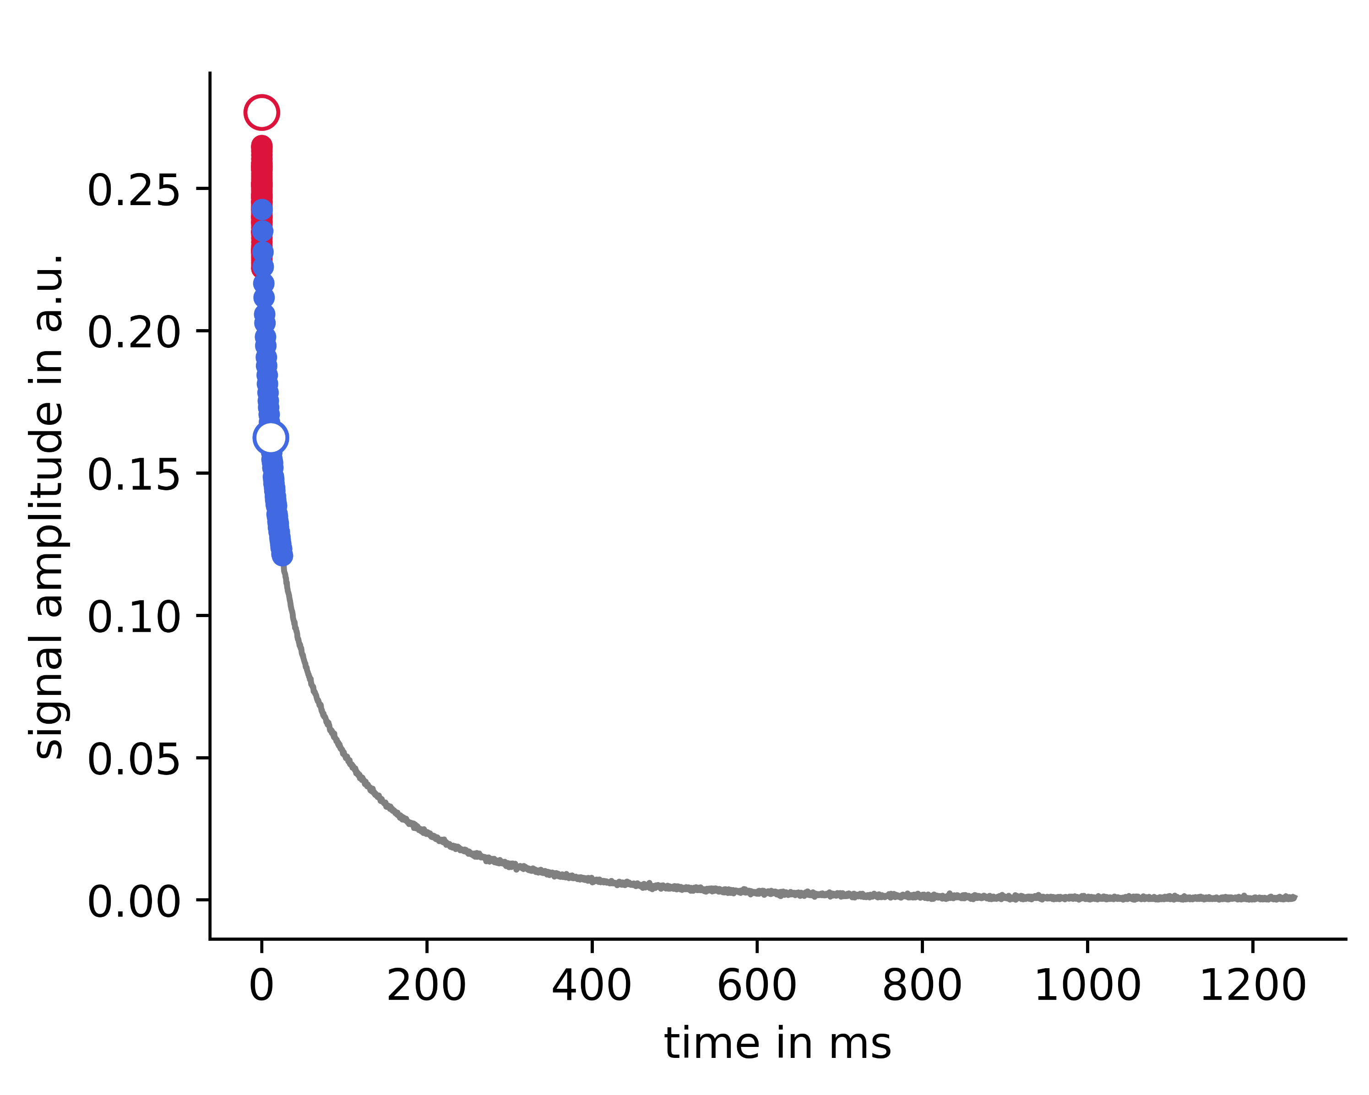

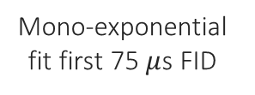


How can we extract the information stored in nmr data?
The Solid Liquid Content Method¹ – a simple T₂ weighted approach
FID
CPMG
0.26
0.20
0.2
0.15
NMR signal amplitude in a.u.
0.22
0
0.05
0
20
Mono-exponential fit first 75 $μ$s FID
Mean value 0-25 ms interval CPMG
0.1
${PD}_{tot}$ - Total Proton Density
Fresh Weight
${PD}_{liq}$ - Liquid Proton Density
Water Weight
0
0
400
800
1200
time in ms
[1] C.W. Windt, et al. A mobile NMR sensor and relaxometric method to non-destructively monitor water and dry matter content in plants, Frontiers in Plant Science, 12 (2021)
Page 4

Slide 5
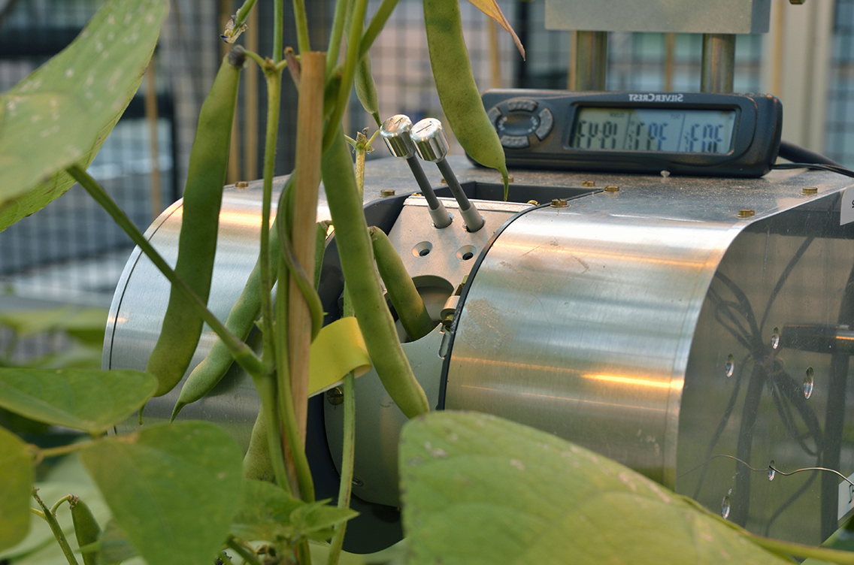
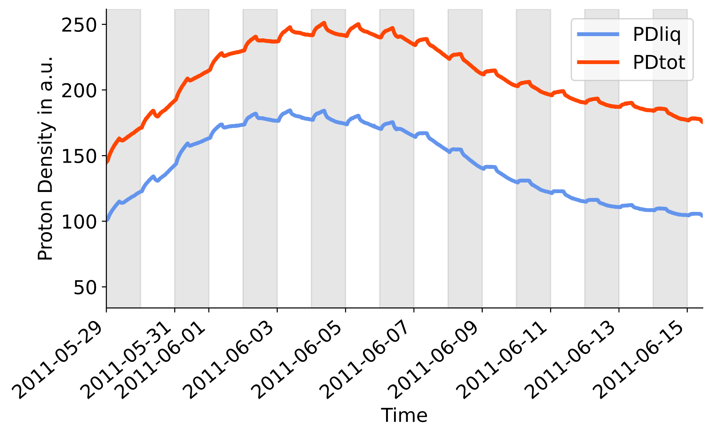




Simple approach allows to monitor long-term dynamics in total and liquid proton density
Long term measurement of a developing bean pod
250
PD_{tot}
PD_{liq}
Proton Density in a.u.
150
FID
CPMG
50
day 1
day 3
day 5
day 7
day 9
day 11
day 13
day 15
day 17
Mono-exponential fit first 75 $μ$s FID
Mean value 0-25 ms interval CPMG
$${PD}_{tot}:$$
Total Proton Density
$${PD}_{liq}:$$
Liquid Proton Density
time

Slide 6




Simple approach allows to monitor long-term dynamics in total and liquid proton density
Dry Weight (DW):
Water Content (WC)
Long term measurement of a developing bean pod
$$WC=\frac{WW}{FW}$$
$$DW=FW−WW$$
250
PD_{tot}
PD_{liq}
Fresh Weight (FW):
Water Weight (WW):
$$FW=a⋅PD_{tot}+b$$
$$WW=c⋅PD_{liq}+d$$
Proton Density in a.u.
150
FID
CPMG
50
day 1
day 3
day 5
day 7
day 9
day 11
day 13
day 15
day 17
Mono-exponential fit first 75 $μ$s FID
Mean value 0-25 ms interval CPMG
$${PD}_{tot}:$$
Total Proton Density
$${PD}_{liq}:$$
Liquid Proton Density
time

Slide 7



So far, SLC method yields good and linear results
But based on empirical observations
FID
CPMG
Fresh Weight (FW):
Water Weight (WW):
$$FW=a⋅PD_{tot}+b$$
$$WW=c⋅PD_{liq}+d$$
Mono-exponential fit first 75 $μ$s FID
Mean value 0-25 ms interval CPMG
?
How good are the estimations of PD_{tot} based on mono-exponential fit?
?
How consistent are the correlations between the proton densities and the weight parameters?
?
What is the influence of the CPMG averaging interval on the estimate of the liquid proton fraction?
Page 7

Slide 8
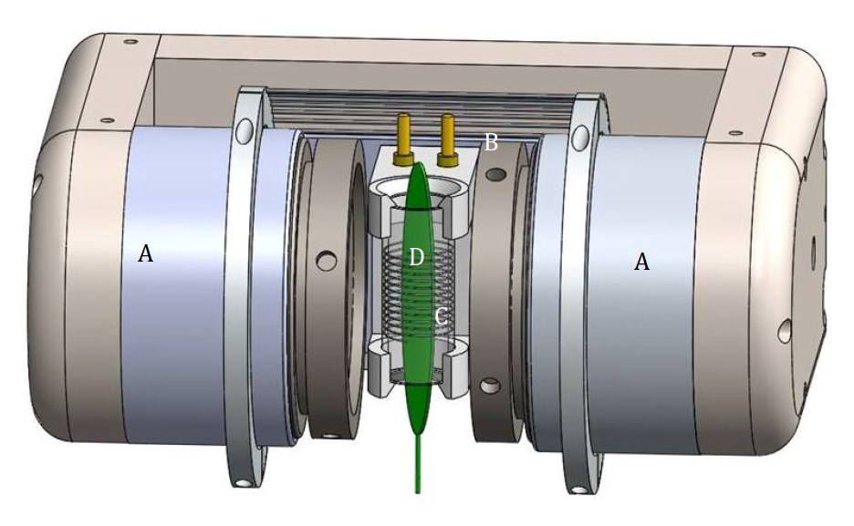
So far, SLC method yields good and linear results
But based on empirical observations
Library of reference measurements
?
How good are the estimations of PD_{tot} based on mono-exponential fit?
Acquire reference measurements for leaves of 12 different plant species
NMR Sensor¹
?
What is the influence of the CPMG averaging interval on the estimate of the liquid proton fraction?
How consistent are the correlations between the proton densities and the weight parameters?
Temperature compensated Samarium Cobalt
233 mT (9.94 MHz)
?
[1] C.W. Windt, et al. A mobile NMR sensor and relaxometric method to non-destructively monitor water and dry matter content in plants, Frontiers in Plant Science, 12 (2021)
Page 8

Slide 9

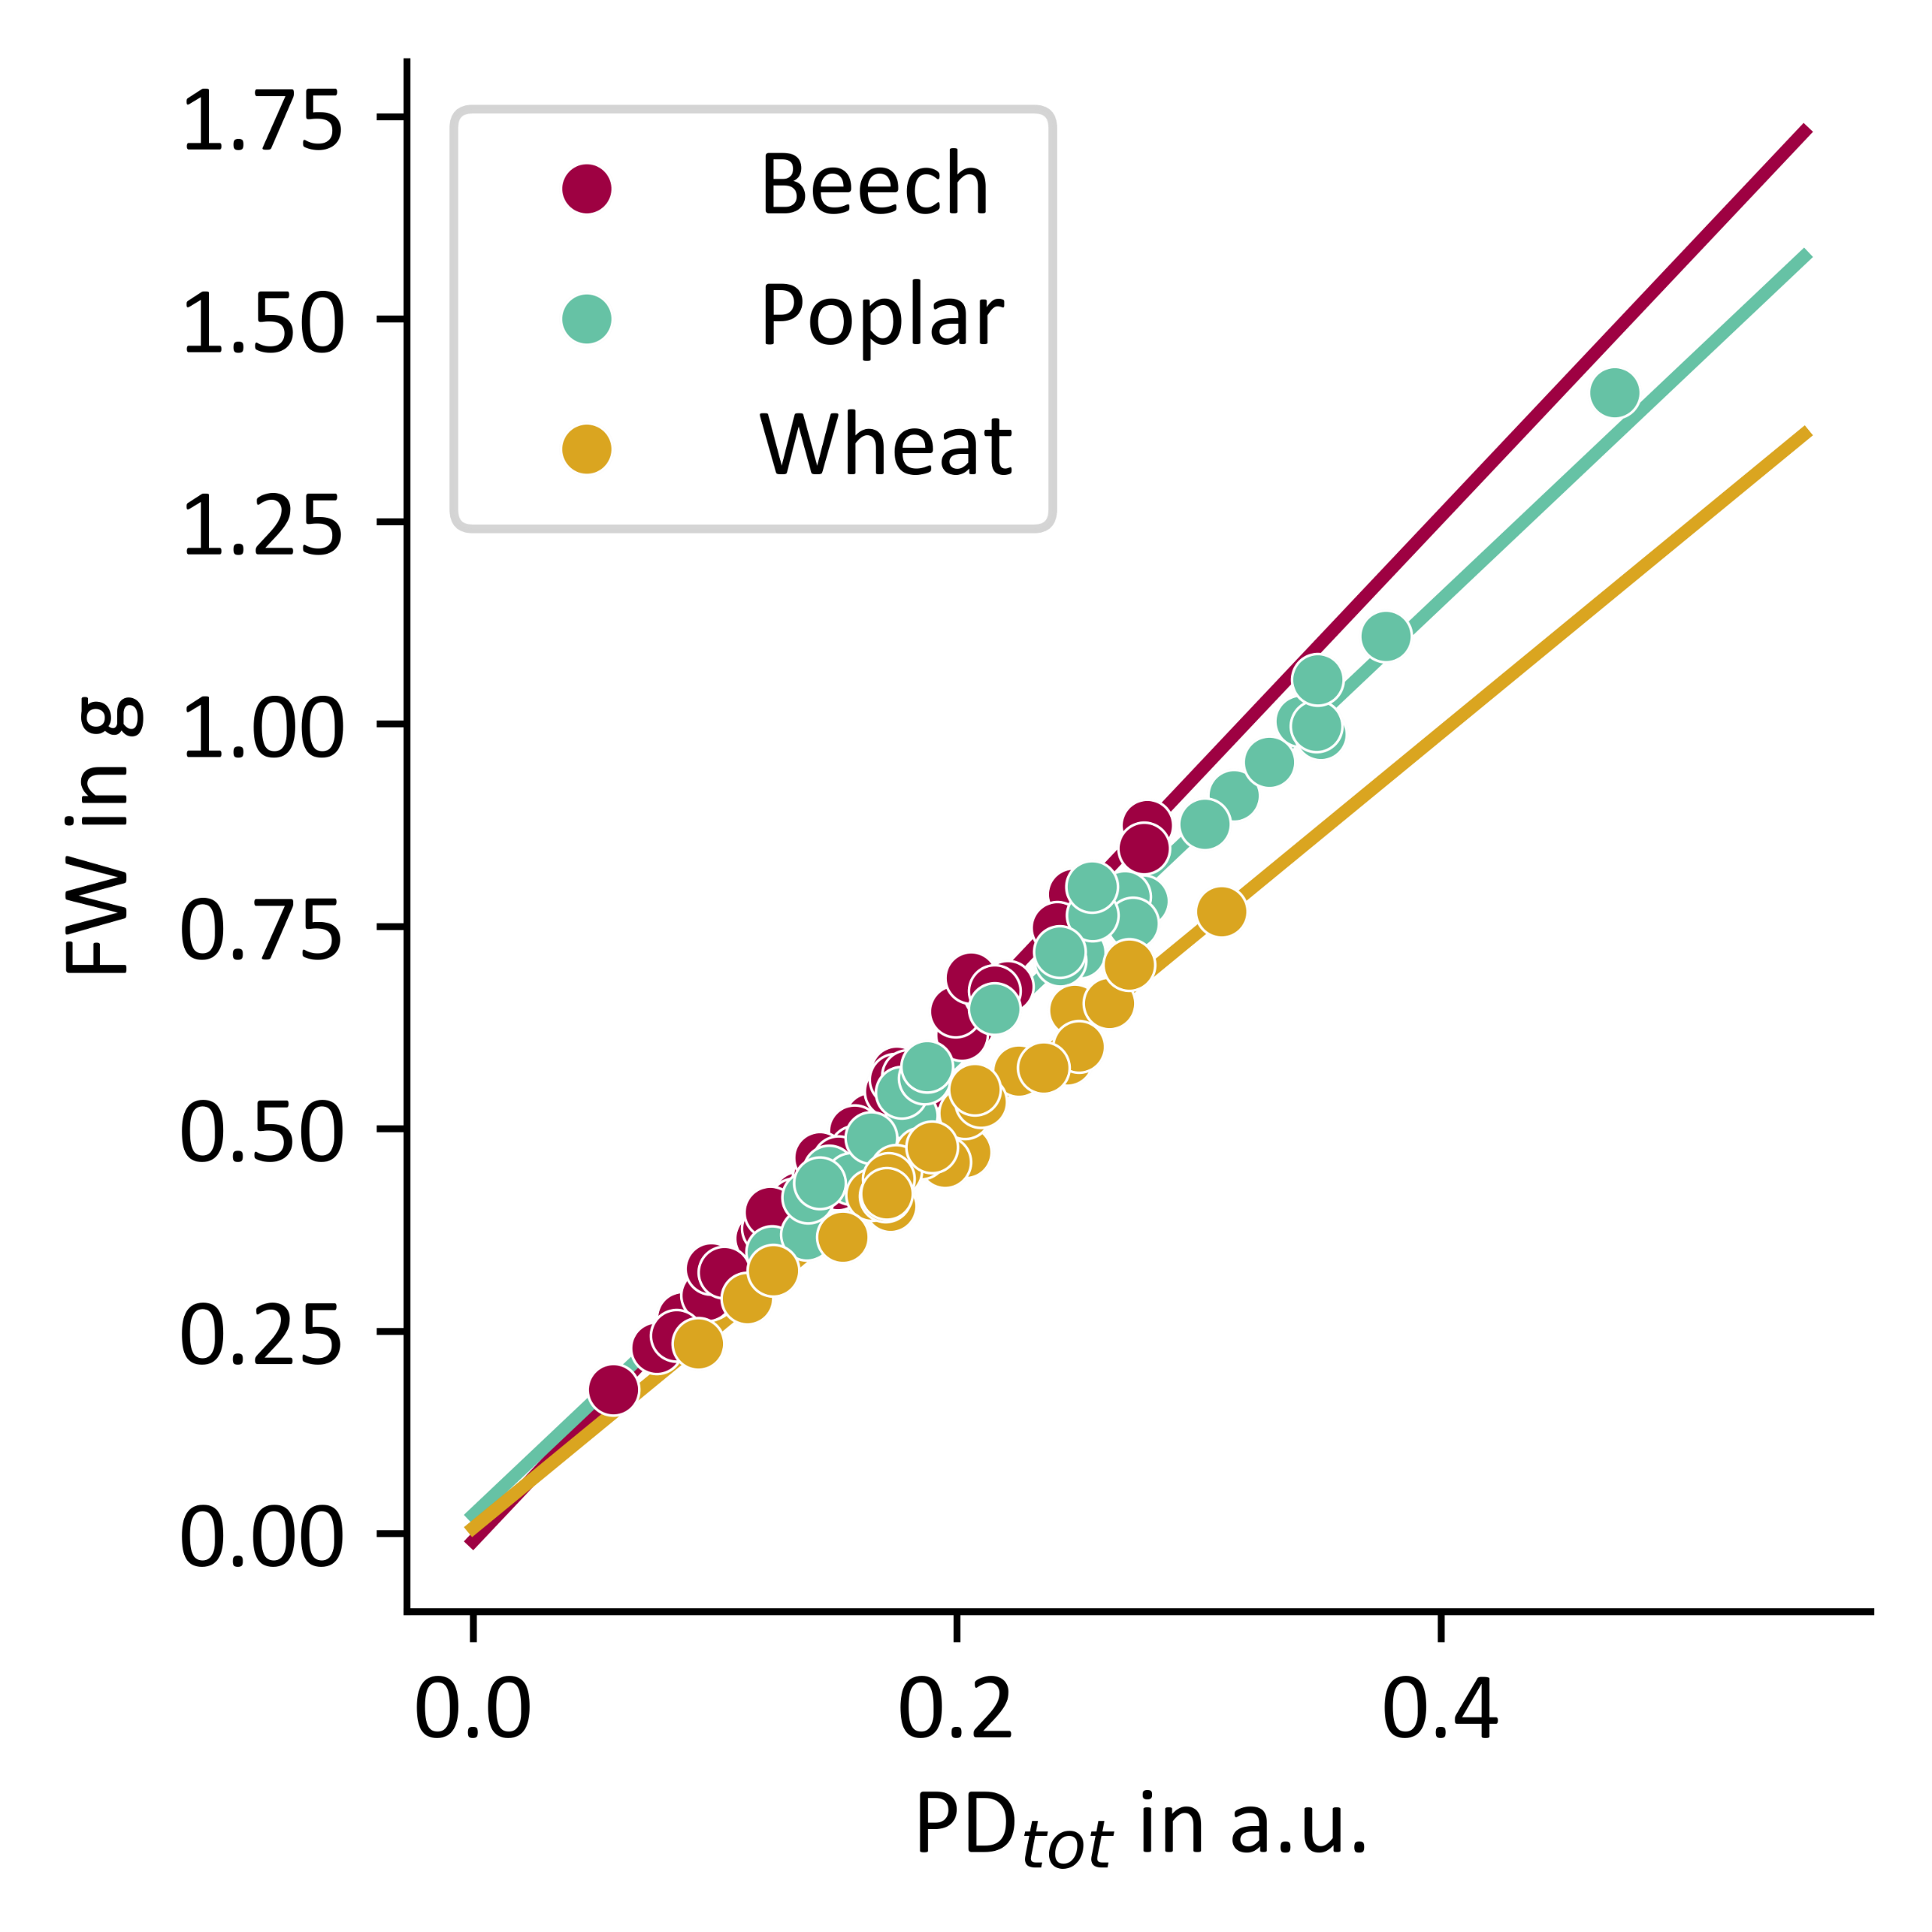
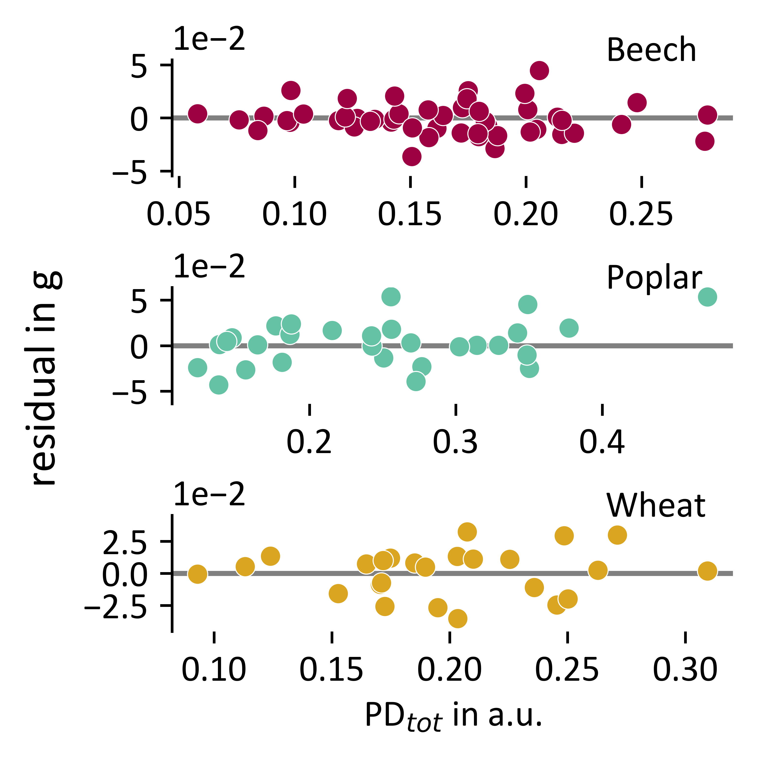

Assumption of mono-exponential signal extrapolation FID
Correlation constant over whole range of fresh weight measured
FID
Beech leaves
Beech
Poplar leaves
Wheat leaves
Mono-exponential fit first 75 $μ$s FID
Poplar
Fresh Weight in g
Residuals in g
Wheat
NMR sensor¹
PD_{tot} in a.u.
PD_{tot} in a.u.
Notes:
Despite this linear correlation between total and fresh weight
Constant over whole range of FW measured as no clear systematics in residuals appear

Slide 10
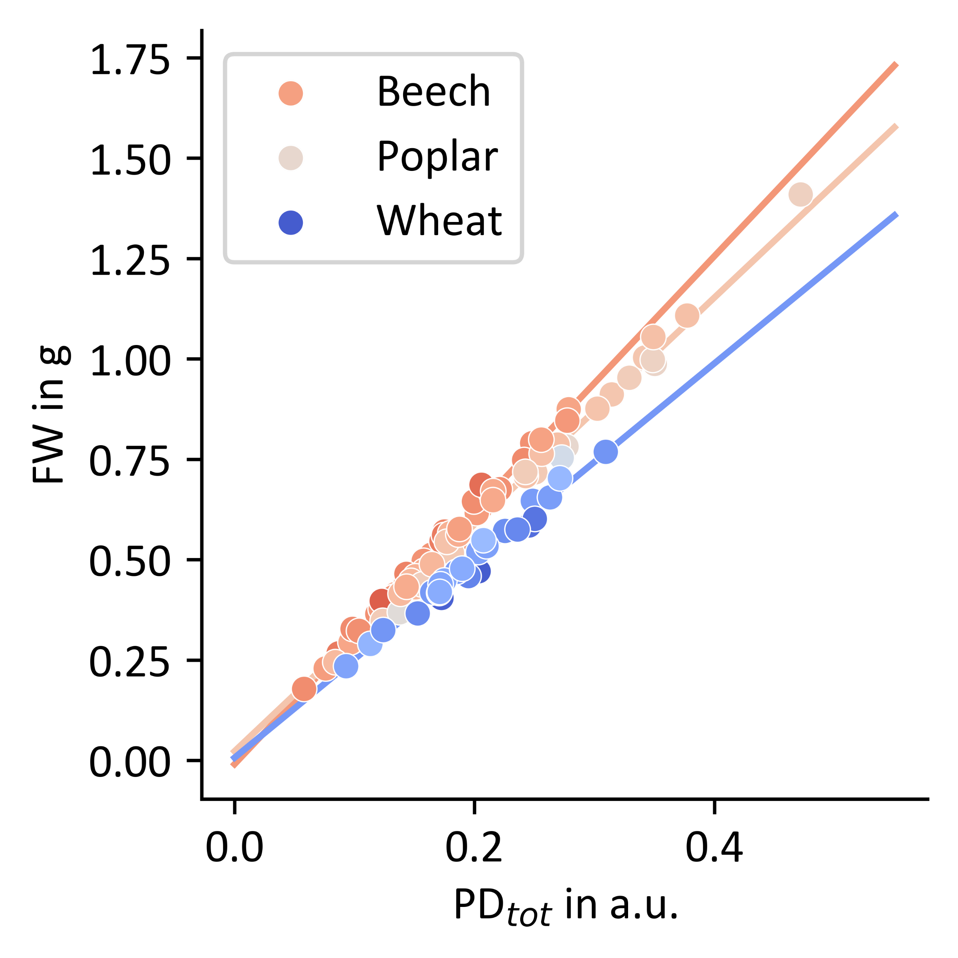
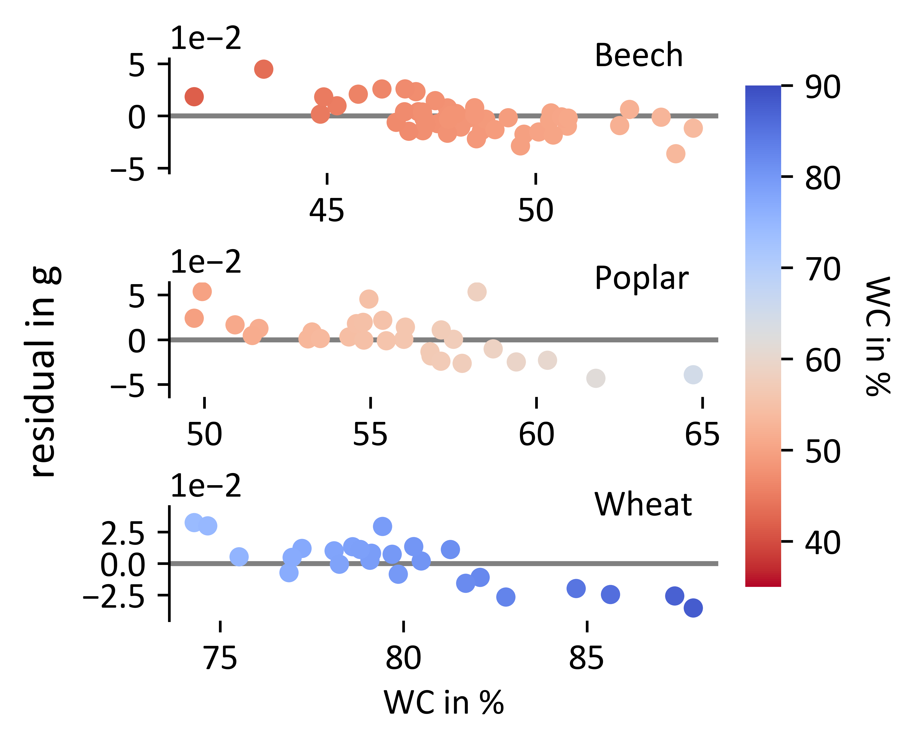
Assumption of mono-exponential signal extrapolation FID
Correlation constant over whole range of fresh weight measured – but dependent on sample WC
FID
Beech
Beech leaves
Beech
Poplar leaves
Wheat leaves
Mono-exponential fit first 75 $μ$s FID
Poplar
Poplar
Fresh Weight in g
Residuals in g
Wheat
Wheat
NMR sensor¹
Water Content in %
PD_{tot} in a.u.
40
50
60
70
80
90
Page 10
Water Content in %
Notes:
Systematics in deviations from linear calibration line appear

Slide 11
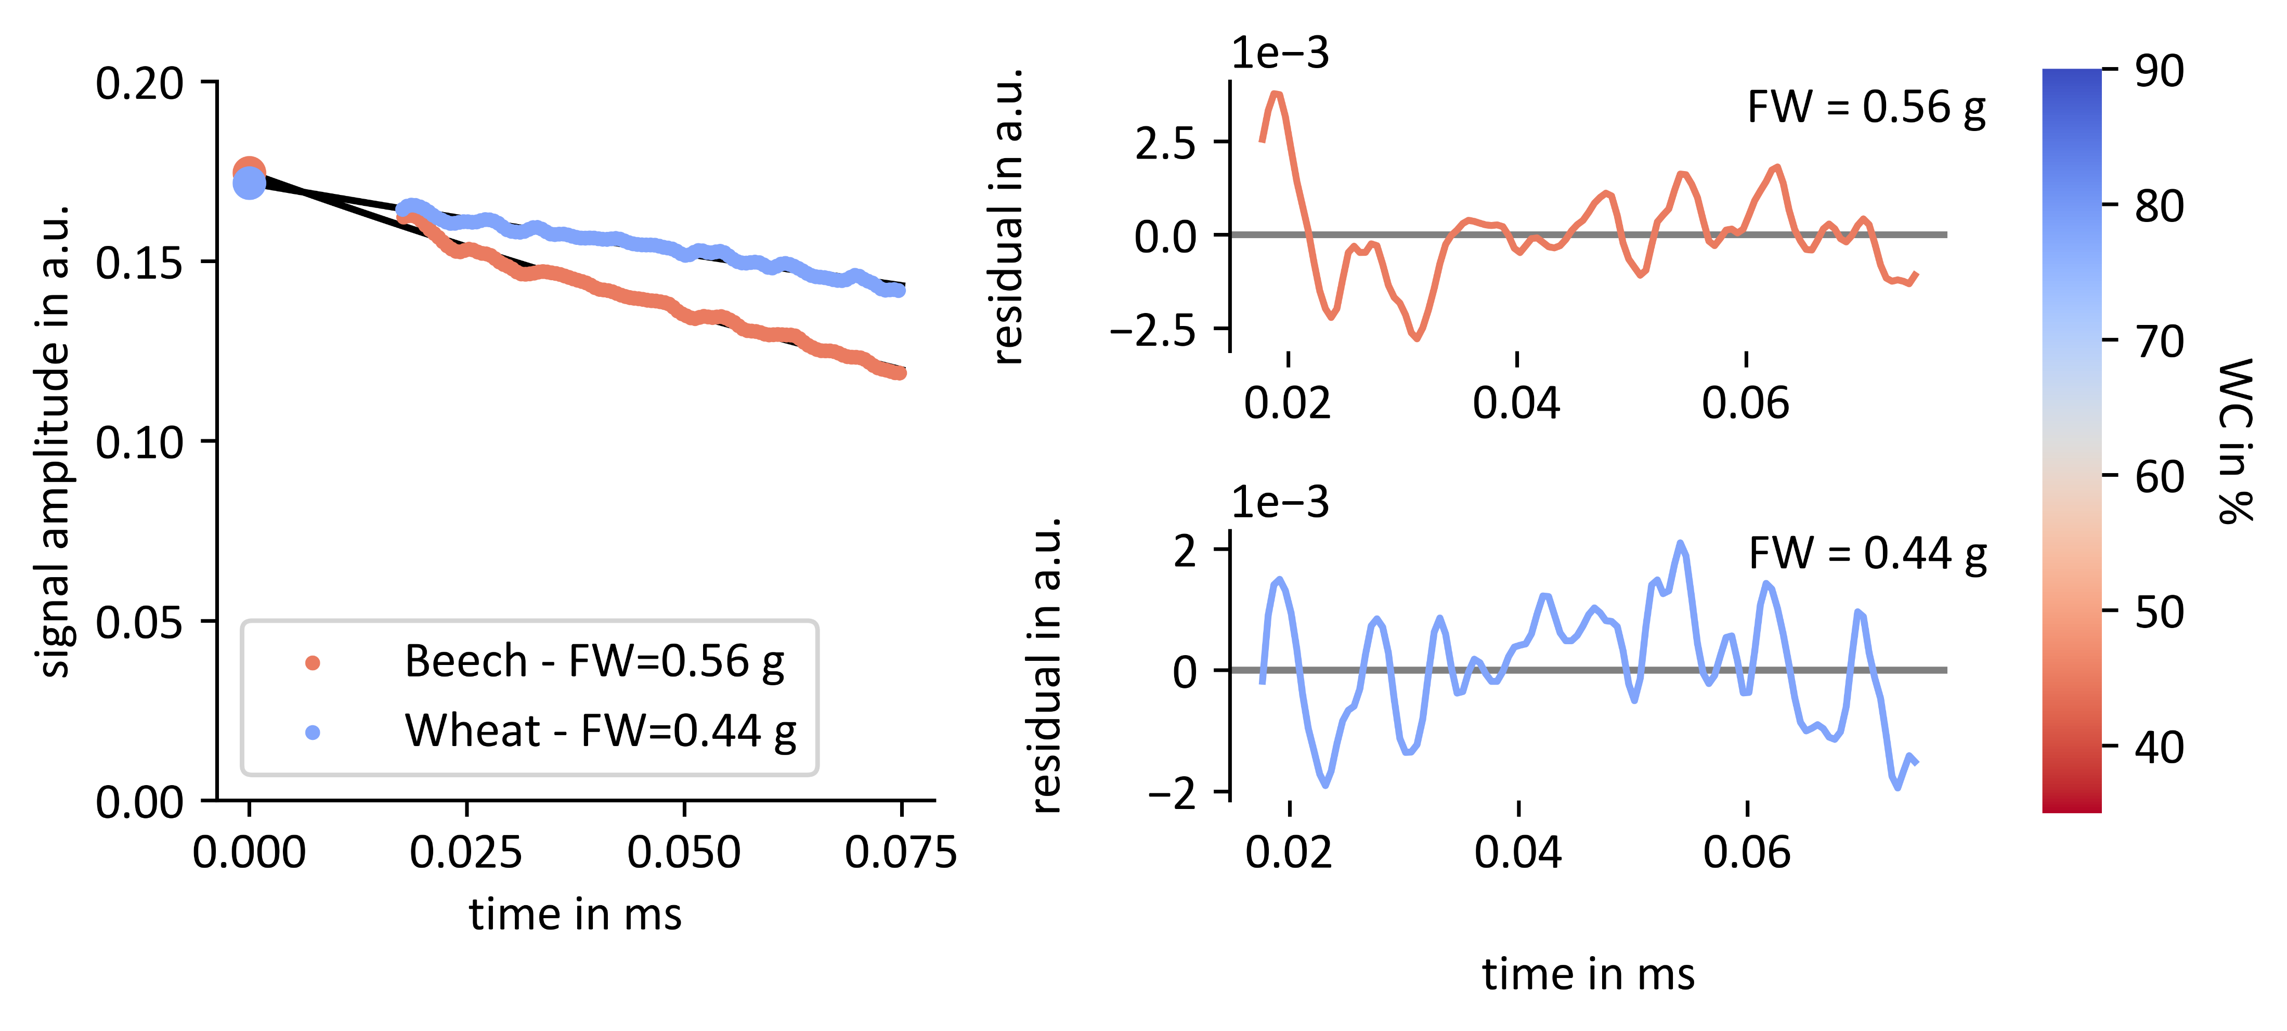
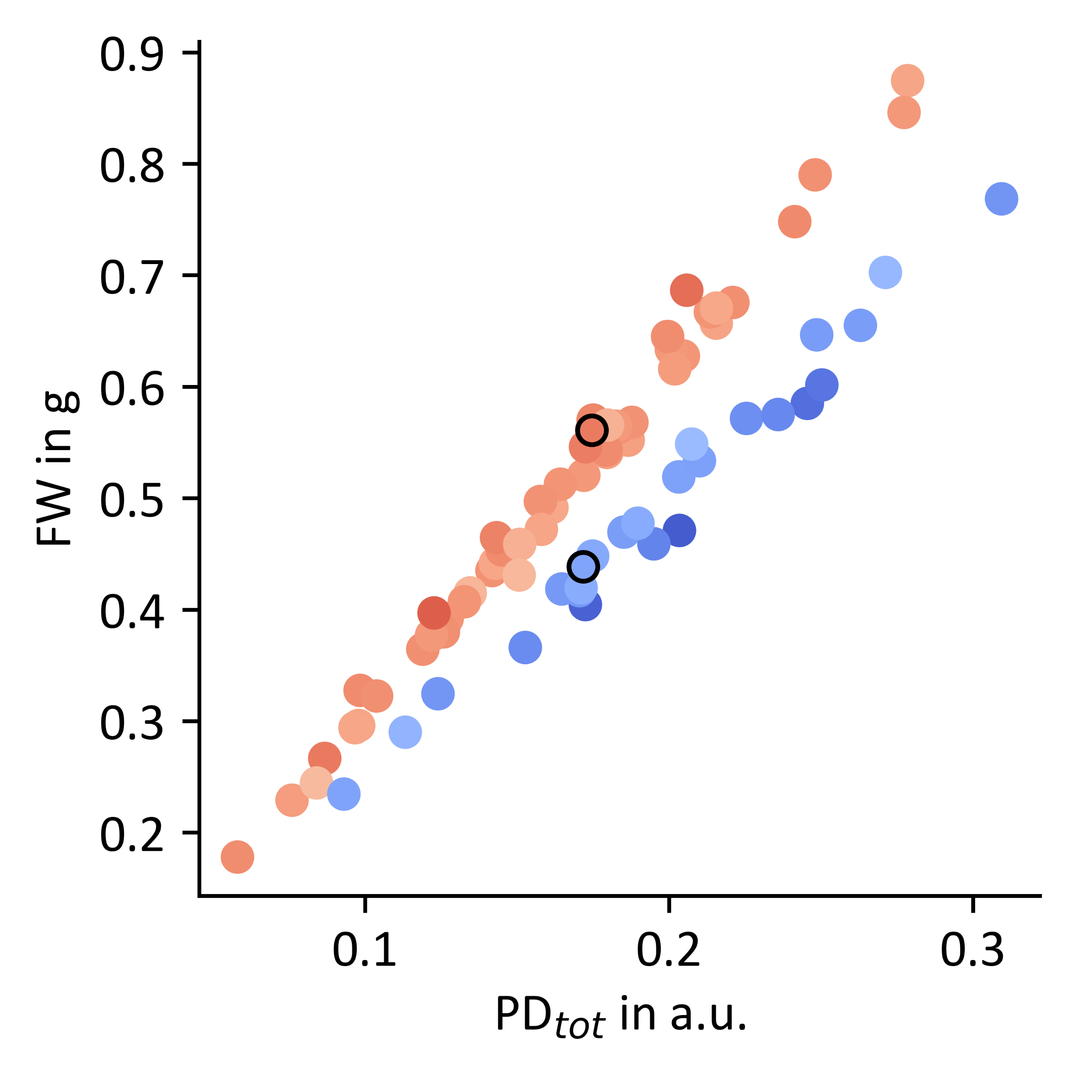
Deviations in fit might explain this dependency on sample water content
Reference measurement
FID
Residuals mono-exponential fit
1
2
1
1
2
2
Beech leaf
FW = 0.56 g
Wheat leaf
FW = 0.44 g
Page 11
Notes:
Certain species, presence of solid and fast decaying proton fraction seems to be not properly detected by mono-exponential fit
Example
Residuals of beech leaf from mono-exp fit, upwards tail that not properly represented by mono-exponential fit
Undererstimation of total proton density

Slide 12
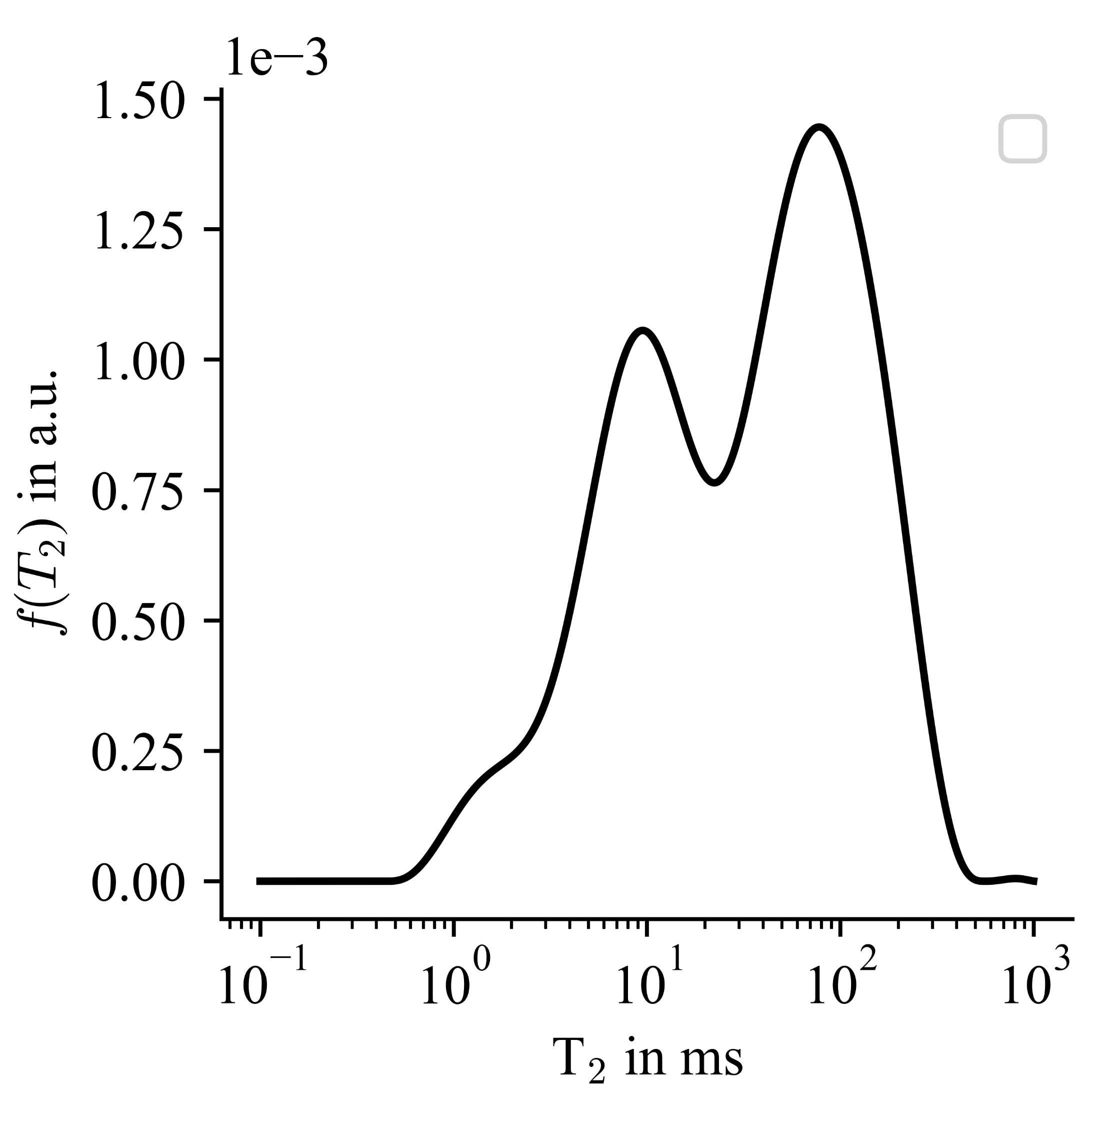


Effect of CPMG averaging Interval on the estimate of the liquid proton fraction
$$S_{NMR}=∫dT_{2}f(T_{2})exp(−t/T_{2})$$
?
0
10
20
Mean value 0-25 ms interval CPMG
T2-relaxation constant distribution poplar leaf
https://amorphous.tf.chiba-u.jp/memo.files/osilap/osilap.html#org1b18844
Page 12
Notes:
Testing how averaging interval affect estimate of liquid proton density

Slide 13
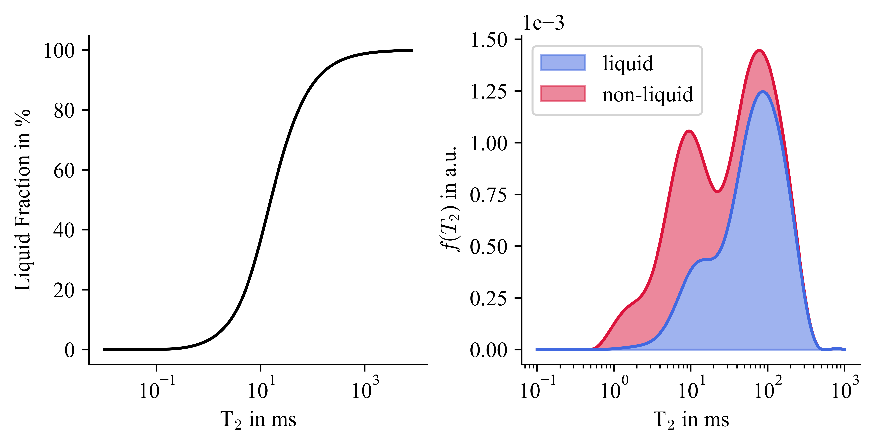
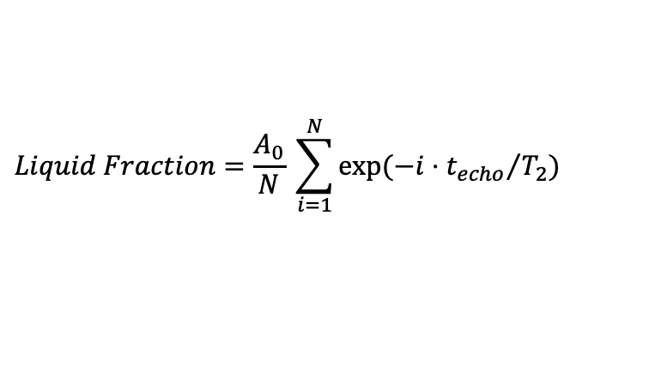
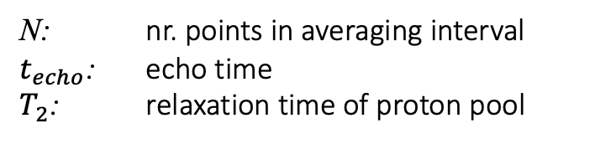
Effect of CPMG averaging Interval on the estimate of the liquid proton fraction
$$S_{NMR}=∫dT_{2}f(T_{2})exp(−t/T_{2})$$
$$Liquid Fraction=\frac{A_{0}}{N} \sum_{i=1}^{N}{exp⁡(−i⋅{t_{echo}}/{T_{2})}}$$
N: nr. points in averaging interval
$t_{echo}$: echo time
$T_{2}$: relaxation time of proton pool
T2-relaxation constant distribution poplar leaf
Page 13
Notes:
Averaging acts as weighting function
To obtain estimation liquid proton proton density – multiply with T2 relaxation constant distribution of leaf samples
Result – blue part, part of spectrum seen as liquid (area thus corresponds to liquid proton density) and red part would be seen as non-liquid
PDliq depends on height + position

Slide 14
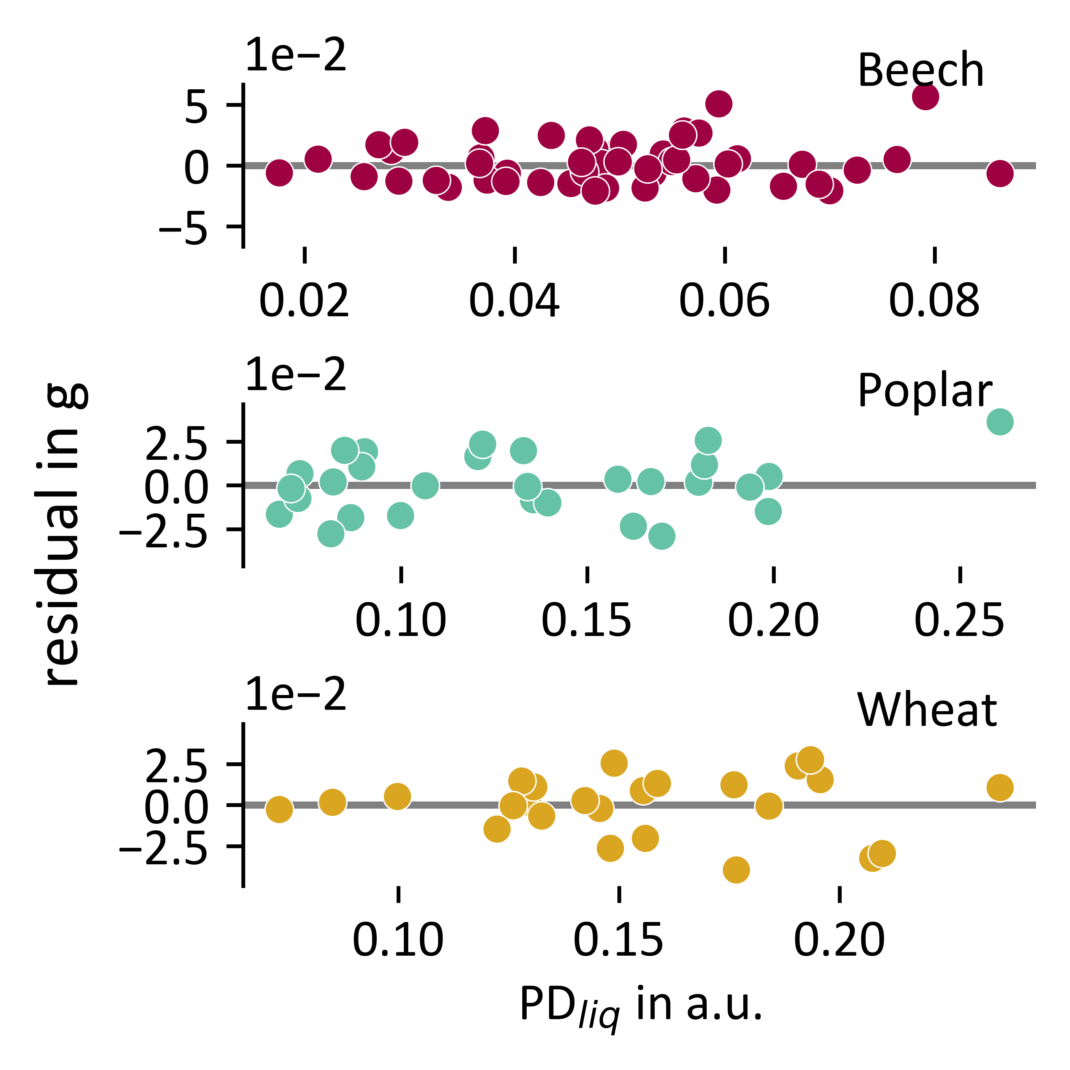
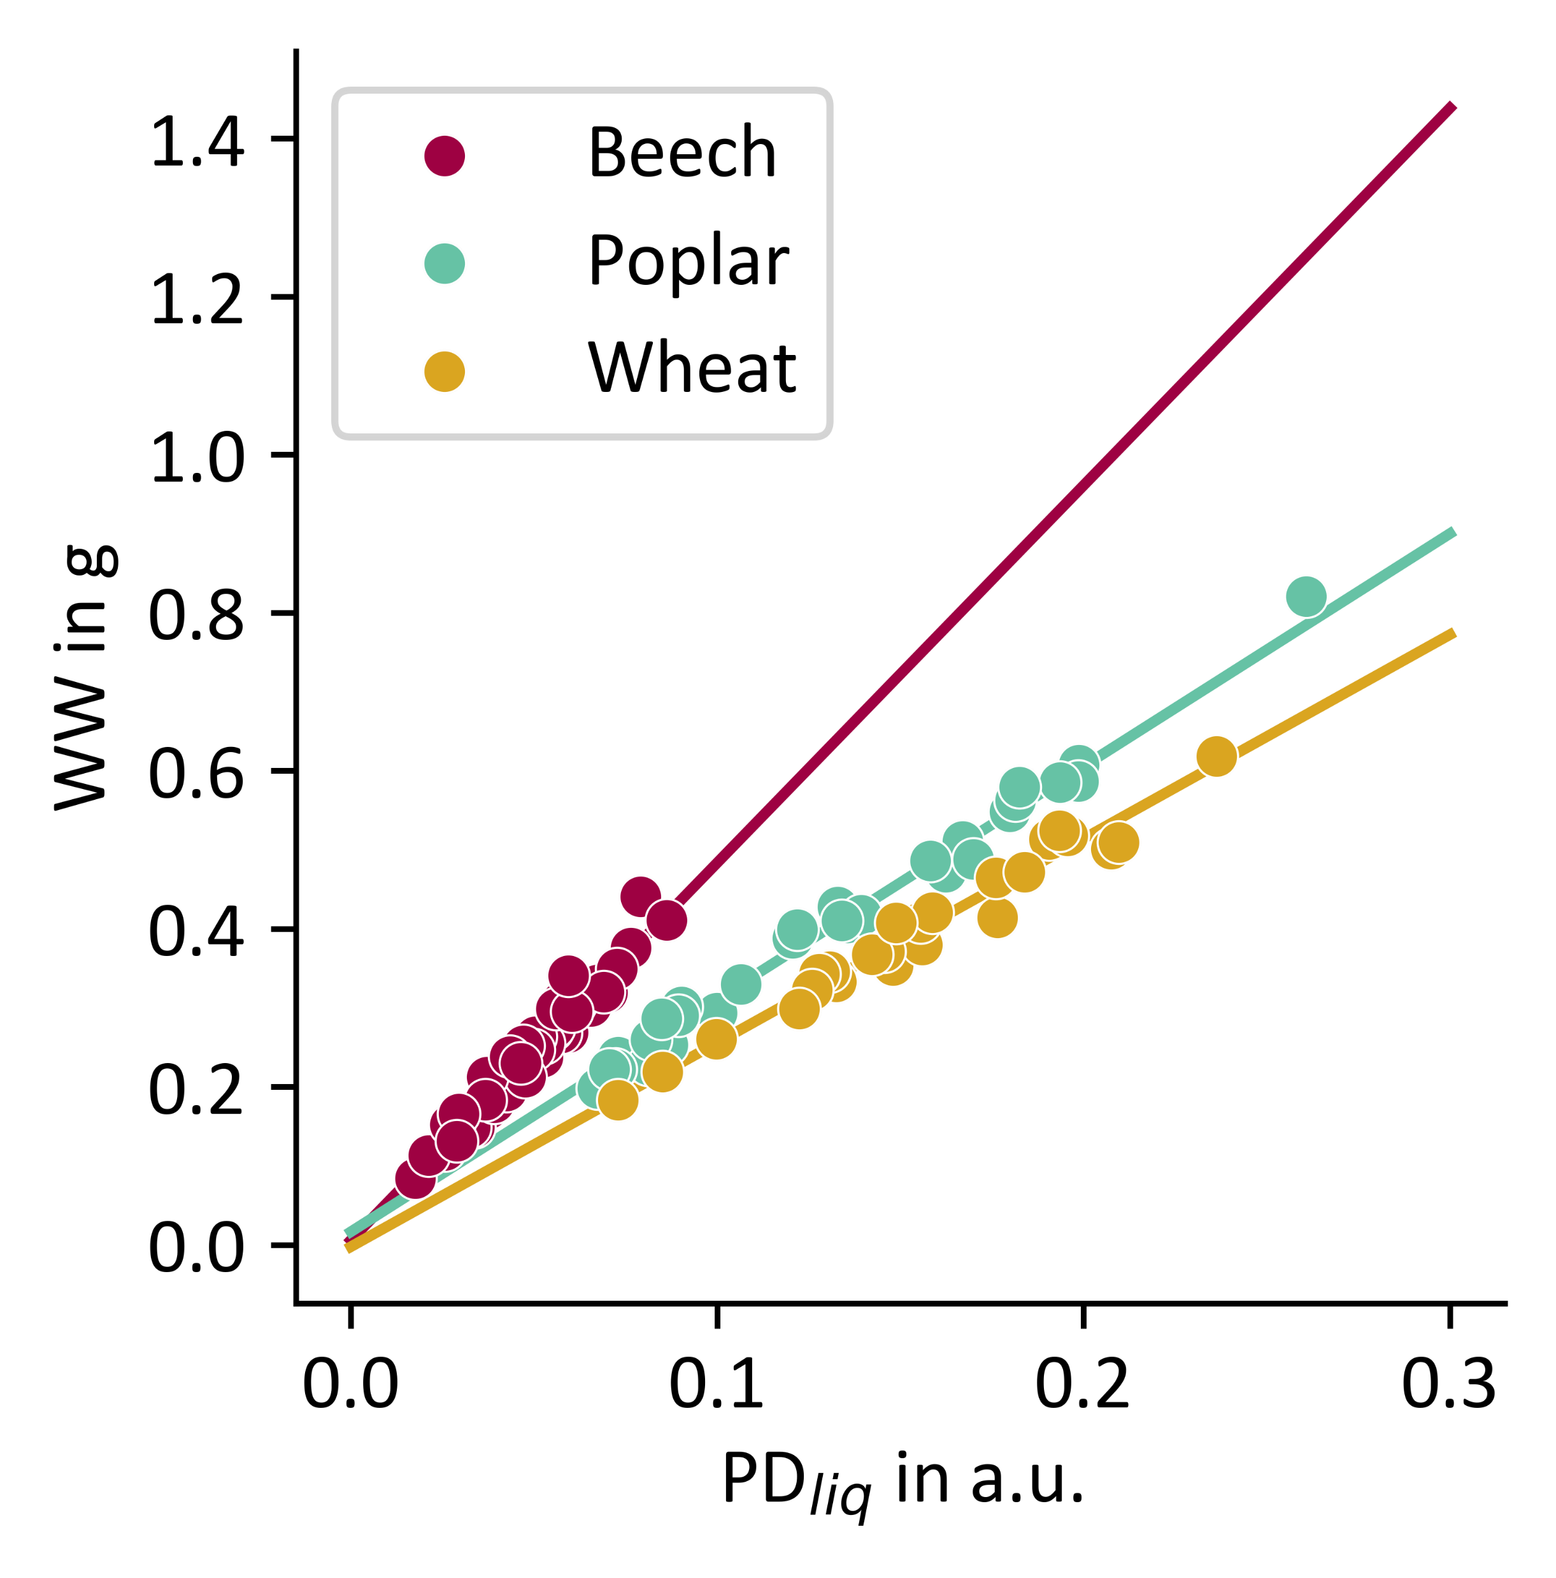
Estimation liquid proton fraction based on averaging 0-25 ms interval CPMG
Correlation constant over whole range of water weight measured
CPMG
Beech leaves
Poplar leaves
Wheat leaves
Mean value 0-25 ms interval CPMG
Water Weight in g
Residuals in g
NMR sensor¹
PD_{liq} in a.u.
PD_{liq} in a.u.
Page 14
Notes:
Linear correlations
Differences in slope between species
Within species: orrelations constant over whole range of WW measured constant

Slide 15
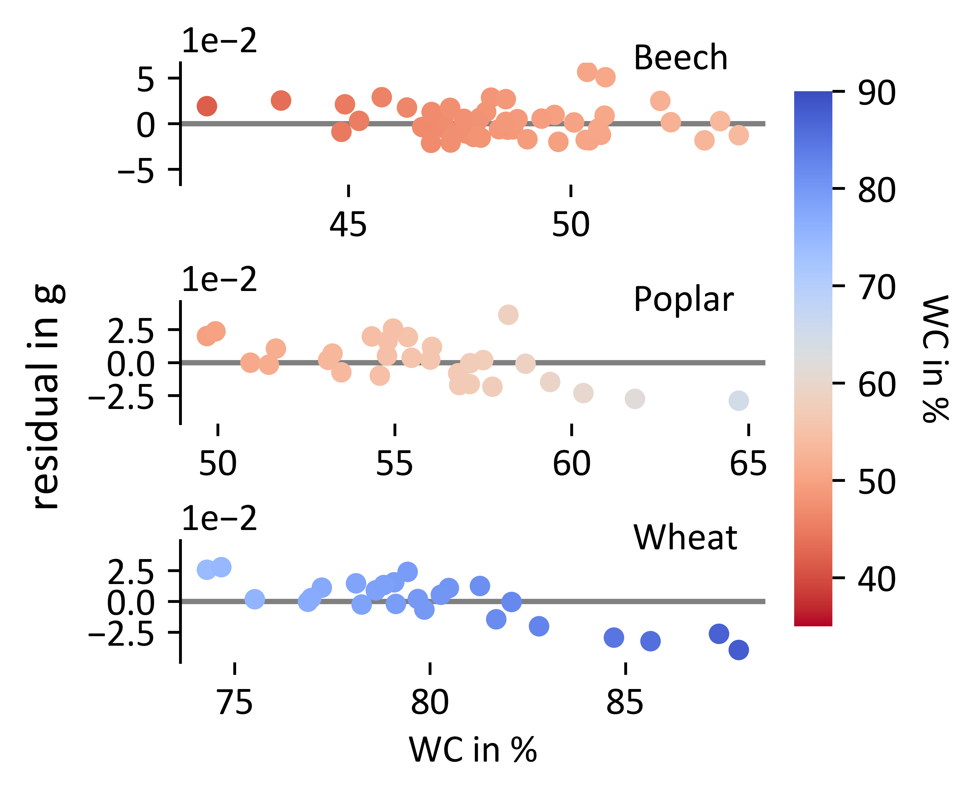
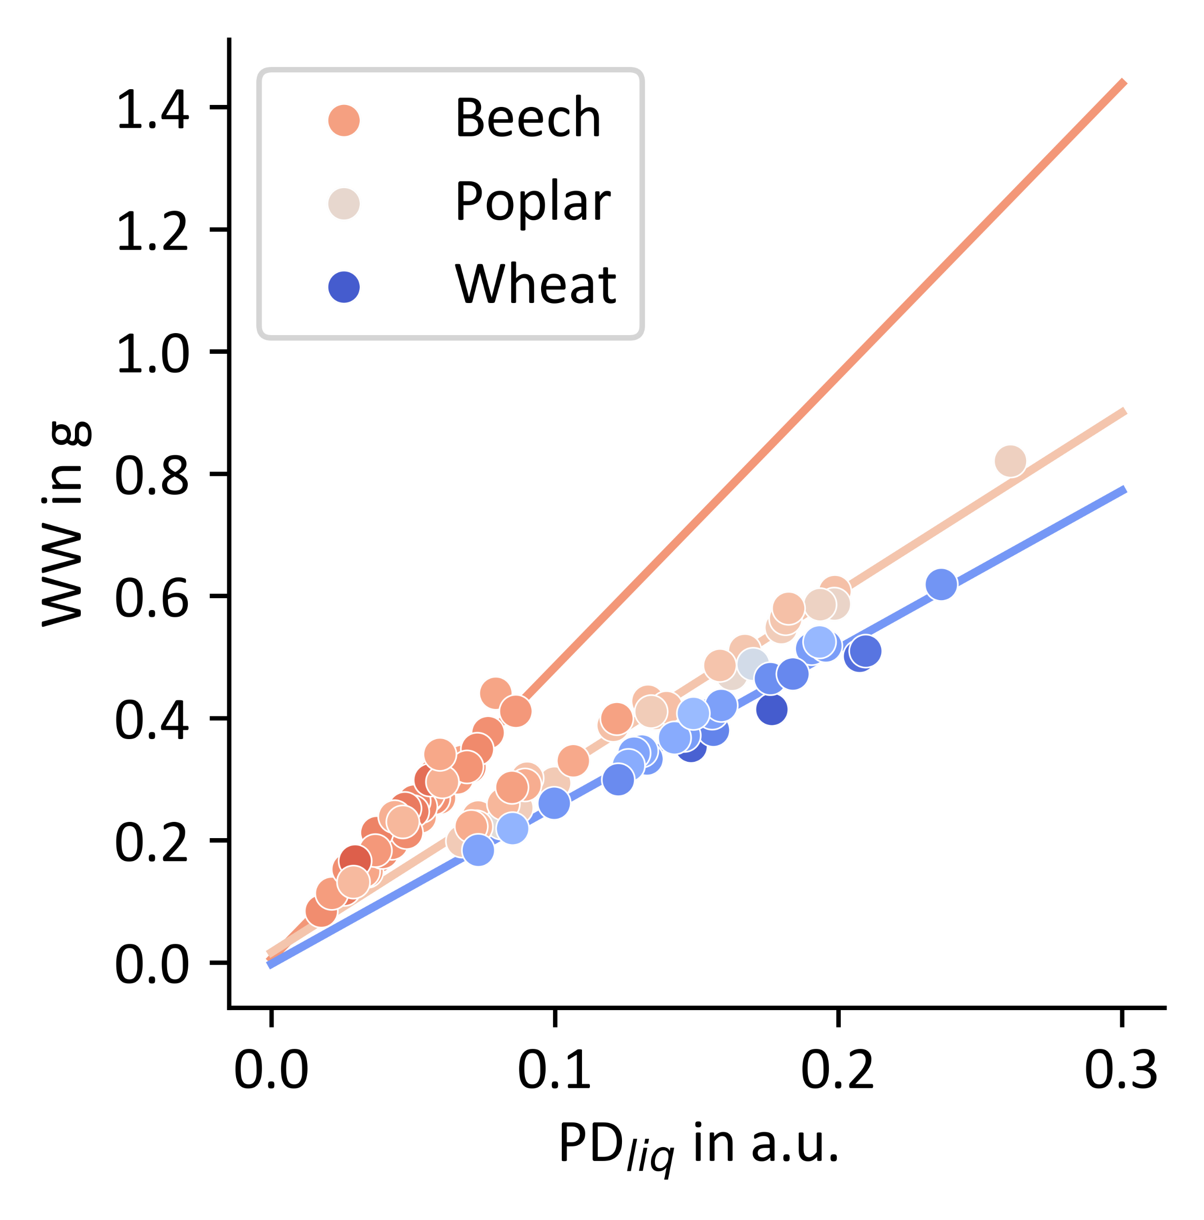
Estimation liquid proton fraction based on averaging 0-25 ms interval CPMG
Correlation constant over whole range of water weight measured - but again depend on sample WC
CPMG
Beech leaves
Poplar leaves
Wheat leaves
Mean value 0-25 ms interval CPMG
Water Weight in g
Residuals in g
NMR sensor¹
WC in %
Water Content in %
PD_{liq} in a.u.
40
50
60
70
80
90
Page 15
WC in %
Water Content in %
Notes:
Again systematic appear

Slide 16
Deviations can partly cancel each other out when determining sample Dry matter or sample water content
FID based
CPMG based
Deviations from linear fit: Fresh Weight
Deviations from linear fit: Water Weight
Residuals in g
Water Content in %
Residuals in g
Water Content in %
Water Content in %
Water Content in %
Page 16
Notes:
Deviations from calibration for determination of FW and from calibration line for deviation of WW seem to follow same trend
Means for determination of sample WC and DW that deviations might partly cancel each other out

Slide 17
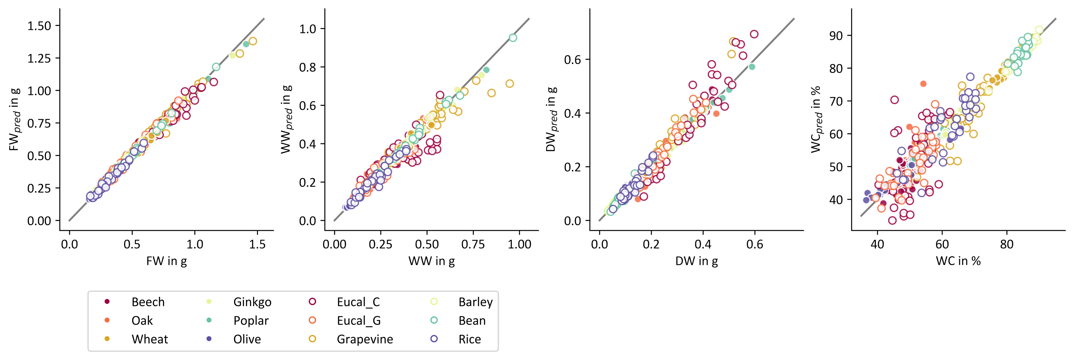
Benchmark Library of Reference Measurements – leaf samples
Results Solid Liquid Content method
1.5
1.0
0.6
80
1.0
DW_{pred} in g
0.6
DW_{pred} in g
FW_{pred} in g
WW_{pred} in g
FW_{pred} in g
WW_{pred} in g
0.4
WC_{pred} in %
60
0.5
0.2
0.2
40
0
0.0
0.5
1.0
1.5
0.2
0.6
40
0
0.5
0
0.5
1.0
40
60
80
FW in g
DW in g
WC in %
FW in g
WW in g
DW in g
WC in %
Ginkgo
Beech
Barley
Eucalyptus Citriodora
Poplar
Oak
Bean
Eucalyptus Gunnii
Olive
Wheat
Rice
Grapevine
Page 17
Notes:
Results of SLC method
SLC method is not perfect

Slide 18
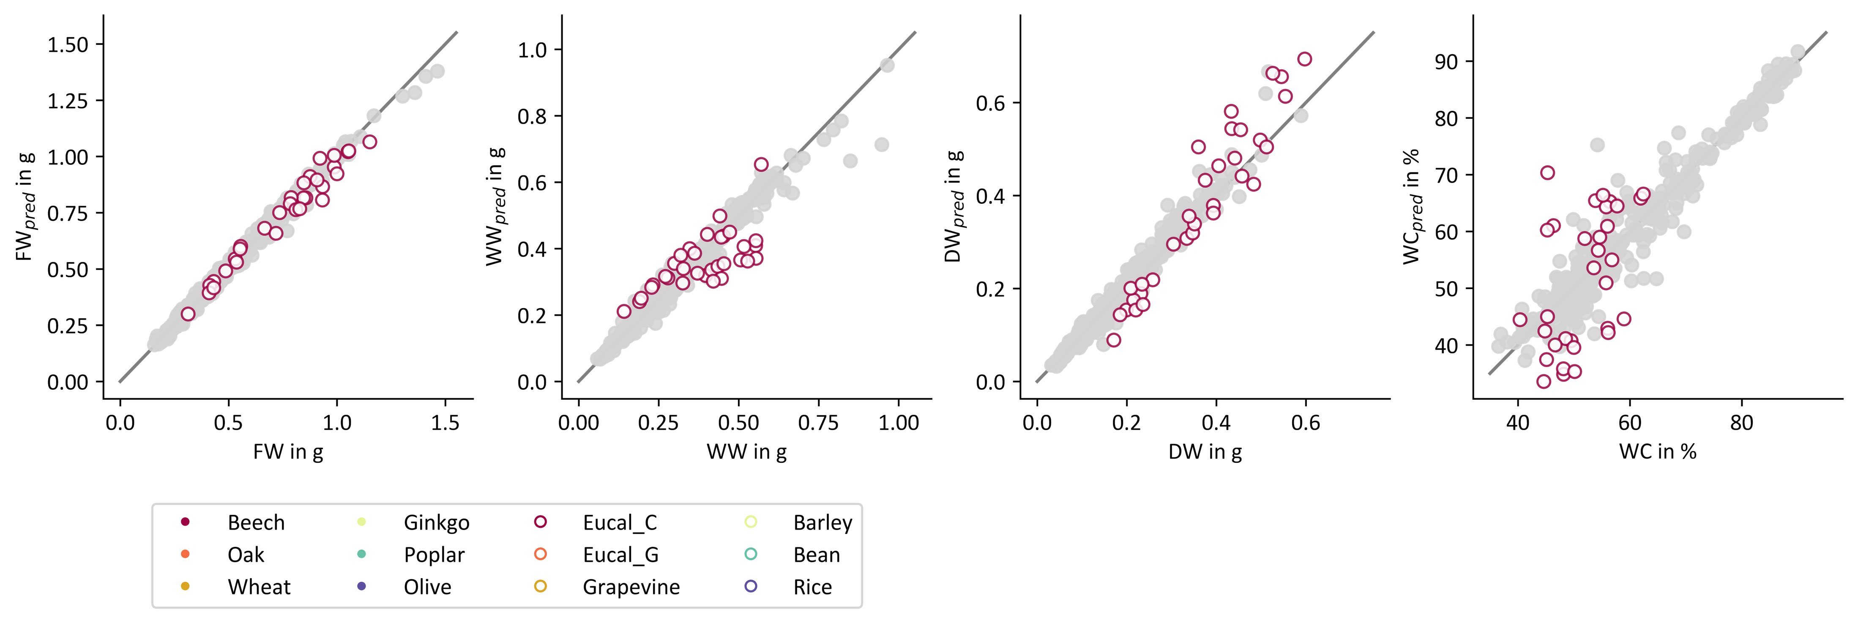
Benchmark Library of Reference Measurements – leaf samples
Results Solid Liquid Content method
RMSE: root mean squared error
1.5
1.0
RMSE: 0.045 g
RMSE: 0.087 g
RMSE: 0.068 g
RMSE: 10.2 %
0.6
80
1.0
0.6
DW_{pred} in g
FW_{pred} in g
WW_{pred} in g
0.4
WC_{pred} in %
60
0.5
0.2
0.2
40
0
1.0
1.5
0.2
0.6
40
0
0.5
0
0.5
1.0
40
60
80
FW in g
WW in g
DW in g
WC in %
Ginkgo
Beech
Barley
Eucalyptus Citriodora
Poplar
Oak
Bean
Eucalyptus Gunnii
Olive
Wheat
Rice
Grapevine
Page 18
Notes:
In certain cases like key features are missed that are required for proper prediction of the parameters we are interested in

Slide 19
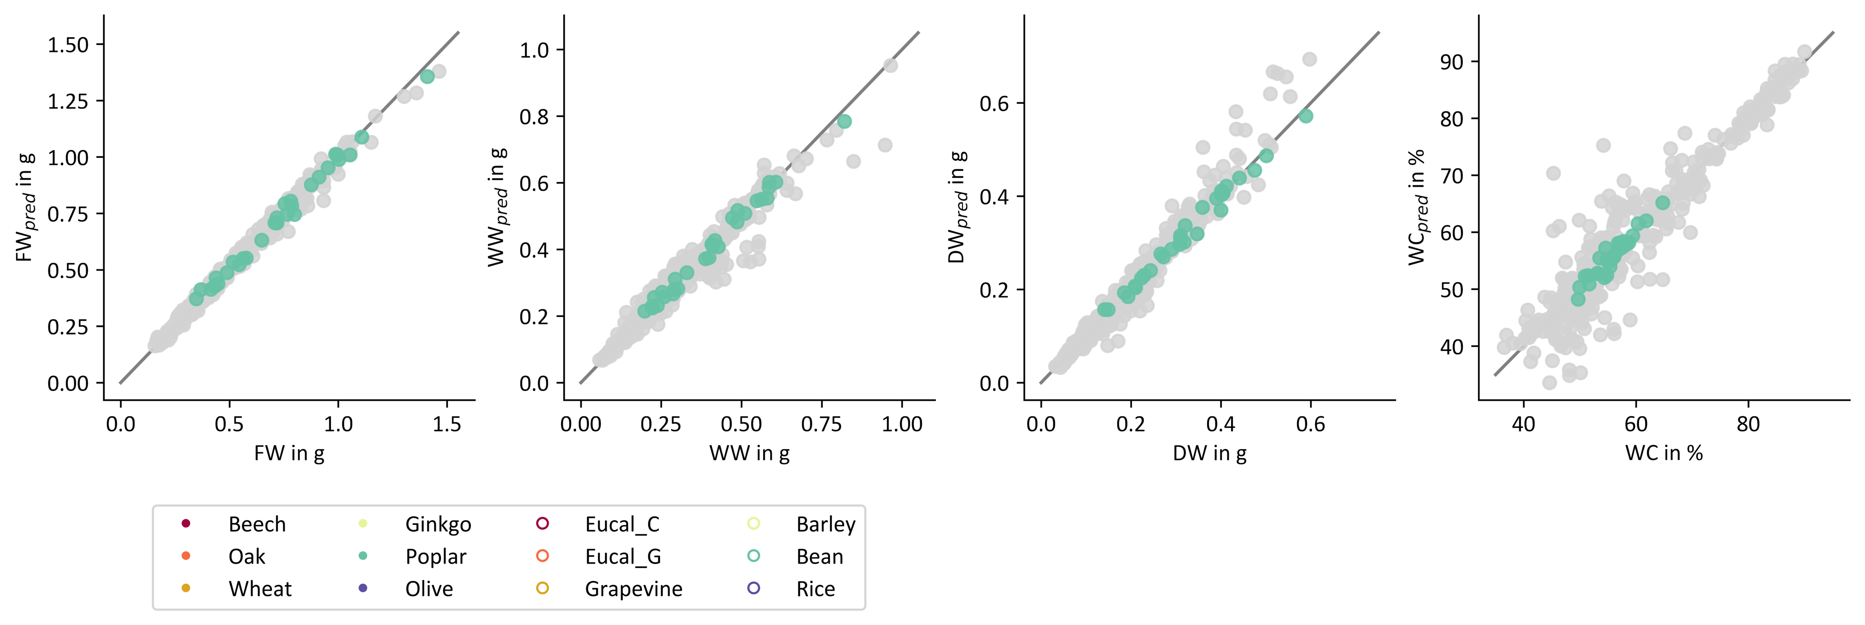
Benchmark Library of Reference Measurements – leaf samples
Results Solid Liquid Content method
RMSE: root mean squared error
1.5
1.0
RMSE: 0.025 g
RMSE: 0.017 g
RMSE: 0.013 g
RMSE: 1.2 %
0.6
80
1.0
DW_{pred} in g
WC_{pred} in %
0.6
DW_{pred} in g
FW_{pred} in g
WW_{pred} in g
FW_{pred} in g
WW_{pred} in g
0.4
WC_{pred} in %
60
0.5
0.2
0.2
40
0
1.0
1.5
0.2
0.6
40
0
0.5
0
0.5
1.0
40
60
80
FW in g
DW in g
WC in %
FW in g
WW in g
DW in g
WC in %
Ginkgo
Beech
Barley
Eucalyptus Citriodora
Poplar
Oak
Bean
Eucalyptus Gunnii
Olive
Wheat
Rice
Grapevine
Page 19
Notes:
Despite simplicity
SLC method gives results we can work with

Slide 20
Summary and conclusion
Type A
Type B
SLC method has the potential to monitor key parameters of plant development
However, the method also has its limitations
Track diurnal and long-term water and dry matter dynamics
Characterize water and dry matter dynamics under heat and drought stress
Page 20
Notes:
In these cases, SLC method yields surprisingly good and linear results
But in general – one must be aware of its limitations
Limitations:
Not universally applicable
Clear systematics in deviations from calibration line appear – especially if wc of sample changes
When deviations are still in acceptable range: can help us get better understanding of water and dry matter dynamics in plants

Slide 21
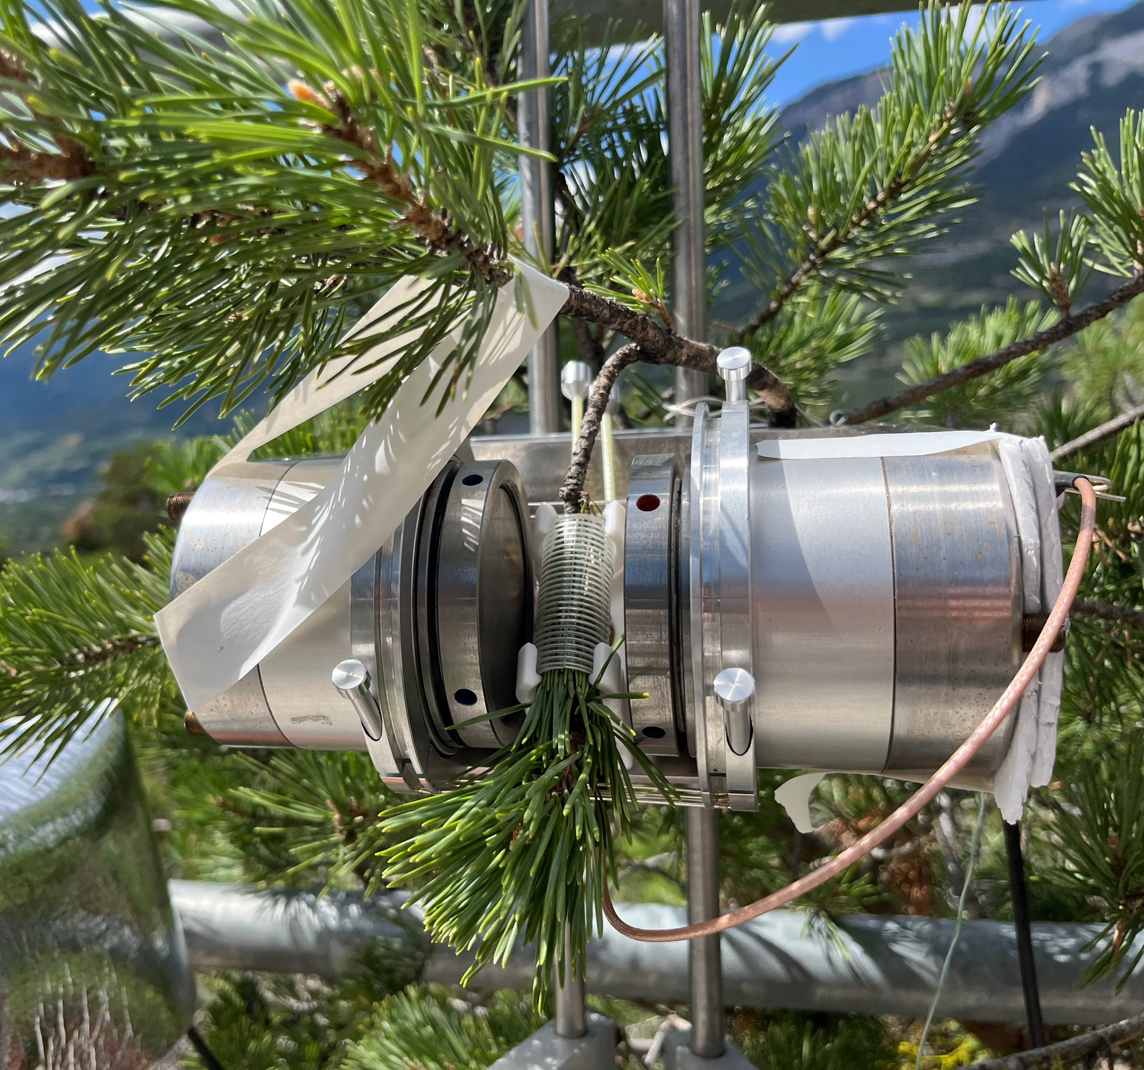
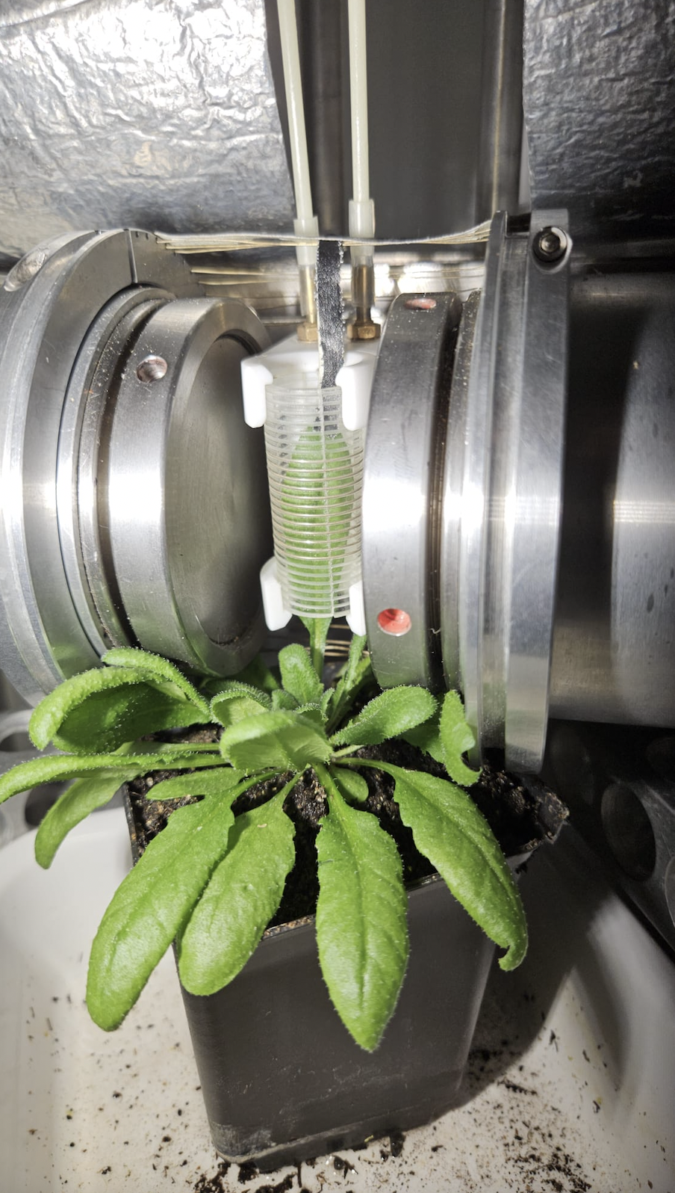
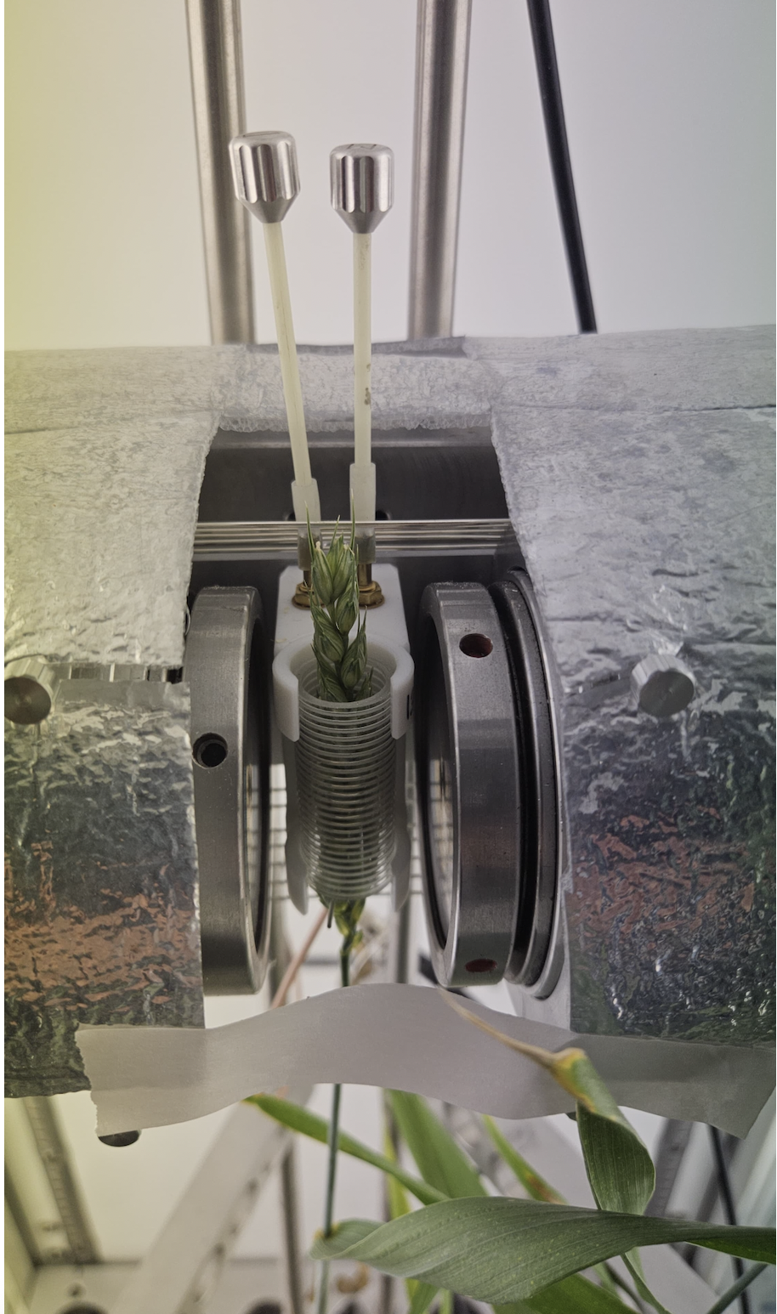
Outlook
Page 21
Notes:
Keen on getting work into the field
Doing in-vivo measurements of various types of plants

Slide 22
Thank you for your attention
ICMRM 18th l Antonia Wörtche, Carel Windt, Volkmar Schulz

