Slide 1

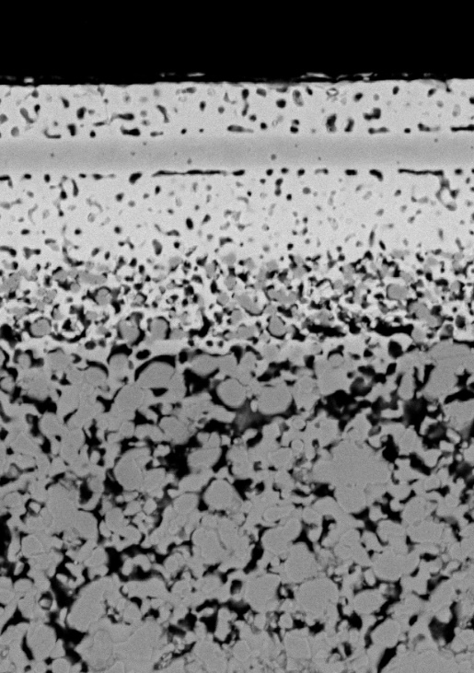
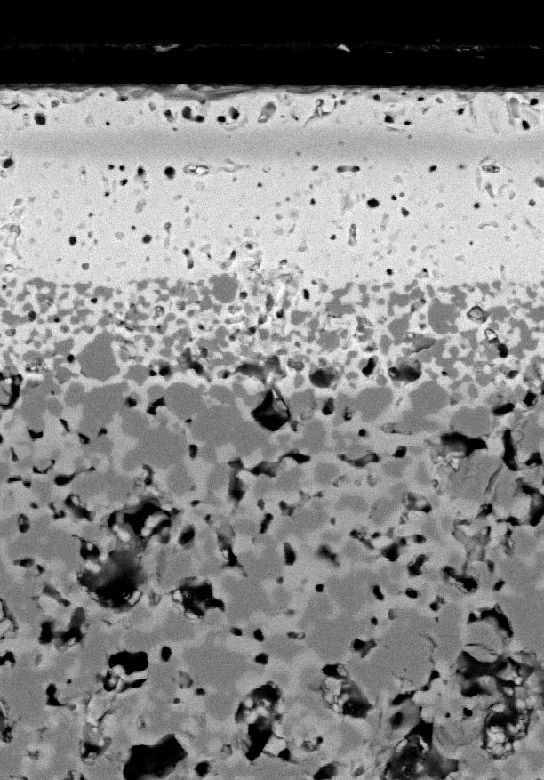
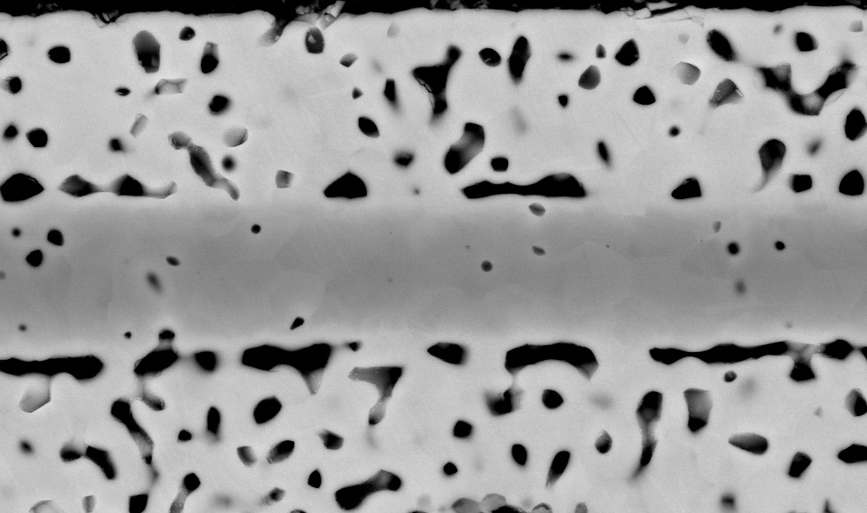
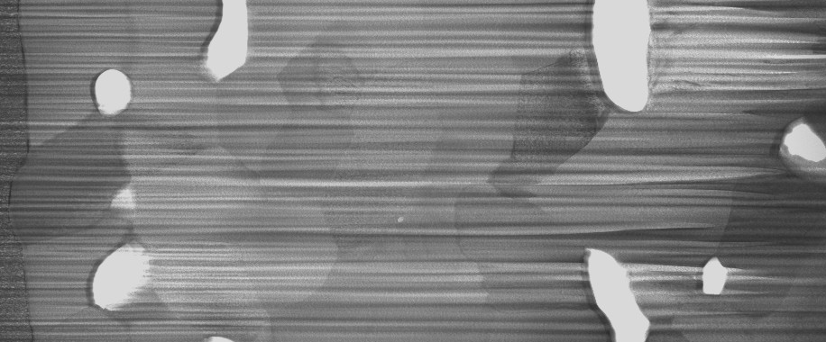
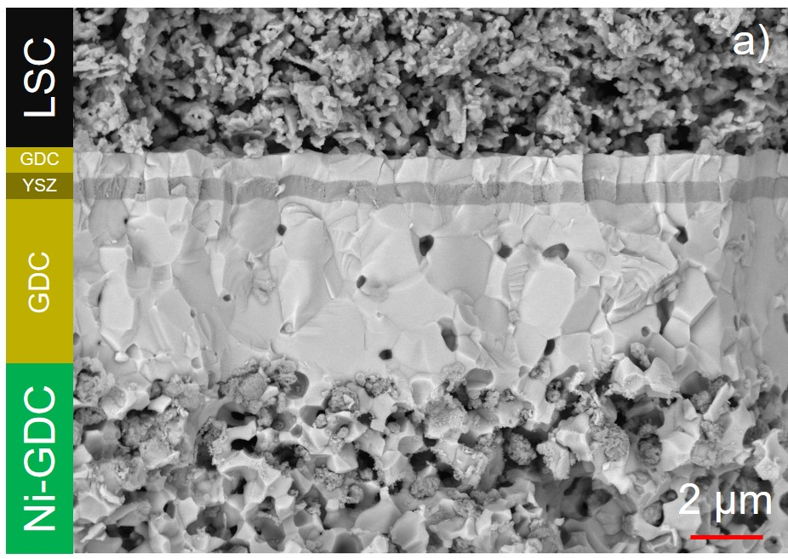
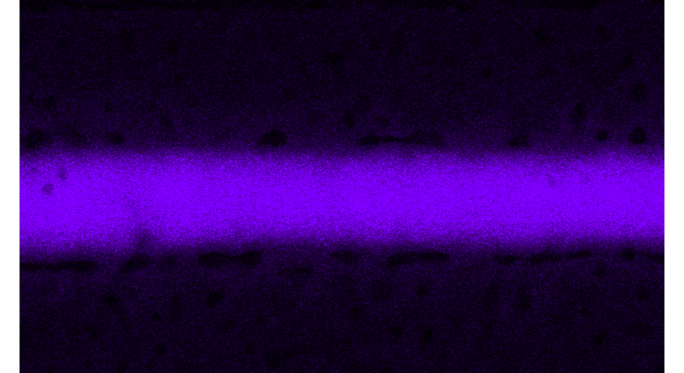
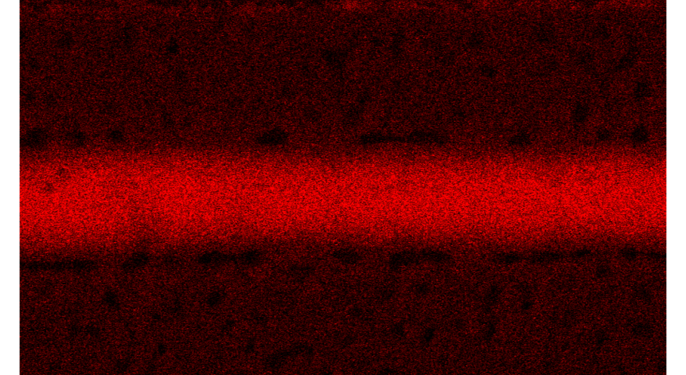
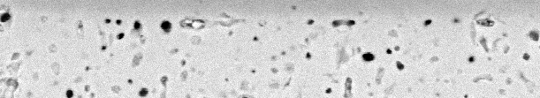
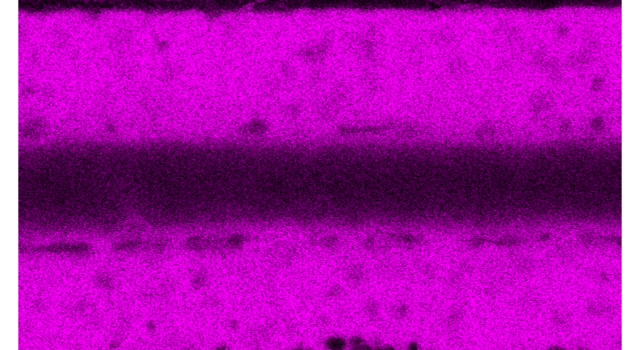
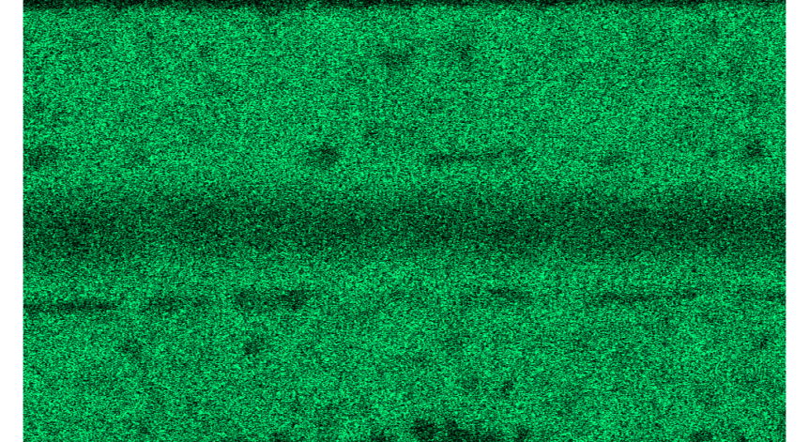

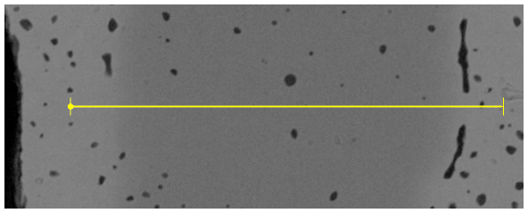
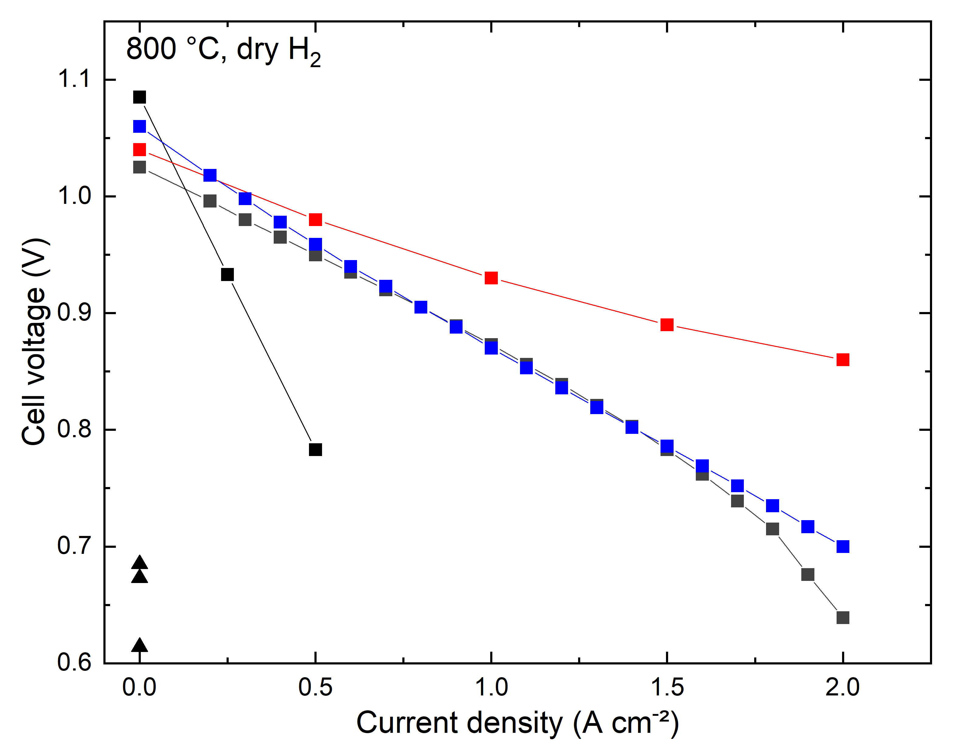


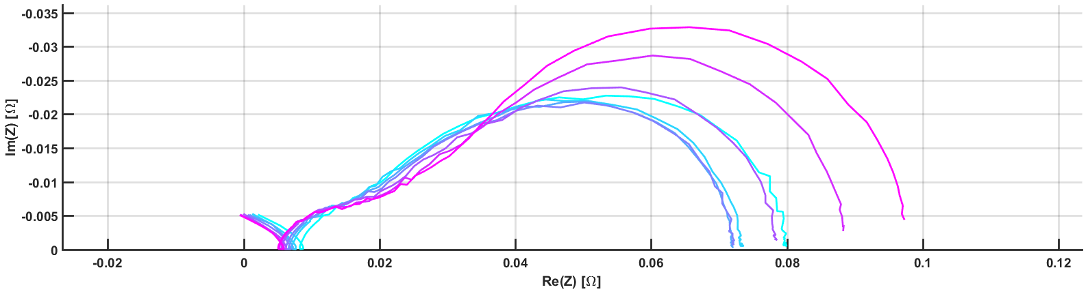
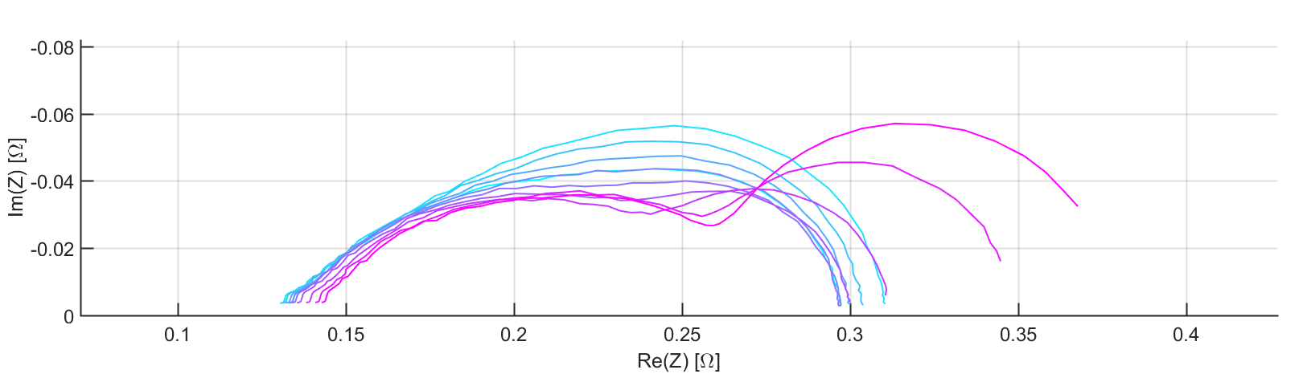
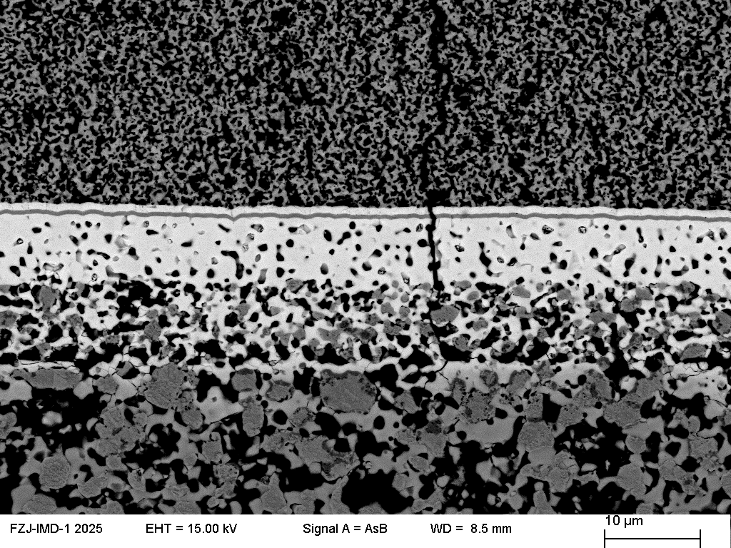
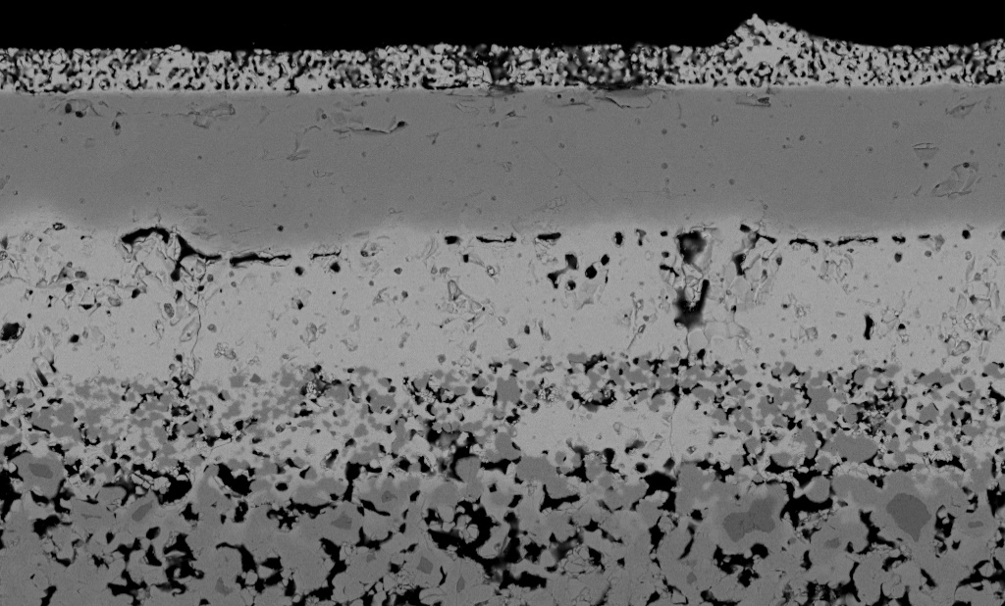
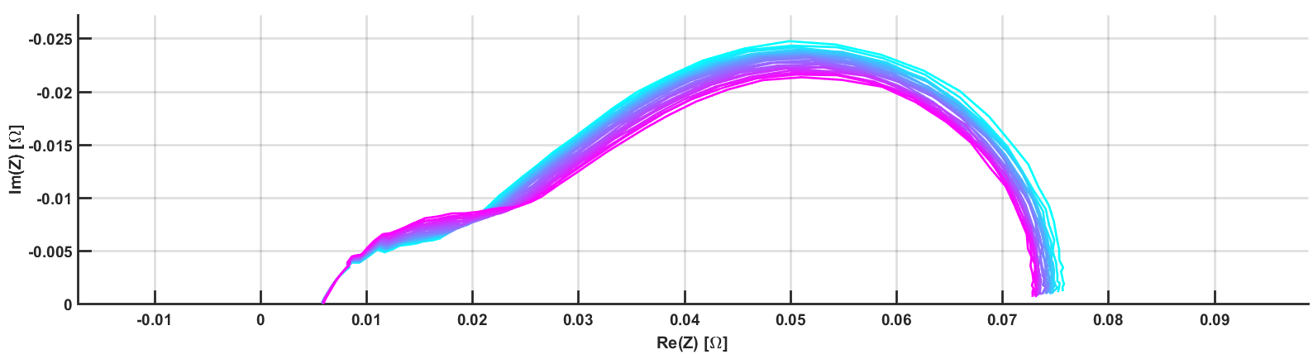
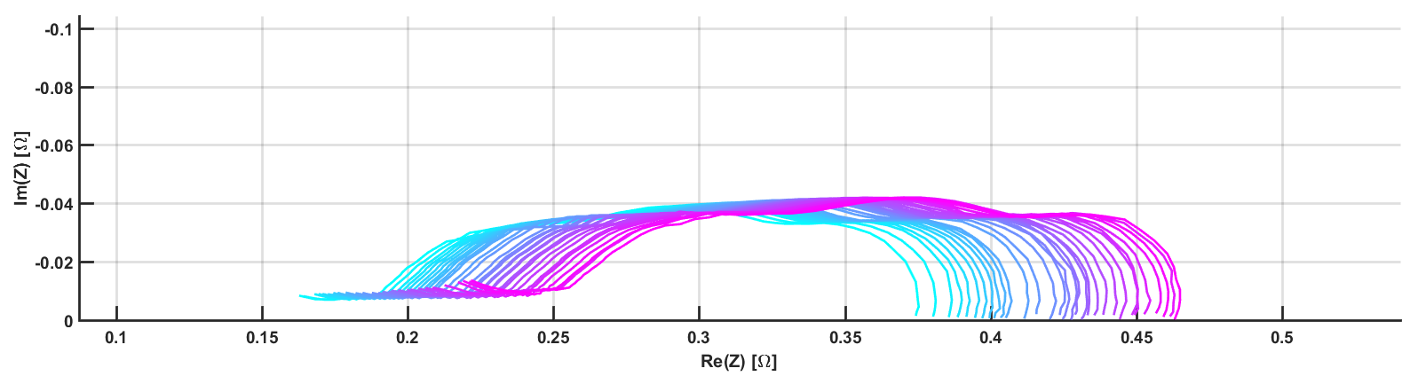
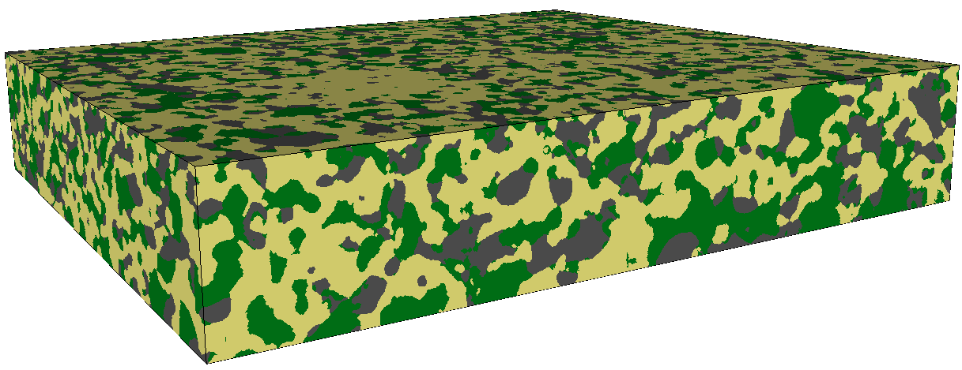
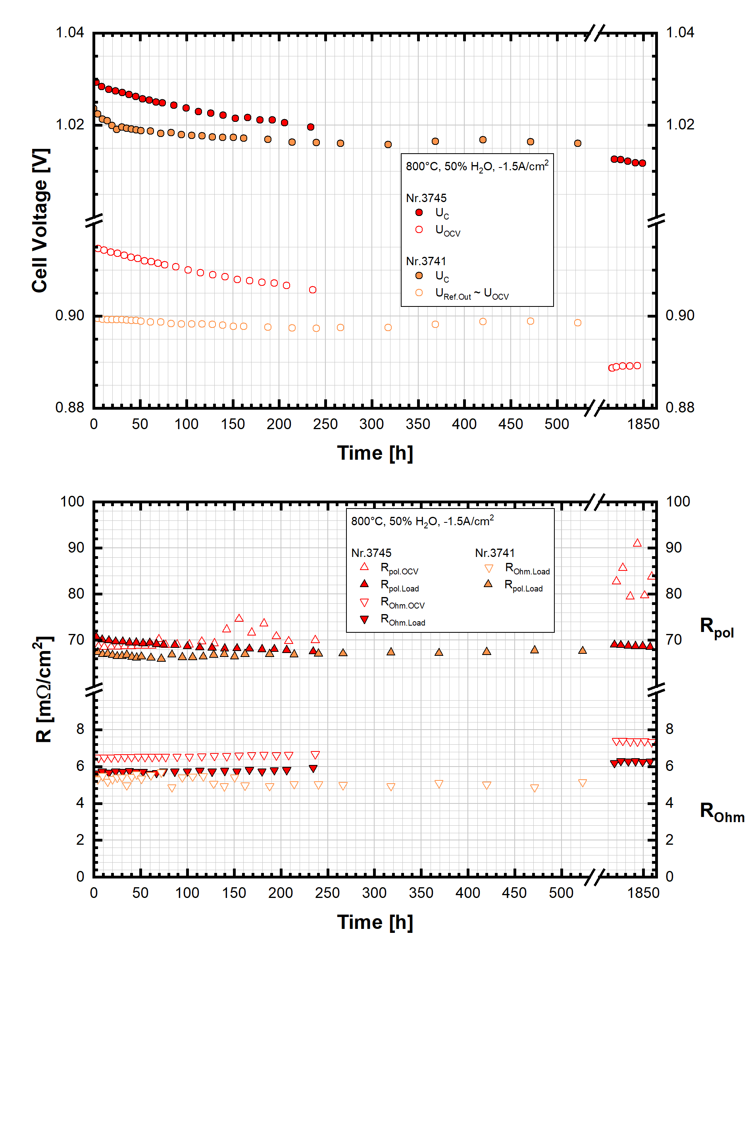
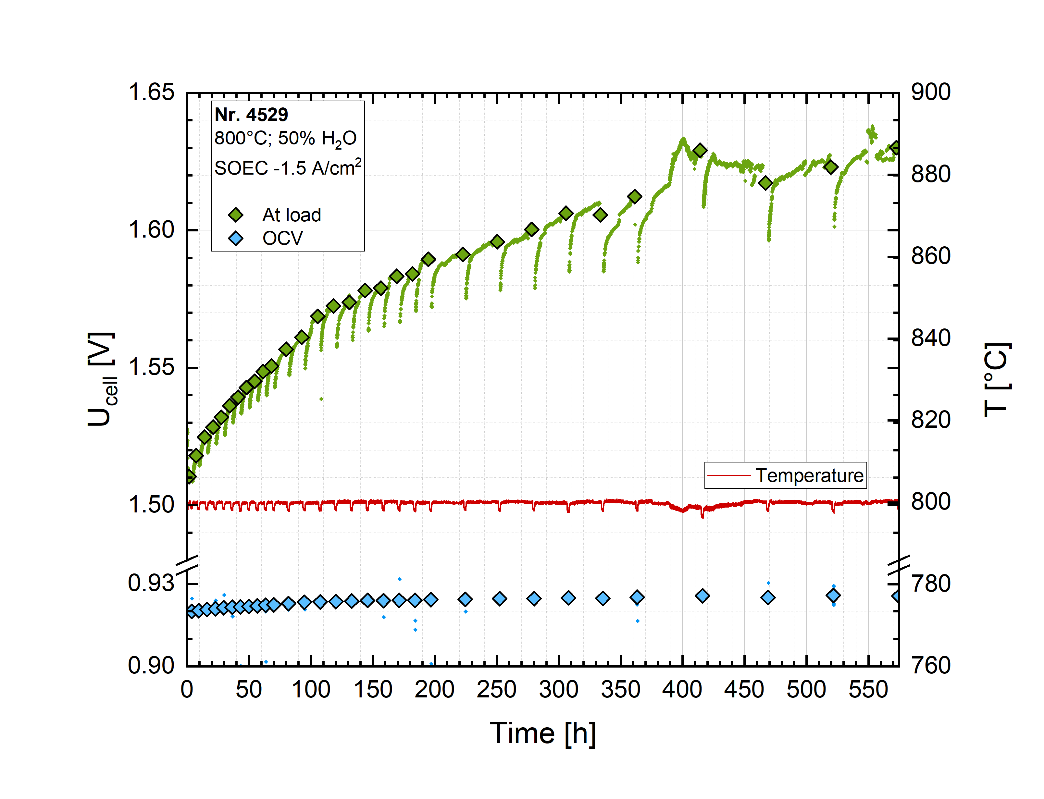
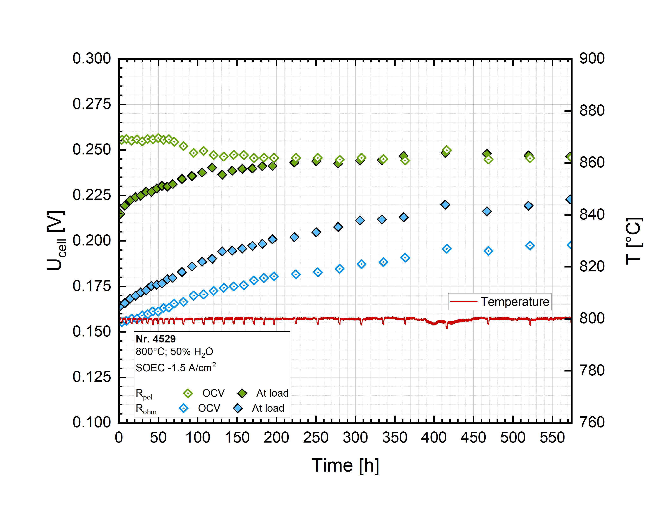

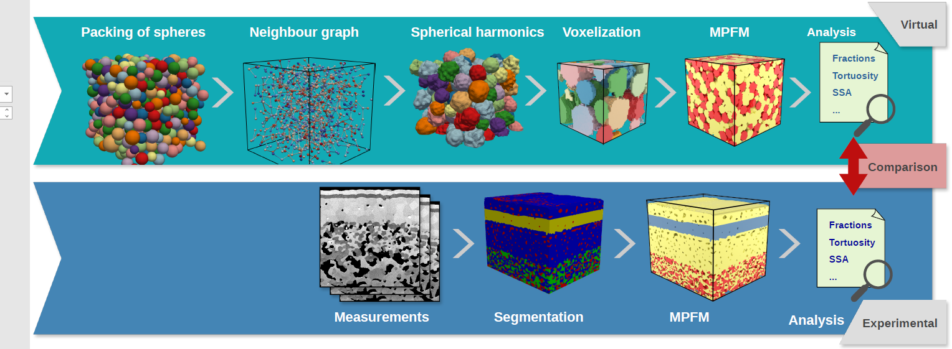
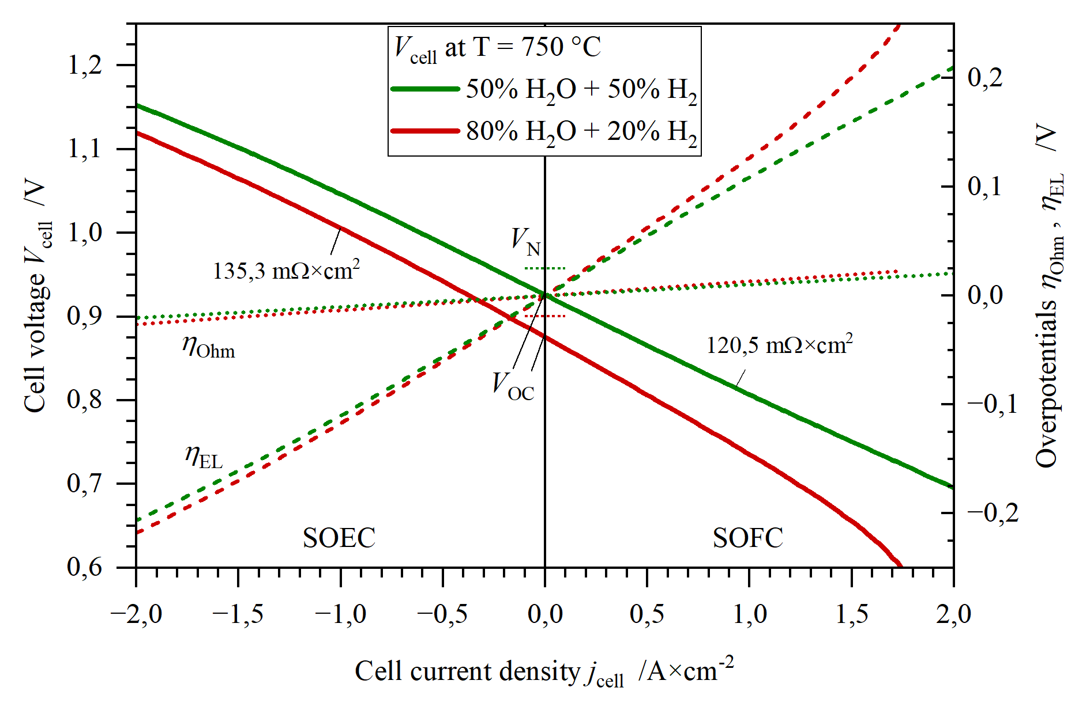
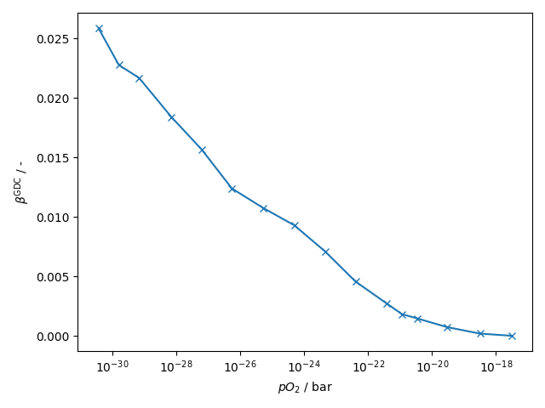



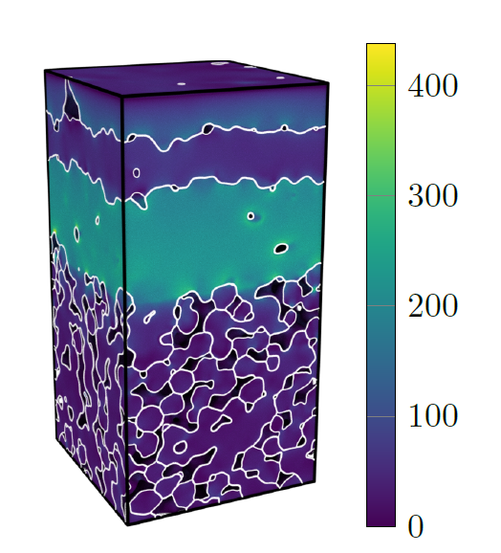
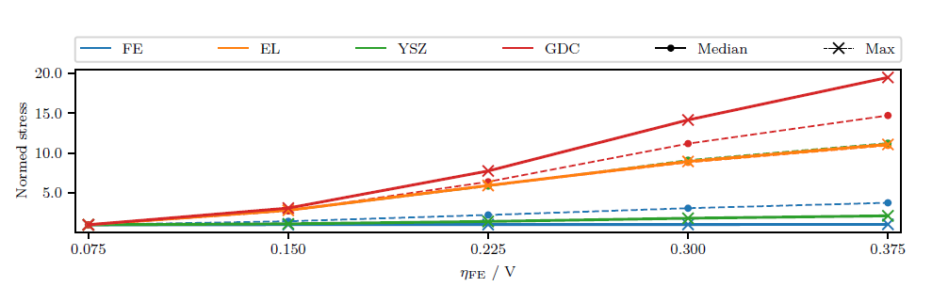
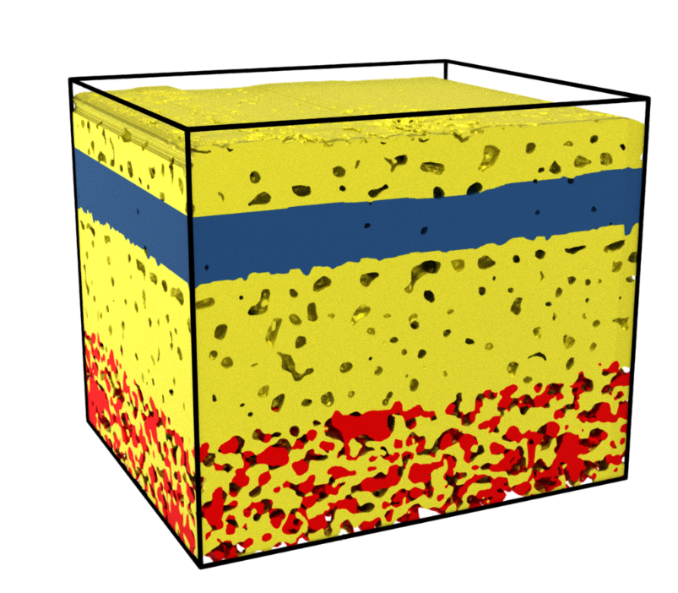
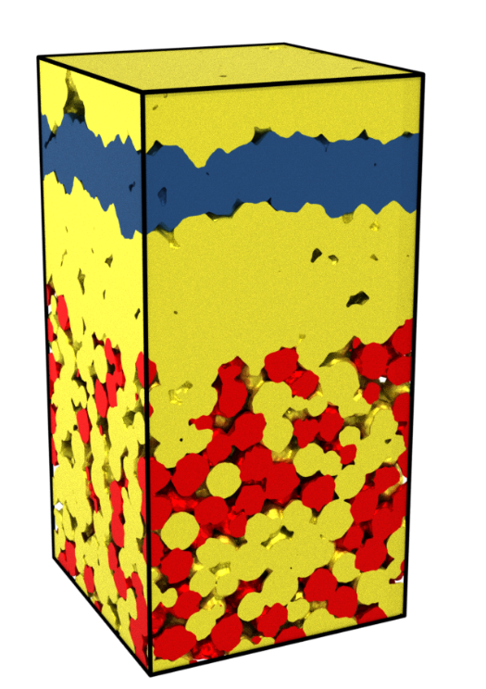

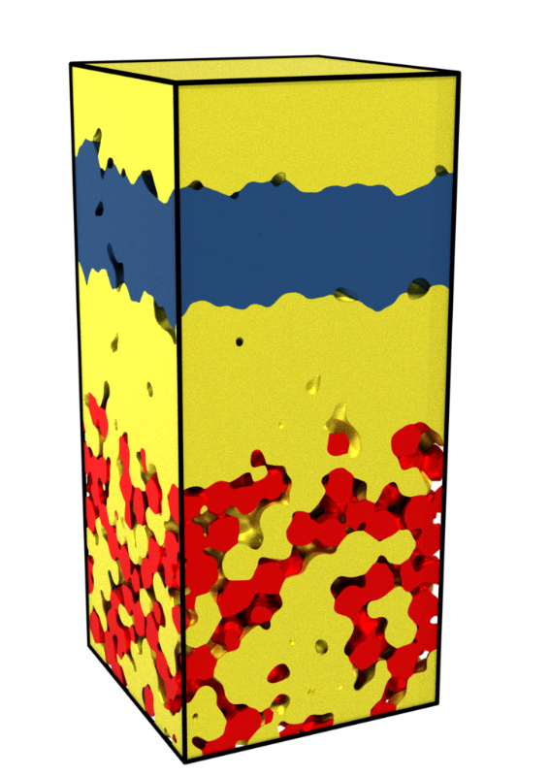
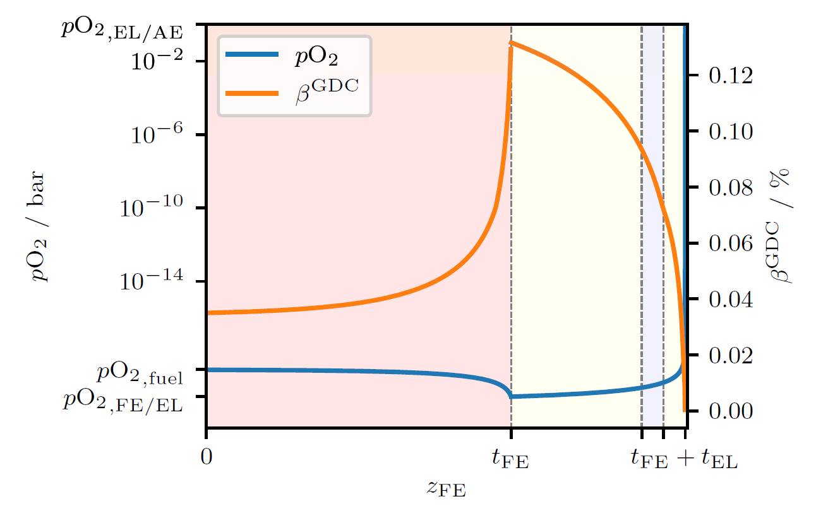
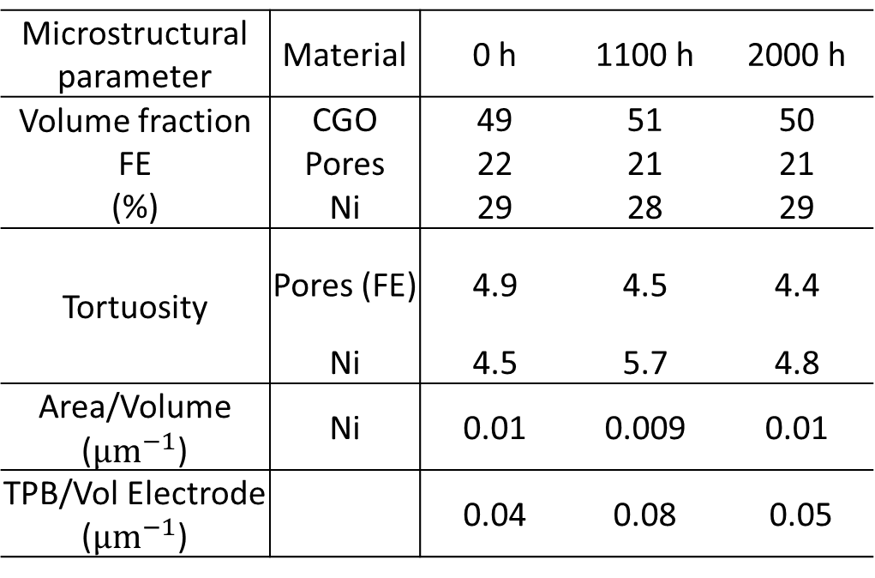
Processing and durability of fuel electrode supported-cells with Ni-GDC electrode
Cell preparation
Microstructure
Ni-GDC electrodes in fuel electrode-supported cells (FESC)
Powder processing and interdiffusion
Physical vapor deposition (PVD) cells
Processing
Interdiffusion during co-sintering
1230 °C
1000 °C
1400 °C
Bimodal
Unimodal
4 µm YSZ
EDX analysis of TEM lamella
Porosity 14 %
Porosity 5 %
GDC
GDC
GDC
YSZ
YSZ
YSZ
NiO-YSZ support
Tape casting
NiO-GDC fuel electrode
Screen printing
GDC electrolyte
Screen printing
Sintered half cell
GDC
GDC
O
Ce
Gd
Zr
Y
2 µm
NiO GDC
NiO GDC
GDC
5 µm
NiO YSZ
10 µm
NiO YSZ
10 µm
Zr
Y
850 °C
Interface
Ce
Gd
LSC air electrode
Screen printing
GDC layer (PVD)
8YSZ layer (PVD)
Contrast inverted
22 µm YSZ
20 µm
OCV + ASR
Optimization of processing
Monomodal PSD minimizes porosity
Powder pre-treatment to adjust shrinkage rate in co-fired layers
Optimization of binder + dispersant content
Influence of powder characteristics on the rheology of ceria-based screen-printing
PVD
GDC
2-step
Screen printing (SP) cells
~ 100 mΩ cm²
GDC
5 µm
YSZ
1230 °C
1000 °C
1400 °C
O
Ce
Gd
Zr
Y
604 mΩ cm²
GDC
GDC
176 mΩ cm²
YSZ
GDC
GDC
151 mΩ cm²
NiO-YSZ support
Tape casting
NiO-GDC fuel electrode
Screen printing
GDC / YSZ / GDC electrolyte
Screen printing
Sintered half cell
YSZ
PVD
GDC
YSZ
GDC
Electrochemical testing
Post-test analysis
PVD cells
SP cells
PVD cells
SP cells
Electrochemical impedance spectroscopy
Electrochemical impedance spectroscopy
LSC
80% pH₂O 5%
800 °C
Air / 50:50 H₂:H₂O
80% pH₂O 5%
800 °C
Air / 50:50 H₂:H₂O
Im(Z) [Ωcm²]
Im(Z) [Ωcm²]
GDC
Ni-GDC
initial Time 350 h
Re(Z) [Ωcm²]
800 °C
Air / 50:50 H₂:H₂O
-1.5 A cm⁻²
initial Time 560 h
Re(Z) [Ωcm²]
800 °C
Air / 50:50 H₂:H₂O
-1.5 A cm⁻²
Ni-YSZ
10 µm
10 µm
Im(Z) [Ωcm²]
Im(Z) [Ωcm²]
Cracks found in the active area of the cell
No cracking next to the air electrode
Very little reoxidation indicates cracking during cooling
Cell after reduction
Agglomerates in GDC layers
High porosity at the YSZ-GDC interfaces after sintering (→ leads to high ohmic resistance due to low contact area)
Dense YSZ and GDC layers
Re(Z) [Ωcm²]
Re(Z) [Ωcm²]
3D reconstruction by FIB-SEM shows no change in microstructural parameters after 2000 hours of SOEC operation
Durability test (800 °C, 50:50 H₂:H₂O, -1.5 Acm⁻²)
Durability test (800 °C, 50:50 H₂:H₂O, -1.5 Acm⁻²)
Cell voltage [V]
R [mΩcm²]
Cell voltage [V]
T [°C]
Microstructural parameter | Material | 0 h | 1100 h | 2000 h
Volume fraction FE (%) | CGO | 49 | 51 | 50
 | Pores | 22 | 21 | 21
 | Ni | 29 | 28 | 29
Tortuosity | Pores (FE) | 4.9 | 4.5 | 4.4
 | Ni | 4.5 | 5.7 | 4.8
Area/Volume ($µm^{−1}$) | Ni | 0.01 | 0.009 | 0.01
TPB/Vol Electrode ($µm^{−1}$) |  | 0.04 | 0.08 | 0.05
R [Ωcm²]
T [°C]
10 µm
Time [h]
Time [h]
Time [h]
Time [h]
Cell after SOEC operation
Cracks at regular intervals through GDC layer
YSZ layer mechanically intact (→ stable OCV)
Strong delamination along YSZ-GDC co-sintered interface (→ increasing ohmic resistance)
No indication of Ni depletion / migration despite high cell voltage
Conclusions
Very low area-specific resistance (ASR)
Stable ASR during durability test
OCV lower than V_{Nernst} indicates gas / electronic leakage
Faradaic efficiency yet unknown (assumed < 100%)
Decreasing OCV indicates increasing leakage
Conclusions
High ASR (higher than SoA Ni-YSZ cells)
High degradation rate during stability test (esp. R_{ohm})
OCV = V_{Nernst} indicates no leakage
Faradaic efficiency yet unknown (assumed 100%)
Stable OCV during testing
Modelling of stress distribution: synthetic microstructures
Generation of synthetic microstructures
Prediction of electro-chemo-mechanical stress
Electrochemical data
Chemical expansion of GDC
Material properties
GDC, air
GDC, 4% H₂
YSZ, air
YSZ, 4% H₂
FIB-SEM 3D reconstruction
Generated microstructure
MPFM aging simulation
Microstructure variation
Distribution of pO₂
MPa
Stress prediction in synthetic microstructures
Acceleration compared to experiments: simple variation of microstructure – property relation
Requires accurate input parameters
Assumptions & boundary conditions critical
MPFM: Multiphase-field method

