Slide 1

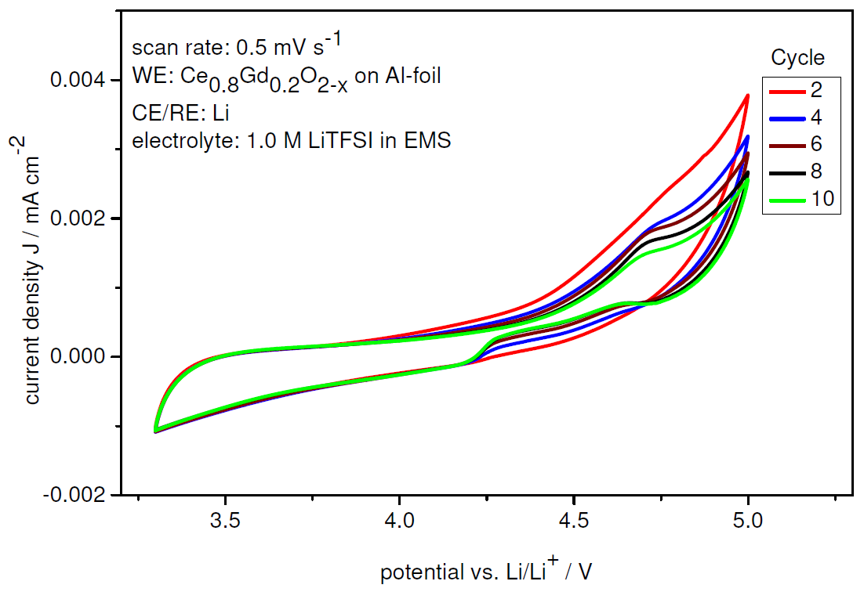
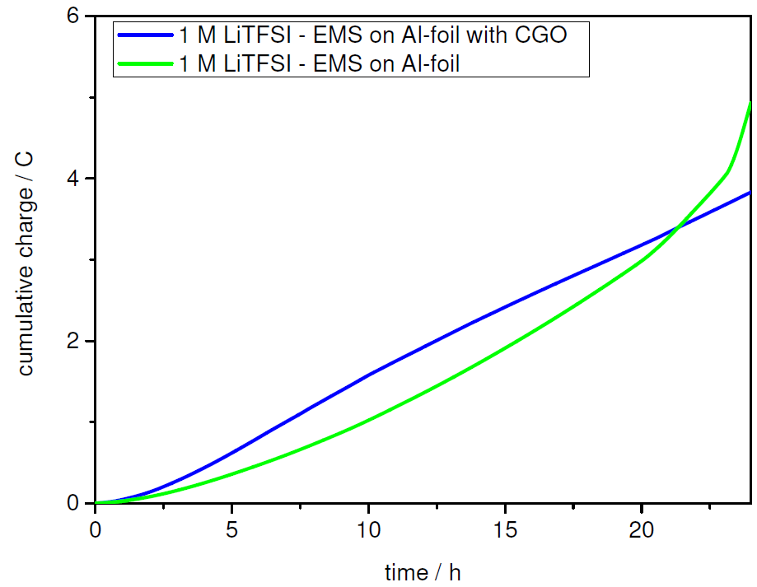
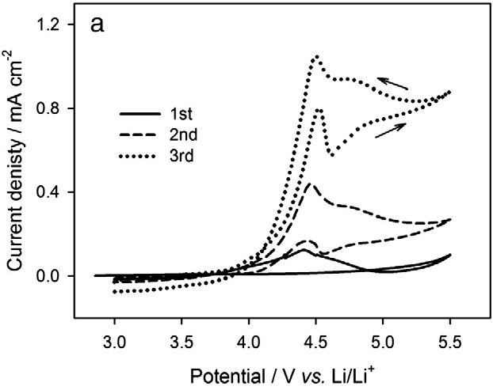
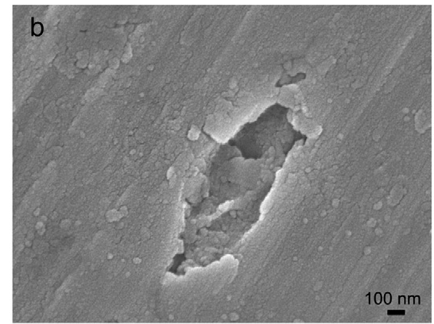
DEPOSITION OF CORROSION PREVENTING COATINGS FOR DUAL-ION BATTERIES
Manuel Krott¹, Sven Uhlenbruck¹, Hans Peter Buchkremer¹, Paul Meister², Martin Winter²
¹Institut for Energy and Climate Research (IEK-1), Forschungszentrum Jülich GmbH, Jülich, Germany
²MEET – Münster Electrochemical Technology, Münster, Germany
Motivation
Commercial lithium ion batteries (LIB) are built with liquid electrolytes containing organic carbonates and lithium hexafluorophosphate (LiPF₆). The flammability of these carbonates implies safety risks which could be avoided by replacing the electrolyte mixtures by ionic liquids (ILs), e.g. based on anions like bis(trifluoromethylsulfonyl)imide (TFSI⁻). Additionally, LiPF₆ (which also tends to thermal decomposition) can be substituted by appropriate conducting salts, e.g. LiTFSI. Since these components show negligible vapor pressure and high thermal stability, the danger of thermal runaway is minimized, but some problems are still to be solved. In this context, anodic dissolution of the aluminum current collector is a very important issue. To overcome this drawback, innovative protection coatings are deposited on aluminum foils by magnetron sputtering.
Anodic dissolution
Characterization
Common LIB: Al₂O₃/AlF₃ mixture protects Al in LiPF₆/ethylene carbonate/dimethyl carbonate electrolytes
ILs: established protection layer cannot develop
Pit corrosion triggered by imide-based anions like bis(trifluoromethylsulfonyl)imide (TFSI ⁻ )
Protective coatings can avoid corrosion
Electrochemical properties
Figure 3:
Left: Cyclic voltammetry (CV) diagram of CGO (Ce_{0.8}Gd_{0.2}O_{2-x} ) layer on aluminum foil. The low and decreasing current density indicates a suppressed corrosion.
Right: Chronoamperometry (CA) diagram of CGO layer on aluminum foil. Cumulative charge slowly rises, pointing at coating defects where corrosion may still occur.
Scanning electron microscopy
Figure 1: Aluminum working electrode in 1 M LiTFSI/PMPyr-FSI electrolyte; (a) cyclic voltammetry, 10 mV/s; (b) FE-SEM after CV
from Cho, E. et al., Electrochem. Comm., 2012, 22, 1-3.
Sputter deposition
substrate heater
U_{Bias}
~
Figure 2:
Illustration of sputtering process. For reactive sputtering, a controlled amount of reactive gas (e.g. oxygen) is added to the argon flow.
substrate
Ar⁺
Cluster
Ar⁺
Ar
target
-
plasma
magnetron
U ~ kV
Figure 4: Surface structures of Ce_{0.8}Gd_{0.2}O_{2-x} thin films deposited on aluminum sheets. Structural defects occur due to highly different thermal expansion coefficients. SEM picture taken by D. Sebold, IEK-1, FZJ.
vacuum
Conclusion
The CV and CA diagrams confirm the electrochemical stability of the protective coating material (Ce_{0.8}Gd_{0.2}O_{2-x} ). However, the SEM pictures indicate structure defects caused by different thermal expansion coefficients. Therefore, the deposition process needs to be optimized to achieve a dense covering of active current collector material..
Financial support by the BMBF („Bundesministerium für Bildung und Forschung“ / Federal ministry of education and research, Germany), under project „INSIDER“ no. 03EK3031B is gratefully acknowledged.

