Slide 1
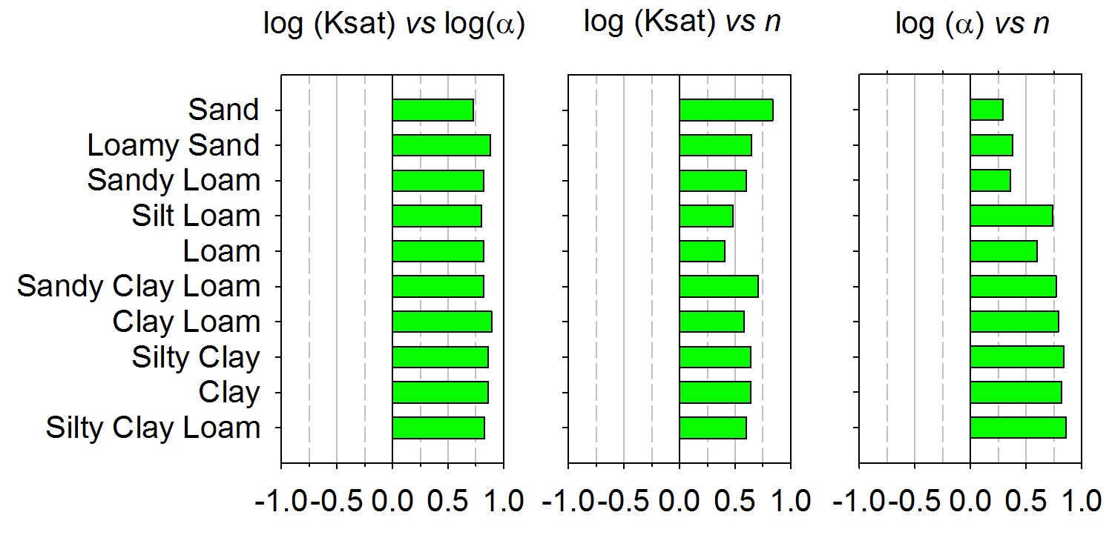
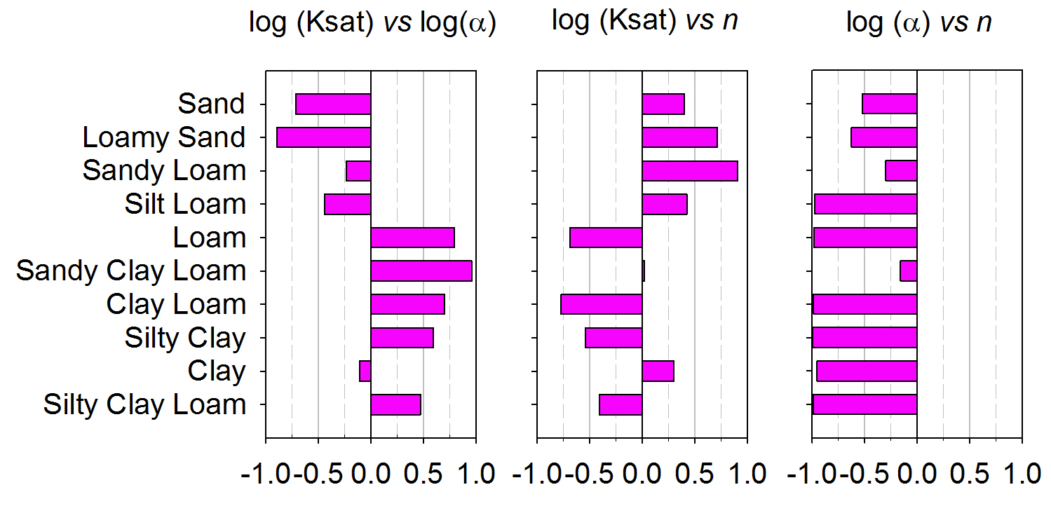
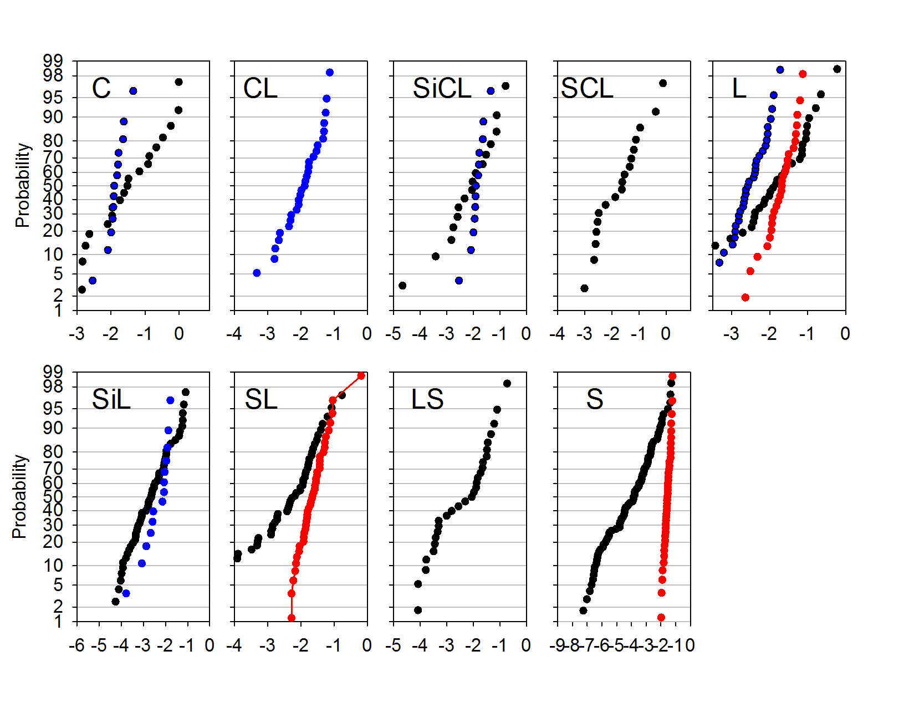
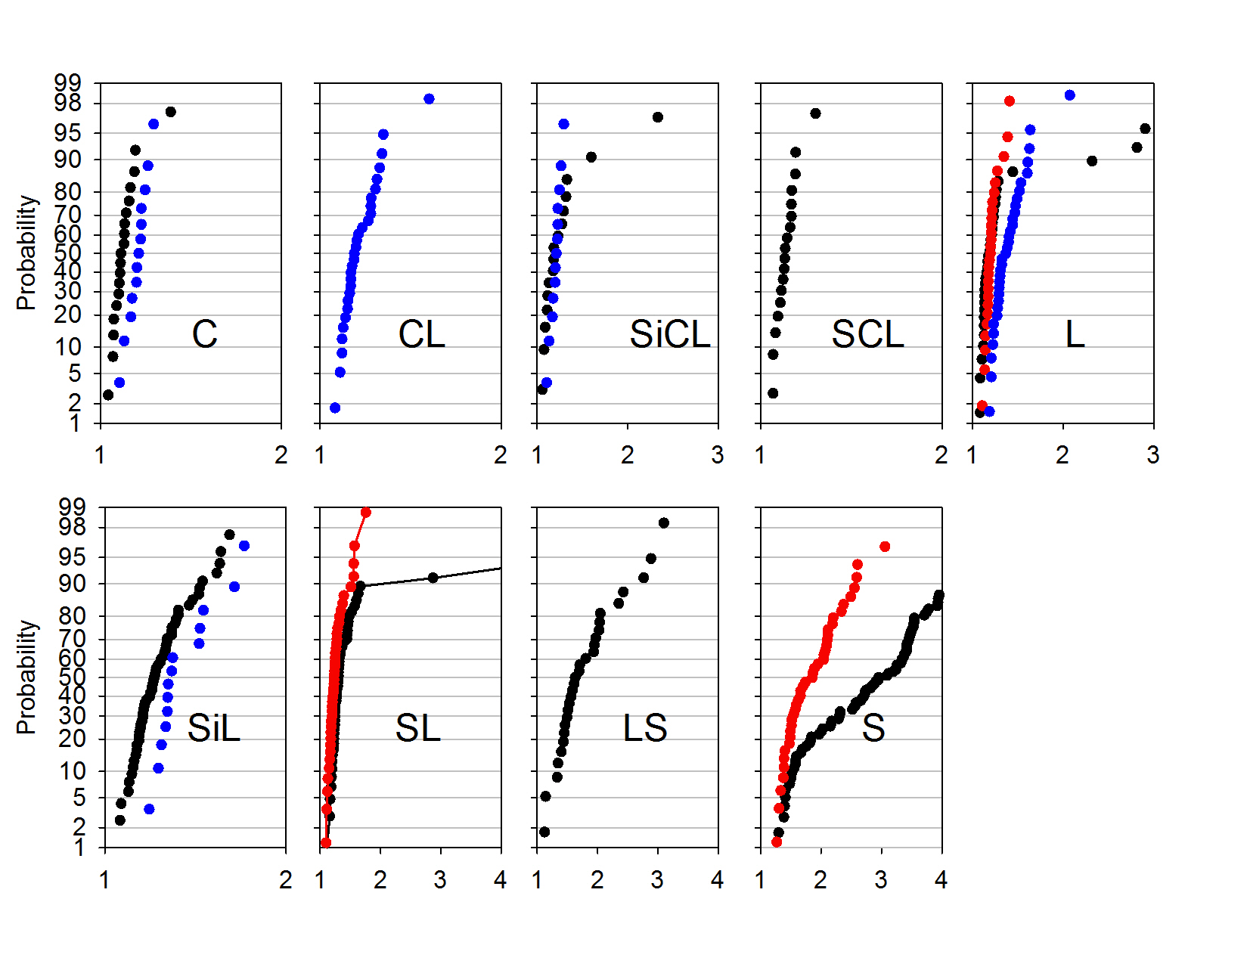
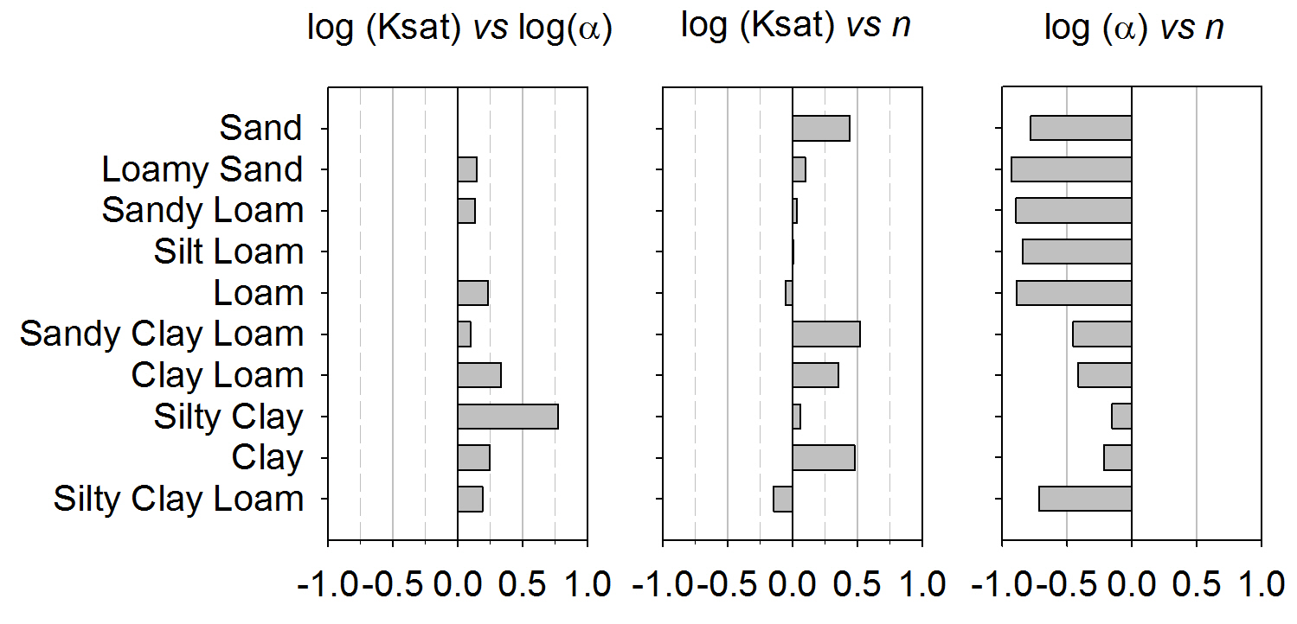
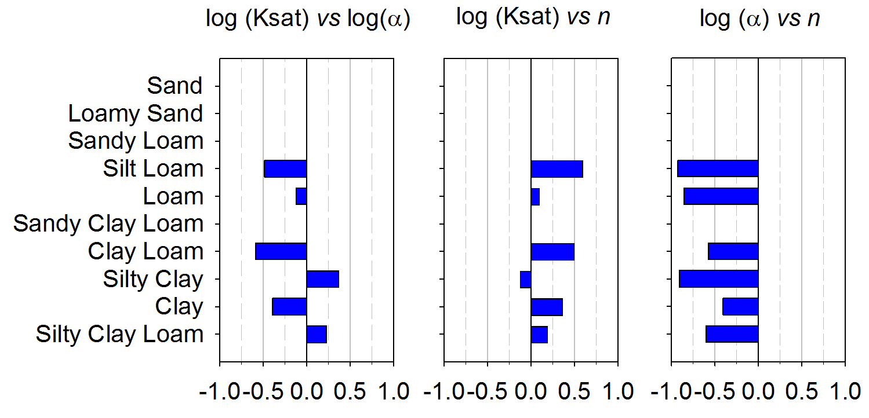
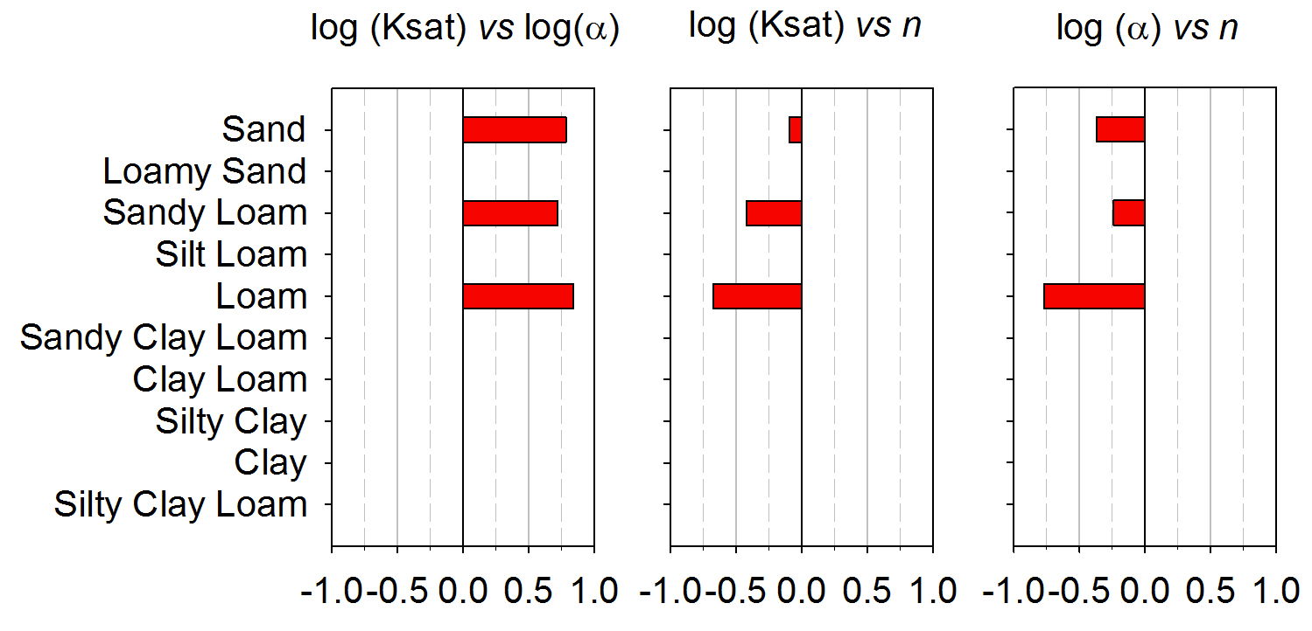
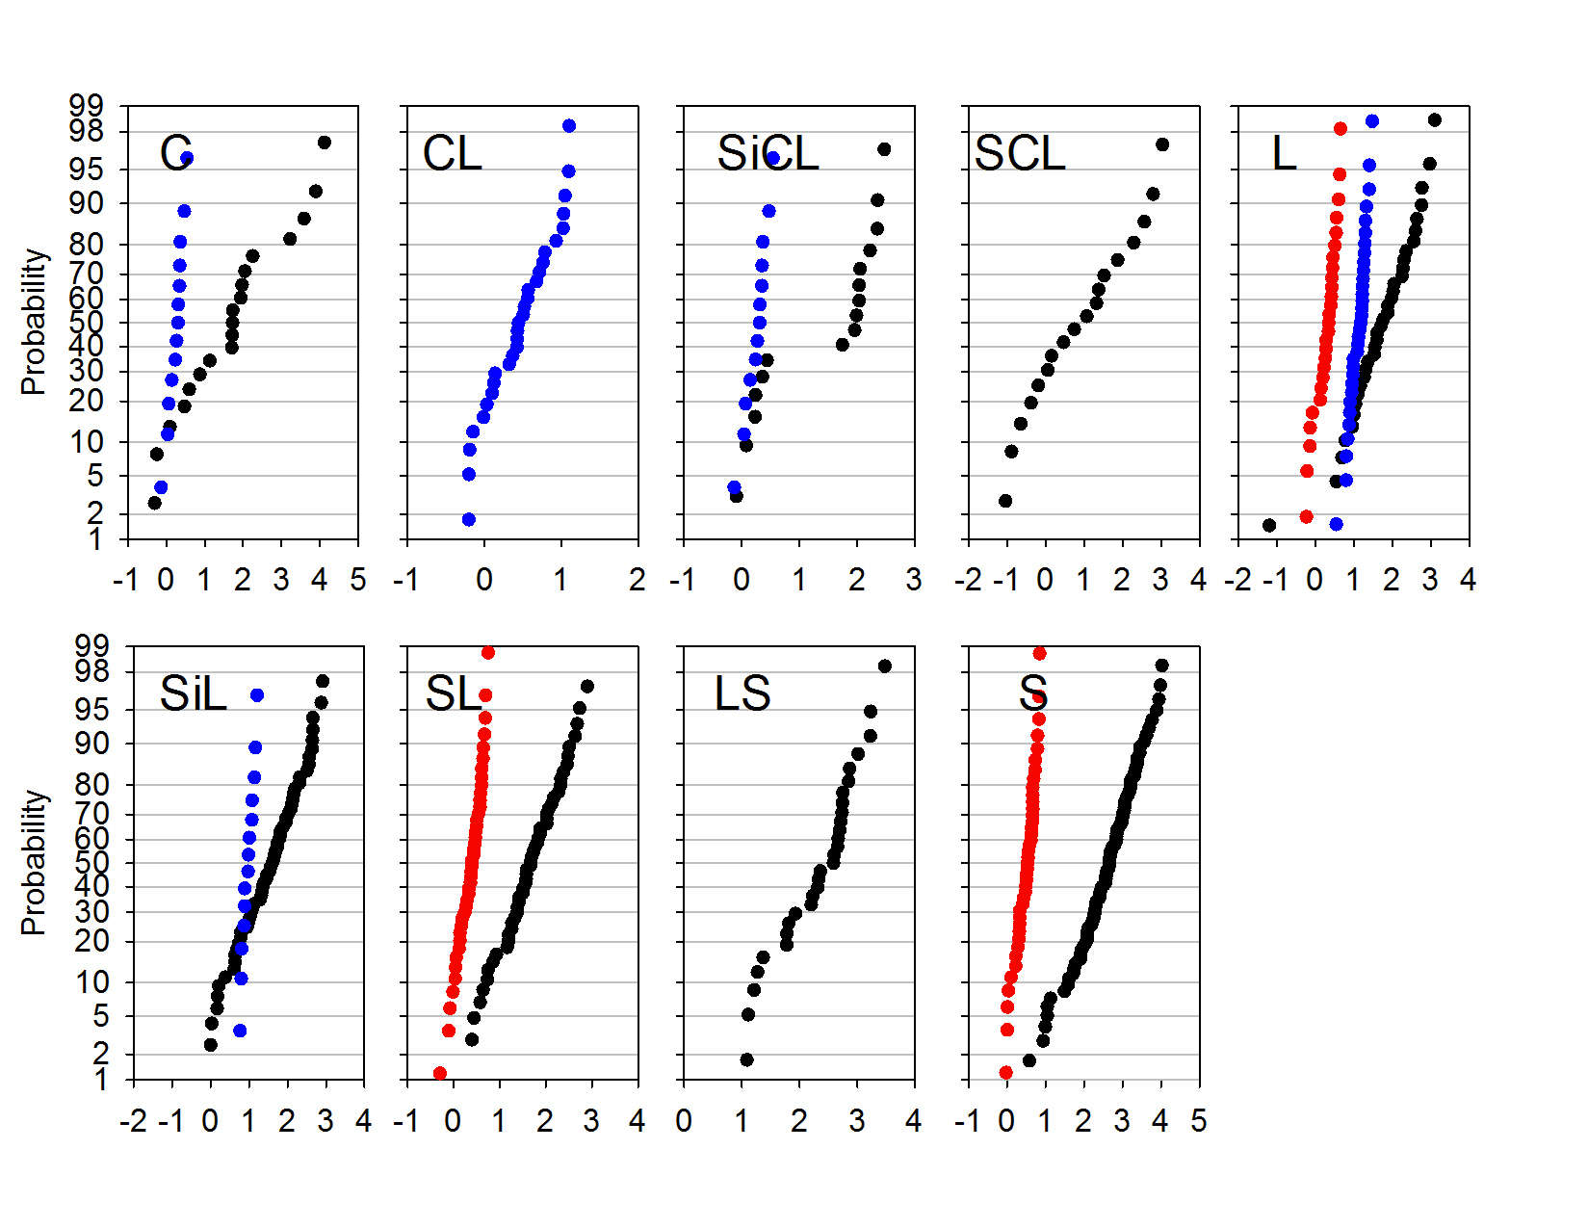
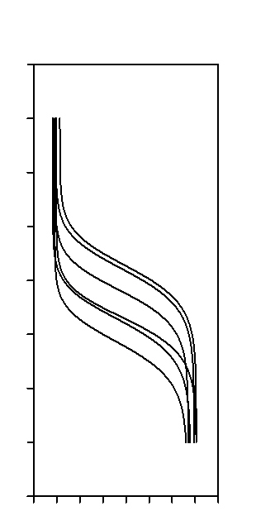
Multivariate Distributions of Soil Hydraulic Parameters
W. Qu¹, Y. Pachepsky², J. A. Huisman¹, G. Martinez Garcia³, H. Bogena¹, H. Vereecken⁴
¹Institute of Agrosphere, Research Center Jülich, Germany, ²USDA-ARS Beltsville Agricultural Research Center, MD, USA,
³The Institute for Agricultural and Fisheries Research and Training, Spain.
1. Need in Pedotransfer for Estimating Variability of Soil Hydraulic Parameters
5. Statistical Distributions of MVG Parameter Values
Within Textural Classes
6. Correlations Between Parameters
Probability distributions of soil and sediment hydraulic parameters are utilized in
inverse modeling and vadose zone flow model calibration (Scharnagl et al., 2010),
sensitivity analysis and uncertainty characterization (Vereecken et al., 1990),
soil moisture sensor data assimilation (Pan et al., 2012),
ensemble flow and transport modeling (Guber et al., 2008),
synthetic parameter field generation (Pan et al., 2010).
Such distributions have to be generated using pedotransfer, i.e. based on soil basic properties,
where it is impractical to carry out measurements in large numbers of samples
sufficient to develop probability distributions of hydraulic parameters
Application of the method A resulted in MVG parameter distributions different from normal, and
(a) different types of distributions (e.g. beta distribution was suggested to be used (i.e. Meyer et al (1997);
(b) preliminary data transform was suggested to work with normal distributions (Carsel and Parish, 1988).
Results of the Method B application are shown below.
2. Objective
The objective of this work is to review results of pedotransfer work for soil hydraulic
parameter variability. PTFs for USDA textural classes will be considered for the
van Genuchten parameterization.
3. Two methods to develop the variability PTFs
Pearson correlation coefficients
Method A. Use existing PTF developed to estimate hydraulic parameters
(e.g., Carsel and Parish, 1988; Meyer et al., 1997, Faulkner et al., 2003).
Create random sets of ‘clay-silt-sand’ triplets in each textural class.
Use PTF to compute hydraulic parameters for each triplet in each class.
Evaluate variability or develop multivariate distribution of parameters
within each textural class.
log(Ksat)
n
Carsel and Parish, 1988
Rosetta (Schaap et al. 2001
UNSODA (Leij et al., 1996)
Vereecken et al. (1989)
S sand
LS loamy sand
SL sandy loam
L loam
SiL silt loam
SCL sandy clay loam
CL clay loam
SiCL silty clay loam
C clay
US Southern Plains (Timlin et al., 1999)
Pearson correlation coefficients
Comments.
1. No agreement in correlations between methods and databases.
2. Consistently large correlation coefficients are found only in application of the method A to Rawls et al. (1982) pedotransfer functions.
3. The negative correlation between log(α) and n is found for all but Carsel and Parish (1988) datasets.
4. Small correlation coefficients in some cases are caused by differences in ranges of parameters – regression slope close to zero.
5. Some of differences between textural classes can be caused by differences in representation of classes in a database.
6. It is not clear to what extent correlations found with method A reflect actual correlations rather than PTF regression coefficients.
Method B. Develop the variability PTFs directly from results of fitting the
van Genuchten equation to the experimental data on water retention and results of hydraulic conductivity measurements (e.g., Rawls et al., 1998).
Estimate parameters α, n, θs and θr for each dataset in a database.
Bin parameters estimates and measured saturated hydraulic conductivity
Ks by textural classes.
Evaluate variability of individual parameters or develop multivariate
distribution of parameters within each textural class.
UNSODA
Vereecken et al. (1989)
US Southern Plains (Timlin et al., 1999)
log(α)
Comments
Using probability scale provides graphs of cumulative distribution functions that are relatively close to linear in the probability range 5% and 95%
Most of databases do not have enough data to characterize the distribution tails in case of application of the method B.
The method A relies on PTF for parameters that were developed from database without good coverage of cases that result in extreme values of parameters.
Fitted parameter values were found with no attention to for correlation between parameters.
The importance of deviations of normality needs to be evaluated with a sensitivity analysis for a specific application.
4. Five databases to illustrate the above methods
7. Conclusions and Suggestions
Method A . Rosetta PTF (Schaap, M. et al., 2001) and Rawls et al. (1982) PTFs .
Method B. UNSODA 1.0 (Leij et al., 1996), mixed bag in terms of measurement
methods and laboratories,
US Southern Plain database (Timlin et al., 1999), the same measurement
methods, different laboratories ),
Vereecken et al. (1989) database (same methods, same laboratory.
1. Correlations between van Genuchten parameters can be strong and apparently have to be accounted for in applications when
the parameter variability is assumed.
2. Parameter variability and correlations are database -specific.
3. Research and comparison of parameter variability and correlations in existing databases presents an interesting matter to explore.
4. It will be interesting to explore the utility of using multivariate distribution of hydraulic parameters rather than
uncorrelated parameter distributions in various types of modeling application.
References – from yakov.pachepsky@ars.usda.gov

