Slide 1
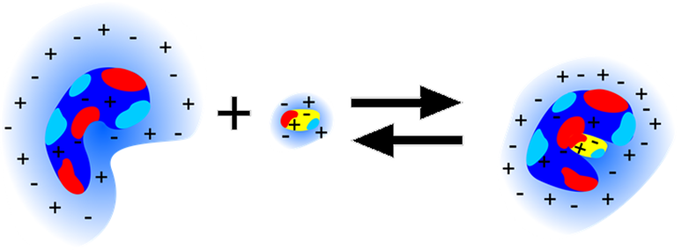
Protein-ligand binding: combining itc and tdfrs measurements
15.06.2021 I Shilpa mohanakumar

Slide 2
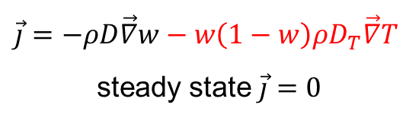

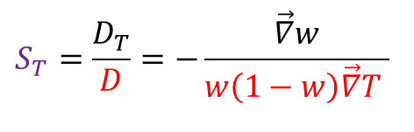
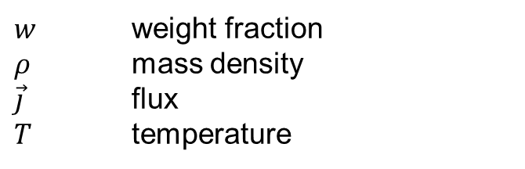
motivation
 motivation previous work studied systems results summary & outlook acknowledgement
Thermophoresis
Motion of solute particles induced by thermal gradient.
$w$ weight fraction
$ρ$ mass density
$\vec{j}$ flux
$T$ temperature
$\vec{j}=−ρD\vec{∇}w−w\left(1−w\right)ρD_{T}\vec{∇}T$
steady state $\vec{j}=0$
$$S_{T}=\frac{D_{T}}{D}=−\frac{\vec{∇}w}{w\left(1−w\right)\vec{∇}T }$$
$$S_{T}∝\frac{∆w}{∆T}$$
Notes:
Second term is the flux along the temp gradient characterized by DT aand first term is the Fickian diffusion along the conecntration gradient charactersied by D
I replaced the vectors with the concentration and temperature difference. It is not possible to divide a vector by a vector, you have to take the magnitude of the vector, but this is also not straight forward because somehow you need also the information, whether the concentration increases or decrease with increasing temperature.

Slide 3
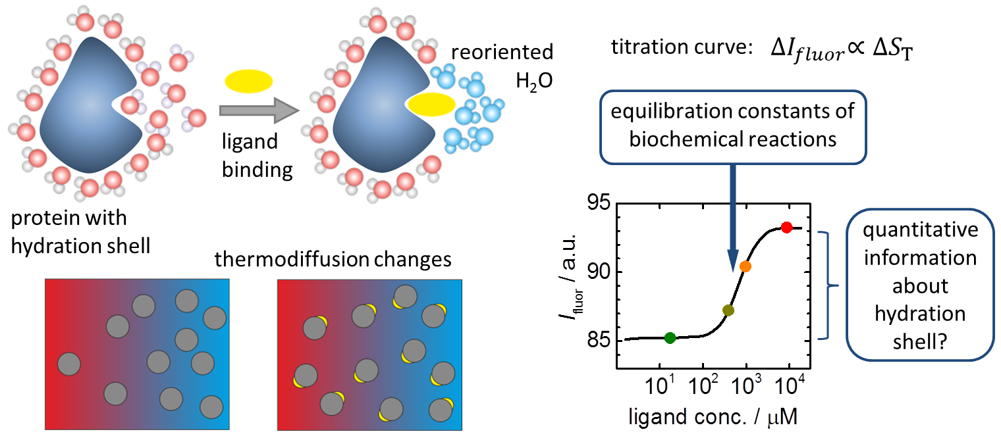
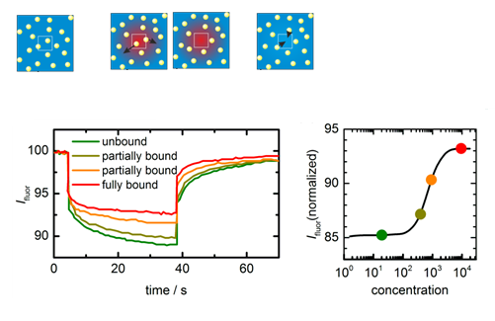
Applications
 introduction studied systems results summary & outlook acknowledgement
Microscale Thermophoresis(MST)
M. Jerabek-Willemsen et al, et al., J. Mol. Struct., 1077(2014), 101
Notes:
MST is an application of thermophoresis. Fluorescence within the capillary is excited and detected through an objective. An IR laser is used to heat the sample. Initially the molecules are homogenous and a constant fluorescence is detected. When IR is switched on, temperature gradient is created and molecules move out of the region which leads to a decrease in fluorescence(T-jump). When IR is switched off, an inverse T jump occurs due to the back diffusion of molecules. This thermophoretic movement of molecules changes upon ligand binding of a non-fluorescent molecule. Thus the change in fluorescence at different ligand concentrations are measured. Change in thermophoresis is measured as change in normalized fluorescence. This is then fitted to obtain the equilibrium constant.

Slide 4
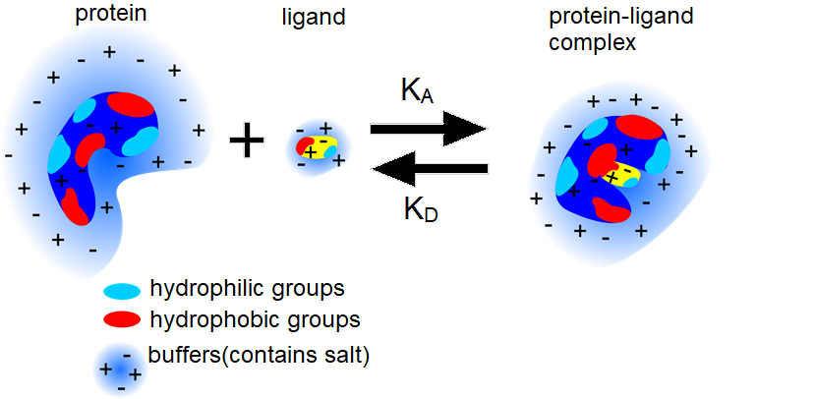
Goal: Protein-ligand systems
 motivation introduction studied systems results summary & outlook acknowledgement
Changes in the hydration layer influence thermophoresis!
Notes:
There are hydrophilic , hydrophobic and charged groups present for both proteins and ligands. Proteins and ligands are studied in buffer solutions which are basically salt in solutions. So when a ligand binds with protein, there are lot of changes that happens in hydration layer, conformation of the protein etc. So in order to solve this complex problem,
And it is a multicomponent system!

Slide 5
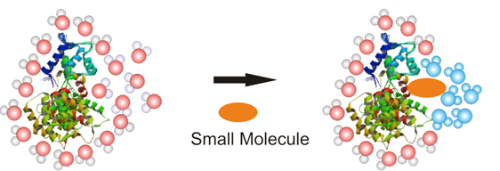
 motivation introduction studied systems results summary & outlook acknowledgement
Changes in the hydration layer can influence thermophoresis.
Can this connection be quantified?
Can it be used to gain information about change in hydration shell upon complex formation?
Can free energy(ΔG), enthalpy(ΔH) and entropy(ΔS) be connected with the thermodiffusion properties?
OPEN QUESTIONS

Slide 6
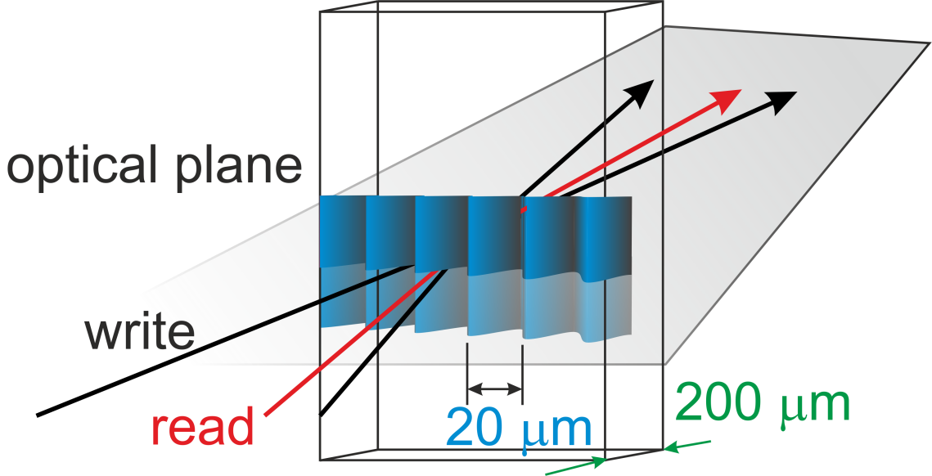
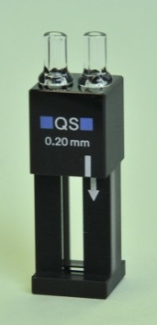
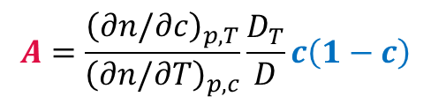
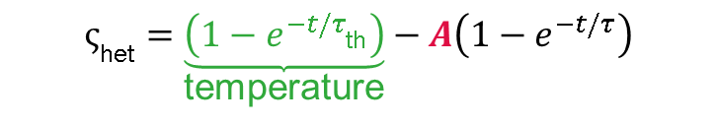
Techniques
introduction studied systems results summary & outlook acknowledgement
Molecules/colloids with higher refractive index moves to cold side
TDFRS
Measured quantity:
Intensity of the diffracted beam
magnitude: 3-4
slow
$$A=\frac{{\left(∂n/∂c\right)}_{p,T}}{{\left(∂n/∂T\right)}_{p,c}}\frac{D_{T}}{D}c\left(1−c\right)$$
fast
$$ς_{\text{het}}=\underset{\text{temperature}}{\underbrace{\left(1−e^{−t/τ_{\text{th}}}\right)}}−A\left(1−e^{−t/τ}\right)$$
S. Wiegand et al., J Phys Chem B, 111 (2007), 14169

Slide 7
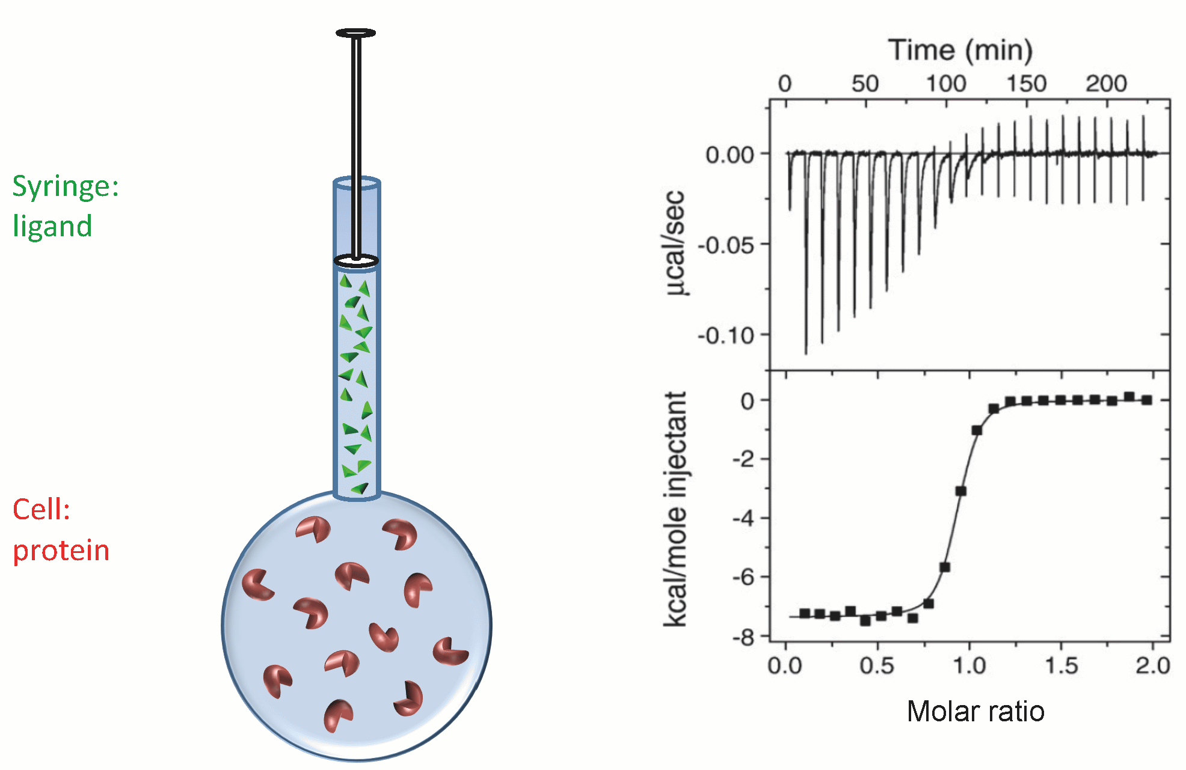
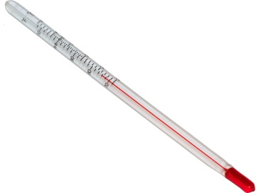
Techniques
introduction studied systems results summary & outlook acknowledgement
ITC
+
→
Directly measures heat associated with binding!
Notes:
Only technique that can measure binging energies of binding reactions. It measures the amount of power required to maintain a constant temperature difference between sample and reference cell. When ligand is injected into the cell, binding reaction occurs. The formation of complex is accompanied by release or absorption of heat. This causes a temperature difference between sample and reference cell. In order to compensate the temperature difference, the system either lowers or raises the thermal power. After each injection, the systems reaches equilibrium and temperature balance is restored. Integrating the are under the peak, provides the heat associated with injection.

Slide 8
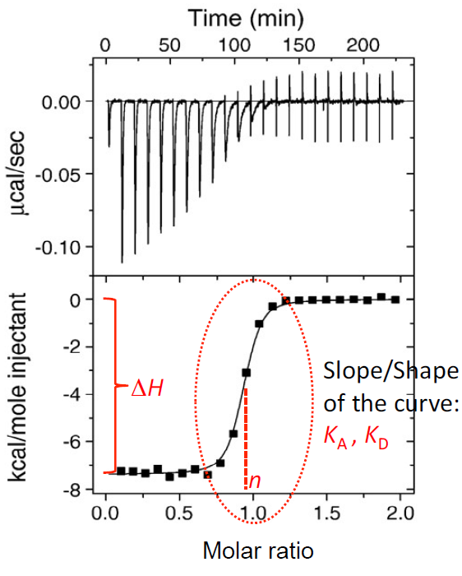


Techniques
introduction studied systems results summary & outlook acknowledgement
ITC: What do we gain?
Binding affinity(K_{a}, K_{d})
Stochiometry(n)
Binding enthalpy(ΔH)
Free energy of binding(ΔG)
Binding entropy(ΔS)
$$∆G=−RT\ln{K}$$
$$∆G=∆H−T∆S$$
Notes:
Thus the thermodynamic parameters can be calculated. dH is directly measured. dG and dS are then calculated from this.

Slide 9
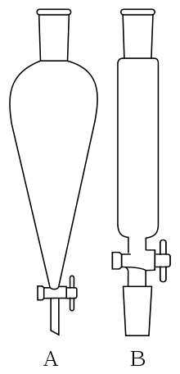
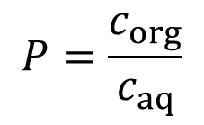



results summary & outlook acknowledgement
Aqeous solutions of non-ionic systems
Temperature dependence of S_{T}
$∆S_{T}$ is measure for temperature dependence
$$∆S_{T}=S_{T}\left(50℃\right)−S_{T}\left(20℃\right)$$
$∆S_{T}$ correlates with hydrophobicity(log P)
organic phase → c_{org}
water → c_{aq}
$$P=\frac{c_{org}}{c_{aq}}$$
saccharides: P. Blanco et al., J. Phys. Chem. B (2010)
cyclodextrins: K. Eguchi et al., Eur. Phys. J. E (2016)
urea: D. Niether et al., PCCP. (2018)
formamide: D. Niether et al., PNAS (2016)
Notes:
The correlation between dSt and log P is something interesting that has been found for non-ionic systems. The molecules which are hydrophilic has larger dST value. This is seen from ST vs T dependence. When the molecule is hydrophilic, there are more chances of forming hydrogen bonds. Now when the temperature increases, hydrogen bonds breaks and ST increases. This leads to a larger dST value. Similarly a hydrophobic molecule leads to a smaller dST value. Thus a clear correlation between hydration and thermodiffusion can be seen.

Slide 10

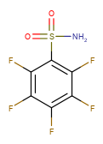
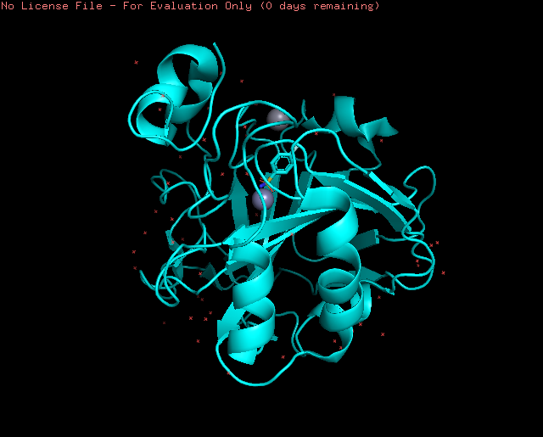
 studied systems results summary & outlook acknowledgement
Protein-ligand systems
Bovine Carbonic Anhydarse II + Ligand
4-fluorobenzene
Sulfonamide(4-FBS)
Pentafluorobenzene
Sulfonamide(PFBS)
Buffer used: sodium phosphate(0.02 M, pH=7.4)
Salt components: Na₂HPO₄.7H₂O
NaH₂PO₄.H₂O
Why fluorinated ligands?
Larger size compared to hydrogen
High electronegativity
Low polarizability
K. Uneyama, Organofluorine Chemistry, Blackwell Publishing, Oxford, 2006.
J. Gao, S. Qiao, G. M. Whitesides, J. Med. Chem., 1995, 38, 2292 –2301.
A. Ikai et al., Acta Cryst., 2004, D60, 792-795
Notes:
The protein that we had selected for our study is BCA. Carbonic anhydrases are Zinc metallic enzymes that catalyses the reversible hydration of CO2 to HCO3-. In eukaryotes they play a role in ion transport as well. The structure is similar to what has been observed in Humans. The ligands are used as benzene sulphonamides. Sodium phosphate buffer of 20 mM was used.

Slide 11

results summary & outlook acknowledgement
Protein-ligand systems
reduced $∆S_{T}$($∆T$) for BCA II + 4-FBS
  → surface of complex is less hydrophilic
indicates breaking of HB
Larger $∆S_{T}$($∆T$) for BCA II
  surface of protein is more hydrophilic
  Difference between $S_{T}$of free protein and complex decreases with increasing temperature
Bovine Carbonic Anhydarse II + 4-FBS
ΔS_{T}(ΔT)
Solvent Accessible Surface Area (PYMOL):
 | Hydrophilic(Å²) | Hydrophobic(Å²)
HCA II | 8500 | 2020
HCA II + 4-FBS | 8250 | 2280
Calculations done using PyMOL
Notes:
So if we look into ST vs T, we see that dST is less for the complex. This means that complex is less hydrophilic. This means the hydrogen bonds break with complex formation. Now if we look into the protein, it has larger dST compared to complex. This means free protein is more hydrophilic. We tried to look into the SASA of HCA II and HCA II+4-FBS with the help of PyMol. Since the structure of HCA and BCA are similar, it is used for comparison and we expect similar results. If we look into the hydrophilic surface area, this falls in line with our results. Complex has less hydrophilic surface area.

Slide 12
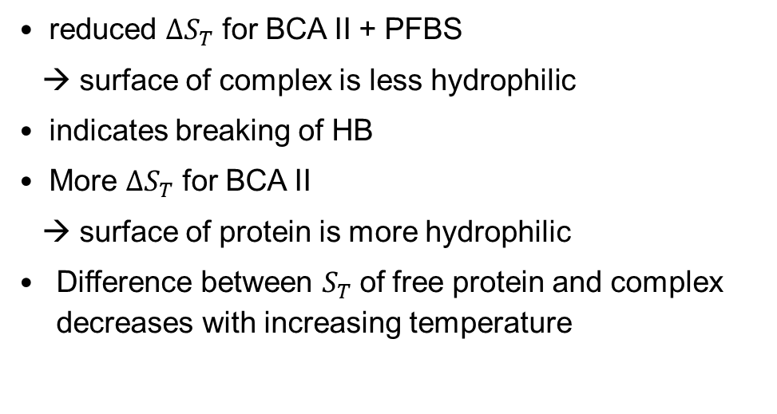
results summary & outlook acknowledgement
Protein-ligand systems
Bovine Carbonic Anhydarse II + PFBS
reduced $∆S_{T}$ for BCA II + PFBS
  → surface of complex is less hydrophilic
indicates breaking of HB
More $∆S_{T}$ for BCA II
  surface of protein is more hydrophilic
  Difference between $S_{T}$of free protein and complex decreases with increasing temperature
Notes:
If we look into BCA II+PFBS, it’s the same story

Slide 13
results summary & outlook acknowledgement
Protein-ligand systems
Isothermal Titration Calorimetry(ITC) measurements
V. M. Krishnamurthy et al., Chem. Asian J. 2007, 2, 94 – 105
Notes:
The next thing we looked into was the thermodynamic parameters obtained from ITC. We found this paper were they studied the ITC measurements of both these systems at 298 K. Our measurements completely agree with their results within the error limits.

Slide 14
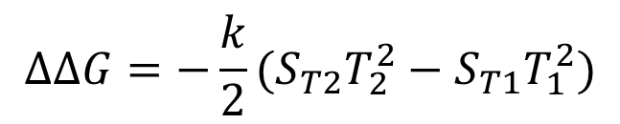
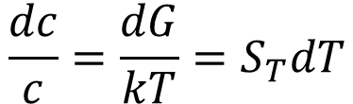
results summary & outlook acknowledgement
Protein-ligand systems
Combining ITC and TDFRS measurements
change of solvation free energy between T1 and T2
ΔG_{T1}
+
TDFRS
$$∆G_{T2}=∆G_{T1}+∆∆G_{SB}−∆∆G_{B}−∆∆G_{S}$$
ΔΔG_{B}
ΔΔG_{S}
ΔΔG_{SB}
When concentration and temperature differences are small;
ΔG_{T2}
$$\frac{dc}{c}=\frac{dG}{kT}=S_{T}dT$$
+
$$∆∆G=−\frac{k}{2}(S_{T2}T_{2}^{2}−S_{T1}T_{1}^{2})$$
free energy change due to ligand binding
ITC
  A. Würger, Cr Mecanique 341, 438 (2013).
D. Niether, 2018, Thermophoresis of biological and biocompatible systems

Slide 15
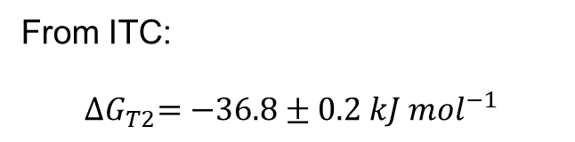
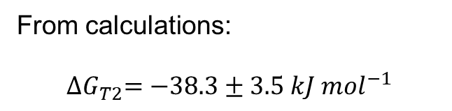


results summary & outlook acknowledgement
Protein-ligand systems
Combining ITC and TDFRS measurements :BCA II+4-FBS system
$$S_{T}^{4−FBS}=0.3159 K^{−1}$$
$$S_{T}^{BCA+4−FBS}=0.2546 K^{−1}$$
20 ºC
+
$${∆G}_{T1}=−37.2kJ {mol}^{−1}$$
From calculations:
$${∆G}_{T2}=−38.3±3.5 kJ {mol}^{−1}$$
$$S_{T}^{BCA}=0.1845 K^{−1}$$
BCA II
4-FBS
ΔΔG_{B}
ΔΔG_{S}
ΔΔG_{SB}
From ITC:
$${∆G}_{T2}=−36.8±0.2 kJ {mol}^{−1}$$
TDFRS
$$S_{T}^{BCA}=0.2405 K^{−1}$$
30 ºC
+
$${∆G}_{T2}=−36.8kJ {mol}^{−1}$$
$$S_{T}^{4−FBS}=0.3823 K^{−1}$$
$$S_{T}^{BCA+4−FBS}=0.29115 K^{−1}$$
ITC
Notes:
So we calculated dG using this equation and it was within the error limits and in terms with what we got from ITC.

Slide 16
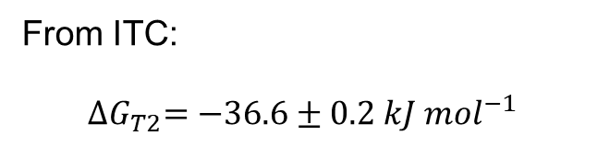
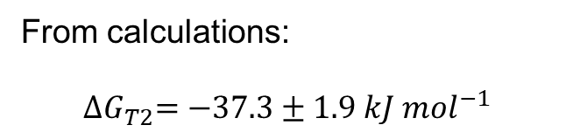


results summary & outlook acknowledgement
Protein-ligand systems
Combining ITC and TDFRS measurements :BCA II+PFBS system
$$S_{T}^{PFBS}=0.3396 K^{−1}$$
$$S_{T}^{BCA+PFBS}=0.2454 K^{−1}$$
20 ºC
+
$${∆G}_{T1}=−36.9kJ {mol}^{−1}$$
From calculations:
$${∆G}_{T2}=−37.3±1.9 kJ {mol}^{−1}$$
$$S_{T}^{BCA}=0.1845 K^{−1}$$
BCA II
PFBS
ΔΔG_{B}
ΔΔG_{S}
ΔΔG_{SB}
From ITC:
$${∆G}_{T2}=−36.6±0.2 kJ {mol}^{−1}$$
TDFRS
$$S_{T}^{BCA}=0.2405 K^{−1}$$
30 ºC
+
$${∆G}_{T2}=−36.6kJ {mol}^{−1}$$
Still needs to be validated for other systems!
$$S_{T}^{PFBS}=0.36335 K^{−1}$$
$$S_{T}^{BCA+PFBS}=0.3067 K^{−1}$$
ITC

Slide 17
results summary & outlook acknowledgement
conclusion
Combining ITC and TDFRS measurements
Preliminary study on the complex formation of BCA II with fluorinated ligands
Temperature dependence of S_{T} shows that complex is less hydrophilic compared to free protein
Free energy of binding(ΔG) determined using ITC and calculated from TDFRS measurements agree within the error limits.

Slide 18


acknowledgement
acknowledgement
Simone Wiegand, Jan K.G. Dhont and the whole IBI-4
Doreen Niether, IEK-8
Thank you and Stay Healthy

Slide 19
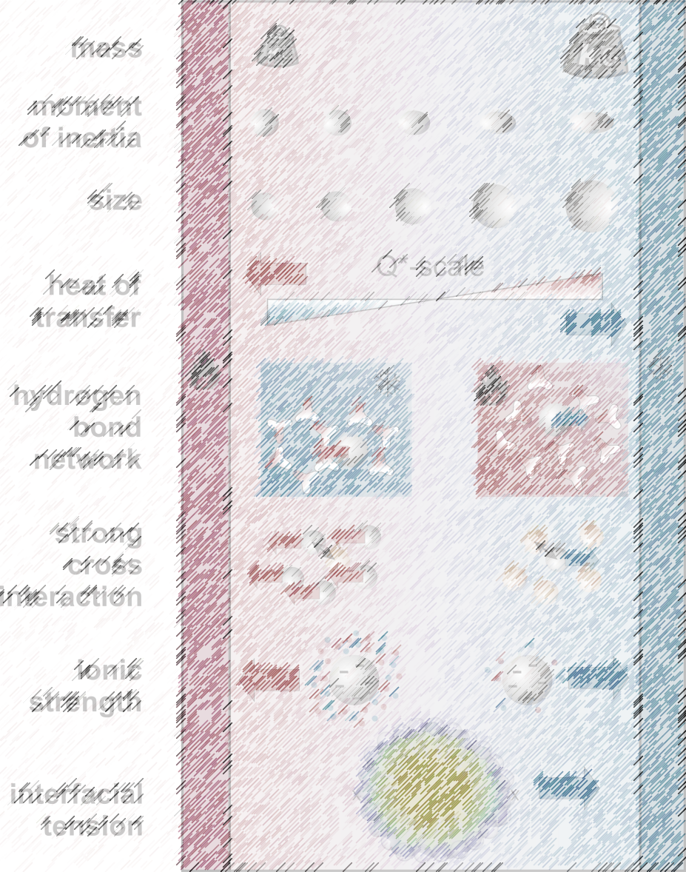
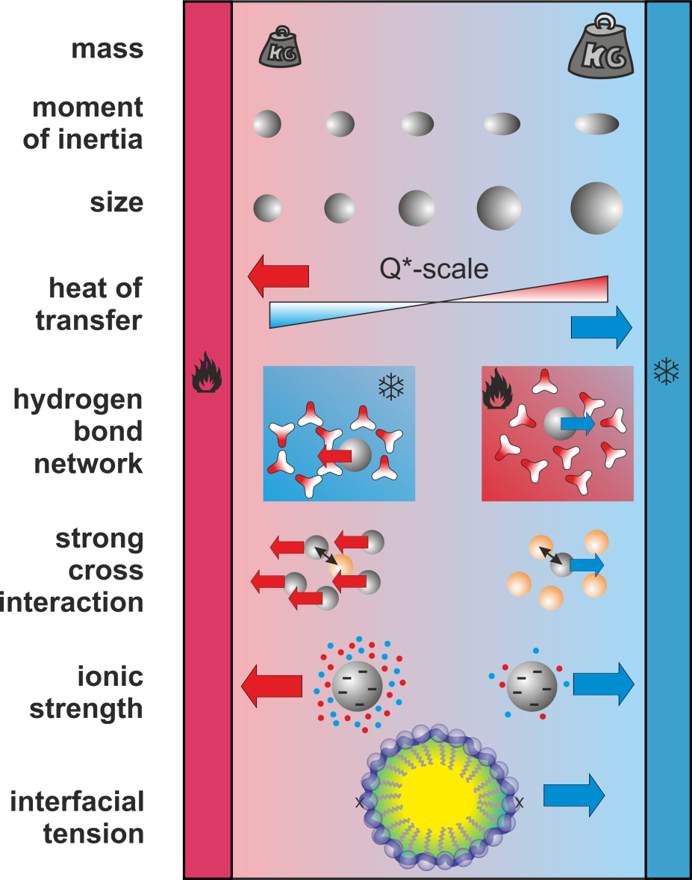

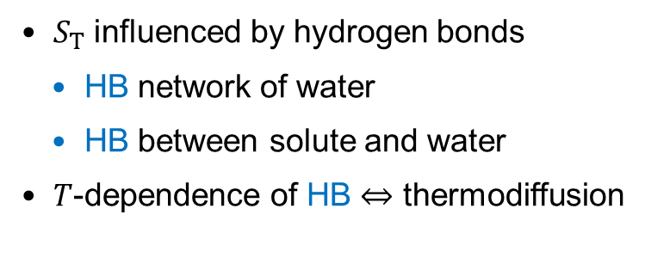


Contributions
 introduction studied systems results summary & outlook acknowledgement
$$S_{T}≈S_{T}^{i}+S_{T}(\text{H}\text{−}\text{bond})+ S_{T}(\text{ionic})$$
$$S_{T}^{chem}$$
$S_{T}$(ionic solutes)
$S_{T}$ influenced by hydrogen bonds
  HB network of water
  HB between solute and water
$T$-dependence of HB ⇔ thermodiffusion
Notes:
ST has contributions from mass, moment of inertia(conc and tem dep terms) and then from conc and temp independent terms. Especially in aqueous systems these comes into picture. Then there are hydrogen bonds networks, ionic interactions and cross interactions. So the question is can the contribution of hydrogen network be really separated from that of ionic effect?

Slide 20
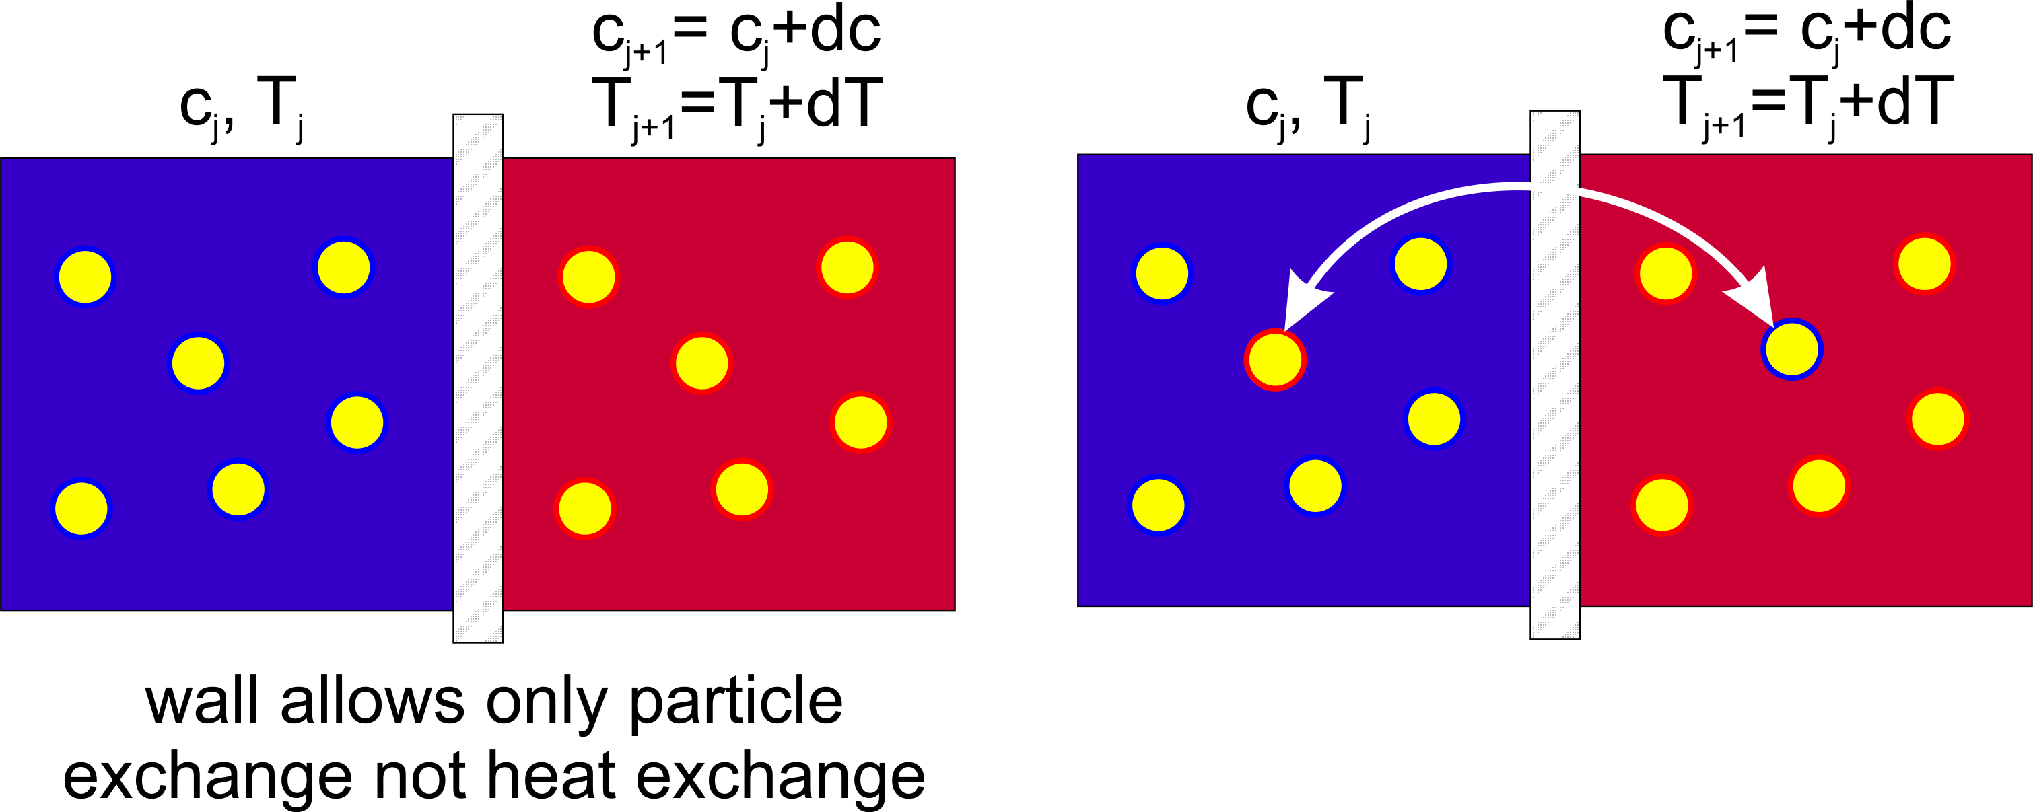
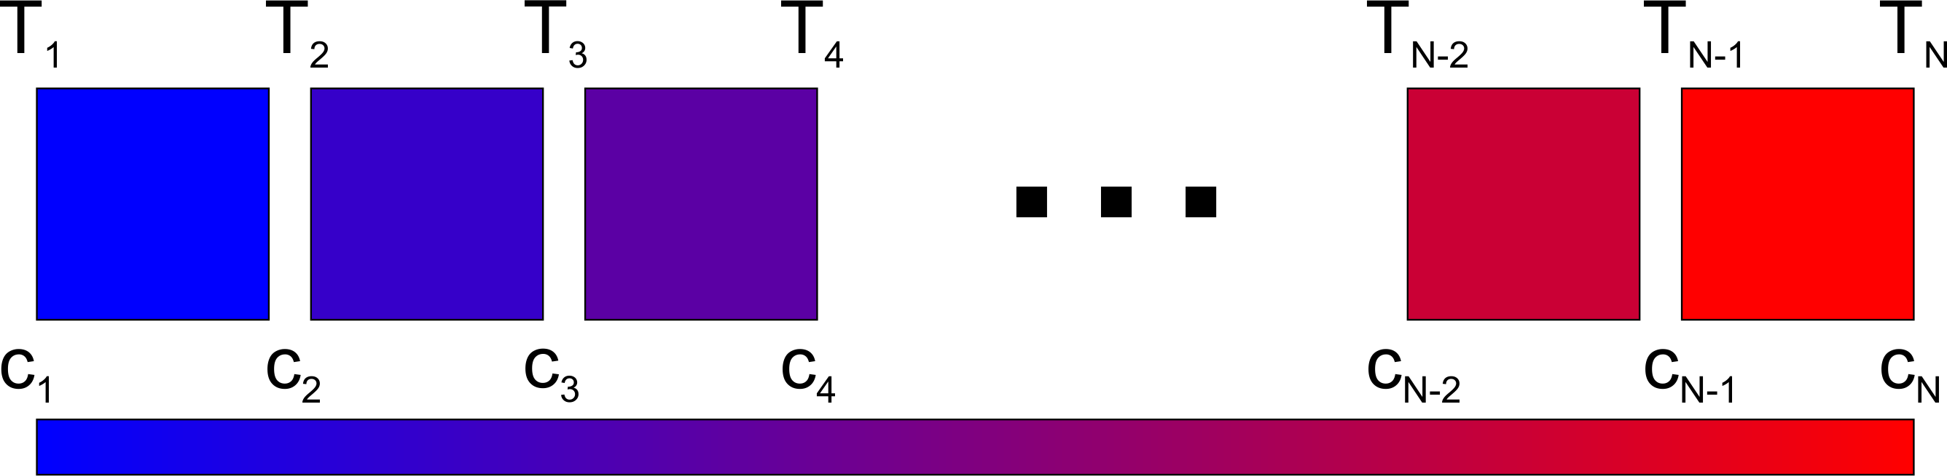
results summary & outlook acknowledgement
Eastman
Series of heat reservoirs differing infinitesimally in temperature
Thermodynamics of non-isothermal systems
  E. D. Eastman, J. Am. Chem. Soc. 48, 1482 (1926).
  E. D. Eastman, J Am Chem Soc 50, 292 (1928).
  E. D. Eastman, J Am Chem Soc 50, 283 (1928).
  A. Würger, Cr Mecanique 341, 438 (2013).
Eastman …
calculates the entropy of transfer S* (unknown)
replaces S* by the Soret coefficient S_{T} (unknown)
Identifies it with the single-particle entropy S
Notes:
The chemical potential µ_i may be thought of as the increase in the free energy of the system, when one mole of component I is added to an infinitely large quantity of the mixture so that it does not significantly change the overall composition

Slide 21
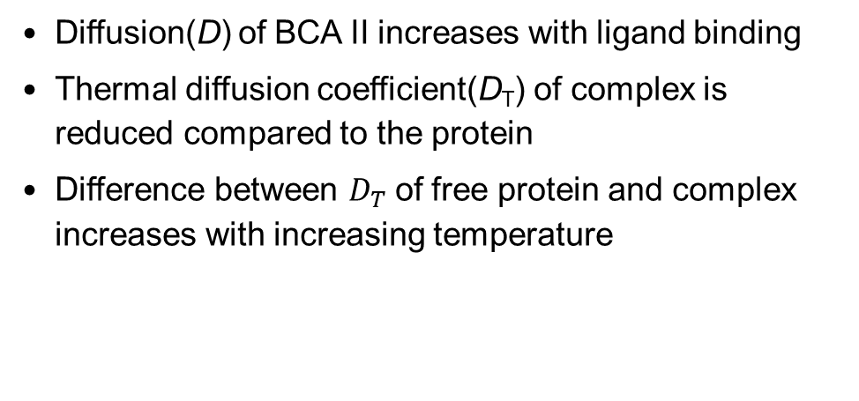
results summary & outlook acknowledgement
Protein-ligand systems
Bovine Carbonic Anhydarse II + 4-FBS
Diffusion(D) of BCA II increases with ligand binding
Thermal diffusion coefficient(D_{T}) of complex is reduced compared to the protein
Difference between $D_{T}$of free protein and complex increases with increasing temperature

Slide 22
results summary & outlook acknowledgement
Protein-ligand systems
Bovine Carbonic Anhydarse II + PFBS
Notes:
There are hydrophilic , hydrophobic and charged groups present for both proteins and ligands. Proteins and ligands are studied in buffer solutions which are basically salt in solutions. So when a ligand binds with protein, there are lot of changes that happens in hydration layer, conformation of the protein etc. So in order to solve this complex problem,

Slide 23
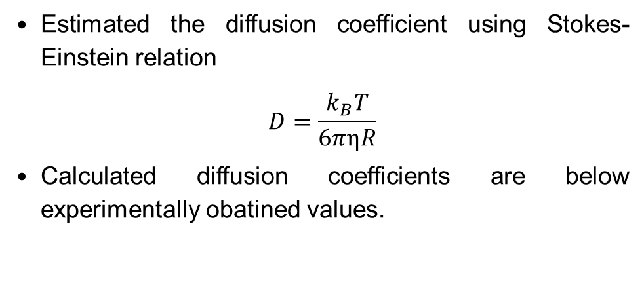
results summary & outlook acknowledgement
Protein-ligand systems
Diffusion coefficient
Estimated the diffusion coefficient using Stokes-Einstein relation
$$D=\frac{k_{B}T}{6πηR}$$
Calculated diffusion coefficients are below experimentally obatined values.
D. Niether et al., Polymers. 2020, 12, 376
.

Slide 24
results summary & outlook acknowledgement
BCA II + Sulfonamides
Effect of fluorination
fluorination
Log P
ΔS_{T}(ΔT)
Strength of HB network
Effect of fluorination was validated from TDFRS measurements!
V. M. Krishnamurthy et al., Chem. Asian J. 2007, 2, 94 – 105

