Slide 1

Statistical Downscaling of Surface Temperature and Precipitation with Deep Neural Networks
B.Gong, M. Langguth, Y. Ji, A. Mozaffari, K. Mache and M. G. Schultz
2022-06-27 I Bing Gong & Michael Langguth | Jülich Supercomputing Centre (JSC)

Slide 2
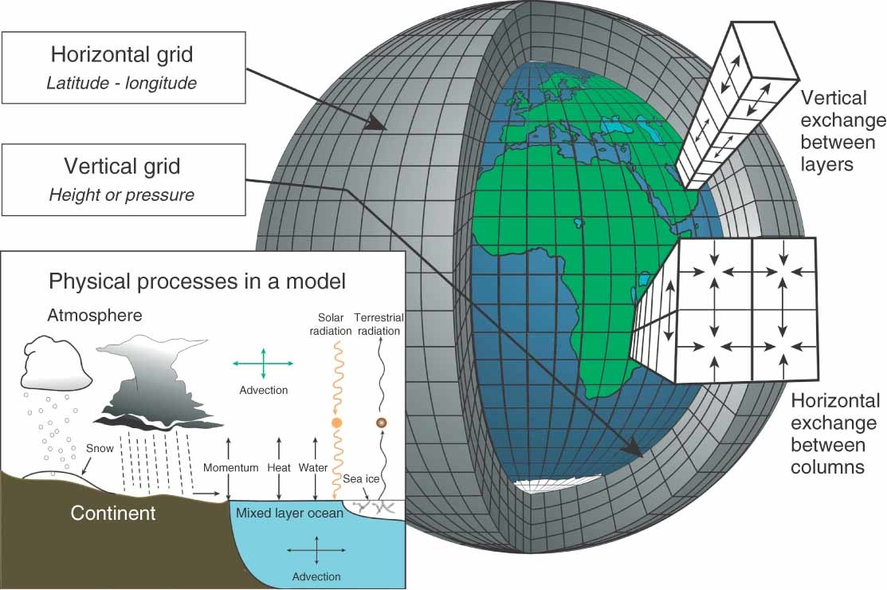
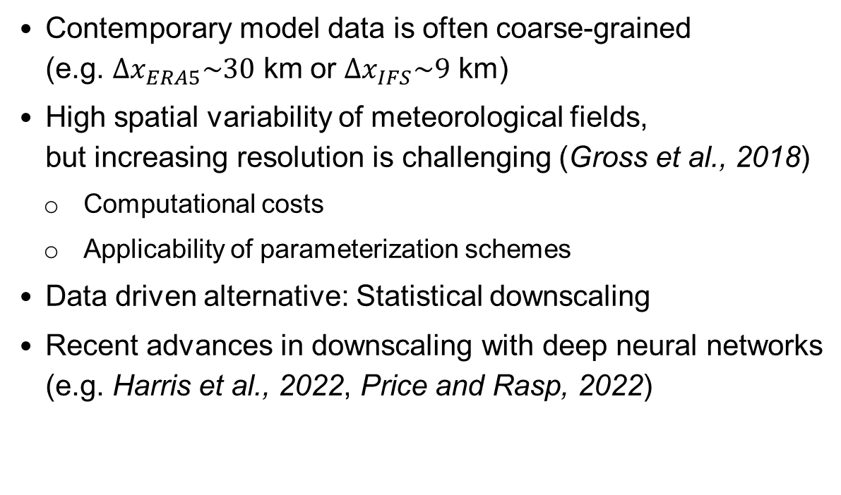
MOTIVATION
Why do we need statistical downscaling?
Contemporary model data is often coarse-grained
(e.g. $∆x_{ERA5}\sim 30$ km or $∆x_{IFS}\sim 9$ km)
  High spatial variability of meteorological fields,
  but increasing resolution is challenging (Gross et al., 2018)
    Computational costs
    Applicability of parameterization schemes
Data driven alternative: Statistical downscaling
Recent advances in downscaling with deep neural networks
(e.g. Harris et al., 2022, Price and Rasp, 2022)
Visualization of a Cartesian grid in an atmospheric model including a sketch of parameterized
(sub-grid scale) processes (from Edwards, 2011).

Slide 3
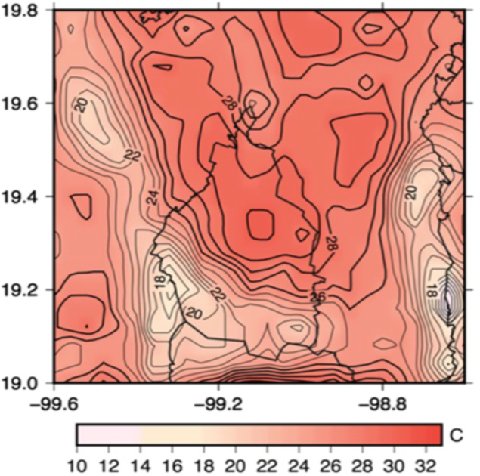

MOTIVATION
What is the motivation for our target variables?
Here: downscaling of hourly 2m temperature [T(2m)] and hourly precipitation
2m temperature with high spatial variability…
  … in presence of complex topography
  … near coastlines
Adverse effects of T(2m) variability (e.g. Sheridan, 2019)
  Local nightly frost
  Local heat stress
90th percentile of $T_{max}$ for Mexico City as an example of local heat stress over complex terrain (Vargas and Magana, 2020).

Slide 4
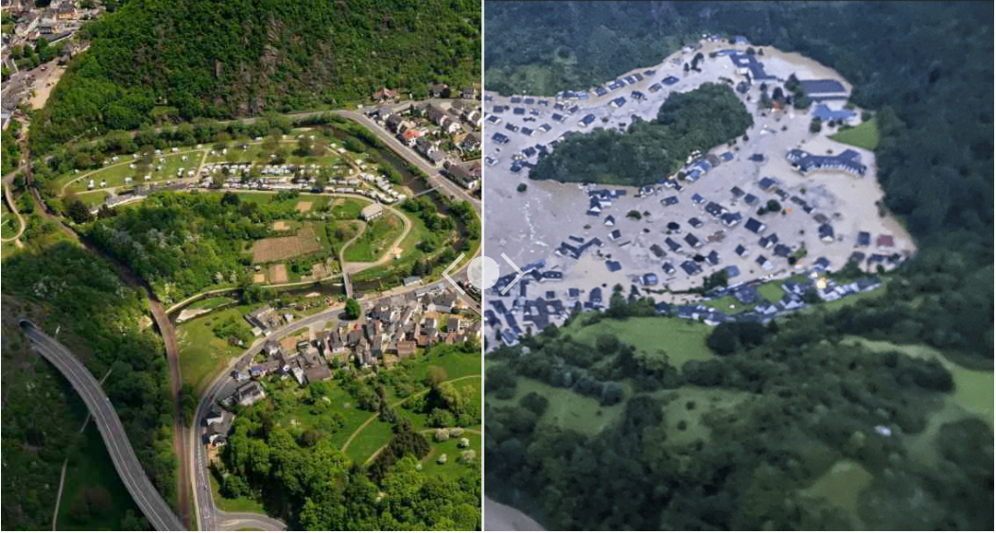
MOTIVATION
What is the motivation for our target variables?
Here: downscaling of hourly 2m temperature [T(2m)] and
hourly precipitation
Precipitation with high spatial variability…
  … in presence of complex topography
  … during convective weather conditions
Adverse effects of strong precipitation events
due to flooding events
  Damage to infrastructure
  Risk of death for humans etc.
Flooded Ahr valley (right) on 2021-07-15. Source: info:bild.de

Slide 5

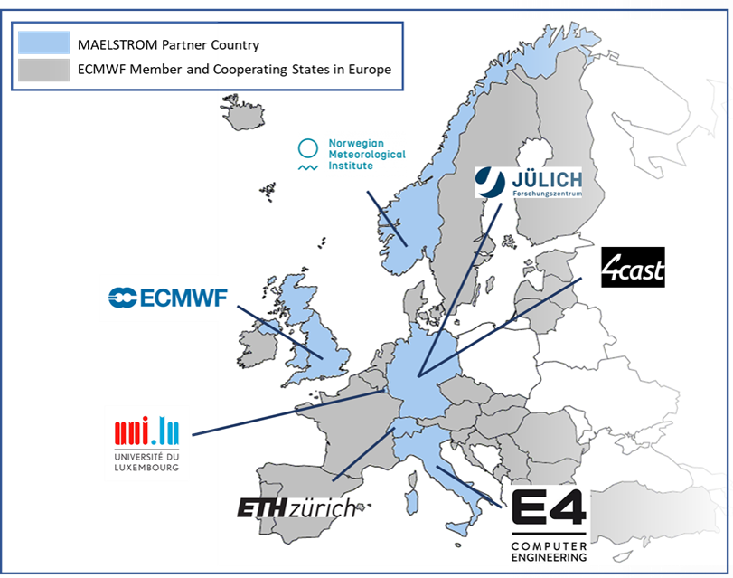
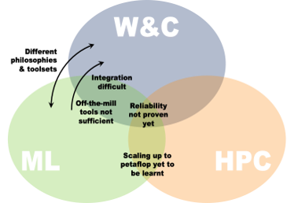
The MAELSTROM PROJECT
Visit the
MAELSTROM
webpage
A brief overview on the applications in WP1
Acronym for MAchinE Learning for Scalable
meTeoROlogy and cliMate
Coordinated by ECMWF with European-wide partners (Apr’21 – Apr’24)
Objective: efficient use of new ML capacities on supercomputers for the Weather and Climate community
Applications in WP1:
  Blend citizen observations and NWP data
  Incorporate social media data into predictions
  Develop neural network emulators for NWP models
  Improve ensemble predictions
  Improve local prediction → Statistical downscaling
  Support energy production with bespoke forecasts
Interacting domains in the MAELSTROM project.
Map which shows the headquarters of all partners of the MAELSTROM consortium.

Slide 6
OUTLINE
Two downscaling tasks
2m temperature downscaling (Michael Langguth)
Precipitation downscaling (Bing Gong)

Slide 7
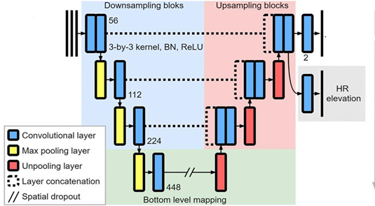
2m temperature DOWNSCALING
Visit the
MAELSTROM
webpage
A first ML solution on a test dataset
Pure downscaling of coarsened IFS forecasts
(0.8° → 0.1°) with a U-Net following Sha et al., 2020
Data from summer season (Apr – Sep) and around noon (10 – 16 UTC) only
Target domain size: 128x96 grid points
Dataset with simple data augmentation:
  Training: 2016-2019 → 20496 samples (~7.5 GB)
  Validation + Testing: 2020 → 640 samples
Published via pip-module climetlab-maelstrom-downscaling
LR T(2m)
LR elevation
HR
T(2m)
U-shaped encoder-decoder network (U-Net) used for
downscaling of T(2m). Trainable parameters: ~3 M.
Adapted from Sha et al., 2020.

Slide 8
2m temperature DOWNSCALING
Visit the
MAELSTROM
webpage
A first ML solution on a test dataset
Benchmarking results (see also MAELSTROM deliverable 3.4):
A100 GPUs on Juwels Booster
V100 GPUs on Juwels Cluster

Slide 9
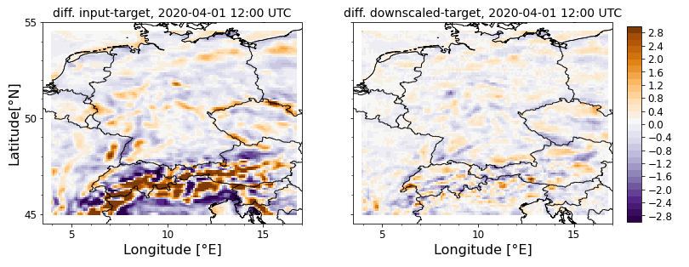
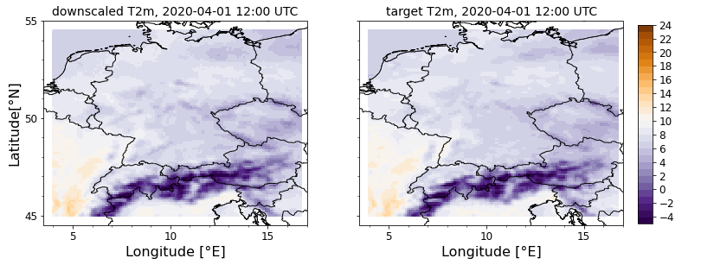
2m temperature DOWNSCALING
Visit the
MAELSTROM
webpage
A first ML solution on a test dataset
Evaluation results (see also MAELSTROM deliverable 1.1 or Jupyter Notebook):
U-Net captures variability due to topography

Slide 10
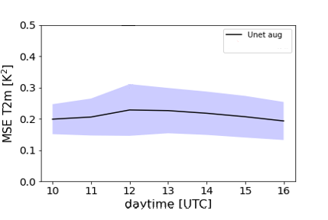
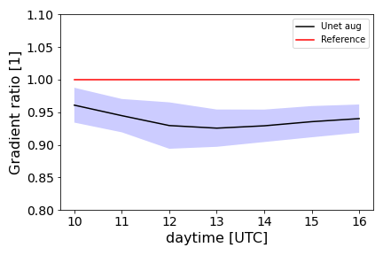
2m temperature DOWNSCALING
Visit the
MAELSTROM
webpage
A first ML solution on a test dataset
Evaluation results (see also MAELSTROM deliverable 1.1 or Jupyter Notebook):
Further issues:
  ‘Synthetic’
  downscaling task
  No model bias correction
  Bound to specific
  daytimes and season
  Underestimated local spatial variability (horizontal gradient)
  Low and consistent MSE

Slide 11
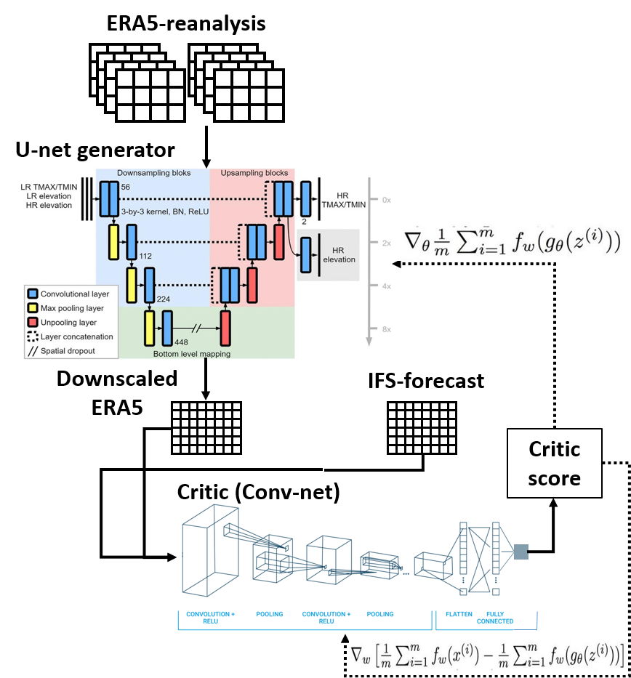
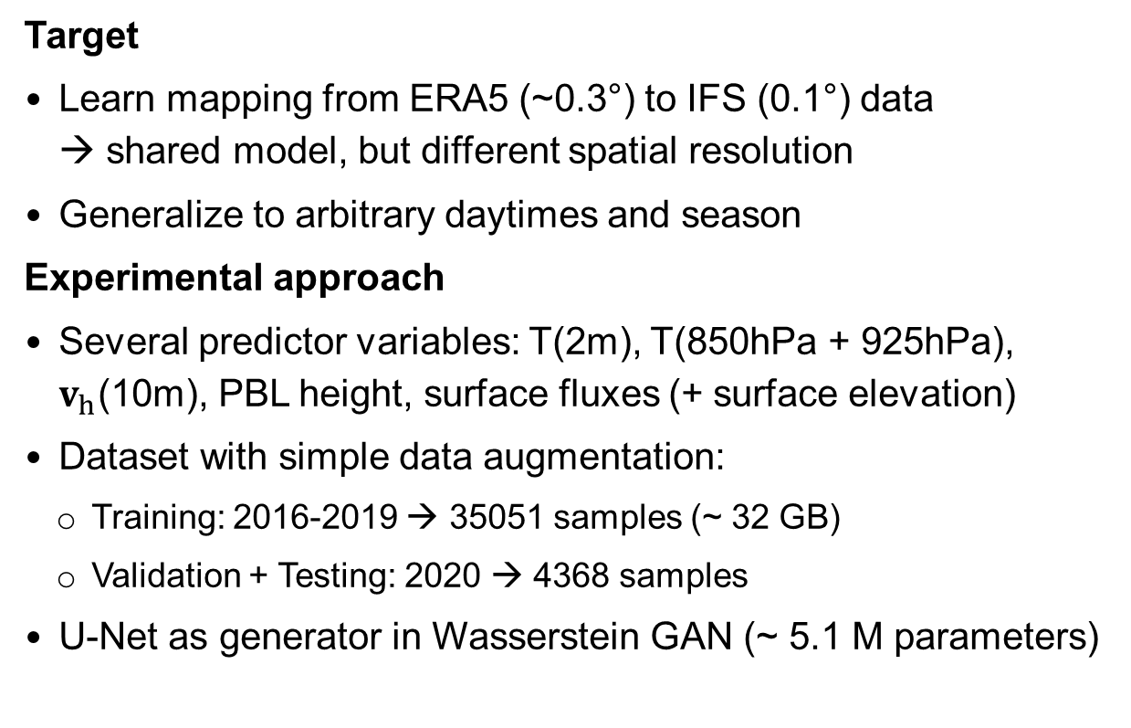
2m temperature DOWNSCALING
Towards a real downscaling task
WGAN model
architecture
Target
Learn mapping from ERA5 (~0.3°) to IFS (0.1°) data
→ shared model, but different spatial resolution
Generalize to arbitrary daytimes and season
Experimental approach
Several predictor variables: T(2m), T(850hPa + 925hPa), $v_{h}$(10m), PBL height, surface fluxes (+ surface elevation)
Dataset with simple data augmentation:
  Training: 2016-2019 → 35051 samples (~ 32 GB)
  Validation + Testing: 2020 → 4368 samples
U-Net as generator in Wasserstein GAN (~ 5.1 M parameters)

Slide 12
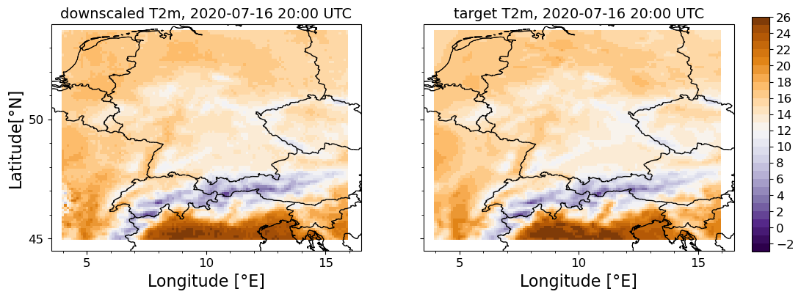
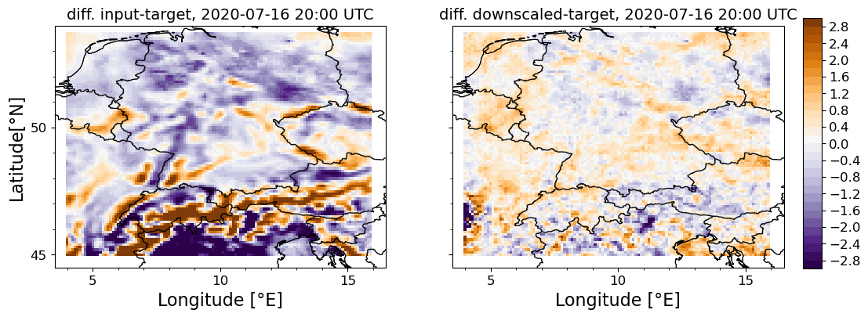
2m temperature DOWNSCALING
Preliminary results of the WGAN
Evaluation results (no benchmarking yet):
WGAN captures variability due to topography
Some indications for bias correction

Slide 13
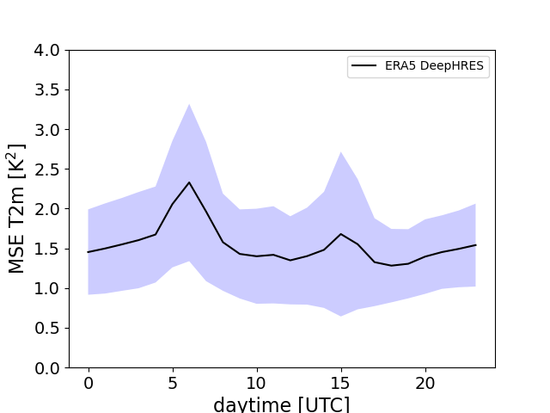
2m temperature DOWNSCALING
Preliminary results of the WGAN
Overall MSE tracks high
Major problems in the morning hours

Slide 14
OUTLINE
Two downscaling tasks
2m temperature downscaling (Michael Langguth)
Precipitation downscaling (Bing Gong)

Slide 15
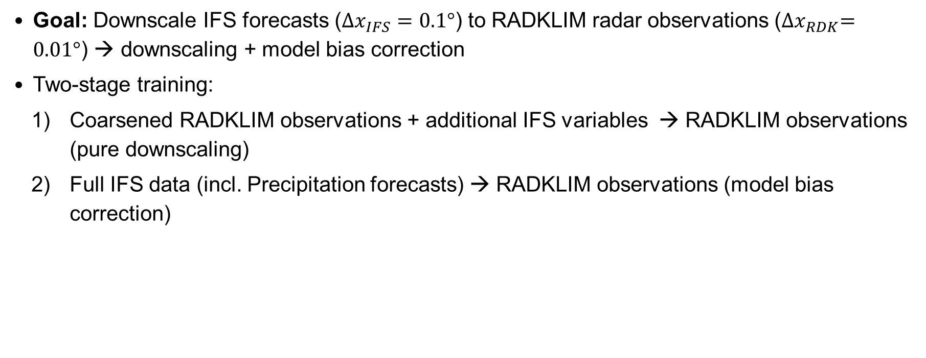
Precipitation downscaling
Research Target
Goal: Downscale IFS forecasts ($∆x_{IFS}=0.1°$) to RADKLIM radar observations (${∆x}_{RDK}=0.01°$) → downscaling + model bias correction
Two-stage training:
  Coarsened RADKLIM observations + additional IFS variables → RADKLIM observations (pure downscaling)
  Full IFS data (incl. Precipitation forecasts) → RADKLIM observations (model bias correction)

Slide 16
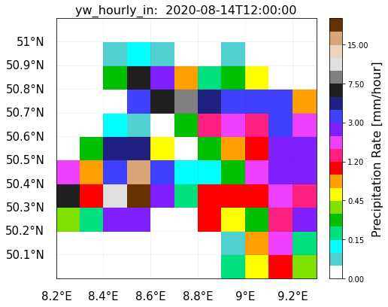
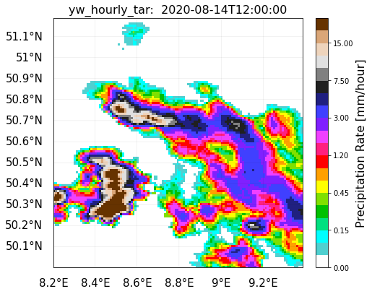
Precipitation downscaling
Research Target
Domain of interest: Germany
One training region, i.e. no patching yet
Low resolution: 12 x 12 grid points
High resolution: 120 x 120 grid points
  7 - 18 hr forecasts from IFS 00 UTC and
  12 UTC runs.
  2017-2019 (training), 2016 (validation), 2020 (testing)
  23,897 training samples
Inputs
Target

Slide 17
Precipitation downscaling
Research Target
To be added in the future:
Current input variables (Harris et al., 2022)
  Coarsened RADKLIM observations
  Surface pressure
  TOA incident solar radiation
  Convective available potential energy
  Total column cloud liquid water
  Total column water vapour
  u&v-wind components (horizontal wind)
  Vertical wind at 700 hPa
Grid-scale precipitation
Convective precipitation
Constant variables:
  Orogrpahy
  Land-sea mask

Slide 18
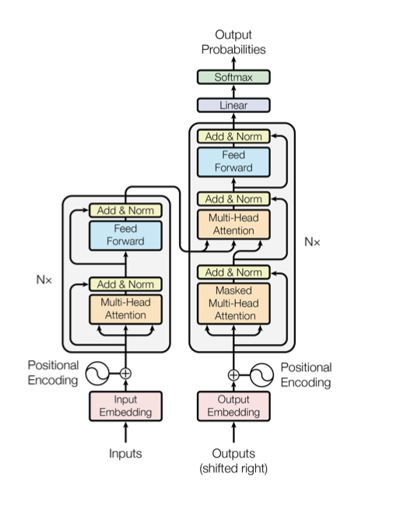
Precipitation downscaling
Transformer
Why do we need Transformer:
Leinonen et al, 2021: One variable (coarsened observation) with temporal recurrency.
Harris et al., 2022 : 12 input variables without temporal component
  Multiple variables + recurrency → computational constraints
Recurrent Neural Network
  memory consumption
  model long-range dependencies in the data
  No (straightforward) parallelization
Vaswani et al., 2017

Slide 19
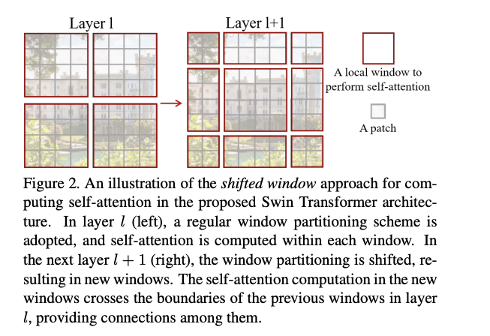
Precipitation downscaling
Transformer
  Swin Transformer (Liu et al., 2021) → New Backbone for vision tasks
    Construct a hierarchical representation feature maps
    Leverage the function of CNN-based architecture, e.g. U-Net
  Better speed-accuracy trade-off compare to ConvNets in computer vision tasks (Liu et al., 2021)
  Can we achieve a better speed-accuracy with Swin Transformer for downscaling of atmospheric data?
  From Liu et al., 2021.

Slide 20
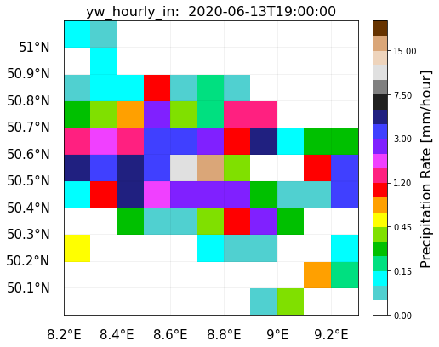
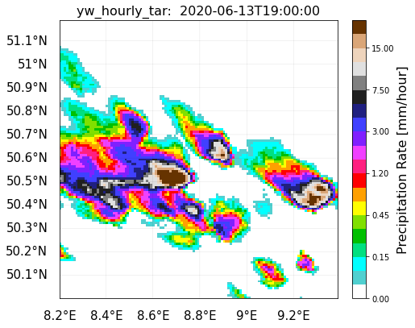
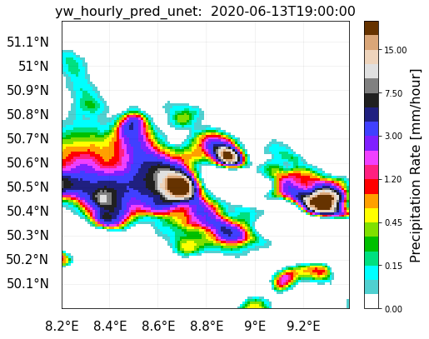
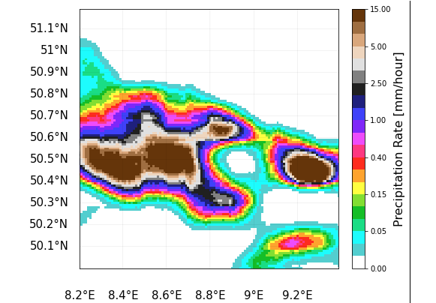
Primary results
Input
Target
A snapshot
    U-Net and SwinIR (Liang et al., 2021) can add fine-scale structure to precipitation field
    But both fields are too smooth (lack of spatial variability), especially for SwinIR
    Heavy precipitation is over-estimated by SwinIR (significant bias)
UNet
SwinIR

Slide 21
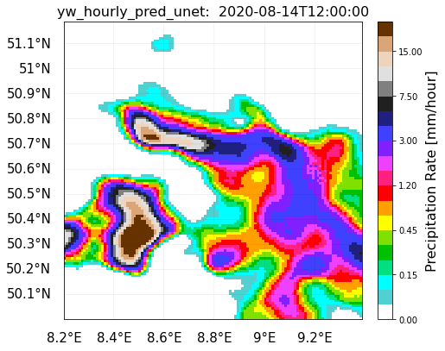
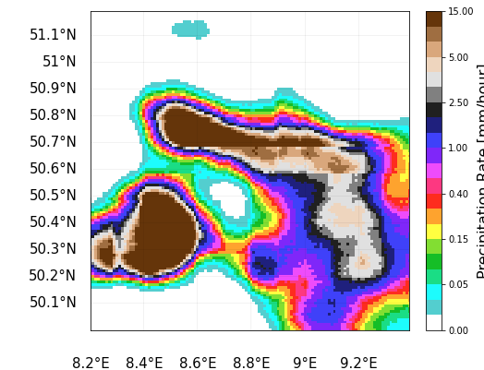
Primary results
Input
Target
A snapshot
    U-Net and SwinIR (Liang et al., 2021) can add fine-scale structure to precipitation field
    But both fields are too smooth (lack of spatial variability), especially for SwinIR
    Heavy precipitation is over-estimated by SwinIR (significant bias)
    Further fine-tuning of SwinIR required
UNet
SwinIR

Slide 22
Outlook
Visit the
MAELSTROM
webpage
The upcoming steps
Improve the neural networks
  Finetune WGAN and Swin Transformer for downscaling
  Comprehensive comparison between models
  Embed auxiliary predictors (daytime & season, land-sea mask and topography)
Stochastic forecasting, especially for precipitation
Add recurrency to Transformer-based downscaling model
Provide a benchmark dataset (ERA5, IFS and RADKLIM data)
  Application on different meteorological variables: T2m, hourly precipitation, but also horizontal wind
  and short-wave radiation

Slide 23



Visit the
MAELSTROM
webpage
Thanks for your attention!
The project is funded by the European Union’s Horizon 2020 research and innovation programme and the EuroHPC Joint Undertaking under Grant Agreement 955513 and co-funded by the German Ministry of Education and Research (BMBF) under funding reference 16HPC029.

Slide 24
References
Gross, Markus, et al. "Physics–dynamics coupling in weather, climate, and earth system models: Challenges and recent progress." Monthly Weather Review 146.11 (2018): 3505-3544. DOI.
Harris, Lucy, et al. "A Generative Deep Learning Approach to Stochastic Downscaling of Precipitation Forecasts." arXiv preprint arXiv:2204.02028 (2022). arXiv.
Leinonen, J., Nerini, D., & Berne, A. (2020). Stochastic super-resolution for downscaling time-evolving atmospheric fields with a generative adversarial network. IEEE Transactions on Geoscience and Remote Sensing, 59(9), 7211-7223. DOI
Liang, Jingyun, et al. "Swinir: Image restoration using swin transformer." Proceedings of the IEEE/CVF International Conference on Computer Vision. 2021. arXiV
Liu, Ze, et al. "Swin transformer: Hierarchical vision transformer using shifted windows." Proceedings of the IEEE/CVF International Conference on Computer Vision. 2021. arXiv.
Price, Ilan, and Stephan Rasp. "Increasing the accuracy and resolution of precipitation forecasts using deep generative models." International Conference on Artificial Intelligence and Statistics. PMLR, 2022. PMLR.

Slide 25
References
Sha, Yingkai, et al. "Deep-learning-based gridded downscaling of surface meteorological variables in complex terrain. Part I: Daily maximum and minimum 2-m temperature." Journal of Applied Meteorology and Climatology 59.12 (2020): 2057-2073. DOI.
Sheridan, Peter F. "Synoptic‐flow interaction with valley cold‐air pools and effects on cold‐air pool persistence: influence of valley size and atmospheric stability." Quarterly Journal of the Royal Meteorological Society 145.721 (2019): 1636-1659. DOI.
Vaswani, Ashish, et al. "Attention is all you need." Advances in neural information processing systems 30 (2017). arXiV

