Slide 1

Implementation of the EU-DEMO Exhaust Modelling Roadmap
S. Wiesen, L. Aho-Mantila, R. Osawa, F. Subba, M. Siccinio, F. Maviglia, M. Coleman, F. Koechl, H. Zohm, M. Bernert, S. Brezinsek, S. Dasbach, A. Kit, D. Matveev, J. Romazanov, M. Wischmeier
and the EUROfusion DEMO central team (DCT)

Slide 2
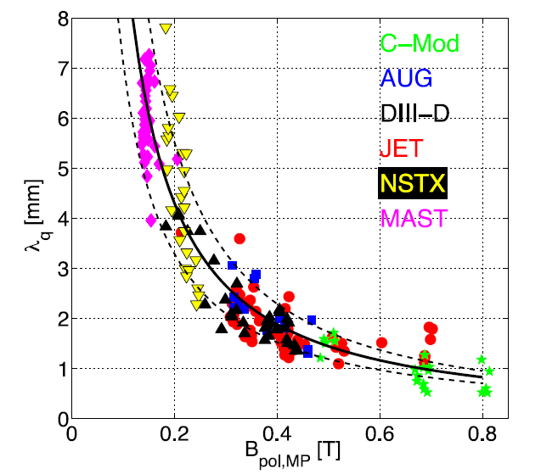

Power exhaust in a nutshell
$$λ_{q}\sim \frac{1}{B_{p}}$$
ITPA Database,
T. Eich et al NF 2013
Faitsch 2020
From the λ_{q}-scaling: upstream q|| ~ 30 GW/m² in DEMO (6 x higher than ITER)
→ Unmitigated q⊥^{target}: 300 MW/m² for DEMO + radiation, neutrals, surface recombination
→ Clearly exceeds the tolerable material limit q⊥^{max} of 5-10 MW/m² (actively cooled W-PFC).
Achievable radiation
in SOL:
DEMO: 30% radiation in core → XPR
… or other exhaust improved scenarios

Slide 3
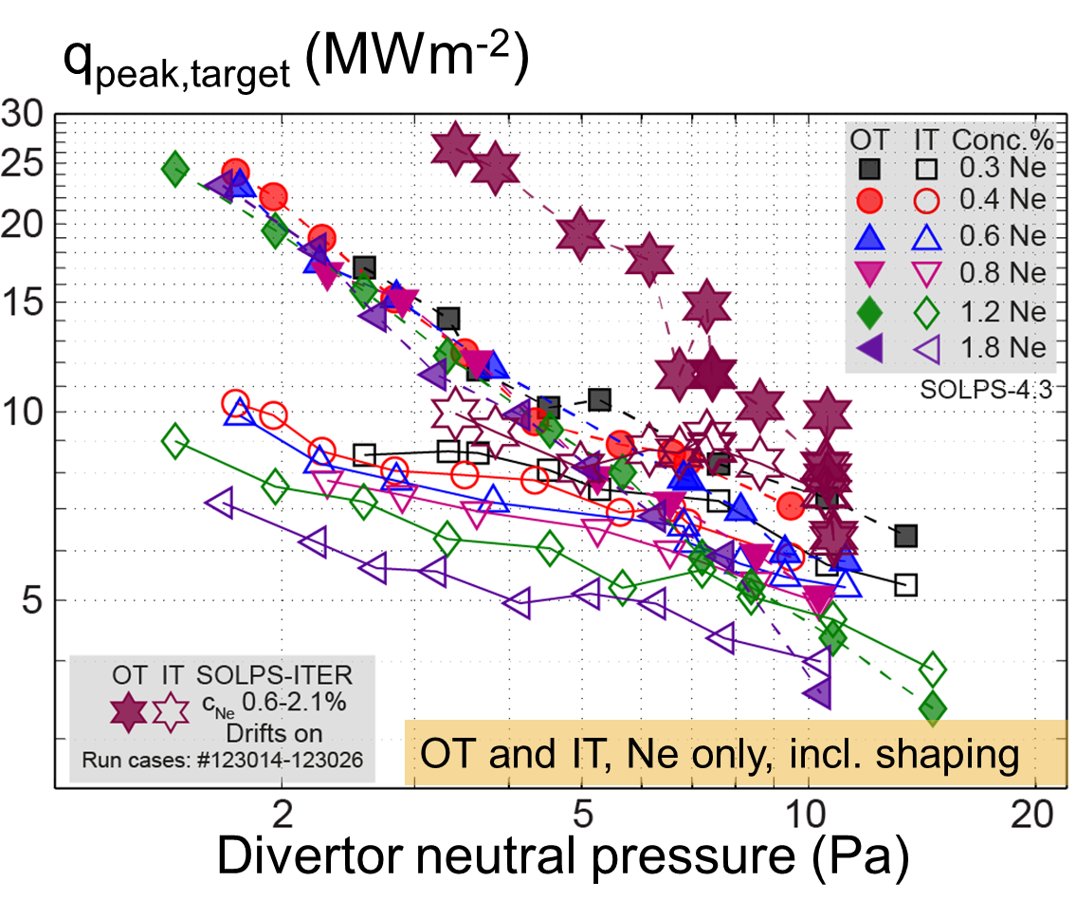
Baseline SOLPS-ITER fluid-kinetic model of EU DEMO divertor design
Role-model
SOLPS-ITER D+He+Ar EU-DEMO reference, 21MA/4.9T scenario (2017), R=9m
76% of P_{SOL} = 150MW dissipated by Ar radiation, f_{GW}= 0.42
HFS fully detached
LFS partial detachment
No XPR exposed
→ 2022: Scans of p_{0,div} and c_{Ar} to assess operational window
ITER
W/m³
P_{rad}
q_{LFS}
R.A. Pitts, et al, NME 2019
F. Subba et al NF 2020

Slide 4
EU DEMO Roadmap 2022-2024
SOLPS-ITER, SN, D + He + Ar
Numerics:
Grid convergence tests
Revised impurity model,
imp. CX processes, XPR regime
Fluid drifts
SOL currents
Kinetic neutrals
Fluid neutrals
Calibration
fluid neutral model
Transport assessment
A) λ_{q}~3mm (ITER like) B) λ_{q} > 3mm (e.g. QCE)
Geometry: SN Divertor Design, pumping, also: DDN topology & PWI

Slide 5
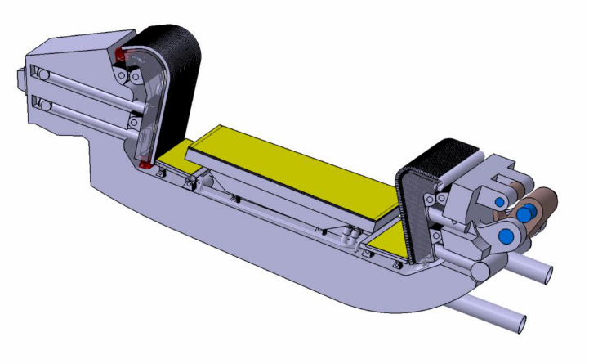
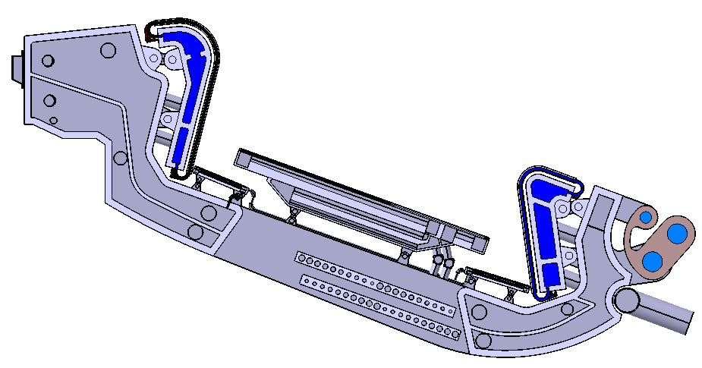
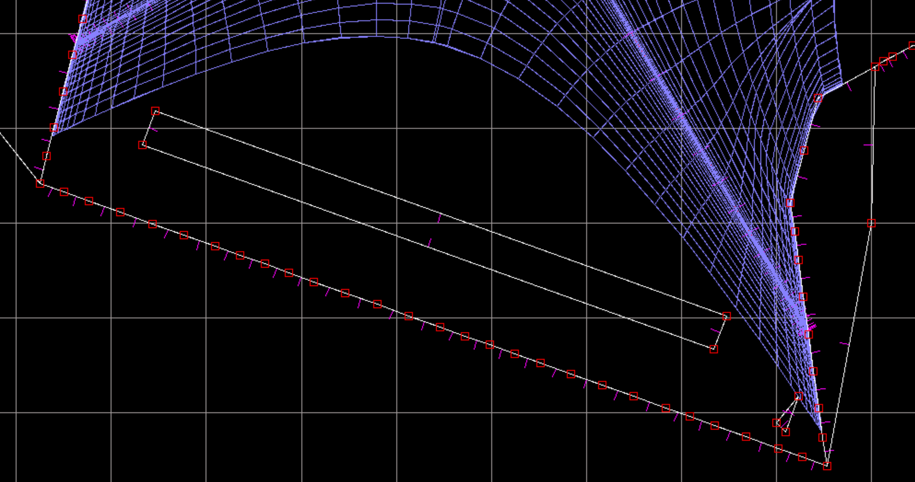
Review and design of EU DEMO divertor shape
Divertor Optimization
Shape & Engineering Systems
Inclusion of a liner, SOLPS-ITER being prepared
Assessment whether
in terms of operational regime,
the liner is advantageous w.r.t.
He-exhaust and divertor performance
(or otherwise too constraining in terms
of the operational window for p_{0,div})
→ 2022: further review of divertor structure and impact on plasma, e.g. heat loads, neutral conductance, pumping, fuelling, erosion pattern of liner, etc
F. Subba et al, P147(C)

Slide 6
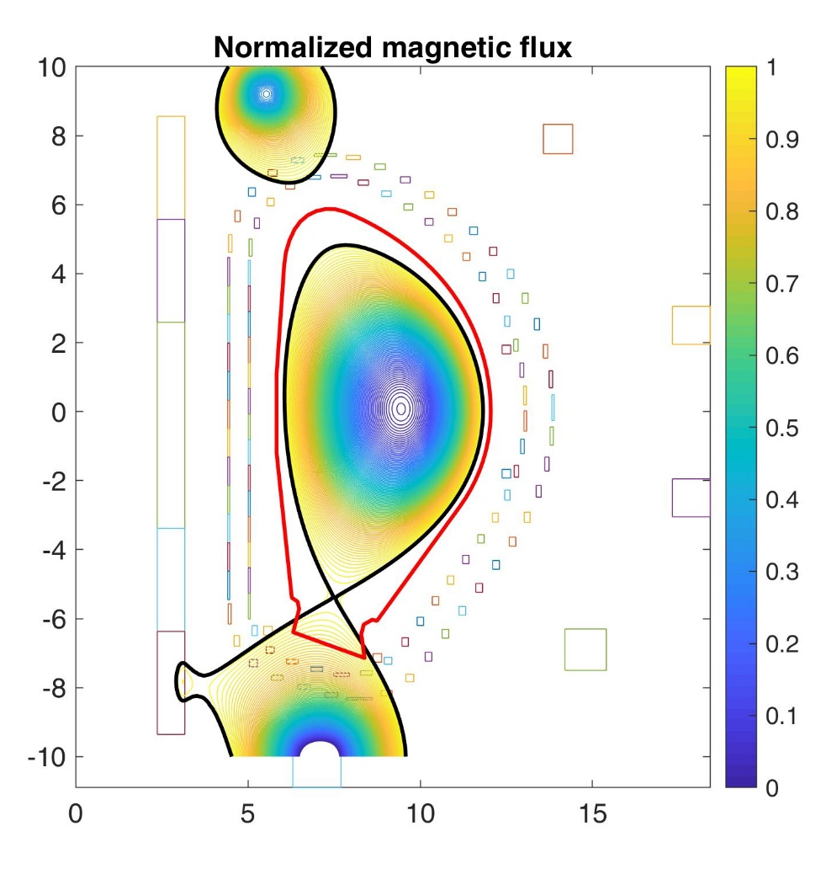
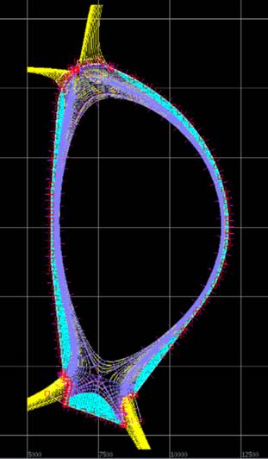
EU DEMO Assessment of FW PWI employing ERO2.0
Lifting the constraint of having the 2nd Xpoint not inside the vessel might provide flexibility to find an optimised (core) physics scenario, e.g high-δ, QCE
A quantitative assessment of the impact on PWI and DEMO FW
Requires extension of SOLPS-ITER simulation grid up to first wall
a) full extension, b) DDN topology (to include 2nd Xpoint)
Provide detailed plasma/neutral distributions to ERO2.0
Volumetric & Surface data, particle & heat fluxes, spectra, etc
(EUROfusion TSVV7)
dr_{sep}
~ 6cm
2021 equilibrium variant
Axis location: R=9.47 m, Z=0.06 m
Plasma current: 18.3 MA
B_{tor} on axis: 5.7 T
Courtesy
SOLPS-ITER grid, R. Osawa

Slide 7
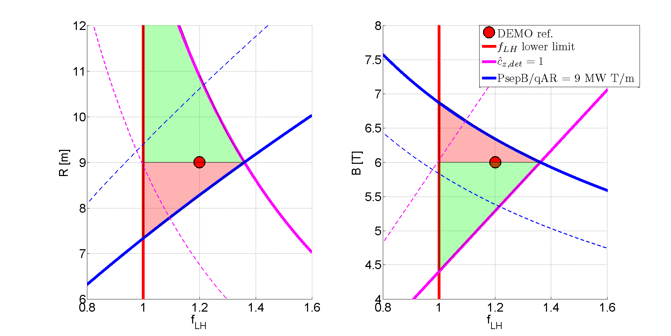
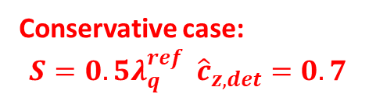
Towards Reduced Models → Rapid Design, Systems Codes & Control
Towards improved figure-of-merits for e.g. heat-flux (i.e. detachment) and c_{Z}
→ allows rapid design through systems code, e.g. radial builds, plant analysis, etc
Also: fast models needed for plasma control systems (PCS) in future devices
Current (reduced) models for exhaust based on incomplete scalings
→ Extensions of 0D/1D models calibrated or “trained” by high-fidelity models for the edge/SOL
Based on
Martin scaling for P_{LH}
Goldston & Reinke
Scalings for c_{Z} and λ_{q}
Conservative case:
$$S={0.5λ}_{q}^{ref} {\hat{c}}_{z,det}=0.7$$
Siccinio, NF 2019

Slide 8
Towards fast Integrated modelling; HFPS-type
Integrated Model based on Engineering Parameters
Existing (reduced) SOL models are only valid for low-density or are not sufficiently reproducing details, e.g. Lengyel model
→ requires calibration or extensions
c.f. A. Jaervinen, P027(G)
Existing pedestal models are quite “core-centric” e.g. include beta-dependence of pedestal width (e.g. EPED)
Q: how to deal with line radiation in pedestal required in DEMO, f_{rad,core} ~ 30% or high n_{sep} ?
Courstesy
T. Luda et al, NF2020, EPS 2022

Slide 9
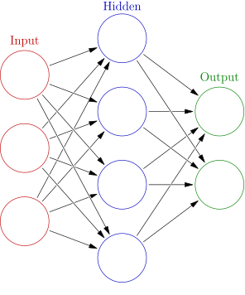
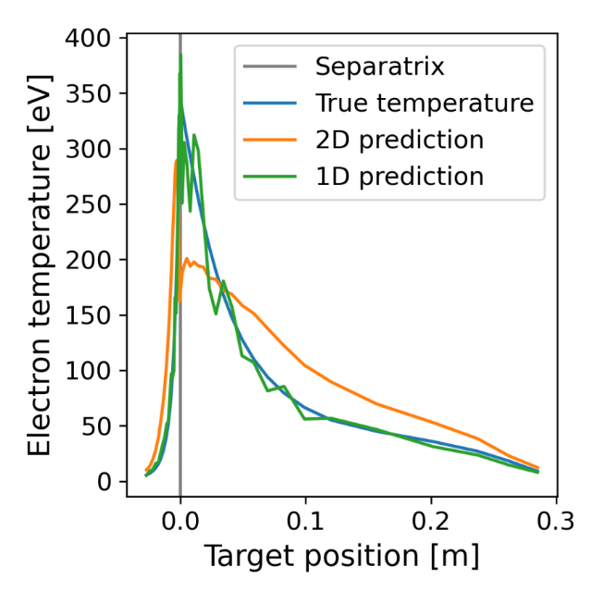
Towards fast NN based surrogate models for interpolation of tokamak edge plasmas
NN trained by using
data from SOLPS-ITER
baseline simulations with
fluid neutrals
S. Dasbach et al, P038(G)

Slide 10
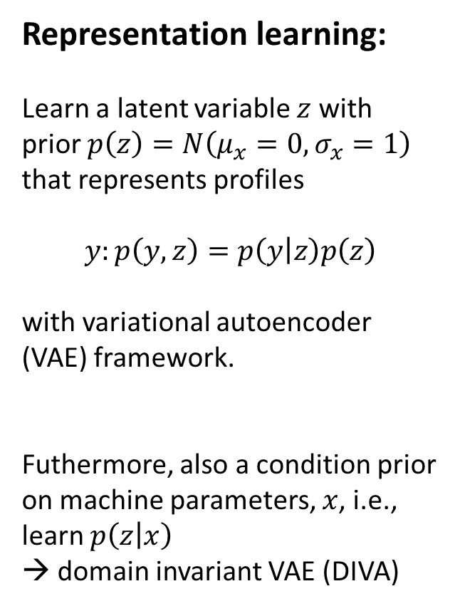
Developing deep learning algorithms for determining n_{e,sep}
Representation learning:
Learn a latent variable $z$ with
prior $p\left(z\right)=N\left(μ_{x}=0,σ_{x}=1\right)$
that represents profiles
$$y:p\left(y,z\right)=p\left(y | z\right)p\left(z\right)$$
with variational autoencoder
(VAE) framework.
Futhermore, also a condition prior
on machine parameters, $x$, i.e.,
learn $p\left(z | x\right)$
→ domain invariant VAE (DIVA)
NN Trained by using
Data from JET
Pedestal database
Frassinetti NF2021
A. Kit et al, P226(F)

Slide 11
Summary
The conceptional design phase for EU-DEMO implies a revision of the exhaust modelling roadmap until 2024.
For the purpose of identifying a controllable exhaust scenario to be employed in EU-DEMO, the required physics foundation of candidate regimes must be re-assessed by using validated numerical tools → SOLPS-ITER EU-DEMO database a la ITER
→ Towards revised physics model: fluid drifts and neutral kinetics, allowing for charge exchange for impurities enhancing non-coronal radiation levels in the edge.
A multi-fidelity approach advantageous to complement the final model to be composed for exploring the EU-DEMO exhaust operational window.
An integrated & optimised core-edge scenario is needed compatible to maintain energy dissipation fraction of up to 95% in the edge, of which 30% in core
→ extension of HFPS by integrating fast & calibrated exhaust models
Recent activities on development of fast NN-based surrogate exhaust models
→ promising and might become relevant for HFPS, fast PCS & systems codes

Slide 12
backup

Slide 13
Dissipation by radiation – tailoring of radiation field – the XPR
Various seeding impurities possible
N (div), Ne (SOL), Ar (SOL+ped), Kr (core), Xe
Xpoint Radiator (XPR), offers:
- full detachment
- large dissipation fraction (up to 100%)
- Controllability demonstrated (AUG, TCV)
- ELM suppressed regime accessible
- compatible with good confinement
ASDEX-Upgrade
stable controlled
N-seeding XPR
M. Bernert
T. Bosman
et al P037(G)
Gloeggler 2020
T. Pütterich, NF2019
S. Wiesen | IEK-4 Theory Seminar | Feb 17th , 2022| Page 13

Slide 14
Role Model: ITER Divertor Design studies: metal wall & SOLPS-ITER
control parameter 2
P_{SOL}=100MW
control parameter 1
R.A. Pitts, E. Kaveeva, V. Rozhanski, S. Wiesen, X. Bonnin et al, NME 2019

Slide 15

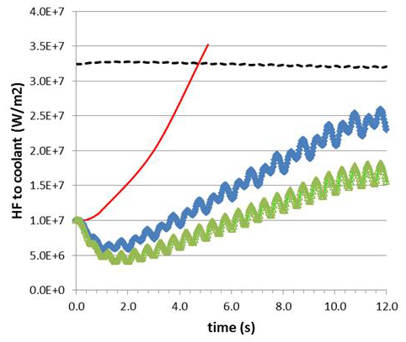
Re-attachment in DEMO
The maximum tolerable steady-state HF on the current DEMO SN divertor plate is 10-20 MW/m².
[J.H. You, G1 review mtg]
This value can be achieved only in detached plasma conditions (with seeded impurities).
In case of accidental divertor reattachment, the divertor reaches burn-out (leading to an in-vessel LOCA) in about 3 sec.
RACLETTE:
10s HF ramp 10..70 MW/m²
Siccinio, NF 2019
S. Wiesen | IEK-4 Theory Seminar | Feb 17th , 2022| Page 15

Slide 16
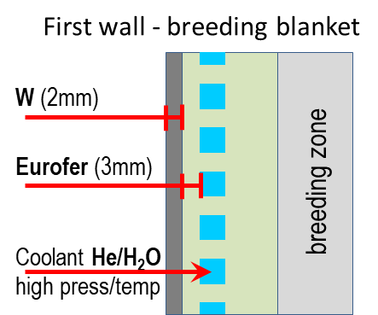
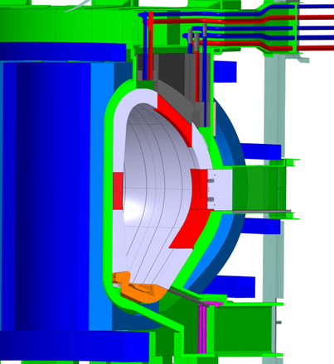
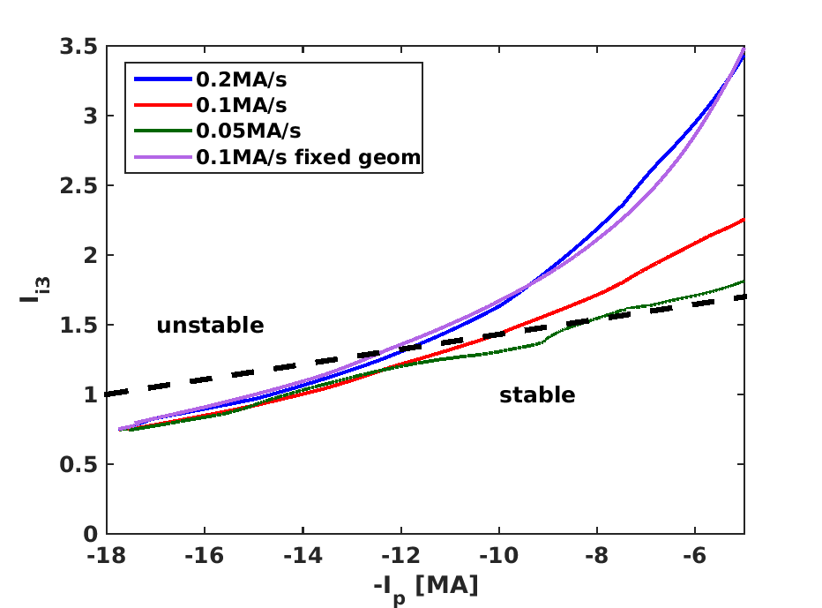
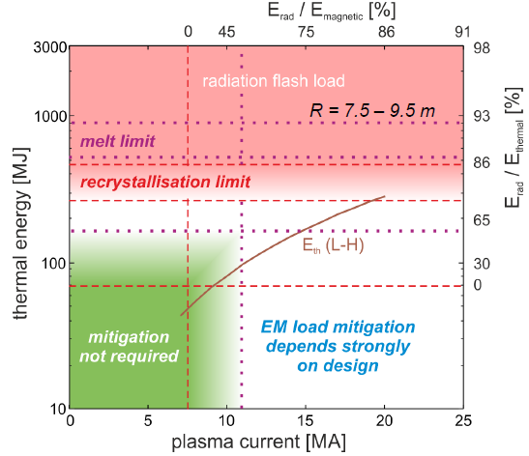
Re-attachment in DEMO
What about “fast termination”?
A fast plasma shutdown (like in ITER) at full current would pose unacceptable risks on the machine integrity [Maviglia, NME 2021],[Lehnen, IAEA 2016].
In parallel, the current cannot be ramped down faster than
~0.2 MA/s without losing vertical stability control.
(the increase of ramp down rate with the use of IVC is presently being investigated)
DEMO
ITER
[Lehnen, IAEA 2016]
[Siccinio, FED 2020]
S. Wiesen | IEK-4 Theory Seminar | Feb 17th , 2022| Page 16

Slide 17
Towards fast NN based surrogate models for interpolation of tokamak edge plasmas
NN trained by using
data from SOLPS-ITER
baseline simulations with
fluid neutrals
Also alternative approaches possible:
Surrogate kinetic models, i.e. replacing the direct coupling to EIRENE (slow convergence) in SOLPS-ITER with trained NN for particle sources → faster convergence
Online learning: start from trained fluid-only NN surrogate for SOLPS-ITER and allow incrementally for more physics
Also: time-dependent models, e.g. SOLPS-ITER calibrated fast NN based 1D divertor model predictors for transients
→ plasma control (Y. Poels, J. Koenders, G. Derks, M. van Berkel et al)
S. Dasbach et al, P038(G)

Slide 18
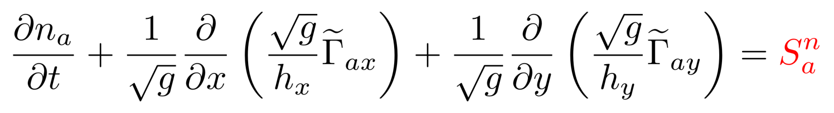
Replace the kinetic neutral model with a fast NN surrogate
Input
Kinetic Neutrals
Fluid Plasma
Kinetic Neutrals
Fluid Plasma
Kinetic Neutrals
…
Input
Surrogate
Fluid Plasma
Surrogate
Fluid Plasma
Surrogate
…
S. Dasbach et al, P038(G)

Slide 19
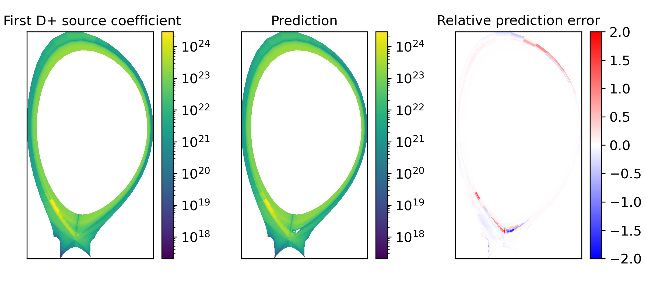
Replace the kinetic neutral model with a fast NN surrogate
The precision would be sufficient if below Monte Carlo noise of reference model
S. Dasbach et al, P038(G)

