Slide 1

Exascale Computing
Der Sprung in eine neue Ära des Höchstleistungsrechnens
11.11.2022 I Thomas Lippert, Andreas Herten, Robert Speck und das Ganze JSC

Slide 2
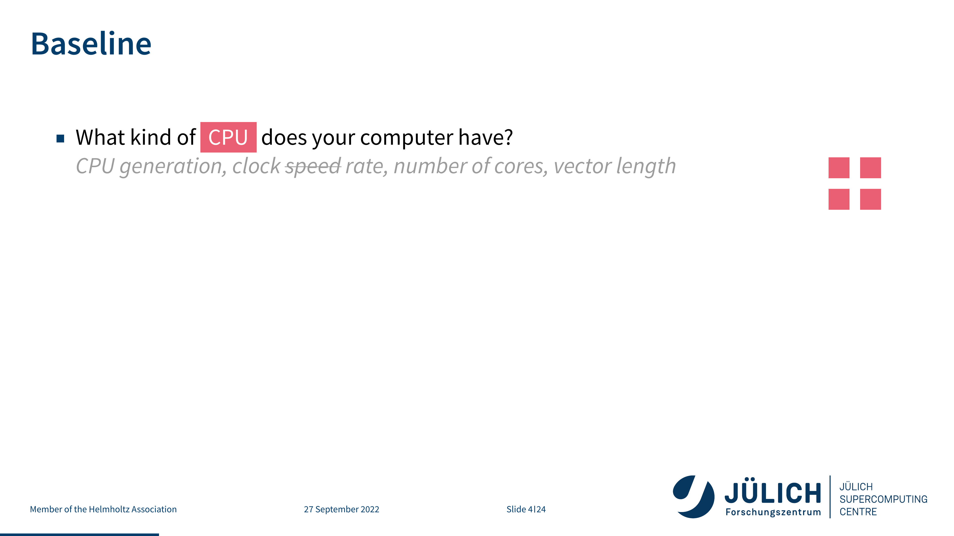

Slide 3
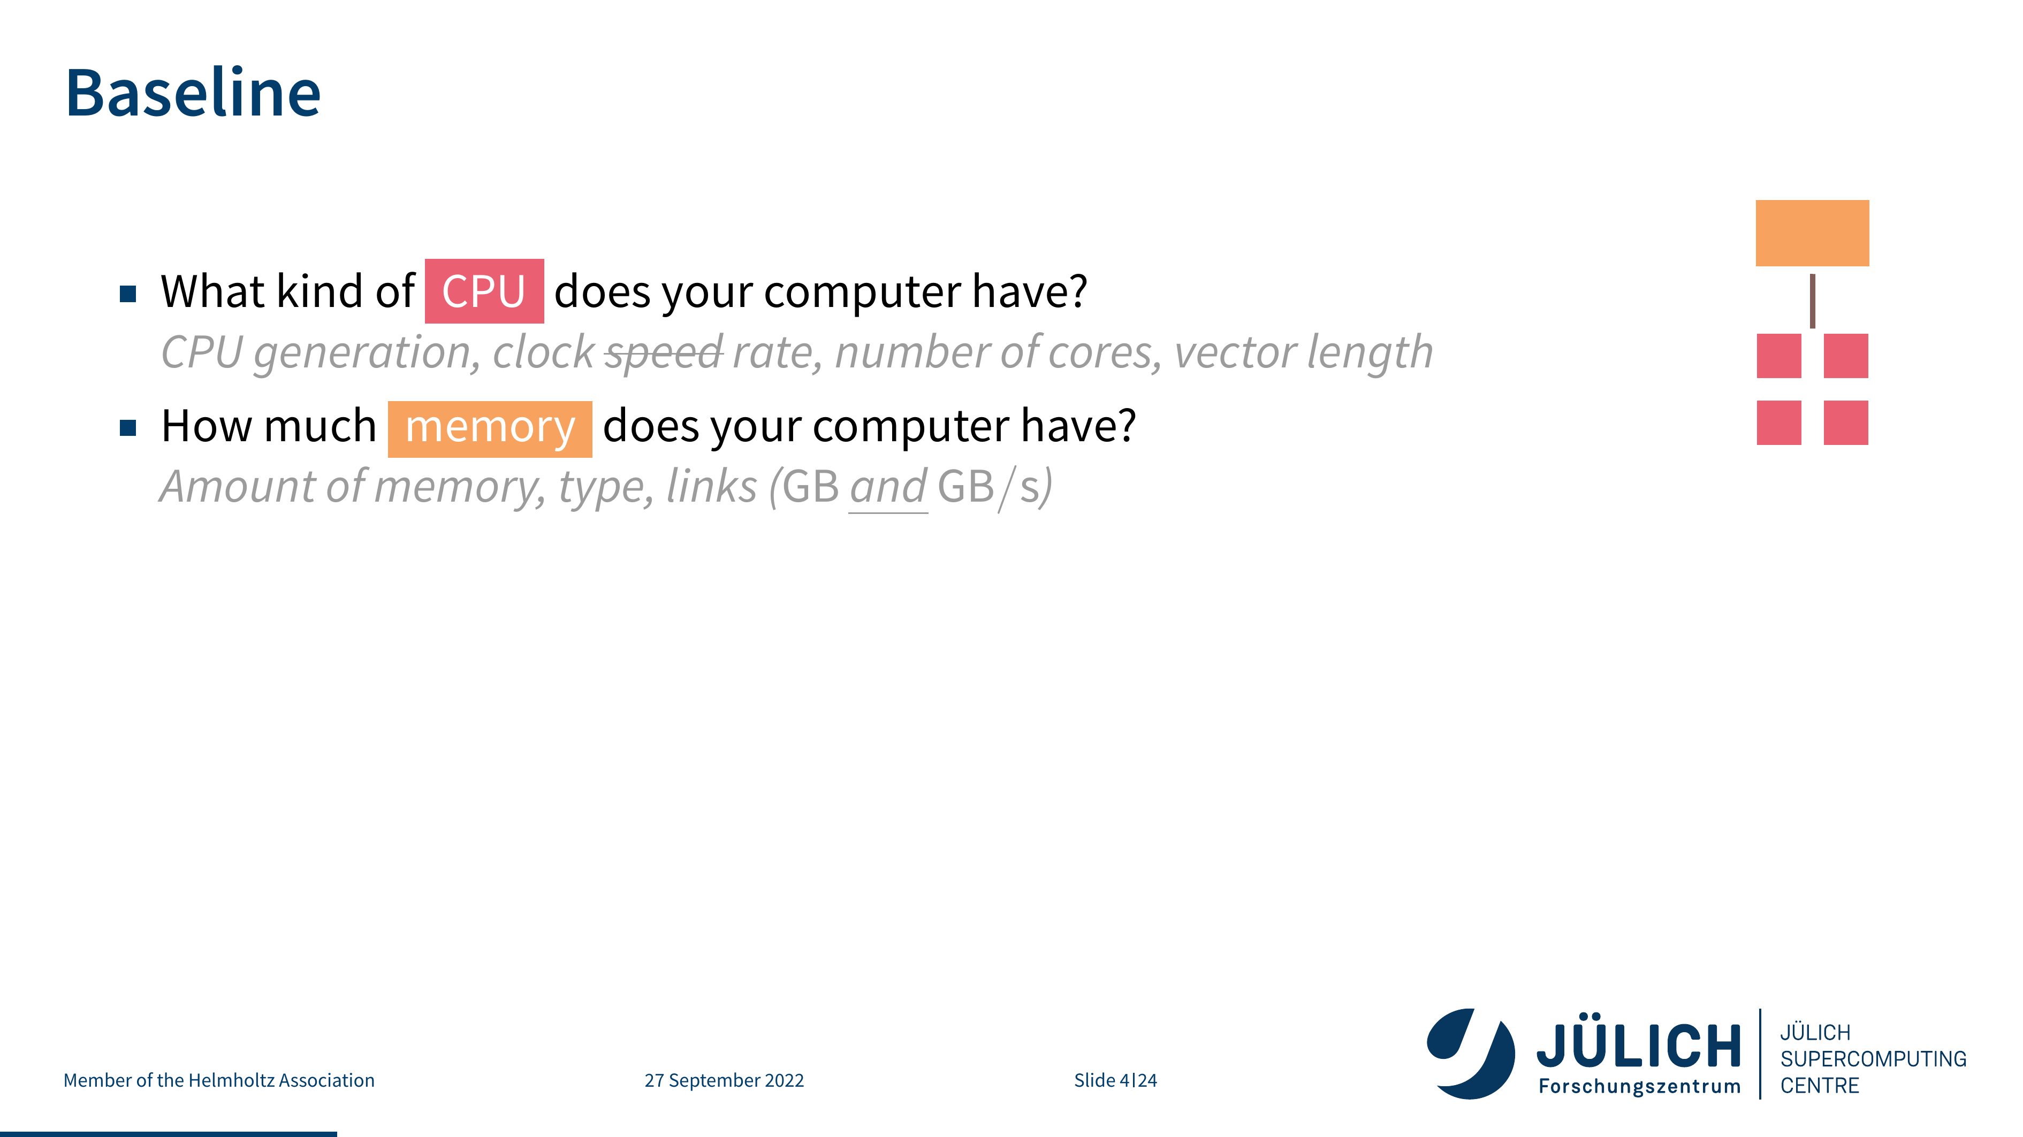

Slide 4
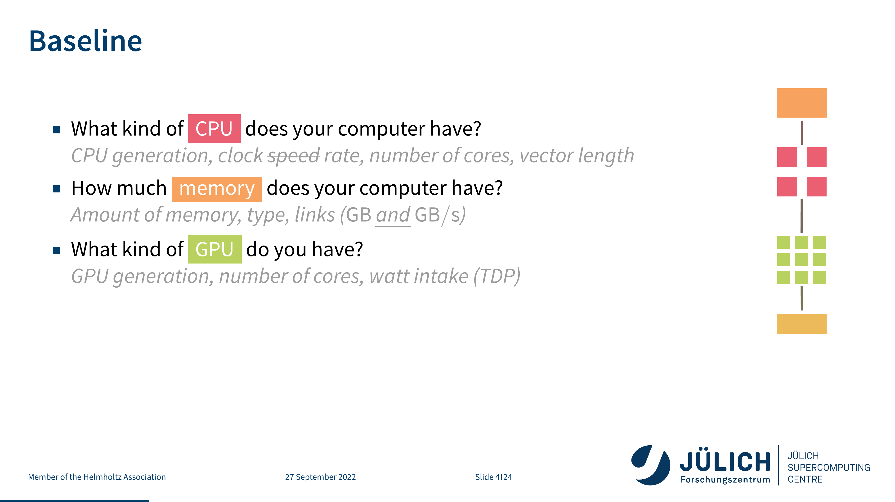

Slide 5
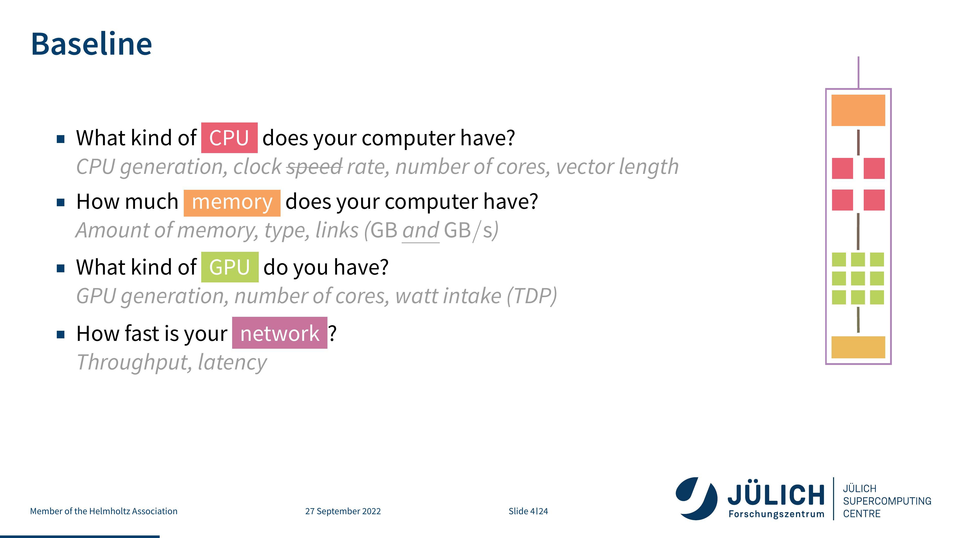

Slide 6
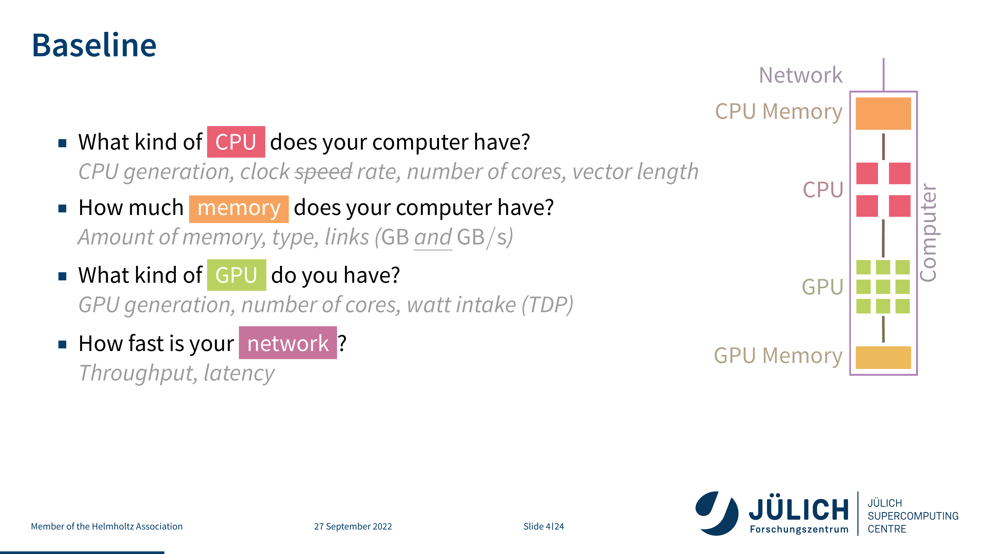

Slide 7
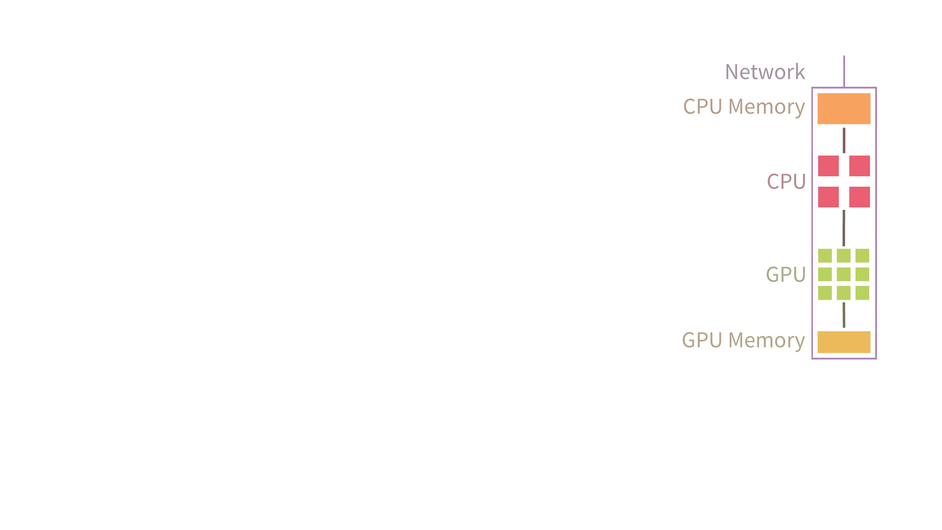

Slide 8
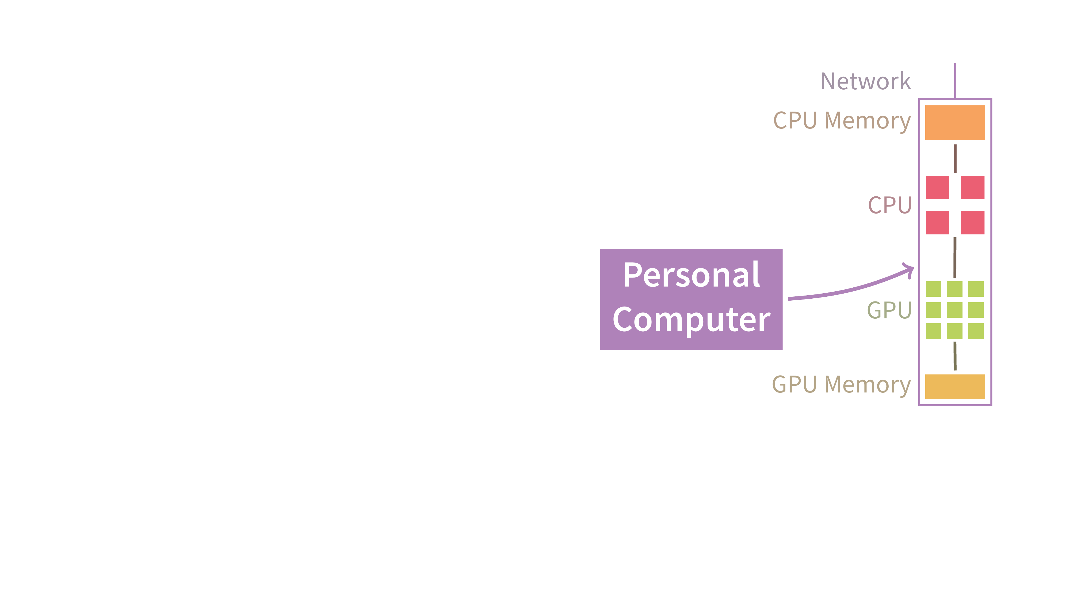

Slide 9
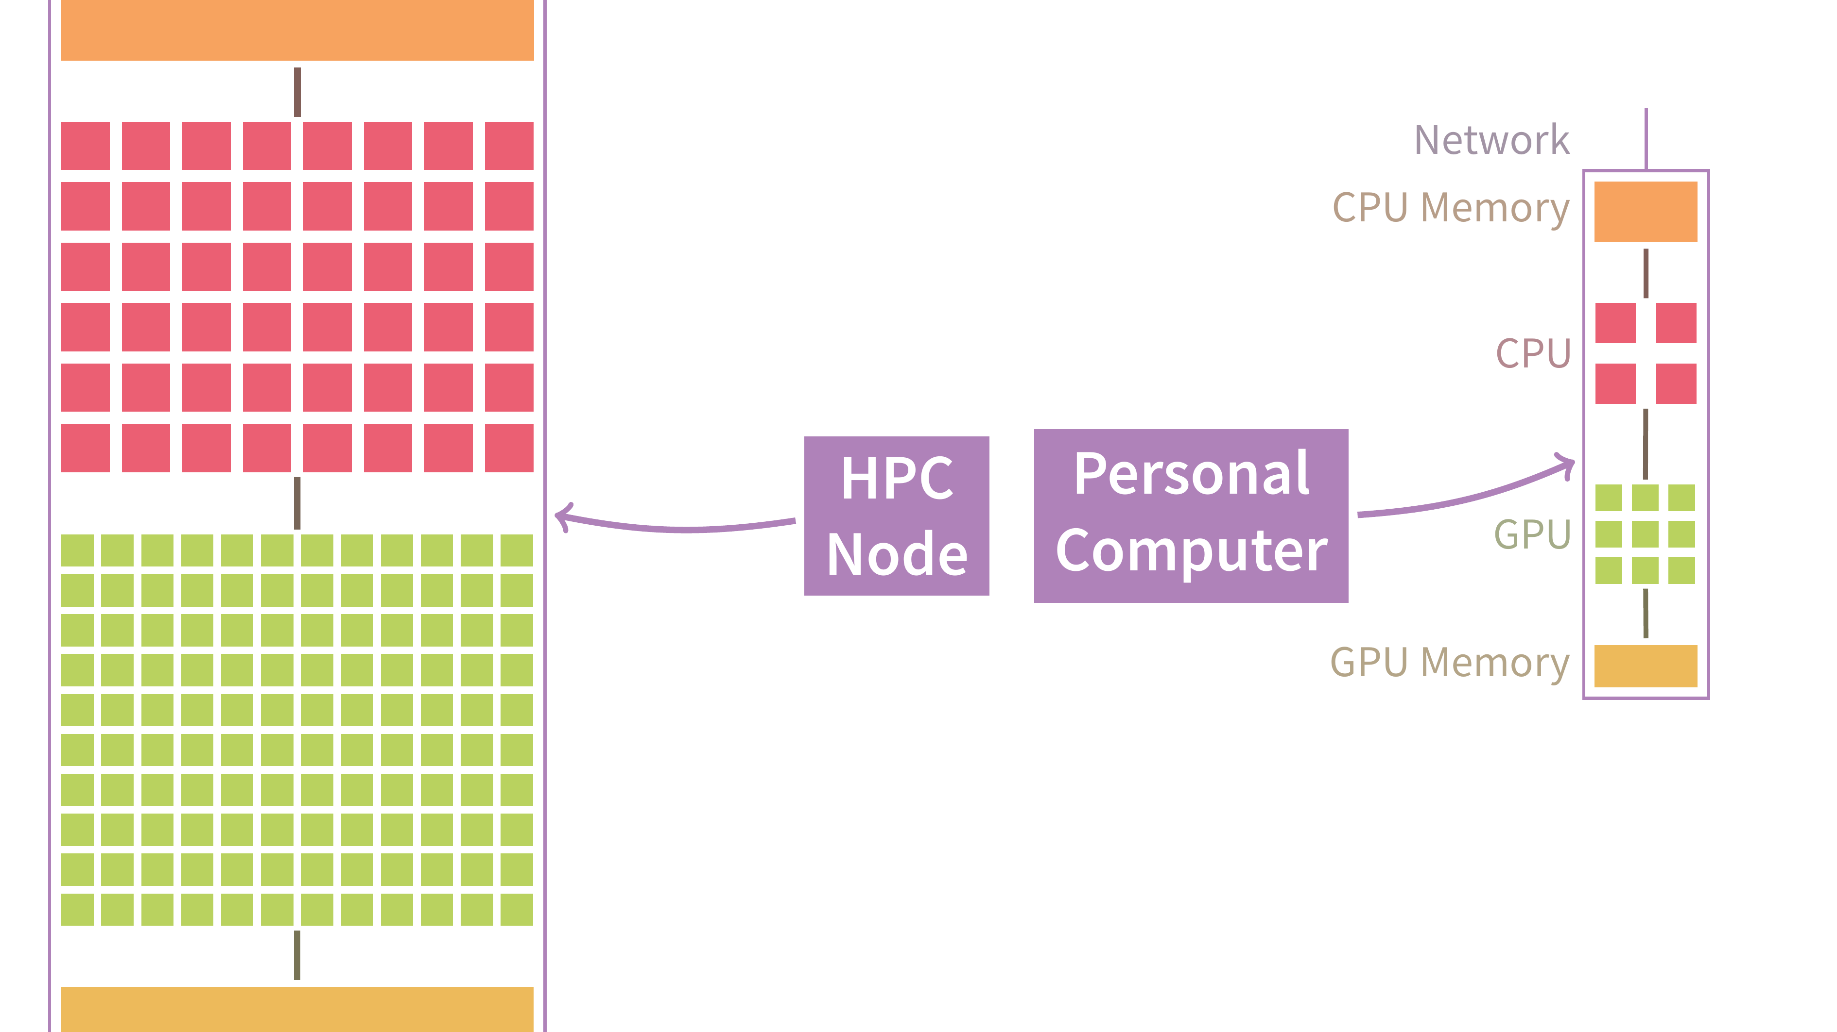

Slide 10
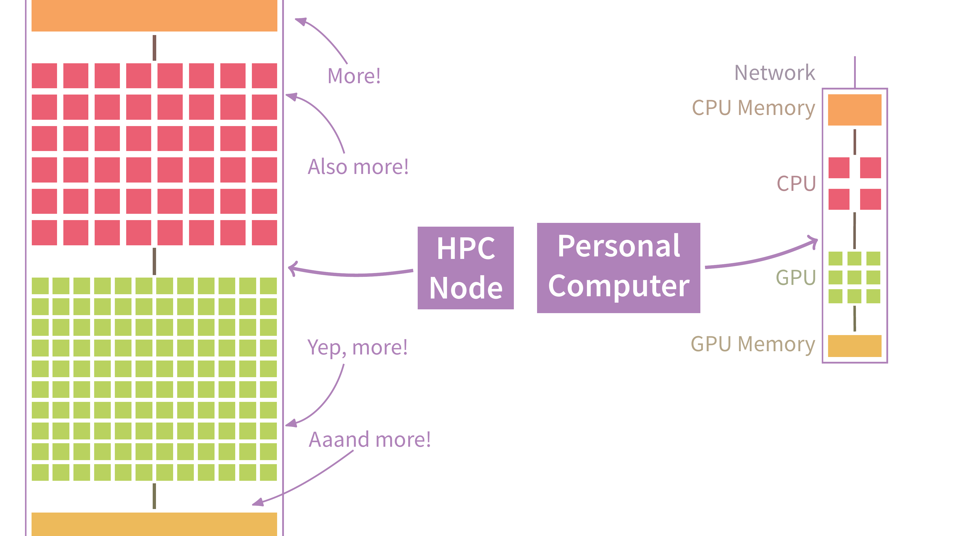

Slide 11


Slide 12
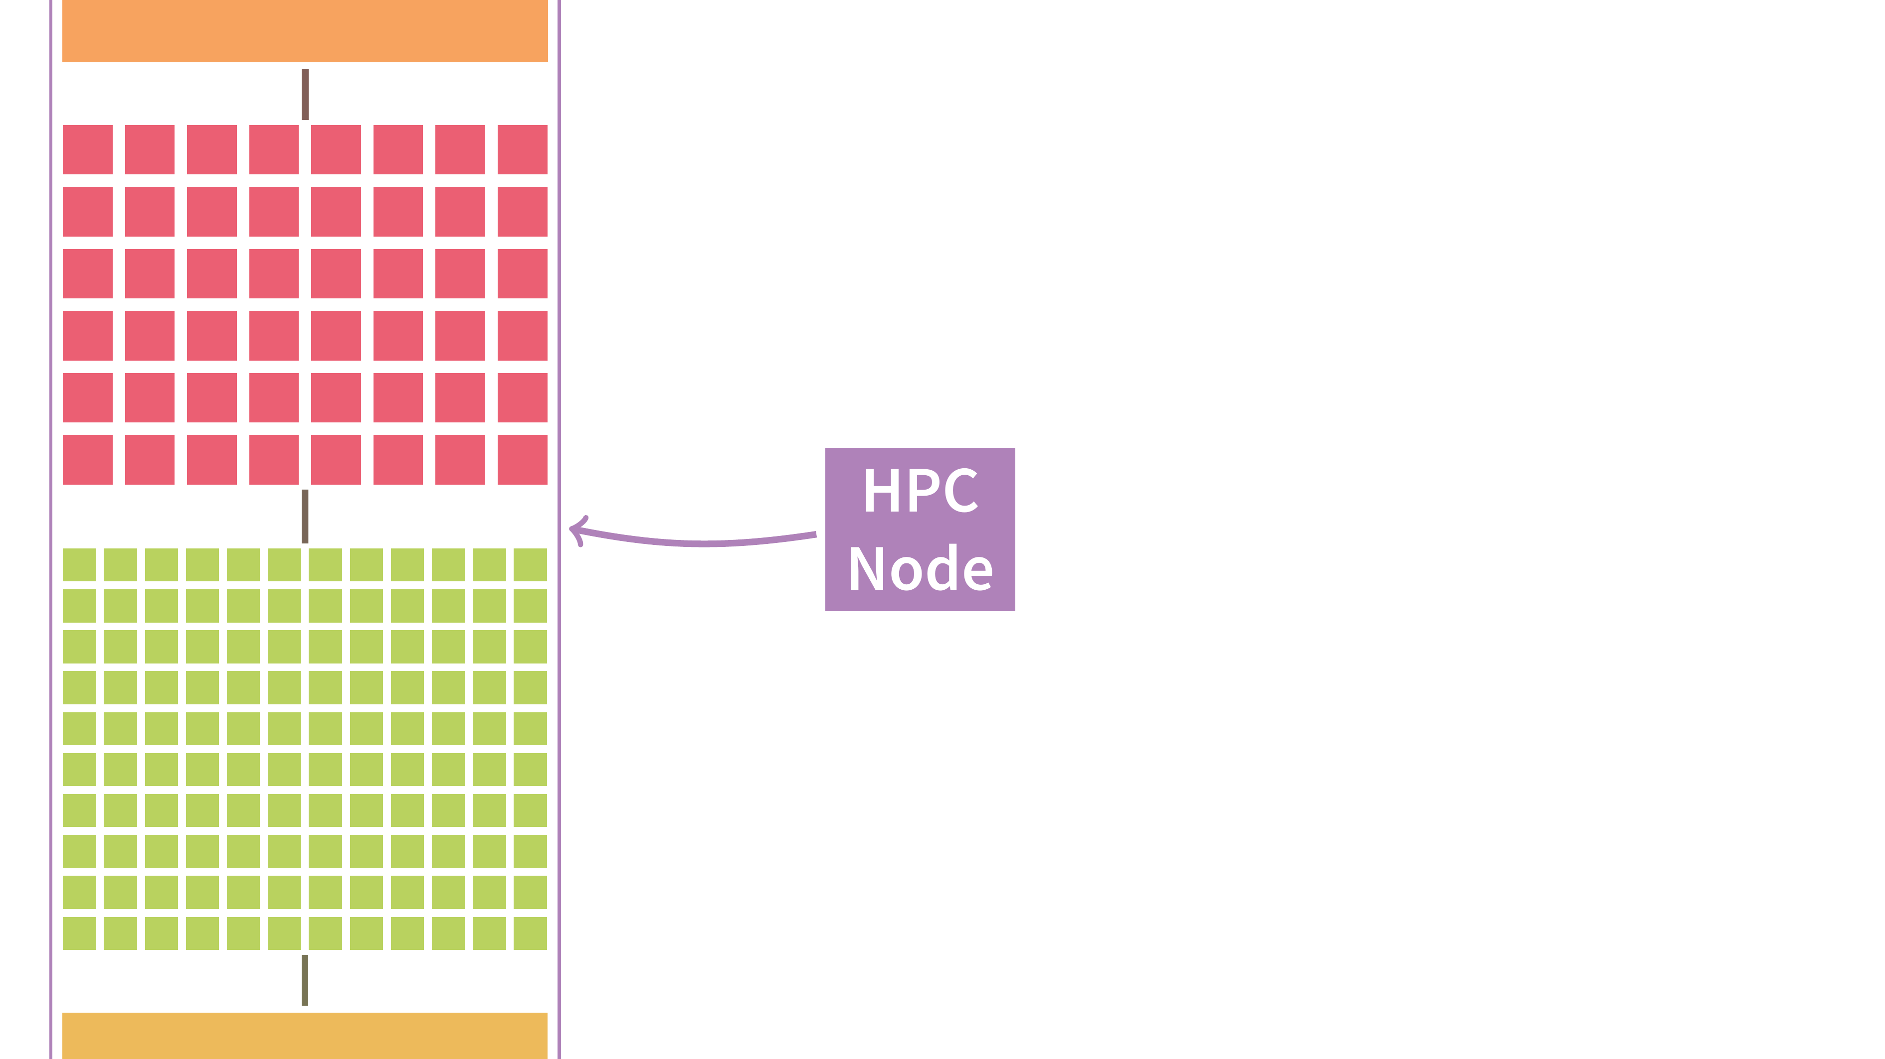

Slide 13
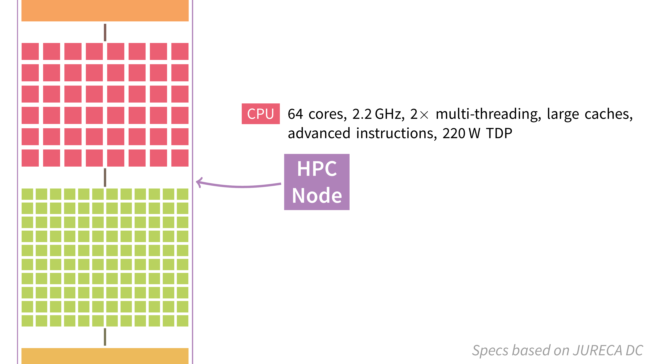

Slide 14
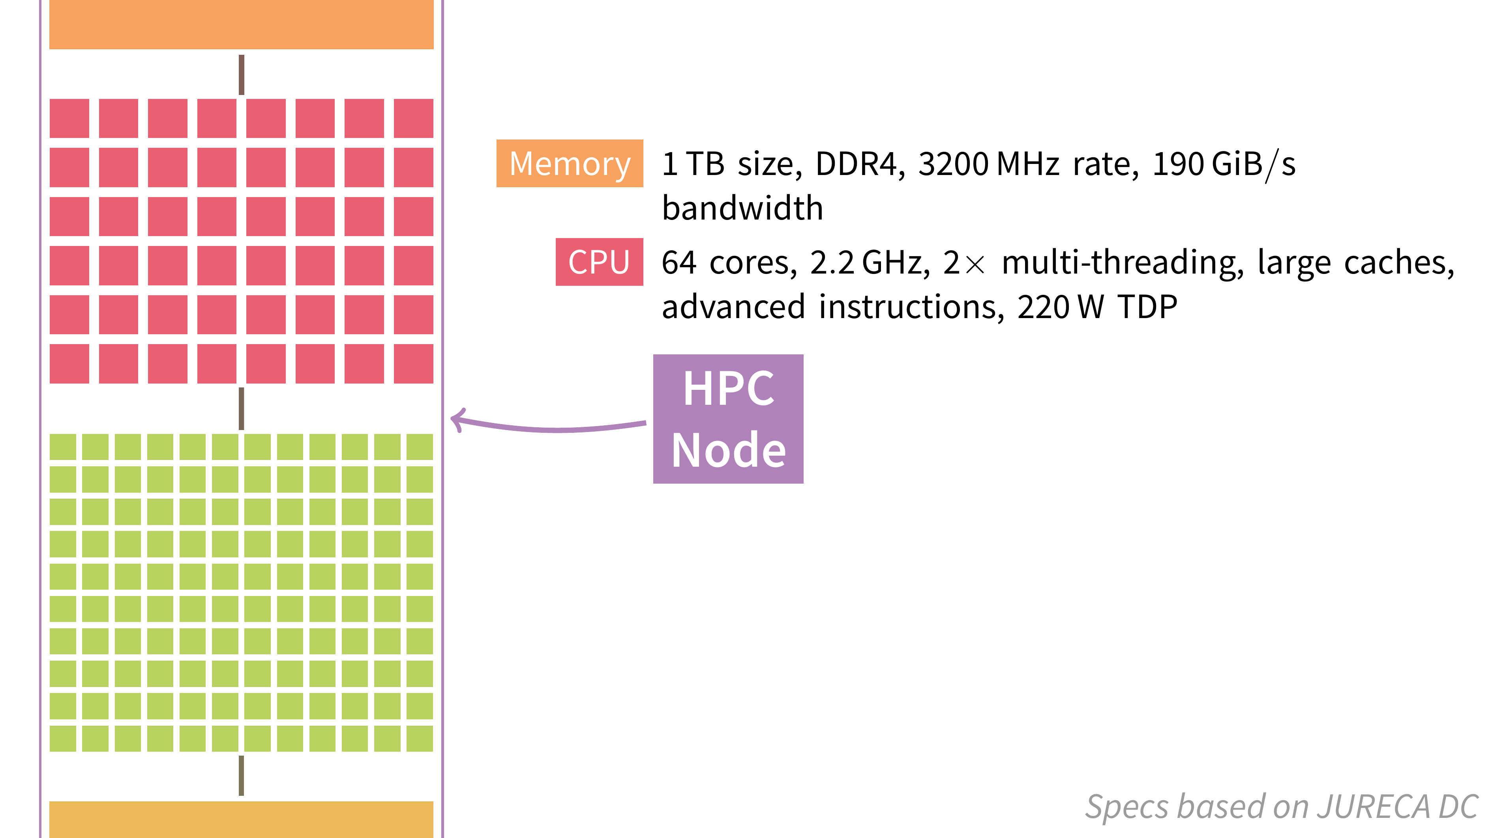

Slide 15
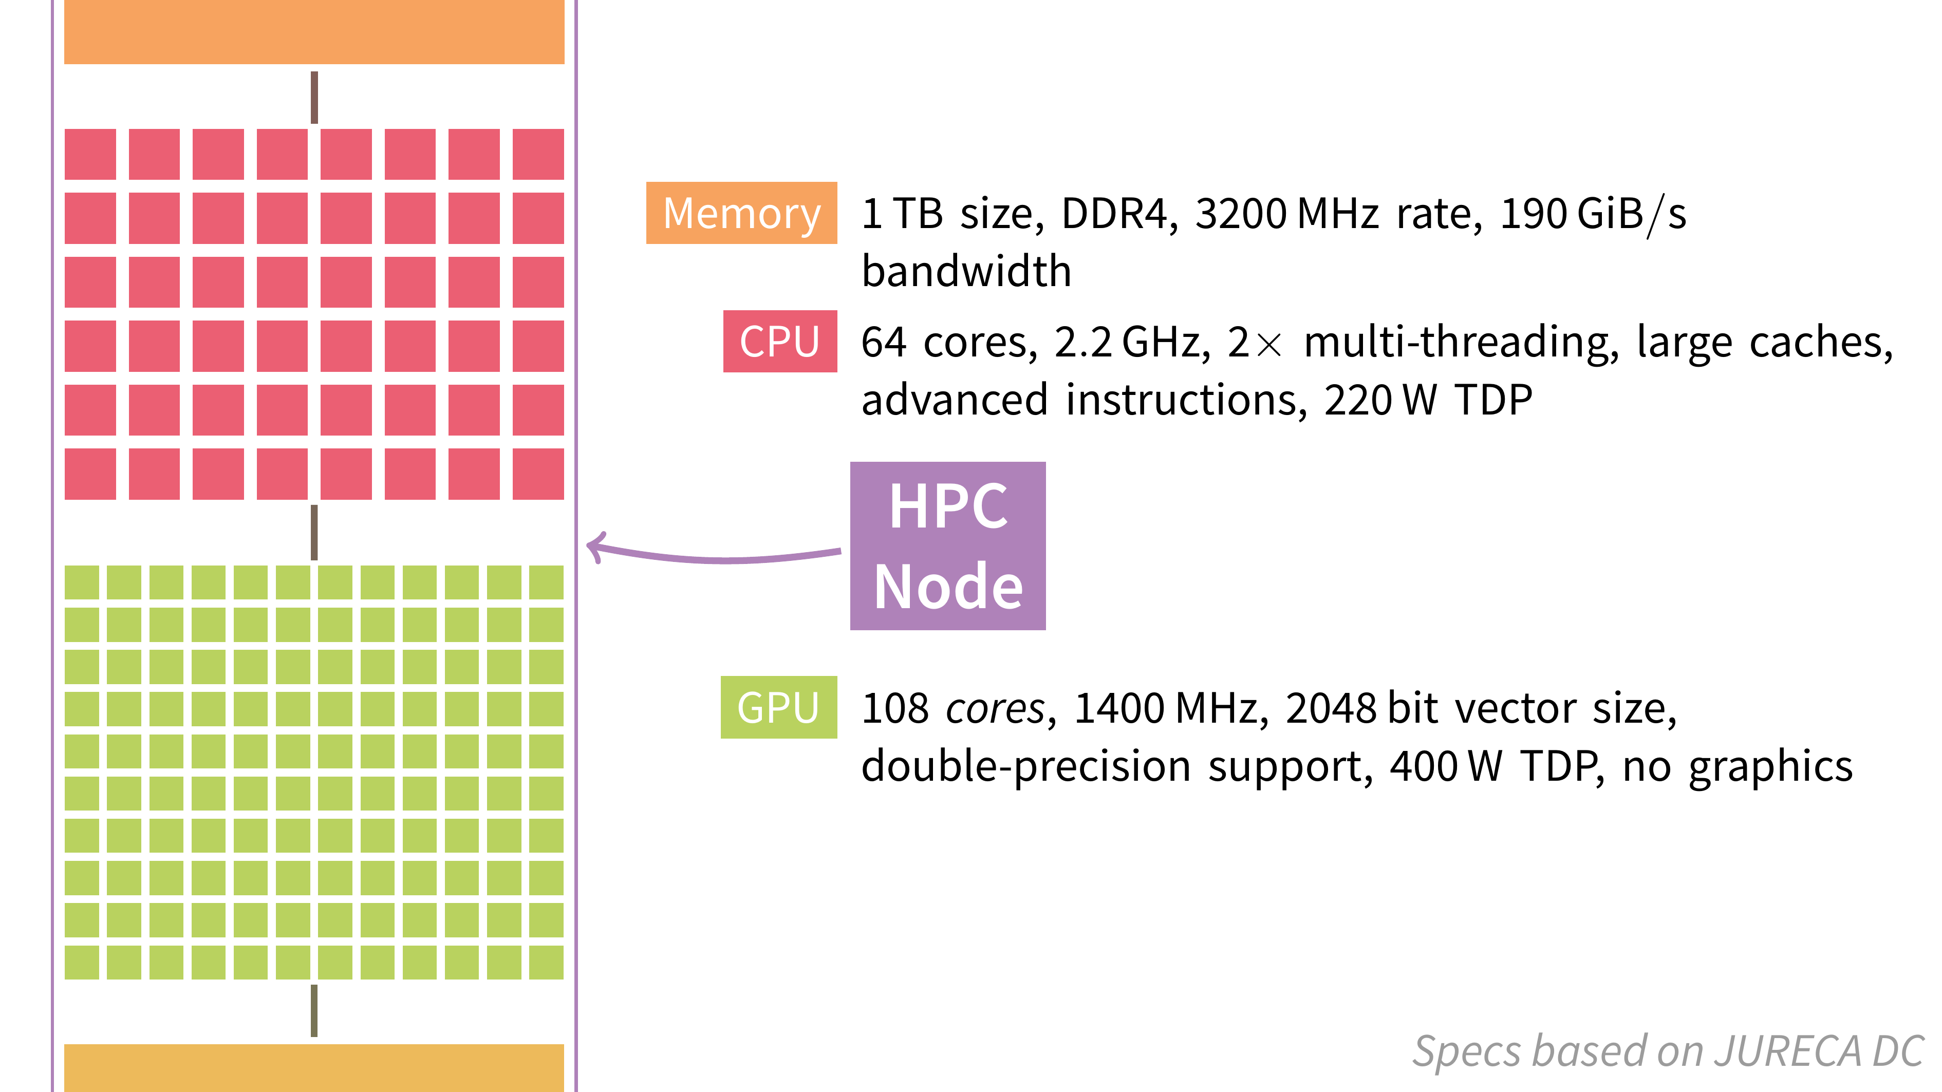

Slide 16
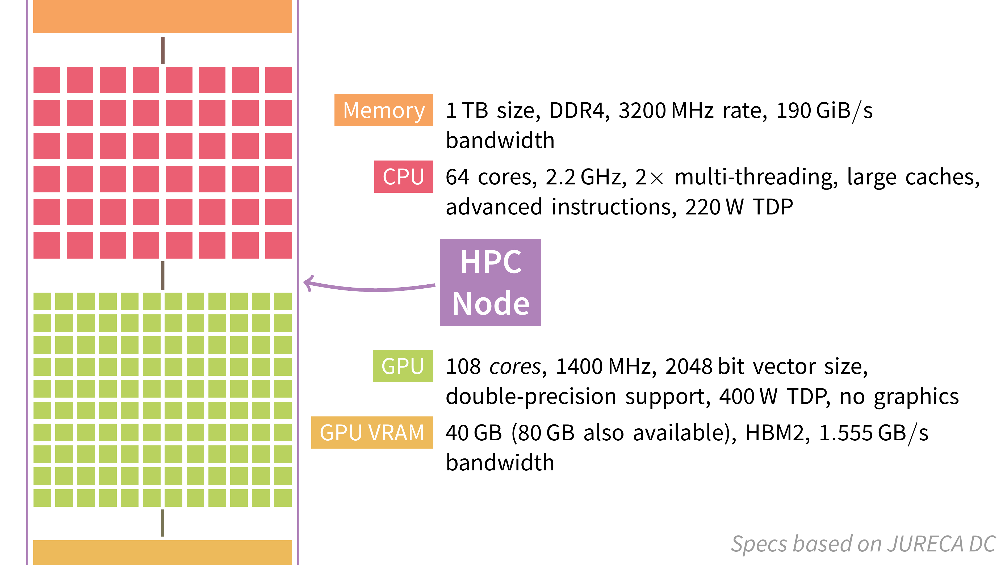

Slide 17


Slide 18
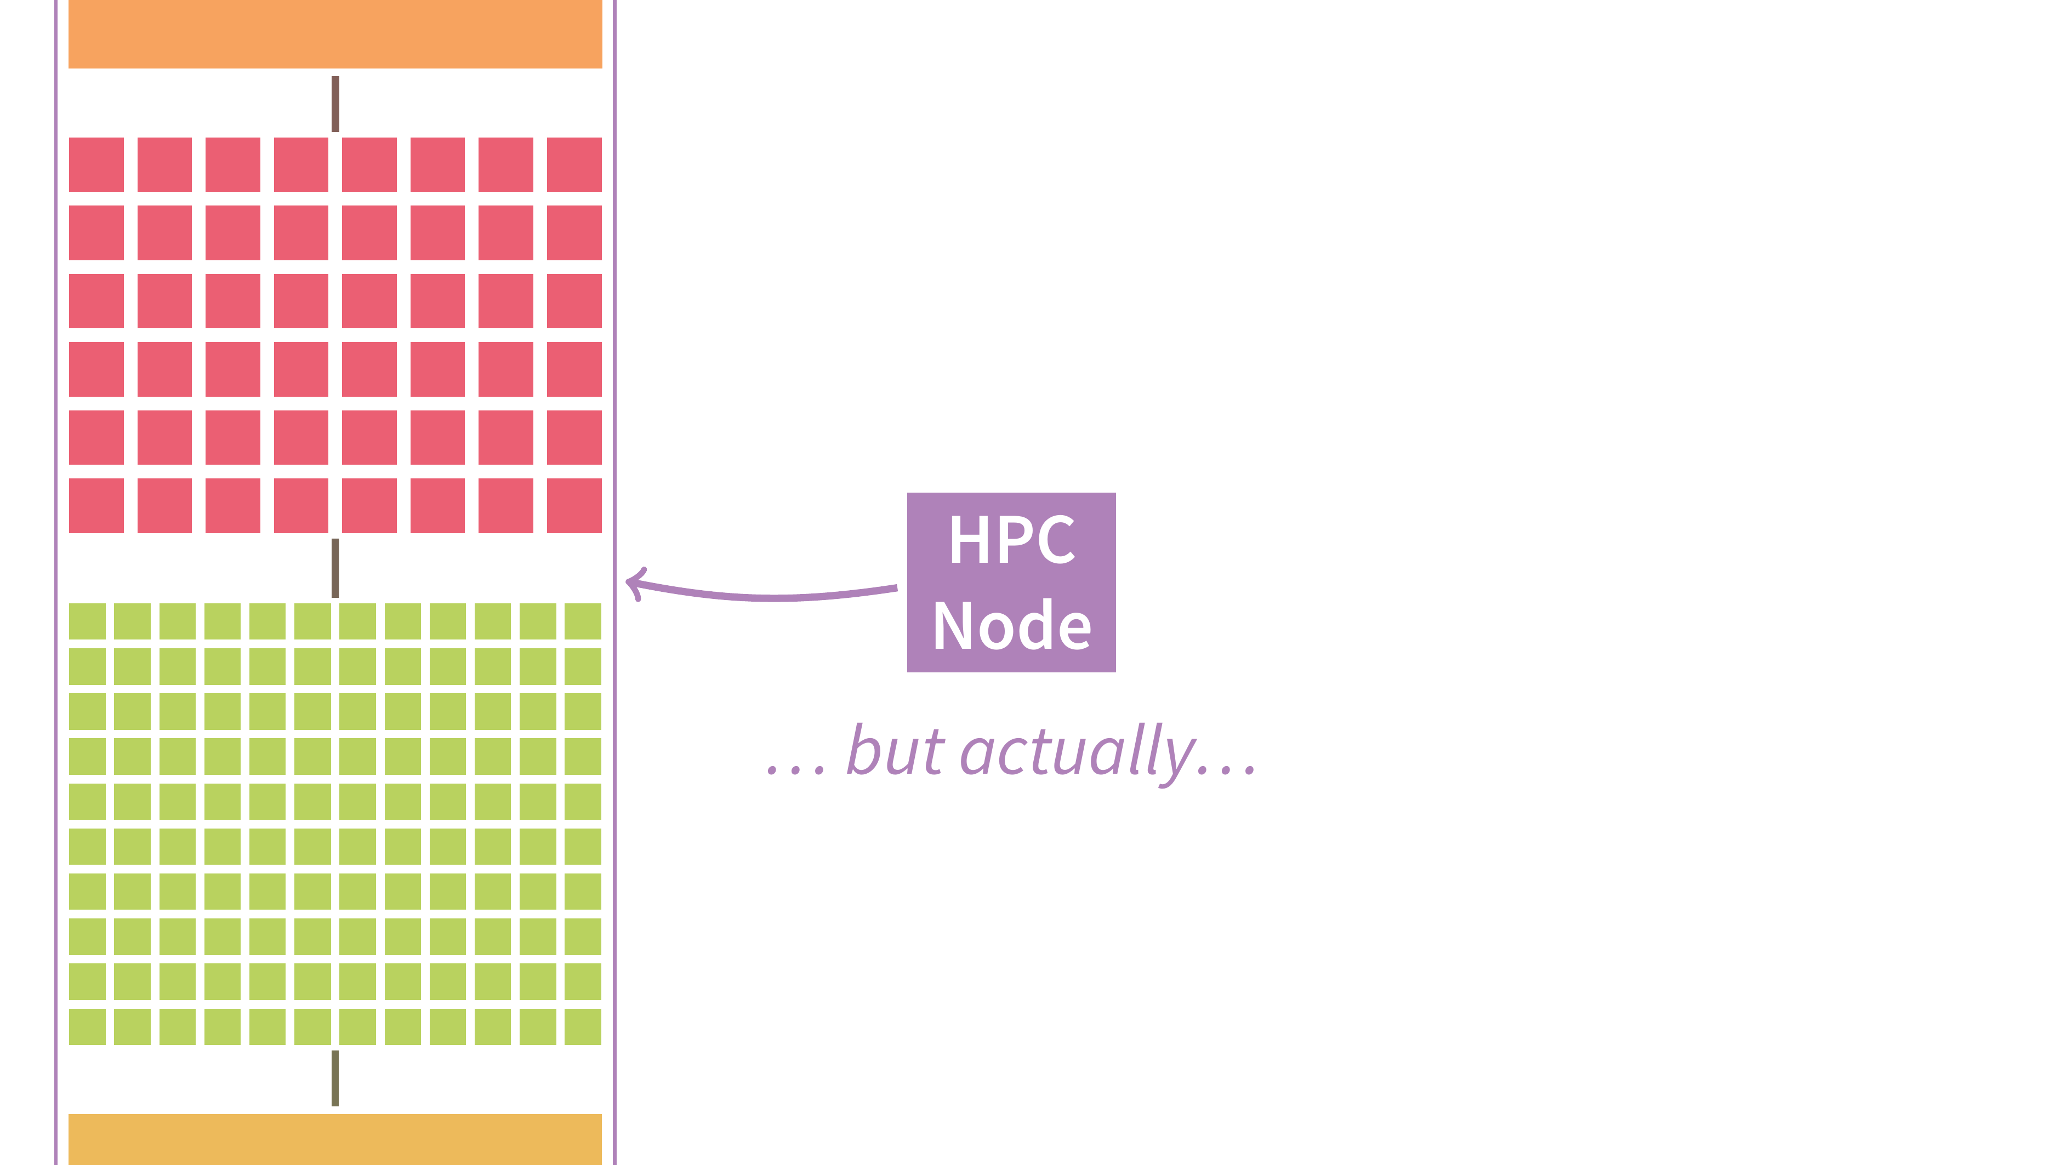

Slide 19
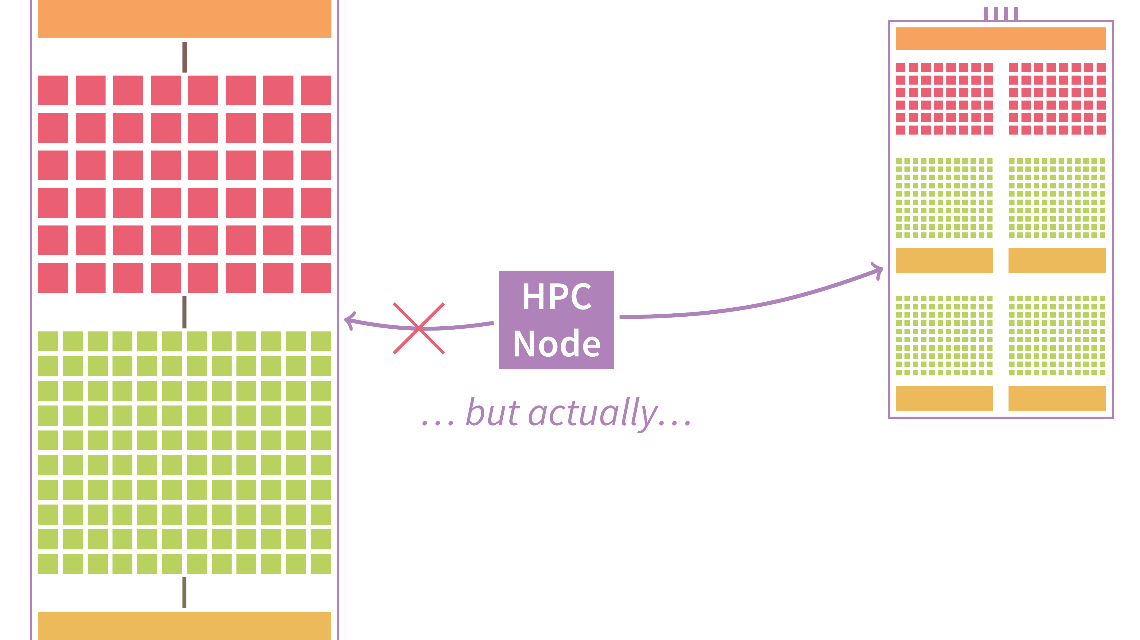

Slide 20
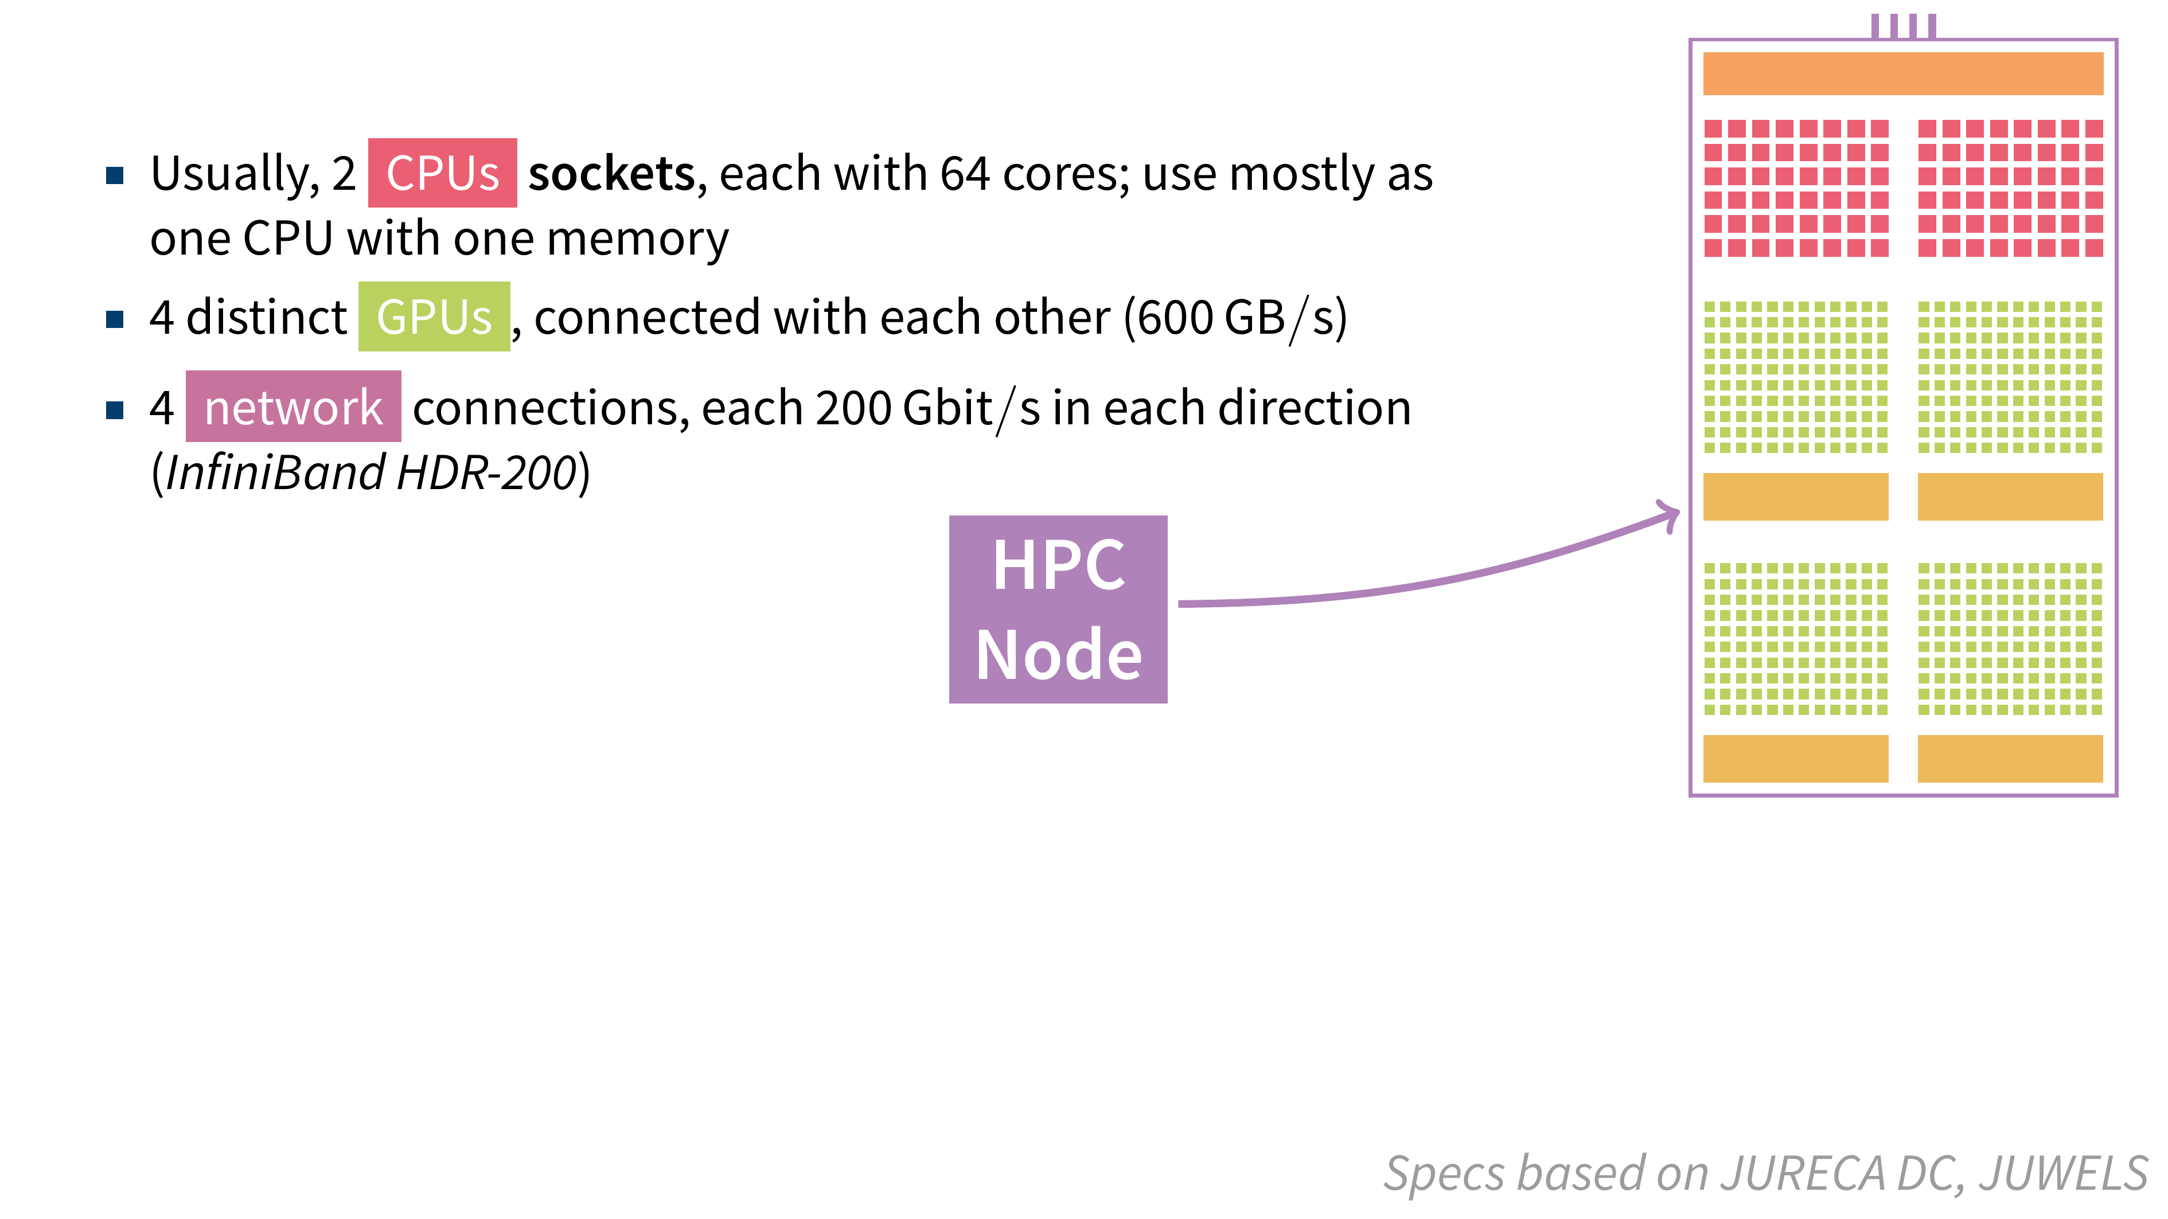

Slide 21
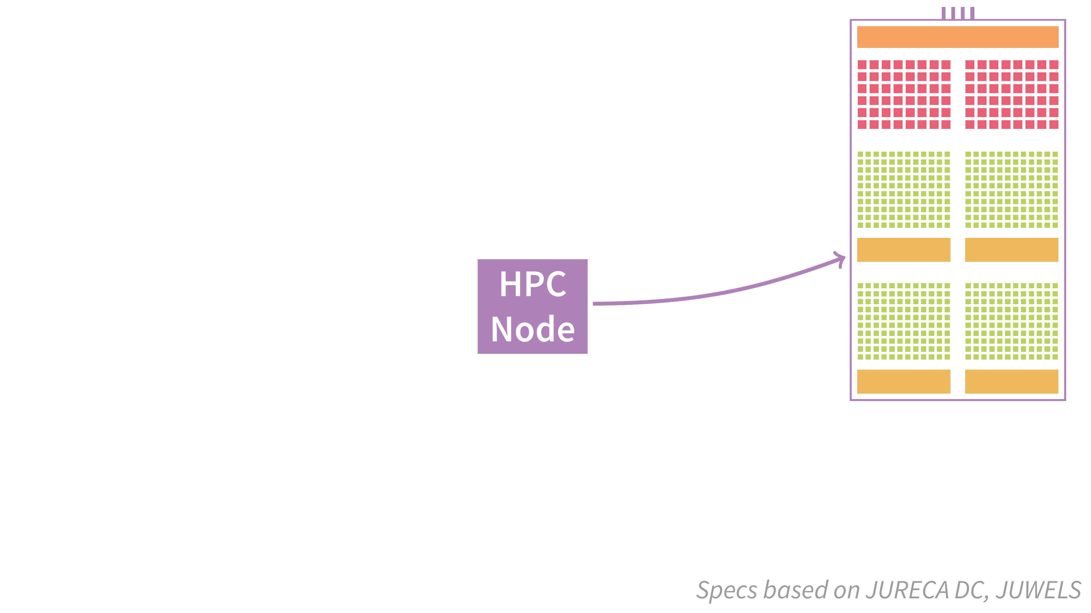

Slide 22
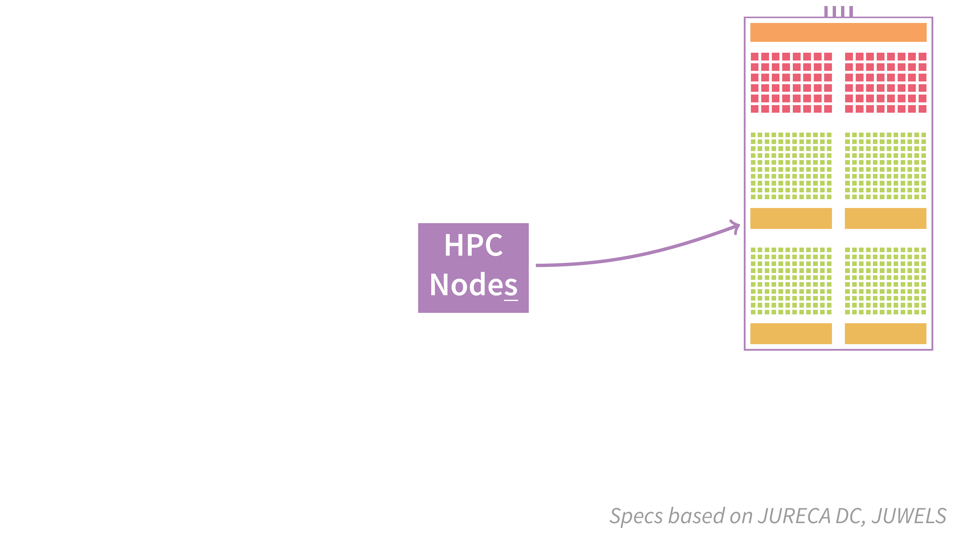

Slide 23
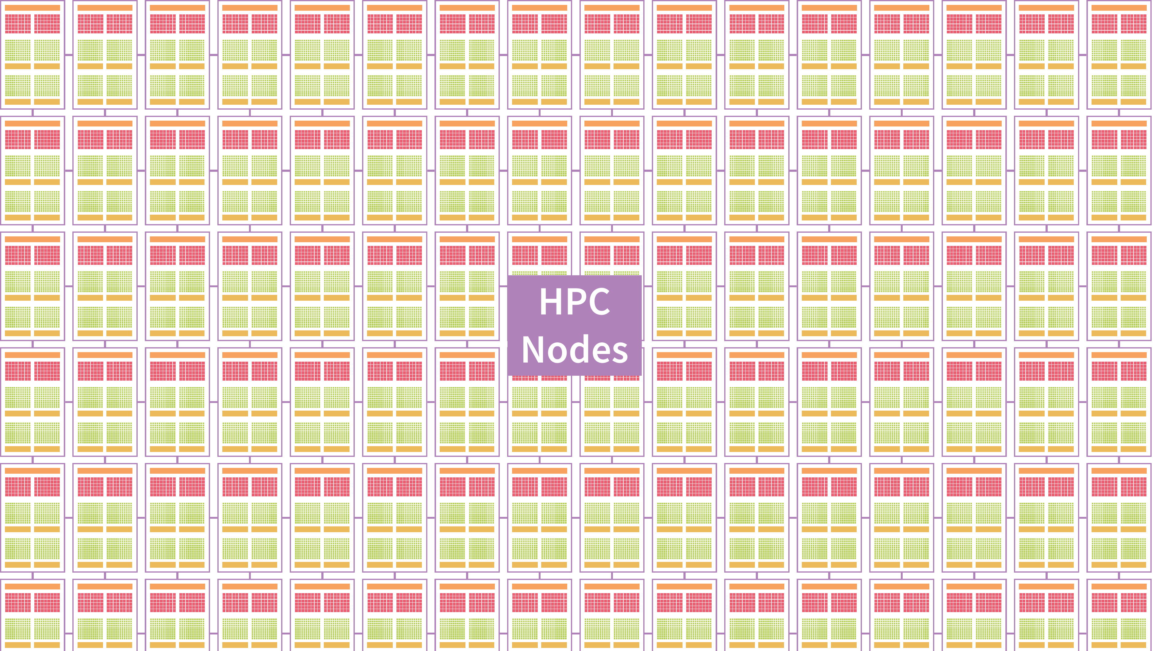

Slide 24


Slide 25
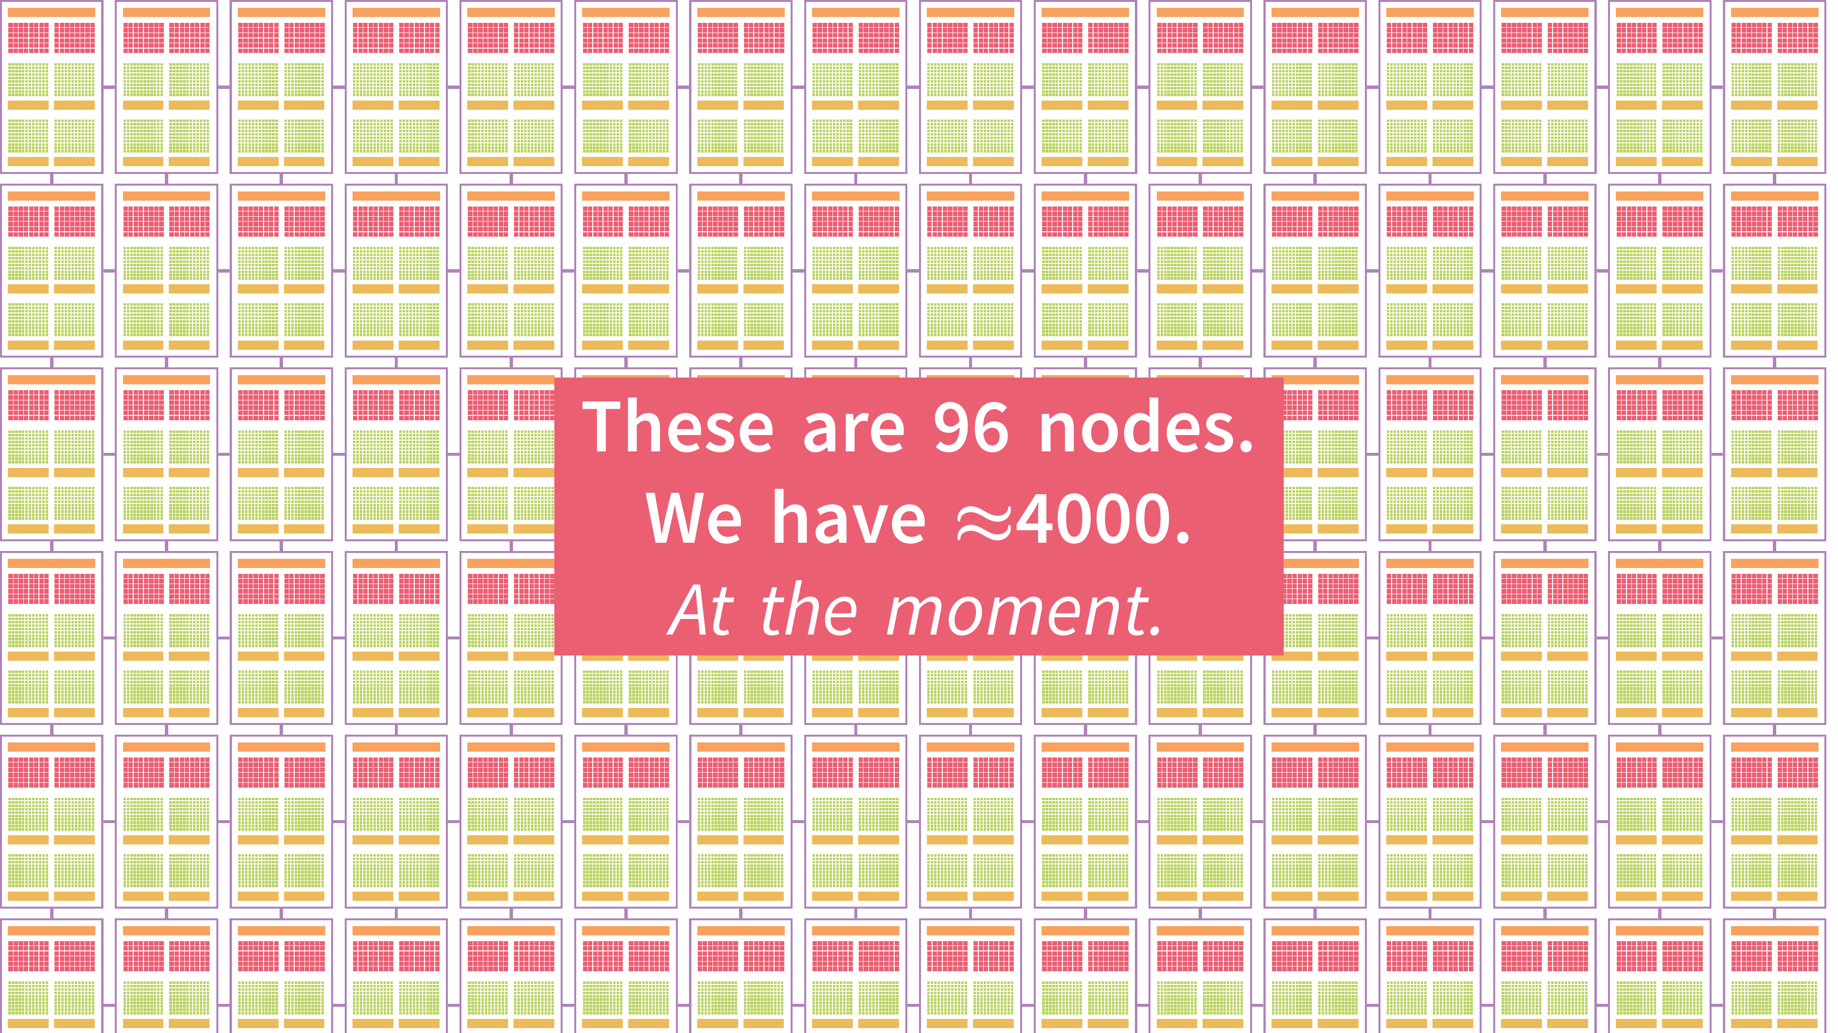

Slide 26
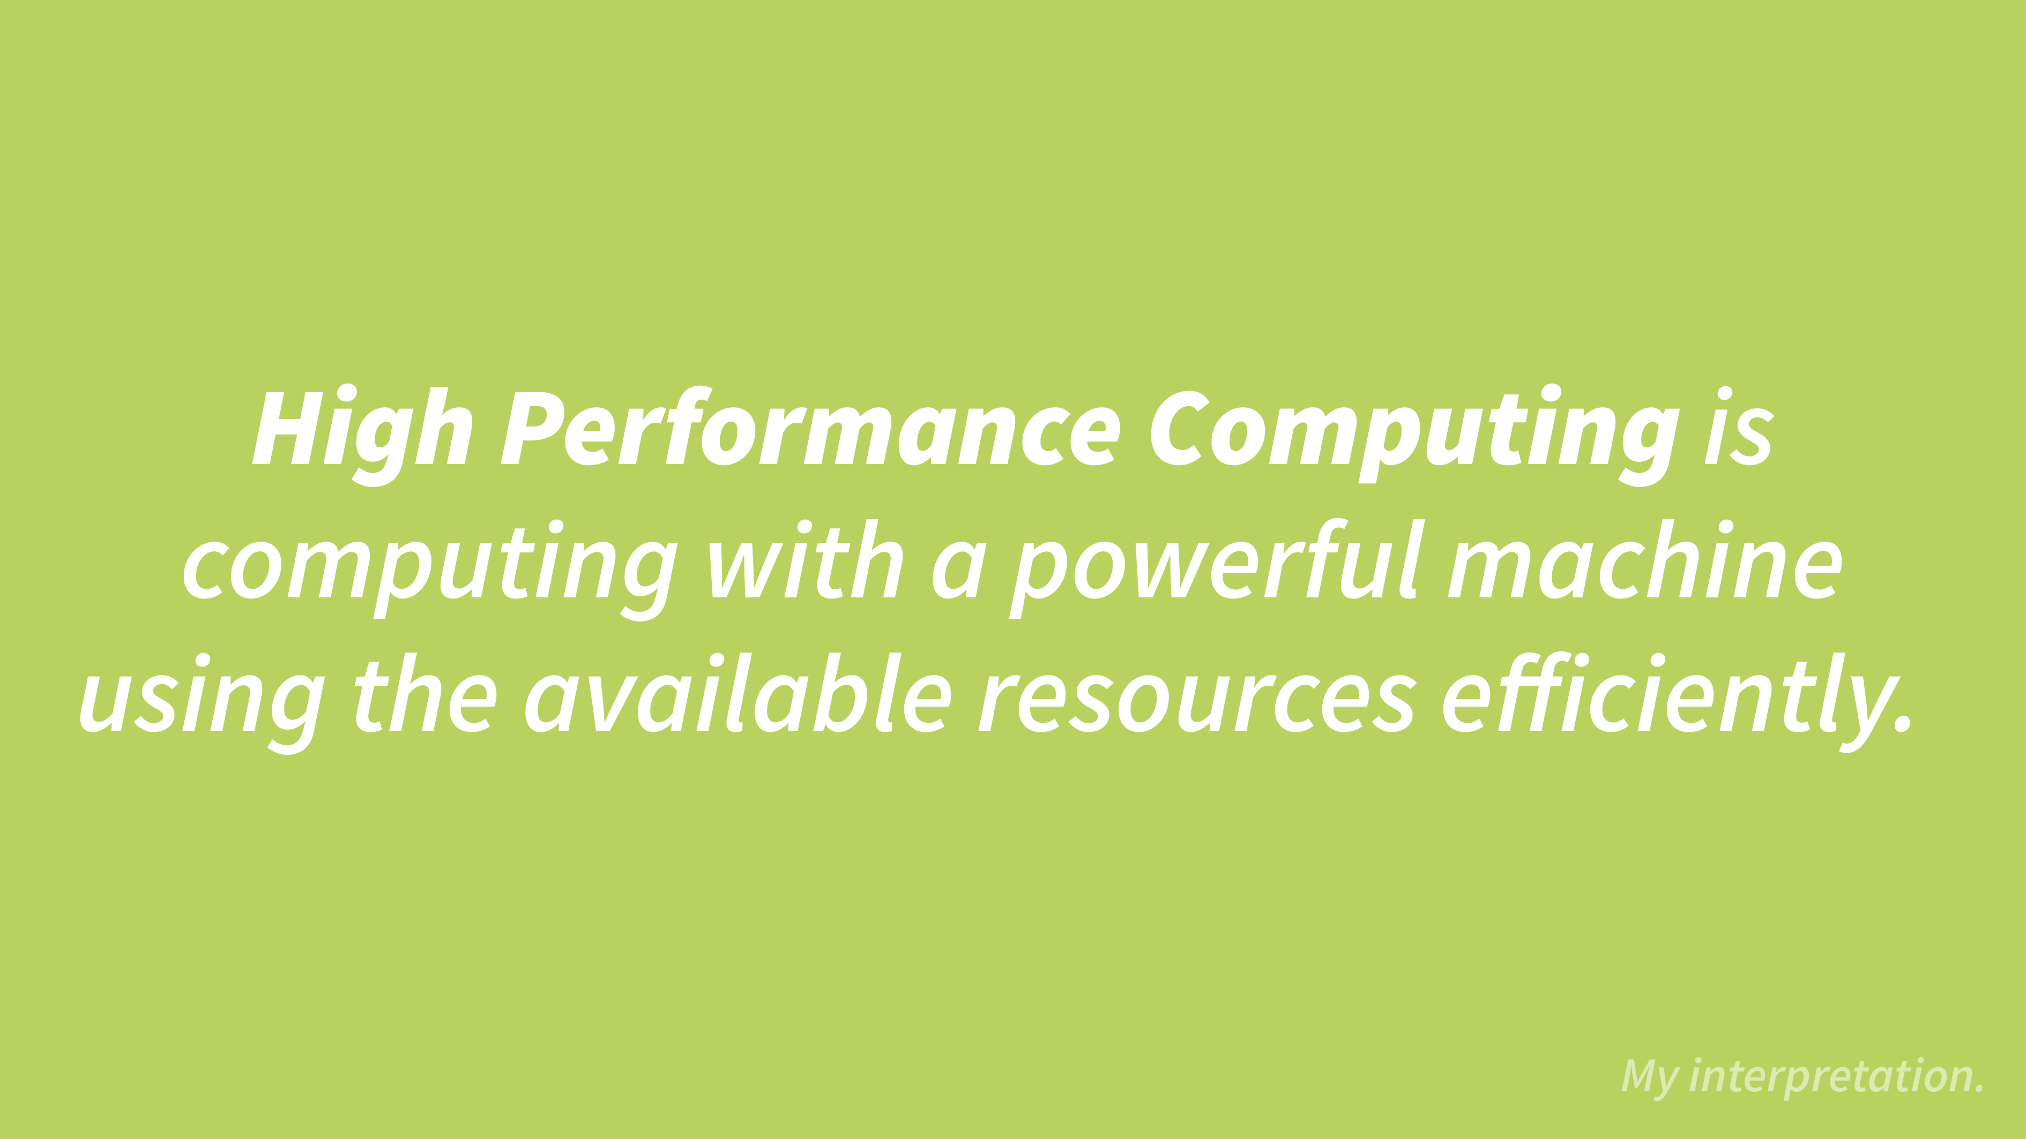

Slide 27
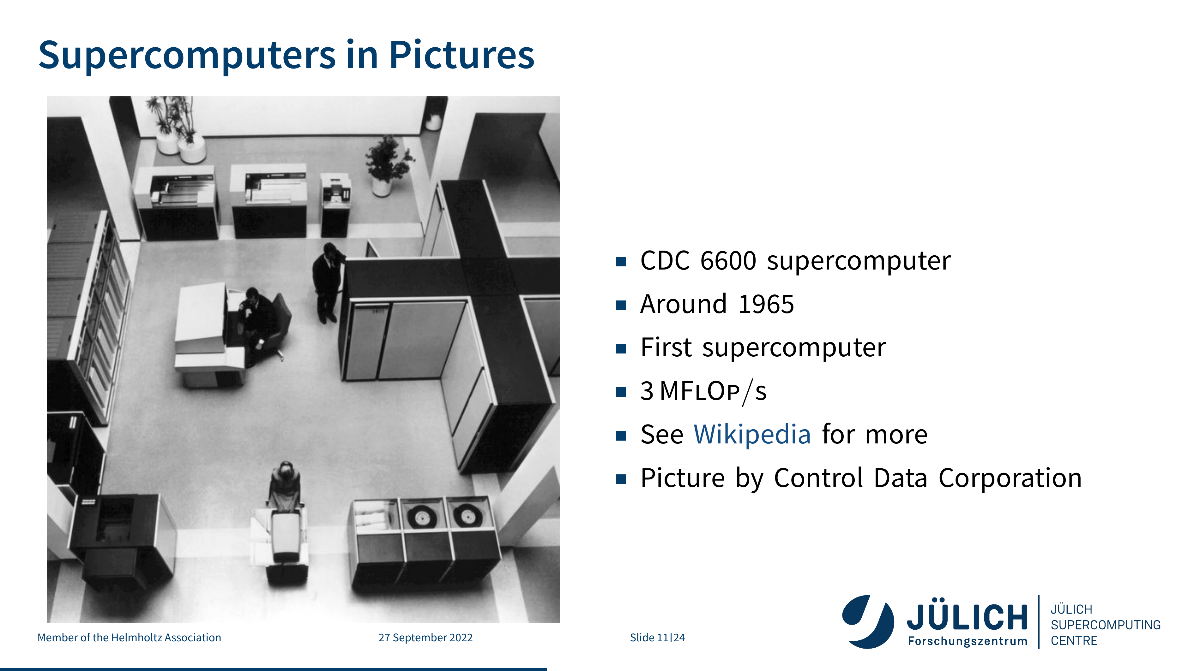

Slide 28
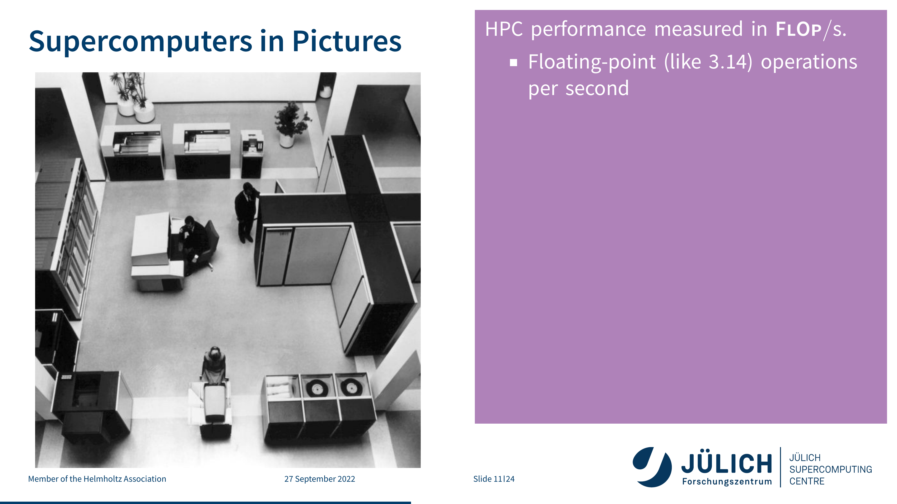

Slide 29
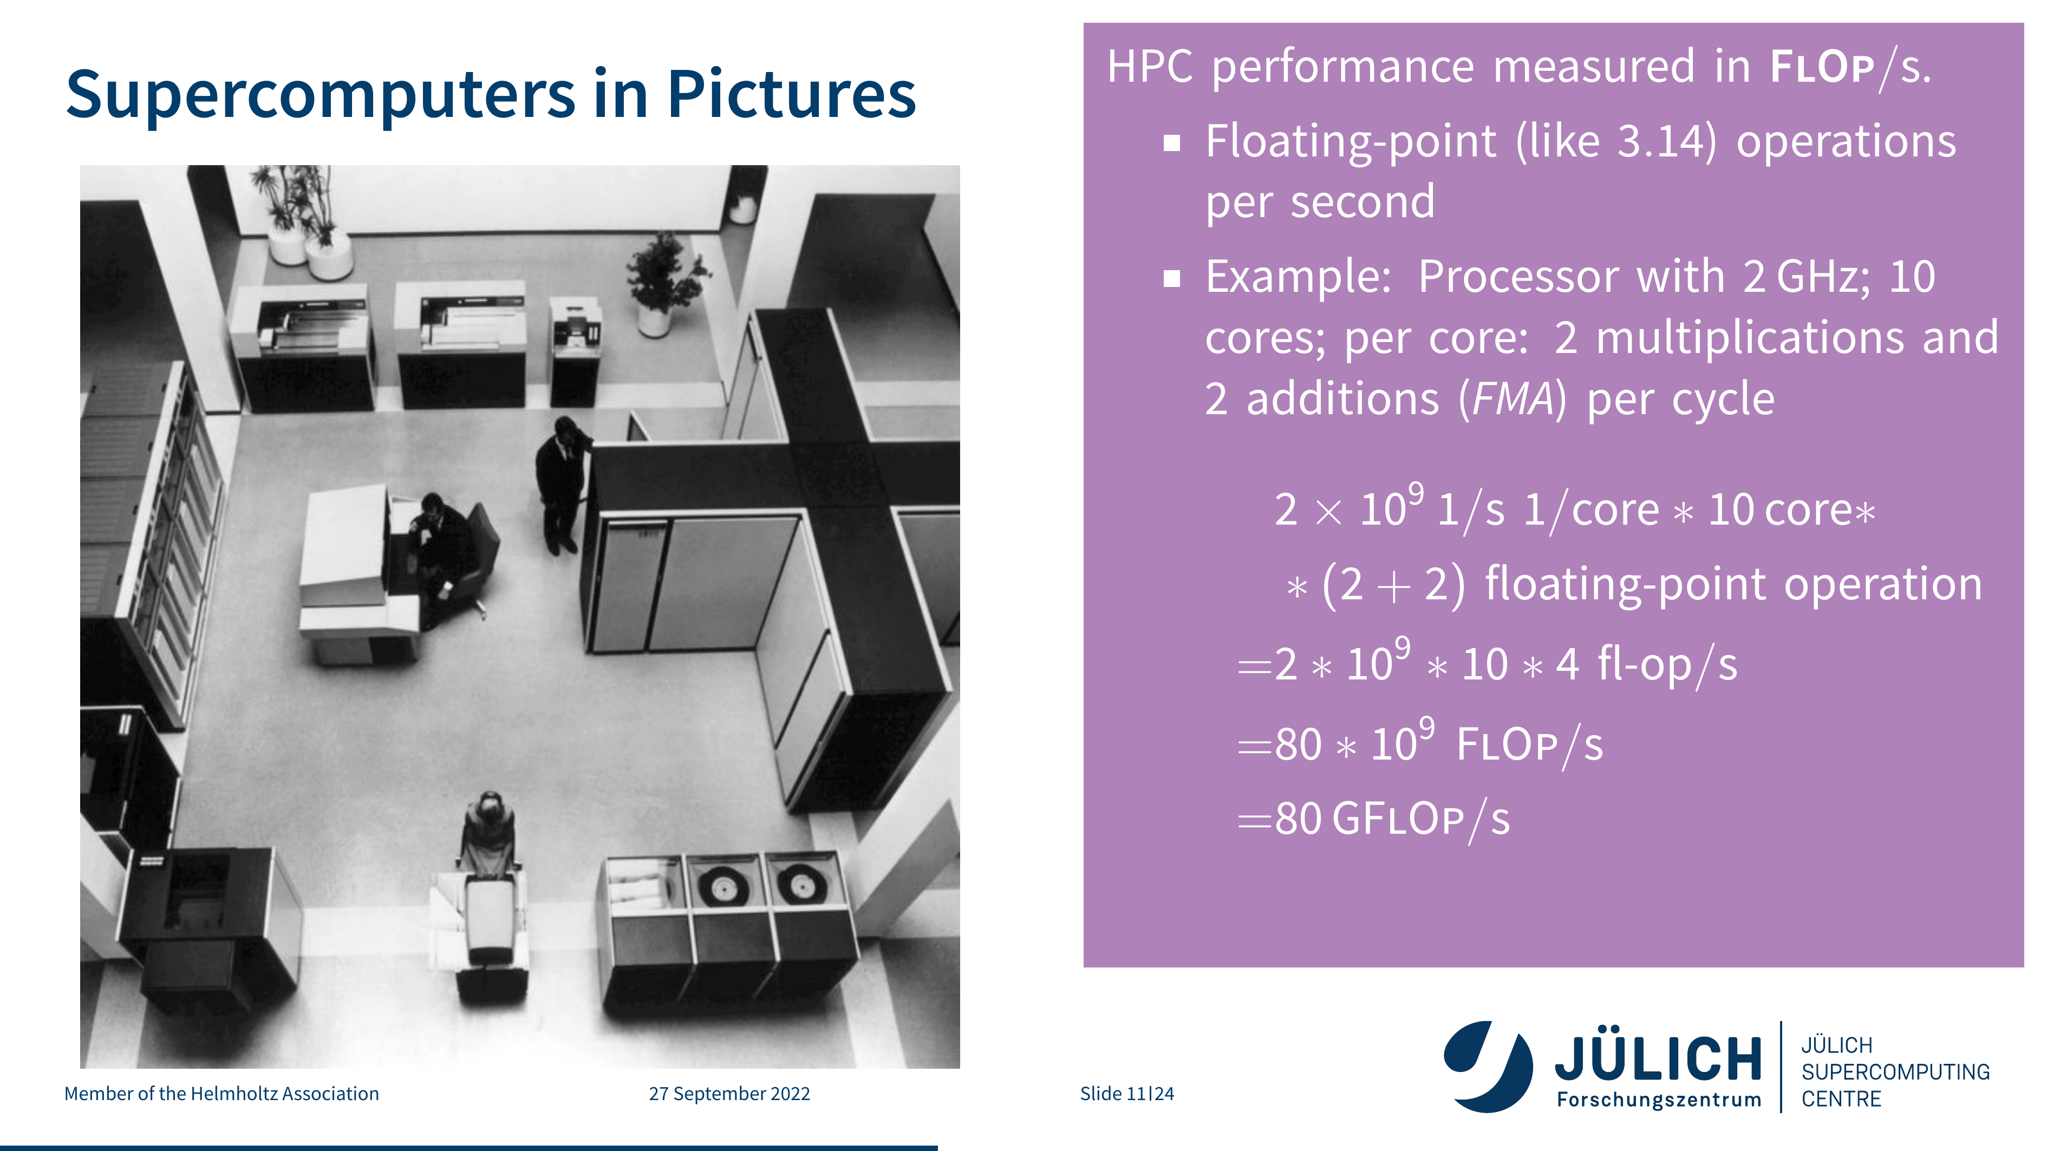

Slide 30
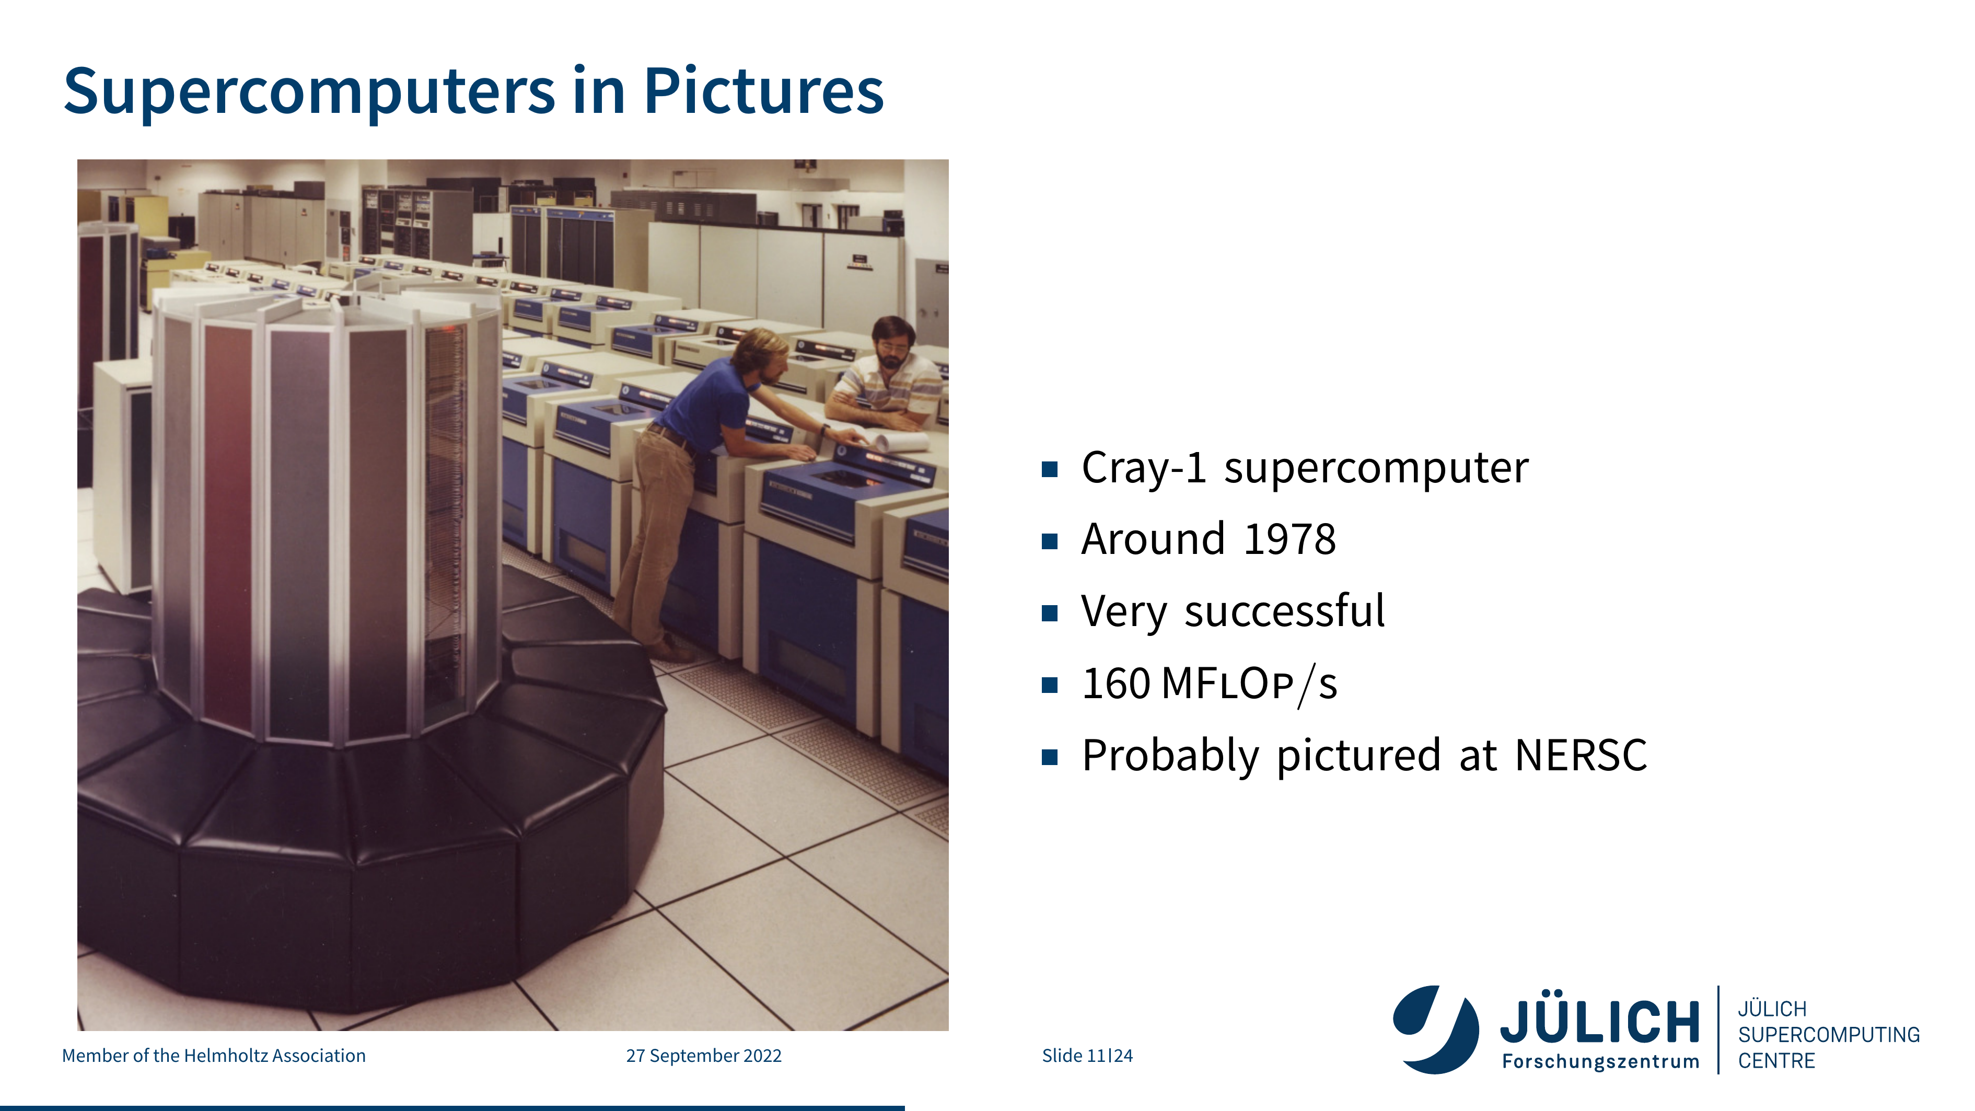

Slide 31
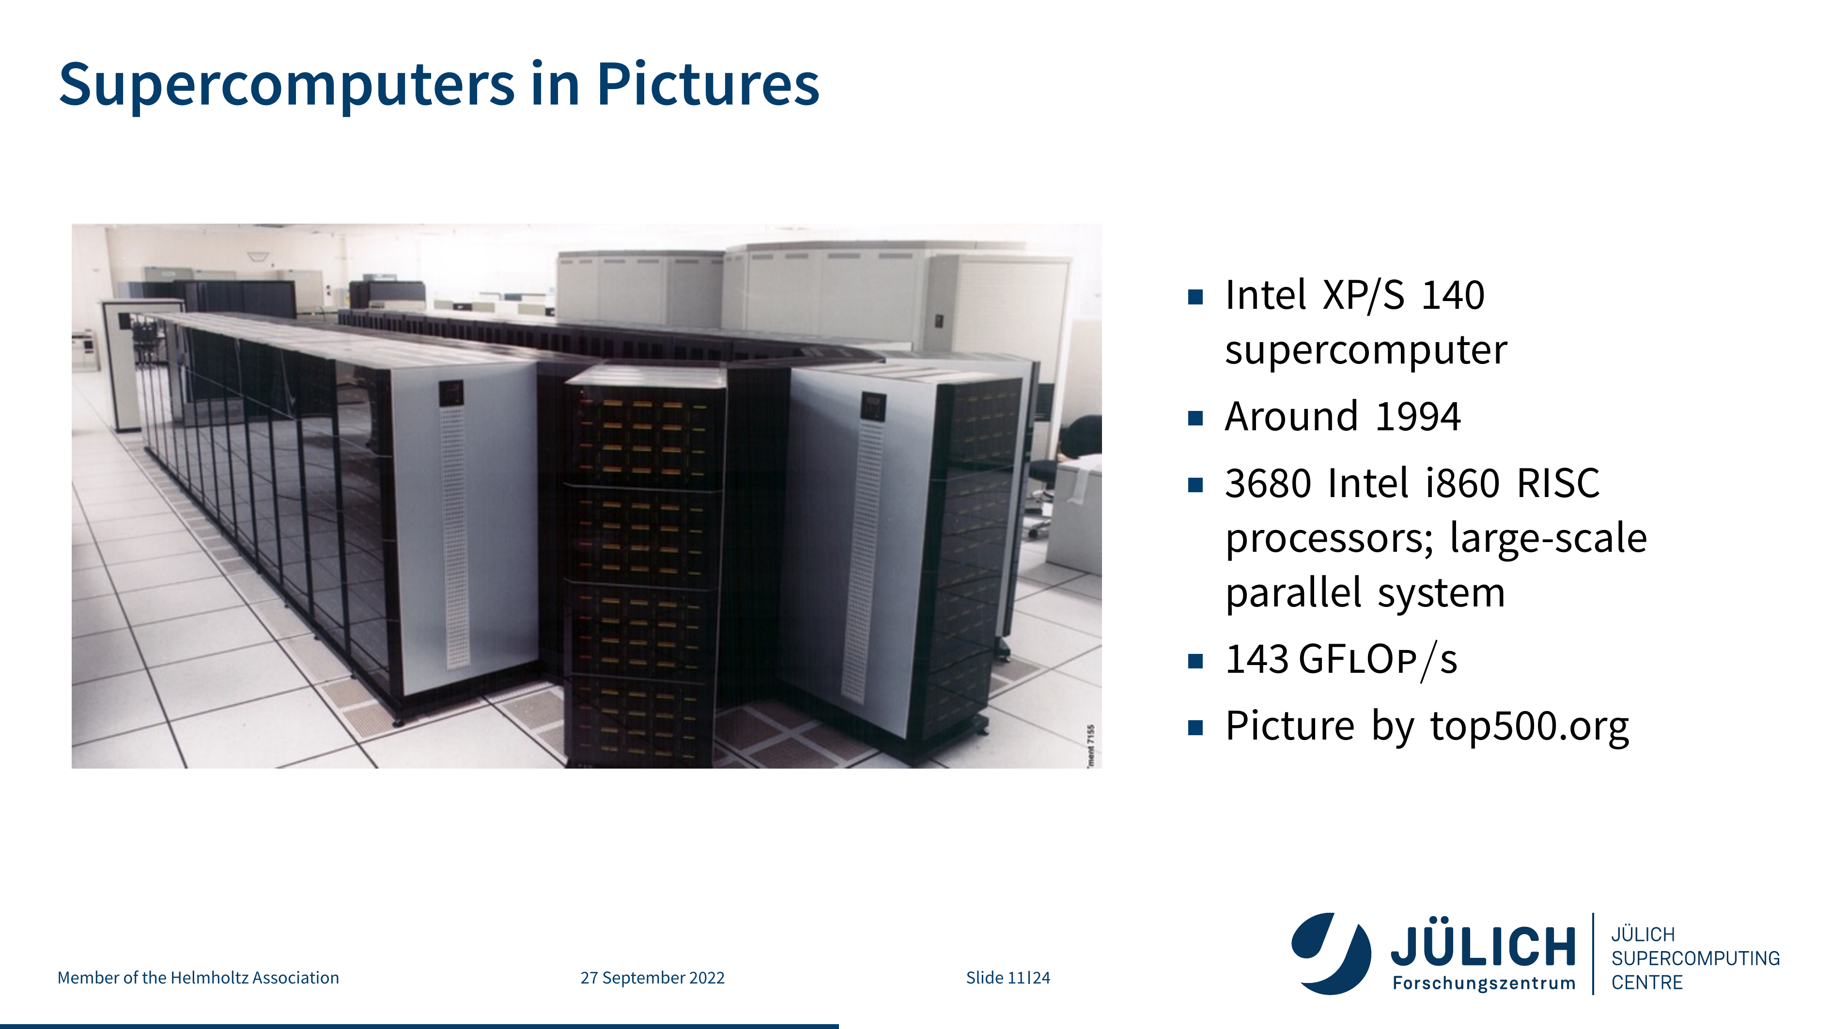

Slide 32
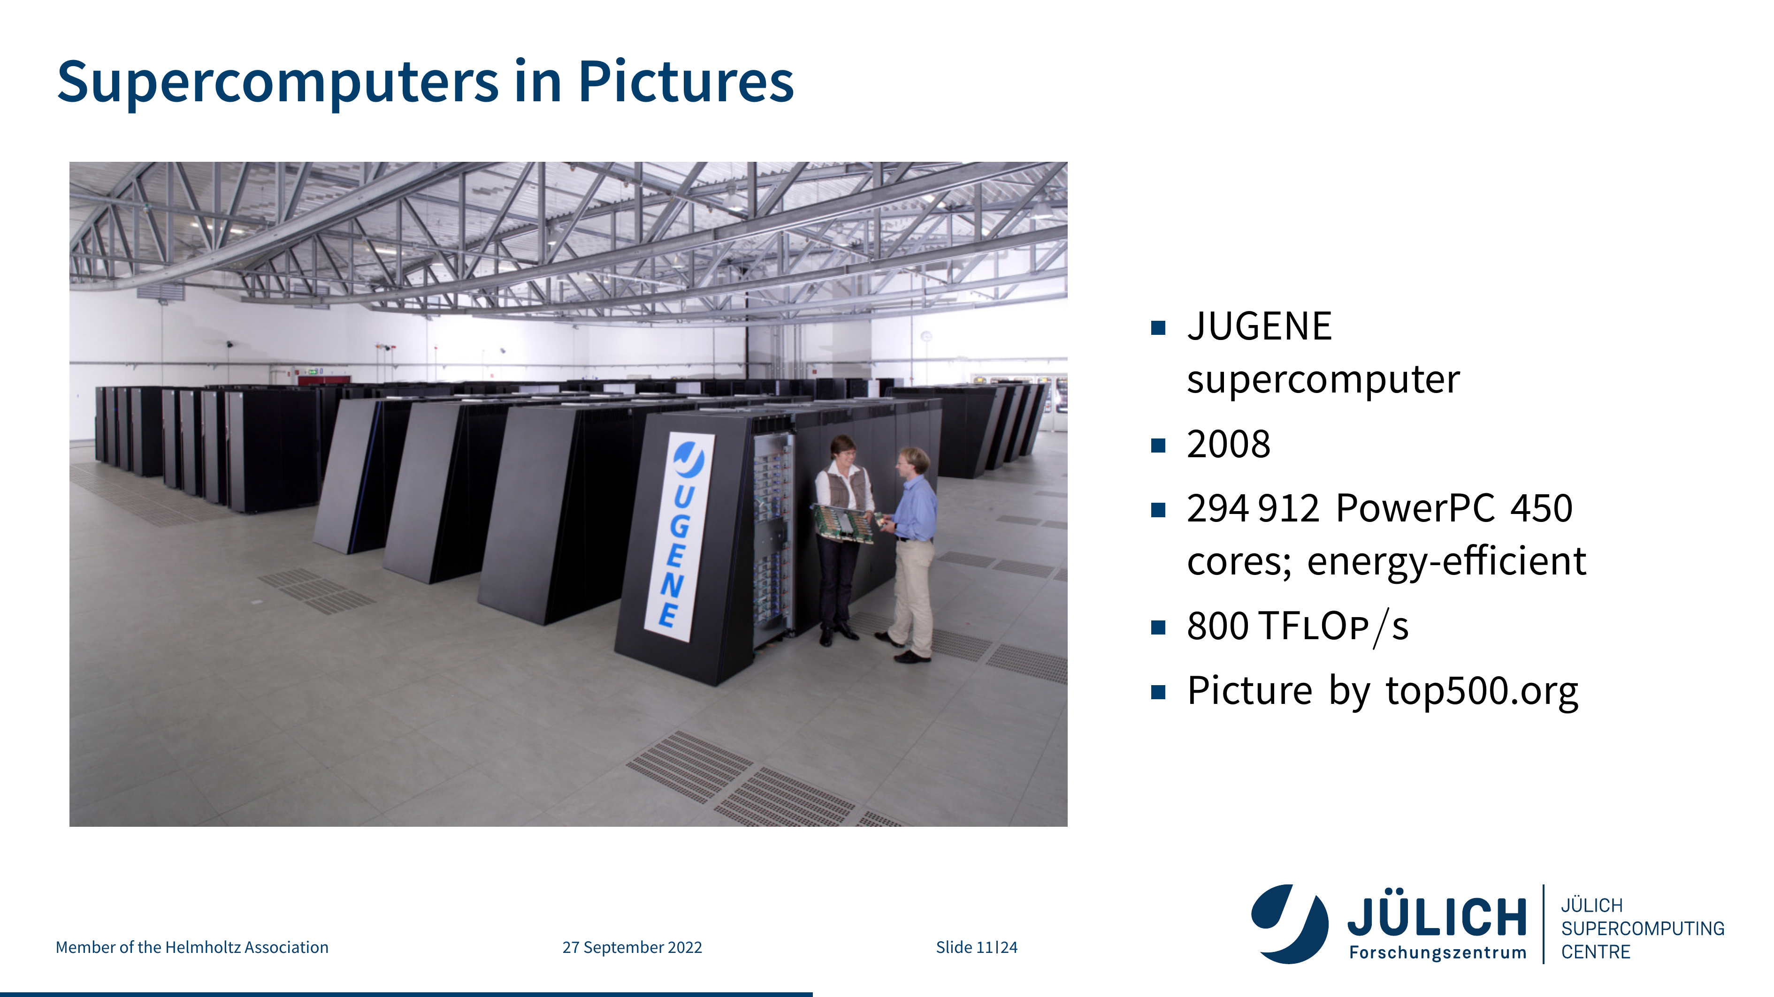

Slide 33
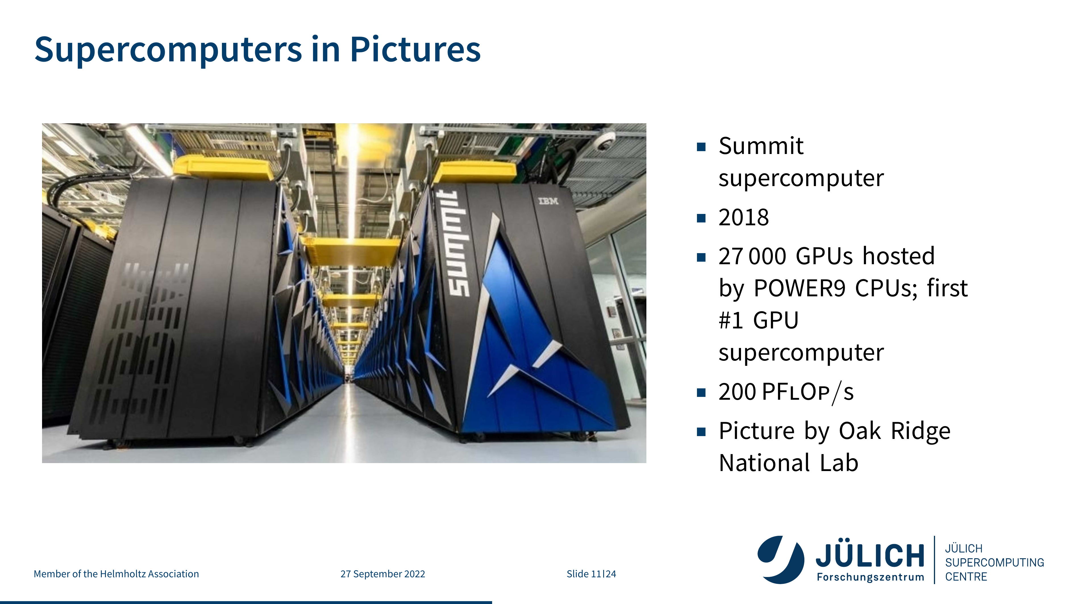

Slide 34
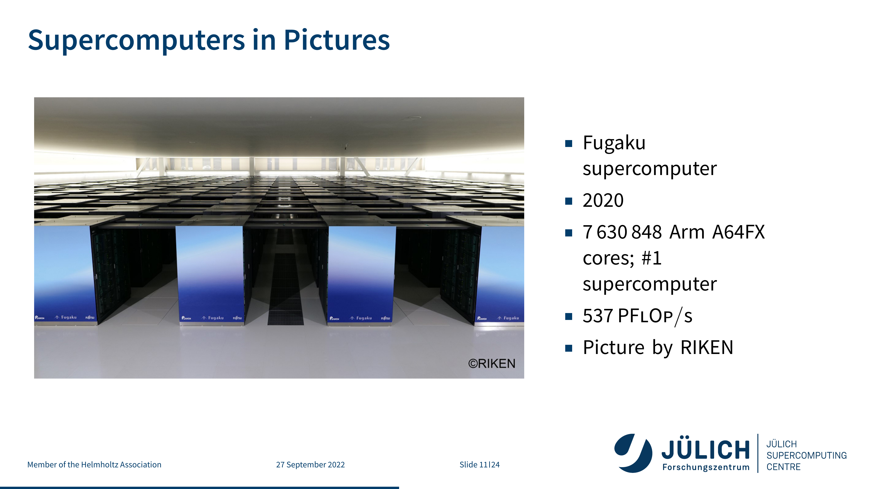

Slide 35
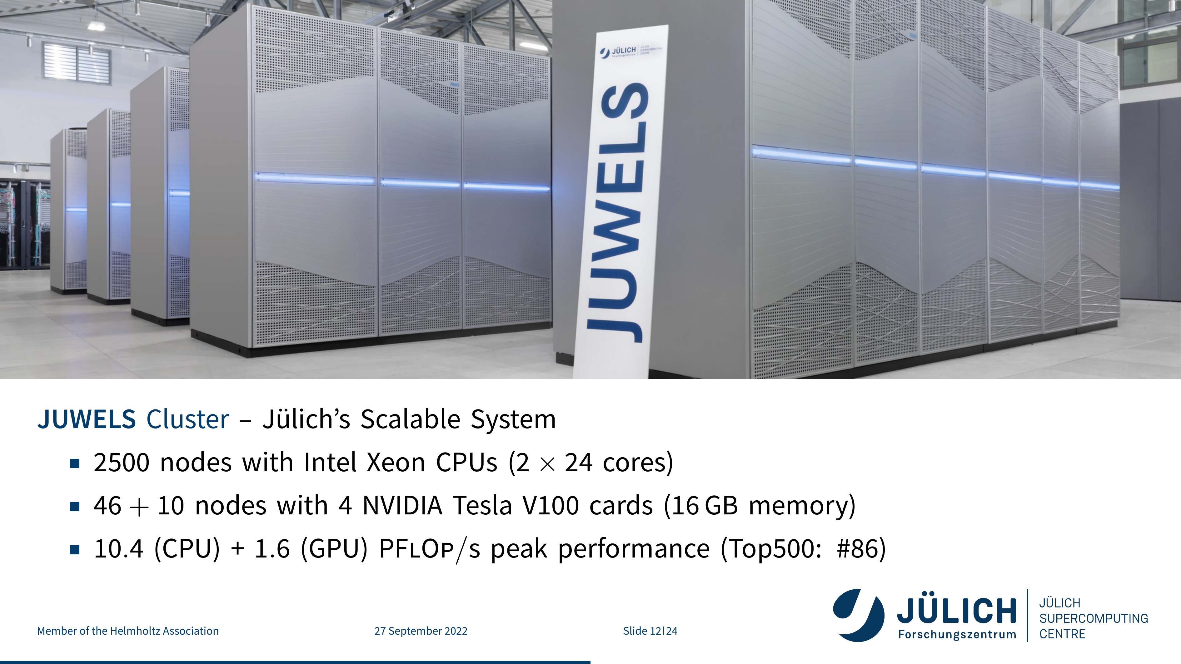

Slide 36
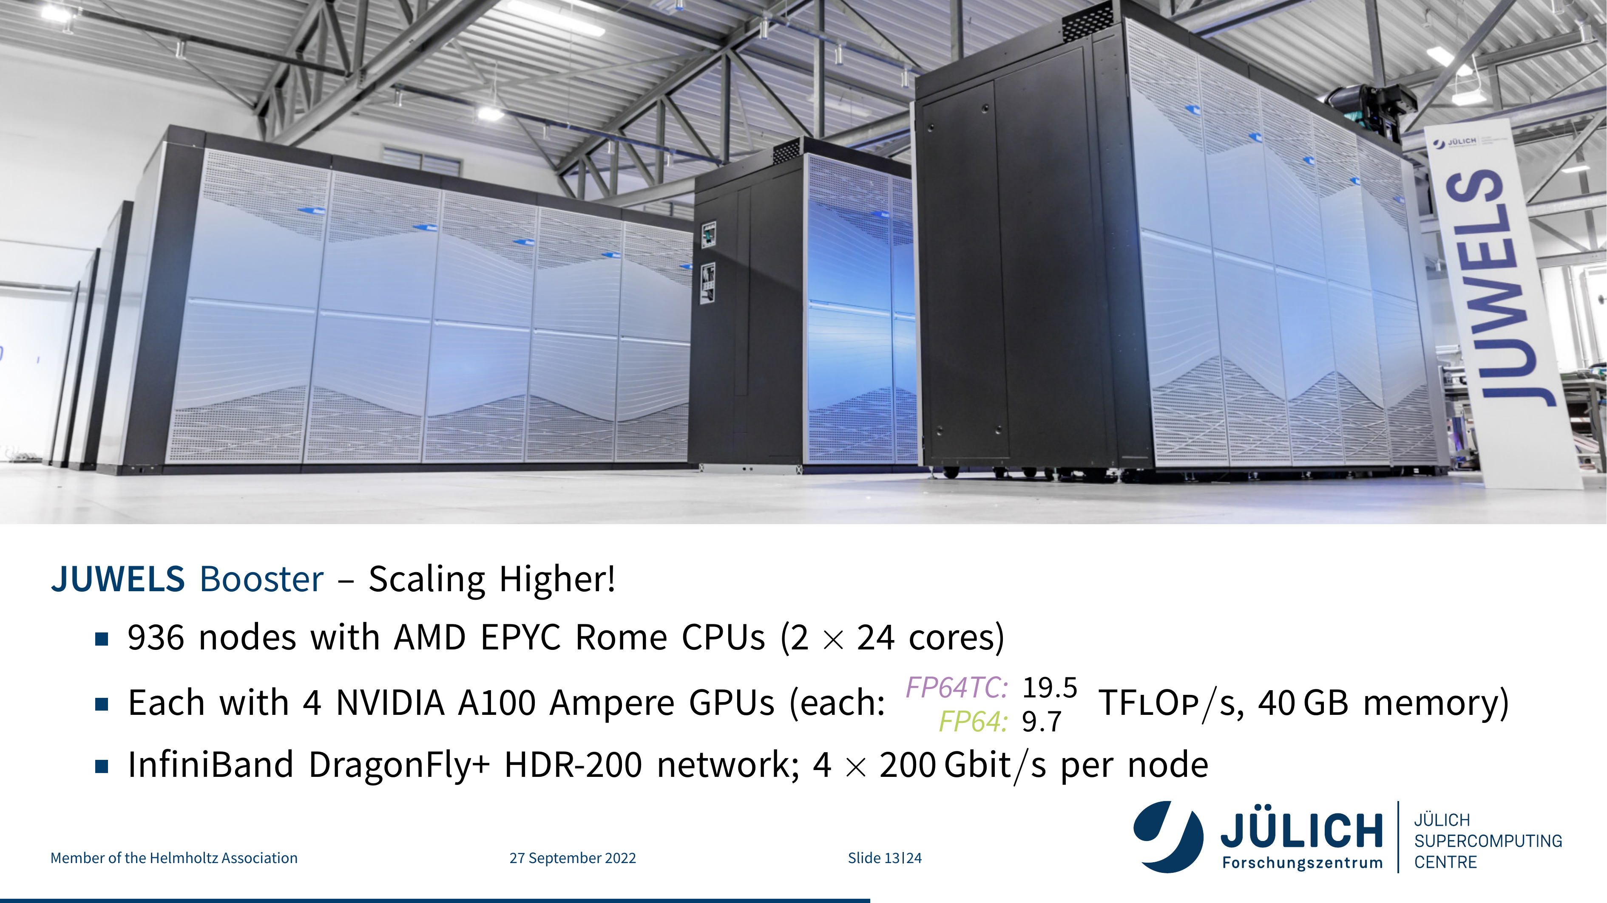

Slide 37
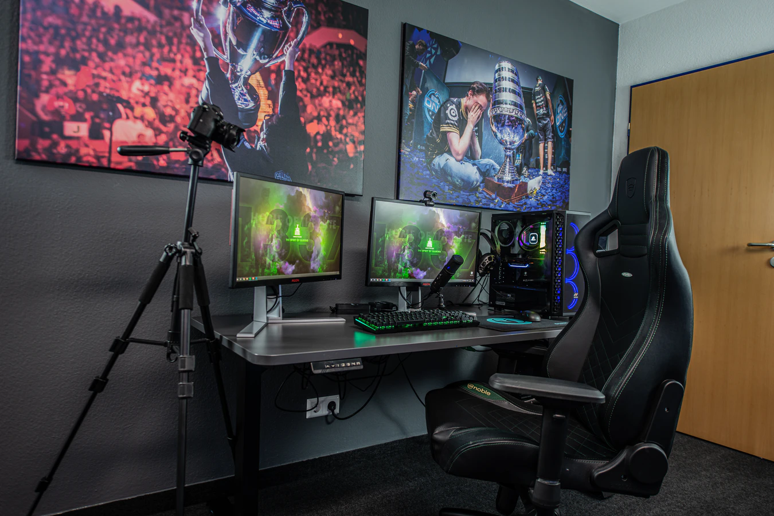
But, why HPC?
Int2cs, CC BY-SA 4.0
via Wikimedia Commons

Slide 38
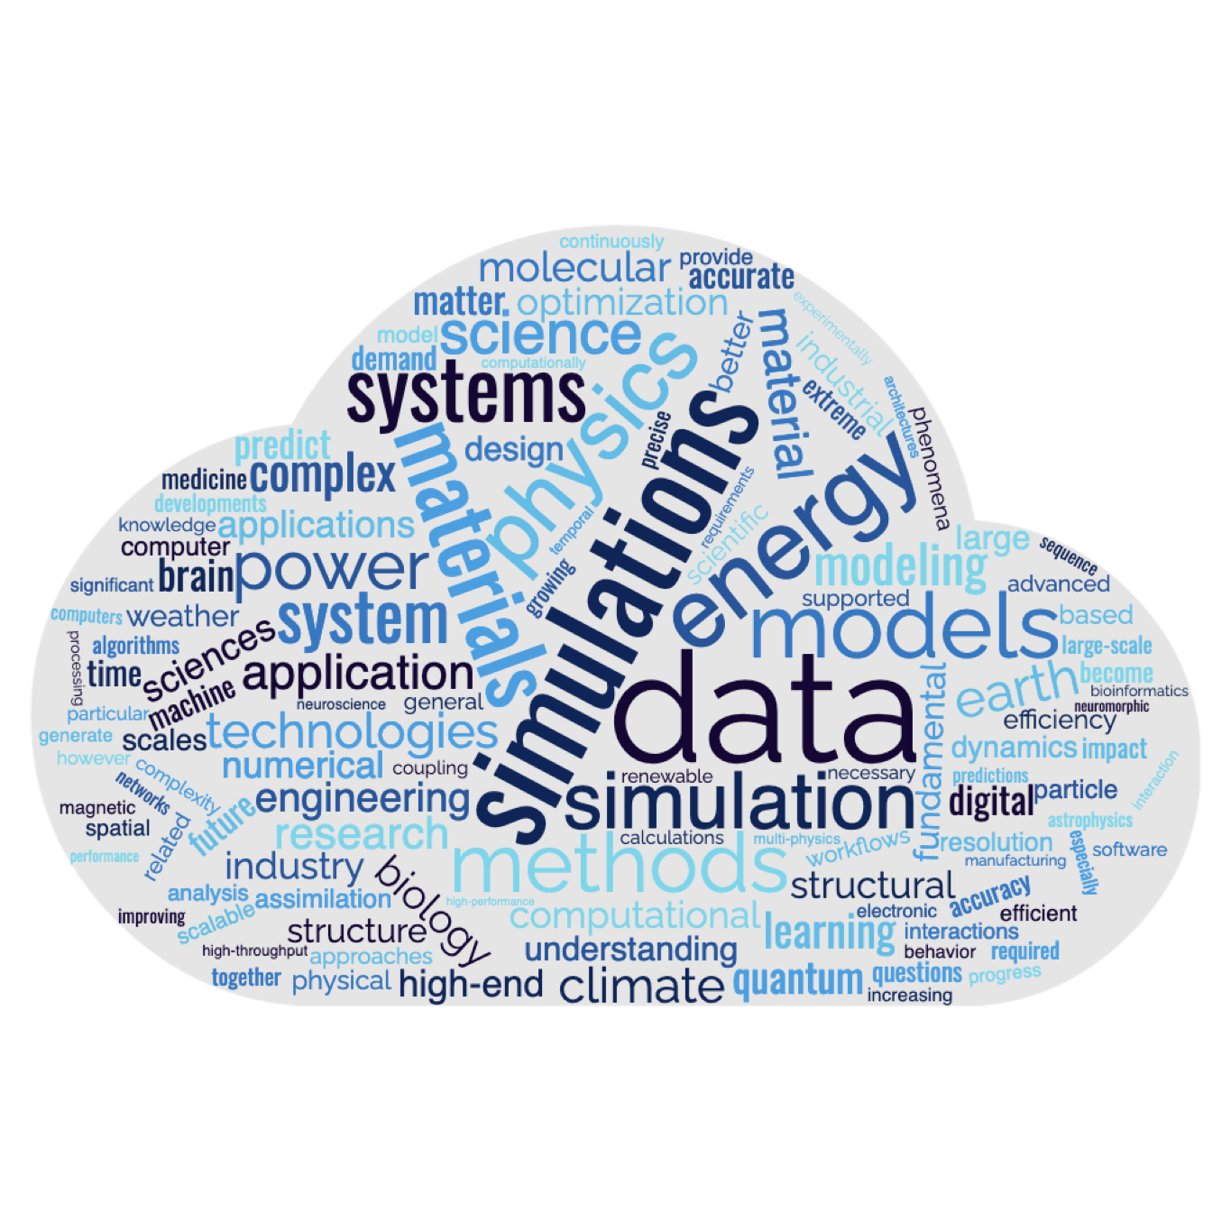
But, why HPC?

Slide 39
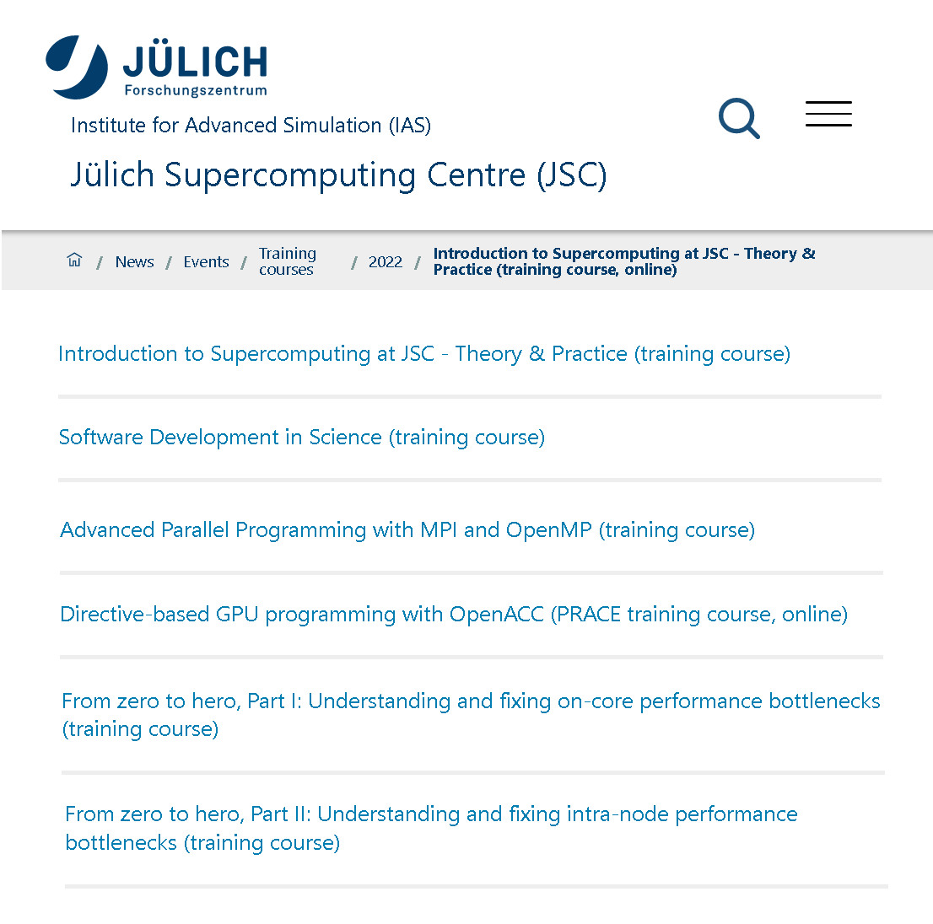

How do you do HPC?
Notes:
Research Groups
Computation Structural Biology
Computational Biophysical Chemistry
Quantum Information Processing.
SimLabs
Plasma – Climate - Fluid & Solid - Quantum Materials – Biology
Neuroscience - Molecular Systems - Nuclear & Particle physics - Terrestrial Systems - Astrophysics
Cross-Sectional Activities:
Deep Learning
Methods & Algorithms
Parallel Performance
Visualization
Application Optimization

Slide 40
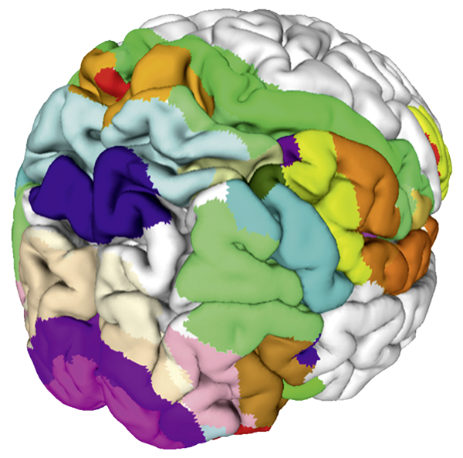
HPC application examples
(non-exhaustive list…)
Explore the human brain (“Jülich Brain Atlas”)
💡 Massive data sets generated from actual brains

Slide 41
Video 1
https://fz-juelich.sciebo.de/s/WKMSp3FGb9y7Ob6

Slide 42
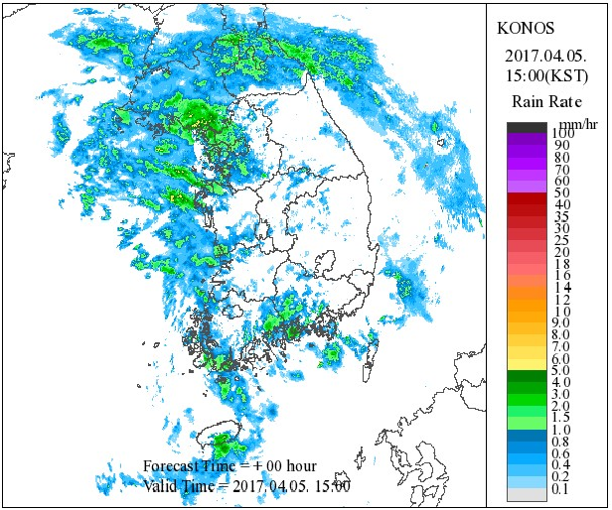
HPC application examples
(non-exhaustive list…)
Explore the human brain (“Jülich Brain Atlas”)
💡 Massive data sets generated from actual brains
Earth system modelling, here: weather forecasting
💡 Deep learning on real-world measurements

Slide 43
Video 2
https://fz-juelich.sciebo.de/s/2JxRiTOCsUf1pXv

Slide 44
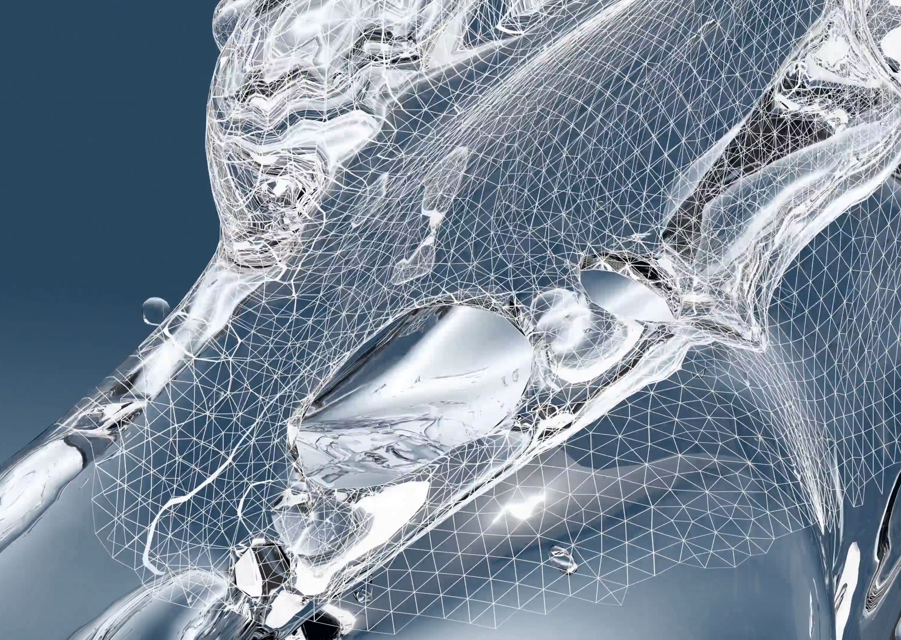
HPC application examples
(non-exhaustive list…)
Explore the human brain (“Jülich Brain Atlas”)
💡 Massive data sets generated from actual brains
Earth system modelling, here: weather forecasting
💡 Deep learning on real-world measurements
Liquid sheet breakup using direct numerical simulation
💡 Large-scale 3D simulations of complex physical phenomena

Slide 45
Video 3
https://fz-juelich.sciebo.de/s/jYLKzcVKQd0UhGQ

Slide 46
But, why Exascale?
Explore the human brain (“Jülich Brain Atlas”)
💡 Massive data sets generated from actual brains
⛔️ Currently only small parts of the brain in high-res
Earth system modelling, here: weather forecasting
💡 Deep learning on real-world measurements
⛔️ What about all the other effects impacting out weather?
Liquid sheet breakup using direct numerical simulation
💡 Large-scale 3D simulations of complex physical phenomena
⛔️ Shape optimization would need many of these simulations

Slide 47
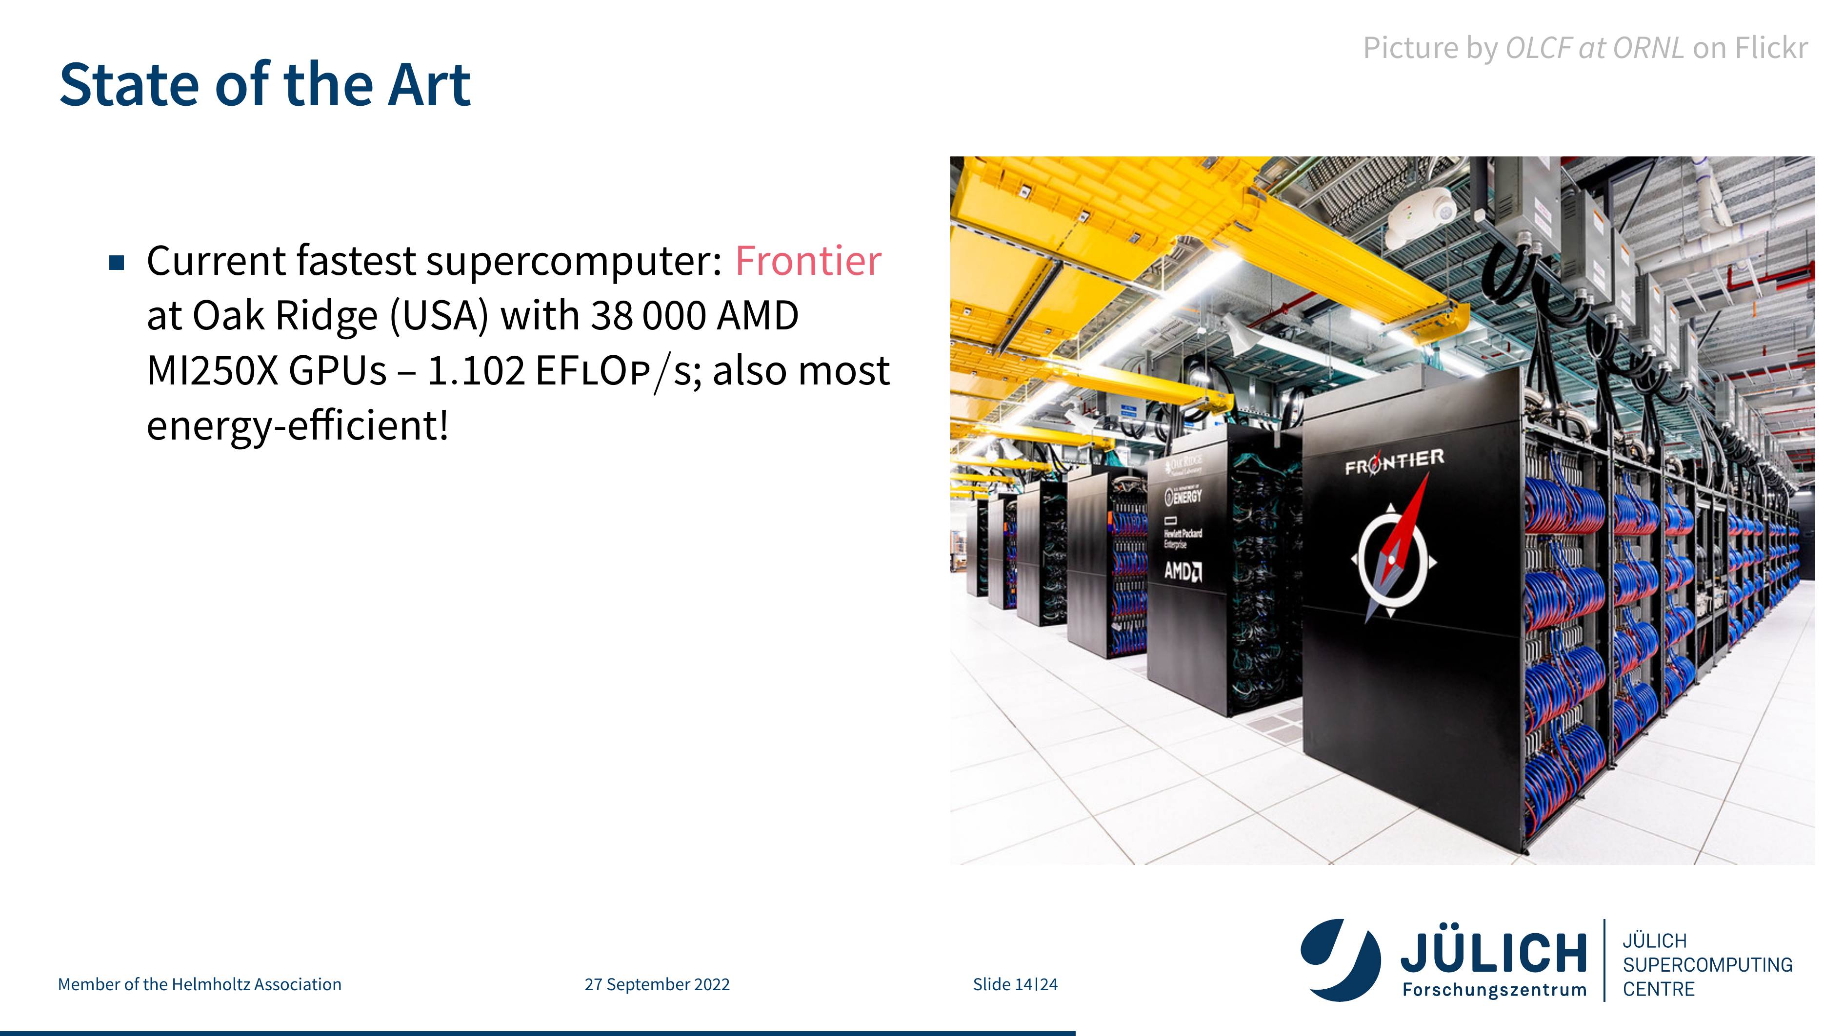

Slide 48
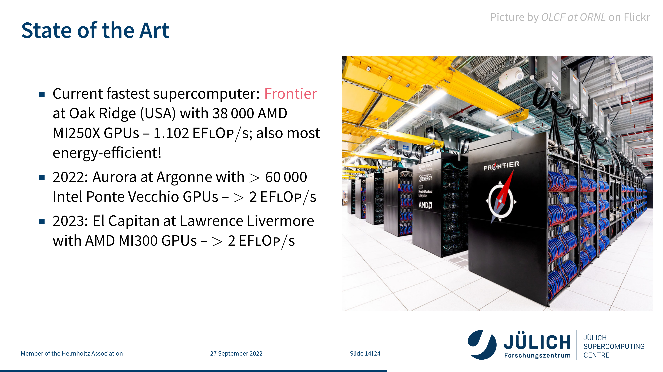

Slide 49
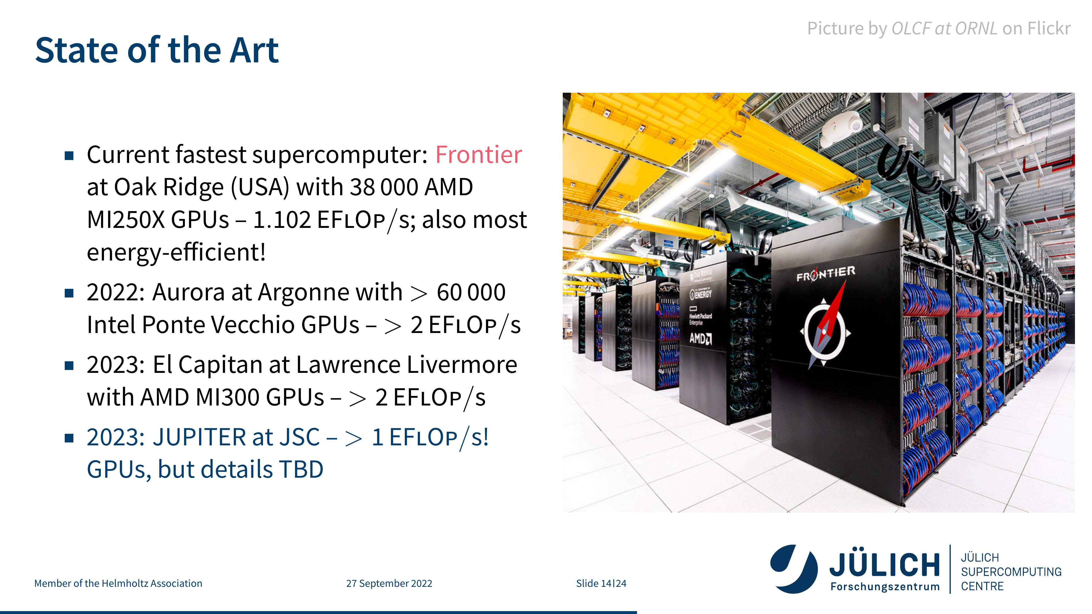

Slide 50
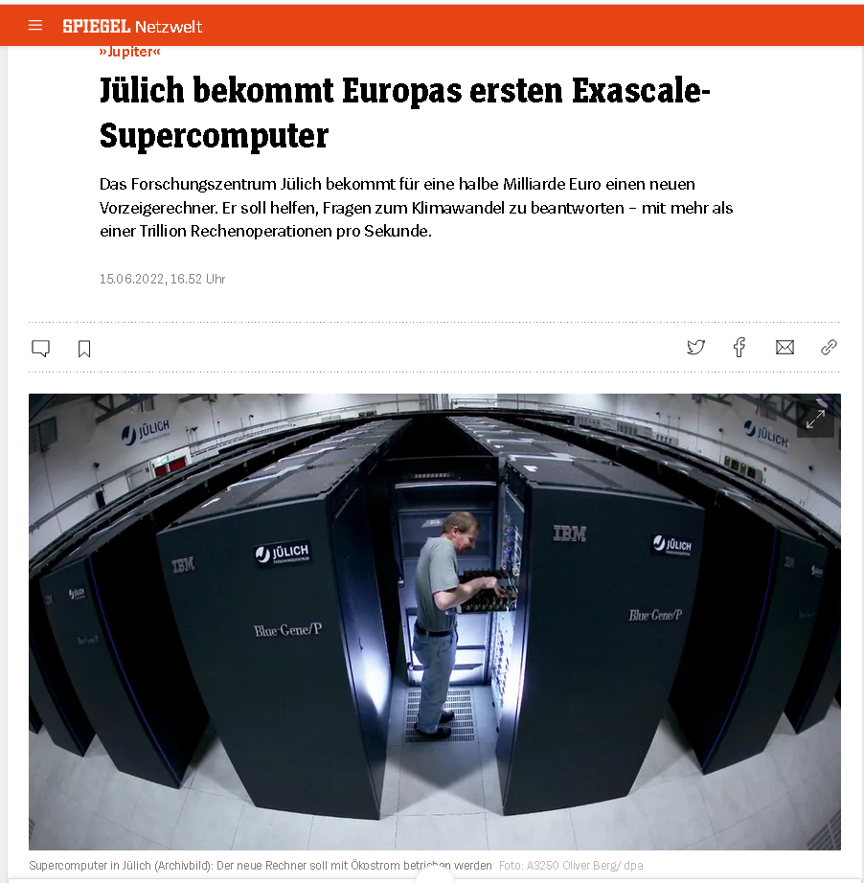
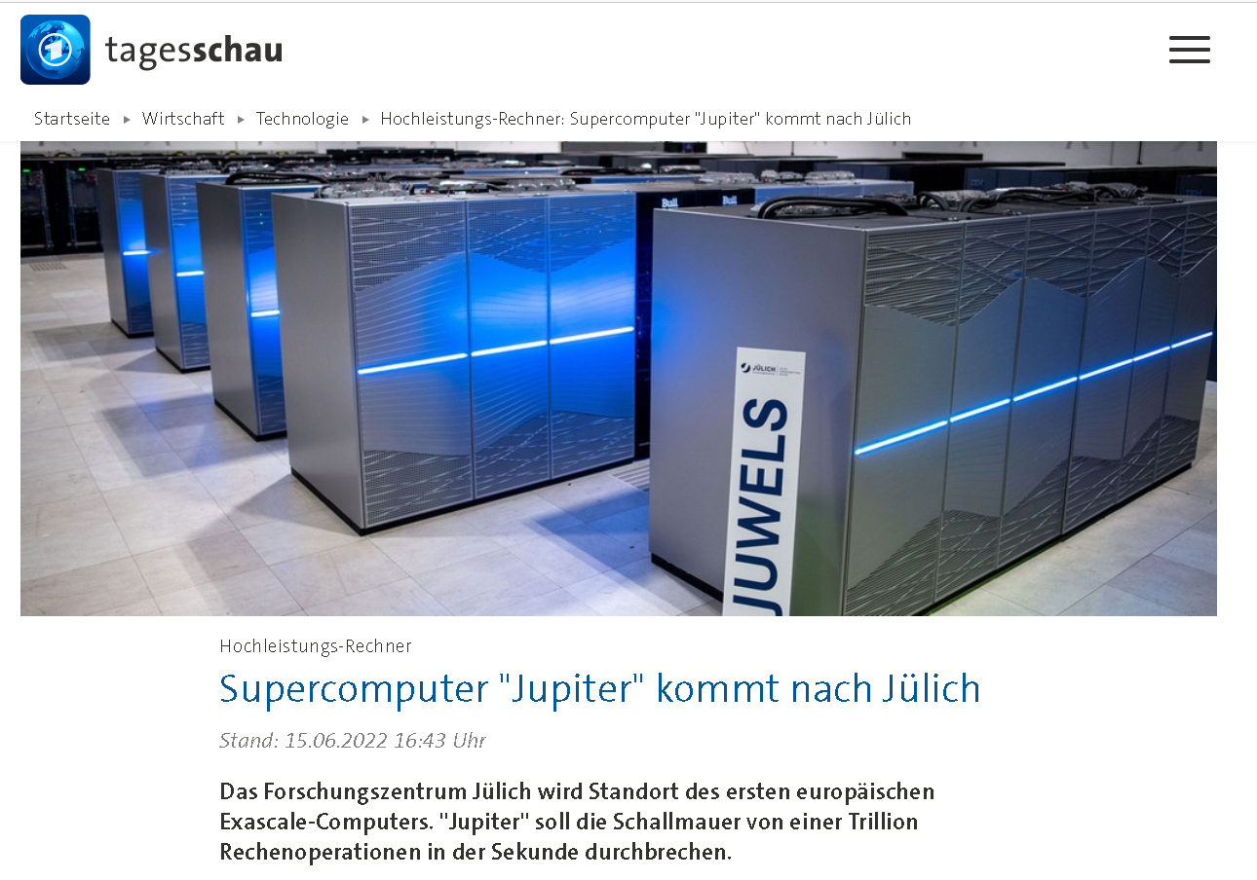
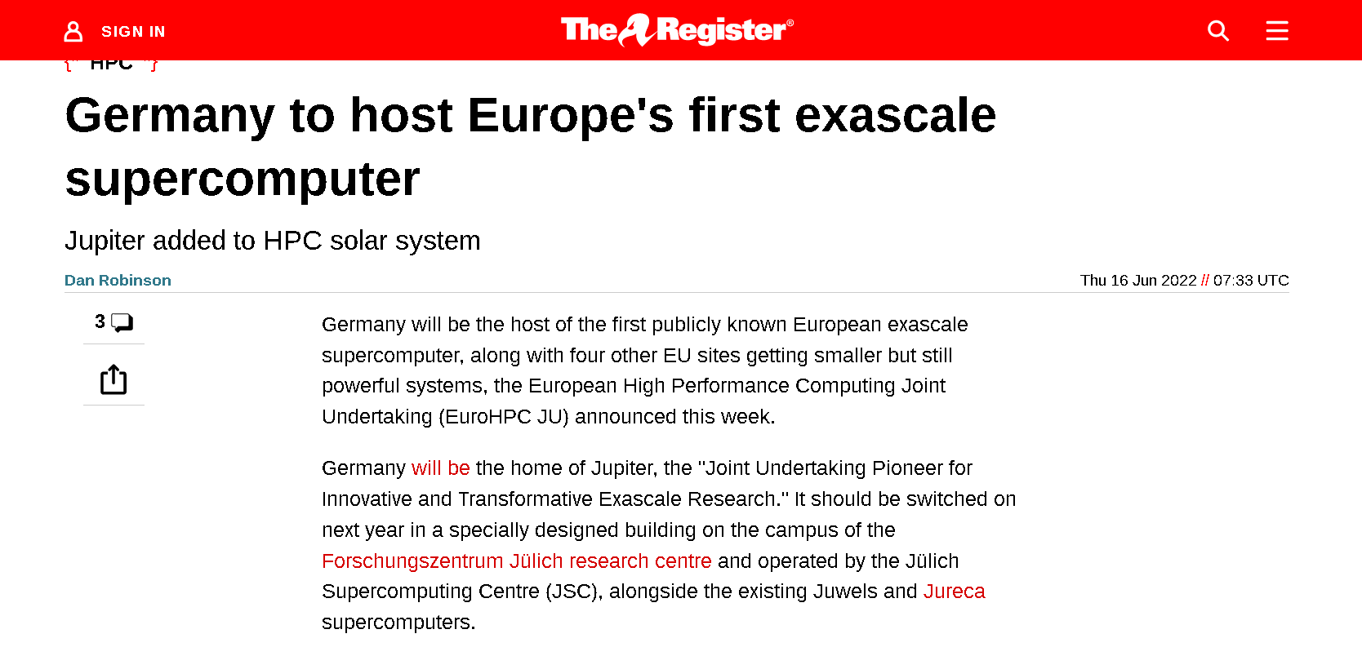
JUPITER announcement
Breaking news! (on 15.06.2022)

Slide 51
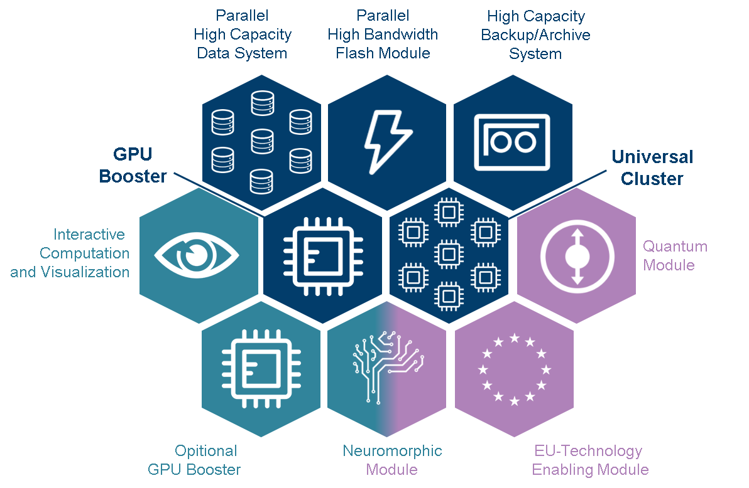
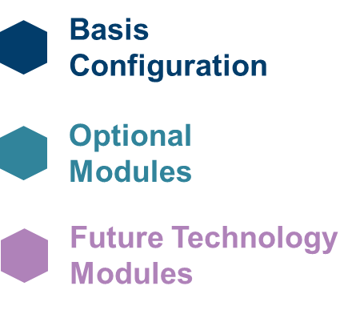
JUPITER – A modular supercomputer
Target >20×
application performance
compared to
JUWELS Booster
> 1 EB
> 1 EF
GPU
7.5 PB/s
x86 or ARM

Slide 52
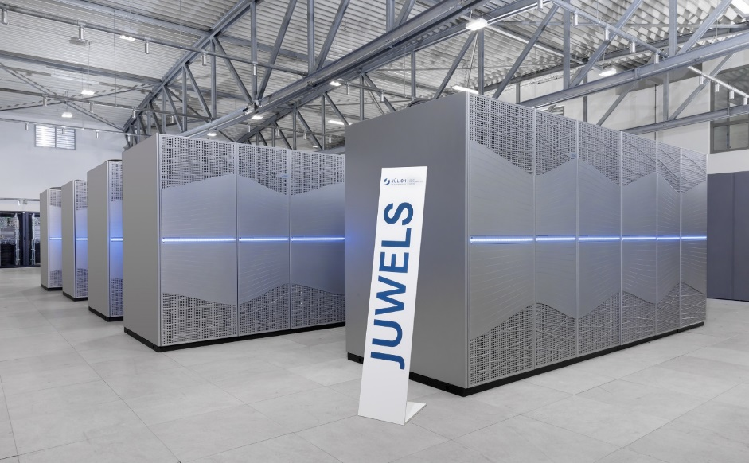
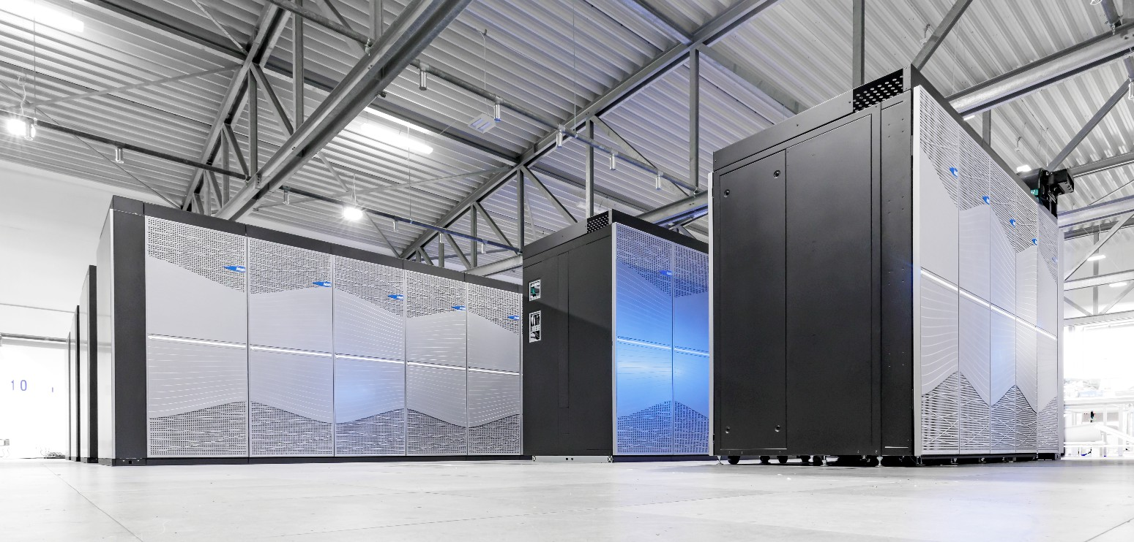
JUWELS – The first modular supercomputer
JUWELS Cluster
Intel Xeon (Skylake) processor
2,500 compute nodes
InfiniBand EDR network
~10 PFLOP/s peak (CPU-based)
JUWELS Booster
AMD EPYC Rome 7402 processor
3,700 NVIDIA A100 GPUs
InfiniBand HDR DragonFly+
~70 PFLOP/s peak (GPU-based)
JUWELS as blueprint for JUPITER
(modulo specific hardware vendors and generations)

Slide 53
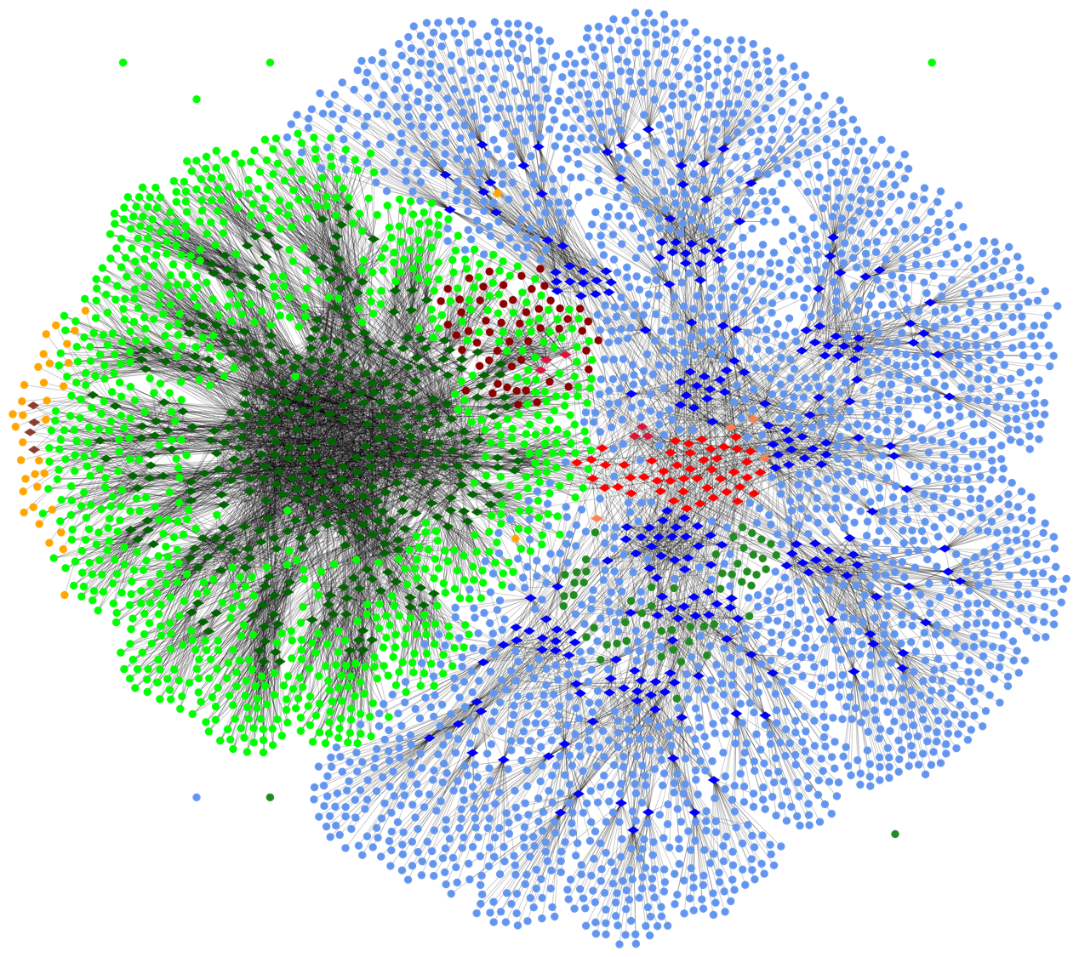
JUWELS connectivity
Welcome to the jungle
Cluster node
Cluster GPU node
Cluster switch
Cluster gateway
Top level switch
Booster node
Booster switch
Booster gateway
JUST-IME node
JUST-IME switch
Service node

Slide 54
Three take-away messages for tonight
1️⃣ HPC can be the only way to achieve specific scientific goals.
2️⃣ Exascale Computing heralds a new era for HPC.
3️⃣ Building and using these machines does not get easier.

Slide 55
One final comment
"I would rather have today's algorithms on yesterday's computers than vice versa."
Philippe Toint

Slide 56
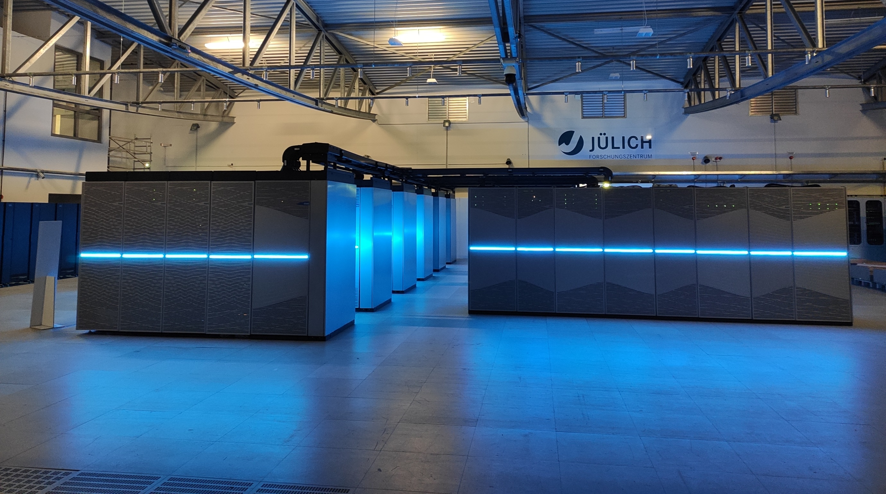
Thank You

Slide 57
JUWELS vs. JUPITER (expectations)
 | JUWELS | JUPITER
Cluster | CPU: Intel Xeon Platinum 8168 GPU: NVIDIA V100 HPL perf.: 10 PFlop/s | CPU: ? (AMD, Arm, Intel,…) GPU: none Mem. Bandwidth: 7.5 PB/s
Booster | CPU: AMD Epyc Rome GPU: NVIDIA A100 GPUs Peak: 70 PFlop/s | CPU: ? (AMD, Arm, Intel,…) GPU: ? (AMD, Intel, NVIDIA) Peak: 1 EFlop/s
Network topology | Fat tree + DragonFly+ | ? (likely some kind of DragonFly)
System access | GCS or PRACE proposals | GCS or EuroHPC proposals
User support | HLST, SDL, ATML, training courses, targeted early access program | same

Slide 58

User Support
Notes:
Research Groups
Computation Structural Biology
Computational Biophysical Chemistry
Quantum Information Processing.
SimLabs
Plasma – Climate - Fluid & Solid - Quantum Materials – Biology
Neuroscience - Molecular Systems - Nuclear & Particle physics - Terrestrial Systems - Astrophysics
Cross-Sectional Activities:
Deep Learning
Methods & Algorithms
Parallel Performance
Visualization
Application Optimization

Slide 59

Special programmes, e.g.:
JUWELS Booster Early Access Program
Preparation Timeline
Additional events
Q1-2020
Q1-2021

