Slide 1
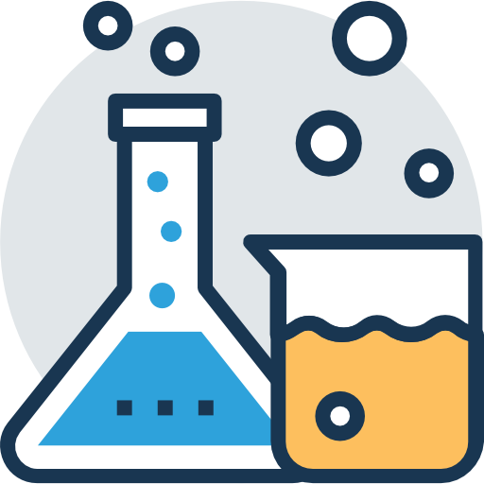
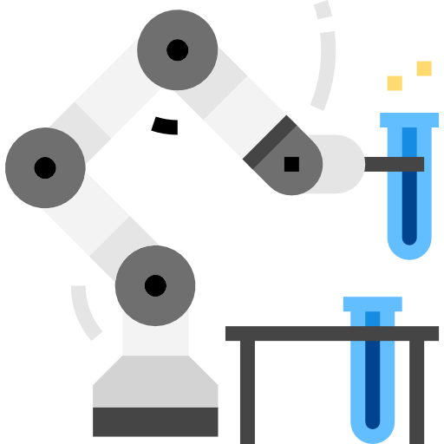

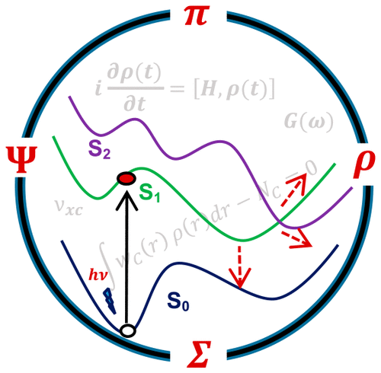
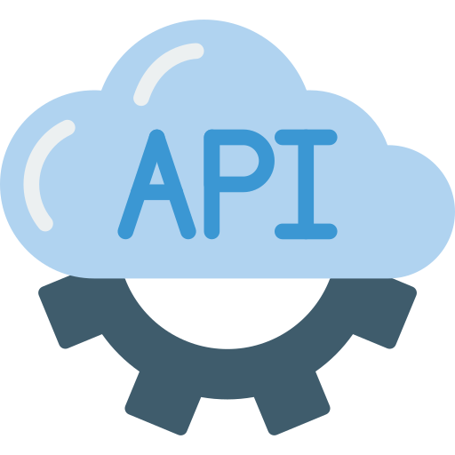

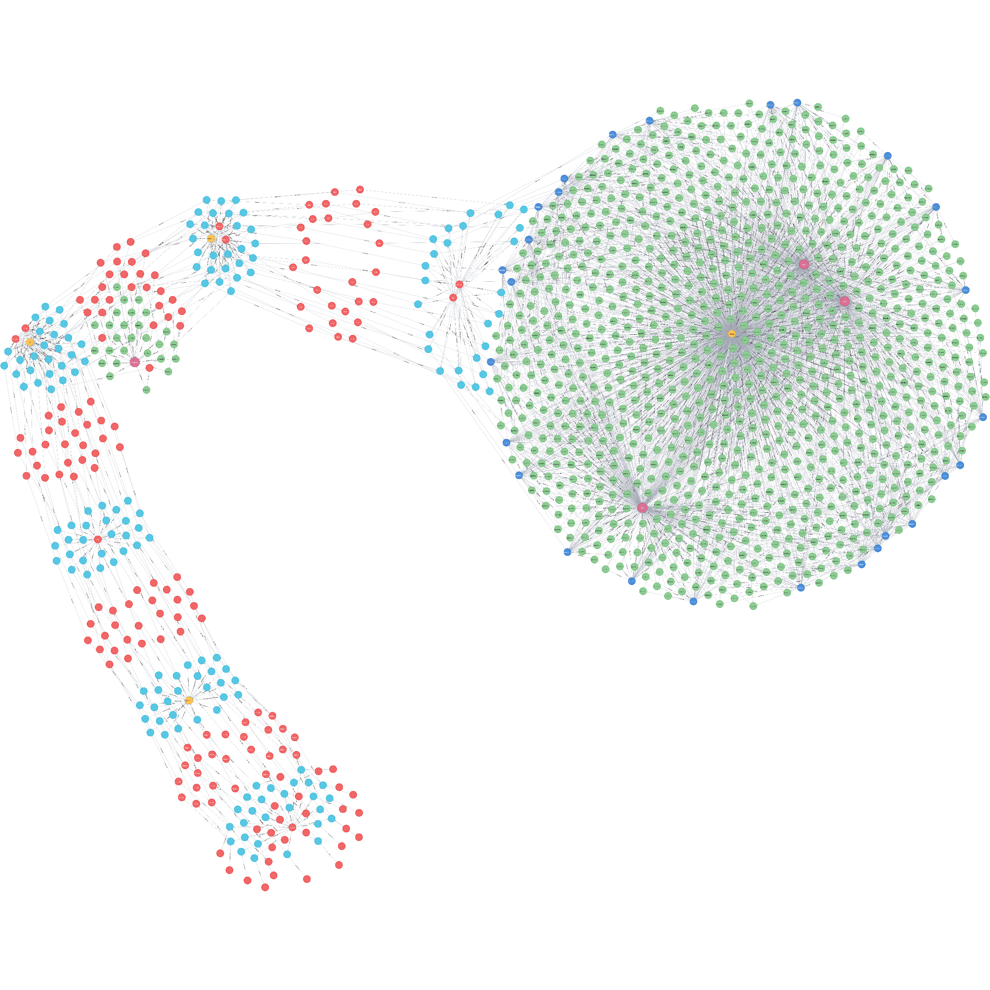
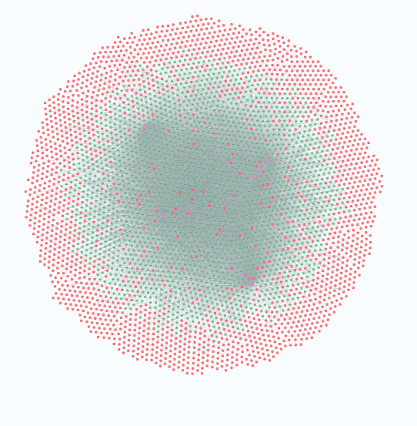
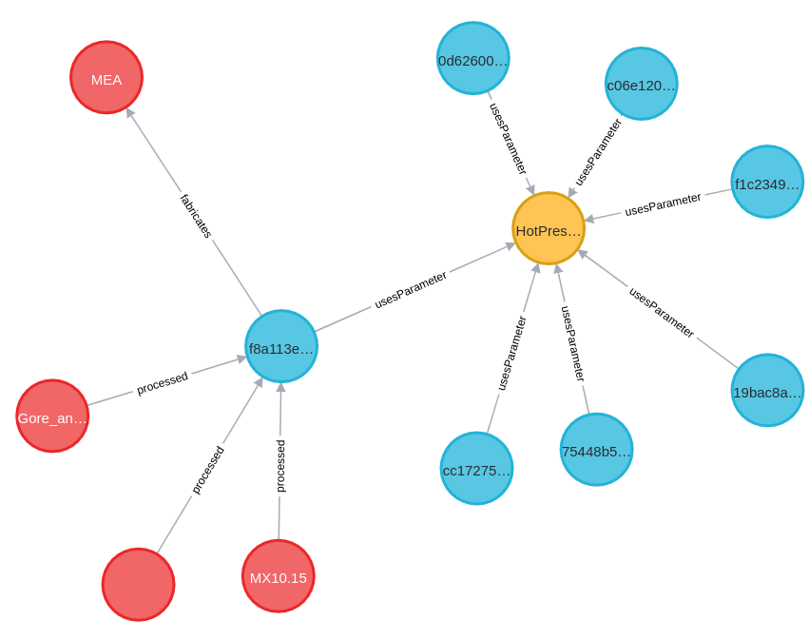
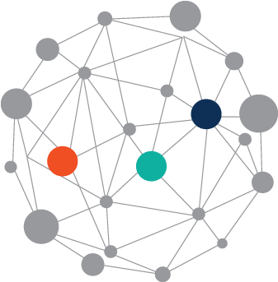
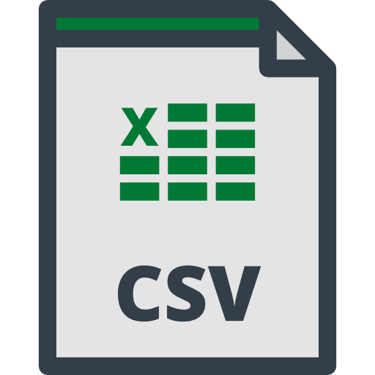

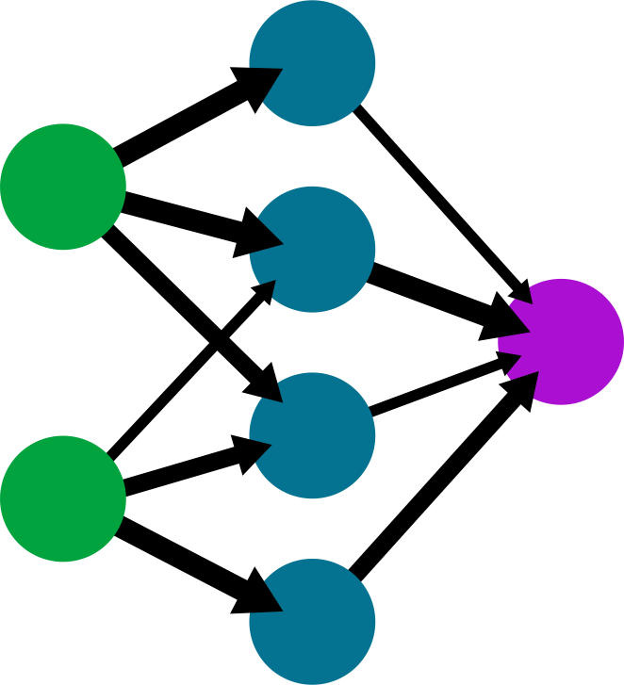
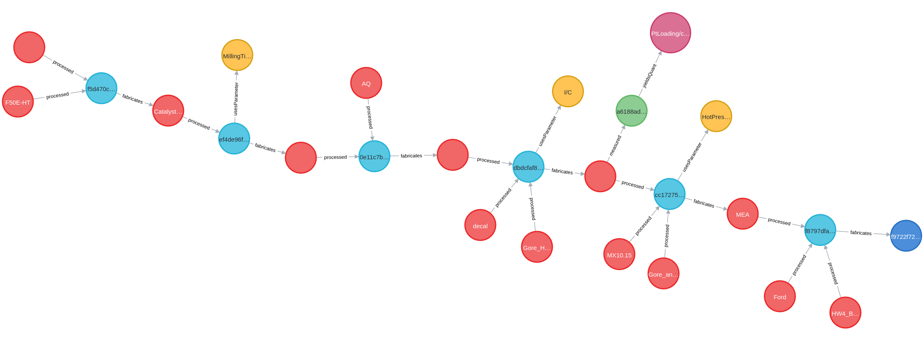









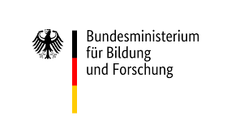

Synergizing Ontologies and
Graph Databases for Energy
Materials-to-Device Workflows
Max Dreger¹, Kourosh Malek¹, Jenia Jitsev², Michael H. Eikerling¹
¹Theory and Computation of Energy Materials (IEK-13), Forschungszentrum Jülich GmbH, 52425 Jülich, Germany
² Jülich Supercomputing Centre (JSC), Forschungszentrum Jülich, 52425 Jülich, Germany
Motivation
Database
  Vast amount of generated data in materials science
  Efficient data management will accelerate research^{[1,2]}
  Data needs to be FAIR^{[3]} and AI-ready^{[4]}
d
  Introduction of a workflow centered H₂ ontology
    Based on EMMO (European Material Modelling Ontology)
    Extended regarding Fuel Cells and fabrication workflows
  Setting up the Graph Database
Introduction of a workflow centered H₂ ontology
  Based on the EMMO ontology
  Extended regarding fuel cells and fabrication workflows
Project Goals
Property
  Standardization of fabrication workflow development
  Optimization for data analysis and AI-enabled models
yieldQuant
measured
hasPart
processed
hasPart
Measurement
Matter
Manufacturing
Project
hasParticipant
fabricates
hasParticipant
Experimental Data
Self-Driven
Labs
Imaging
Data
Simulation
Data
Metadata
Object Graph Mapping
Data Sources
2. Setting up the Graph Data Base
Fabrications
Simulations
Process
Database
Workflow
Material/
Component
Measurement
Manufacturing
Property
Parameter
Device
Backend
Backend
Theoretical Background
      Ontology-data model mapping^{[10]}
  Enables ontology-based output
  → improves interoperability
      Object-Graph Mapping^{[11]}
  DB items expressed as python objects
  → enables integration in platform
      Ontologies^{[5]}
  Formal description of
  domain-specific knowledge
  EMMO^{[6,7]} (European
  Material Modelling Ontology)
      Graph Databases^{[8,9]}
  Usage of graph structures
  for data storage
  Nodes have labels and are
  connected via relationships
Process
Ontology
Object
isA
hasParticipant
hasPart
Manufactured
Next Steps
Graph DB
  Implementation of an API to facilitate input/output
  ML models (e.g., supervised pretraining)
  Extension of ontology to different domains
Material
Process
Cat.
Ink
processed
Process
ID
References
Data Sources
[1] Tanaka, I., Rajan, K. & Wolverton, C. Data-centric science for materials innovation. MRS Bull. 43, 659–663 (2018).
[2] Draxl, C. & Scheffler, M. In Handbook of Materials Modeling eds Andreoni, W. & Yip, S. 49–73 Springer (2020).
[3] Wilkinson, M. D. et al. The FAIR Guiding Principles for scientific data management and stewardship. Sci. Data 3, 160018 (2016).
[4] Scheffler, M., Aeschlimann, M et al. FAIR data enabling new horizons for materials research. Nature 604 (2022).
[5] Uschold, M., and King, M. Towards a methodology for building ontologies. Edinburgh: AIAI (1995).
[6] https://emmo-repo.github.io/versions/1.0.0-beta4/emmo.html (02.08.2022).
[7] https://big-map.github.io/BattINFO/index.html (02.08.2022).
[8] Ian, R., Webber, J., et al. Graph databases: new opportunities for connected data. O'Reilly Media, Inc., (2015).
[9] Van Bruggen, Rik. Learning Neo4j. Packt Publishing Ltd, (2014).
[10] https://neo4j.com/labs/neosemantics/4.0/ (02.08.2022).
[11] https://neomodel.readthedocs.io/en/latest/ (02.08.2022).
  High heterogeneity in data types, spatial and temporal scales as well as scientific methods
Requirements
  Standardization of data types
  Well-defined and flexible data infrastructure
Acknowledgement:
The funding of this project is provided by the German-Canadian Materials Acceleration Center (GCMAC) and the HITEC fellowship.
Additionally, the authors gratefully acknowledge the cooperation of Prof. Jasna Jankovic (UCONN, USA) and Fabian Tipp (JSC) for providing fabrication data and simulation data and Dr. Mohammad J. Eslamibidgoli for his support during the different stages of the project.

