Slide 1
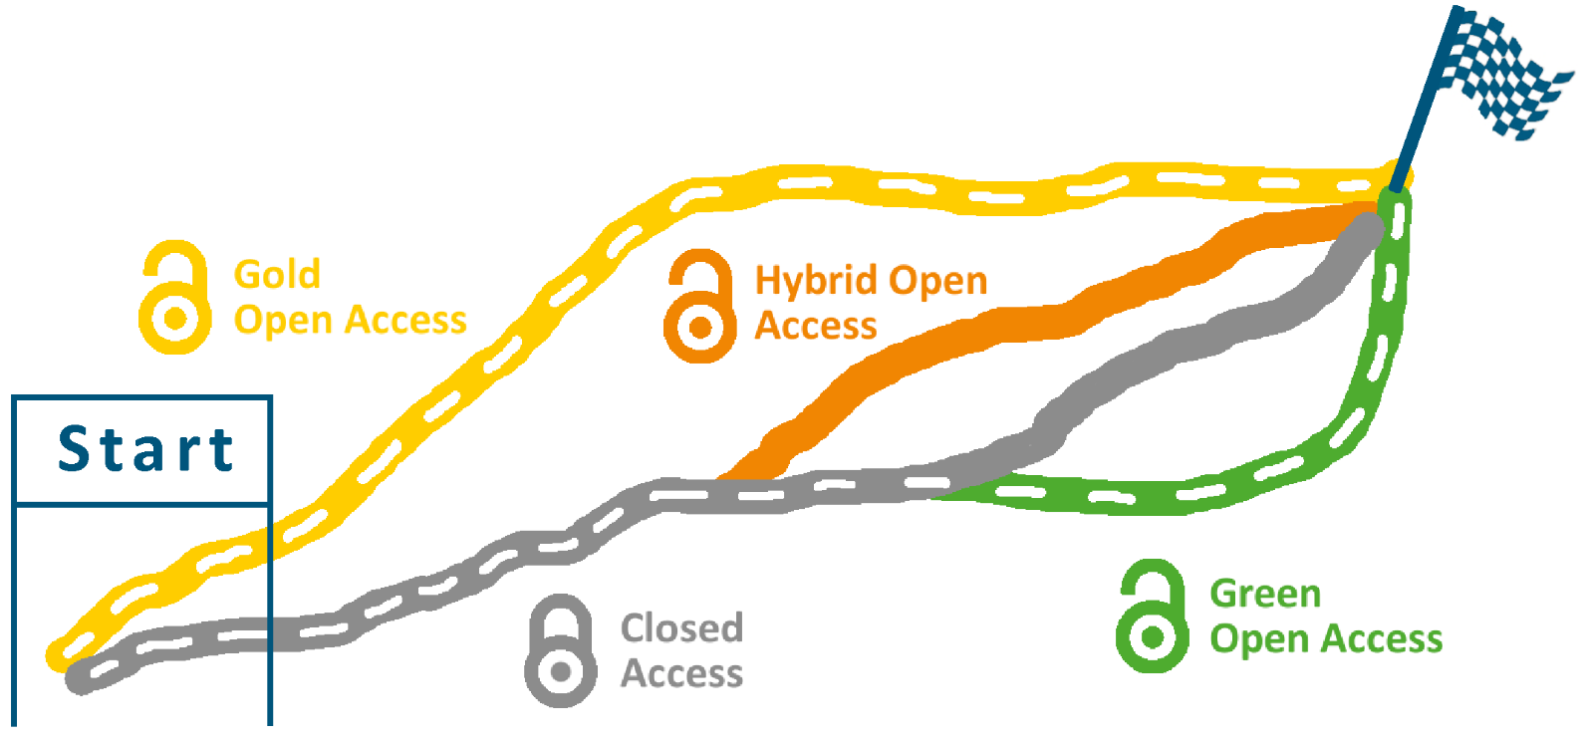
Open Access
Monthly Meeting DocTeam
01 February 2023 I Dr. Bernhard Mittermaier, ZB
Based on http://hdl.handle.net/2128/19919

Slide 2
“Open Access describes the goal of making global knowledge accessible and re-usable in digital form without financial, technical or legal barriers.”
Allianz der deutschen Wissenschaftsorganisationen

Slide 3
c
Open Access Journals | Diamond Open Access | Publisher‘s version immediately available without restrictions on publisher‘s website No Article Processing Charge No additional charge Author retains the copyright
 | Gold Open Access | Publisher‘s version immediately available without restrictions on publisher‘s website Article Processing Charge No additional charge Author retains the copyright
Subscription Journals | Green Open Access | Post-Print immediately or after embargo available without restrictions in repository Possibly publication fees No additional charge Author transfers the copyright, Permissions
 | Hybrid Open Access | Publisher‘s version immediately available without restrictions on publisher‘s website Possibly publication fees Additional charge Author might transfer the copyright
 | Closed Access | Publisher‘s version immediately available for subscribers on publisher‘s website Possibly publication fees No additional charge Author transfers the copyright Permissions for re-use necessary

Slide 4
Open Access Journals | Diamond Open Access | Publisher‘s version immediately available without restrictions on publisher‘s website No Article Processing Charge No additional charge Author retains the copyright
 | Gold Open Access | Publisher‘s version immediately available without restrictions on publisher‘s website Article Processing Charge No additional charge Author retains the copyright
Subscription Journals | Green Open Access | Post-Print immediately or after embargo available without restrictions in repository Possibly publication fees No additional charge Author transfers the copyright, Permissions
 | Hybrid Open Access | Publisher‘s version immediately available without restrictions on publisher‘s website Possibly publication fees Additional charge Author might transfer the copyright
 | Closed Access | Publisher‘s version immediately available for subscribers on publisher‘s website Possibly publication fees No additional charge Author transfers the copyright Permissions for re-use necessary
c

Slide 5
Open Access Journals | Diamond Open Access | Publisher‘s version immediately available without restrictions on publisher‘s website No Article Processing Charge No additional charge Author retains the copyright
 | Gold Open Access | Publisher‘s version immediately available without restrictions on publisher‘s website Article Processing Charge No additional charge Author retains the copyright
Subscription Journals | Green Open Access | Post-Print immediately or after embargo available without restrictions in repository Possibly publication fees No additional charge Author transfers the copyright, Permissions
 | Hybrid Open Access | Publisher‘s version immediately available without restrictions on publisher‘s website Possibly publication fees Additional charge Author might transfer the copyright
 | Closed Access | Publisher‘s version immediately available for subscribers on publisher‘s website Possibly publication fees No additional charge Author transfers the copyright Permissions for re-use necessary

Slide 6
Open Access Journals | Diamond Open Access | Publisher‘s version immediately available without restrictions on publisher‘s website No Article Processing Charge No additional charge Author retains the copyright
 | Gold Open Access | Publisher‘s version immediately available without restrictions on publisher‘s website Article Processing Charge No additional charge Author retains the copyright
Subscription Journals | Green Open Access | Post-Print immediately or after embargo available without restrictions in repository Possibly publication fees No additional charge Author transfers the copyright, Permissions
 | Hybrid Open Access | Publisher‘s version immediately available without restrictions on publisher‘s website Possibly publication fees Additional charge Author might transfer the copyright
 | Closed Access | Publisher‘s version immediately available for subscribers on publisher‘s website Possibly publication fees No additional charge Author transfers the copyright Permissions for re-use necessary

Slide 7
Submission
Acceptance
Publication
Peer-Review

Slide 8
Submission
Acceptance
Publication
Peer-Review
Pre-Print
Post-Print
Publisher‘s Version
First Draft
Final Draft Post-Referee
Publisher‘s PDF
Author‘s Manuscript
Author‘s Fulltext
without Publisher‘s layout
without Publisher‘s layout
with Publisher‘s layout

Slide 9

Icon made by Freepik from Flaticon and is licensed by CC BY 3.0.

Slide 10

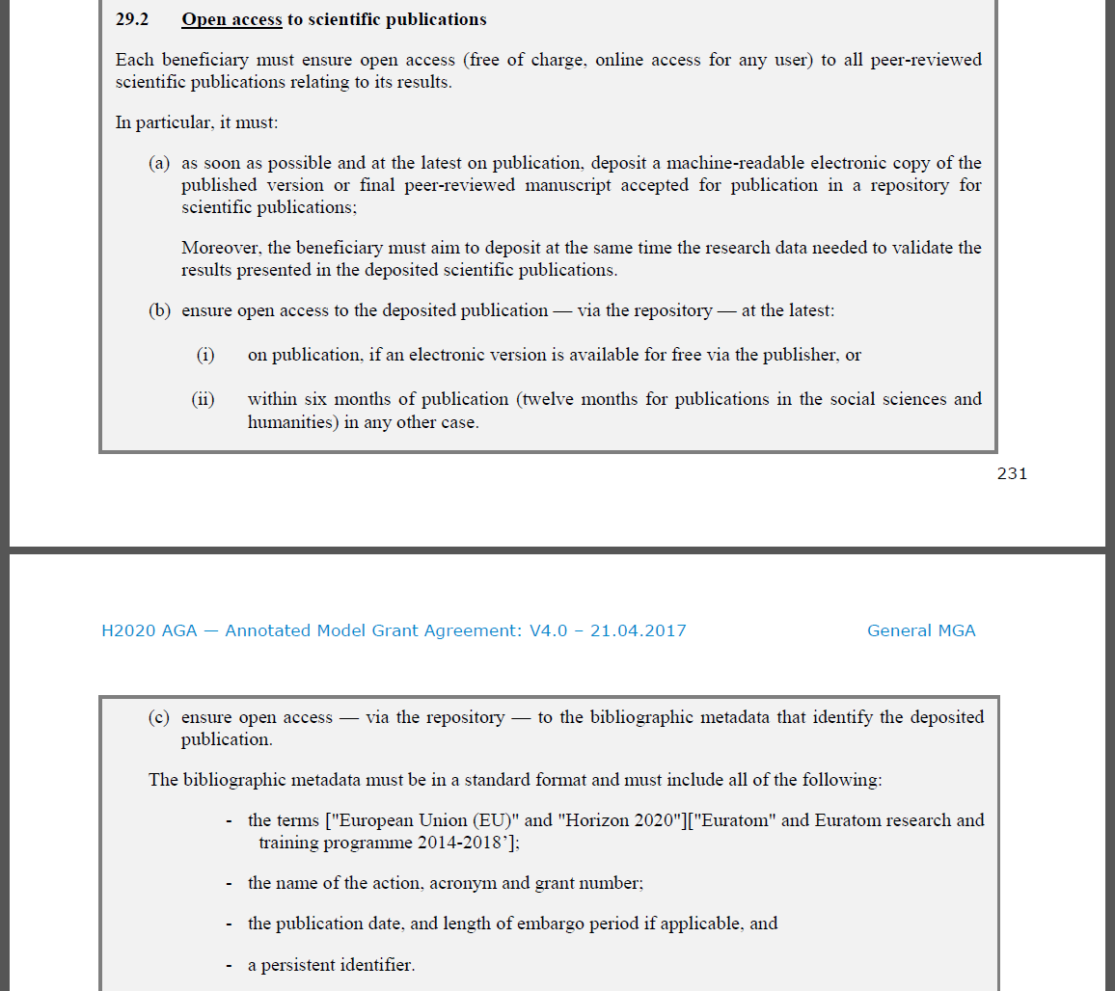
Horizon 2020
Open Access for all peer-reviewed publications
Gold, Hybrid or Green Open Access
Green using a repository after a maximum of 6 month embargo
Publication linked to Grant ID
Persistent Identifier

Slide 11

DFG
“The DFG expects the research results funded by it to be published and to be made available, where possible, digitally and on the internet via open access. To achieve this, the contributions involved should either be deposited in discipline-specific or institutional electronic archives (repositories) following conventional publication, or should be published in a recognised peer-reviewed open access journal.”
In this programme, the approved funds are available exclusively for the financing of publications of articles in Gold Open Access Journals.
DFG: Guidelines for the Use of Funds
DFG: Verwendungsrichtlinien Allgemeine Bedingungen für Förderverträge mit der DFG

Slide 12

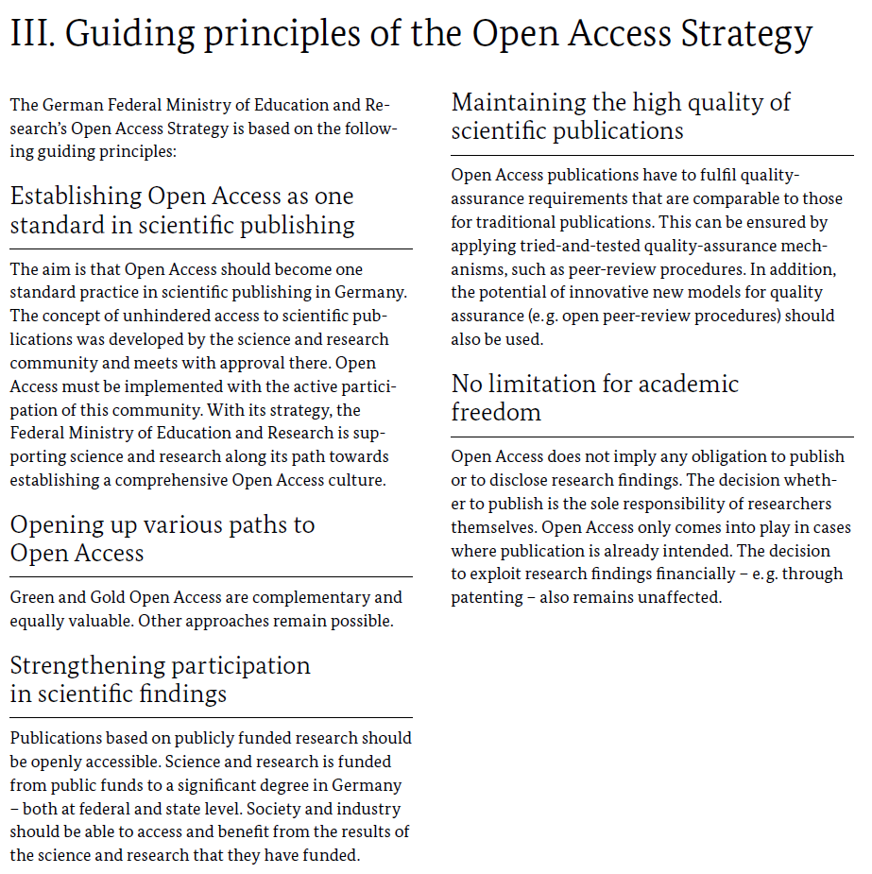
BMBF
High quality via Peer-Review
Open Access as standard in scientific publishing
Gold, Hybrid or Green Open Access
no obligation to publish or disclose research findings
the decision whether to publish is the sole responsibility of researchers themselves
Open Access only where publication is already intended

Slide 13

Peer-reviewed journal articles
Diamond, Gold, Hybrid or Green Open Access
Green using a repository after a maximum of 12 month embargo

Slide 14


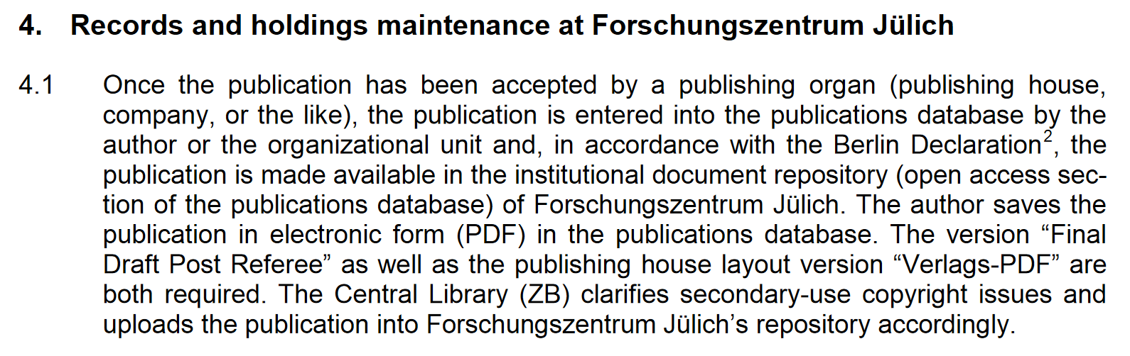

Slide 15
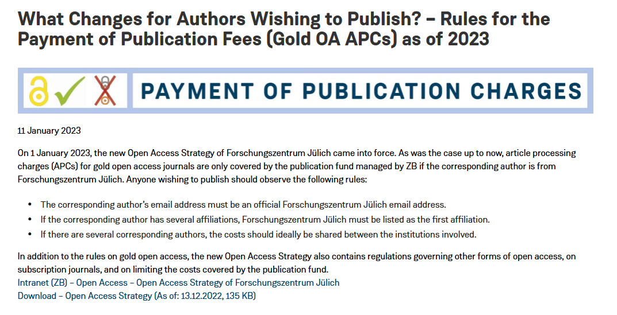
https://intranet.fz-juelich.de/en/organization/zb/news/2023/open-access-strategy-gold-oa-apc-2023-01-11
https://intranet.fz-juelich.de/en/organization/zb/downloads/open-access-strategy-forschungszentrum-julich-2023.pdf/@@download/file

Slide 16
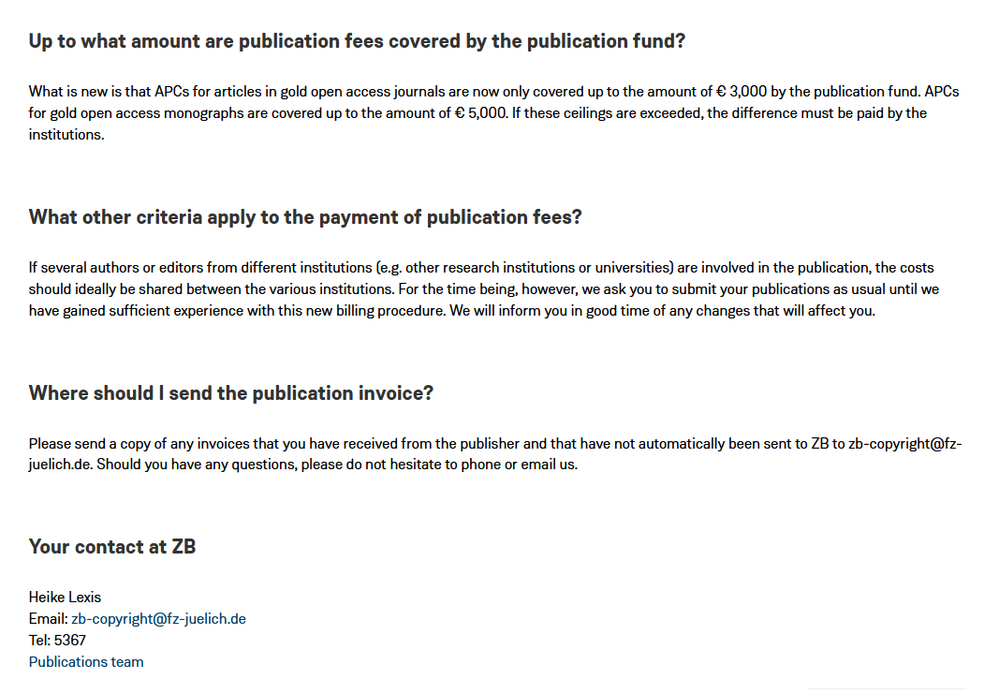
https://intranet.fz-juelich.de/en/organization/zb/news/2023/open-access-strategy-gold-oa-apc-2023-01-11

Slide 17

Impact
Icon made by Freepik from Flaticon and is licensed by CC BY 3.0.

Slide 18




The Impact factor
previous years
2014
2015
2016
2017
IF 2016 =
2016 citations to 2015 and 2014 publications
2015 and 2014 publications
Clarivate (2017)
Icons made by Freepik from Flaticon and are licensed by CC BY 3.0.

Slide 19
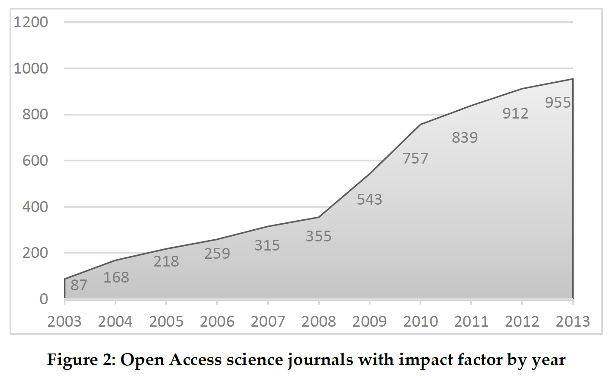
Barbaro et al. (2015)
Find OA journals with IF
„Open Access“ option in Journal Citation Report (JCR)

Slide 20
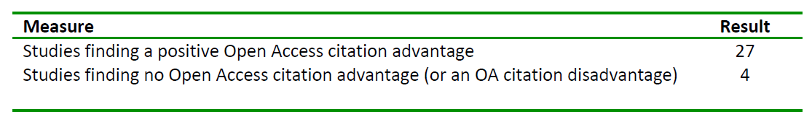
The impact of open access on citations
Summary of 31 studies regarding the impact of Open Access on citations.
Swan (2010)

Slide 21
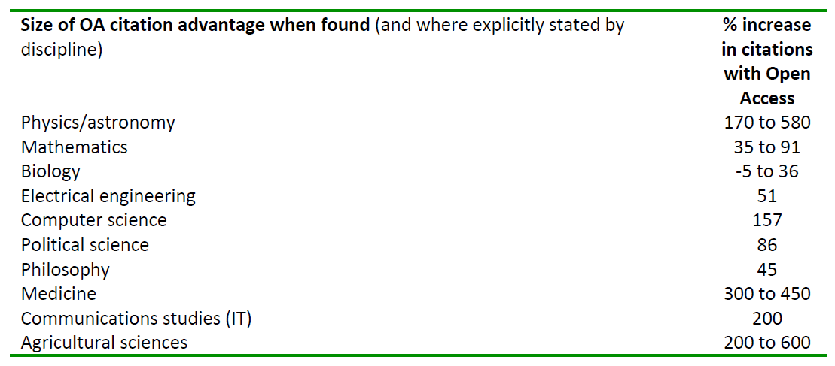
The impact of open access on citations
Summary of 31 studies regarding the impact of Open Access on citations.
Swan (2010)

Slide 23

Icon made by Becris from Flaticon and is licensed by CC BY 3.0.

Slide 24
Submission
Acceptance
Publication
Peer-Review
Advice for Authors

Slide 25
Handling of the complete payment process
  Processing all kind of invoices or statements related to publications, irrespectively of the funder: publication fund or institute
  Invoice order
  Invoice check
  Order to pay
  Correspondence with publisher and financial department
Publication fund
  All fees for publications in Open Access Journals where the Corresponding Author is affiliated to Forschungszentrum Jülich including permissions for republication of copyright protected material

Slide 26
Submission
Acceptance
Publication
Peer-Review
Advice for Authors
Publication Fees
JuSER

Slide 27
Scientists/Research Institutes
During journal selection consider Closed and Gold Open Access
Provide Green Open Access for Closed Access publications
Talk to your publishers as author, reviewer or even as editor to flip their journals or provide better Green Open Access conditions
Library
Provide money for Gold Open Access publications in a publication fund
Provide infrastructure and assistance for Green Open Access
Training courses and online information about Open Access
Negotiations with publishers, e.g. for Open Access cooperations and in project DEAL

Slide 28
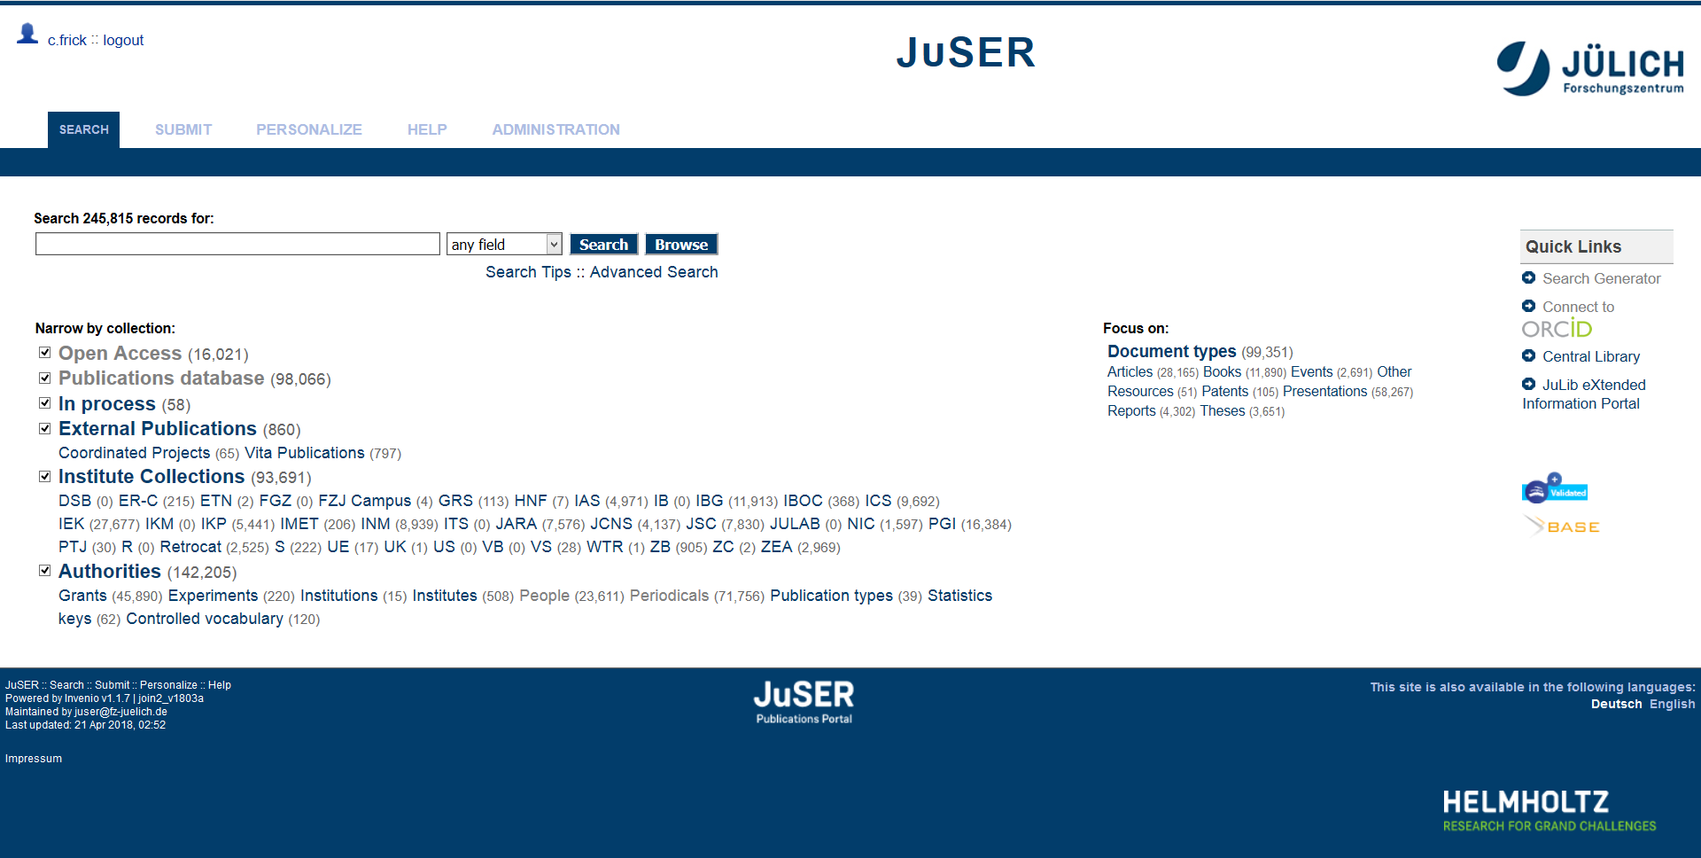
Create juser entry

Slide 29
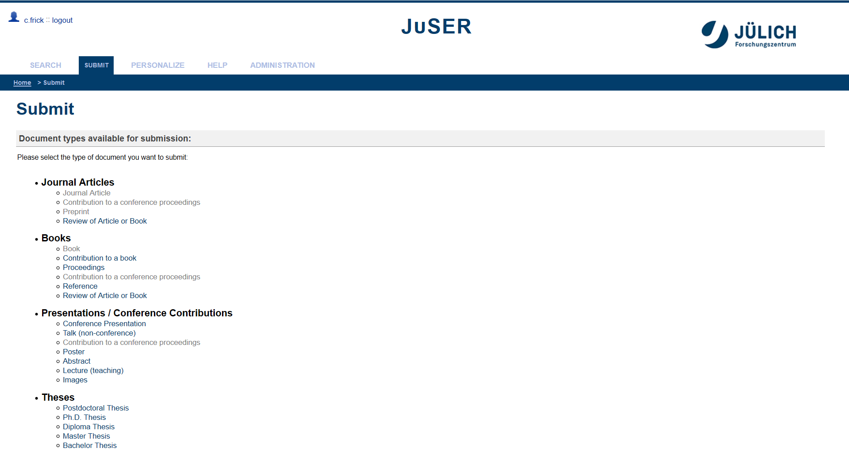
Create juser entry

Slide 30
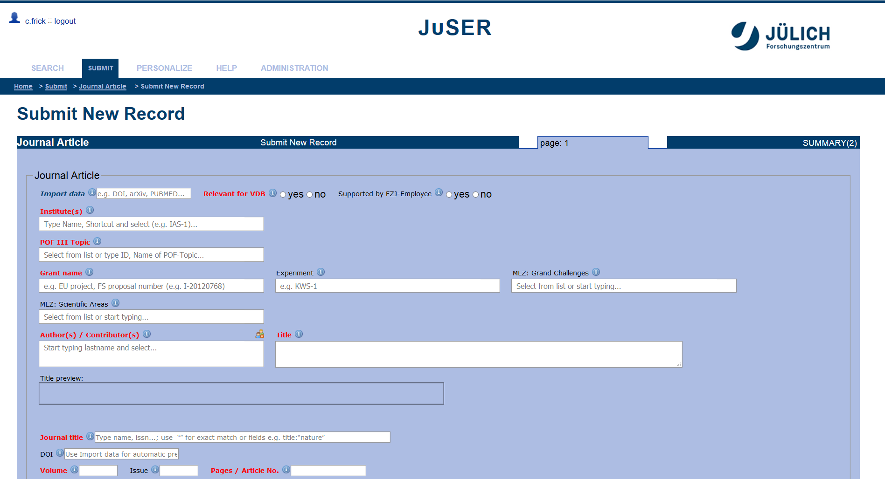
Create juser entry

Slide 31
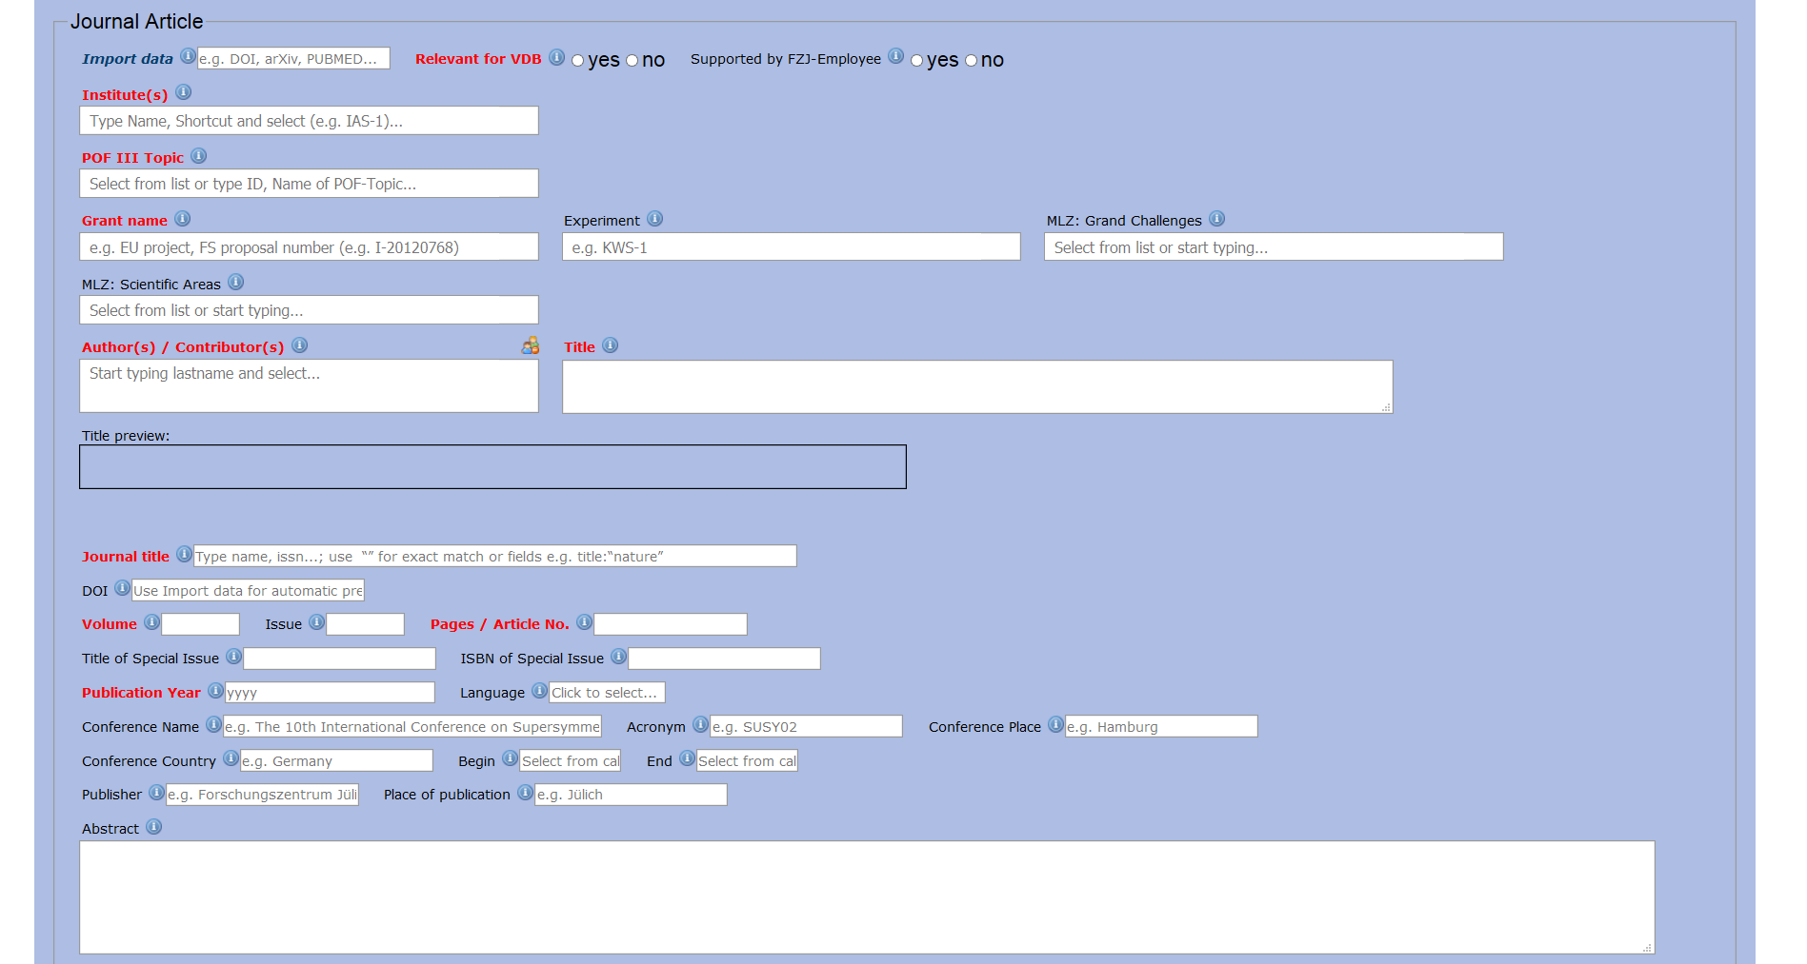
Create juser entry

Slide 32

Create juser entry

Slide 33
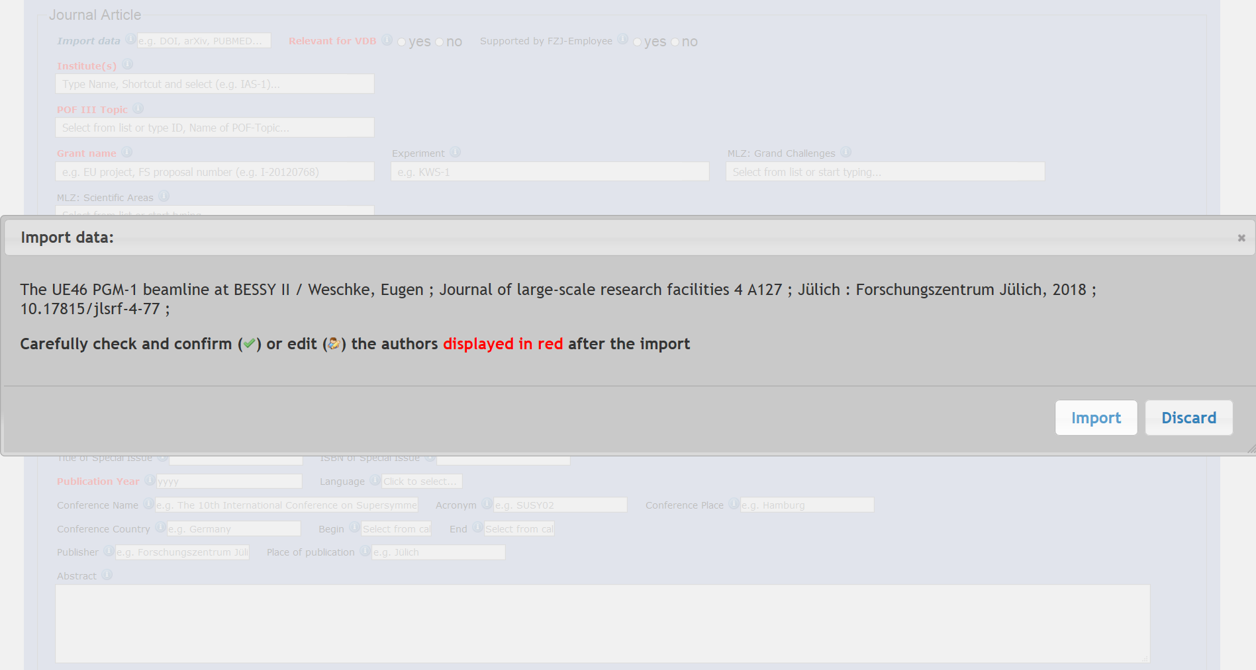
Create juser entry

Slide 34
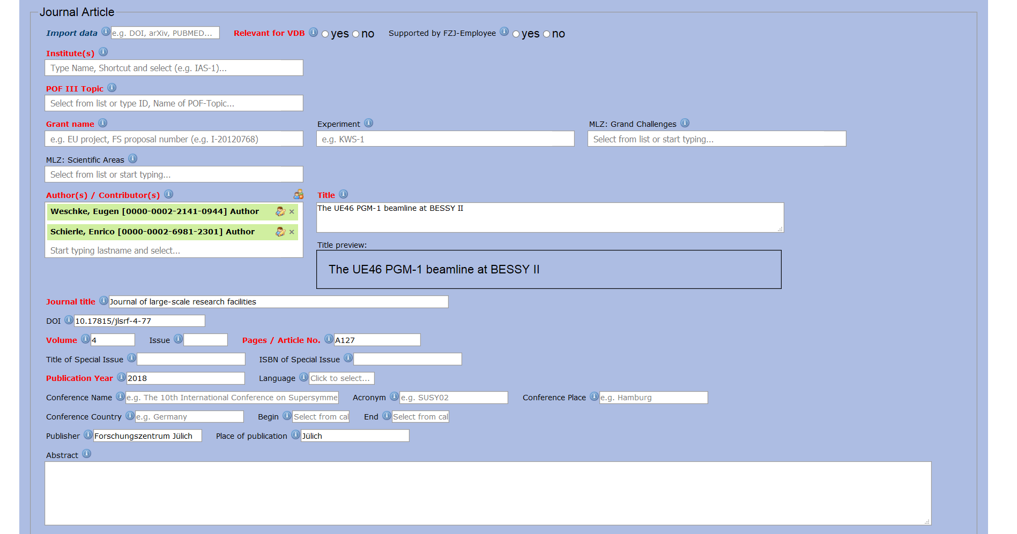
Create juser entry

Slide 35
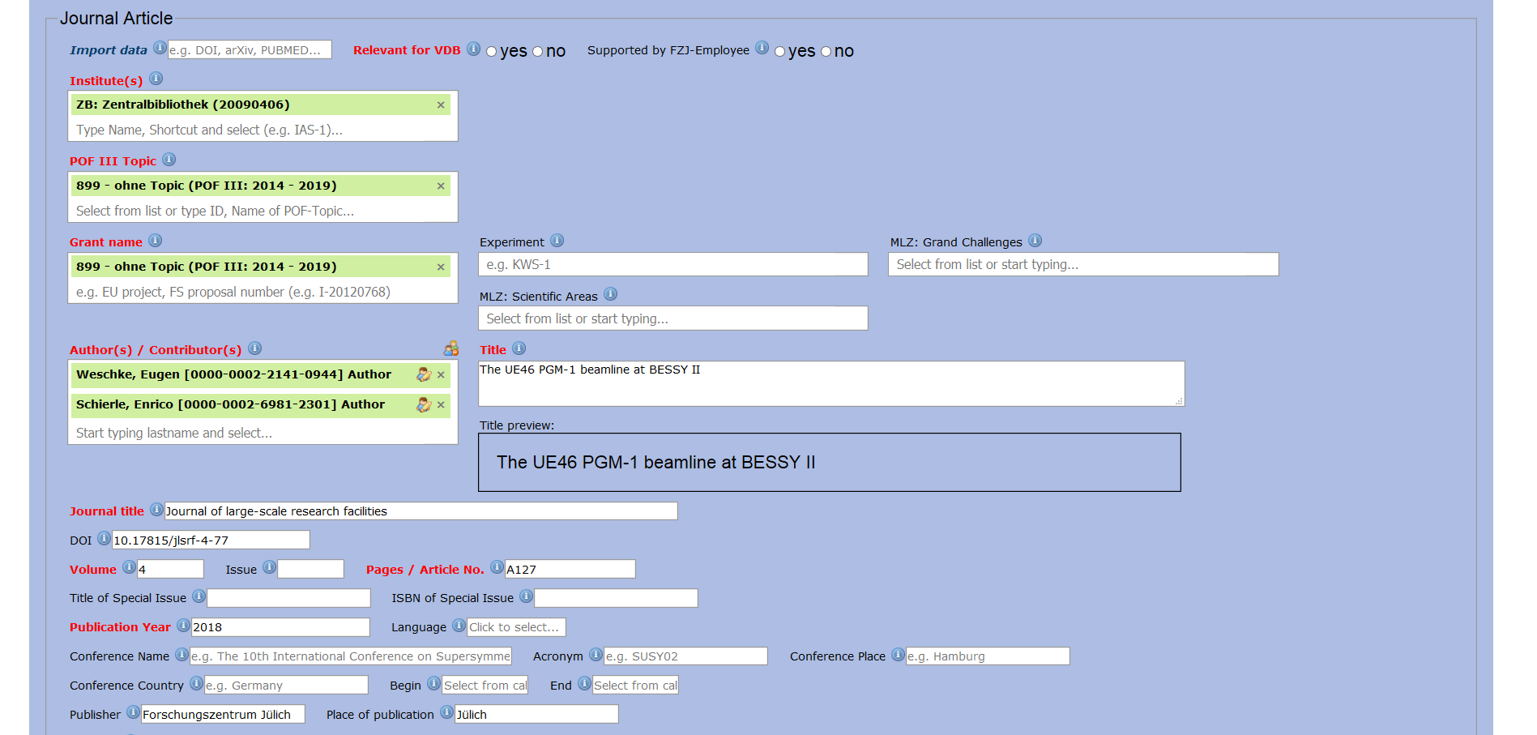
Create juser entry

Slide 36
Create juser entry

Slide 37
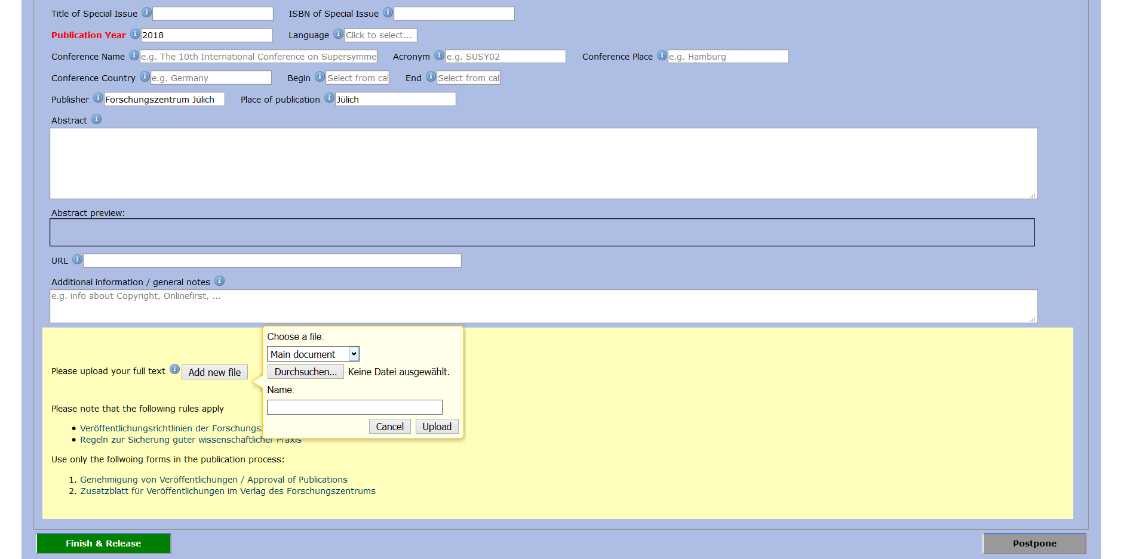
Create juser entry

Slide 38
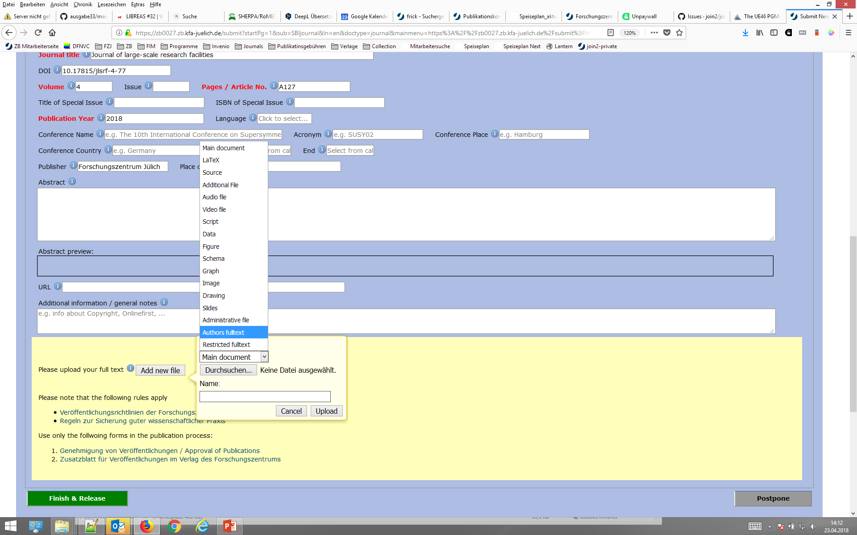
Create juser entry

Slide 39

Create juser entry

Slide 40
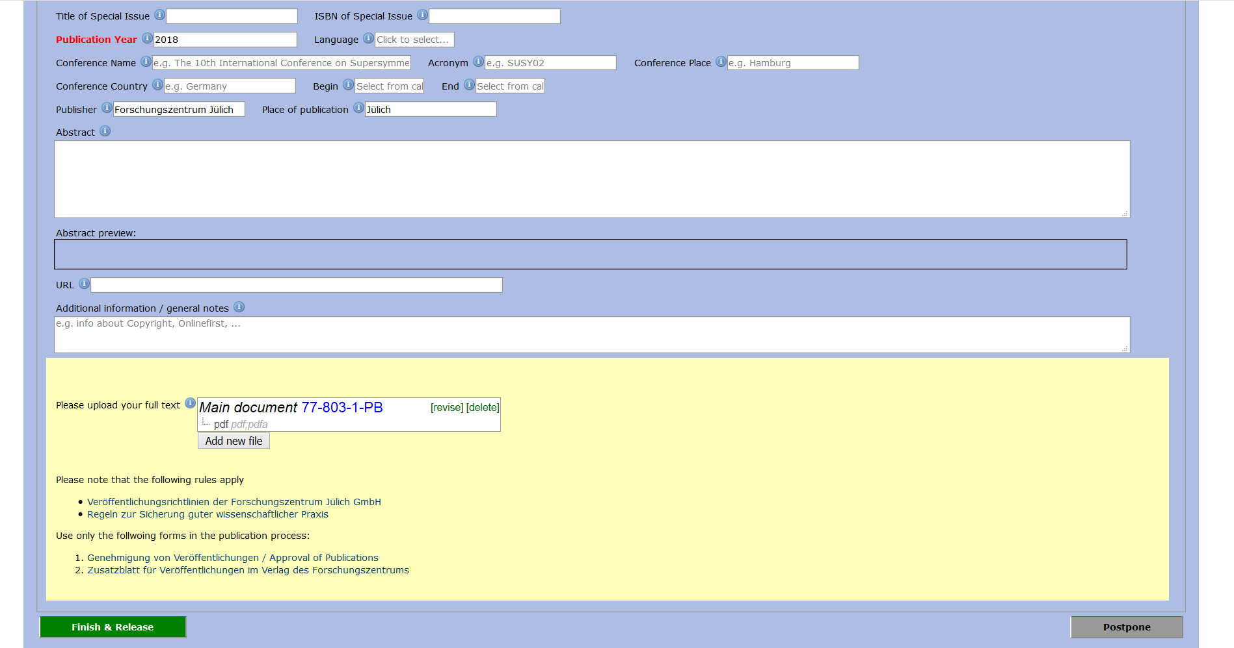
Create juser entry

Slide 41
links
Further Information
Forschungszentrum Jülich, Central Library: Publication Charges – Payment from the Publication Fund. https://intranet.fz-juelich.de/zb/publication_charges
Forschungszentrum Jülich, Central Library: Project DEAL. http://intranet.fz-juelich.de/zb/oa_deal_en
Horizon 2020 (European Commission, EC): Fact sheet: Open Access in Horizon 2020. https://ec.europa.eu/programmes/horizon2020/sites/horizon2020/files/FactSheet_Open_Access.pdf
Horizon 2020 (European Commission, EC): Fact Sheet: Open access to publications and data in Horizon 2020: Frequently Asked Questions (FAQ). https://www.iprhelpdesk.eu/sites/default/files/newsdocuments/Open_Access_in_H2020.pdf
Informationsplattform Open Access: Open Access - Der freie Zugang zu wissenschaftlicher Information. https://open-access.net
Mittermaier (2015): Das Double-dipping beim Hybrid Open Access. http://hdl.handle.net/2128/9352
Mittermaier (2016): Der Schritt zurück als Schritt nach vorn – Macht der Siegeszug des Open Access Bibliotheken arbeitslos? Schriften des Forschungszentrums Jülich Reihe Bibliothek / Library 22. http://hdl.handle.net/2128/11435
OpenAIRE: Openaire Factsheet for Research Administrators. https://www.openaire.eu/openaire-factsheet-for-research-administrators
Schimmer, Geschuhn, & Palzenberger (2013). Open Access in Zahlen: Der Umbruch in der Wissenschaftskommunikation als Herausforderung für Bibliotheken. Zeitschrift für Bibliothekswesen und Bibliographie, 60 (5), 244–250. doi:10.3196/186429501360532.

Slide 42
links
Tools
Forschungszentrum Jülich, Central Library: Open-Access Tools
http://intranet.fz-juelich.de/zb/oa_tools
Forschungszentrum Jülich, Central Library: Predatory Journals http://intranet.fz-juelich.de/zb/oa_pj_en
Academia Stack Exchange: Academia Stack Exchange is a question and answer site for academics and those enrolled in higher education. https://academia.stackexchange.com/
Creative Commons Germany: Creative Commons (CC) is a non-profit organisation providing different kinds of Open Access licences. https://de.creativecommons.org/
DOAJ: Directory of Open Access Journals. https://doaj.org/
JCR: Journal Citation Report. Finding the impact factors of journals based on Web of Sciences. https://jcr.incites.thomsonreuters.com/
JuSER: Publication database and repository of Forschungszentrums Jülich. https://juser.fz-juelich.de/
OpenAIRE: Assists in monitoring H2020 and other EC funded research outputs. https://www.openaire.eu
Sherpa/JULIET: Research funders’ open access policies. http://www.sherpa.ac.uk/juliet
Sherpa/RoMEO: Publisher copyright policies & self-archiving. http://www.sherpa.ac.uk/romeo
SJR: Scopus Journal Rank - SCImago Journal & Country Rank. http://www.scimagojr.com/journalrank.php
Unpaywall: Read paywalled research papers for free. http://unpaywall.org/

Slide 43
links
Publication guidelines and Open Access Policies
Forschungszentrum Jülich, Central Library: Open Access – Guidelines and Research Funding http://intranet.fz-juelich.de/zb/oa_guidelines
BMBF: Open Access in Deutschland. Die Strategie des Bundesministeriums für Bildung und Forschung. https://www.bmbf.de/pub/Open_Access_in_Deutschland.pdf
DFG: Verwendungsrichtlinien Allgemeine Bedingungen für Förderverträge mit der Deutschen Forschungsgemeinschaft e.V. (DFG). http://www.dfg.de/formulare/2_00/v/dfg_2_00_de_v0317.pdf
DFG: Guidelines for the Use of Funds. http://www.dfg.de/formulare/2_012e/2_012e.pdf
European Research Council (ERC): Open Access Guidelines for research results funded by the ERC. https://erc.europa.eu/sites/default/files/document/file/ERC_Open_Access_Guidelines-revised_2014.pdf
FZJ: Publications by Forschungszentrum Jülich GmbH. http://intranet.fz-juelich.de/SharedDocs/Interne_Regelungen/Publications_by_Forschungszentrum_Juelich_GmbH_RL_IR_251-2.html
Helmholtz Gemeinschaft: Open Access Policy of the Helmholtz Association. http://os.helmholtz.de/de/open-science-in-der-helmholtz-gemeinschaft/open-access-richtlinien/open-access-richtlinie-der-helmholtz-gemeinschaft-2016/open-access-policy-of-the-helmholtz-association-2016/
Horizon 2020 (European Commission, EC): Guidelines to the Rules on Open Access to Scientific Publications and Open Access to Research Data in Horizon 2020. http://ec.europa.eu/research/participants/data/ref/h2020/grants_manual/hi/oa_pilot/h2020-hi-oa-pilot-guide_en.pdf

Slide 44
links
Impact and Citations
Barbaro et al. (2015):The presence of High-impact factor Open Access Journals in Science, Technology, Engineering and Medicine (STEM) disciplines. JLIS.it, 6 (3), p. 57-75. http://dx.doi.org/10.4403/jlis.it-11257.
Björk & Solomon (2012). Open access versus subscription journals: a comparison of scientific impact. BMC medicine, 10 (73). http://dx.doi.org/10.1186/1741-7015-10-73
Chua et al. (2017): The impact factor of an open access journal does not contribute to an article’s citations. F1000Research, 6, 208. http://dx.doi.org/10.12688/f1000research.10892.1
Clarivate (2017): Journal Citation Reports: A Primer on the JCR and Journal Impact Factor.
Prashant & Schatz (2015): Journal Impact Factor and the Real Impact of Your Paper. The Journal of Physical Chemistry Letters, 6 (15), p. 3074-3075. http://dx.doi.org/10.1021/acs.jpclett.5b01527
Swan (2010): The Open Access citation advantage: Studies and results to date. Project report, 17 pages. http://eprints.soton.ac.uk/id/eprint/268516

